Slide 1
Land Snails from Phia Den/Phia Oac parks, Cao Bang Province, Vietnam
Joint WAR and IEBR Expedition
25 May to 3 June 2016

Slide 2
Snails found near joint Station

Slide 3
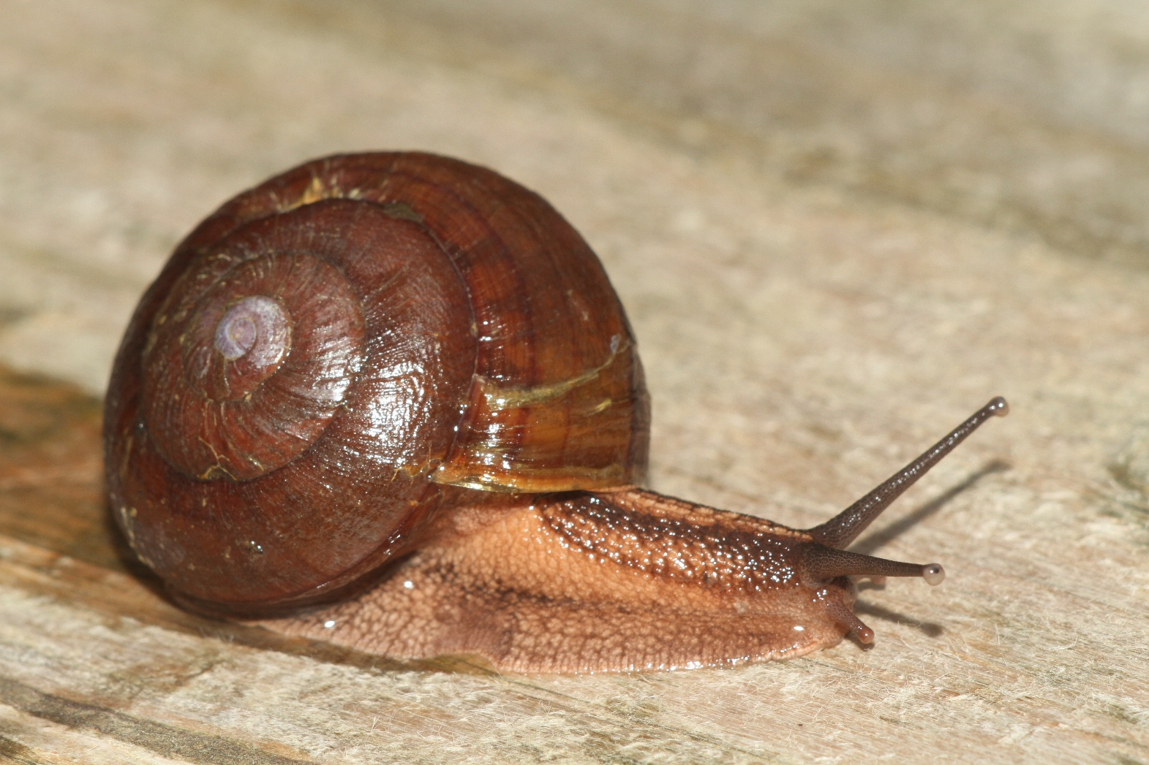
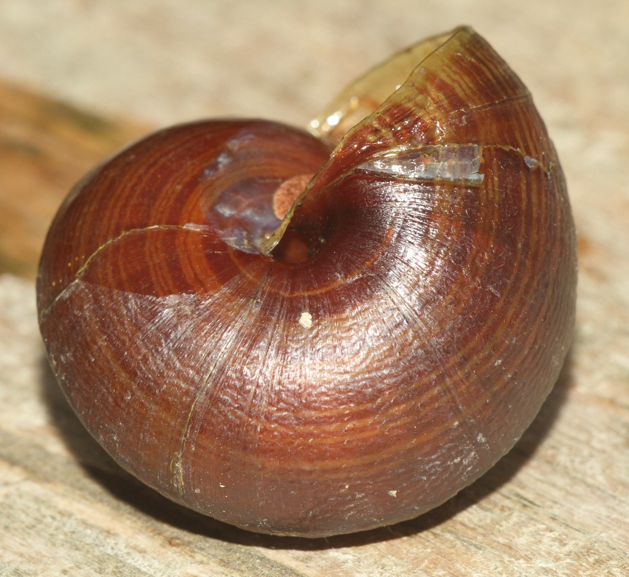
Family Camaenidae – species 1
40 mm shell juvenile
Road near camp

Slide 4
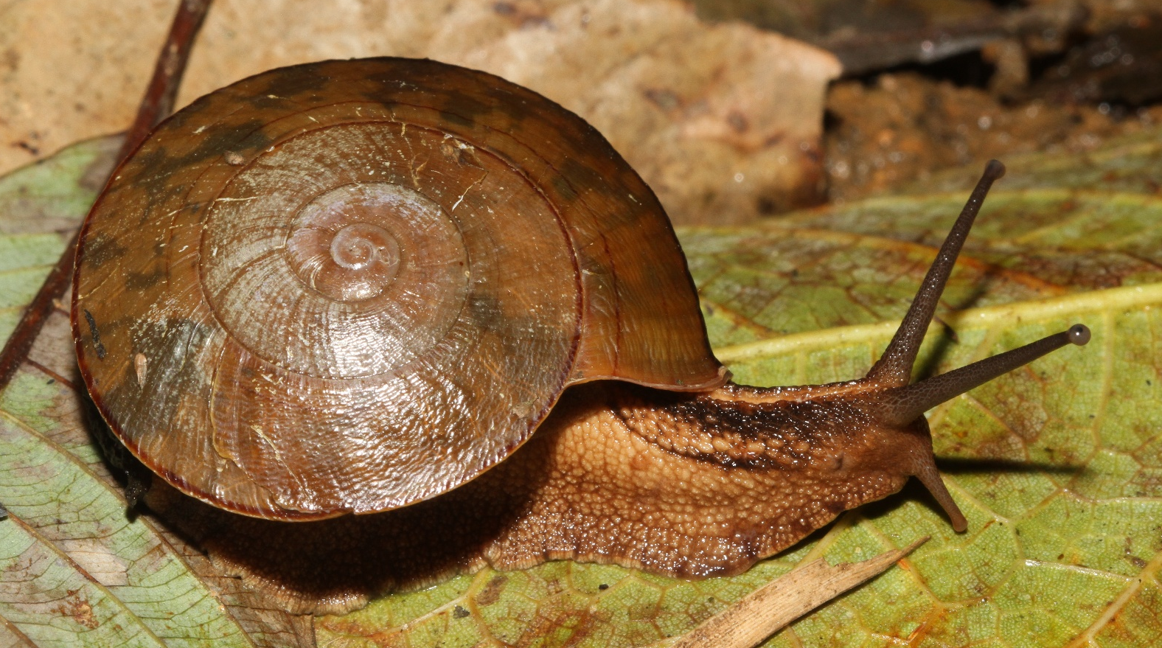
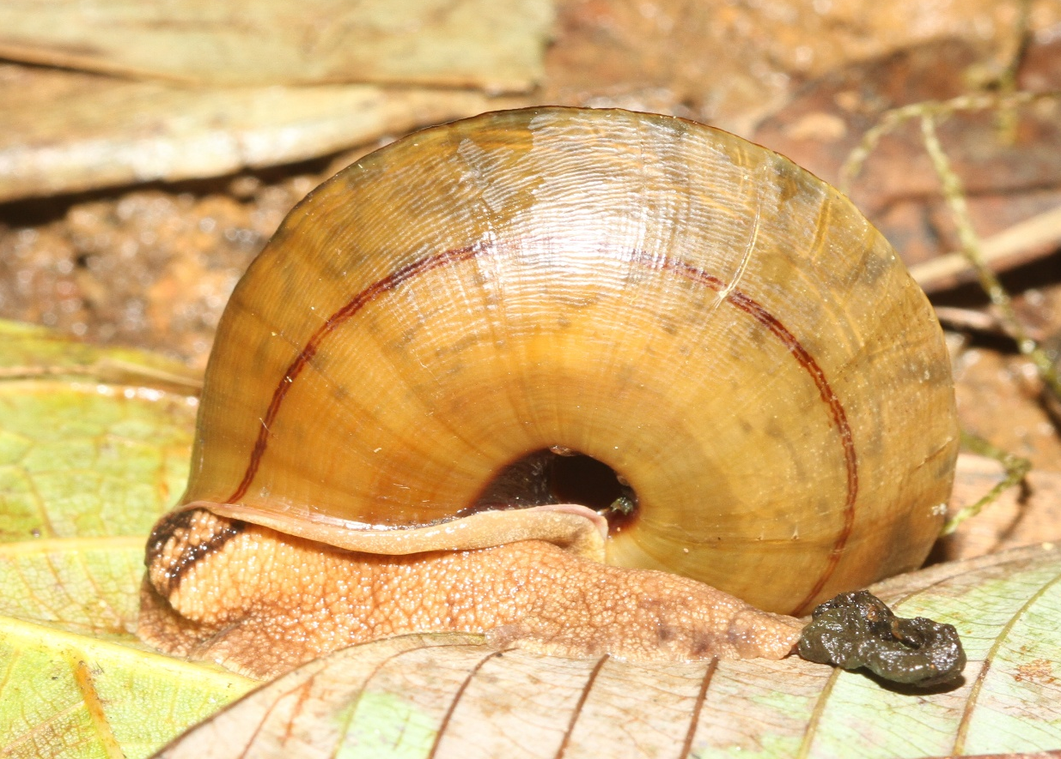
Family Camaenidae – species 2
39 mm shell
Along road near top
27 V 2017

Slide 5
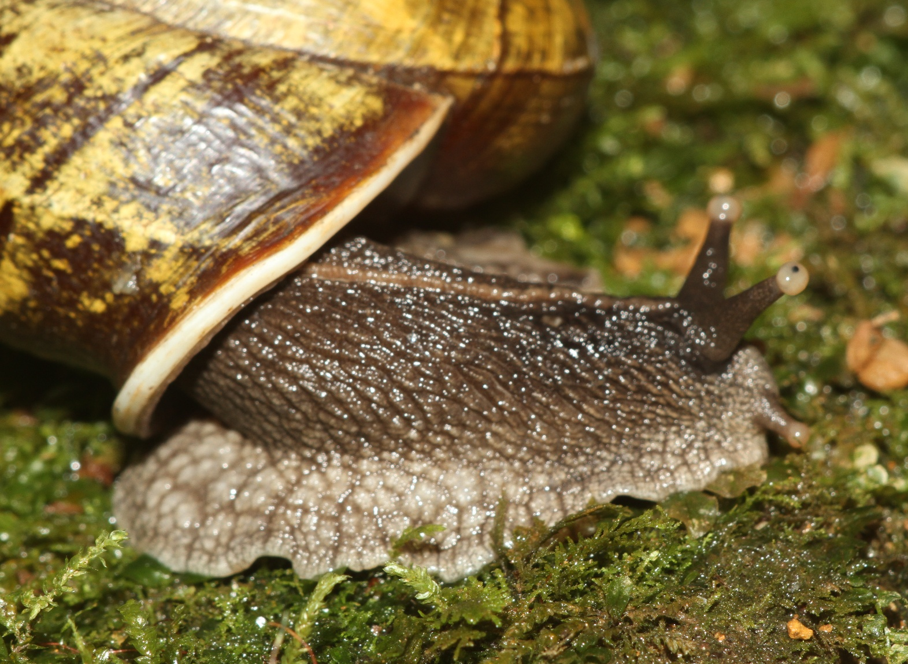
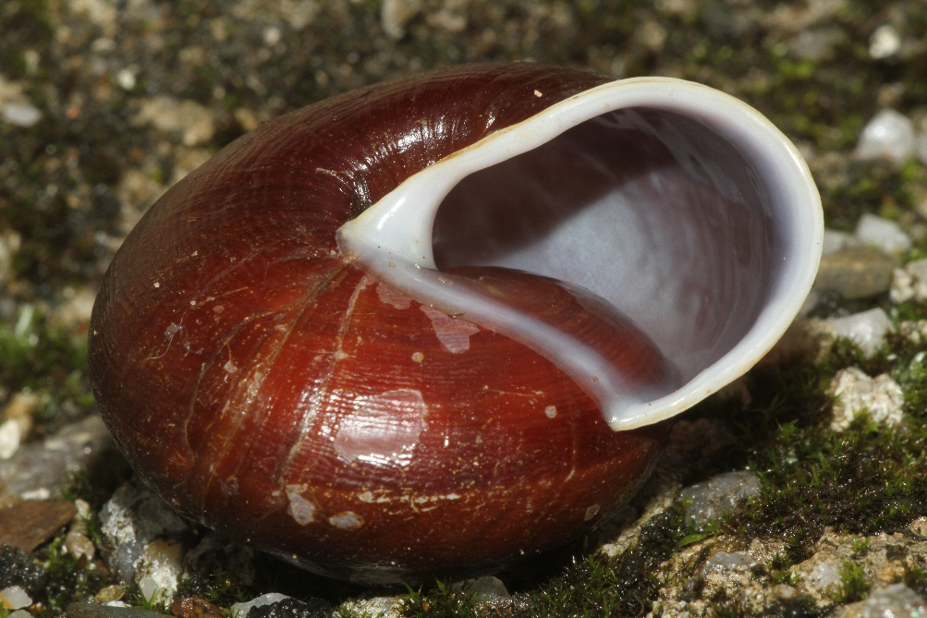
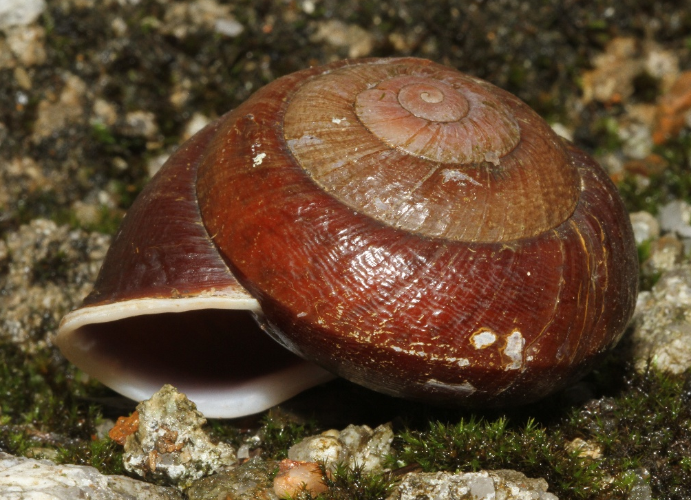
Family Camaenidae – species 3
52 mm shell, sinistral
Road near camp

Slide 6
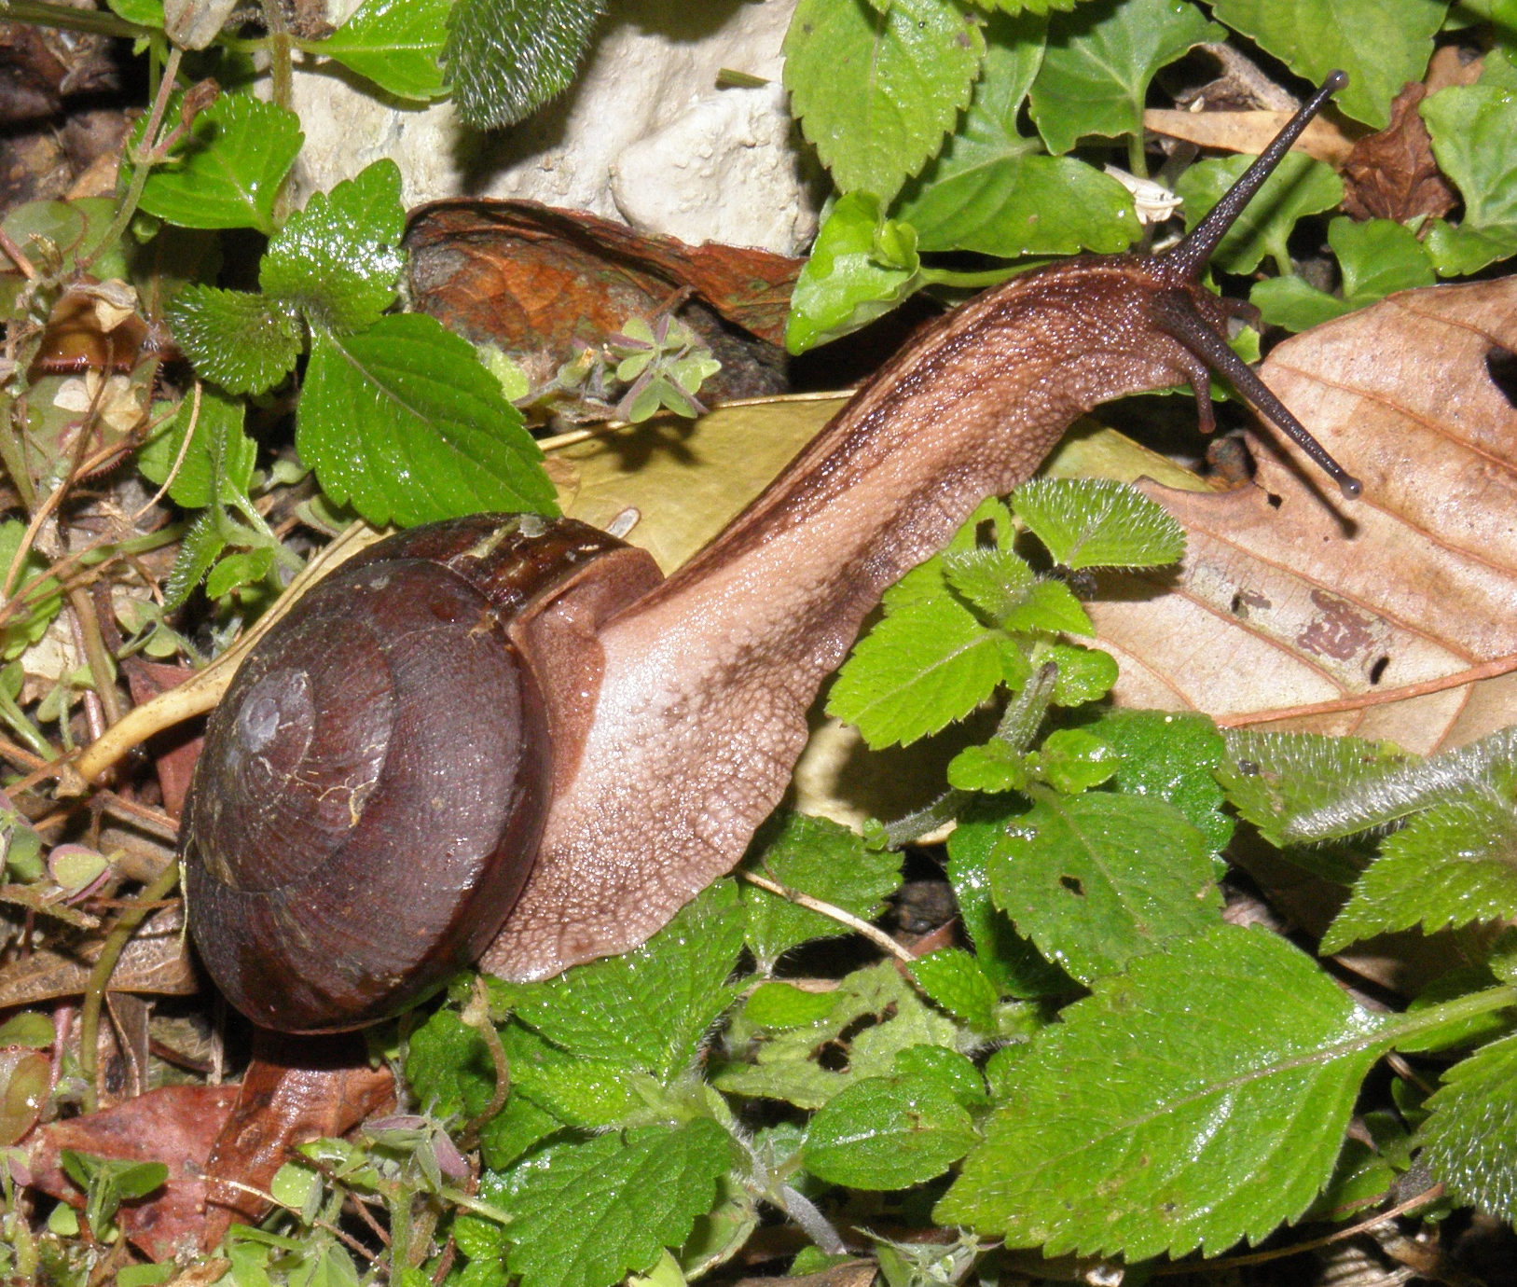
Family Camaenidae – species 4
Ca. 45 mm shell, dextral
Road near camp

Slide 7
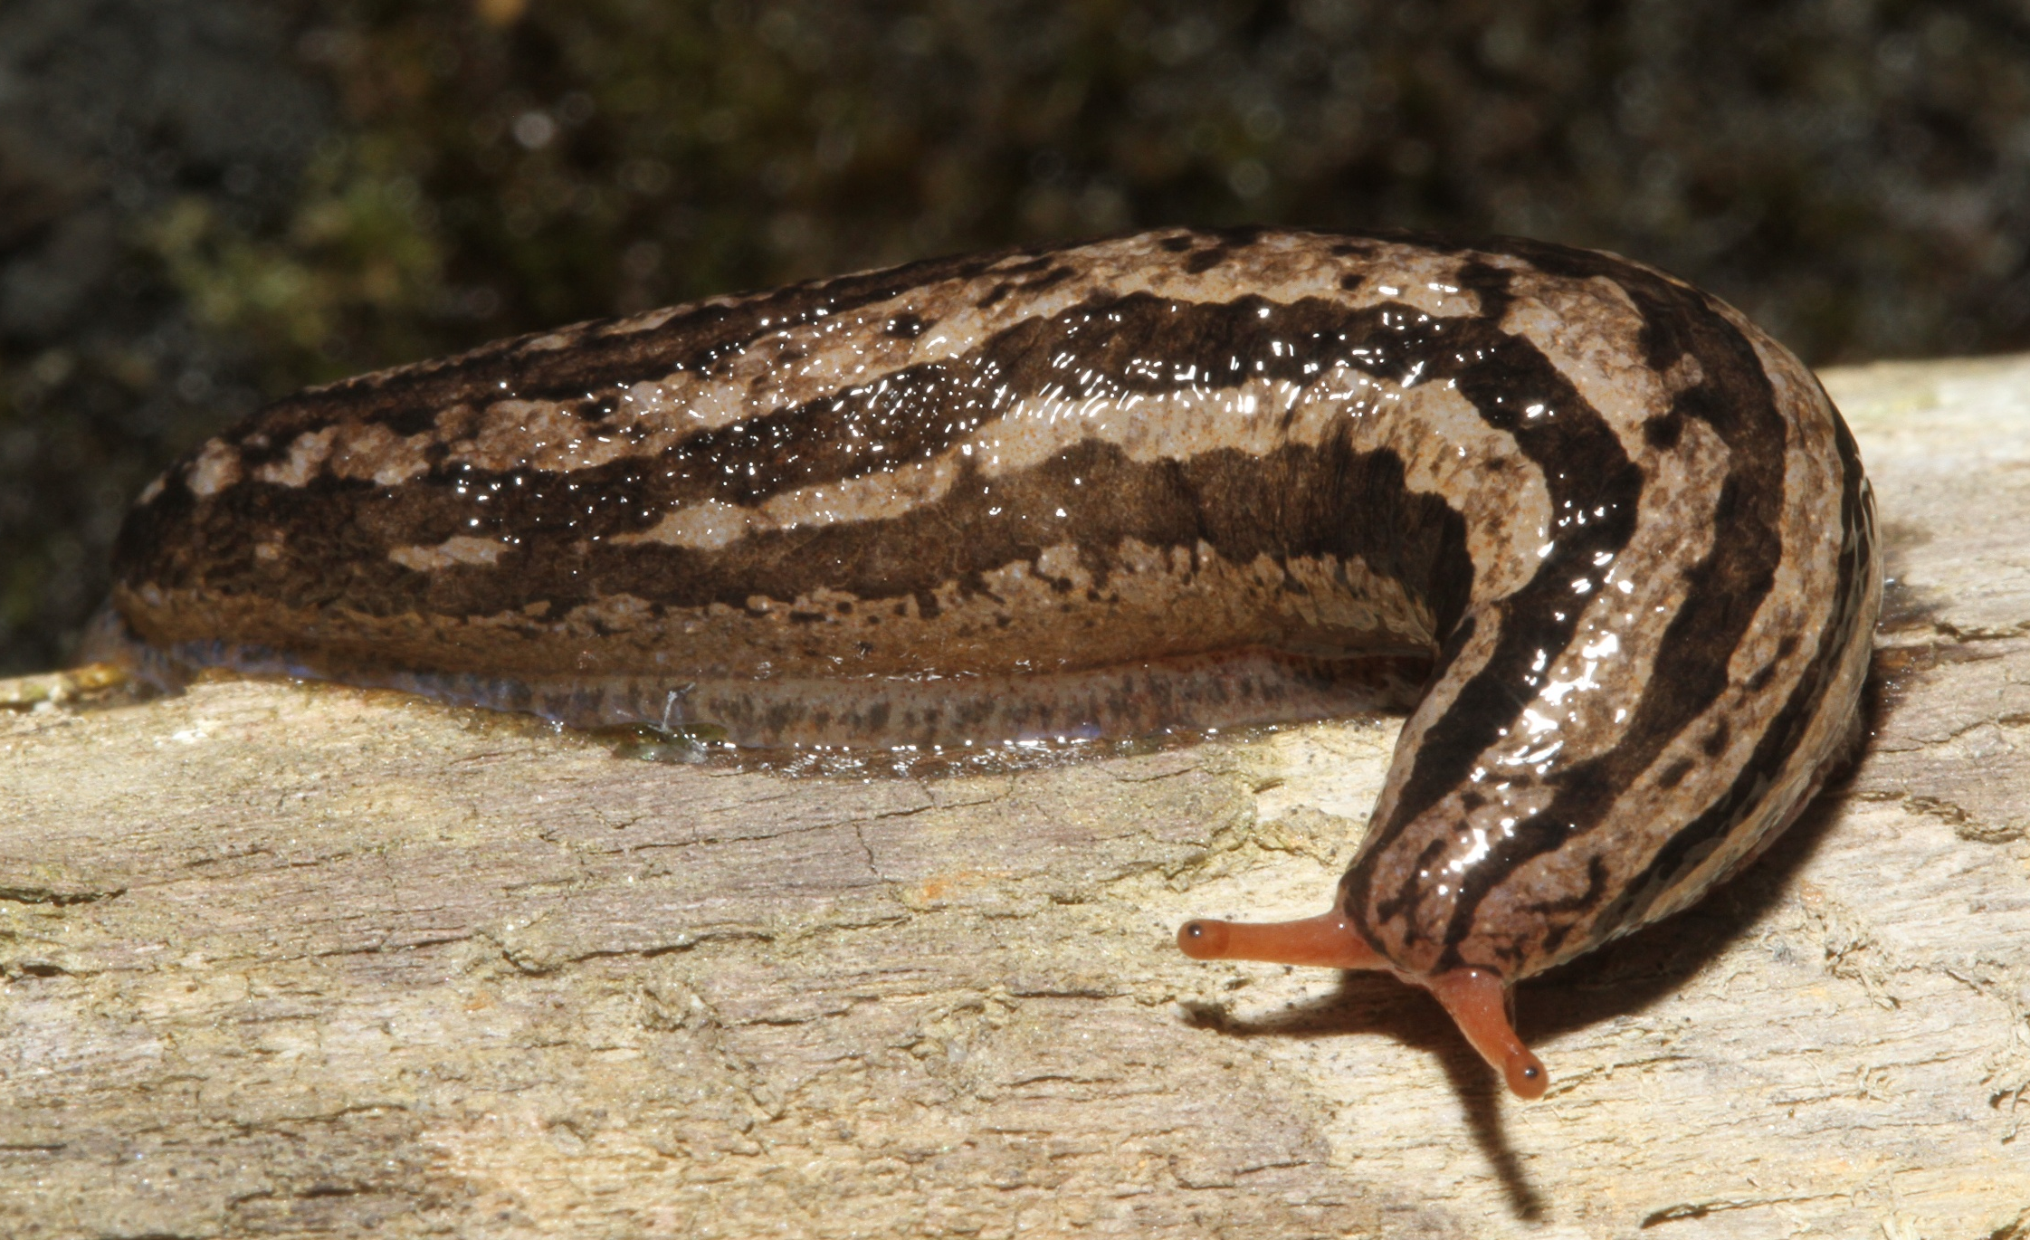
Family Philomycidae – Megamatium species
About 40 mm
On tree at camp

Slide 8
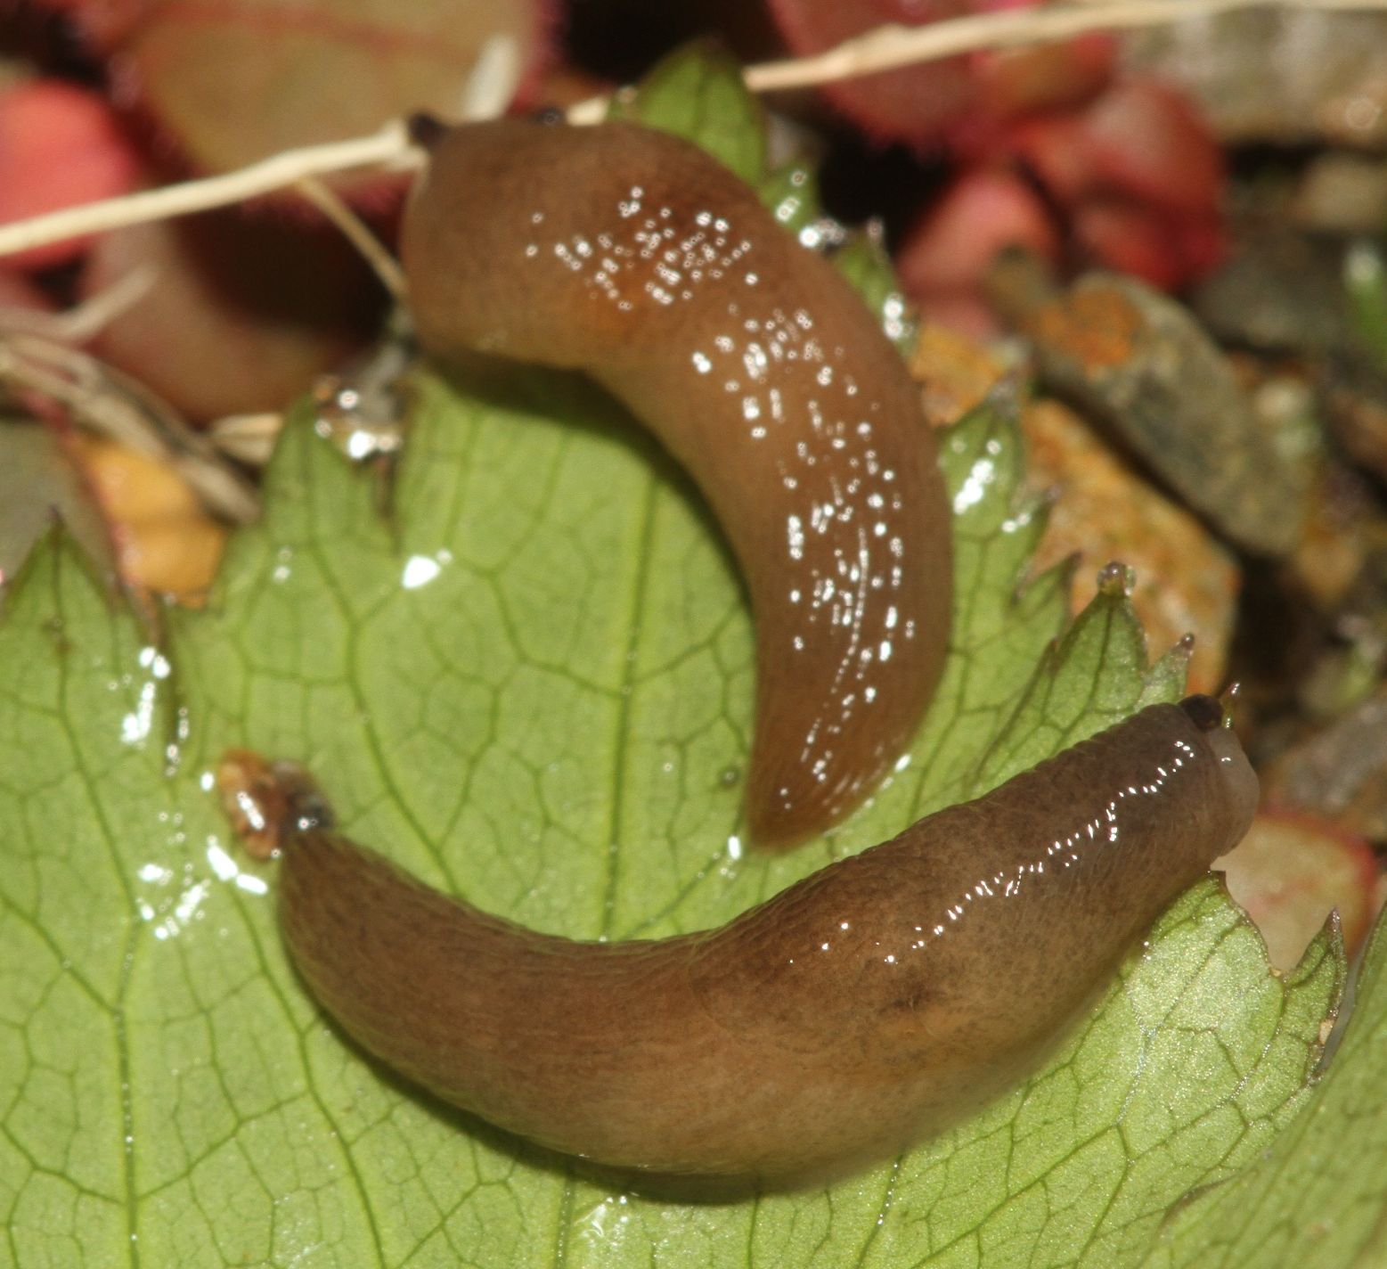
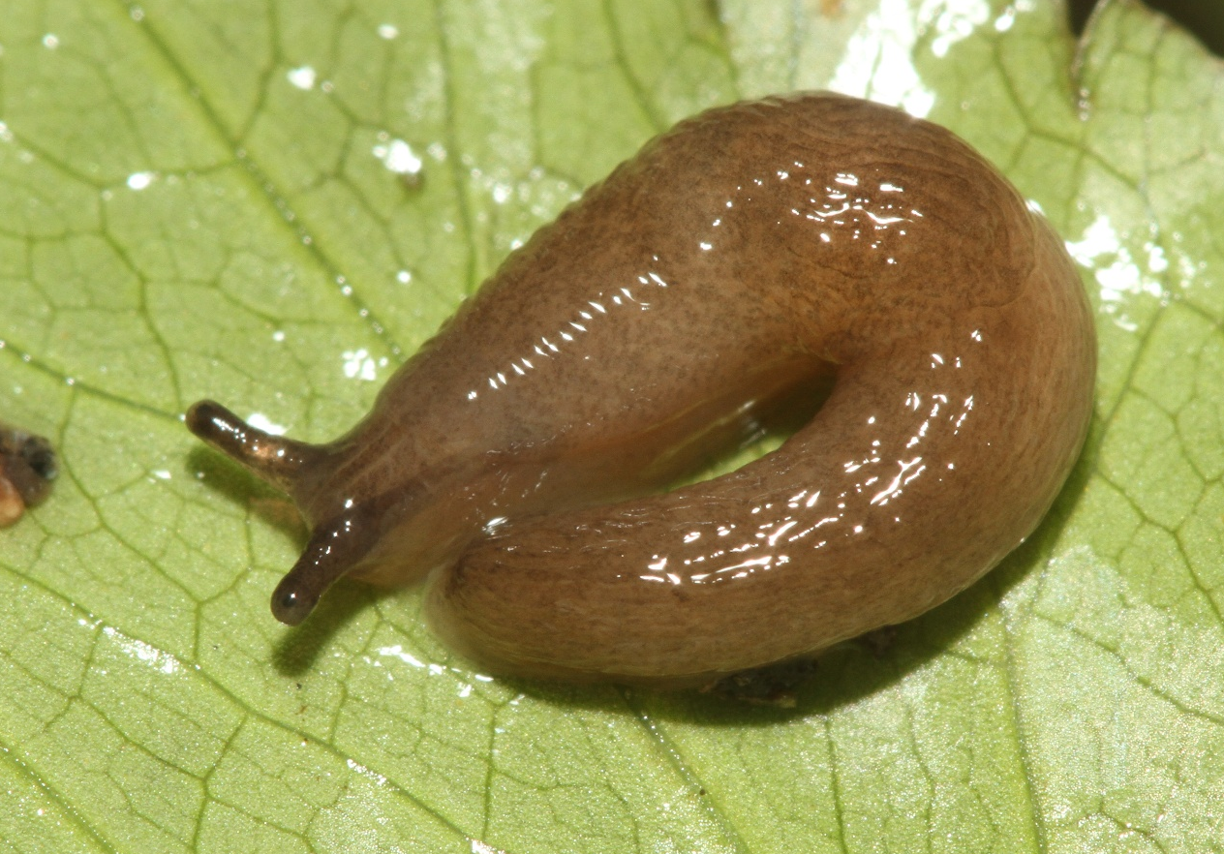
Family Agriolimacidae – Deroceras species
15-25 mm
On buildings and trees in camp

Slide 9
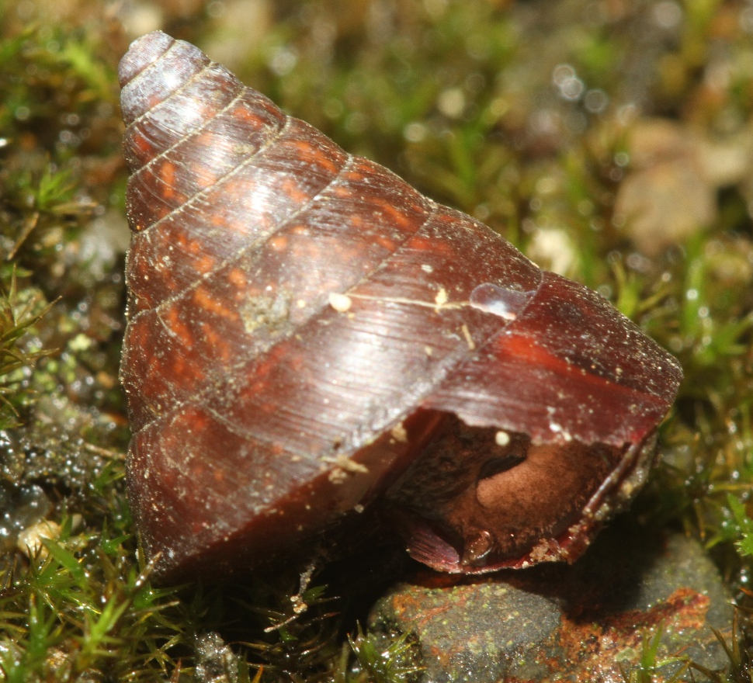
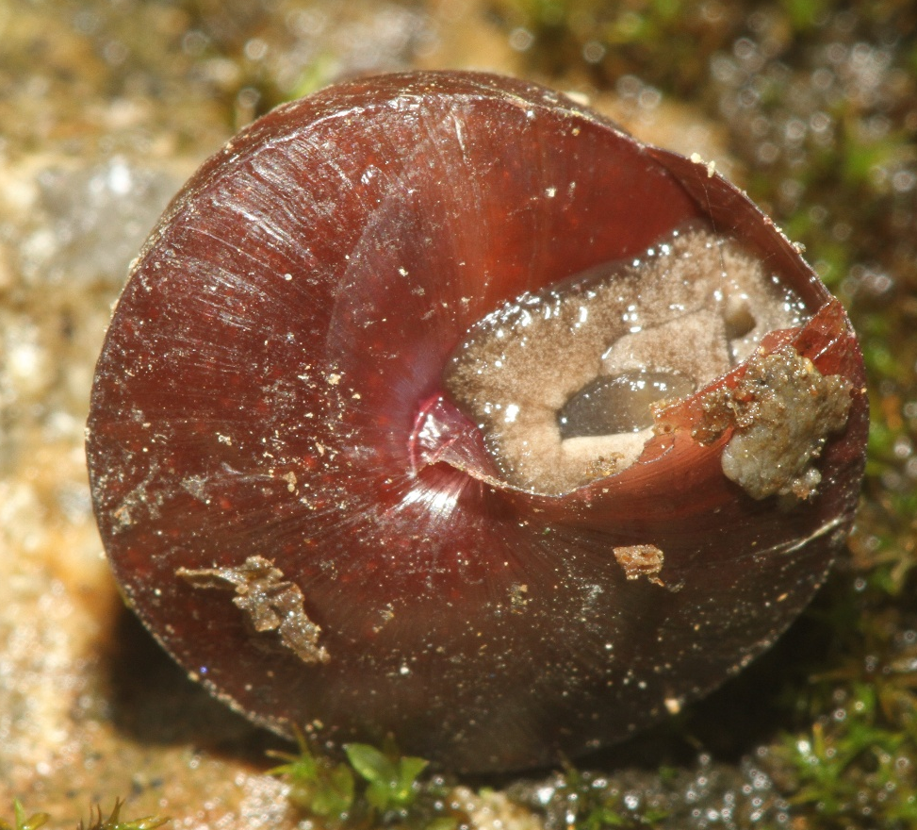
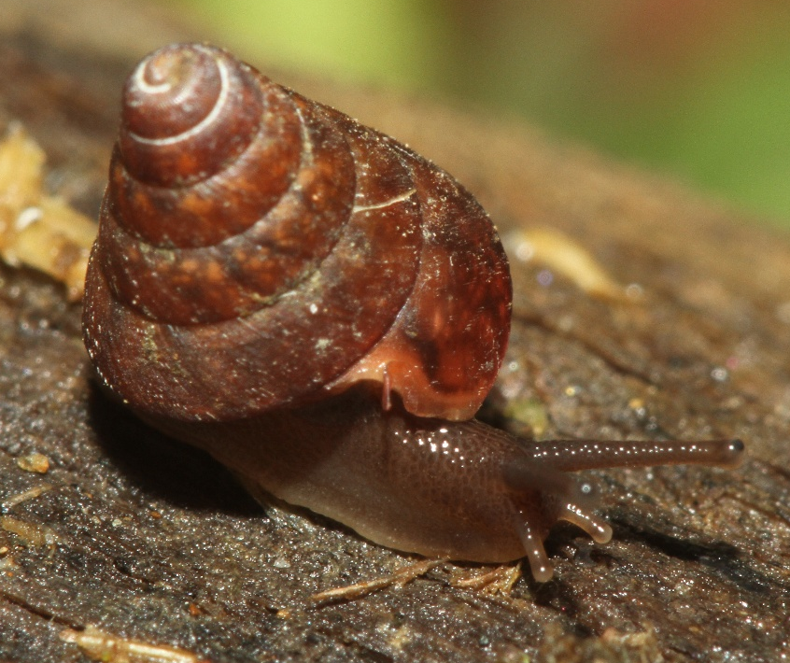
Family – top snail species 1
7x7 mm
On building at camp
15x15 mm
On building at camp

Slide 10
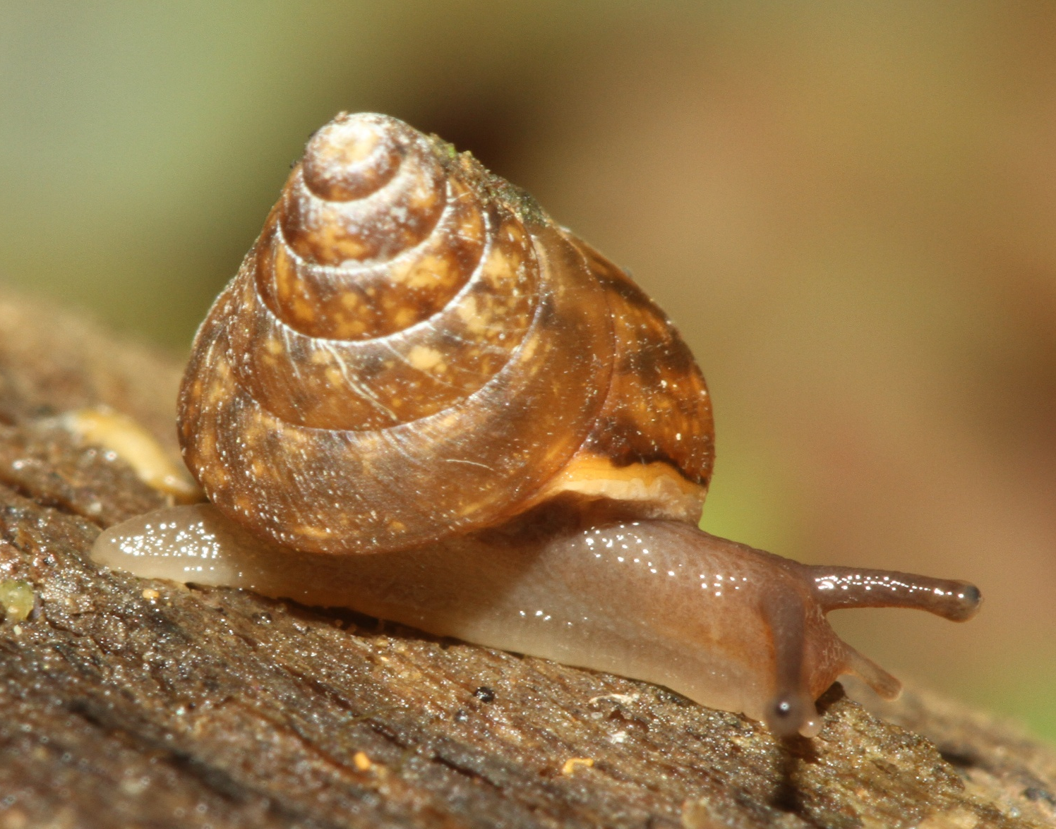
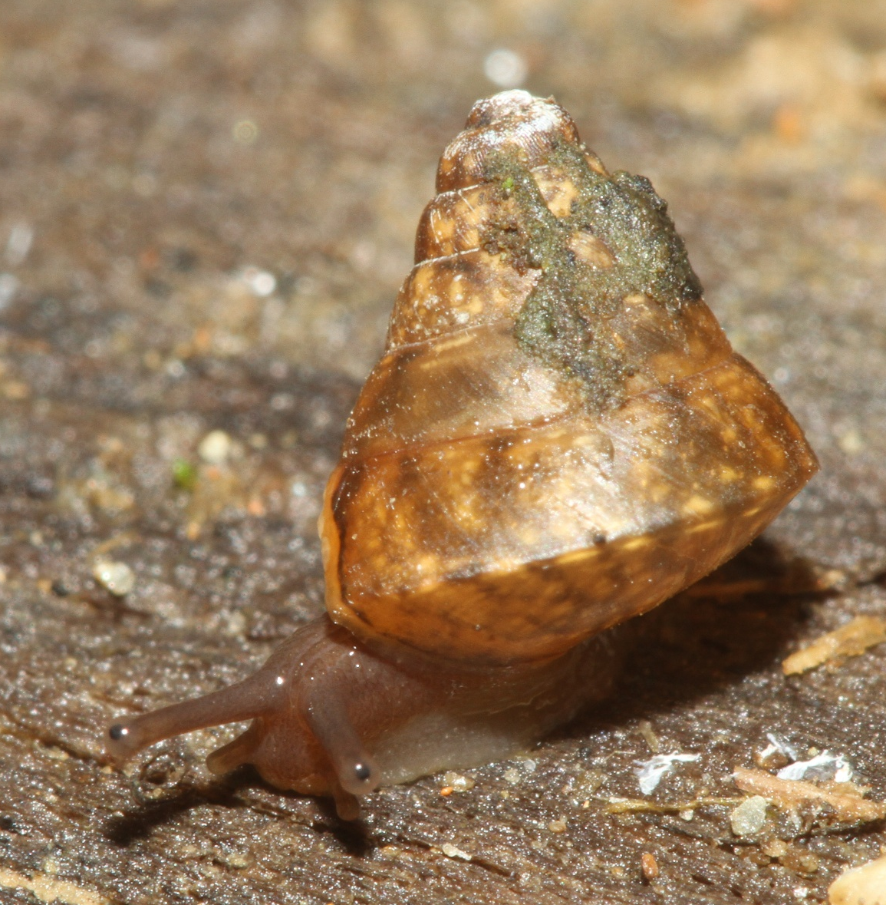
Family – top snail species 2
7x6 mm, pale body and shell
On building at camp

Slide 11
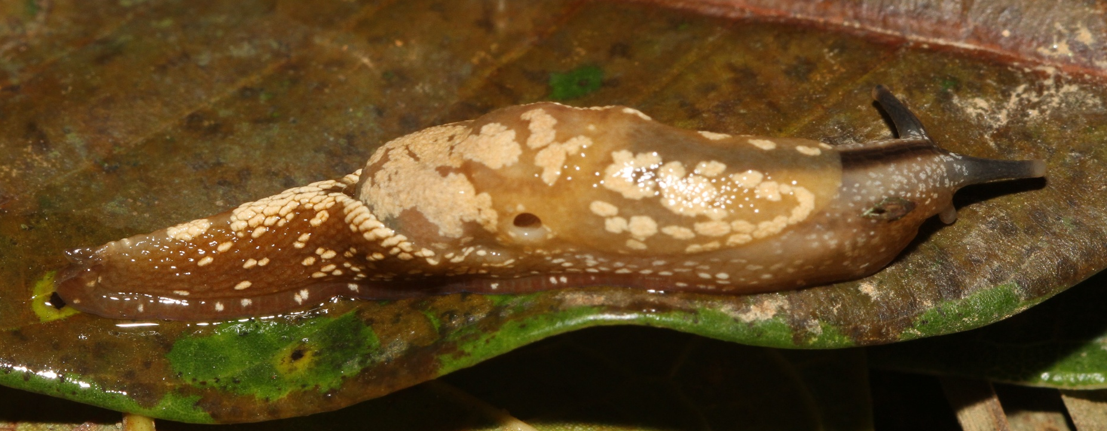
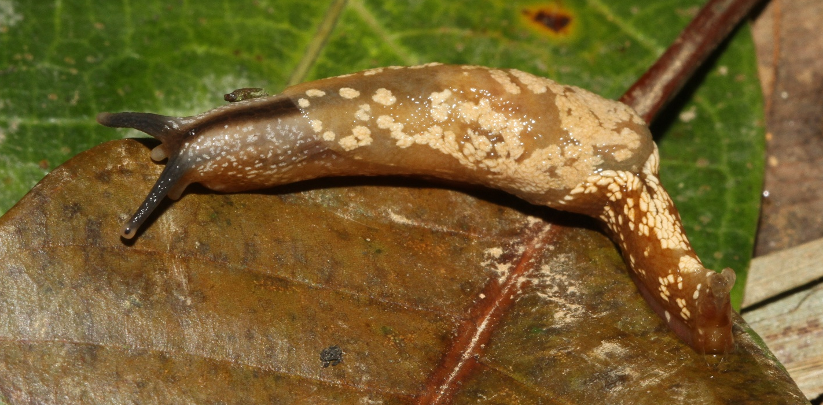
Family – semislug species 1
42 mm extended
Along road near camp

Slide 12
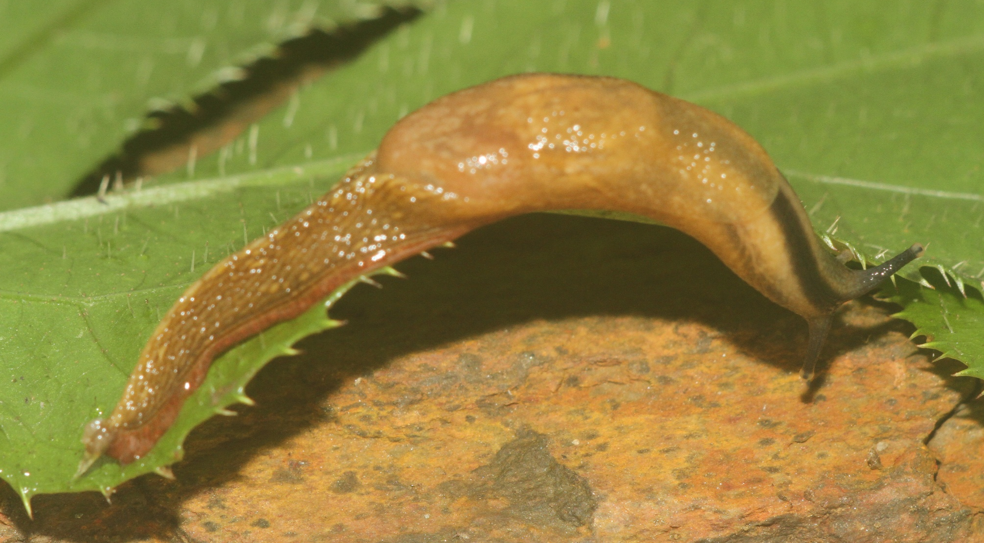
Family – semislug species 2
45 mm extended
Along road near camp

Slide 13
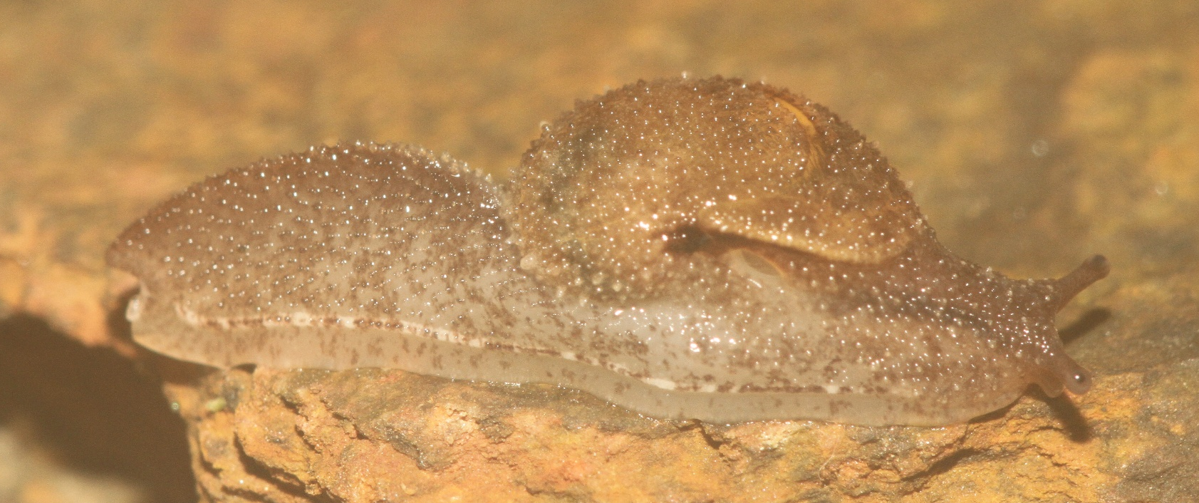
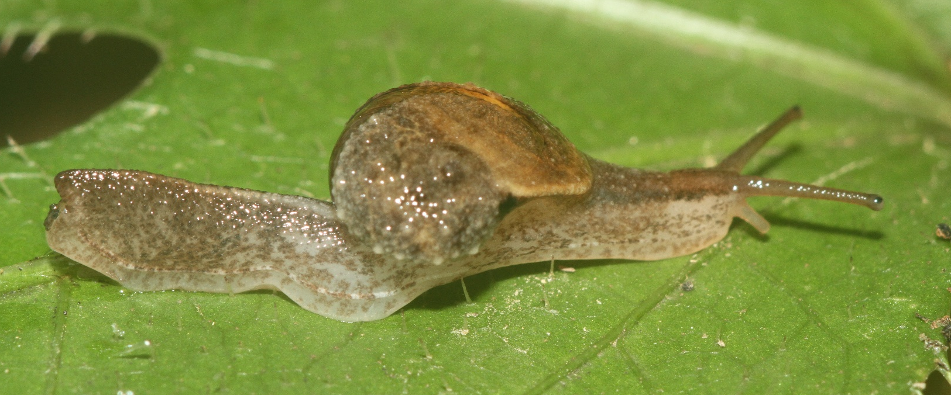
Family – semislug species 3
25 mm extended
Along road near camp

Slide 14
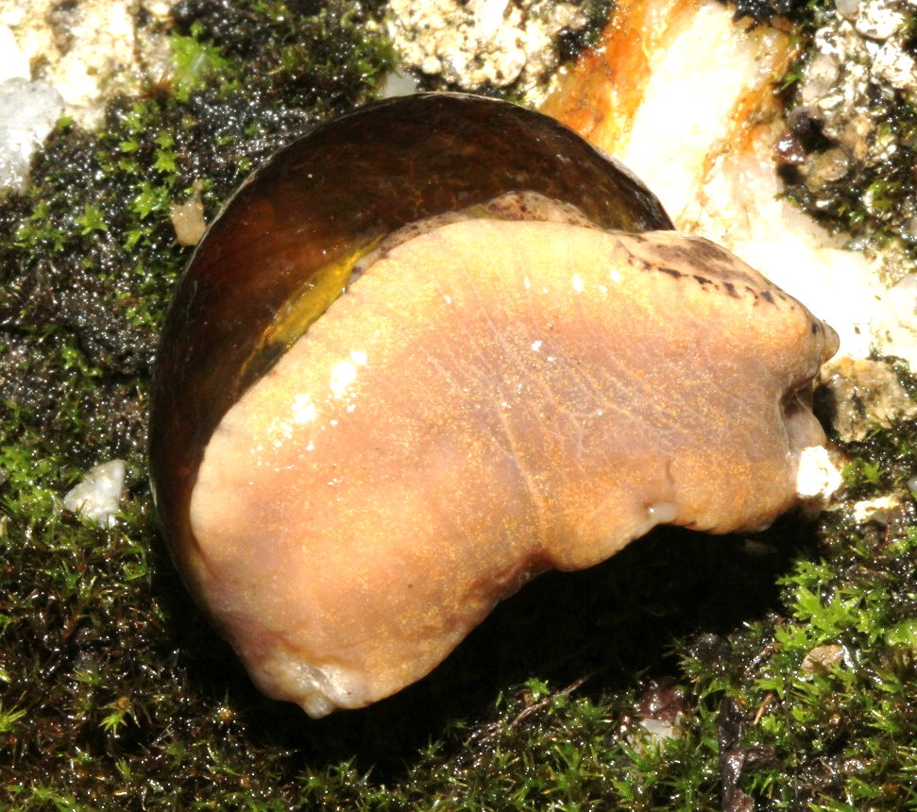
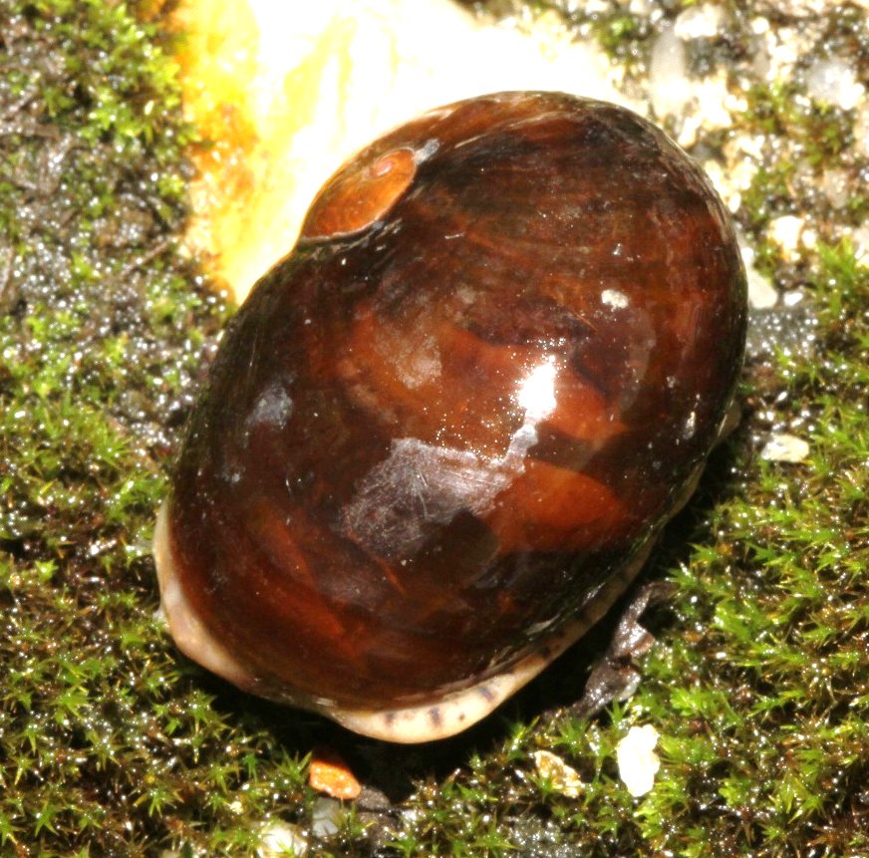
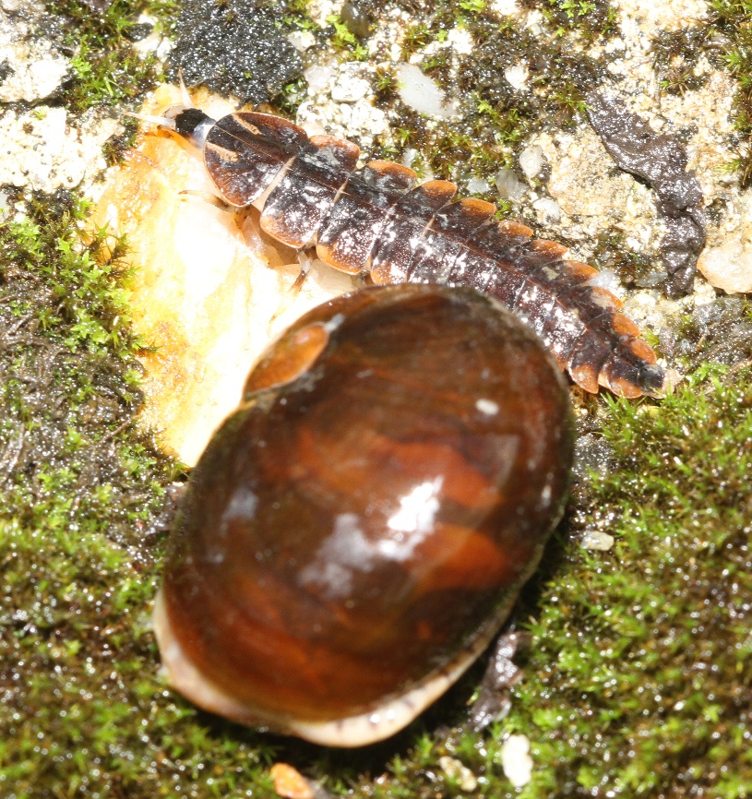
Family – semislug species 4
Shell about 25 mm
Near top of road
Insect predator present

Slide 15
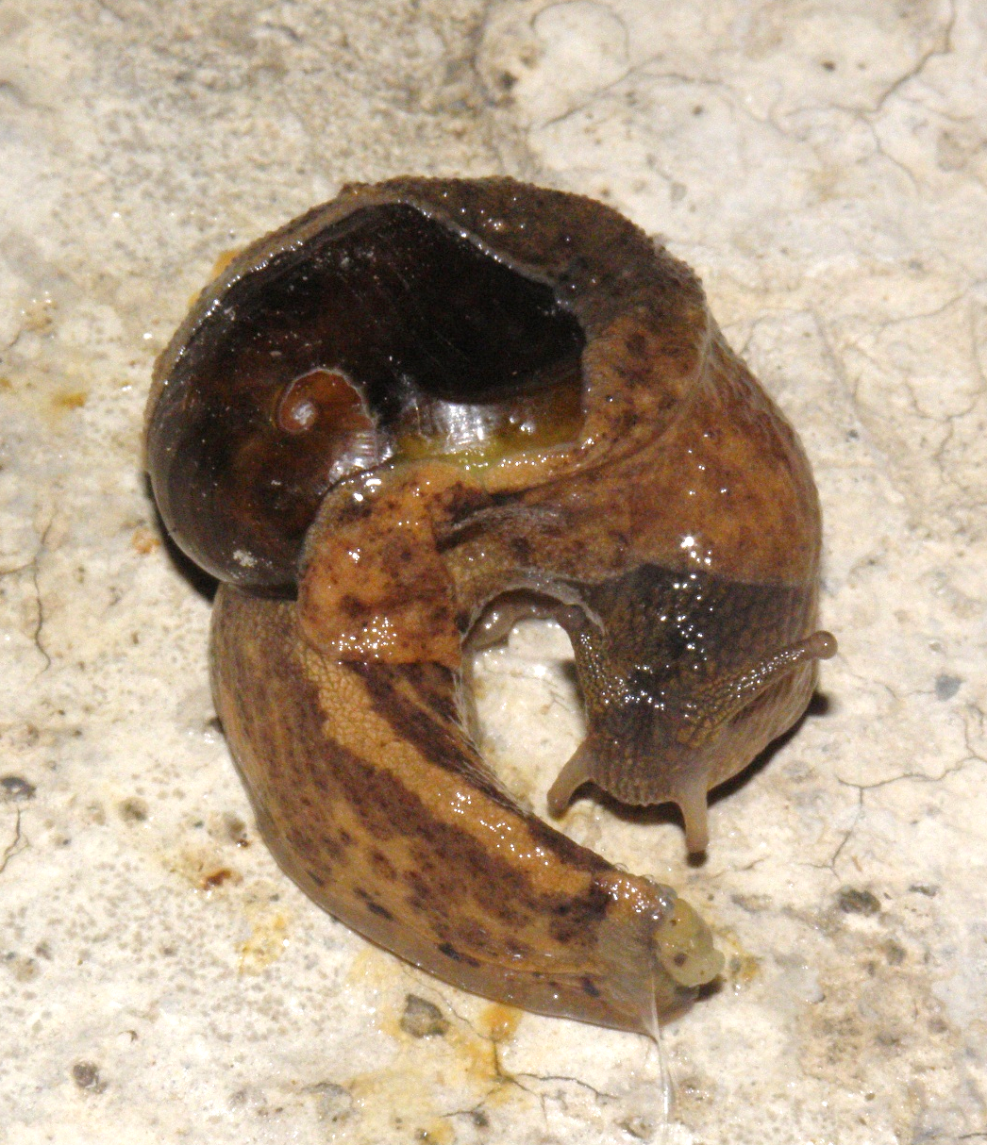
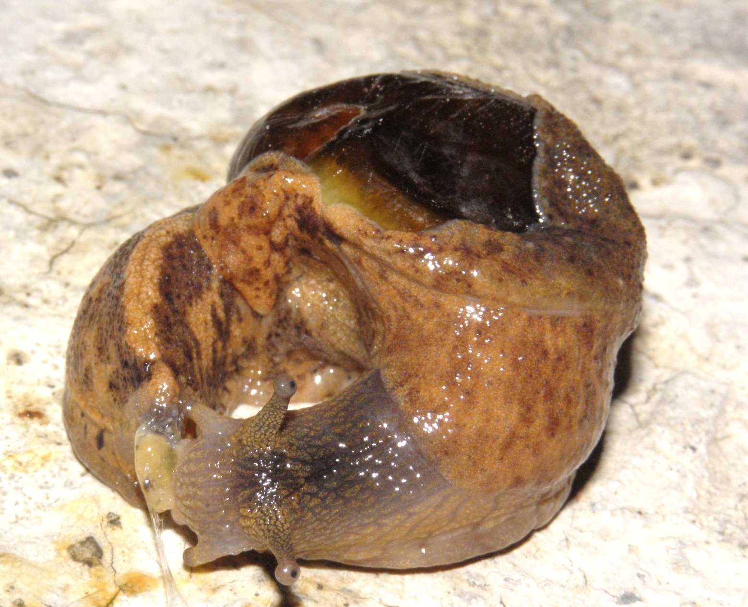
Family – semislug species 4
Shell about 25 mm
Road near camp
Tail gland use visible

Slide 16
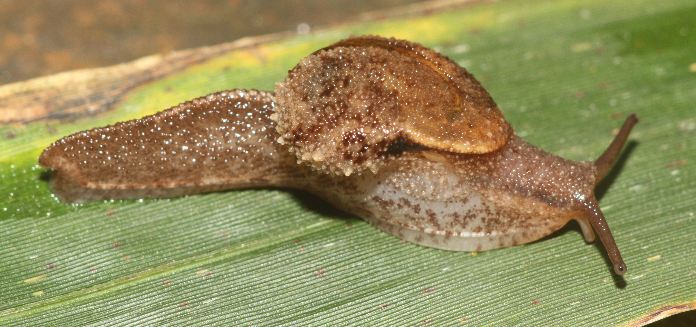
Family – semislug species 5
35 mm extended
On vegetation near camp

Slide 17
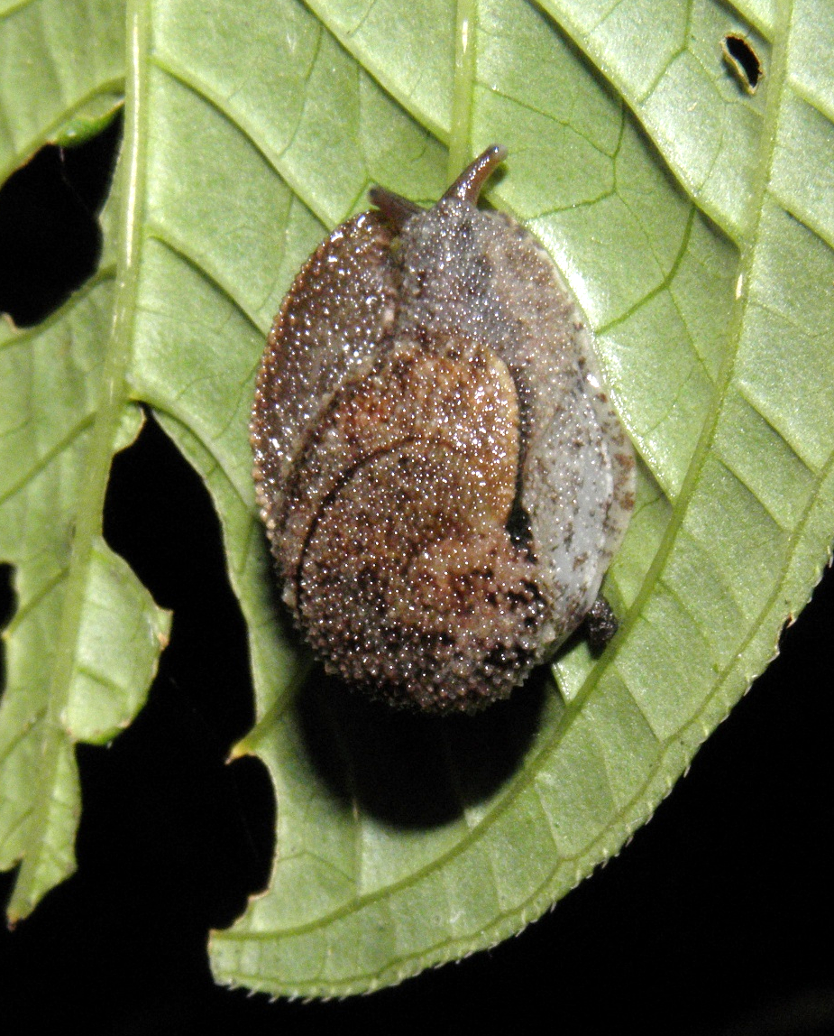
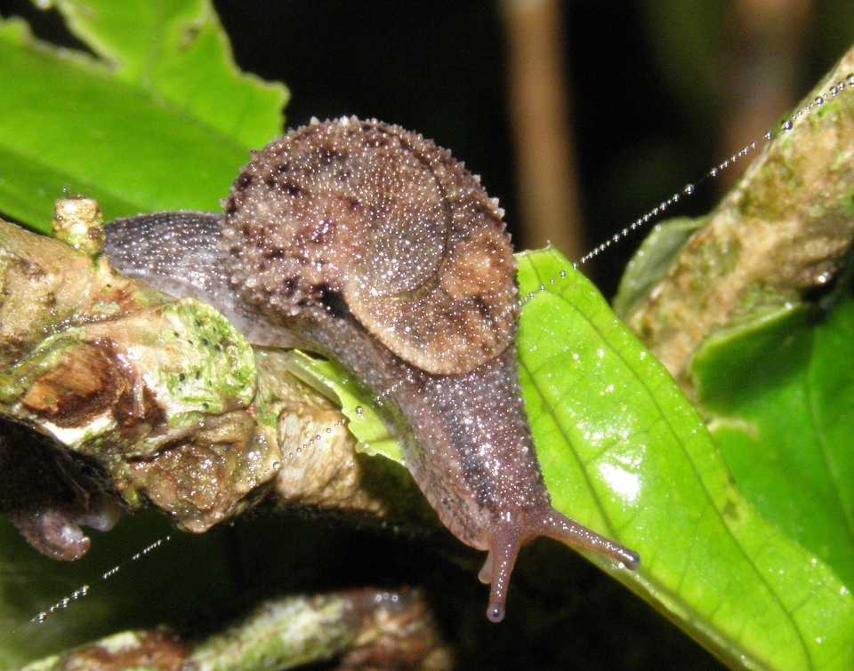
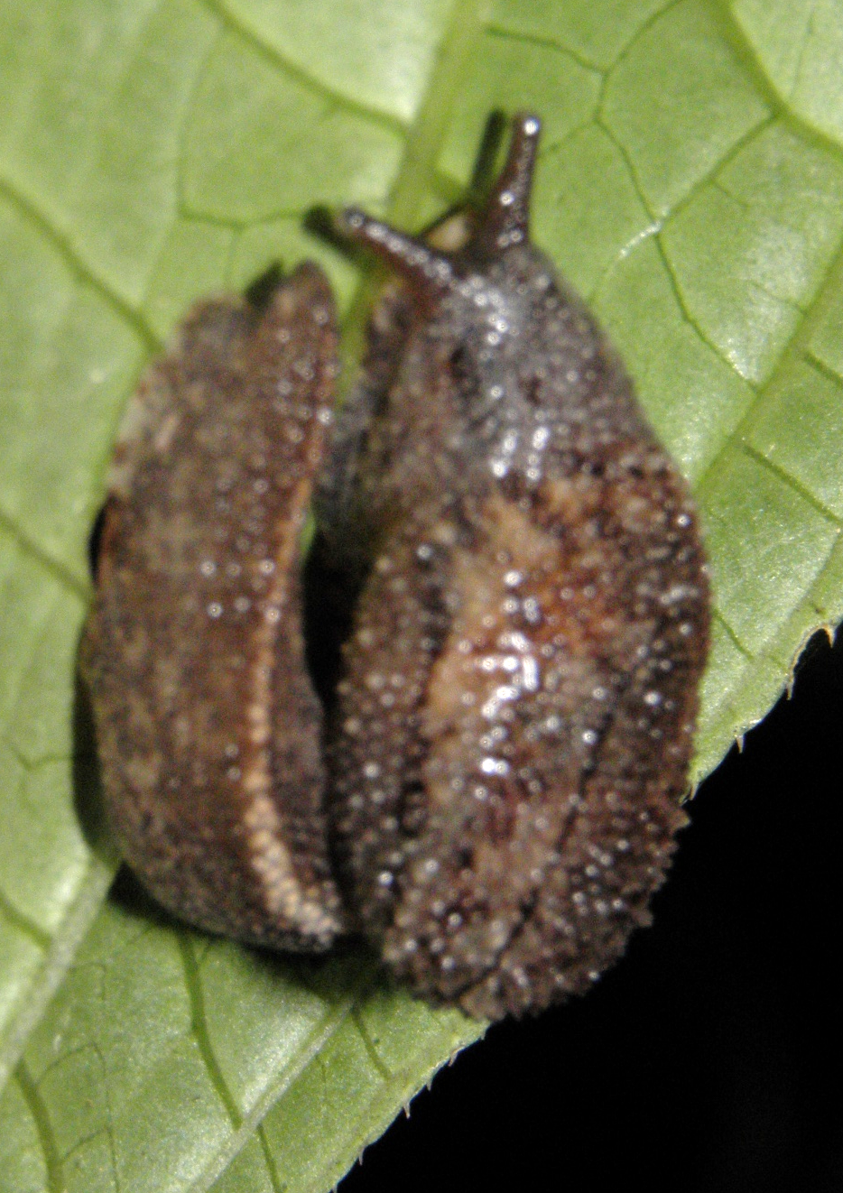
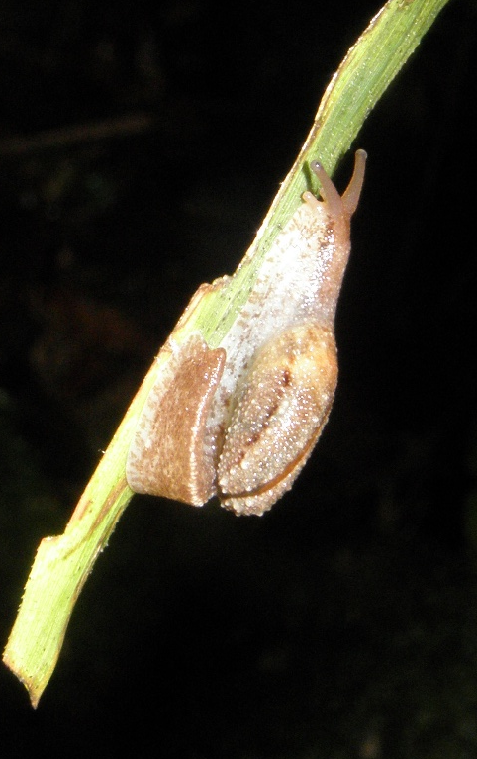
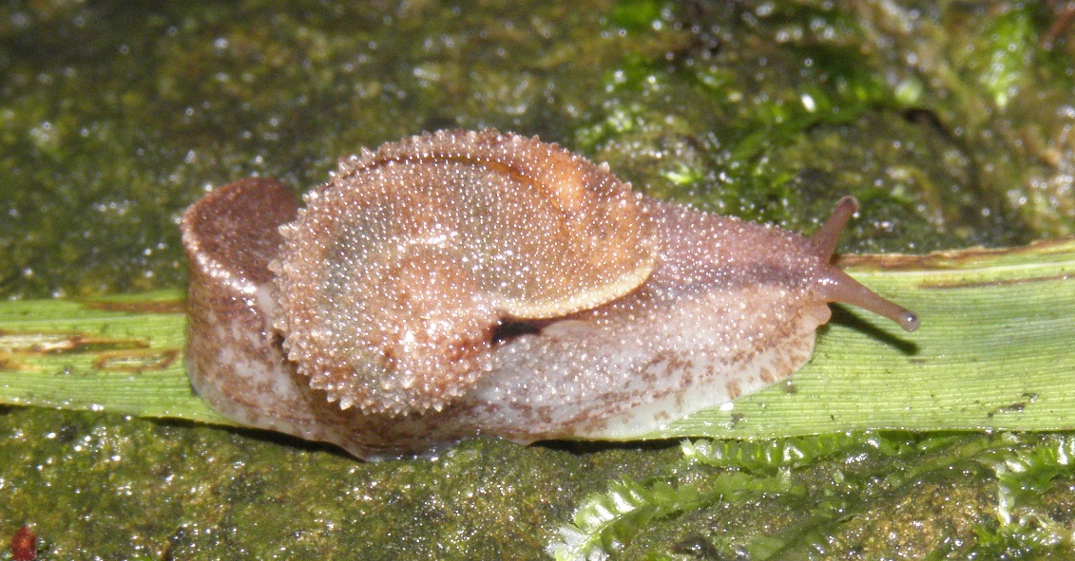
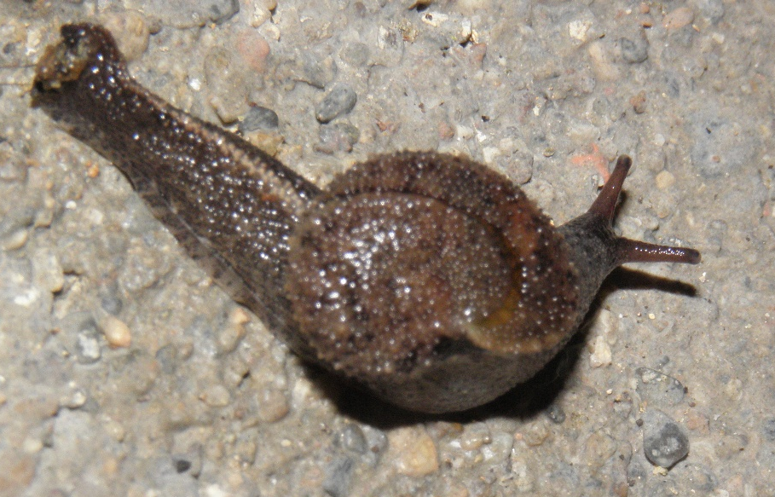
Family – semislug species
On vegetation near camp at night

Slide 18
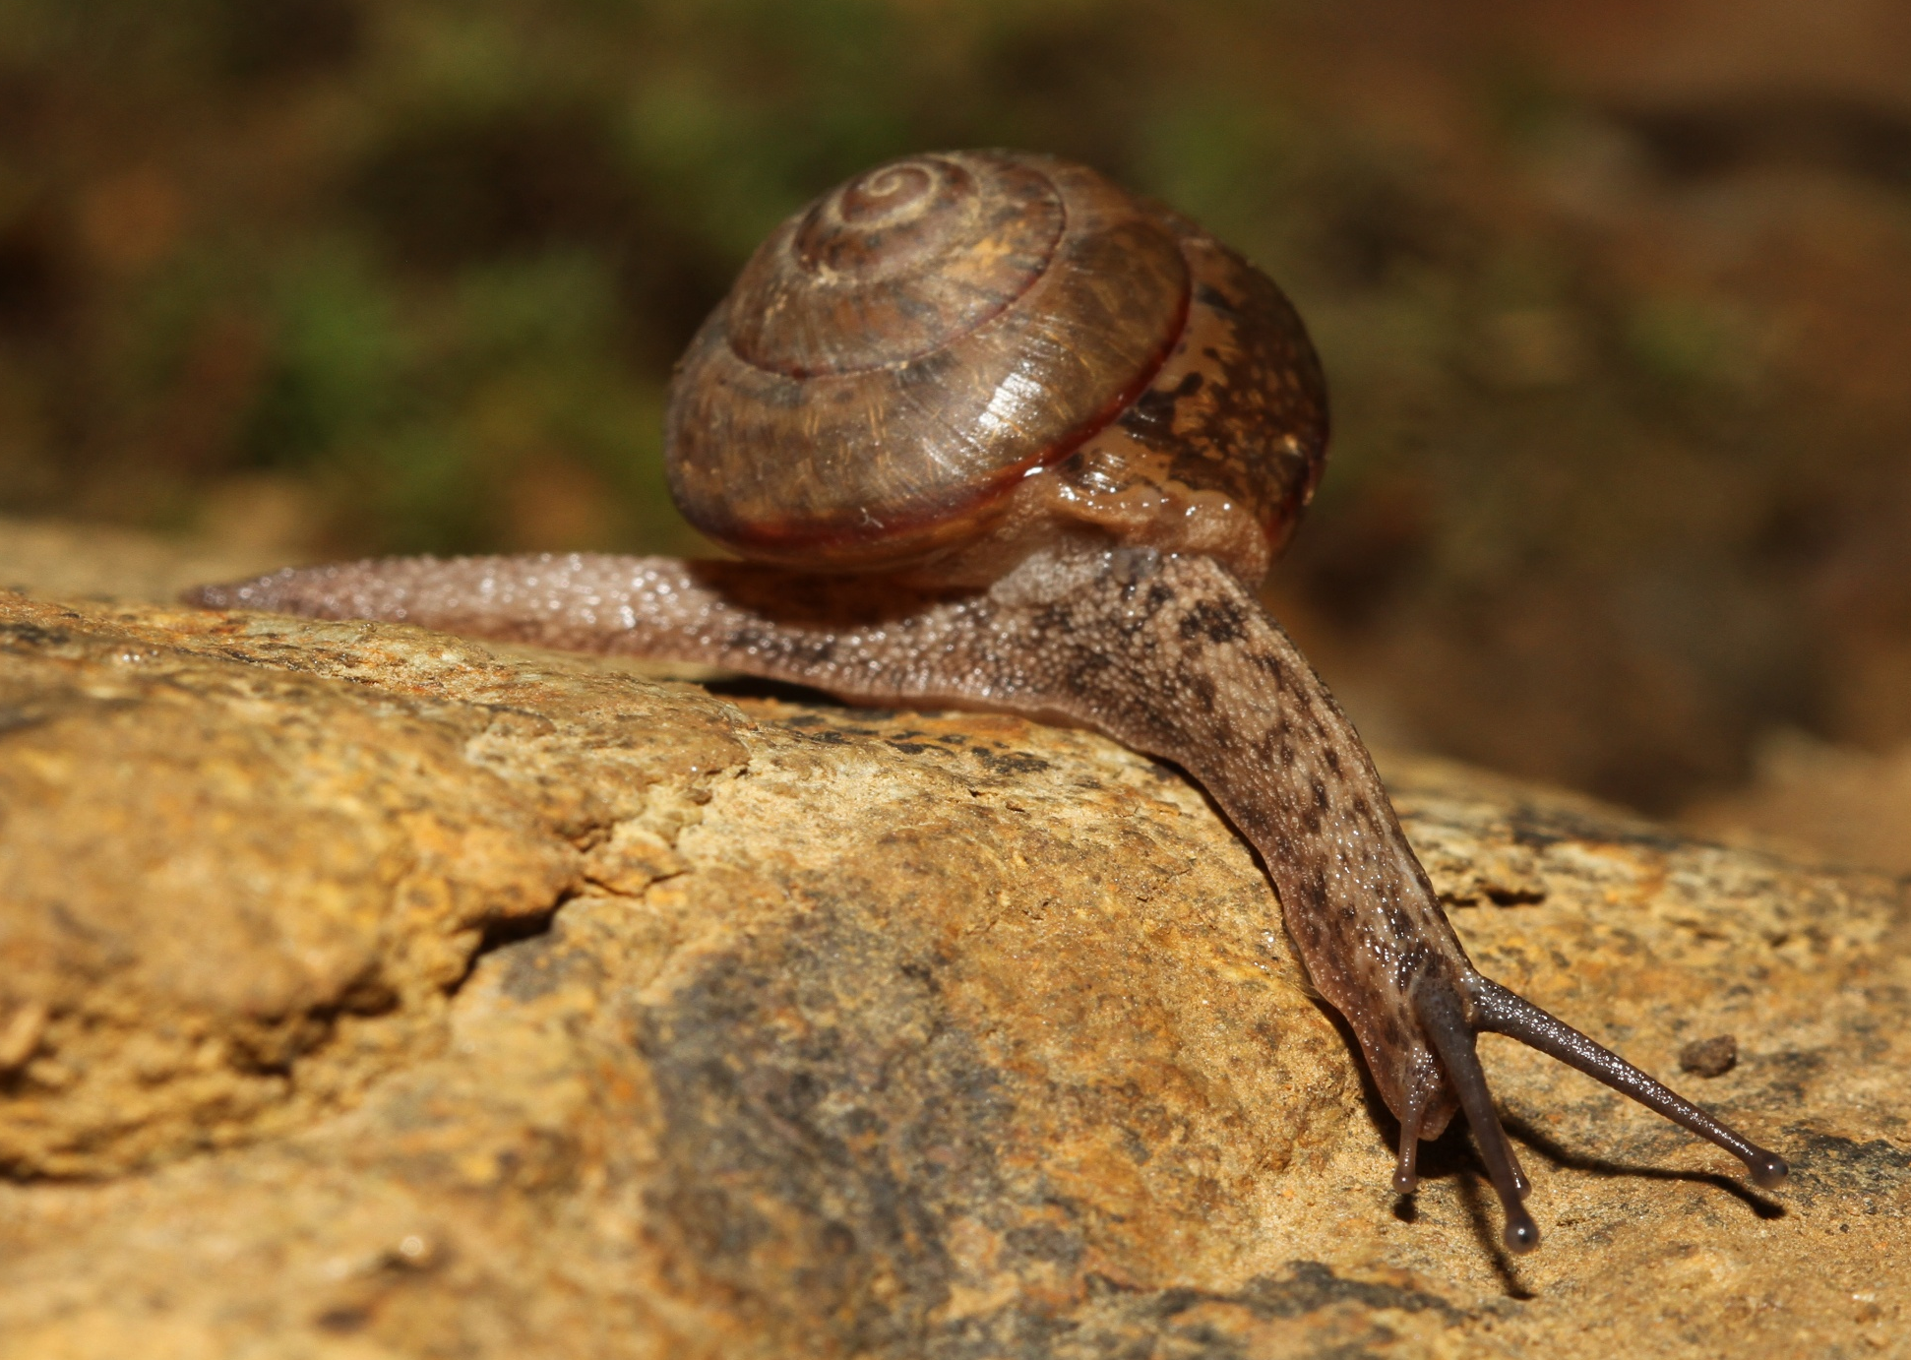
Family Ariophantidae – species 1
19 mm shell
Trail to bat cave

