Slide 1
Land Snails of Sonora
Robert Wayne Van Devender
Department of Biology
Appalachian State University

Slide 2
Bulimulidae – Rabdotus nigromontanus

Slide 3
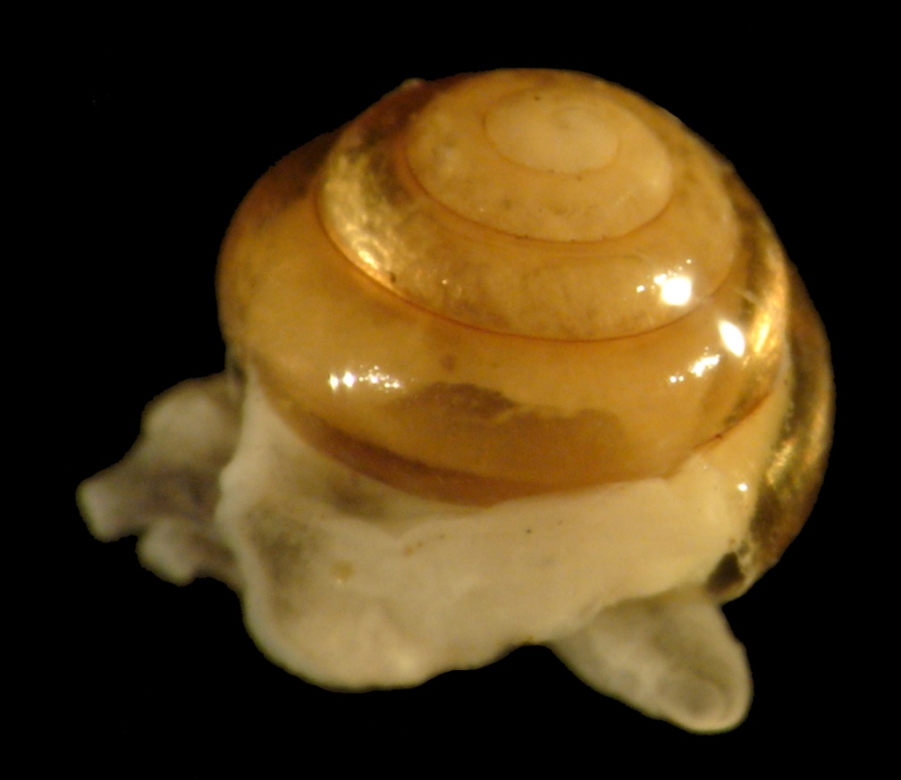
Helicarionidae - Habroconus species

Slide 4
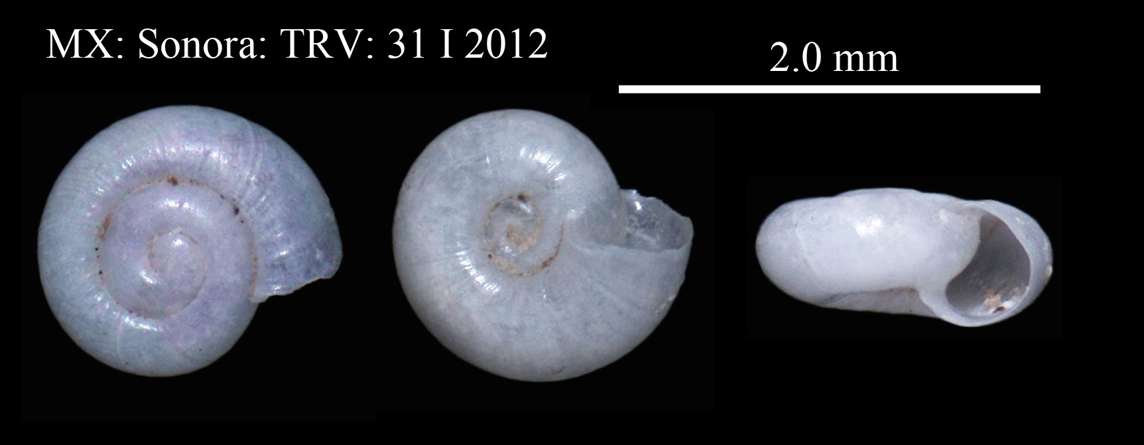
Helicodiscidae – Helicodiscus singleyana

Slide 5
Xanthonychidae - Sonorella cf. hachitana

Slide 6
Philomycidae - Pallifera arizonensis
Snail from Rio Saracachi, Sonora

Slide 7
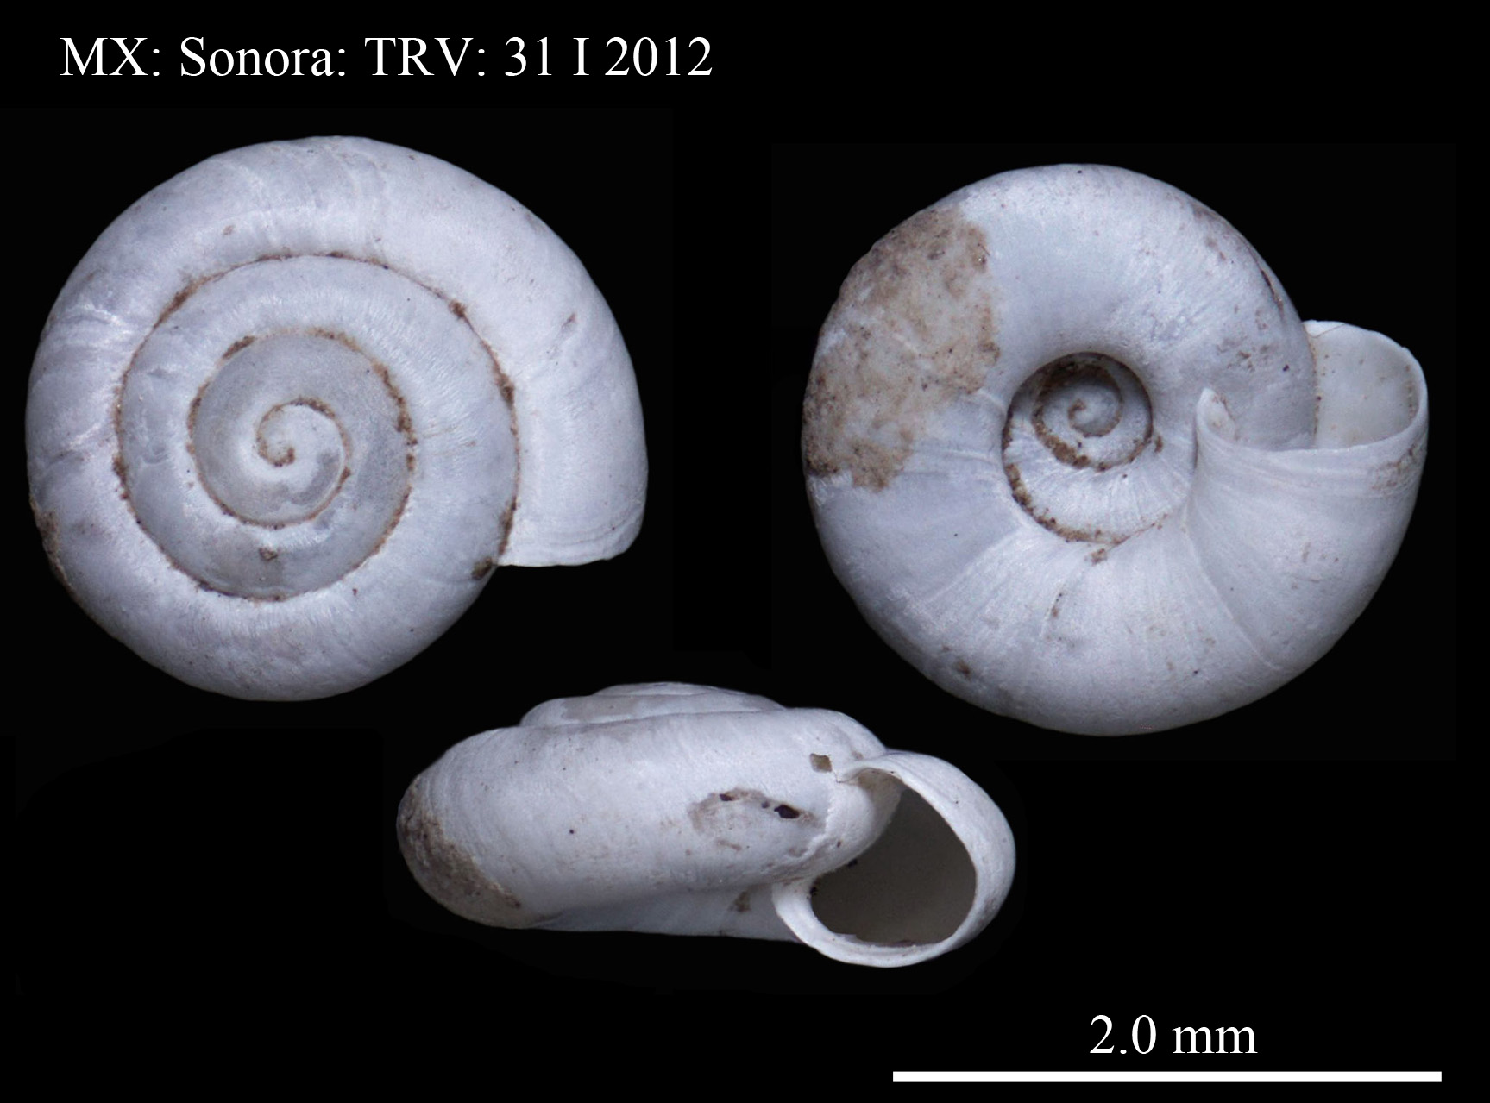
Small flat snail

Slide 8
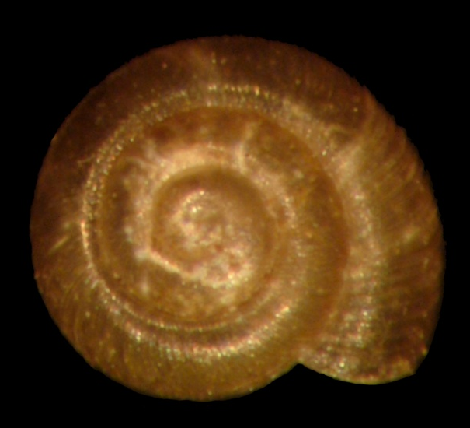
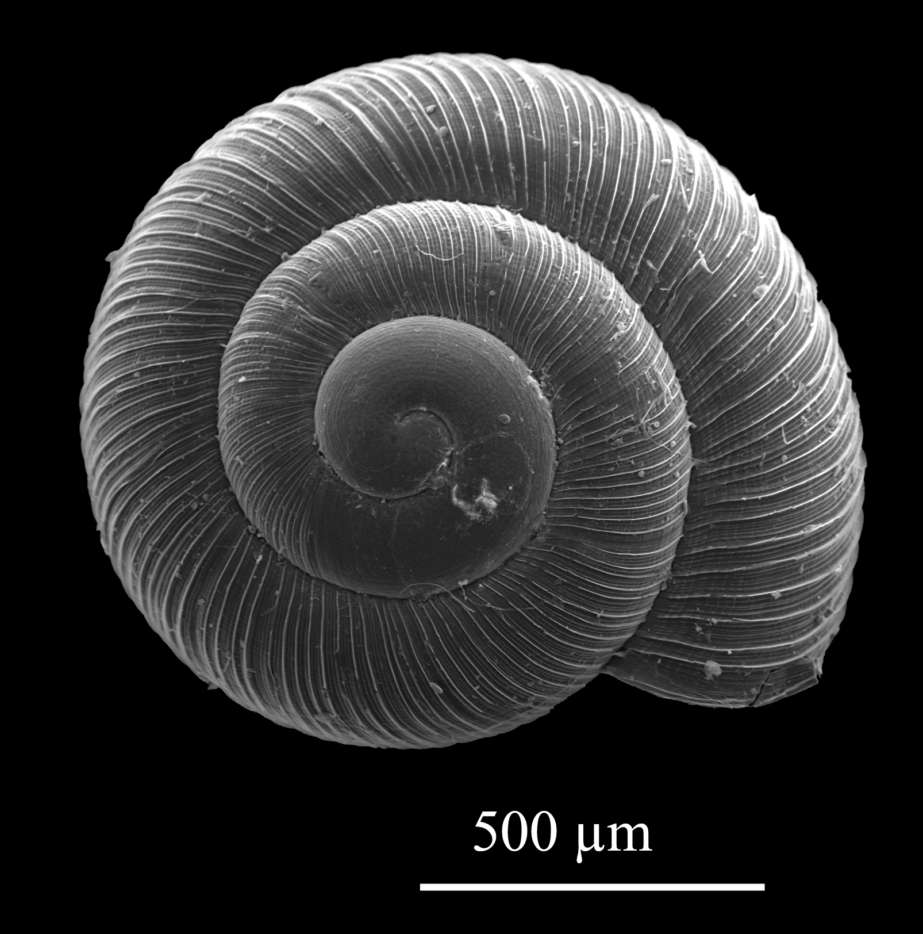
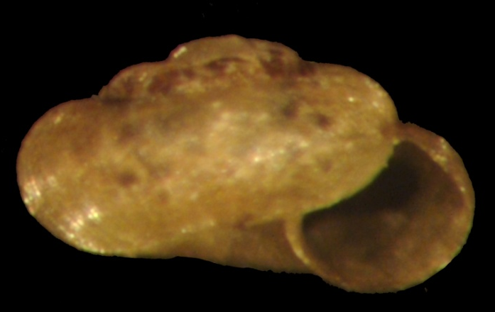
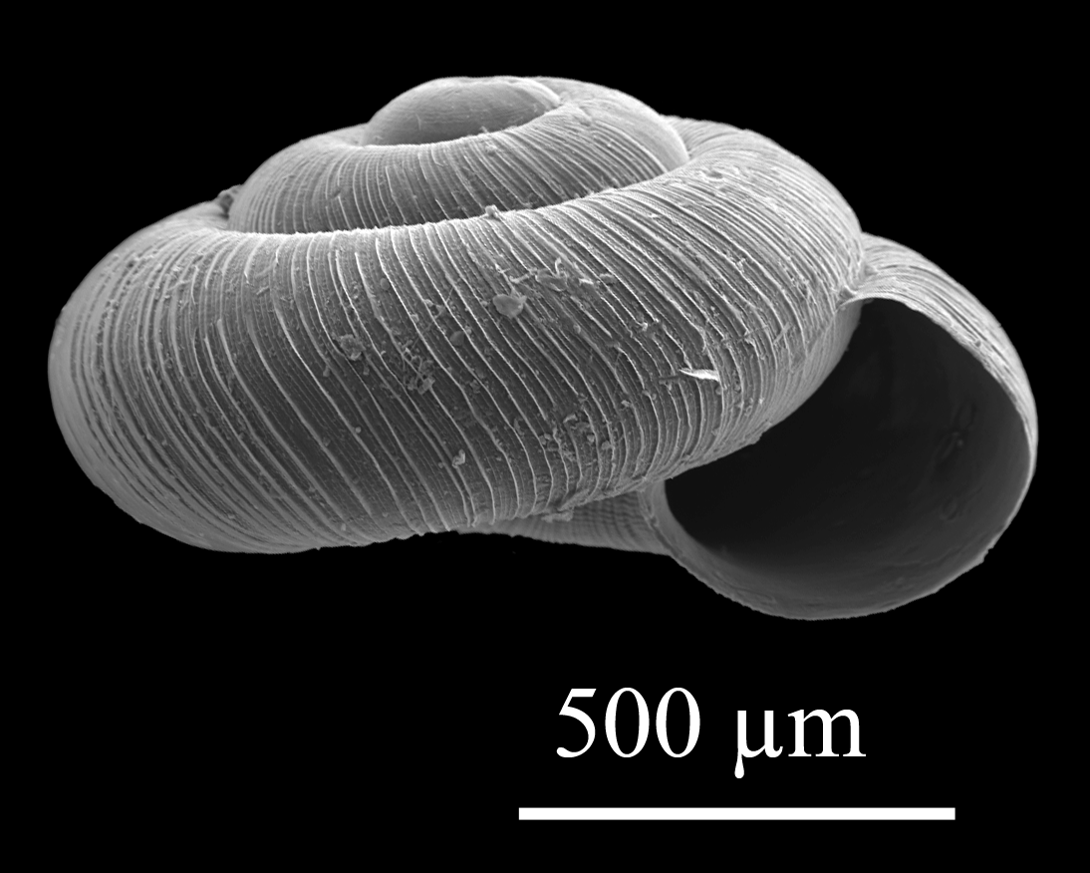
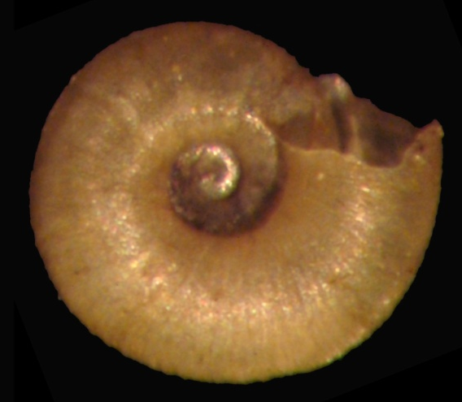
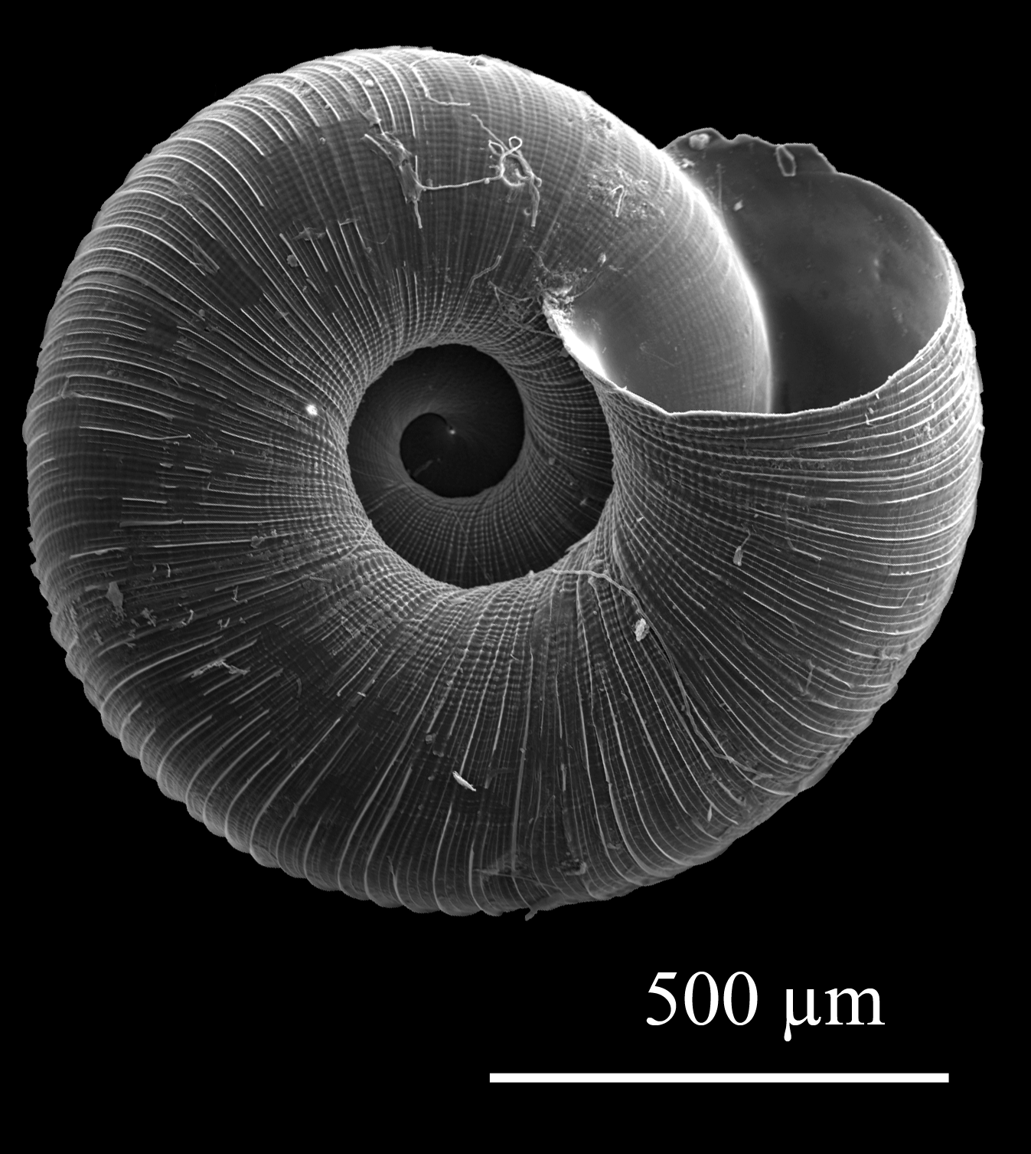
Family Punctidae Punctum californicum cf.
Notes:
Similar to figure 355 on p. 648 of Pilsbry 2, part 2 Pilsbry, 1948 from Dragoon Mts. of Cochise Co, AZ.
Arizona specimens smaller than California specimens.
Characters of AZ specimens and P. minutissimum overlap.
P. minutissimum not known from closer than Puebla, MX or Otero Co., NM.
Last whorl “flatter” than illustrated for P. minutissimum in Pilsbry.

Slide 9
Punctidae – Punctum species

Slide 10
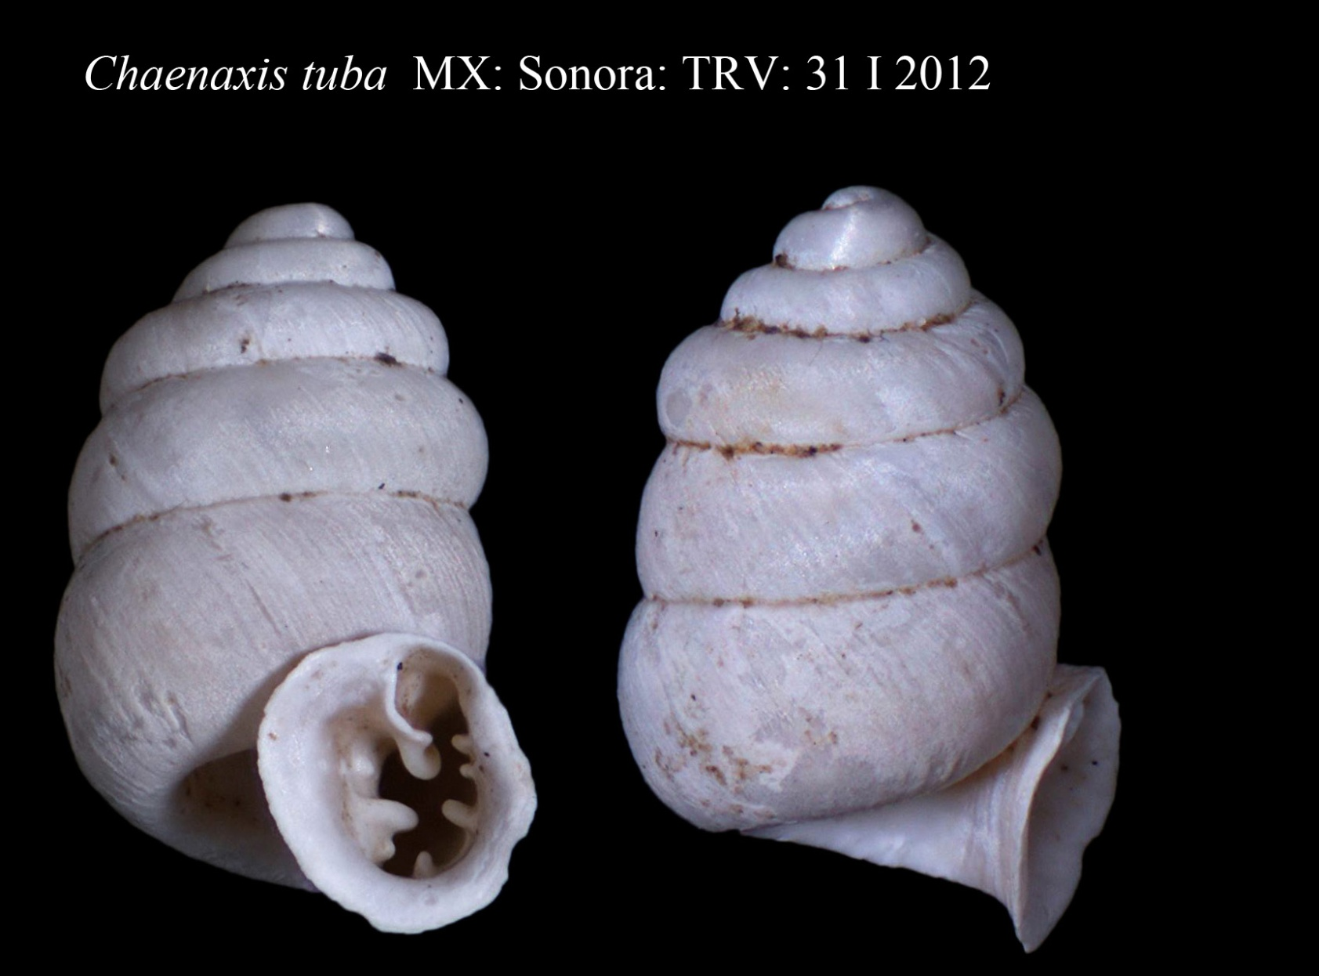
Pupillidae - Chaenaxis tuba

Slide 11
Pupillidae – Gastrocopta cristata
Rio Saracachi

Slide 12
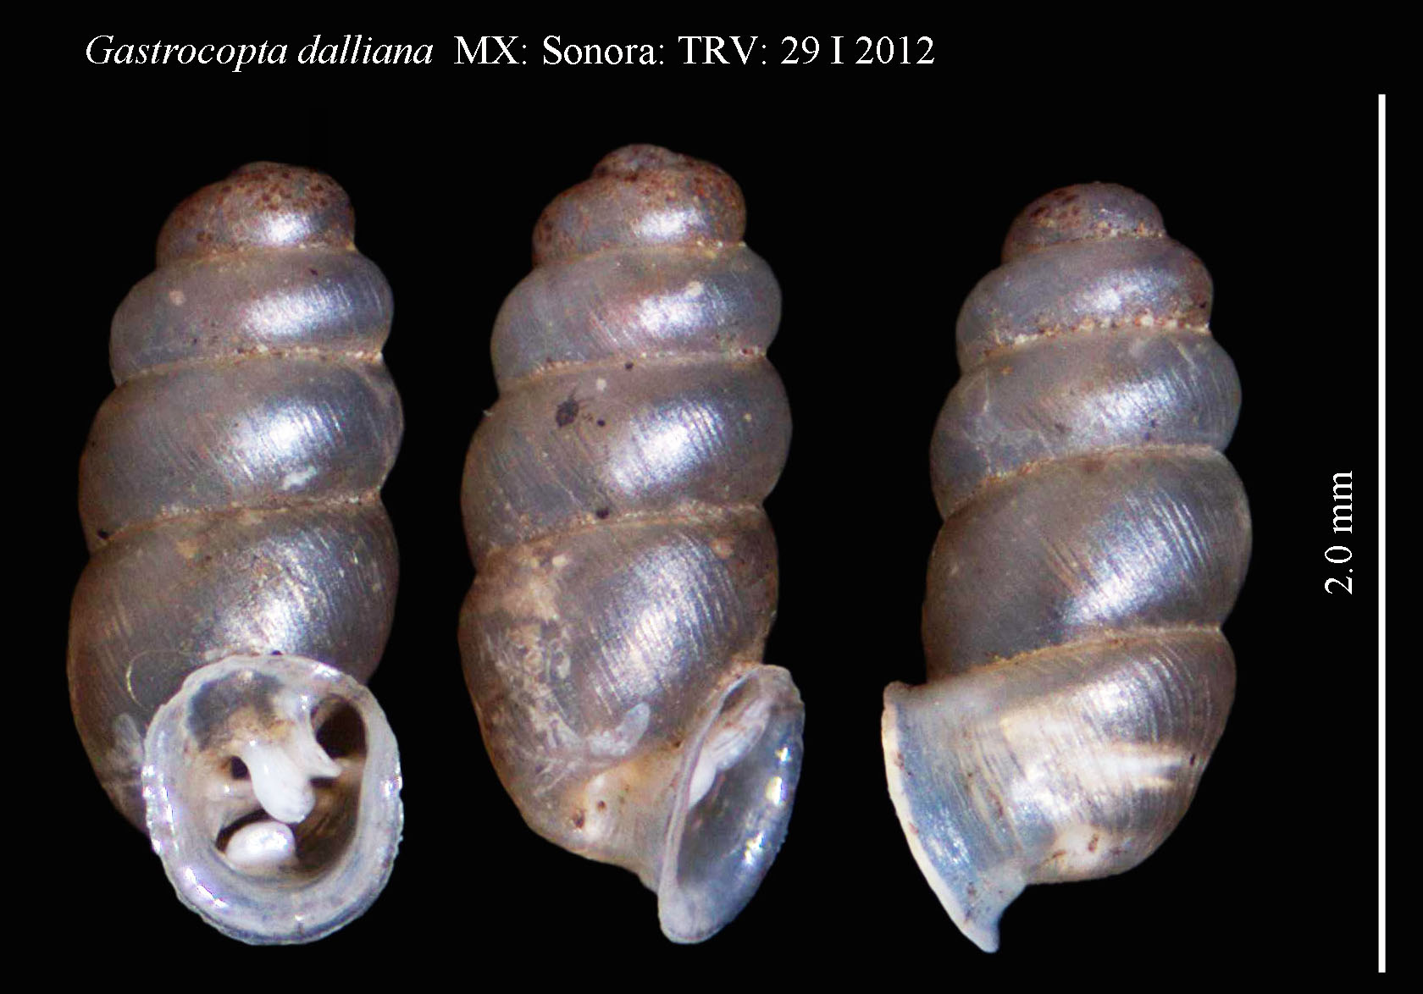
Pupillidae – Gastrocopta dalliana

Slide 13
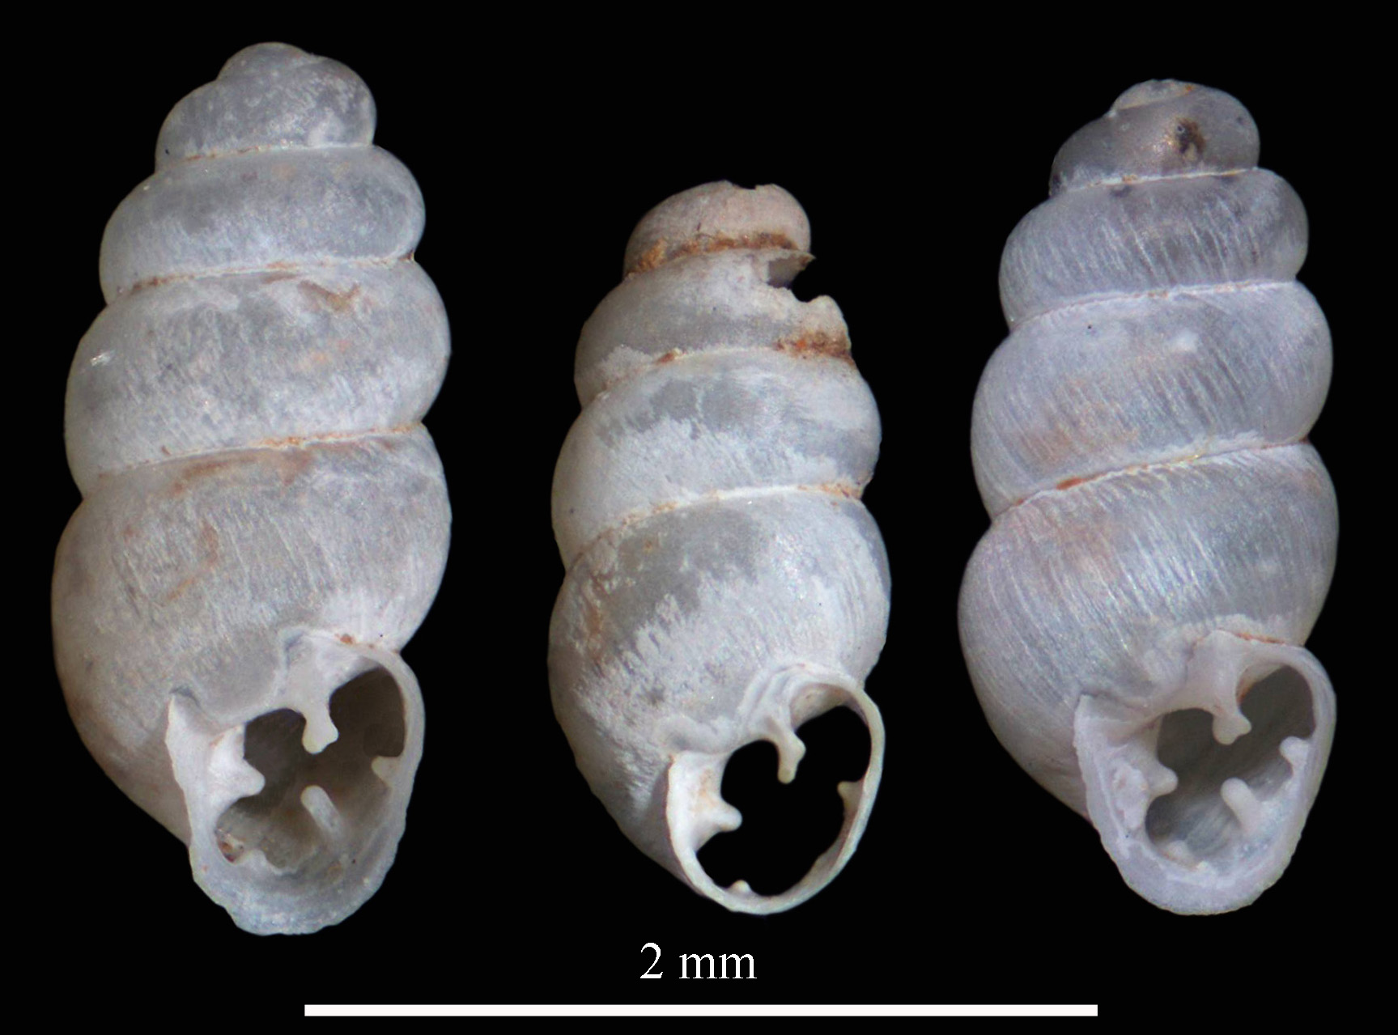
Pupillidae – Gastrocopta pellucida

Slide 14
Pupillidae – Gastrocopta ashmuni

Slide 15
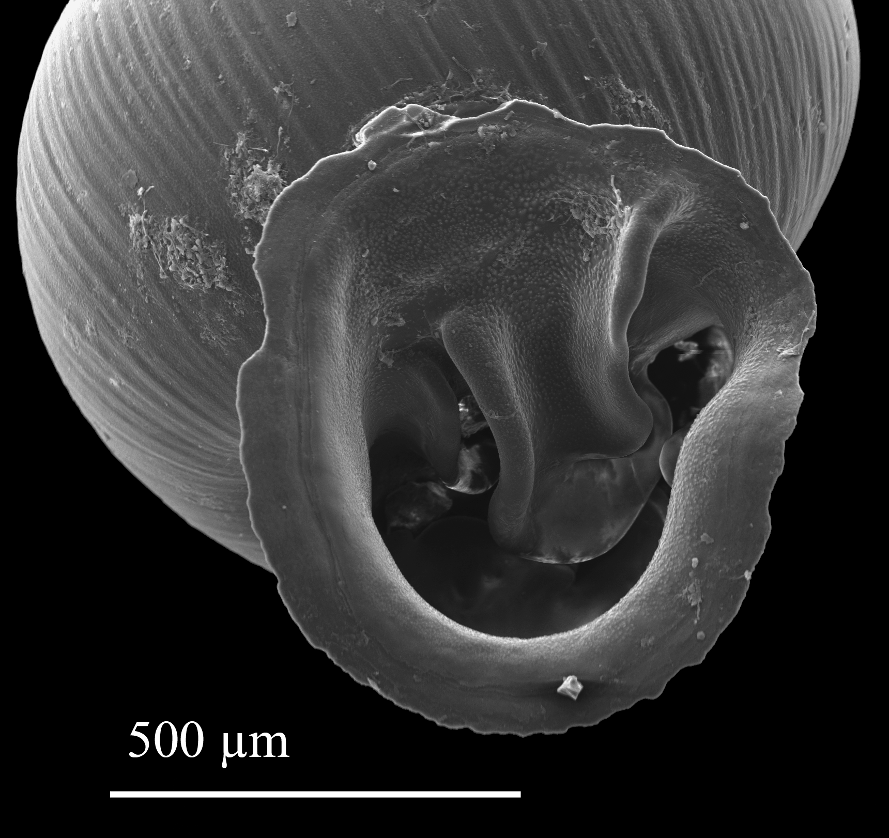
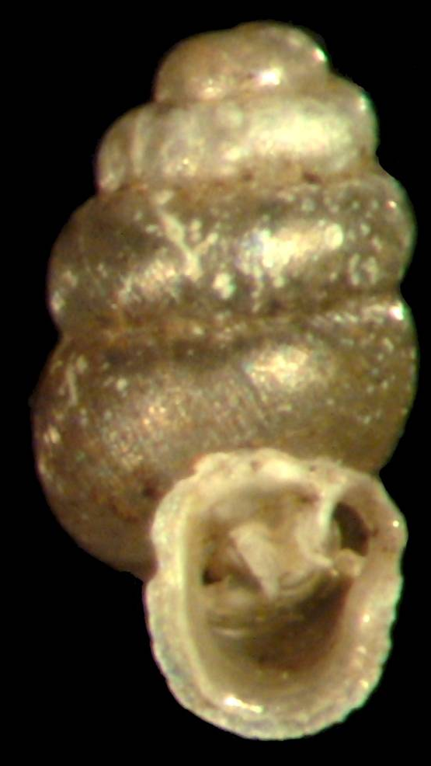
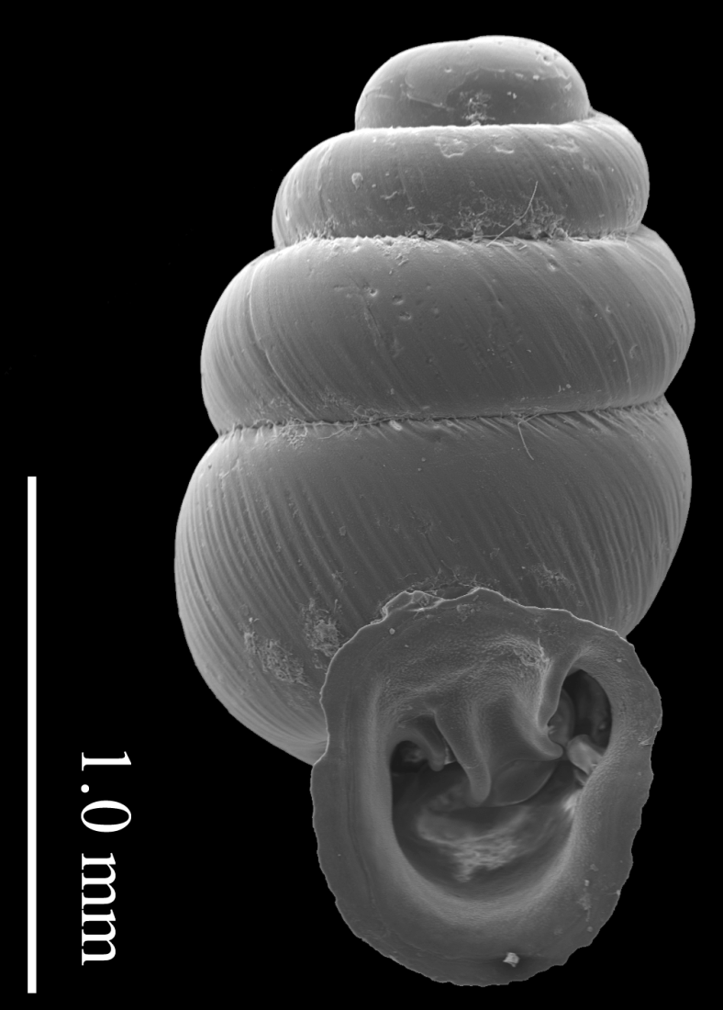
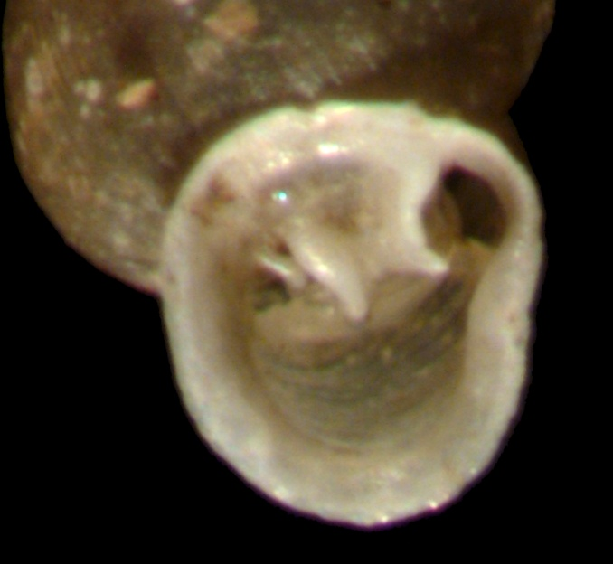
Pupillidae - Gastrocopta ashmuni
Notes:
Angular and parietal united to form a lambda figure.
Inner end of parietal turns strongly right towards the periphery.
Columella sinuous and emerges onto the parietal wall to appear like an infraparietal fold.
Basal and both palatals horizontal and deeply placed in aperture.

Slide 16
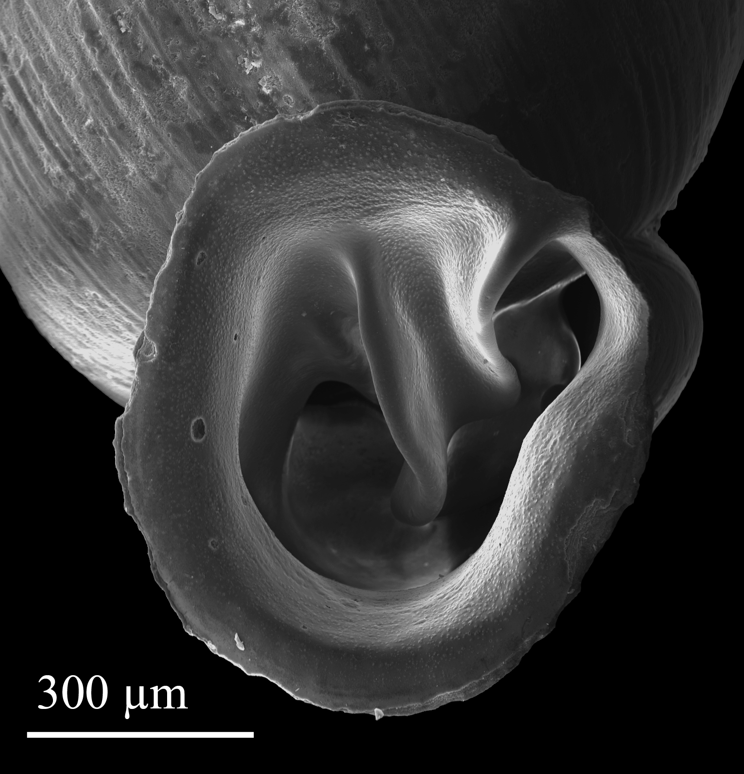
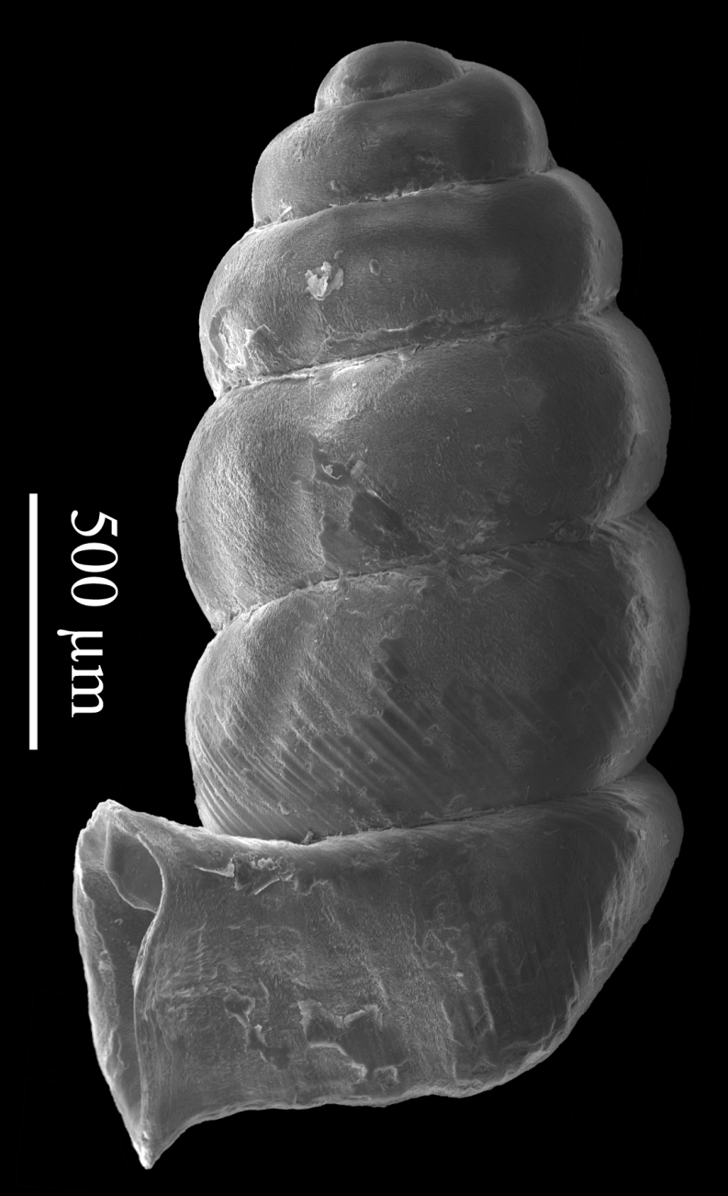
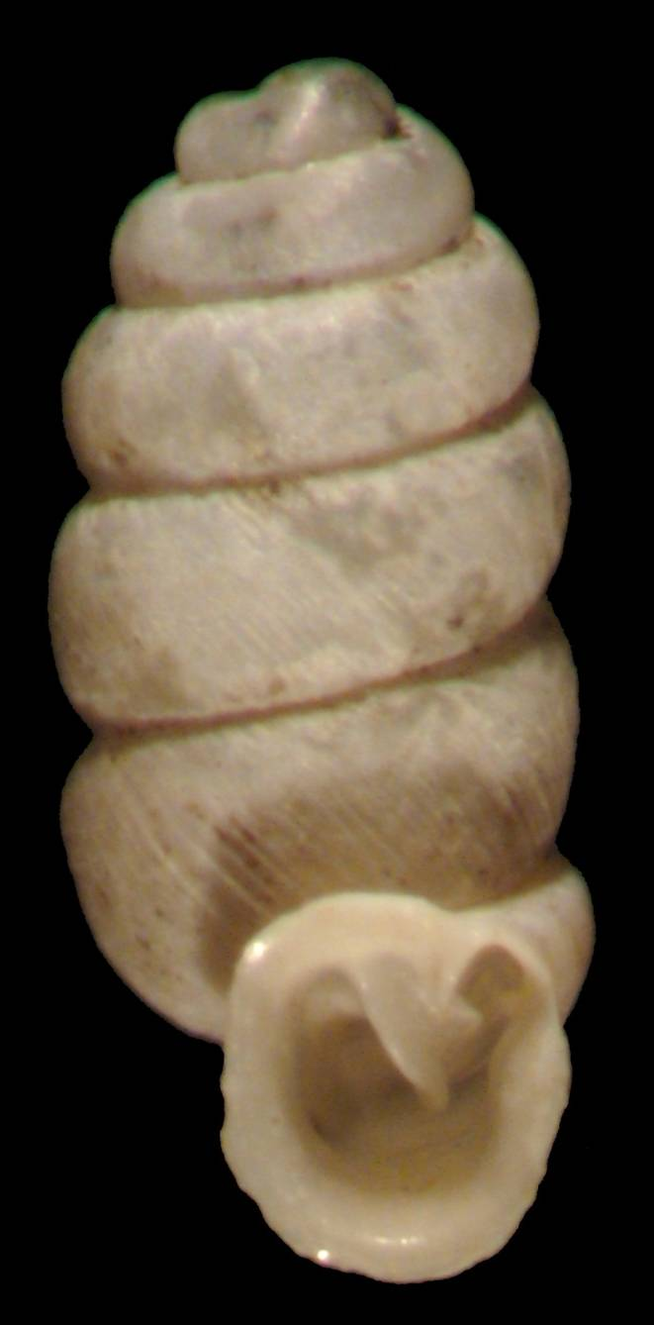
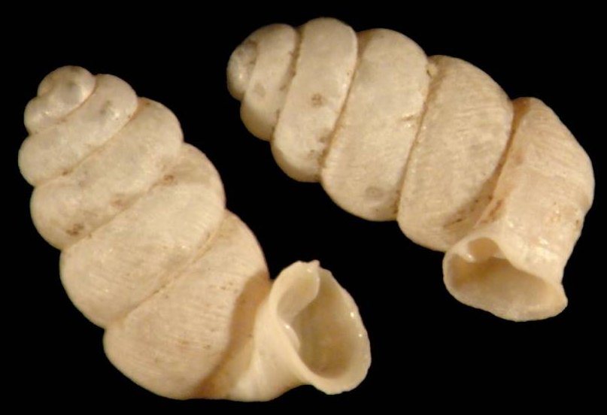
Pupillidae - Gastrocopta ashmuni (goose-neck form)
Notes:
Angular and parietal united to form a lambda figure.
Inner end of parietal turns strongly right towards the periphery.
Columella sinuous and emerges onto the parietal wall to appear like an infraparietal fold.
Basal and both palatals horizontal and deeply placed in aperture.
Tubular aperture extends well beyond shell margin

Slide 17
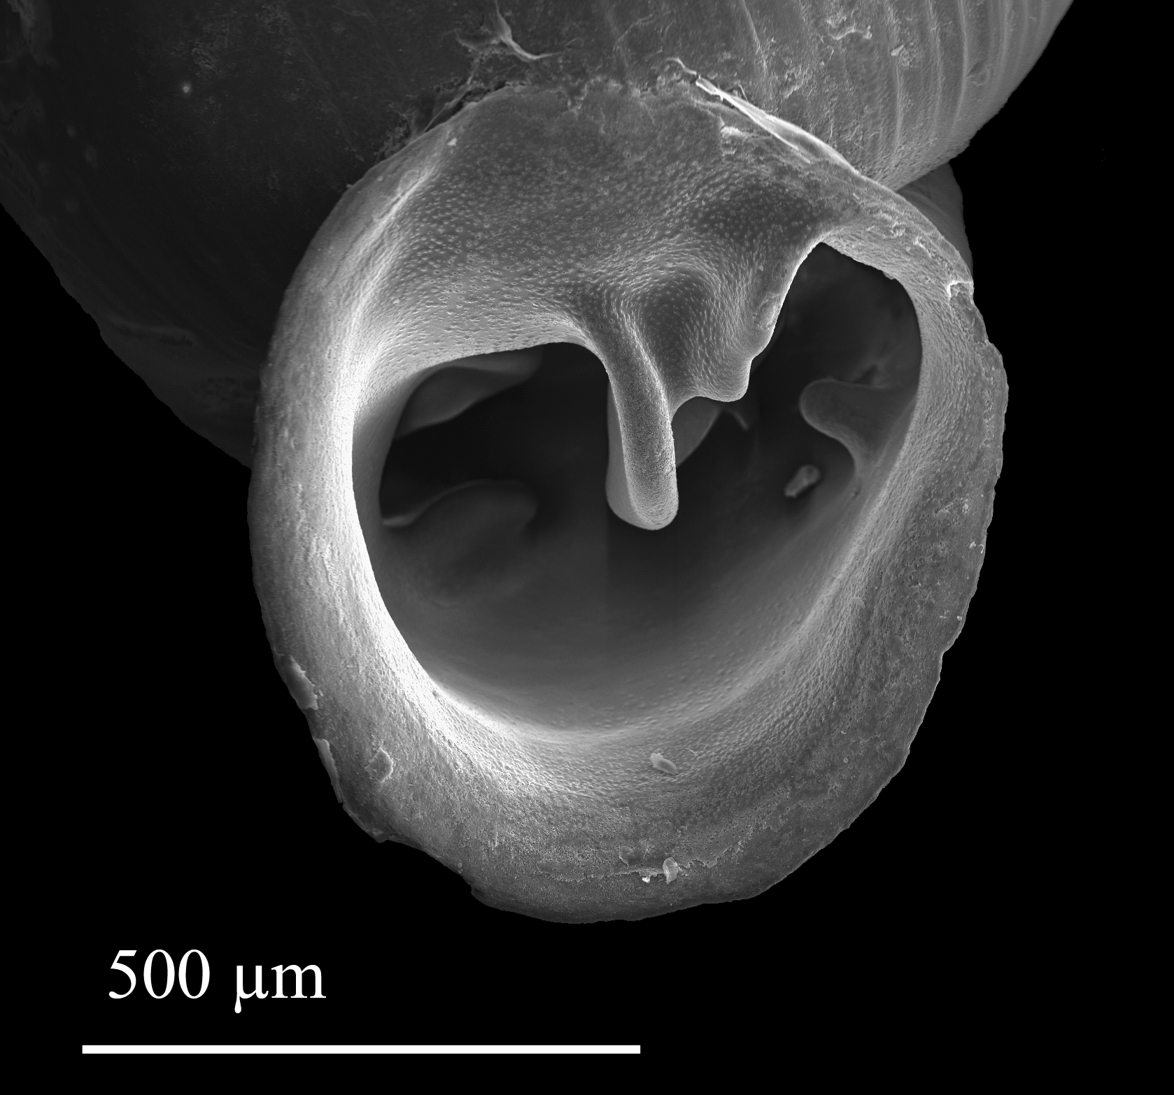
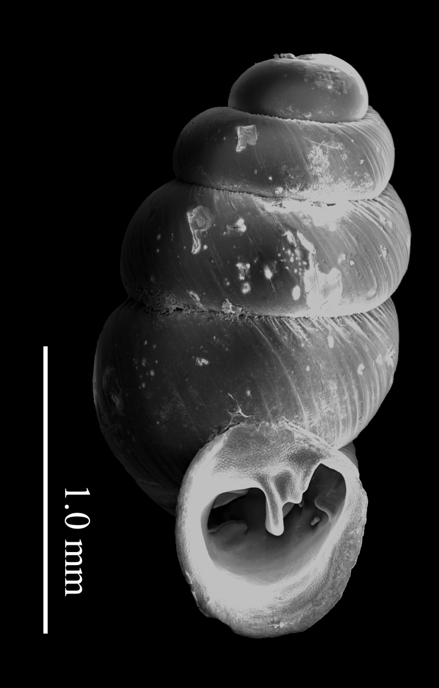
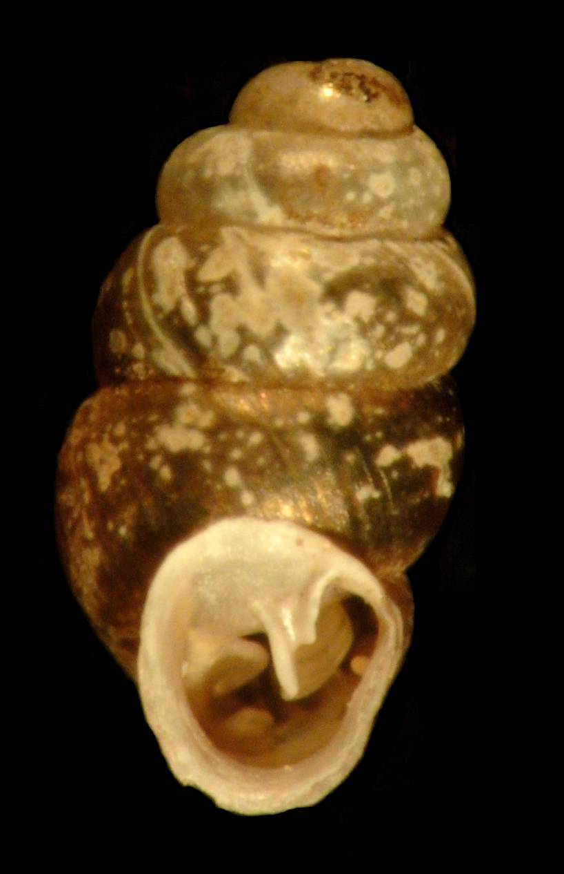
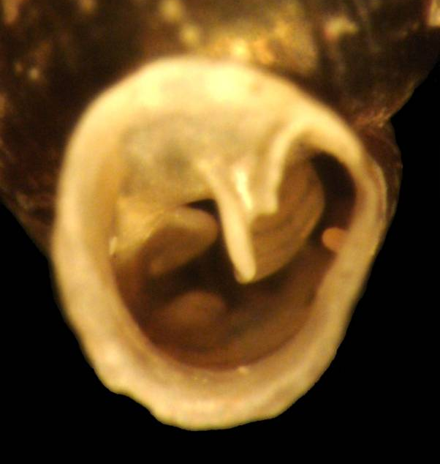
Pupillidae - Gastrocopta cochisensis
Notes:
Similar to G. ashmuni but without columella emerging onto the parietal wall.
Angular and parietal smaller than in G. ashmuni.
Parietal curves to right towards periphery deep inside of aperture.
Columella emerges horizontally.
Reflected lips of aperture scarcely separated from body whorl.

Slide 18
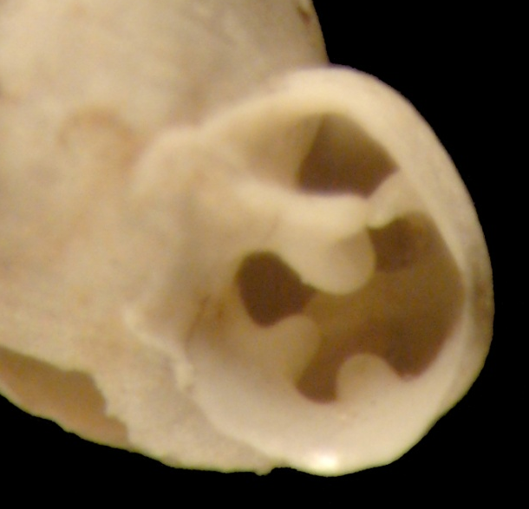
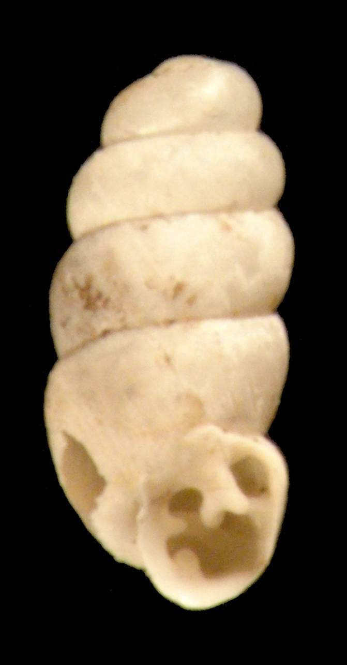
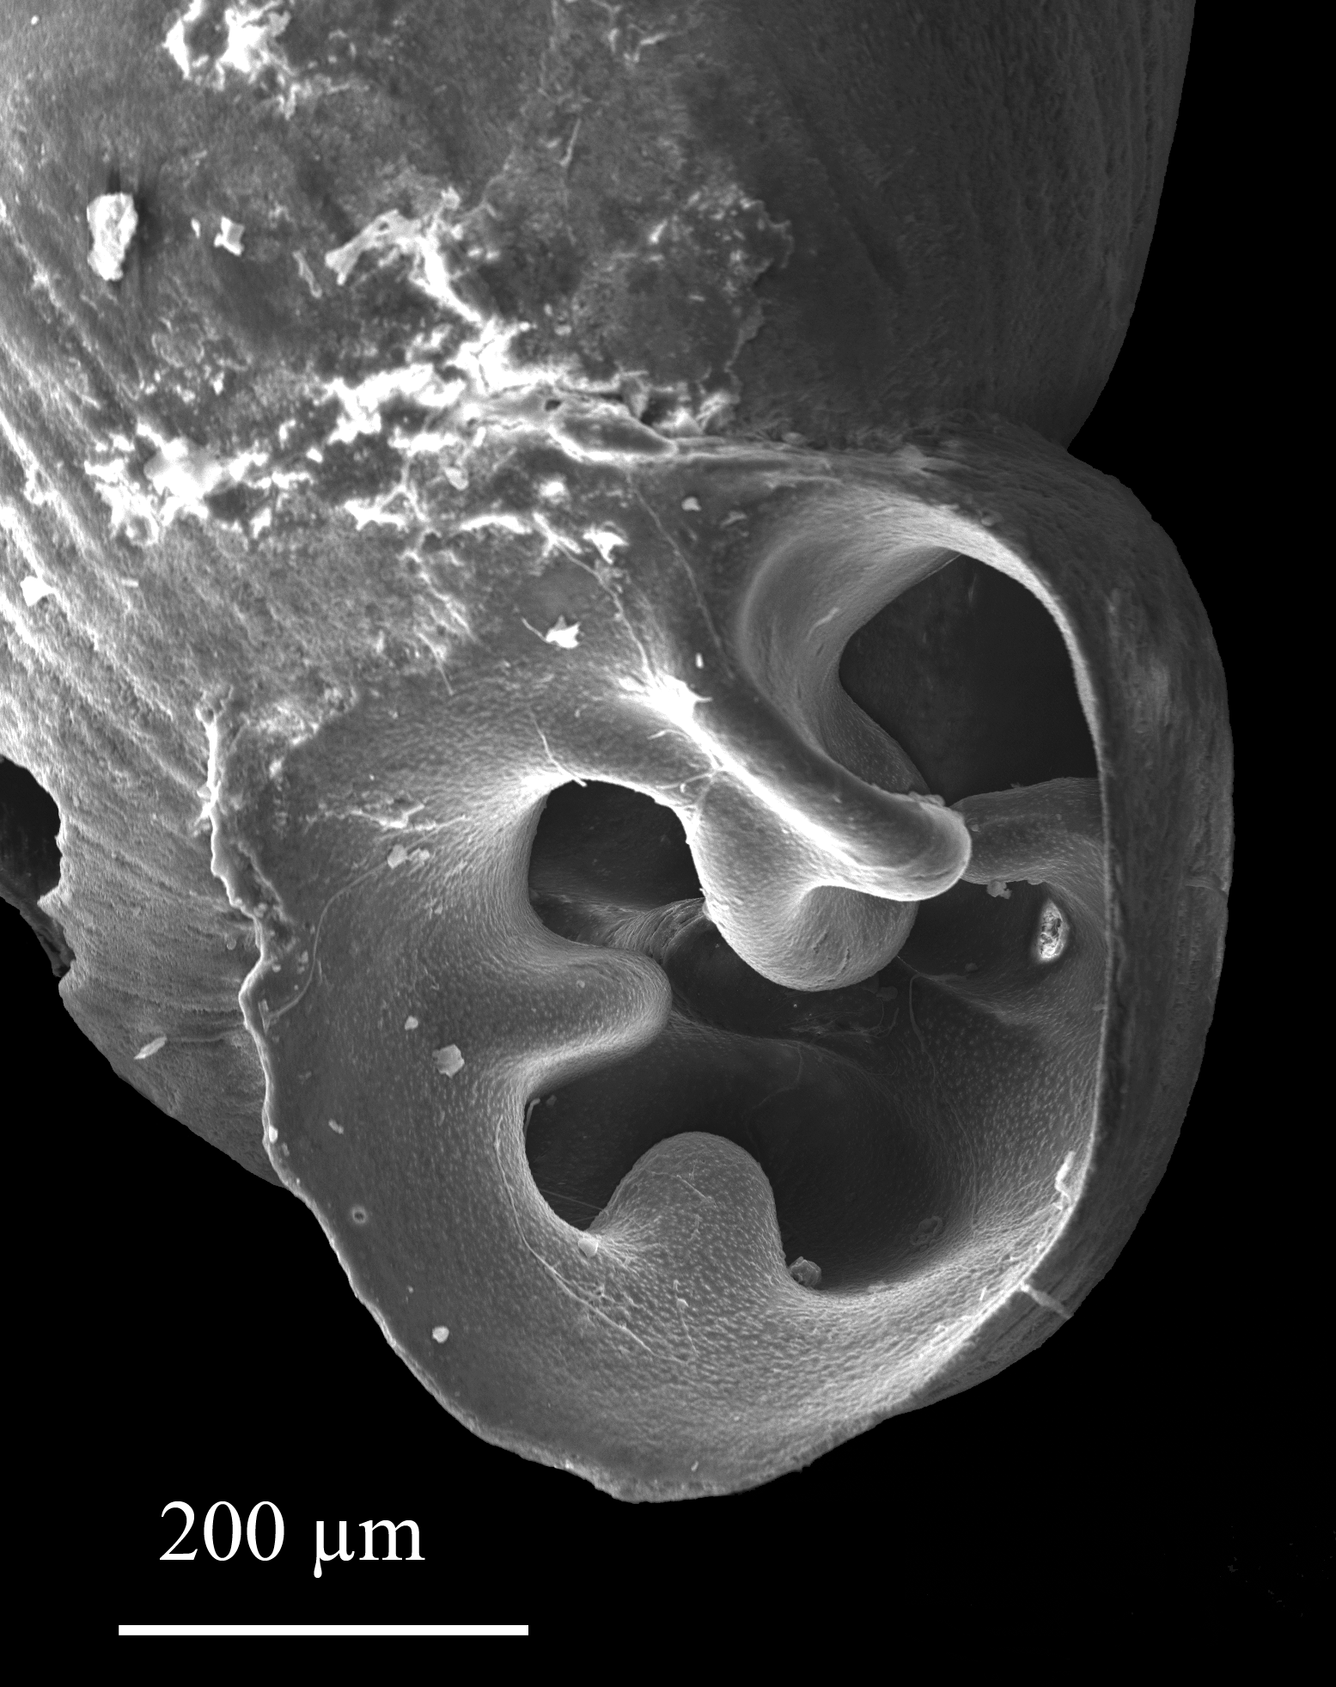
Pupillidae - Gastrocopta species
Notes:
Teeth smaller than G. cochisensis so all are easily visible in frontal view.
Columella horizontal.
Angular extends from lip but parietal ends well back from the lip where the two lamellae meet.
Parietal wall not covered with callus.
Size rather small.

Slide 19
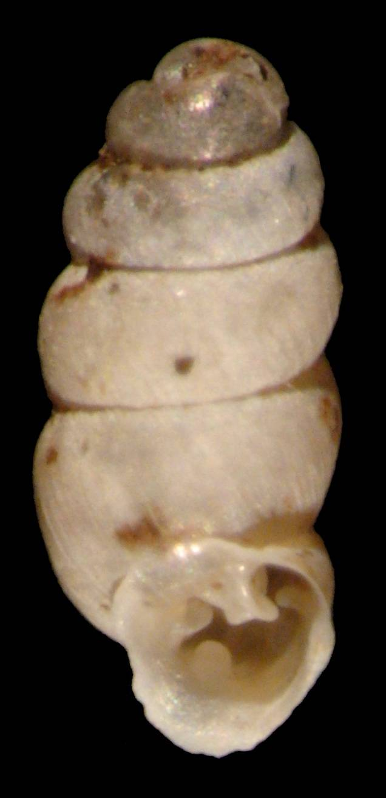
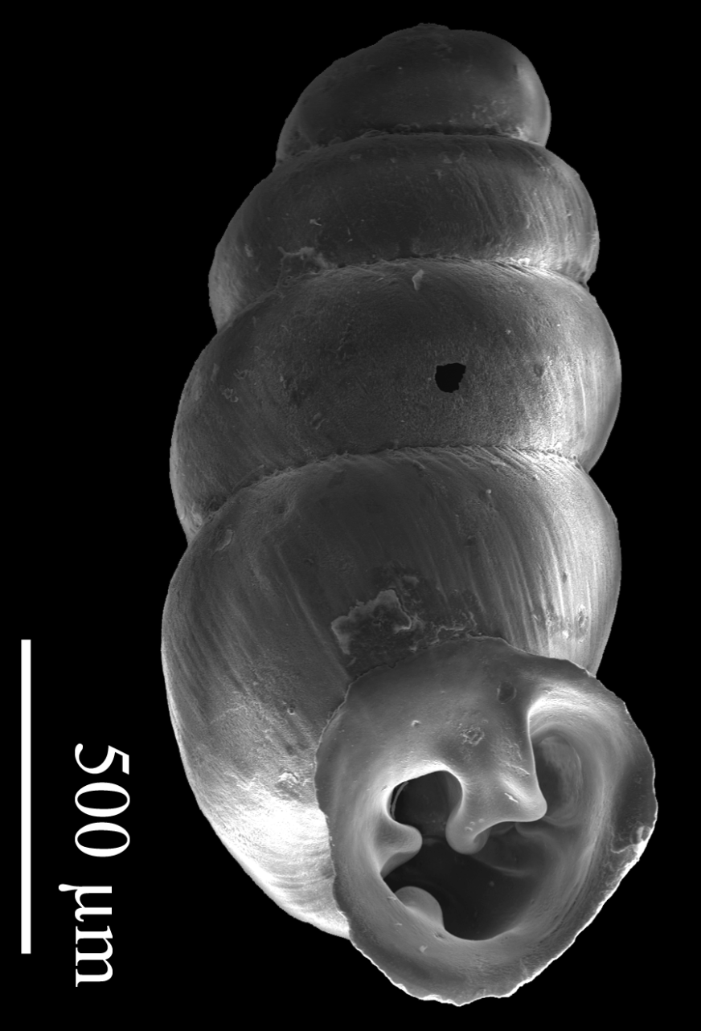
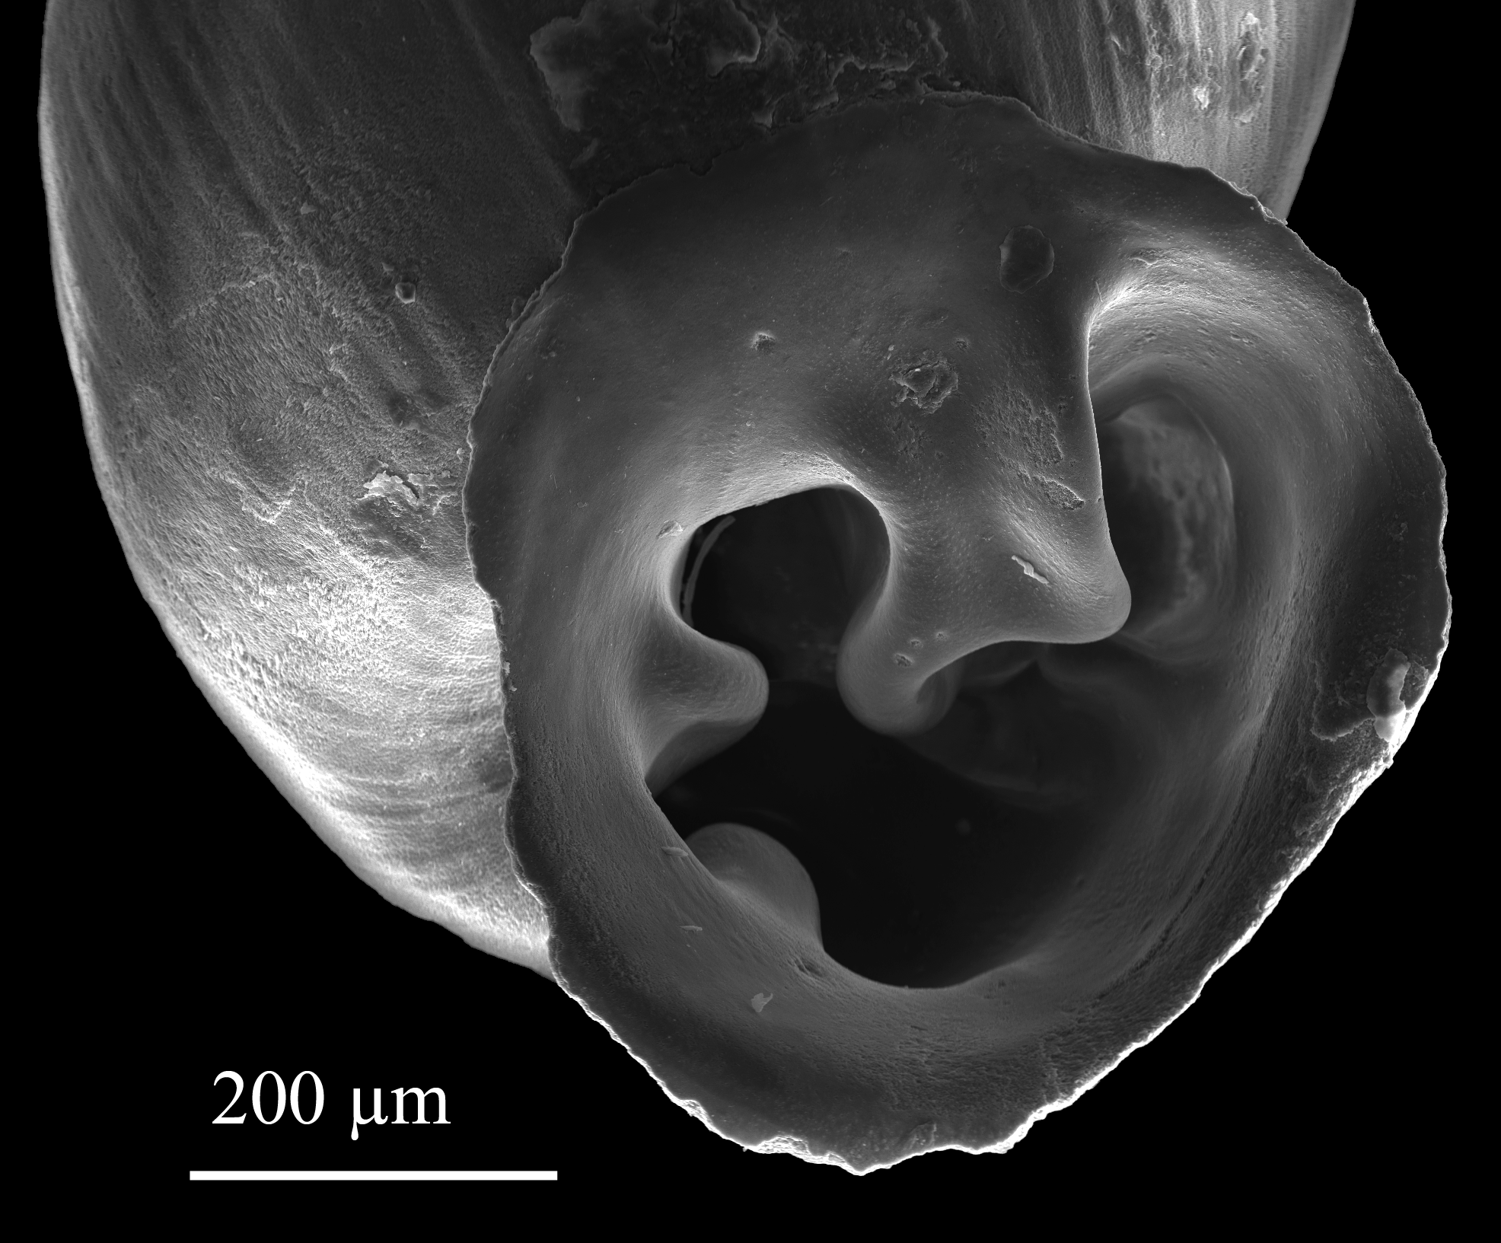
Pupillidae - Gastrocopta cf. bilamellata
Notes:
Teeth smaller than G. cochisensis so all are easily visible in frontal view.
Columella horizontal but inner portion descending.
Angular extends from lip and parietal a bit towards the lip and columella where the two lamellae meet.
Callus connects ends of aperture.
Size rather small.

Slide 20
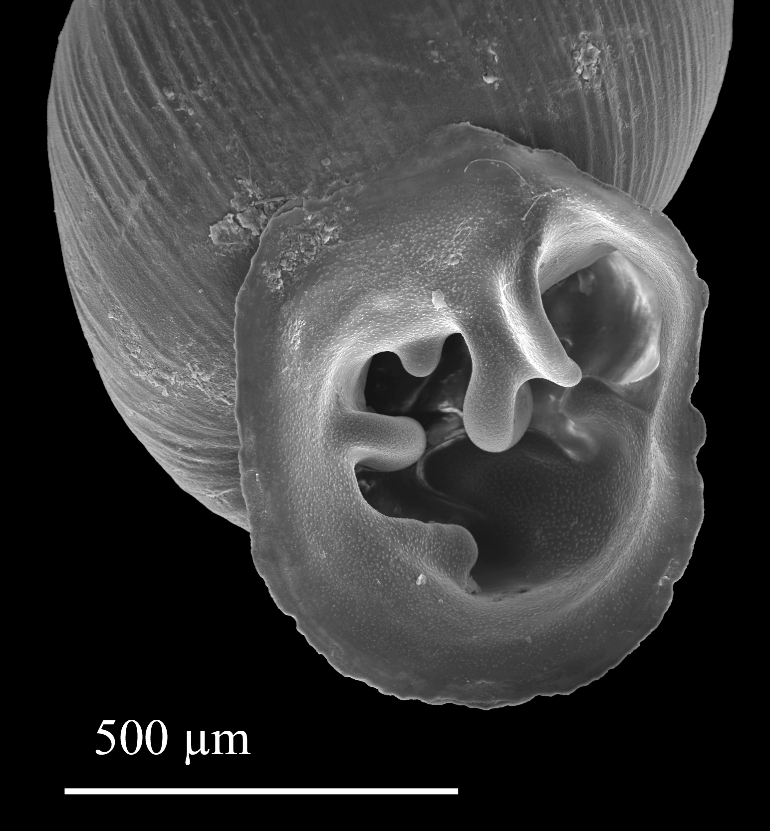
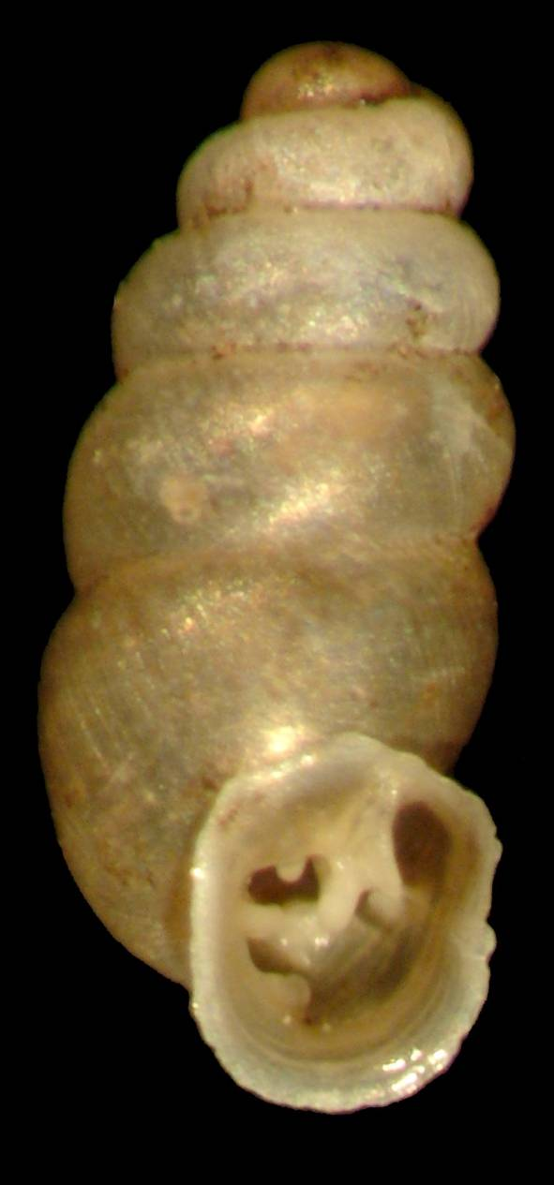
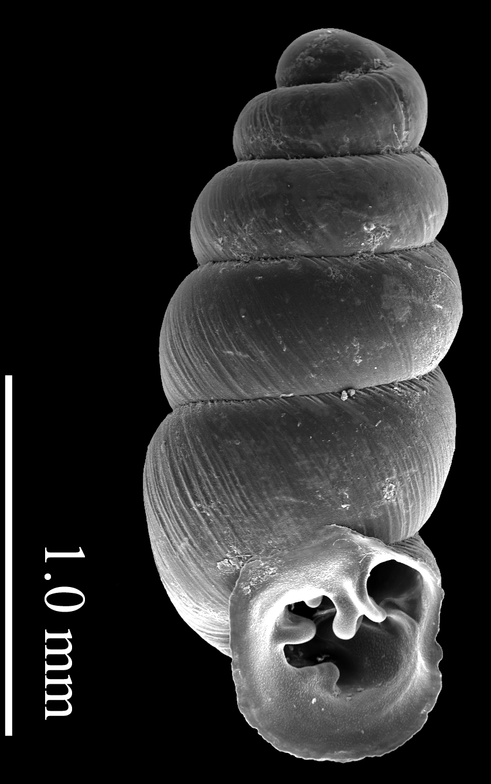
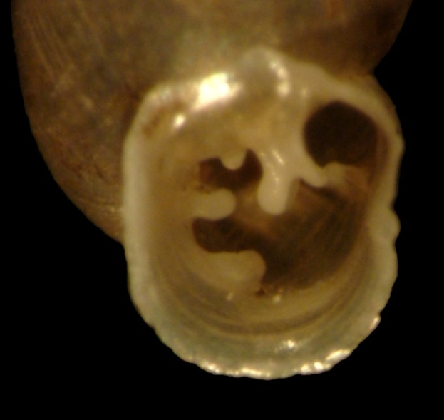
Pupillidae - Gastrocopta sp. like G. dalliana
Notes:
Teeth smaller than G. cochisensis so all are easily visible in frontal view.
Columella horizontal. Infraparietal noticeable.
Angular extends from lip but parietal ends well back from the lip where the two lamellae meet.
Size rather small.

Slide 21
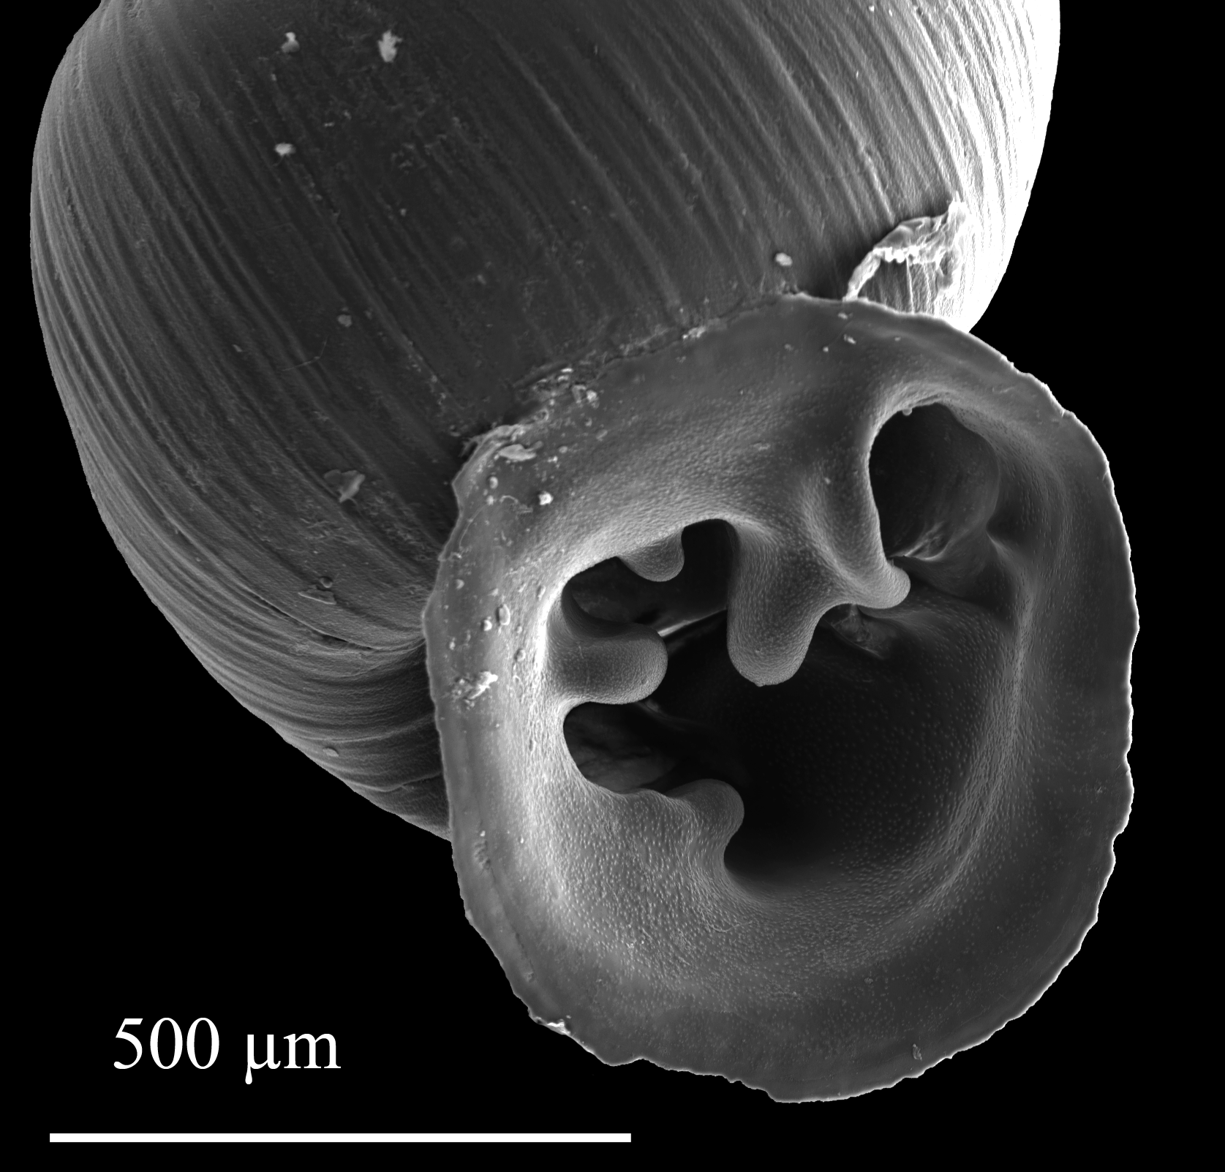
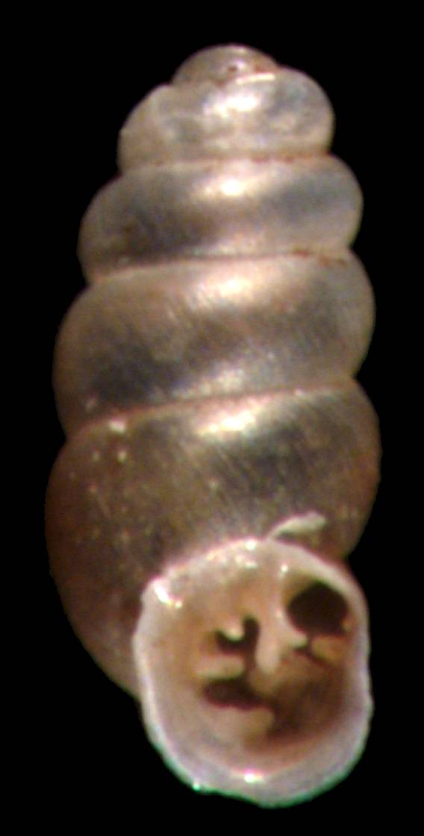
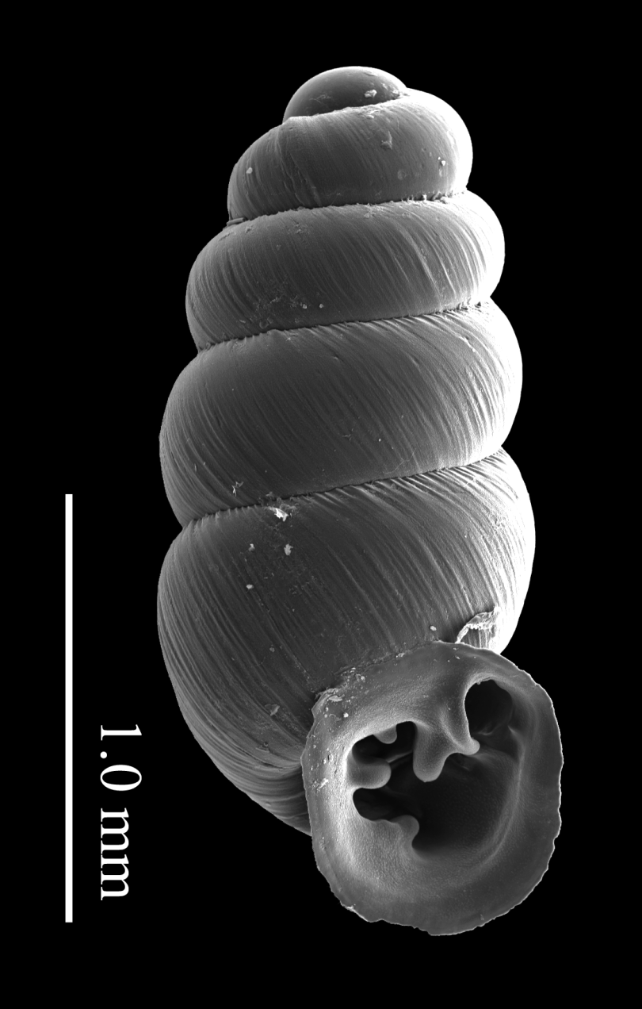
Pupillidae - Gastrocopta sp. like G. dalliana
Notes:
Shell characterized by a small infraparietal.
Basal descending slightly.
Lower palatal large, horizontal and very deeply placed.
Angular and parietal somewhat separate with two separate knobs.

Slide 22
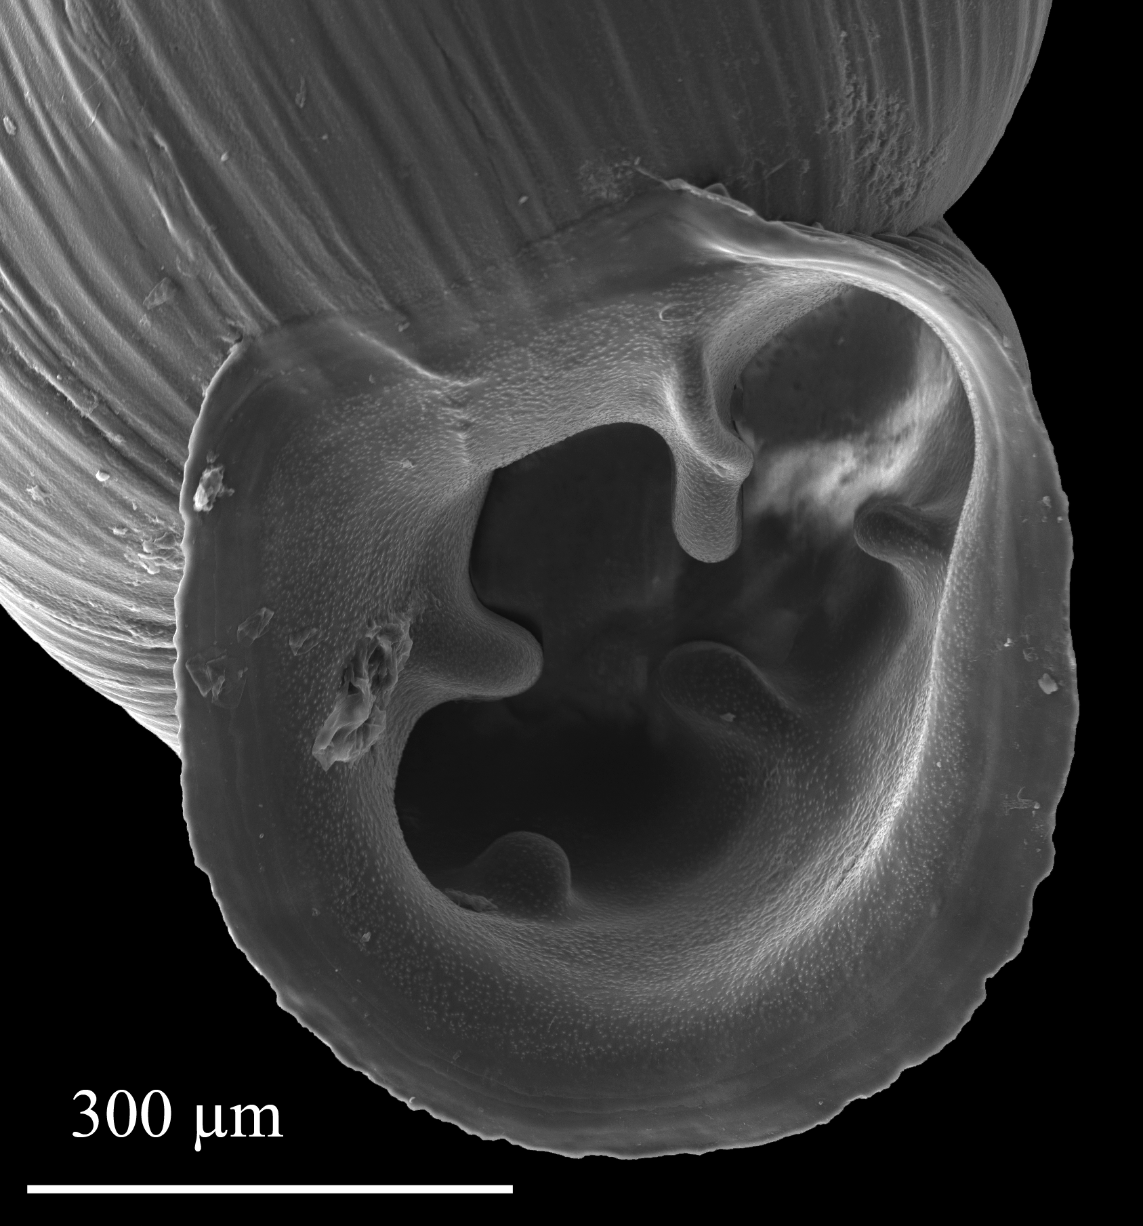
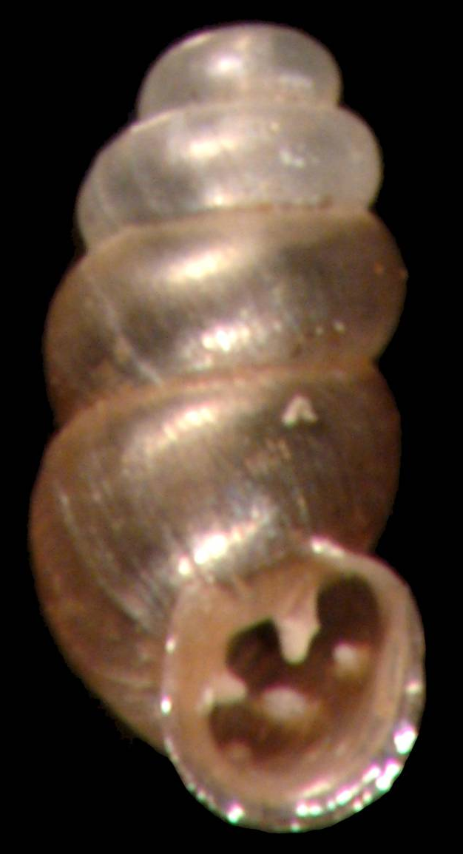
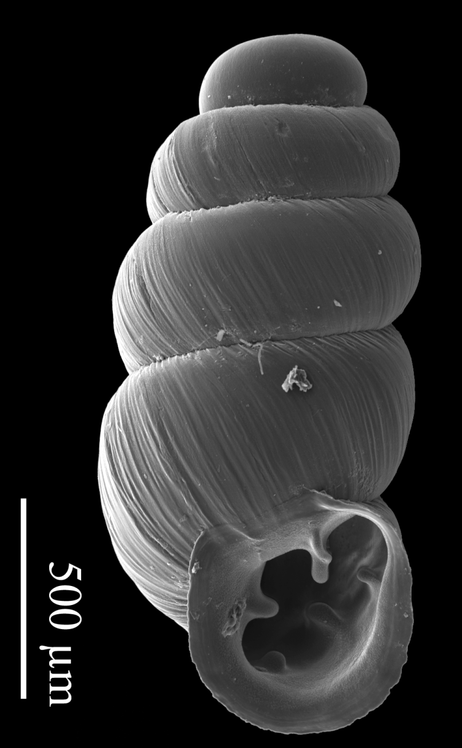
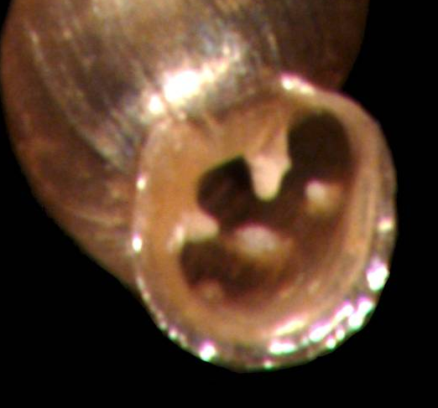
Pupillidae – Gastrocopta pellucida
Notes:
Angular and parietal somewhat bifid.
Ends of lip not united by callus across the parietal wall.
Columella simple and horizontal.
Basal and palatals entering into the aperture.
Shape variable but can be rather small.

Slide 23
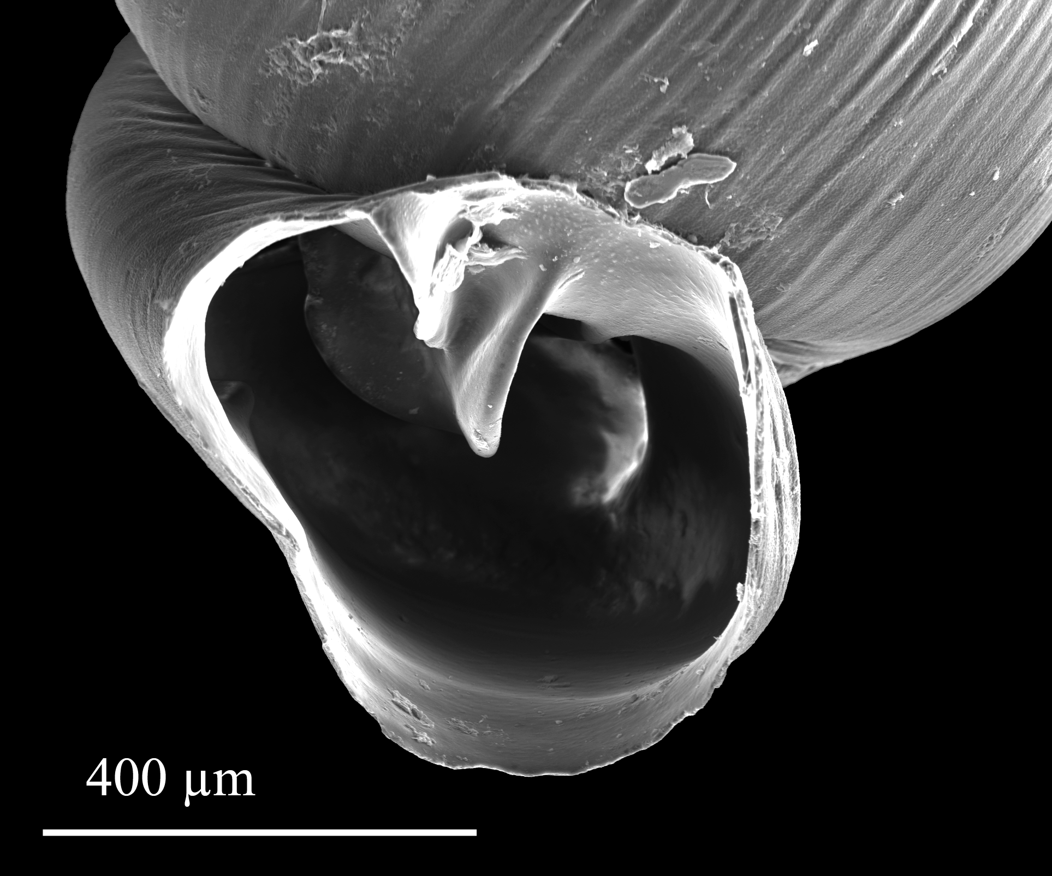
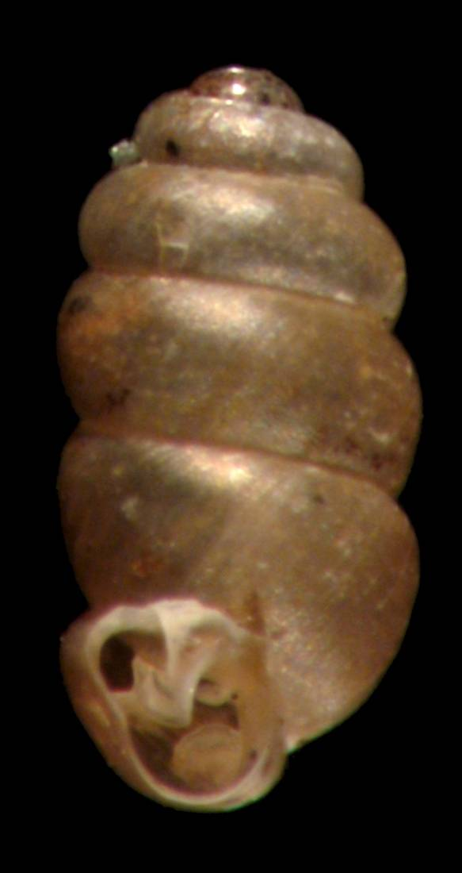
Pupillidae - Gastrocopta perversa
Notes:
Similar to G. ashmuni but sinistral.
Aperture emerges far from the body whorl in mature specimens.

Slide 24
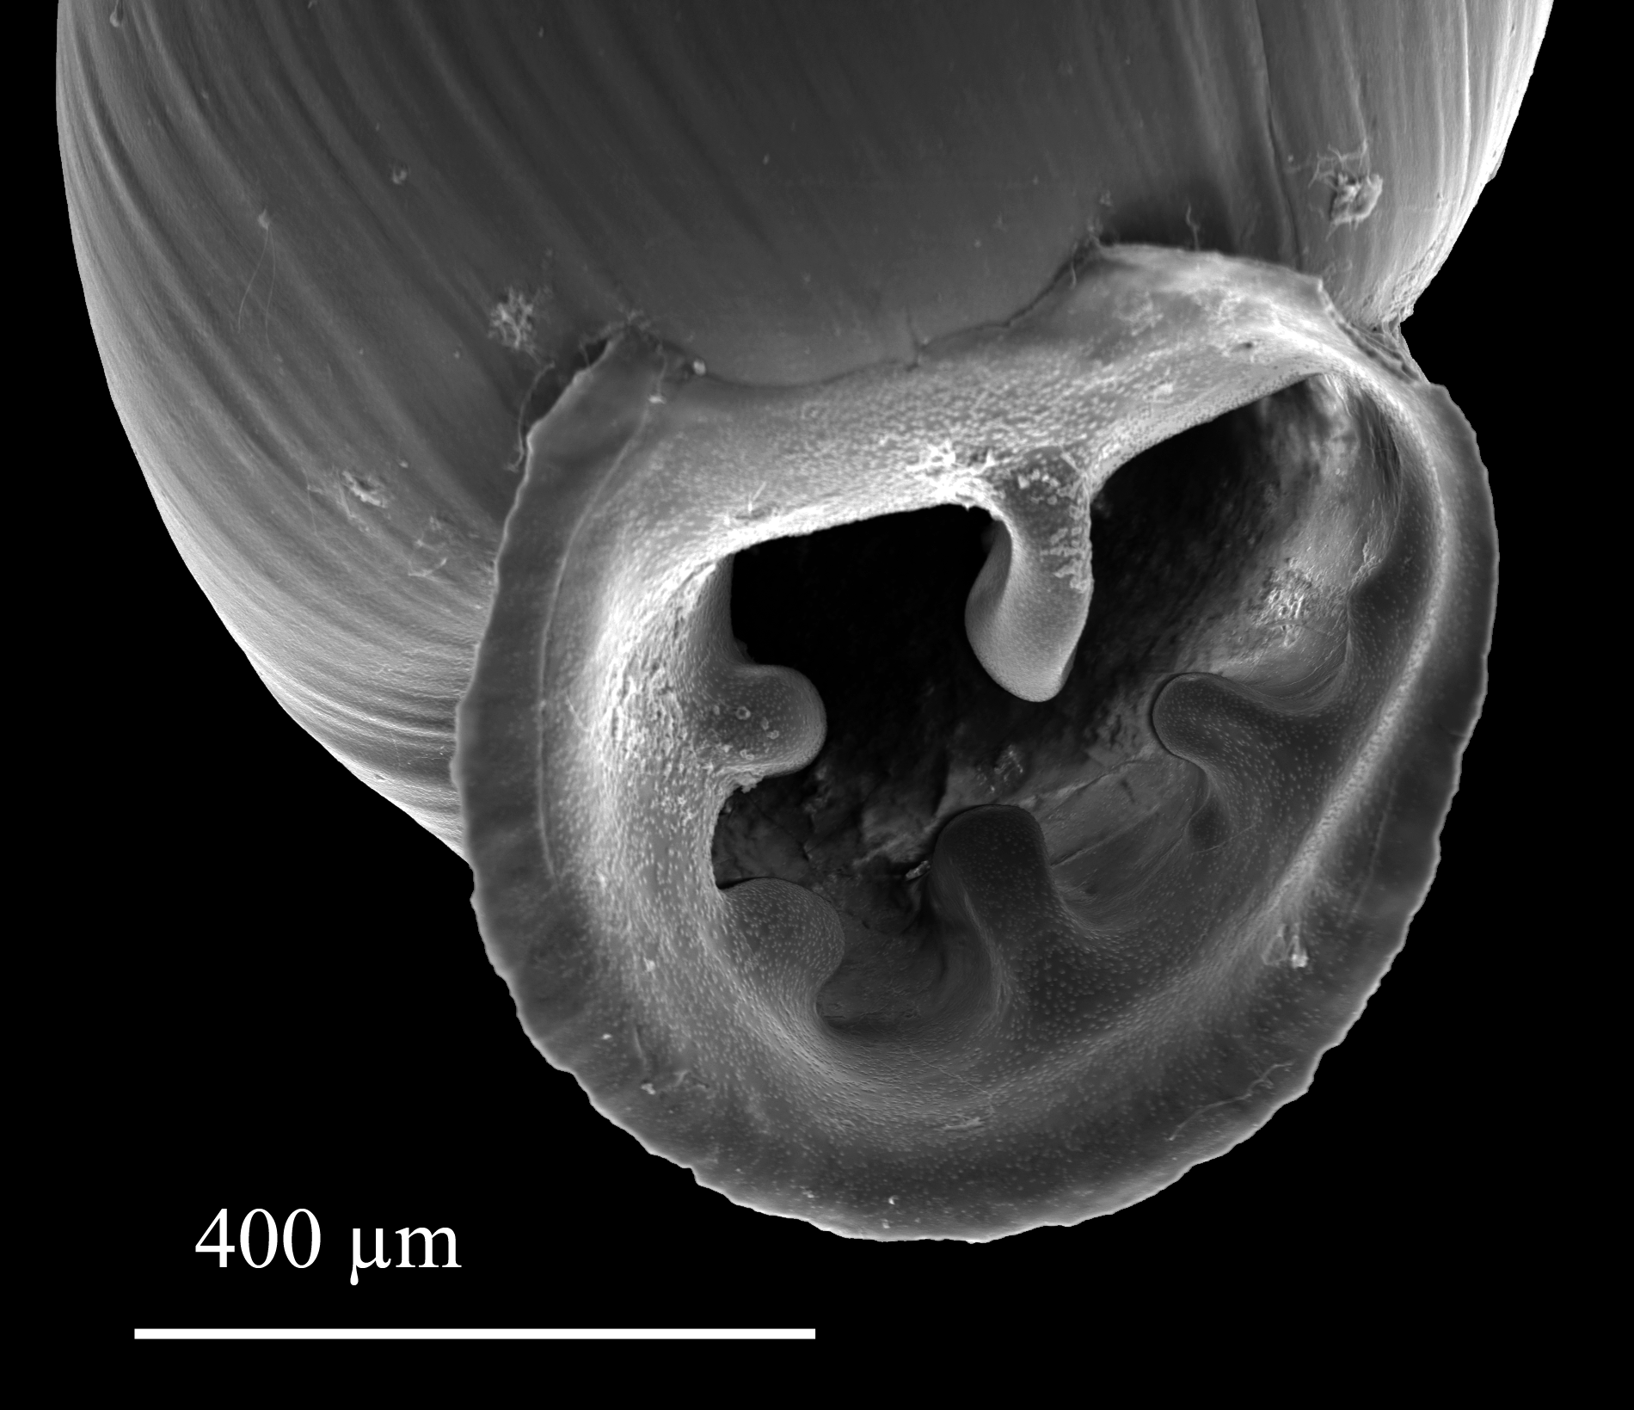
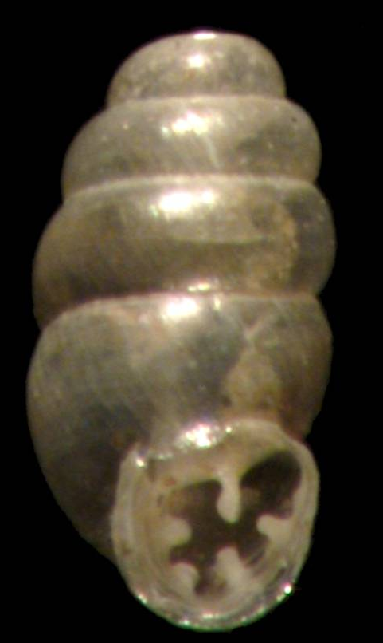
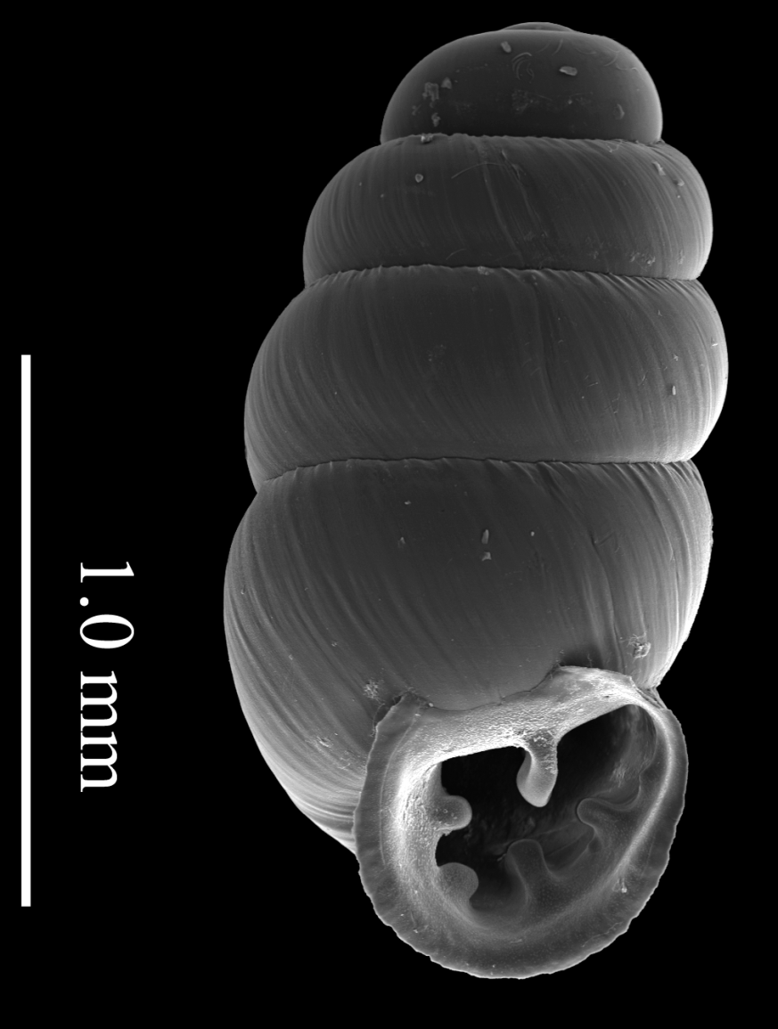
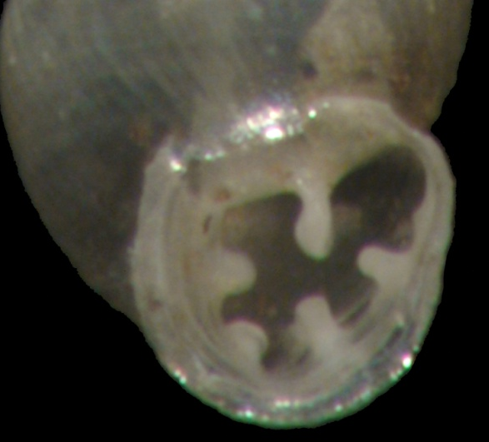
Pupillidae - Gastrocopta pilsbryana
Notes:
Simple angulo-parietal
Simple columella
Five uniform-sized teeth.

Slide 25
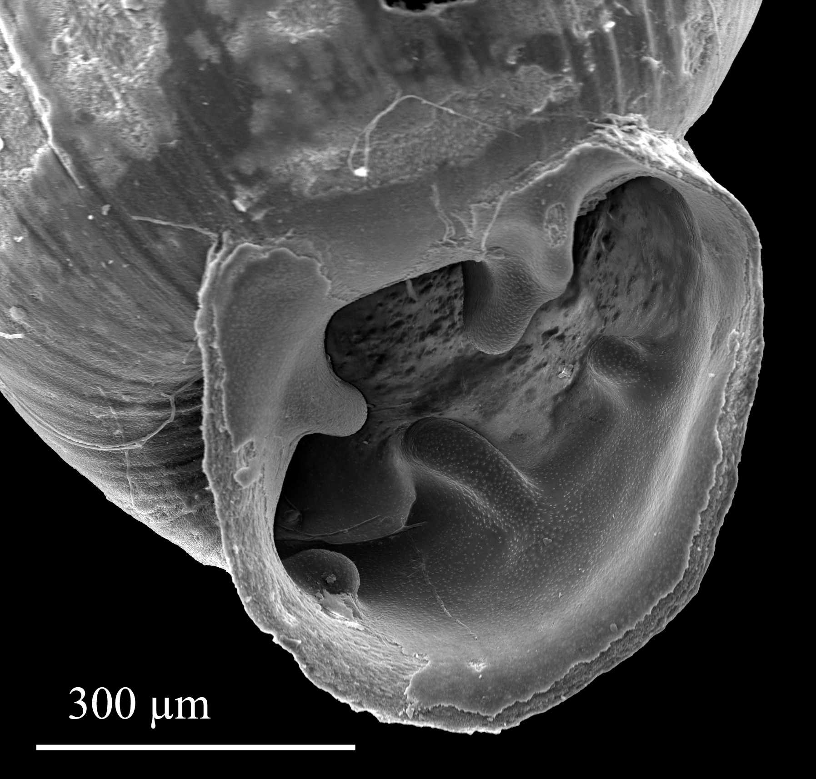
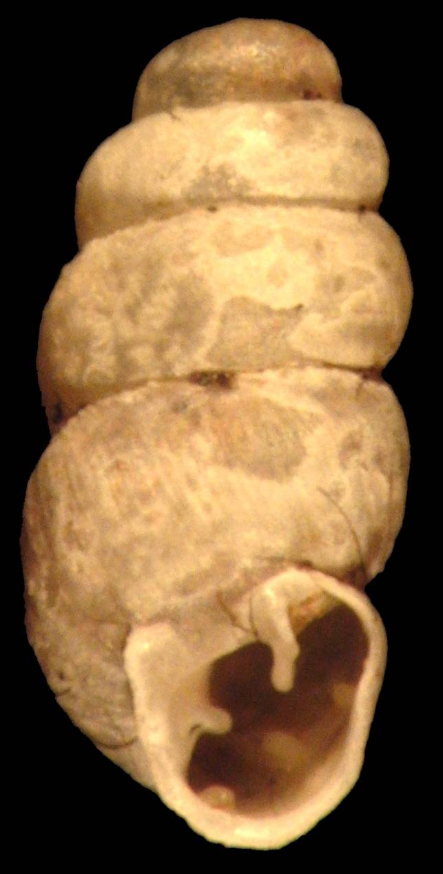
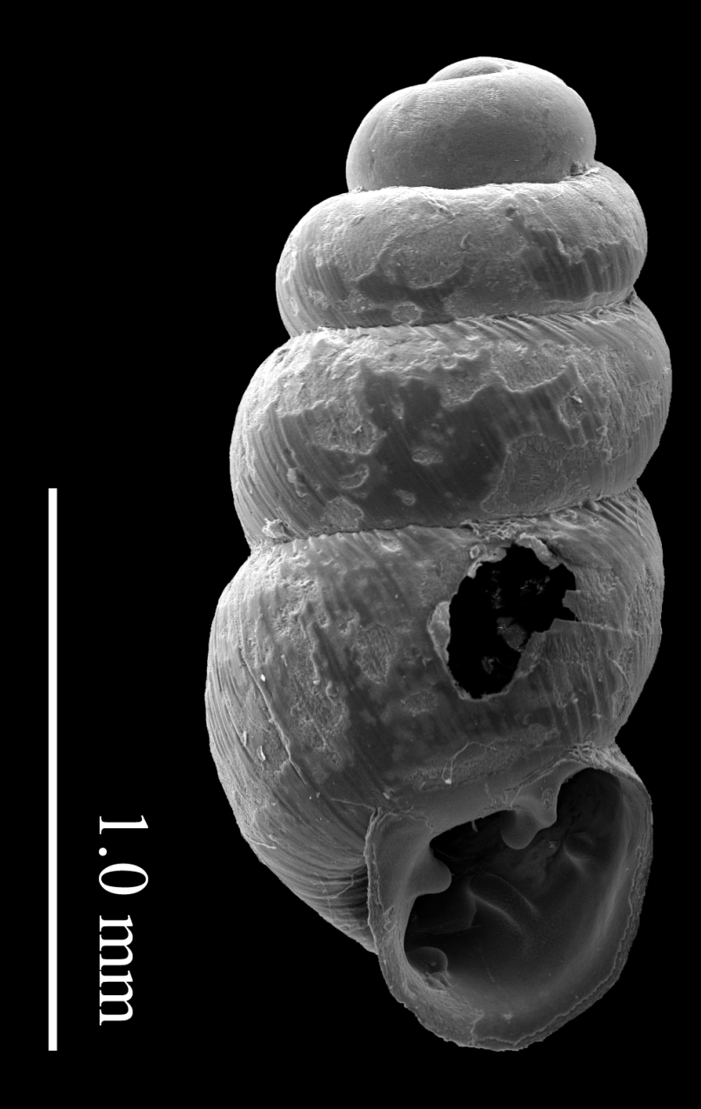
Pupillidae - Gastrocopta sterkiana ?

Slide 26
Pupillidae – Pupoides albilabris
2009

Slide 27
Spiraxidae – Euglandina/Guillarmodia

Slide 28
Family Succineidae Succinea luteola cf.
Notes:
Have one shell that may or may not be the same. Uncertain even of the genus on this.

Slide 29
Family Thysanophoridae Thysanophora horni

Slide 30
Family Valloniidae Vallonia perspectiva

Slide 31
Urocoptidae – Holospira sp. nov.

Slide 32
Urocoptidae - Holospira

Slide 33
Urocoptidae - Holospira

Slide 34
Urocoptidae - Holospira

Slide 35
Unknown

Slide 36
Xanthonychidae – Sonorella species
Rio Saracachi - 2009

Slide 37
Family Zonitidae Glyphyalinia umbilicata
Notes:
Sometimes called Glyphyalinia indentata paucilirata but definitely not typical indentata.

Slide 38
Zonitidae - Glyphyalinia umbilicata
2010

Slide 39
Zonitidae - Glyphyalinia species
Rio Saracachi – 2009

Slide 40
Zonitidae - Hawaiia minuscula
Rio Saracachi – 2009

Slide 41
Zontidae - Striatura meridionalis

Slide 42
Zonitidae - Ventridens species
Rio Saracachi – 2009 – 4 mm

Slide 43
Zonitidae - Zonitoides arboreus
Notes:
Aperture doesn’t quite look “right” but close?

