Slide 1
Land Snails
Comparing North Carolina and South Carolina
Amy S. Van Devender
Robert Wayne Van Devender

Slide 2
Phylum Mollusca – 85,000 species
Class Gastropoda – 70,000 species
Land pulmonates - 20,500 species
Native species in United States
and Canada – 1200 species
Eastern natives – 527 species
North Carolina – 262 species
South Carolina – 102 species
Exotics in U. S. and Canada - >70 species

Slide 3
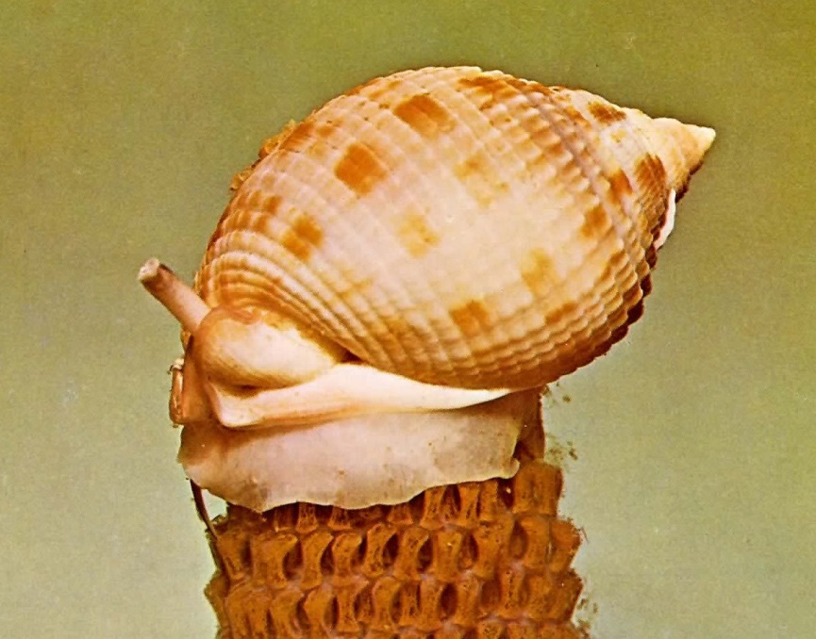
The Scotch bonnet, Semicassis granulata, the North Carolina state shell welcomes the COA to Wilmington. Picture abstracted from Indo-Pacific Mollusca (1968) by Tucker Abbott. (Note egg cases beneath shell.)

Slide 4
Gastropods – Land vs Marine
Breathing pore for air Siphon for water
Lung Gill
No operculum usually Operculum usually
Two sets of tentacles One pair of tentacles
Mostly hermaphroditic varied
Tiny to 45mm (120 mm) Tiny to 500 mm

Slide 5
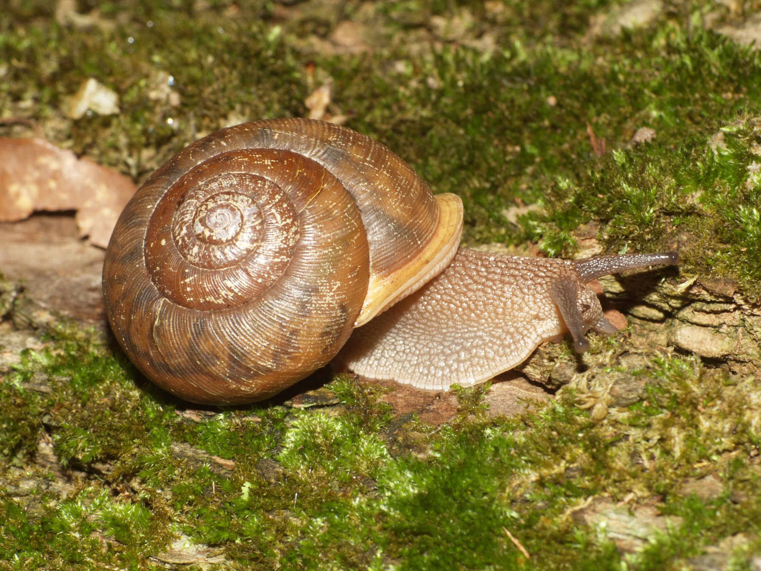

Slide 6
Shell
Mantle
Eyestalk
Sensory Antenna
Foot
Genital Pore

Slide 7
Characters to Help with Identification
Presence of shell
Shell size
Number of whorls
Shape of shell
Sculpture or ornamentation
Size of umbilicus
“Teeth” or lamellae
Color of shell and body

Slide 8
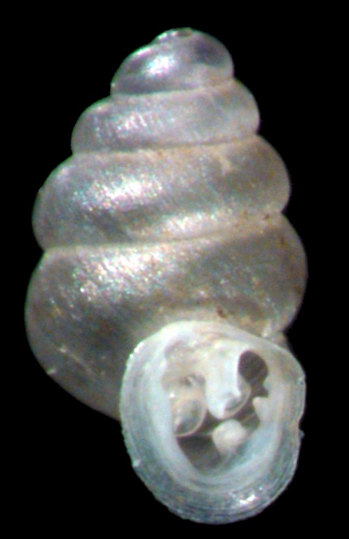
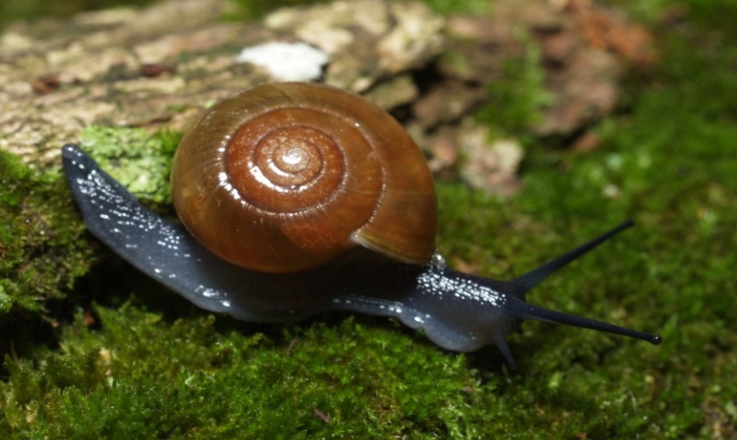
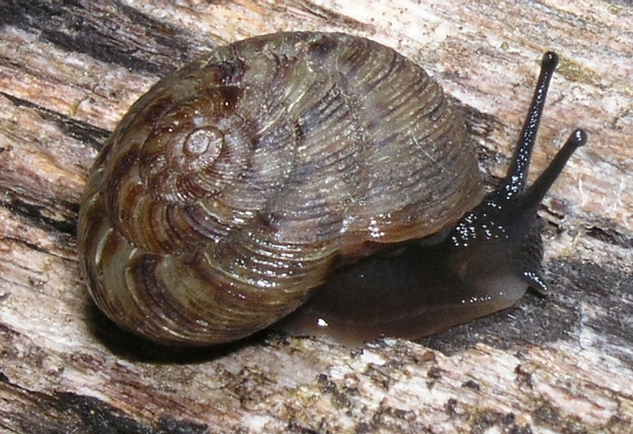
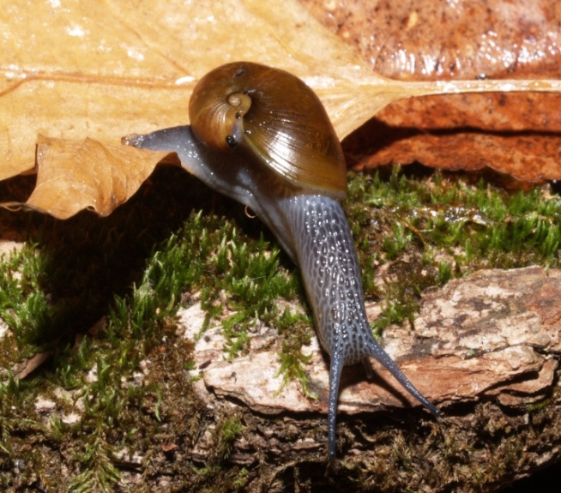
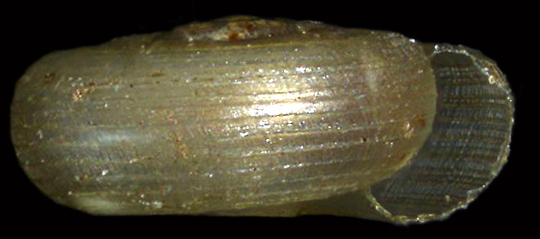
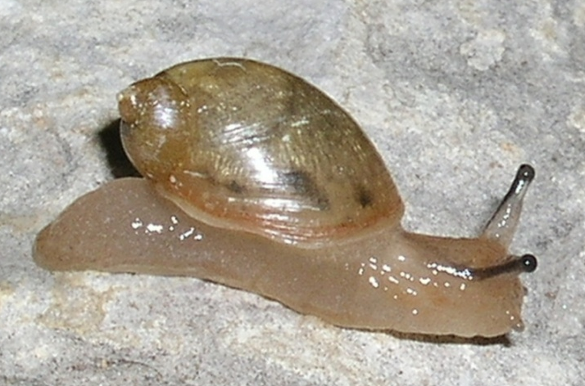
Shell shapes

Slide 9
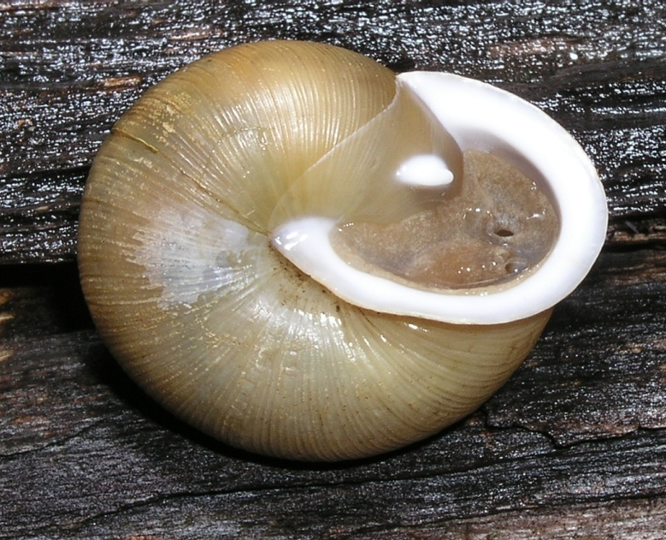
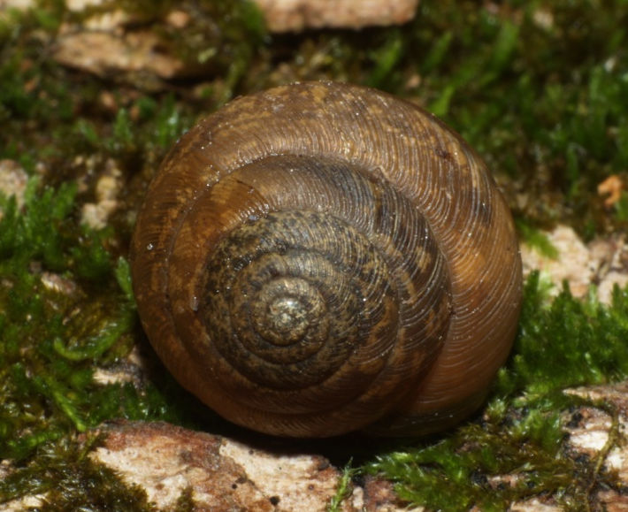
Most widespread species
Mesodon thyroidus
Zonitoides arboreus
Ventridens intertextus
Haplotrema concavum

Slide 10
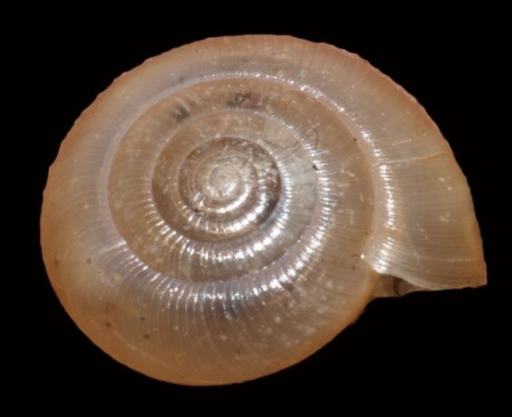
Rare Land Snails of NC
Helicodiscus saludensis
Patera clarki nantahala
Glyphyalinia junaluskana
Paravitrea lacteodens
Glyphyalinia clingmani

Slide 11
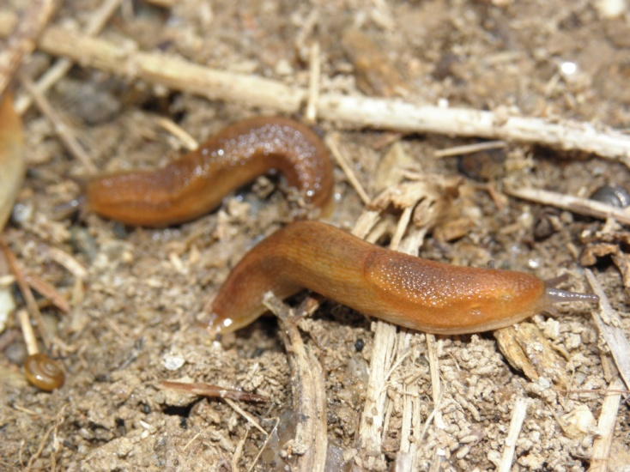
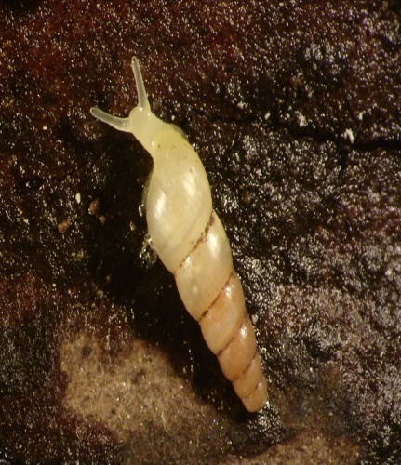
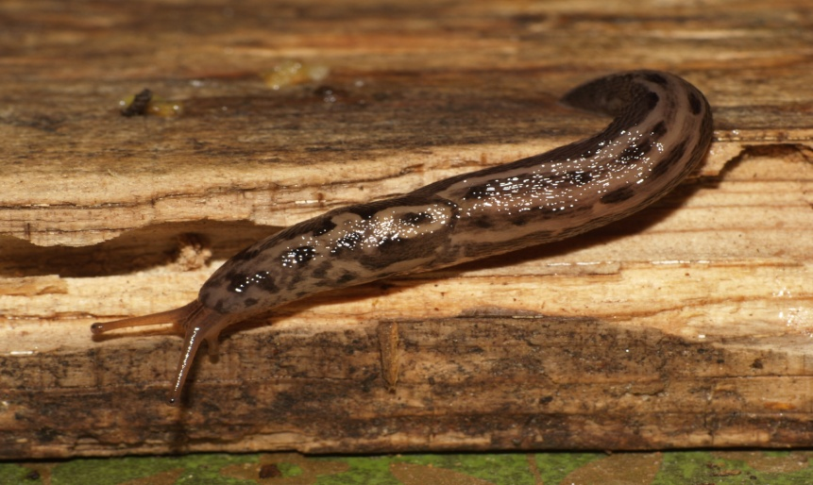
Introduced Land Snails
Arion subfuscus
Cernuella cisalpina
Allopeas clavulinum
Limax maximus

Slide 12
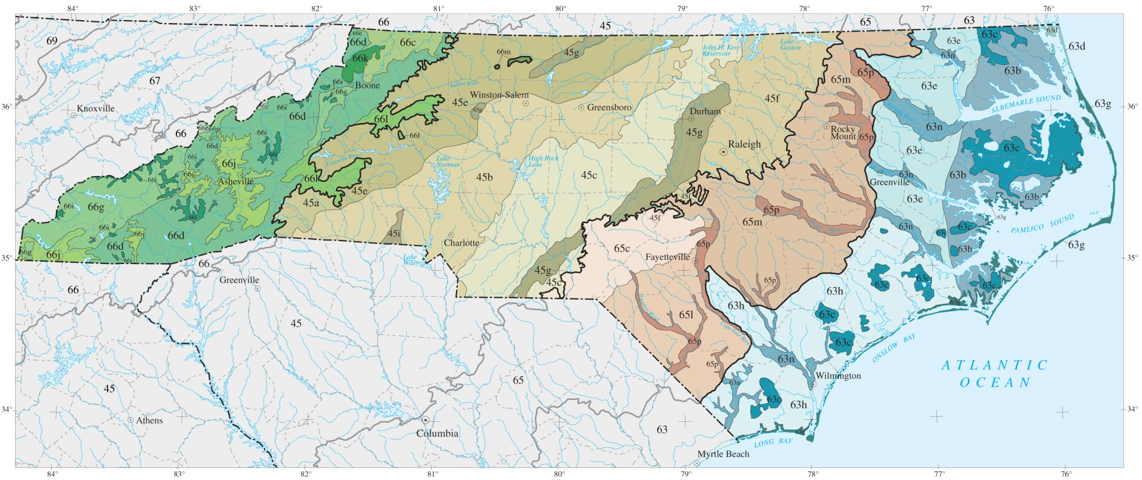
North Carolina Ecoregion –Level III and IV

Slide 13
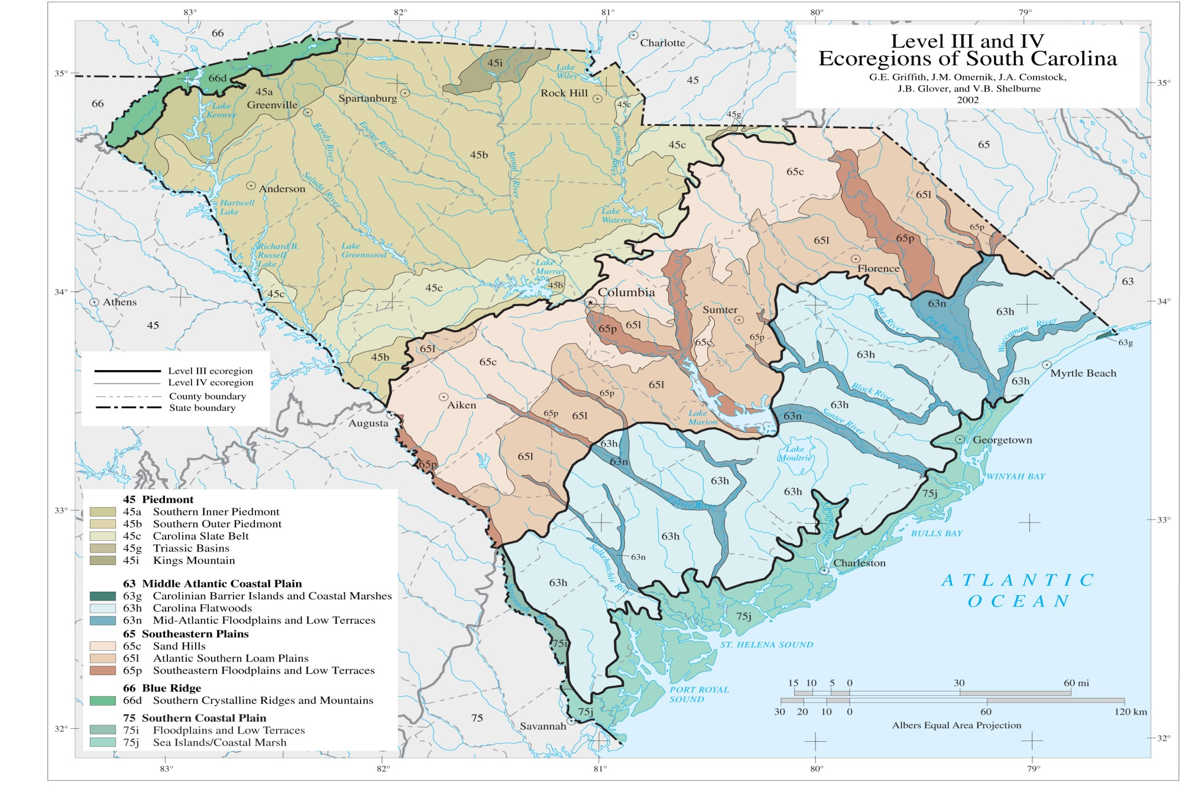

Slide 14
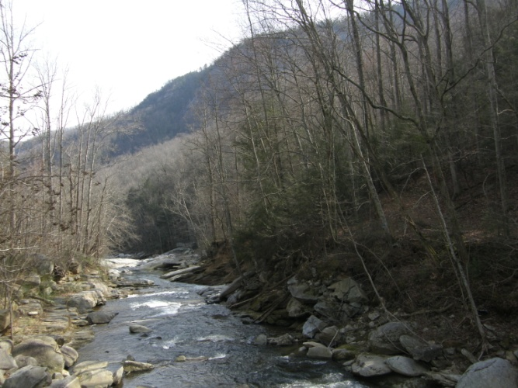
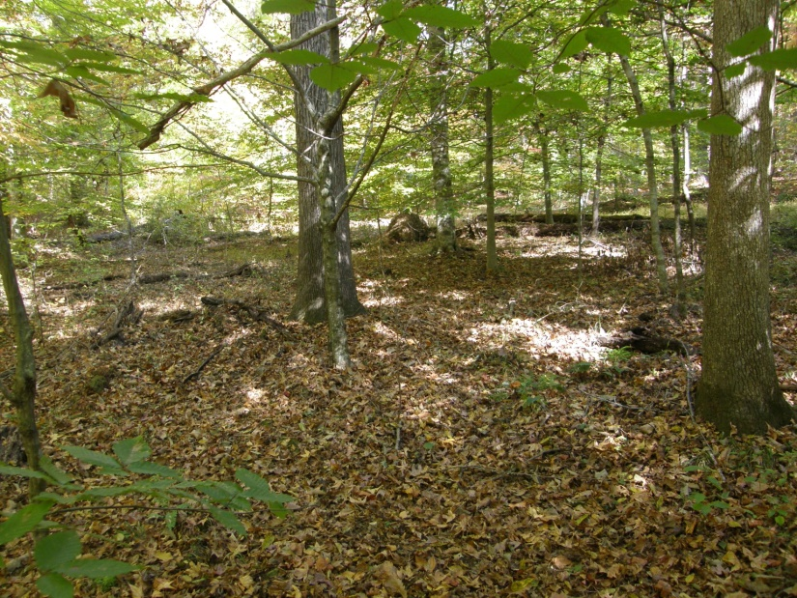
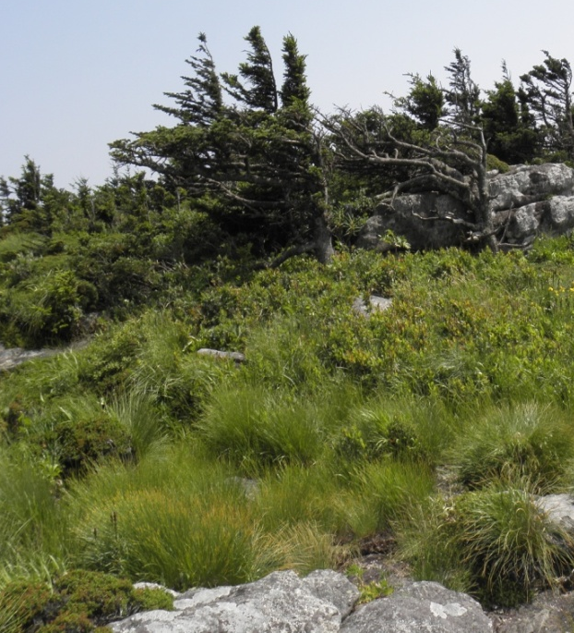
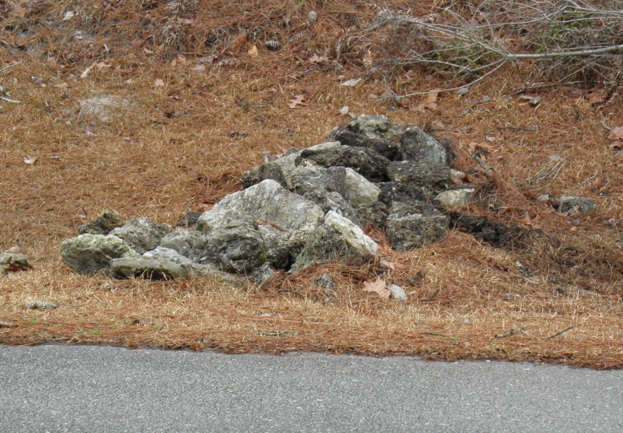
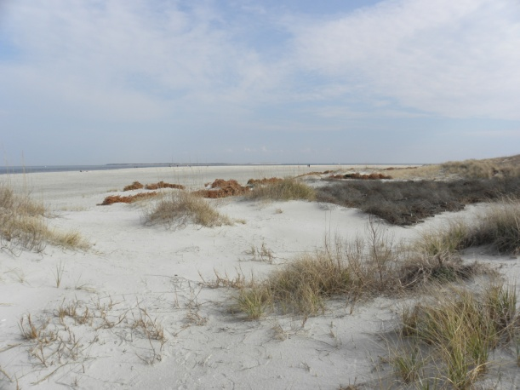
Snail Habitats

Slide 15
Number of species by group

Slide 16
26 Families of NC Land Snails (New)
Agriolimacidae
Arionidae
Cionellidae
Discidae
Ellobidae
Euconulidae*
Gastrodontidae*
Haplotrematidae
Helicinidae
Helicidae
Helicodiscidae
Hygromidae
Limacidae
Oxychilidae*
Philomycidae
Polygryridae
Pomatiopsidae
Pristilomatidae*
Punctidae
Pupillidae
Spiraxidae
Strobilopsidae
Subulinidae
Succineidae
Vallonidae
Vertiginidae
* former Zonitidae

Slide 17
Where is Zonitidae - Pilsbry, 1946 in Bouchet and Rocroi, 2005?
OLD:
NEW:
Four subfamilies
Euconulinae
Zonitinae
Gastrodontinae
Vitrininae
Six familes
Euconulidae
Oxychilidae
Gastrodontidae
Pristilomatidae
Vitrinidae in another superfamily
Zonitidae restricted to Europe

Slide 18
Small genera (in size and species #)
Euconulindae
Pristilomatidae

Slide 19
Gastrodontidae Gastrodonta – 1 species Striatura – 3 species Zonitoides – 4 species

Slide 20
Gastrodontidae Ventridens – 15 species
Shells small to moderate Many whorls (up to 9)
Often have blade-like teeth following whorl of shell

Slide 21
Oxychilidae Mesomphix – 9 species
Large shells >15 mm
Species often hard to tell apart
Immatures resemble other genera
Sculpture important
Umbilicus size important

Slide 22
Oxychilidae Pilsbryna -2 species small, few whorls, incised lines, odd teeth Vitrinizonites – 1 species few whorls

Slide 23
Oxychilidae Paravitrea – 11 species

Slide 24
Oxychilidae Glyphyalinia -14 species
Few, rapidly expanding whorls
Presence of incised lines
Lots of variation in width of umbilicus with three main types (completely closed, slightly open and
moderately open)
Color

Slide 25
Oxychilidae - Glyphyalinia

Slide 26
Polygryridae -Triodopsis

Slide 27
# of Species by State

Slide 28
Summary
North Carolina
South Carolina
Surface area
53,821 sq. mi.
Elevation
0 – 6684 ft.
# species
262
Habitat
coastal plain, sm. sandhills,
Piedmont, many mountains
Surface area
32,007 sq. mi.
Elevation
0 – 3560 ft.
# species
102
Habitat
coastal plain, sandhills,
Piedmont, few mountains

Slide 29
Selected Resources
Bouchet, P. and Racroi, J.-P. 2005. Classification and nomeclator of gastropod families. Malacologia 47(1-2):397.
Burch, J. B. 1962. How to Know the Eastern Land Snails. William C. Brown Company. Dubuque, IA.
Dourson, D. 2012. Kentucky’s land Snails and their ecological communities. Goatslug Publications, Bakersville, NC.
Dourson, D. 2013. Land Snails of the Great Smoky Mountains National Park and Southern Appalachians
Tennessee and North Carolina. Goatslug Publications. Bakersville, North Carolina
Hubricht, L. 1985. The Distributions of the Native Land Mollusks of the Eastern United States. Fieldiana Zoology New Series, No. 24, Publication 1359: Field Museum of Natural History, Chicago, IL.
Nekola, J.C. 2014, Overview of the North American terrestrial gastropod fauna. American Malacological Bulletin. 32(1):1=35
Pilsbry, H.A. 1946. Land Mollusca of North America (North of Mexico), Vol. II., Part 1. The Academy of Natural Sciences of Philadelphia Monographs. Philadelphia, PA.
Turgeon, D.D., J.F.J. Quinn, A.E. Bogan, E.V. Coan, F.G.Hochberg, W.G. Lyons, P.M. Mikkelson, R.J. Neves, C.F.E. Roper, G. Rosenberg, B. Roth, A. Scheltema, F.G.Thompson, M. Vecchione, & J. D. Williams. 1998. Common and Scientific Names of Aquatic Invertebrates from the United States and Canada: Mollusks, 2nd edition. American Fisheries Society, Special Publication 26.

Slide 30
Acknowledgements
We are pleased to thank Dr. Guichuan Hou and the William C. and Ruth Ann Dewel Microscopy Facility at Appalachian State University for assistance with imaging, the staff of the NC Museum of Natural Sciences for their help and encouragement, the curators of the Field Museum of Natural History, the Carnegie Museum, the Academy of Natural Sciences, Philadelphia and the University of Florida for loaning specimens, NC Natural Heritage Program for their cooperation and NC Division of Parks and Recreation and NC Wildlife Resources Commission for allowing access and arranging collecting permits, and the Van Devender Family Trust for funding.

Slide 33
Selected References
Bouchet, P. and Racroi, J.-P. 2005. Classification and nomeclator of gastropod families. Malacologia 47(1-2):397.
Burch, J. B. 1962. How to Know the Eastern Land Snails. William C. Brown Company. Dubuque, IA.
Burch, J. B. 1969. Land mollusks of the southern Appalachians. Pp. 247-264 In: D. C.Holt, ed. The Distributional History of the Biota of the Southern Appalachians. Part I: Invertebrates. VPI State University. Blacksburg, VA.
Dourson, D. 2012. Kentucky’s land Snails and their ecological communities. Goatslug Publications, Bakersville, NC.
Hausdorf, B. 1998. Phylogeny of the Limacoidea sensu lato (Gastropoda: Stylommatophora. Journal of Molluscan Studies 64:35-66.
Hubricht, L. 1985. The Distributions of the Native Land Mollusks of the Eastern United States. Fieldiana Zoology New Series, No. 24, Publication 1359: Field Museum of Natural History, Chicago, IL.
Pilsbry, H.A. 1946. Land Mollusca of North America (North of Mexico), Vol. II., Part 1. The Academy of Natural Sciences of Philadelphia Monographs. Philadelphia, PA.
Turgeon, D.D., J.F.J. Quinn, A.E. Bogan, E.V. Coan, F.G.Hochberg, W.G. Lyons, P.M. Mikkelson, R.J. Neves, C.F.E. Roper, G. Rosenberg, B. Roth, A. Scheltema, F.G.Thompson, M. Vecchione, & J. D. Williams. 1998. Common and Scientific Names of Aquatic Invertebrates from the United States and Canada: Mollusks, 2nd edition. American Fisheries Society, Special Publication 26.

Slide 34
22 Families of NC Land Snails (Old)
Arionidae*
Carychiidae
Cionellidae
Discidae
Haplotrematidae
Helicarionidae
Helicidae*
Helicinidae
Helicodiscidae
Hygromiidae*
Limacidae*
Philomycidae
Polygyridae
Pomatiopsidae
Punctidae
Pupillidae
Spiraxidae
Strobilopsidae
Subulinidae*
Succineidae
Valloniidae
Zonitidae
*exotic

Slide 35
OLD PROBLEMS
Lack of taxonomic keys
Characters difficult to distinguish (need microscope, need better descriptions)
Little comparative material
Little knowledge of behavior or habitat specificity
Collecting not systematic
Few workers in field

Slide 36
Limacoidea Cladogram
“New” classification of one group in 1998

Slide 37
European
North American slugs
North American
Notes:
Blue are known from North America
Red is European or Eurasian
Green are North American slugs

Slide 38
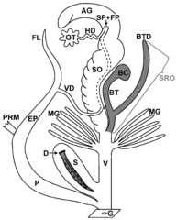
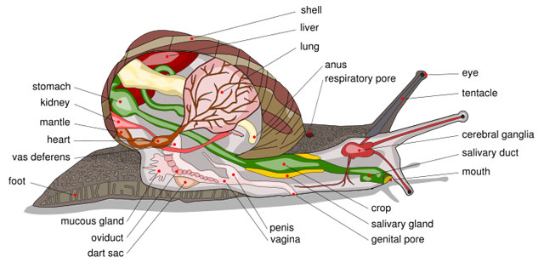
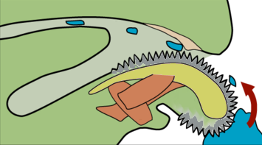
Anatomy
Wikipedia Commons
RWV
Wikipedia Commons
Wikipedia Commons

