Slide 1
Helicodiscidae of North Carolina Rare and Rarer Still
Amy and Wayne Van Devender
AMU 2015

Slide 2
A little history …
Pilsbry (1948) listed 8 species of Helicodiscus in Helicodiscinae in Family Endodontidae, 2 species of Clappiella in Zonitidae, and a new Polygridae tentatively called a Polygyra. Two species were then known from North Carolina.
Solem (1975) placed the Polygrya in with the helicodiscids as Polygyriscus virginianus. Then in 1984 he reviewed the characteristics of Family Helicodiscidae.
Hubricht (1985) lists 22 species in the family from the eastern U.S. and 4 species from NC. He described ten species.
Currently 9 (or 10) species of Helicodiscus and Lucilla are known in or adjacent to North Carolina.

Slide 3
Species in or near North Carolina
Helicodiscus parallelus (Say, 1817)
Helicodiscus fimbriatus Wetherby,1881
Helicodiscus bonamicus Hubricht,1978
Helicodiscus notius (Hubricht, 1962)
Helicodiscus multidens Hubricht, 1962
Helicodiscus saludensis (Morrison, 1937)
Helicodiscus hexodon Hubricht,1966
Lucilla singleyanus (Pilsbry,1890)
Lucilla scintilla R.T. Lowe,1852
Helicodiscus sp. nov.

Slide 4
Variable Characters
Size
# whorls
Microsculpture of shell
Teeth - # and placement
Size of umbilicus
Habitat

Slide 5
Variable Characters
Size
# whorls
Microsculpture of shell
Teeth - # and placement
Size of umbilicus
Habitat

Slide 6
Size variation in North Carolina Helicodiscidae
Notes:
All shells are to the same scale.
Individuals are not necessarily large adults.
Some species reach sizes somewhat larger than illustrated here.

Slide 7
Variable Characters
Size
# whorls
Microsculpture of shell
Teeth - # and placement
Size of umbilicus
Habitat

Slide 8
Shell Microstructure
Faint or none: L. scintilla, L. singleyana
Lirae: H. notius, H. parallelus
Lirae and fringe: H. bonamicus H. fimbriatus, H. hexodon, H. multidens
Transverse rows of beads: H. saludensis
Notes:
Radial striae like in Discus may be present.
Fringes considerably in size and shape and are easily lost during life or cleaning.
Beading is somewhat similar to that seen inVentridens intertextus.

Slide 9
Variable Characters
Size
# whorls
Microsculpture of shell
Teeth - # and placement
Size of umbilicus
Habitat

Slide 10
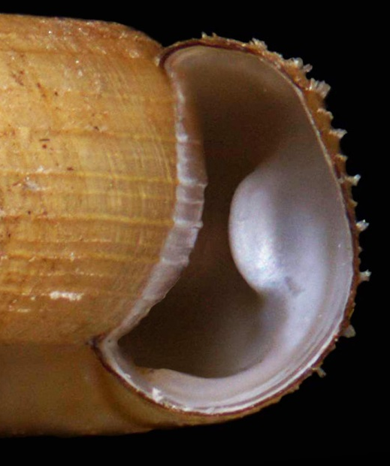
Internal lamellae
Pair of cones: H. notius, H. parallelus
Three transverse blades: H. multidens
None visible: many individuals of most species
Conic basal and vertical palatal: H. saludensis, H. hexodon

Slide 11
Variable Characters
Size
# whorls
Microsculpture of shell
Teeth - # and placement
Size of umbilicus
Habitat

Slide 12
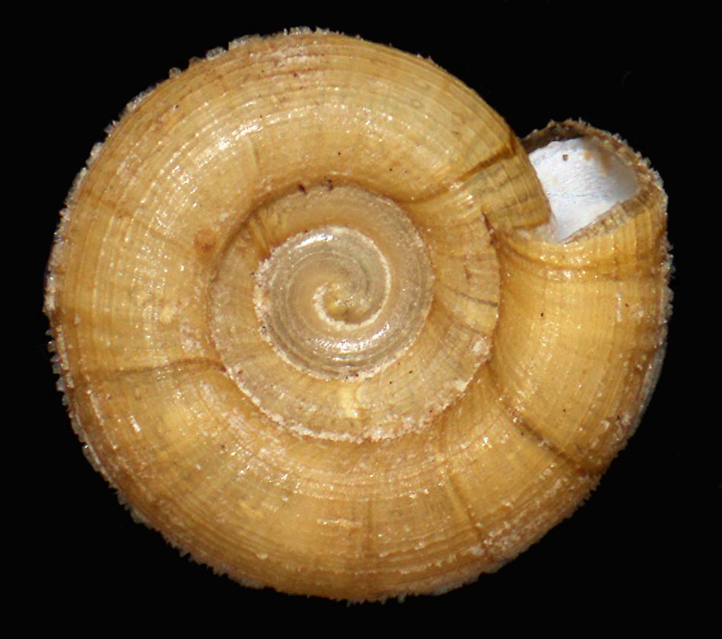
Umbilicus size
Narrow U/D = 0.31: L. scintilla
Wide U/D = 0.47 : H. hexodon
Notes:
Umbilicus is measured along the insertion of the last whorl from aperture across the axis of the shell.
Diameter is the maximum measurement across the shell.

Slide 13
Variable Characters
Size
# whorls
Microsculpture of shell
Teeth - # and placement
Size of umbilicus
Habitat/distribution

Slide 14
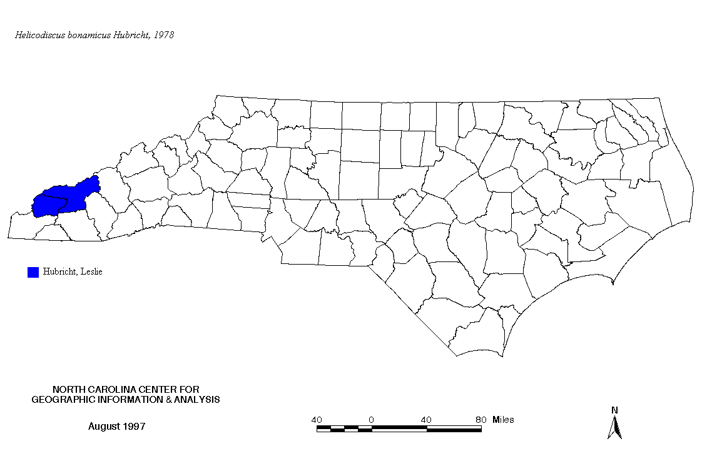
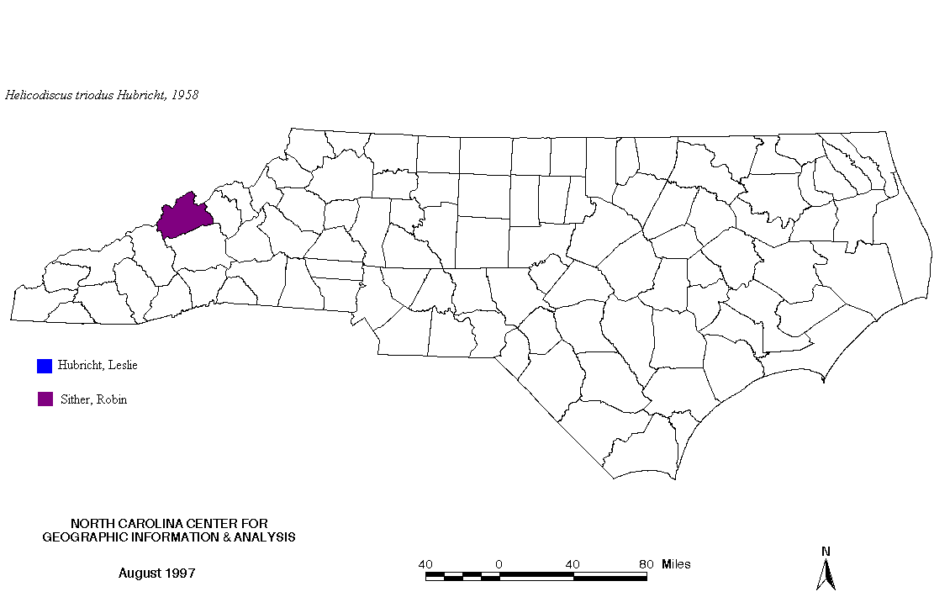
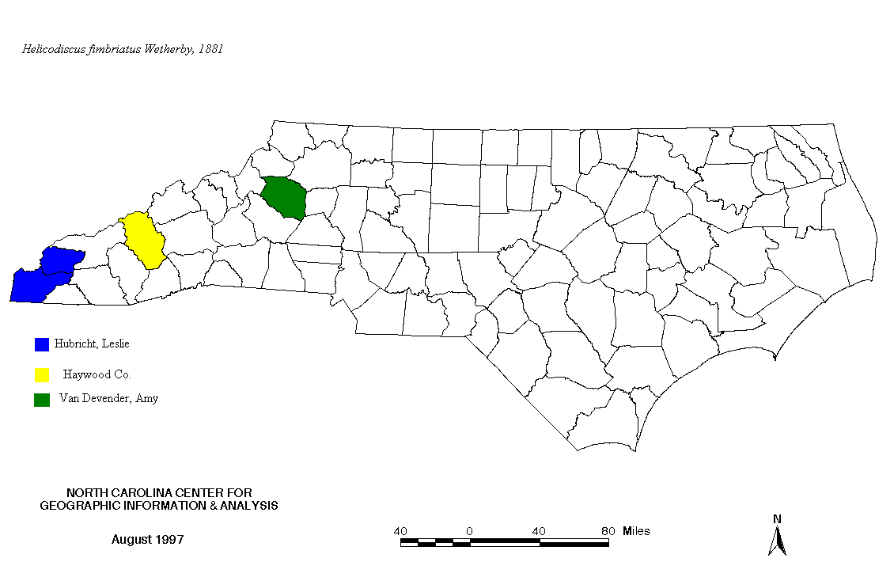
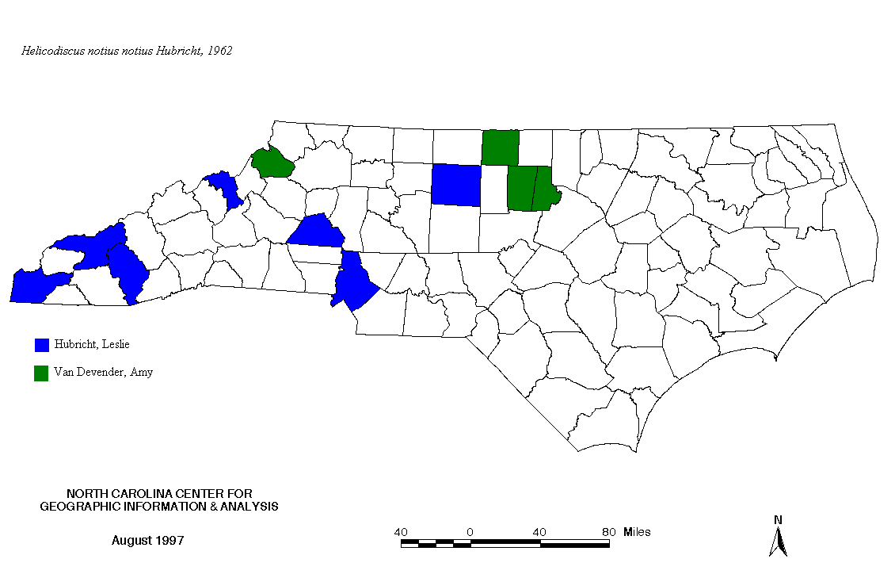
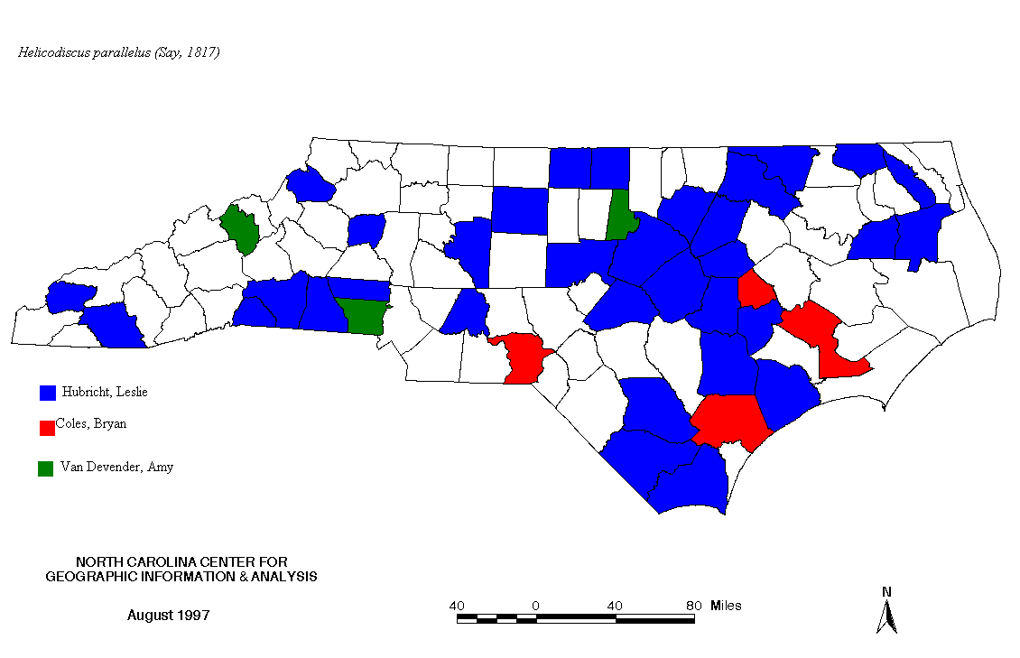
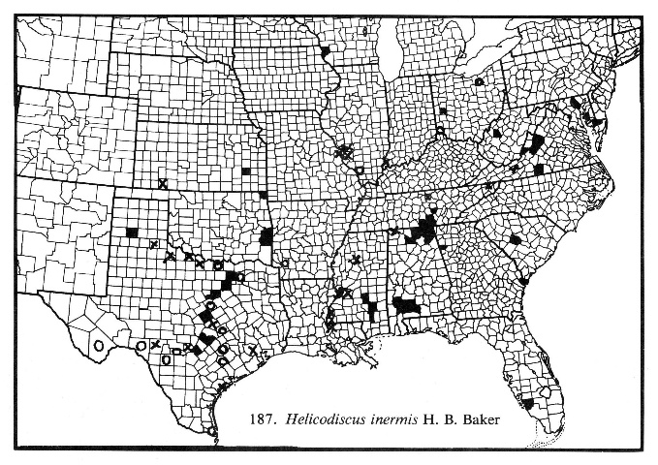
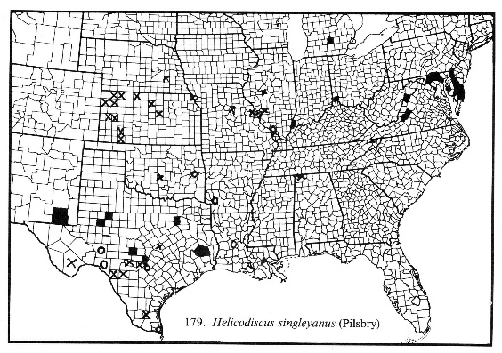
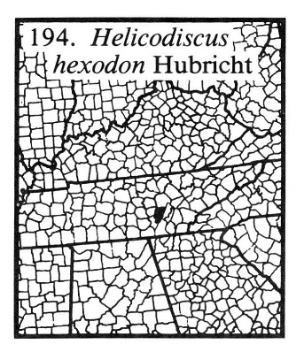
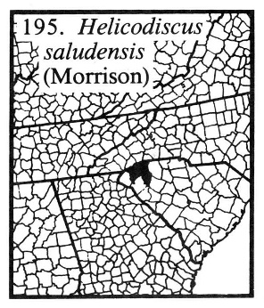
Distribution of NC Helicodiscidae

Slide 15
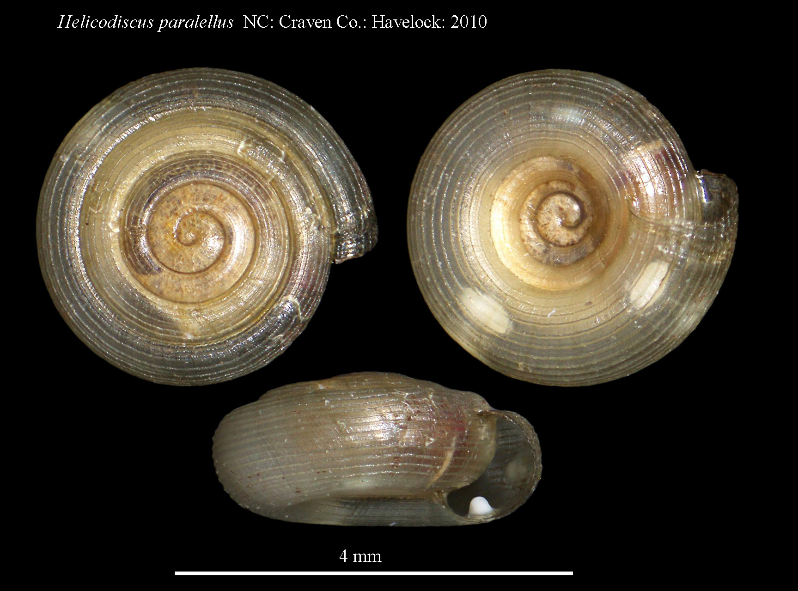
Helicodiscus parallelus
NC: Craven Co.: Havelock: 2010
Notes:
Lirae conspicuous.
1-2 pairs of conical teeth in aperture; but may be deep inside
Width to 3.2 mm
Umbilicus moderately wide and deep
Whorls up to 4.5

Slide 16
Helicodiscus fimbriatus
TN: Polk Co.
Notes:
Lirae conspicuous with 6-8 enlarged with fluted projections, which may be lost
Up to 6 pairs of teeth in final whorl; but none may be visible in the aperture
Up to 5 mm wide
Umbilicus is wide and shallow
The 6-8 lines offluted projections may be inconspicuous in some populations
Status is G4, SC in NC

Slide 17
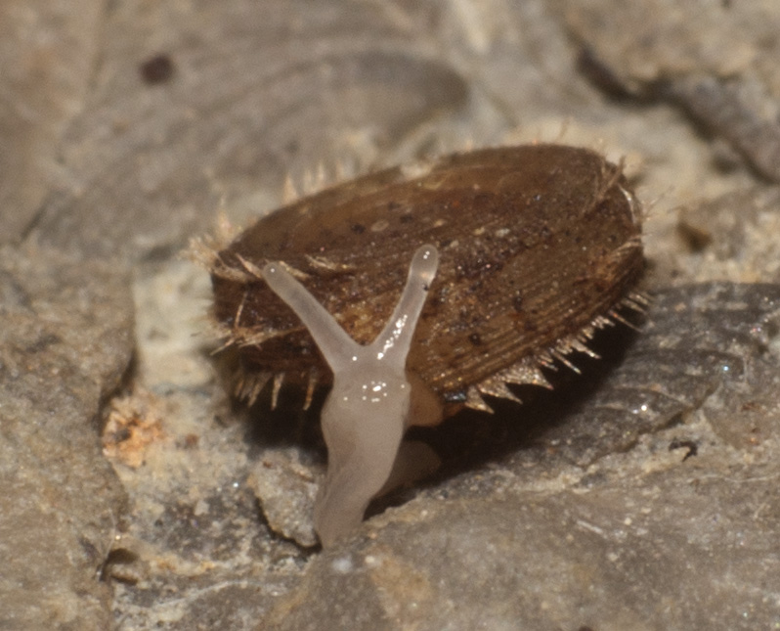
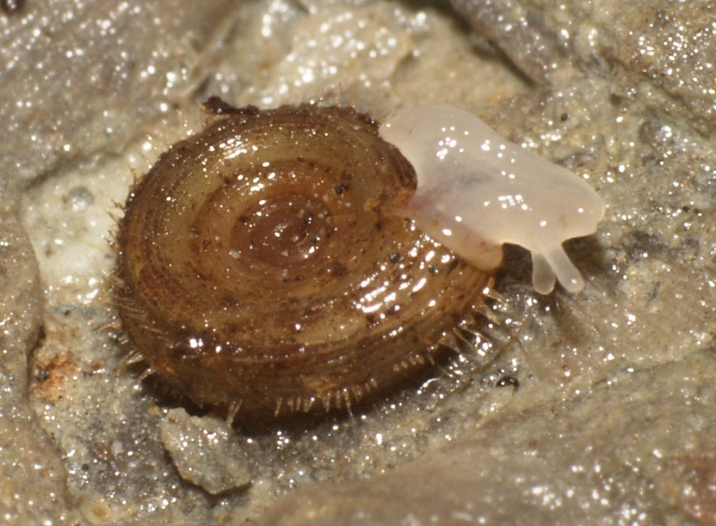
Helicodiscus bonamicus
Notes:
Lirae conspicuous and fringed with three to five carrying elongate hair-like projections, which may be lost
One pair of conical teeth in final whorl; but none may be visible in the aperture
Up to 4.2 mm wide; but we have not seen any this large
Umbilicus is wide and shallow
Spire seems to be concave.
Projections may be lost in old or worn shells
Status is G1, SC in NC

Slide 18
Helicodiscus notius
NC: Gaston Co.: ASV 2007-145
Notes:
Lirae conspicuous (even on first whorl) but not enlarged
One pair of conical teeth in final whorl; but none may be visible in the aperture
Up to 3.66 mm wide
Umbilicus is wide and shallow
Up to 5.5 whorls

Slide 19
Helicodiscus multidens
NC: Madison Co.: FMNH 285049
Notes:
Lirae present and carry a flattened fringe
Flattened teeth in triplets with a parietal lamella
Up to 4.75 mm wide
Umbilicus is moderately wide and deep
Status is unranked in NC , but rare – Chicago specimen illustrated.
Up to 4.5 whorls

Slide 20
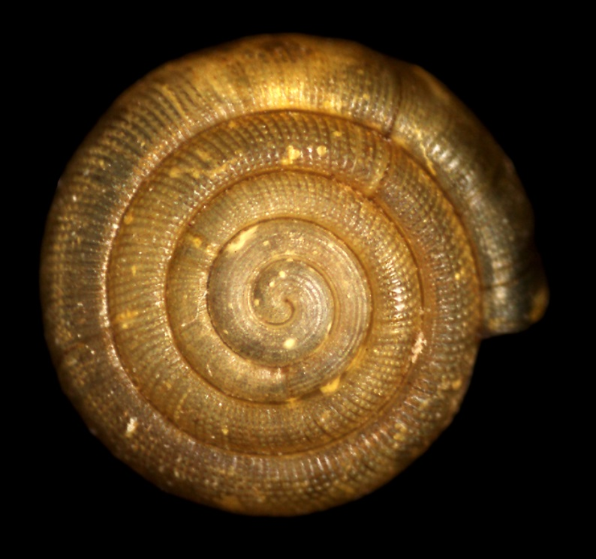
Helicodiscus saludensis
Notes:
Lirae absent – replaced with transverse rows of bead-like bumps.
Teeth in alternating rows of a more-or-less conical basal and a flattened palatal
2.4-3.5 mm wide
Umbilicus is narrow and fairly deep
4.5-5.5 whorls in adults
Status is unranked in NC but rare

Slide 21
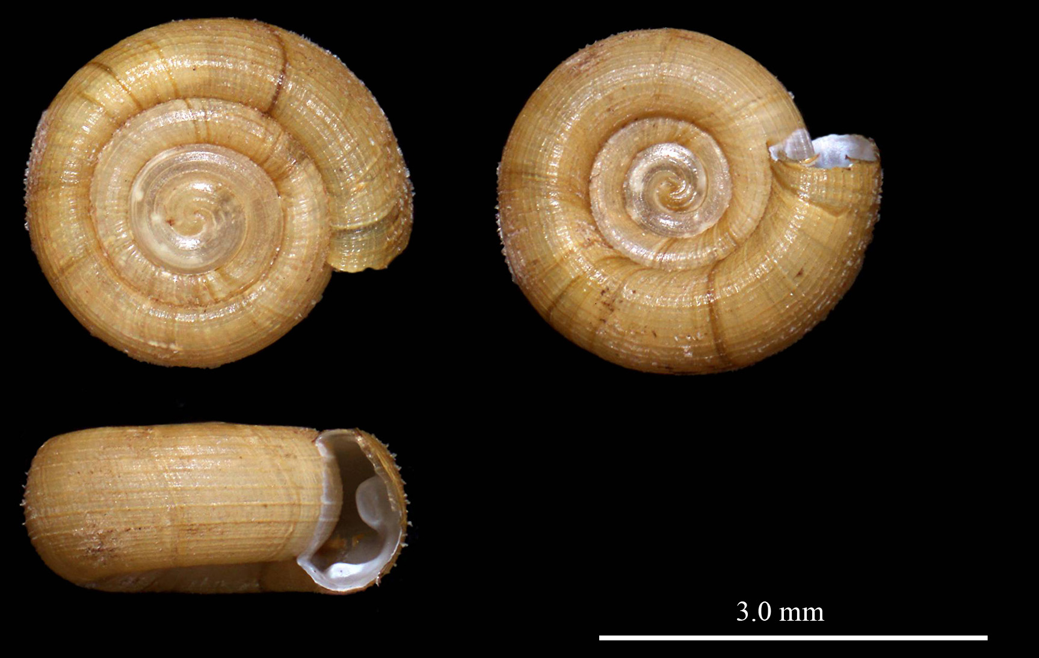
Helicodiscus hexodon
TN: Bledsoe Co.: ASV 2015-118: topotype
Notes:
Lirae present with fringes on most lirae.
Teeth in up to three pairs of a somewhat transverse basal and a flattened, blade-like palatal
Up to 4.9 mm wide
Umbilicus is wide and shallow (widest in group)
5-5.5 whorls in adults
Status is unranked in NC but recently found near the border in TN (Near threatened in TN)

Slide 22
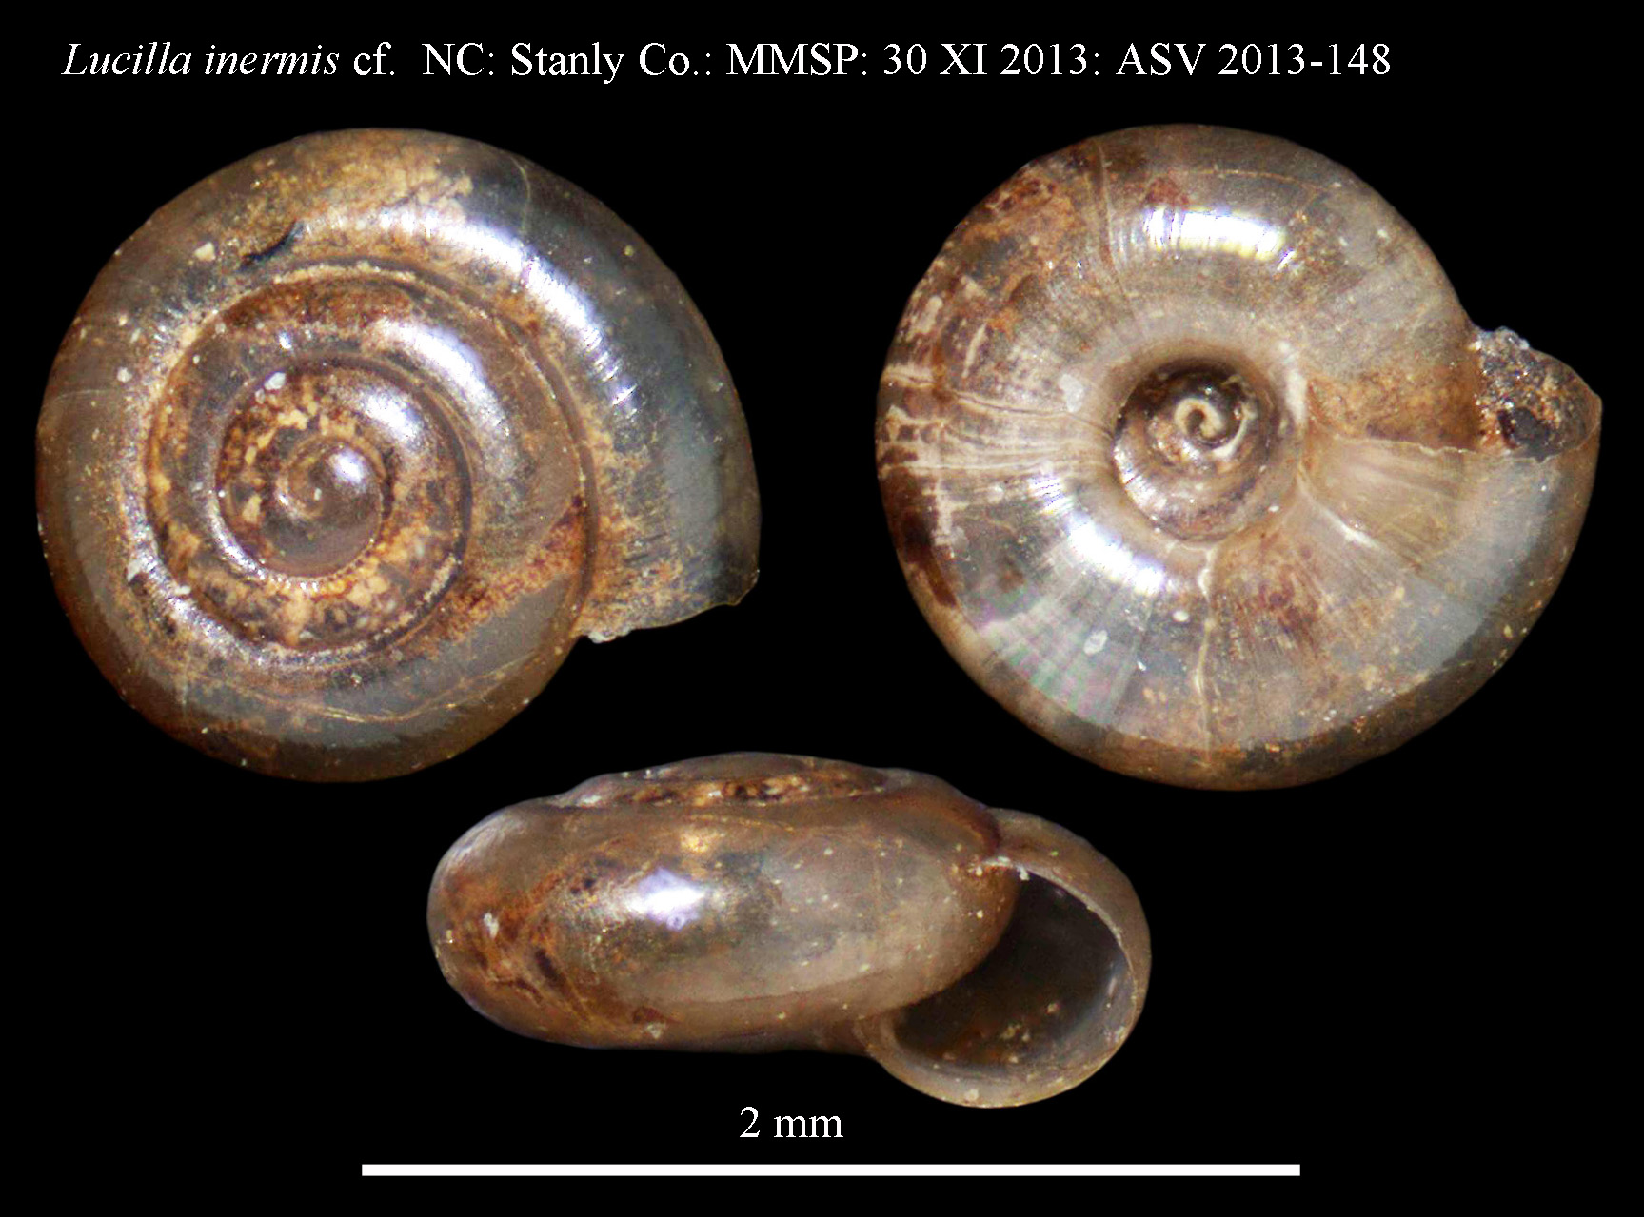
Lucilla scintilla
NC: Stanley Co.: ASV 2013-148
Notes:
Lirae absent , surface smooth and shiny
Teeth absent
2 - 2.5 mm wide
Umbilicus is very narrow and deep
3-4 whorls in adults
Status is unranked in NC but distribution essentially unknown (Watuaga, Burke, Stanly cos.)

Slide 23
Lucilla scintilla and Lucilla singleyanus
Lucilla scintilla TN: Grundy Co.: FMNH 240312
Lucilla singleyana OK: Haskell Co.: FMNH 2392112
Notes:
1. Lucilla singleyana is a bit larger and taller
2. 4 whorls
3. Microscopic lines usually present
4. Umbilicus larger

Slide 24
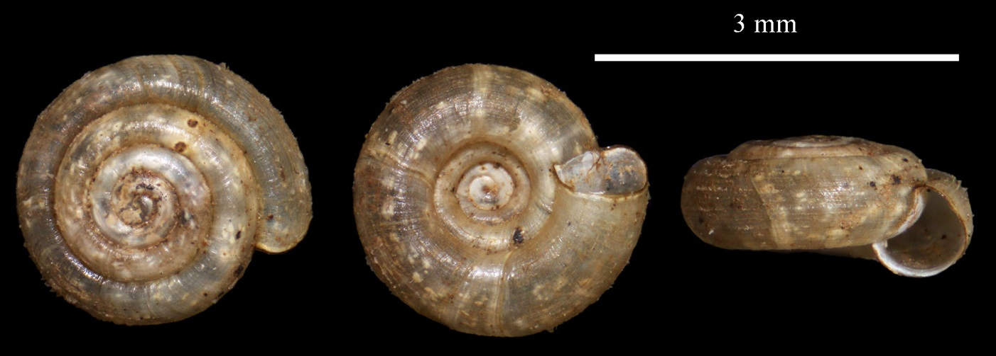
Helicodiscus sp. nov.
NC: Stanly Co.: 14 III 2013
NC: Stanly Co.: VII 2012
NC: Stanly Co.: 30 XI 2013
NC: Stanly Co.: VII 2012
Notes:
All lirae with fringes like H. multidens and H. hexodon; but alternate lirae with much longer fringes
Teeth absent
Up to 2.4 mm wide
Umbilicus is rather narrow and deep
Spire is depressed
Up to 4.75 whorls
May be more widespread (Morrow Mountain, Stanly, Gaston and Alexander Co., Wilkes? Virginia?

Slide 25
Acknowlegdements
We are pleased to thank the Department of Biology at Appalachian State University for the use of an Olympus photoscope and Dr. Guichuan Hou of the William C. and Ruth Ann Dewel Microscopy Facility for assistance with imaging; the staff of the NC Museum of Natural Sciences for their help and encouragement; Jochen Gerber of the Field Museum of Natural History and the staff of the University of Florida for hosting us and loaning specimens; Dan Dourson, Jeff Nekola and Denise Furr for loans of specimens, field time and conversation; NC Natural Heritage Program for their cooperation and NC Division of Parks and Recreation and NC Wildlife Resources Commission for allowing access and arranging collecting permits; and the Van Devender Family Trust for funding.

Slide 29
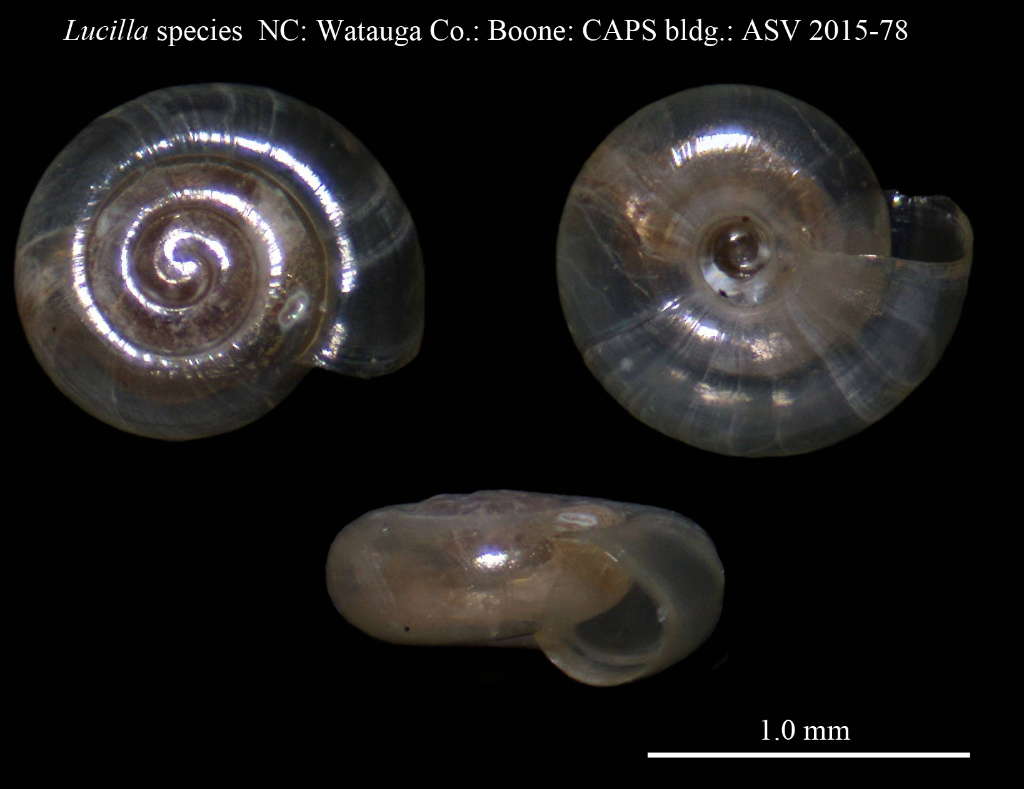
Lucilla scintilla
NC: Watauga Co.: ASV 2015-78
Notes:
Lirae absent , surface smooth and shiny
Teeth absent
2 - 2.5 mm wide
Umbilicus is very narrow and deep
3-4 whorls in adults
Status is unranked in NC but distribution essentially unknown (Watuaga, Burke, Stanly Cos.)

Slide 31
Lucilla singleyana
OK: Haskell Co.: FMNH 2392112

Slide 32
Lucilla scintilla
NC: Haywood Co.

Slide 33
Lucilla scintilla
NC: Burke Co.: UF 464999
TN: Grundy Co.: FMNH 240312

Slide 34
Helicodiscus fimbriatus
NC: Ashford: FMNH 46687

Slide 35
Helicodiscus notius
NC: Catawba Co.: 2008

Slide 36
Helicodiscus fimbriatus
NC: Ashford
FMNH 46687

Slide 37
Helicodiscus parallelus
NC: Wake Co.:

Slide 38
Helicodiscus parallelus
NC: Wake Co.: 2007

Slide 39
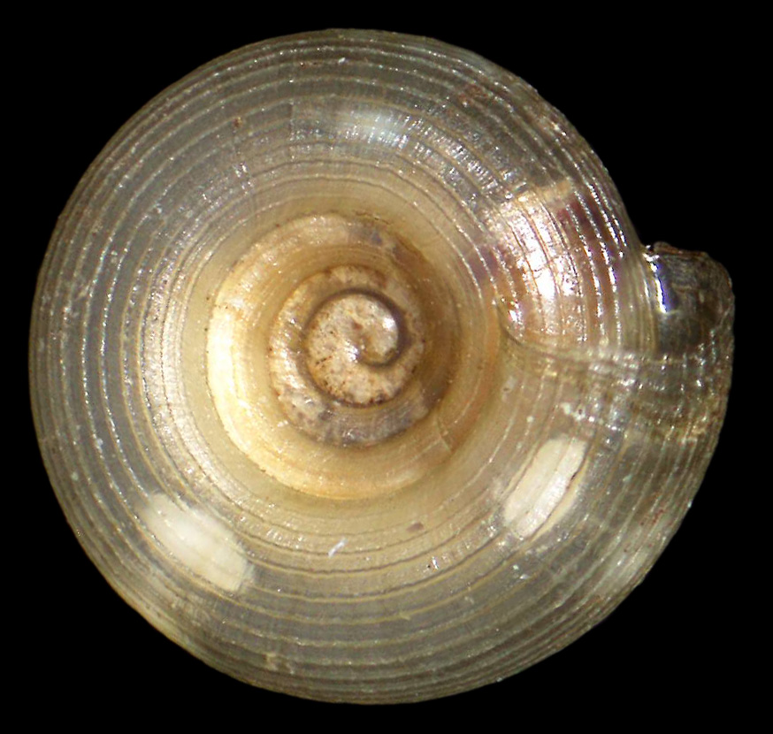
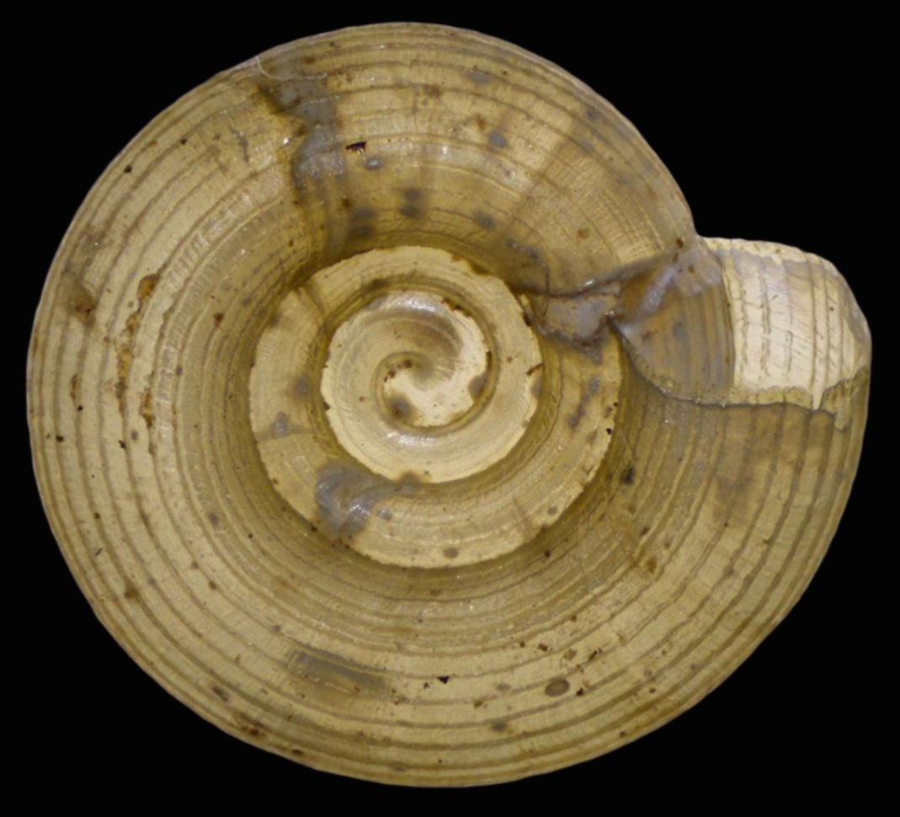
Umbilicus size
Narrow U/D = 0.41: H. parallelus
Wide U/D = 0.44 : H. notius

Slide 41
Helicodiscus bonamicus

