Slide 1
Exploring the Galapagos Islands
Wayne Van Devender

Slide 2
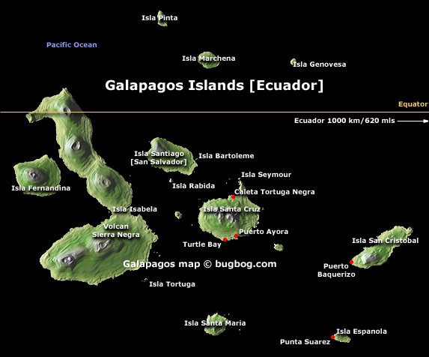

Slide 3
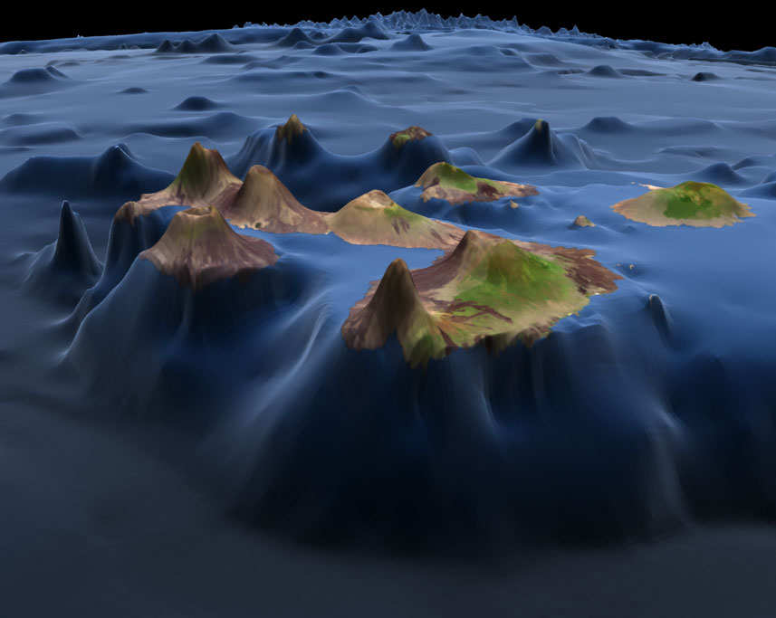

Slide 4
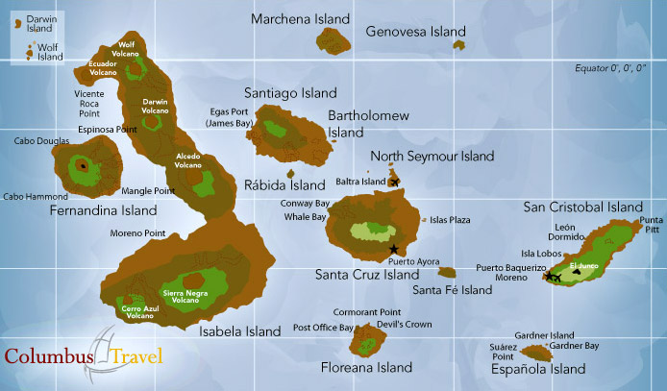
Day 8
Day 9
Day 10
Day 7
Day 11
Day 6
Day 4
Day 5
Day 2
Day 1
Day 3

Slide 5
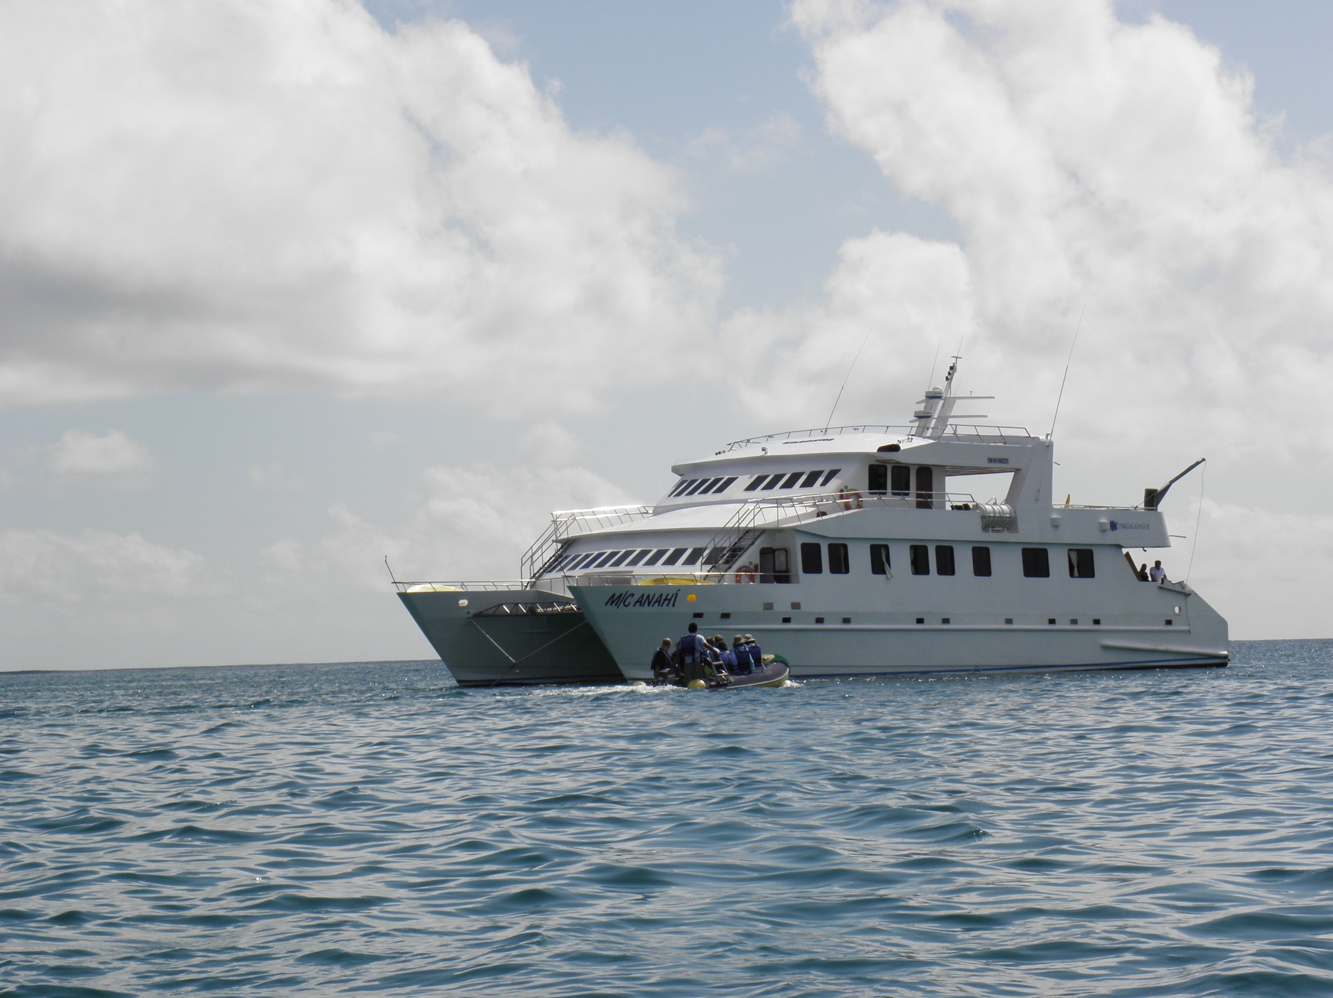

Slide 6
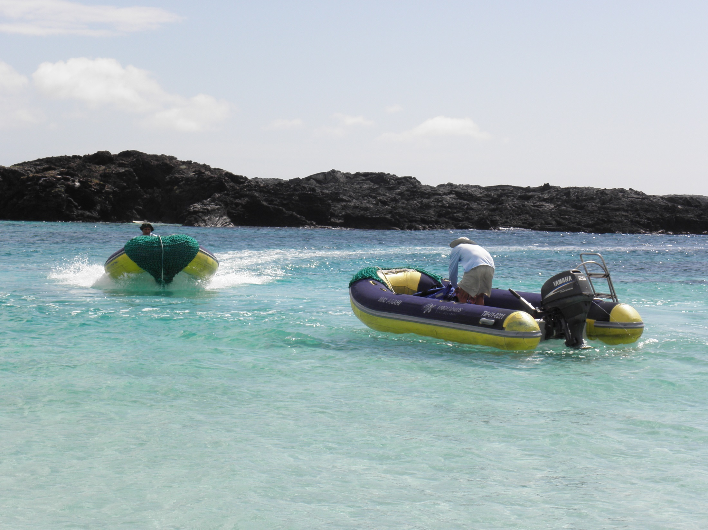

Slide 7
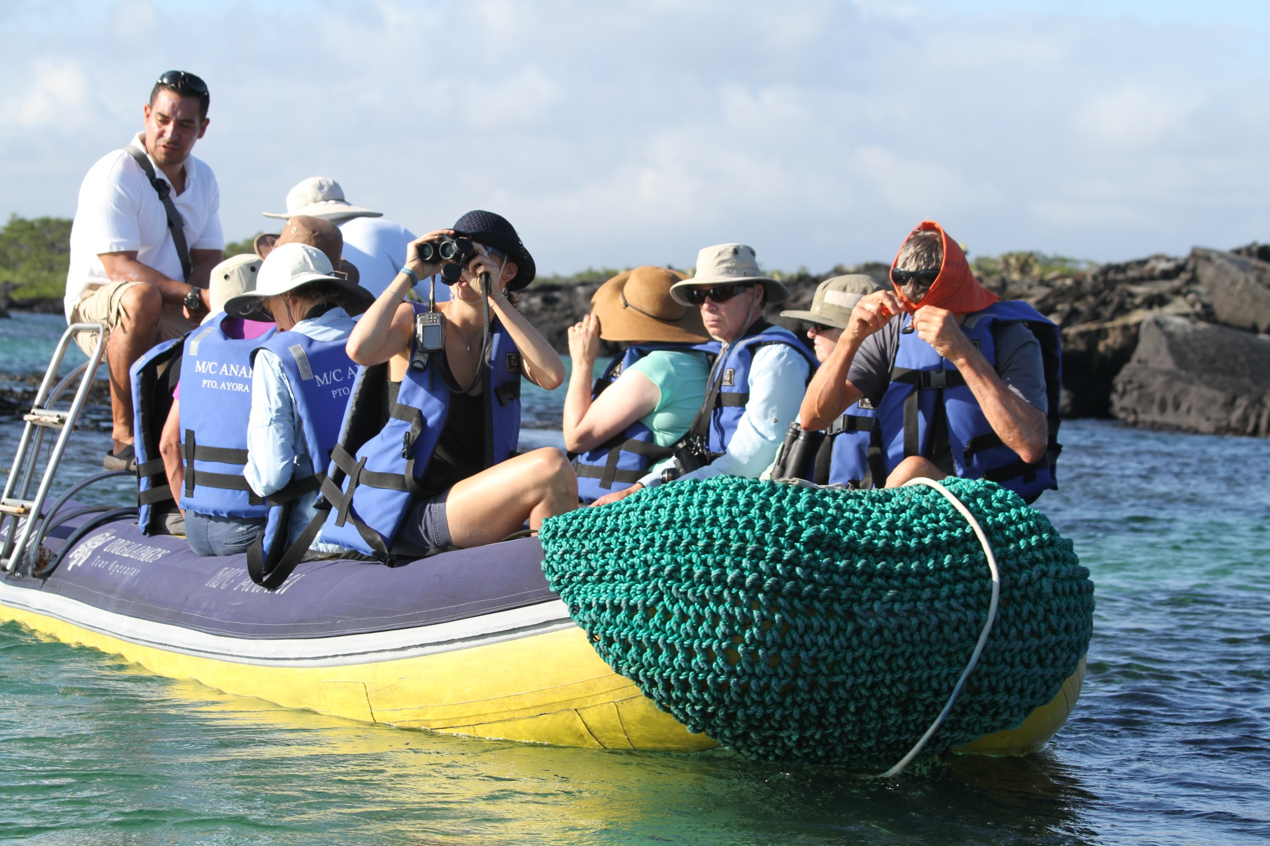

Slide 8
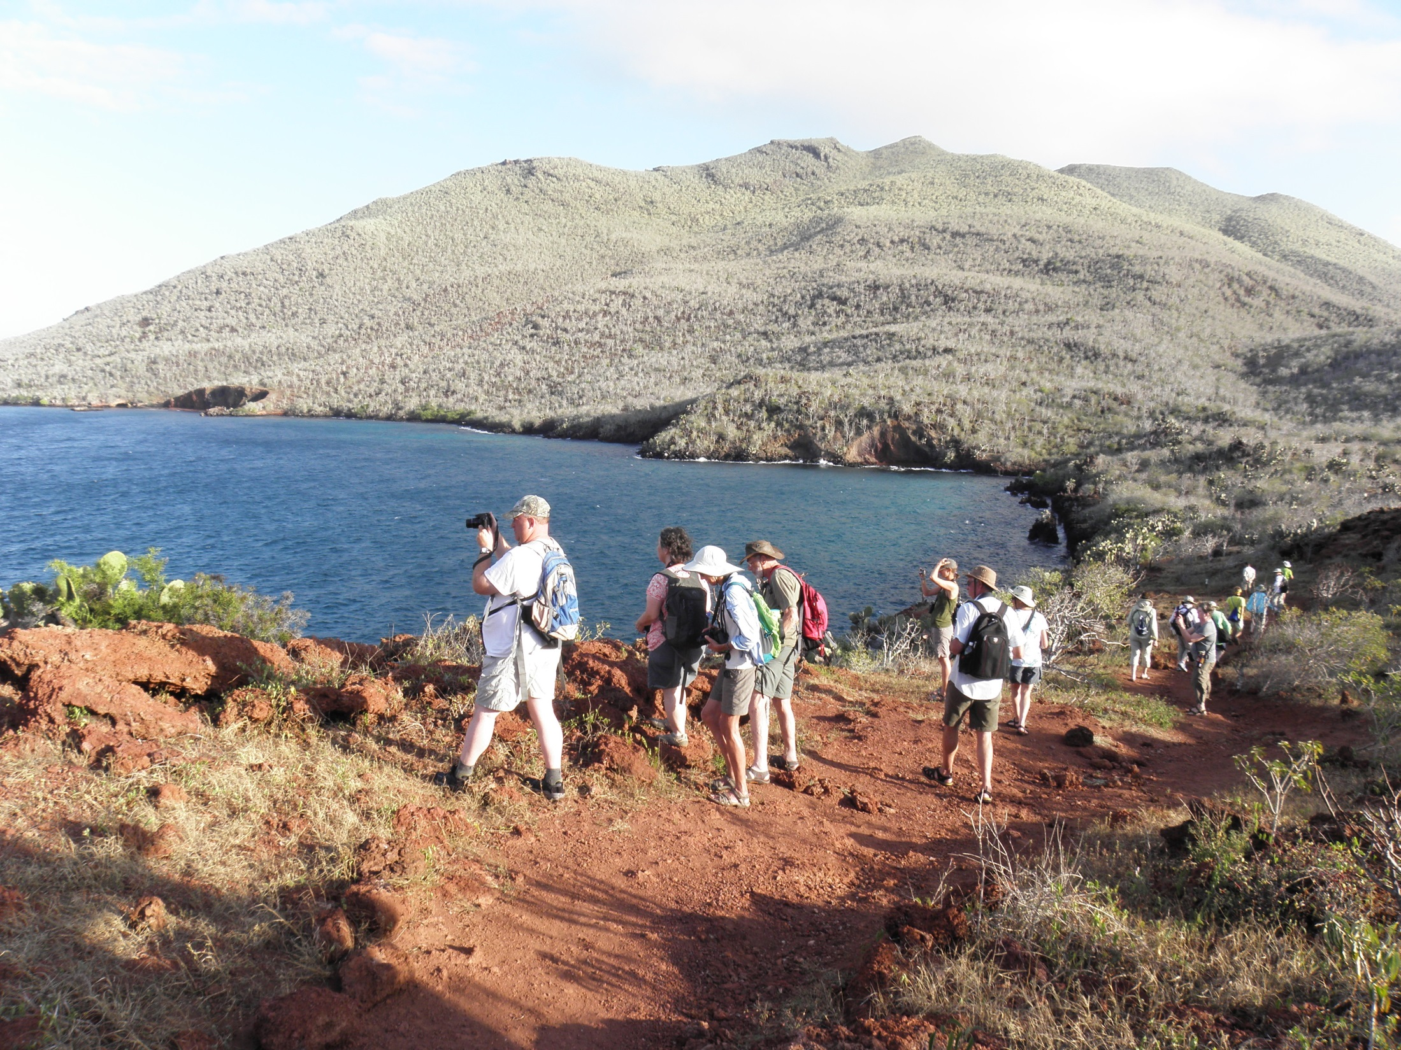

Slide 9
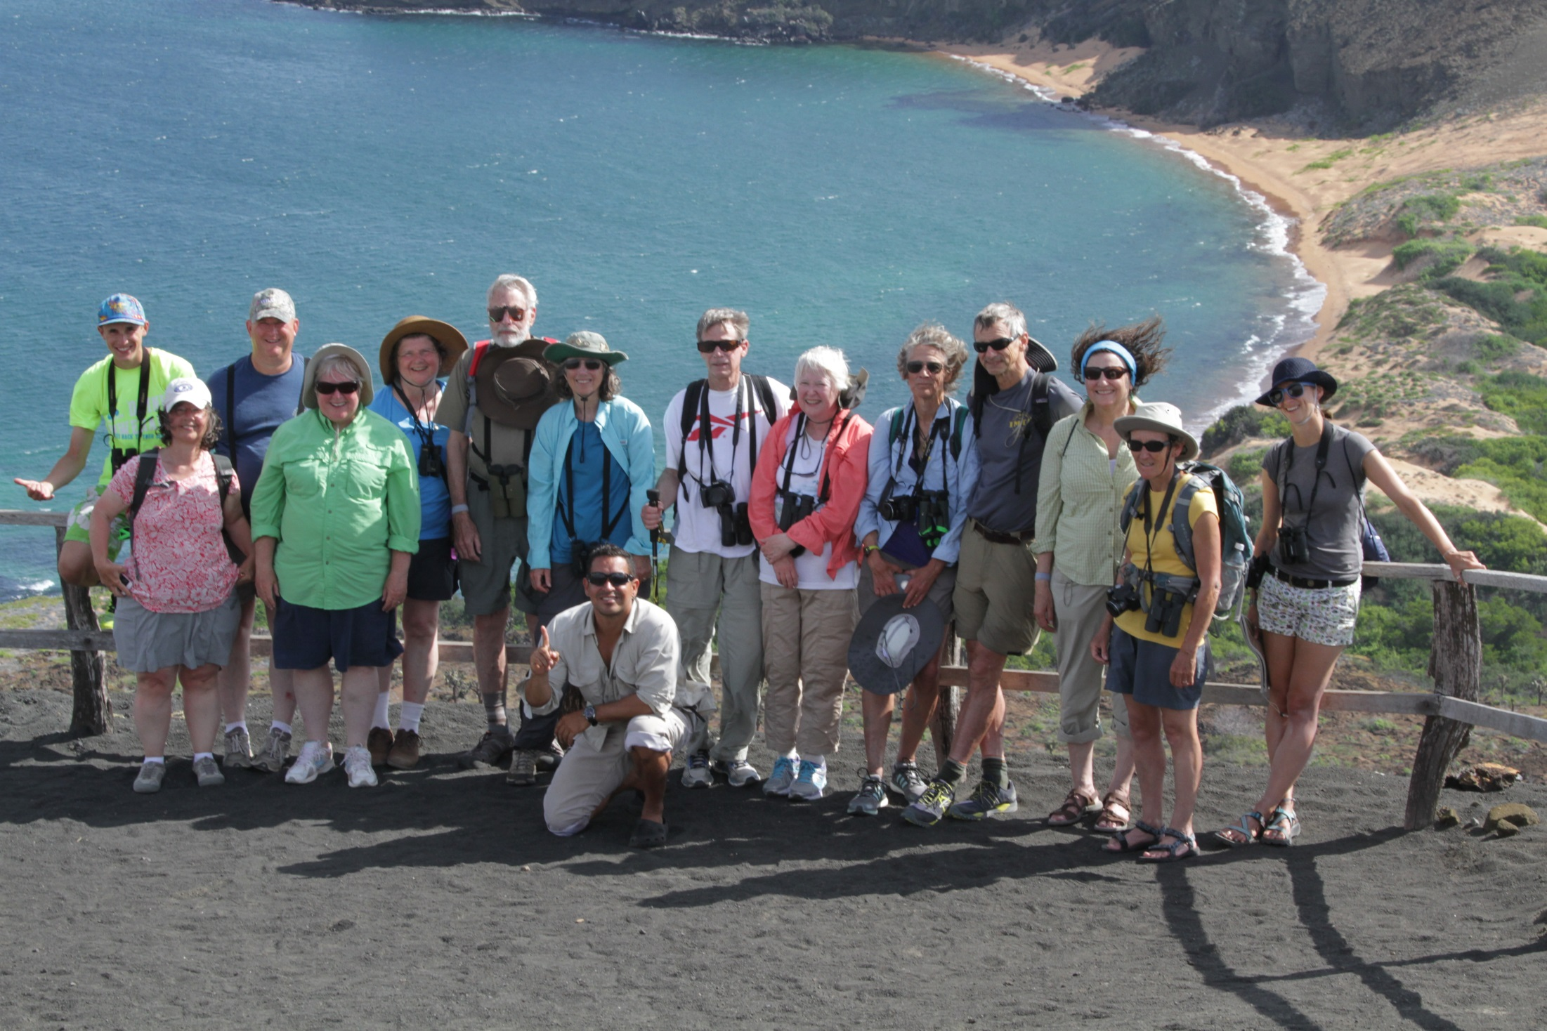

Slide 10
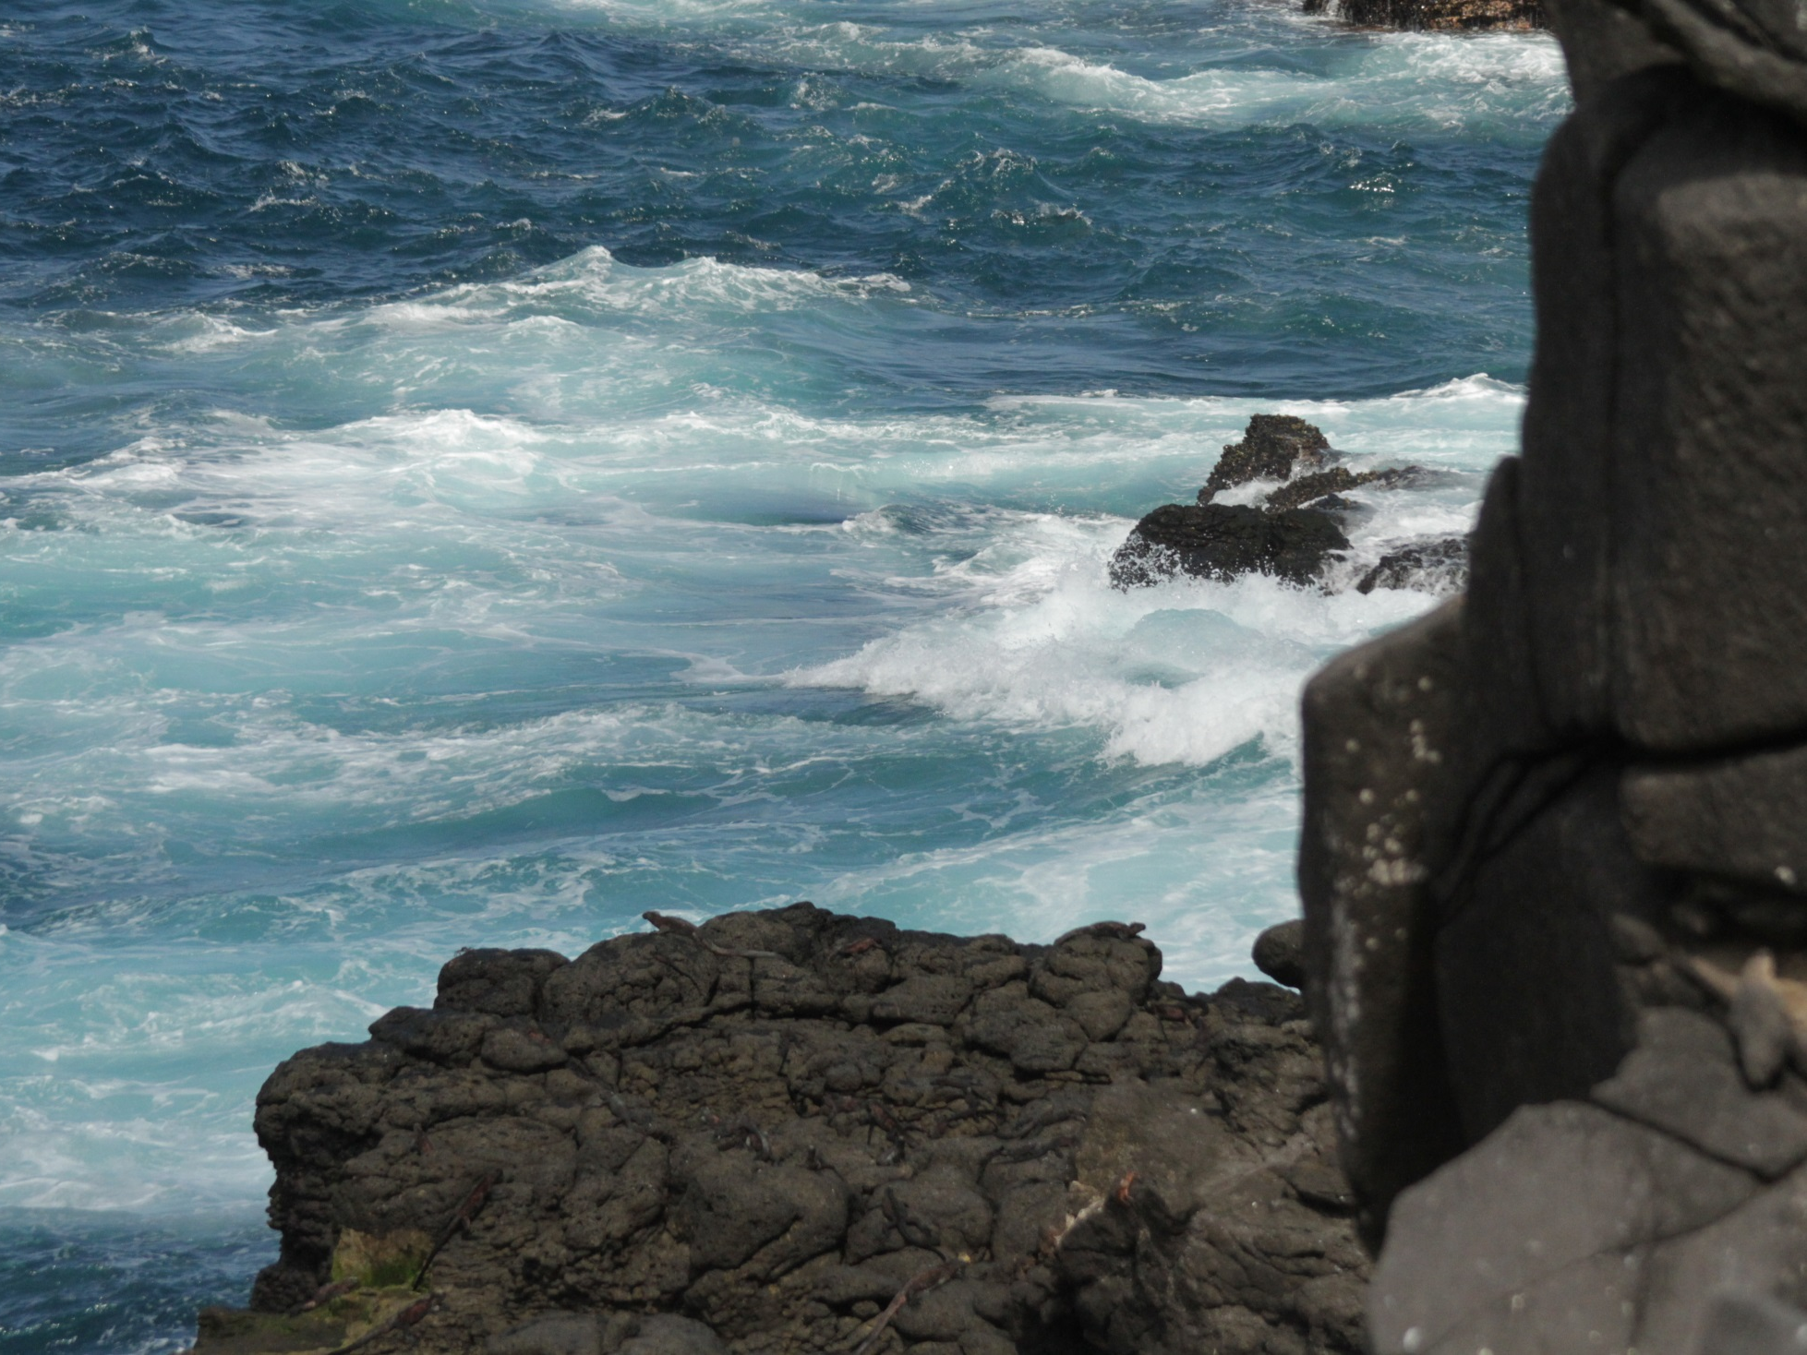

Slide 11
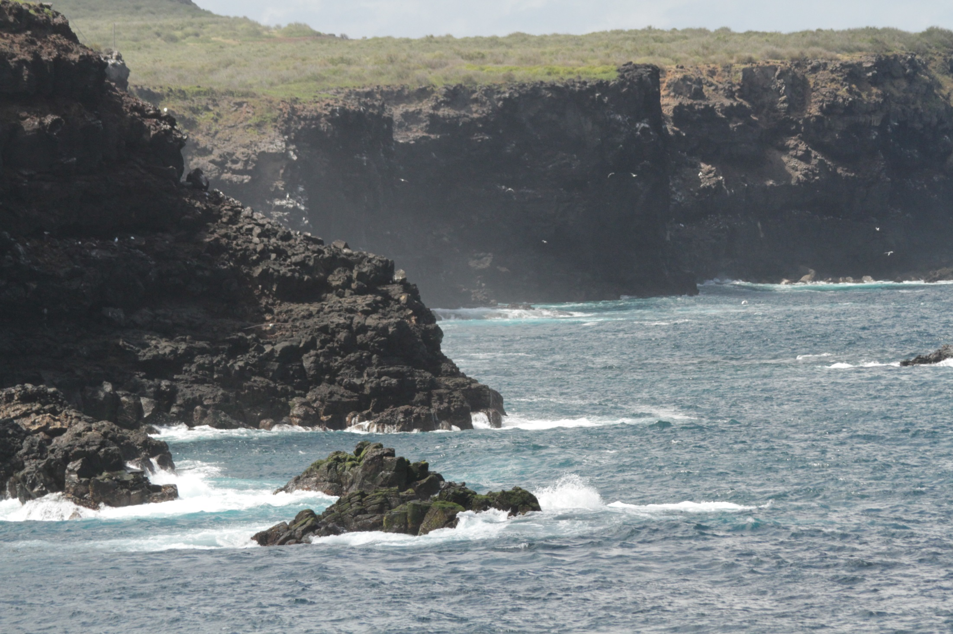

Slide 12
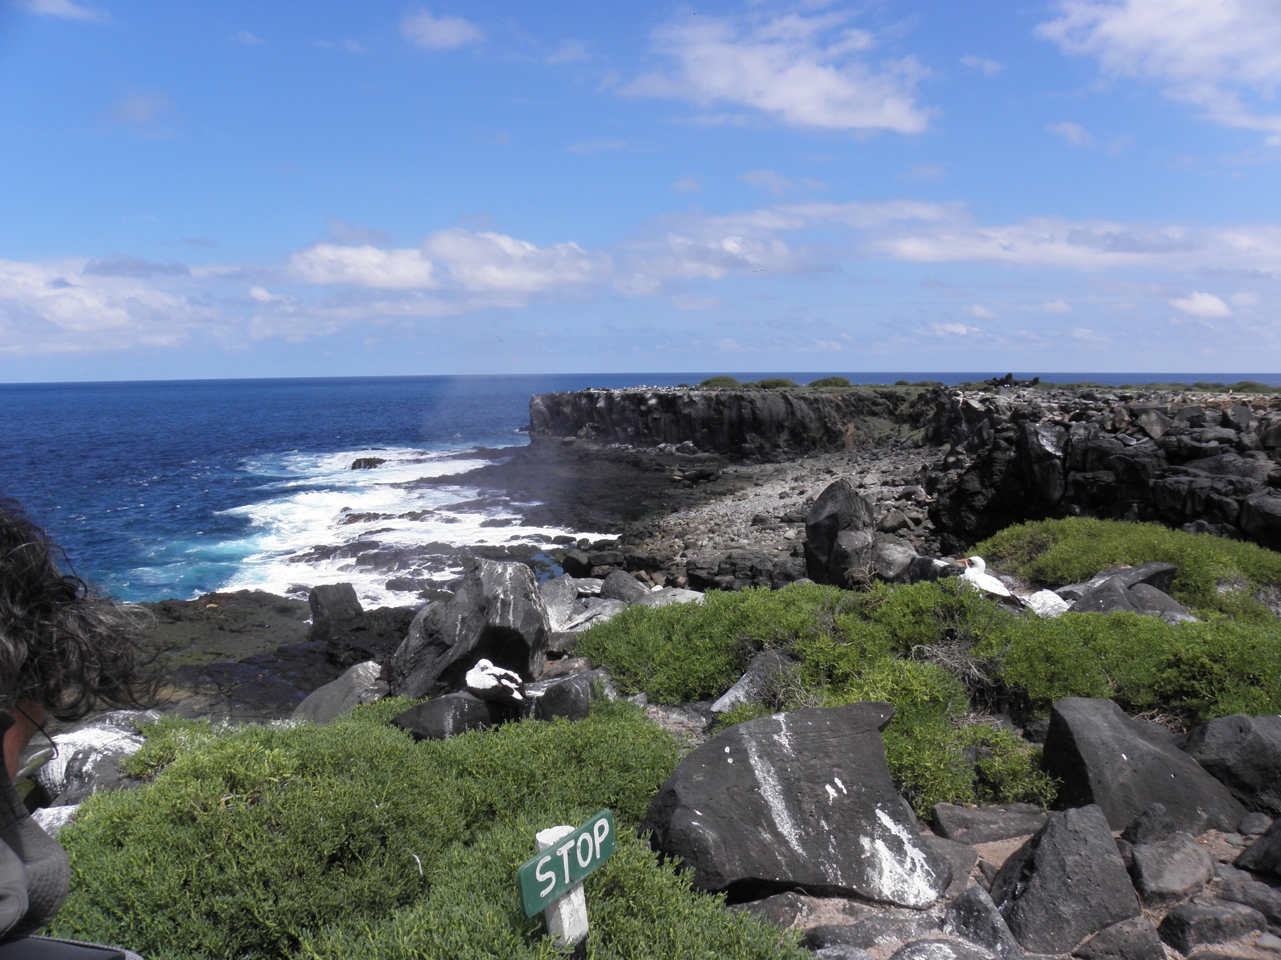

Slide 13
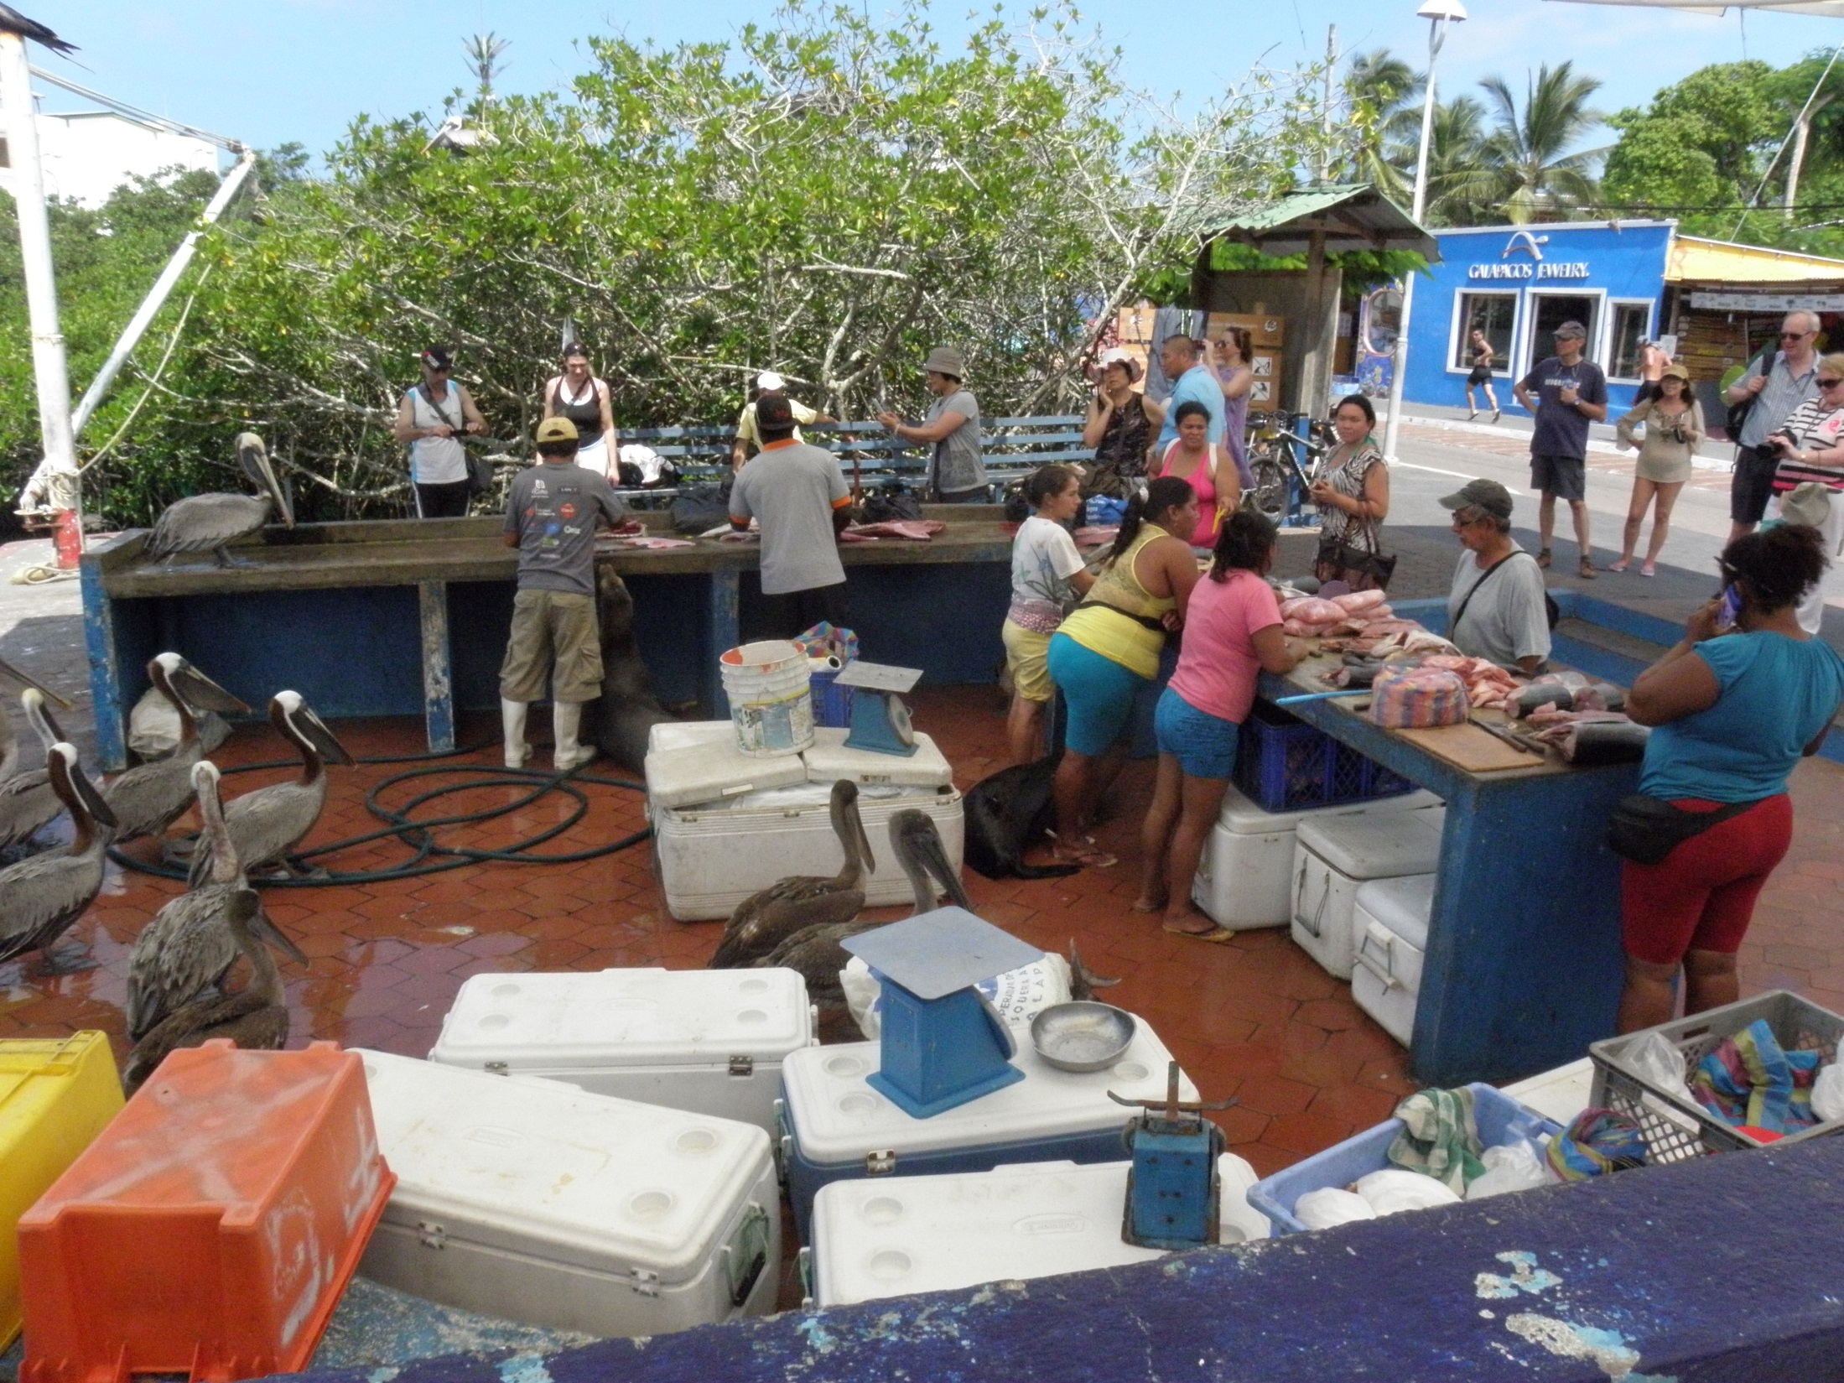

Slide 14
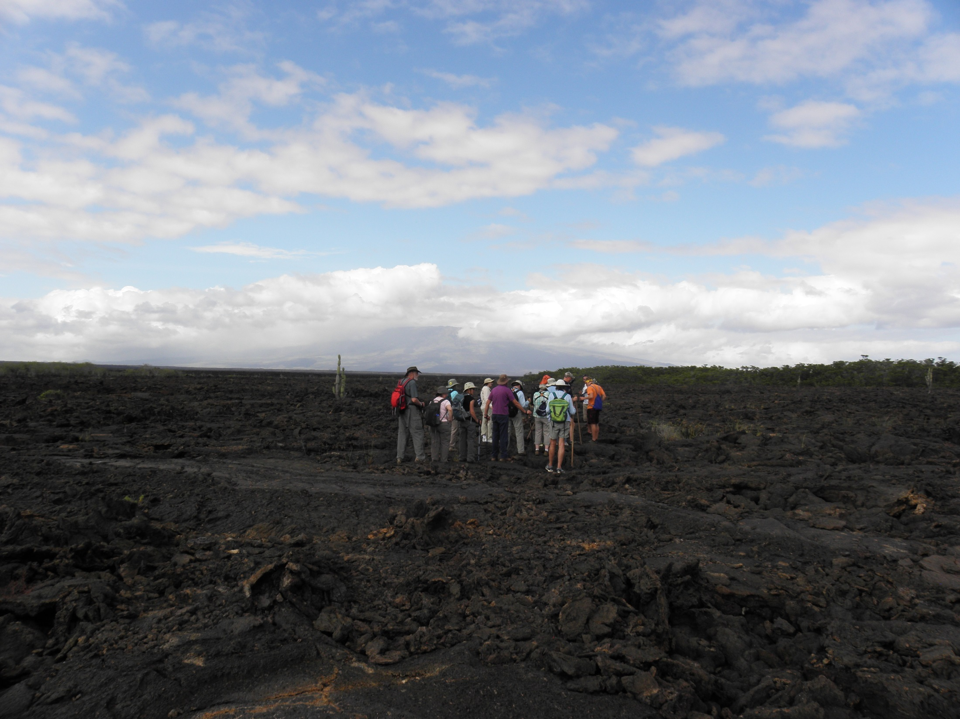

Slide 15
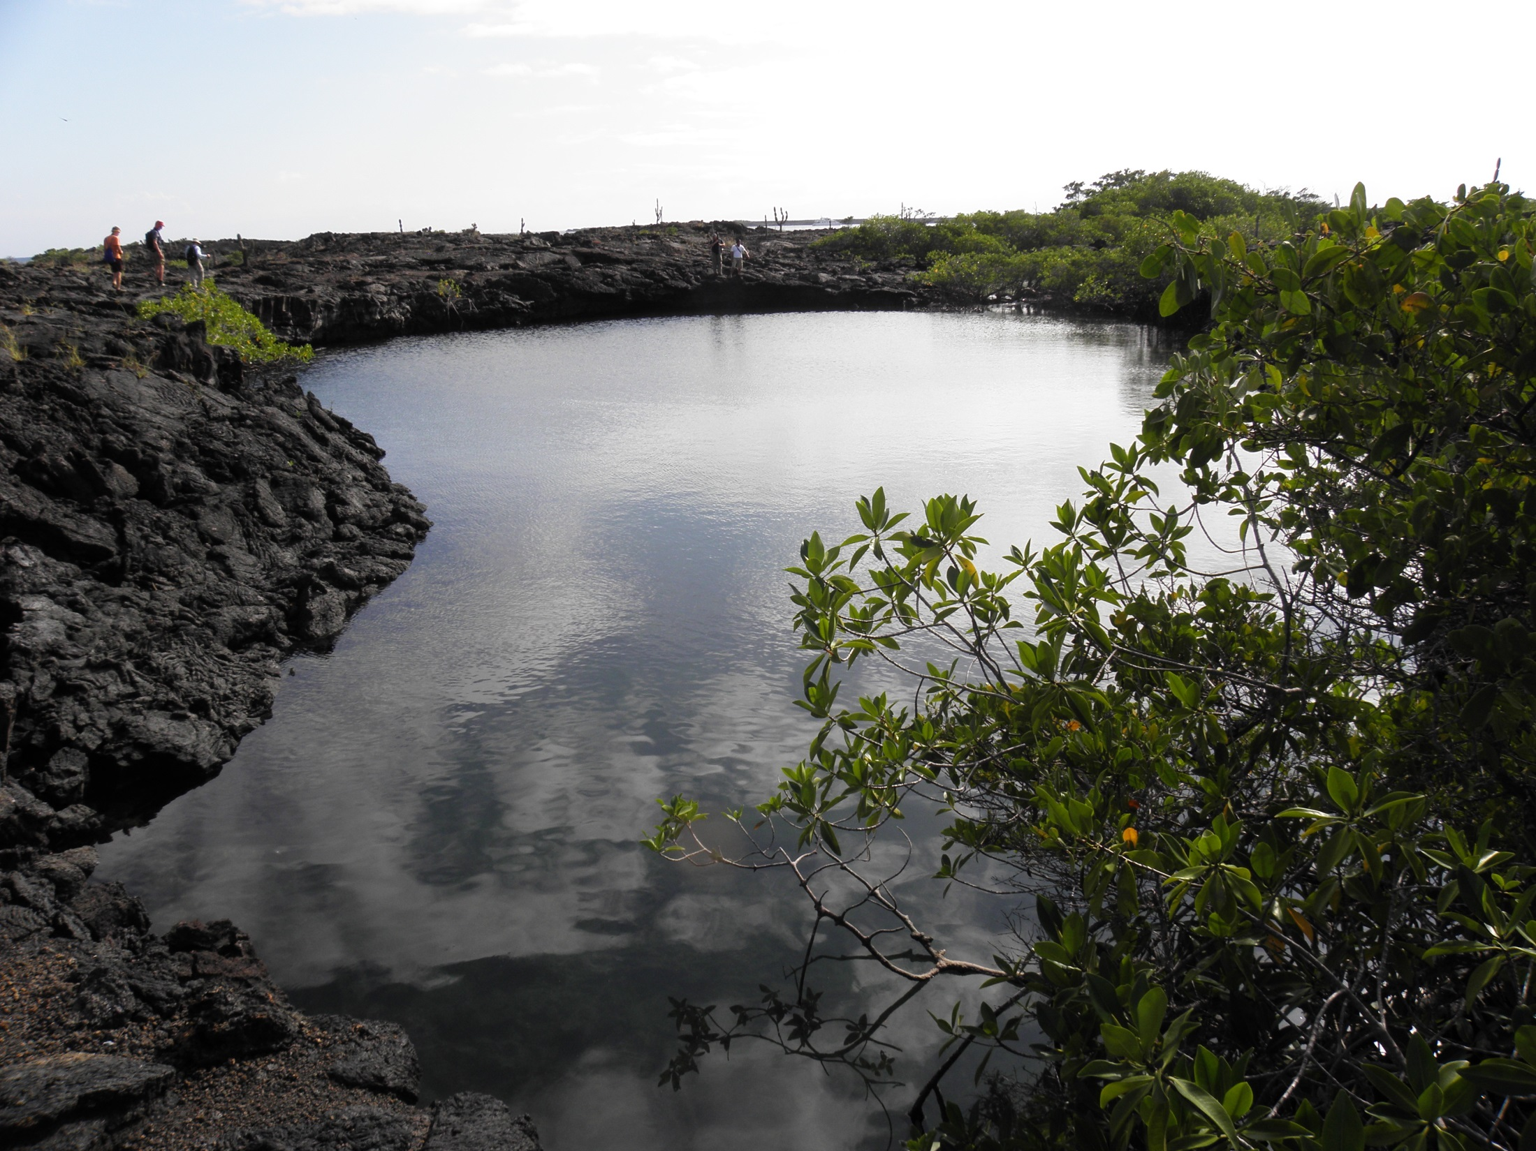

Slide 16
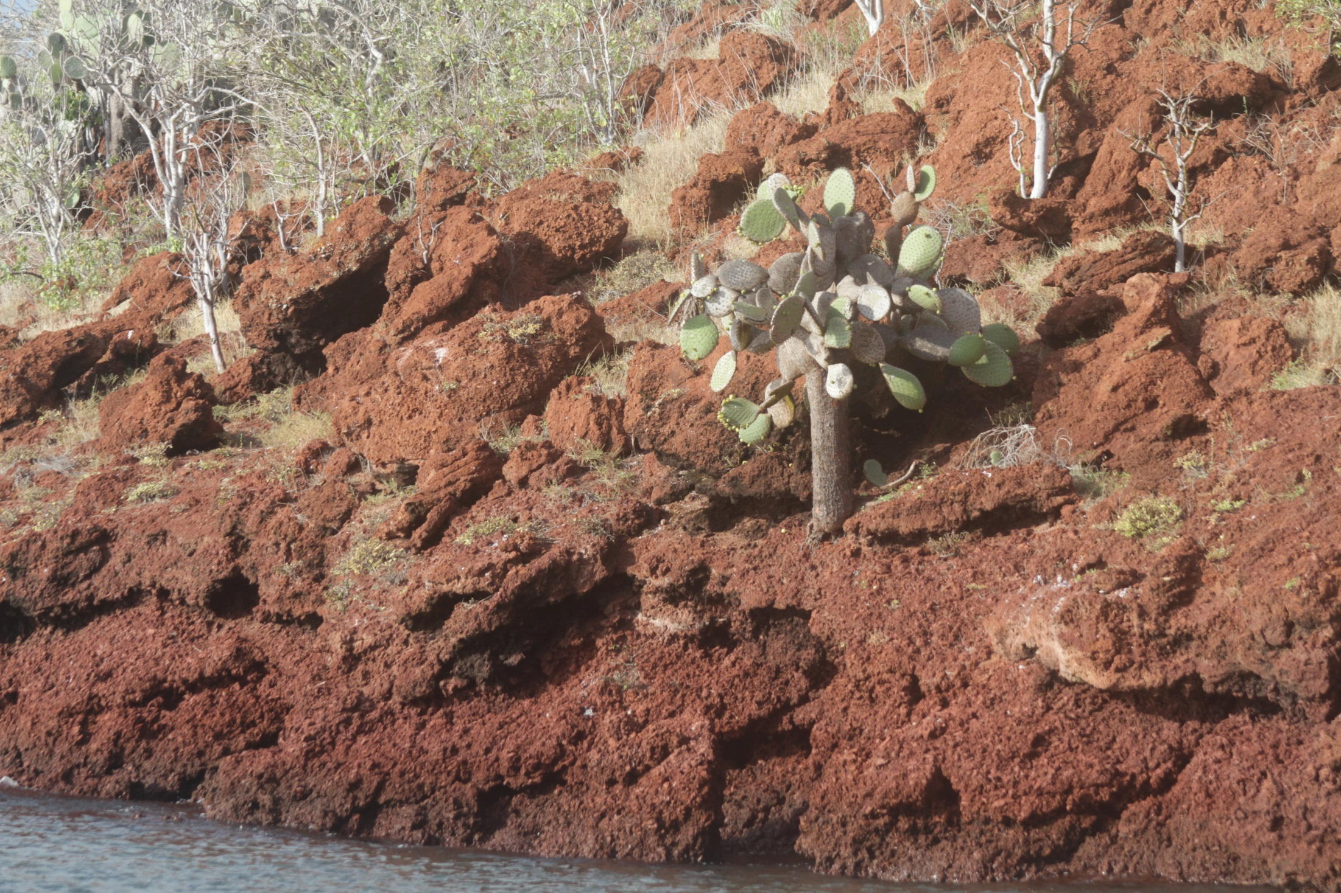

Slide 17
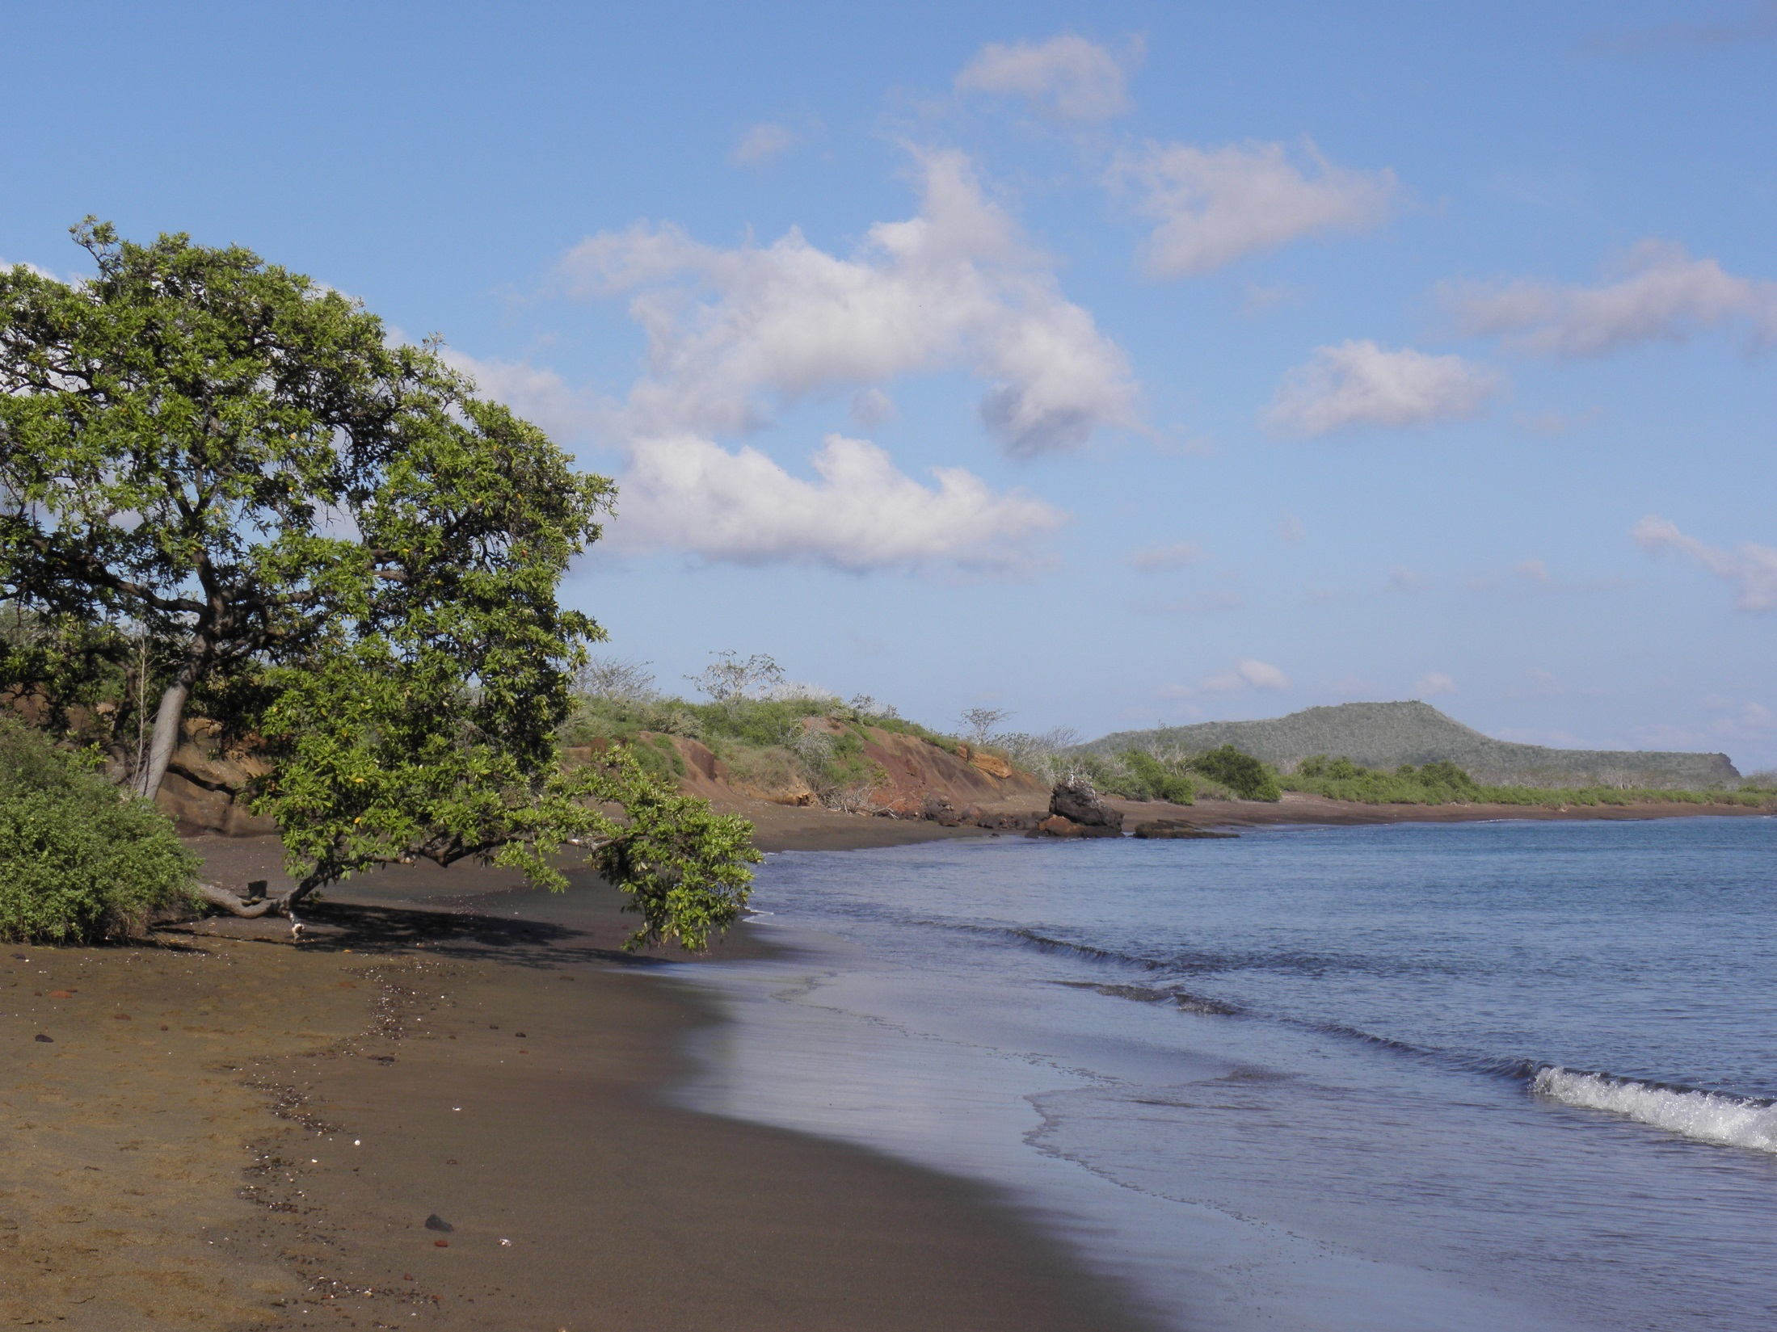

Slide 18
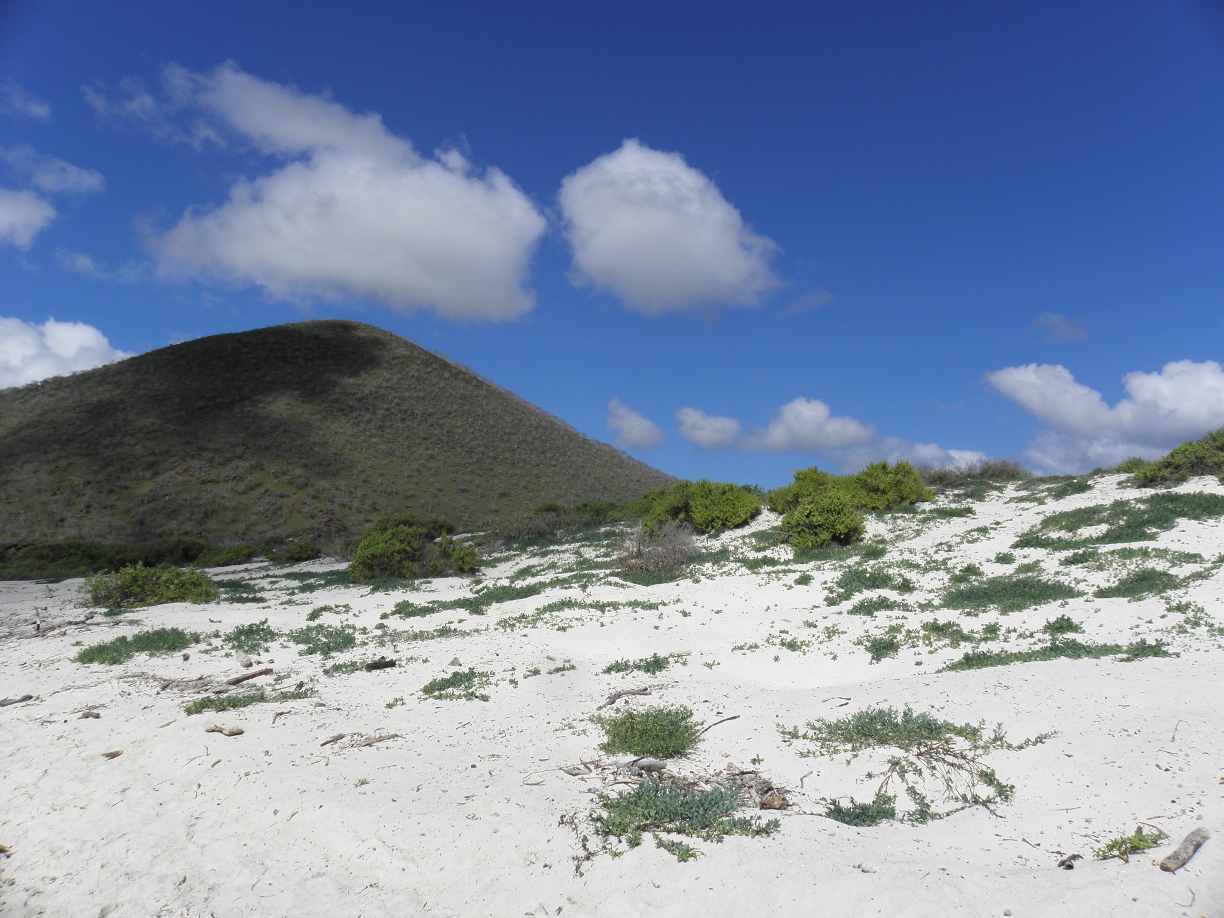

Slide 19
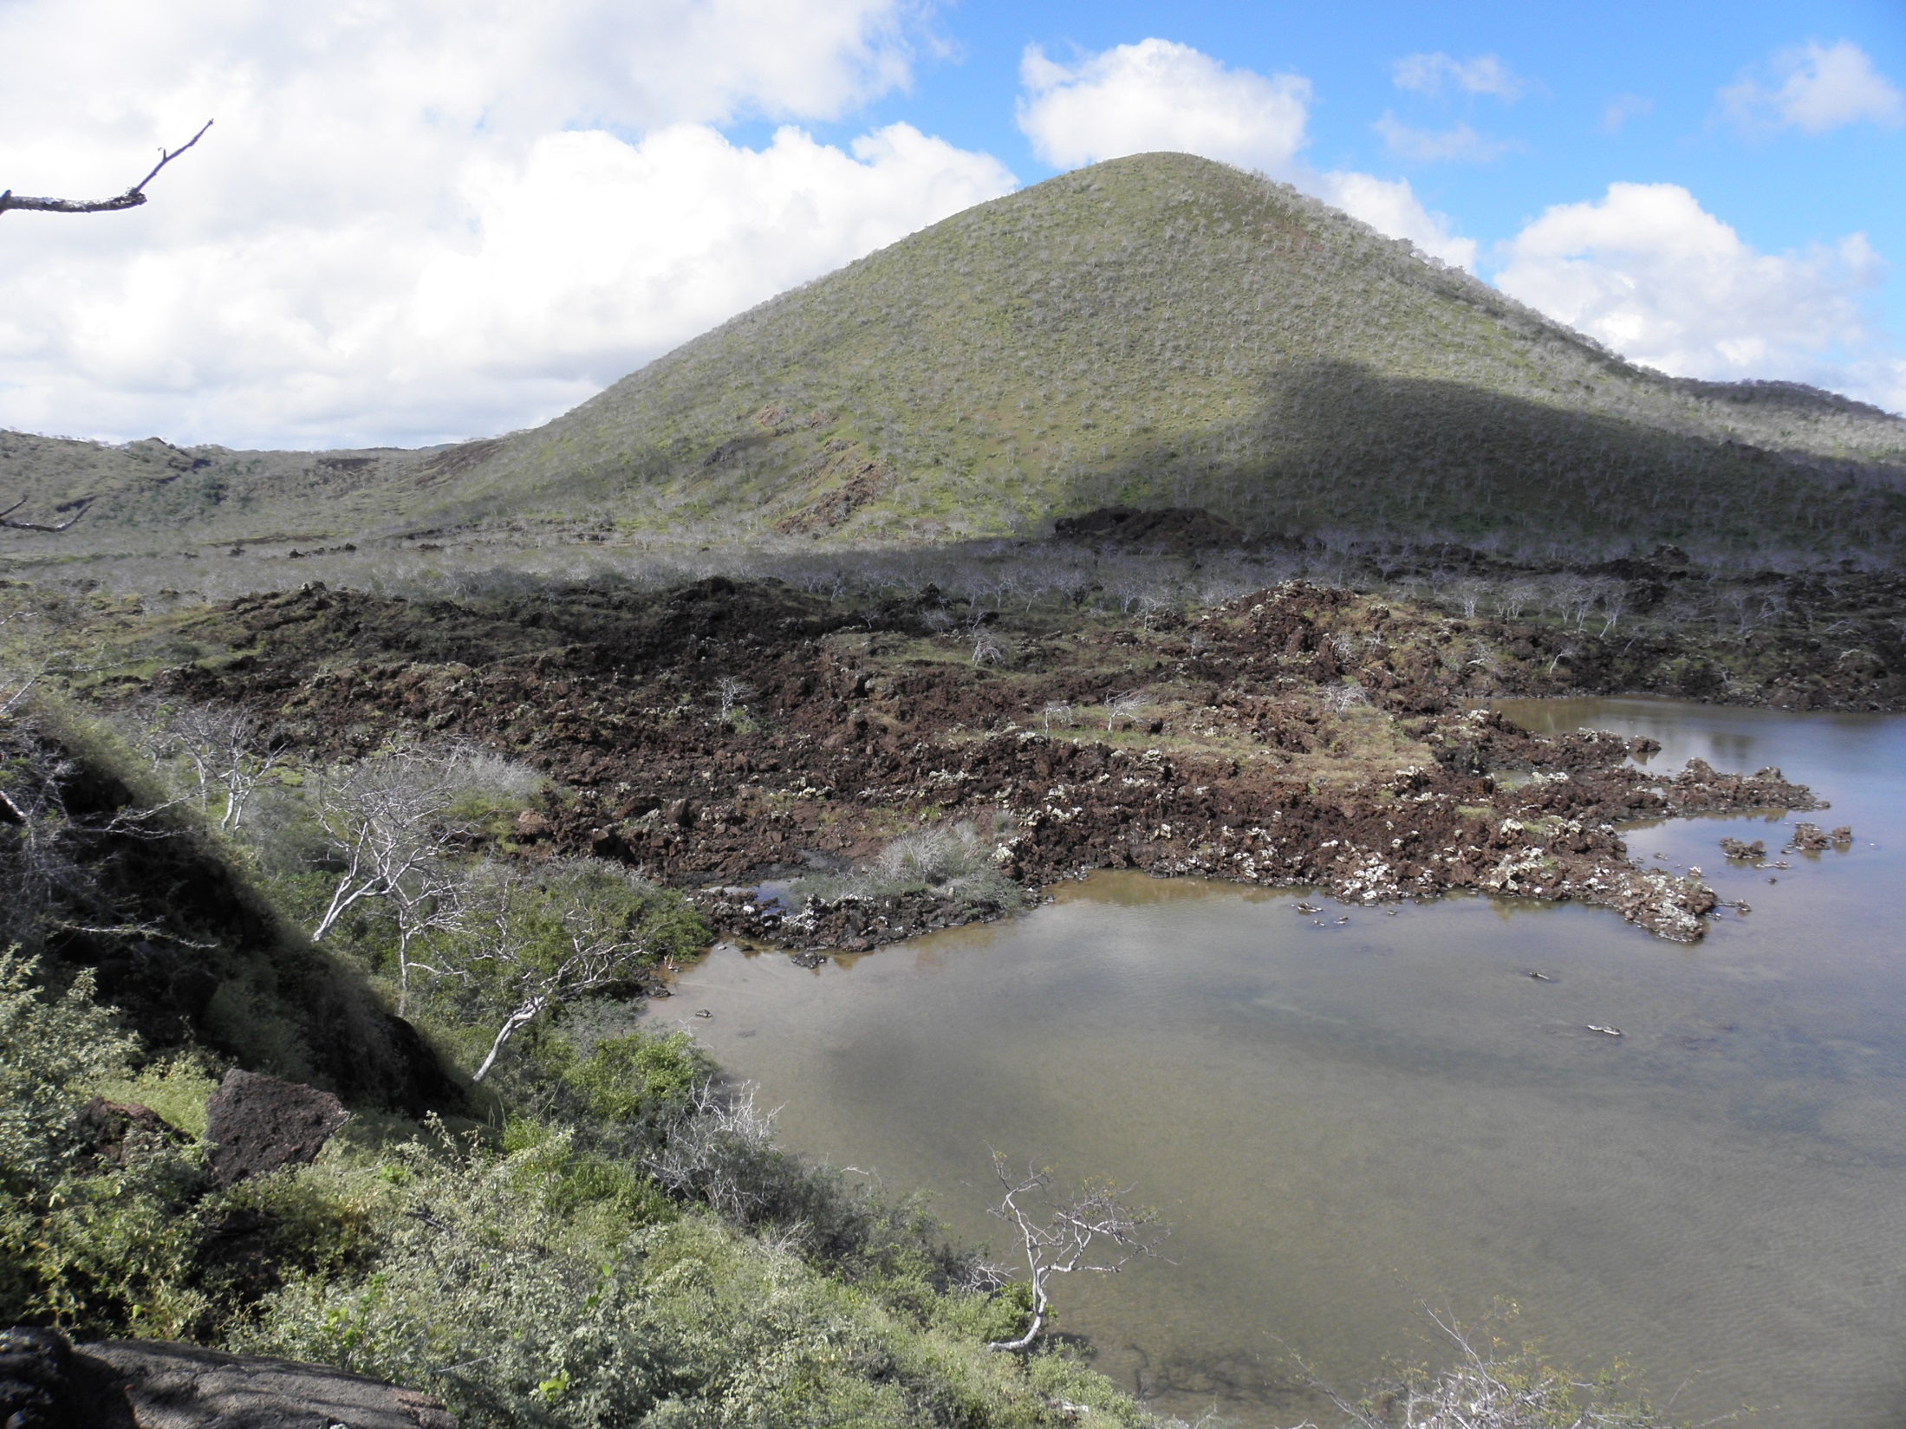

Slide 20
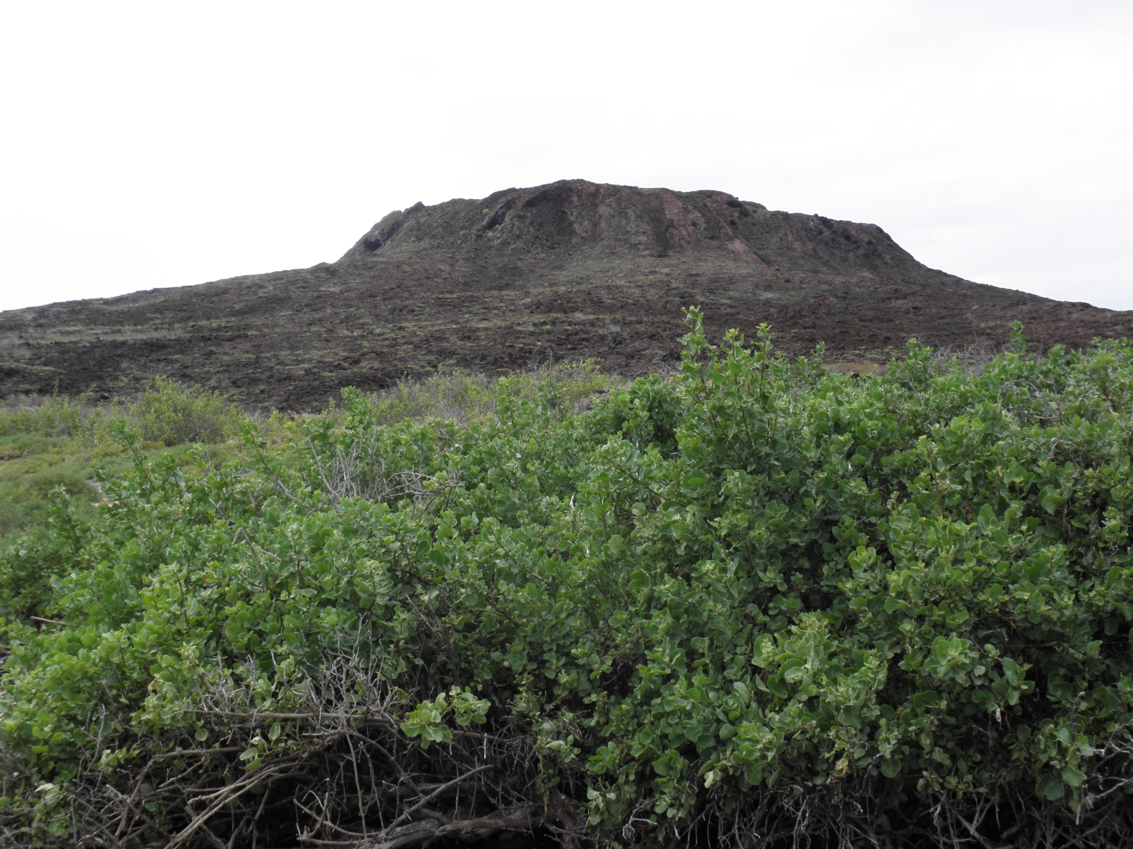

Slide 21
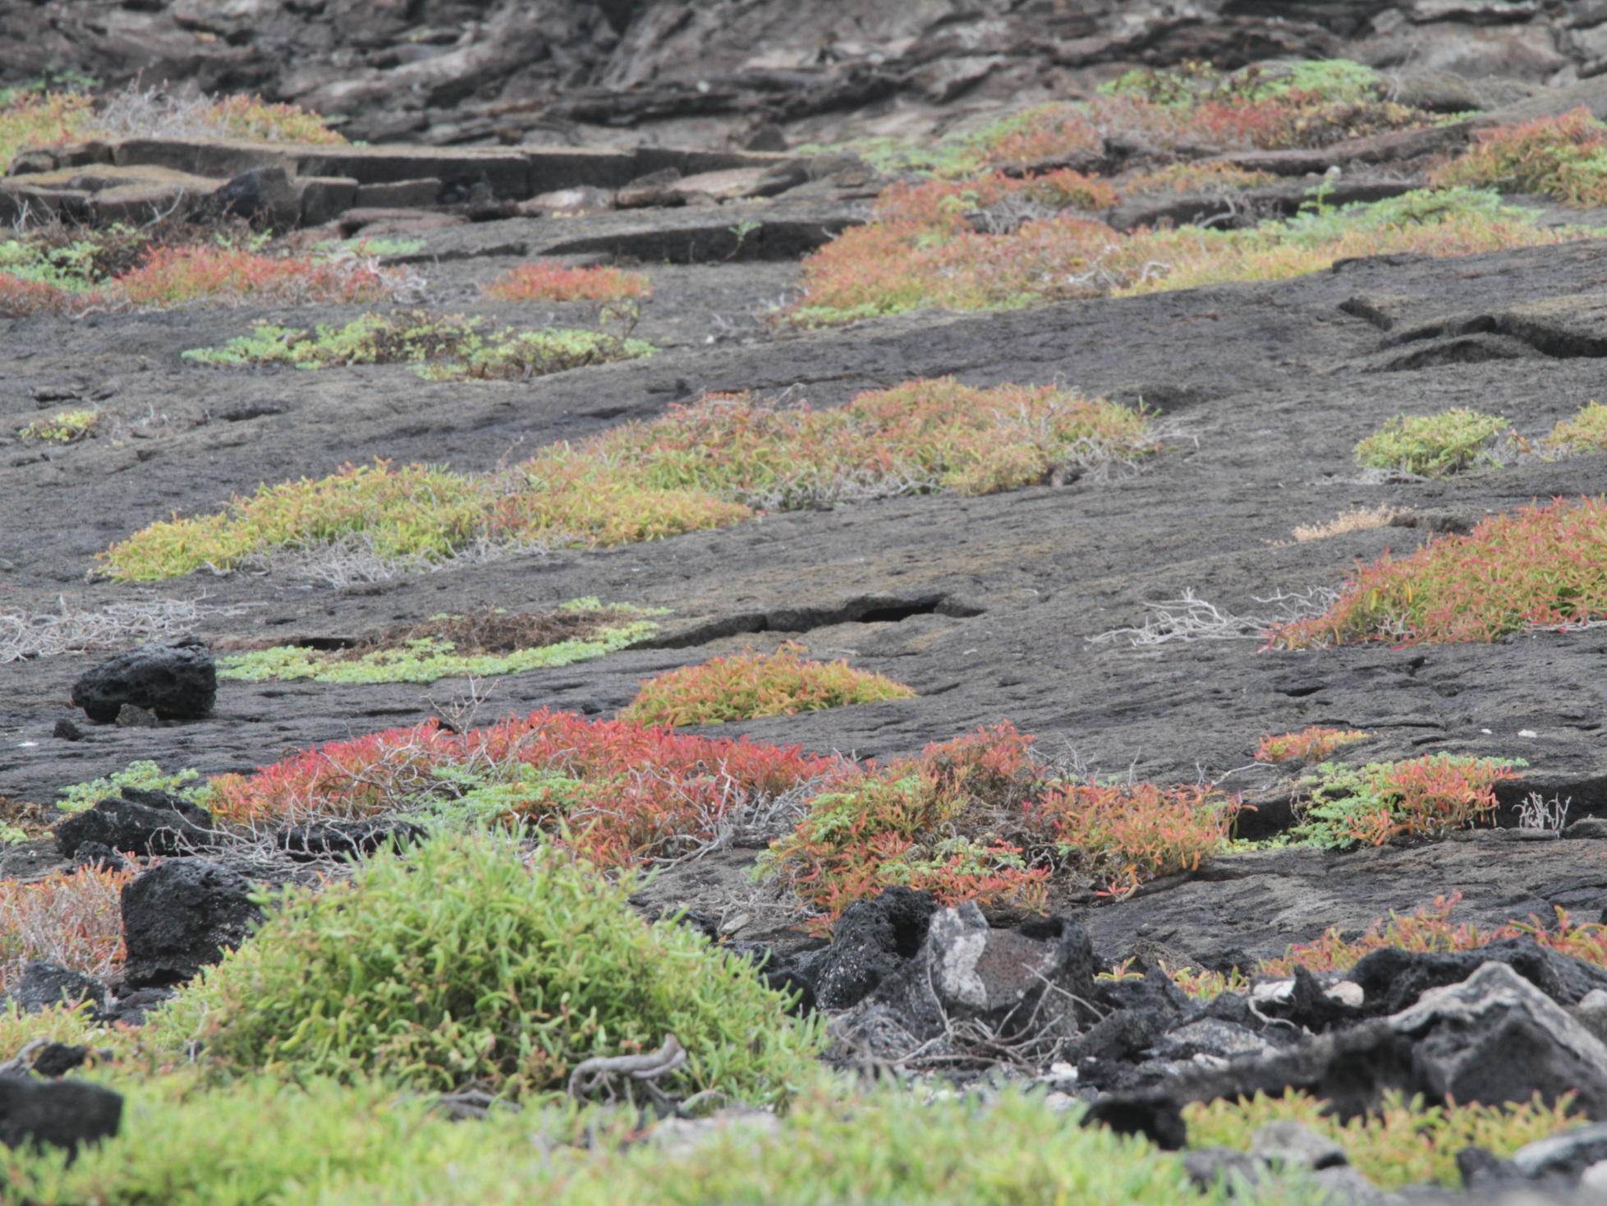

Slide 22
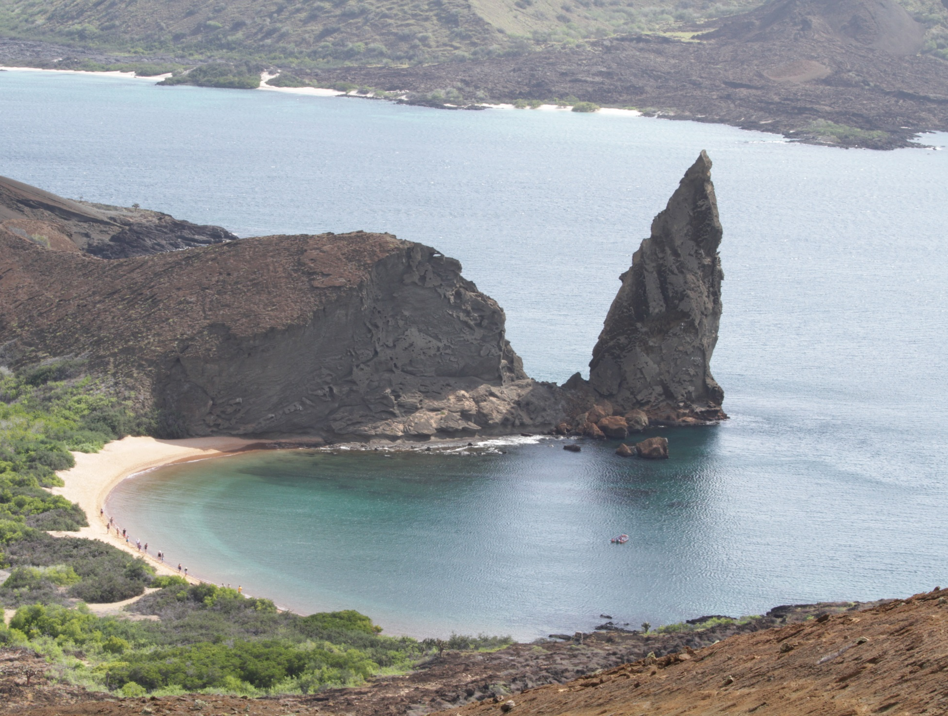

Slide 23
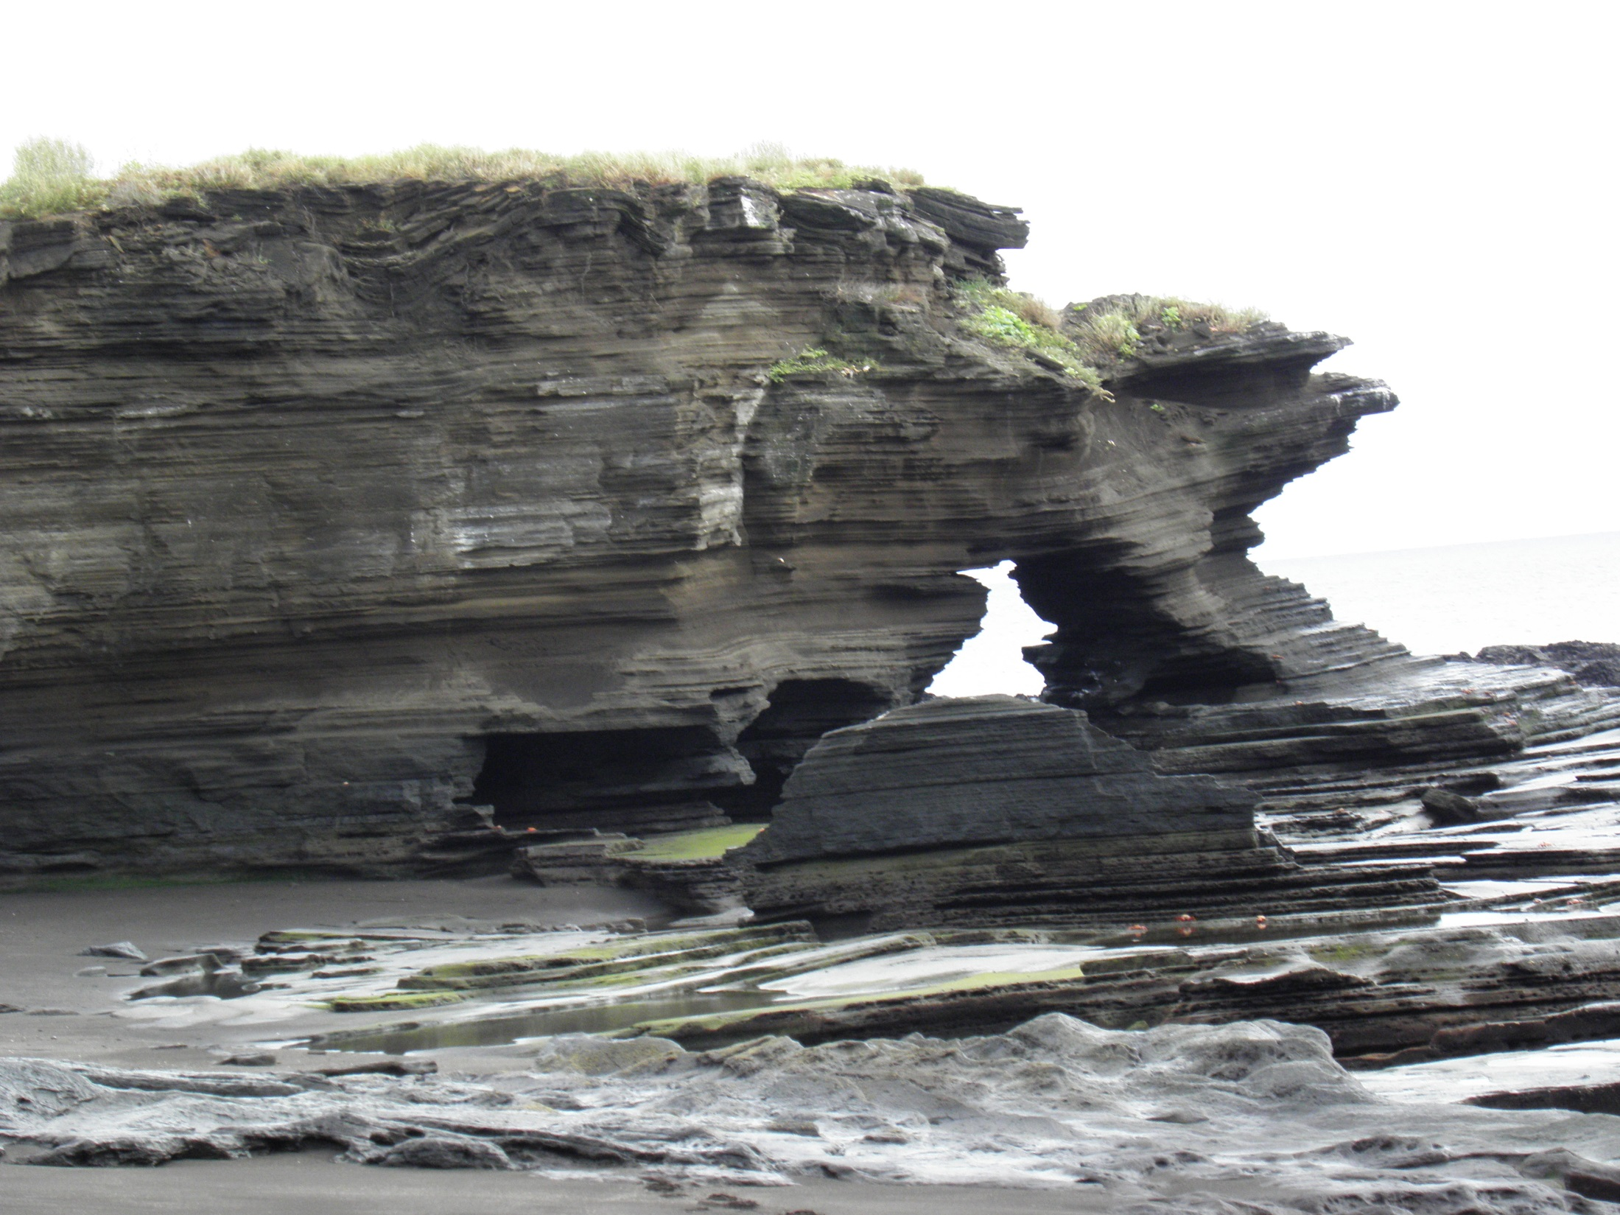

Slide 24
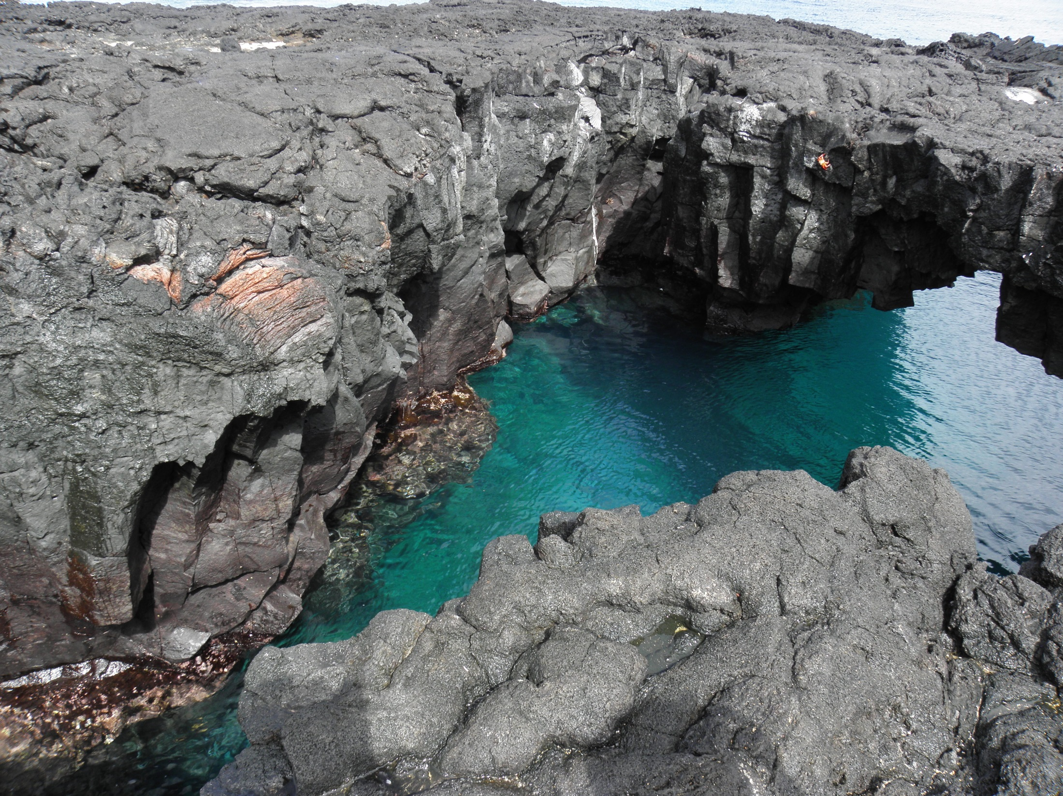

Slide 25
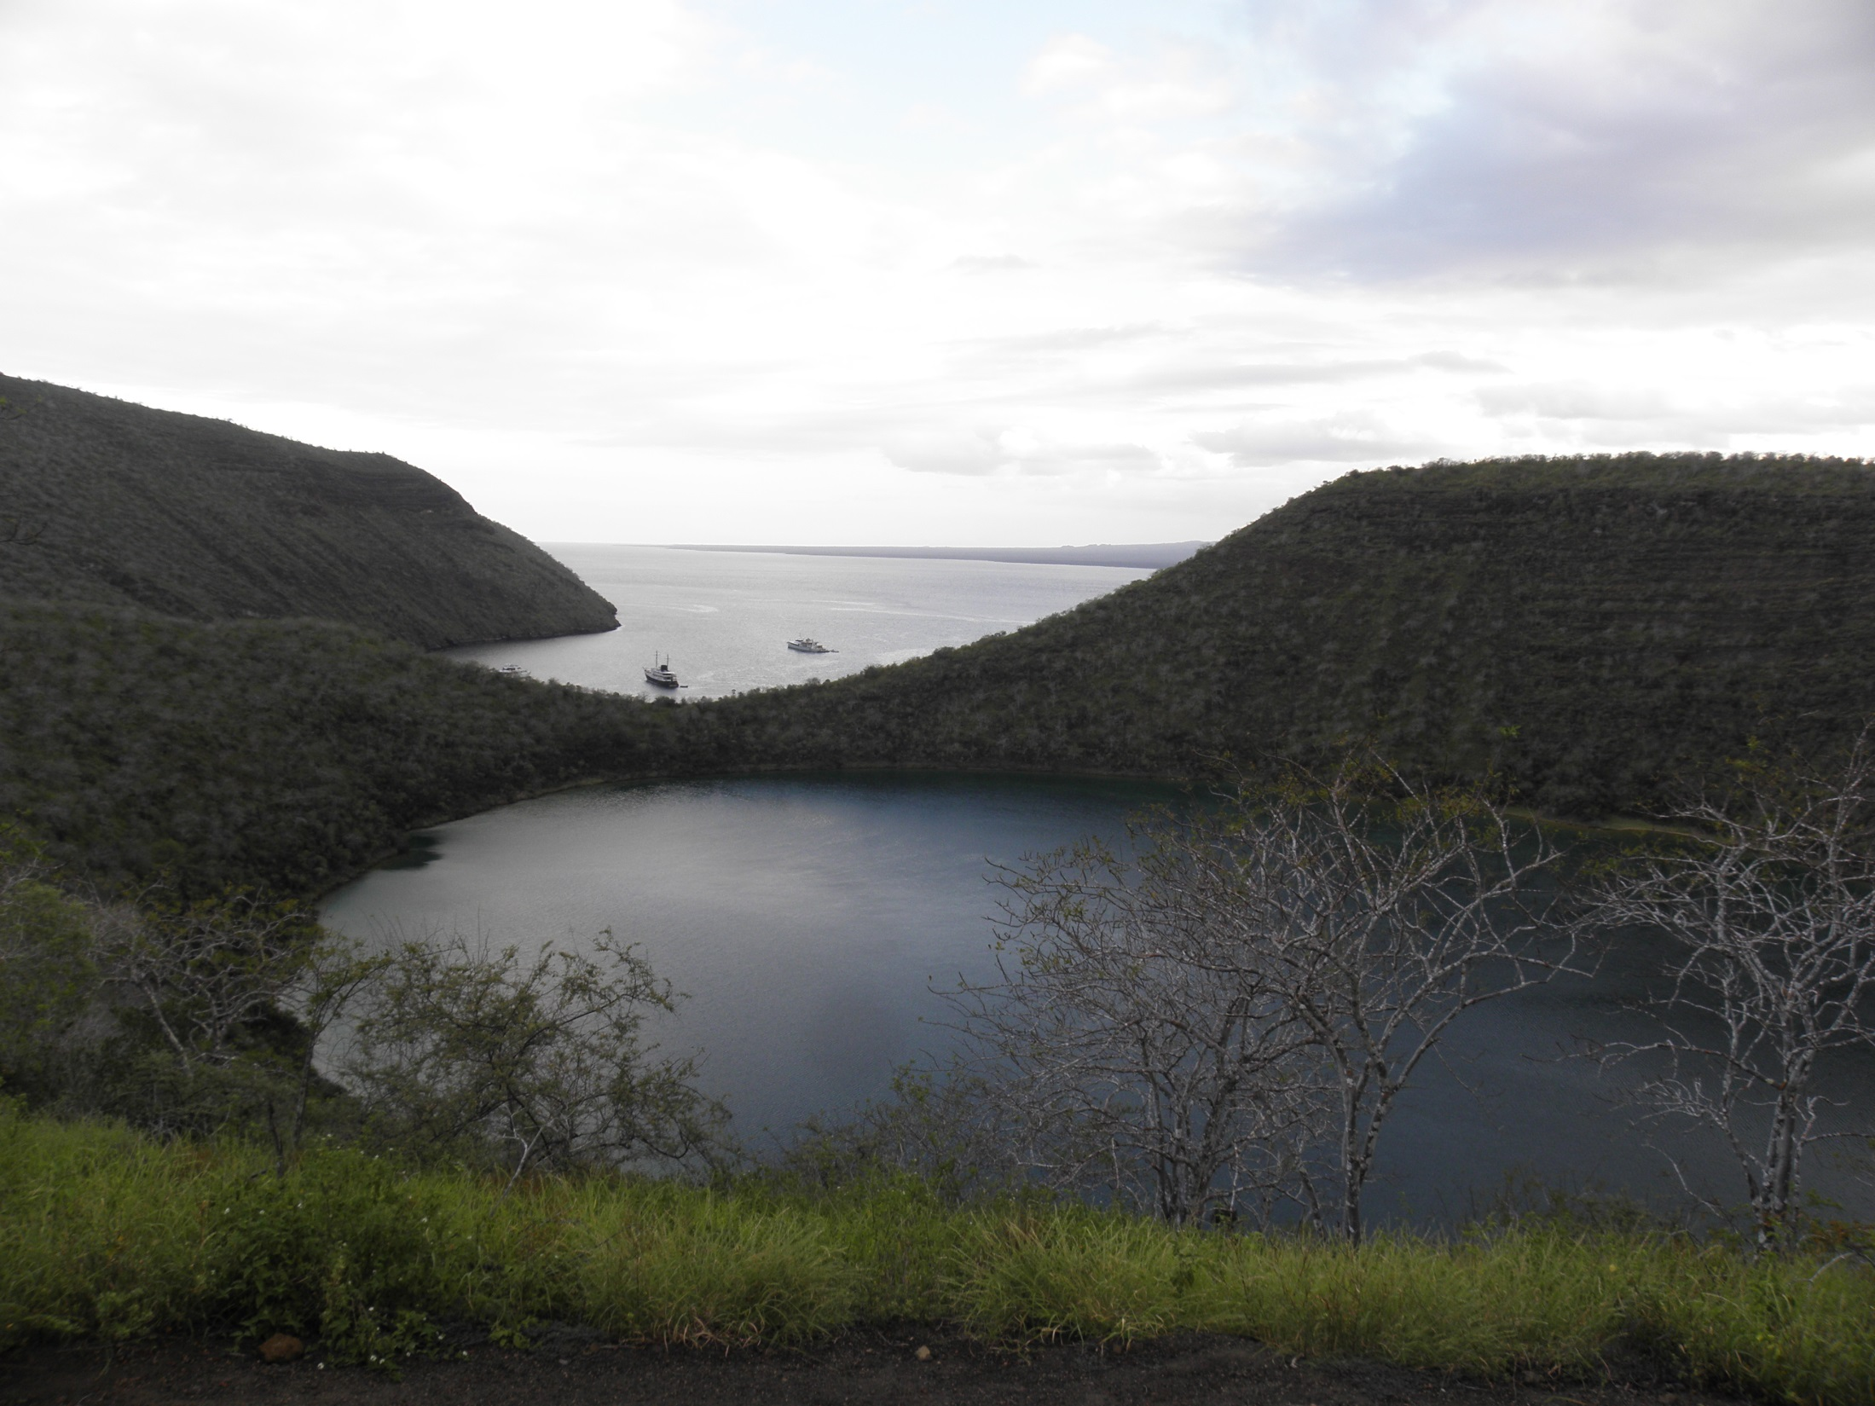

Slide 26
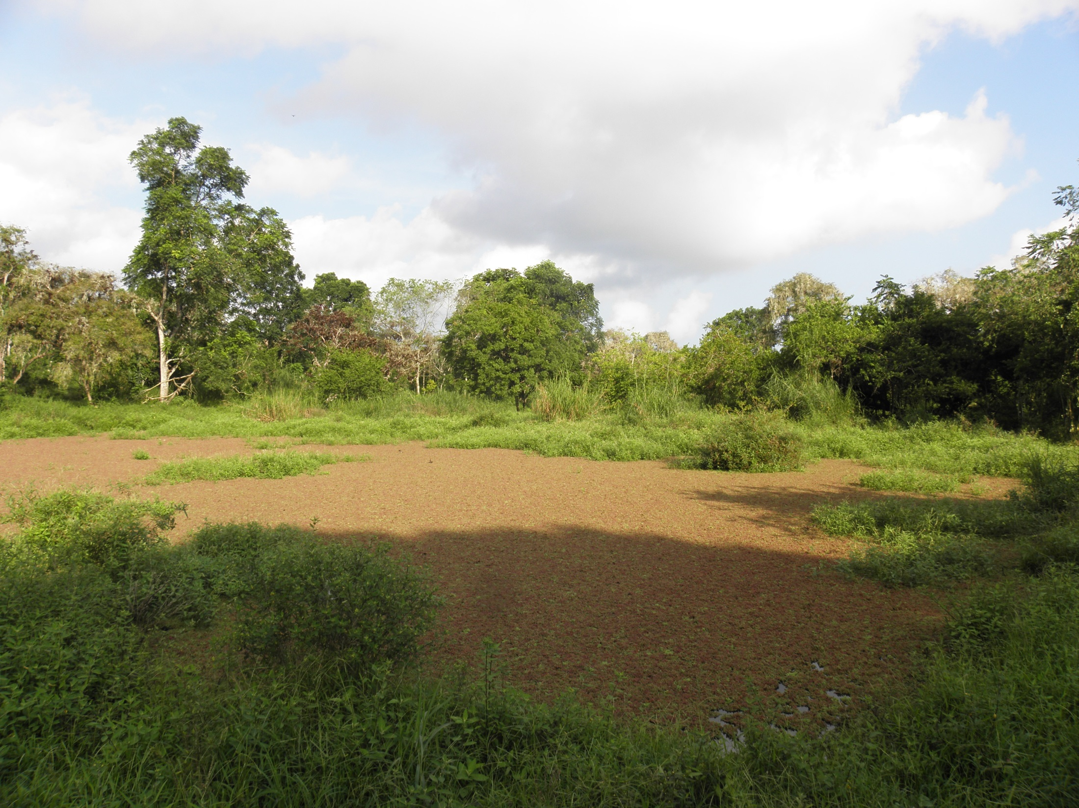
Notes:
Fresh water pond/swamp

Slide 27
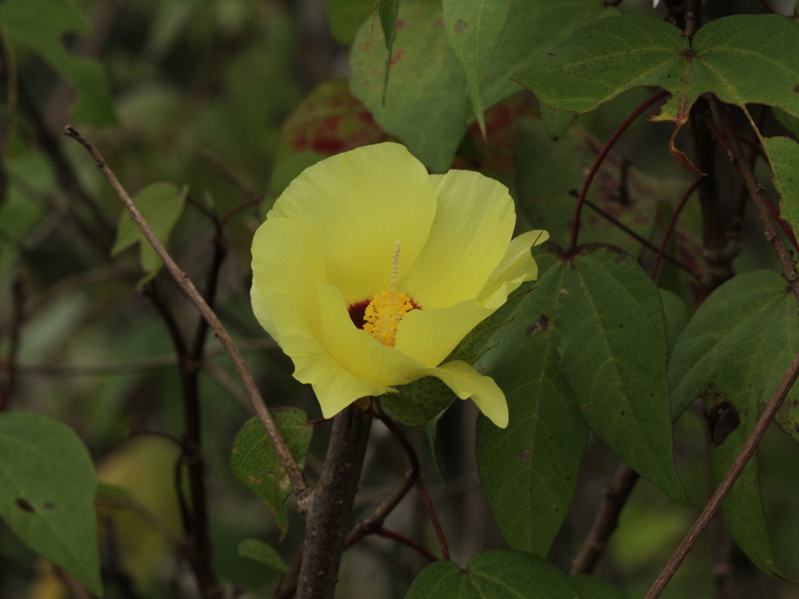
Galapagos cotton

Slide 28
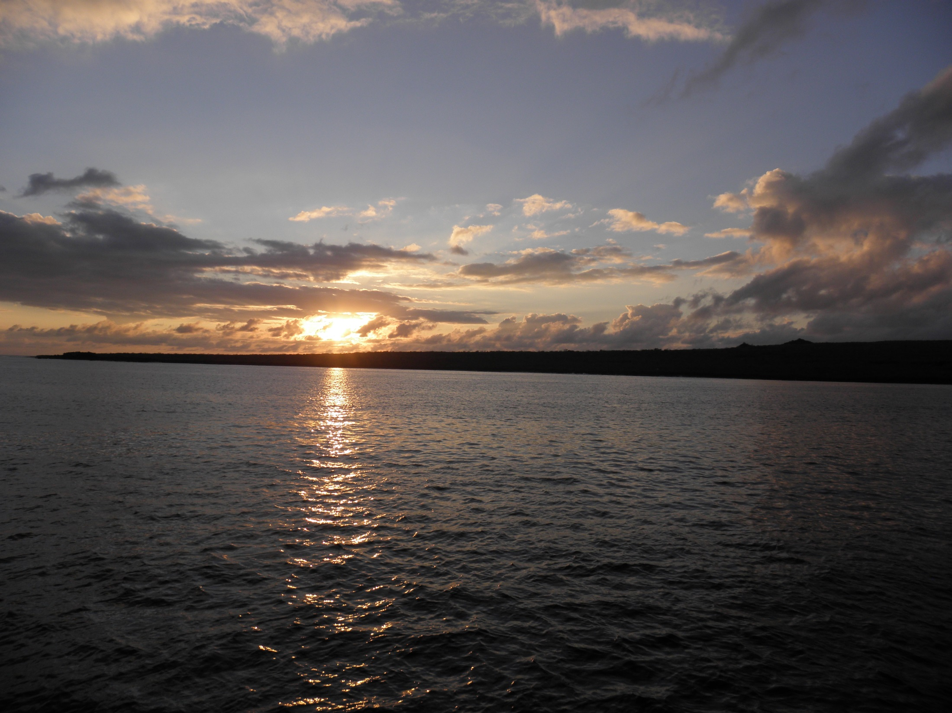

Slide 29
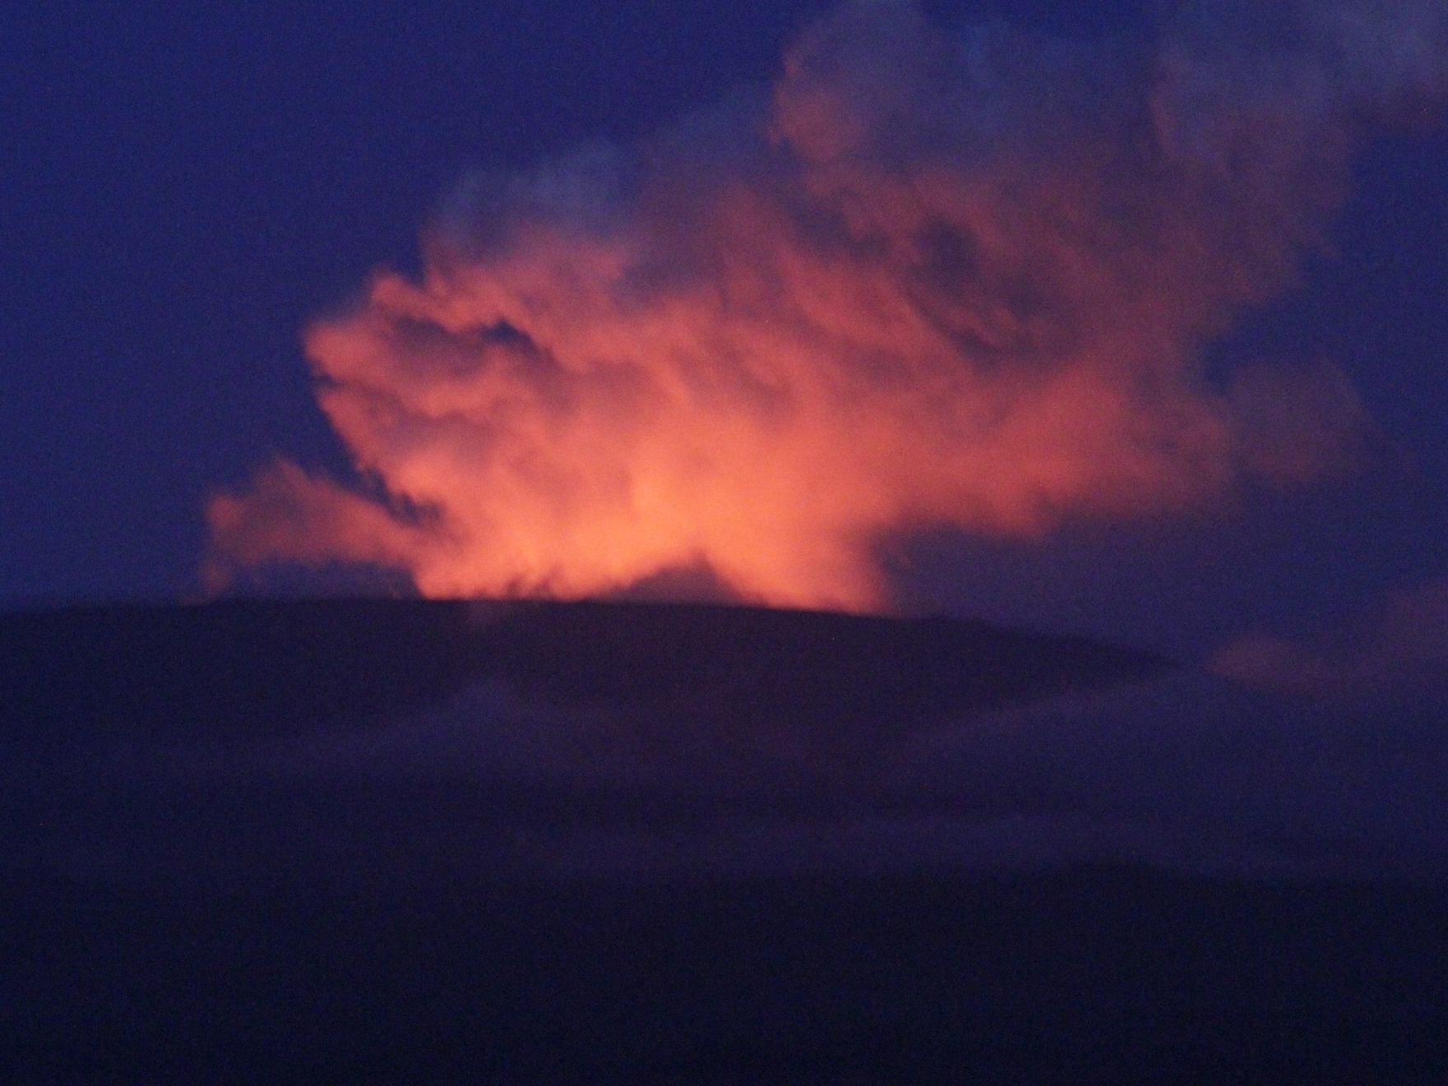

Slide 30
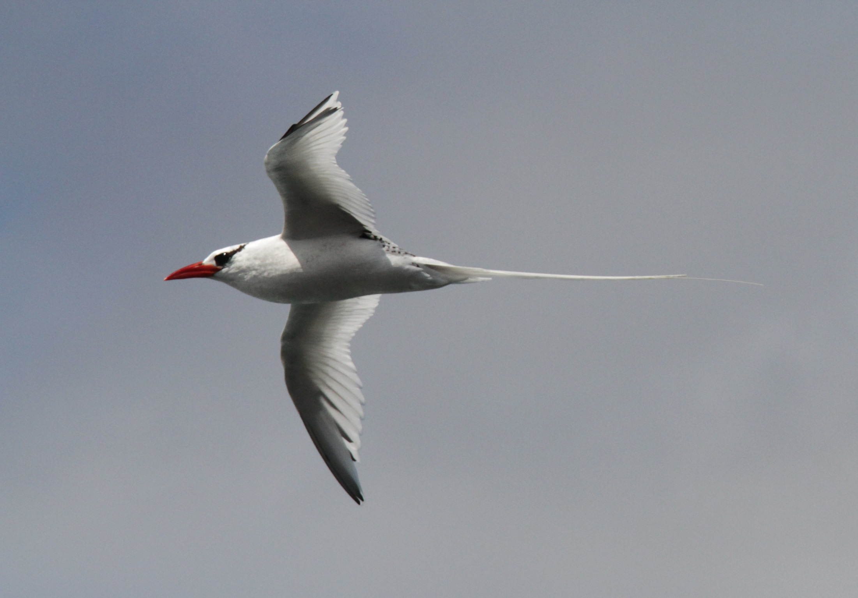
Red-billed tropicbird

Slide 31
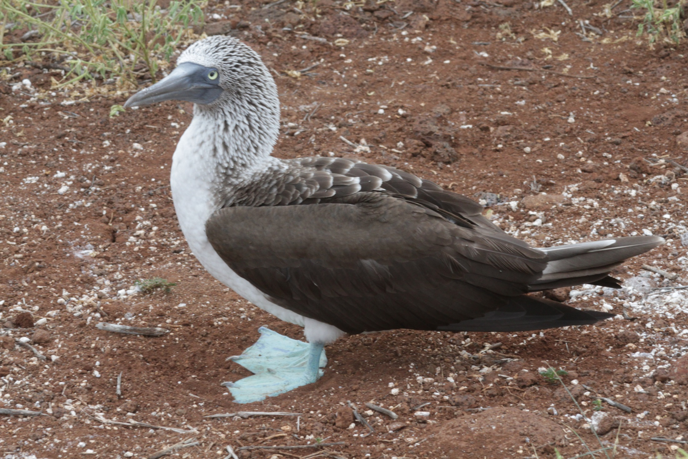
Blue-footed booby

Slide 32
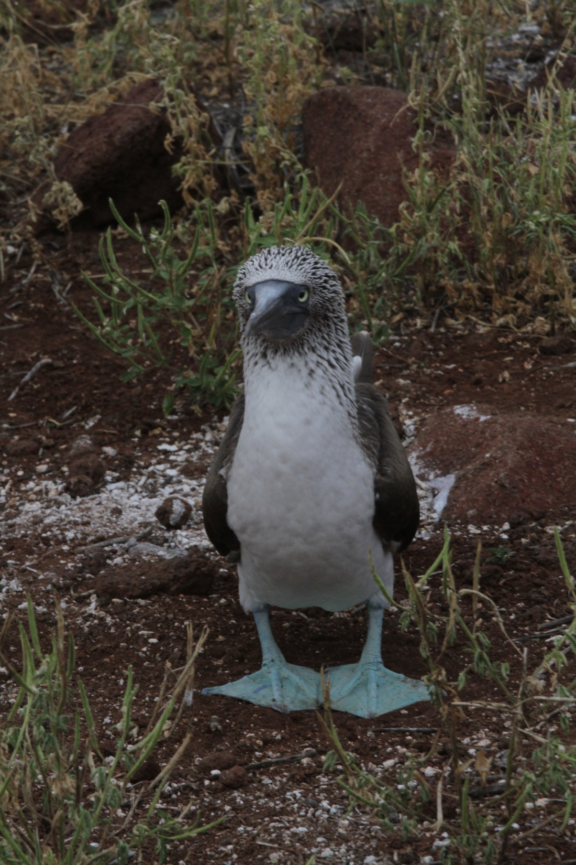
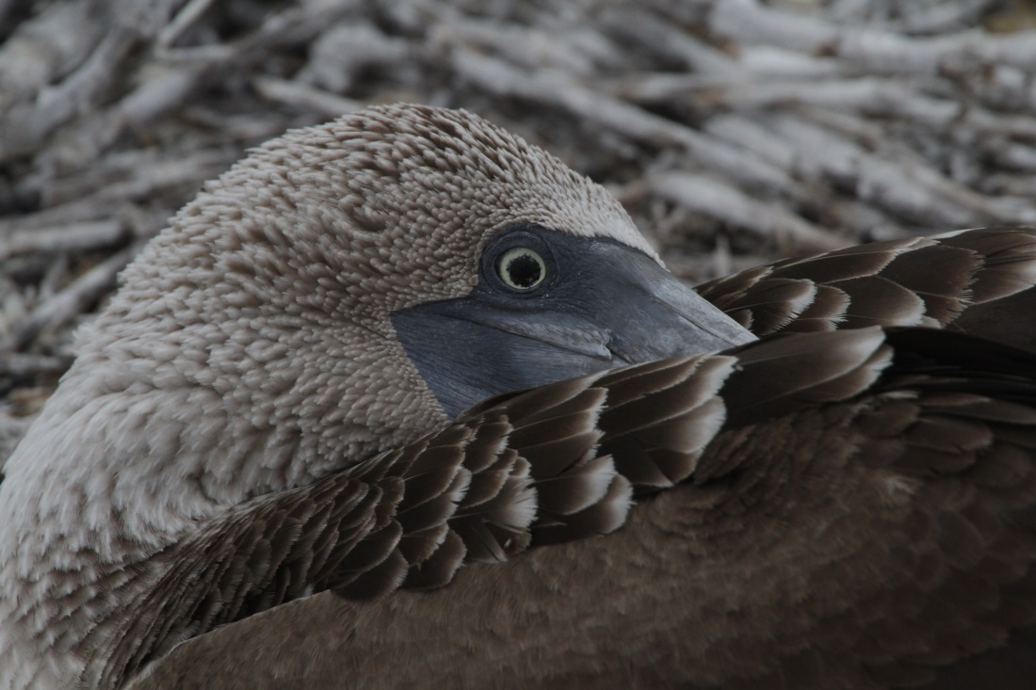
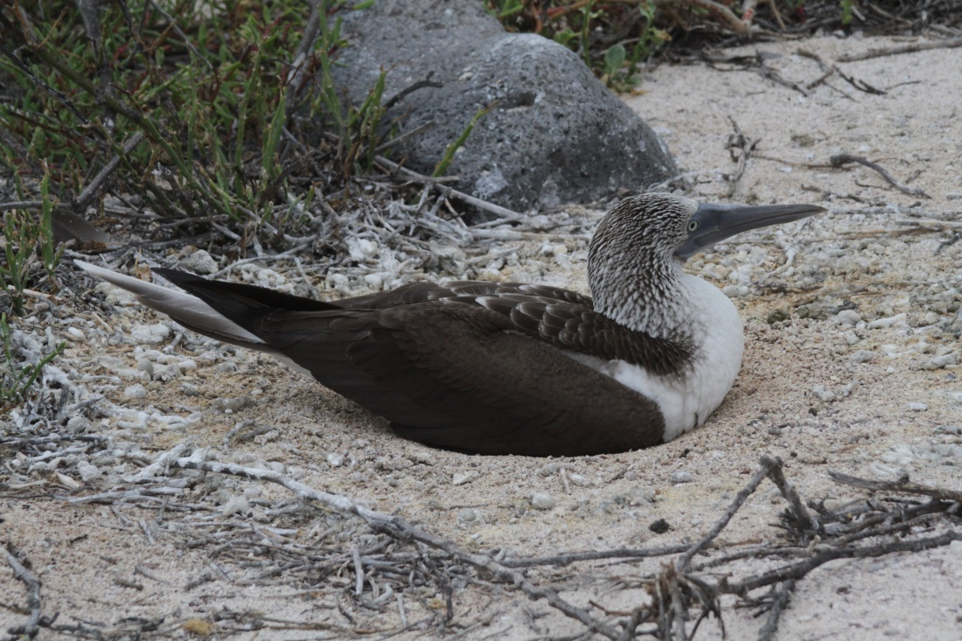
Blue-footed booby

Slide 33
Blue-footed booby

Slide 34
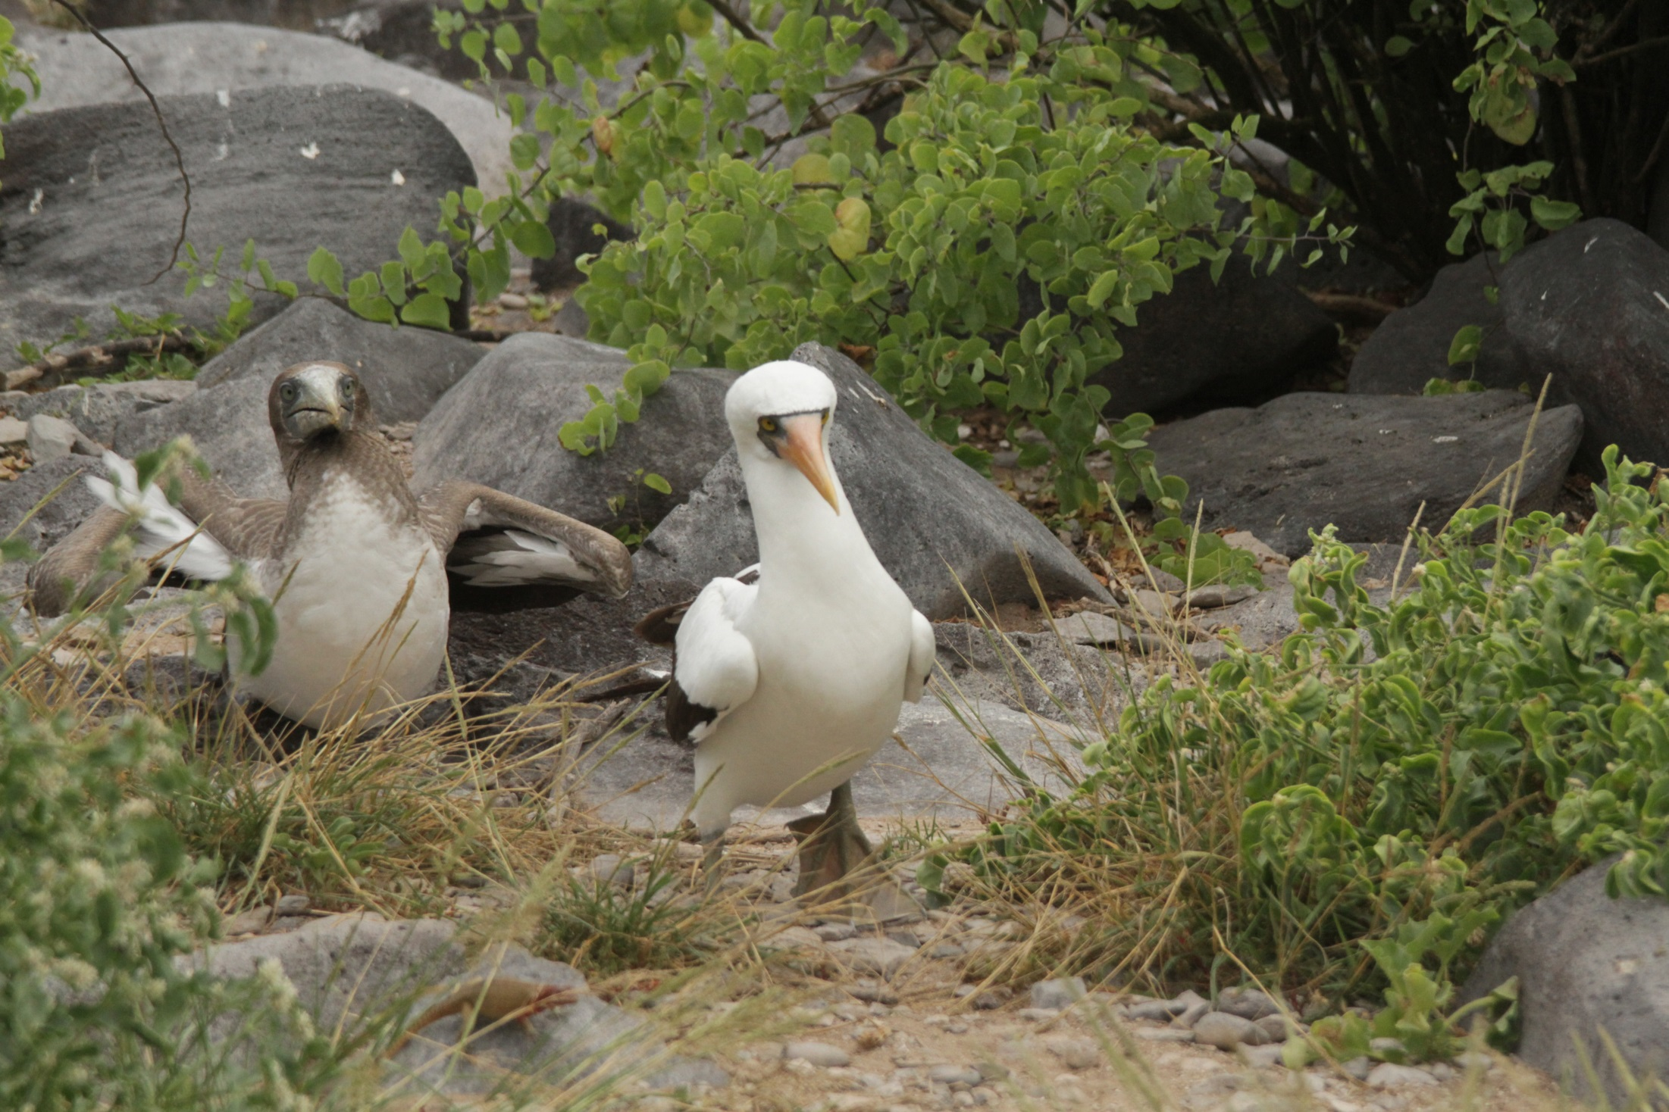
Nazca booby

Slide 35
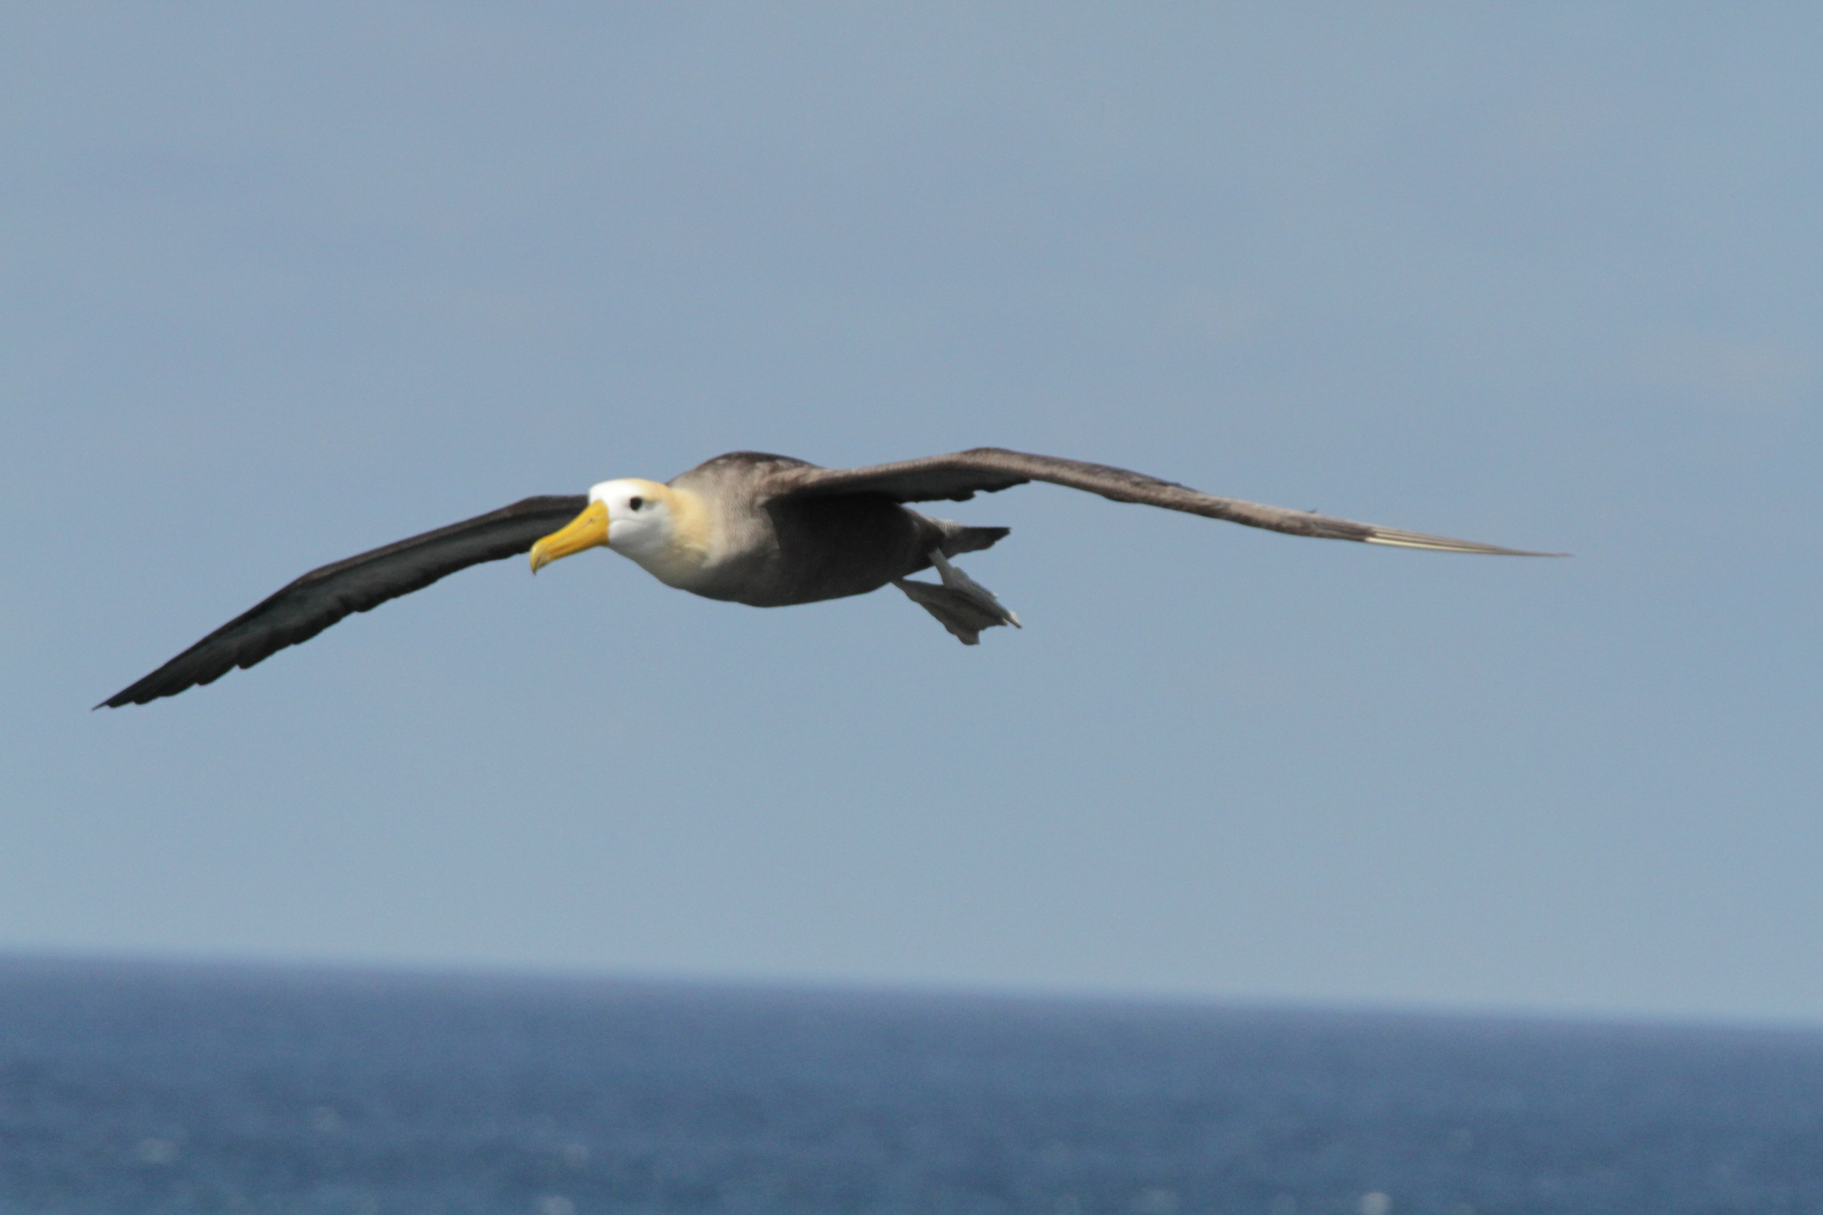
Waved albatross

Slide 36
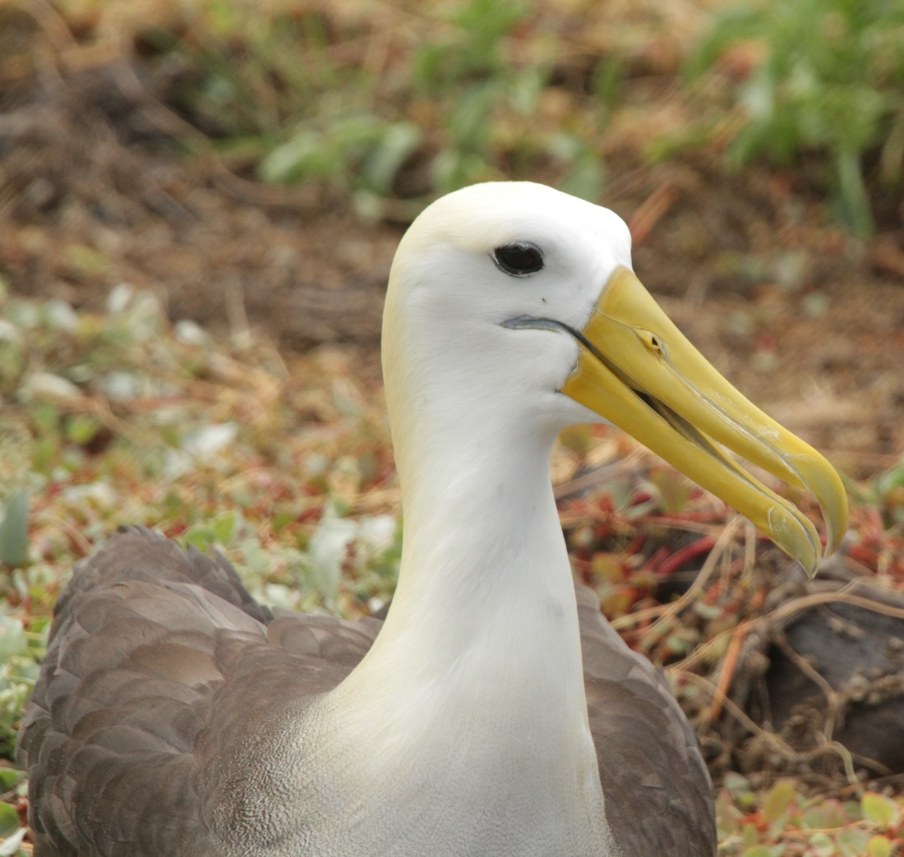
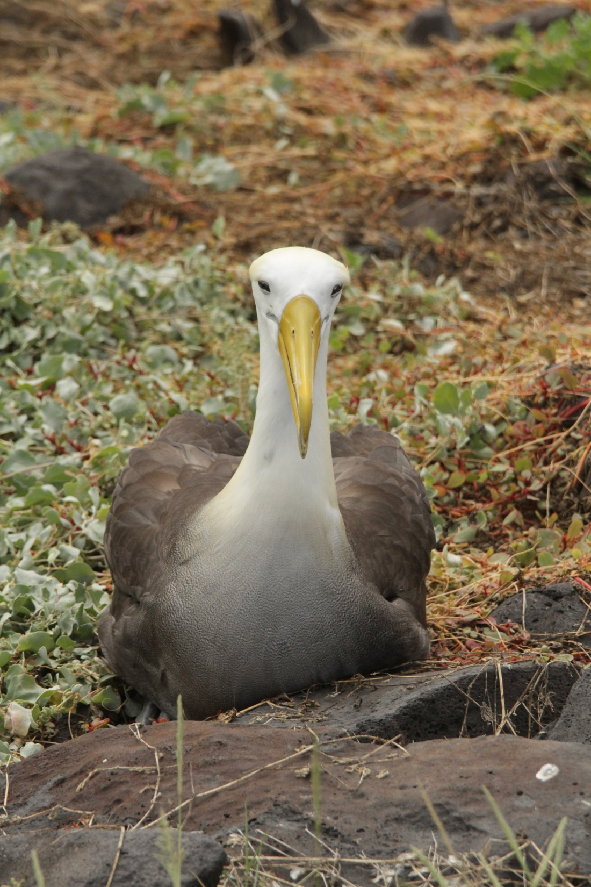
Waved albatross

Slide 37
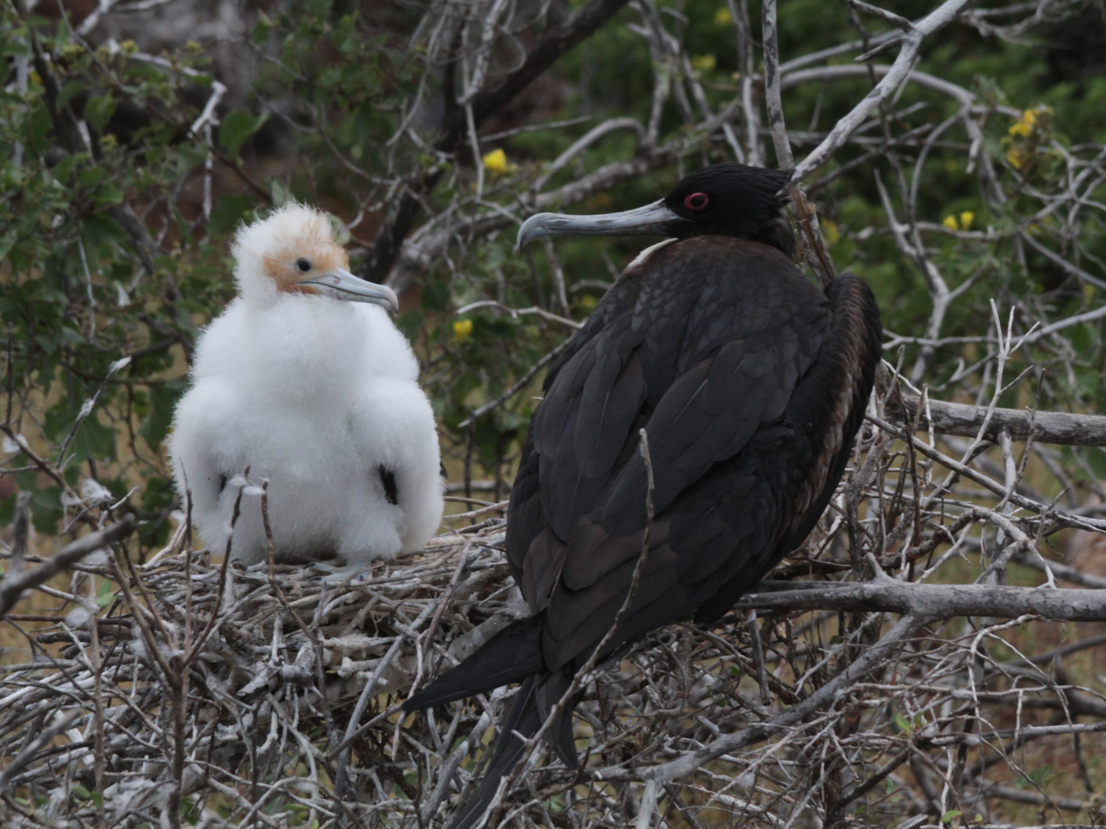
Great frigate bird

Slide 38
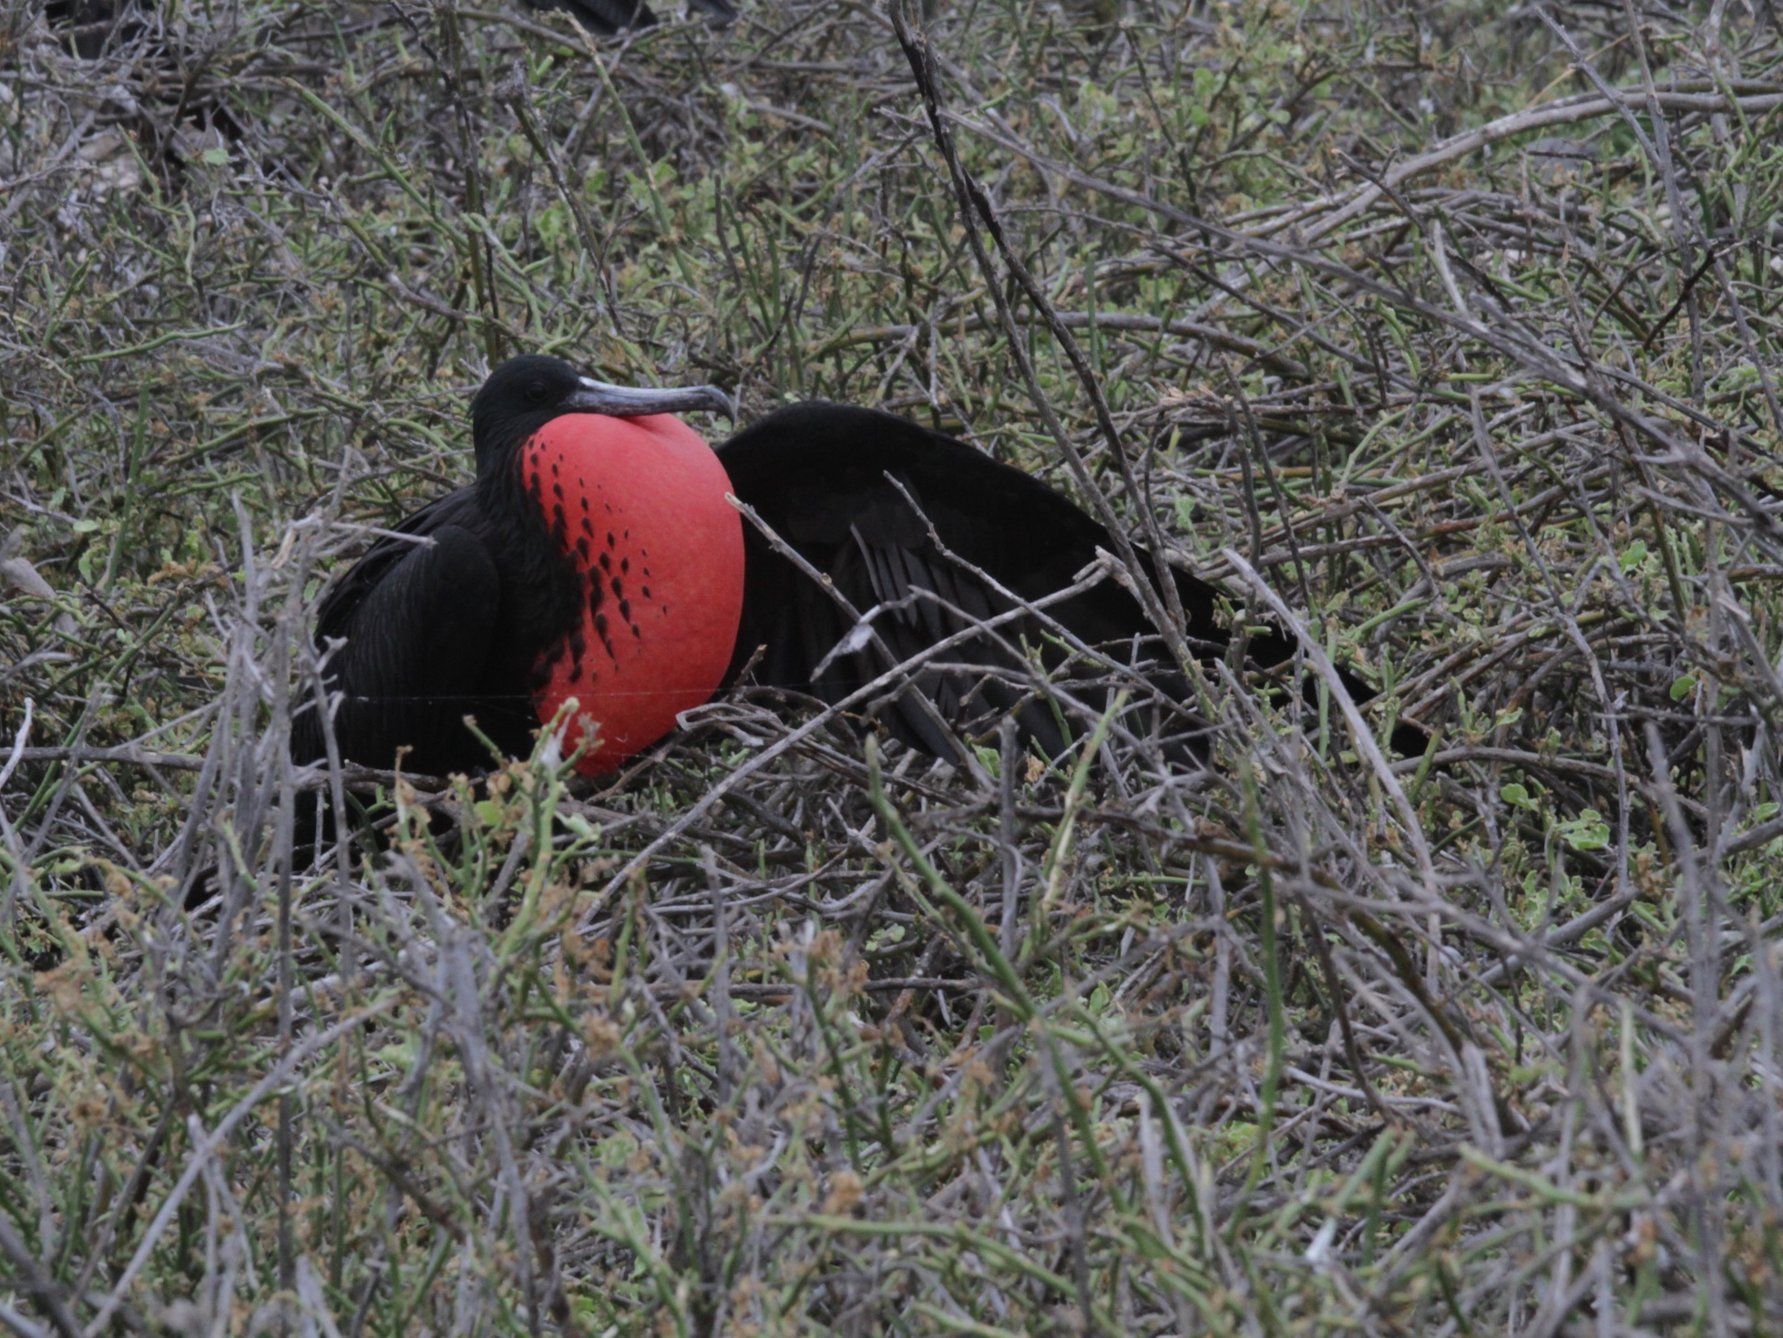
Magnificent frigate bird
Notes:
South Seymour Island

Slide 39
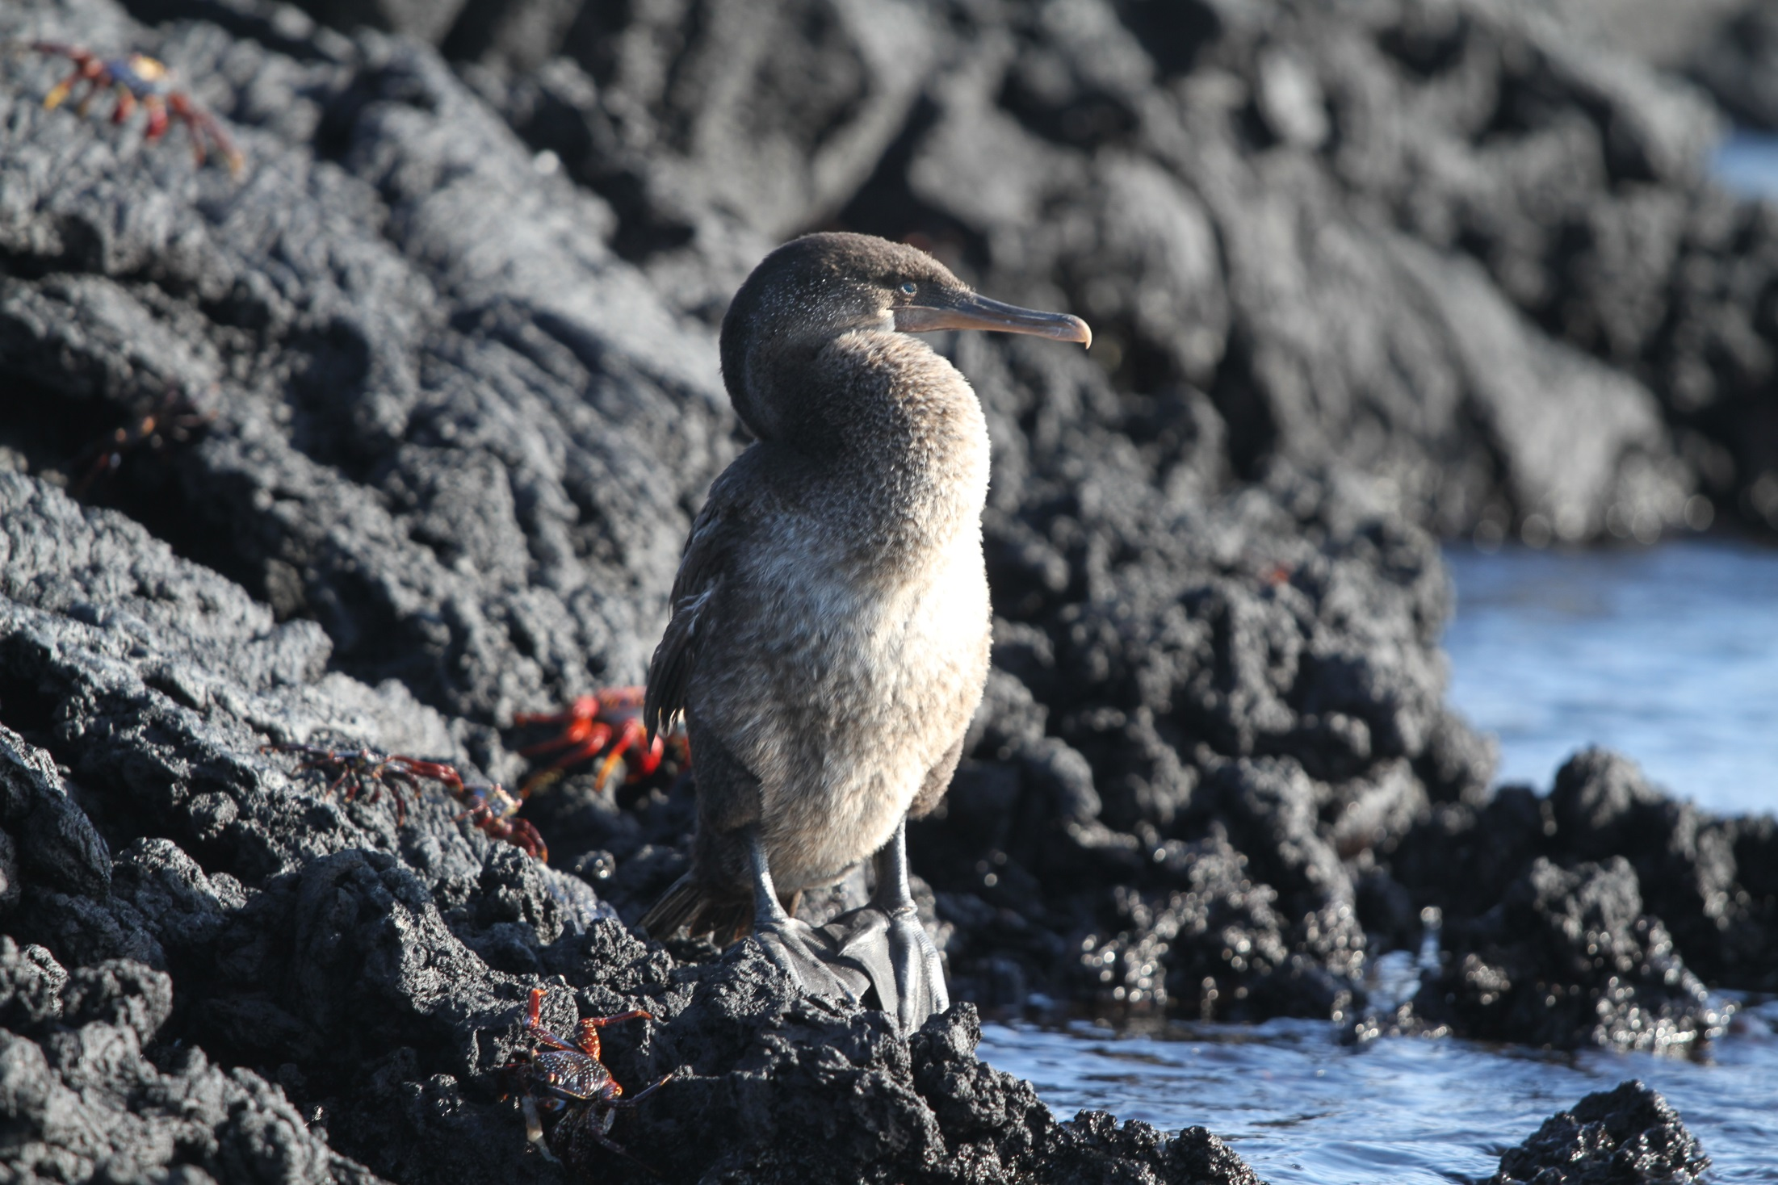
Flightless cormorant

Slide 40
Galapagos penguin

Slide 41
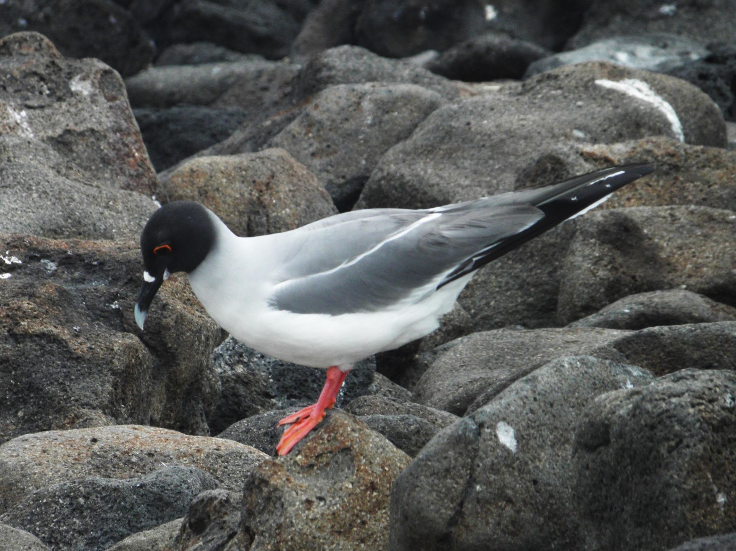
Swallow-tailed gull

Slide 42
Lava gull

Slide 43
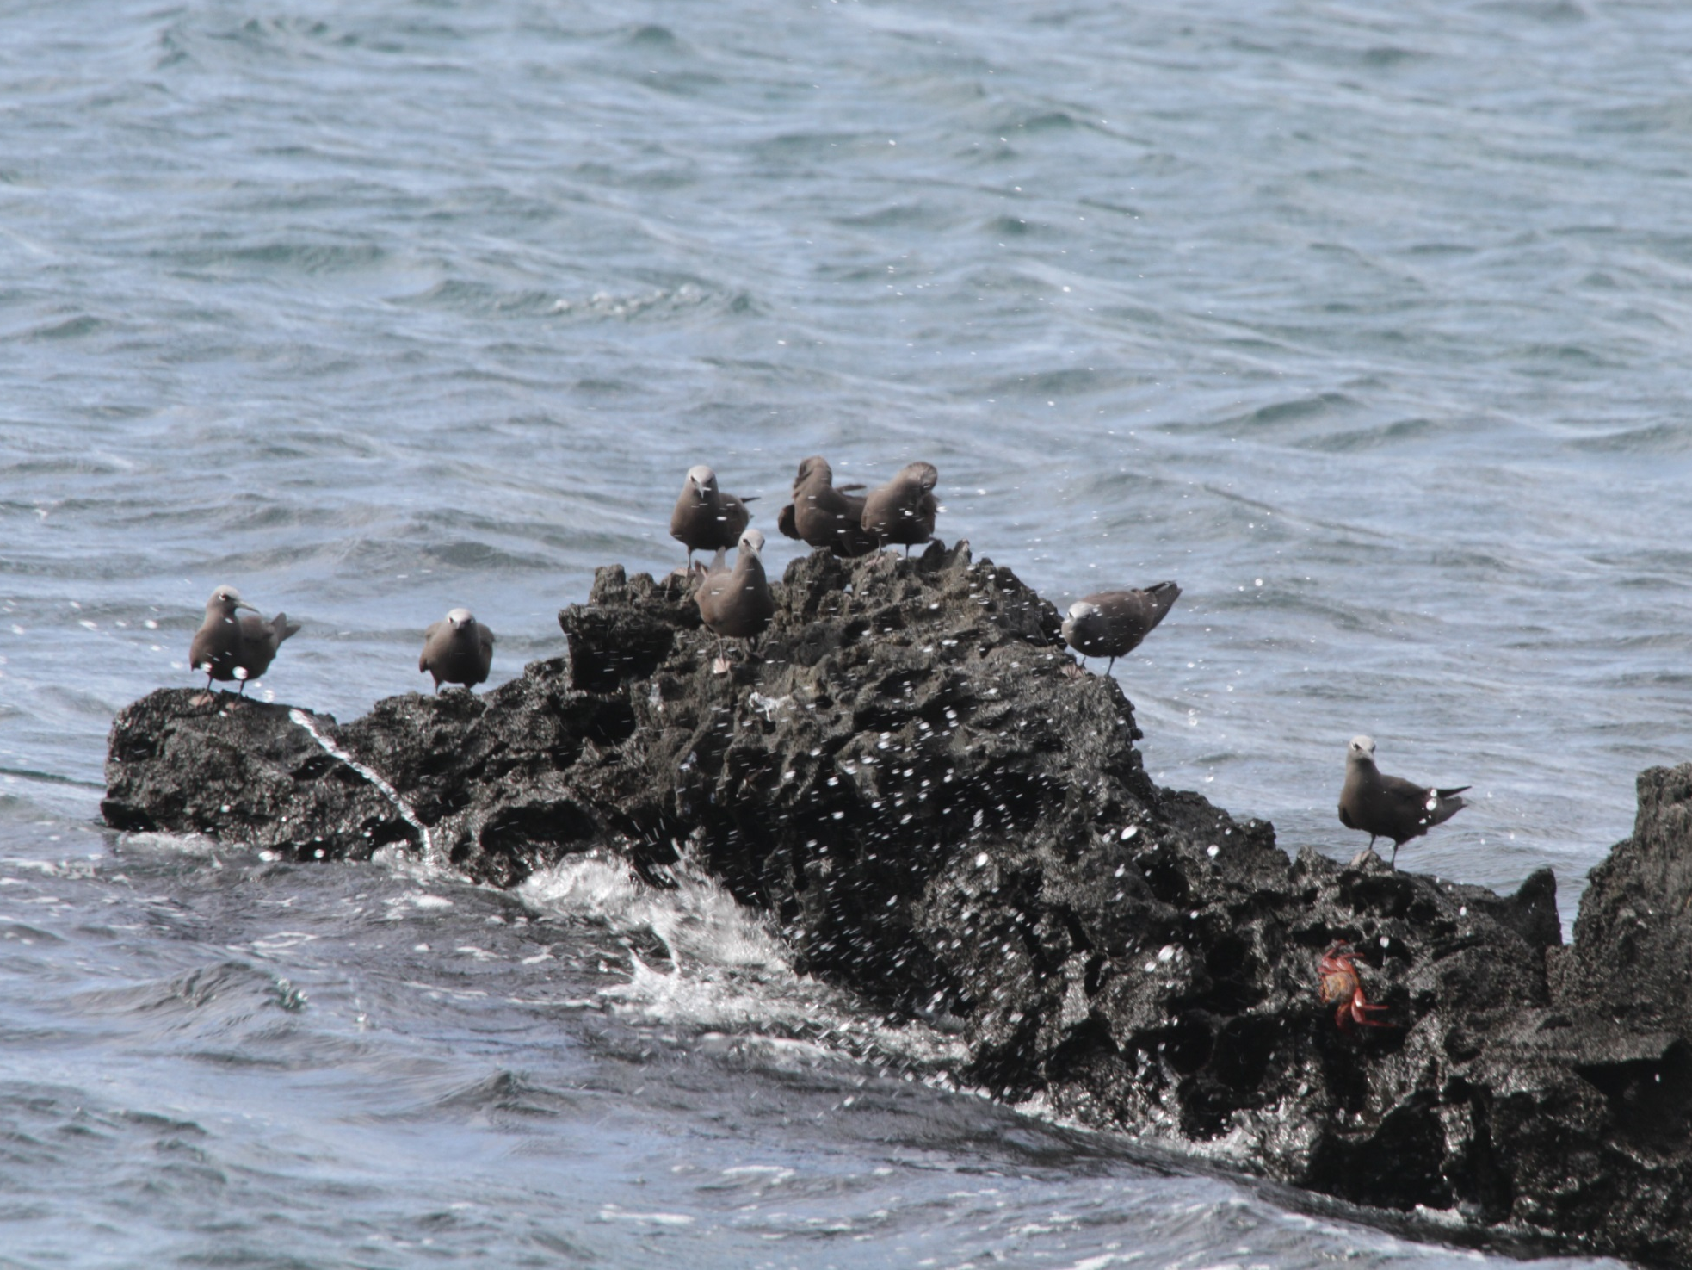
Brown noddy tern
Notes:
Bartolome

Slide 44
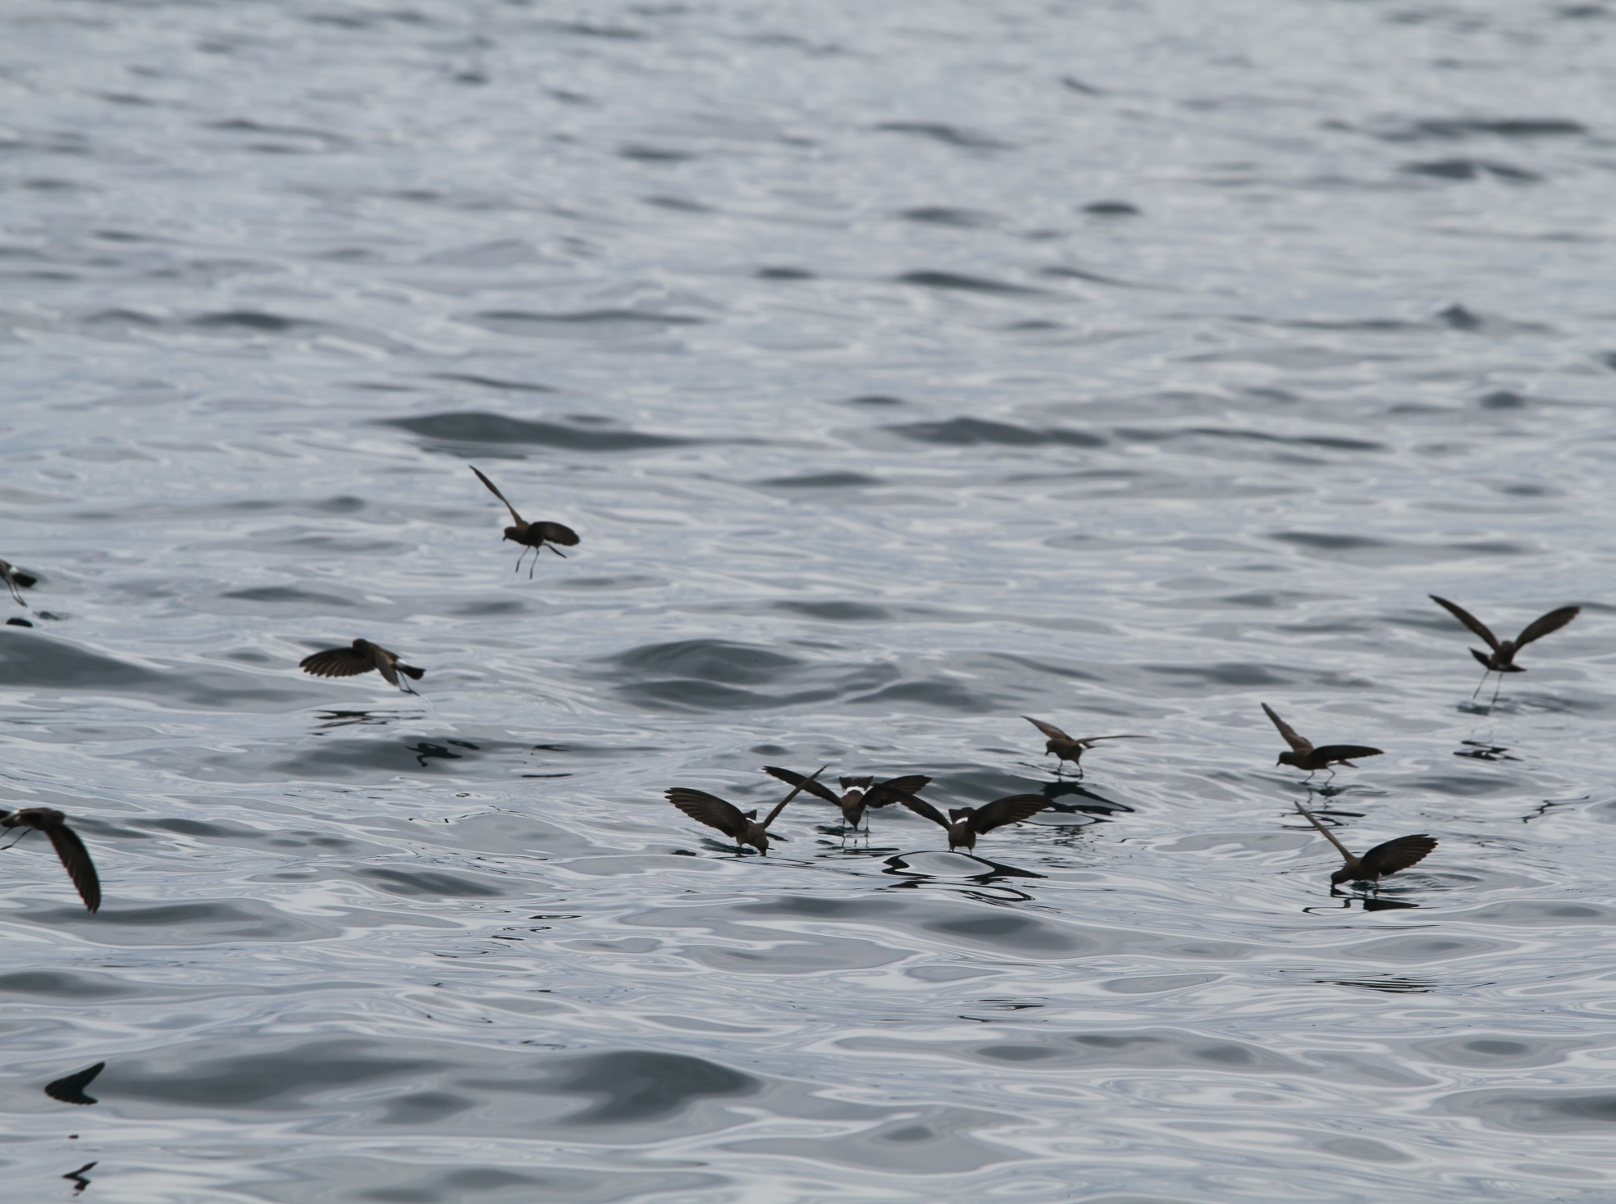
Elliot’s storm petrel

Slide 45
Galapagos shearwater
Notes:
Isla Isabella

Slide 46
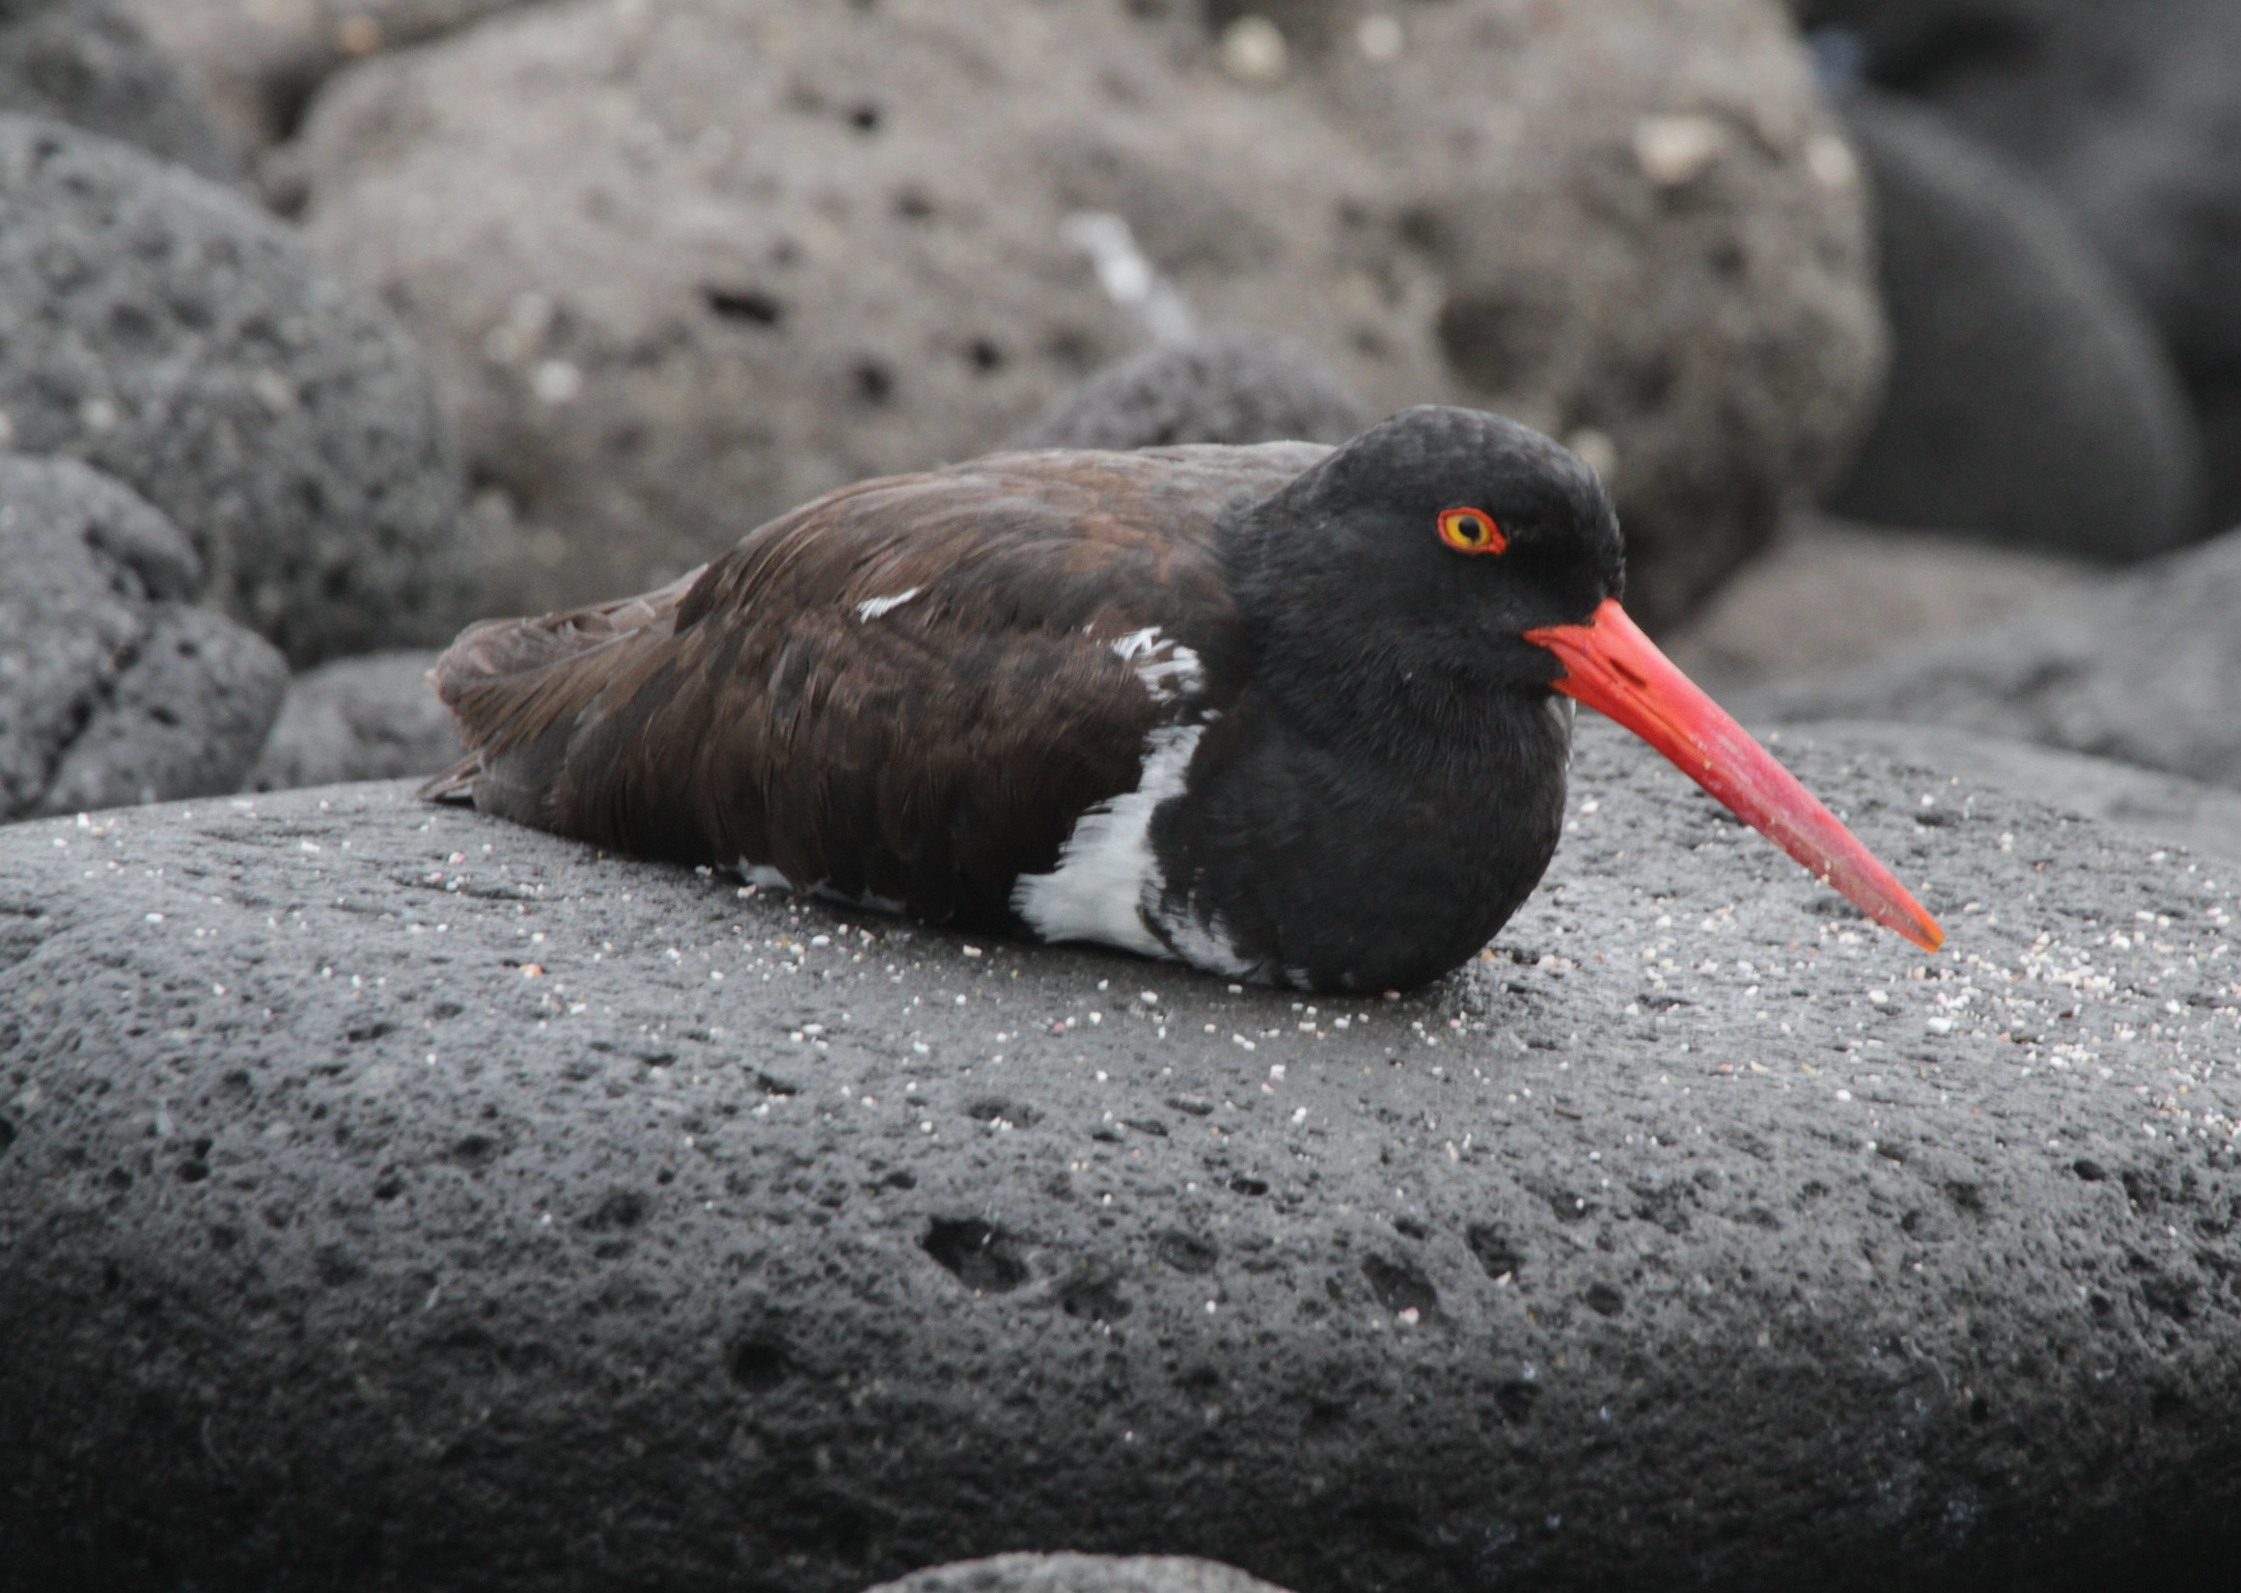
American oyster catcher

Slide 47
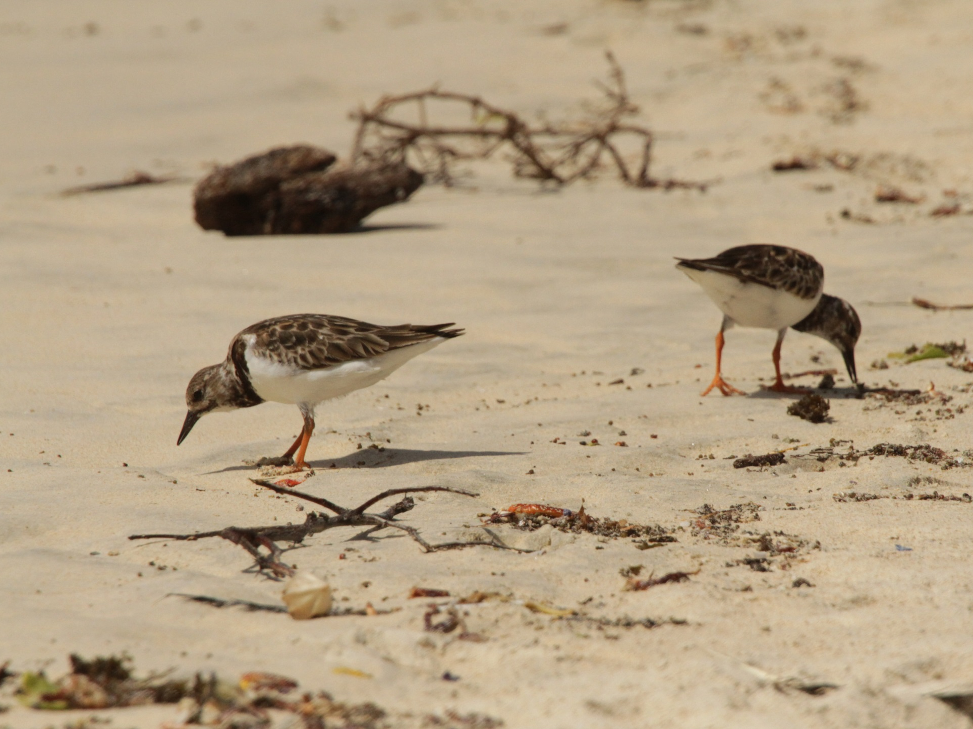
Ruddy turnstone

Slide 48
Ruddy turnstone and Wandering tattler

Slide 49
Common moorhen male

Slide 50
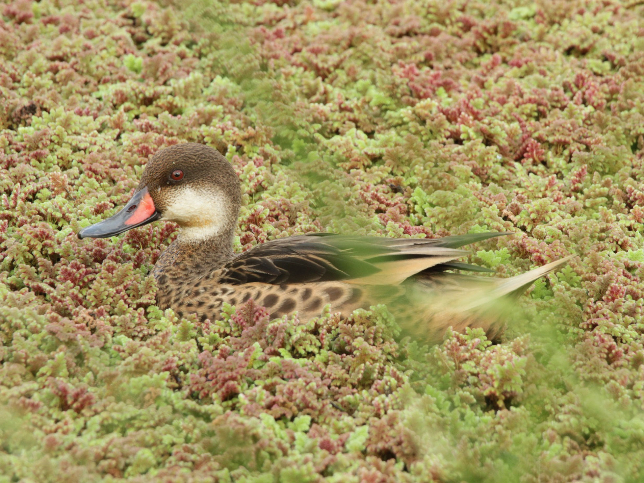
White-cheeked pintail

Slide 51
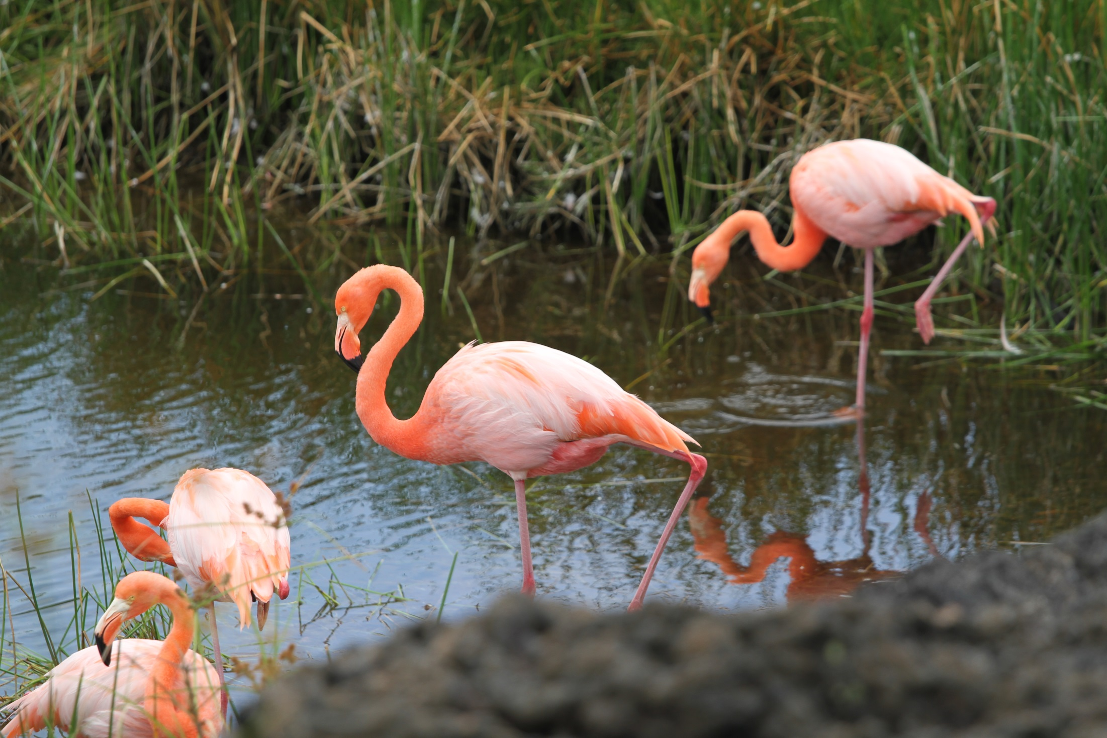
Galapagos flamingo

Slide 52
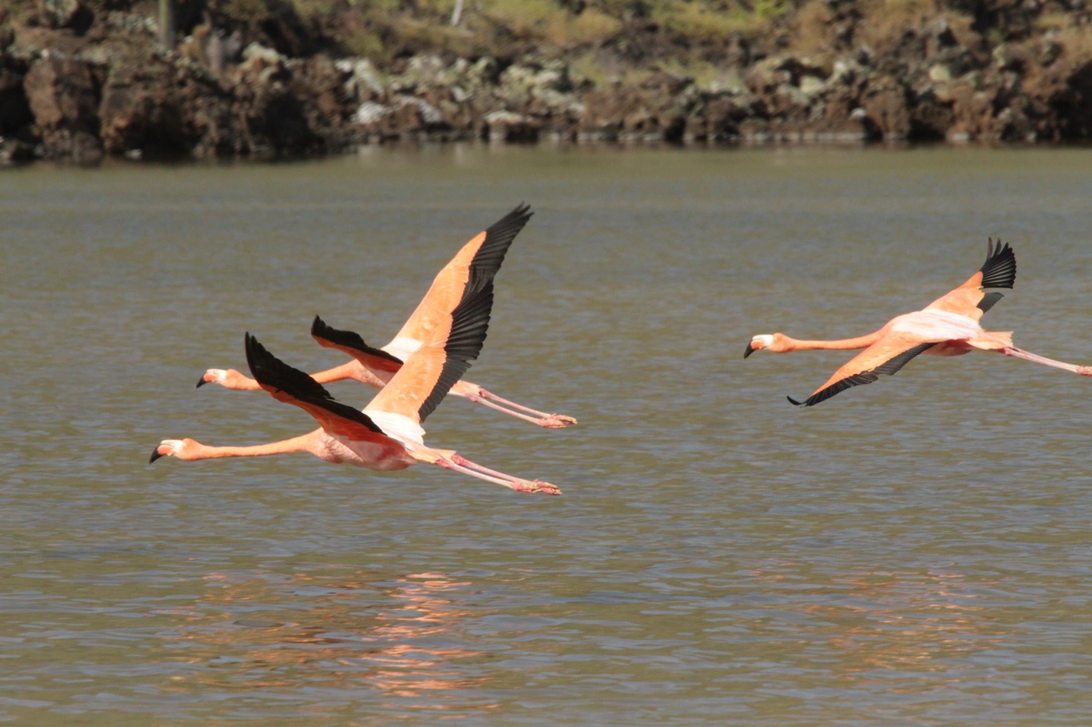
Galapagos flamingo

Slide 53
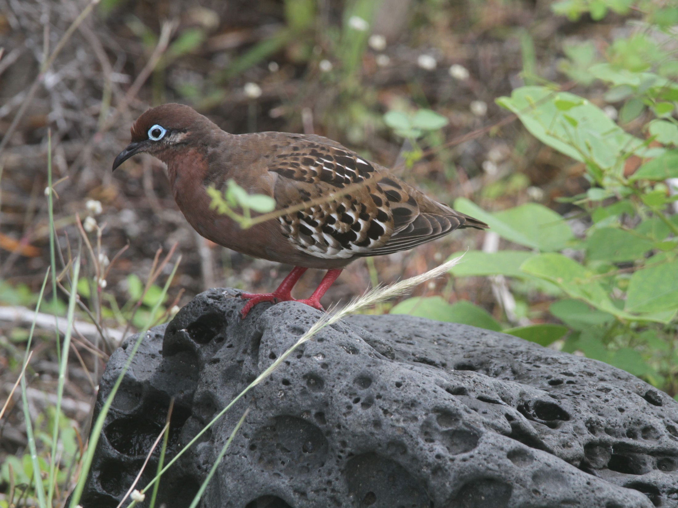
Galapagos dove

Slide 54
Galapagos hawk

Slide 55
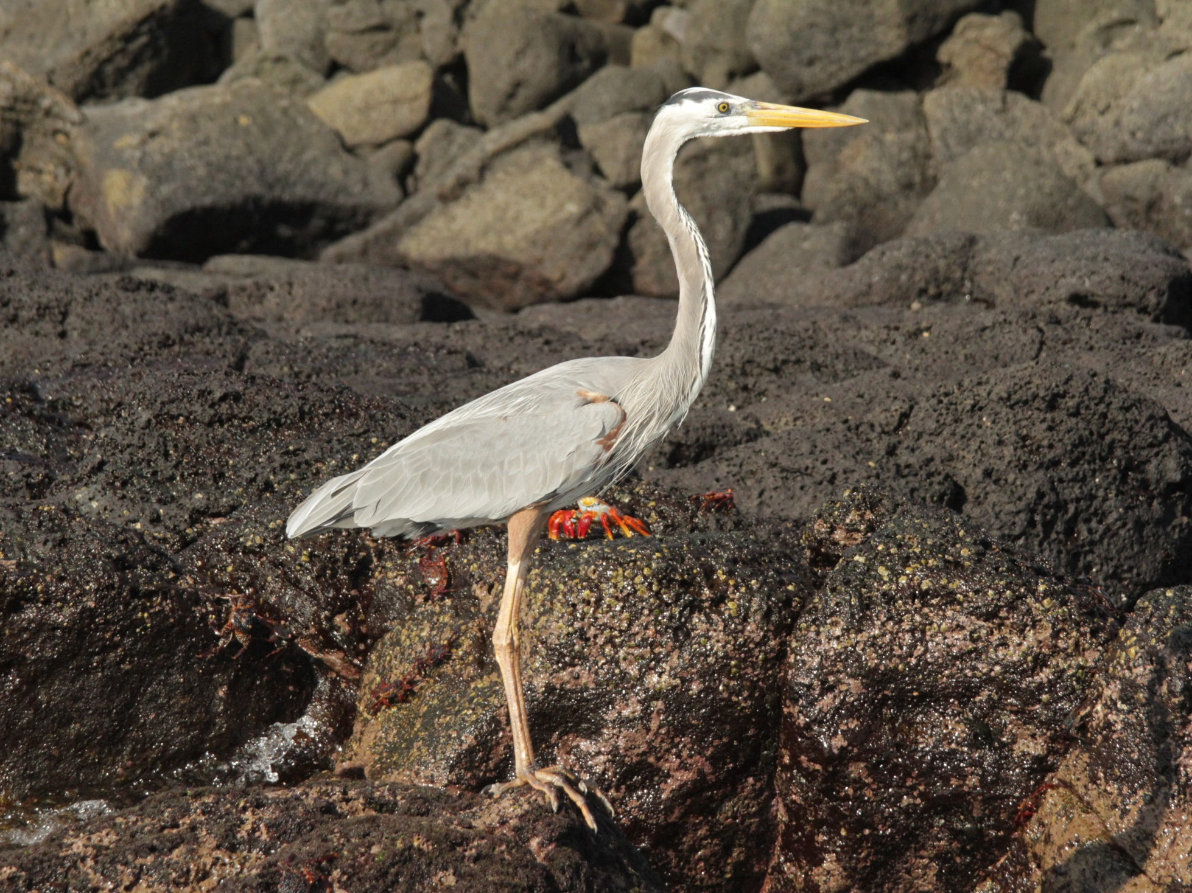
Great blue heron

Slide 56
Striated heron

Slide 57
Yellow-crowned night heron

Slide 58
Yellow warbler

Slide 59
Vermillion flycatcher

Slide 60
Galapagos flycatcher
Notes:
Isla Floreana

Slide 61
San Cristobal Mockingbird
Notes:
Isla San Cristobal

Slide 62
Hood or Espanola Mockingbird
Notes:
Isla Espanola

Slide 63
Galapagos mockingbird
Notes:
Isla Isabella, Urbina Bay

Slide 64
Dark-billed cuckoo
Notes:
Isla Isabella

Slide 65
Smooth-billed ani
Notes:
Isla Santa Cruz

Slide 66
Large ground finch female
Notes:
Santa Cruz, Puerta Ayora

Slide 67
Large ground finch male
Notes:
Isla Espanola

Slide 68
Small ground finch

Slide 69
Small ground finch
Notes:
Left: Espanola Island
Right: Santa Cruz, Puerto Ayora

Slide 70
Mangrove finch
Notes:
Isla Espanola

Slide 71
Medium tree finch
Notes:
Isla San Cristobal

Slide 72
Vegetarian finch

Slide 73
Warbler finch
Notes:
Isla Floreana

Slide 74
Woodpecker finch
Notes:
Isla Santa Cruz

Slide 75
Common cactus finch
Notes:
Isla Santa Cruz

Slide 76
Common cactus finch
Notes:
Puerto Ayora

Slide 77
Common cactus finch
Notes:
Isla Isabella

Slide 78
Small tree finch
Notes:
San Cristobal

Slide 79
Notes:
Fernandina

