Slide 1
Salamanders of Grandfather Mountain NC
Wayne Van Devender
Department of Biology
Appalachian State University

Slide 2
Components of High Diversity
SE USA – general hotspot for salamanders (All families in the world but 1 occurs here.)
High relief from top to bottom (1200’-5900’)
Multiple habitat types
Multiple drainages

Slide 3
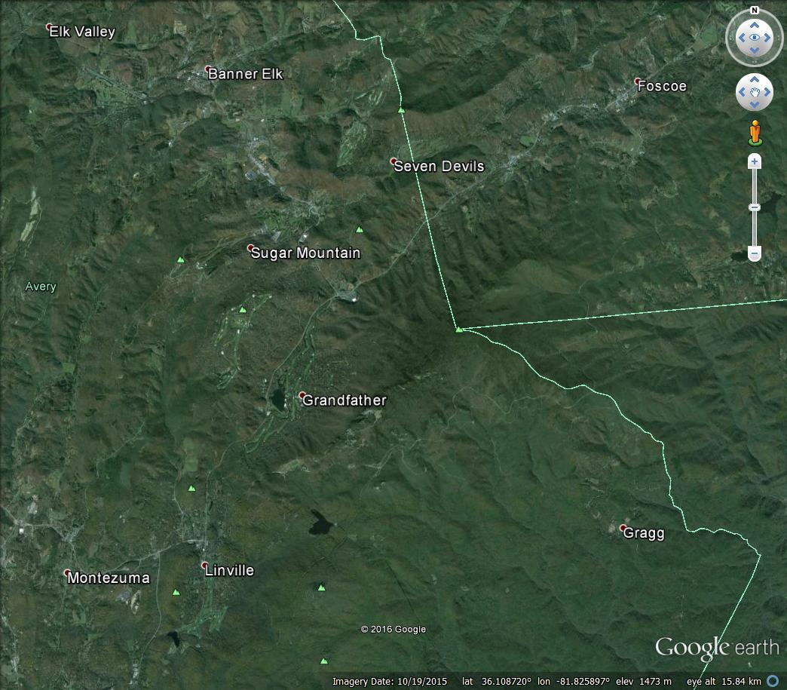

Slide 4
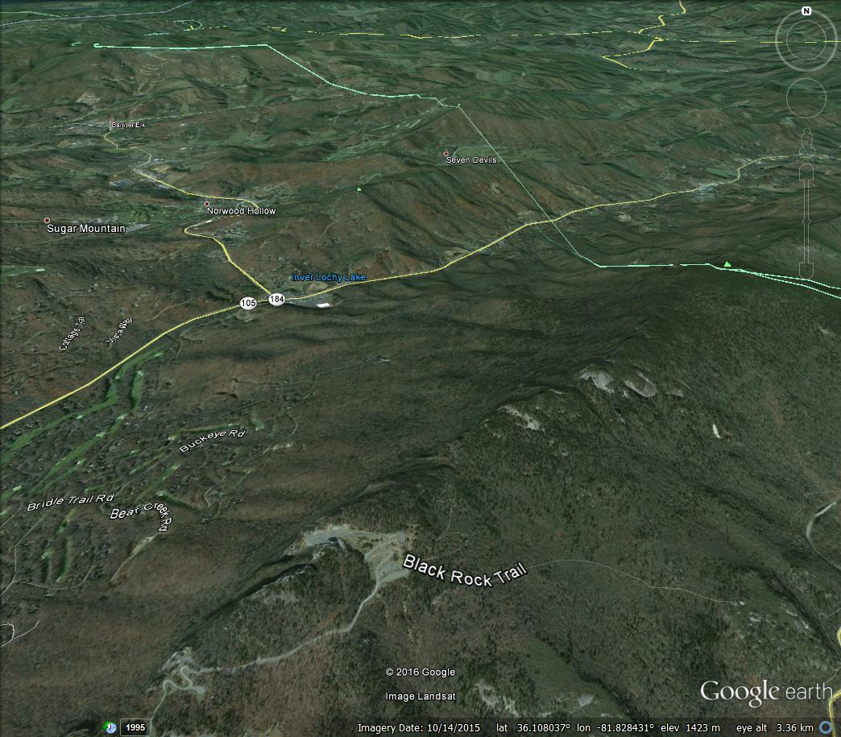

Slide 5
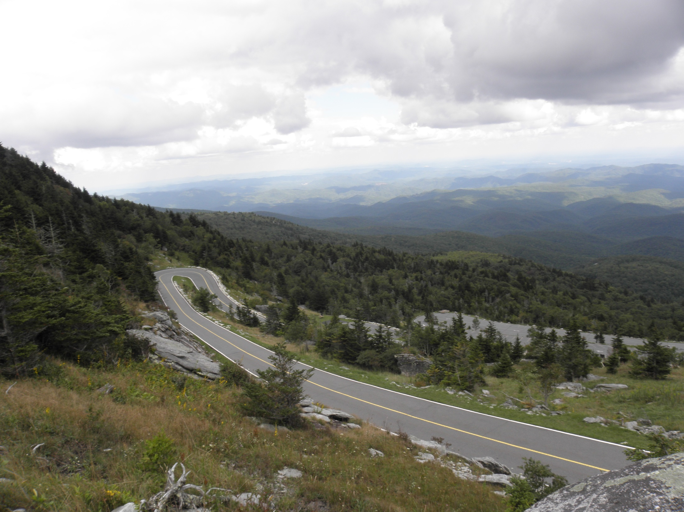

Slide 6
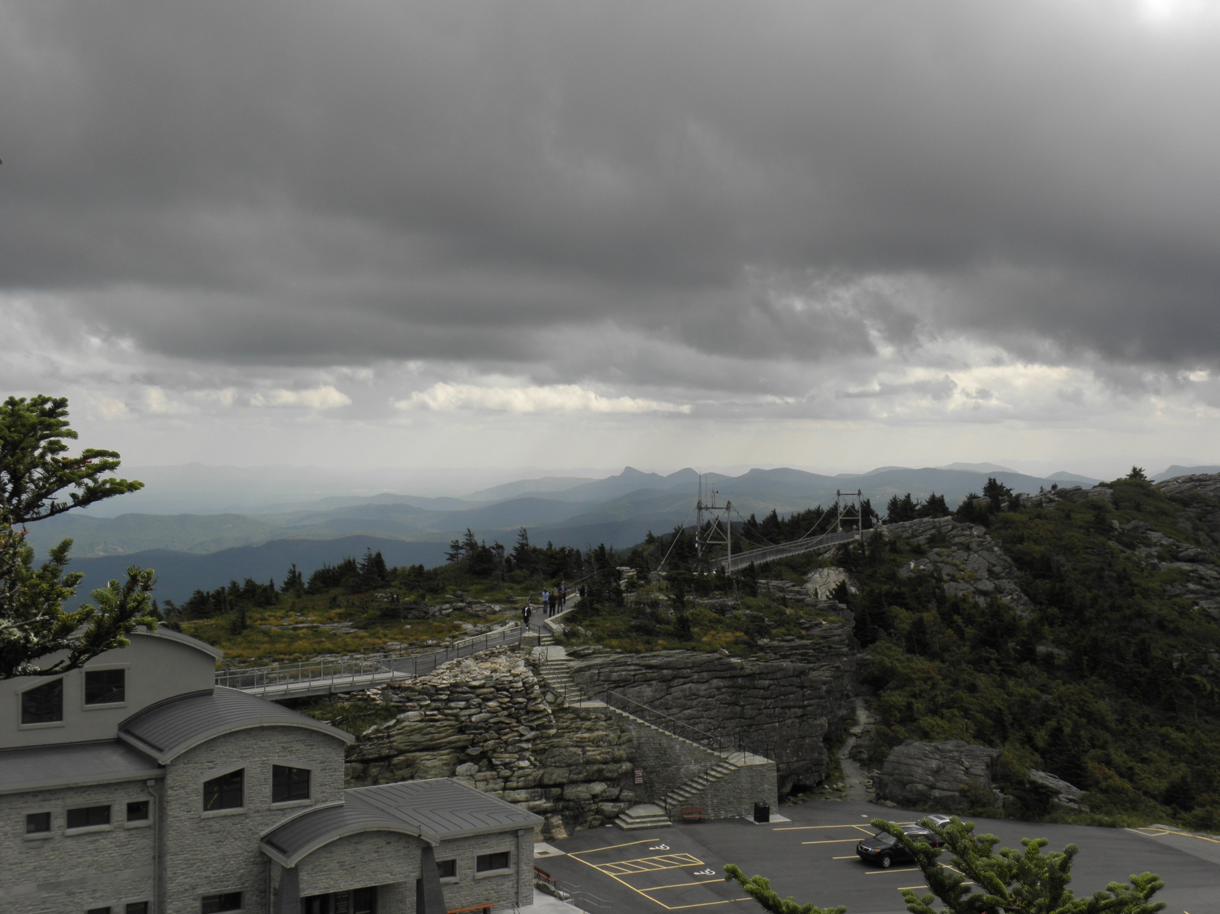

Slide 7
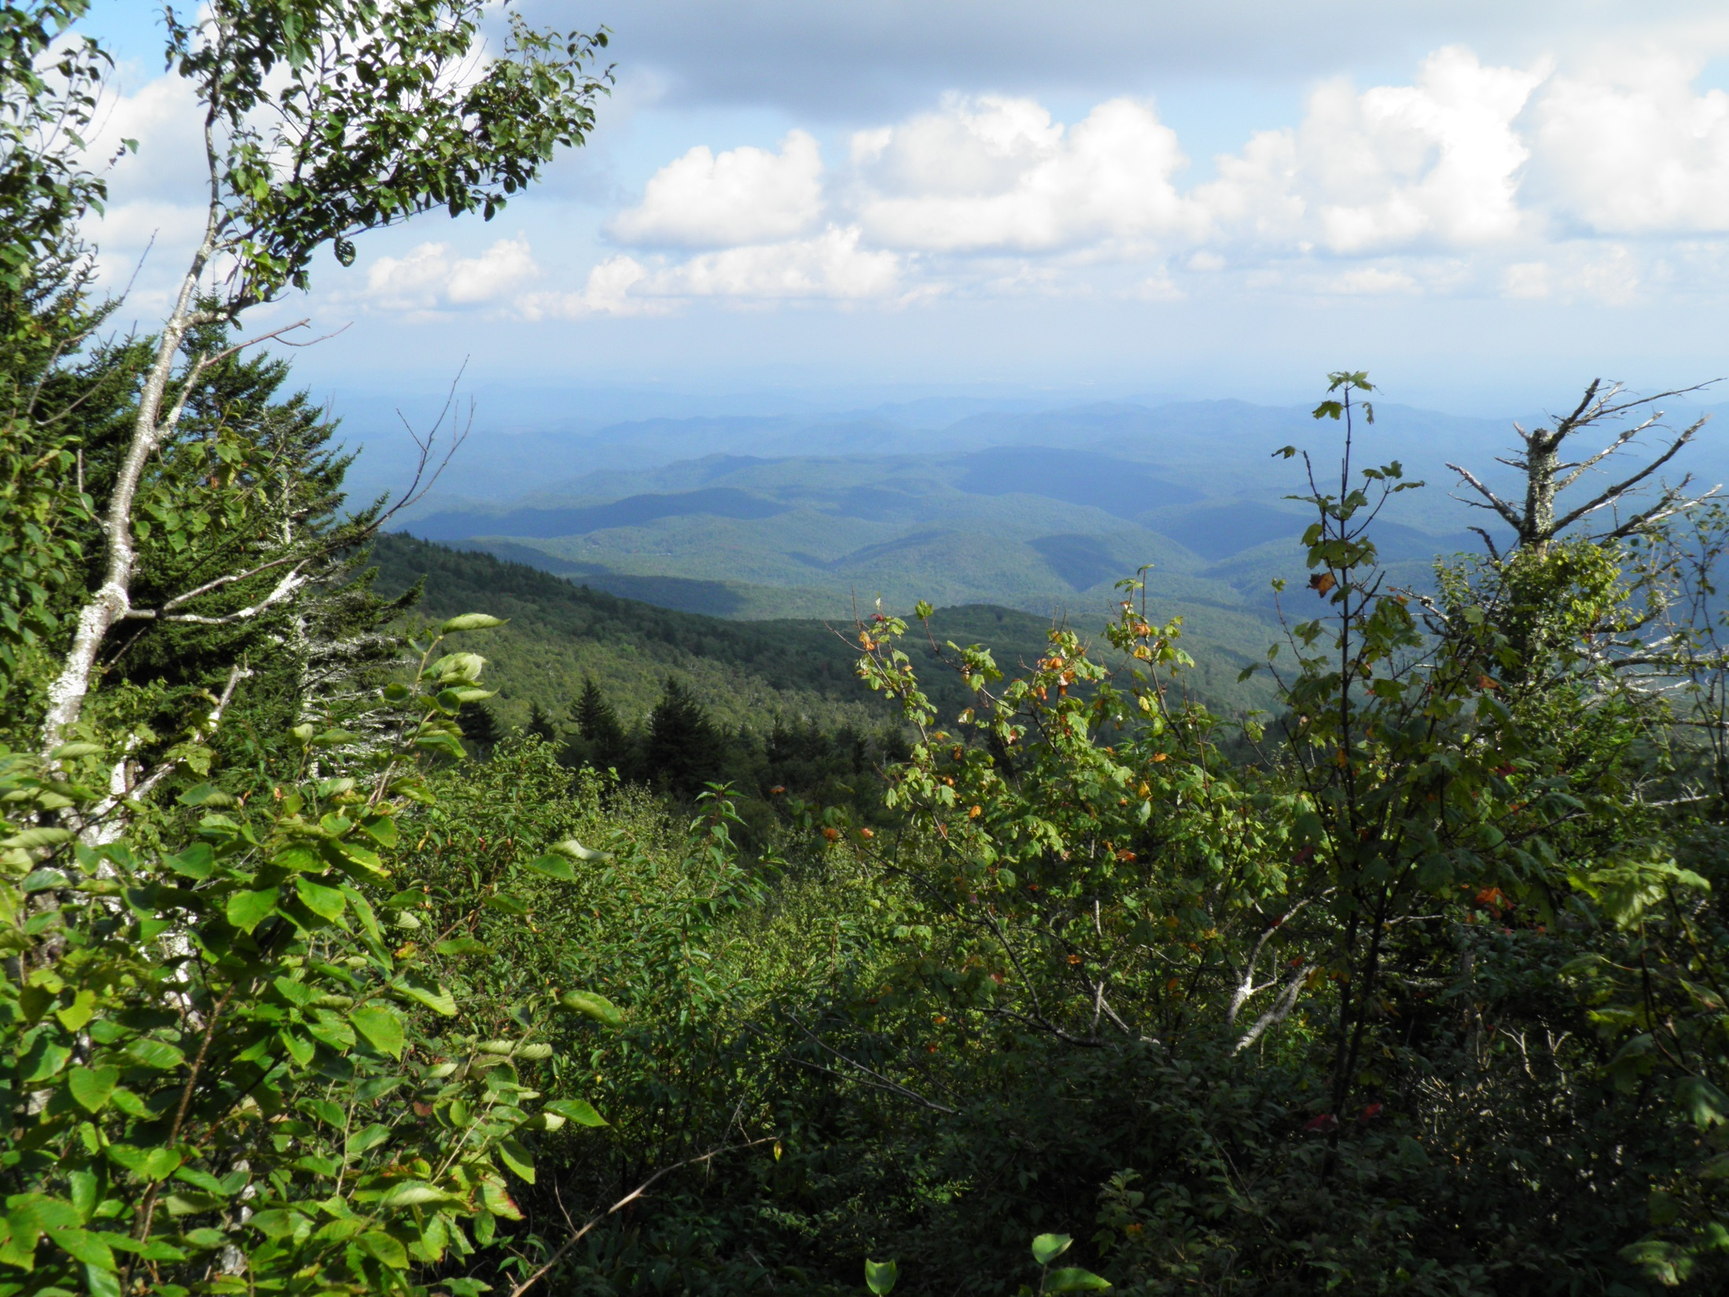

Slide 8
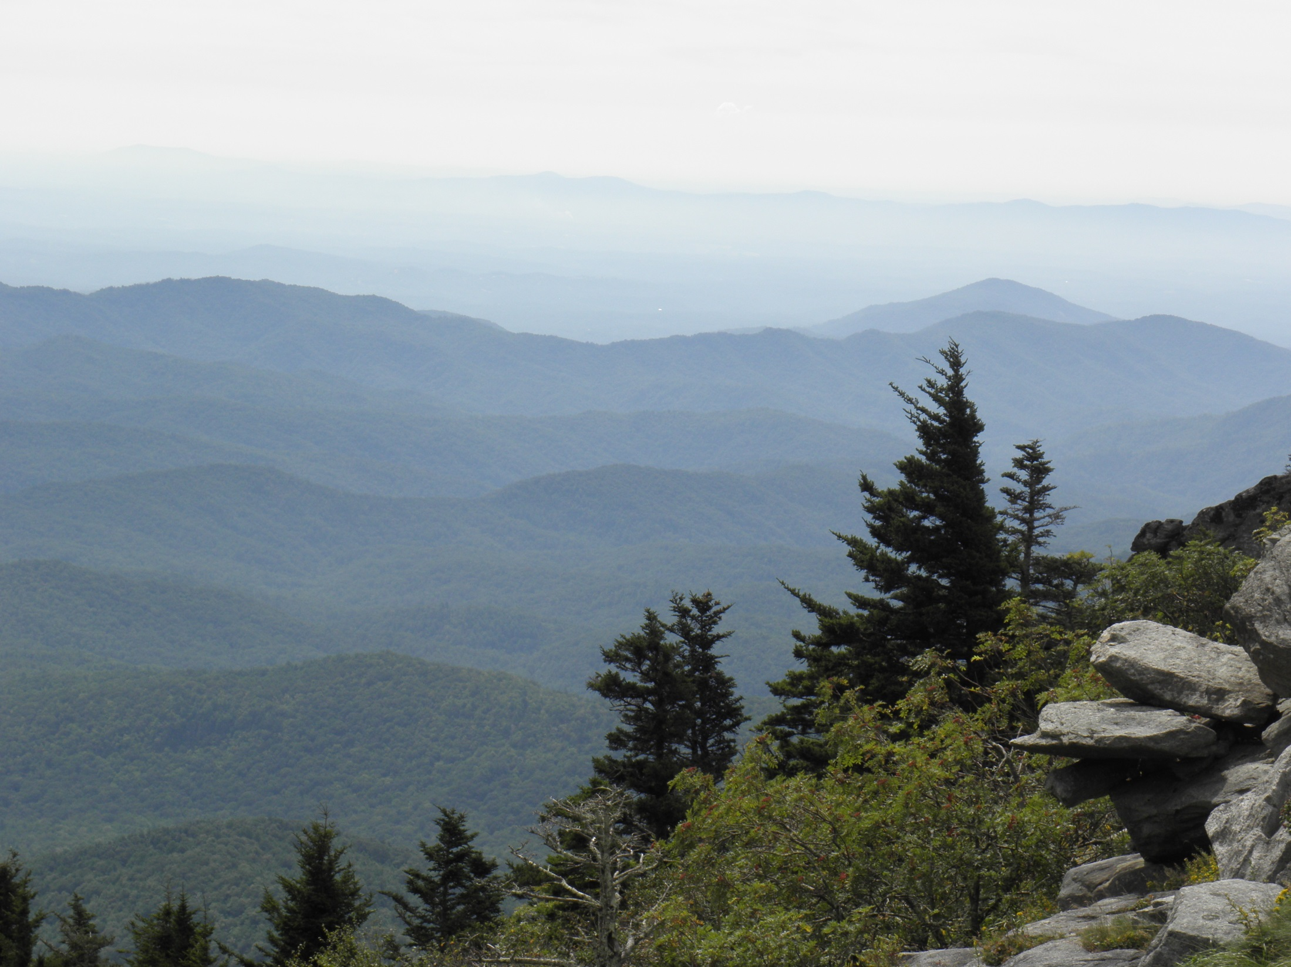

Slide 9
Families of Salamanders
Ambystomatidae – mole salamanders 1 species
Salamandridae – true salamanders 1 species
Cryptobranchidae – giant salamander 1 species
Plethodontidae – lungless salamanders 18-20 species

Slide 10
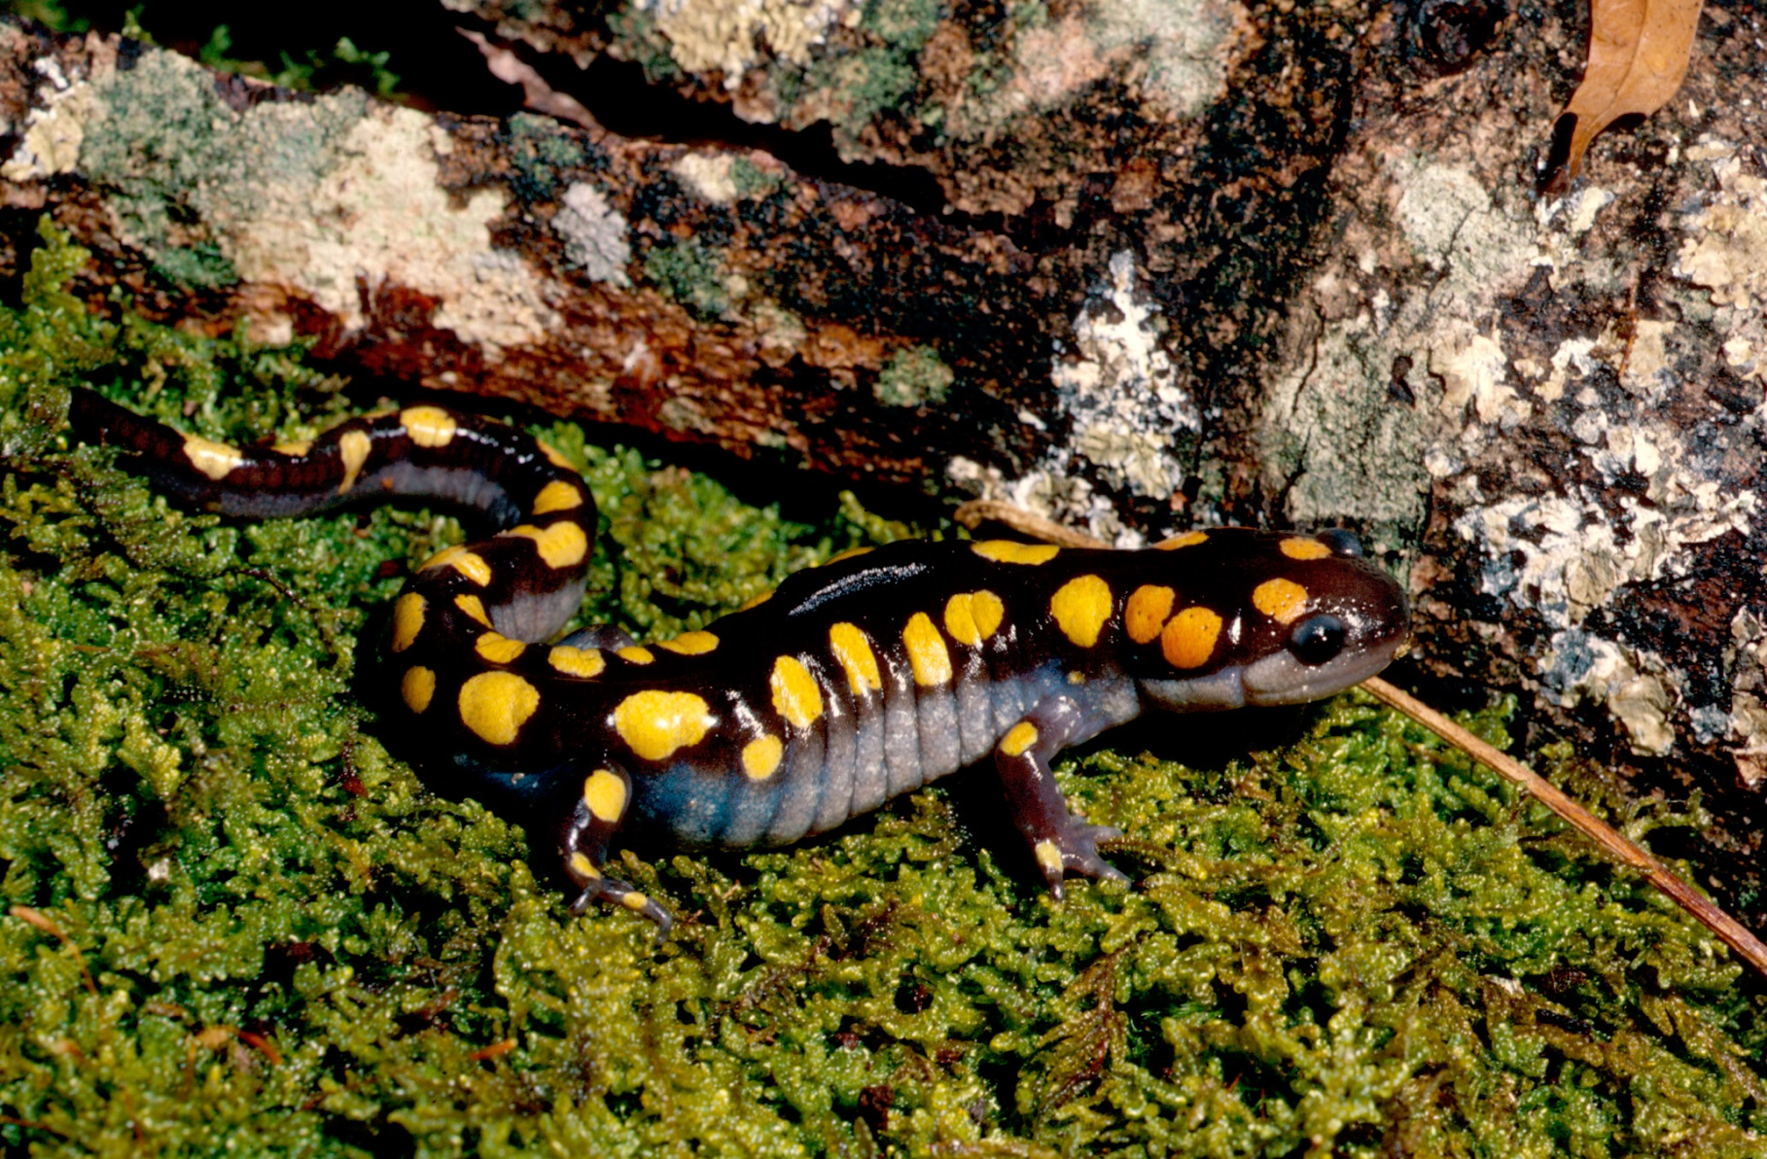
Ambystoma maculatum spotted salamander

Slide 11
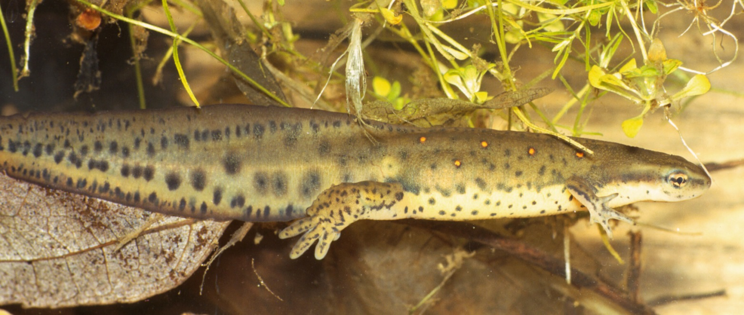
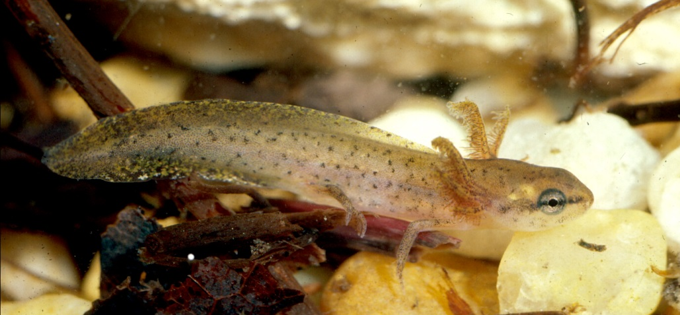
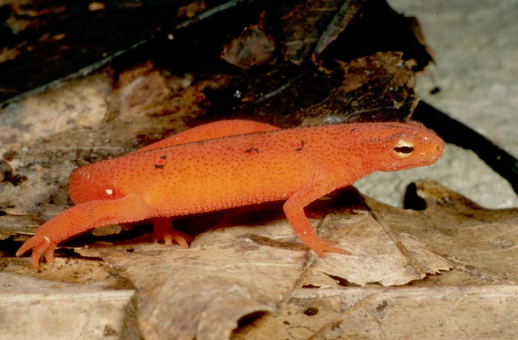
Notophthalmus viridescens red spotted newt

Slide 12
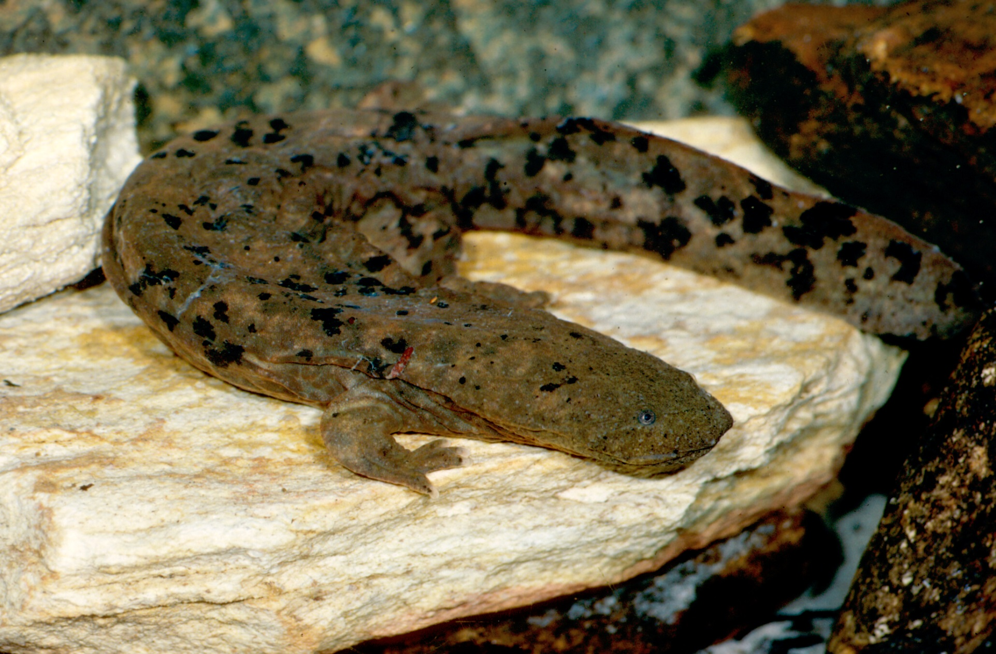
Cryptobranchus alleghaniensis hellbender

Slide 13
Lungless Salamanders
Dusky salamanders Desmognathus – 7-8 species
Salamanders with larvae – true salamanders Eurycea – 3-4 species Gyrinophilus – 1 species Hemidactylium - 1 species Pseudotriton – 2 species
Woodland salamanders Plethodon - 6 species

Slide 14
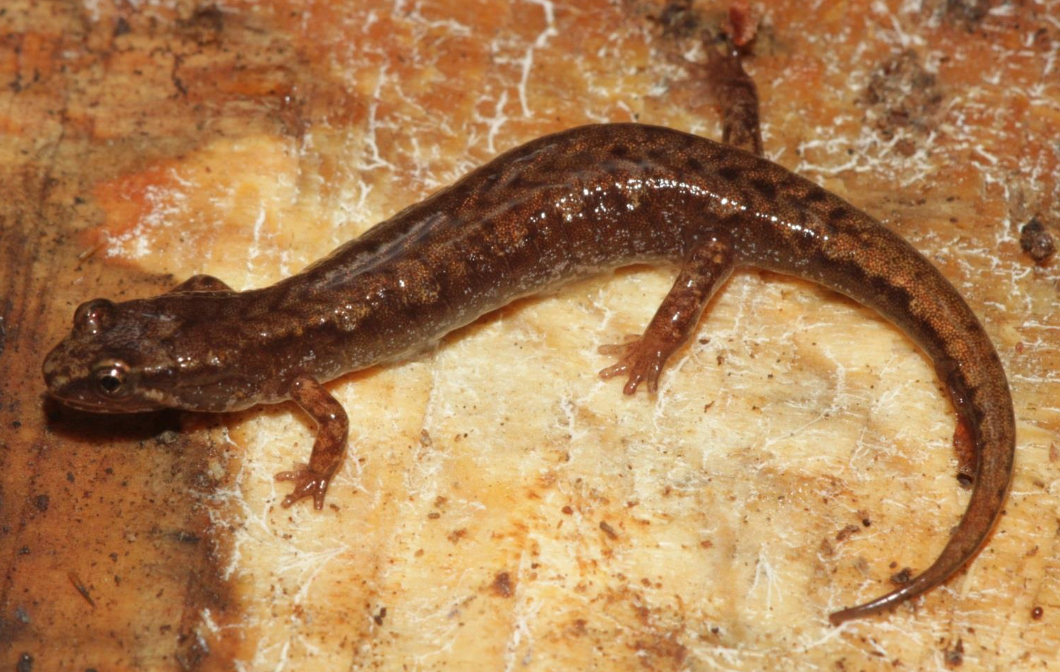
Desmognathus organi northern pigmy salamander

Slide 15
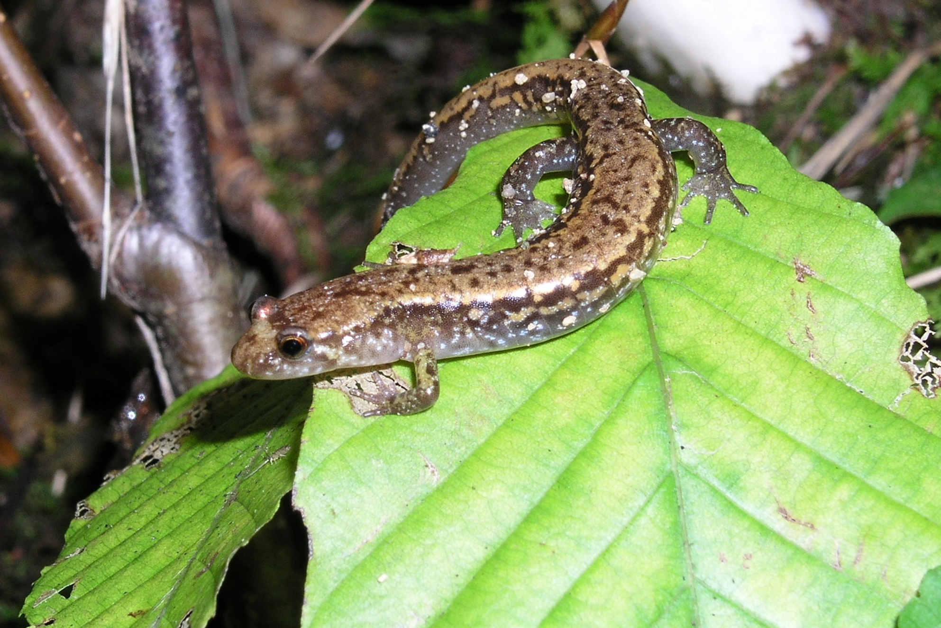
Desmognathus orestes Blue Ridge Mountain Dusky Salamander

Slide 16
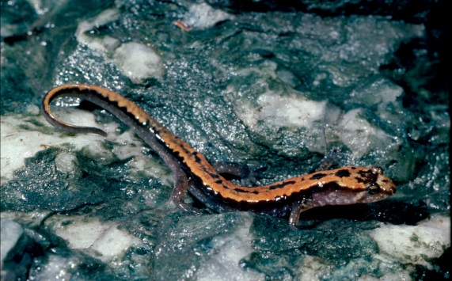
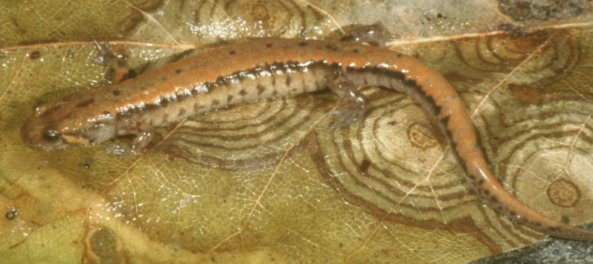
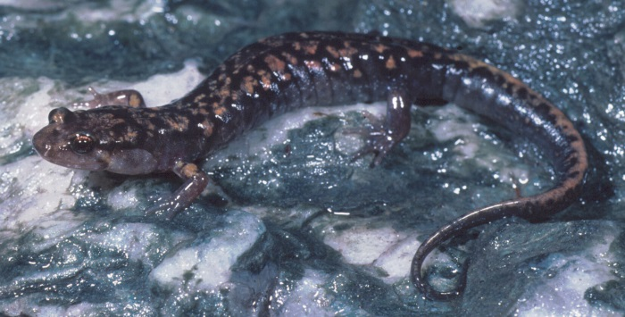
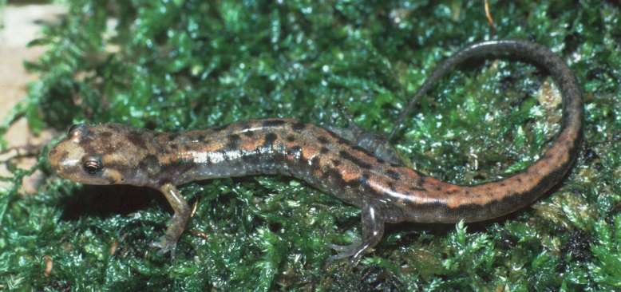
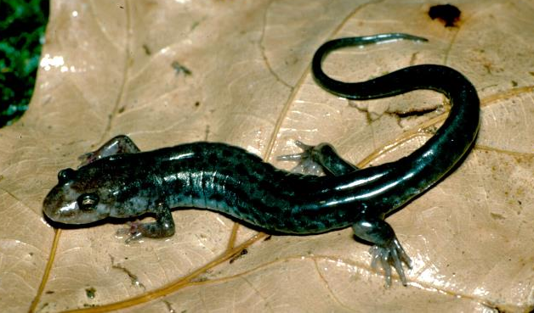
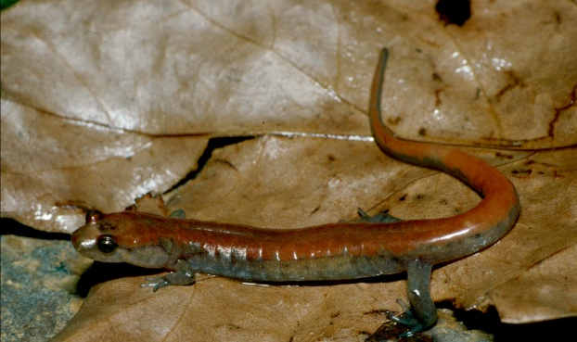
Desmognathus orestes Blue Ridge Mountain Dusky Salamander

Slide 17
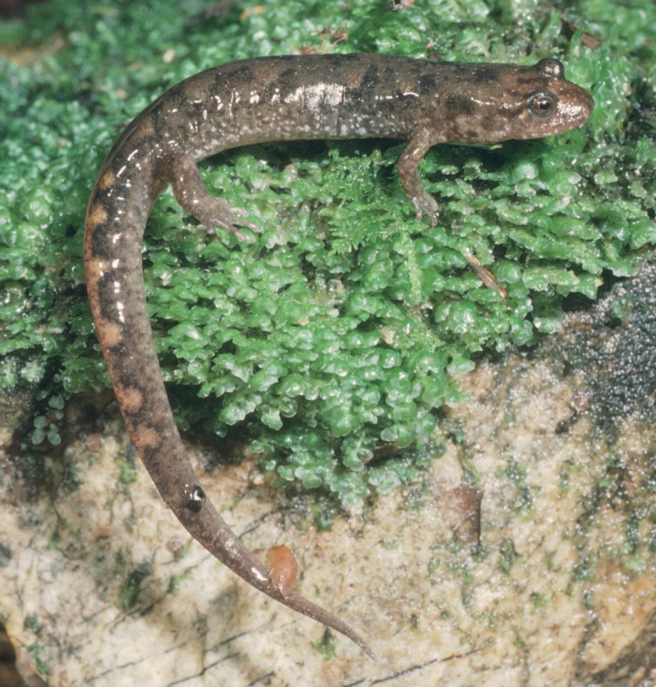
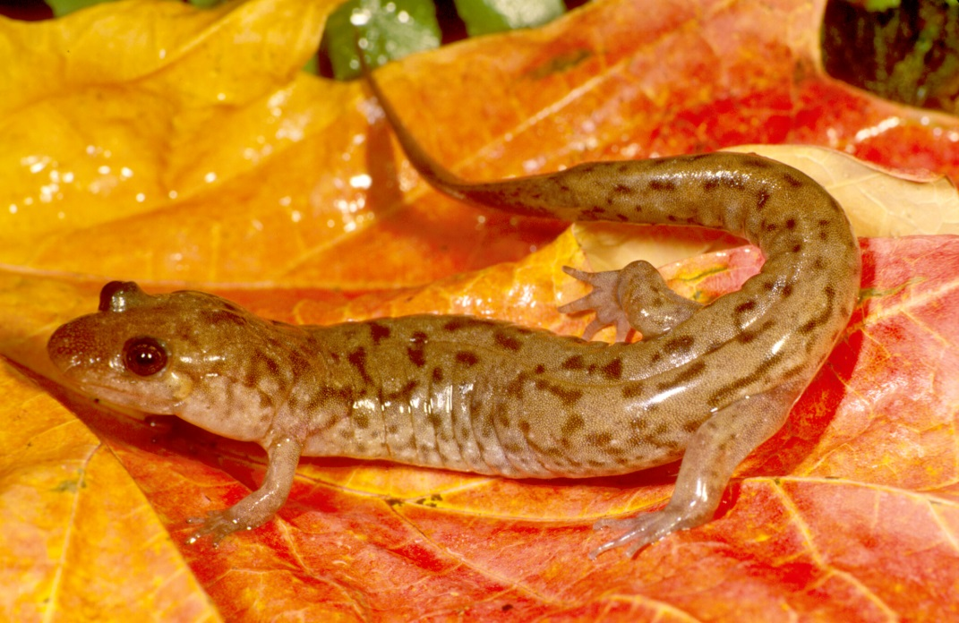
Desmognathus monticola Seal Salamander

Slide 18
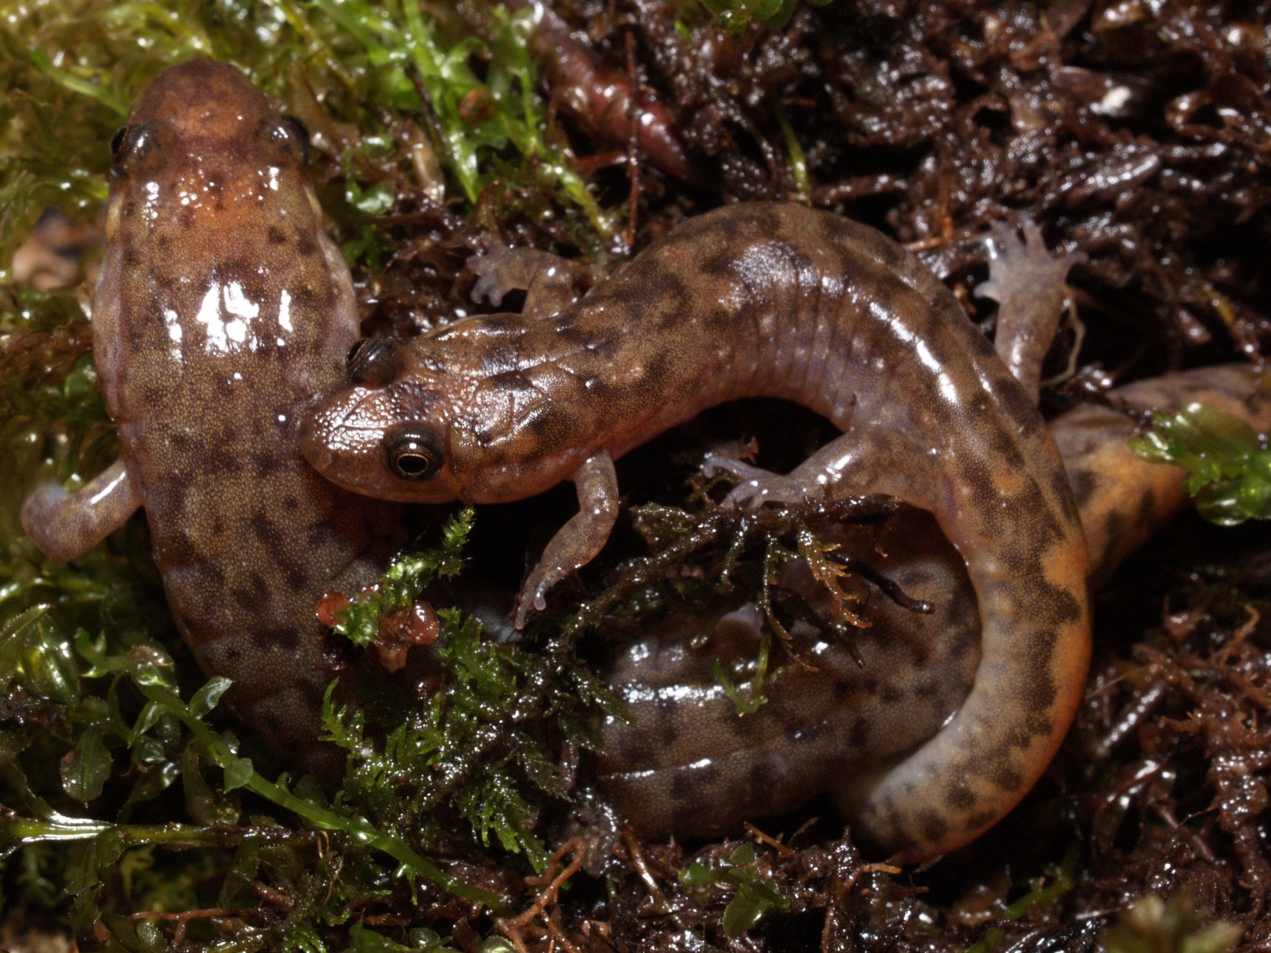
Desmognathus monticola Seal Salamander

Slide 19
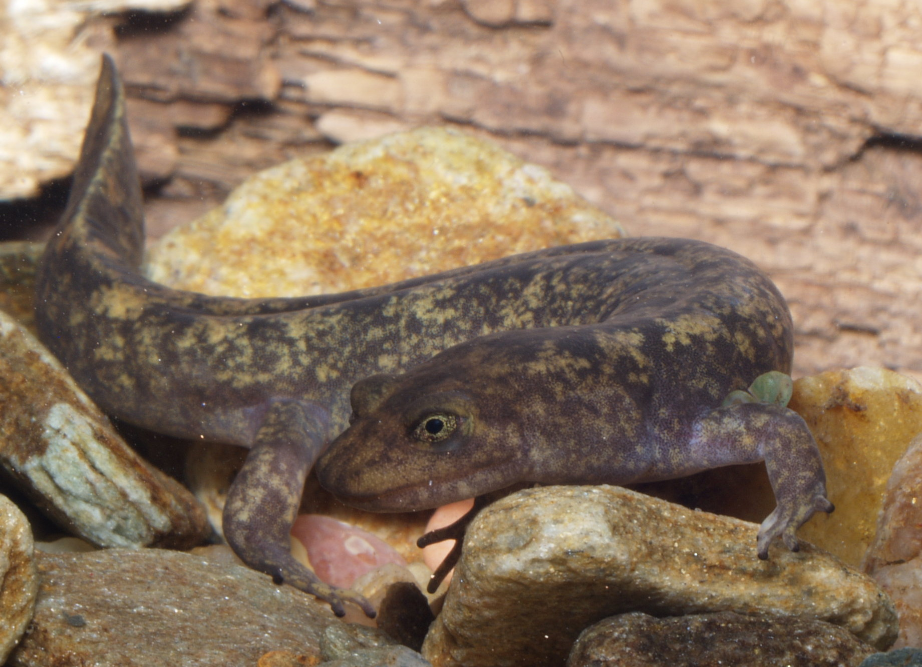
Desmognathus marmoratus Shovel-nosed Salamander

Slide 20
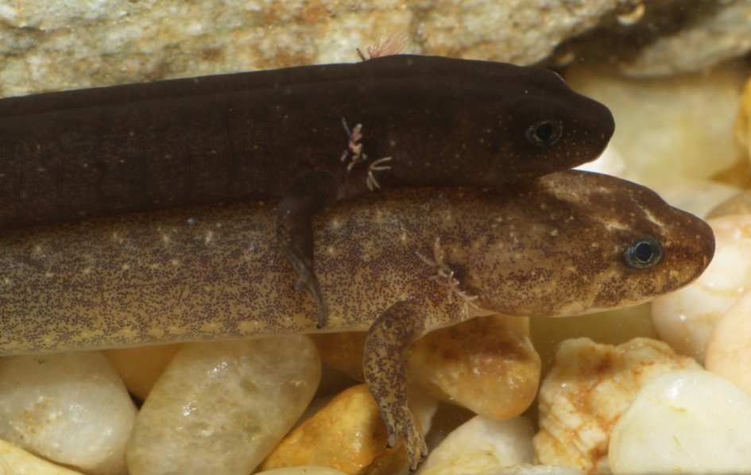
Desmognathus marmoratus Shovel-nosed Salamander

Slide 21
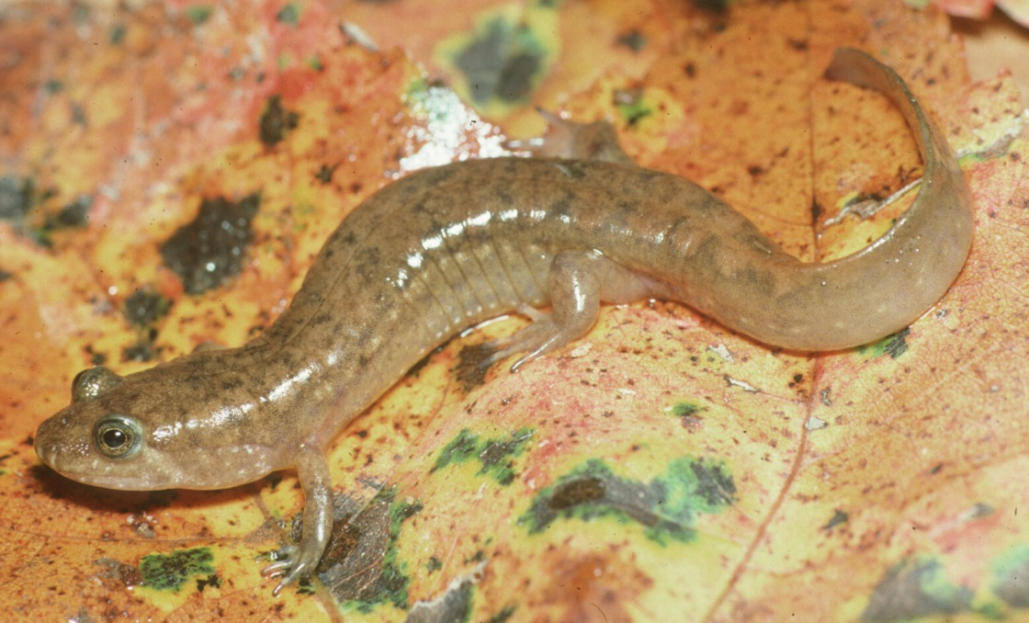
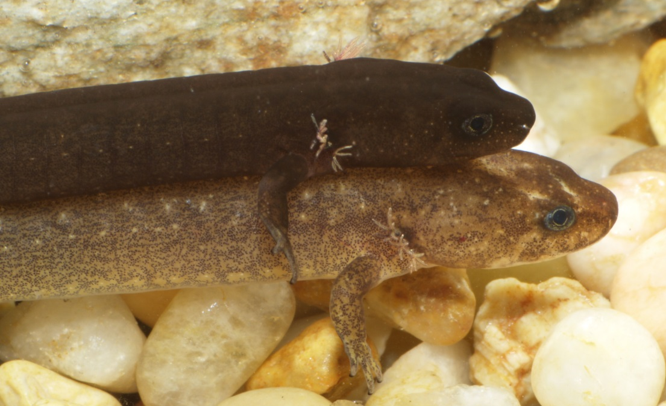
Desmognathus quadramaculatus Black-bellied Salamander

Slide 22
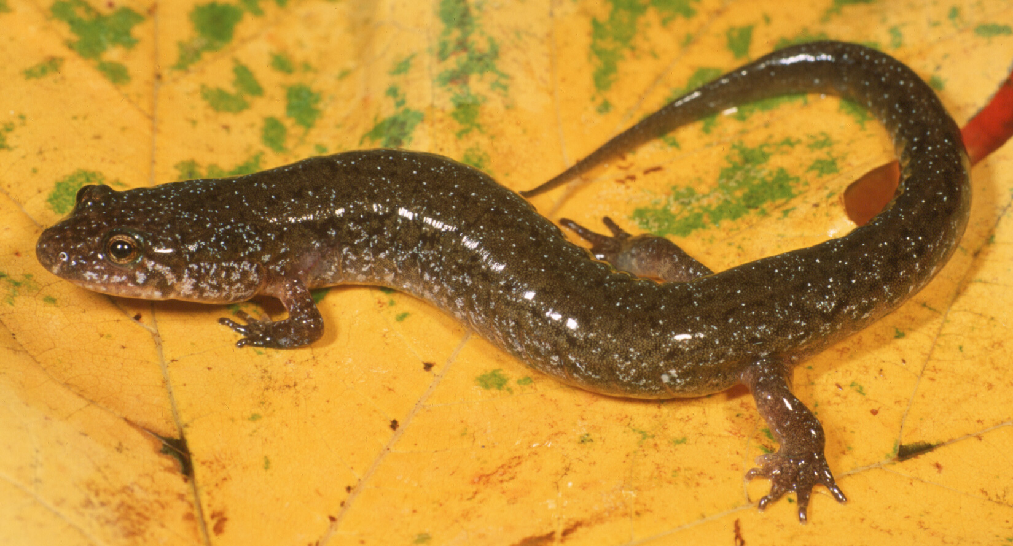
Desmognathus fuscus Northern Dusky Salamander
Notes:
Photo from the Boone area
Known from Price Park area

Slide 23
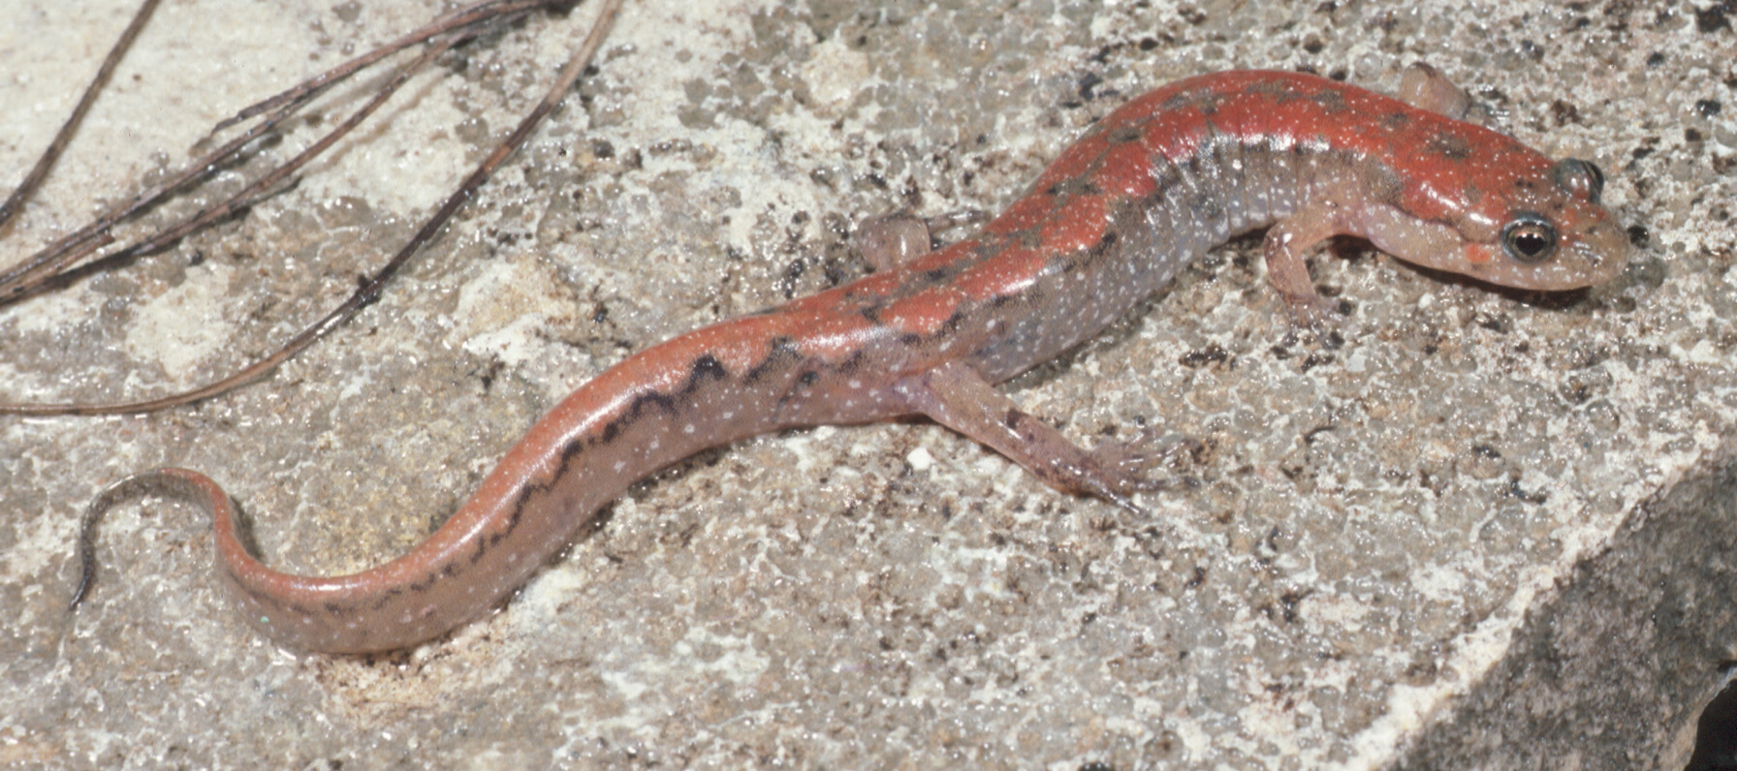
Desmognathus “fuscus” Foothills Dusky Salamander

Slide 24
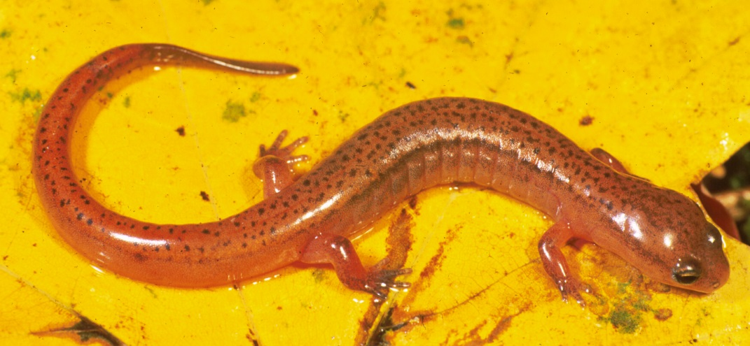
Eurycea wilderae Blue Ridge Two-lined Salamander

Slide 25
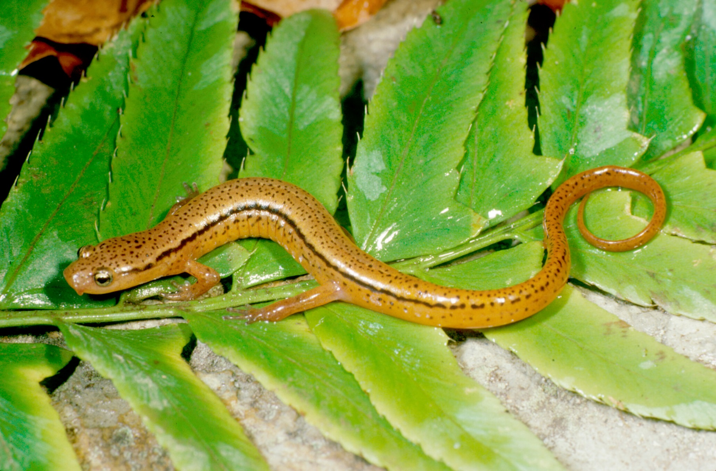
Eurycea cirrigera Southern Two-lined Salamander
Notes:
Actual distribution poorly known but may be at lowest elevations

Slide 26
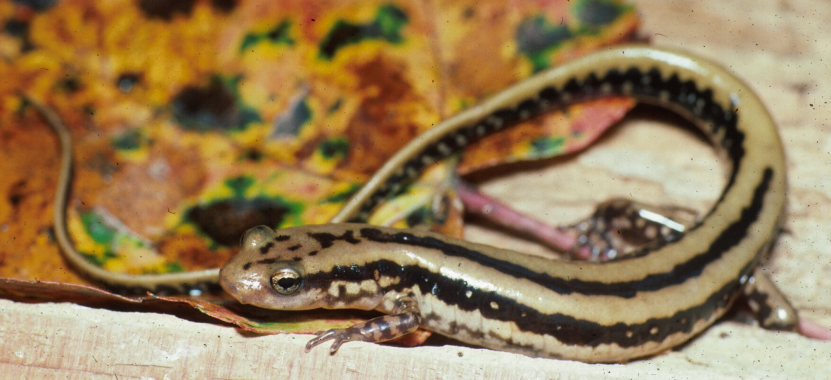
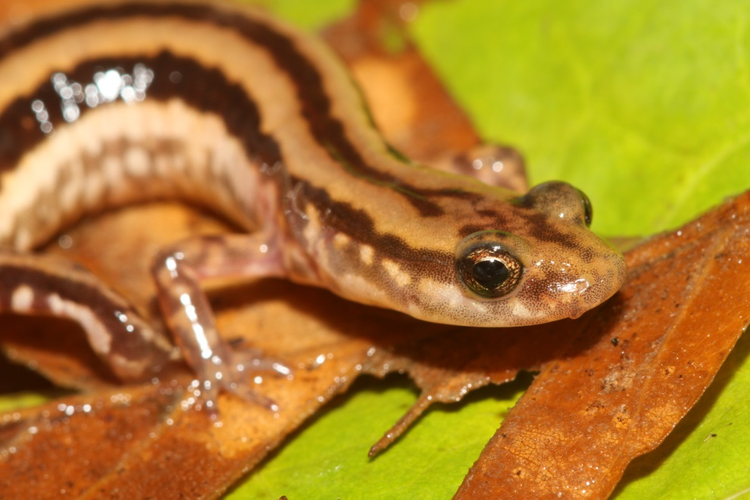
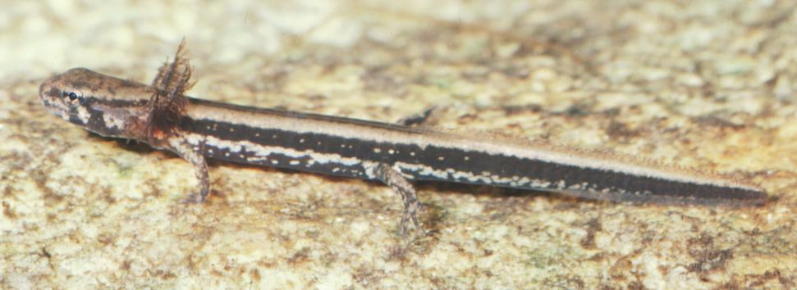
Eurycea guttolineata Three-lined Salamander

Slide 27
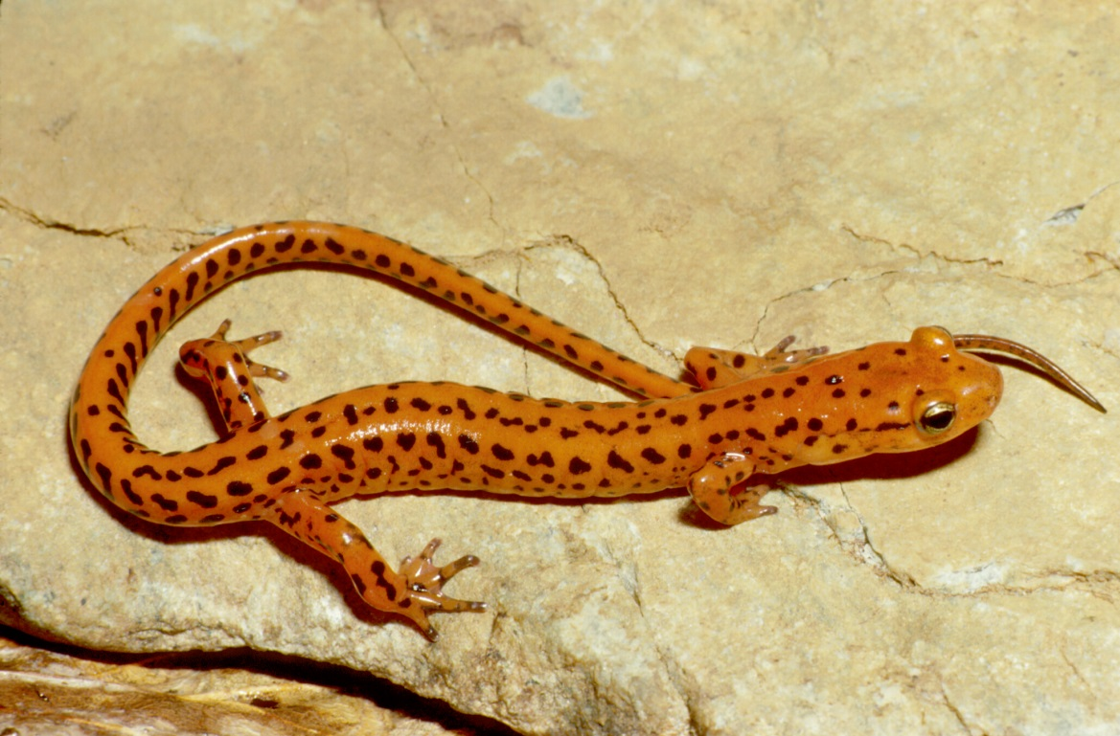
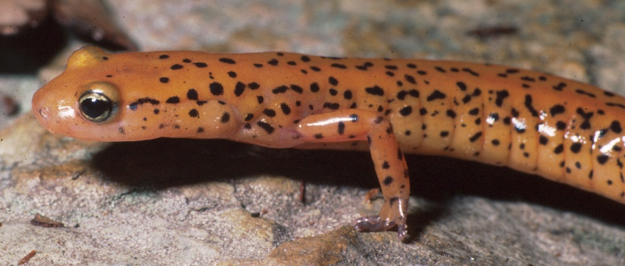
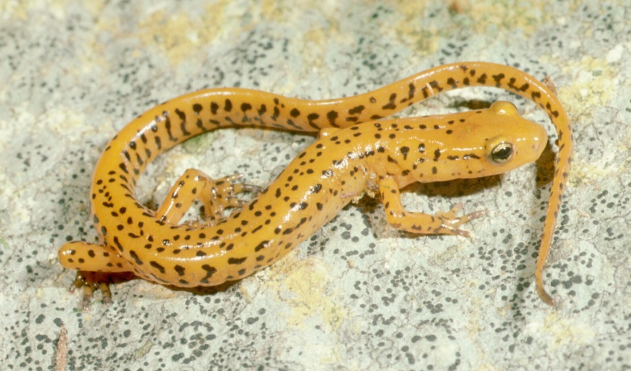
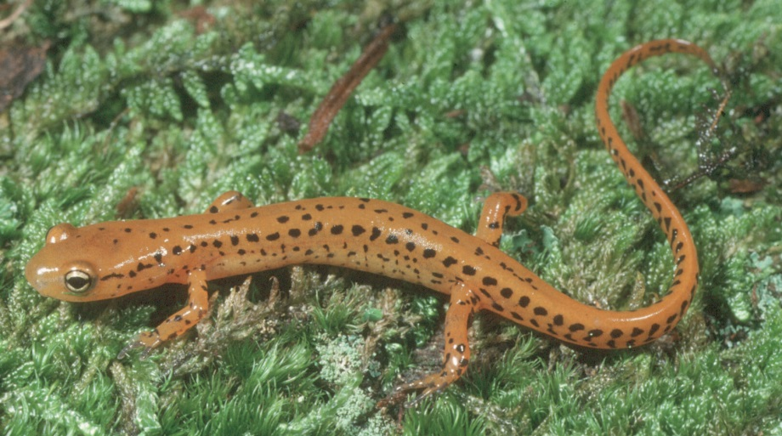
Eurycea longicauda Long-tailed Salamander

Slide 28
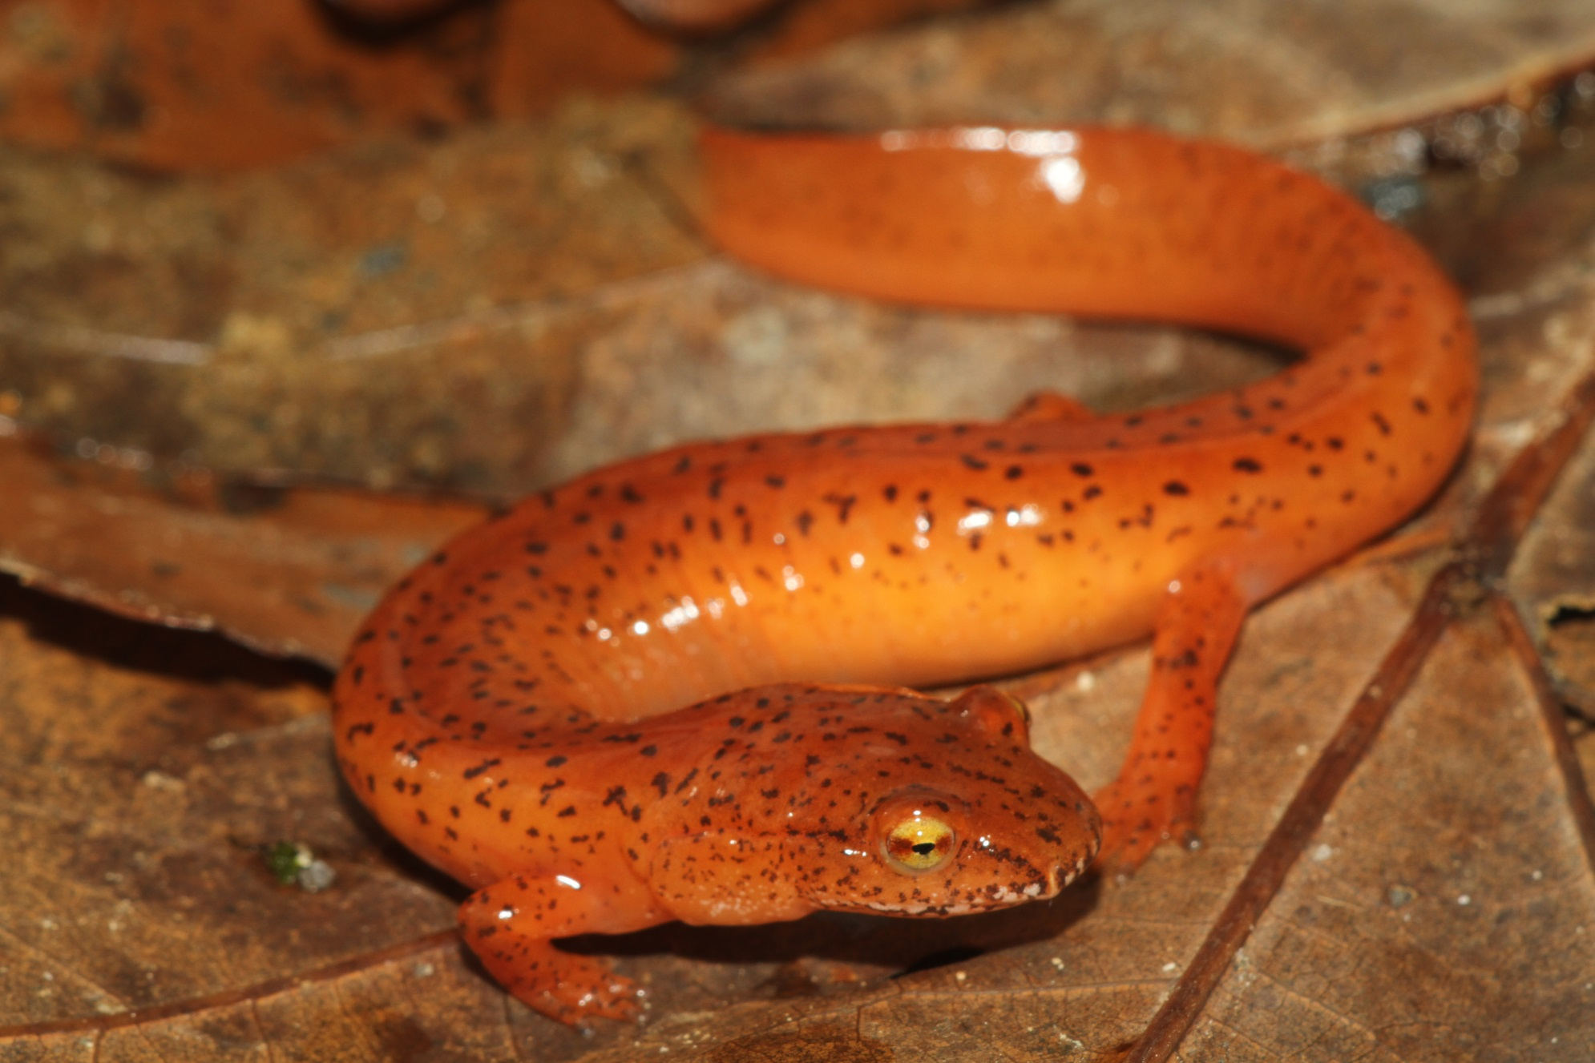
Gyrinophilus danielsi Blue Ridge Spring Salamander

Slide 29
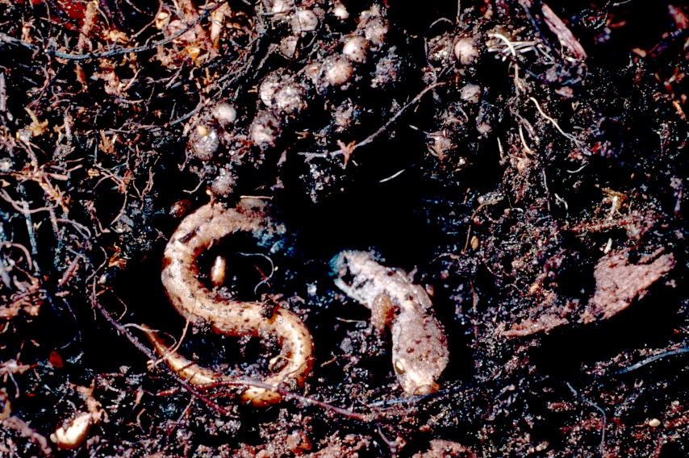
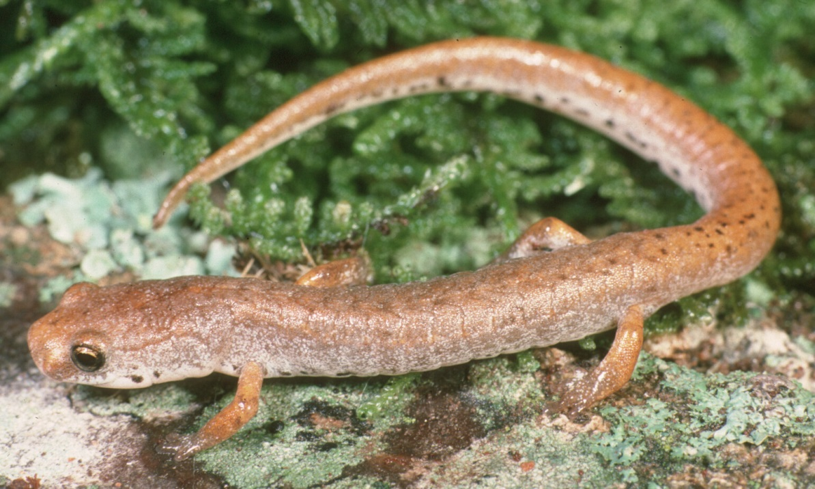
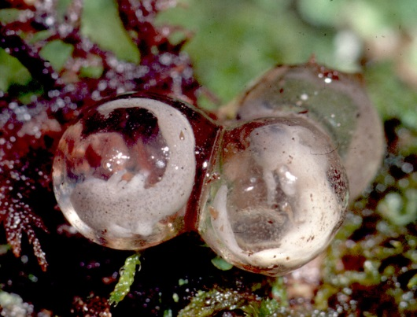
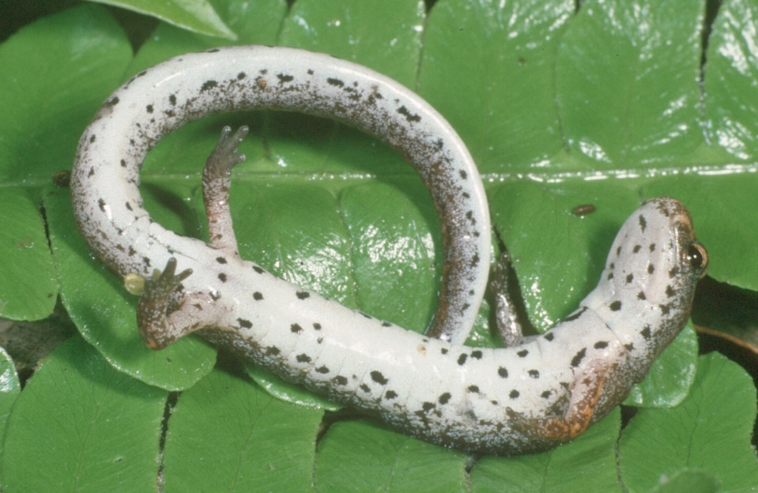
Hemidactylium scutatum Four-toed Salamander

Slide 30
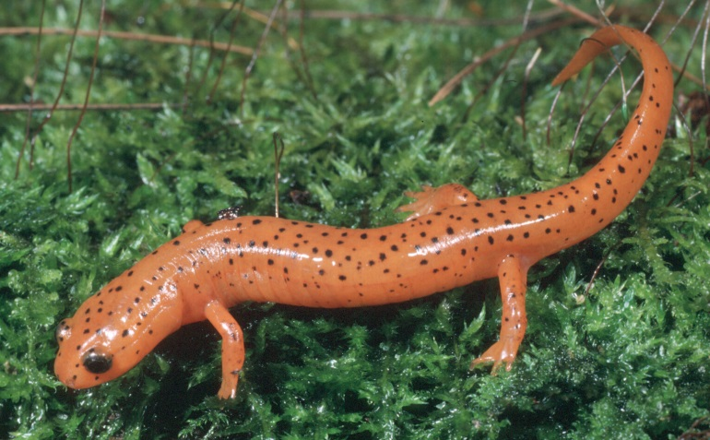
Pseudotriton montanus Mud Salamander

Slide 31
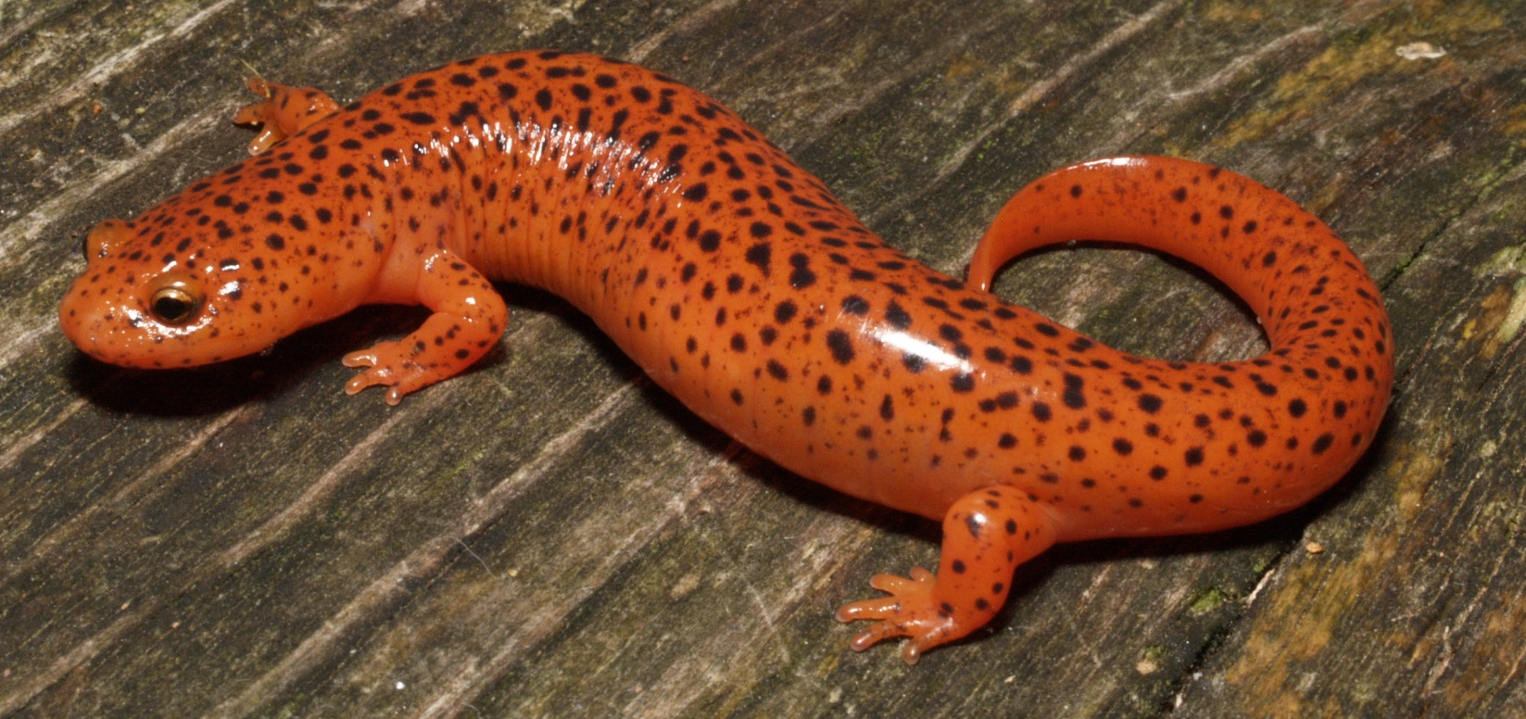
Pseudotriton ruber Red Salamander

Slide 32
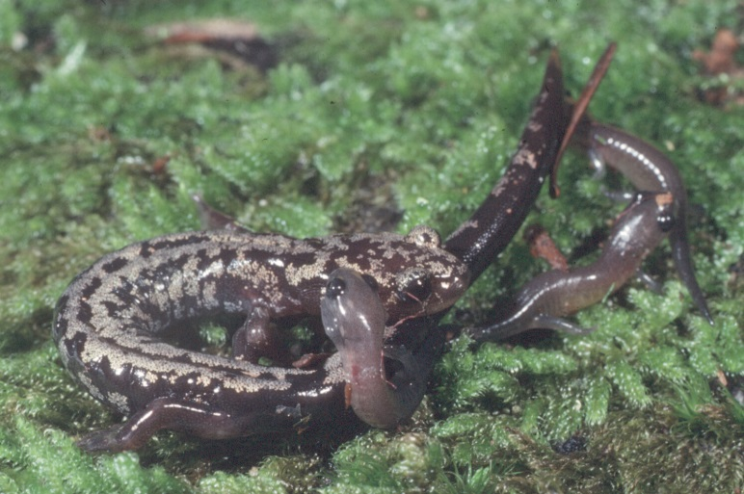
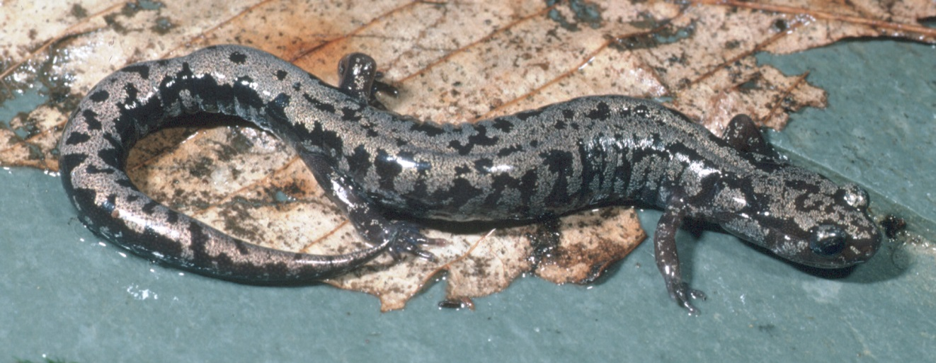
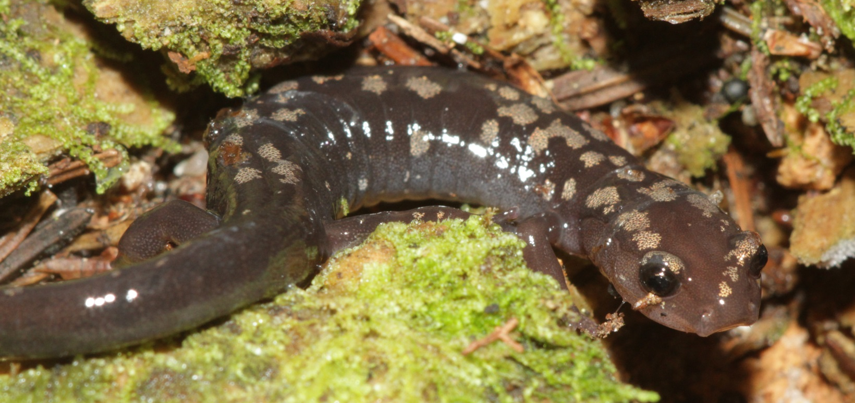
Plethodon welleri Weller’s Salamander

Slide 33
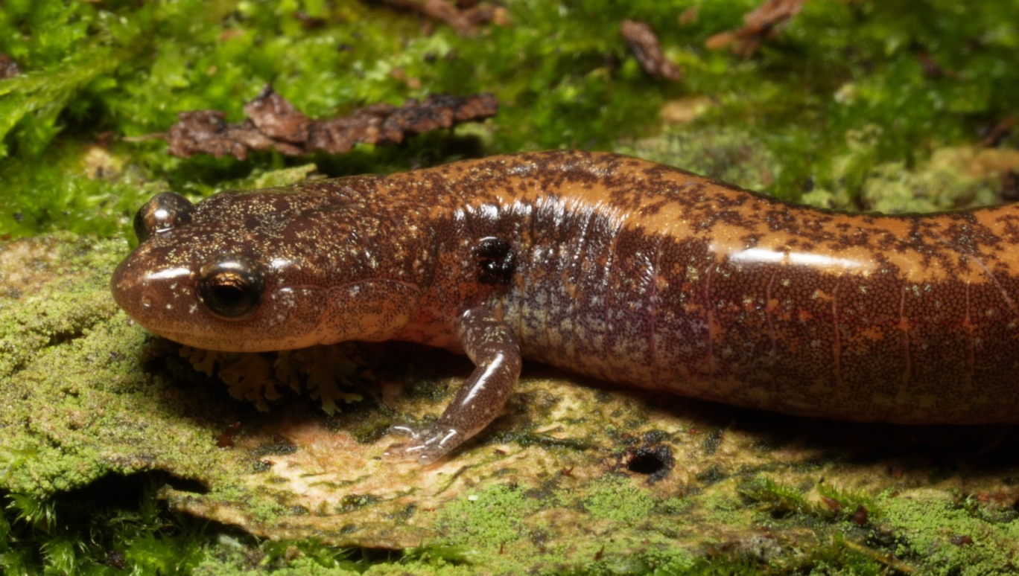
Plethodon cinereus Red-backed Salamander

Slide 34
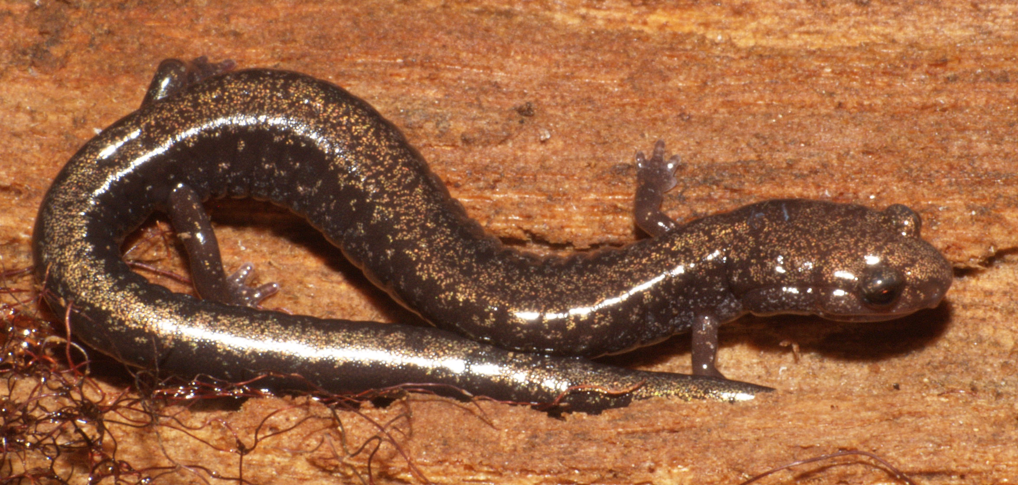
Plethodon richmondi Ravine Salamander

Slide 35
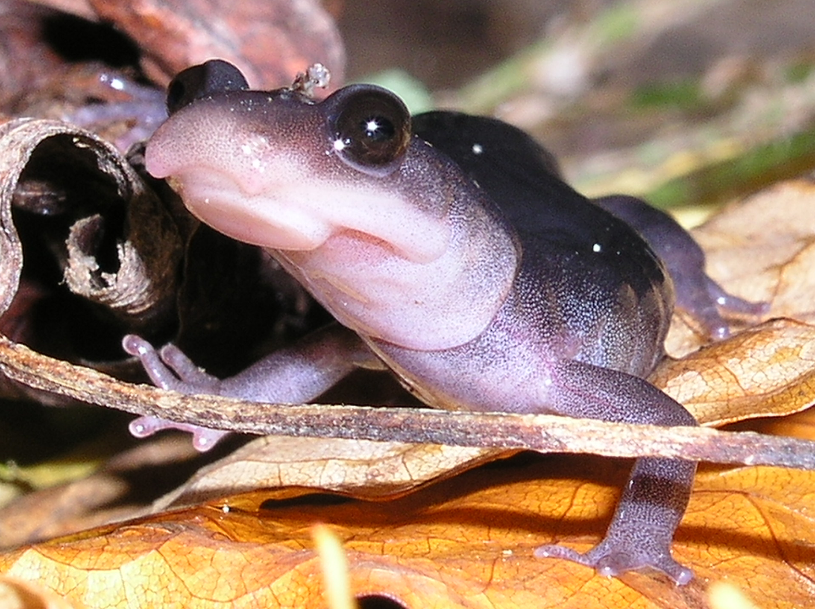
Plethodon montanus Northern Gray-cheeked Salamander

Slide 36
Plethodon montanus Northern Gray-cheeked Salamander

Slide 37
Plethodon cylindraceus White-spotted Slimy Salamander

Slide 38
Plethodon yonahlossee Yonahlossee Salamander

Slide 39
Plethodon yonahlossee Yonahlossee Salamander

Slide 40
Plethodon yonahlossee Yonahlossee Salamander

