Slide 1
Some Snails in Cuba
Wayne Van Devender
January 4, 2017

Slide 2
Annulariidae – Annularops semicana

Slide 3
Bradybaenidae – Bradybaena similaris

Slide 4
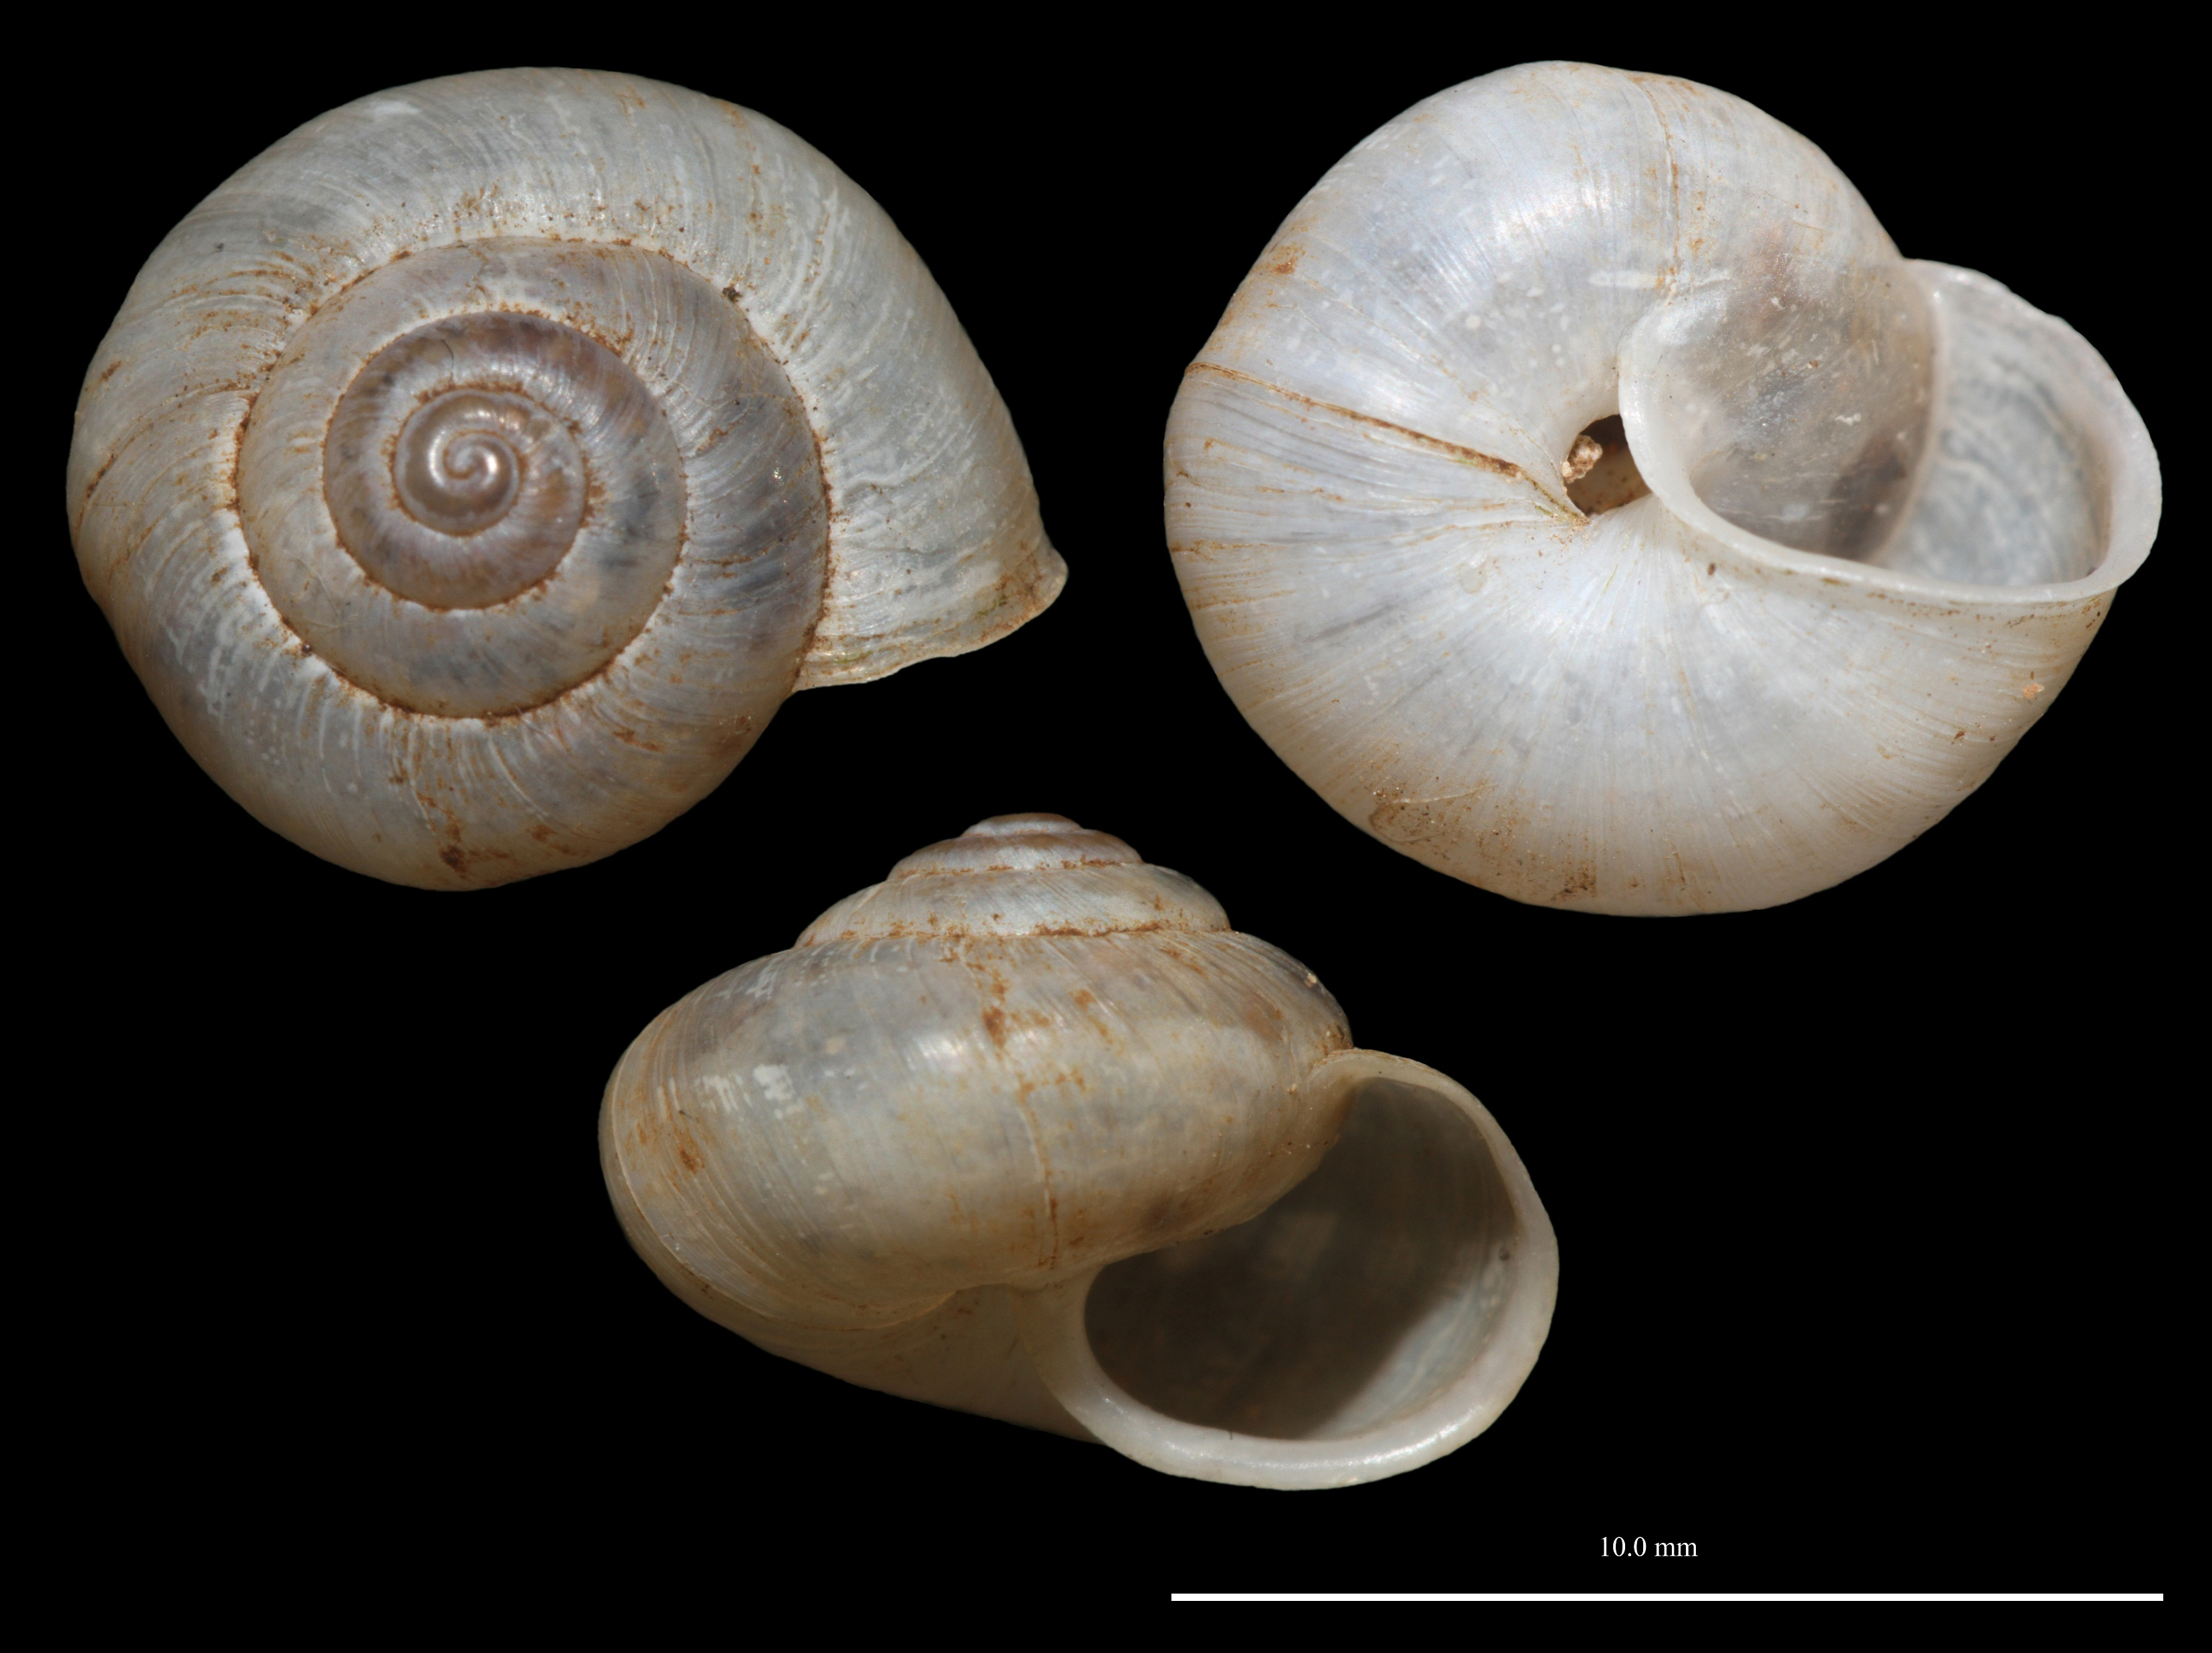
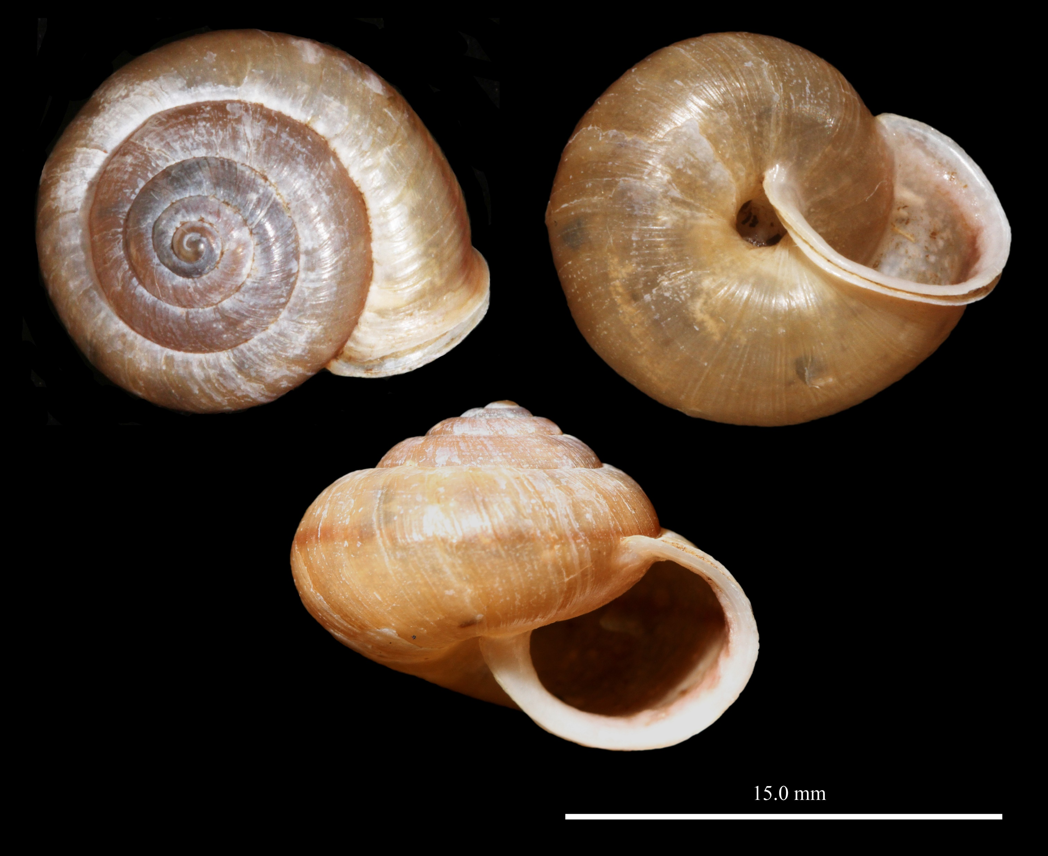
Bradybaenidae – Bradybaena similaris

Slide 5
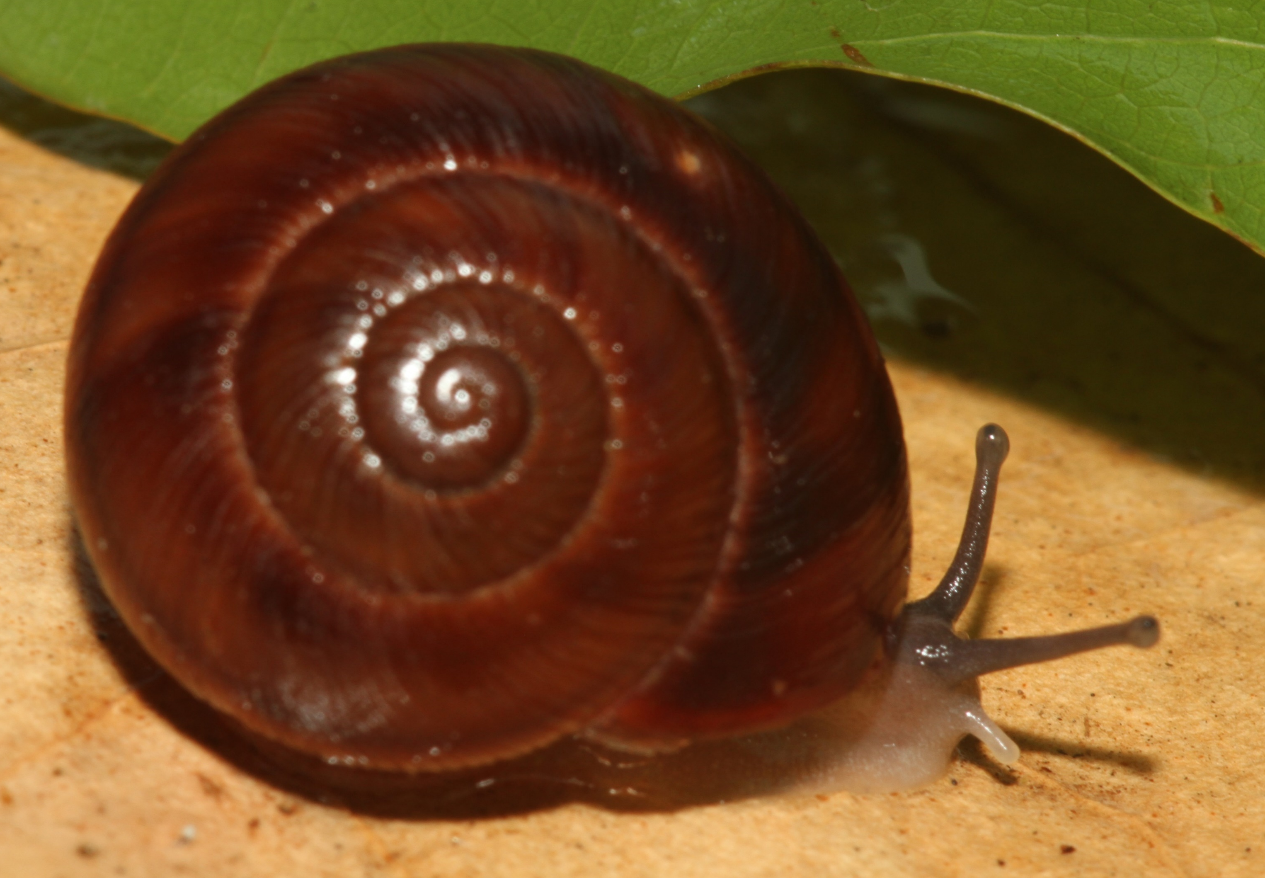
Cepolidae – Eurycampta species

Slide 6
Cepolidae – Jeanneretia parraiana

Slide 7
Cepolidae – Jeanneretia parraiana?

Slide 8
Cepolidae – Setipellis stigmaticus

Slide 9
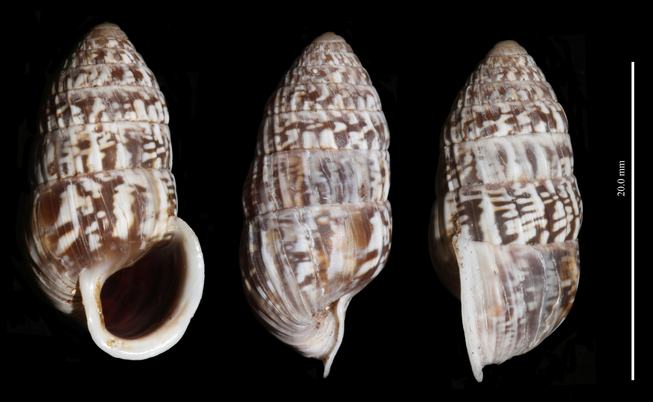
Cerionidae – Cerion iostomum

Slide 10
Helicinidae – Alcadia species

Slide 11
Helicinidae – Emoda sagaiana

Slide 12
Helicinidae – Viana laevigata

Slide 13
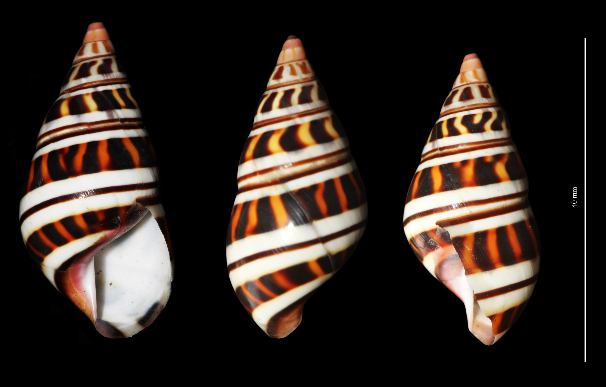
Orthalicidaeidae – Liguus blainianus blainianus

Slide 14
Oleacinidae – smaller species from gas station

Slide 15
Oleacinidae – smaller species from Havana

Slide 16
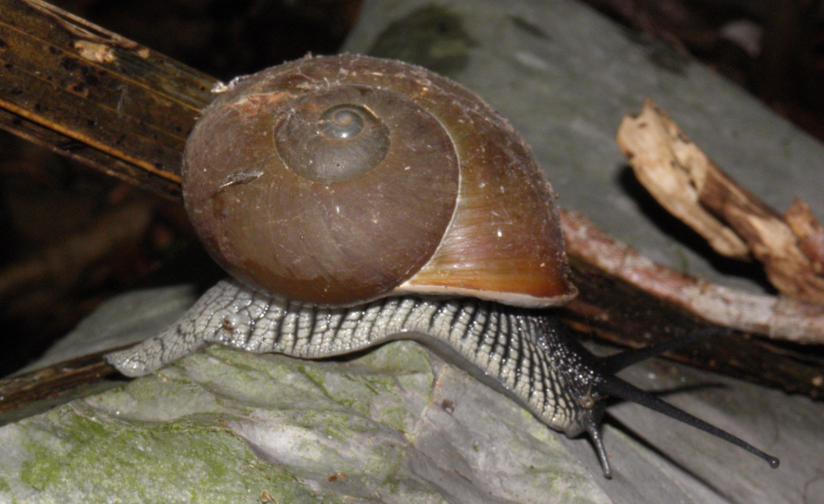
Pleurodontidae – Zachrysia guanensis

Slide 17
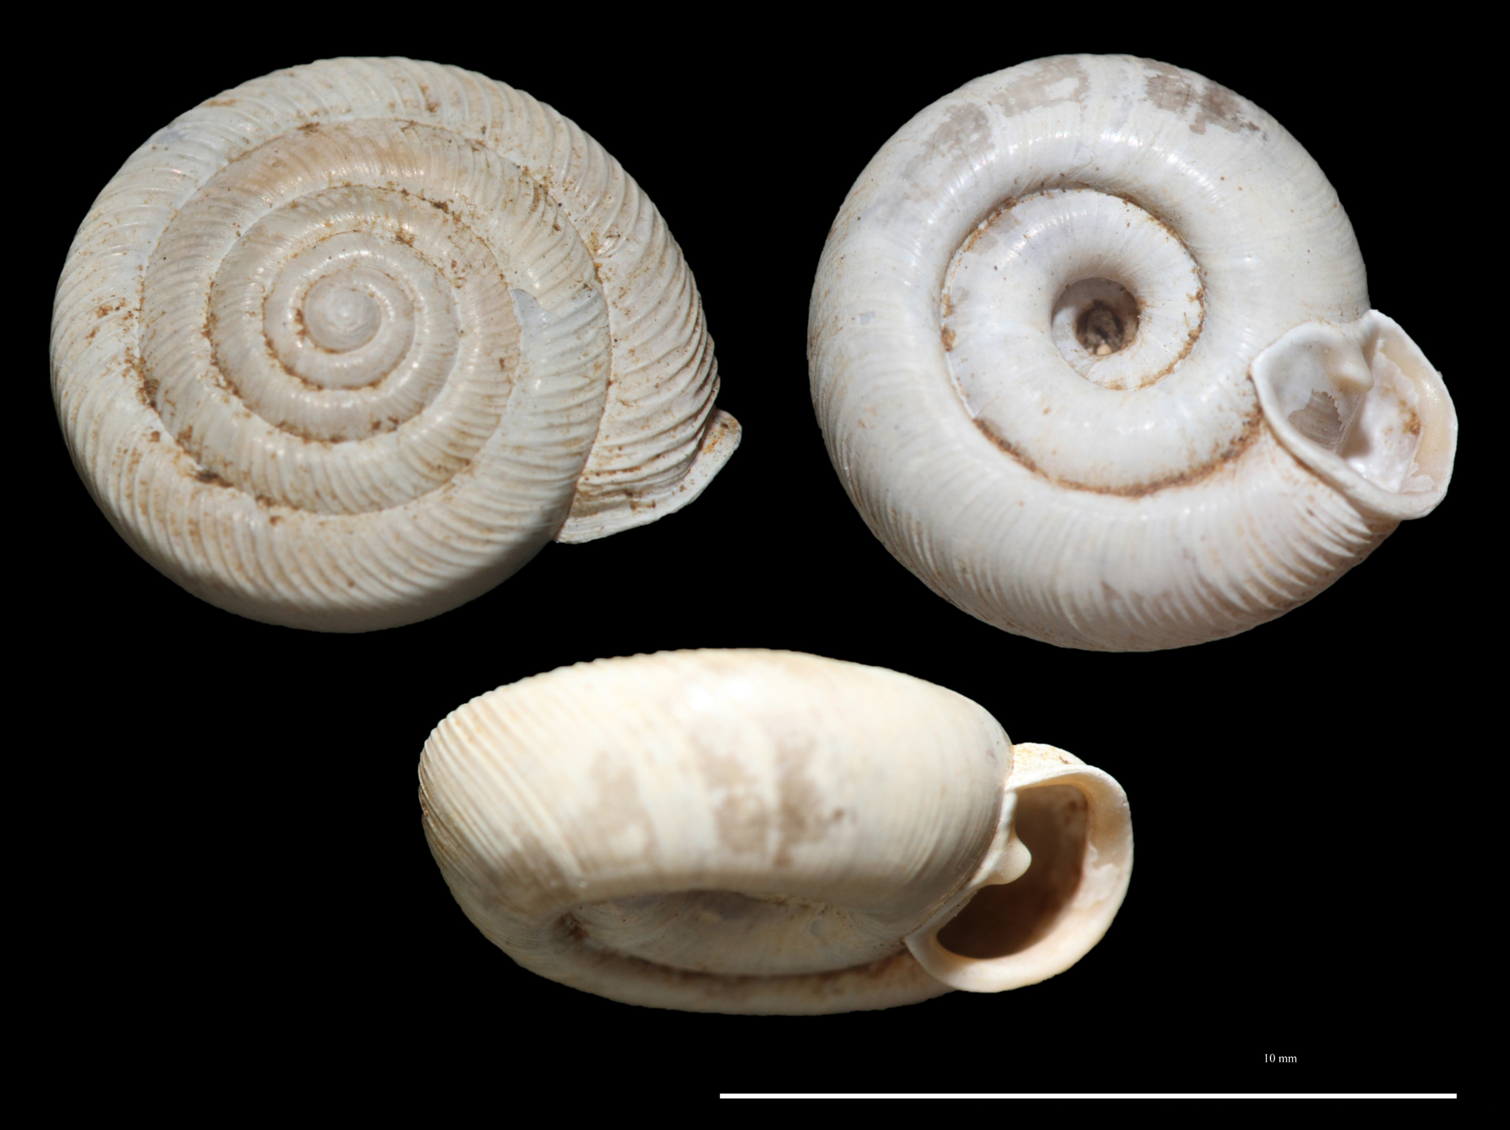
Polygyridae – Polygyra lingulata

Slide 18
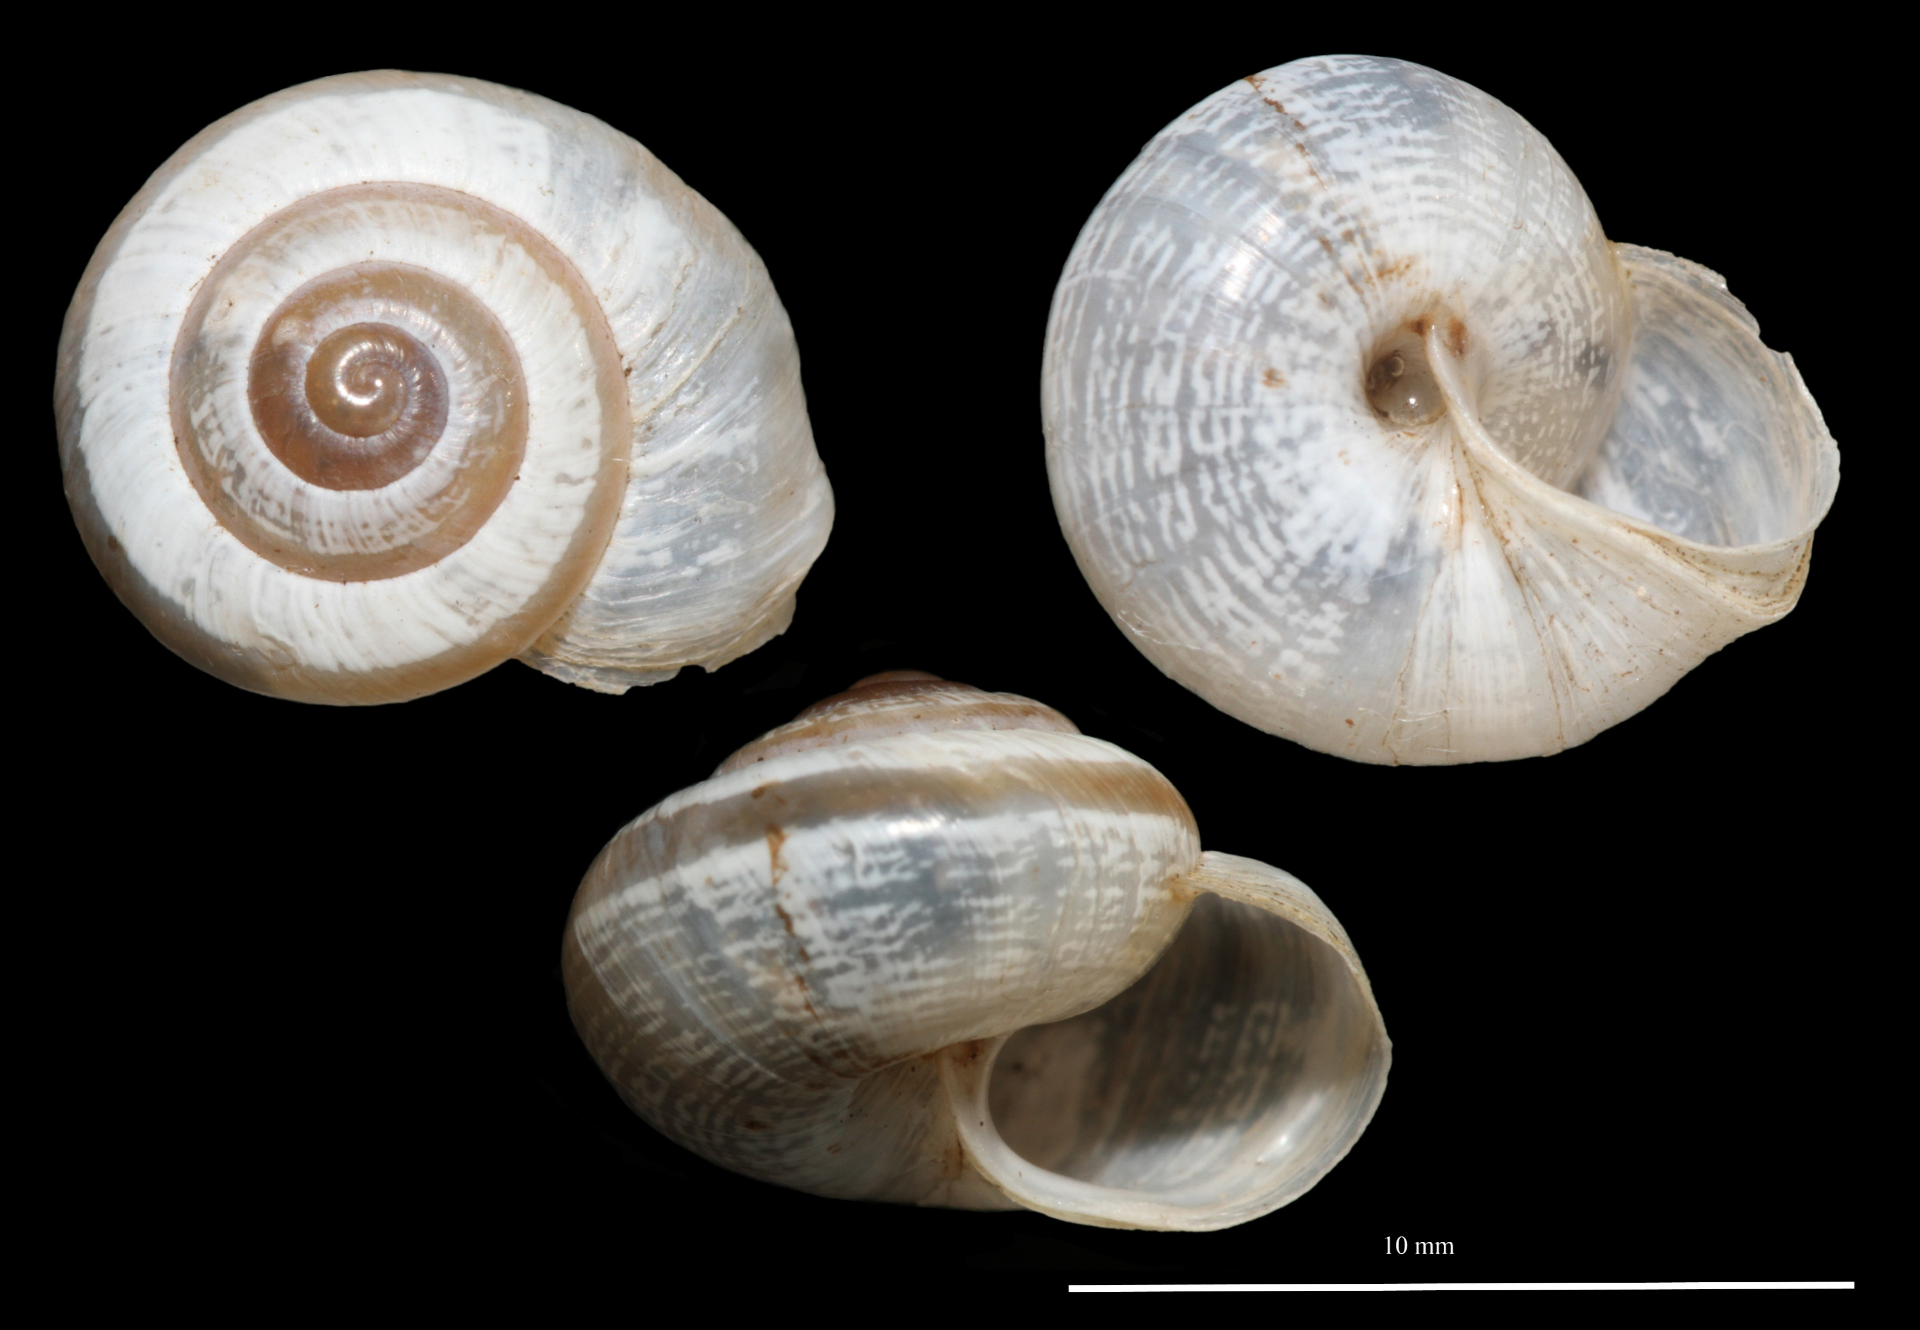
Polygyridae – Praticolella griseola

Slide 19
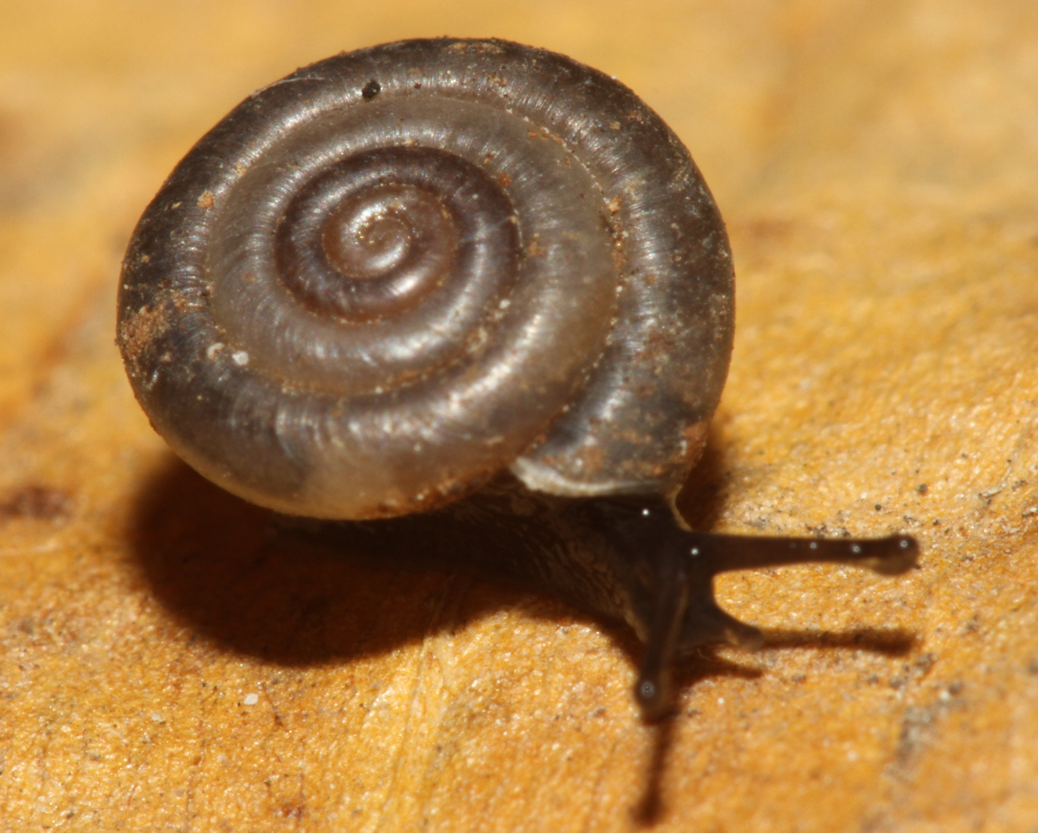
Sagdidae – Lacteoluna selinina

Slide 20
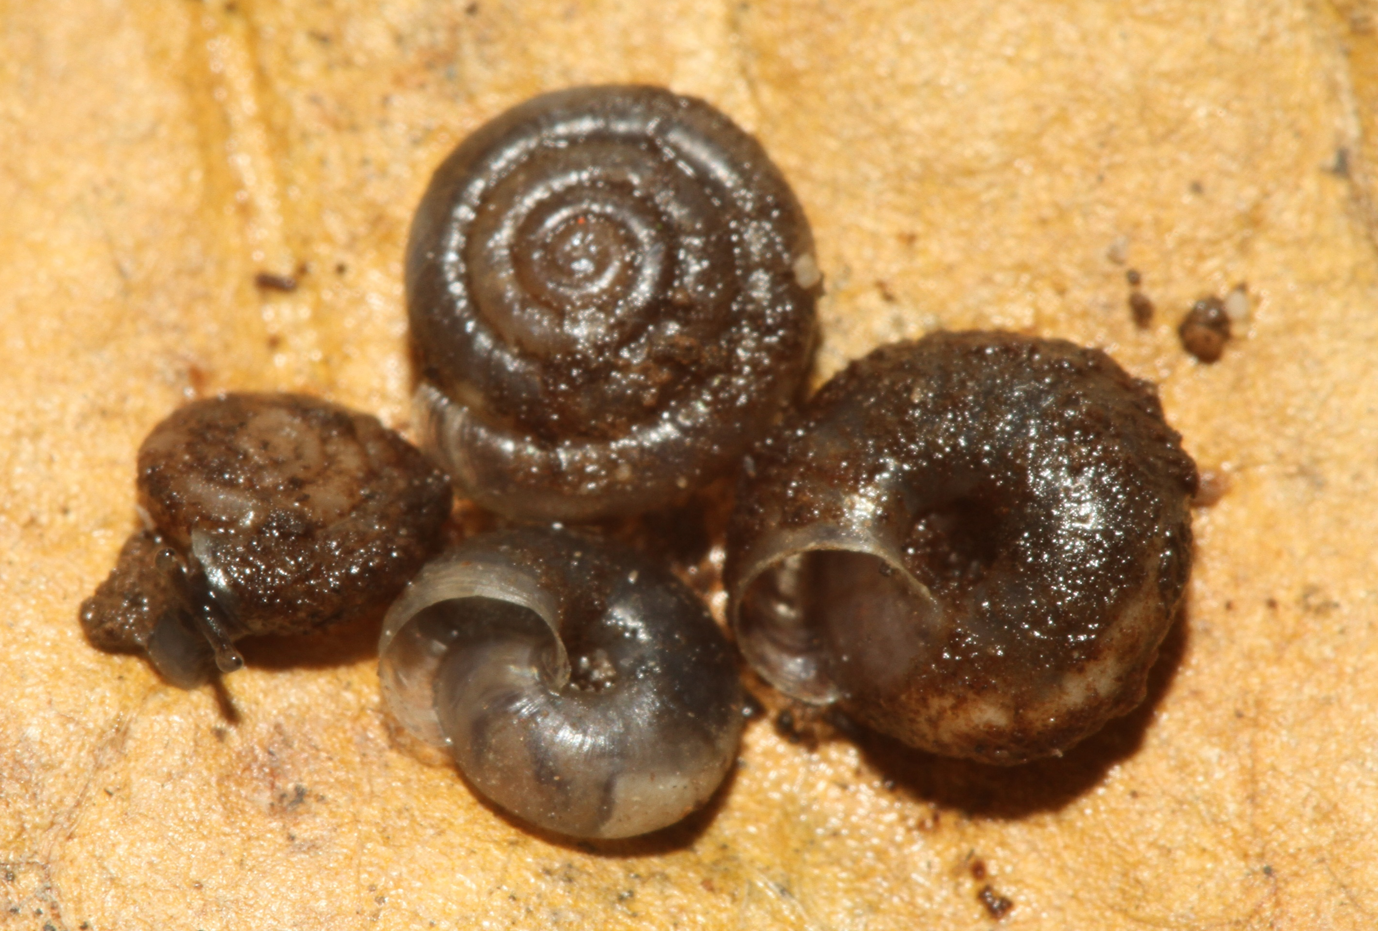
Sagdidae – Lacteoluna selinina

Slide 21
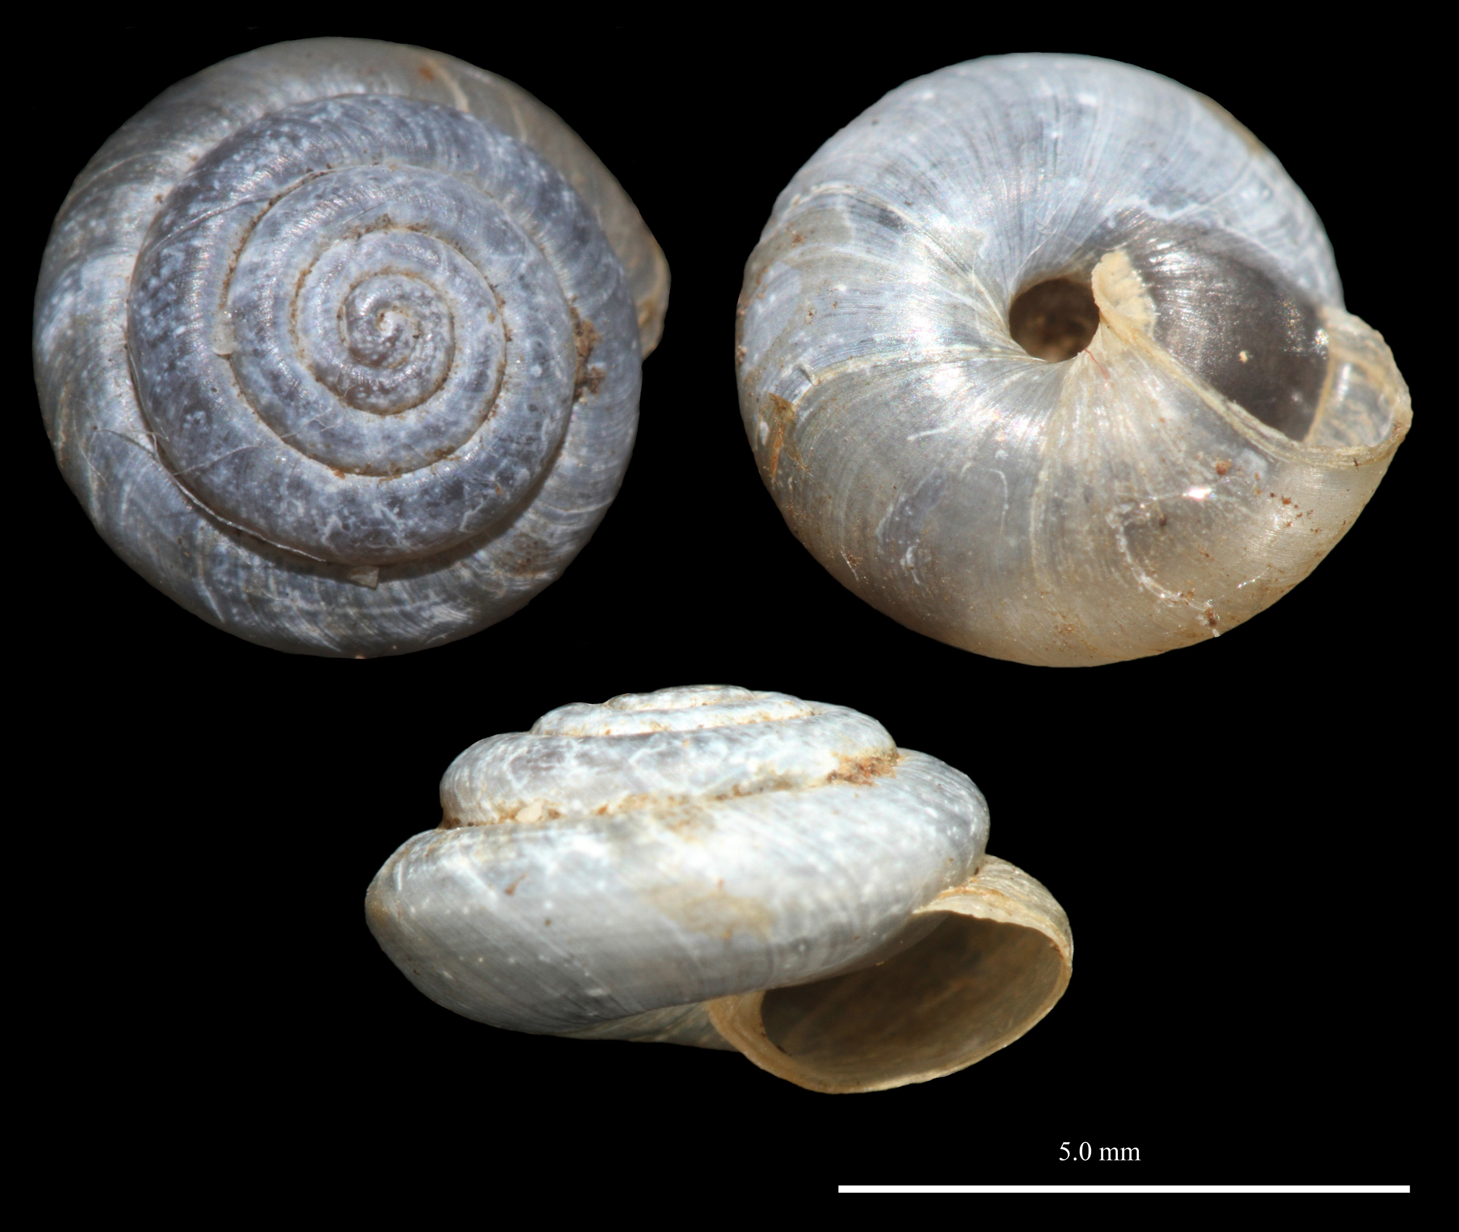
Sagdidae – Lacteoluna selinina

Slide 22
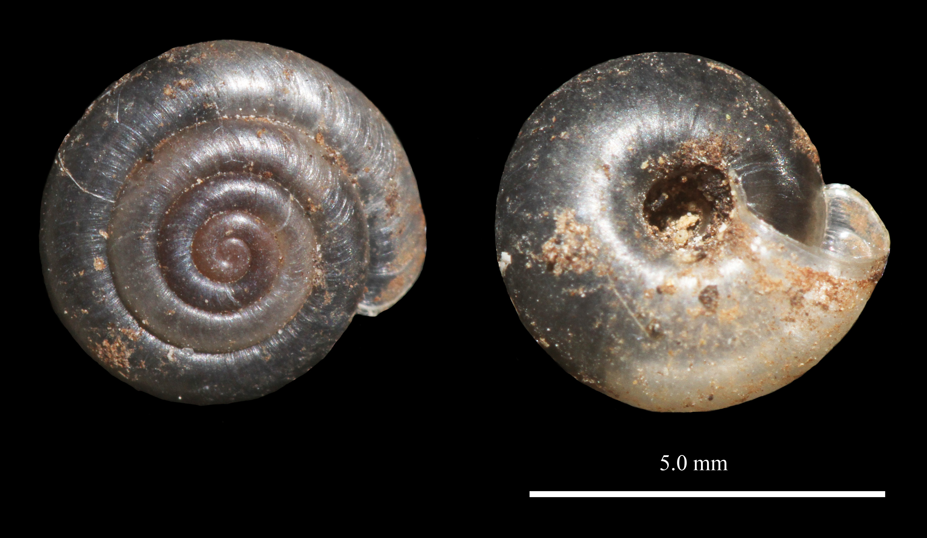
Sagdidae – Lacteoluna selinina

Slide 23
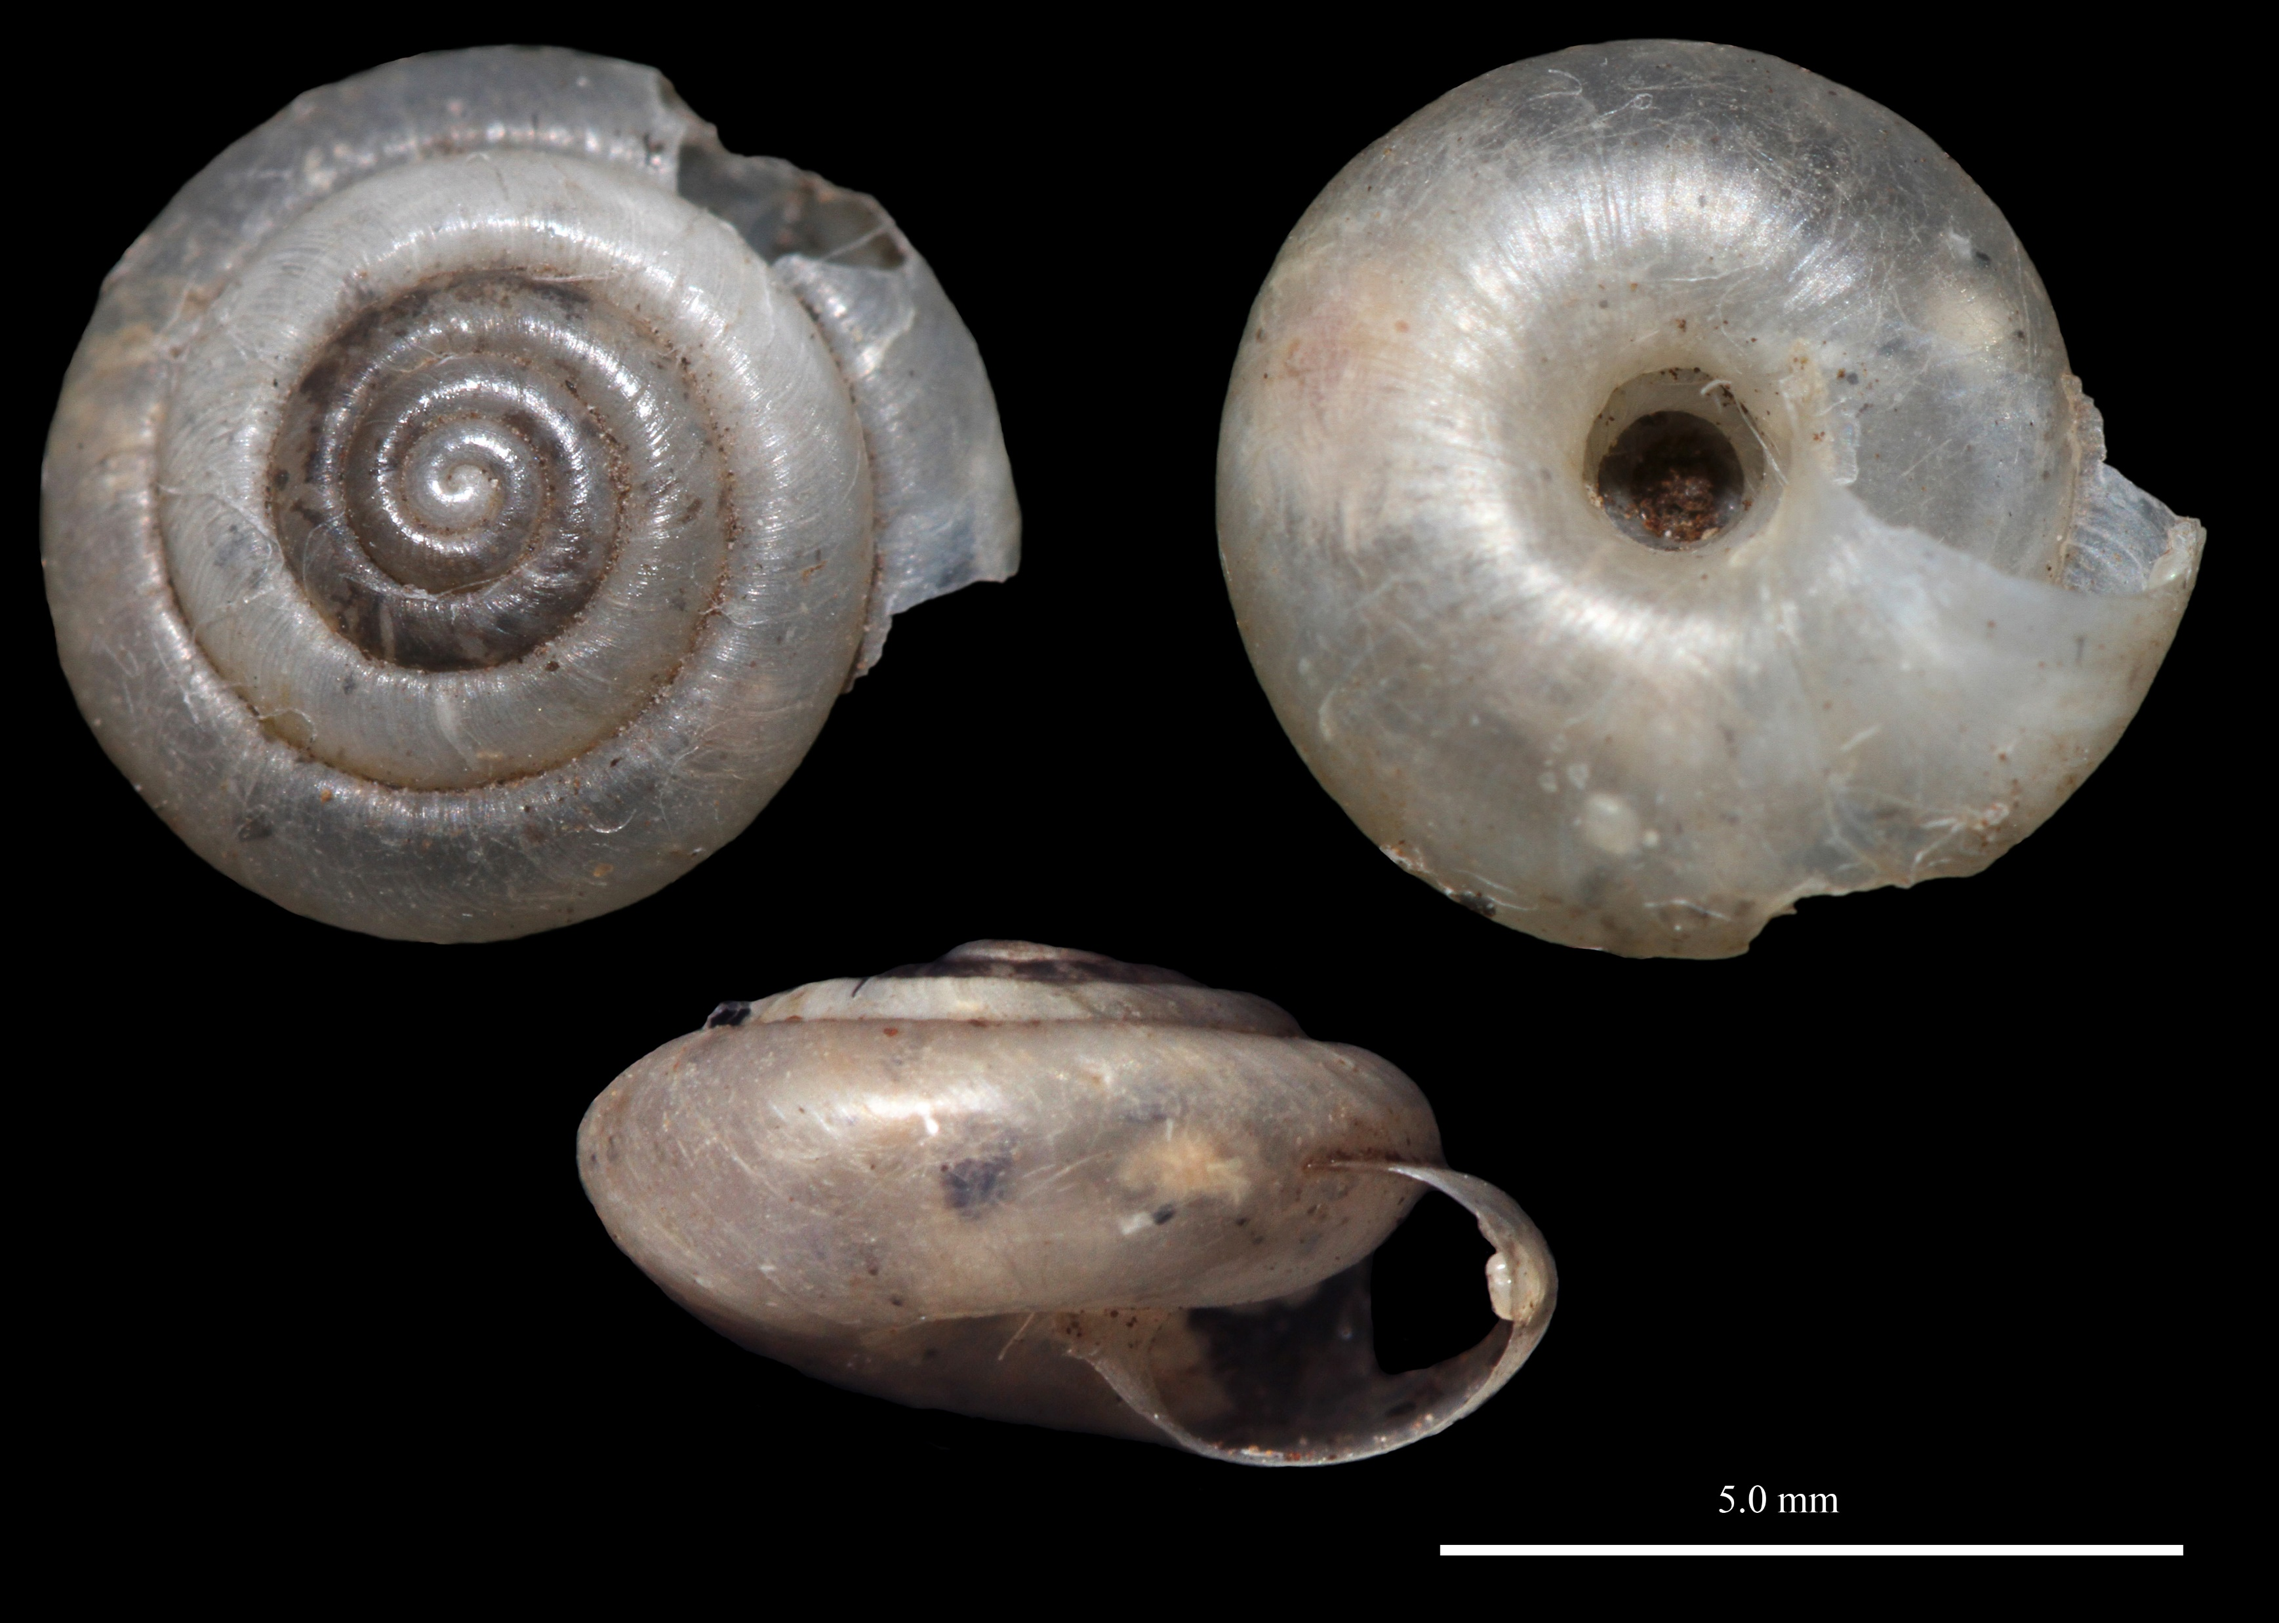
Sagdidae – Volvidens trichostoma

Slide 24
Veronicellidae – Leidyula floridana

Slide 25
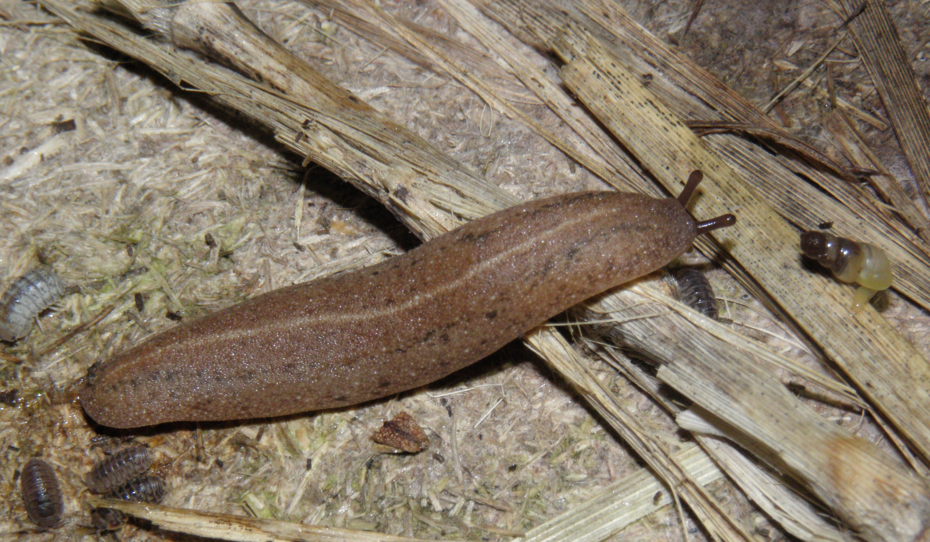
Veronicellidae – Veronicella cubensis

Slide 26
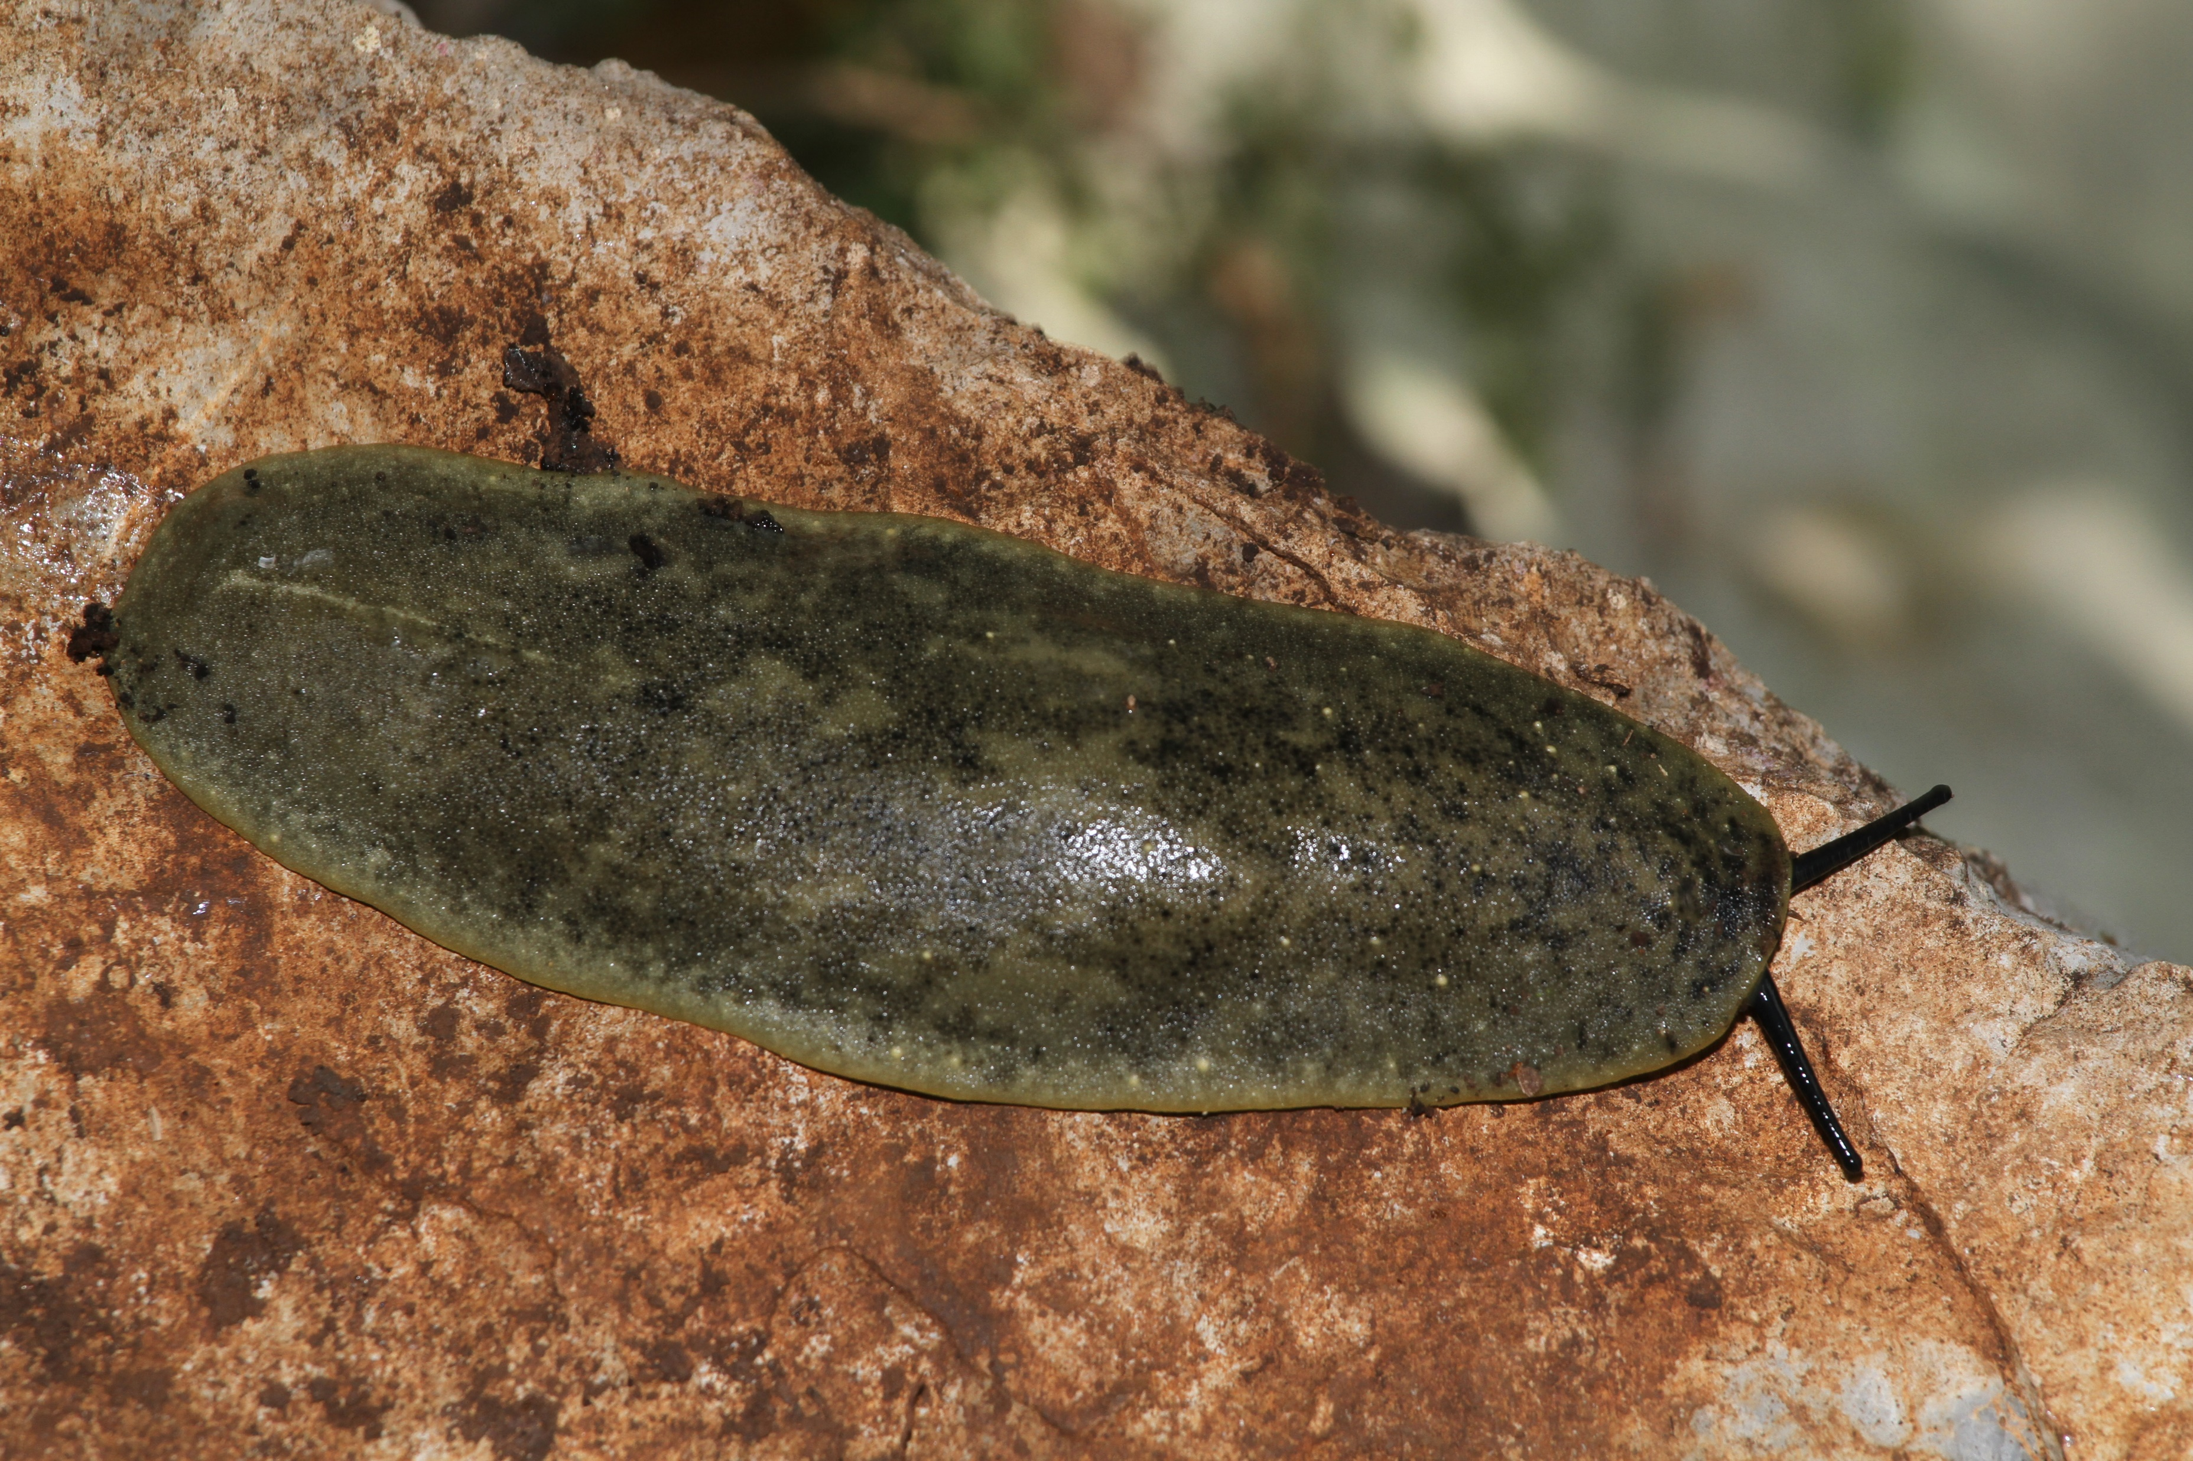
Veronicellidae – Veronicella tenax

