Slide 1
Small, Tall Snails in Cuba
Wayne Van Devender
January 4, 2017

Slide 2
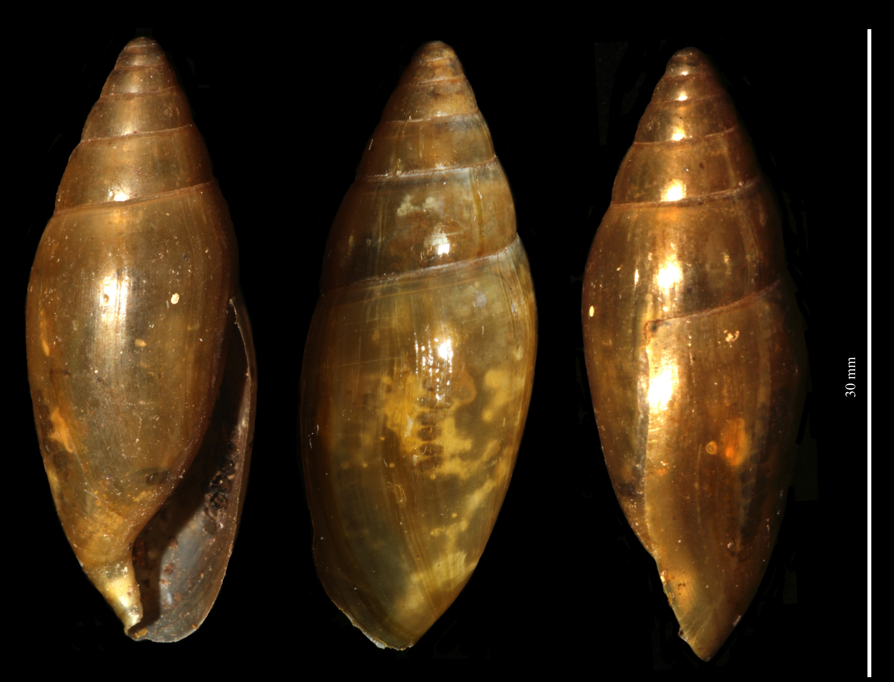
Oleacinidae –

Slide 3
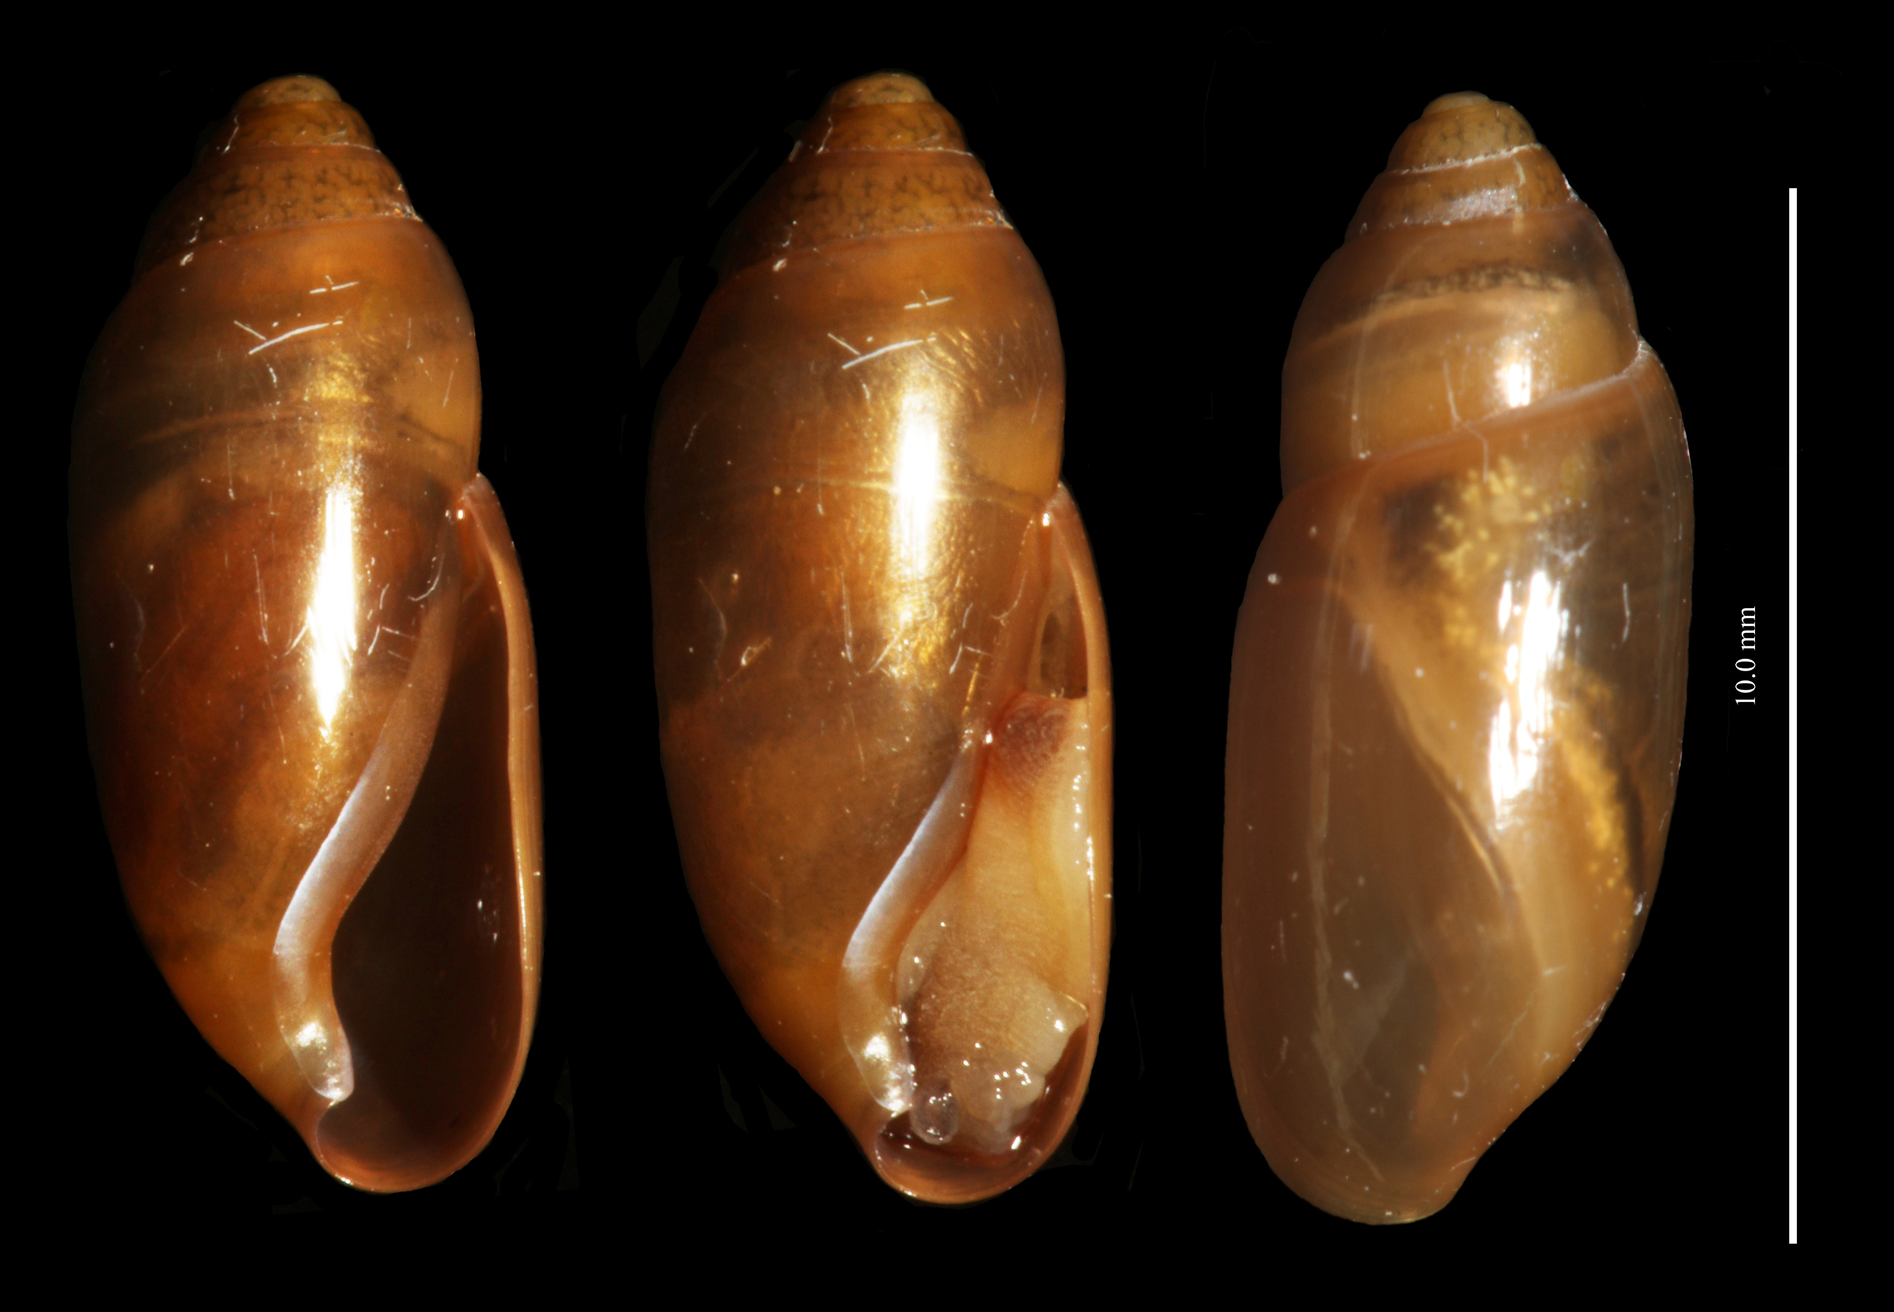
Oleacinidae –

Slide 4
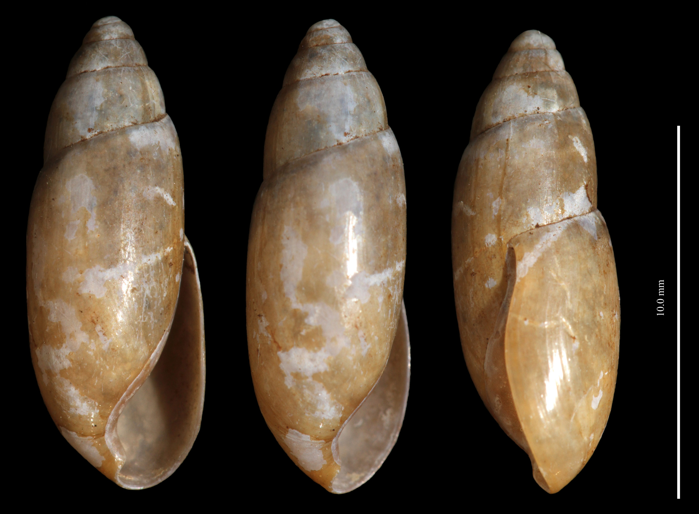
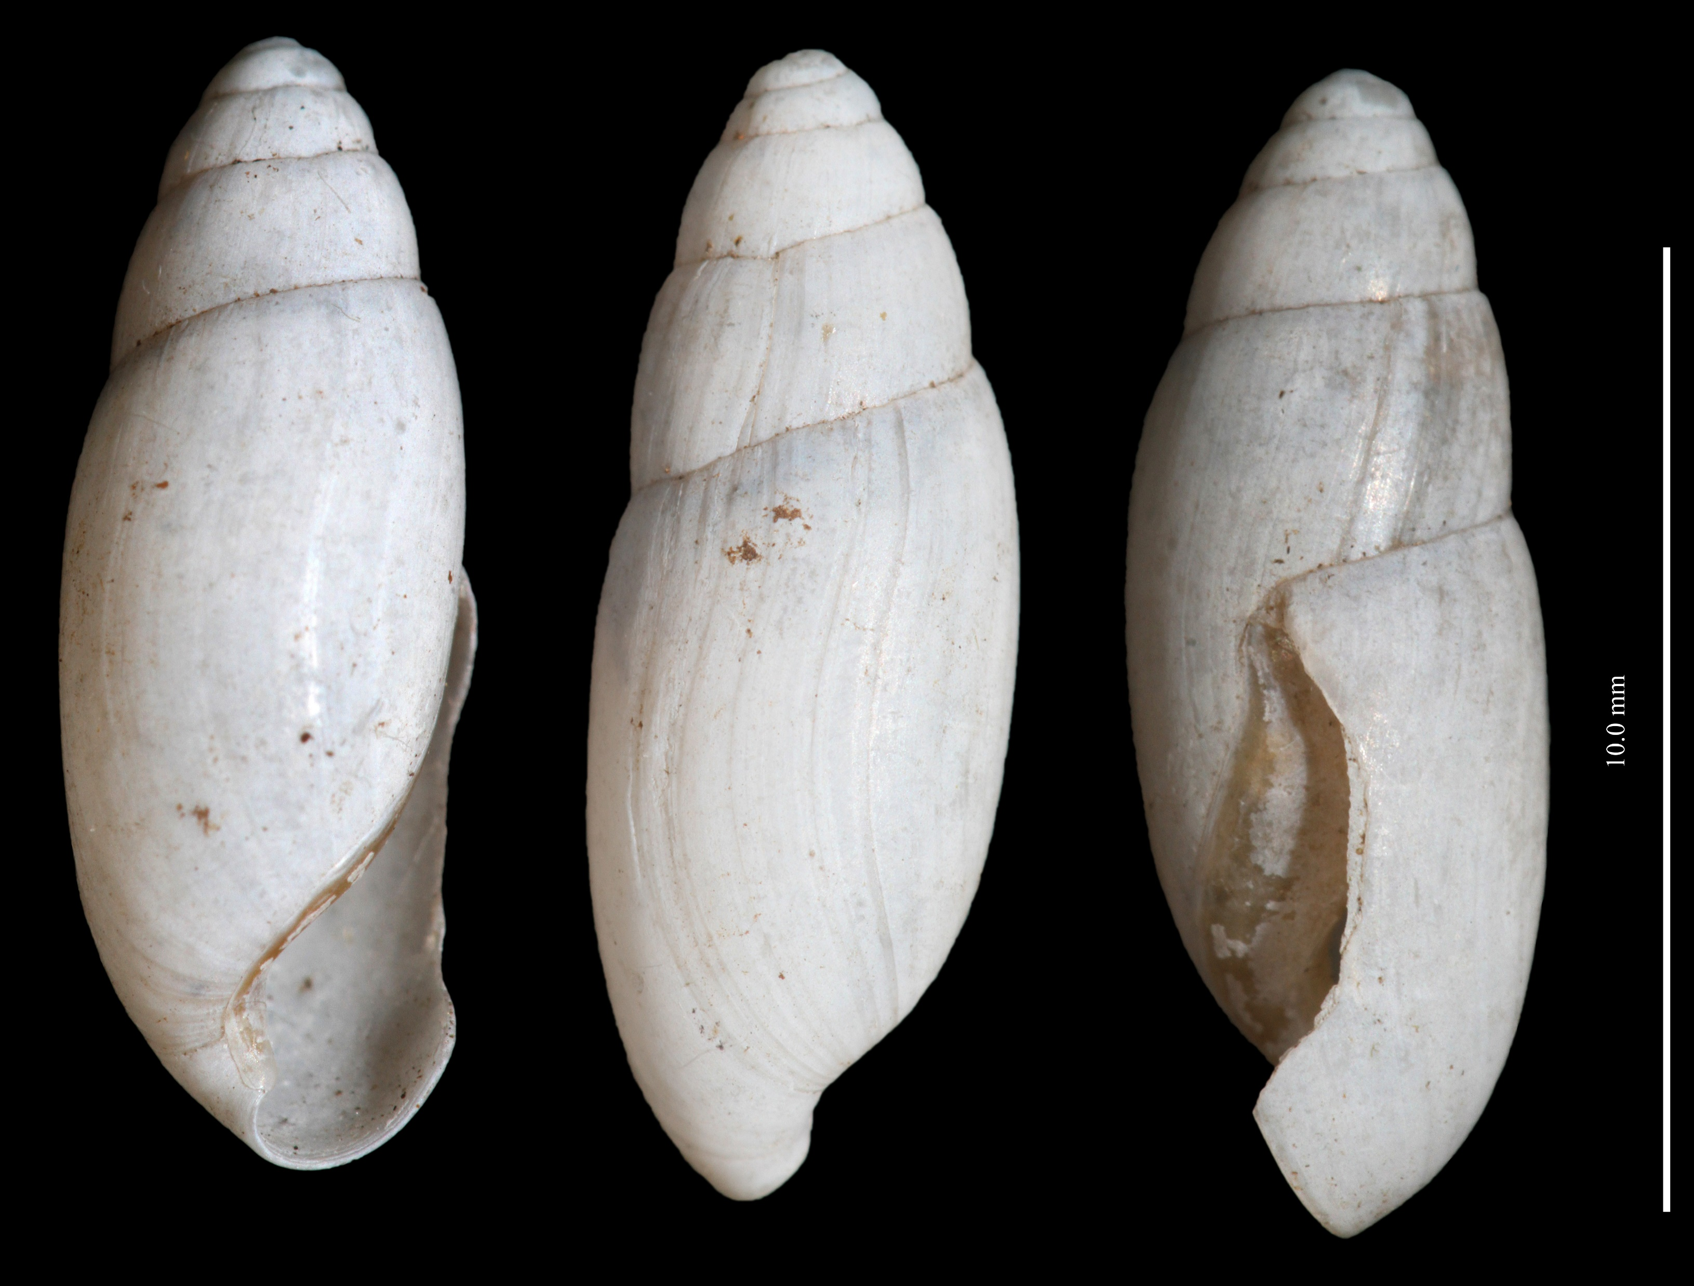
Oleacinidae –

Slide 5
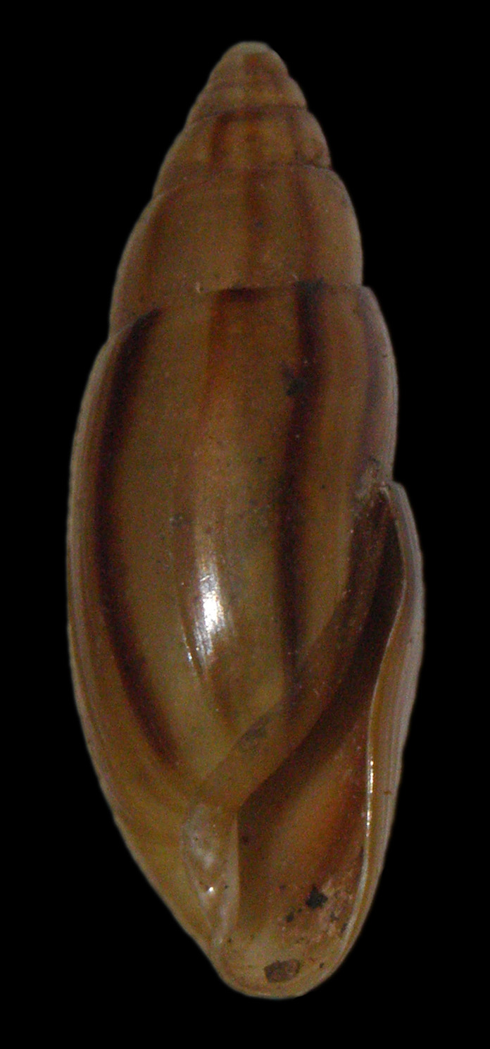
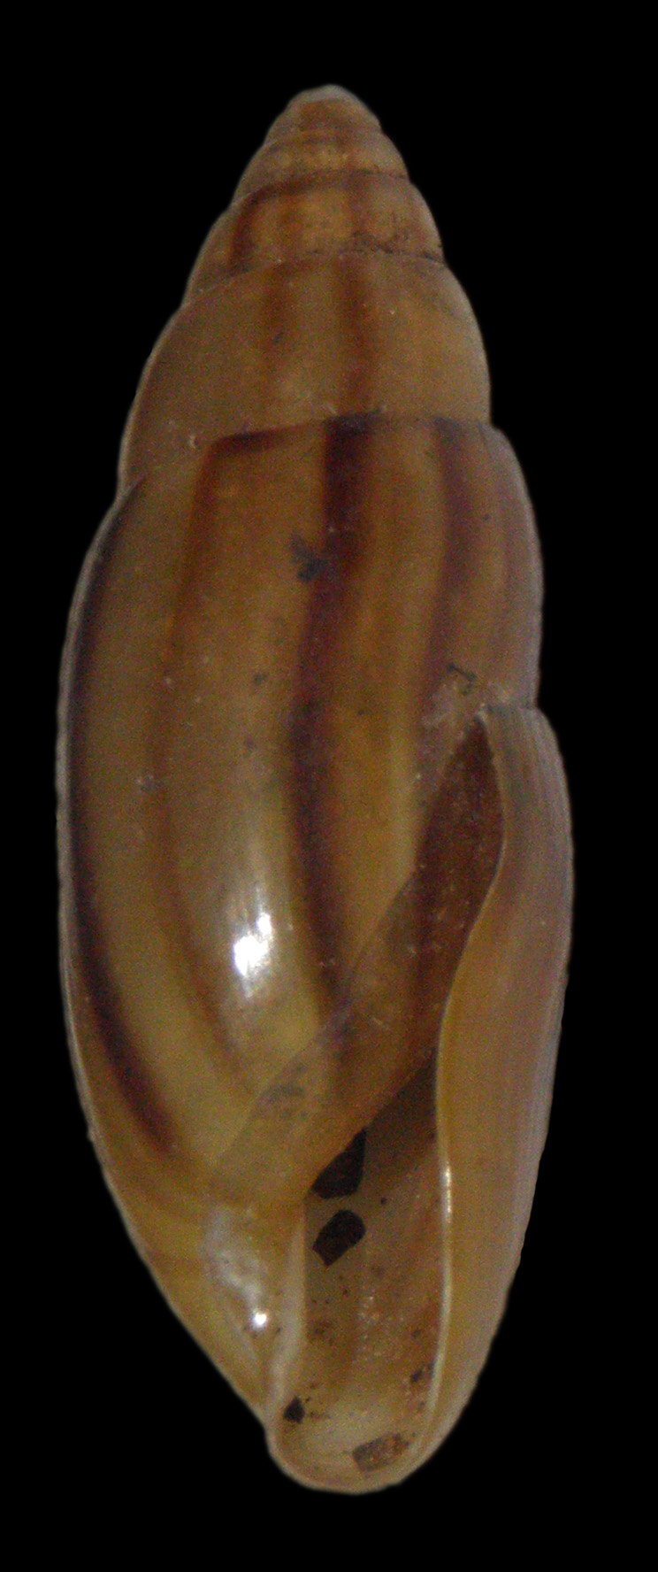
Oleacinidae – Rectoleacina cubensis

Slide 6
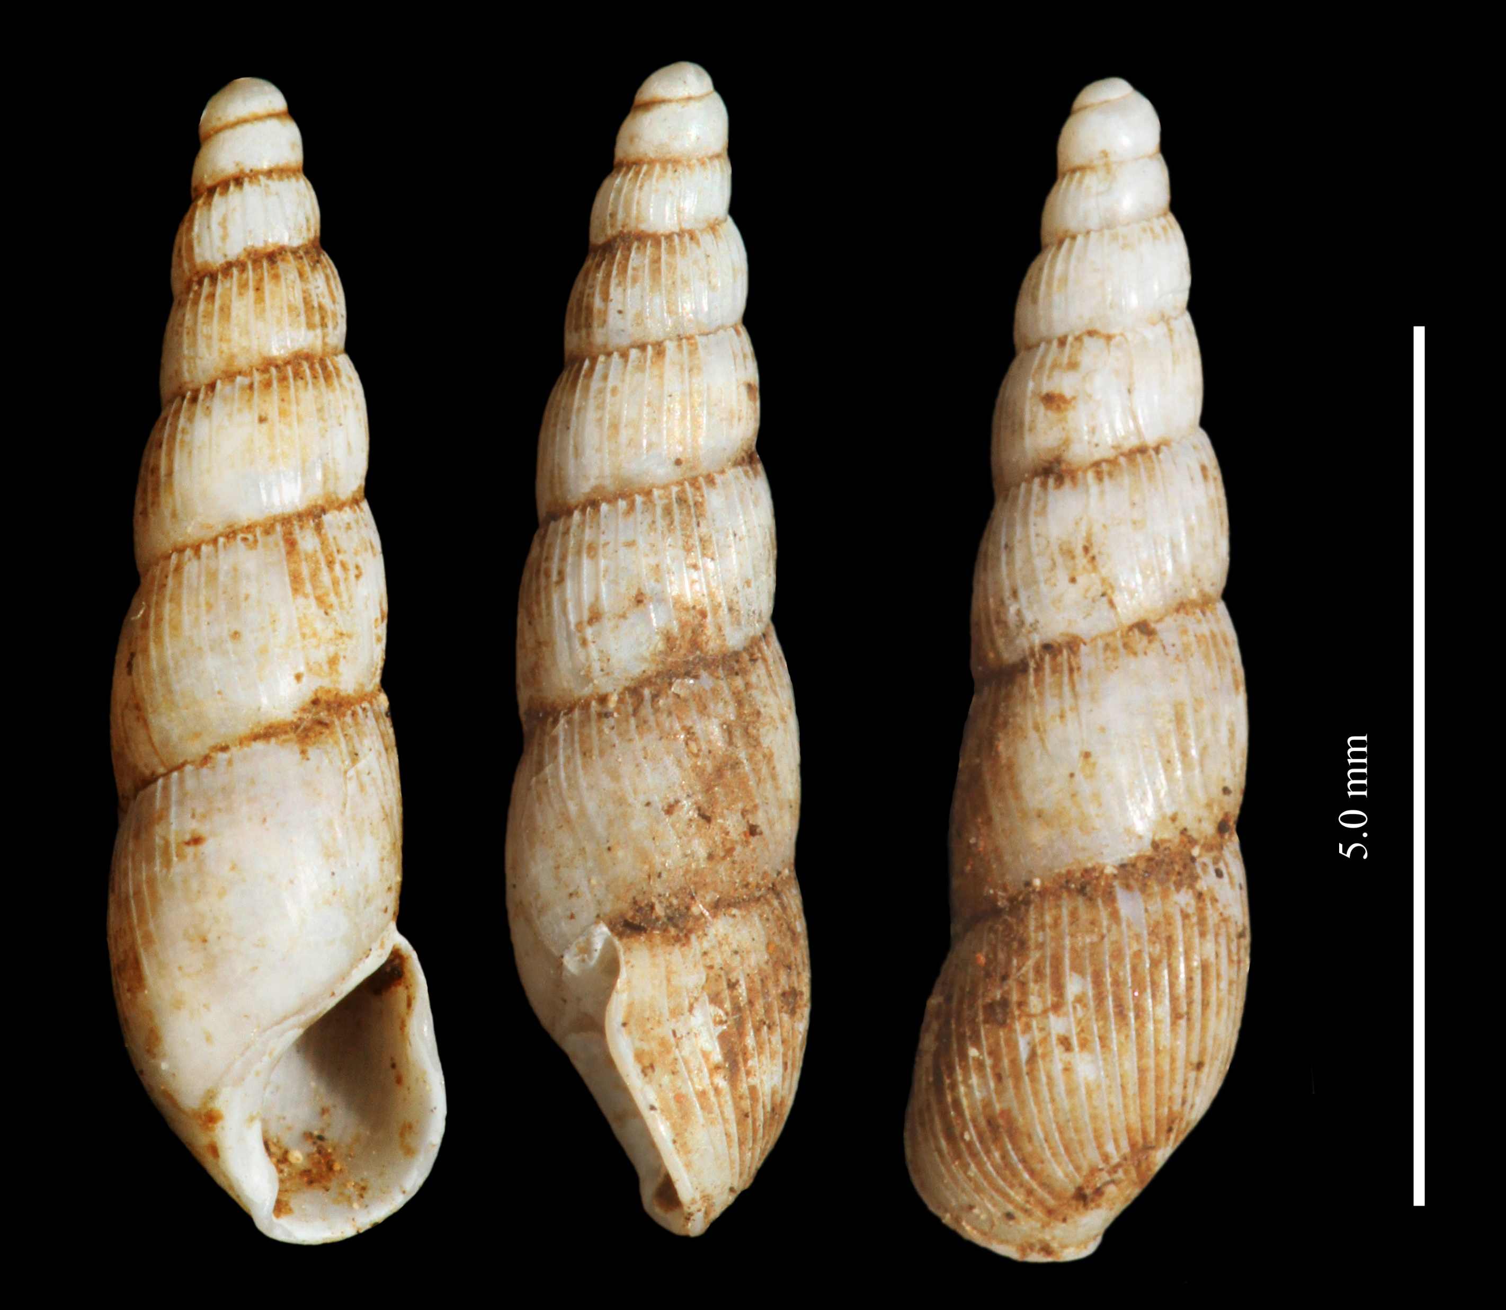
Streptaxidae – Streptostele musicola

Slide 7
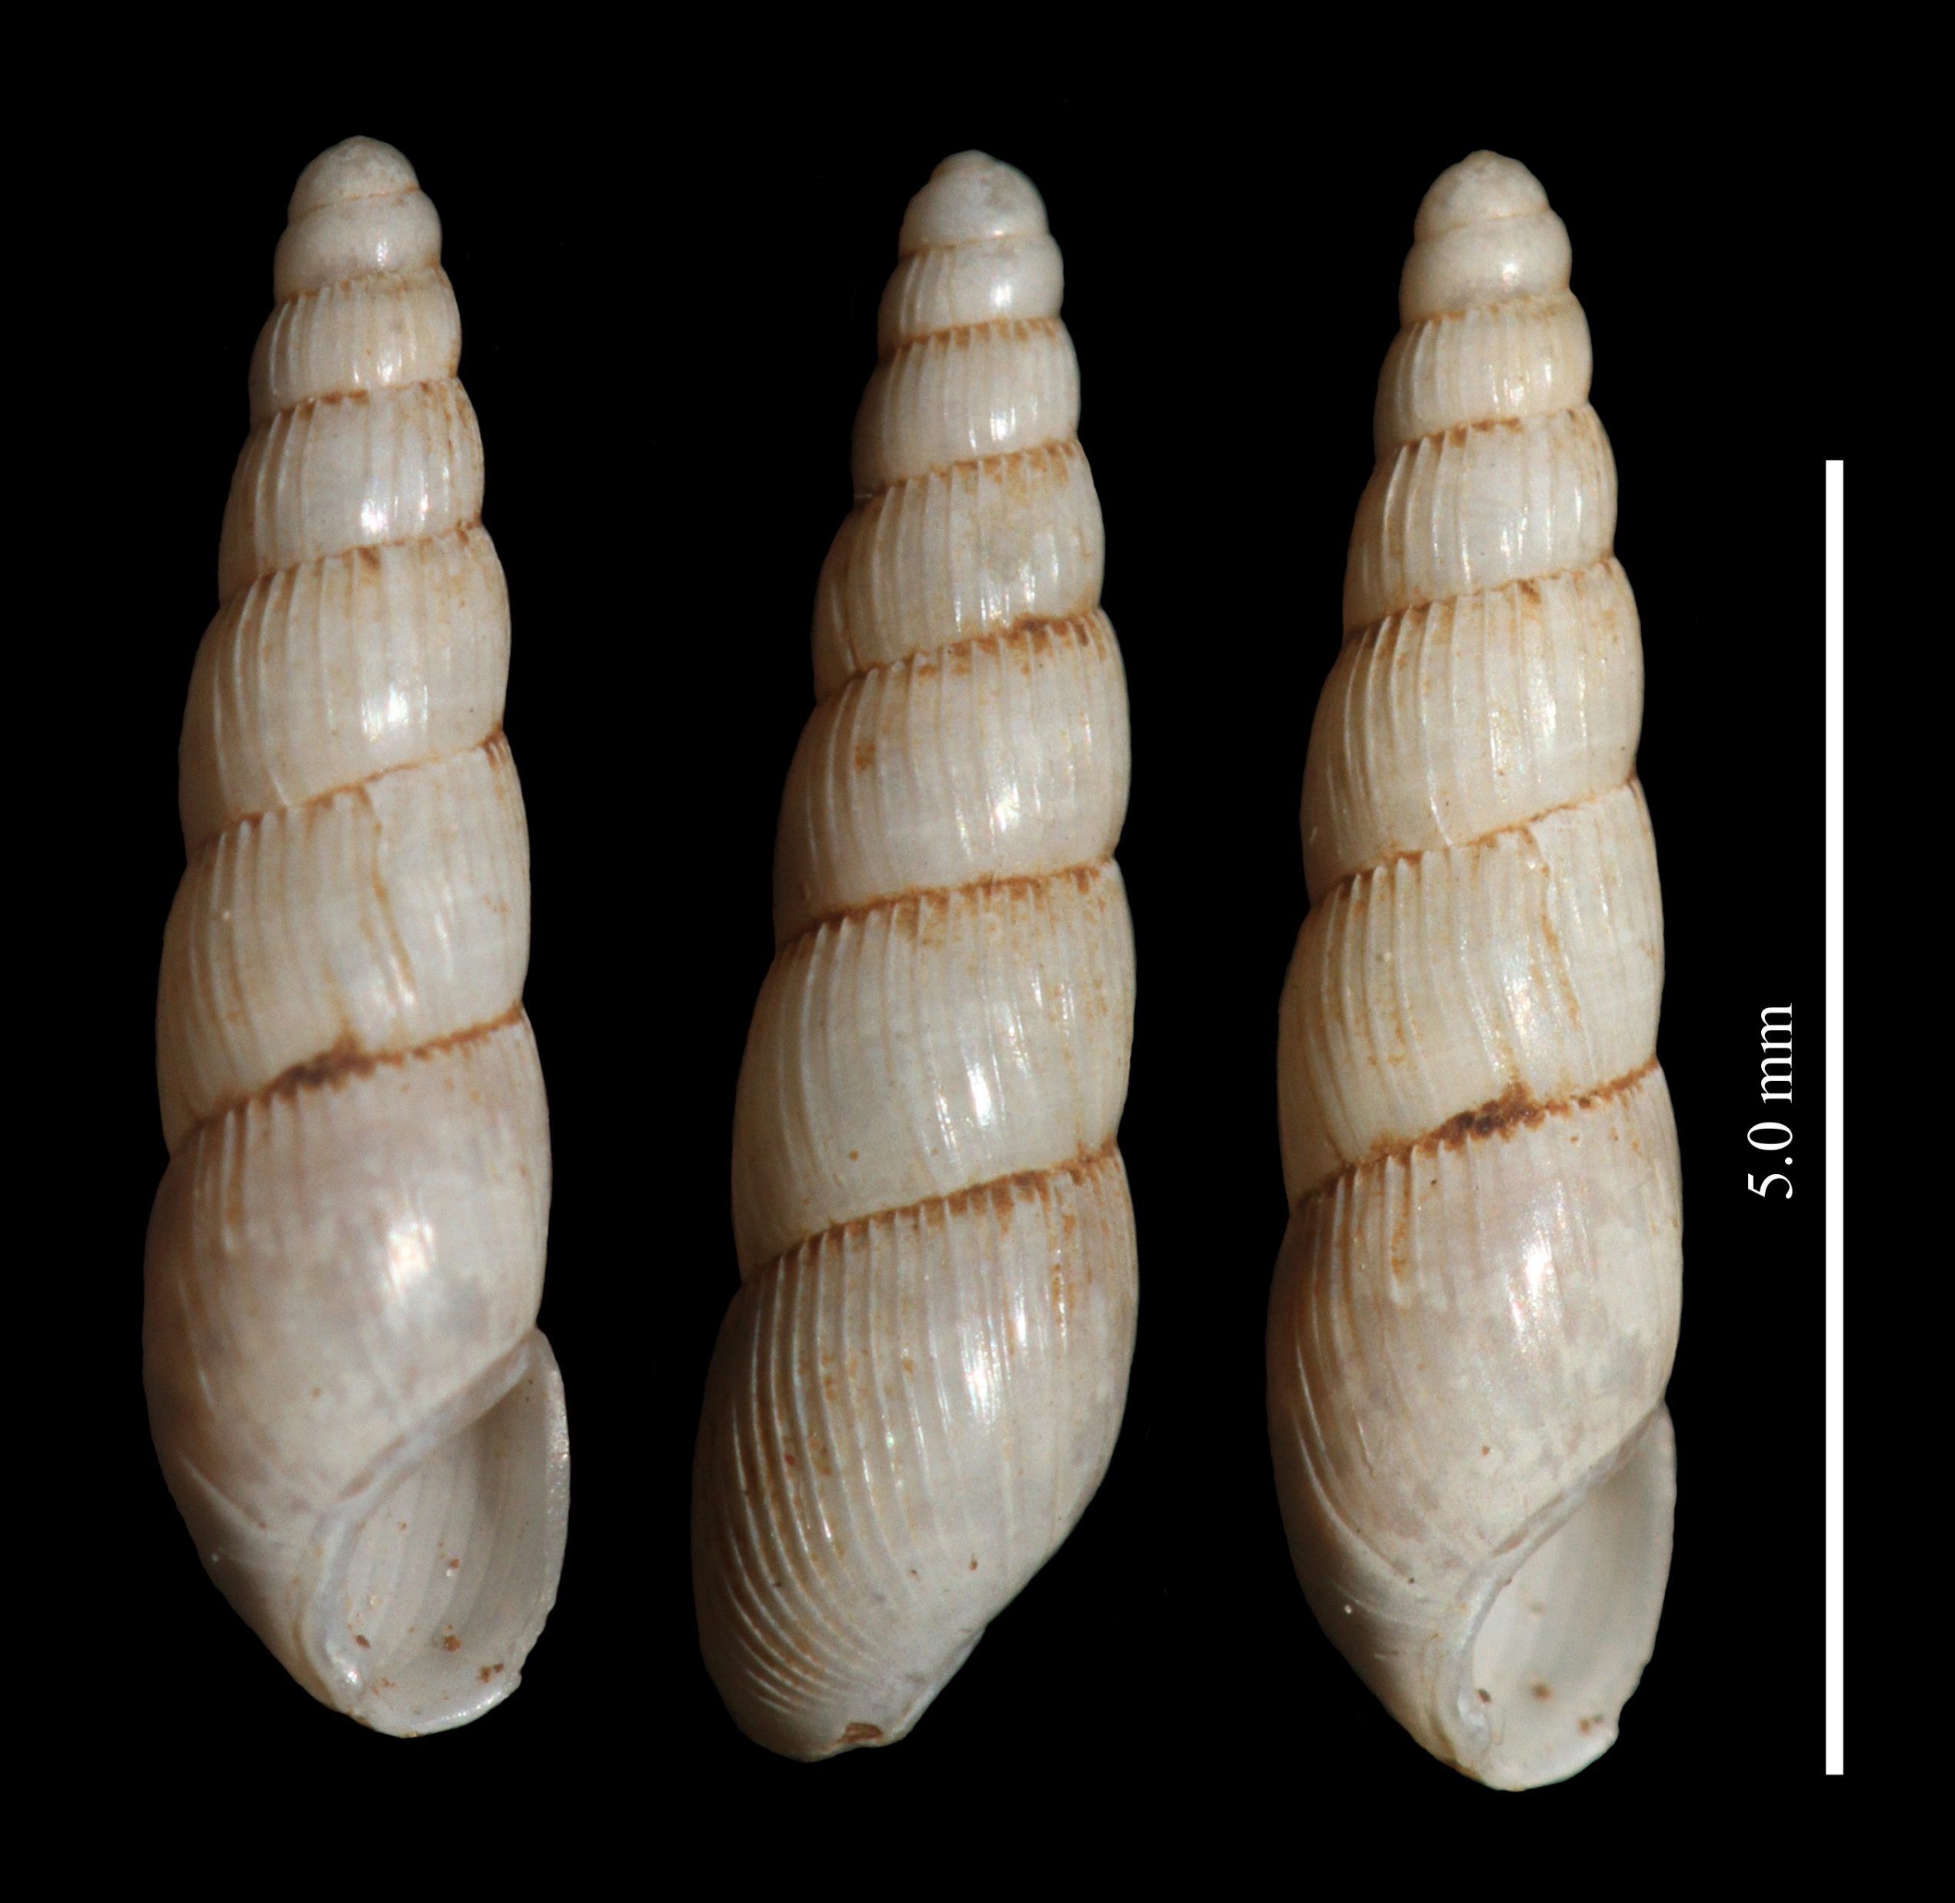
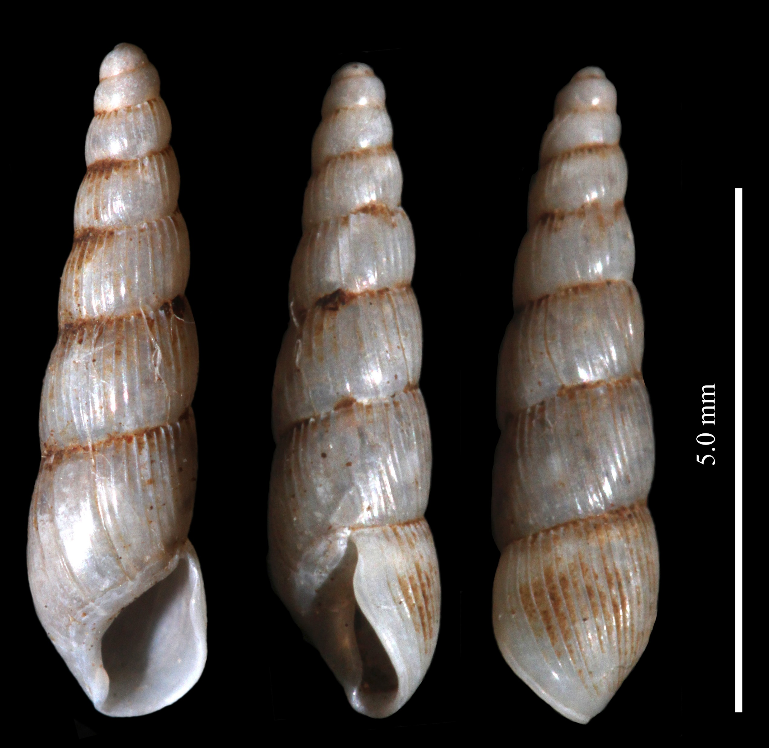
Streptaxidae – Streptostele musicola

Slide 8
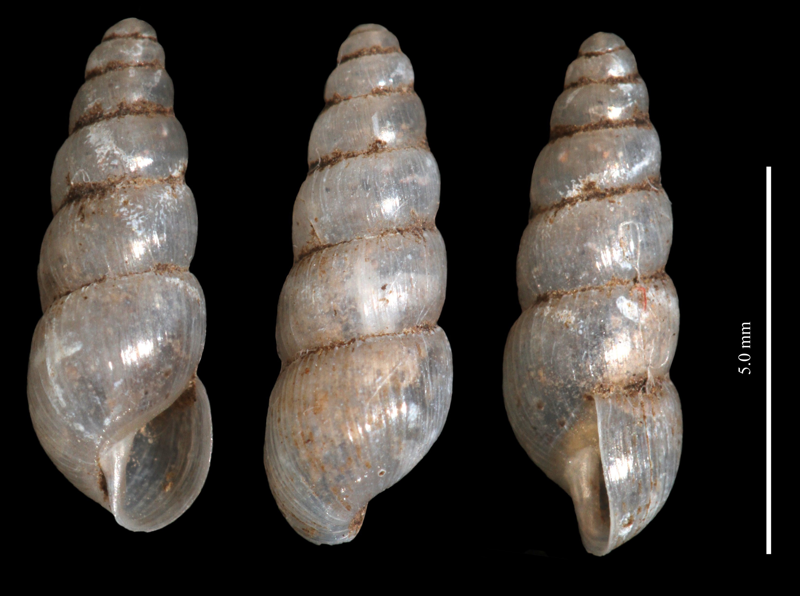
Subulinidae – Allopeas gracile?

Slide 9
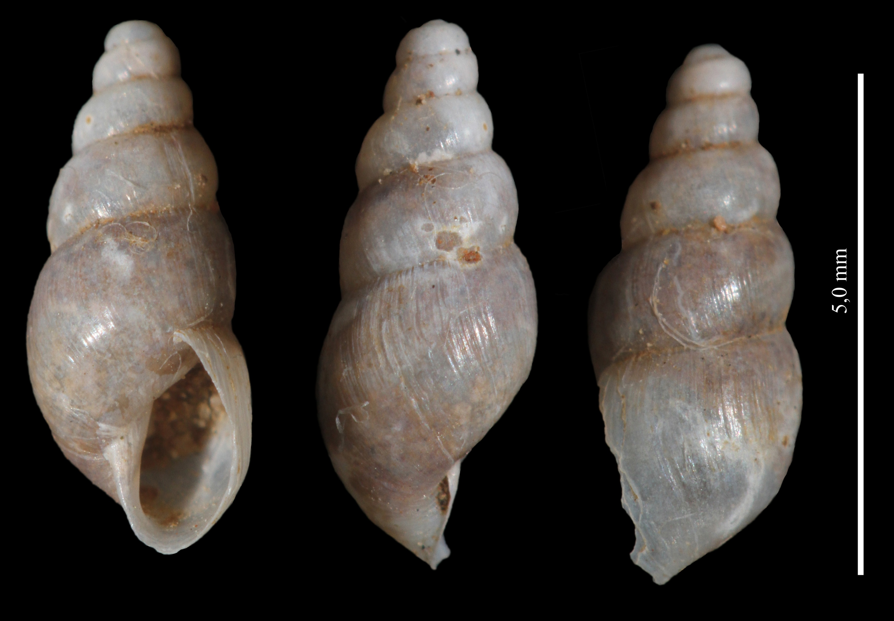
Subulinidae – Allopeas gracile?

Slide 10
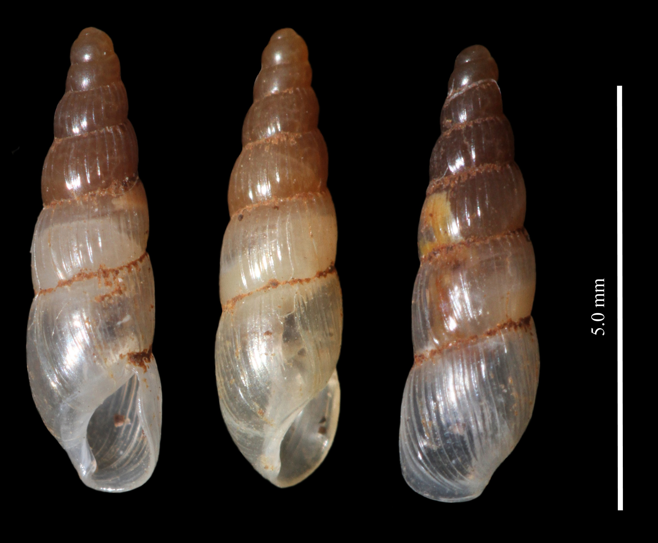
Subulinidae – Allopeas micra?

Slide 11
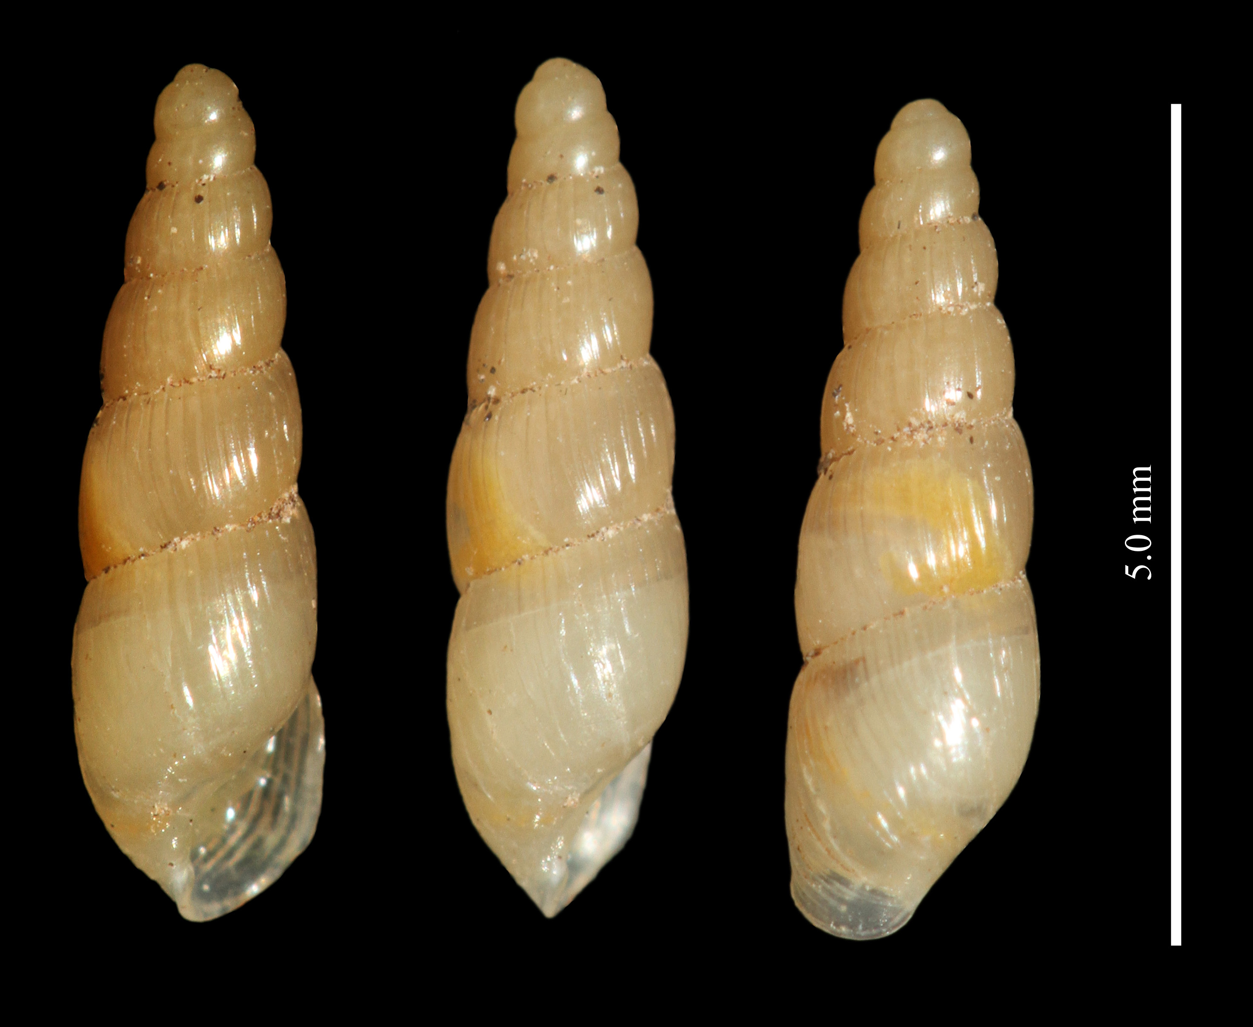
Subulinidae – Allopeas micra?

Slide 12
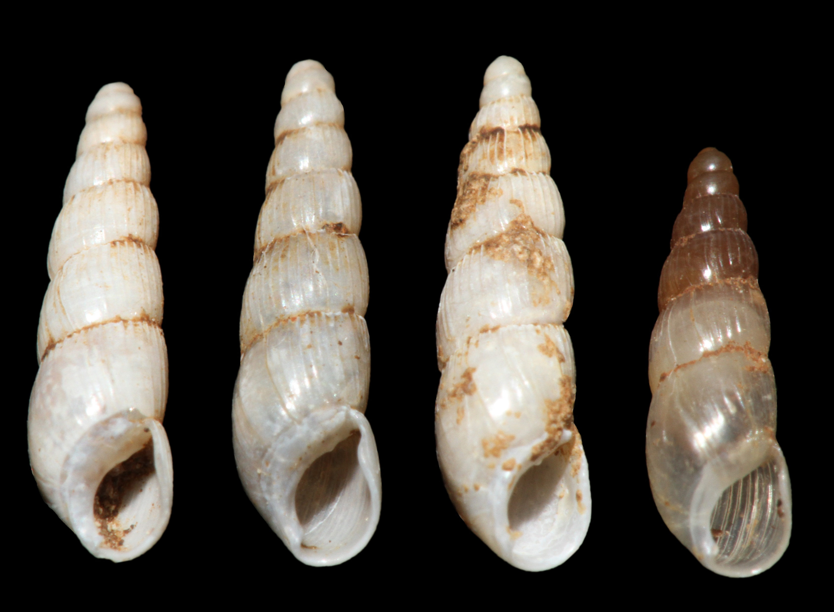
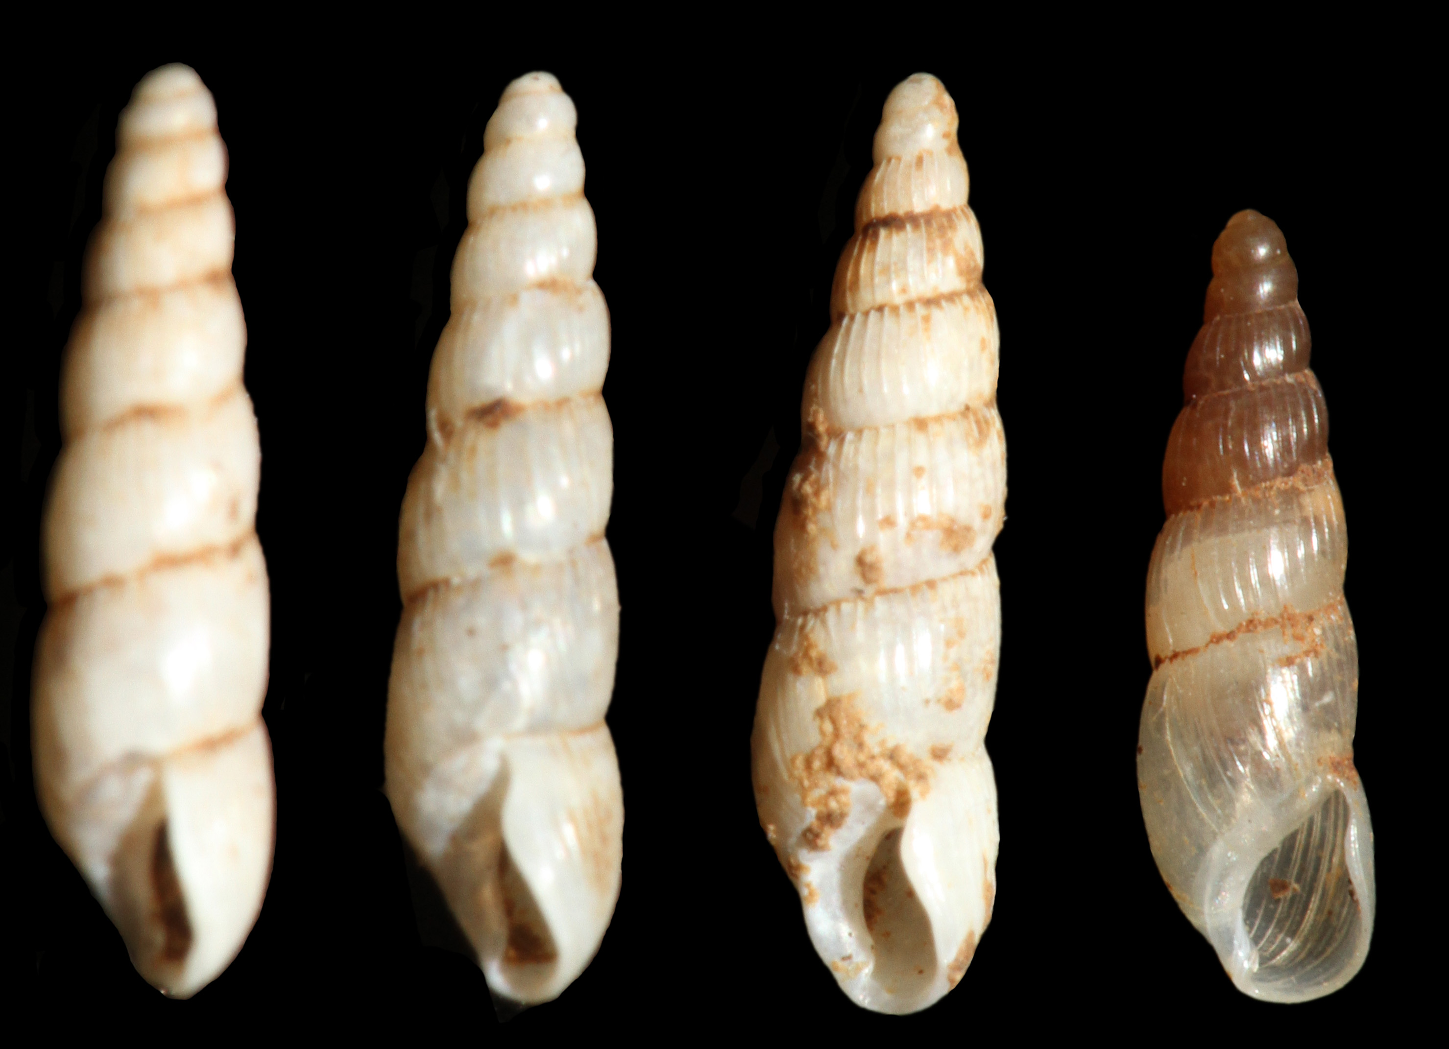
Subulinidae -

Slide 13
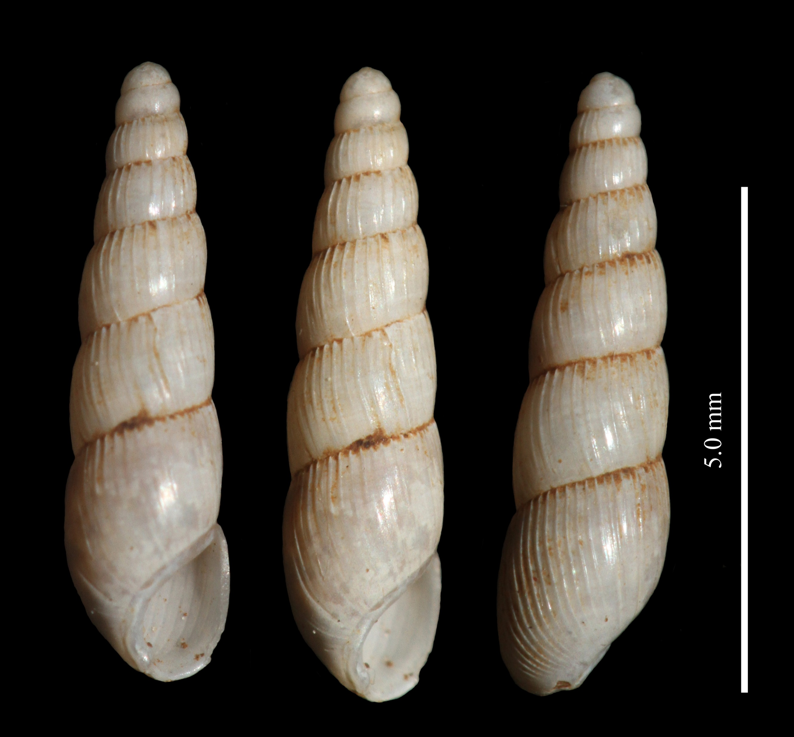
Subulinidae -

Slide 14
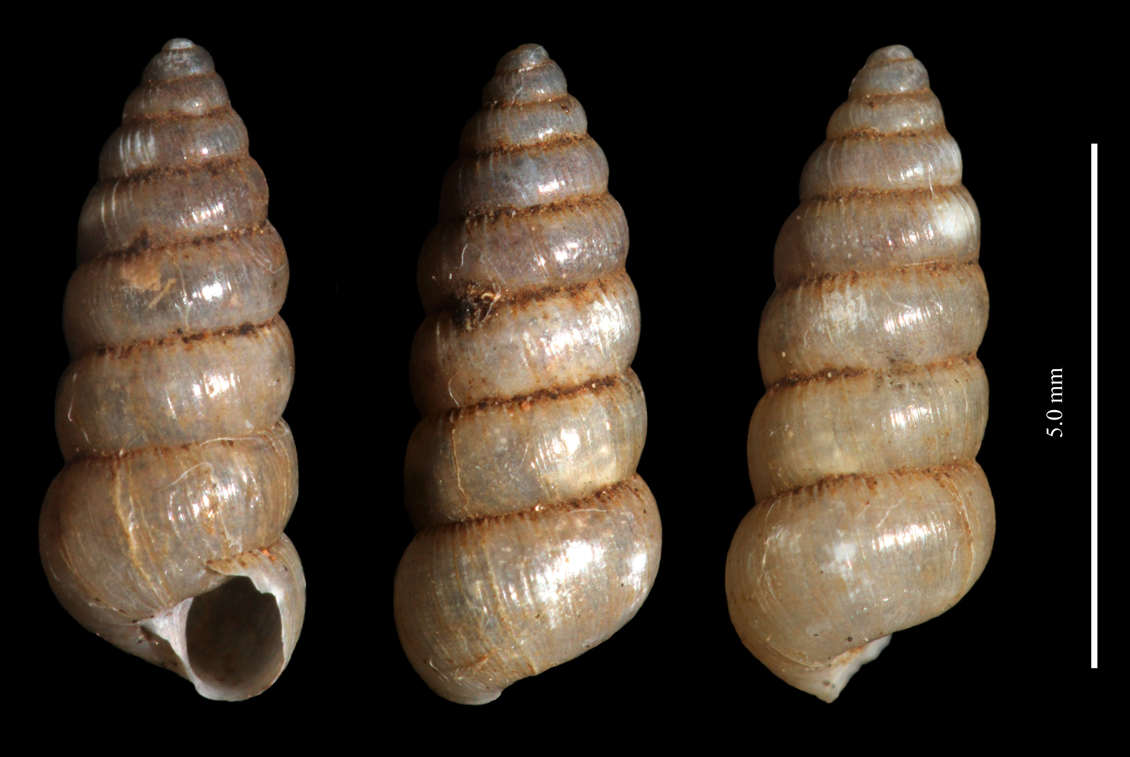
Subulinidae – Beckianum beckianum

Slide 15
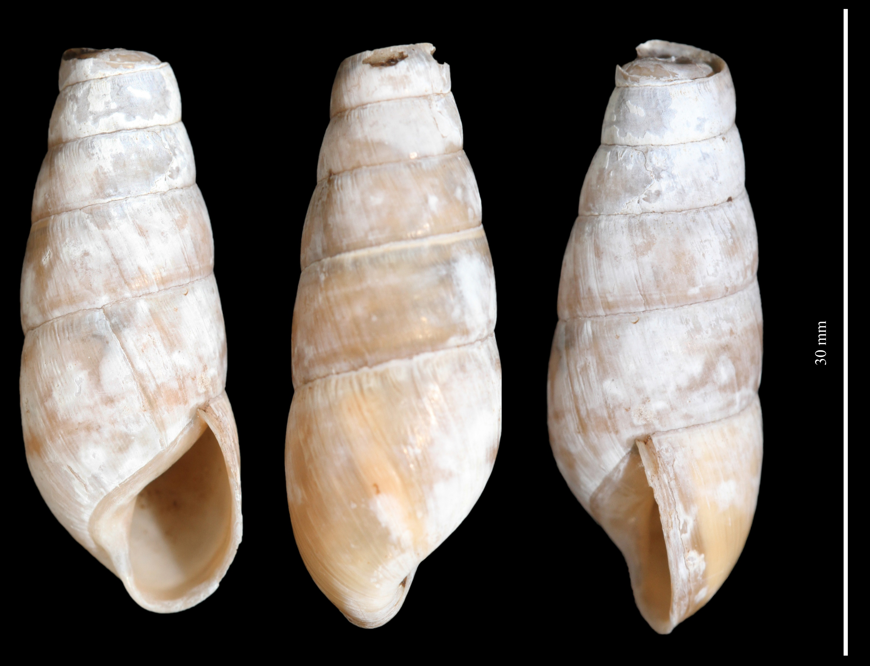
Subulinidae – Rumina decollata

Slide 16
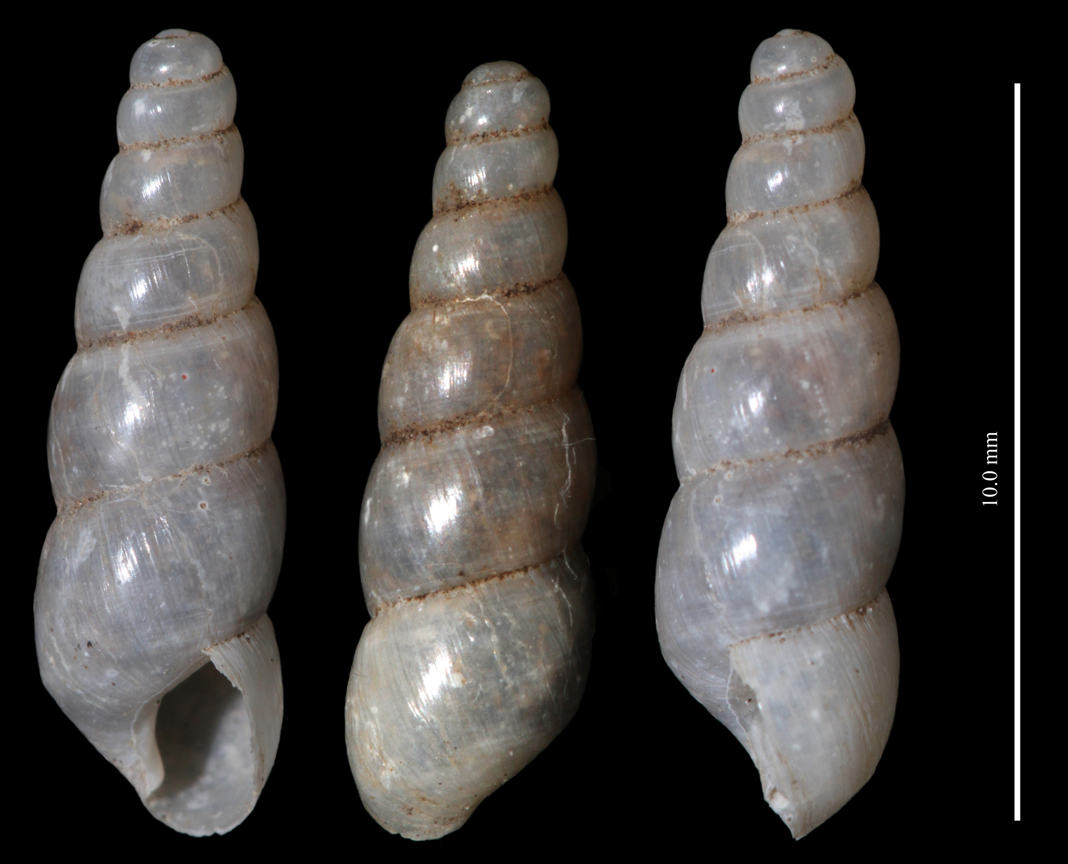
Subulinidae – Subulina octona?

Slide 17
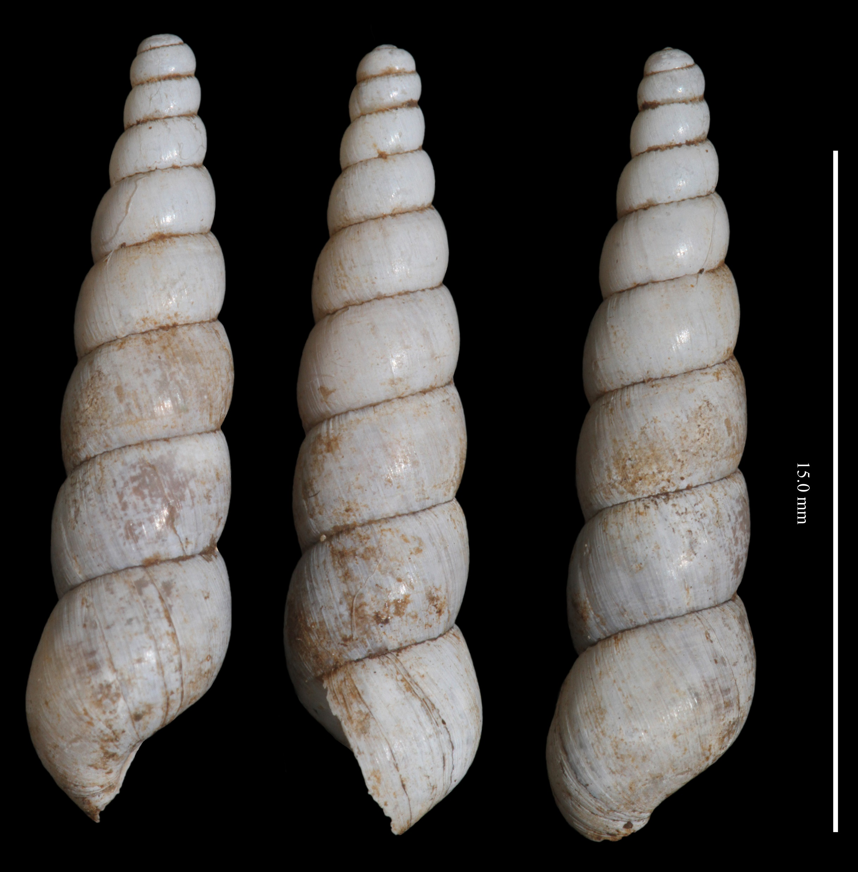
Subulinidae – Subulina octona

