Slide 1

Microhydro System Design & Installation
^{Course Number: AECAIA092614 A}
Michael Uchal
^{Date: September 26-27, 2014}
Appalachian State University
^{Provider Number: 60114136}

Slide 2
10 LU Credits earned on completion of this course will be reported to AIA CES for AIA members. Certificates of Completion for both AIA members and non-AIA members will be received at the end of the class.
Engineers will self report with their Certificate of Completion.
This course is registered with AIA CES for continuing professional education. As such, it does not include content that may be deemed or construed to be an approval or endorsement by the AIA of any material of construction or any method or manner of
handling, using, distributing, or dealing in any material or product.
_______________________________________
Questions related to specific materials, methods, and services will be addressed at the conclusion of this presentation.

Slide 3
Course
Description
This 1-1/2 day workshop will cover the basics of small scale hydro power with a field trip to local microhydro installation. Participants will learn about: site assessment techniques including the measurement of head and flow; system design; types of turbines and their associated performance and cost; system components such as the intake, penstock and balance of system; maintenance and troubleshooting; and case studies. Please join us for 1-1/2 days packed with information and site visits for hands on demonstrations.

Slide 4
Learning
Objectives
At the end of the this course, participants will be able to:
1. Participants will learn about the basics of small scale hydro power.
^{2.} Participants will learn about site assessment techniques including the measurement of head and flow, system design, and types of turbines.
3. Participants will learn costs associated with the performance a microhydro system, system components and maintenance.
4. Participants will visit a local microhydro installation, learn about maintenance, troubleshooting, and case studies.

Slide 5
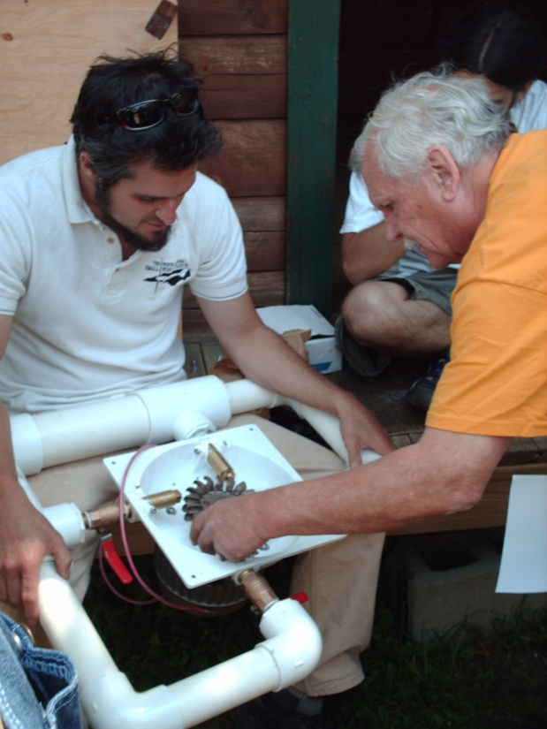
Tentative Agenda
Friday, September 18, 2015
9:00 Hydro Presentation in Classroom
12:00 Lunch at ASU
1:00 Travel to Mollies Branch Hydro Site
3:00 Hydro Presentation in Classroom
Saturday, September 29, 2015
9:00 Hydro Presentation in Classroom
1:00 Conclude for the day

Slide 6
Introductions
Who are you? What are you interested in?

Slide 7
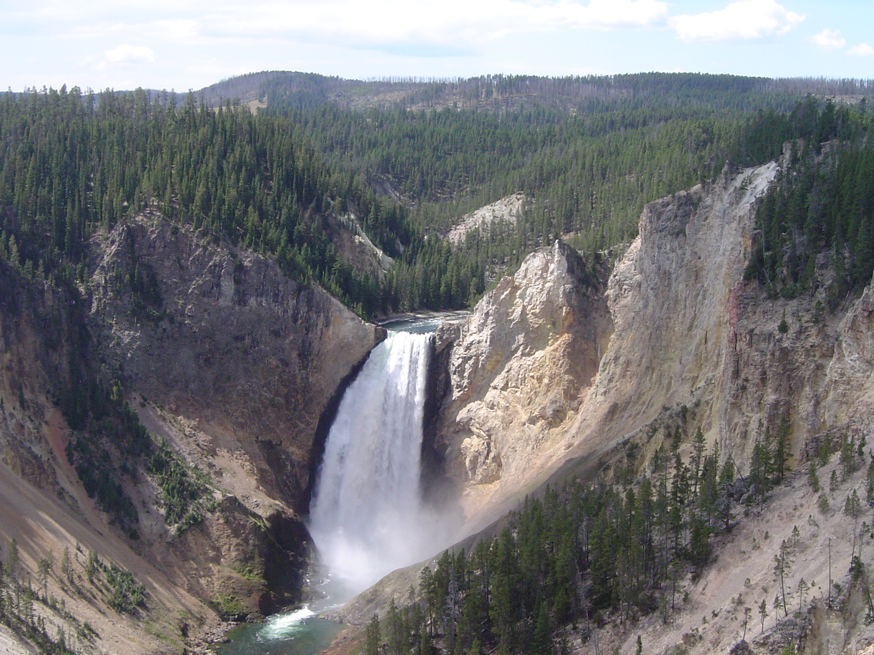
Hydro Power
Renewable energy in water that flows from a higher to a lower elevation under the influence of earth’s gravitational field
Yosemite National Park

Slide 8
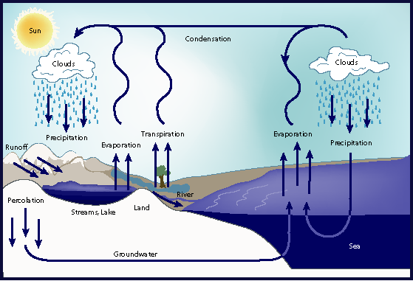
Hydro, Driven by Solar Power

Slide 9
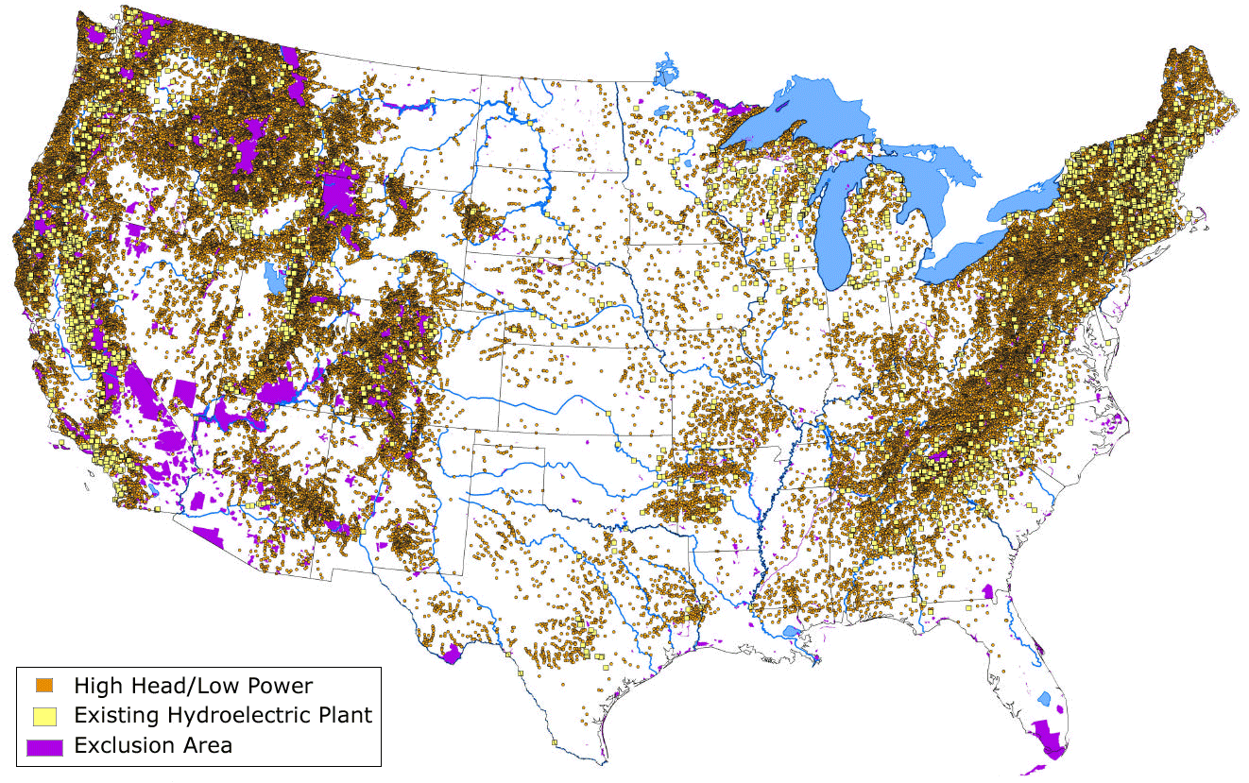
Existing hydroelectric plants (yellow) and potential high head/low power energy sites (orange) in the conterminous United States. Purple represents areas excluded from hydropower development due to Federal statutes and policies.
Source: Water Energy Resources of the United States with Emphasis on Low Head/Low Power Resources (p. 47), U.S. Department of Energy

Slide 10
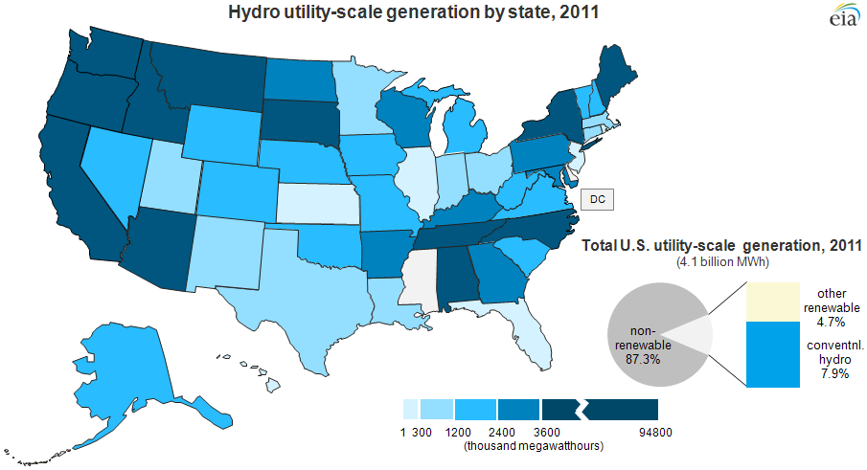
Hydro Stats

Slide 11
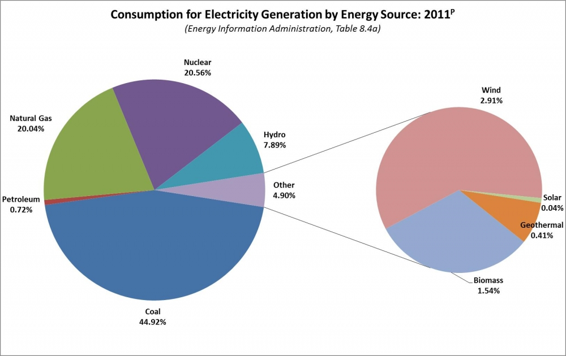

Slide 12
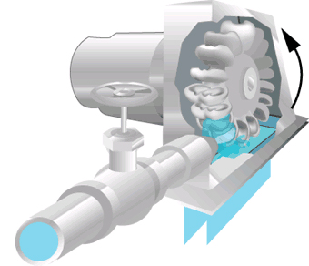
Hydropower Categories
Nano <100 W
Pico <5 kW
Micro <100 kW
Mini <1000 kW
Small <10 MW
Large 10MW and UP

Slide 13
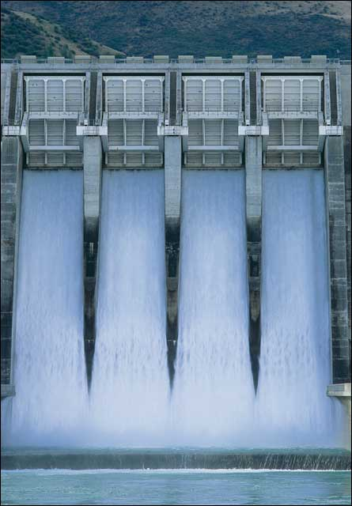
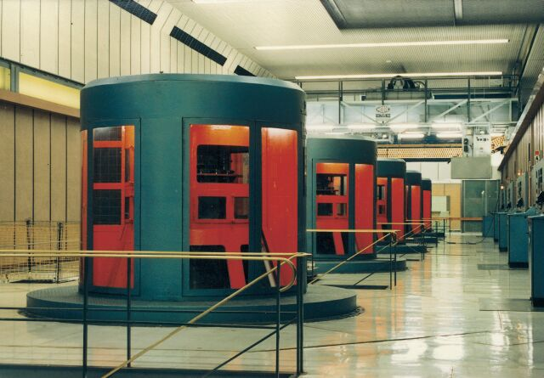
Most of that global hydro power is produced by small and large-scale hydroelectric plants

Slide 14
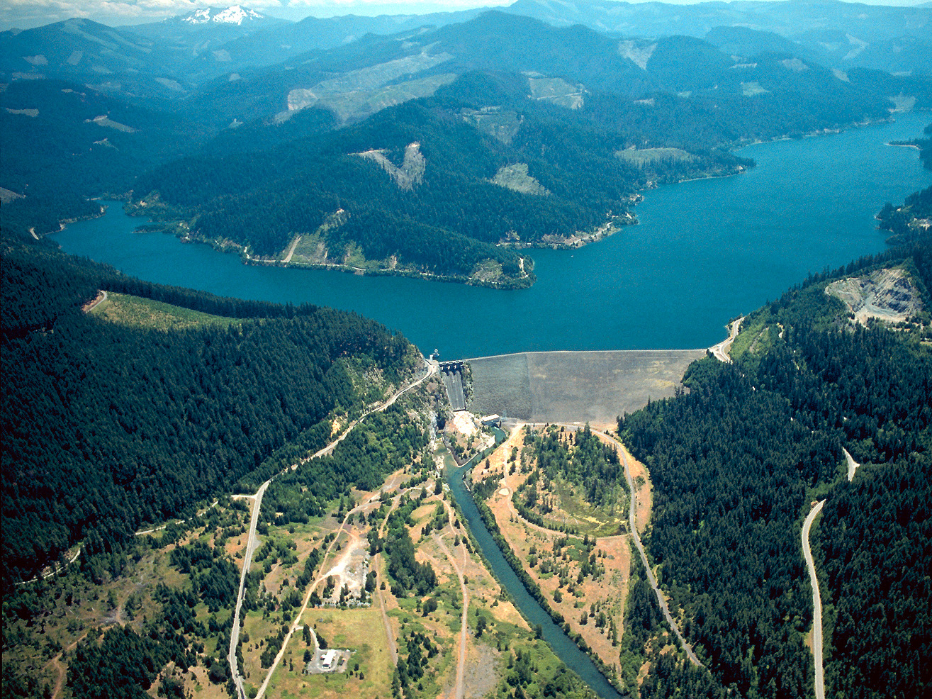
Hills Creek Dam
(Type: Storage)
Willamette River, Oregon
Corps of Engineers
In service: May 2, 1962
30 MW

Slide 15
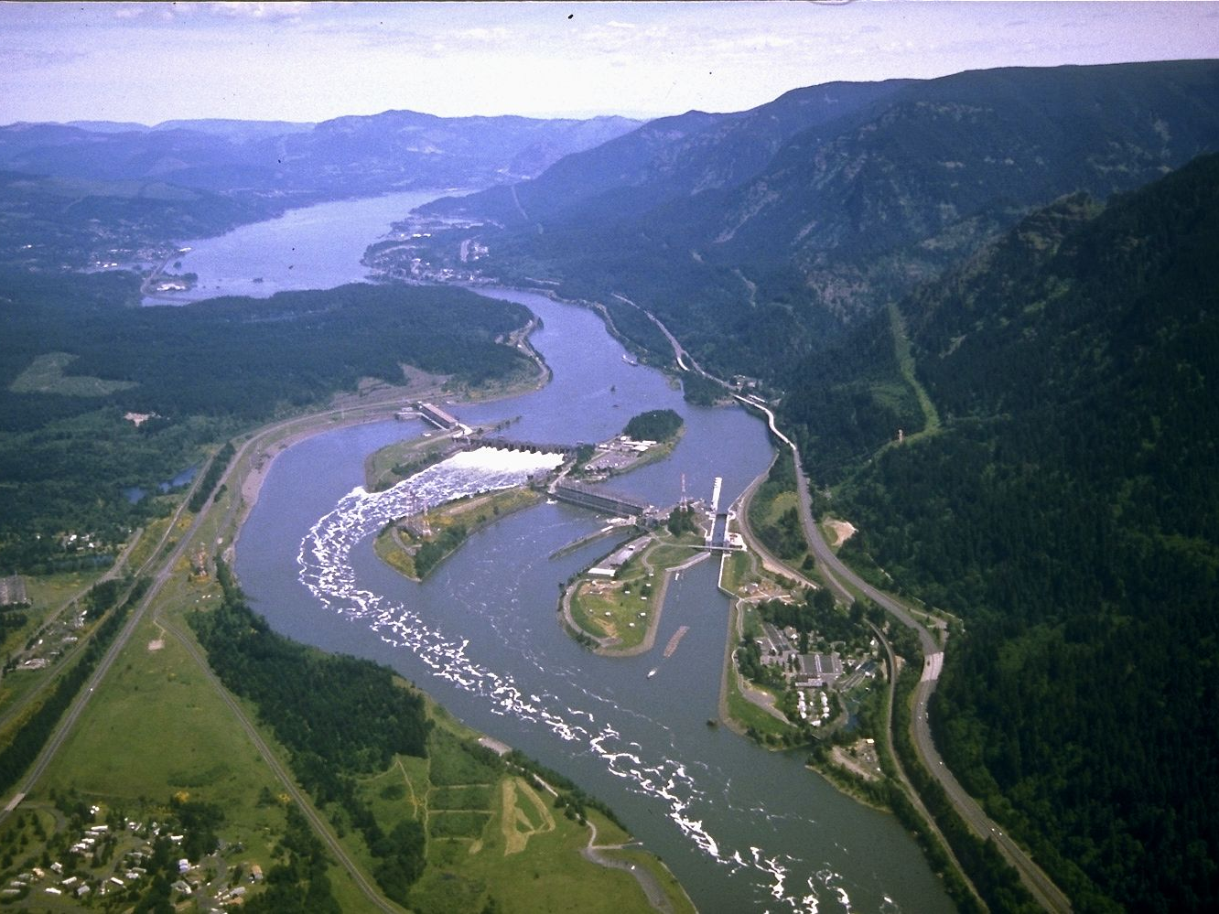

Bonneville Dam
(Type: Run-of-river)
Columbia River
Oregon/Washington border
>1,000 MW
wikimedia.org

Slide 16
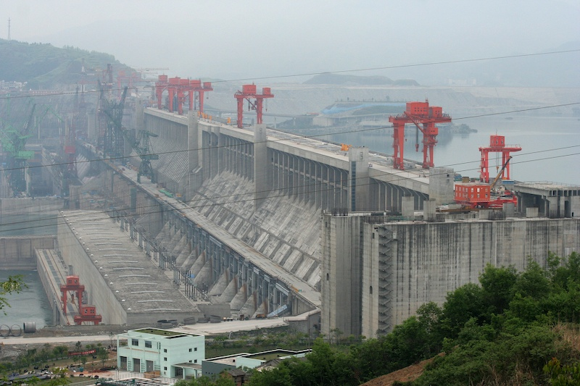
Largest: Three Gorges Dam
Proposed 22,500 MW (~2011)

Slide 17
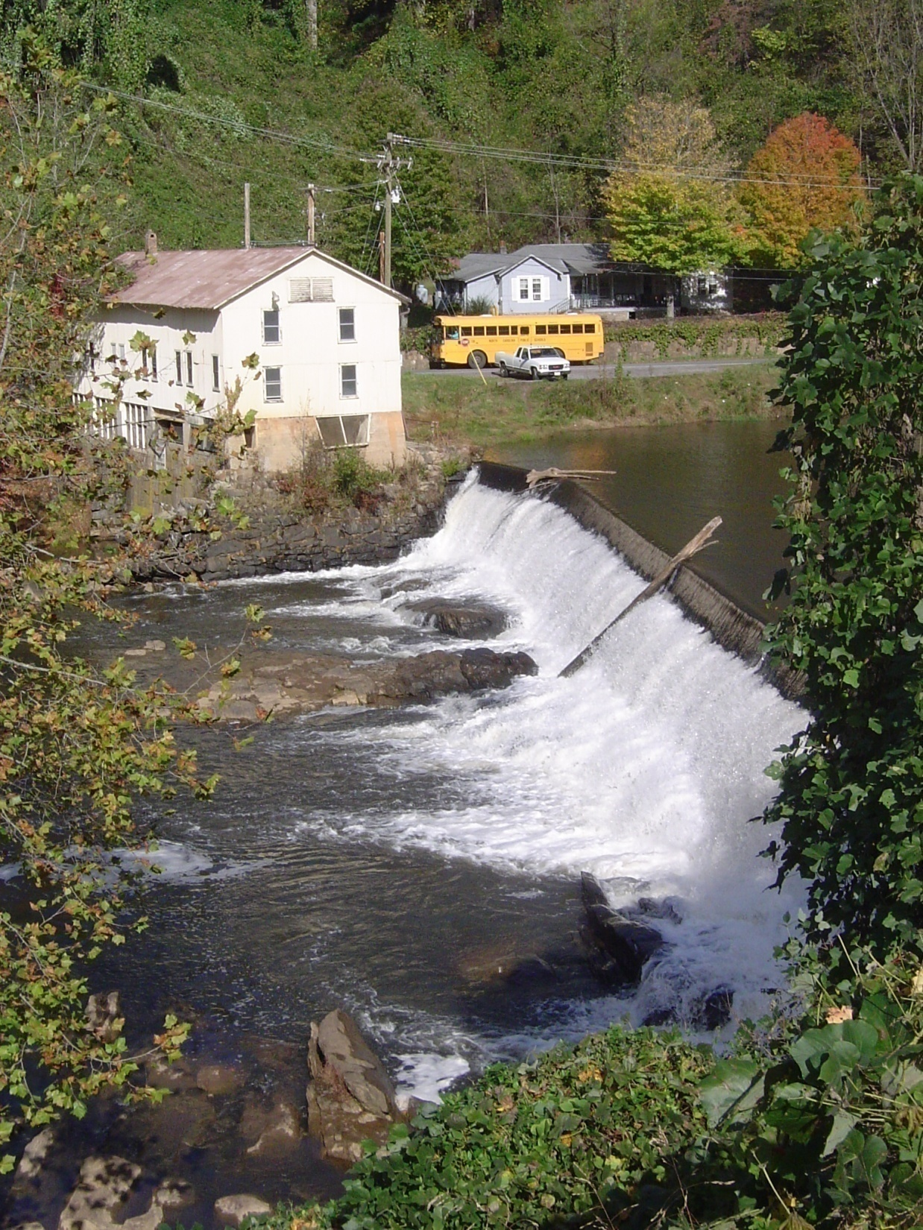
We don’t need a river, just some falling water to tap into

Slide 18

We don’t need a river, just some falling water to tap into

Slide 19
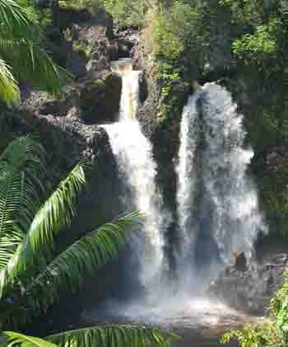
What is Microhydro?
Defined as electricity generated from falling water with a capacity less then 100 kW.
With the right resource, microhydro systems enable clean, renewable, on-site generation of electricity at an affordable price with minimal environmental impact.

Slide 20
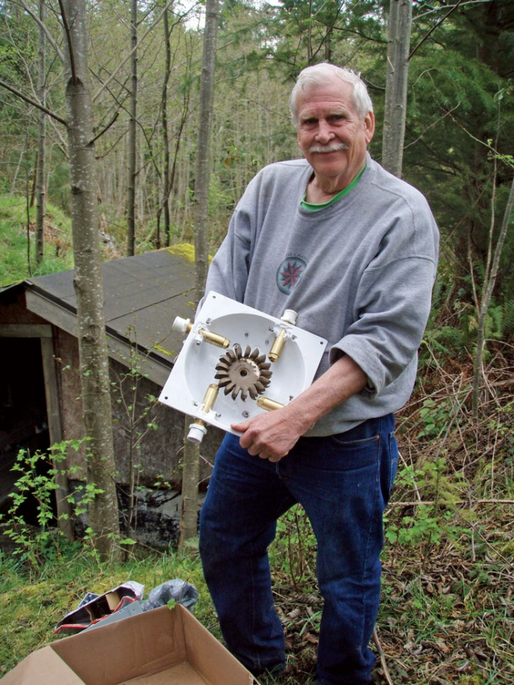
Why Microhydro?
Affordable (often the most affordable)
Reliable
No air pollution
No waste products
Can be a good resource in the mountains
Microhydro is often the most cost effective way to renewably generating electricity - in many cases competing with the price of grid power - with no emissions.

Slide 21

Hydro Potential in Western NC
1592 potential sites with 5 – 200 KW potential in 24 western counties
Many more with less than 5 KW
  1KW site would be adequate to power a conventional home
28 MW total output capacity
308 million kWh annual output (30,000 houses)

Slide 22

Regulations
The US Army Corps of Engineers has jurisdiction over virtually all waterways in the United States.
  If you plan on moving a rock in a stream you better ask first!

Slide 23
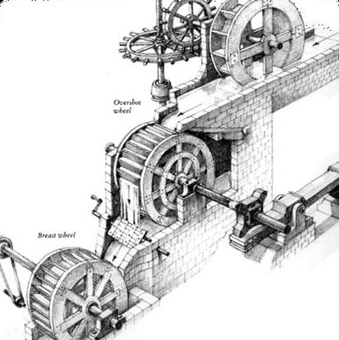
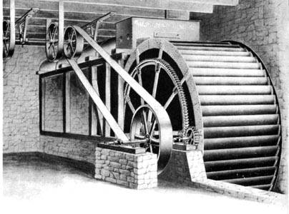
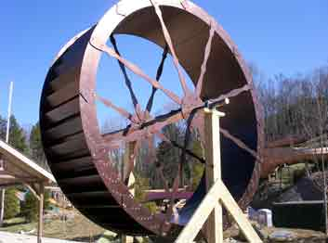
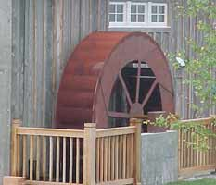
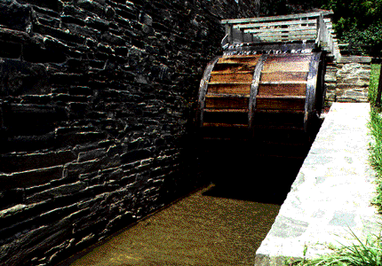
Mechanical Power from Water Wheels began 2000 years ago

Slide 24
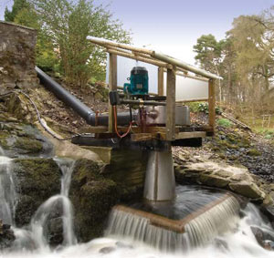
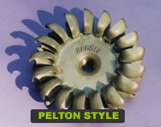
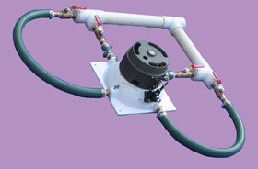
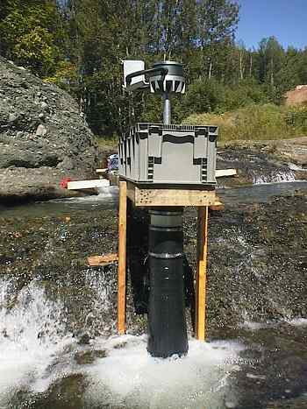

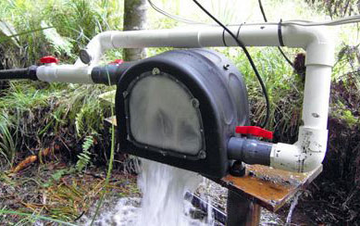
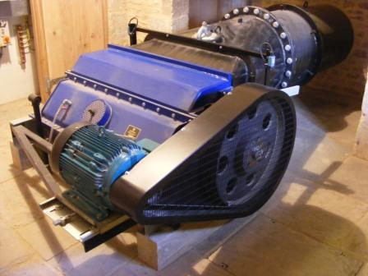
Microhydro Power Today

Slide 25
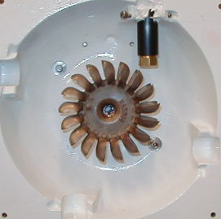
These Turbines are turned by water. That turning motion transfers energy by causing coils of wire to move relative to magnets.
With the high head situations we commonly see in the mountains, pelton wheels and turgo wheels are commonly used.
Jets are sprayed into cups of these wheels

Slide 26
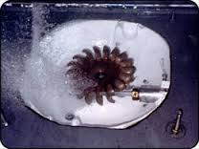
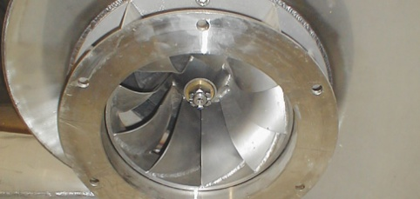
At the heart of the micro hydro system is a water wheel or turbine enclosed within a structure.
 | high head | medium head | low head
impulse turbines | Pelton Turgo | cross-flow multi-jet Pelton Turgo | cross-flow
reaction turbines |  | Francis Pump-as-turbine (PAT) | propeller Kaplan

Slide 27
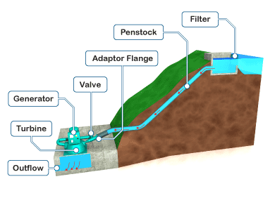
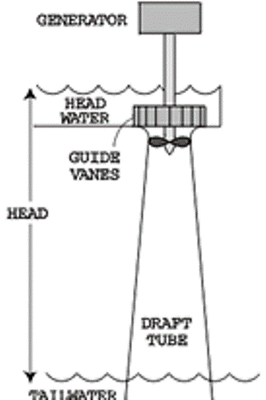
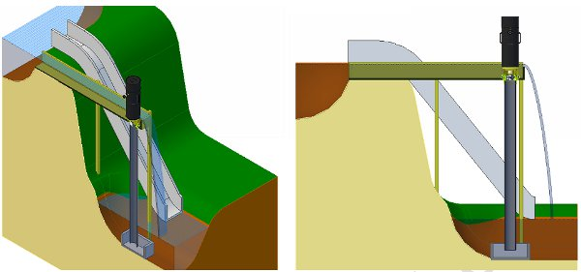
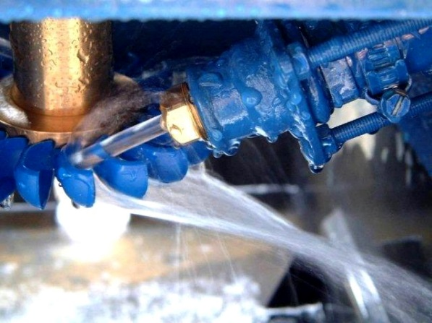
High Head, Low Flow Low Head, High Flow
https://www.google.com/search?q=hydro&client=firefox-a&hs=hp6&rls=org.mozilla:en-US:official&channel=sb&source=lnms&tbm=isch&sa=X&ei=NDggVNSWNeLGsQS5_4KgAg&ved=0CAgQ_AUoAQ&biw=1682&bih=920#rls=org.mozilla:en-US:official&channel=sb&tbm=isch&q=hydro+turbine&facrc=_&imgdii=_&imgrc=LyX_HmLqt1AEgM%253A%3BWqrtR5w7-6nRfM%3Bhttp%253A%252F%252Fwww.raine-or-shine.com%252Fimages%252Fhydro-diag.png%3Bhttp%253A%252F%252Fwww.raine-or-shine.com%252Fwind-water-turbines.php%3B390%3B292

Slide 28
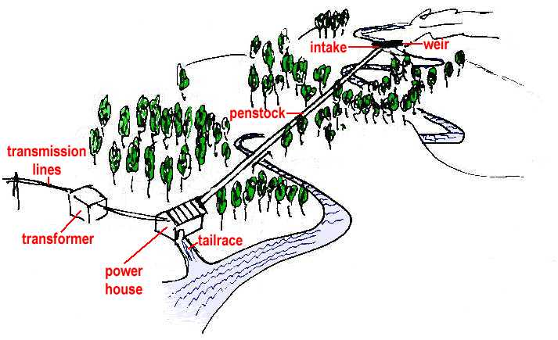
System Basics

Slide 29
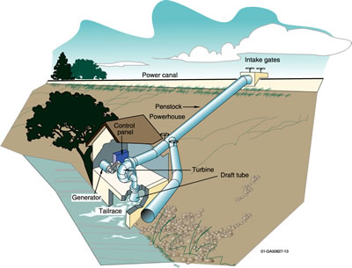
System Components
Intake
Penstock or pipe
Turbine / power house
Tailrace
Balance of System
  Controller
  Battery bank
  Disconnect
  Dump load
  meter

Slide 30

The Hydro Resource

Slide 31
Why is resource assessment important?
It wont work without the resource! (Lawn ornament)
It will not provide a return on investment without working!
You MUST have both HEAD and FLOW for a successful hydro system!!!!!!!!!

Slide 32
Hydro Power Output
Power output (watts) = Flow (GPM) X Net Head (ft)
8 – 12

Slide 33

Measuring Head
https://www.transitionnetwork.org/news/2012-07-19/measuring-transition-important-survey

Slide 34
Static Head vs. Dynamic / Net Head
Static Head
Dynamic Head
The amount of head when the water is not moving.
Does not account for the friction of the pipe as water flows down the penstock
Amount of head when water is flowing through the penstock
Is always lower than static head due to friction losses.
You want to minimize this loss.
Stay tuned on how to achieve this

Slide 35
Measuring Static Head
Stick with carpenters level
Sight level
Water level
Pipe with pressure gauge
GPS Unit
Transit
Topo map
Altimeter
While you are on site, you could measure the penstock length as well.

Slide 36

Measuring Static Head
5’ stick with level (3 people)
5’

Slide 37

Measuring Static Head
Sight level (2 people)
Eye level

Slide 38

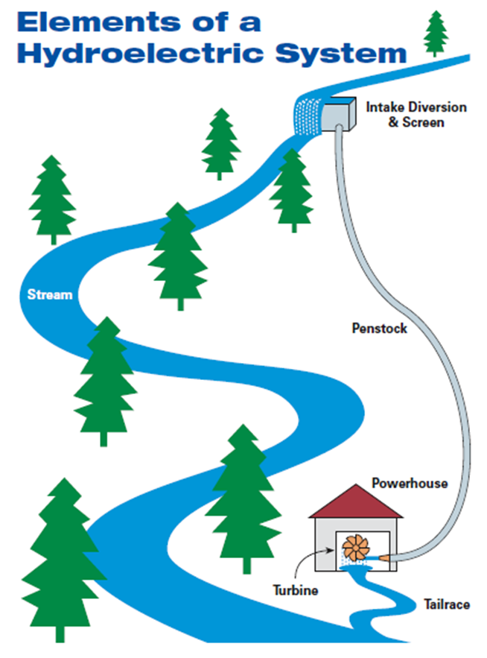
Remember, you don’t have to follow the creek.
Make sure your elevations are the same as the actual site, or correct for differences.

Slide 39
Measuring Static Head
Water level and measuring tape
(2 people)
(Good for low head)
Hose filled with H2O
Water level

Slide 40
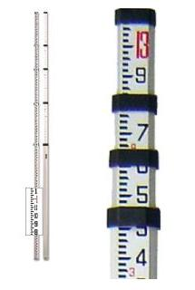

Measuring Static Head
Transit
Most accurate if you have the equipment

Slide 41
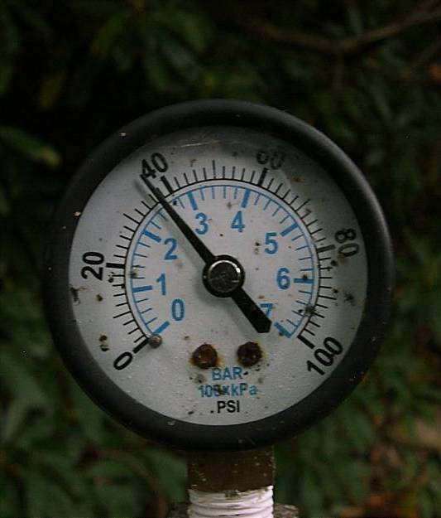
Measuring Static Head
Pipe with pressure gauge at the bottom
Could use garden hose(s)
2.31 feet = 1 psi
Or 0.43 psi / foot
This gauge reads 38 psi
38 psi x 2.31 feet/psi = 88 ft of static head

Slide 42
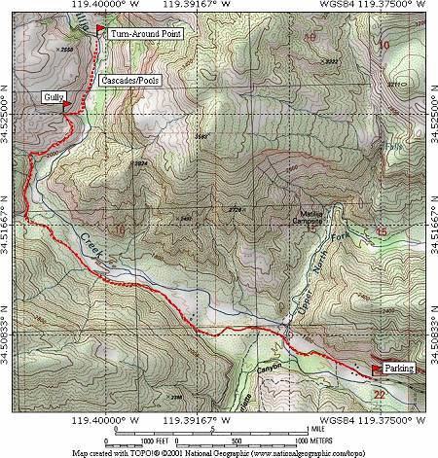
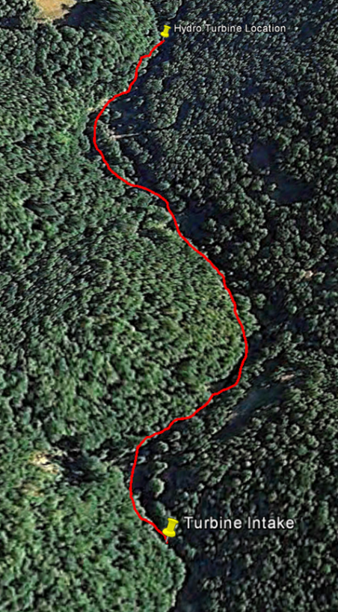

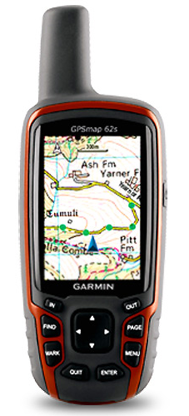
Measuring Static Head
GPS, altimeter, topo map, google earth.
Difference in elevation readings
Not accurate enough for most system calculations and design
  Often used as a preliminary assessment.
  Save time and fuel!

Slide 43

Measuring Flow

Slide 44

Measuring Flow
Units
  GPM: gallons per minute
  CFM: cubic feet per minute
  CFS: cubic feet per second
How much to use?
  Don’t take the whole creek!
  Use minimum flow
  Avoid taking more than ½ of the flow max
      (1/3 is preferred)
  Let the ecosystem thrive

Slide 45
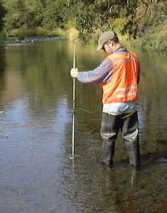
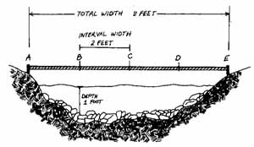
Methods of Flow Assessment
Container method
  Small stream, small waterfall
Float method
  Larger, flat, uniform stream
V-notch Weir
Rectangular Weir
Make several measurements to assess seasonal variation
More difficult method:
Used for long term studies

Slide 46
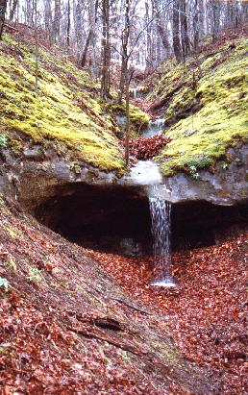

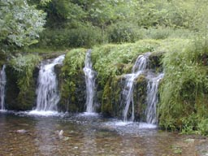
Container Method: high head low flow
Small stream, little waterfall
This may be tricky, but possible!

Slide 47

5 gallon bucket - only good up to 300gpm

Slide 48
5 gallon bucket
If the measured flow using a 5 gallon bucket and a stop watch was 5 gallons in 1.5 seconds, how many GPM would this be?

Slide 49
5 gallon bucket
If the measured flow using a 5 gallon bucket and a stop watch was 5 gallons in 1.5 seconds, how many GPM would this be?

Slide 50
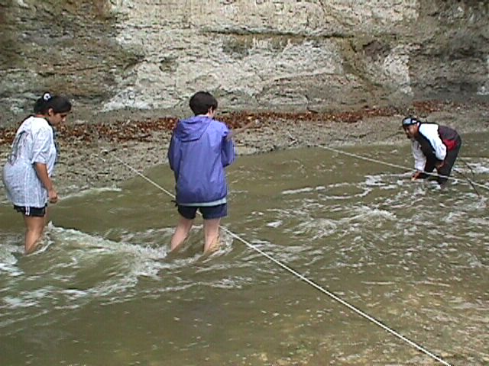
Float method
Big, flat, uniform creek

Slide 51
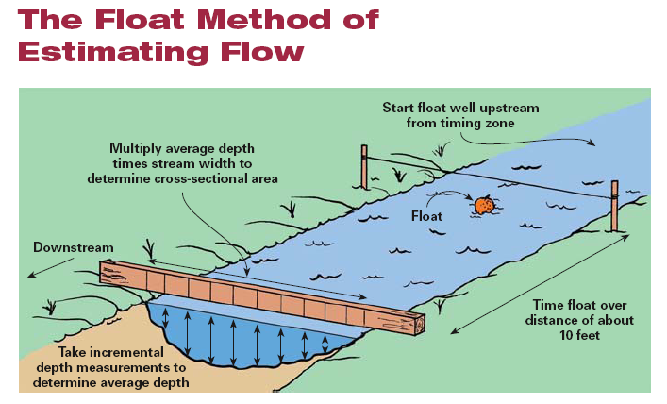

Slide 52
Float method
Calculate the average depth
Lay a straight edge across the stream, measure the depth every foot, average the depths

Slide 53

Float method
2. Calculate the cross sectional area
Area (ft²) = Average depth (ft) x Width (ft)

Slide 54
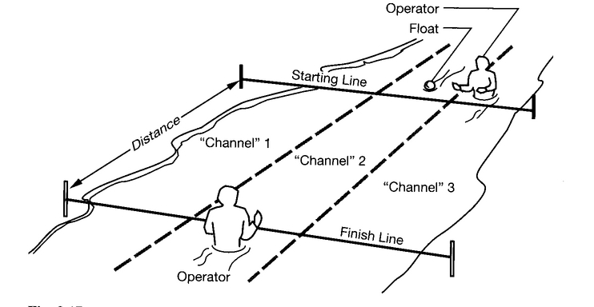
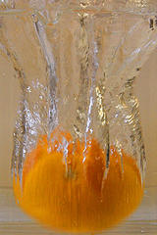
Float method
3. Calculate velocity
Measure where you measured the area, an orange makes a good float, start well upstream, a 10’ span is good, average multiple measurements.

Slide 55
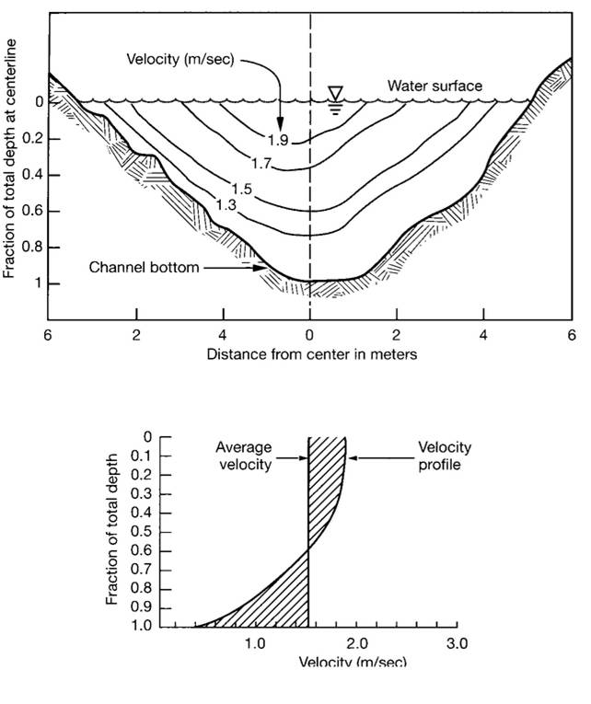
Float method
5. Correct for Friction
Flow (ft³/s) = Velocity (ft/s) x Cross Sectional Area (ft²) x .83
Multiply x 0.83 to correct for friction on the bottom of the stream

Slide 56

Float Method
So, if these guys measure this 3’ wide stream and get an average depth of 8” and it takes an orange an average 5 seconds to go 10 feet, what is the flow in GPM?
Area = 3’ x 8” x (1’/12”) = 2 ft²
Velocity = 10 ft/5 s = 2 ft/s
Flow = 2 ft² x 2 ft/ s = 4 ft³/s
4 ft³/s x 7.48 gal/1 ft³ x 60s/1 min = 1795 gpm
Correct for friction, 1795 gpm x .83 = 1490 gpm

Slide 57

Weir Method
For larger flows or more accurate measurements over time
Small
  V-notch
Larger
  Rectangular
All you needs is depth and the table

Slide 58

Needed info: Weir Width

Slide 59

Needed info: Water depth

Slide 60

Reference Chart: use chart to determine flow
Assume the following:
Your weir opening is 15 inches wide
The water depth is 7.25 inches deep
What is your flow in cfm?
Answer: for 7-1/4 inch deep water 7.80 cfm move through the weir opening / inch.
Multiply this number by the width of your weir opening. In this case 15 inches.
117 cfm or 875 gpm

Slide 61

V-notch Weir

Slide 62

System Design
http://www.ericsson.com/uxblog/2012/09/automagic-some-user-experience-design-principles/

Slide 63

Basic Components of the System
H2o Intake
Pipeline/penstock
Turbine
Balance of system
Tailrace

Slide 64

Intake Design
Supply water to the system
Intake must:
  Screen out rock and other debris ¼-inch and larger
    (High head systems– remove silt as well)
  Keep out water creatures – fish and others aquatic life
  Reduce the formation of air bubbles entering the system
Ouch!!!!!!

Slide 65

Pipe with a screen
Benefits:
  Simple construction
  Low cost
Drawbacks:
  Must be cleaned often
Home Power Magazine

Slide 66

Open Pipe with Settling Container
Benefits:
  Low maintenance
  Low cost
  Filter find particulates
Drawback:
  Can cause air bubbles
Home Power Magazine

Slide 67

Screen Box
Benefits:
  Catch a lot of debris
Drawback:
  Difficult to construct
  Hard to clean
  Requires a weir
Home Power Magazine

Slide 68

Pond Bucket
Benefits:
  Ease of construction
  Low air intake
Drawbacks:
  Requires slow moving
  Water
  Difficult access for
  cleaning
Home Power Magazine

Slide 69


Culvert Intake / Tap
Benefits:
  Uses existing infrastructure
Drawbacks
  Difficult to construct
  Restricts culvert flow
Spillway – Coanda Effect
Benefits:
  Self-cleaning
  Recued ecological impact
Drawback:
  Expensive
Home Power Magazine

Slide 70



The Intake
Diverting clean water into the penstock
Steam Flow
Hydro-Shear Coanda Effect screen
Start of Penstock
Shown here:
www.hydroscreen.com

Slide 71

Slow-Water Water Diversion
Benefits:
  Large Streams
Drawbacks:
  Construction difficulty
  Stream blowout
Siphon Intake
Benefits:
  Easy installation
Drawbacks:
  Needs screen
  Losses prime
  Special priming process
Home Power Magazine

Slide 72

The Intake
Diverting clean water into the penstock
Steam Flow
Overflow
A sandy/silty creek may need more settling time
Screen
Start of Penstock

Slide 73



Pipeline / Penstock
The component that delivers the water to the turbine.

Slide 74

Factors to Consider
surface roughness
design pressure
method of jointing
weight and ease of installation
accessibility of the site
terrain
soil type
design life and maintenance
weather conditions
availability
relative cost
likelihood of structural damage.

Slide 75

Burying Pipe
Burying the penstock improve aesthetics.
It is vital to ensure a buried penstock is properly and meticulously installed
  subsequent problems such as leaks are much harder to detect and rectify.
A good idea if using PVC

Slide 76



Penstock Support System
PVC likes to stay straight
HDPE can follow the contour of the ground

Slide 77
Penstock Materials
Steel
  Rust, rough (high losses)
  High wear and high pressure (road crossing, bottom of penstock)
AL irrigation pipe
  Low pressure rating
  Can’t be buried or else it will corrode
Pressure Rated PVC
  Readily available and easily joined
  UV degradation and physical damage
  Buried, covered or painted
PVC sewer pipe
  Low-budget, not pressure-rated!
HPDE (Polyethylene)
  Toughest, you can drag it into place, can be exposed to sunlight
  Joined by a fusion welder

Slide 78



Fusion Welding

Slide 79

Pipe Friction Losses
Must use charts to calculate head loss due to pipe friction
Flow varies with D³
  4” pipe can flow 8x more water than 2” pipe

Slide 80
Designed System Flow and Output
Designed Flow = Amount of Flow you will use from a hydrological system.
The sites flow can fluctuate during the year!
You can design around these constraints:
You have Options!
Option #1
  Determine the low or most constant flow and design a system around this flow.
Option #2
  Determine high and low median flows and design a system that can adapt to these conditions.
    This may take more site assessment throughout the year and ultimately cost more, but could save more in the end.
More on how to do this a little later!

Slide 81


Choosing your Penstock
Factors to determine:
  Volume of Water
  Material
  Diameter of Pipe
  Length of Pipe
  Changes in Direction

Slide 82

Other Penstock Design Considerations
Reduce Air
Reduce Turbulence by:
  Keep penstocks as straight as possible!
  Steady elevation declines
Standpipe Vent

Slide 83

Steady elevation declines
Keep the declines as consistent as possible.
If you form high spots, include a bleeder valve.
Home Power 125

Slide 84


Keep them straight and constant
(as possible)
Both the penstock and the manifold!

Slide 85

Avoid sudden enlargements!

Slide 86
Solution: Gradual Enlargements!
7 degree angle of enlargement is optimal for most fittings!

Slide 87
Avoid sudden constrictions!

Slide 88
Solution: Gradual Constrictions!
Source: westerndynamics. Com for all pipe images.

Slide 89
Step 1:
After you have determine static head, flow, and penstock length
Determine allowable penstock losses:
  System losses should be between 5% and 20%
    This is for financial reasons. Larger pipe costs more and is often not worth the investment for small efficiency gains.
  Remember: larger pipe has less friction loss!
    All determined based on cost of pipe and achievable outputs
      Larger diameter pipe costs more – you may want a lower efficiency to save on installation cost.

Slide 90
Step 2:
Determine a high and low friction loss
Assume the following:
140 ft static head
300 GPM max stream flow
200 GPM min stream flow
Design flow of 100 GPM?
1300’ penstock
What size PVC pipe will be best?

Slide 91
Step 2:
Determine a high and low friction loss
Efficiency loss of 5% (low loss):
Total Static Head: 140 feet
  140 feet X .05 = 7 feet
  140 static head – 7 feet of total loss = 133 feet dynamic head
Efficiency loss of 20% (high loss):
Total Static Head: 140 feet
140 feet X .20 = 28 feet
140 static head – 28 feet of loss = 112 feet of dynamic head

Slide 92

Step 3:
Determine Pipe Diameter
    1. Use the Penstock chart to determine friction losses / 100 feet of pipe.
    2. Look-up your designed flow on
    the left column
    3. Compare it to different diameter
    pipes.
    4. Convert PSI to feet (if necessary)
    PSI X 2.31 = feet of head
    5. Multiply by # of 100 foot lengths

Slide 93
Step 3 Cont.:
Determine Pipe Diameter
    1. Use the Penstock chart to determine friction losses / 100 feet of pipe.
    2. Look-up your designed flow on
    the left column (100 GPM)
    3. Total loss is 6.29 (2 in.) 0.92 (3 in.)
    4. Convert 0.92 psi to feet
    0.92 X 2.31 = 2.12 feet
    5. Multiply by # of 100 foot lengths
    2.12 feet X 13 (100 foot lengths) =
    = 27.56 feet of total head loss
    Will this work? – Yes but not ideal – go bigger!

Slide 94
Step 3 Cont.:
Determine Pipe Diameter
    1. Use the Penstock chart to determine friction losses / 100 feet of pipe.
    2. Look-up your designed flow on
    the left column (100 GPM)
    3. Total loss of 4 inch pipe (on chart)
    = 0.25 psi or 0.578 feet
    5. Multiply by # of 100 foot lengths
    0.578 feet X 13 (100 foot lengths)
    = 7.51 feet of total head loss
    Will this work? Yes – just over 5% loss

Slide 95
Step 4:
Determine Friction losses in fittings
    Refer to friction loss tables for fittings, valves, and bends.
    Use the “Equivalaent length of feet” charts for easy calculations.
      Determine number of fittings of each type.
      Find the total equivalent length of feet of pipe
      Determine friction loss of for # of feet for each material.
      Add to total losses in head calculations.

Slide 96
Step 5:
Calculate Dynamic / Net Head
    Subtract the total loss of head for length of pipe based on the chart from the static head measurement.
    Our example:
      140 feet of total static head
      7.51 feet of total head loss (NOT including fittings)
      140 feet of static head – 7.51 feet of total loss =
      132.49 feet of Dynamic / Net Head!

Slide 97


Step 6:
Determine Nozzle Size
    Use the chart from the manufacturer to determine number and size of nozzles for the turbine.
    Step 1: Find Dynamic/Net head on the left column.
    Step 2: Find a combination of nozzles that will provide the amount of flow you have.
    Remember: For harris hydro systems, a 0.5 inch nozzel is the limit for a Pelton Wheel

Slide 98


Slide 99
WOW, that is a weak chart! What happens between 120 and 150 feet of head?

Slide 100
Step 6:
Determine Nozzle Size
(using linear interpolation)
    To make an accurate calculation use LINEAR INTERPOLATION
Linear Interpolation: Calculating a value based on known values both higher and lower.
How do we use it to determine NOZZLE FLOW?
Find the higher and lower known values for DYNAMIC HEAD and the known FLOW RATES for a certain NOZZLE SIZE.
Use the formula below:
High Head Value - Lower Head
=
High Head Value - Your Cal. Head__
High Head Nozzle Flow rate - Lower Head Nozzle Flow Rate
High Head Nozzle Flow Rate - X
Solve for: X

Slide 101
Step 6:
Determine Nozzle Size
(using linear interpolation CONTINUED)
    EXAMLE PROBLEM:
Low Flow
Rate
Low Head Value
High Flow
Rate
High Head Value

Slide 102
Step 6:
Determine Nozzle Size
(using linear interpolation CONTINUED)
    EXAMPLE PROBLEM:
150 - 120_______
150 - 132.49__
=
46 - 41.2
46 - X
30____
17.51__
=
4.8
46 - X
30____
17.51__
=
4.8
46 - X

Slide 103
Step 6:
Determine Nozzle Size
(using linear interpolation CONTINUED)
    EXAMPLE PROBLEM:
30____
17.51__
=
4.8
46 - X
84.048
30(46 – X)
=
1380 – 30 X
84.048
=
1380 – 30 X
84.048
=
+30 X
+30 X
1380 = 30 X + 84.048
- 84.048
- 84.048
1295.95 = 30 X
30
30
X = 43.1 GPM

Slide 104
Does it 43.1GPM Seem Right? YES, it looks good!

Slide 105
Step 6:
Determine Nozzle Size
(using linear interpolation CONTINUED)
    To Determine Nozzle Size:
    Repeat the above steps for each nozzle size
    Find a nozzle combination that totals your overall calculated flow.
      Well, two 7/16 inch nozzles would give us 86.3 GPM (43.1 X 2 = 86.3)
        We need 100 GPM.
    What do we do?

Slide 106
Refer to the chart and find another nozzle that will work
We need about 14 GPM flowing through a 3rd nozzle.

Slide 107
Step 6:
Determine Nozzle Size
(using linear interpolation CONTINUED)
    After using the linear interpolation formula on the ¼ inch nozzle we get:
    14.006 GPM for 132.49 Feet of Head
    so
    86.3 GPM for two 7/16” nozzles + 14.006 GPM for one ¼” nozzle gives us a total of:
    100.306 GPM
    WILL THIS WORK?
    YES!!!!!

Slide 108

Turbines

Slide 109




Reaction Turbines
Submerged in the flow;
driven by the pressure differential
Francis
http://www.youtube.com/watch?v=tjTh7A4jnbc
http://www.waterwheelfactory.com/francis.htm

Slide 110




Kaplan Turbine
Reaction Turbines
Submerged in the flow;
driven by the pressure differential

Slide 111


Banki and Crossflow
Impulse – sheet of water
Banki
Crossflow

Slide 112






Pelton
Impulse – jet of water

Slide 113





Turgo: More water than pelton

Slide 114


Slide 115


LowPower Engineering aka Harris Hydro
20-600 feet of head
2-250 GPM of flow
1 nozzle $1850
2 nozzle $1950
4 nozzle $2200
707-986-7771
denisl@wildblue.net
http://harrishydro.biz/

Slide 116



Energy Systems & Design
Stream Engine
Heads from 6 to 300 feet.
www.microhydropower.com
2 Nozzle Bronze $2395
4 Nozzle Bronze $2545
High Voltage Option $200
High Current Option $100

Slide 117

Energy Systems & Design
Low Head Propeller Turbine
heads of 2 feet up to 10 feet.
At the maximum head, the output is 1 kW.
www.microhydropower.com
Water Baby
Operates much the same as the Stream Engine but requires very little water (pelton wheel)
Will operate on as little as 3 gpm but requires at least 100 feet of head.
Baby Generator, 1 Nozzle (12/24 volt)
Extra Nozzles (installed)
High Voltage (48/120 volt)
LH1000 with Draft Tube
High Voltage Option
High Current Option

Slide 118


Hydro Induction Power
Good for long wire runs, 60' - 500' head, 10 - 600 gpm
The units produce 3-Phase 120V, 240V, or 480V 'wild' (unregulated) AC, which is then stepped down to battery voltage.
The heavy-duty brushless alternator is housed on the Harris Housing
www.hipowerhydro.com
HV 600 with 2 Nozzles $2500
HV 600 with 4 Nozzles $2600
HV 1200 with 4 Nozzles $3000
HV 1800 with 4 Nozzles $3500
HV 3600 with 4 Nozzles $5000
Turgo option $600

Slide 119


Hydro Induction Power
Now offer a new LOW VOLTAGE (12V/24V), brushless unit (48V coming in 2006).
It can generate either 12V or 24V with pressures from 20psi to 150psi (46' - 400'). Above this pressure, it will generate 48V.
12/24V Hydro with 1 Nozzle: $1350
12/24V Hydro with 2 Nozzles:$1400
12/24V Hydro with 3 Nozzles:$1450
12/24V Hydro with 4 Nozzles:$1500
Upgrade from Harris Hydro: $500
Turgo option $600
www.homehydro.com

Slide 120




Power Spout
http://www.powerspout.com/

Slide 121



Canyon Hydro
Serious engineering
100 KW Canyon Crossflow
Canyon 751
Canyon 2435
gpm
KW
gpm
KW
50
139
1
1665
12
100
197
3
2415
36
Great
Resource
200
277
8
3335
101
300
340
15
4084
185
www.canyonhydro.com

Slide 122

Alternative Power & Machine
Economy models
Permanent magnet units
Accessories
Niche: Ease of maintenance and adjustment
www.apmhydro.com

Slide 123



Other
www.ampair.com....it’s a wind and hydro turbine
$1300
The Jack Rabbit, just drop it into the river
$1295

Slide 124

Electricity and Microhydro
Balance of System

Slide 125
First Things First. What does a microhydro turbine produce?
Wild Alternating Current (Wild AC) most of the time
  “Wild” due to the fluctuating voltage, current and frequency.
  Why is this?
    Most modern small hydro turbines are direct drive permanent magnet systems (there are exceptions)
  In most cases the wild AC needs to be rectified.
    Conversion of Alternating Current (AC) to Direct Current (DC)
WILD AC
120 AC @ 60Hz
DC

Slide 126



Electricity from a Spinning Shaft
Click Here for Animation
http://www.reuk.co.uk/OtherImages/moving-magnet-past-wire-to-make-current.jpg

Slide 127


Why Alternating Current?
Simplicity of permanent magnets alternators
This AC power is rectified to Direct Current regardless of battery or grid-tie configuration.
3 phase output is most common
http://bp1.blogger.com/_Ist6QgbdKFo/SIsThFlYcTI/AAAAAAAAAGw/-cBy0MQjDvI/s400/5.bmp

Slide 128

Why Three Phase?
Most effective use of space and materials!

Slide 129


What is the BOS?
DC only system (small cabin)
  Charge controller
  Batteries
Conventional AC system (house)
  Charge controller
  Batteries
  Inverter

Slide 130

Typical Off-Grid Battery Charging System

Slide 131

Off-Grid Batteryless System

Slide 132

Grid-Tie Batteryless System

Slide 133
Electrical Transmission / Wire Run

Slide 134
Wire Run / Wire Sizing
Needed information:
  Distance from turbine to load
  Voltage of the turbine
  Max output of the turbine
  Type of output? AC or DC, 3 phase or single phase.
Important Considerations
  Diameter of wire (American Wire Gauge – AWG)
  Length of wire
  Free Air or Conduit
  Type of insulation on wire
  Temperature of location where wire located
  Moisture where wire is located
  Will conductor be exposed to sunlight
  Color of insulation
  Voltage Drop

Slide 135

Good location of turbine to load
Turbine Powerhouse

Slide 136

2,000 foot wire run

Slide 137

Ampacity
The quantity of electrons or amperes that a conductor can safely carry
  Factors affecting ampacity
    Size (diameter) of wire
    Type of wire (copper or aluminum)
    Insulation
    Temperature

Slide 138

American Wire Gauge (AWG)

Slide 139

Wire Sizing for DC Applications
Voltage drop is caused by a conductors electrical resistance
This voltage drop can be used to calculate power loss
For DC systems – efficiency is paramount!
Voltage Drop (Volts) =
Electrical Resistance (Ohms) X Current (Amps)
Power Loss (Watts) =
Voltage Drop (volts) X Current (Amps)
Power Loss (Watts) = Ohms X Amps²

Slide 140
Voltage Drop
Voltage drop occurs when too many amps try to pass through a conductor which is too small
If volts are lost then power is lost!
Power Loss = Voltage Drop x Amps
Need to assess Voltage Drop to avoid wasting power and compromising system performance
Vdrop = I (current) x R (resistance)
Typically will require a larger wire than required for ampacity rating
NEC REQUIREMENT: Article 215.2 requires no more than 3% drop for feeder ciricuits, and 5% drop for feeder and branch circuits combined.

Slide 141
Calculating Voltage Drop
According to NEC
  For 2-wire DC circuits, 2-wire AC circuits
  VD = 2 X L X R X I
  1000
  VD = Voltage drop @ 75 degrees C
  L = one-way length of circuit (ft)
  R = conductor resistance in ohms / 1000 feet
  I = load current (amps) – assumed as supply current as well.

Slide 142

Voltage Drop Calculation
VD = ?
L = 500 feet
AWG = 00
R = ?
I = 20.8
For resistance of conductor see chapter 9 TABLE 8 in NEC Handbook.
  VD = 2 X 500 X 0.101 X 20.8
  1000
  VD = 2.10 volts

Slide 143

VDI Voltage drop Index
Easy method for determining wire size
What you need to know
  Amps (Watts/volts)
  Feet (one-way distance)
  Acceptable % volt drop
  Voltage

Slide 144
How to Use Formula and Chart
Example: 1 KW, 24 volt system, 50 feet, 3% drop
Amps = 1000 watts/ 24 volts = 41.67 amps
VDI = 41.67 amps * 50 feet = 28.9
3% * 24 volts

Slide 145

VDI Chart
24V VDI = 28.9
2 AWG wire
That’s pretty big wire
What if we make it a
48 volt system?

Slide 146
How to Use Formula and Chart
Example: 1 KW, 48 volt system, 50 feet, 3% drop
Amps = 1000 watts/ 48 volts = 20.8 amps
VDI = 20.8 amps * 50 feet = 7.23
3% * 48 volts

Slide 147
VDI Chart
48V VDI = 7.2
8 AWG wire
That’s better
(smaller, less $,
same losses).

Slide 148
How to Use Formula and Chart
Example: 1 KW, 160 volt system, 50 feet, 3% drop + Midnite classic
Amps = 1000 watts/ 160 volts = 6.25 amps
VDI = 6.25 amps * 50 feet = 0.65
3% * 160 volts

Slide 149
VDI Chart
160V VDI = 0.65
16 AWG wire
That’s so much better
(even smaller, much
less $, same losses).

Slide 150

Charge Controllers

Slide 151


Purpose of Charge Controller
Basic Functions
  To prevent overcharging a battery, which could damage it and shorten its life and possibly some loads powered by it

Slide 152
Features to Consider
Voltage Rating
Charge control algorithm
Amperage rating (plan for future expansion)
Source of Electricity (PV, Wind, Hydro)
Adjustability
Temperature Compensation
Meters
Low battery voltage disconnect or alarm
Wire terminals

Slide 153

Conventional Charge Controllers
For Solar System

Slide 154

Typical (traditional) Charge Controllers
For Wind and Hydro

Slide 155

Basic Types of Charge Controllers
Interrupting –Type Switches charging current off and on.
  Least expensive and simplest type
  Best for flooded batteries
Linear-Type or Pulse Width Modulating (PWM)
  Limits charging in a gradual manner
  Compatible with more types of batteries

Slide 156
Multiple Stage Charging
(for most RE batteries)
Stage One (Bulk Mode)
  A preset maximum constant amount of current (amps) is put into the battery. As this occurs, the voltage increases
Stage Two (Absorption Mode)
  After a preset voltage is reached (14.2 volts for a 12 volt systems) the voltage is then held constant. As the battery continues to charge at constant voltage, the current decreases.
Stage Three (Float Mode)
  When the current has decreased to a preset low limit, or a set amount of time has passed (absorption time), then the controller switches to Float Mode. Now the battery is kept at a preset Float voltage, and a small amount of power (amps) is supplied, as required to maintain the preset voltage.

Slide 157

Battery Charging
Home Power May 2012

Slide 158
Pulse Width Modulation
Charge Controllers
The third stage requires current to slowly decrease and voltage to remain the same
PWM Achieves this by rapidly switching current on and off
By adjusting the width of the pulses (pulse width modulation) the current that the battery "sees" can be adjusted.
Thus, the controller is able to provide a fine control.

Slide 159



Maximum Power Point Tracking Controllers (MPPT)

Slide 160
MPPT Controllers
Can significantly increase 30% more power
Looks at the output current, and compares it to the battery voltage
Determines the best power that the system can provide to charge the battery. Then, converts the “power” to the best voltage to get maximum AMPS into the battery.
Most modern MPPT's are around 92-97% efficient in the conversion.
You typically get a 20 to 45% power gain in winter and 10-15% in summer. (for solar systems)

Slide 161



A class of its own!!!
http://www.midnitesolar.com/video/classRunOver/classicRunOver.php

Slide 162

The Midnite Solar Classic
“A revolution in charge controller technology”
  Michael Uchal
http://www.midnitesolar.com/ (Home site)
http://www.midnitesolar.com/products.php?menuItem=products&productCat_ID=21&productCatName=Charge%20Controllers%20-%20Classics (Classic)
http://www.midnitesolar.com/videoDisplay.php
(Educational Videos)

Slide 163



What if one charge controllers is not enough?
Answer: Parallel configuration

Slide 164

Diversion Loads
AKA “Dump Loads”

Slide 165
Why a Diversion Load?
Protect the turbine!
  “Most” small scale hydro turbines can not run unloaded.
Protect the battery bank from overcharging.

Slide 166



Slide 167


Basic Diversion Loads
Air Heating
Water Heating

Slide 168
Dump Loads and the
National Electric Code
1: Dump Load MUST be able to safely handle 1.5 times the total power output of the turbine.
2: Must be installed in a manner that isolates it from flammable materials.
3: The amperage rating of the controller must be at least 30% higher than the dump load current.

Slide 169


Batteries in Renewable Energy Systems

Slide 170
Presentation Outline
Why batteries?
Battery basics
Battery operation
Terminology
Battery charging/discharging
Battery sizing
Battery maintenance
Batteries and the National Electric Code

Slide 171
Why are batteries needed?
  For off-grid, and battery back-up renewable energy systems. batteries are needed to:
    Store energy provided from the charging systems for later use to power loads.
    Provide enough power for any power surges that occur within the electrical system.
    Batteries in some small grid-tied RE systems are used for power conditioning purposes for the grid interconnection.

Slide 172
Battery Types
Batteries can be classified by:
  Non-rechargeable (primary) (disposable)
  Rechargeable (secondary)
  Application
    Automotive, electronics, deep-cycle (renewable energy), marine applications
  Construction
    Chemistry
    Flooded
    Gelled
    Absorbed Glass Mat (AGM)

Slide 173




Deep-Cycle Lead-Acid Batteries

Slide 174
Deep Cycle vs. Other Tech.
Deep Cycle
Lower in cost
Rechargeable
Deliver energy over a long period of time.
Recyclable
Long life if maintained
Slower discharge rate.
Other Battery Types
Alkaline – non-rechargeable
Lithium-ion
Nickel-metal hydride
  Both in cordless tools
Nickel-cadmium
The list goes on!
Uses: Tools, electronics, electric cars, etc.

Slide 175

Components of a Lead Acid Battery
Anode plates (Lead Dioxide when charged, lead sulfate when discharged), positive
Cathode Plates (Lead when charged, lead sulfate when discharged), negative
Electrolyte 35% sulfuric acid and 65% water solution when charged; water when discharged.

Slide 176
Principle of Operation
The cell has one plate made of lead (cathode or negative) and another plate made of lead dioxide (anode or positive), with a strong sulfuric acid electrolyte in which the plates are immersed.
Lead in cathode combines with SO4 (sulfate) to create PbSO4 (lead sulfate), plus electrons.
Lead dioxide, hydrogen ions and SO4 ions, plus electrons from the lead plate, create PbSO4 and water on the lead dioxide anode plate.
As the battery discharges, both plates build up PbSO4 and water builds up in the acid. The characteristic voltage is about 2 volts per cell, so by combining six cells you get a 12-volt battery.
The reaction is completely reversible. If you apply current to the battery at the right voltage, lead and lead dioxide form again on the plates so you can reuse the battery over and over. In a zinc-carbon battery, there is no easy way to reverse the reaction because there is no easy way to get hydrogen gas back into the electrolyte.

Slide 177


Slide 178
Flooded Lead-Acid Battery info:
For most Renewable Energy Systems the following battery info must me known:
  Battery Capacity
  Battery Nominal Voltage
  Number of cells
  Specific charging / discharging information
  Temperature compensations

Slide 179

Battery Capacity (Amp-Hours)
Battery capacity is rated in amp-hours.
  1 amp-hour is the equivalent of drawing 1 amp steadily for one hour, or 2 amps steadily for half an hour.

Slide 180

Formula for Amp-Hours
To determine the amp-hours used:
Amps (used by load) X Time =
Amps-hours used

Slide 181
Battery Capacity (Amp-Hours)
Question:
If you were to use a load that requires 30 amps for 25 minutes. How many amp hours have you used?
Answer:
30 amps X (25min / 60min in 1 hour) =
30 amps X 0.41 hours =
12.5 Amp-Hours

Slide 182

Factors Affecting Battery Capacity
Rate of discharge
Depth of discharge
Temperature
Age
Recharging characteristics

Slide 183
Series and parallel connections
Battery banks are designed, not just purchased.
  A RE battery bank can be designed to fit the needs of the system.
    Series connections: Voltage increases, amperages stays the same.
    Parallel connections: Amperage increases, voltage stays the same.

Slide 184

Series Connections

Slide 185

Parallel Connections

Slide 186

Series & Parallel

Slide 187

12 Volt Batteries

Slide 188

24 Volt Batteries

Slide 189

48 Volt Batteries

Slide 190
Energy in Batteries:
Battery capacity can also be expressed in Power
  If Watts is equal to Amps X Volts
  Then Watt-hours is equal to Amp-hours X Volts
    This concept will help with battery sizing later.

Slide 191
Battery Charging
Lead-Acid batteries in RE systems utilize 3 stages of charging:
  Bulk – Stage 1: high amperage increasing voltage
  Absorption - Stage 2: Decreasing amperage, steady voltage
  Float - Stage 3: lower amperage, steady but lower voltage

Slide 192
Battery Charging
Home Power May 2012

Slide 193
What is the C-Rate?
The rate of charge/discharge of the battery.
Often expressed in C/5, C/10, C/20, etc.
  The “C” is the total battery capacity
  The #/rate is the amount of hours for charge/discharge
EXAMPLE:
C-rate of C/10 for a 350 amp-hour battery would be:
  350 amp-hours / 10 = 35 amps for 10 hours

Slide 194
C-Rate continued:
Another EXAMPLE:
If you have a completely discharged battery bank with a total capacity of 440 amp-hours and you wish to charge it at a C-Rate of C/20, how many amps are needed for how many hours to fully charge this battery bank?
Answer: 440 amp-hours / 20 hours=
22 amps for 20 hours
NOTE: This is a very simplified example. This calcuation does not take in account temperature and different charging algorithms.

Slide 195
C-Rate and RE batteries
In most cases, C/20 is suggested for deep cycle, flooded, lead acid battery charging in RE systems. And no faster than C/10 for discharging (typically).
What up with that?:
  Higher currents during charging provided to the battery at faster C-Rates (C/10, C/5) produce excessive heat that can structurally damage the plates of the batteries. Heat also increases electrical resistance which wastes energy. For these reasons, a slower C-Rate such as C/20 is suggested for longer battery life, less wasted energy resulting in less system maintenance cost.

Slide 196

C-Rate and Battery Performance

Slide 197
State of Charge (SOC)
SOC refers to how charged, or discharged a battery is given in a percentage.
The SOC can be determined by:
  Voltage (low accuracy)
  Specific Gravity of the electrolyte (Most Accurate)
  Amp-hour meters (specific equipment - accurate)

Slide 198


Slide 199


Slide 200


Slide 201

Hydrometer Readings

Slide 202

Hydrometer Readings

Slide 203





Amp Hour Meters

Slide 204
Preventative Battery Maintenance
Prevent damage to your batteries by:
  Regular Equalization Charges
  Keeping electrolyte levels correct
  Keep your batteries warm
  Keep your batteries charged.

Slide 205
Equalization Charge
Over several cycles of the batteries charging/discharging, the separate cells that make up the nominal battery voltage will not all be equal to 2 VDC (nominal). If the difference in voltage from cell to cell is greater than 0.05 VDC, an equalization charge is needed.

Slide 206
What is an equalization charge?
A controlled “overcharge” of a currently full battery bank.
Often performed at the C/20 rate for a period of several hours (possibly 6 – 7 hours)
  Many solar, wind, and hydro charge controllers can perform equalization charges manually or programmed to do so every 1 – 3 months.
  Sometimes a generator is needed for off-grid systems to provide consistent energy during this time.
  Often needed 4 – 12 times a year depending on battery charge/discharge cycles.

Slide 207


Slide 208
Removing Sulfation
Charge at 2.6 to 2.7 - volts per cell (equalization charge)
Low current rate (approximately 5 Amps for small batteries and 10-Amps for larger ones) until the specific gravity of the electrolyte starts to rise.
Be careful not to let the internal temperature of the battery rise above 125° F. If it does, turn the charger off and let the battery cool.
Continue charging until each cell in the battery is brought up to full charge (nominal 1.265 specific gravity or higher).

Slide 210

Hydro Caps

Slide 211
Water Miser Caps

Slide 212
Battery Maintenance
Cleaned using a baking soda and water mix; a couple of table spoons to a pint of water. NEVER CLEAN WITH CAPS OFF.
  Be very carful to not allow ANY of this solution into the battery cells!!!
Cable connection needs to be clean and tightened.
Check fluid level. Use Distilled water. Only fill a charged battery, never a fully discharged battery.
To prevent corrosion of cables on top post batteries use a small bead of silicon sealer at the base of the post and place a felt battery washer over it. Coat the washer with high temperature grease or petroleum jelly (Vaseline), then place cable on the post and tighten. Coat the exposed cable end with the grease.

Slide 213
Battery Bank Sizing
Needed Information:
  Total amp-hours needed by the load per day.
  Total surge capacity (in amps) that will be required of the system
  System voltage
  Battery temperatures
  Total number of storage days
  Lowest battery SOC desired

Slide 214
Step 1: Amp-hours
Determine the total amp-hours that needs to be supplied to the load per day.
  For example: Lets assume a home uses a conservative 6,000 kWh/year and a potential for 700 watts of 48 volt hydro output.
    How many amp-hours per day does the house use?
    Answer: 6,000 kWh X 1000 watts in 1 kW =
              6,000,000 watt-hours per year =
              6,000,000 / 365 days per year =
              16,438 watt-hours per day =
              16,438 watt-hours / system voltage (48vdc) =
              343 amp-hours per day (estimated)

Slide 215
Step 2: Account for inverter losses?
Since we are storing energy in DC batteries that will be used for AC loads, an inverter(s) will be used. Inverters lose energy in the inversion process.
Account for this by dividing your daily amp-hour use by 0.90 (90% inverter efficiency).
  NOTE: Check the efficiency of your specific inverter
343 amp-hours / 0.90 =
381.11 (rounded to 380 amp-hours per day)

Slide 216
Step 3: Number of storage days
Next, multiply the amp-hours needed per day by the number of days you wish to go without your RE resource.
Hint: for hydro alone, it is easy. Assume 1 day since this resource is continuous. for wind, it is difficult – when will the wind blow?
                Great questions!
For solar – think 3-5 days.
If your hydro resource can cover your energy use multiply your amp-hours per day by 1
  380 X 1 = 380 amp-hours per day

Slide 217
Step 4: Battery Reserve
Deep-cycle batteries need to maintain a reserve on their charge. 20% is the least, 50% is much better. 80% - BOOYAH!!!!
  Lets assume 50% reserve on this system.
  Account for the 50% reserve by dividing your amp-hours per day by 0.5
    380 amp-hours per day / 0.5 = 760 amp-hours

Slide 218

Step 5: Account for temperature of battery bank:
Based on the temperatures your batteries will operate in, the capacity of your bank could be compromised.
For lower temperatures, the bank must be sized larger to account for low efficiencies.

Slide 219
Account for Temperature of battery bank:
Lets assume your batteries could experience conditions around 50 degrees.
Multiply your capacity (760 amp-hours) by the given correction factor (manufacturer dependent)
760 amp-hours X 1.19 (temp. correction factor) = 904 amp-hours
Suggestion: store your batteries in a climate controlled space and reduce the size of your batteries. It’s a balancing game of cost.

Slide 220
Step 6: Heavy Electrical Loads
Determine if any heavy surges will be needed to be supplied by this system. If so, what are they?
Let assume that at any given time, this system will need to provide a total of 4.5kW to 120 volt loads at one time for just a few moments. What is this in DC amps?
  4500 watts = Amps X Volts
  4500 watts / 48 volts =93.75 amps.

Slide 221
Heavy Electrical Loads Continued:
93.75 amps of potential DC surge.
Consider that we have a total of 700 watts of continuous power provided from the hydro turbine.
  How many amps is this?
    Watts = amps X volts
    700 watts / 48 volts = 14.5 amps
    So how many amp must the battery supply to make up for what the hydro cant?
    93.75 amps needed minus (-) 14.5 amps from hydro =
              79.25 amps from the battery WOW, that’s a lot.

Slide 222
Heavy Electrical Loads Continued:
Can the battery safely supply 79.25 amps?
  Consider your C-Rate
  C/20 =
    total battery capacity / 20 hours (for a C/20)
    904 amp-hours / 20 hours = 45.2 amps
  C/10=
    Total battery capacity / 10 hours (for C/10
    904 amp-hours / 10 hours = 90.4 amps
  What the C-rate for 79.25 amps?
    904 amps / Hours = 79.25 amps
    904 amp-hours / 79.25 amps = 11.4 hours
    So this C-Rate = C/11.4
    Yes, this battery bank can handle it without any problems

Slide 223
Step 7: Battery Bank Size
Your designed battery bank of 904 amp-hours:
  Can provide all energy used by residence.
  Can run those loads for 1 full day without hydro input.
  Only will drop to 50% SOC after one day
  Has been sized for 50ºF
  Can easily handle any surge of the residence.
WOW, that’s a big battery.

Slide 224
Step 8: Choose the batteries
OK you need a 48 VDC 904 amp-hour battery
  Can you purchase such a battery? NO
  So what do you do? BUILD ONE!
  Choose several 6 or 12 VDC batteries from a manufacturer to make the battery you need.

Slide 225

Step 8: Choose the batteries
Lets assume you find Trojan T-105-RE
  Voltage: 6 VDC
  Capacity: 225 amp –hours
Now what? You need 904 amp-hours
Divide total amp-hours needed by
the individual amp-hours of the
battery.
904 / 225 = 4.01 (rounded down to 4)
  This is the number of parallel strings you need.

Slide 226
Step 8: Choose the batteries
You need 4 parallel strings to achieve the capacity.
  Be care carful with 4 parallel strings – Most charge controllers can not charge over 2 strings equally!!!!!
What about voltage?
Voltage of system / voltage of each battery
  48 vdc / 6 vdc = 8 batteries in series.
  Total # of batteries = Total parallel strings X number of batteries in series
  4 parallel strings X 8 batteries in series = 32 batteries

Slide 227
COST
How much will this battery bank cost?
Each T-105RE costs as high as $225 each
32 batteries X $220 a pop
WOW, that $7,040 just for batteries.
What can you do to improve this system?

Slide 228
Suggestions to reduce the battery bank size:
Consider the power input from the RE system. Remove this power from your total energy needed for the residence!
Choose a 20% SOC of your battery bank after 1 day of full use.
Climate control your battery bank!!!!!!!
Commit to conservation of energy use

Slide 229
Batteries and the
National Electric Code
Article 480: Storage Batteries
  Mostly information for industrial / commercial systems of higher voltages above 50 VDC nominal
  For all storage batteries
    480.9 (A) ventilation.
      Provisions shall be made for sufficient diffusion and ventilation of the gases from the battery to prevent the accumulation of an explosive mixture.

Slide 230
Batteries and the
National Electric Code
Special Equipment
  The NEC provides code requirements for wind and solar systems, but not hydro.
  It is safe to assume that the same requirements apply to Hydro
Article 694 Small Wind Electric System
  VIII. Storage batteries
    6940.70(B)(1) Operating Voltage
      Storage batteries shall have the cells connected to operate at less than 50 volts nominal. Lead-acid storage batteries shall have no more than twenty-four 2-volt cells connected in series (48 volts, nominal)

Slide 231
Batteries and the
National Electric Code
Article 694 Small Wind Electric System
  VIII. Storage batteries
    694.70(B)(2) Guarding of Live Parts
      Live parts of battery systems shall be guarded to prevent accidental contact by persons or objects, regardless of voltage or battery type.
  694.70(C) Current Limiting.
    A listed, current-limiting overcurrent device shall be installed in each adjacent circuit adjacent to the batteries when the available short-circuit current from a battery or battery bank exceeds the interrupting or withstand rating of other equipment in that circuit. The installation of current-limiting fuses shall comply with 694.26

Slide 232
Batteries and the
National Electric Code
Article 694 Small Wind Electric System
  Basically,
    Keep your batteries at 48 volts or less nominal
    Vent the battery bank
    Enclose the battery bank
    Fuse your connections

Slide 233

Inverter Technology

Slide 234
Inverters:
Invert Direct Current (DC) to Alternating Current (AC)
Step up voltage to useable amounts (120,240)
12 Volts DC battery
120 Volts AC

Slide 235


INVERTER
INVERTER
DIRECT CURRENT
ALTERNATING CURRENT

Slide 236
Inverter Basics
Power rating
  Amount of power (watts) an inverter can provide to the loads.
    Continuous Power Rating: Amount of power (watts) an inverter can continually provide to the loads
    Surge Power Rating: Amount of power (watts) an inverter can provide to loads for SHORT periods of time.
Input Voltage
  Input voltage the inverter is designed to accept.
    Battery based inverters accept nominal voltages of 12,24, and 48 volts DC

Slide 237
Inverter Basics
Input Voltage Continued
  Grid-Tied inverters often accept 200 – 600 VDC
    Most Hydro electric grid-tied inverters are specified by the wind turbine manufacturer.
Idle Power Consumption
  Amount of power the inverter uses when not in OPERATION
Inverter Options
  Low Voltage Disconnect: Inverter shuts off at low input voltage.
  Generator input: inverter has internal battery charger or ability to run AC loads directly from motorized generators for low wind/solar input.

Slide 238
Inverter Technology
NOT ALL INVERTERS ARE CREATED EQUAL
Inverter Types:
Battery (off-grid) inverters
Grid-Tie with battery backup
Batteryless grid-tied

Slide 239

Inverter AC Outputs
NOT ALL INVERTERS ARE CREATED EQUAL
Square Wave
Modified Square Wave
Stepped Sine Wave
Pure Sine Wave
http://www.dansdata.com/images/diyups/waveforms600.jpg

Slide 240



Square Wave Inverters
Low cost, Low Performance
Alternates b/w 120 volts + and 120 volts –
Subjects electronics to voltage fluctuations based on battery voltages
Home Power 134

Slide 241


Modified Square Wave Inverters
Much like the square wave tech. but with an added OFF function between + and – pulses.
Still low performance but better than Square wave.
Most common low cost battery based inverters
Not suitable for grid-tie applications
Often marketed as “Modified Sine Wave” inverters
Home Power 134

Slide 242



Stepped Sine Wave Inverters
Improvement over the modified square wave with MORE “steps”
Efficiencies up to >90%
Often NOT grid-tied but suitable for off-grid battery based applications.
Higher in price with higher performance.
exeltech
Home Power 134

Slide 243

PURE/TRUE Sine Wave Inverters
A TRUE sine wave that matches GRID power (Sometimes BETTER)
Efficiencies greater than 95%
Off-Grid and Grid-Tied applications
Higher cost but BEST performances
Meets UL 1741 (Distributed Energy Resources) Certification
Digital and microprocessor controlled
Home Power 134

Slide 244
Battery Based Off-Grid Inverters
INVERTER
Make usable AC power from input DC battery voltage where grid connection is not an option or desired.

Slide 245
Battery Based Off-Grid Inverters
Requirements:
Inverter input voltages
  12,24, or 48 volt nominal voltages
Inverter output:
  Total output for stand-alone systems must be sized to supply the load of the largest single piece of utilization equipment (NEC 694.18)
  Inverters should be sized to meet the total load requirements of any possible surges.
Utility interactive equipment NOT needed.

Slide 246



Off-Grid Battery Based Inverters
Outback FX & VFX
Magnum MS
Sunny Island

Slide 247


Grid-Tie with Battery Backup

Slide 248
Grid-Tie with Battery Backup
Requirements:
  Input Voltage: Nominal battery voltage (12,24,48)
  Grid-interactive: Only inverters listed and identified as interactive shall be permitted in interactive systems (NEC 694.60)
  Inverter Output: same rules apply for off-grid system power output.
    (UL 1741)
    120 / 240 VAC @ 60Hz

Slide 249

Grid-Tie with Battery Backup
OutBack G-Series
The Sunny Island 5048-US
Xantrex XW

Slide 250

Batteryless Grid–Tied Inverters

Slide 251
Batteryless Grid–Tied Inverters
Requirements:
  Input voltage: Must accept voltage range of turbine.
  Inverter Output: Must be able to output total hydro turbine rated output.
    120 / 240 VAC @ 60Hz
  Grid Interactive: (NEC 694.60) (UL 1741) (Distributed Energy Resources)

Slide 252

Sample Last Slide
This concludes The American Institute of Architects Continuing Education Systems Course
Contact Information:
energy.appstate.edu
Janet Miller, millerjm1@appstate.edu
Follow us on Facebook!
AppEnergyCenter

