Slide 1
Green Technology Training & Enterprise Center
Purpose: to provide regional workforce training in green building for green energy trades.
Sustainability
Natural and renewable materials like stone, brick and wood were used in the design of this facility. The use of these materials complement building details giving off warmth and a strong presence. Active sustainable features used include photovoltaic solar panels, a Geoexchange HVAC system, hydronic radiant floor heating, LED lighting and automated operable windows. A few passive sustainable elements were also used including structural insulated wall panels, a trombe wall, green roofs and bio swales.
Awards:
WGBA SE2 Award of Merit, 2012
In Business Magazine Commercial Design Award, 2012
Plain, WI -- 10,600 sq ft
LEED® Gold Certified

Slide 2
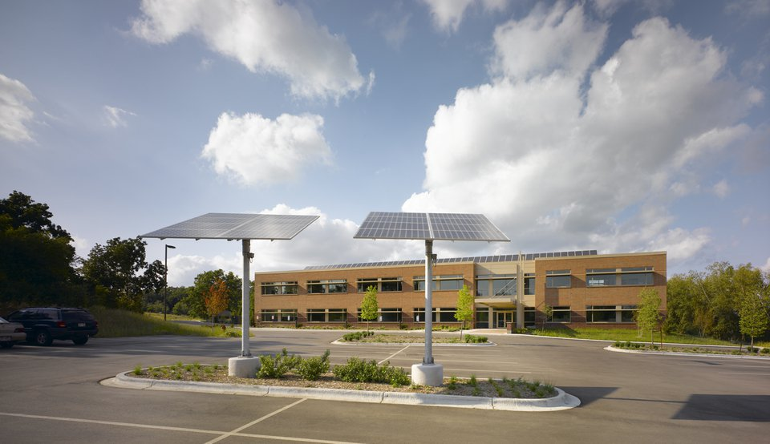

Slide 3
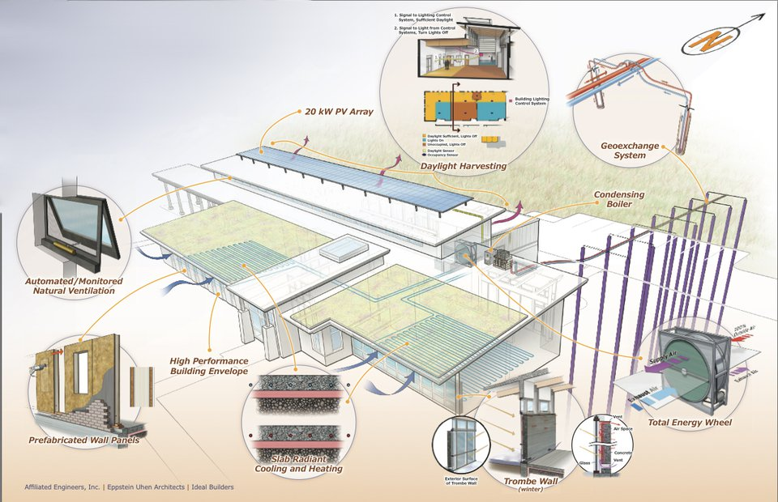

Slide 5
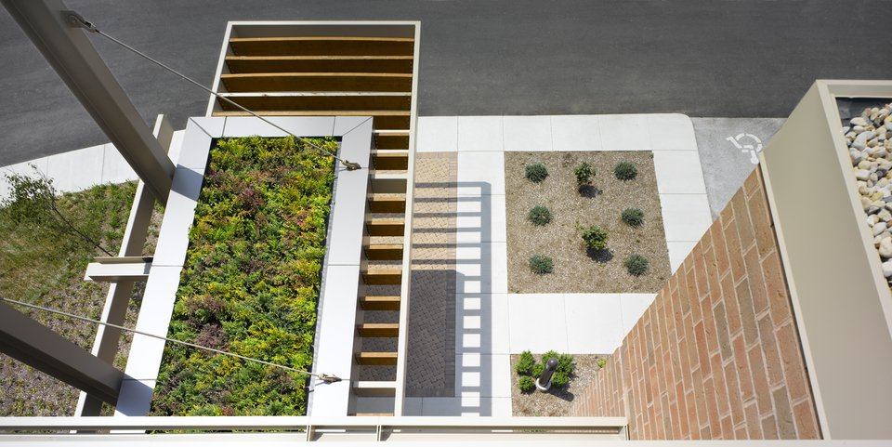

Slide 6
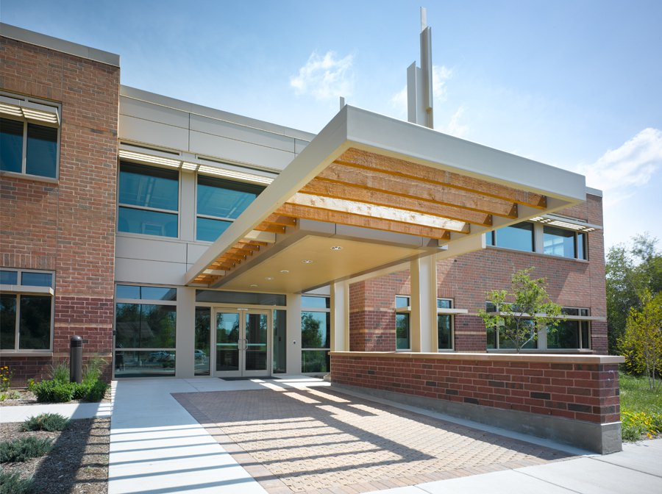
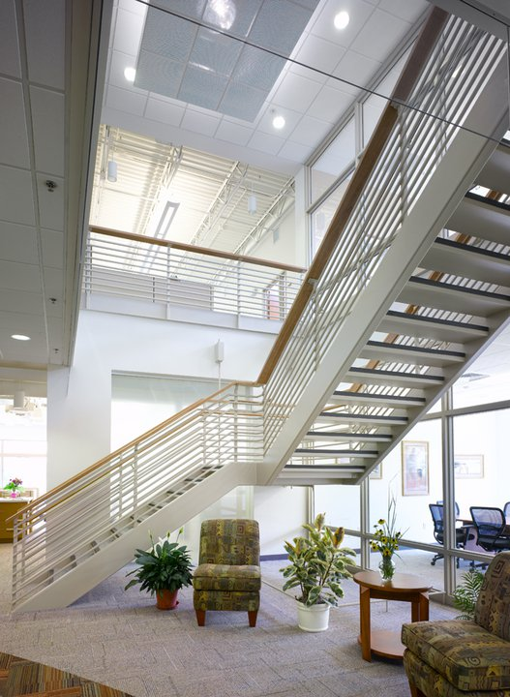

Slide 7
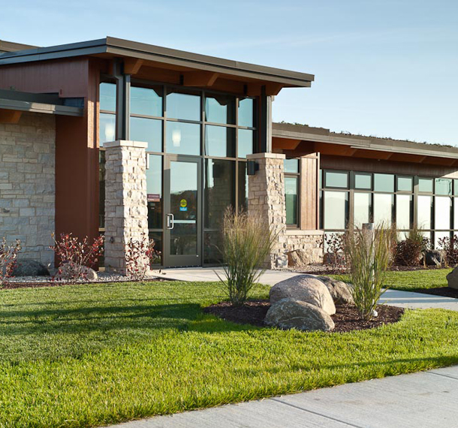
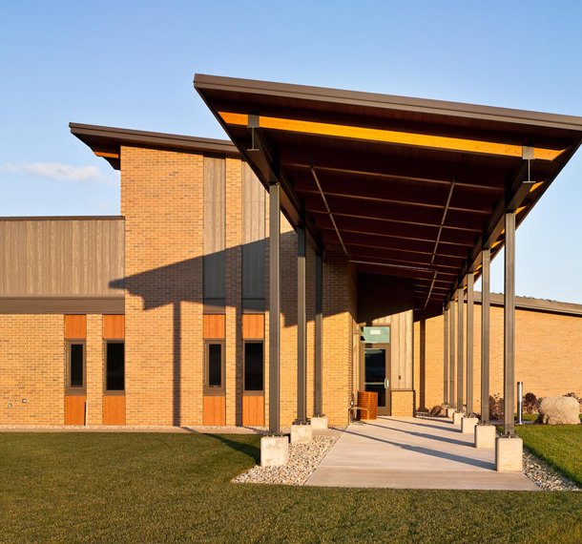

Slide 8
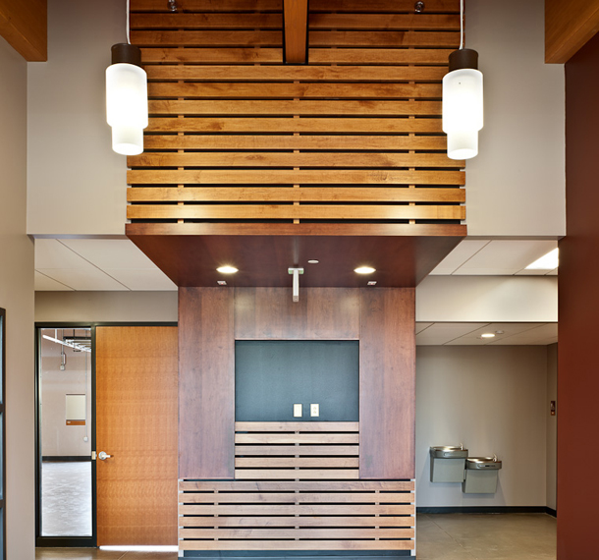
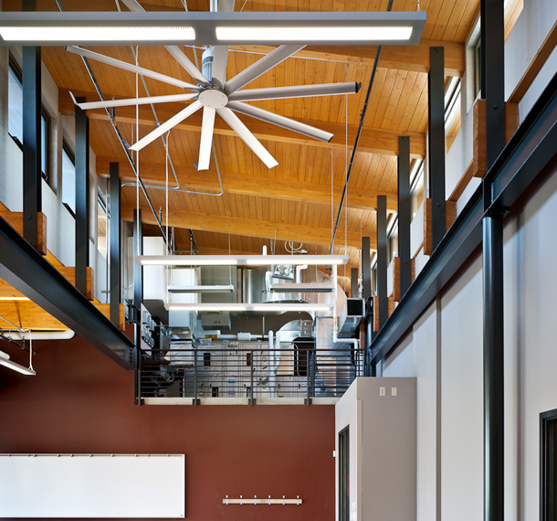

Slide 9
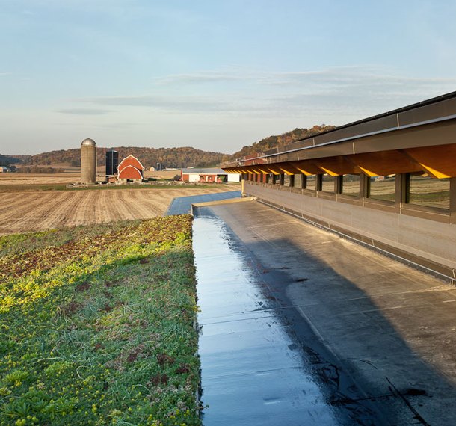

Slide 10
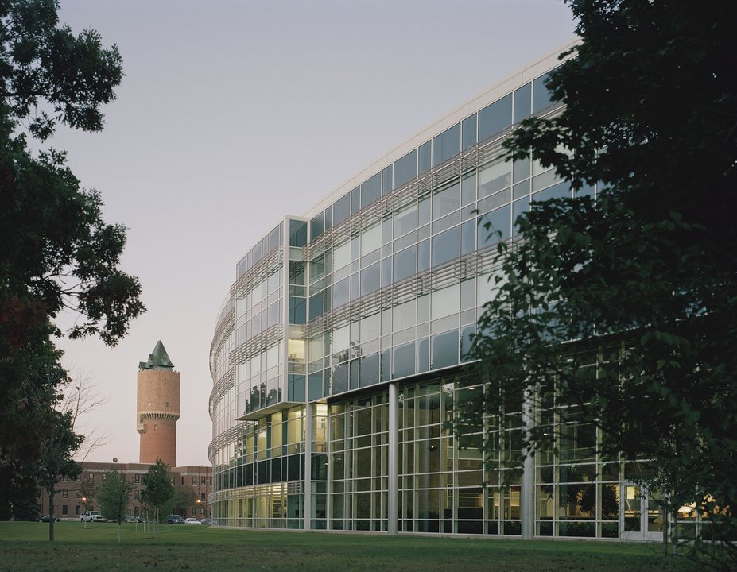
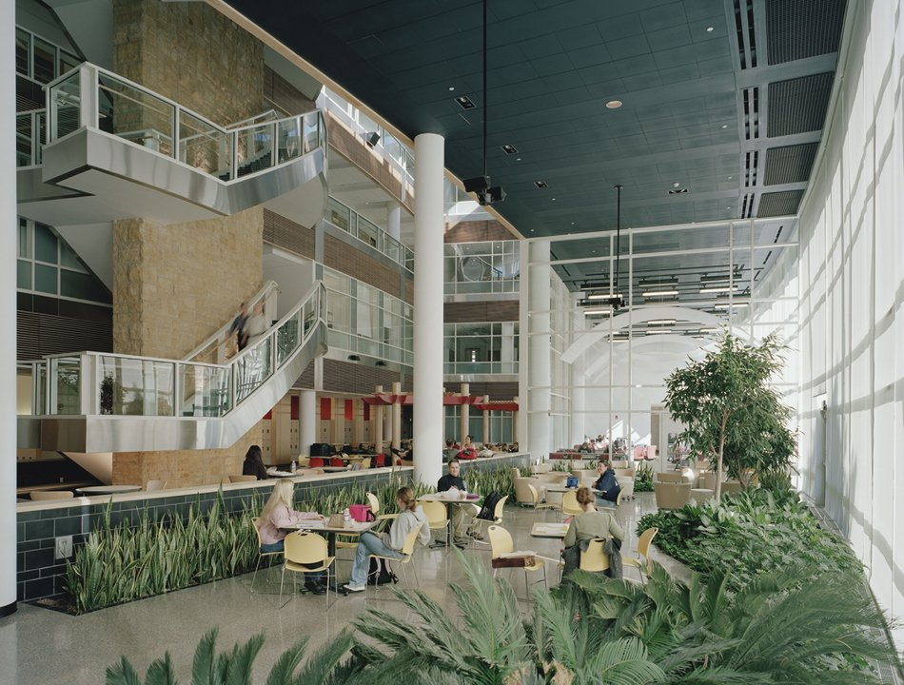
WMU College of Health & Human Services

Slide 11
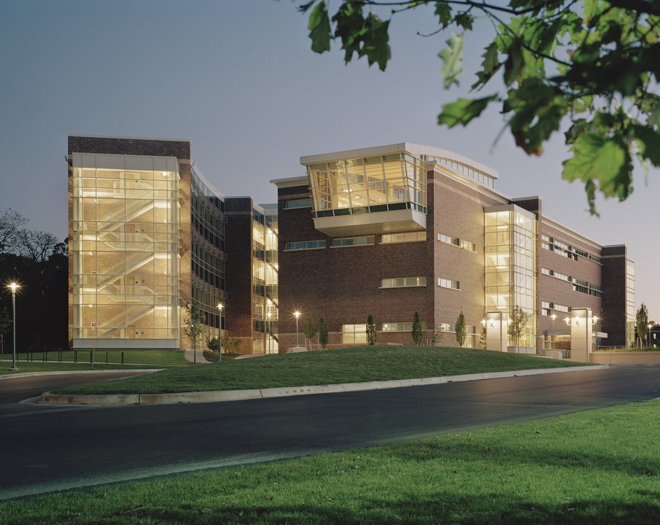

Slide 12
