Slide 1
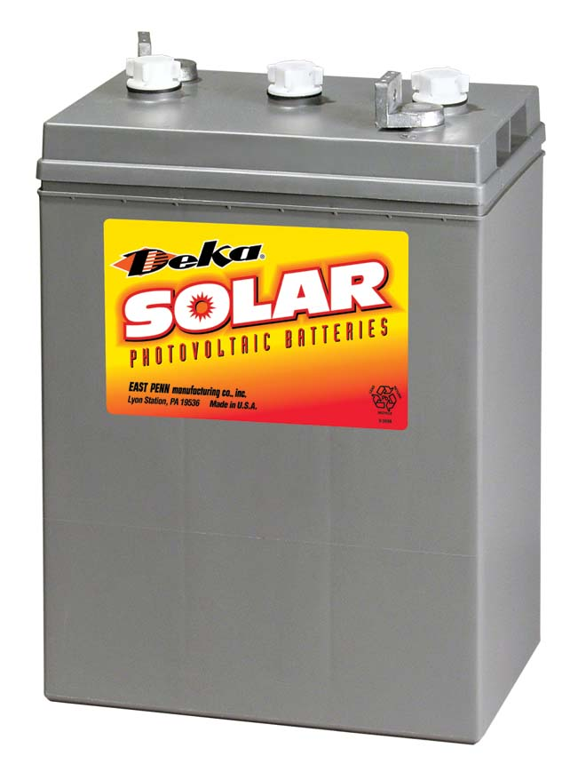
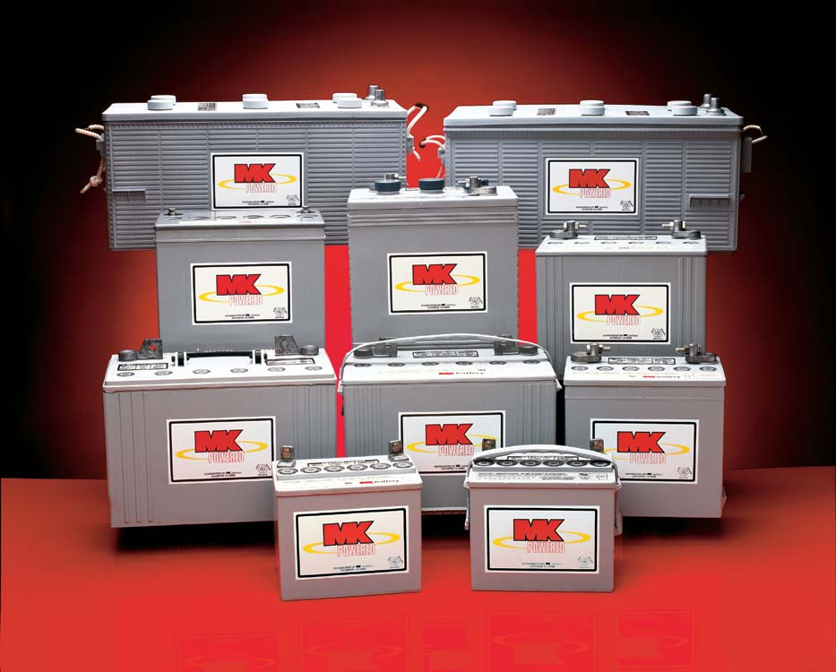
Batteries

Slide 2
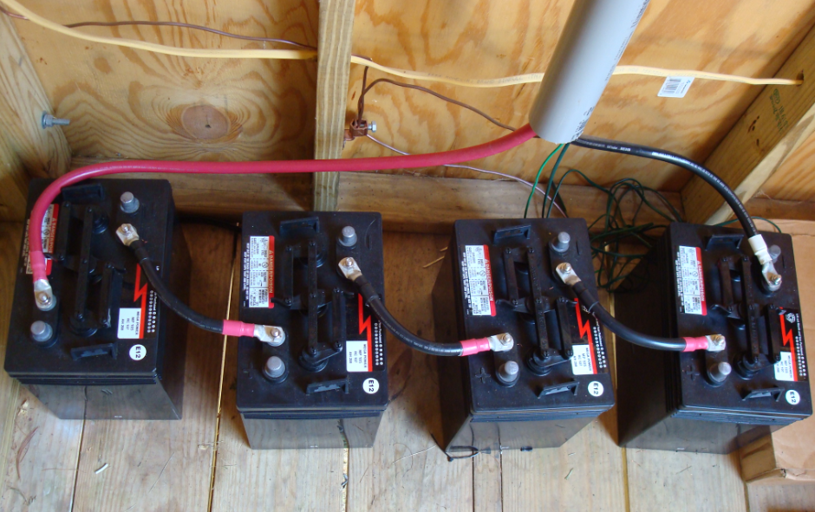
Battery Overview
Types
Parts
Maintenance
Safety
Cleaning
Checking State of Charge
  Voltage Charts
Equalization Charge
Charging
Battery Capacity
Wiring

Slide 3
Battery Types
Batteries can be classified by:
  Rechargeable or Non-rechargeable (disposable)
  Their application
    Automotive, electronics, deep-cycle (renewable energy), marine
  Their construction
    Chemistry
    Flooded
    Gelled
    Absorbed Glass Mat (AGM)

Slide 4
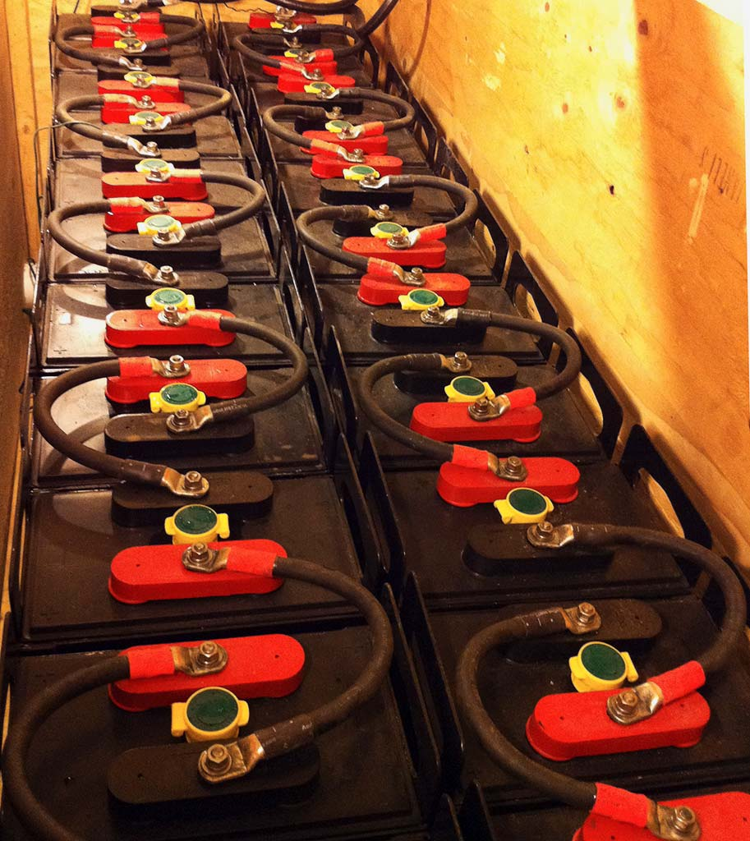
Types of Rechargeable Batteries
Lead-acid
  Deep Cycle
  Sealed (VRLA)
  Absorbed Glass Mat (AGM)
  Gel
Lithium-ion
Nickel-cadmium
Notes:
Lead acid are the best for RE systems. If taken care of, can last anywhere from 10 to 20 years.
Lithium-ion and nikel-cadmium are VERY Expensive at this point
Do Not use car batteries!
Not Deep Cycle and Not Suitable for RE Systems

Slide 5
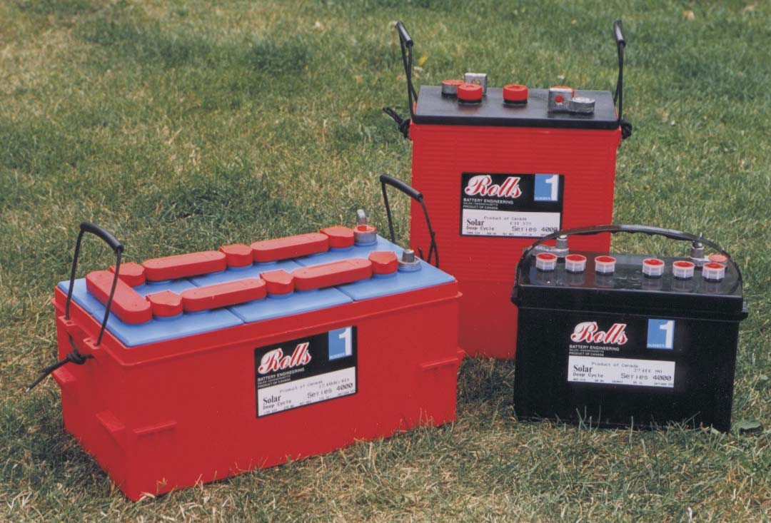
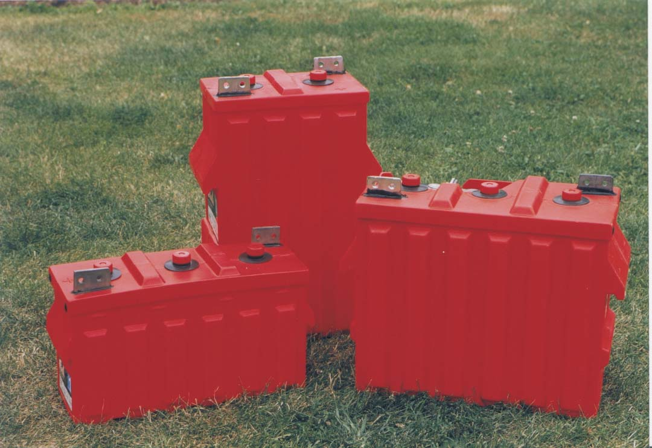
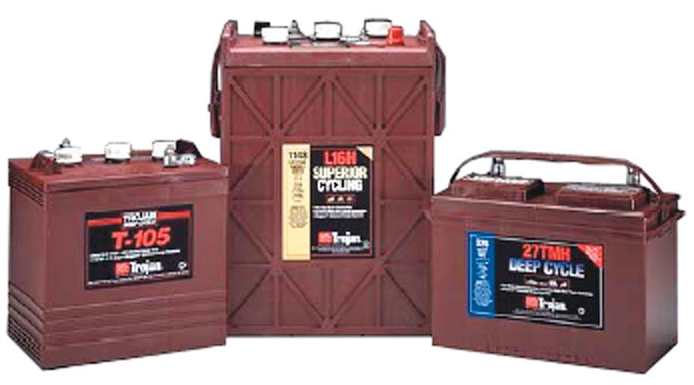
Deep Cycle Lead Acid Batteries

Slide 6
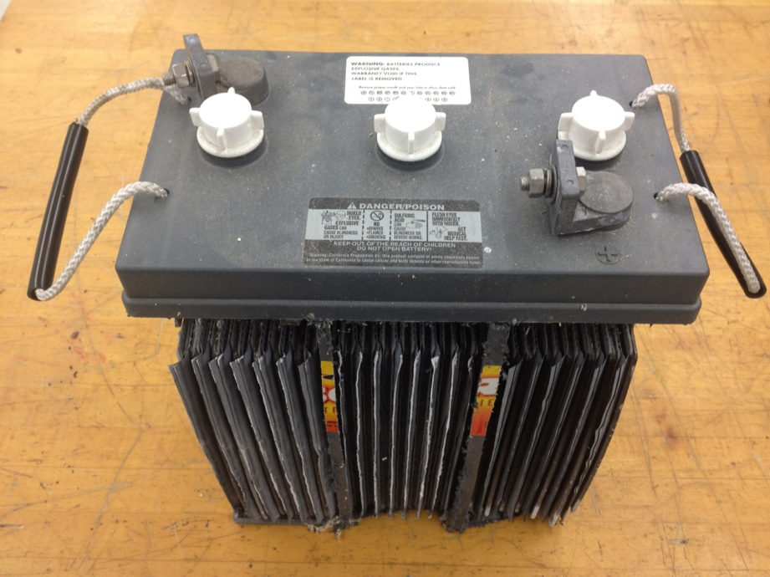
Deep Cycle Lead-Acid Battery
Vent Caps
Negative Terminal
Carrying Handles
Protective Casing
Positive Terminal
Cathode Plates
Anode Plates
Cell Dividers
Cell Dividers

Slide 7

Terminals & Plates
Positive Terminal
Negative Terminal
Anode Plates
  Lead-Dioxide when charged
  Lead-Sulfate when discharged
Negative Terminal
Cathode Plates
  Lead when charged
  Lead-Sulfate when discharged
Positive Terminal

Slide 8
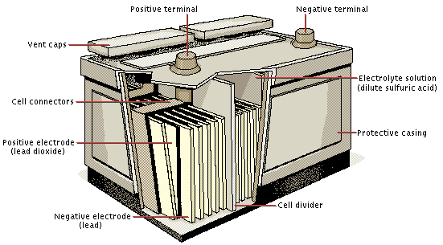
Cells
Vent Caps
Allow air to escape and enter the battery
Used for access to use hydrometer or to add distilled water
Dividers
Keep plates from touching and causing a short circuit
Connectors
Allows current to pass to the next cell

Slide 9
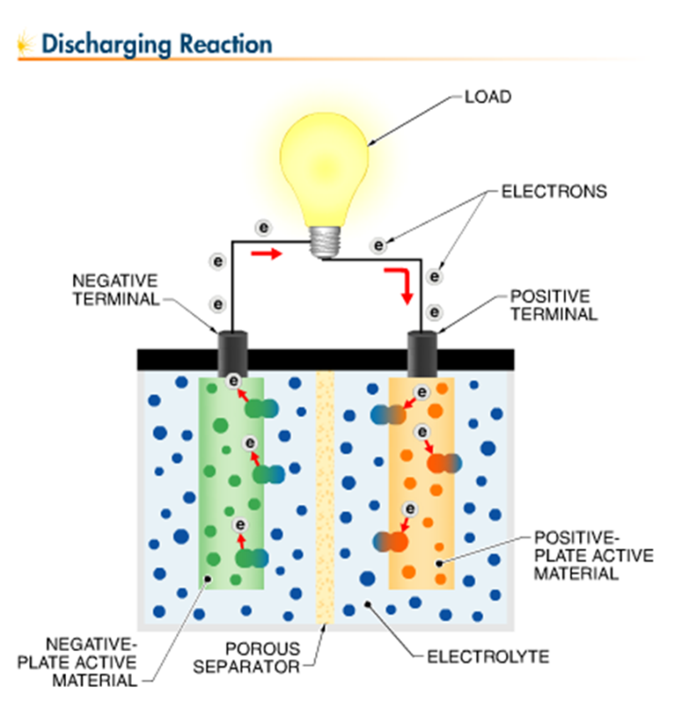
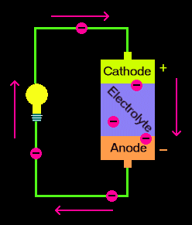
Electrolyte Solution
Purpose
Facts
Reacts with plates to produce a charge
Each cell (fully charged) produces around 2 volts

Slide 10
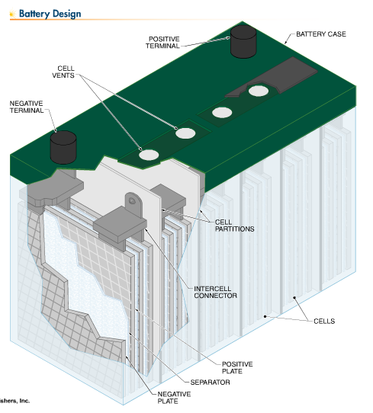
Components of a Lead Acid Battery
Anode plates (Lead Dioxide when charged, lead sulfate when discharged), positive
Cathode Plates (Lead when charged, lead sulfate when discharged), negative
Electrolyte 35% sulfuric acid and 65% water solution when charged; water when discharged.

Slide 11
Principle of Operation
The cell has one plate made of lead (cathode or negative) and another plate made of lead dioxide (anode or positive), with a strong sulfuric acid electrolyte in which the plates are immersed.
Lead in cathode combines with SO4 (sulfate) to create PbSO4 (lead sulfate), plus electrons.
Lead dioxide, hydrogen ions and SO4 ions, plus electrons from the lead plate, create PbSO4 and water on the lead dioxide anode plate.
As the battery discharges, both plates build up PbSO4 and water builds up in the acid. The characteristic voltage is about 2 volts per cell, so by combining six cells you get a 12-volt battery.
The reaction is completely reversible. If you apply current to the battery at the right voltage, lead and lead dioxide form again on the plates so you can reuse the battery over and over. In a zinc-carbon battery, there is no easy way to reverse the reaction because there is no easy way to get hydrogen gas back into the electrolyte.

Slide 12


Slide 13
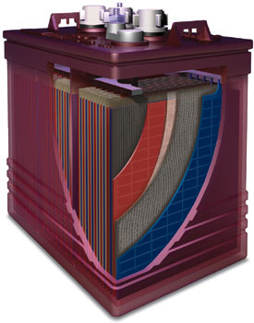
Battery Voltage & Capacity (Amp-Hours)
Lead Acid Batteries have approximately 2 volts per cell.
Each cell has a cap.
3 caps indicates a 6 volt battery
(3 cells X 2 volts).
Battery capacity is rated in amp-hours.
A 200 AH battery can deliver 1 amp for 200 hours

Slide 14
Battery Capacity (Amp-Hours)
Battery capacity is rated in amp-hours.
  1 amp-hour is the equivalent of drawing 1 amp steadily for one hour, or 2 amps steadily for half an hour.

Slide 15

Formula for Amp-Hours
To determine the amp-hours used:
Amps (used by load) X Time = Amps-hours used

Slide 16
Battery Capacity (Amp-Hours)
Question:
If you were to use a load that requires 30 amps for 25 minutes. How many amp hours have you used?
Answer:
30 amps X (25min / 60min in 1 hour) =
30 amps X .41 hours =
30 amps X .41 hours = 12.5 Amp-Hours

Slide 17
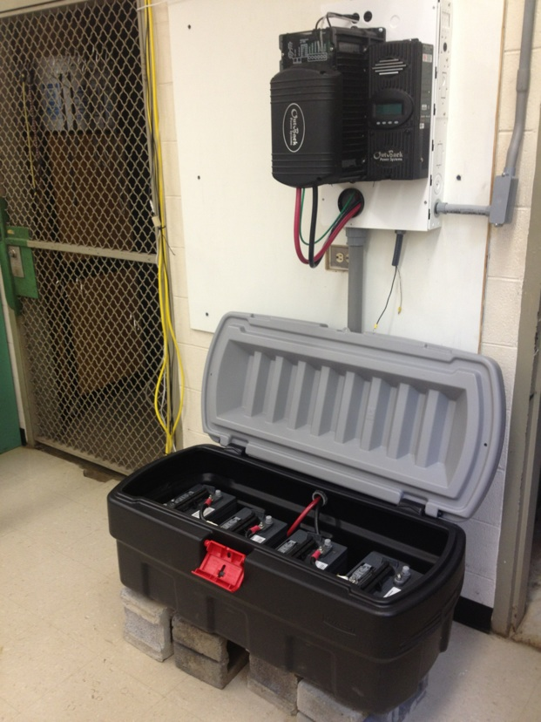
Protective Casing
Boxes and Enclosures
Lid
  Prevent accidents from things falling on battery terminals
  Top access for maintenance
Base
  Holds batteries in place
  Prevents spilled liquid from escaping bank area
Notes:
Proper housing. Make sure your batteries are housed in a safe, easily accessible place. Most batteries require an enclosure that is lockable, sealed, insulated, and vented outdoors.
Consider battery layout, as it is preferable not to lean over one battery to reach another—making access easy reduces the chance of accidental shorting.
Freezing. Avoid locations where freezing temperature is expected. Keeping a battery at a high state of charge will also prevent freezing. Freezing results in irreparable damage to a battery's plates and container.
Heat Avoid direct exposure to heat sources, such as radiators or space heaters. Temperatures above 80° F accelerate the battery's self-discharge characteristics.

Slide 18
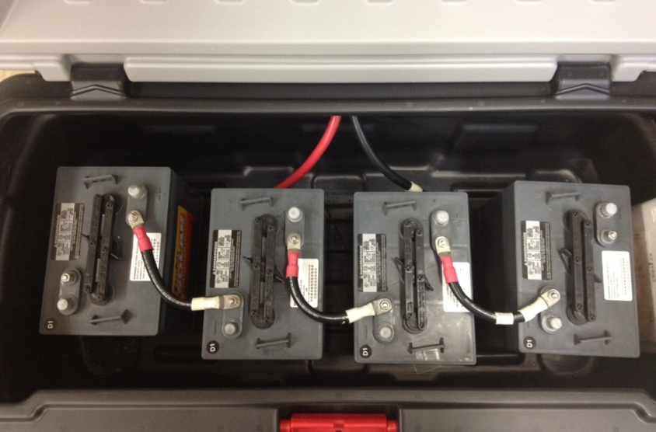
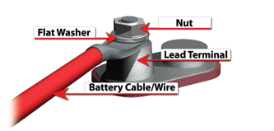
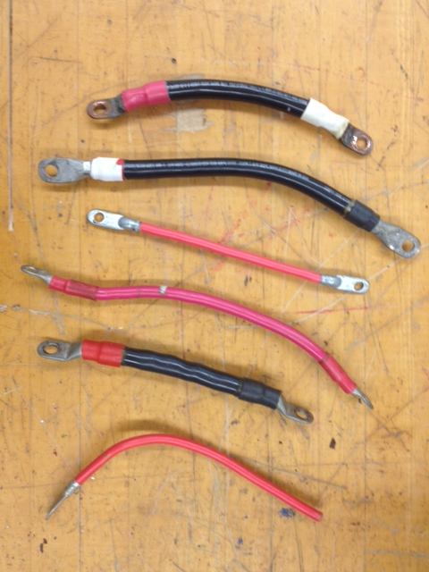
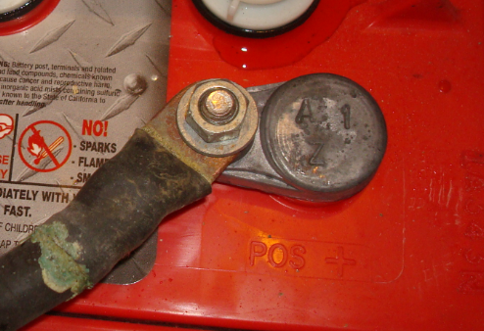
Battery Connections
Ampacity
Battery cables should be sized to handle the expected load
Notes:
Battery cables provide the link between the batteries, equipment and charging system. Faulty connections can lead to poor performance and terminal damage, meltdown or fire
If using washers, it is very important to ensure the battery wire connection is contacting the lead surface of the terminal and the washer is placed on top of the wire connection. If you place the washer between the terminal lead and the battery wire, this creates high resistance and can cause terminal meltdown.

Slide 19
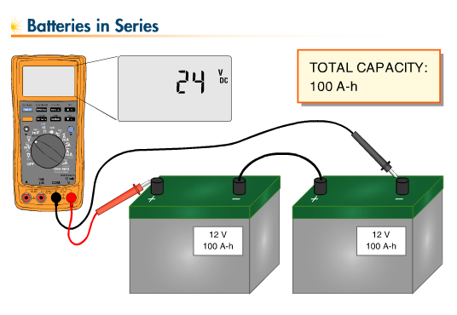
Series Connections

Slide 20
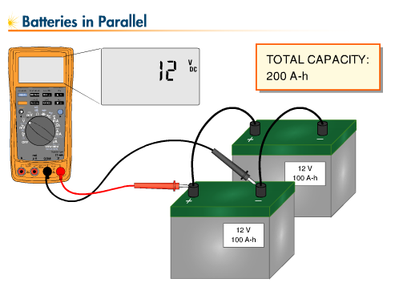
Parallel Connections

Slide 21
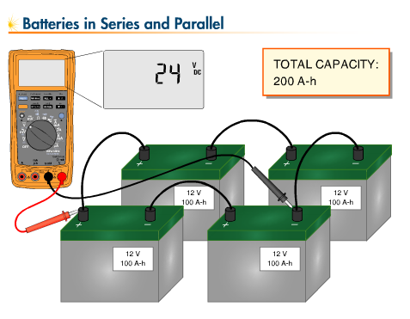
Series & Parallel

Slide 22
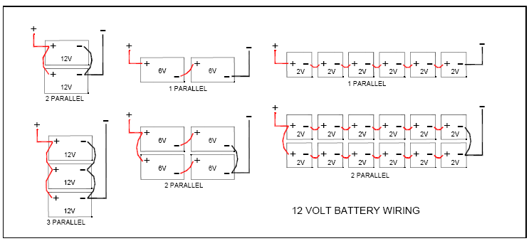
12 Volt Batteries

Slide 23
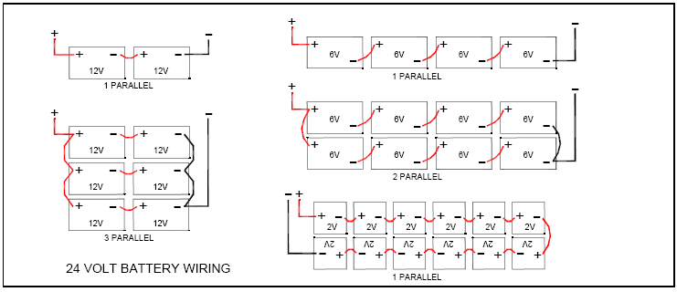
24 Volt Batteries

Slide 24
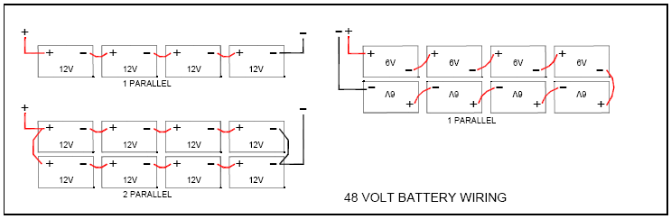
48 Volt Batteries

Slide 25
Battery Connections
Ampacity
Battery cables should be sized to handle the expected load
Notes:
Battery cables provide the link between the batteries, equipment and charging system. Faulty connections can lead to poor performance and terminal damage, meltdown or fire
If using washers, it is very important to ensure the battery wire connection is contacting the lead surface of the terminal and the washer is placed on top of the wire connection. If you place the washer between the terminal lead and the battery wire, this creates high resistance and can cause terminal meltdown.

Slide 26
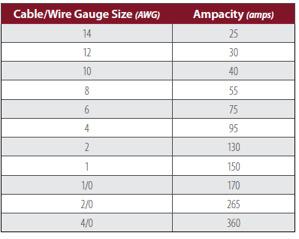
Battery Cable Sizing
Size for expected load..
Example: Assume a max expected load is around 100 amps. According to the chart, 2 AWG wire is recommended for the battery and inverter connections.
Notes:
Battery cables should be sized to handle the expected load.
Table values are for cable lengths less than 6 feet (1829 mm). In series/parallel battery banks, it is preferable for all series cables to be the same length and all parallel cables to be the same length.

Slide 27
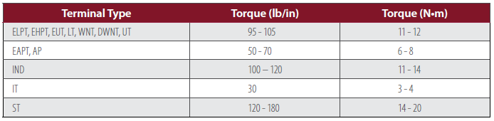

Battery Connection Torque Values
WARNING: Use an insulated wrench when making battery connections.
Notes:
Tighten all cable connections to the proper specification to make sure there is good contact with the terminals. Over-tightening the connection to the terminal can result in terminal breakage and loose connections, which can result in meltdown or fire.

Slide 28
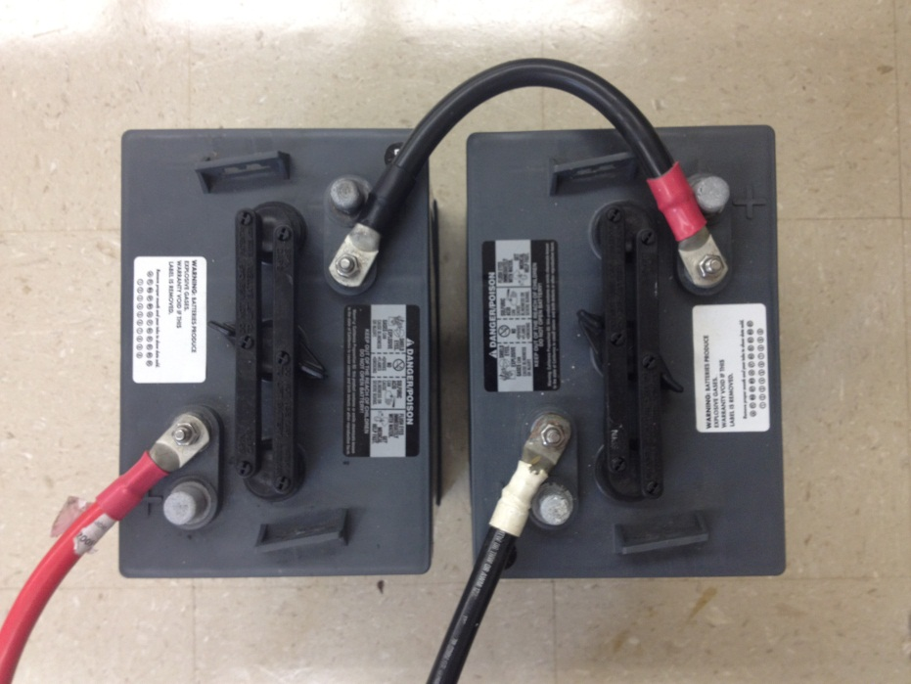
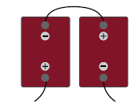
Battery Wiring
Series
Example
Two T-105, 6V batteries rated at 225 Amp-Hours (AH) connected in series
System Voltage: 6V + 6V = 12V
System Capacity = 225AH
Series
Notes:
To increase voltage, connect batteries in series. This will not increase the system capacity.

Slide 29
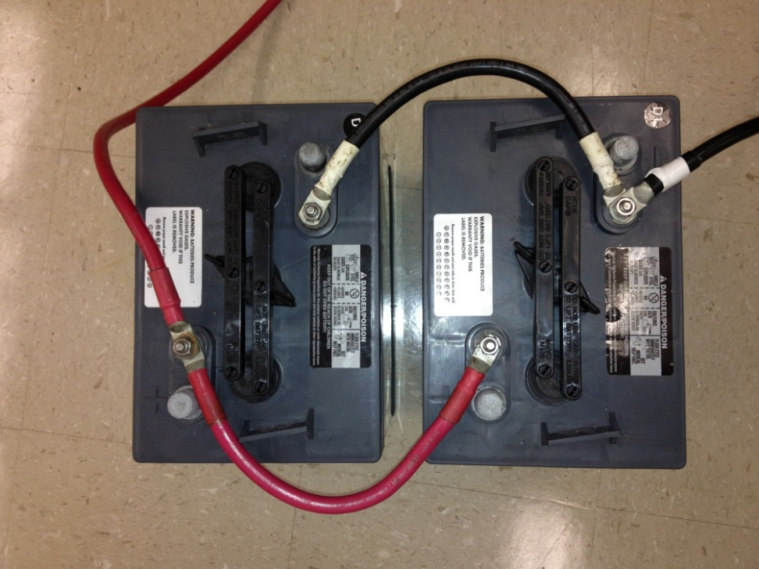
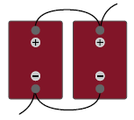
Battery Wiring
Parallel
Example
Two T-105, 6V batteries rated at 225AH connected in parallel
System Voltage: 6V
System Capacity = 225AH + 225AH = 450AH
Parallel
Notes:
To increase capacity, connect batteries in parallel. This will not increase the system voltage

Slide 30
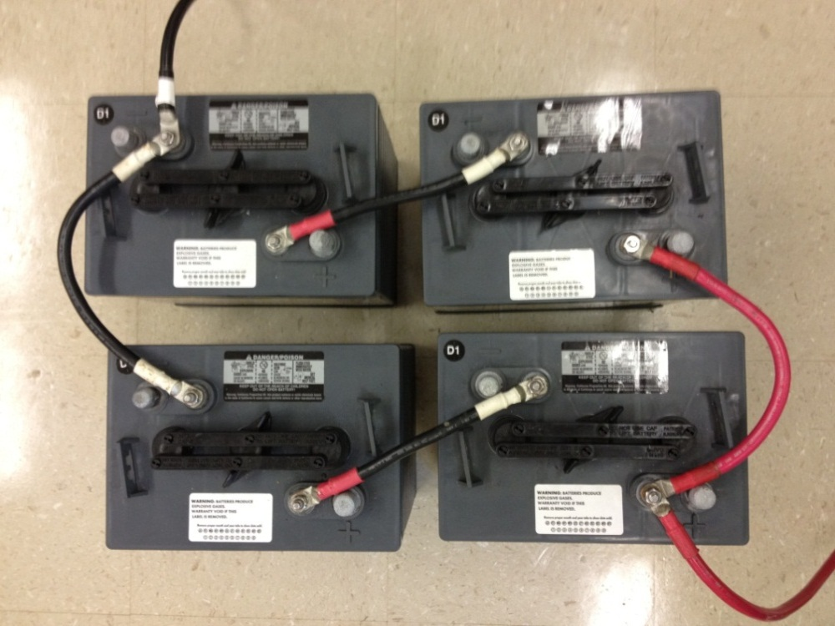
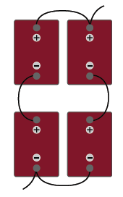
Battery Wiring
Series & Parallel Connections
Example
Four T-105, 6V batteries rated at 225AH connected in series/parallel
System Voltage: 6V + 6V = 12V
System Capacity = 225AH + 225AH = 450AH
Notes:
To increase both voltage and capacity, connect additional batteries in series and parallel

Slide 31
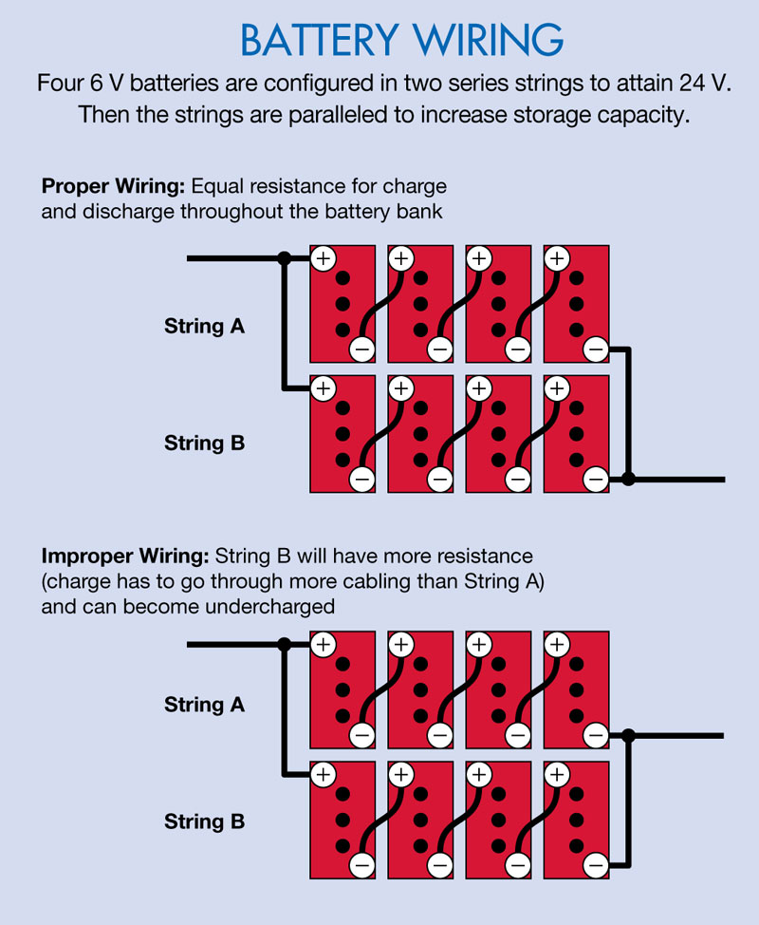

Slide 32
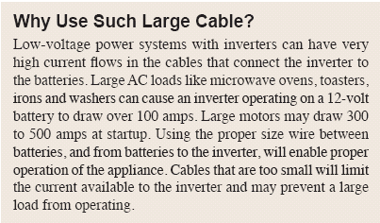
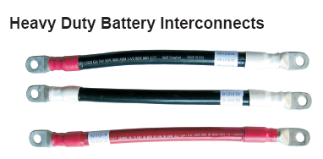
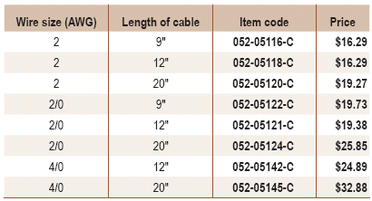
Battery Cables

Slide 33
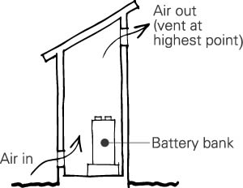
Ventilation
Deep-cycle flooded/wet lead acid batteries release small amounts of gas during usage, particularly during the charging process.
Notes:
Deep-cycle AGM and gel batteries generally do not release gas but can if too much pressure builds up during charging. It is critical to charge batteries in a properly ventilated area.

Slide 34
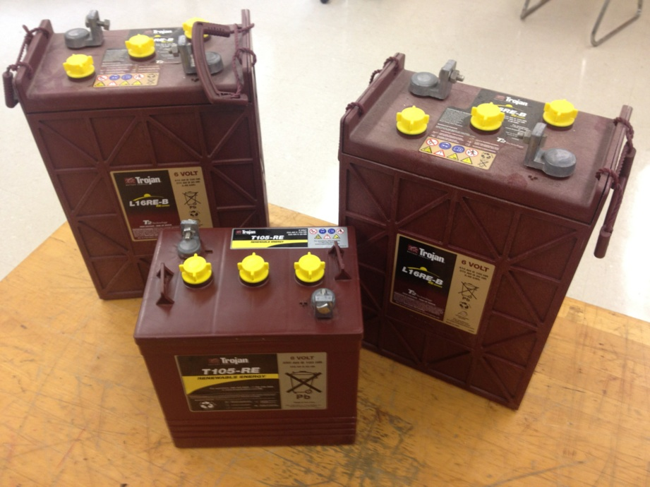
Battery Orientation
Notes:
Deep-cycle flooded/wet batteries must be placed upright at all times. Fluid in the battery will spill if the battery is placed on its side or at an angle.

Slide 35
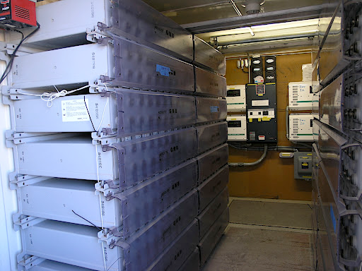
Battery Orientation
Notes:
Deep-cycle AGM or gel batteries are spill-proof so they can be placed either upright or on their side.

Slide 36
BATTERY MAINTENANCE

Slide 37
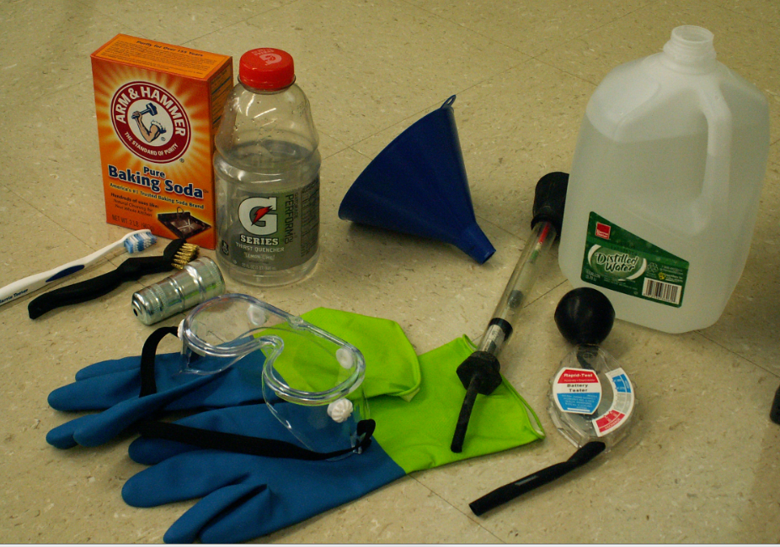
Safety
Concerns
No metal objects near batteries
  Short circuiting a battery causes explosions
  Remove all jewelry
Safety goggles
Gloves?

Slide 38
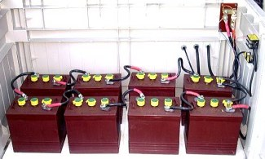
Regular Maintenance
Even if a battery bank is working well, performing routine maintenance can prevent future problems. All batteries should be thoroughly inspected monthly.
Notes:
The cases and terminals should be kept clean and corrosion-free. While flooded batteries typically show corrosion buildup around the terminals from gassing, it should be minimal. Sealed batteries should not have any buildup.

Slide 39
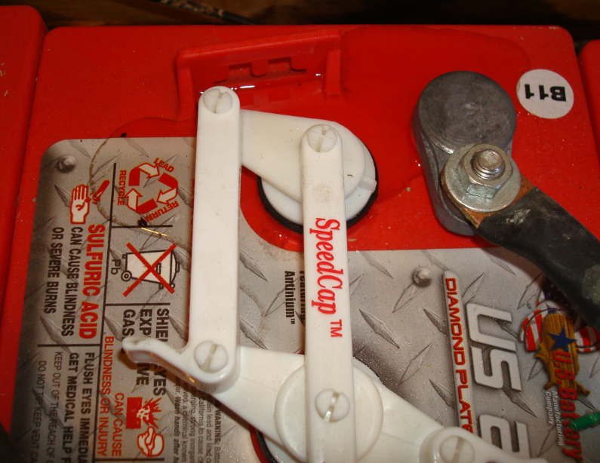
Preventative Maintenance
Inspection
Examine outside of battery. Are terminal and connections clean, free of dirt and corrosion, dry?
If fluids are on top of battery they are overwatered or overcharged?
Tighten loose connections and replace damaged cables

Slide 40
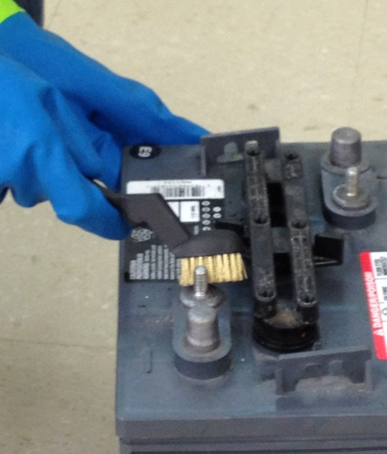
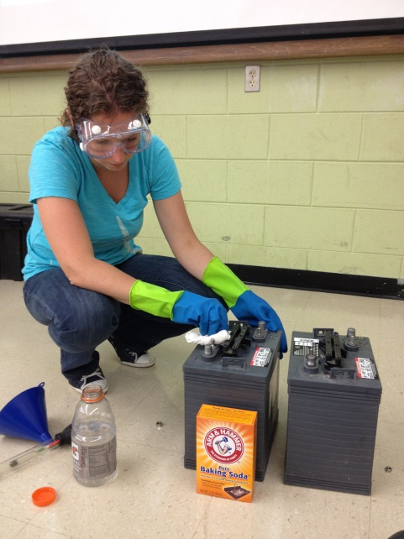
Cleaning Batteries
Clean Terminals
Remove Battery Cables
Mix 2 Tablespoons Baking Soda with 1 Pint of Water
Use brush to remove any corrosion around the terminals
Clean battery tops with distilled water and dry
Notes:
To neutralize any escaped acid, wipe battery cases and terminals with a clean cloth or soft brush dipped in a baking soda and water solution (1 pound of soda to 1 gallon of water), make sure vent caps are on and securely tightened.
A bubbling solution is a sign that some acid is present; wait until bubbling stops and then wipe with clean water and dry. Be careful not to let anything into the battery through the vent caps.
Once the cases and terminals are clean, check the terminal connections and inspect the battery cables for any wear or loose crimps, and replace if necessary.
Clean and recoat terminals and lugs with a thin layer of anticorrosion treatment (petroleum jelly works). Always leave your batteries clean so you can easily see any future corrosion or acid leakage.

Slide 41
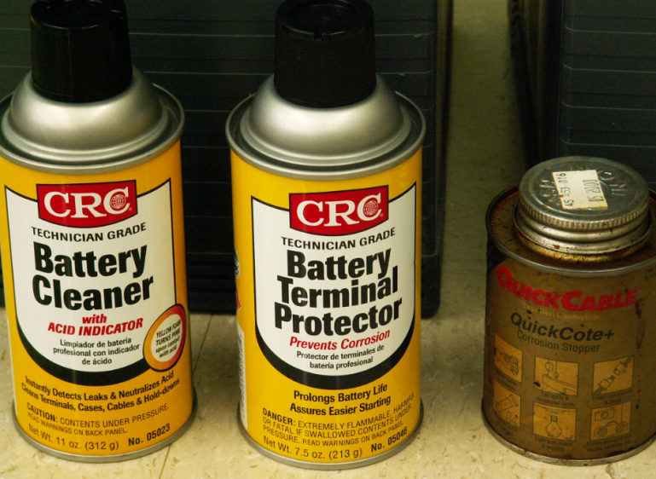
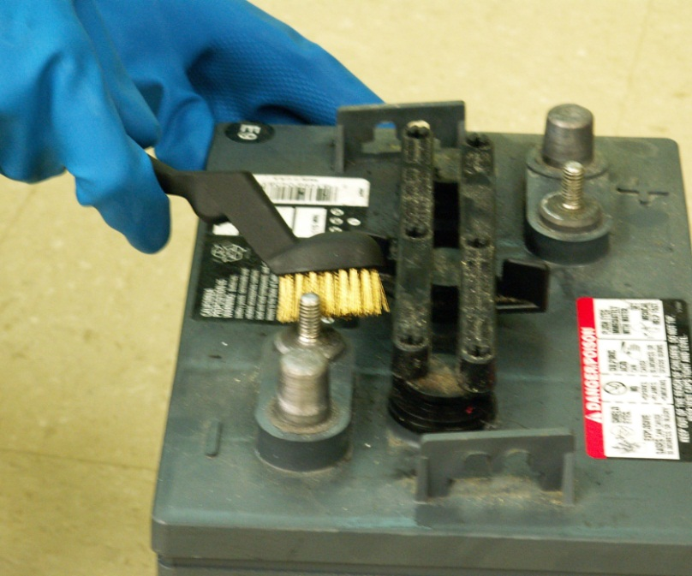
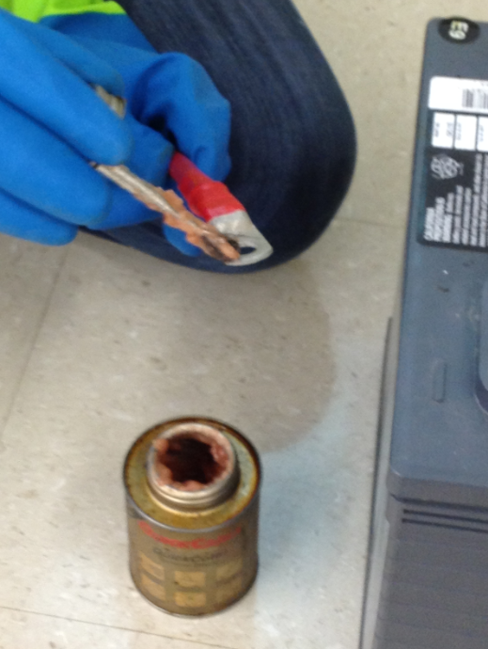
Terminal Protection
Corrosion can build up on terminals if they are not kept clean and dry. To prevent corrosion, apply a thin coat of terminal protector spray
Notes:
Corrosion can build up on terminals if they are not kept clean and dry. To prevent corrosion, apply a thin coat of terminal protector spray

Slide 42
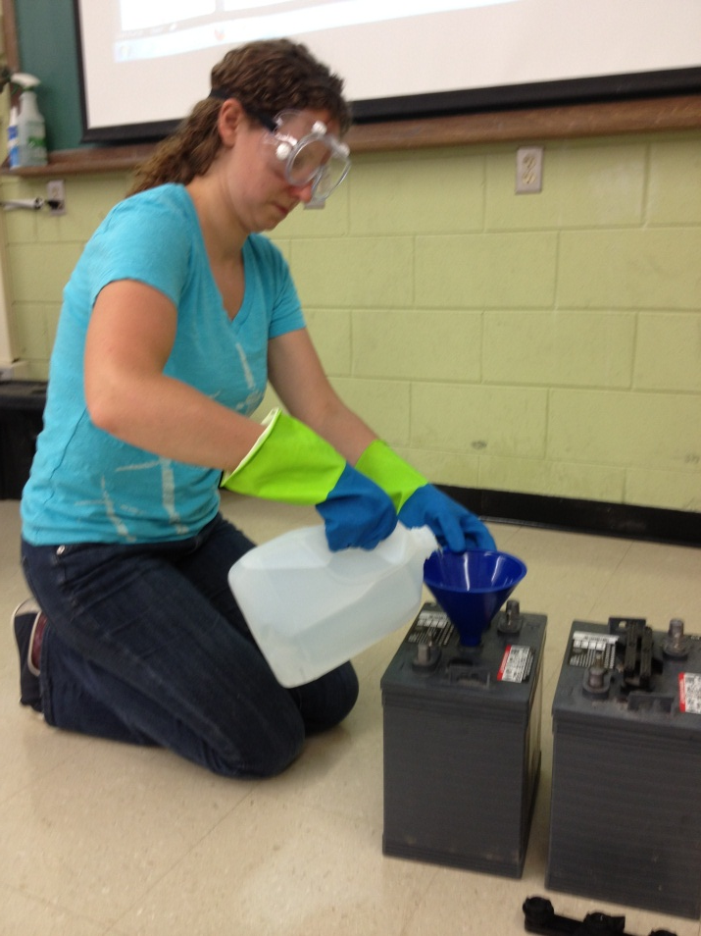
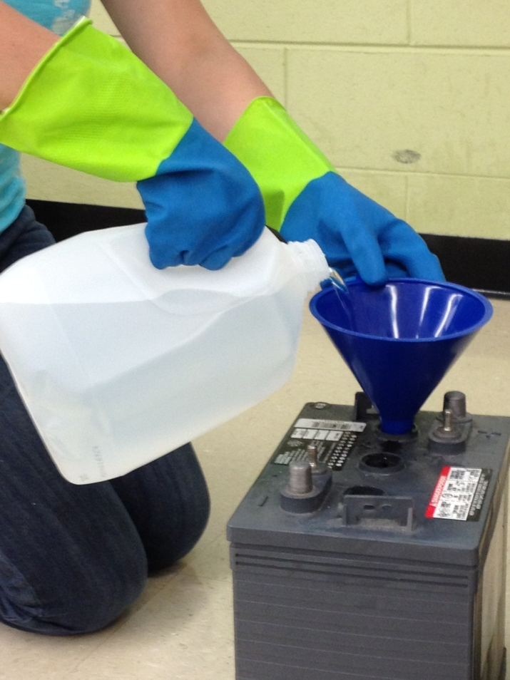
Watering (Deep cycle flooded/wet batteries)
Fully charge batteries before adding water
Notes:
Fully charge batteries before adding water! Exception: You may add water to discharged batteries if the plates are exposed. If this is the case, add enough water to cover the plates and then charge the batteries. After charged, follow watering instructions.
To add water:
Remove vent caps and place upside down (prevents dirt from infecting)
Check electrolyte level. If it is above plates, do not add water. If it is barely covering the plates, add distilled or de-ionized water to a level of 1/8 below the vent well.
Re-secure caps

Slide 43
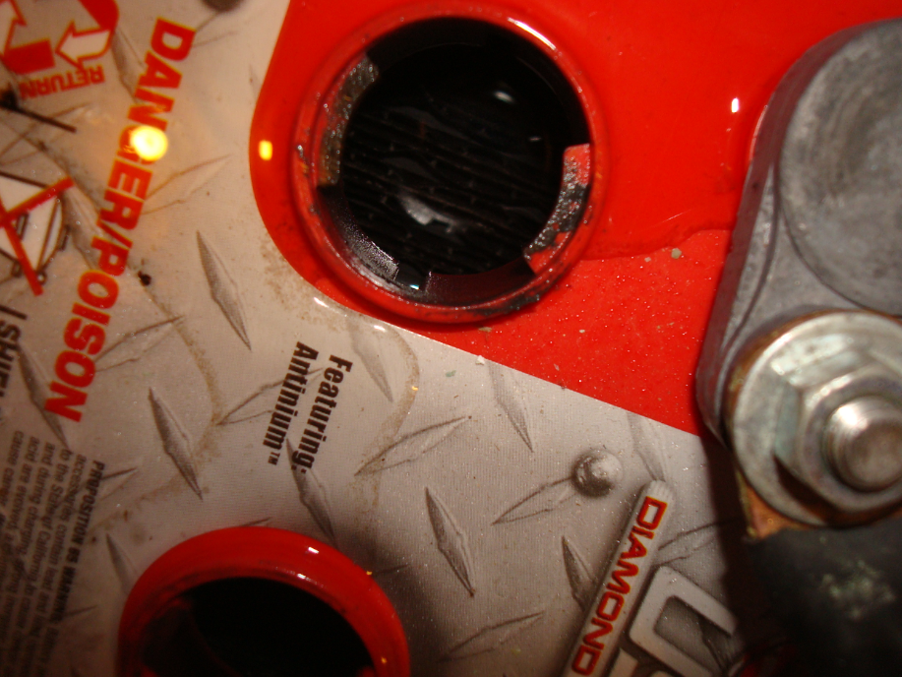

Watering (Deep cycle flooded/wet batteries)
Notes:
Fully charge batteries before adding water! Exception: You may add water to discharged batteries if the plates are exposed. If this is the case, add enough water to cover the plates and then charge the batteries. After charged, follow watering instructions.
To add water:
Remove vent caps and place upside down (prevents dirt from infecting)
Check electrolyte level. If it is above plates, do not add water. If it is barely covering the plates, add distilled or de-ionized water to a level of 1/8 below the vent well.
Re-secure caps

Slide 44



Cleaning Batteries
Corrosion can build up on terminals if they are not kept clean and dry. To prevent corrosion, apply a thin coat of terminal protector spray
Notes:
Corrosion can build up on terminals if they are not kept clean and dry. To prevent corrosion, apply a thin coat of terminal protector spray

Slide 45



State of Charge
Notes:
A battery’s lifespan is affected by how deeply it is discharged before getting charged back up, and how long it stays in that discharged state.
A battery’s state of charge (SOC) is the amount of energy remaining in the battery. The lower the SOC is allowed to drop, the shorter its lifespan will be.
Sizing an off-grid battery bank for 50% SOC is common, but remote systems with no backup power sources may be designed to maintain SOC at 75% or above to extend battery life—the fewer times a heavy, unwieldy battery bank needs to be replaced, the better. Backup power systems are often designed to go down to 20% SOC since they are rarely discharged.
An amp-hour meter is a more common and fairly accurate way to keep track of SOC.
These meters require a shunt to measure the current going into and coming out of the batteries, and some can keep track of more than one charging source (PV, wind, generator, etc.).
Some have built-in alarms, generator start relays, and data logging capabilities. With proper setup, they can give you a much better picture of the SOC.

Slide 46

Checking SOC with Multi-meter
Check State of Charge
Place Red (+) terminal of the multi-meter to the positive side of the battery terminal
Place Black (-) terminal of the multi-meter to the Negative side of the battery terminal

Slide 47


Slide 48

Equalization Charge
Purpose:
Hardened Sulfate will form on the plates over time if it is not fully charged
  This lowers the capacity (Amp hours)
An equalization charge every 3 – 4 weeks prevents the sulfate from hardening
Notes:
Equalizing is an overcharge performed on deep-cycle flooded/wet batteries after they have been fully charged.
Confirm that the batteries are deep-cycle flooded/wet.
Check electrolyte levels to make sure plates are covered with water before charging.
Check that all vent caps are secured properly on the battery before charging.
Set charger to equalizing mode.
The batteries will gas (bubble) during the equalization process.
Measure the specific gravity every hour. Refer to Table 7 for specific gravity and voltage measurements. Discontinue the equalization charge when the gravity no longer rises.
WAR N I N G Do not equalize deep-cycle AGM or gel batteries.

Slide 49

Storing Batteries
Notes:
Batteries self discharge faster in high temperatures…avoid direct exposure to heat sources
Avoid locations where freezing temperatures are expected. Batteries can freeze in cold temperatures
Charge batteries before placing in storage.
Store in a cool, dry location, protected from the elements.
Disconnect from equipment to eliminate potential parasitic loads that may discharge the battery.
Batteries gradually self-discharge during storage.
Monitor the specific gravity or voltage every 4-6 weeks.
Stored batteries should be given a boost charge when they are at 70% state of charge (SOC) or less. Refer to Table 7 for specific gravity and voltage measurements.
When batteries are taken out of storage, recharge before storing

Slide 50

Recording Maintenance Checks
Notes:
One of the best ways to track your batteries’ health is to keep regular, precise records.
Ideally, readings should be taken after the batteries have been at rest for 12 to 24 hours and are fully charged, but this is generally impossible in an off-grid situation. Checking after 30 minutes of rest (no loads, no charging) will still give you good information.
These checks can alert you to bad cells, or let you know if the entire bank may be on its way out. Any differences in cell voltages or SG indicate you may have a failing (or failed) cell, and checking your readings against the expected SOC will tell you if they are losing capacity. The sooner you spot a problem, the more likely you will be able to fix it.

Slide 51
BATTERY TROUBLESHOOTING

Slide 52


Testing Preparation
Notes:
Check that all vent caps are secured properly on the battery.
Clean the top of the battery, terminals and connections with a cloth or brush and a solution of baking soda and water (1 cup of baking soda to 1 gallon of water).
Do not allow cleaning solution to get inside the battery. Rinse with water and dry with a clean cloth.
Check battery cables and connections. Replace any damaged cables. Tighten any loose connections with an insulated wrench. Refer to Torque Values section 2.2.2.
For deep-cycle flooded/wet batteries, check the electrolyte level and add water if necessary. Fully charge batteries.

Slide 53

On Charge Voltage Testing
Notes:
Disconnect and reconnect DC plug to restart charger.
While the batteries are on-charge record the current in the last ½ hour of charge (if possible) and measure the battery set voltage.
If the current at the end of charge, is below 5 amps and the battery set voltage is above 56V for a 48V system; 42V for a 36V system; 28V for a 24V system; 14V for a 12V battery; 9.3V for a 8V battery or 7V for a 6V battery, then proceed to the next step. Otherwise check the charger for proper output and recharge the batteries if necessary. If the set voltages are still low, you may have a failed battery.
While the batteries are on-charge, measure the individual battery voltages.
If any battery voltage is below 7V for 6V battery, 9.3V for 8V battery and 14V for 12V battery, and a voltage variation is greater than 0.5V for 6V battery or 1.0V for a 12V battery, from any other battery in set, it may be a failed battery.

Slide 54

Specific Gravity Testing
Notes:
Fill and drain the hydrometer 2-3 times before drawing a sample from the battery.
Measure specific gravity readings for all battery cells.
If any battery voltage is below 7V for 6V battery, 9.3V for 8V battery and 14V for 12V battery, and a voltage variation is greater than 0.5V for 6V battery or 1.0V for a 12V battery, from any other battery in set, it may be a failed battery.
Correct specific gravity readings for temperature by adding 0.004 for every 10°F (5°C) above 80°F (27°C) and subtract 0.004 for every 10°F (5°C) below 80°F (27°C).
If every cell in the battery set is below 1.250 the batteries may be undercharged; recharge batteries.
If any battery has a specific gravity variation of more than 0.030 between cells equalize the set.
If there is still a variation there may be a failed battery.

Slide 55

Battery Recycling

Slide 56

Factors Affecting Battery Capacity
Rate of discharge
Depth of discharge
Temperature
Age
Recharging characteristics

Slide 57

C-Rate and Battery Performance

Slide 58


Slide 59


Slide 60


Slide 61

Hydrometer Readings

Slide 62





Amp Hour Meters

Slide 63
Equalization Charge
Hardened sulfate will form in a battery that is constantly being cycled in the middle of its capacity range (somewhere between 80% charged and 80% discharged), and is never recharged to 100%. Over time, a portion of the plate's active materials turns into hard sulfate. If the battery is continually cycled in this manner, it will lose more and more of its capacity until it no longer has enough capacity to perform the task for which it was intended. An equalizing charge, applied routinely every three to four weeks, should prevent the sulfate from hardening.

Slide 64


Slide 65
Removing Sulfation
Charge at 2.6 to 2.7 - volts per cell
Low current rate (approximately 5 Amps for small batteries and 10-Amps for larger ones) until the specific gravity of the electrolyte starts to rise.
Be careful not to let the internal temperature of the battery rise above 125° F. If it does, turn the charger off and let the battery cool.
Continue charging until each cell in the battery is brought up to full charge (nominal 1.265 specific gravity or higher).

Slide 67


Slide 68

Hydro Caps

Slide 69
Water Miser Caps

Slide 70
Battery Maintenance
Cleaned using a baking soda and water mix; a couple of table spoons to a pint of water.
Cable connection needs to be clean and tightened.
Check fluid level. Use Distilled water.
To prevent corrosion of cables on top post batteries use a small bead of silicon sealer at the base of the post and place a felt battery washer over it. Coat the washer with high temperature grease or petroleum jelly (Vaseline), then place cable on the post and tighten. Coat the exposed cable end with the grease.

Slide 71

Battery Boxes and Enclosures

Slide 72


