Slide 1

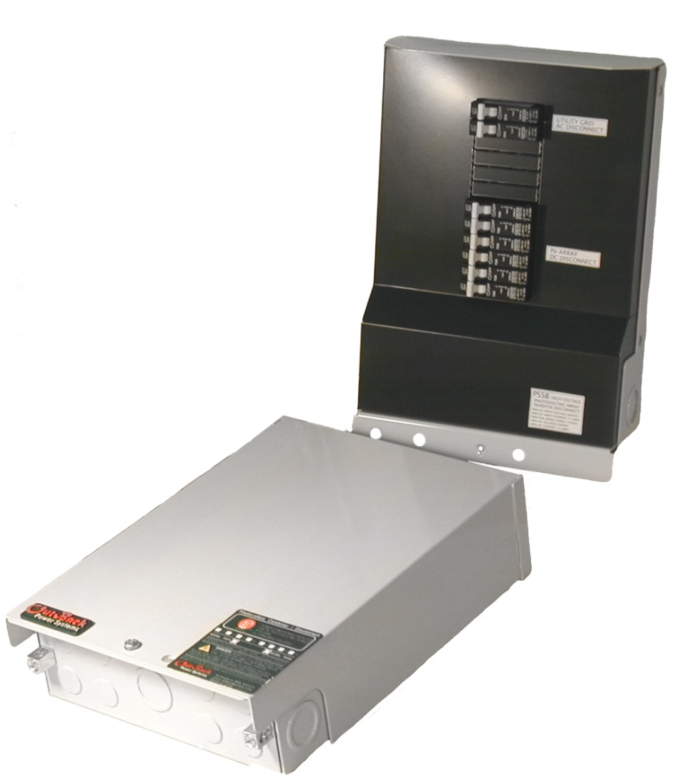
Combiner Boxes & Disconnects
PV combiner boxes are commonly used to parallel either multiple PV modules or series strings of modules and provide series overcurrent protection as specified by the National Electrical Code (NEC)

Slide 2
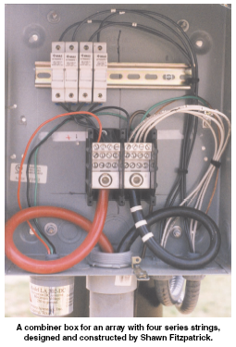
Functions of Combiner Boxes
Overcurrent protection for modules & conductors
Bonding location for conductors designed to avoid voltage drop and conductors sized for ampacity
Combines series strings in parallel
Allows one to remove a module, subarray or series string from array without affecting the rest of the array
Can be a location to disconnect DC power from Inverter
Grounding terminal location
Lighting arrestor location

Slide 3
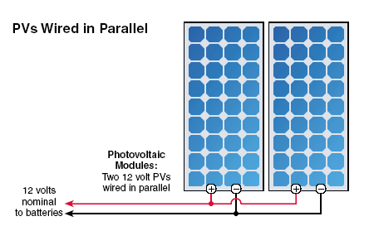
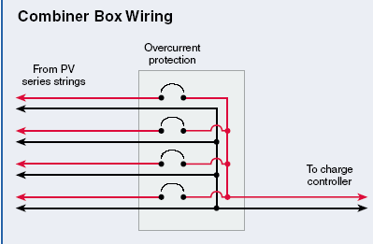
Daisy Chain
vs
Combiner Box Wiring

Slide 4
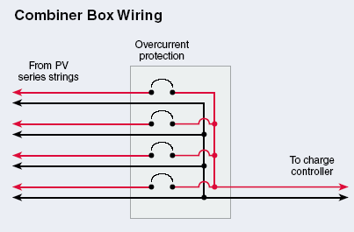

Slide 5
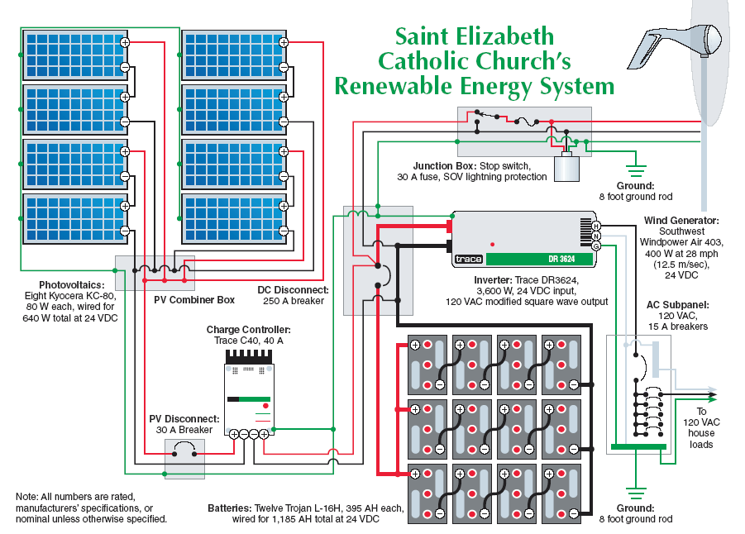

Slide 6
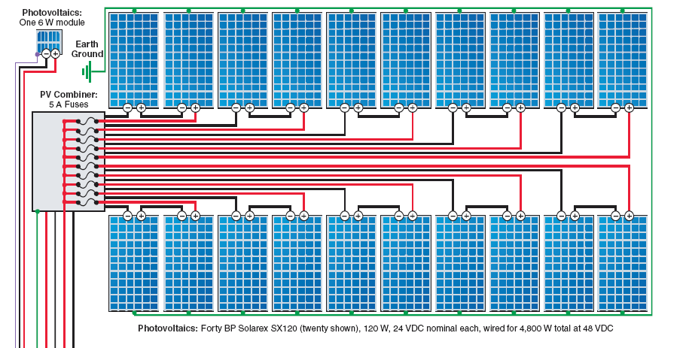

Slide 7
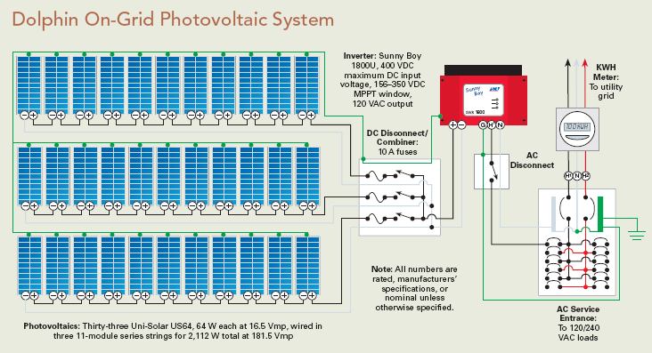
Direct Grid Tie System

Slide 8
Midnight Solar PV Combiner

Slide 9
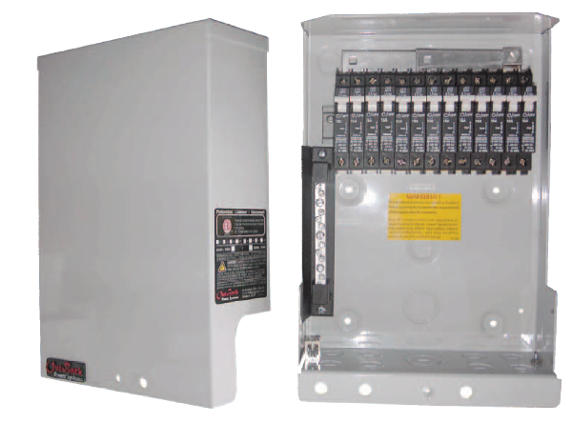
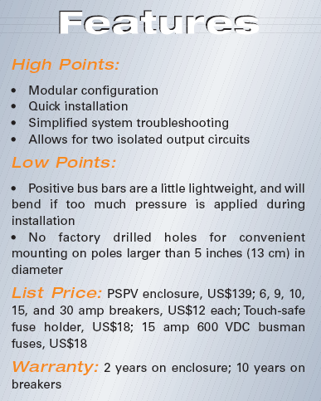
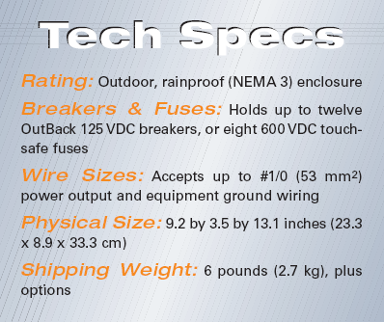
Outback Combiner Box

Slide 10
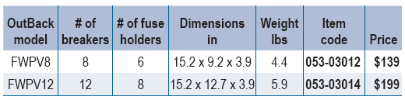

Slide 11
Outback Combiner Boxes

Slide 12
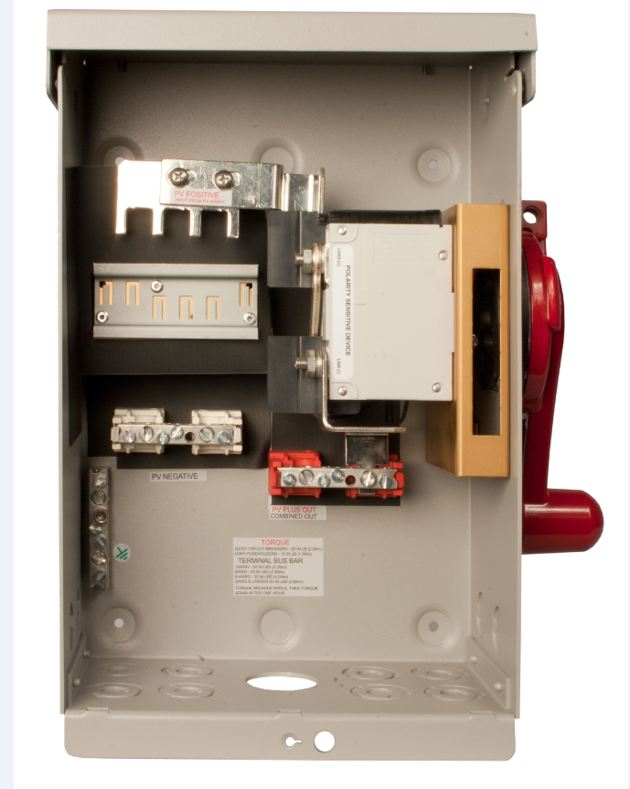
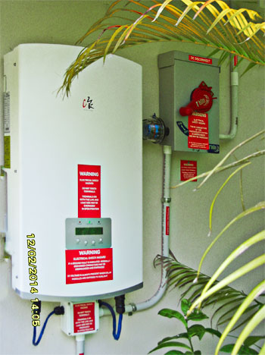
Disconnecting Combiner Boxes

Slide 13
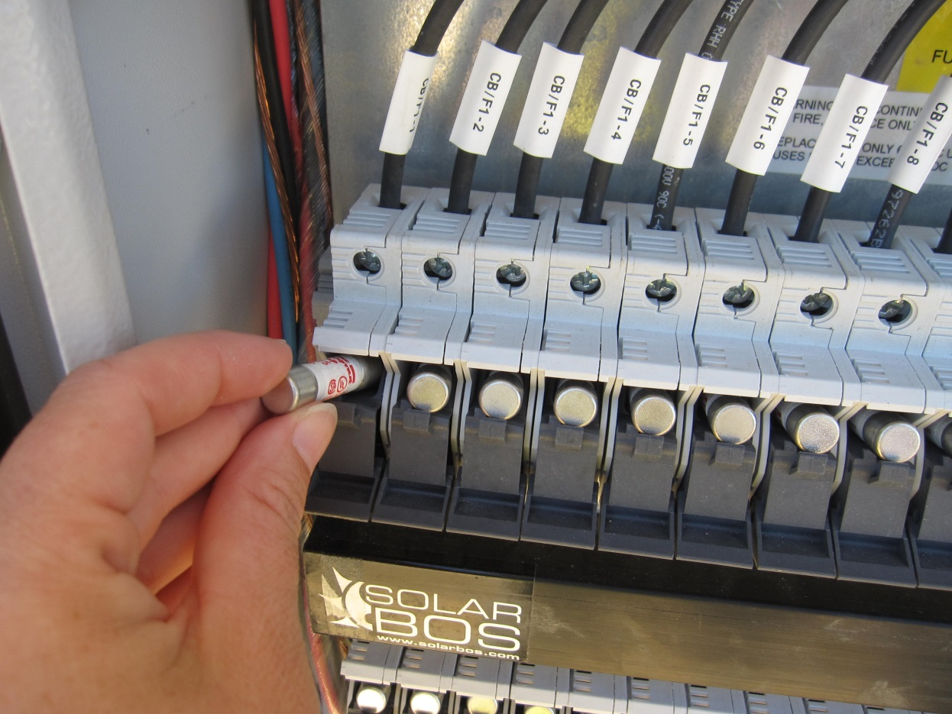
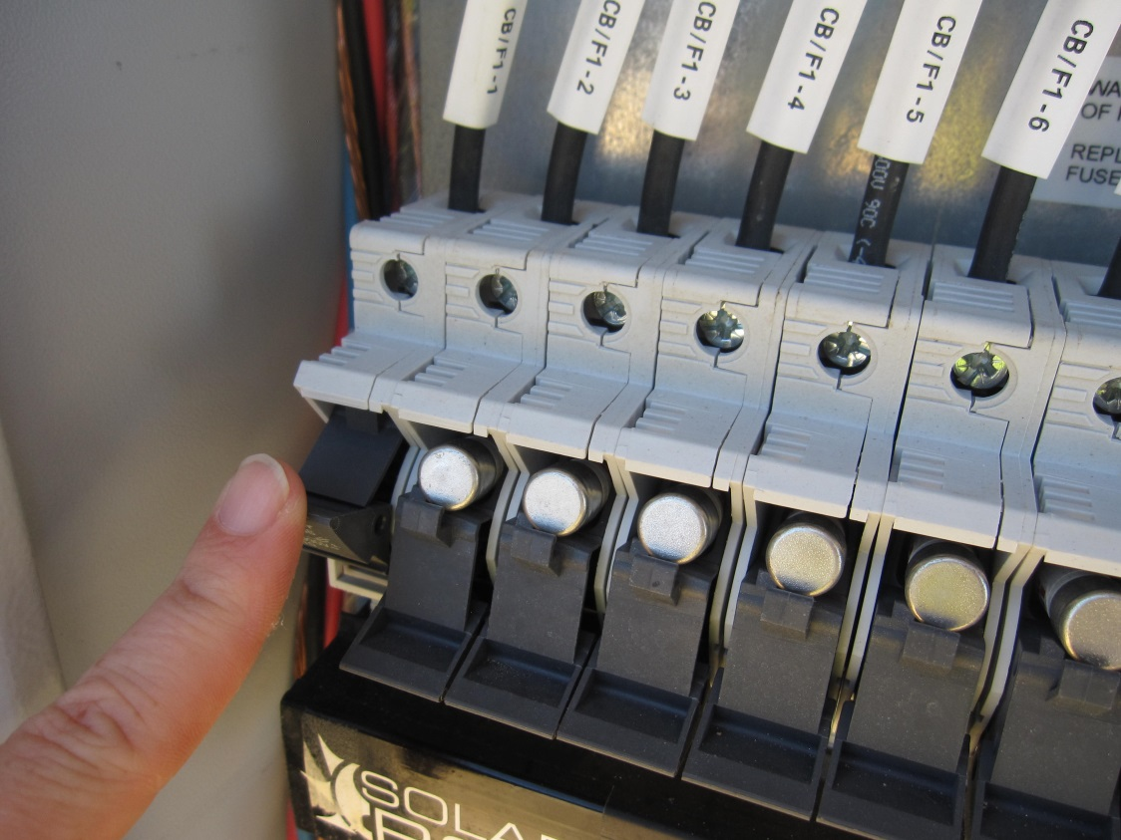
Fuses & Fuse Holders
DO NOT open under load

Slide 14
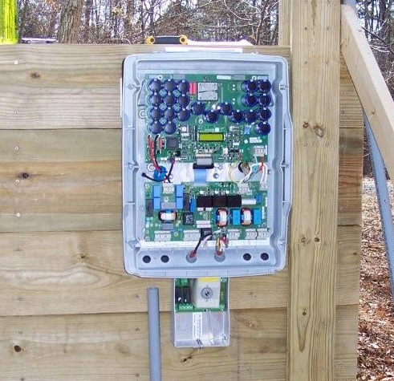
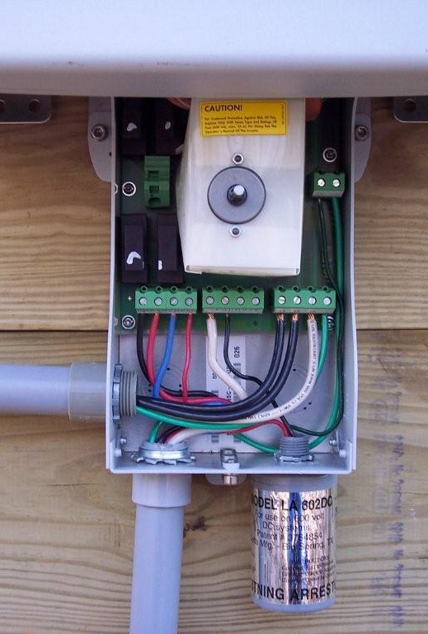
Inverter Integrated Combiner
Integrated Disconnect
Fused Combiner

Slide 15
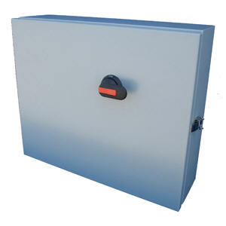
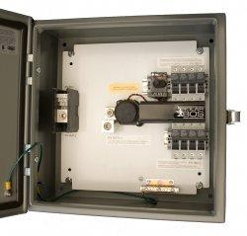
Large Commercial or Utility Scale Combiner Box
SolarBOS Integrated Disconnect
Fused Combiner

Slide 16
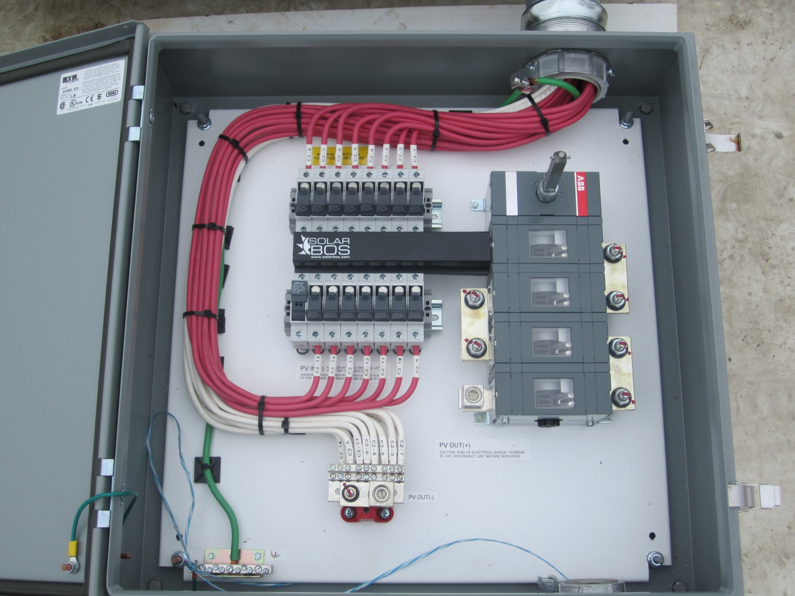
Large Commercial or Utility Scale Combiner Box
Integrated Disconnect
Fused Combiner

Slide 17
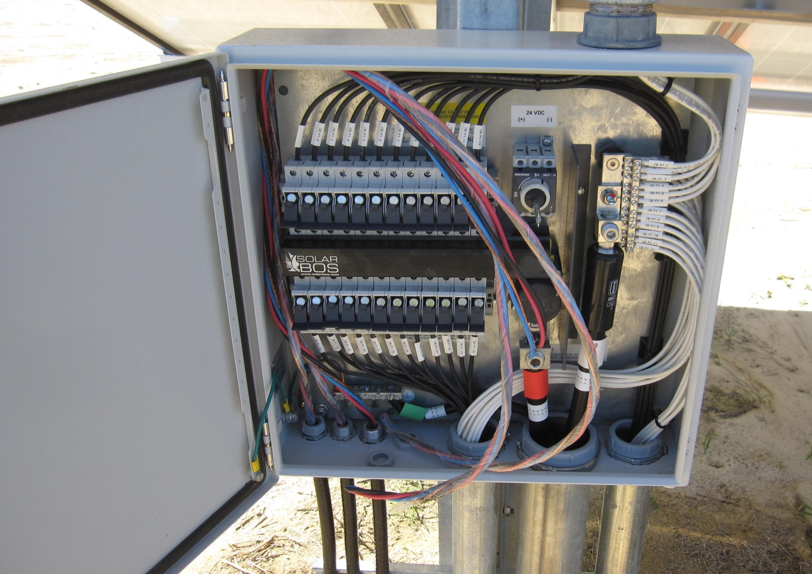
Large Commercial or Utility Scale Combiner Box - Contacting Combiner
Integrated Disconnect
Fused Combiner

Slide 18
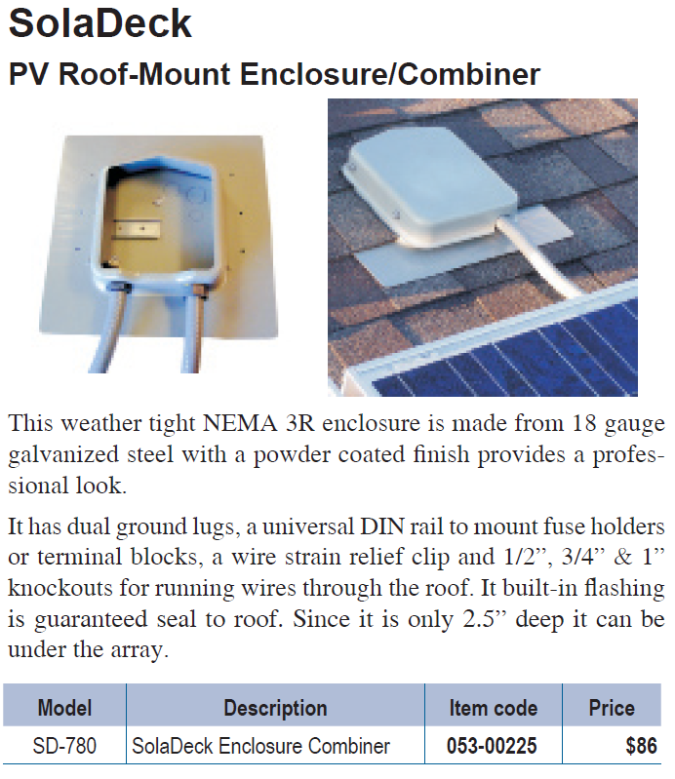
Roof Mounted Combiners

Slide 19
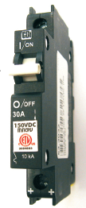
Overcurrent Devices
Fuses & Circuit Breakers
  All overcurrent devices designed to open the circuit when subjected to current exceeding their nominal rating
  Ungrounded conductors in all circuits are required to have overcurrent protection
  Must be DC rated and have adequate DC voltage rating
  Disconnect mechanism is required

Slide 20
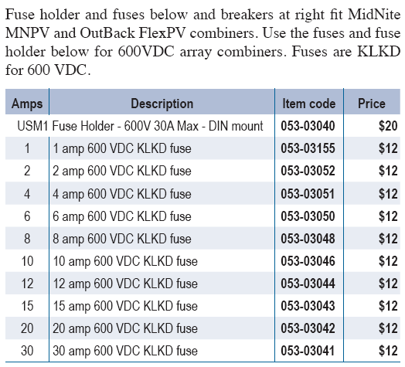
Fuses & Fuse Holders
Need to consider amperage rating and voltage rating

Slide 21
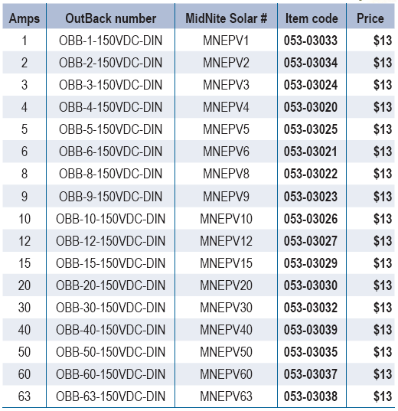
Circuit Breakers

Slide 22
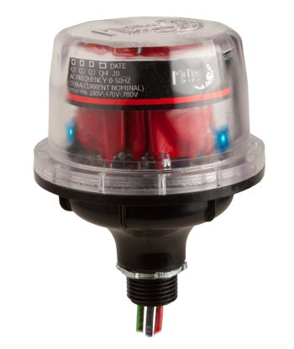
Midnite Surge Protection Device $119.00
http://www.midnitesolar.com/video/spd/spd.php

Slide 23
Surge Protection

Slide 24
Over Current Device Requirements for Combiner Boxes
Fuse or circuit breaker size must be less than the series fuse rating of module or the temperature derated ampacity of the conductor, whichever is less
Fuse or circuit breaker must be greater than the Isc x 1.56
Fuse or circuit breaker should be DC rated
Fuse or circuit breaker must have a voltage rating higher than the Voc at record low temperature
Fuse or circuit breaker should be UL listed
Fuse needs to be in “touch-safe” holder

Slide 26
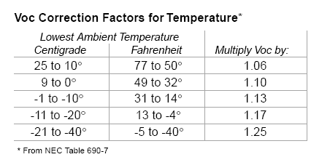
DC Voltage rating of all wiring disconnects &
over current devices must be 25% over Voc of PV array or use correction factor from NEC Table 690-7 when lowest ambient temperature is known or calculate using the Voc temperature coefficient of PV modules being used

Slide 27
Example Voltage Estimation
If 8 - 24 volt modules are connected in series for a direct grid tie system, what should be the voltage used to select overcurrent devices if lowest expected temperature is -30 F. (Voc temperature coefficient is -.36%/C)
(Voc/module @ 25 C = 44.4 volts)
  8 modules x 44.4 Voc x 1.25 = 444 volts
        or
  -.36%/c = .36 / 100 =.oo36 x 44.4 Voc = .1598 Volts / C
  .1598 x (-30 – 25) = .1598 x 55 = 8.79 volt increase over 25 C (STC)
  (44.4 + 8.79) x 8 = 425 volts

Slide 28


Slide 29
Overcurrent Device Sizing Example
What size fuse or circuit breaker should I use in a combiner box when 4 – Sharp 80 watt 12 volt (36 cell) PV modules are wired in series to make a 48 volt series string. The Isc is 5.15 amps. So 5.15 x 1.56 = 8 amps. The modules have a series fuse rating of 10 amps. Module Voc is 21.6 and record cold temperature is -31 and temperature Coefficient of Voc = -.36%/C
    Over current rating needs to be less than or equal to the series fuse rating of module which is 10 amps
    Overcurrent device needs to be greater than or equal to 8 amps
    So use a 8 - 10 amp DC rated fuse or circuit breaker
    Voltage rating for over current device =
    .0036 x 21.6 = .077 Volts/C
    .077 V X (-31 – 25) = 4.35 Volt increase at -31
    Voc = 21.6 + 4.35 = 25.95 @ -31 C
    Array Voc = 25.95 x 4 = 103.8 Voc

Slide 30
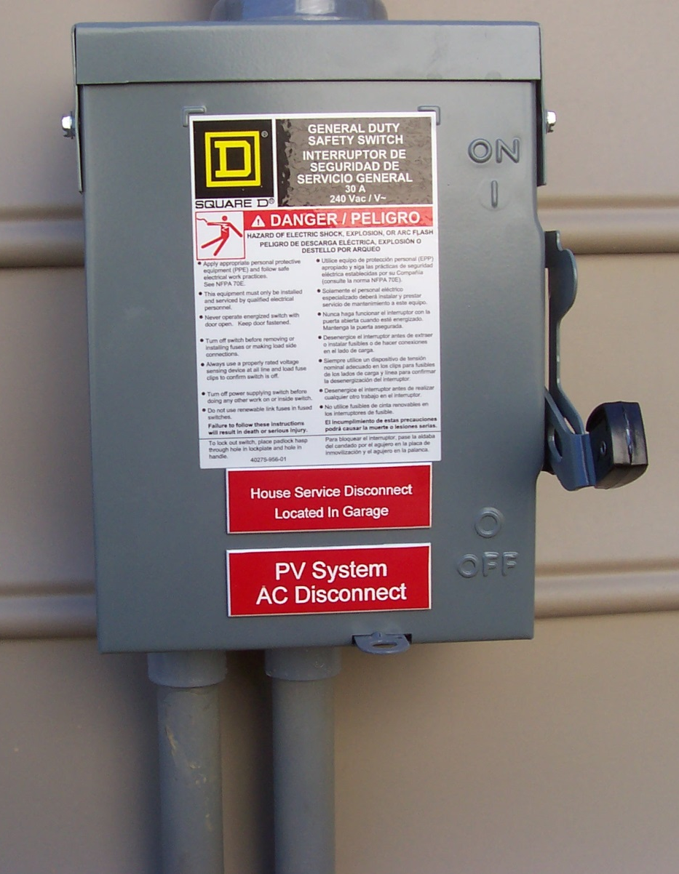
Disconnects
Equipment – from all power sources
PV Power Source - DC Disconnect
PV System – AC Disconnect
Current and voltage ratings must be adequate
Courtesy Don Hursey

Slide 31
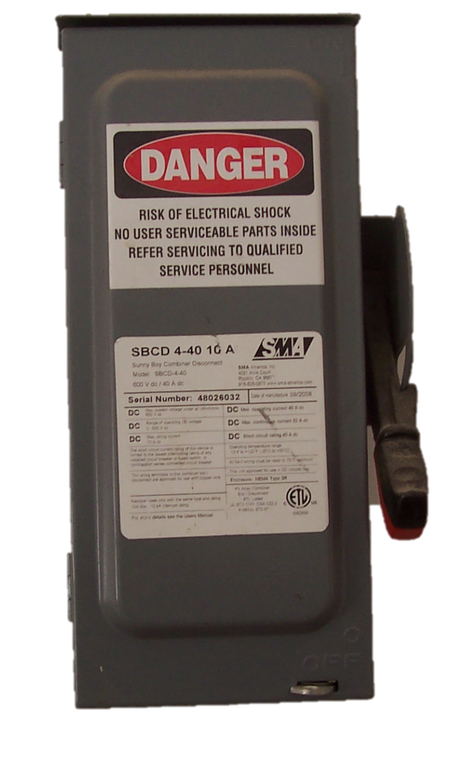
DC Disconnects
Usually bigger and more expensive than AC disconnects
Check voltage and current ratings for all disconnects to make sure they meet or exceed circuit requirements
Courtesy Don Hursey

Slide 32
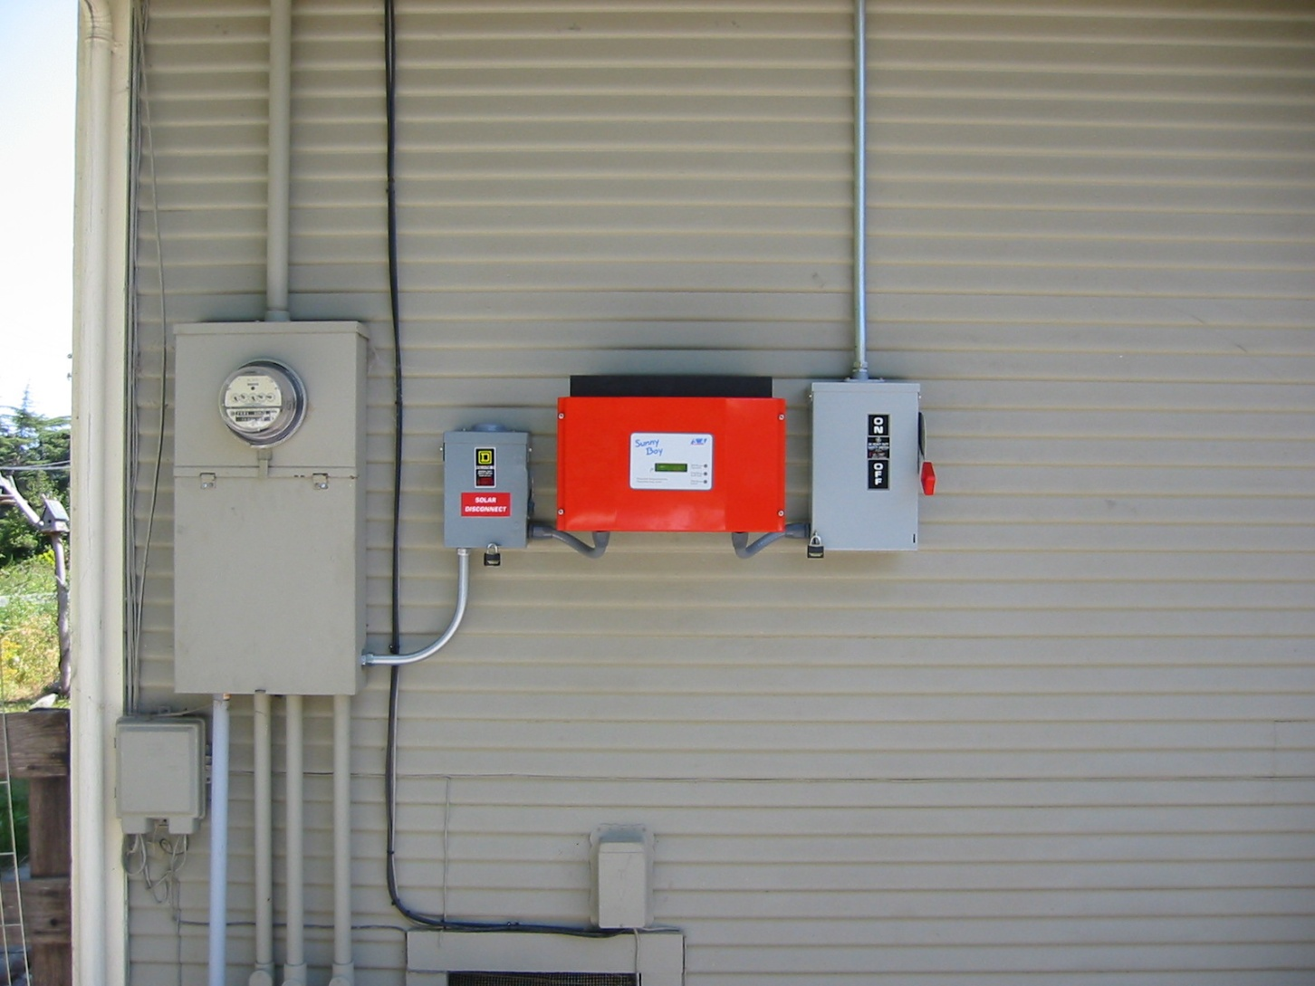
AC & DC Disconnect in Grid Tied System

Slide 33
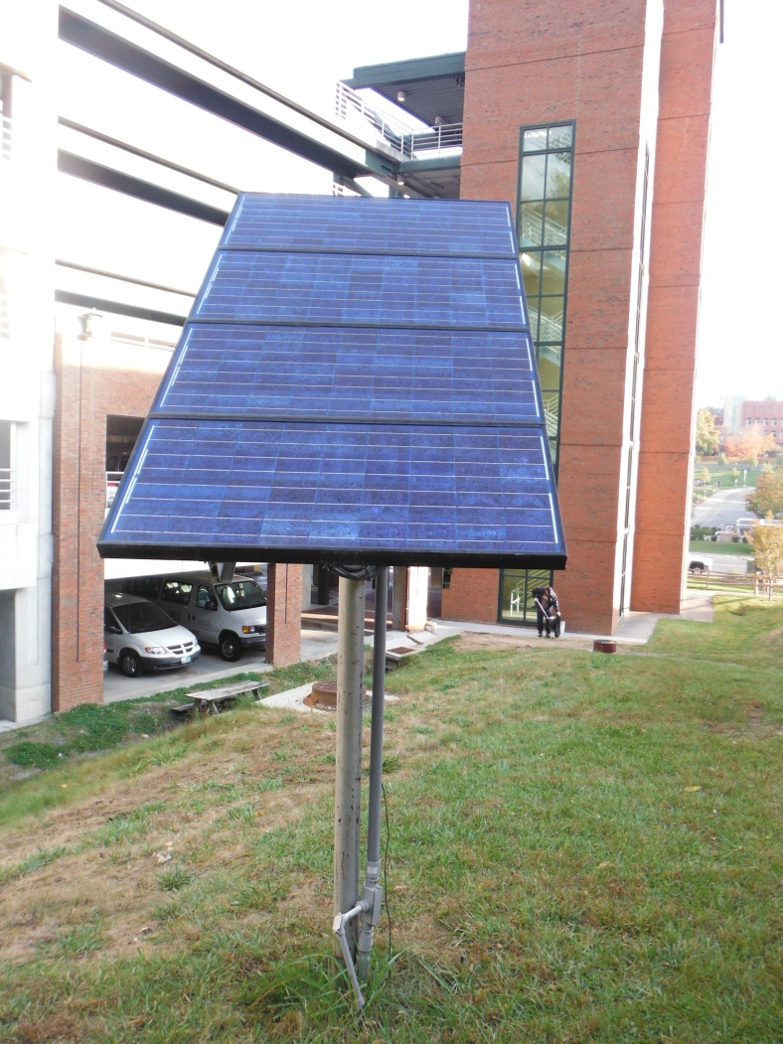
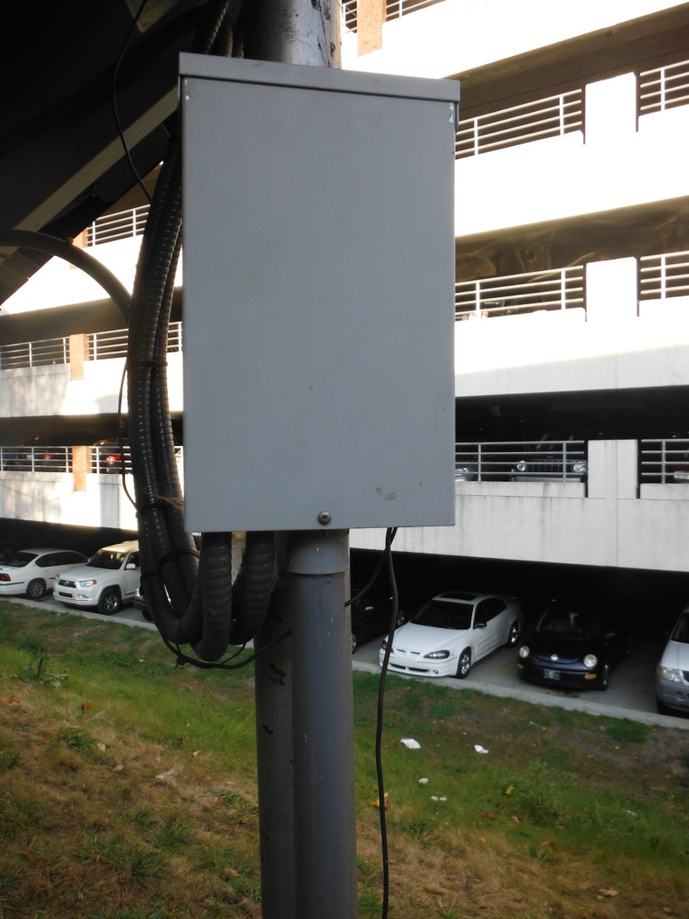
12 Volt P V Array

Slide 34
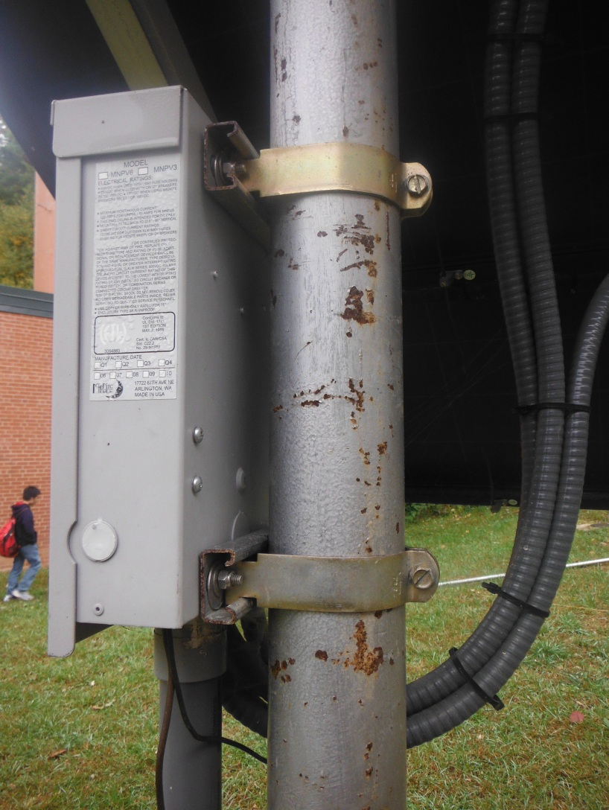
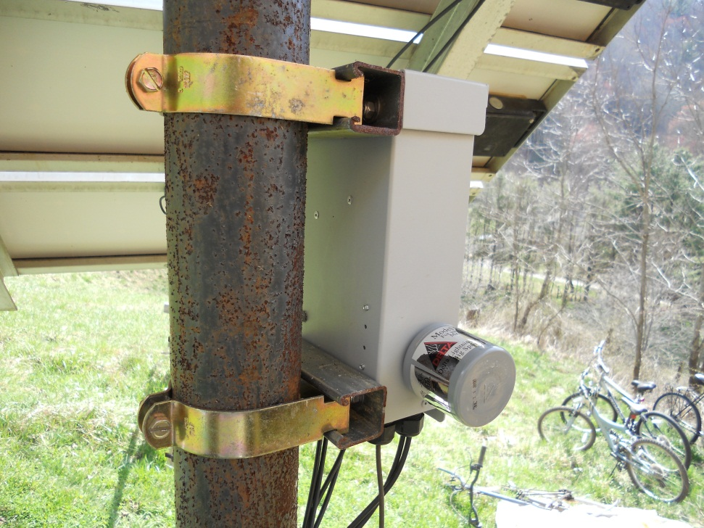
Connecting to Mounting pole
Uni-strut: 5/8” deep and 1 5/8” deep

Slide 35
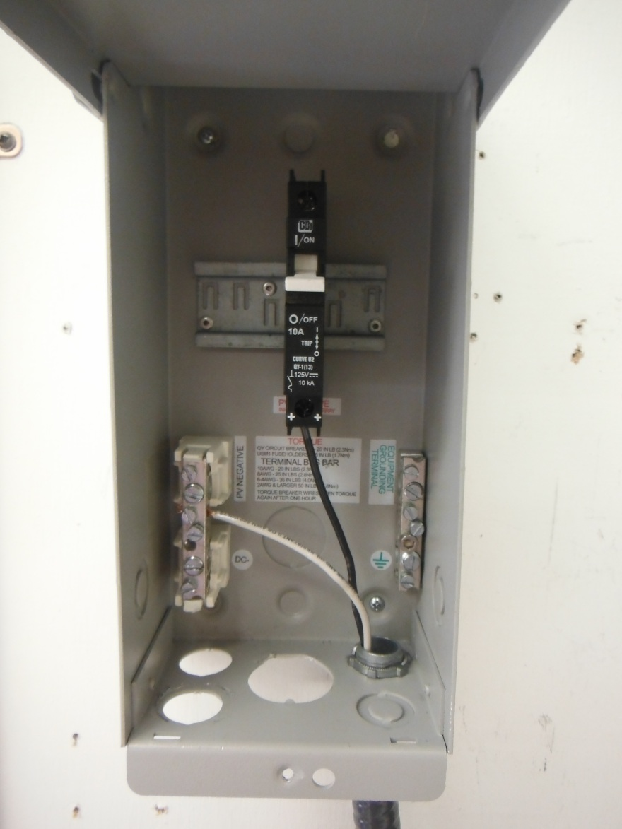
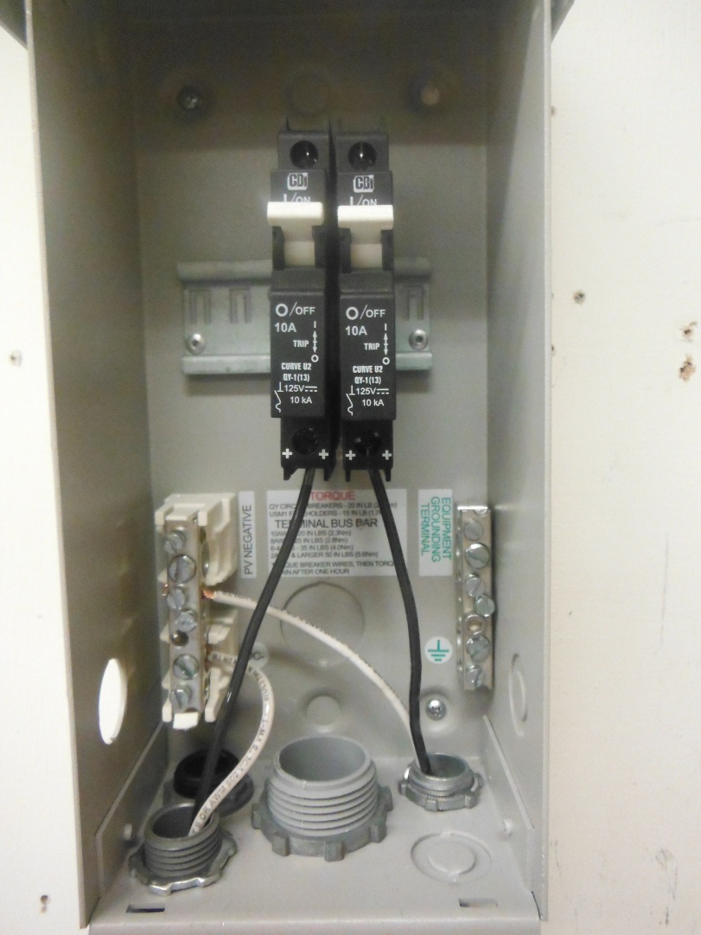
Combiner Box Circuit Breakers

Slide 36
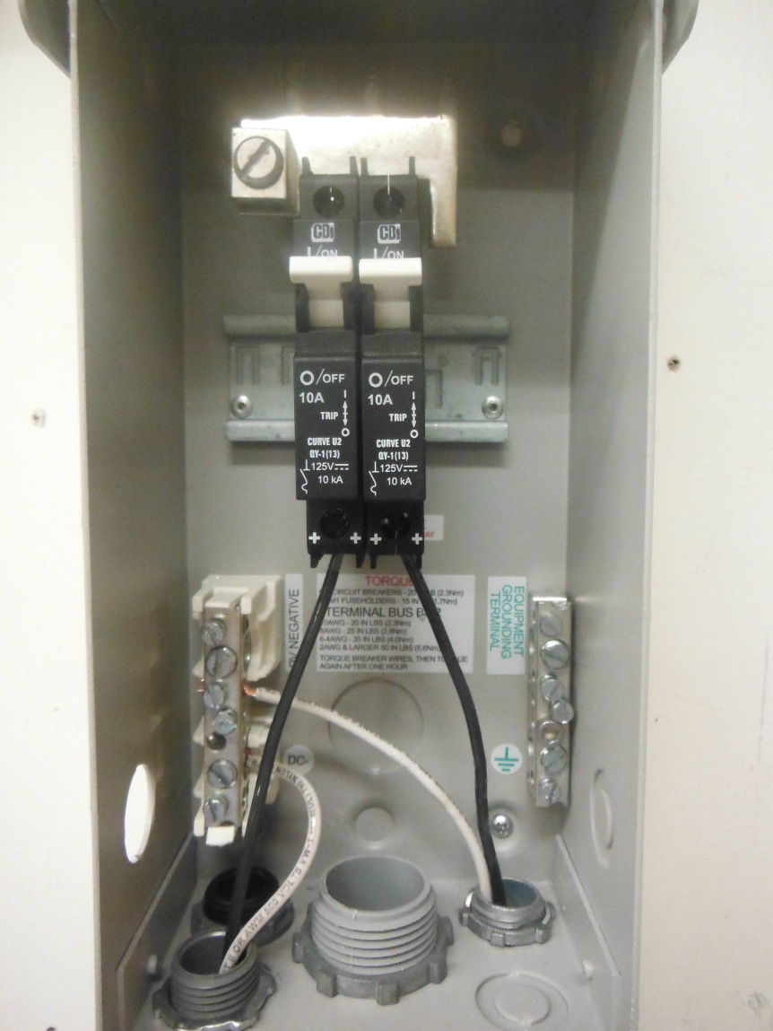
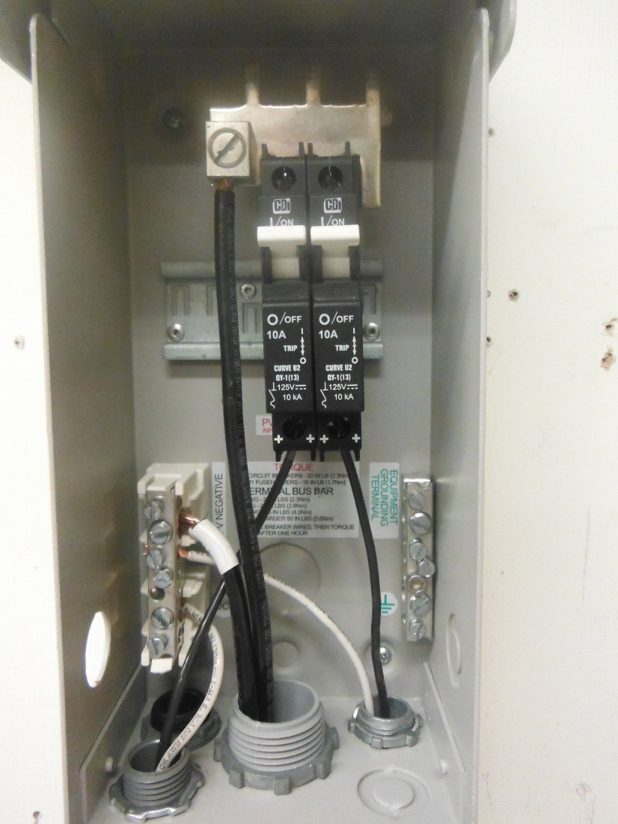
2 Parallel Strings in Combiner Box

Slide 37
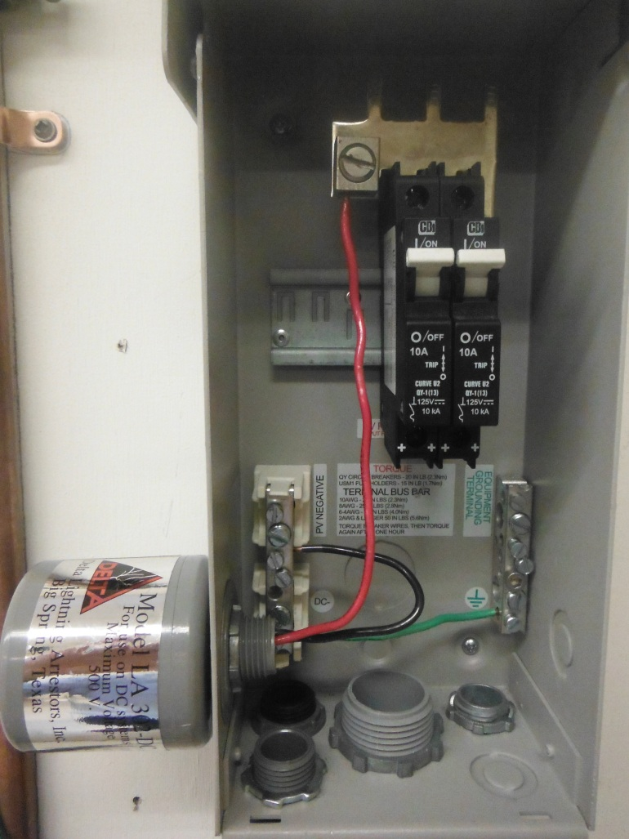
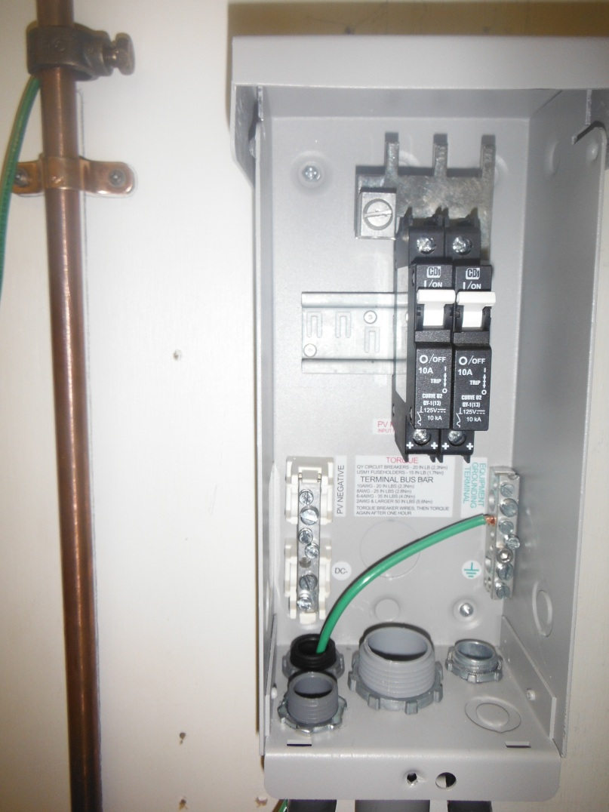
Lightning Arrestor & Grounding Electrode Conductor

Slide 38
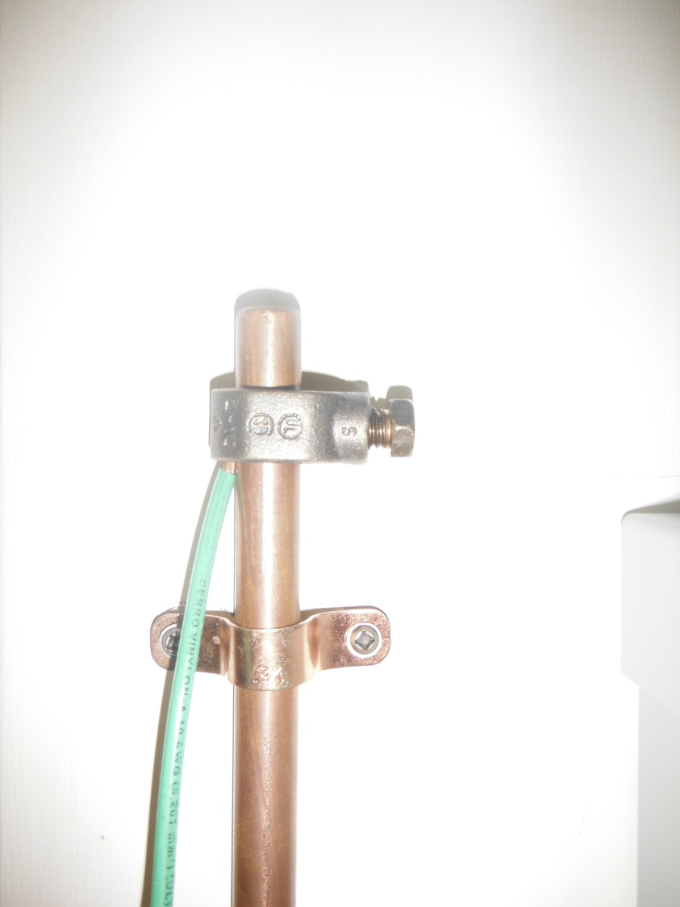
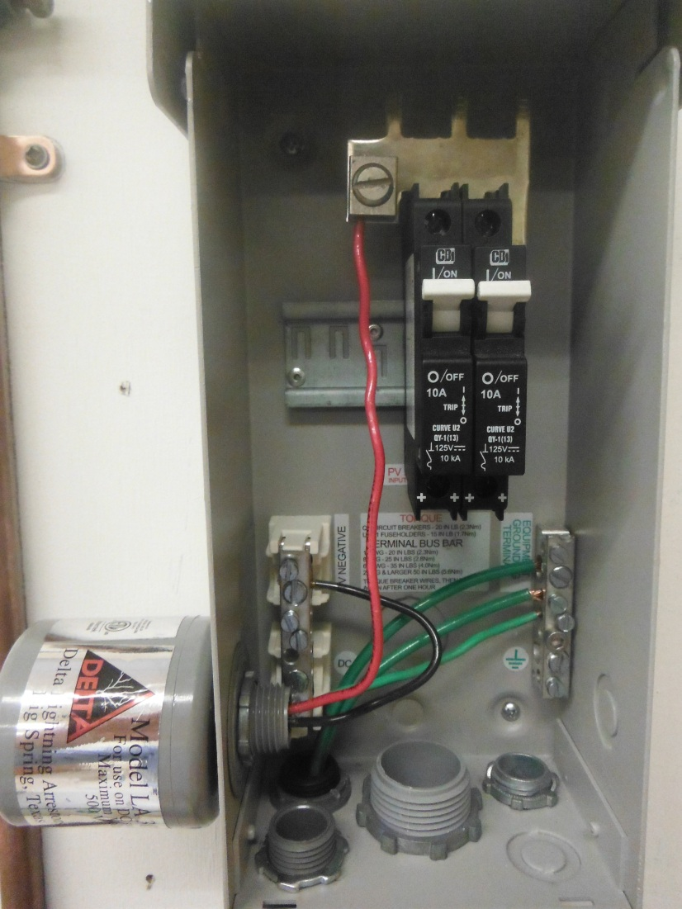
Lightning Arrestor, Equipment Ground, & Grounding Electrode Conductor

Slide 39
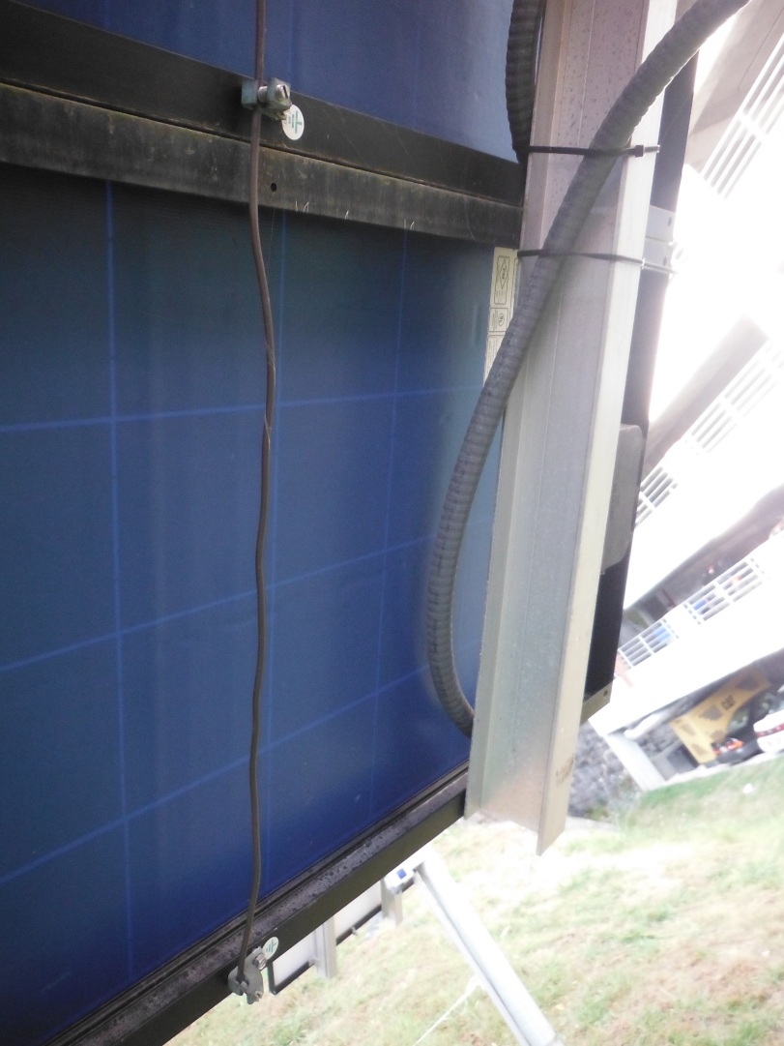
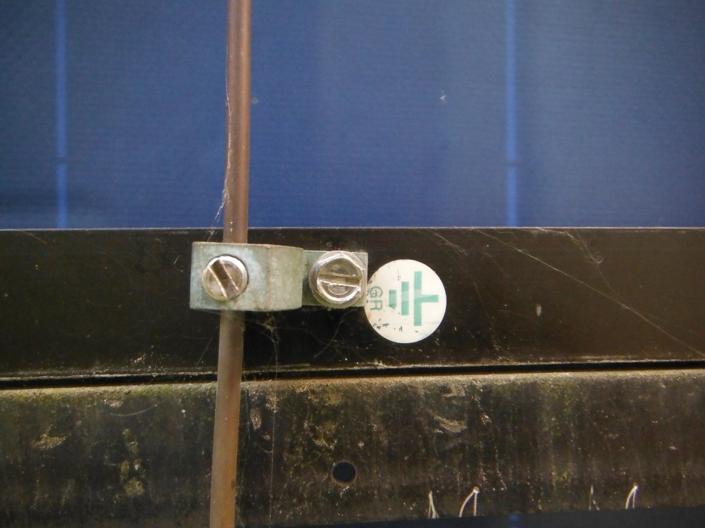
Equipment Grounding

Slide 40
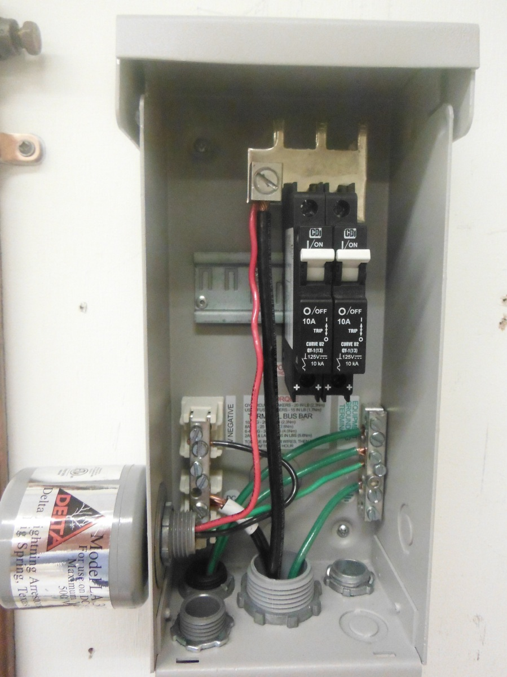
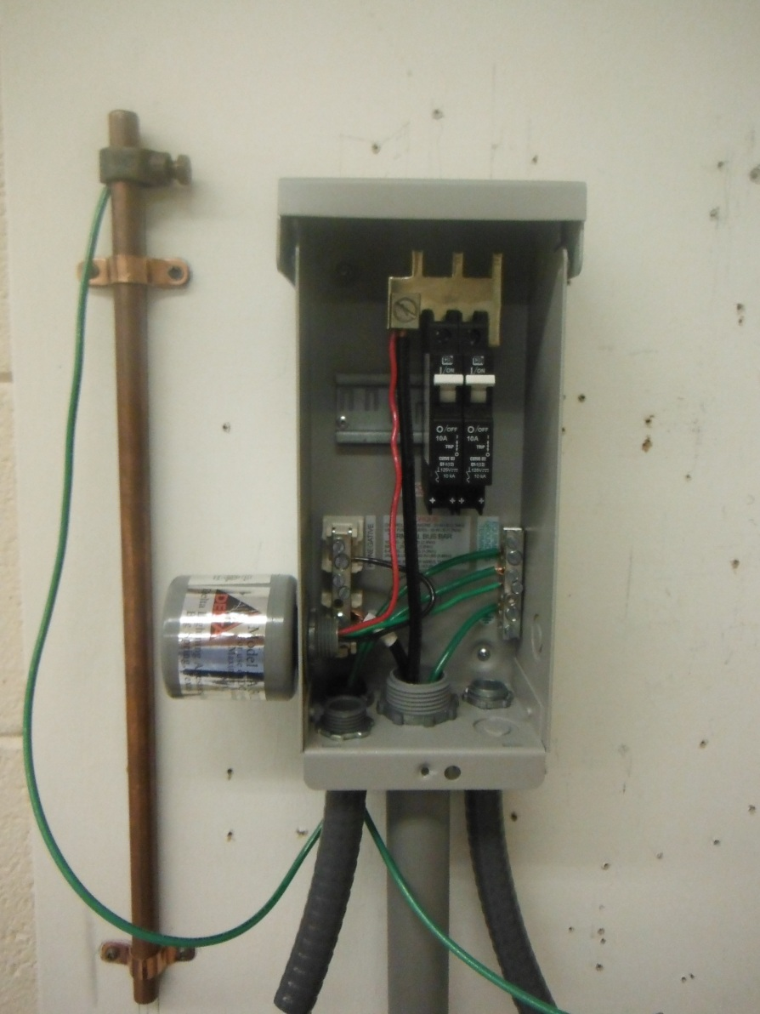
Combiner Box

Slide 41
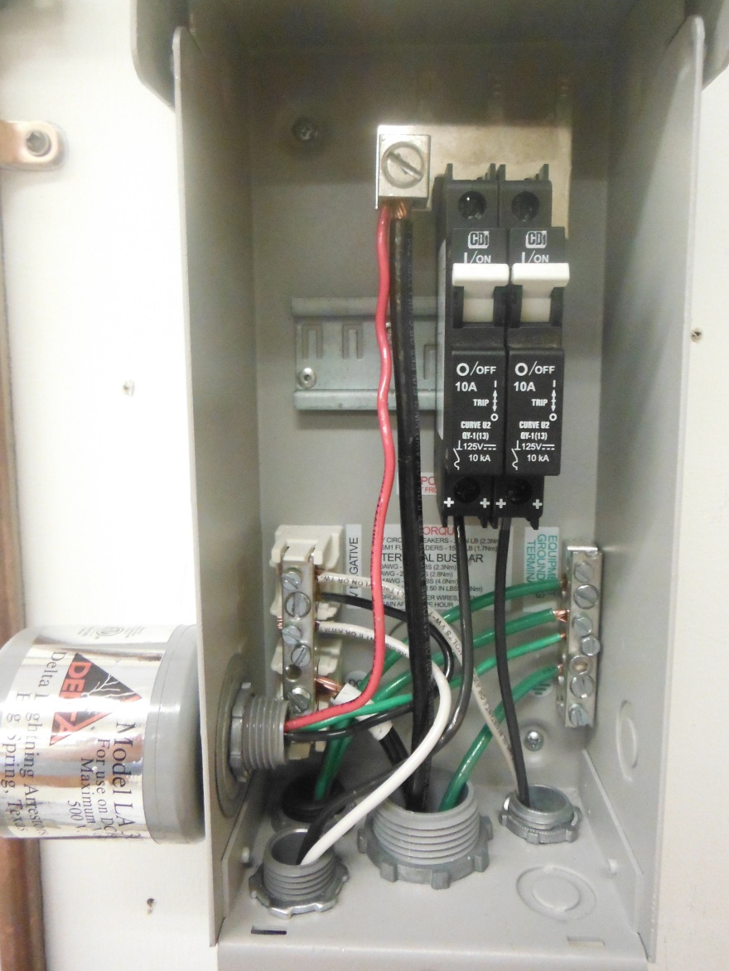
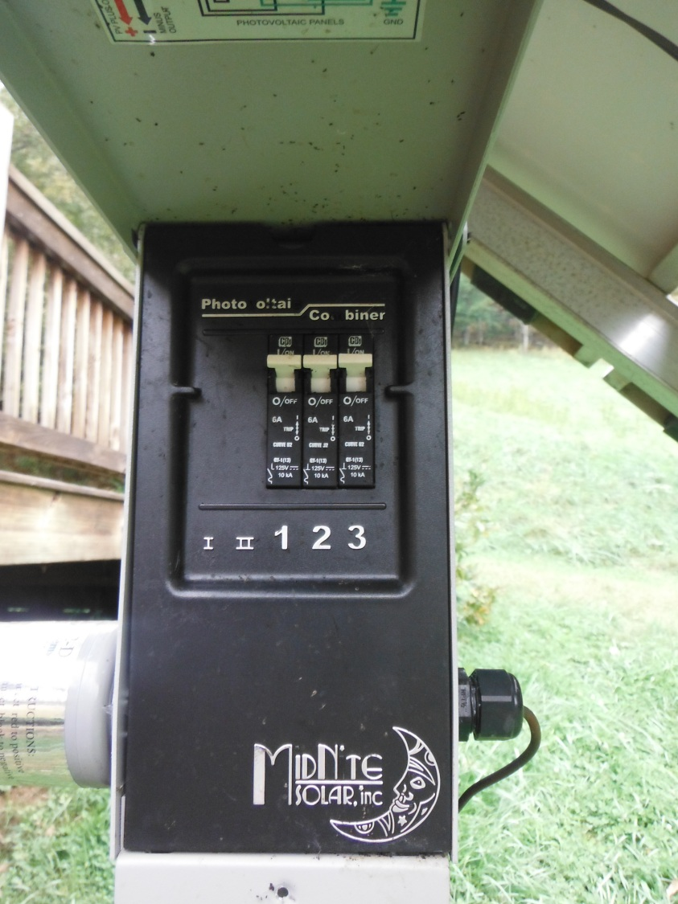
Combiner Box Completed

Slide 42
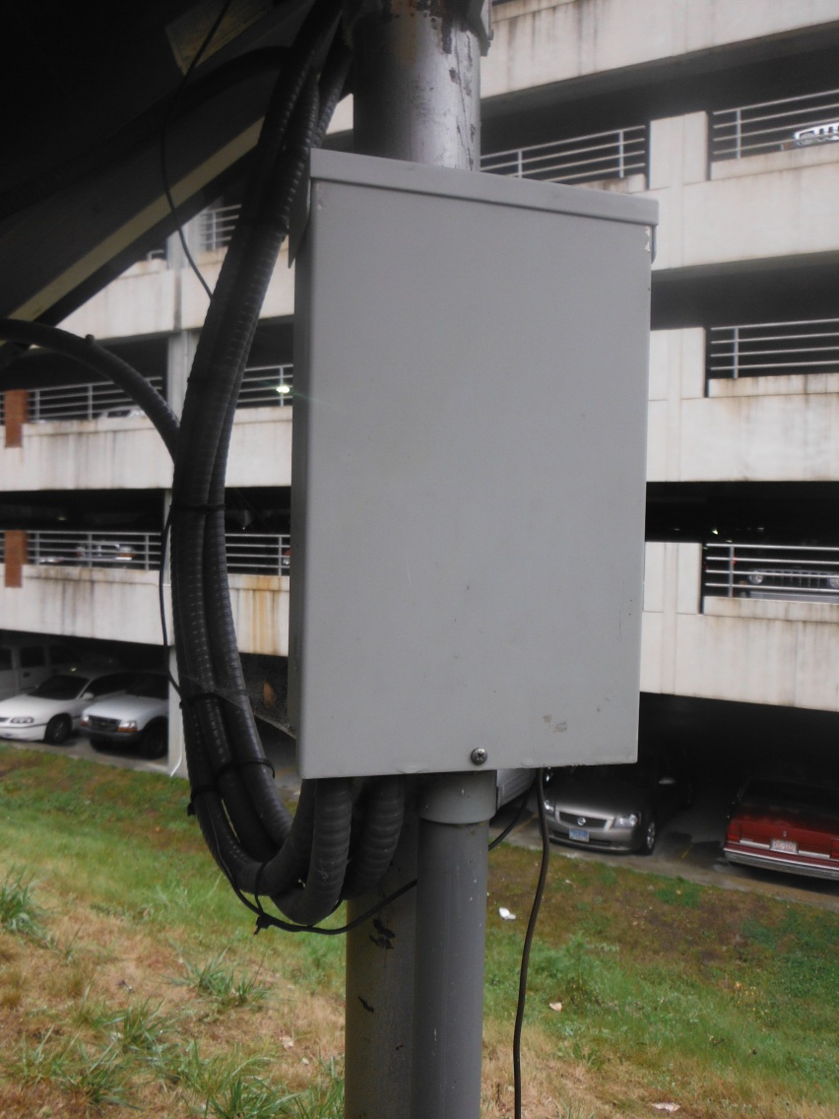

Pole Mounted Combiner Box

Slide 43


Pole Mounted Combiner Box

