Slide 1
Public Policy & Economics

Slide 2
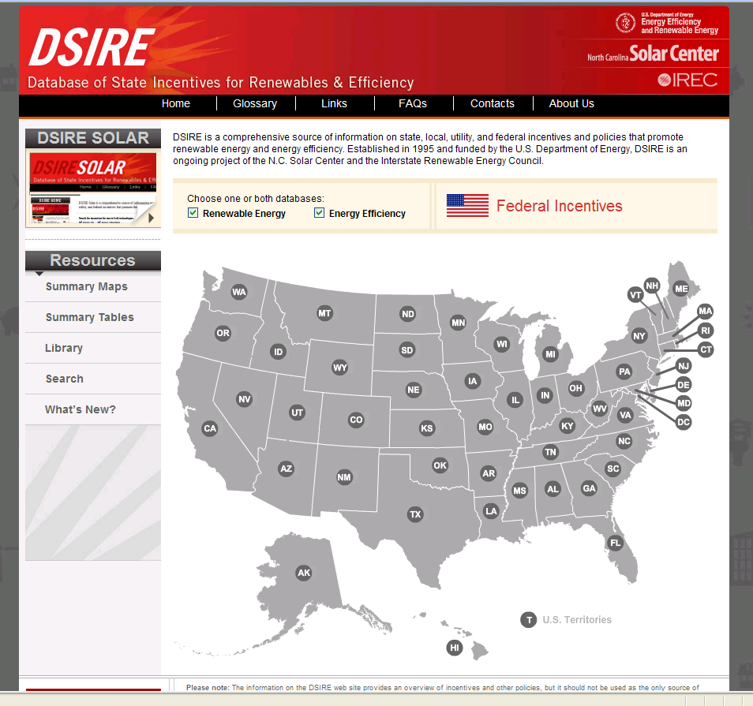
The DSIRE Project
Database of State Incentives for Renewables & Efficiency
Created in 1995
Managed by NC Solar Center in partnership with IREC
Funded by U.S. DOE
> 2,700 RE & EE financial incentives & regulatory policies
Federal, State, Local, Utility
DSIRE Solar Policy Guide
DSIRE Solar Policy Comparison Tables
~ 200,000 unique visitors/month
www.dsireusa.org
Notes:
2
Clean Energy State Program Guide: Mainstreaming Solar Electricity
http://www.cleanegroup.org/Reports/CEG_Mainstreaming-Solar-Electricity_Apr2008.pdf

Slide 3
PURPA
Federal - Public Utility Regulatory Policies Act of 1978
Requires utilities to purchase power from Qualified Facilities (QFs) at their avoided cost rate
Avoided cost rate represents what it would cost the utility to generate an additional kWh
Notes:
At the federal level, one of the early drivers in development/investments in renewable energy facilities was PURPA. PURPA is still the basis of some utility rates and policies, especially when you talk about things like feed-in tariffs (and avoided cost).

Slide 4
Renewable Portfolio Standards (RPS)
Require utilities to have a certain percentage of their electricity sales come from renewables by a certain date
Interim compliance targets
Potential market for “RECs”
Solar carve-outs or multipliers for solar in 16 states and DC

Slide 5
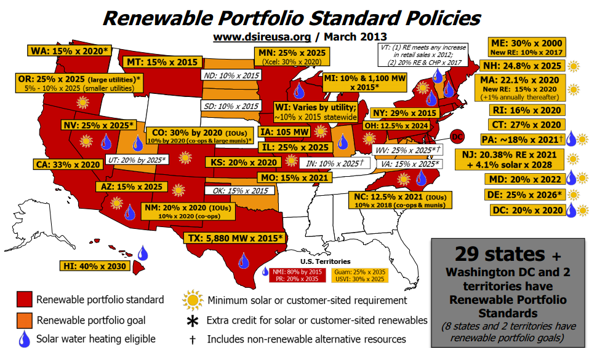

Slide 6
North Carolina Renewable Energy and Energy Efficiency Portfolio Standard (REPS)
Senate Bill 3 or “SB3”
Passed August 2007

Slide 7
Key Features of NC REPS
12.5% Renewable Energy and Energy Efficiency Portfolio Standard
  Based on 2006 North Carolina Utilities Commission (NCUC) Study (“LaCapra Report”)
Major Cost Recovery Provisions to Utilities for EE, Clean Smokestacks, Potential New Coal/Nuke Plants
Tax Relief to Industrials for Electricity

Slide 8
Key Features of NC REPS
Target Percentages & Applicability
  10% by 2018 – all electric service providers in state
  12.5% by 2021 – only investor owned electric utilities (Duke, Progress, & Dominion)
Eligible Technologies
  Wide range of renewable, energy efficiency, & thermal technologies (solar thermal & CHP)
  IOUs - Up to 25% of REPS from efficiency by 2018; Up to 40% of REPS from efficiency by 2021
  Coops & Munis - Can meet entire standard (other than Solar, Poultry, & Hog Set Aside) with efficiency

Slide 9
Key Features of NC REPS
Existing renewable sources
  Existing Small Hydro (<10MW) eligible
  Coops and Munis only - Up to 30% of REPS with existing large hydro (Southeastern Power Administration)
Geographic areas eligible
  Up to ¼ of REPS can be met with out-of-state RECs
  Electric power purchased from a new renewable energy facility located outside the State are eligible if the electric power and RECs can be delivered to retail electric customers in North Carolina.

Slide 10
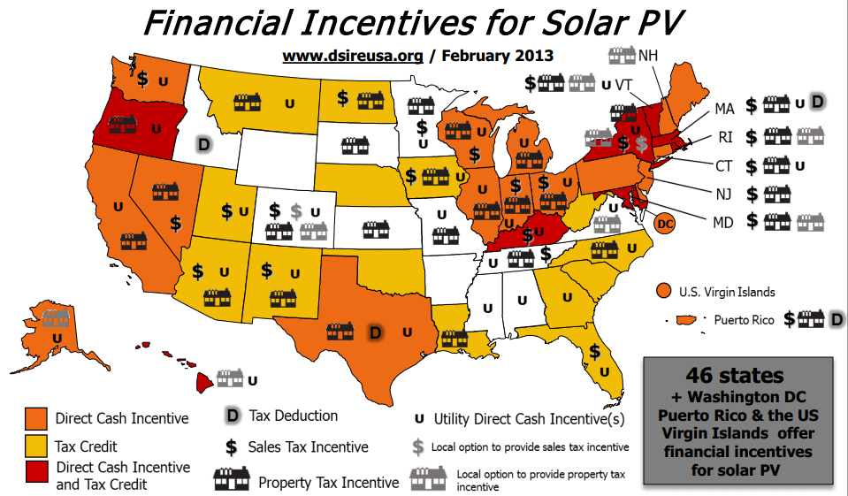

Slide 11
Feed-In Tariffs
Provide guaranteed contracts for a premium $/kWh payment for a fixed period of time
Over 40 countries have adopted feed-in tariffs
Germany most commonly cited feed-in tariff
Gainesville Regional Utilities started the first true feed-in tariff in America on March 1, 2009 --- $0.32/kWh for 20 years. Fully subscribed almost immediately.
HI, CA, OR, and VT have feed-in tariffs (of sorts)
Many other states are studying them
Federal regulation makes a state-run feed-in tariff challenging

Slide 12
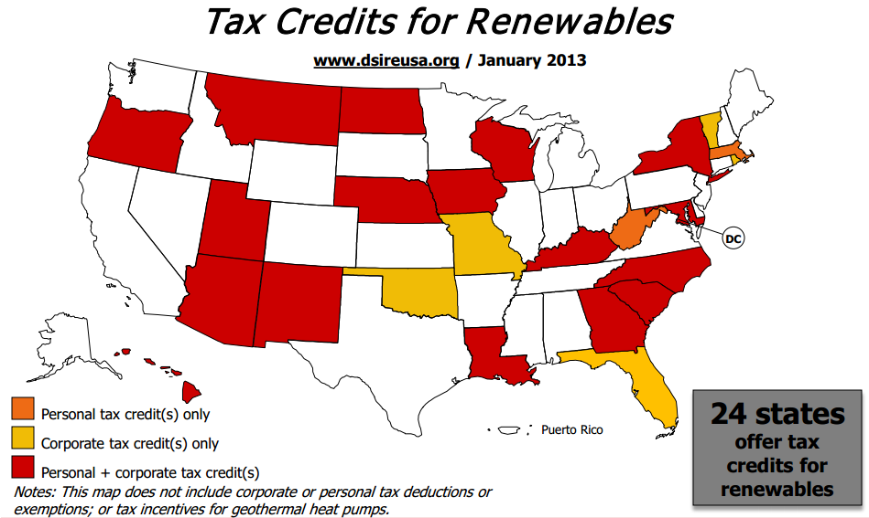

Slide 13
Tax Credit vs. Tax Deduction
Tax Deductions: Tax deductions – such as those for home mortgages and charitable giving – lower your taxable income.
Tax Credit: Tax credits directly reduce the amount of tax you owe. If you owe $5,000 in taxes, a $1,400 tax credit will reduce your tax burden to $3,600. You don’t receive an income tax credit when you buy the product like an instant rebate. You claim the credit on your income tax forms at the end of the year.
Notes:
13
13

Slide 14
NC RE Tax Credit
Tax credit equal to 35% of the cost of renewable energy property constructed, purchased, or leased by a taxpayer. May be taken against income tax, corporate tax, franchise tax, or gross premiums tax.
Eligible costs include: Equipment and associated design, construction cost, and installation costs less any discounts, rebates, advertising, etc
The allowable credit may not exceed 50% of a taxpayer's liability for the year, reduced by the sum of all other credits. For single-family homeowners, if the credit is not used entirely during the first year, the remaining amount may be carried over for the next five years. For all other taxpayers, the credit is taken in five equal installments beginning with the year in which the property is placed in service.
Tax Credit Guidelines: http://www.dornc.com/practitioner/individual/directives/ renewableenergyguidelines.html
Notes:
14

Slide 15
NC RE Tax Credit – Residential
$1,400 per dwelling unit for solar energy equipment for domestic water heating, including pool heating
$3,500 per dwelling unit for solar energy equipment for active space heating, combined active space and domestic hot water systems, and passive space heating.
$8,400 per installation for a geothermal heat pump or geothermal equipment.
$10,500 per installation for any other renewable energy property for residential purposes.
Tax credit expires January 1, 2016
Notes:
15

Slide 16
NC RE Tax Credit – Non-residential
A maximum of $2.5 million per installation for all solar, wind, hydro, geothermal, combined heat and power, and biomass applications for commercial or industrial facilities, including PV, daylighting, solar water-heating and space-heating technologies.
Tax credit expires January 1, 2016
Notes:
16

Slide 17
Non-Profit Eligibility?
SB 3 of 2007 amended North Carolina's renewable energy tax credit statute to allow a taxpayer who donates money to a tax-exempt nonprofit to help fund a renewable energy project to claim a tax credit. The donor can claim a share of the credit -- proportional to the project costs donated -- that the nonprofit could claim if the organization were subject to tax. HB 2436 of 2008 applied this same mechanism to donations made to units of state and local governments.
Notes:
17

Slide 18
Federal Tax Incentives
30% of installed cost
No maximum limit
Federal Accelerated Depreciation
  Systems placed in service in 2008 and 2009 are eligible for a 50% bonus depreciation. The remaining 50% of the adjusted basis of the property is depreciated over 5 year schedule

Slide 19
The Investment Tax Credit (ITC)
30% of the system cost (includes installation costs), with no cap
Eligible technologies: PV, solar water heat, wind (100 kW max), fuel cells, geothermal heat pumps, geothermal electric (commercial), microturbines (comm), CHP (comm)
Expires December 31, 2016
Cash grants in lieu of tax credit available for commercial property installed in 2009, 2010 and 2011
System owners must be taxpayers to use the ITC. A number of ownership structures can allow the credit to flow to credit-hungry project investors.

Slide 20
Modified Accelerated Cost Recovery System (MACRS)
  Businesses recover investments in assets through depreciation deductions taken over a specified number of years depending on the type of property
  Solar thermal, solar electric, geothermal, wind, fuel cells, microturbines, solar hybrid lighting may be depreciated according to an accelerated schedule of 6 years
  “Class life” of 6 years Year 1: 20%
  Year 2: 32%
Year 3: 19.2%
Year 4: 11.52%
Year 5: 11.52%
Year 6: 5.76%
Notes:
20
MACRS w/ no bonus is actually taken over 6 years: 20%, 32%, 19.2%, 11.52%, 11.52%, 5.76%
Under the Modified Accelerated Cost Recovery System (MACRS), businesses can recover investments in solar, wind and geothermal property through depreciation deductions.
It’s the system for computing depreciation for most business assets.
The MACRS establishes a set of class lives for various types of property, ranging from three to 50 years, over which the property may be depreciated. For solar, wind and geothermal property placed in service after 1986, the current MACRS property class is five years.
** Applies to SHW, solar space heat, solar thermal electric, solar thermal process heat, PV, Wind, geothermal electric

Slide 21
Example 1:
2-kW Residential PV system
Cost and Savings | Amount
Eligible Expenditures State Tax Credit Federal Tax Credit Federal Tax Adjustment | $8,000 ($2,800) ($2,400) $672
Net Cost | $3472
Source: NC Solar Center www.ncsc.ncsu.edu

Slide 22
Example 2:
10-kW commercial pv system
Cost and Savings | Amount
Eligible Expenditures State Tax Credit Federal Tax Credit Federal Tax Adjustment Federal and State Depreciation Deductions State Tax Adjustment for Federal Bonus Depreciation | $40,000 ($14,000) ($12,000) $3,920 ($11,736) $997
Net Cost | $7181
Source: NC Solar Center www.ncsc.ncsu.edu

Slide 23
Interconnection &
Net Metering
Interconnection - An interconnection standard includes the technical requirements and the legal procedures whereby a customer-sited generator interfaces with the electricity grid.
Net Metering - Financial arrangement between a utility and a small power producers which allows the customer-generated electricity to be sold back to the utility.

Slide 24
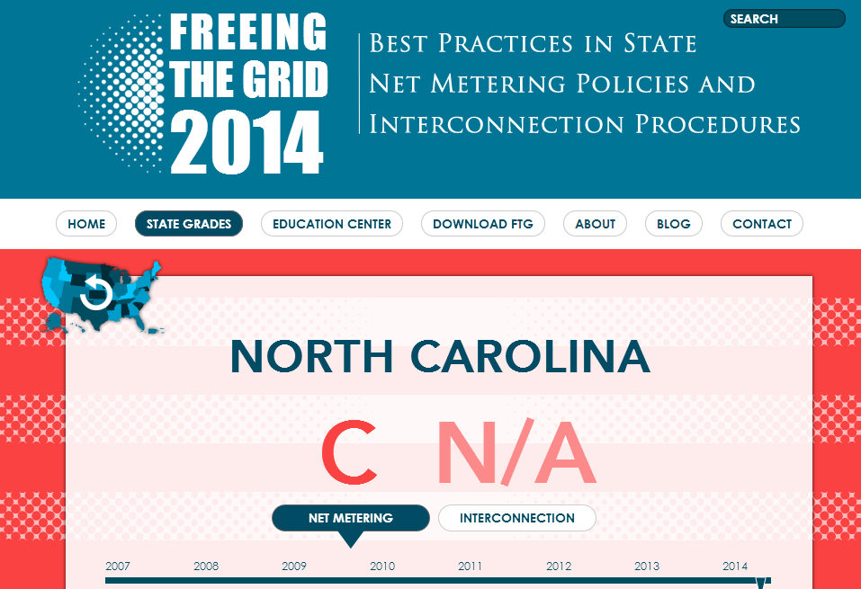

Interconnection and Net Metering

Slide 25
NC Interconnection Standards
Standards established by NCUC for Investor-Owned Utilities
The NCUC standards, like the FERC standards, use a three-tiered approach to simplify the interconnection process:
  Systems up to 10 kilowatts (kW) must follow the 10-kW "inverter process" of simplified interconnection;
  Systems larger than 10 kW and up to two megawatts (MW) must follow the "fast-track process;" and
  Systems greater than 2 MW must follow the "study process.”

Slide 26
NC Interconnection Standards
Insurance requirements vary by system size and/or type; levels established by NCUC.
External disconnect switch not required for inverter-based systems up to 10 kW (utility may choose to install at its own expense); utility's discretion for all other systems.
Generators are responsible only for the costs of upgrades and improvements directly associated with a system's interconnection, but these costs may be determined by utilities.

Slide 27
NC Interconnection Standards
Fee structure for applications:
  $100 for generators up to 20 kW
  $250 for generators larger than 20 kW but not larger than 100 kW
  $500 for generators larger than 100 kW but not larger than to 2MW
  FERC fee structure applies for systems over 2 MW.

Slide 28
Interconnection Standards
Interconnection refers to the issues that must be settled between the system owner and the utility and local permitting authorities before the system is connected to the grid.
Technical – safety, power quality, system impacts
Contractual – legal and procedural issues
Rates, fees and metering issues

Slide 29
Interconnection Standards:
Best Practices
    Establish state-wide policies that are uniform, transparent, detailed, and public
    Set fees and technical requirements proportional to a project’s size
    Process applications quickly; set timetable
    Standardize and simplify forms
    No redundant safety requirements – external disconnect switch
    No additional insurance requirements for small systems
Notes:
29
29

Slide 30
Net Metering
NC net metering updated June 2009
Size limit: 1 MW; applies to investor-owned utilities
Participants may net meter under any rate schedule, however, they forfeit RECs to utilities unless they are on a time-of-use rate
Net excess generation credited to customer's next bill at retail rate; granted to utility at beginning of summer billing season

Slide 31
Net Metering
For residential systems up to 20 kilowatts (kW) and non-residential systems up to 100 kW in capacity, utilities may not assess a standby charge.
Larger systems may incur standby fees.
Systems participating in net metering may not participate in NC GreenPower.

Slide 32
Net Metering
Financial arrangement between a utility and a small power producer which allows the power to be used on-site
When system is overproducing, meter spins backwards
Excess kWh credits are typically rolled over to next month at the retail rate
Usually adopted by the state legislature or utility commission
Co-ops and munis?
Many caveats and fine details can make a net metering policy heavily favor the utility or the customer

Slide 33
Net-Metering Best Practices
Maximum system size ≥ 2 MW
All renewables eligible (+CHP)
All utilities must participate
All customer classes eligible
Limit on aggregate capacity ≥ 5%
Standardized and streamlined interconnection standards
No application fee
No special charges or monthly fees
Customer retains REC’s
Allow for meter aggregation; “community renewables”

Slide 34
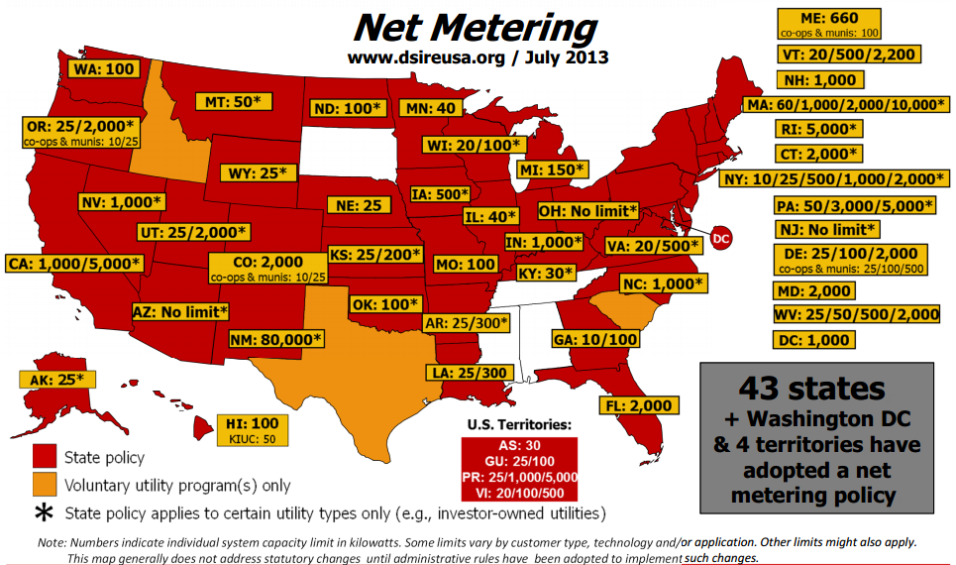

Slide 35
Community Solar
AKA - Solar Gardens, Neighborhood Net Metering, Virtual Net Metering, Meter Aggregation etc.
Several different models adopted by a handful of states
In essence, allows multiple utility customers to buy a share in a large project and receive bill credits via net metering

Slide 36
Solar Access Laws
Solar easements allow for the rights to existing solar access on the part of one property owner to be secured from an owner whose property could be developed in such a way as to restrict that resource. Most common type of solar access law.
18 states limit or prohibit restrictions that neighborhood covenants and/or local ordinances may impose on the use of solar equipment.
Notes:
36
36
1

Slide 37
Solar Access Law
SB 670 – 2007
Cities and counties in North Carolina generally may not adopt ordinances prohibiting the installation of "a solar collector that gathers solar radiation as a substitute for traditional energy for water heating, active space heating and cooling, passive heating, or generating electricity for residential dwellings.”
HOA covenants or similar binding agreements that would prohibit the installation of solar-energy collectors for residential dwellings on land subject to the deed restriction, covenant or agreement are void and unenforceable.
  Only applies to policies and covenants adopted after October 1, 2007. Restrictions enacted prior to enactment of law are still enforceable.
Cities and counties may enact ordinances that are visible from the ground in common or public access areas.
HOA’s found in violation must pay reasonable attorney’s fees to the homeowner if the case is brought to court.

Slide 38
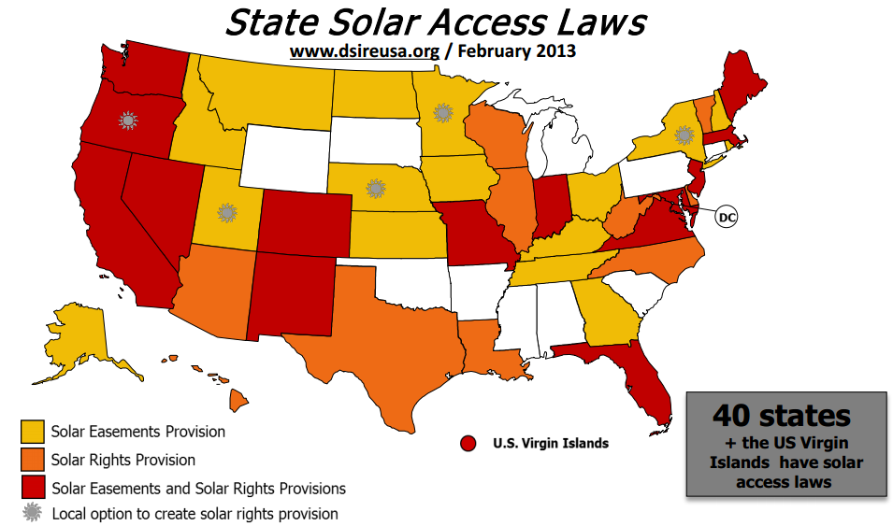

Slide 39
Prohibiting Unreasonable Restrictions by HOAs and Local Governments
Define the type of solar energy equipment protected by the law
  i.e., solar electric, solar thermal, passive solar construction, etc. [New Mexico]
Provide a clear and quantifiable standard for what constitutes an unreasonable restriction on solar energy systems
  i.e., changes for aesthetic reasons cannot increase installation costs >10% [Hawaii]
Define the types of structures covered by the law
  i.e., residential, commercial. [California]
Award costs and reasonable attorneys' fees to the prevailing party in any civil action arising from disputes with HOAs. [Arizona]
Model statute under development
  US DOE Solar America Board for Codes & Standards (http://www.solarabcs.org)
Notes:
39
39

Slide 40
3rd-Party Power Purchase Agreements (PPA)
Arrangement where the host-site does not own the system, but purchases the electricity produced by the system
Offers the host guaranteed electricity prices and increases PV penetration
Issues:
  Will system be eligible for net metering?
  REC ownership
  Under some states’ laws the PPA may be considered a utility subject to regulation
Leases of systems offer a potential work-around
2008 saw the first PPA and leasing arrangements for residential systems.

Slide 41
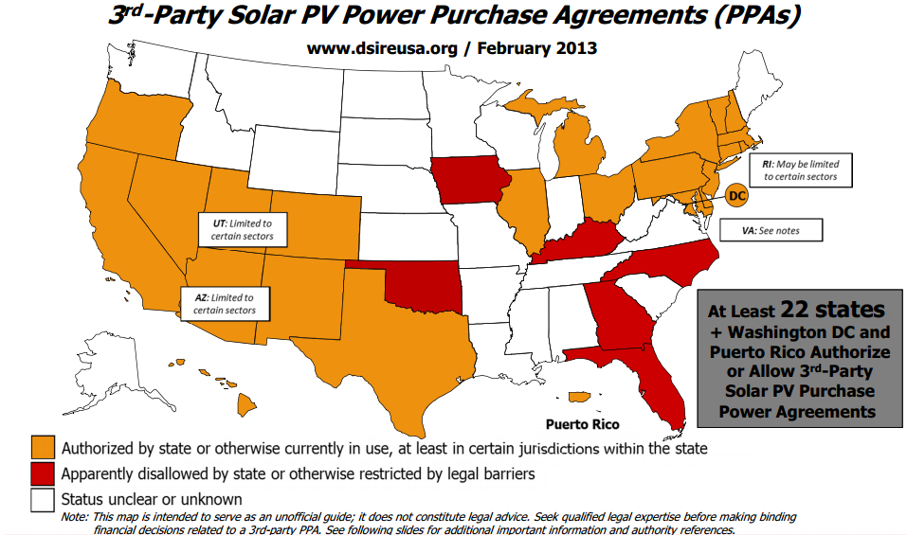

Slide 42
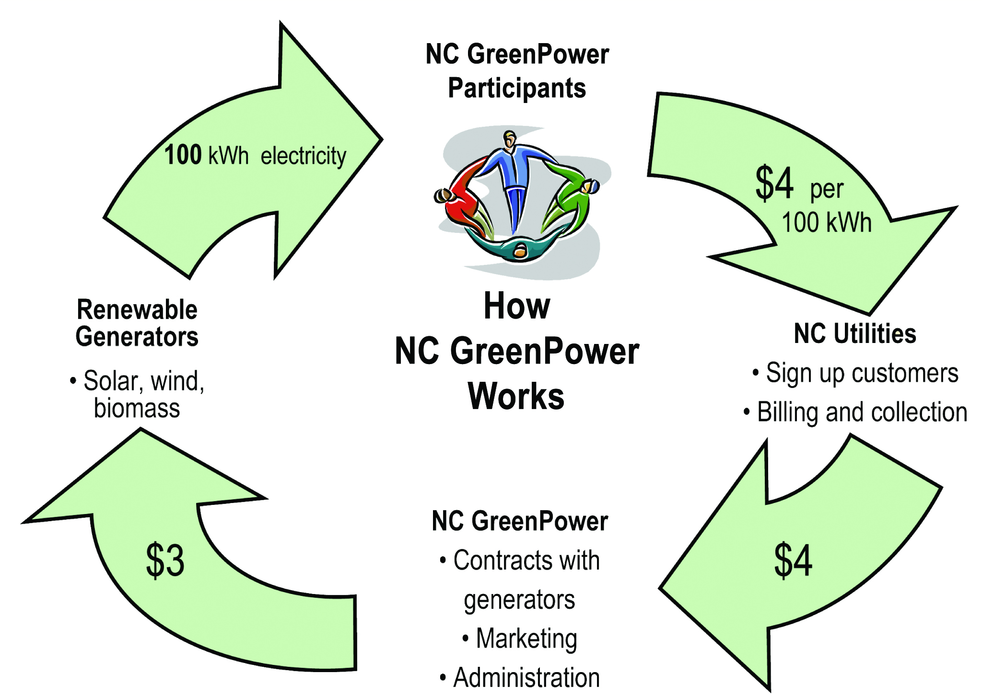

NC GreenPower
Pays a premium to RE generators for their “Renewable Energy Credits” (RECs).
$0.06/kWh for small solar (5 kw or less)
Bidding required in response to an open RFP for projects greater than 5 kw

Slide 43
NC GreenPower
Non-profit organization
Funded by voluntary contributions by utility customers who want to buy “green energy”
No long-term contracts
Incentive is only available as long as consumers continue to make donations
Cannot net-meter --- must buy all electricity, sell all electricity to the utility

Slide 44
NC GreenPower
Tax-deductible contributions go directly toward the purchase of renewable energy from independent generators located in North Carolina
Each $4 block of NC GreenPower subscribed monthly will annually offset:
  2497 pounds of carbon dioxide (CO2)
  7 pounds of sulfur dioxide (SO2)
  3 pounds of nitrogen oxides (NOx)
  972 pounds of coal required to produce the same energy
The annual reduction of CO2emissions from one block of NC GreenPower subscribed monthly is equivalent to planting 192 trees, or not driving 3,039 miles or 73 days.

Slide 45
Other NC Energy Policies
Project Registration – NCUC
Property Tax Abatement for Solar
Solar Access Laws
Interconnection and Net Metering
Utility Programs & Other Markets
  Progress Sunsense Program
  Tennessee Valley Authority (TVA)
  PJM Interconnection

Slide 46
Project Registration
North Carolina Utilities Commission (NCUC):
Certificate of Public Convenience and
Necessity (Chapter 8; Rule R8-64)
  Required by projects 2 MW or greater in capacity
  Certificate must be obtained prior to construction
OR
Report of Proposed Construction (Rule R8-65)
  Required by projects less than 2 MW in capacity
  Report must be filed prior to construction
  Facilities selling RECs for REPS compliance must file register facility; can be filed in conjunction with report of proposed construction

Slide 47
Property Tax Abatement for PV Systems
SB 1878 of 2008 created an 80% property tax abatement for PV (solar electric) systems
For example, a system assessed at $1,000,000 would pay property tax on $200,000.
Applies to commercial systems taking MACRS depreciation.
Residential systems not taking depreciation receive 100% property tax abatement.

Slide 48

Duke Energy Progress SunSense Solar PV
Rebate and bill credit for residential PV (2 kW – 10 kW AC)
Participants will receive a one-time upfront rebate of $500 per kW AC and a monthly bill credit based on the same system AC rating at $4.50 per kW.
The program limit is 1 MW AC each year.
(178 kW has been accepted so far for 2014)
Duke Energy Progress must receive and approve application before installation. All non-energy benefits (environmental, RECs, etc) are passed onto Duke Energy Progress under terms of the program.

Slide 49
Tennessee Valley Authority
Generation Partners
  Eligible size less 50 kW DC or less
  www.tva.com/greenpowerswitch/partners/
Solar Solutions Initiative; started February 2012
  Eligible Size >50 kW up to 1 MW DC
  http://www.tva.com/renewablestandardoffer/ssi.htm
Renewable Standard Offer
  Eligible Size >50 kW up to 20 MW DC
  http://www.tva.com/renewablestandardoffer/

Slide 50
Web Resources
NC Installers
www.greenprofessionals.org
Incentives
www.dsireusa.org
NC Solar Center
www.ncsc.ncsu.edu
ASU Energy Center
www.energy.appstate.edu
USDA Farm Bill (grants and loans)
www.farmenergy.org
Home Power Magazine
www.homepower.com
American Solar Energy Society (ASES)
www.ases.org
Solar Energy Industries Association (SEIA)
www.seia.org

Slide 51
Resources
Database of State Incentives For Renewables and Efficiency (DSIRE)
  www.dsireusa.org
  Provides information on State and Federal tax incentives
NC Solar Center
  www.ncsc.ncsu.edu
  Provides updated fact sheets on incentives for renewable energy in North Carolina
North Carolina Sustainable Energy Association
  http://www.ncsustainableenergy.org/

Slide 52
Questions & Comments
Betsy McCorkle
Director of Government Affairs
NCSEA
(919) 832-7601 ext. 108
betsy@energync.org
Brian Lips
Senior Policy Analyst
NC Solar Center - NCSU
(919) 515-3954
Brian_Lips@ncsu.edu

Slide 53

This concludes The American Institute of Architects Continuing Education Systems Course
Contact Information:
Energy.appstate.edu
Janet Miller, millerjm1@appstate.edu

