Slide 1
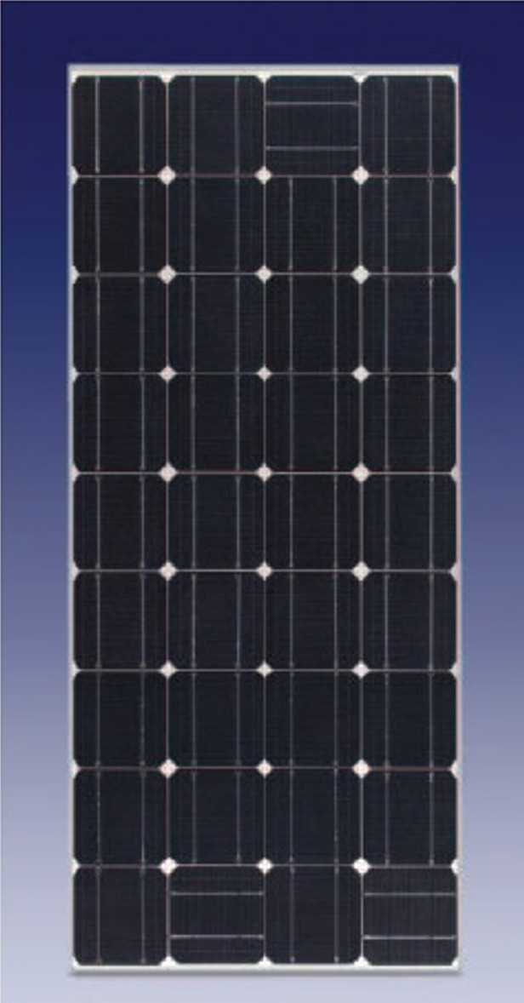
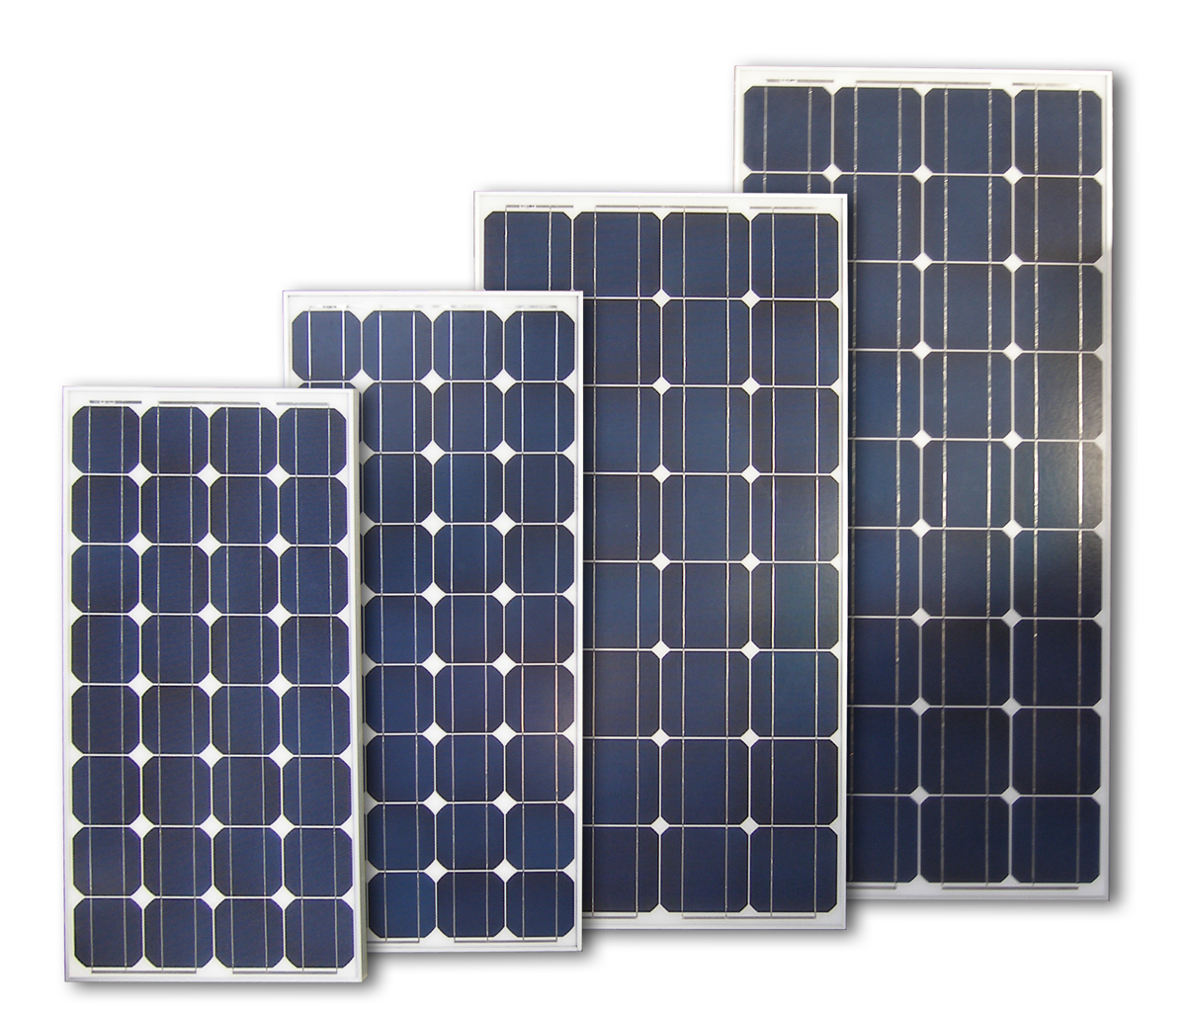
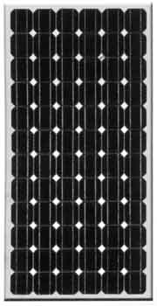
PV Cell & Module Types, Specifications,
& Environmental Responses

Slide 2
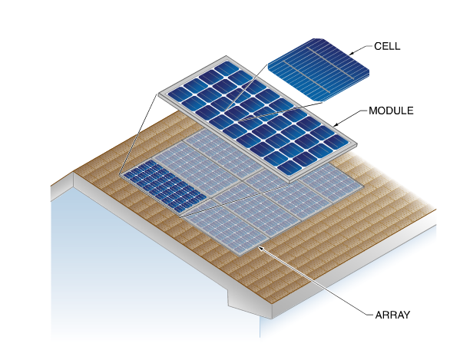
Cells, Modules, & Arrays

Slide 3
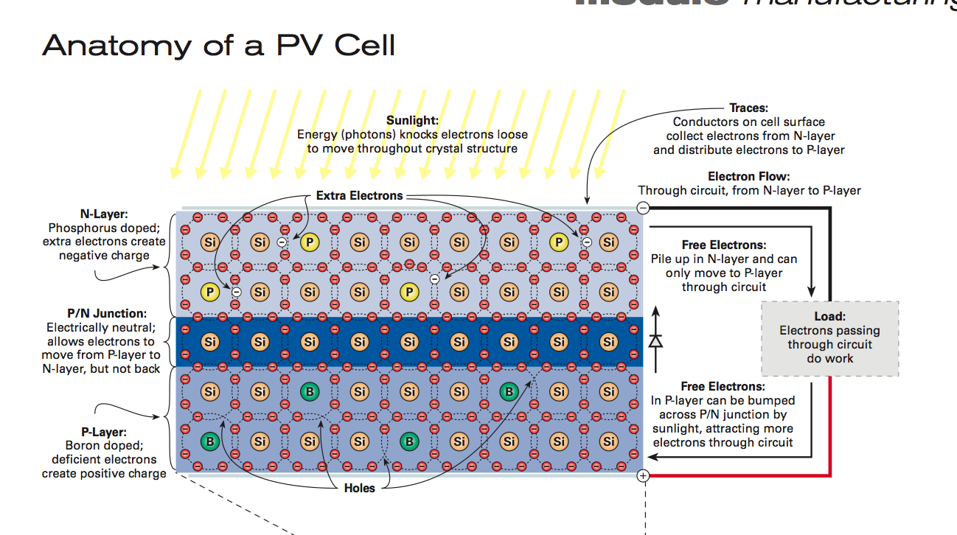
PV Cells – Operate at ~.5 volts
Courtesy Home Power Magazine

Slide 4
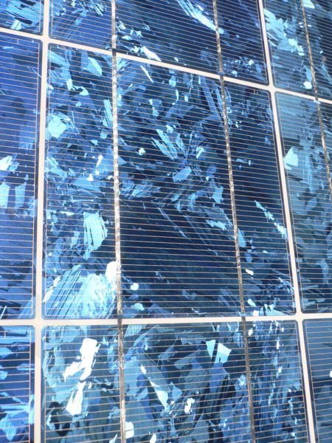
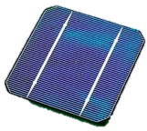
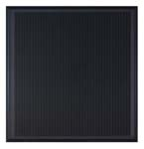
Types of PV Cells/Products
Mono or Single Crystalline
Multi or Polycrystalline
Thin Film /Amorphous Silicon

Slide 5
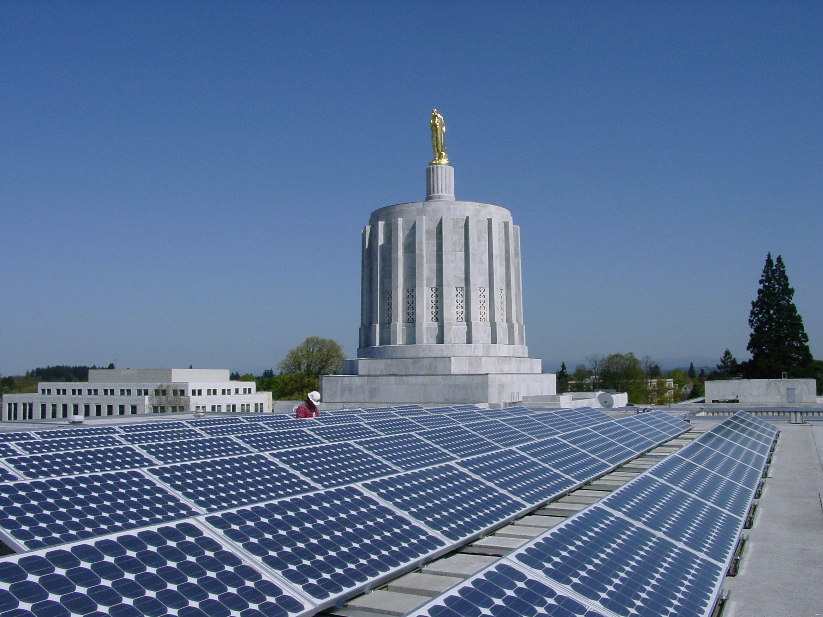
Monocrystalline Silicon
Warranties 25 years
Efficiency 12-21%
Notes:
The main purpose of this and the subsequent slides is to show the students photos of the different technologies and how they appear when installed. Point out the physical characteristics (the dead white space in the mono panels for example).
The white box with the statistics is there to give the students a feel for the overall similarities and differences. Don’t spend too much time getting into the meanings of all the items, just relate them all to one another.

Slide 6
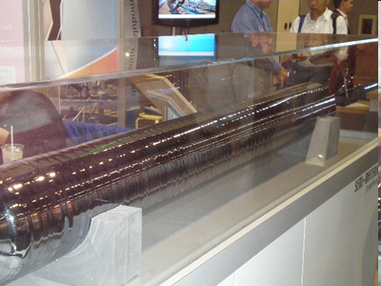
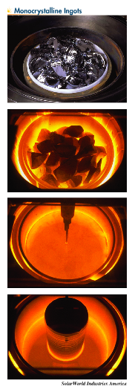
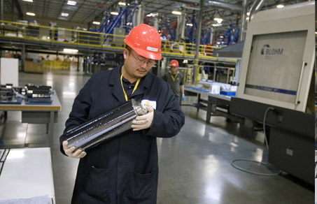

Slide 7
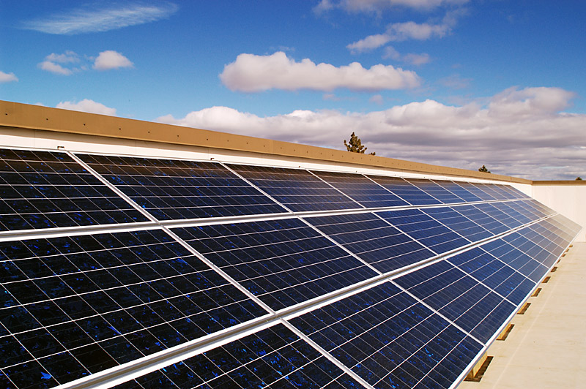
Multi or Polycrystalline Silicon
Warranties 25 years
Efficiency 11-16%

Slide 8
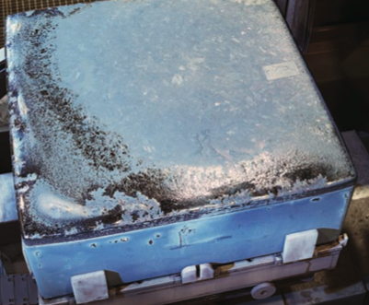
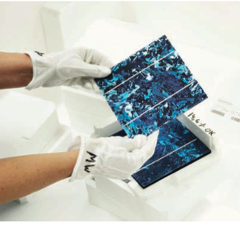
Multicrystalline ingot ready
for sawing
Cells ready for module assembly
Photos courtesy HomePower magazine/REC group

Slide 9
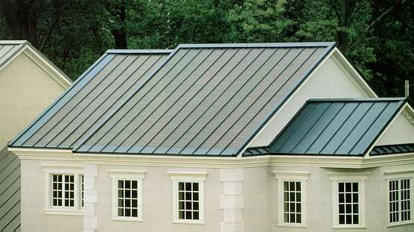
Thin Film - used mainly for utility scale
Amorphous Si (a-Si), CIGS, or CadTel
Warranties 20 -25 years
Efficiency 6-12%
Notes:
It is good to point out that this is just one type of amorphous panel, this manufacturer, Unisolar, makes framed versions as well that are mounted like crystalline framed modules.

Slide 10
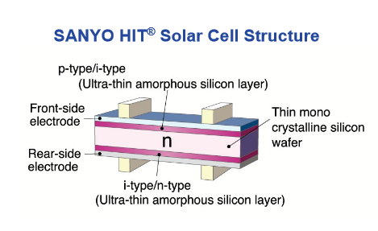

Slide 11
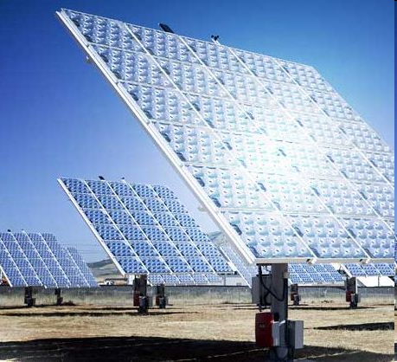
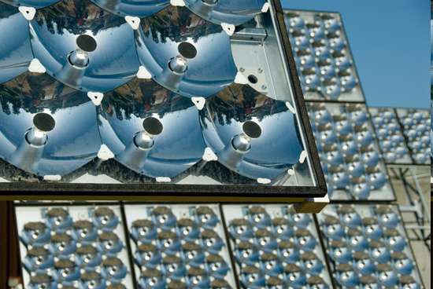
Concentrating PV
Must Dual Axis-Track CPV

Slide 12
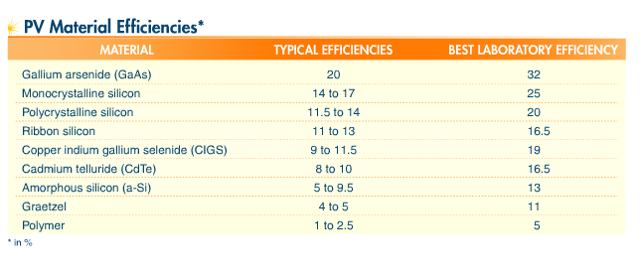
PV Materials & Efficiencies

Slide 13
PV Efficiencies (www.wikipedia.com)
1883 - less than 1% efficiency
1954 – AT&T labs marks 6% efficiency.
1955 - 2% efficient commercial solar cell for $25/cell or $1,785/Watt.
1957 - 8% efficient commercial solar cell
1958 - 9% efficient commercial solar cells
1959 - 10% efficient commercial solar cell
1960 - 14% efficient commercial solar cell
1976 - first amorphous silicon PV cells have an efficiency of 1.1%
1980 - thin-film solar cell exceeding 10% efficiency
1985 - 20% efficient silicon cell
1989 - Reflective solar concentrators are first used with solar cells.
1994 - concentrator cell (180 suns) becomes the first solar cell to exceed 30% conversion efficiency
2005 - Solar cells in modules convert around 17% of visible incidental radiant energy

Slide 14
Best Research-Cell Efficiencies
36
Multijunction Concentrators
Three-junction (2-terminal, monolithic)
Two-junction (2-terminal, monolithic)
Crystalline Si Cells
Single crystal
Multicrystalline
Thin Si
Thin Film Technologies
Cu(In,Ga)Se₂
CdTe
Amorphous Si:H (stabilized)
Emerging PV
Organic cells
Spectrolab
Spectrolab
32
Japan
Energy
NREL/
Spectrolab
28
NREL
NREL
UNSW
24
UNSW
Spire
UNSW
UNSW
UNSW
NREL
Cu(In,Ga)Se₂
14x concentration
Spire
Stanford
20
ARCO
Georgia Tech
UNSW
NREL
Efficiency (%)
Georgia Tech
Sharp
Westing-
house
Varian
NREL
NREL
16
No. Carolina
State University
University
So. Florida
NREL
NREL
Euro-CIS
AstroPower
NREL
Solarex
ARCO
Boeing
Boeing
12
Boeing
Kodak
United
Solar
Masushita
AMETEK
8
Kodak
Boeing
AstroPower
United Solar
Monosolar
Photon
Energy
Boeing
RCA
Solarex
University California
Berkeley
4
University
of Maine
RCA
Princeton
RCA
RCA
RCA
University
Konstanz
RCA
RCA
NREL
0
1975
1980
1985
1990
1995
2000
026587136

Slide 15
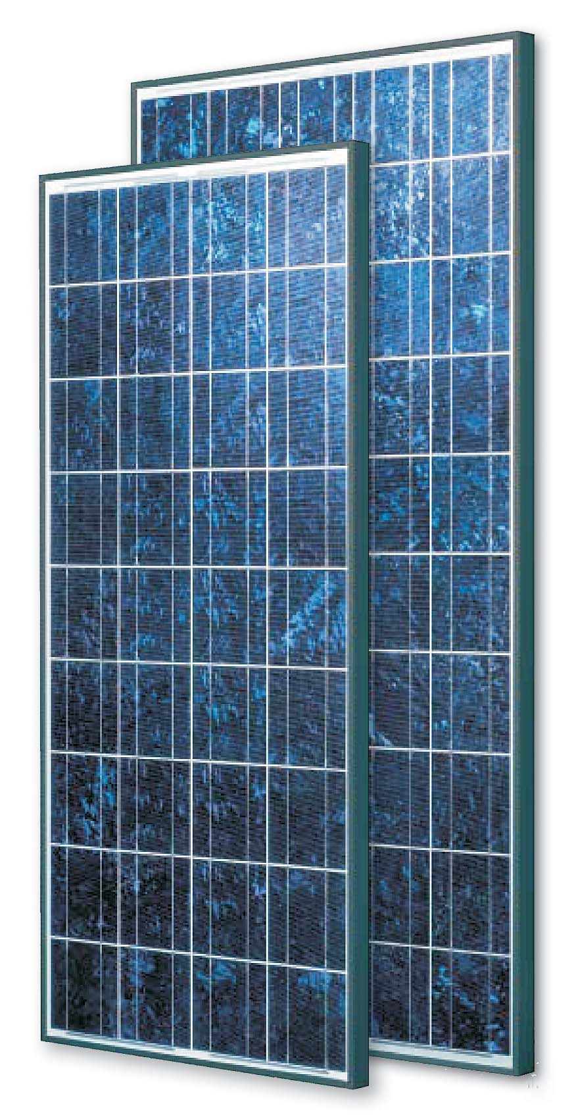
PV Modules
Many sizes and types available (5 – 435 watts)
Efficiencies 6 – 21%
Cells in series: 36 – 150
36 – 60 – 72 cells most common
25 year warranties
Currently ~$1/watt or less for most large modules bought in significant quantities

Slide 16
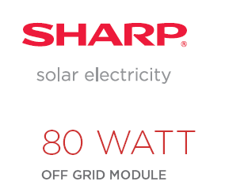

Slide 18
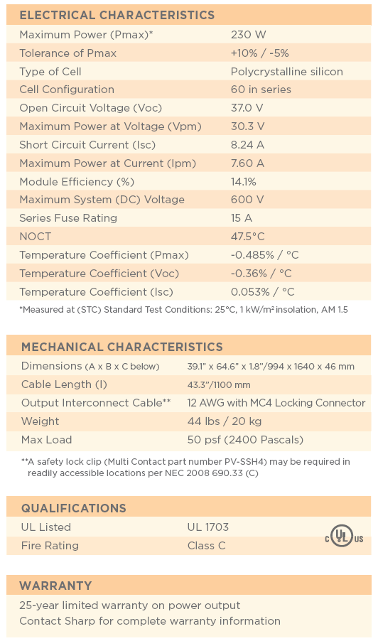

Slide 19
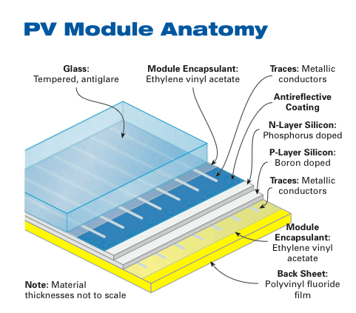
PV Modules
Courtesy Home Power Magazine

Slide 20
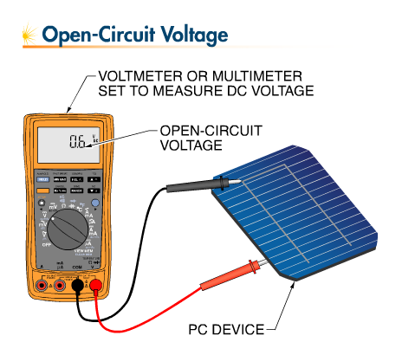
Silicon Cell Voltage
.5 - .6 volts/cell
Not related to size
Voltage affected by temperature
Open circuit voltage
Maximum power voltage
For Sharp 80 watt (36 cells)
Voc = 21.6/36 = .6 Voc/cell

Slide 22
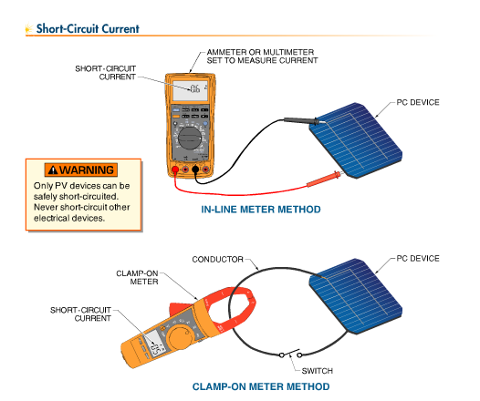
Silicon Cell Current Production
Related to size of cell
.2 amps/square inch or .03 amps (30 milliamps) per square centimeter
Affected by irradiance primarily
Short Circuit Current
  Used to determine maximum current
  Isc X 1.56 to estimate maximum current for wire sizing
Maximum Power Current

Slide 23
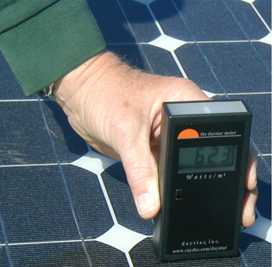
Amperage is proportional to irradiance
If a module has a short-circuit current of 8 amps at 1000 w/m2, what would the short circuit current be at 623 watts/m²?
  623 watts/m² ÷ 1000 watts/m² = .623 or 62.3%
  8 A x .623 = 4.98 A

Slide 24
Two factors that affect PV Module Performance
Temperature
Irradiance (solar power)

Slide 25
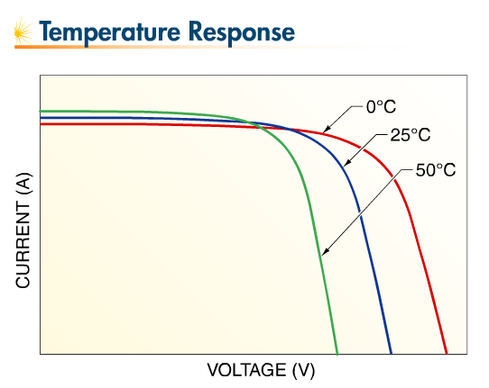
Temperature’s Impact on Voltage & Current

Slide 26
Response to Temperature
Increasing temperature reduces power output
Increasing temperature increases current slightly
Current
Decreasing temperature increases voltage
T = 0 ºC
Increasing temperature reduces voltage
T = 25 ºC
T = 50 ºC
Voltage
Notes:
This is the first demonstration of how temperature affects voltage and current. The point of this slide is to show how voltage has a dramatic change with temperature while current change is minimal.
This is a good place to introduce the term “inversely proportional” in respect to temperature and voltage. We don’t need to get too far into specifics here, just show the general concept and how the IV curves move around.

Slide 27
Response to Irradiance
IV Curves at Constant Temperature
Current increases proportionally increasing irradiance
1000 W/m²
Maximum power voltage changes little with irradiance
750 W/m²
Current
500 W/m²
250 W/m²
Voltage changes insignificantly with irradiance
Voltage
Notes:
Another way to look at the effect of irradiance on current values. Since they got the concept in the last slide, this slide is intended to get them to evaluate how the IV curve is changed and even apply some math to determine the current values over varying irradiance values. Point out how the curves are shifting in the vertical dimension much more than the horizontal. You can even give a Isc value for a module at STC conditions and get them to calculate the new values for different irradiance values. This will come up again in the next slide so make sure they are aware of the way to accomplish it. Ask students to ID different points on the curves (Voc, Isc…)

Slide 28
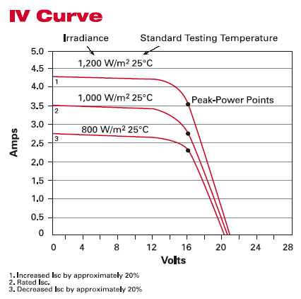
IV Curve

Slide 29
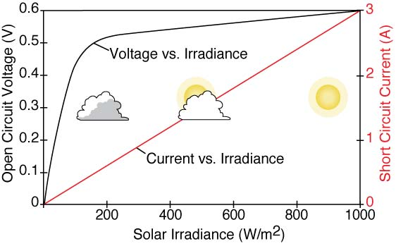
Impact of Irradiance on Voltage & Current
Voltage increases rapidly, current increases proportionally w/ irradiance

Slide 30
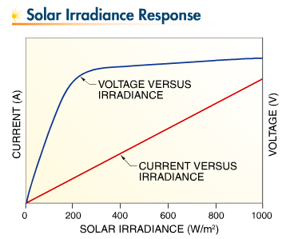
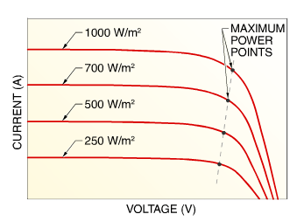
Impact of Irradiance on Voltage & Current

Slide 31
Efficiency
Ratio of power out put to solar power input
Multiply full sun irradiance (1000 watts/m²) by area of module in m² and divide into rated power of module in watts
Example
  Efficiency = P _{mp} / solar irradiance x area (m2)
  What is efficiency of module with a surface area of 1.2 m² and maximum power output of 160 W when exposed to 1000 w/m²
  160/(1000 x 1.2) = .133 0r 13.3%

Slide 33
Power Density
To calculate “power density”, first consider the units
  Watts/area = Watts/ft² or Watts/m²
Watts is the nameplate rating of the module
The area is the length times the width of the entire module
  These measurements are found on the module spec sheet.
Example: 200 Watt Evergreen ES-A 195-f2
65 inches in length and 37.5 inches in width
Area = 65 in x 37.5 in = 2,437.5 in² and 144 in² = 1 ft²
Area =( 2,437.5 in²) ÷ (144 in²/ft²) = 16.93 ft²
Power Density = 200 Watts ÷ 16.93 ft² = 11.81 W/ft²

Slide 34
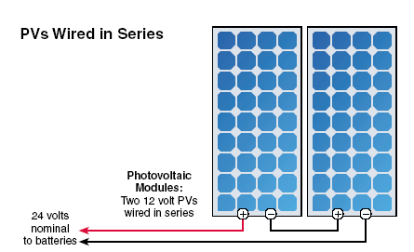
Series Wiring (Voltage Increases)

Slide 35
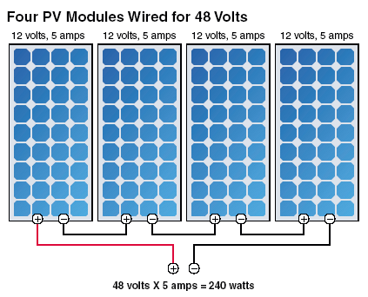
Series Wiring

Slide 36
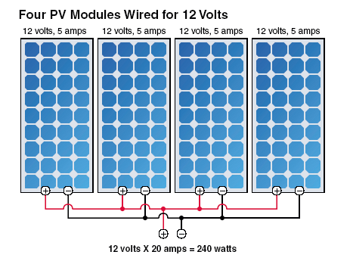
Parallel Wiring (Amperage Increases)

Slide 37
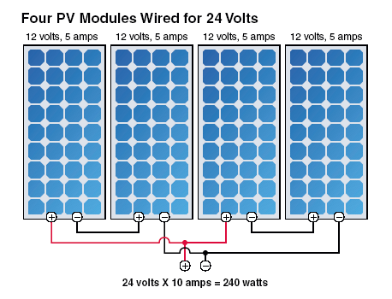
Series & Parallel

Slide 38
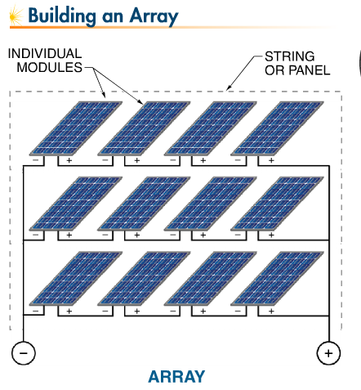

Slide 39
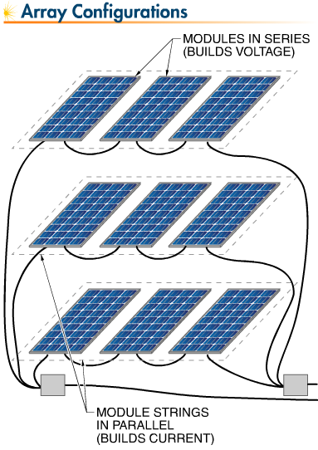

Slide 40
Wiring Exercise Tips for Batteries and PV Modules
Make series connections, positive to negative terminals, building voltage to system voltage.
Never return to these terminals.
Circle ‘open’ terminals.
Make parallel connections, positive to positive and negative to negative (in a combiner box).
Wire a single pair, positive and negative, to next piece of equipment.

Slide 41
48 Volt battery charging system

Slide 42
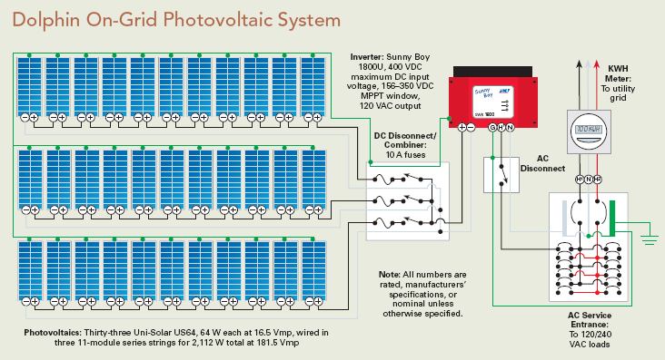
Direct Grid Tie System

Slide 43
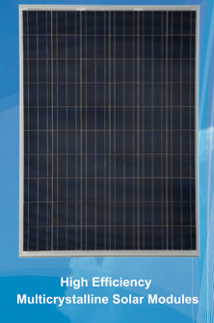
Standard Test Conditions (STC)
        STC (Name Plate Rating)
        Cell temp 25 Degree C
        Irradiance 1000 W/square meter
        Air Mass Index 1.5

Slide 44
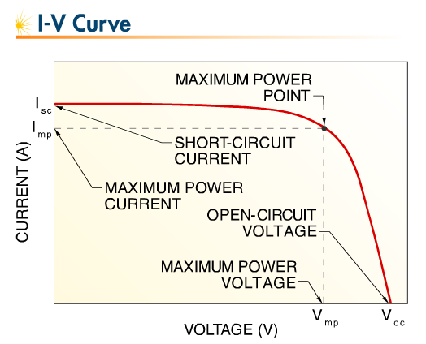
Photovoltaic Device IV Curve at STC
(25 C (77 F) and 100 watts/m²)

Slide 45
The IV Curve
Short Circuit Current
Isc
Maximum Power Point (MPP) in Watts
Max Power Current
Imp
Area Under Curve = Watts
Current
Voltage
Vmp
Voc
Max Power Voltage
Open Circuit Voltage
Notes:
This is a curve they need to know in their sleep. It will come up again many times in the class and in one form or another it will be on the test. The five major points on the graph are called out individually and need to be explained one by one.
This is a good time to introduce the fact that PV modules are current limited and can be place in a short circuit situation without harming the modules. Isc is where the voltage = 0.

Slide 47
Test Conditions
Standard Test Conditions (STC)
  1000 w/m² & cell temp of 25 C (77F)
Standard Operating Conditions (SOC)
  1000 w/m² & nominal operating cell temperature (NOCT)
Nominal Operating Cell Temperature (NOCT)
  temperature of open circuit module based on 800 w/m² , ambient temp of 20 C (68F) and wind speed of 1 m/s (varies by module)
Nominal Operating Conditions (NOC)
  800 w/m² & NOCT
PVUSA Test Conditions (PTC)
  1000 w/m² ; ambient air temperature of 20C (68F); and wind speed of 1 m/s

Slide 49
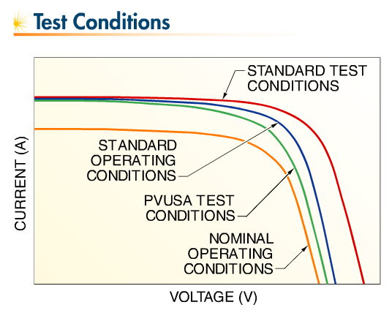

Slide 50
Temperature Response
High temperatures significantly reduces voltage & power
High temperatures slightly increases amperage (often ignored)
Low temperatures significantly increase voltage & power
Low temperatures slightly decrease amperage (often ignored)
Focus is on internal cell temperatures at the P-N junction not ambient temperatures typically
Cell temperature influenced by ambient temperature, wind speed, solar irradiance, thermal characteristics of module and installation method
Cell temperatures of 25C (77F) over ambient are typical for most arrays at peak sun (1000 w/m2)

Slide 51
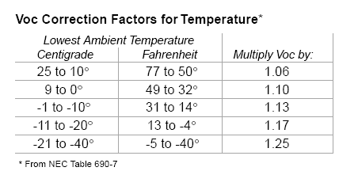
Calculating maximum voltage and maximum string size
  Example: How many modules, each having a Voc of 36.5 V can be placed in a series string without exceeding the 600 volt limit of a grid tie inverter when the record low temperature is -30 C?
Voc = 36.5 volts x 1.25 = 45.62 Voc
600 volt inverter/45.62= 13 modules

Slide 52
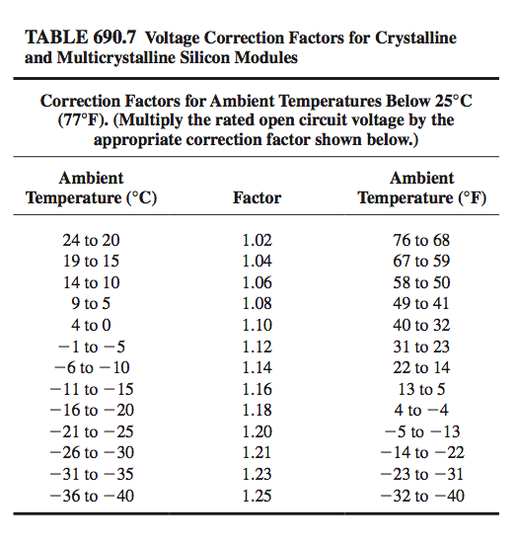
Quick Estimate per NEC 690.7. Chart
  Example:
  How many modules, each having a Voc of 36.5 V can be placed in a series string (source circuit) without exceeding the 600 volt limit of a grid tied inverter when the record low temperature is -30 C?
Voc = 36.5 volts x 1.21 = 44.16 Voc
600 volt inverter/44.16= 13.5 modules
Round down to 13 modules

Slide 53
Direct Grid Tie System

Slide 55
Temperature Coefficients
Voltage Change Due to Cell Temperature
Temperature Coefficients are the rate of change in voltage, current, or power output due to increasing cell temperature
  Can be expressed as unit change or percentage change (uses 25ºC as reference point)
    Typical percentage change coefficients
      -0.33%/C for open circuit voltage
      -0.45%/C for power
- 0.5% / °C
-0.5% / K
- 0.2 V / °C
- 100 mV / K
273 K = 0°C ; 274 K = 1°C ; 373 K = 100°C

Slide 56
Open Circuit Voltage Temperature Coefficient - TkVoc
Used to calculate maximum system voltage and for series module string sizing
Example: What will be maximum expected voltage if we have 10 modules with a Voc of 37 installed at site with record low of -10ºC and a TkVoc -33%/ ºC.
1) Find the temperature change from STC (delta T)
  -10ºC - 25C = -35ºC
2) Find the percentage change
-35º x -.33%/ºC = 11.55%
3) Find the maximum voltage
10 modules x 37V = 370V
370V x 100% + 11.55% - 370 x 1.1155 = 412.75

Slide 57
Using Temperature Coefficients
Temperature Coefficients are the rate of change in voltage, current, or power output due to increasing or decreasing cell temperature in comparison with 25C or STC cell temperature.
  Negative coefficient means parameter (ie: voltage & power) decreases with increasing cell temperature or increases with decreasing cell temperature
  Positive coefficient means parameter (ie: amperage) increases with increasing cell temperature
  Can be expressed as unit change or percentage change (typically uses 25C (77F) as reference
    Typical unit change values are .13V/C
    Typical percentage change coefficients
      -0.36%/C for voltage
      + 0.10%/C for current
      -0.50%/C for power
Weather data:
http://www.weather.com/weather/climatology

Slide 58
Open Circuit Voltage Temperature Coefficient
(% change per degree C)
Example
  How many Sharp 216 watt modules, each having a Voc of 36.5 V and temperature coefficient of -0.36%/C, can be placed in a series string without exceeding the 600 volt limit of a grid tie inverter when the record low temperature is -31 C?
    -0.36%/C = .36/100 = .0036
    .0036 x 36.5 V = .13 V/C
    Delta T = 20C to – 31 = 51 C
    .13 V/C x 51 = 6.63 volts
    36.5 Voc + 6.63 volts = 43.13 Voc @ -31C
    600 V/43.13= 13.9 modules = 13 modules

Slide 59
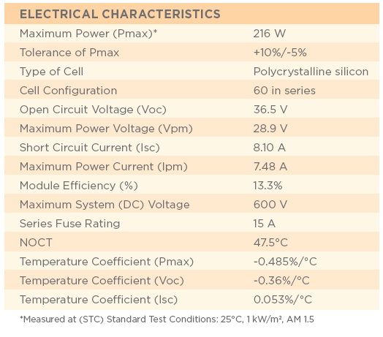

Slide 60
Calculation Method for Matching Array and Inverter Voltage Windows:
The solar array minimum and maximum voltages are calculated as follows:
Winter Time calculation for max voltage
  V_{max}=X_{Series}* V_{oc}+ (L_{temp} to 25C delta T) x V change/C
Summer Time calculation for minimum voltage
  V_{min}=X_{Series}* V_{mp}- (H_{temp} to 25°C delta T + 30) x V_{change/C}
    Add 30 C to summer delta T for ground mount
    Add 40 C to summer delta T for Roof mount (wiles reported temps between 158 & 176F)

Slide 61

Calculating Minimum Voltage
Use Vmp as reference (28.9 V) & Record High Temp
    -0.36%/C = .36/100 = .0036
    .0036 x 28.9 V = .10 V/C
    Delta T = 34– 25 = 9 C
    Add 30 C for ground mount and 40 C for roof mount
    9 C + 40 C = 49 C is estimated temp inside module
    .10 V/C x 49 = 4.9 volts
    28.9 Vmp – 4.9V = 24 Vmp @ 34 C
    If inverter minimum start voltage is 150V then:
    150 / 24 V = 6.25 modules or rounding up 7
C to F = C x 9/5 + 32
F to C = F – 32 x 5/9

Slide 62
PV Current: Short Circuit (Isc) & Maximum Power (Ipm)

Slide 63
Temperature Coefficients
Voltage Change Due to Cell Temperature
Temperature Coefficients are the rate of change in voltage, current, or power output due to increasing cell temperature
  Can be expressed as unit change or percentage change (uses 25ºC as reference point)
    Typical percentage change coefficients
      -0.33%/C for open circuit voltage
      -0.45%/C for power
- 0.5% / °C
-0.5% / K
- 0.2 V / °C
- 100 mV / K
273 K = 0°C ; 274 K = 1°C ; 373 K = 100°C

Slide 64
Open Circuit Voltage Temperature Coefficient - TkVoc
Used to calculate maximum system voltage and for series module string sizing
Example: What will be maximum expected voltage if we have 10 modules with a Voc of 37 installed at site with record low of -10ºC and a TkVoc -33%/ ºC.
1) Find the temperature change from STC (delta T)
  -10ºC - 25C = -35ºC
2) Find the percentage change
-35º x -.33%/ºC = 11.55%
3) Find the maximum voltage
10 modules x 37V = 370V
370V x 100% + 11.55% - 370 x 1.1155 = 412.75

Slide 65
Quick Estimate per NEC 690.7. Chart
  Example:
  How many modules, each having a Voc of 36.5 V can be placed in a series string (source circuit) without exceeding the 600 volt limit of a grid tied inverter when the record low temperature is -30 C?
Voc = 36.5 volts x 1.21 = 44.16 Voc
600 volt inverter/44.16= 13.5 modules
Round down to 13 modules

Slide 66
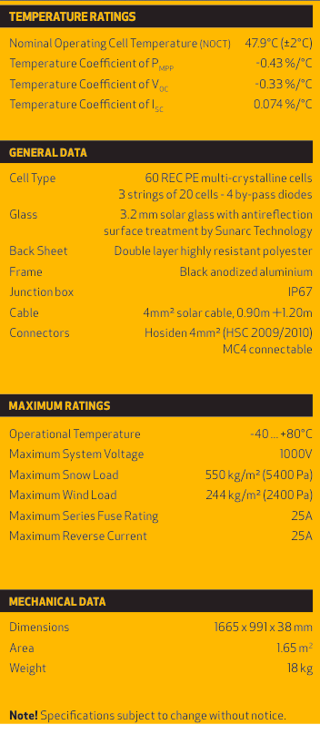
Module Specifications
Rated Power at STC (watts)
Rated Power Tolerance (%)
  Look for small negative or positive only
Rated Power per Square Foot (watts) & Efficiency in %
  Power density (5.6 – 19.6 watts/SF)
  Efficiency is ratio of output power to input power (6 -21%)
Series Fuse Rating
  Current rating of a series fuse used to protect module from overcurrent under fault condition (7 – 20 amps)
Connector Type
  Module output terminal or Junction box (J boxes) or cable/connector configuration (weather tight connectors
  Lockable connectors required in readily accessible locales (Tyco or MC4)

Slide 67
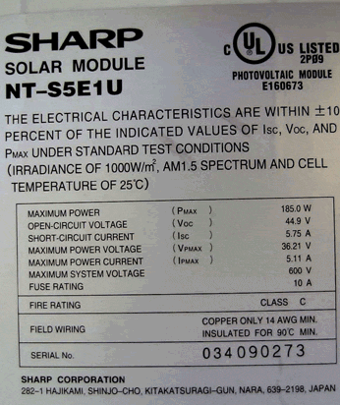
Module Namplate

Slide 68
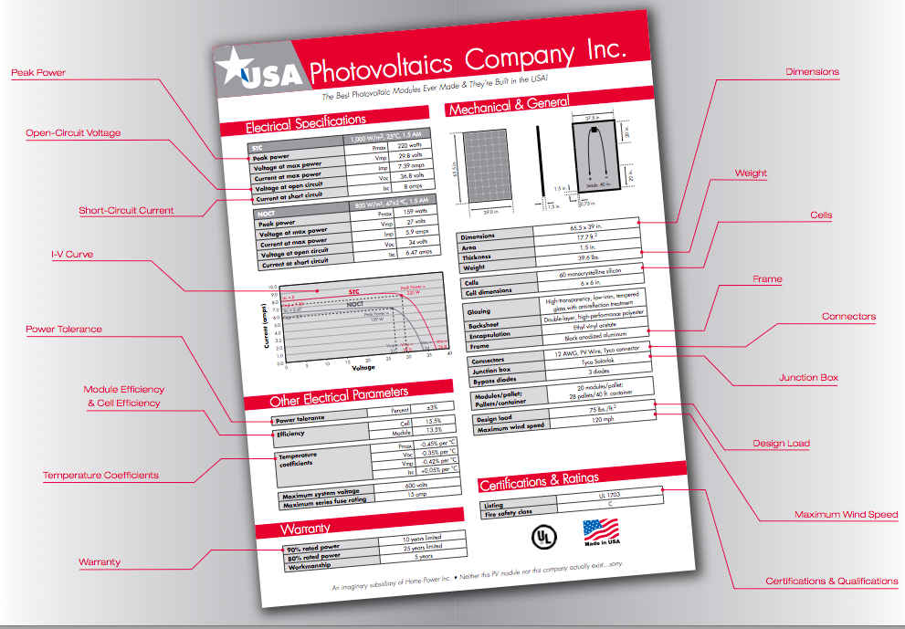

Slide 69
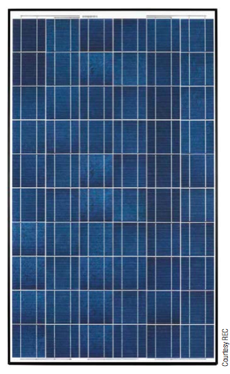
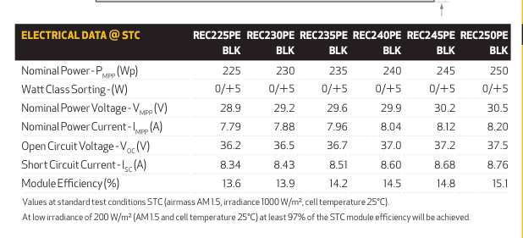
Module Specifications

Slide 70
Module Specification Terminology
Standard test conditions – 1000 W/m² , cell temperature = 25° C, AM 1.5
Nameplate rating – the max power output in watts of a module under STC (standard test conditions)
Open circuit voltage – Voc - voltage across the output wires of a module under minimal light conditions, no load. 12 volt nominal module - ~21 volts
Short circuit current – Isc – maximum current a module can produce under the midday sun (1000W/m²)
Maximum power voltage – Vmp, Vmax – operating voltage when module produces nameplate rating in watts, 12 volt nominal module ~ 17 volts
Maximum power current – Imp, Imax – operating current when module produces nameplate rating in watts.

Slide 71

Choosing a module
Cost
Aesthetics
Material Warranty (years)
  Range of 1 – 10 years
Power Warranty (Years) – limited warranty for module power at STC minus power tolerance percentage (+/- 5%)
  20 years common at 90% for first 10 years and 80% for next 10 years (100 watts x .95 x .90 = 85.5 watts)
Power Density/Efficiency
Etc…

Slide 72
Module Specifications

Slide 73
Module Specification Terminology
Standard test conditions – 1000 W/m² , cell temperature = 25° C, AM 1.5
Nameplate rating – the max power output in watts of a module under STC (standard test conditions)
Open circuit voltage – Voc - voltage across the output wires of a module under minimal light conditions, no load. 12 volt nominal module - ~21 volts
Short circuit current – Isc – maximum current a module can produce under the midday sun (1000W/m²)
Maximum power voltage – Vmp, Vmax – operating voltage when module produces nameplate rating in watts, 12 volt nominal module ~ 17 volts
Maximum power current – Imp, Imax – operating current when module produces nameplate rating in watts.

Slide 74
PV Modules
Many sizes and types available (5 – 350 watts)
Efficiencies 6 – 21%
Cells in series: 36 - 150
25 year warranties
Currently ~$1/watt or less for most large modules bought in significant quantities

Slide 75
Module Namplate

Slide 77
Module Specifications
Rated Power at STC (watts)
Rated Power Tolerance (%)
  Look for small negative or positive only
Rated Power per Square Foot (watts) & Efficiency in %
  Power density (5.6 – 19.6 watts/SF)
  Efficiency is ratio of output power to input power (6 -21%)
Series Fuse Rating
  Current rating of a series fuse used to protect module from overcurrent under fault condition (7 – 20 amps)
Connector Type
  Module output terminal or Junction box (J boxes) or cable/connector configuration (weather tight connectors
  Lockable connectors required in readily accessible locales (Tyco or MC4)

Slide 78

Module Specifications
Courtesy Home Power Magazine

Slide 79


Quick Connects (MC, Tyco, etc)

Slide 80

Module J-Box
Field Serviceable Junction Box:
Less common today and found primarily on smaller modules
Sealed Junction Box:
Most common, safer to wire, but usually cannot replace leads
Courtesy Homepower Magazine/Kris SUtton

Slide 81

Module J-Box

Slide 82
Choosing a module
Cost
Aesthetics
Material Warranty (years)
  Range of 1 – 10 years
Power Warranty (Years) – limited warranty for module power at STC minus power tolerance percentage (+/- 5%)
  20 years common at 90% for first 10 years and 80% for next 10 years (100 watts x .95 x .90 = 85.5 watts)
Power Density/Efficiency
Etc…

Slide 83
Bypass Diodes
Bypass diodes are connected in parallel with series strings of cells to prevent cell overheating when cells or parts of an array are shaded.Shaded cells are bypassed.
When cells are not shaded, the bypass diode is reverse biased and does not conduct current
When a cells is shaded, the bypass diode is forward biased and conducts current
Neg (-)
Pos (+)
Shaded cell

Slide 84
Sealed Junction Box with Conductors and Connectors Installed

Slide 85

1000 watts of crystalline PV fits in ~100 square feet.
How much space per watt?
Thin film efficiency is about half, so 500 watts of thin film in ~100 square feet

