Slide 1
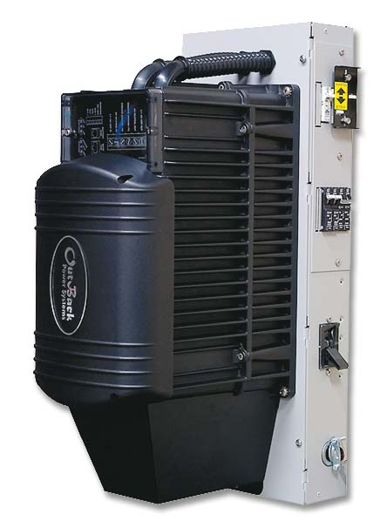
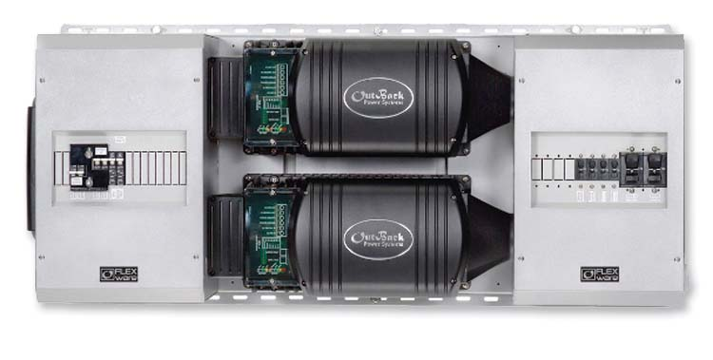
Power Systems/DC disconnects & Junction Boxes
Integration Hardware/E-Panels

Slide 2
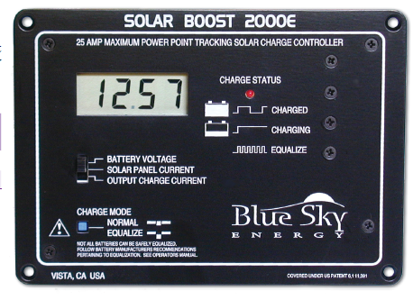
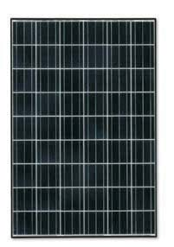
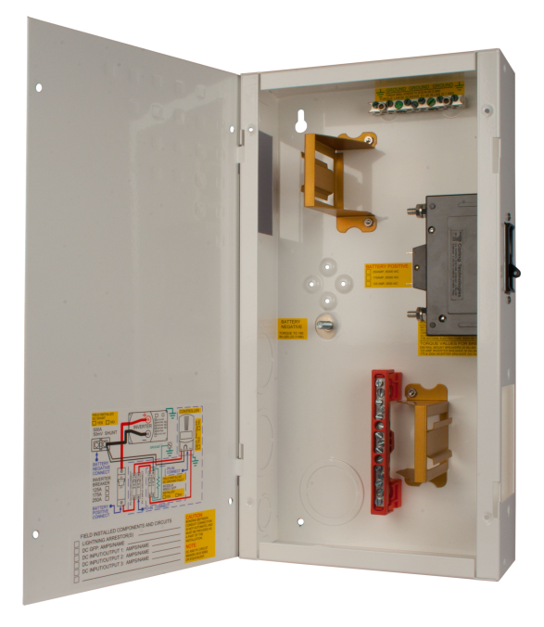
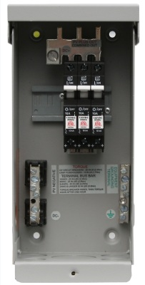
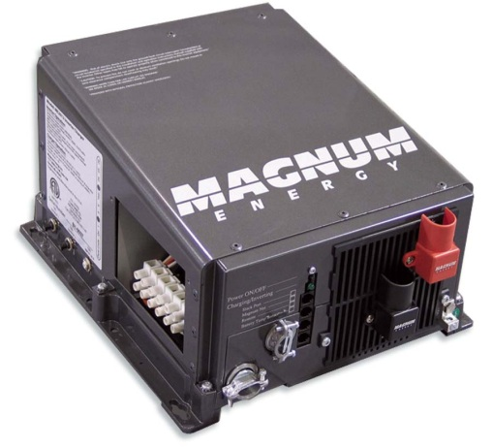
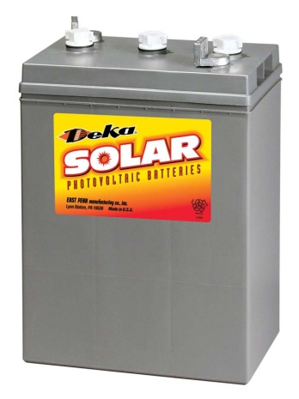
Charge Controller
DC Junction Box
Combiner Box
PV array
Inverter
Battery

Slide 3
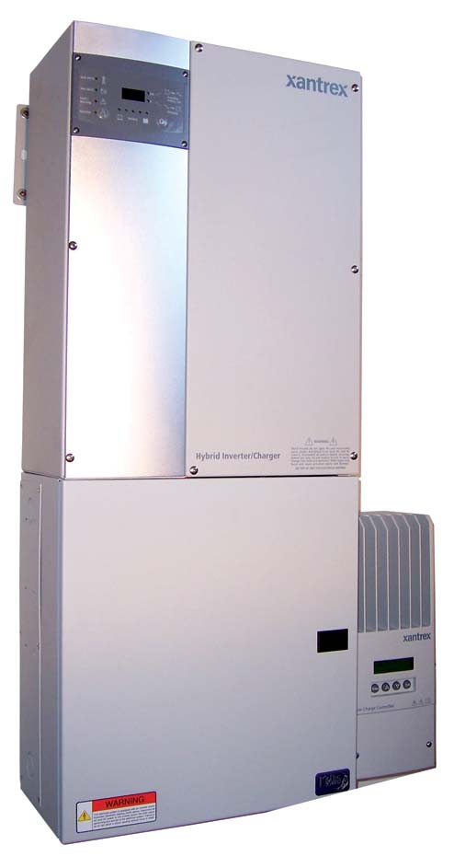
Functions
Overcurrent protection
Solar Charge Controller PV Disconnect
Solar Charge Controller Battery Disconnect
Shunt location for system monitoring
Junction for conductors
DC Load center
Mounting Location for Charge Controller
Lightning protection

Slide 4
Ananda Power Center 1990

Slide 5
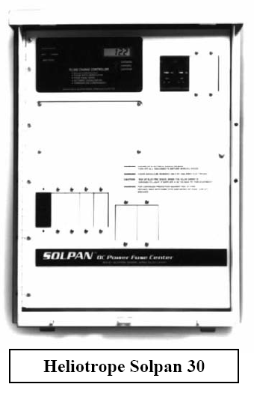
Heliotrope Solpan 30

Slide 6
Trace or Xantrex DC250

Slide 7
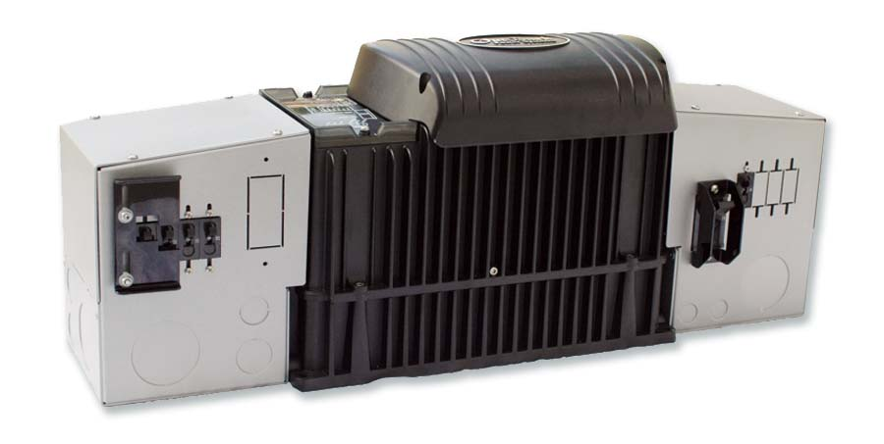
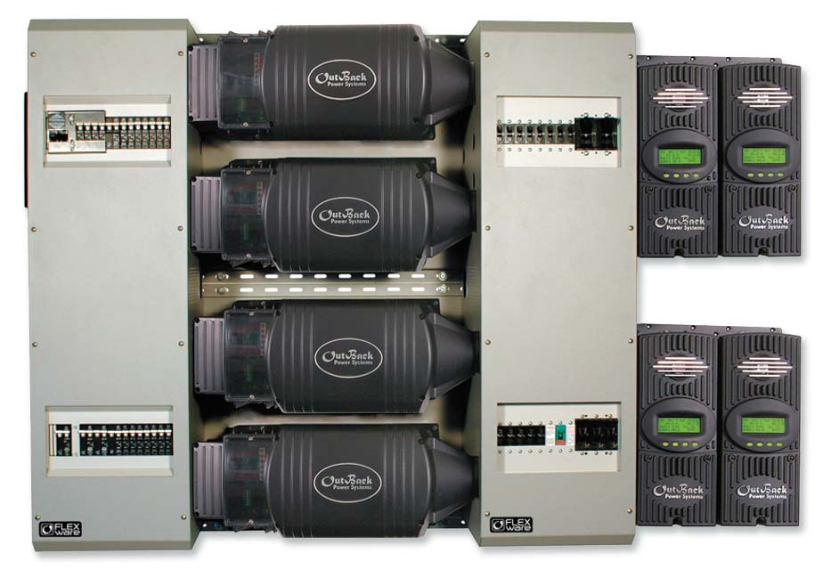
OutBack Power Systems Flexware (PSDC)
Integration Hardware

Slide 8
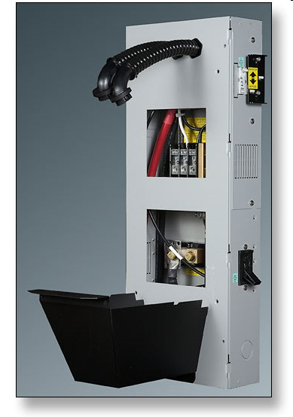
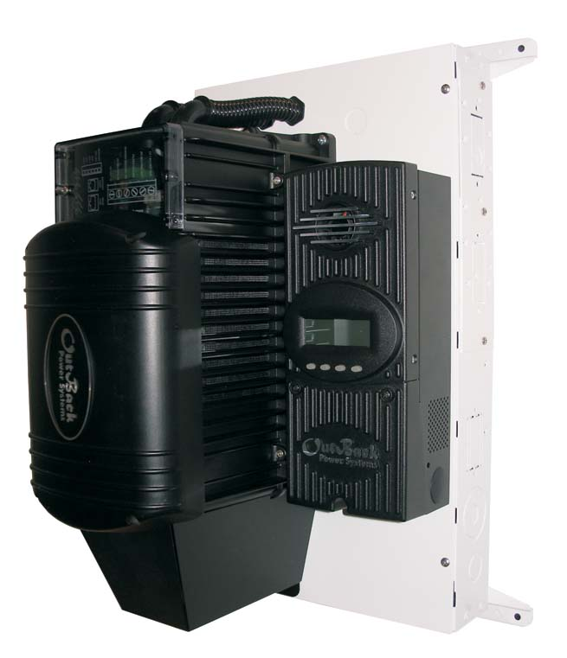
MidNite Solar E-Panel

Slide 9
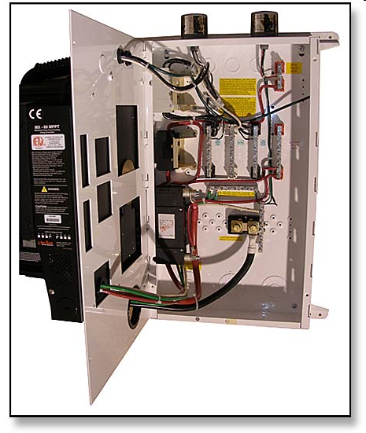
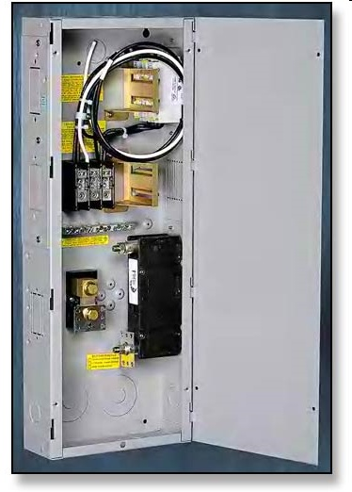

Slide 10
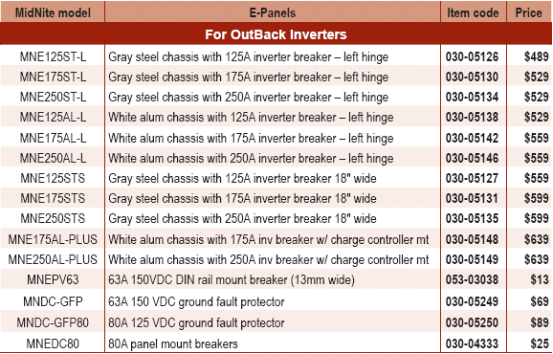
Midnite Solar E-Panels

Slide 11
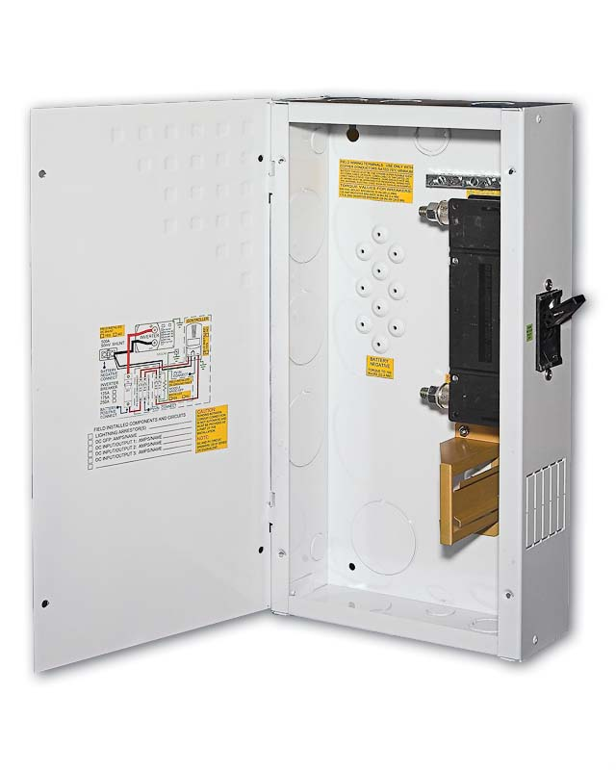
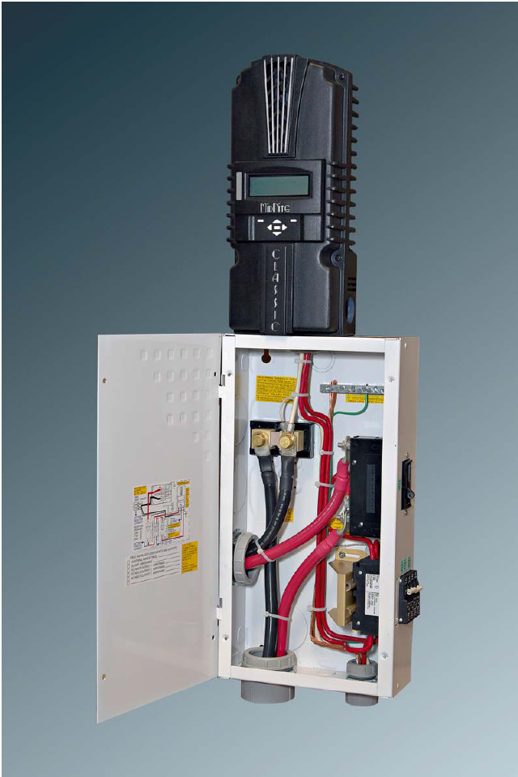
Midnite Mini-DC Disconnect

Slide 12
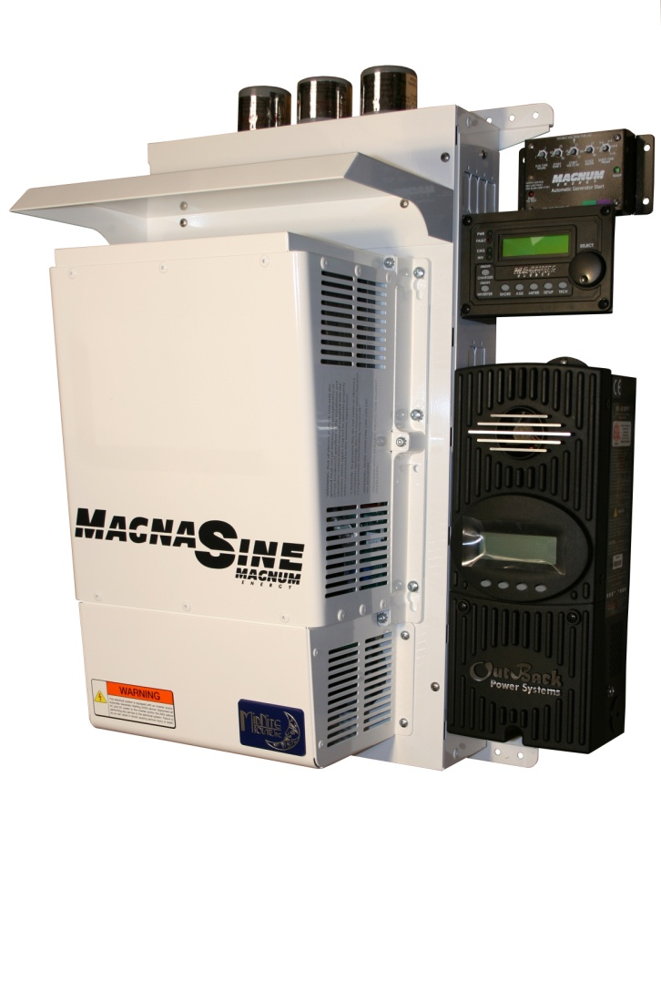
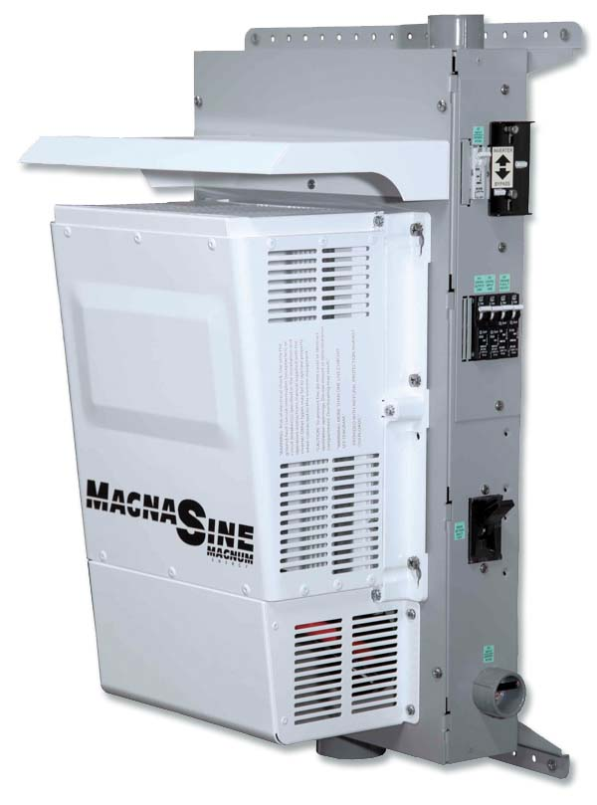
Magnum E - Panels

Slide 13
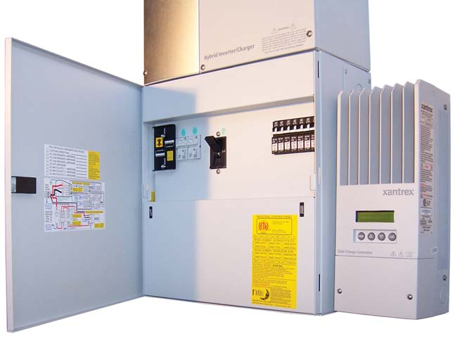
Schneider (Xantrex) XW System

Slide 14
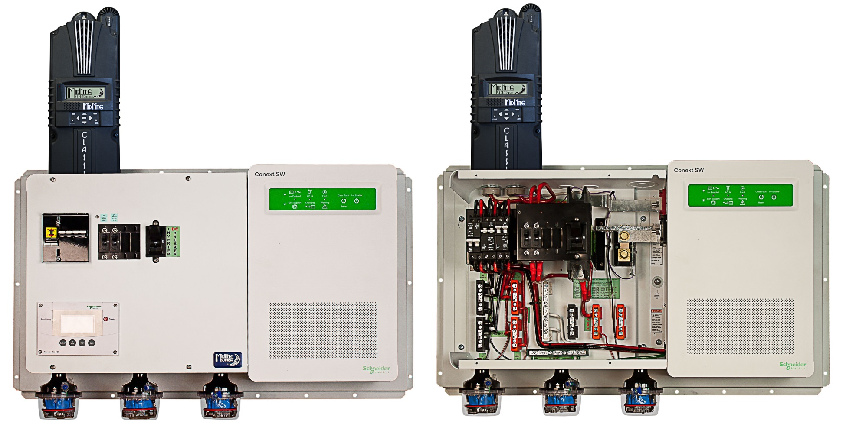
Schneider Conext SW with Midnite

Slide 15
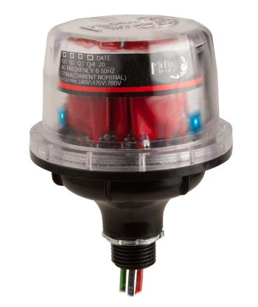
Components

Slide 16
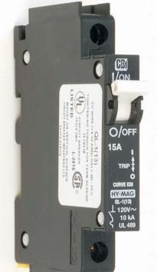
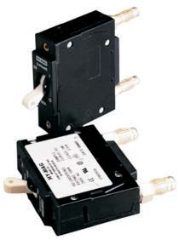
Circuit Breakers
Ground-Fault Detection & Interruption System
DC rated circuit breakers for source circuits & Inverter/battery

Slide 17
Breaker Sizing for Charge Controller Wiring
Amp rating for 2 breakers used on either side of charge controller must be greater than Isc x 1.56 of each series string entering combiner box x number of series strings
Amp rating must be less than ampacity of wire used

Slide 18
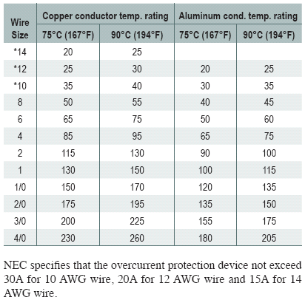
Example breaker sizing for system with 2 - 24 series strings
5.15 amps x 1.56 x 2 = 16 amps
2 breakers must be larger than 12.8 amps
Less than ampacity of wire used

Slide 19
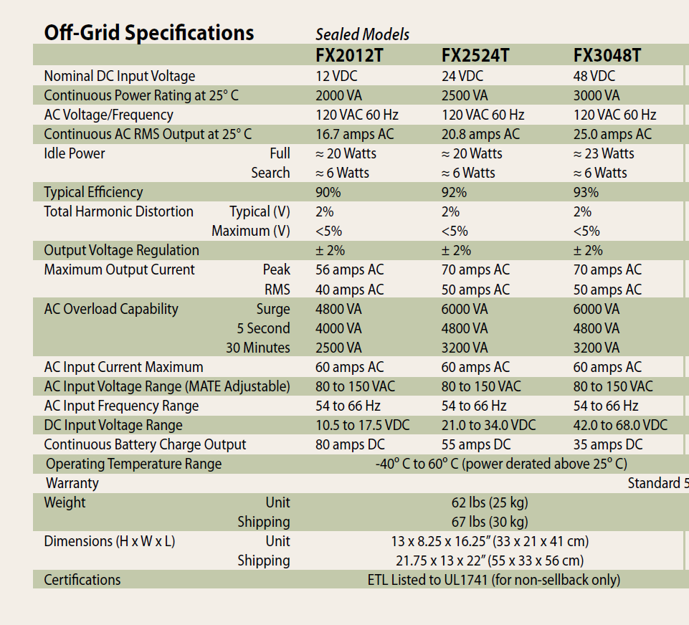
Minimum Breaker size for Inverter Wiring
Maximum continuous AC output wattage / efficiency
Maximum DC wattage divided by cut-out voltage

Slide 20
Breaker Size for Inverter
2500 AC watts/.92 = 2717 DC watts
2717 DC watts / 21 volts = 129 amps
Breaker should be larger than 129 amps and need a conductor with an ampacity greater than 129

Slide 21
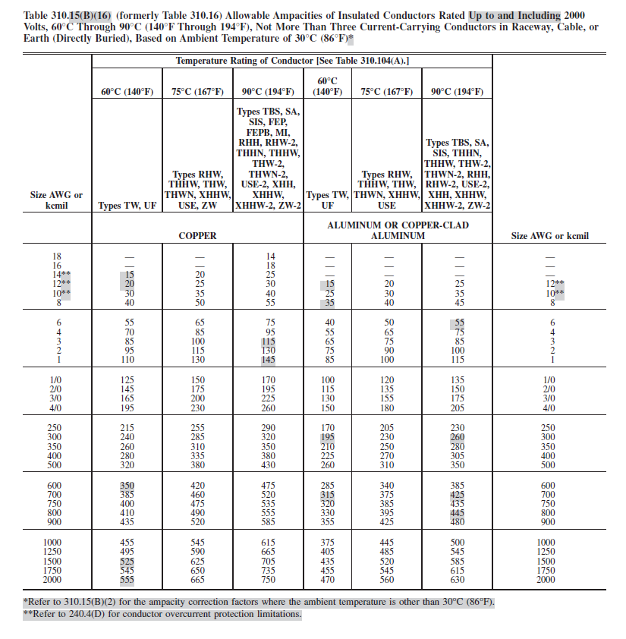

Slide 23
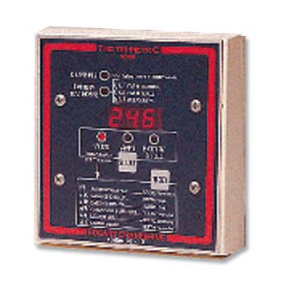
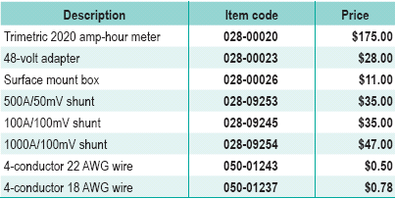
Tri Metric Meter

Slide 24
GFP or GFDI
(Ground Fault Detector Interrupter)

Slide 26
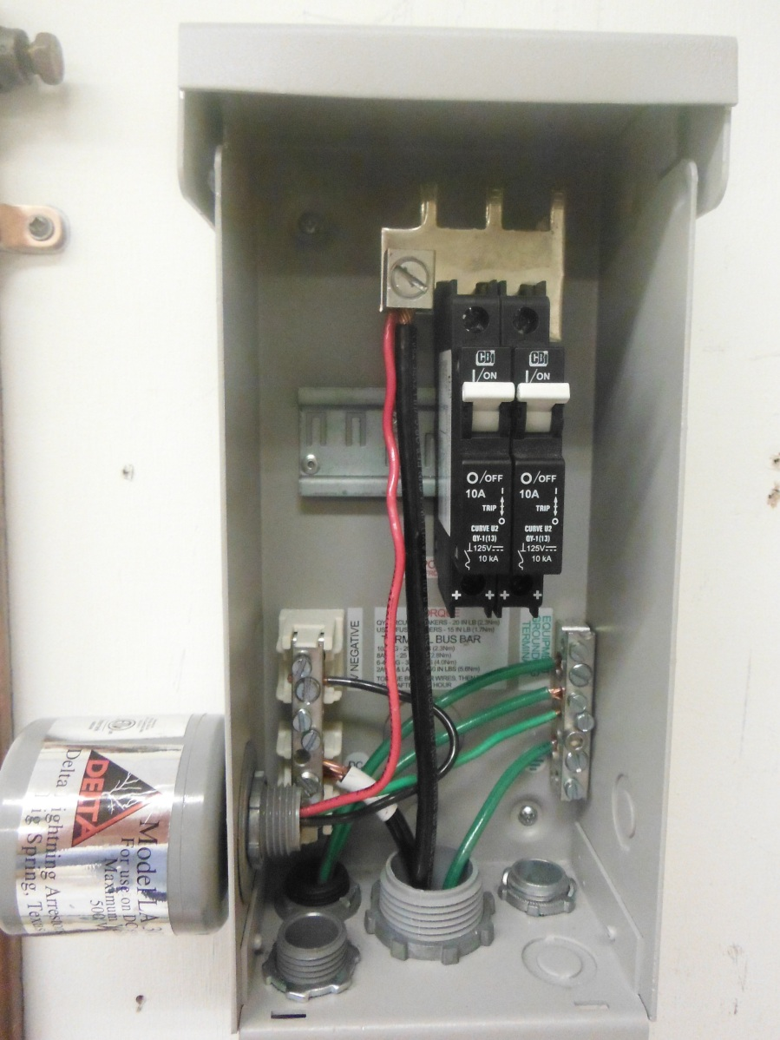

Slide 27
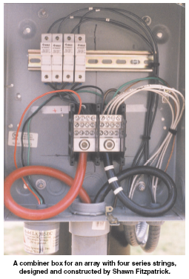

Slide 28
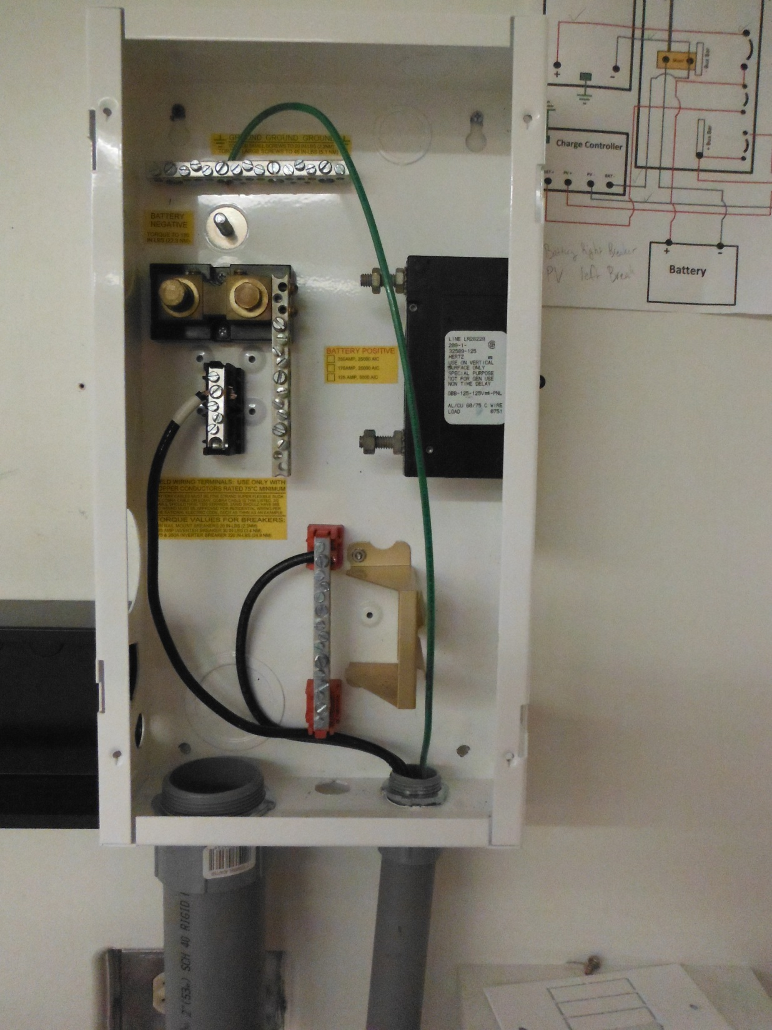

Slide 29
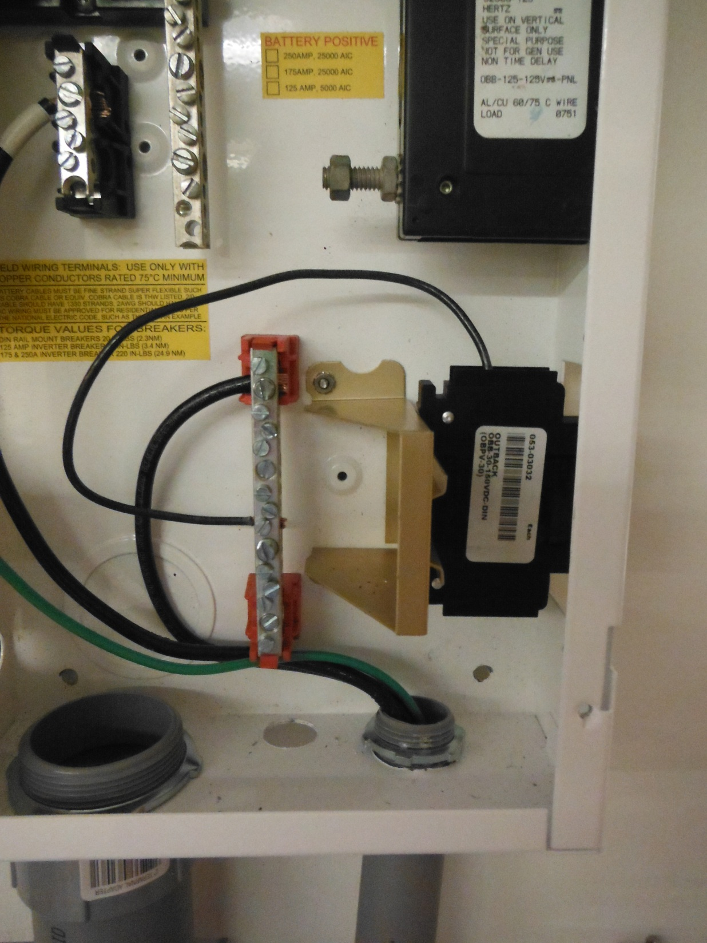

Slide 30
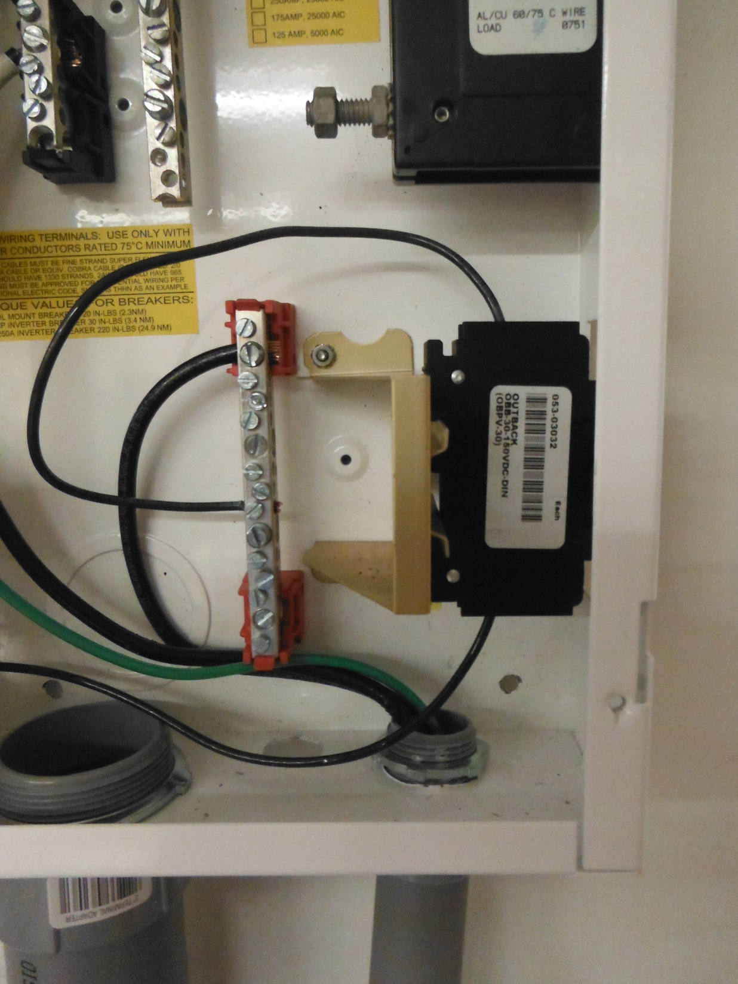

Slide 31
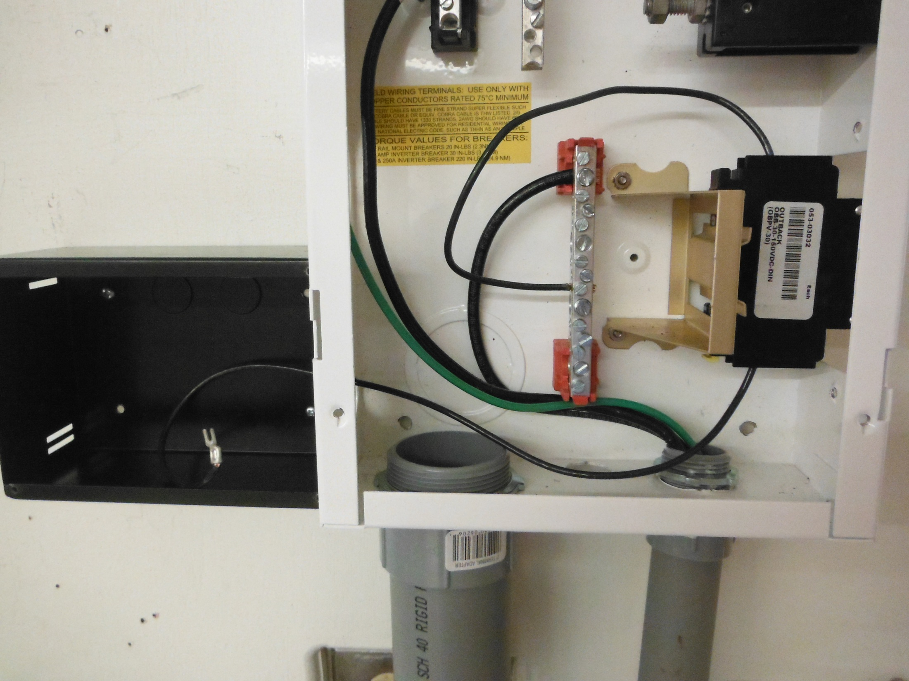

Slide 32
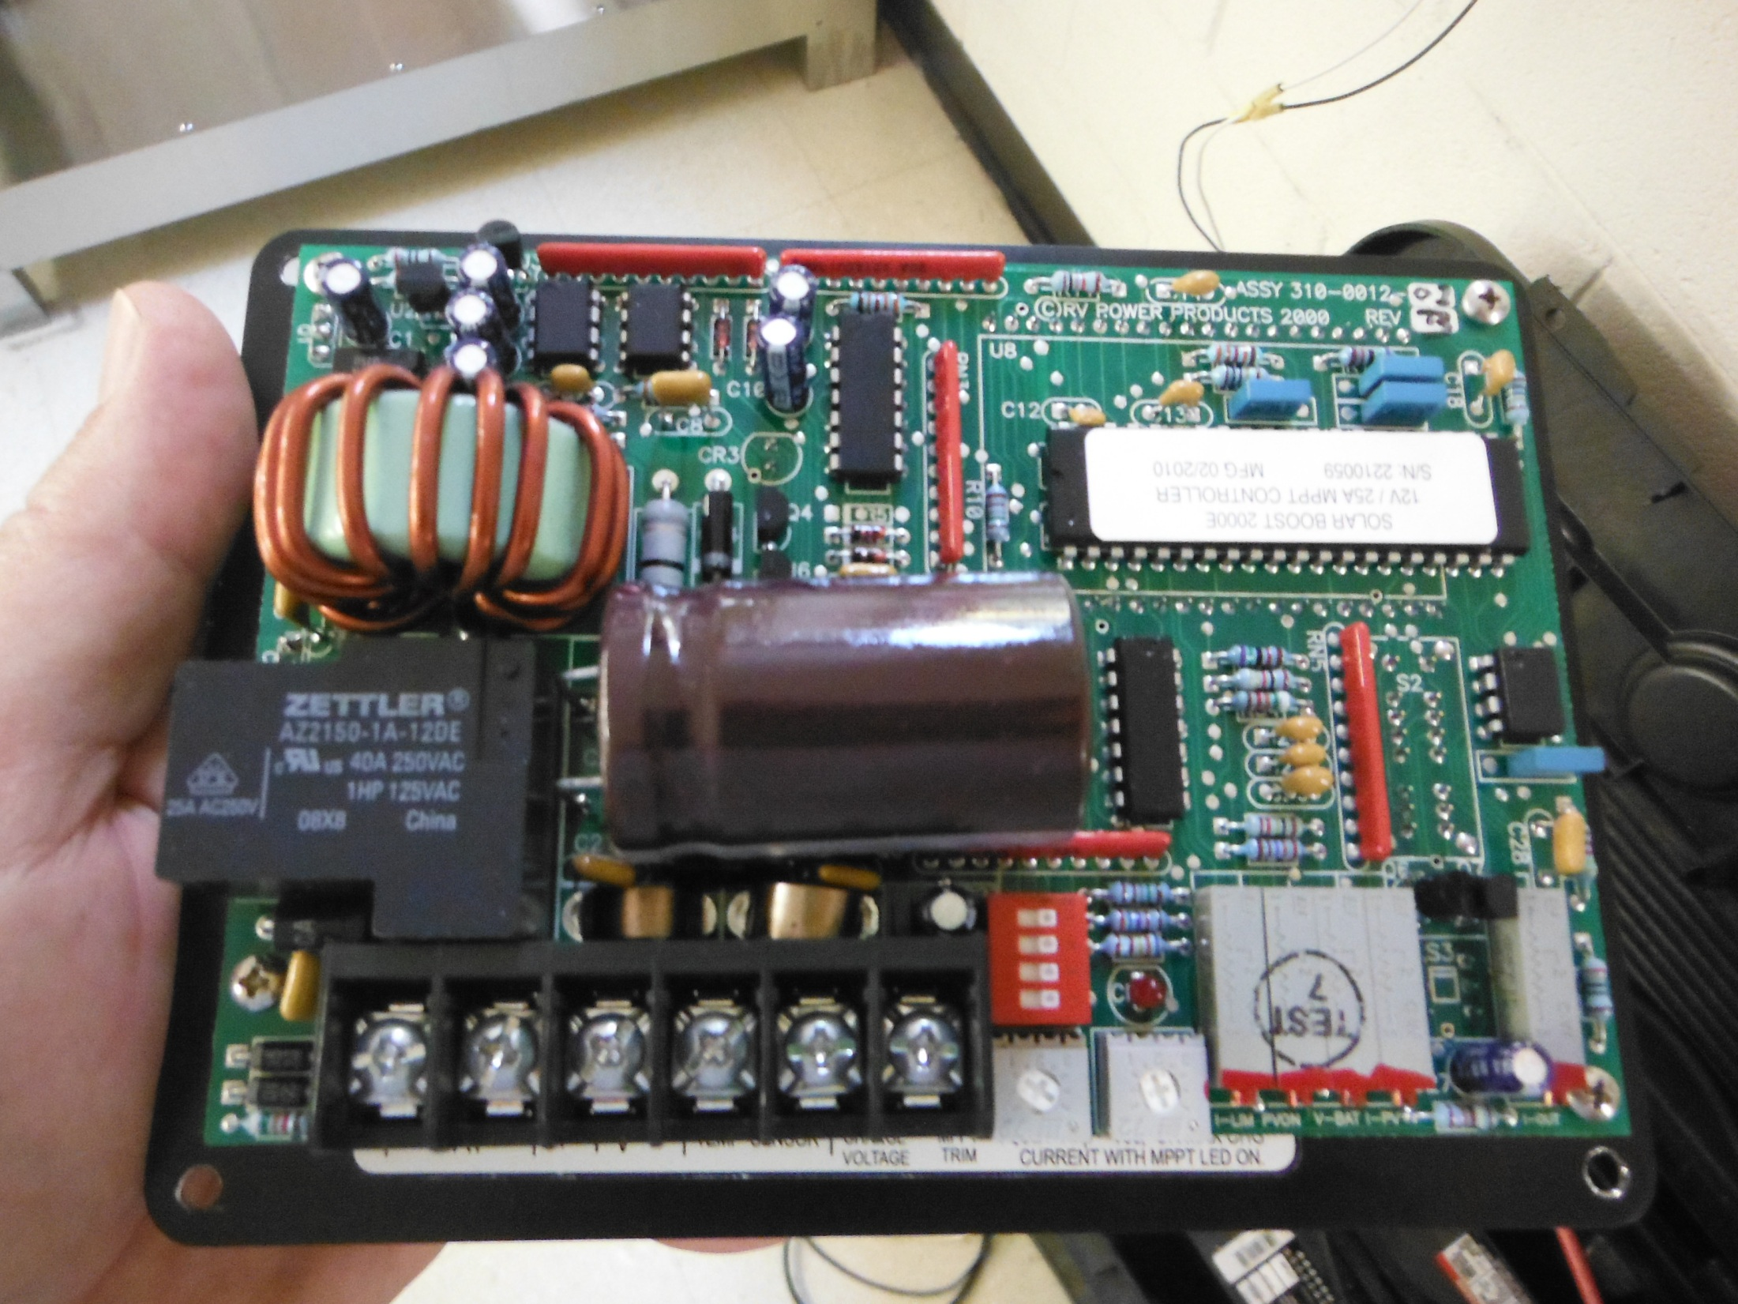

Slide 33
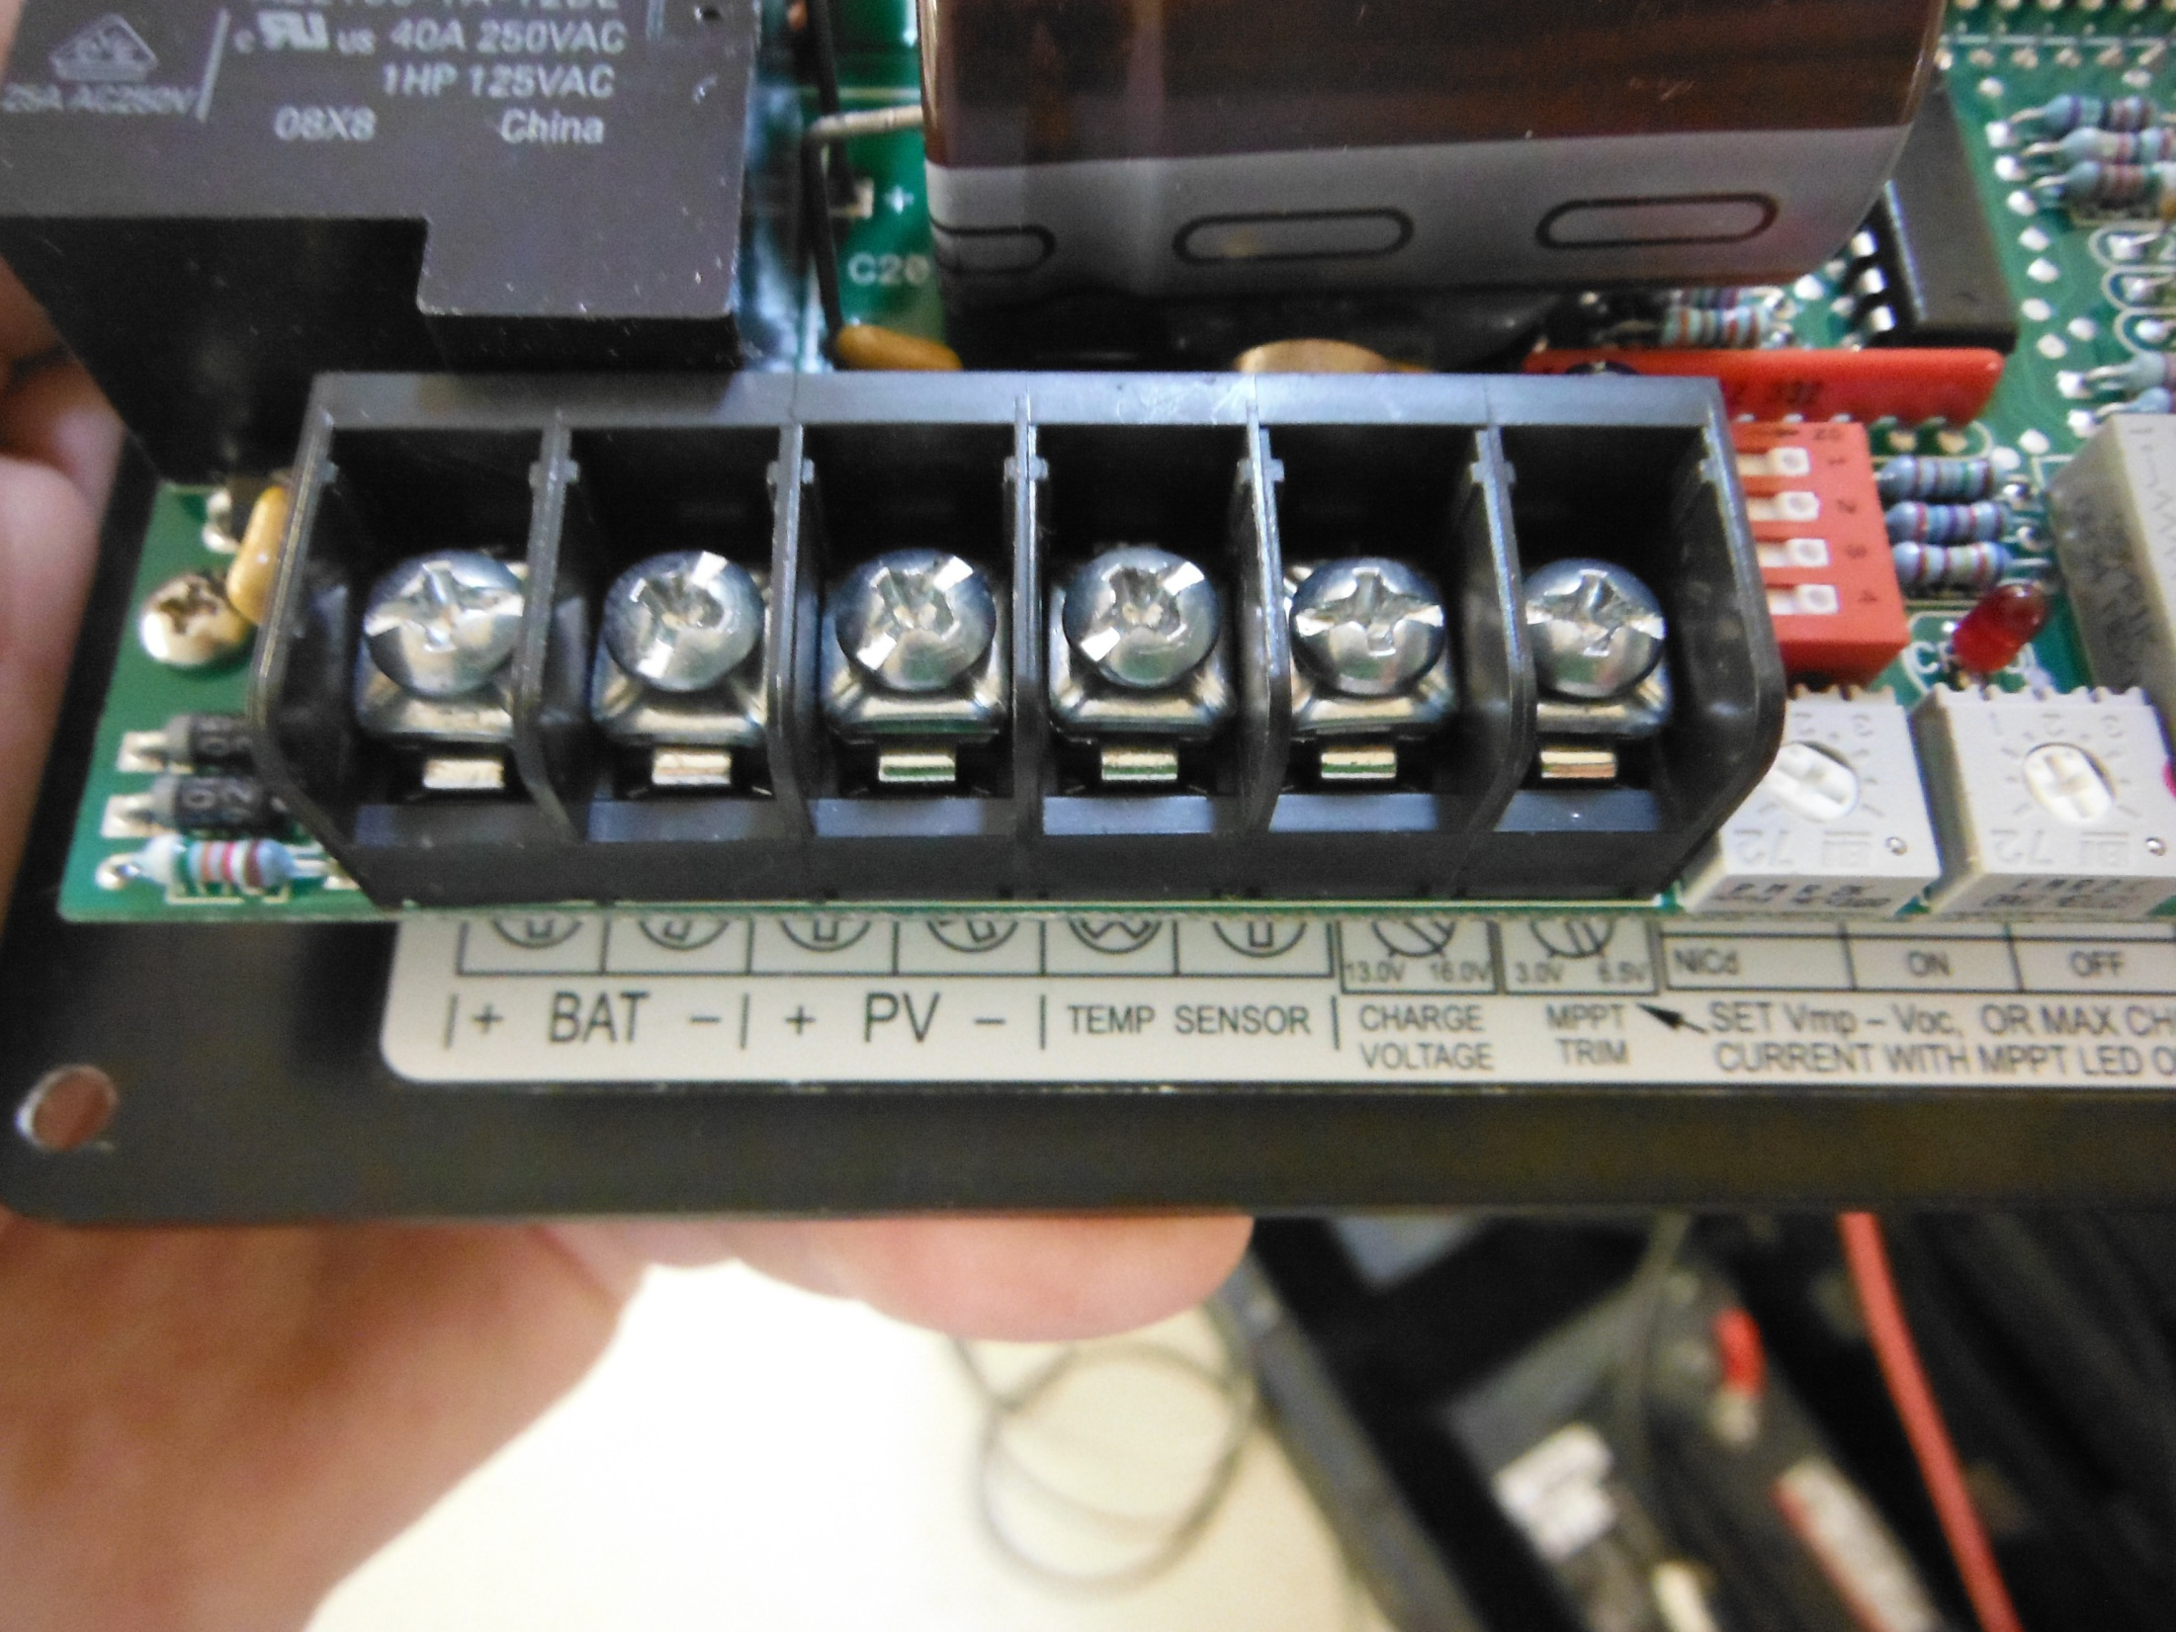

Slide 34
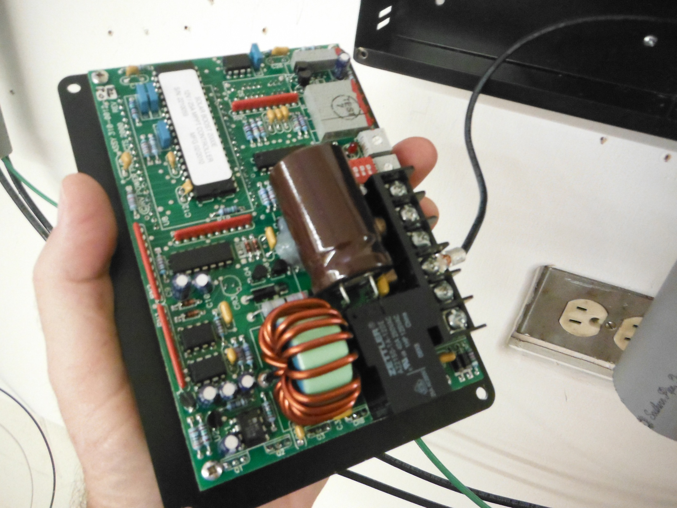

Slide 35
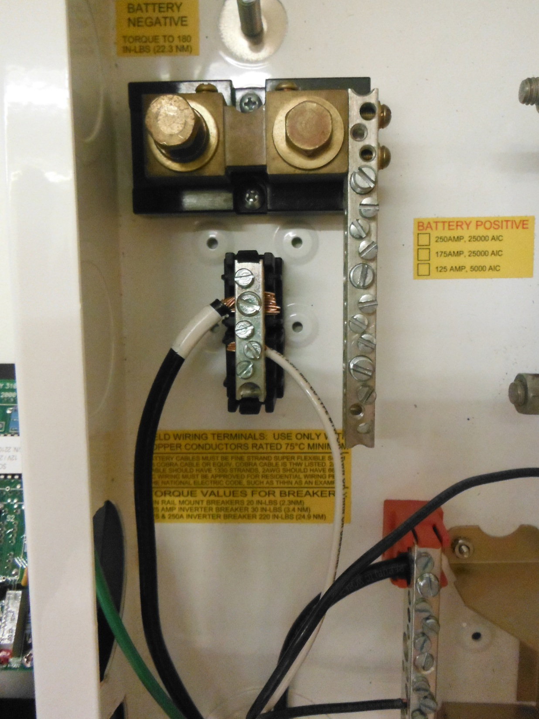

Slide 36
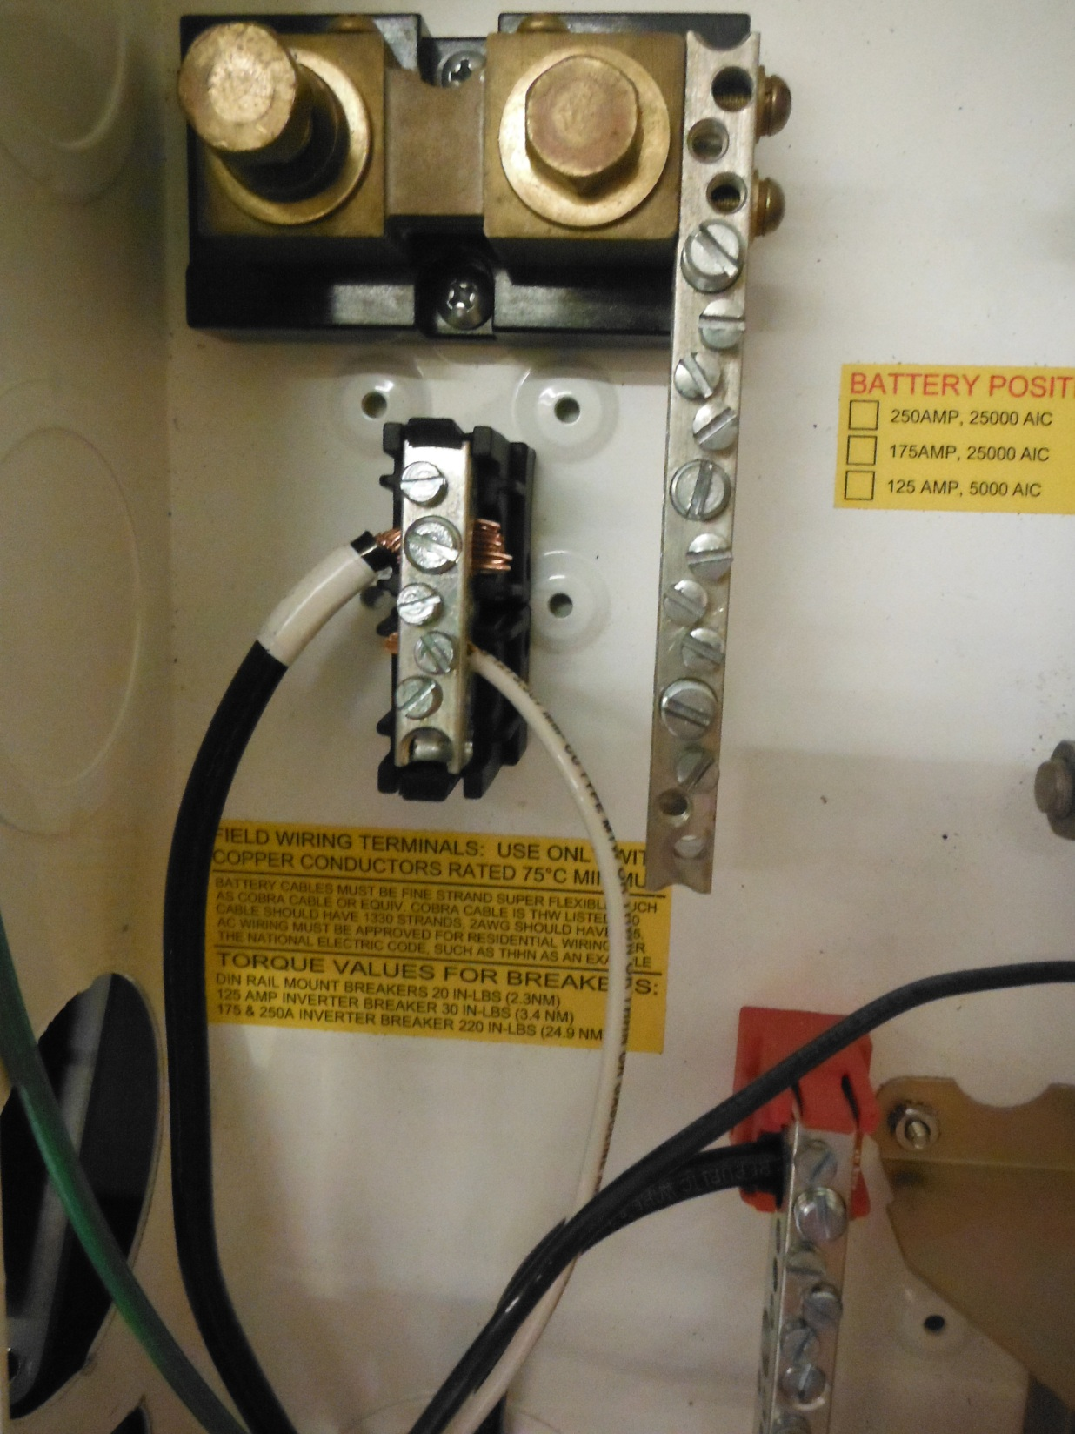

Slide 37
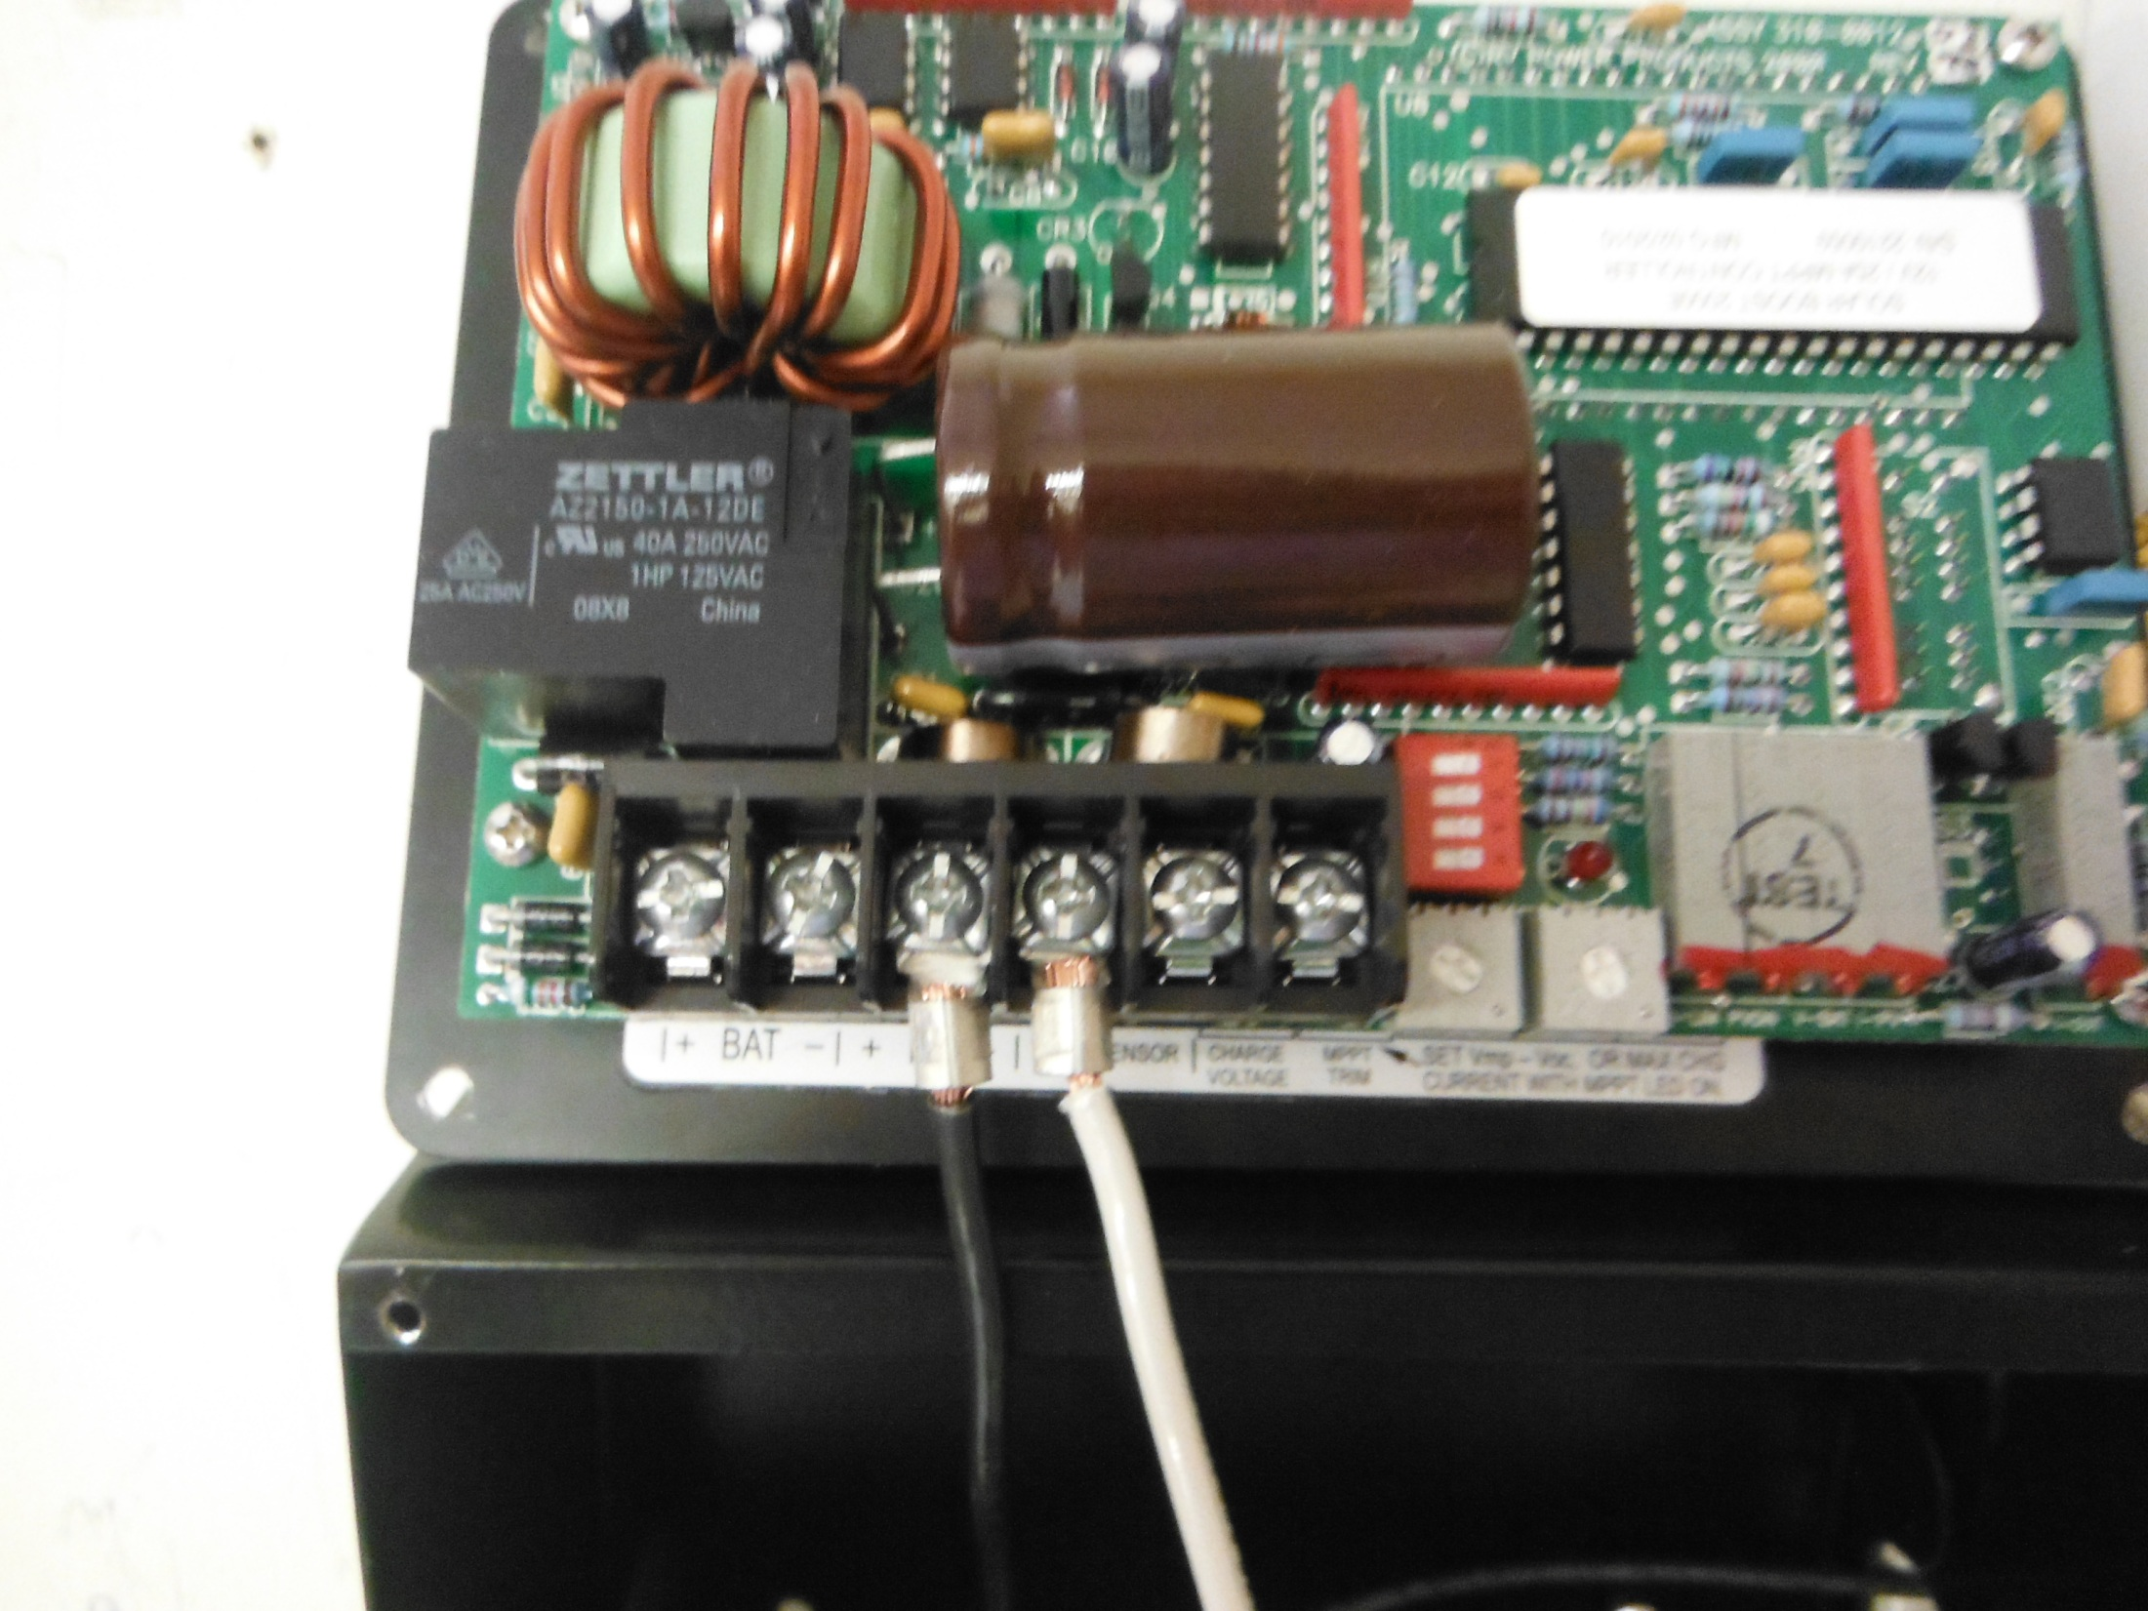

Slide 38
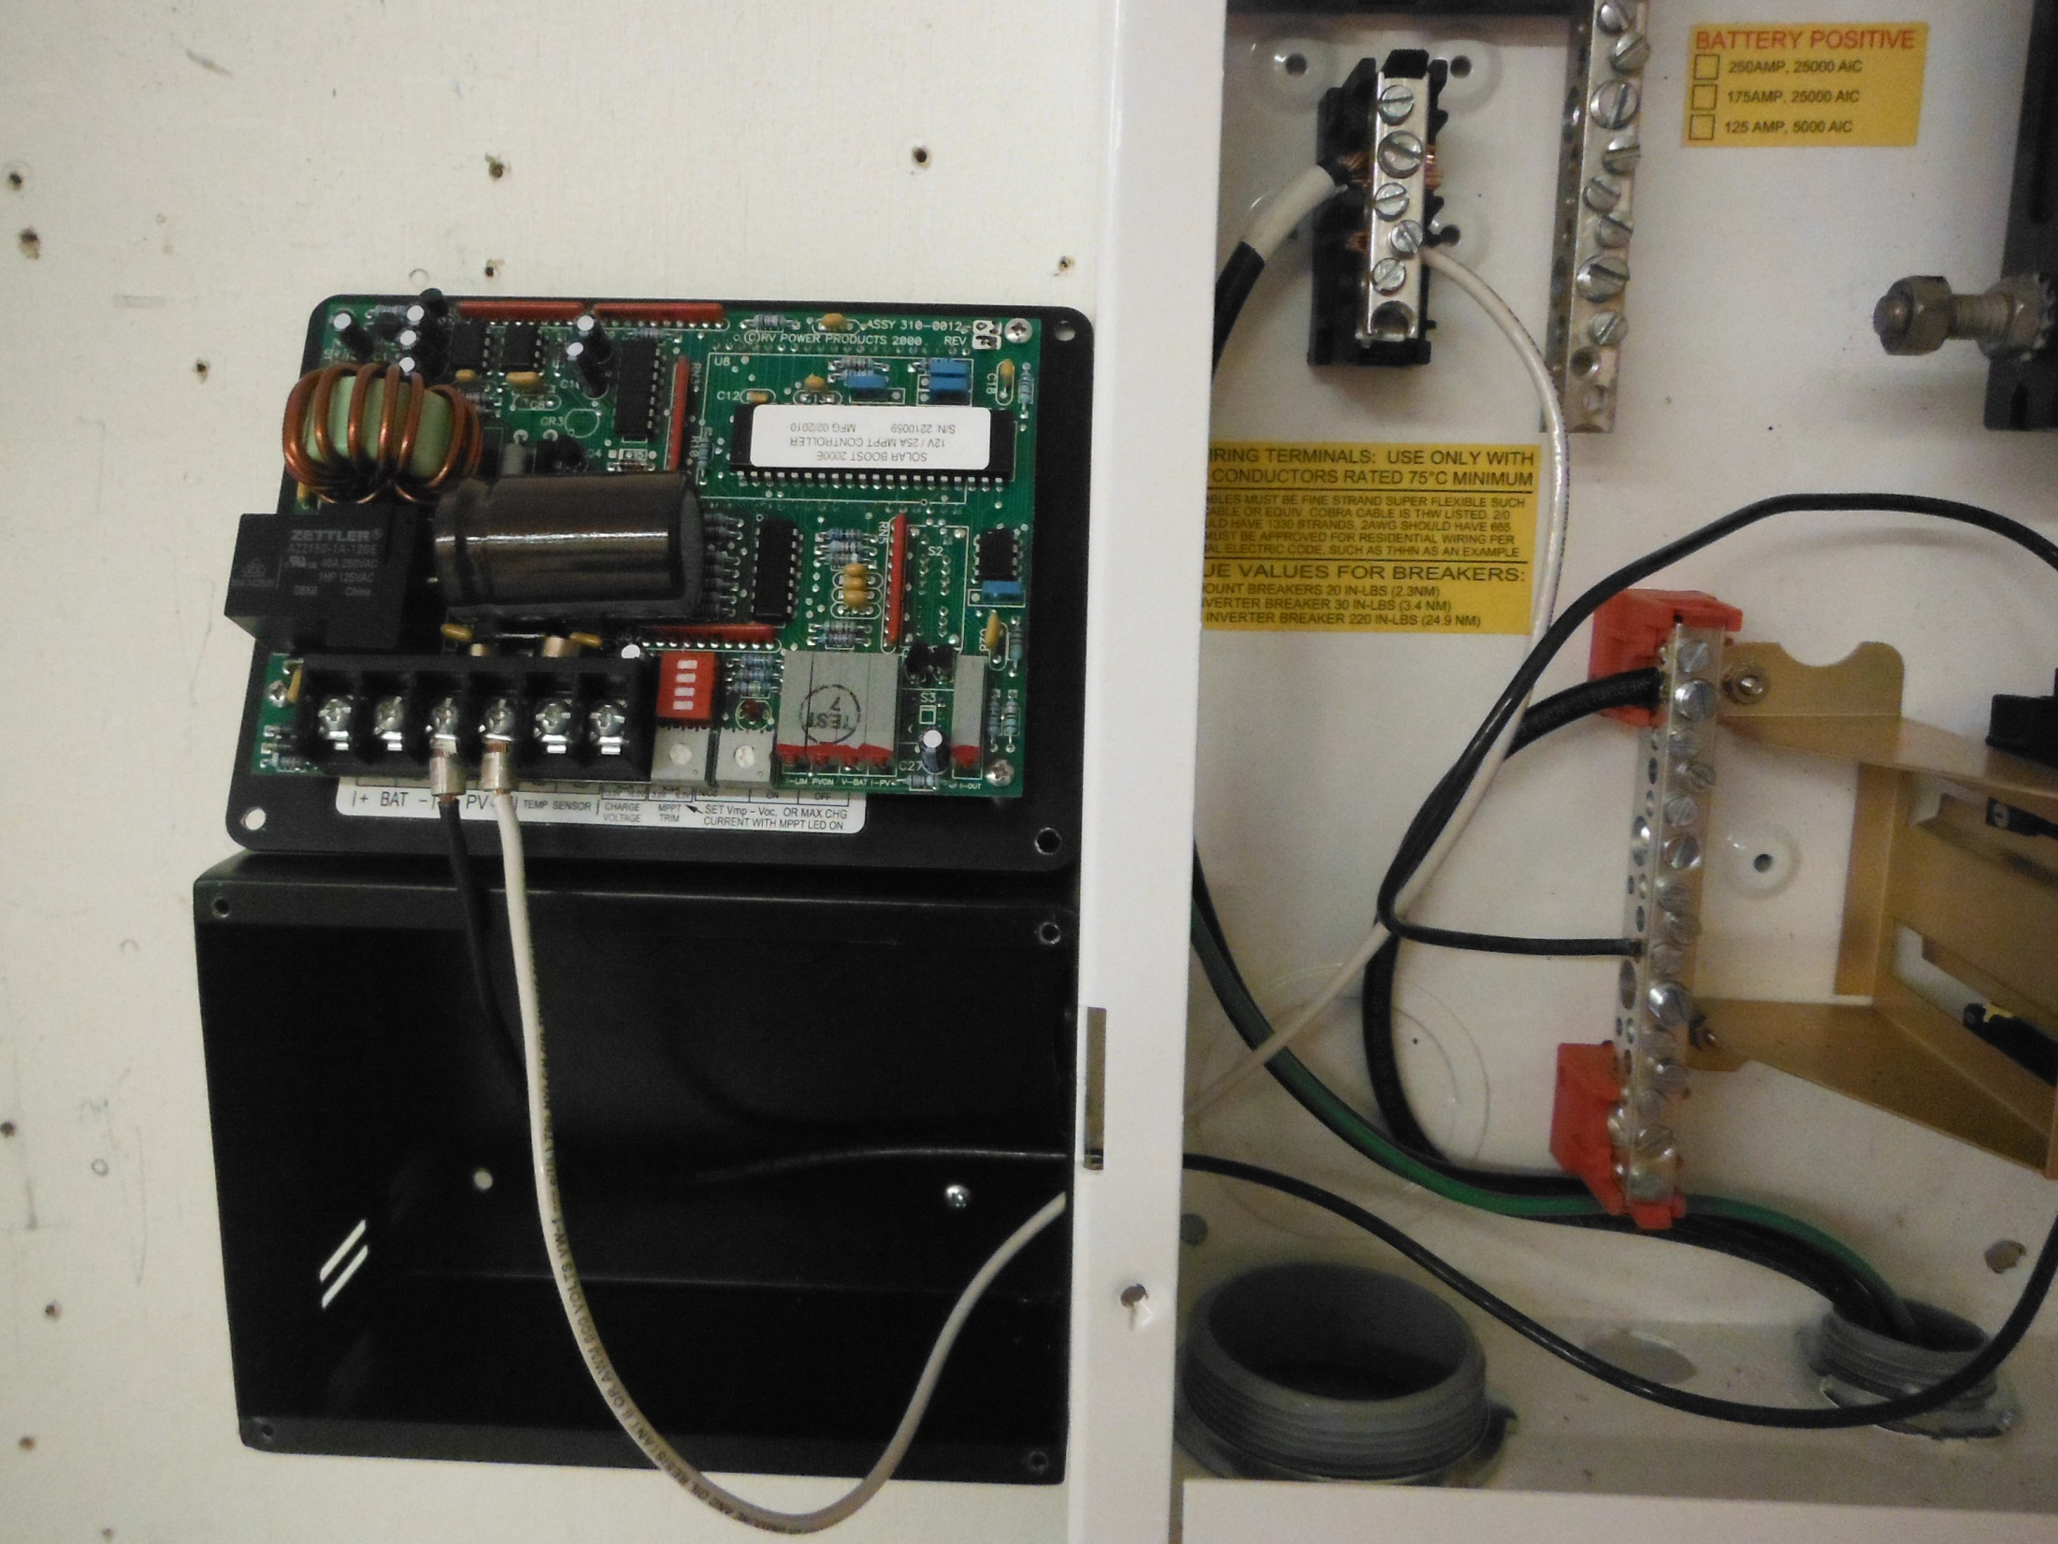

Slide 39
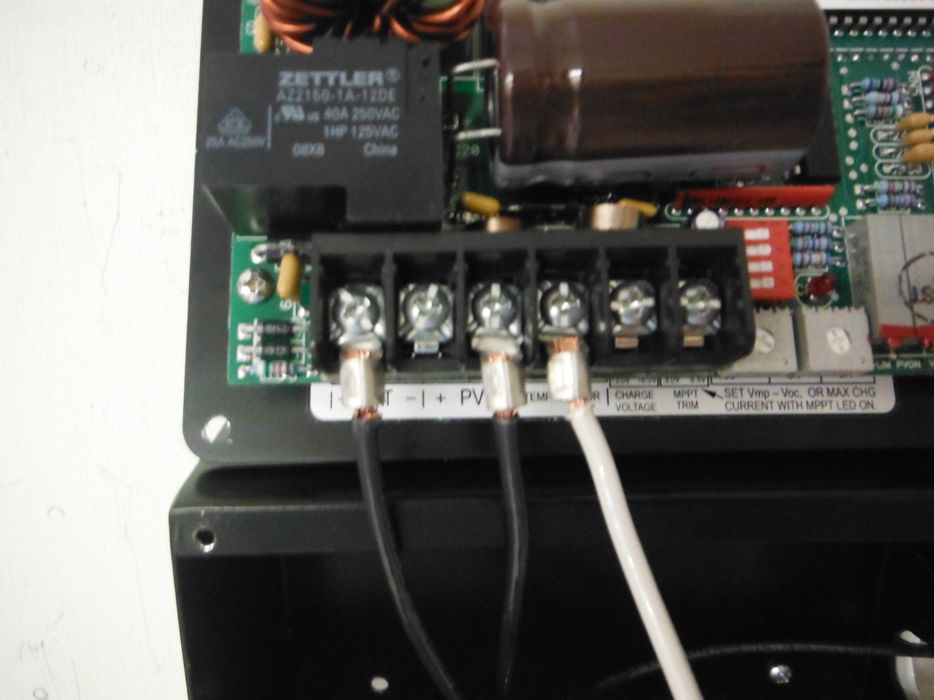

Slide 40
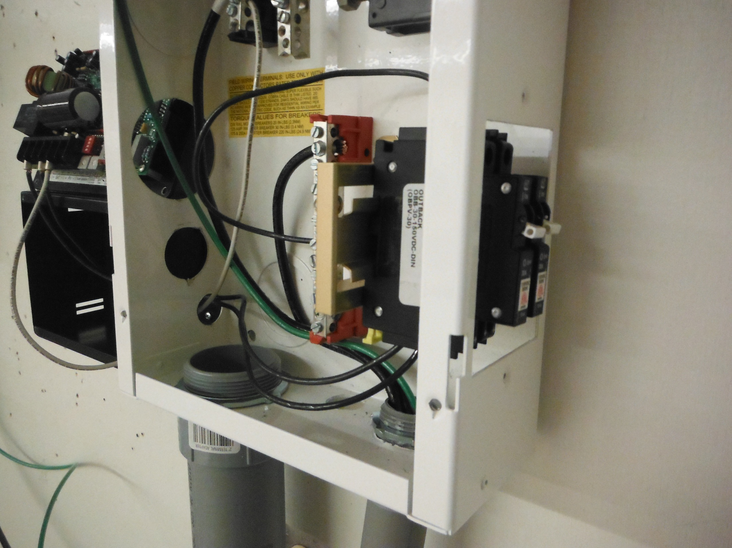

Slide 41
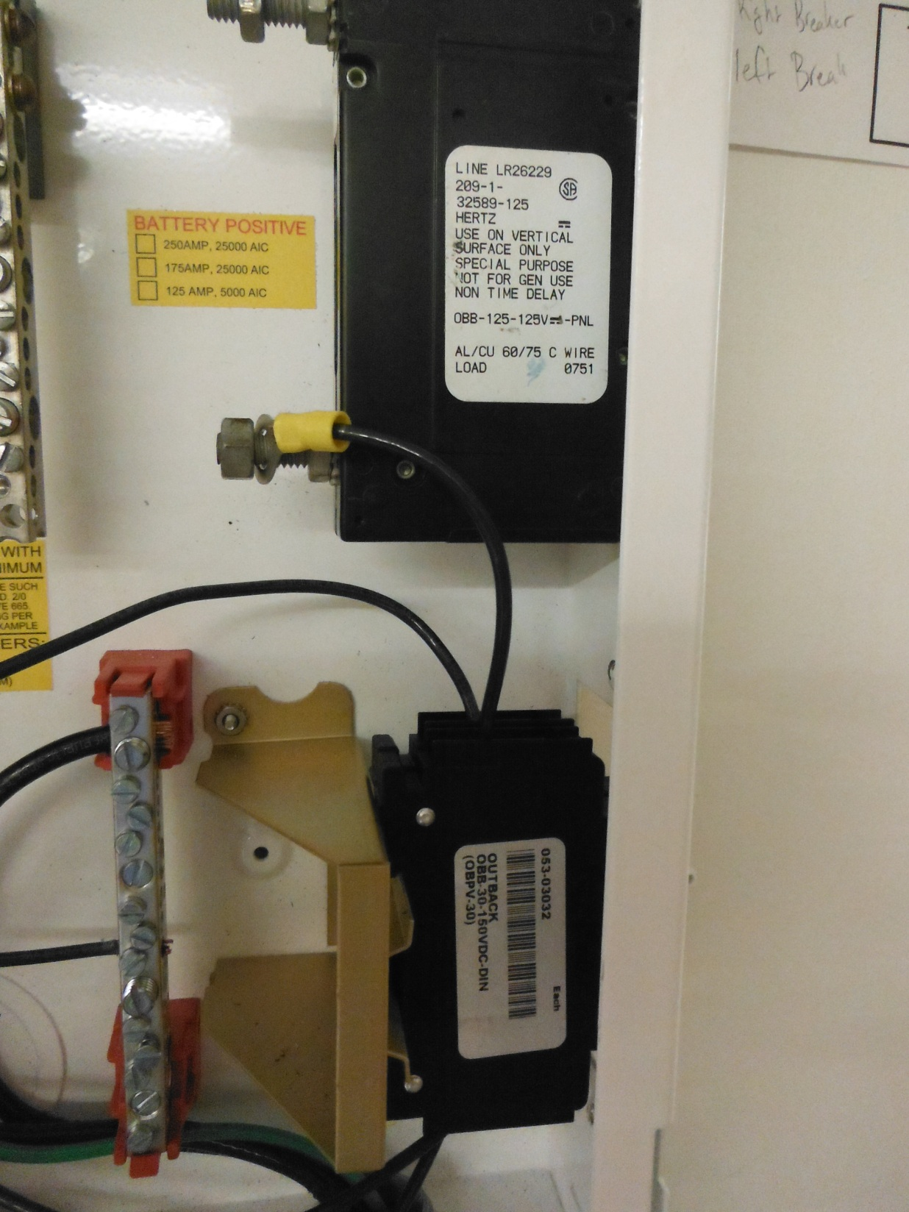

Slide 42
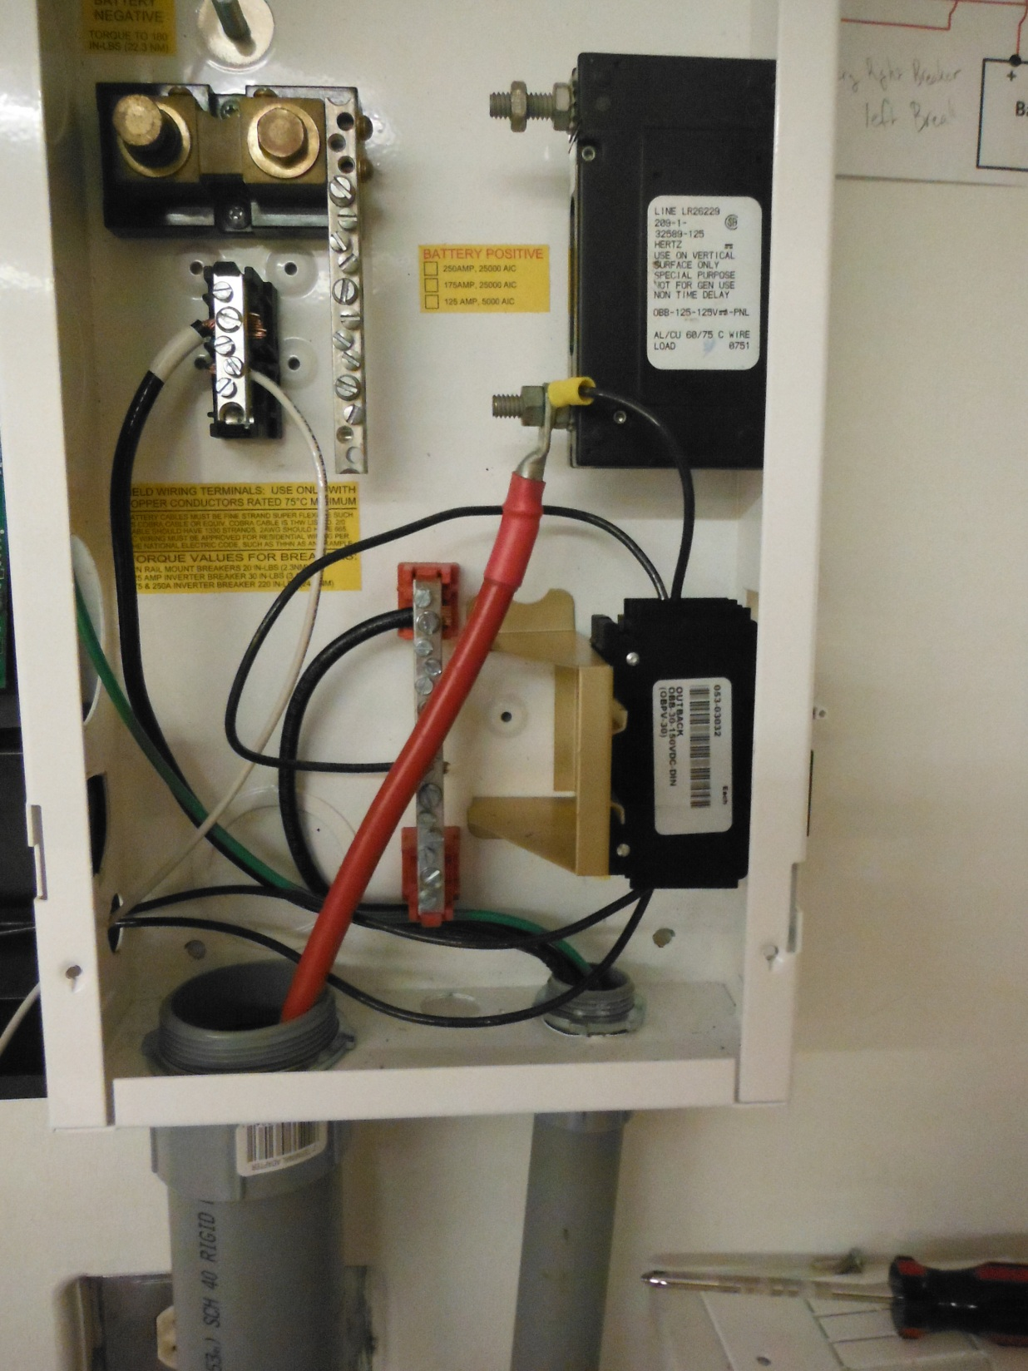

Slide 43
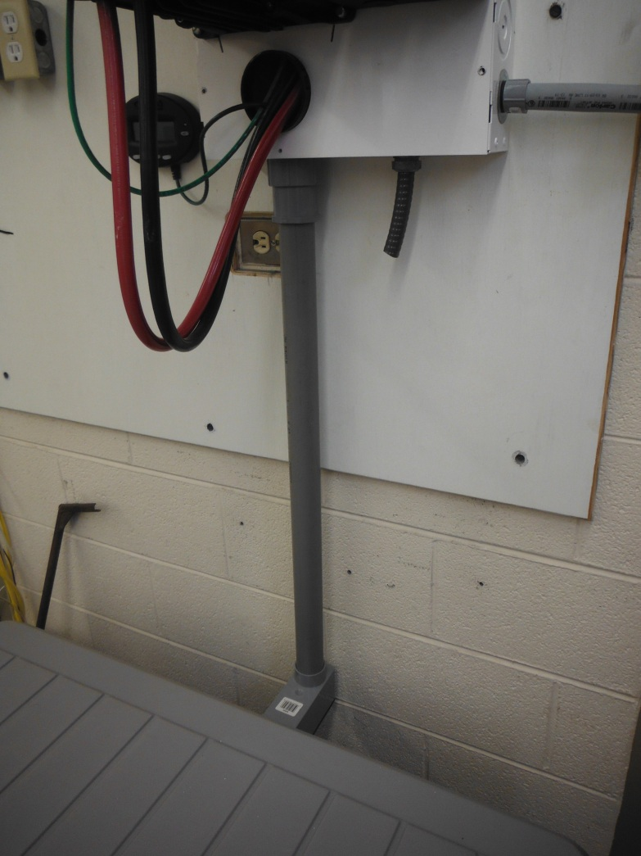
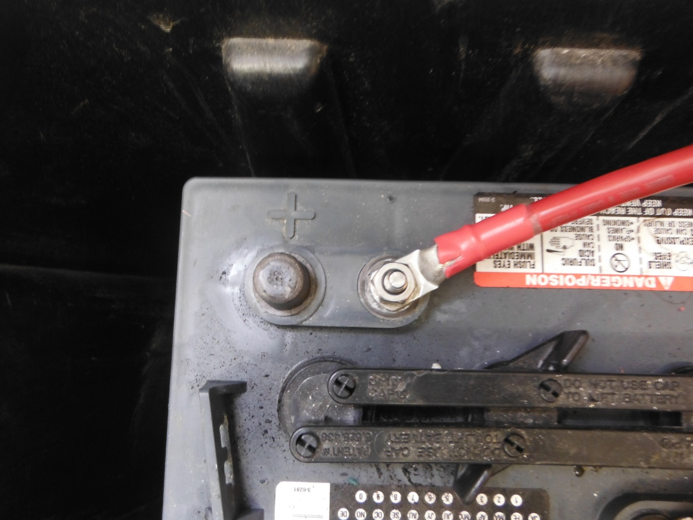


Slide 44


Slide 45


Slide 46


Slide 47


Slide 48


Slide 49


Slide 50


Slide 51


