Slide 1
Charge Controllers
Regulating Battery Charging

Slide 2
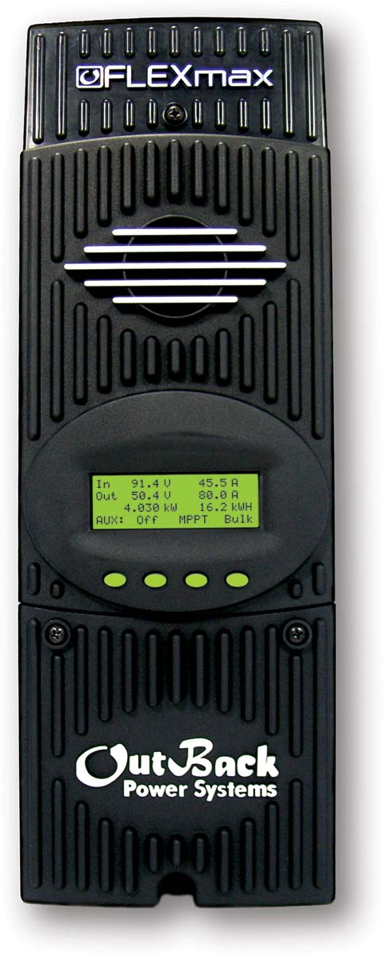
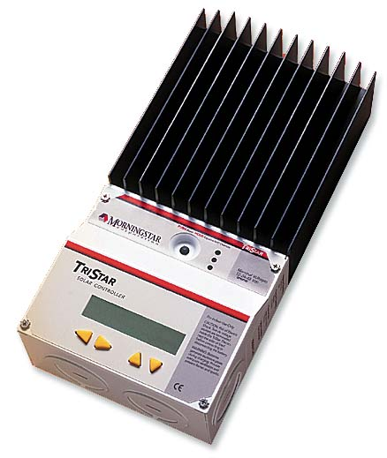
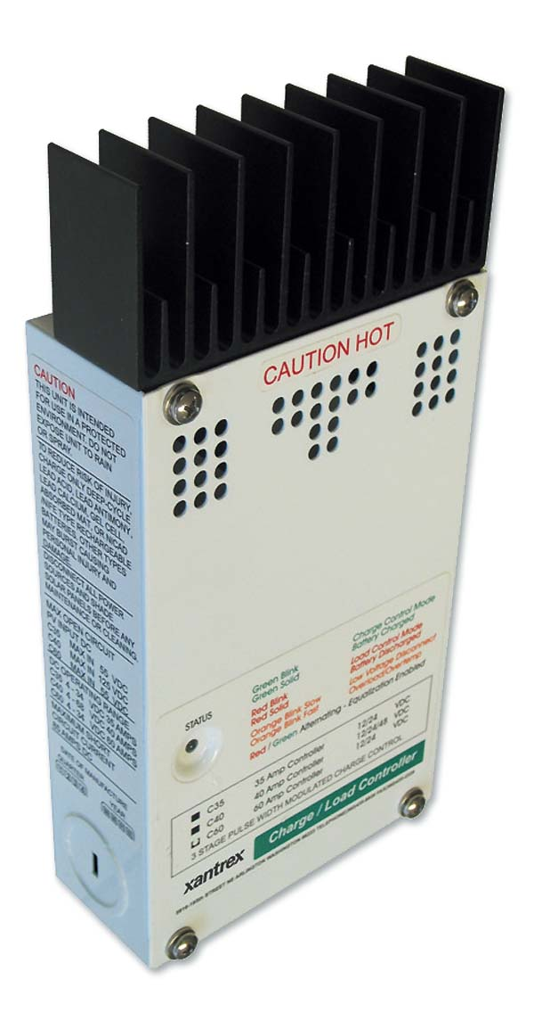
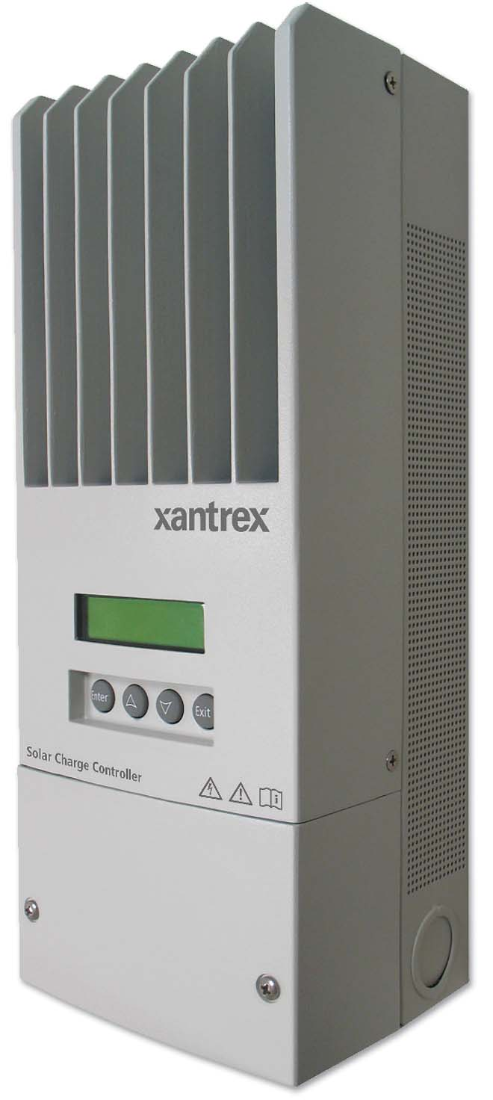
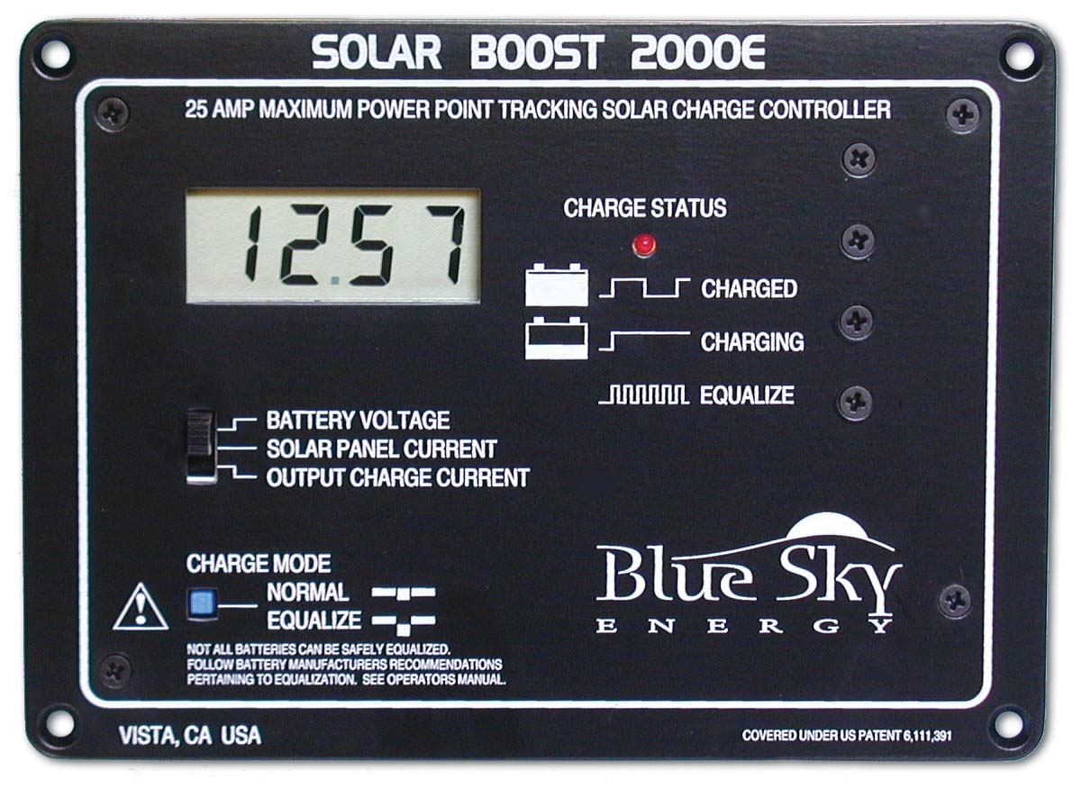
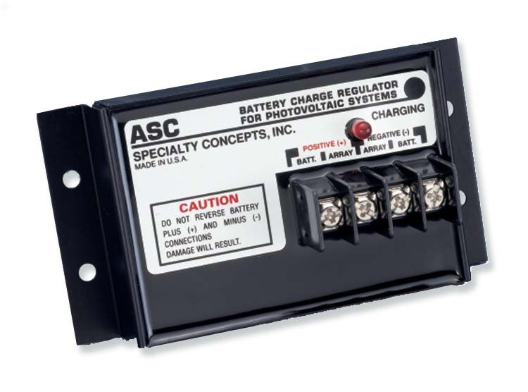

Slide 3
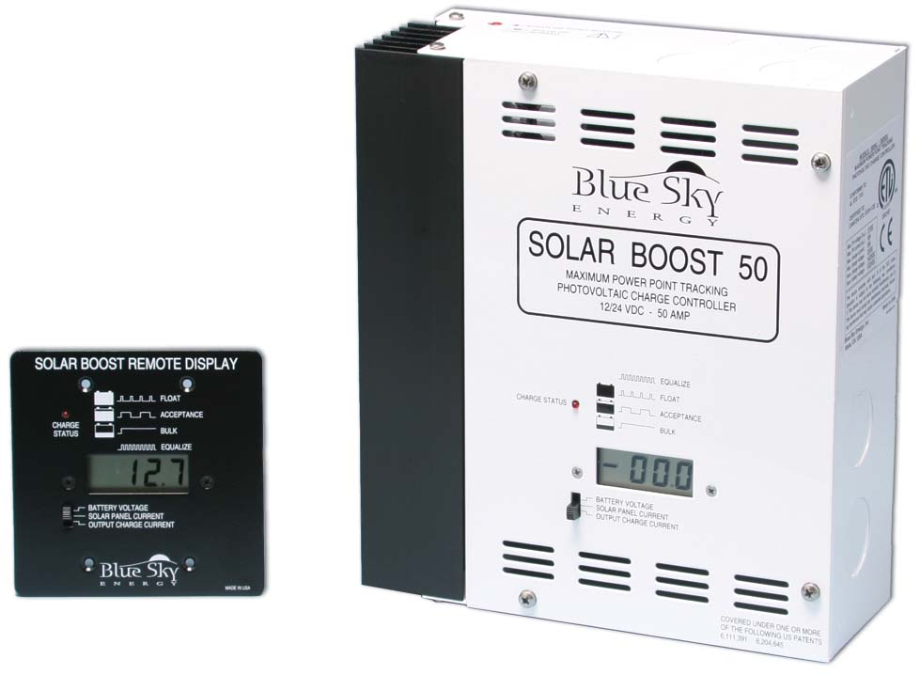
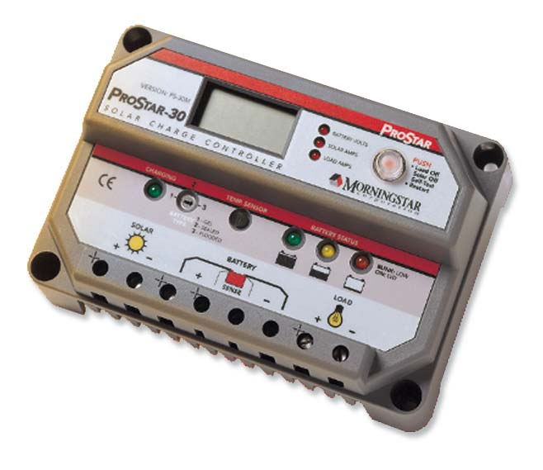
Purpose of a Charge Controller
Basic Functions
  To prevent overcharging a battery, which could damage it and shorten its life and possibly some loads powered by it
  Block reverse current flow
  Can also protect equipment from high voltages, display battery voltage & Charging amperage, protect battery from overdischarge

Slide 4
Features to Consider
Voltage Rating
Amperage rating (plan for future expansion)
Charge control algorithm
Source of Electricity (PV, Wind, Hydro)
Adjustability
Temperature Compensation
Automatic equalization
Meters
Low battery voltage disconnect or alarm
Wire terminals

Slide 5
Basic Types of Charge Controllers
Interupting –Type Switches charging current off and on.
  Least expensive and simplest type
  Best for flooded batteries
Linear-Type or Pulse Width Modulating (PWM)
  Limits charging in a gradual manner
  Compatible with more types of batteries
Maximum Power Point Tracking (MPPT)
  Newest & most efficient type

Slide 6
Methods of Installation: Series or Parallel
Open circuits the array to control charging
Most common approach
  Series Interrupting
  Pulse Width Modulating
  MPPT

Slide 7
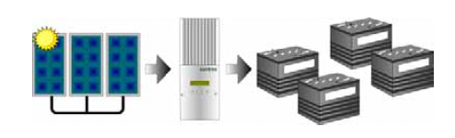
Typical Series Installation

Slide 8
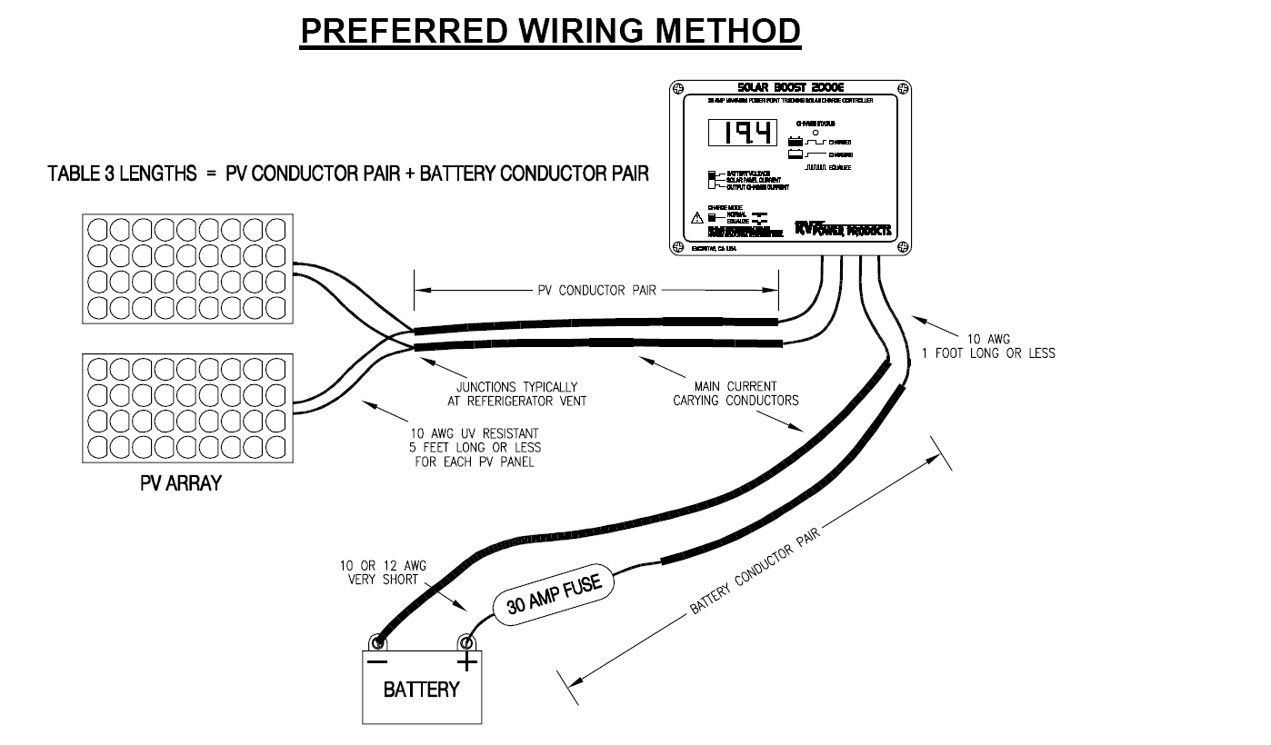
Basic Series Installation

Slide 9
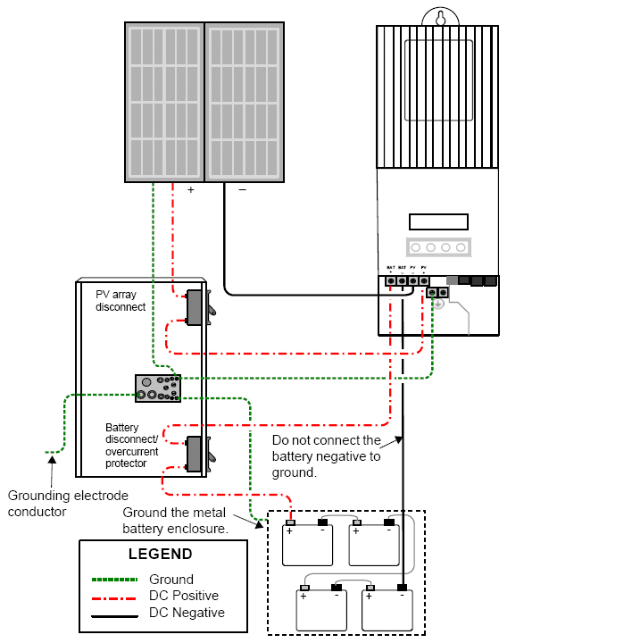
Typical Series Installation with DC Junction Box

Slide 10
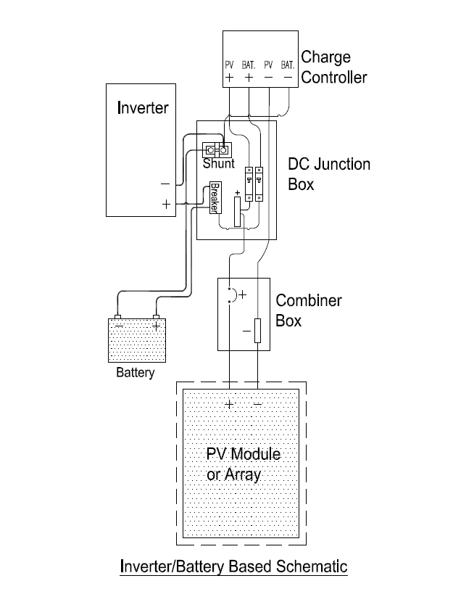

Slide 11
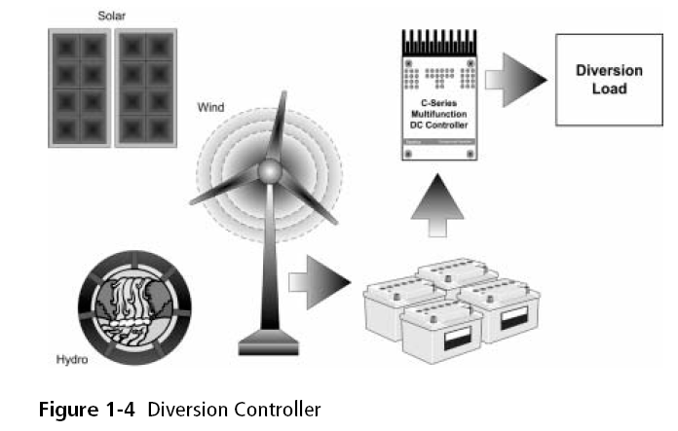
Parallel Installation with Diversion Load or Dump Load

Slide 12
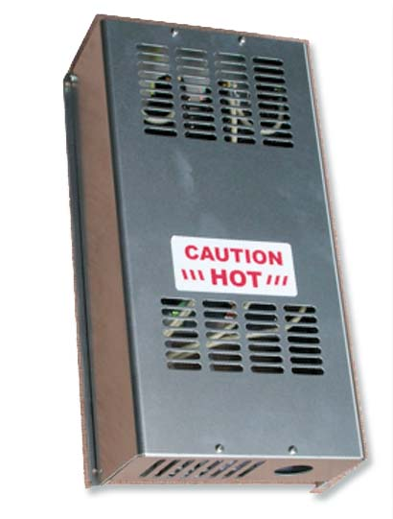
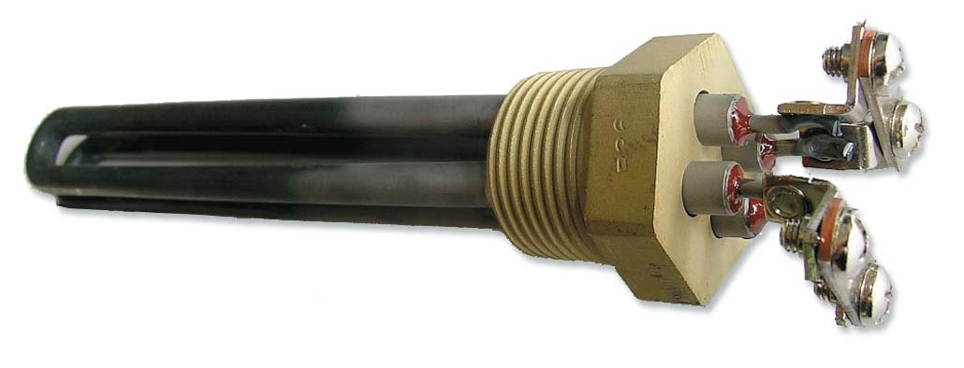
Diversion Loads

Slide 13
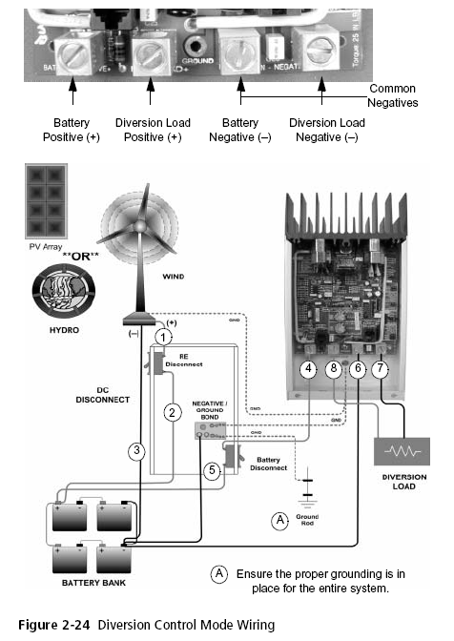

Slide 14
Relay Charge Controllers

Slide 15
Relay Charge Controller Features
General Specifications: Completely encapsulated and waterproof
Available in 4, 8, 12, and 16 amp versions
Available in 12 volt and 24 volt (6 volt, 36 volt, and 48 volt on special order)
Optional INTERNAL or EXTERNAL temperature compensation
Optional 10A Load Disconnect (12, 24 volt only)

Slide 16
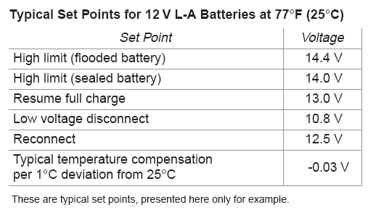
Typical Performance of Relay Controller

Slide 17
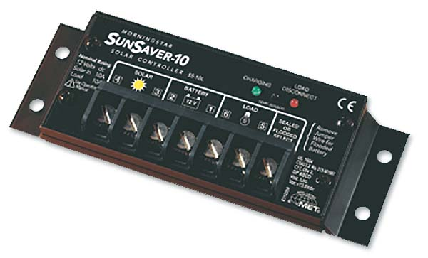
Pulse Width Modulating (PWM) controllers

Slide 18
Multiple Stage Charging
Stage One (Bulk Mode)
  A preset maximum constant amount of current (amps) is put into the battery. As this occurs, the voltage increases
Stage Two (Absorption Mode)
  After a preset voltage is reached (14.2 volts for a 12 volt systems) the voltage is then held constant. As the battery continues to charge at constant voltage, the current decreases.
Stage Three (Float Mode)
  When the current has decreased to a preset low limit, or a set amount of time has passed (absorption time), then the controller switches to Float Mode. Now the battery is kept at a preset Float voltage, and a small amount of power (amps) is supplied, as required to maintain the preset voltage.

Slide 19
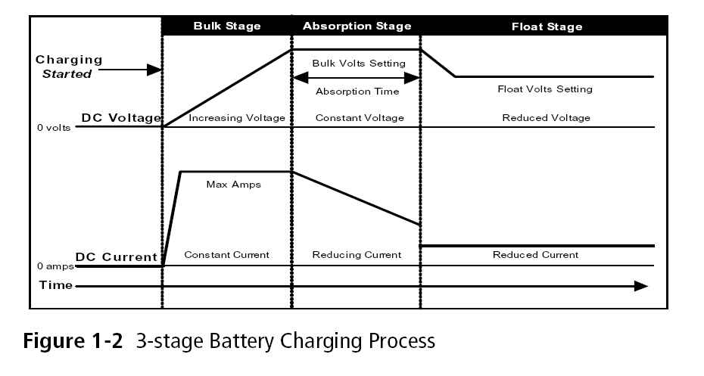
Xantrex PWM Controller

Slide 20
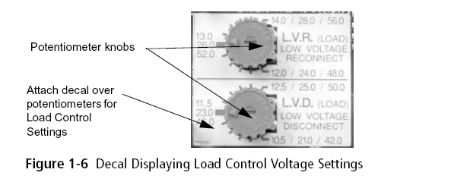
Adjustability

Slide 21
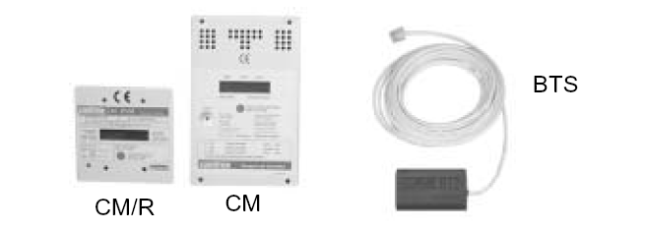
Temperature Sensors & Meters

Slide 22
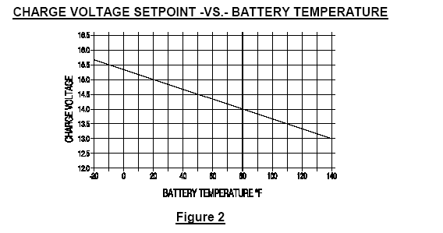
Temperature Compensation

Slide 23
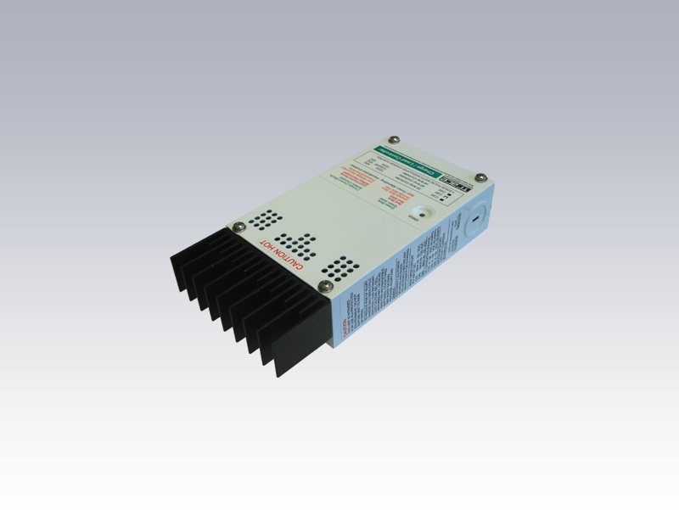
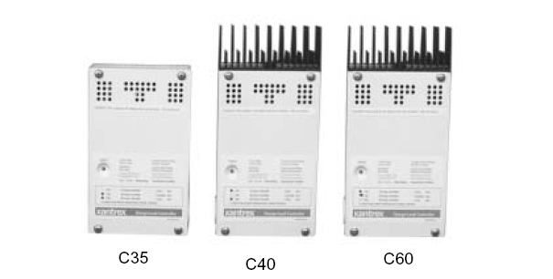
Xantrex (Schneider) C 35, 40, & 60

Slide 24
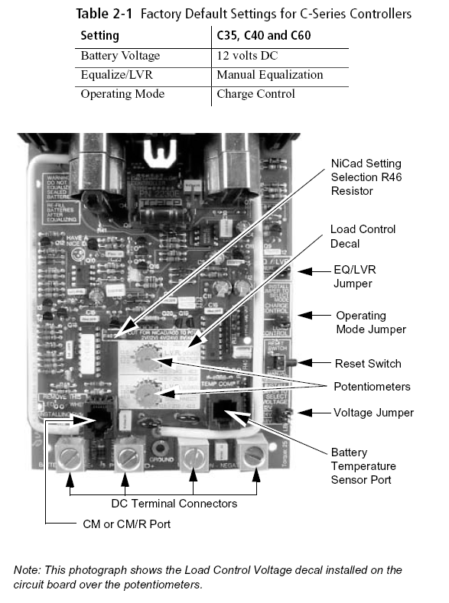

Slide 25
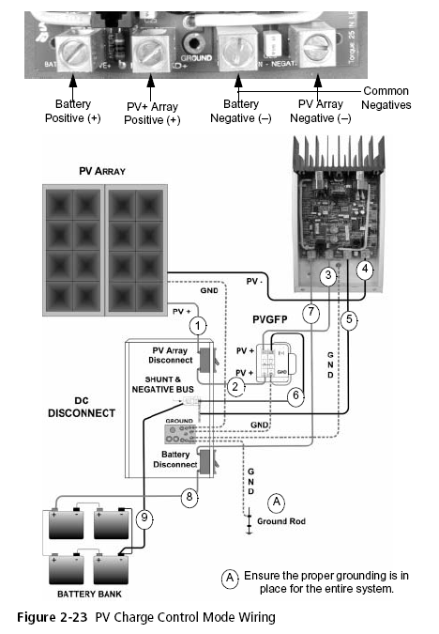

Slide 26
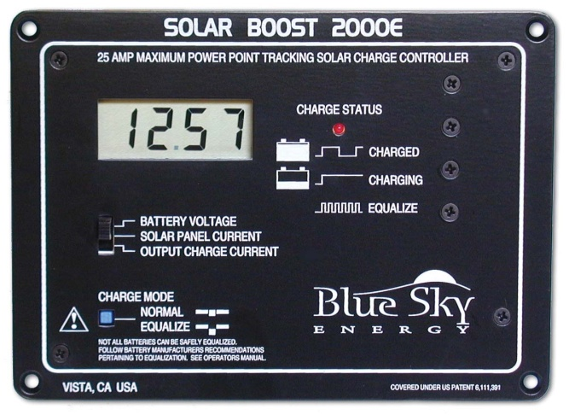
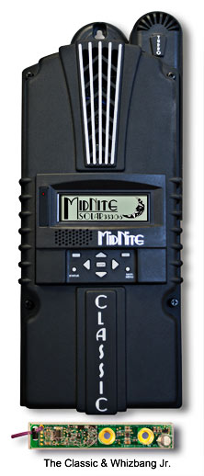
Maximum Power Point Tracking Controllers (MPPT)

Slide 27
MPPT Controllers
Can significantly increase 30% more power
Looks at the output of the panels, and compares it to the battery voltage
Figures out what is the best power that the panel can put out to charge the battery. It takes this and converts it to best voltage to get maximum AMPS into the battery.
Most modern MPPT's are around 92-97% efficient in the conversion.
You typically get a 20 to 45% power gain in winter and 10-15% in summer.

Slide 28
MPPT Controller cont’d
Amps is the most important thing in charging
MPPT sees battery is low, converts extra voltage to amps
16.9 volts and 7.1 amps (120 watts) → 12.5 volts 9.6 amps (still 120 watts)

Slide 29
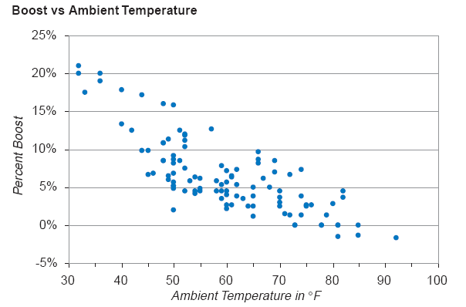
MPPT Controller & Temperature

Slide 30
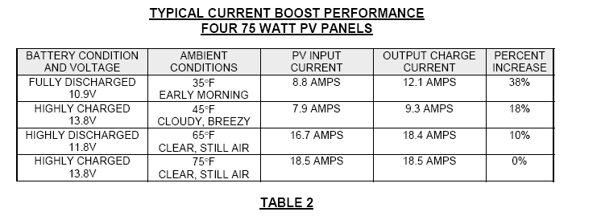
MPPT Amperage Boost

Slide 31
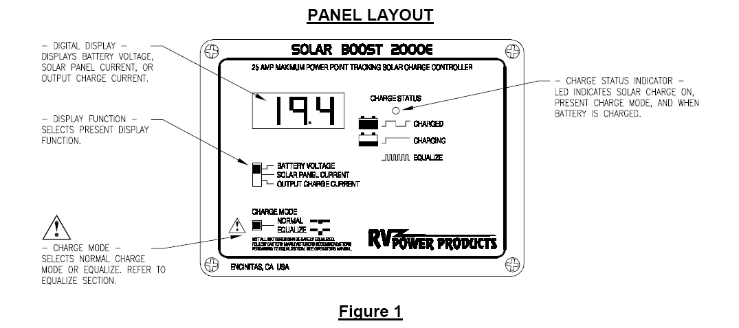
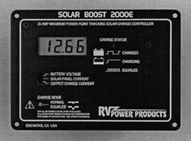
Blue Sky MPPT Controllers

Slide 32
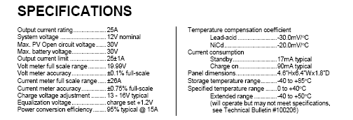
Blue Sky MPPT Controller

Slide 33
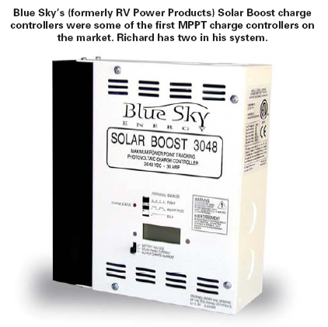

Slide 34
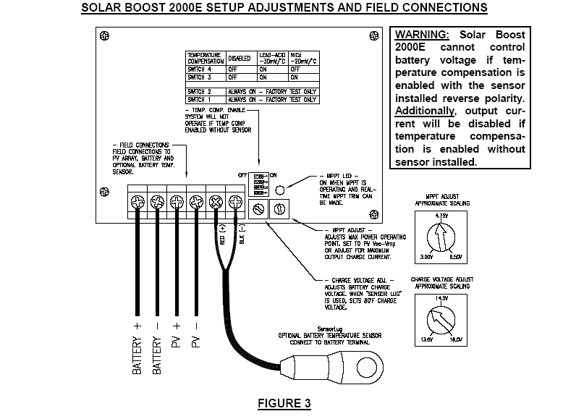

Slide 35
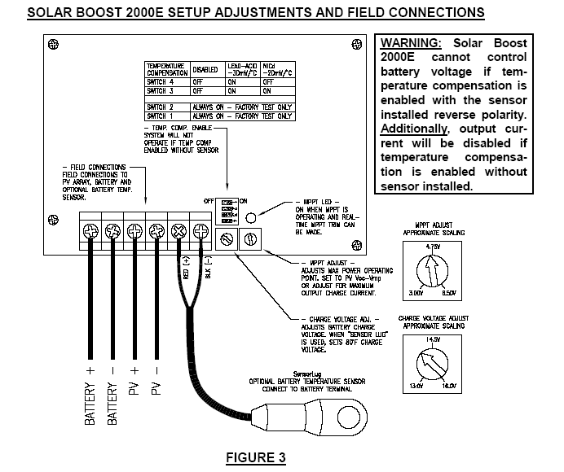

Slide 37
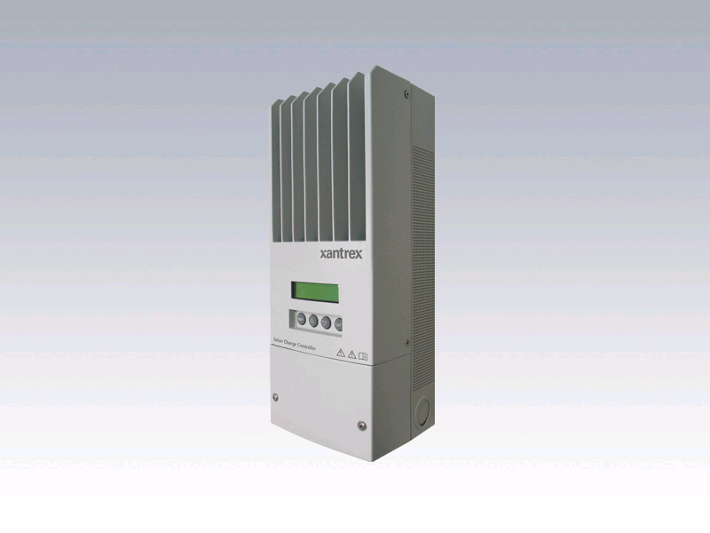
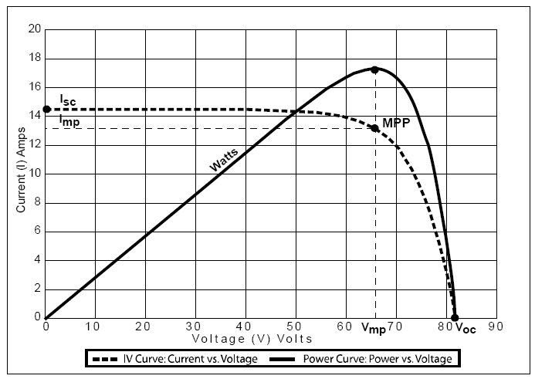
Schneider MPPT XW (150 VDC)

Slide 38
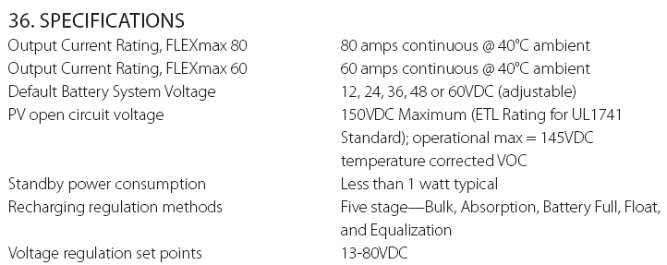
Outback MPPT Controller

Slide 39
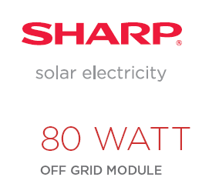

Slide 40
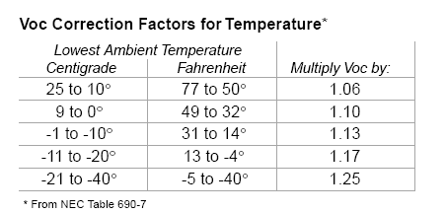
Easy way to calculate maximum voltage and maximum string size
  Example: How many Sharp 80 watt modules, each having a Voc of 21.6 V can be placed in a series string without exceeding the 150 volt limit of an Outback MPPT charge controller when the record low temperature is -30 C?
Voc = 21.6 volts x 1.25 = 27 Voc @ -30C
150 volt MPPT Charge Controller/27= 5.5 modules = 5 modules

Slide 41
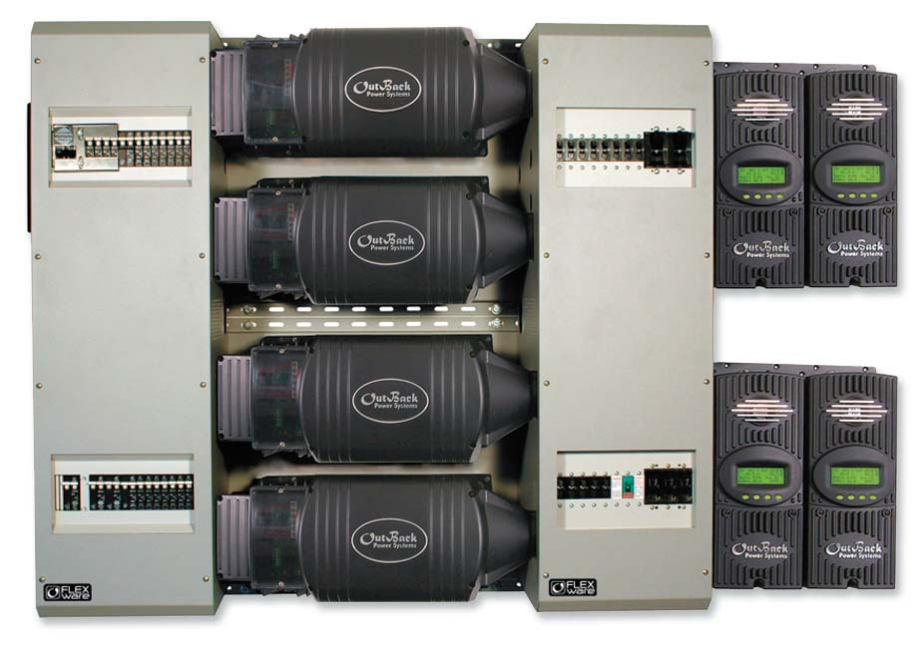
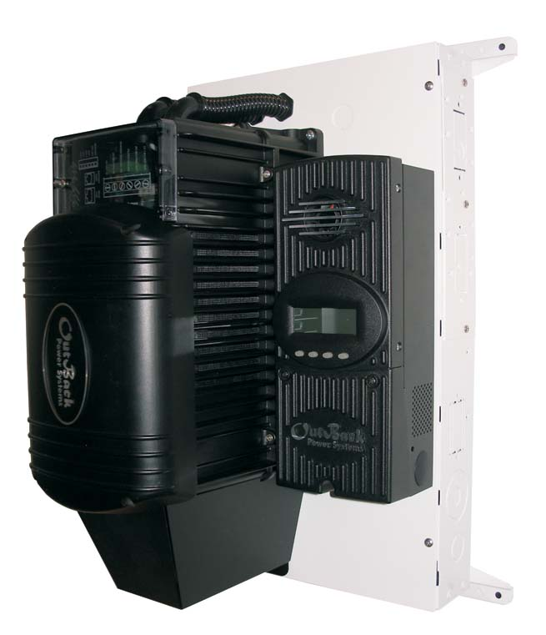
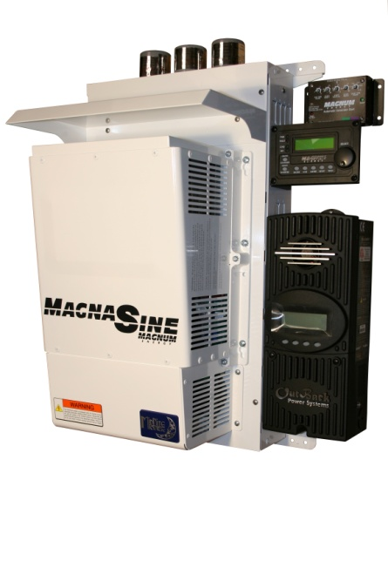

Slide 42
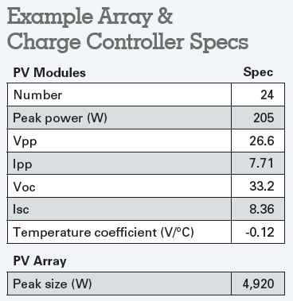
MPPT Sizing Example

Slide 43
MPPT Sizing Steps
1) Find maximum Voc per module based on record low of -29 (weather.com)
    Voc = 33.2 V
    Temperature difference 25 – (-29) = 54 C
    54 C x .12 V/C = 6.48 V
    33.2 + 6.48 = 39.68 Voc @ -29

Slide 44
MPPT Sizing Example
2) Find the maximum number of modules that can be used in series based on a controller’s maximum Voc (150 volts for Outback)
  150 V / 39.68 Voc @ -29 C = 3.7 = 3 modules in series is maximum

Slide 45
Outback MPPT Controller

Slide 46
MPPT
3) Find the number of controllers required and the number of module series strings per controller
  4,920 (array peak size) / 46 V (minimum expected battery voltage) = 107 amps max array amps
  107 A (total max output current from array) / 60 amps (output per controller) = 1.8 or 2 controllers
  24 modules / 3 modules per string = 8 strings
  4 strings per controller; each controller will be wired to 12 modules

Slide 47
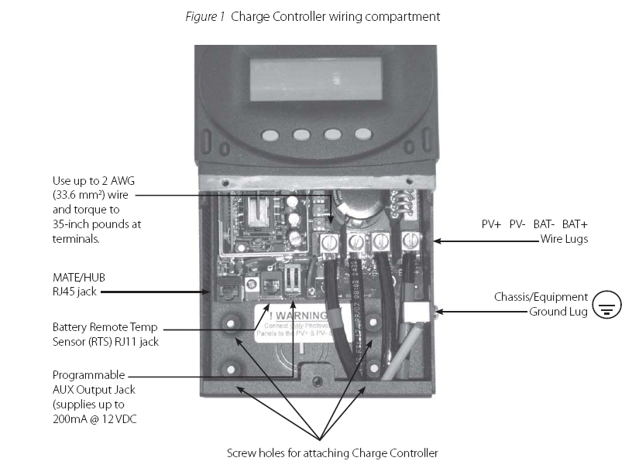
Outback MPPT

