Slide 1
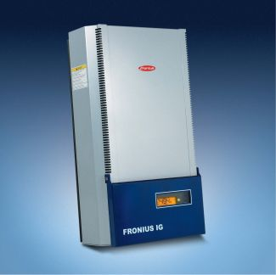
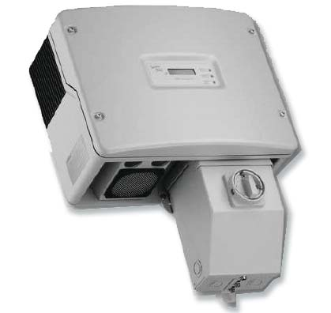
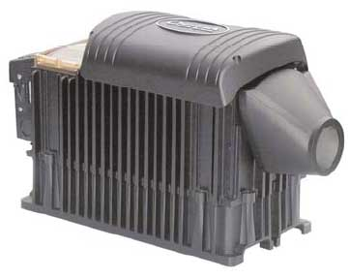
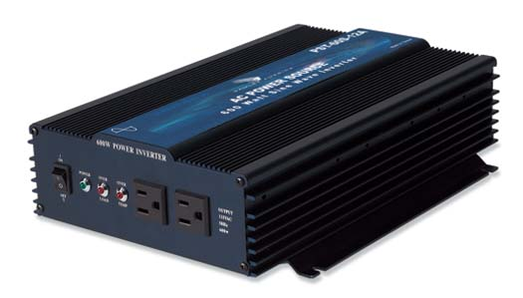
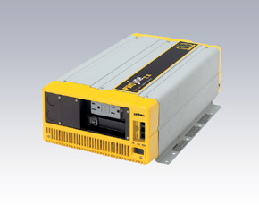
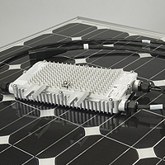
Inverters

Slide 2
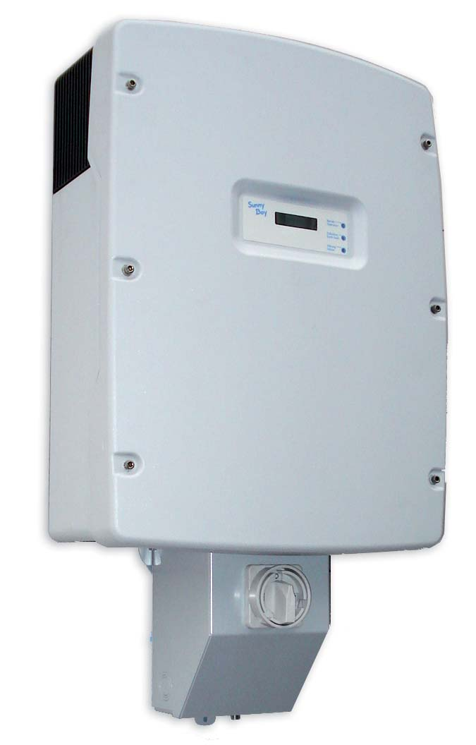
Inverter Functions
Change DC to AC
Increases or decreases voltage from array voltage to:
  120 Volts
  240 Volts
  208 Volts
Regulate Frequency
  50 HZ
  60 HZ
Feed Electricity back to grid
Battery Charging

Slide 3
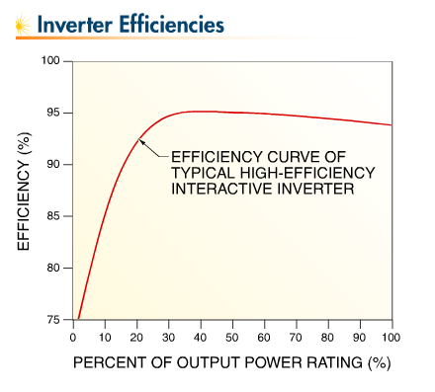

Slide 4
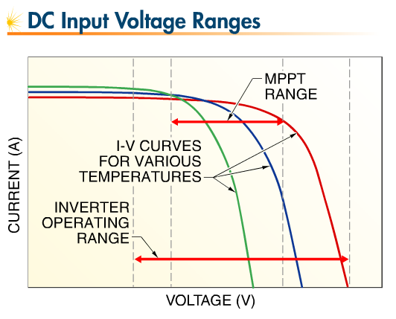
Input Ranges

Slide 5
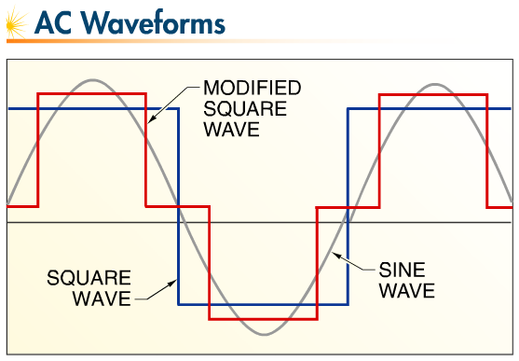
Inverter Wave Forms
Square wave
Modified Square Wave
Sine Wave

Slide 6
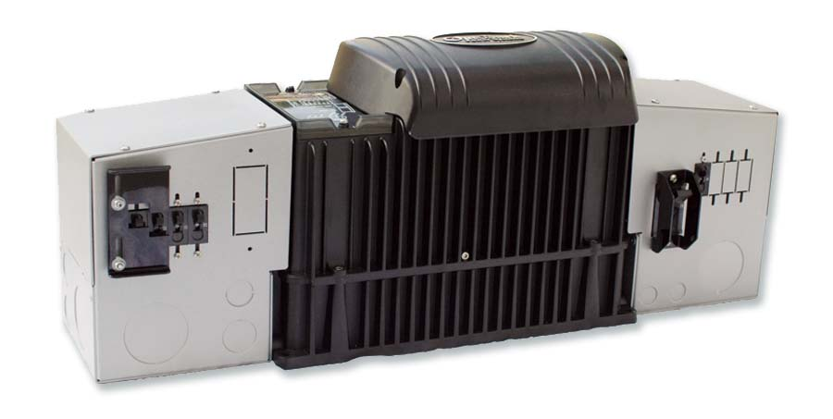
Types
Stand Alone Inverters
  Battery based
Direct Utility Intertie
  No Battery
MultiFunction
  Battery charging grid tie

Slide 7
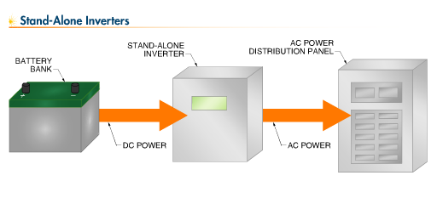
Stand Alone Inverters

Slide 8
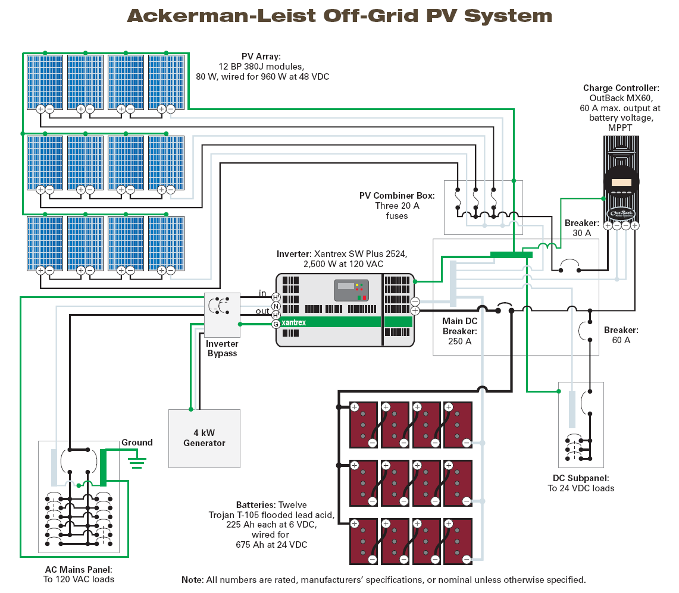
Stand Alone

Slide 9
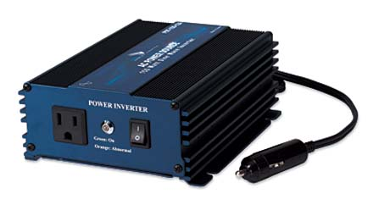
Stand Alone Inverters
Considerations
  Maximum load
  Maximum surge
  AC output voltage
  Input battery voltage
100 watts to 60 KW
Pure sine & modified sine wave available
High Surge

Slide 10
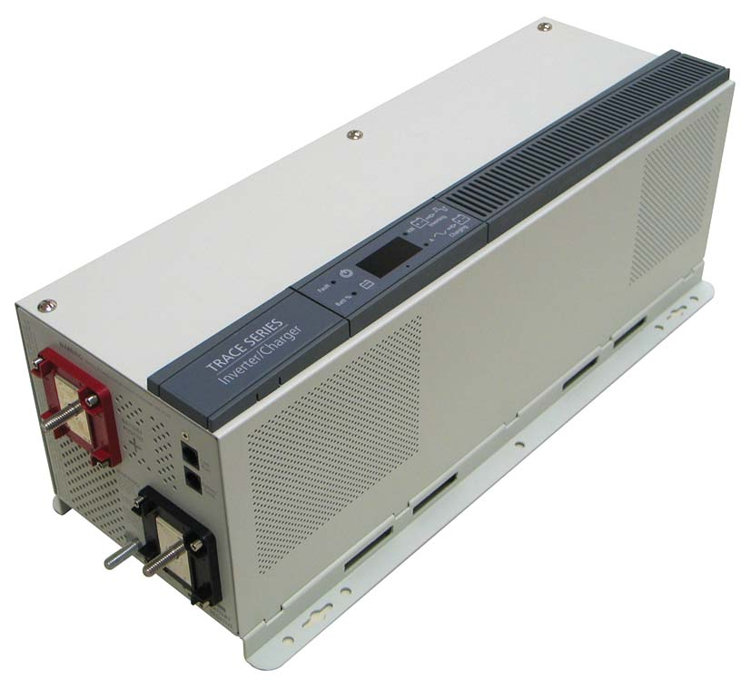
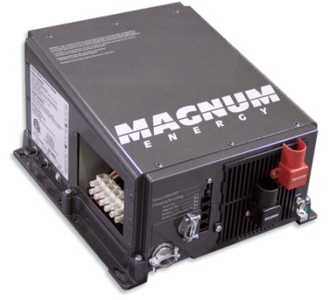
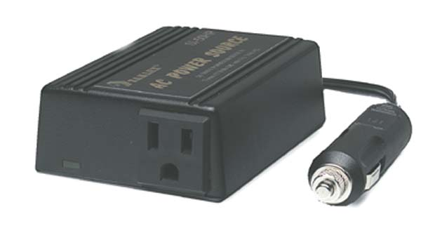
Modified Square or Modified Sine Wave Stand Alone Inverters
Types
  Xantrex TR Series
  Samlex
Least expensive - $.29 - .66/watt
Some electronic devices may buzz
Clocks don’t run accurately
Can’t charge battery packs, run laser printers, copiers, light dimmers, variable speed tools, Silicon Controlled rectifiers
High Surge
High Efficiency

Slide 11
Xantrex TR Series Inverters
12 & 24 DC Volt Input
120 volt AC
1500 – 3600 watts
Modified sine wave
Battery charging capability
$.39 - .58/watt

Slide 12
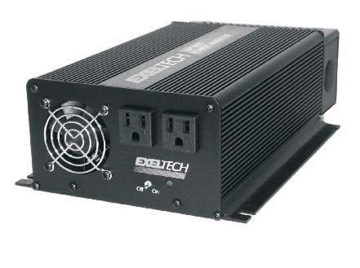
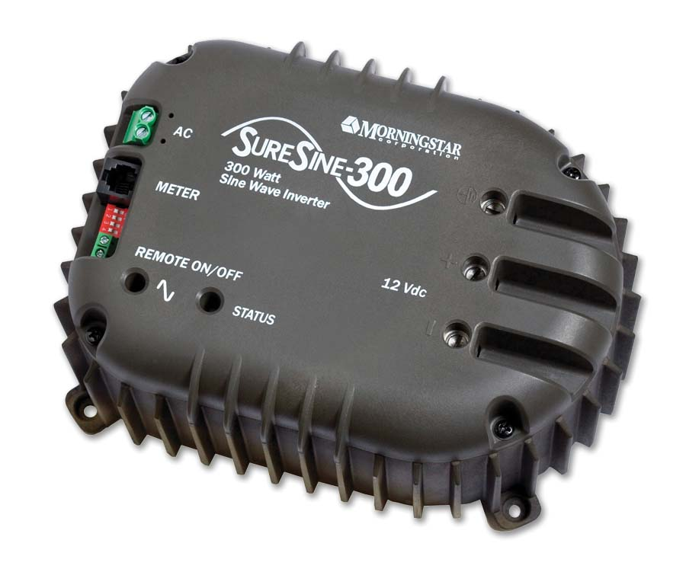
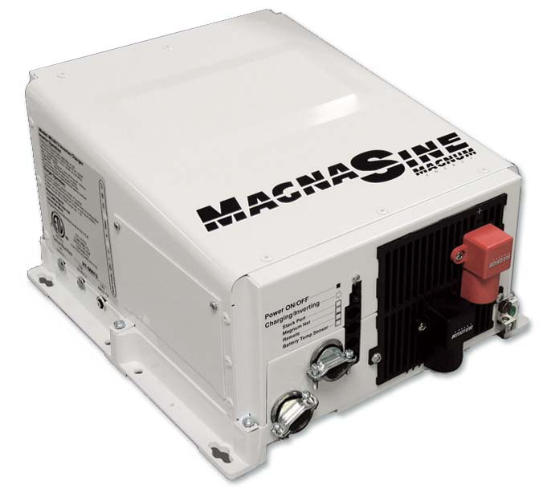
Sine wave Stand Alone Inverters

Slide 13
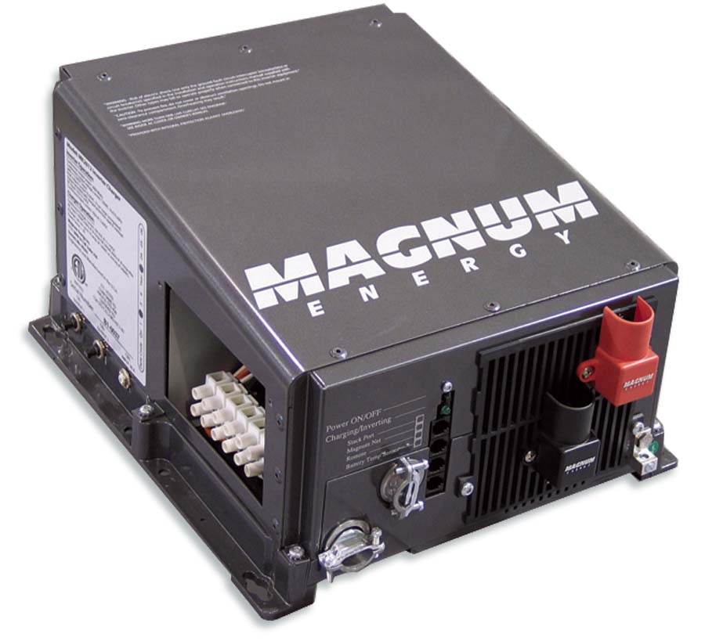
Magnum
Makes sine wave & modified sine output inverters
600 - 4400 watts
12 – 48 volt models
120 & 240 models
$.50 - $1.19/watt

Slide 15
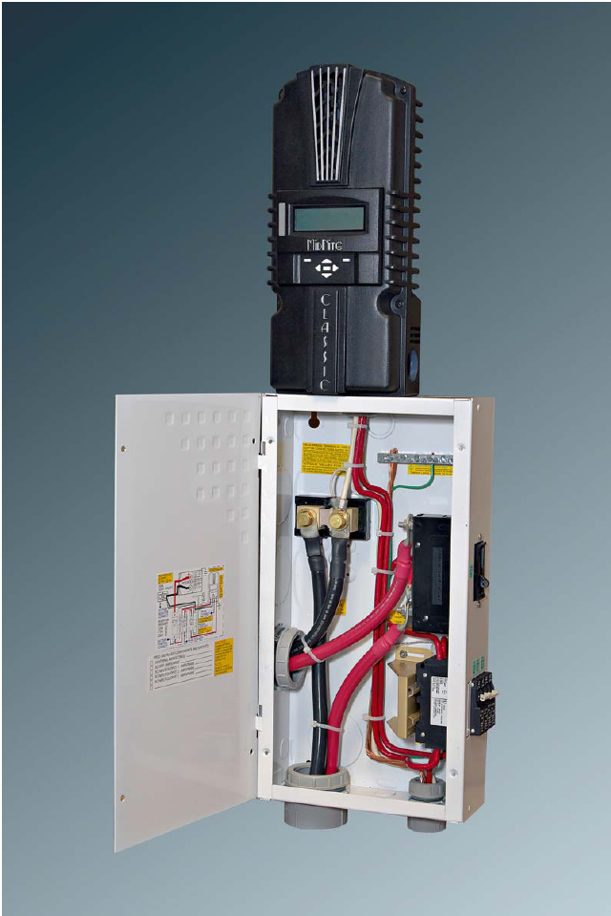
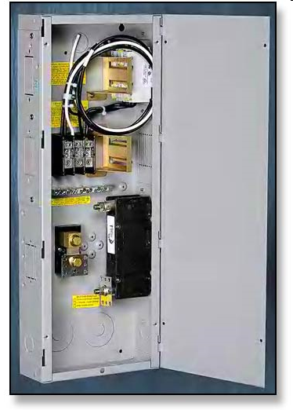
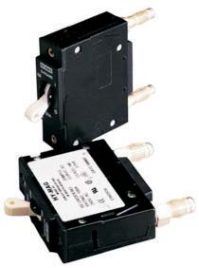
Over Current Protection

Slide 16
Sizing Overcurrent Protection
Divide rated output by lowest voltage that inverter will operate at to get maximum AC amps
Divide maximum AC amps by inverter efficiency to get maximum DC amps
Multiply maximum DC amps by 1.25 to avoid exposing conductor or overcurrent protection to more than 80% of its rated ampacity

Slide 17
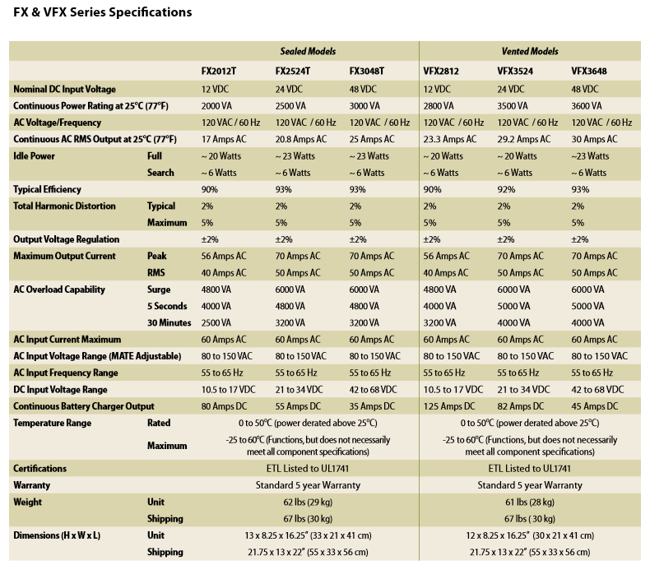

Slide 18
Example of Conductor & Circuit Breaker Sizing
2500 watts / 21 V = 119 amps AC
119 AC amps / .93 = 128 amps DC
128 x 1.25 = 160 amps (for continuous duty)
Conductor must have ampacity of 160 amps or more.
Circuit Breaker must also have amp rating of at least 160 amps also, but less than or equal to the ampacity of conductor used

Slide 19
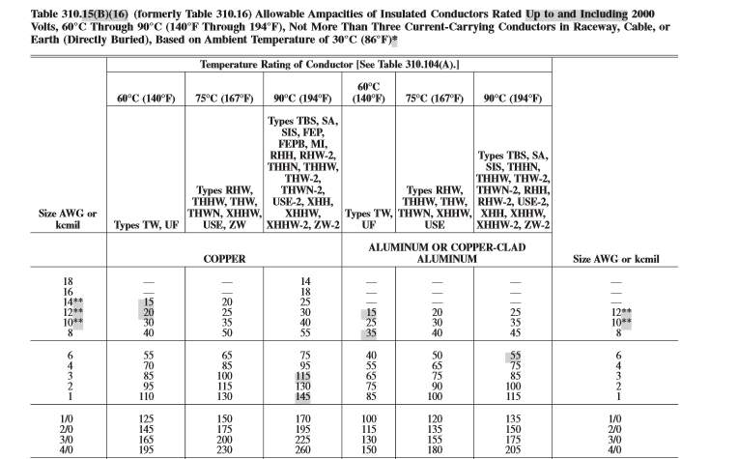

Slide 20
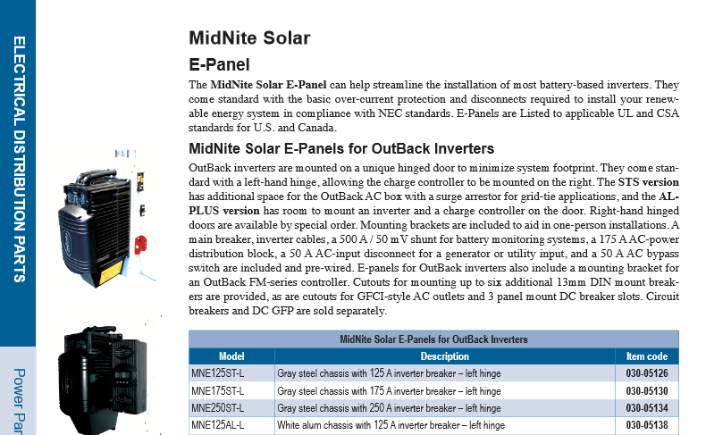

Slide 21
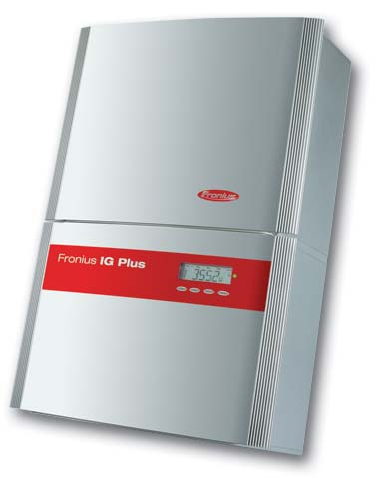
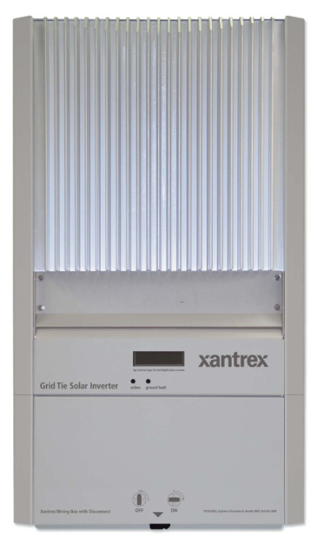
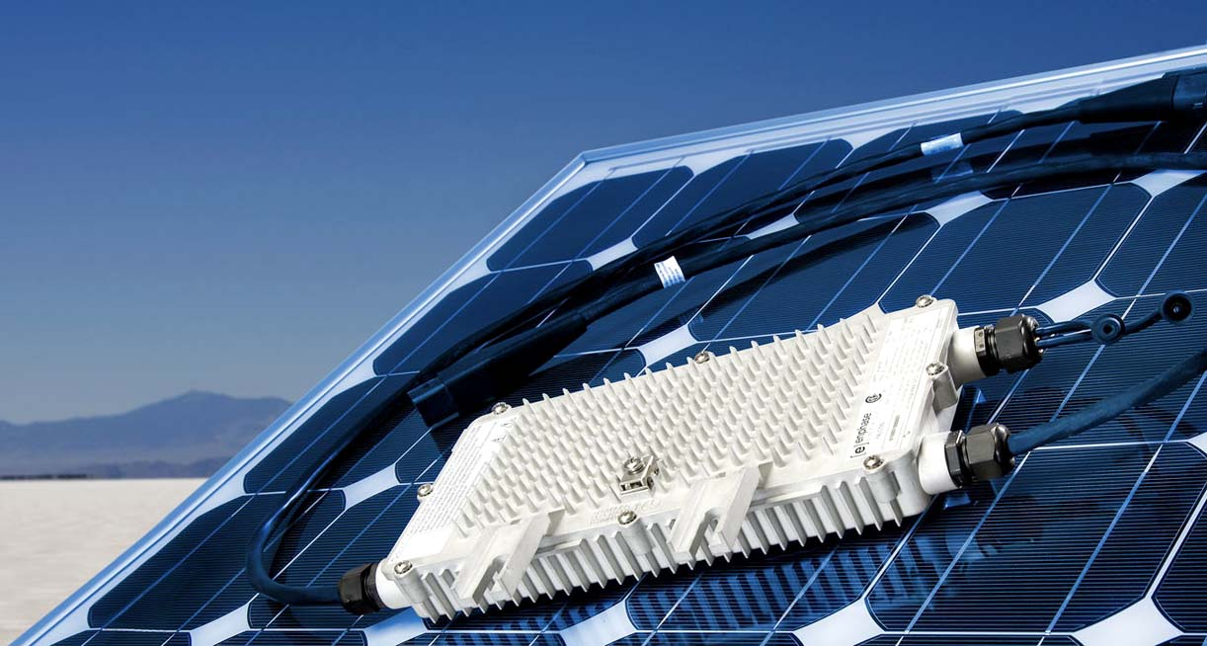
Direct Grid Tie Inverters

Slide 22
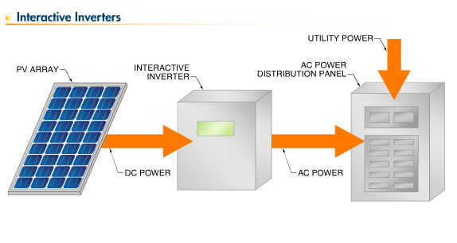
Direct Utility Tied Inverters

Slide 23
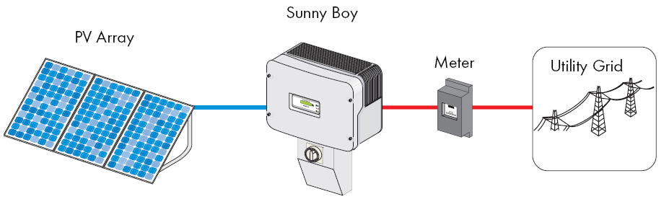
Direct Grid Tie Inverter

Slide 24
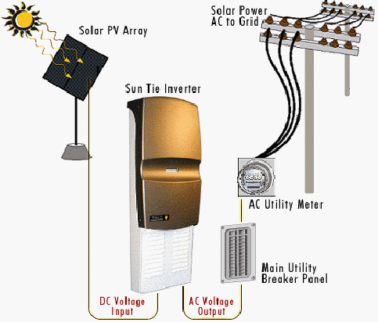
Direct Grid Tie

Slide 25
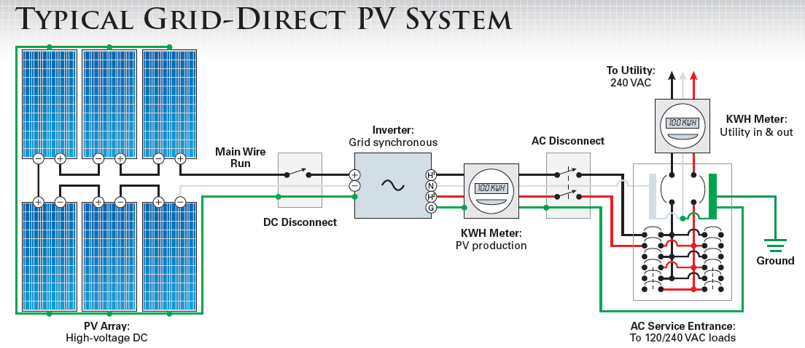
Grid Tie PV System

Slide 28
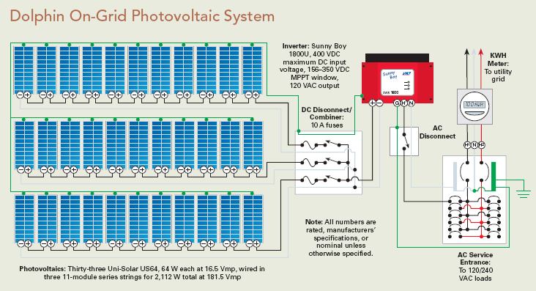

Slide 29
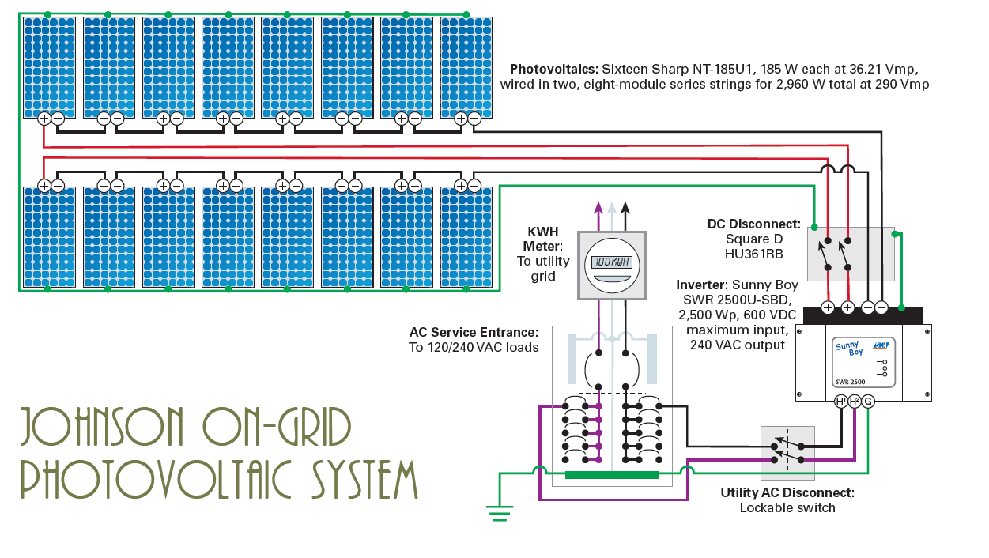

Slide 30
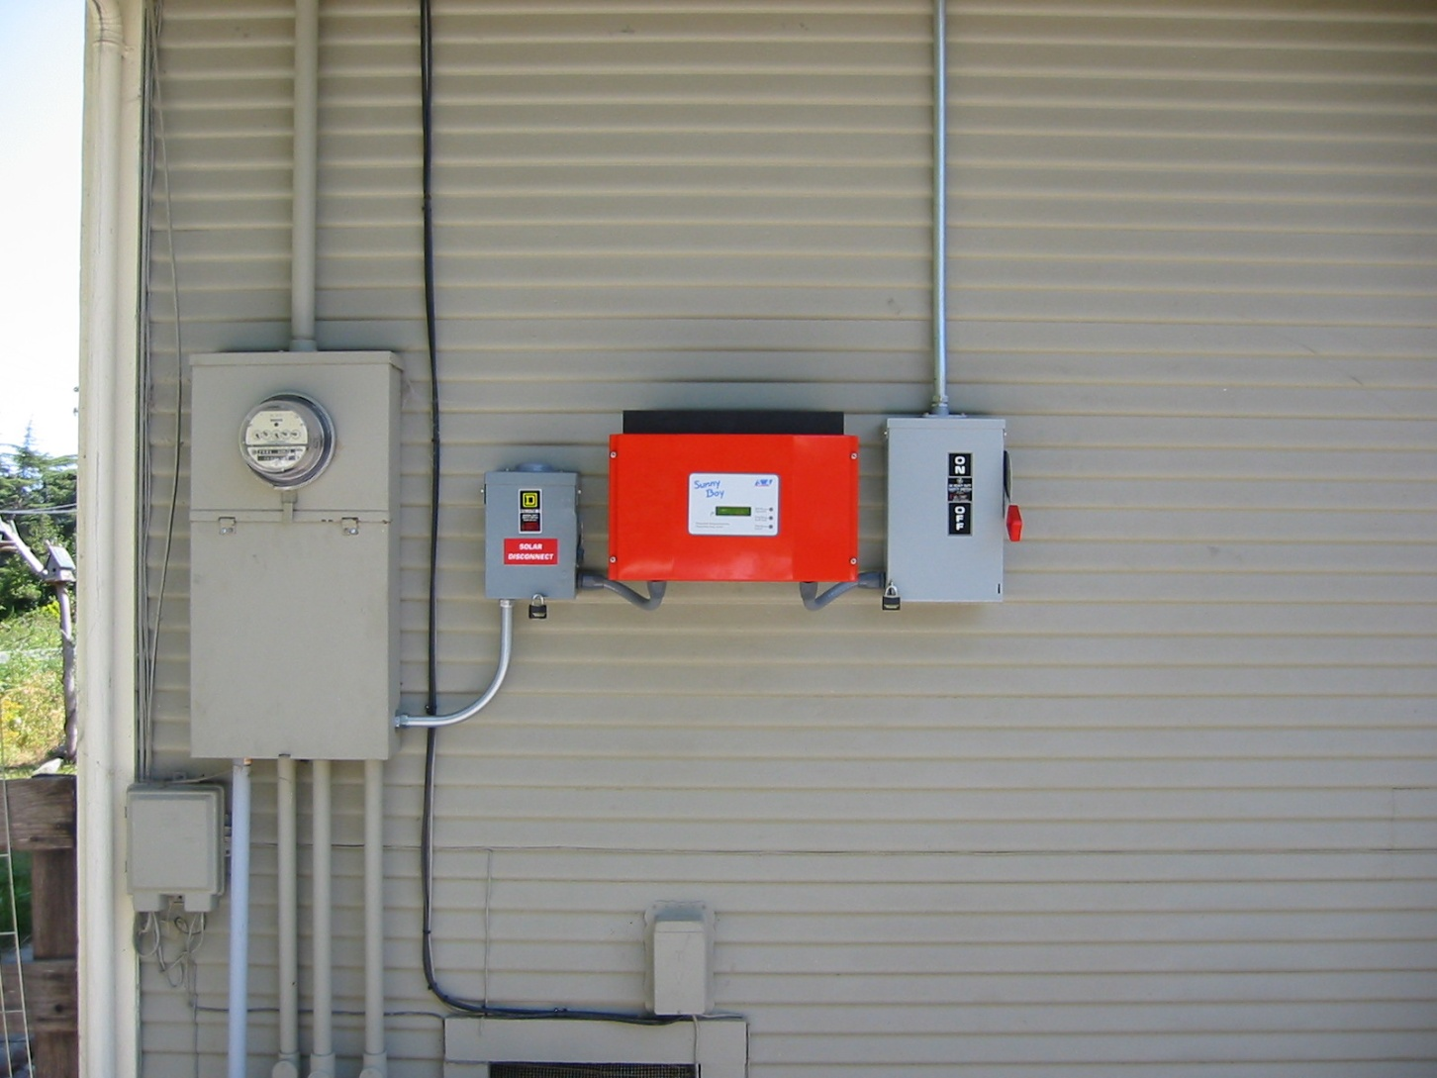
Balance of System: Grid Tie

Slide 32
Sunny Boy Inverter

Slide 33
Sunny Boy with DC Disconnect

Slide 34
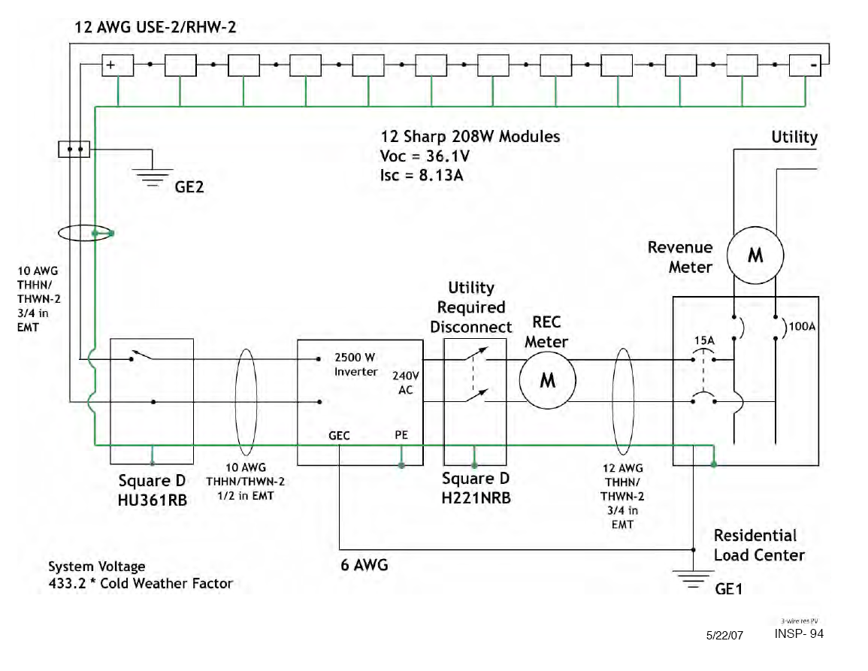

Slide 36
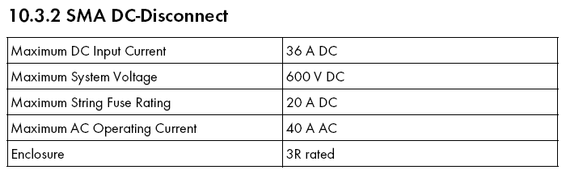

Slide 37
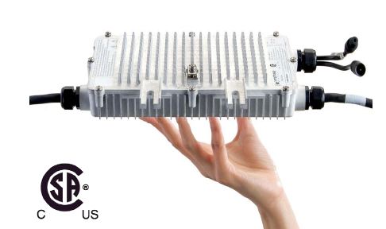
Enphase Microinverters
http://www.youtube.com/watch?v=Fzj2a-9M4qo
http://www.youtube.com/watch?v=RC3mNUhcx6o

Slide 38
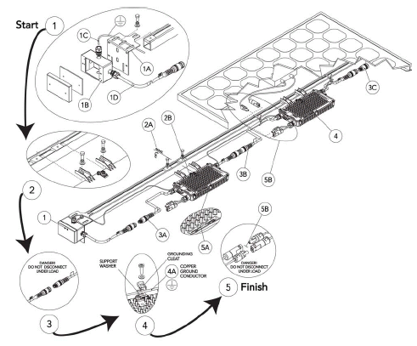

Slide 39
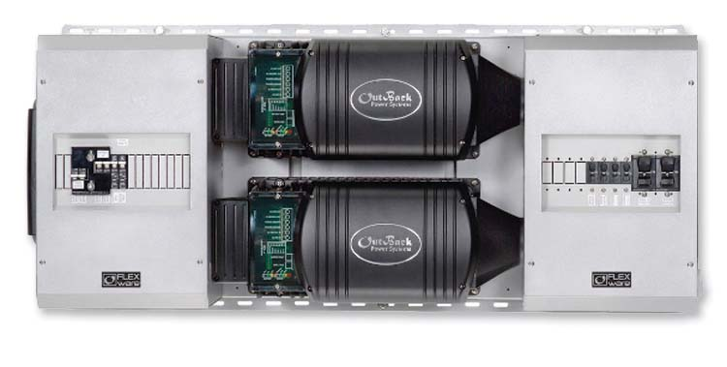
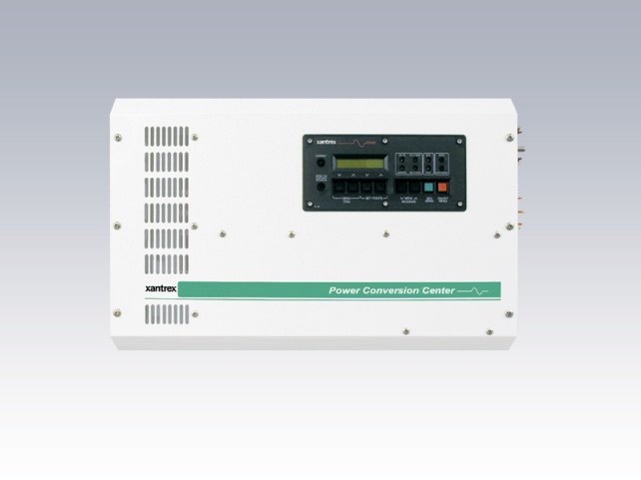
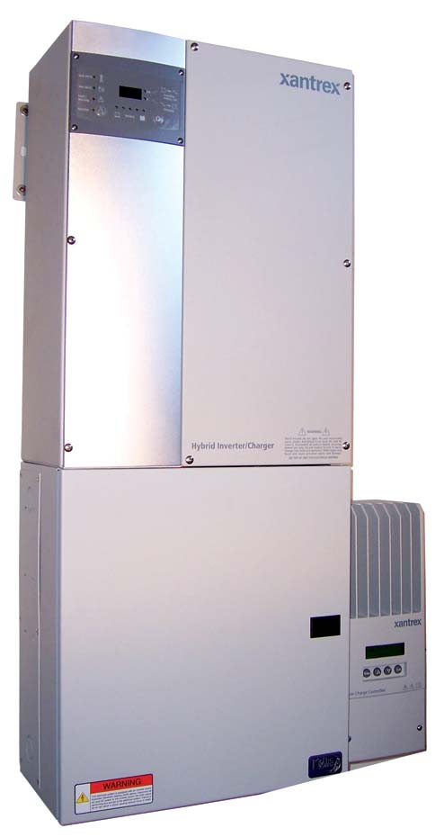
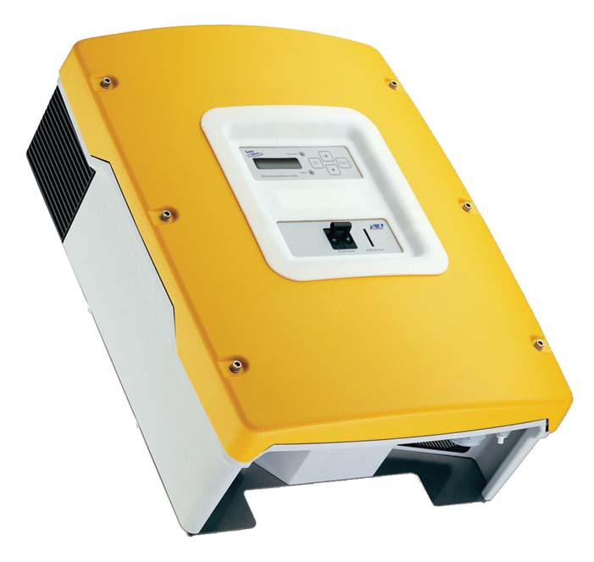
Dual Function Inverters

Slide 40
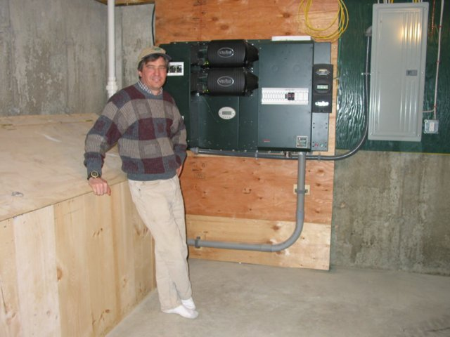
Multi-Function Inverters

Slide 41
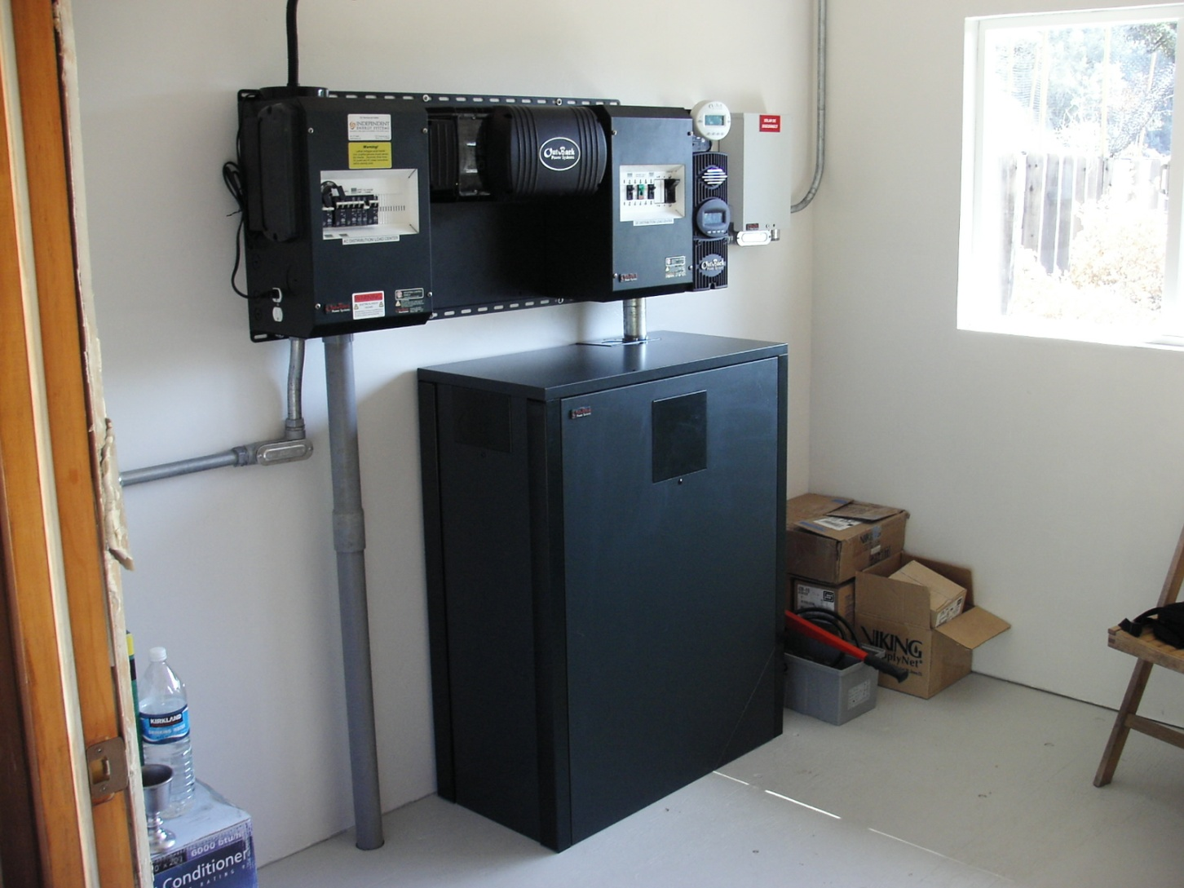
With Batteries & Grid

Slide 42
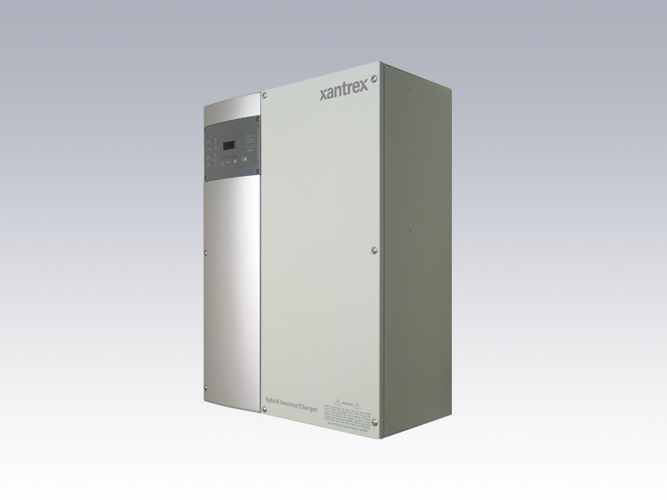
Xantrex XW Battery Based Inverter

Slide 43
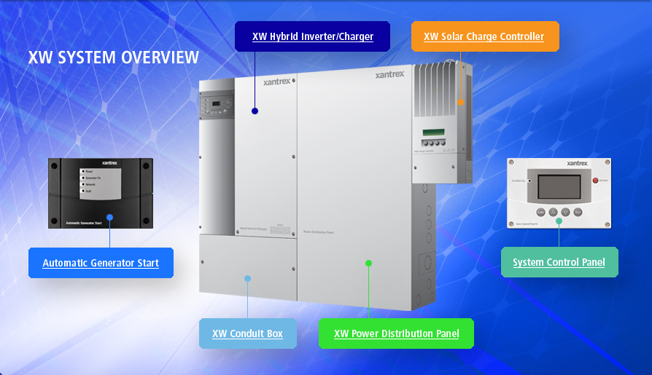
http://www.youtube.com/watch?v=I91mHLu1Guw

Slide 44
Xantrex XW Battery Based Inverter

Slide 45
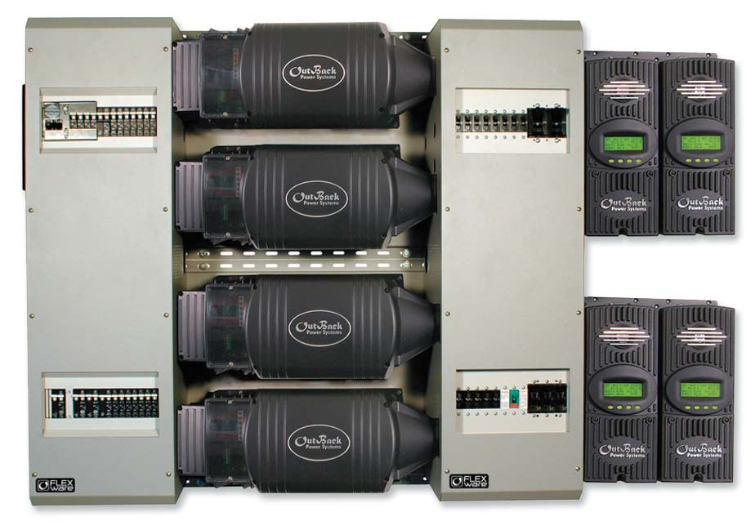
Outback Multifunction

Slide 46

Multi – Function Inverters

Slide 47



Slide 48


Slide 49

Multi Function Inverters

Slide 50



Accessories

