Slide 1
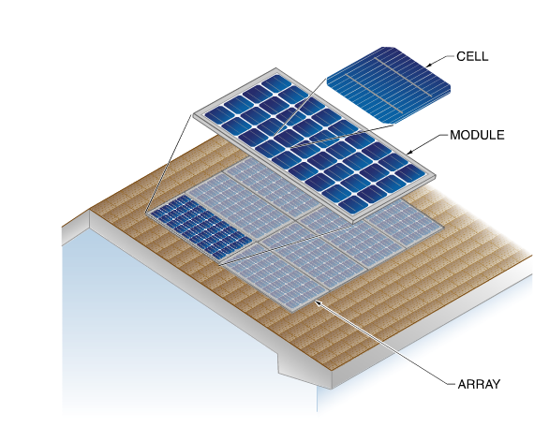
Cells, Modules, & Arrays

Slide 2
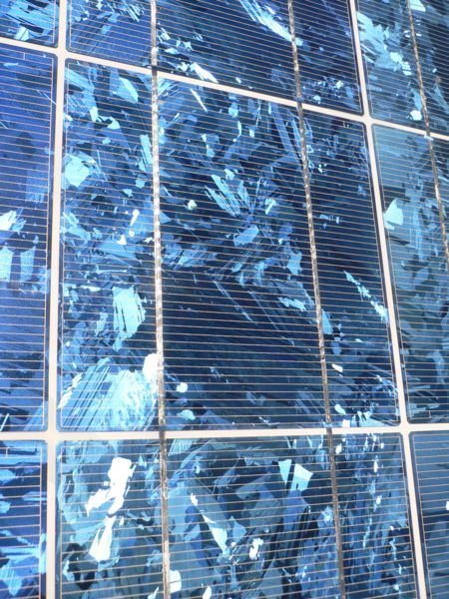
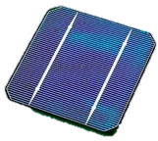
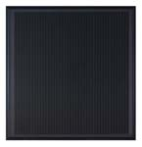
Types of PV Cells/Products
Single Crystal
Multi or Polycrystalline
Thin Film /Amorphous Silicon

Slide 3
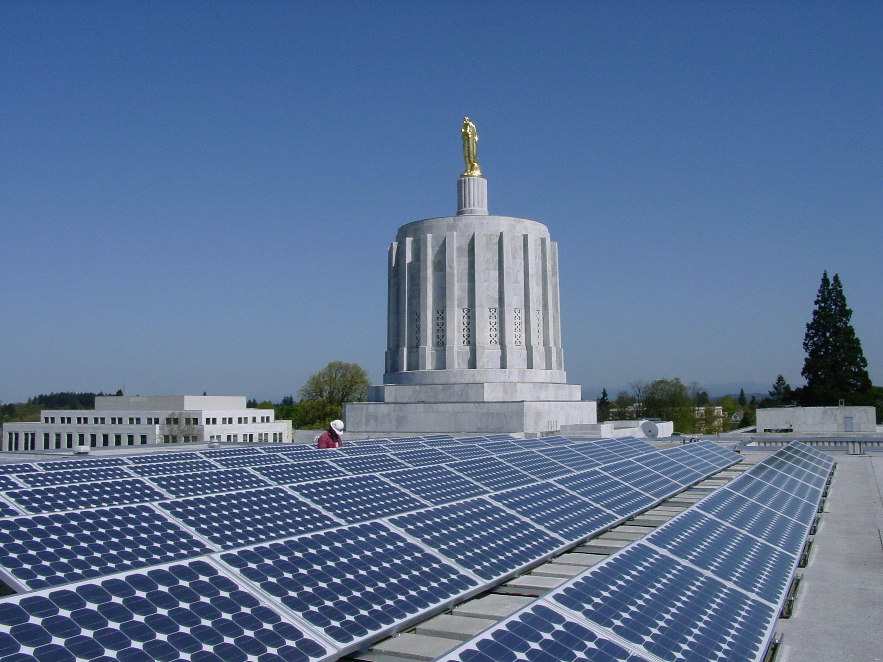
Monocrystalline Silicon
Warranties 25 years
Efficiency 12-21%
Notes:
The main purpose of this and the subsequent slides is to show the students photos of the different technologies and how they appear when installed. Point out the physical characteristics (the dead white space in the mono panels for example).
The white box with the statistics is there to give the students a feel for the overall similarities and differences. Don’t spend too much time getting into the meanings of all the items, just relate them all to one another.

Slide 4
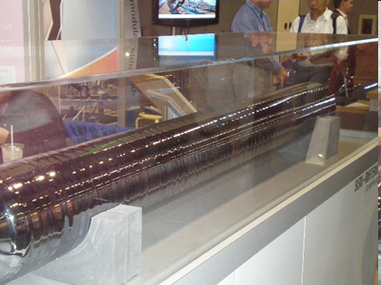
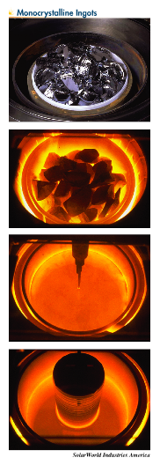
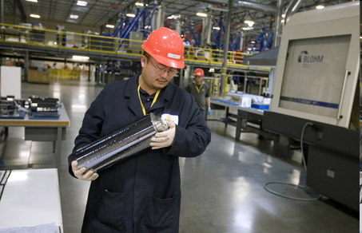

Slide 5
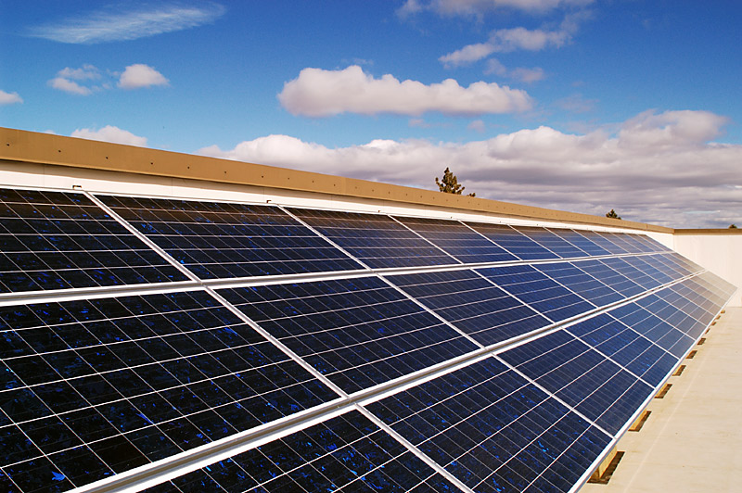
Multi or Polycrystalline Silicon
Warranties 25 years
Efficiency 11-16%

Slide 6
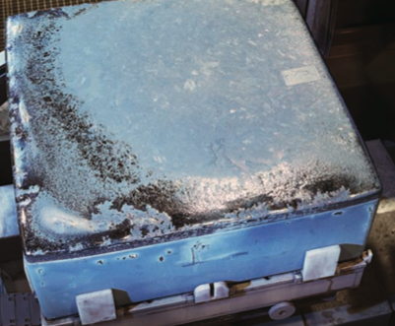
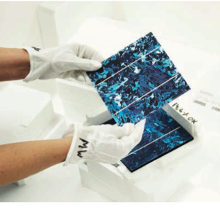
Multicrystalline ingot ready
for sawing
Cells ready for module assembly
Photos courtesy HomePower magazine/REC group

Slide 7
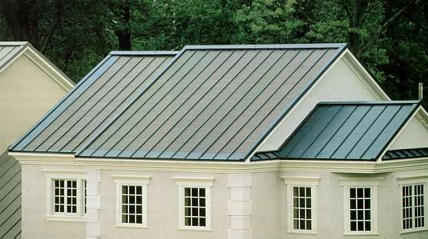
Thin Film - used mainly for utility scale
Amorphous Si (a-Si), CIGS, or CadTel
Warranties 20 -25 years
Efficiency 6-12%
Notes:
It is good to point out that this is just one type of amorphous panel, this manufacturer, Unisolar, makes framed versions as well that are mounted like crystalline framed modules.

Slide 8
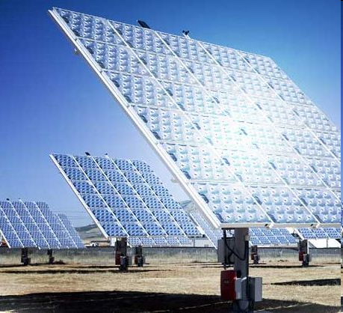
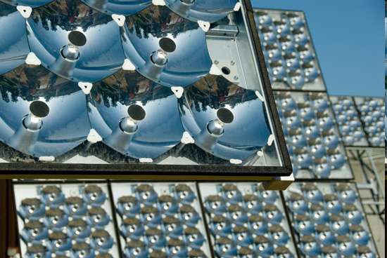
Concentrating PV
Must Dual Axis-Track CPV

Slide 9
PV Efficiencies (www.wikipedia.com)
1883 - less than 1% efficiency
1954 – AT&T labs marks 6% efficiency.
1955 - 2% efficient commercial solar cell for $25/cell or $1,785/Watt.
1957 - 8% efficient commercial solar cell
1958 - 9% efficient commercial solar cells
1959 - 10% efficient commercial solar cell
1960 - 14% efficient commercial solar cell
1976 - first amorphous silicon PV cells have an efficiency of 1.1%
1980 - thin-film solar cell exceeding 10% efficiency
1985 - 20% efficient silicon cell
1989 - Reflective solar concentrators are first used with solar cells.
1994 - concentrator cell (180 suns) becomes the first solar cell to exceed 30% conversion efficiency
2005 - Solar cells in modules convert around 17% of visible incidental radiant energy

Slide 10
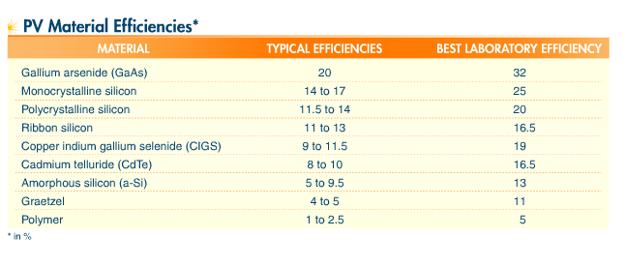
PV Materials & Efficiencies

Slide 11
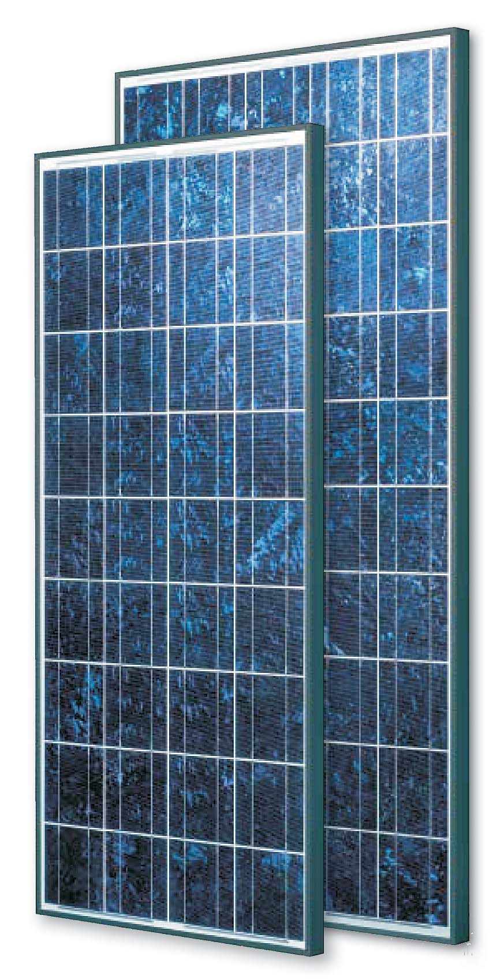
PV Modules
Many sizes and types available (5 – 435 watts)
Efficiencies 6 – 21%
Cells in series: 36 – 150
36 – 60 – 72 cells most common
25 year warranties
Currently ~$1/watt or less for most large modules bought in significant quantities

Slide 12
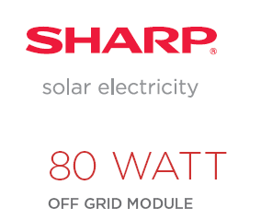

Slide 14
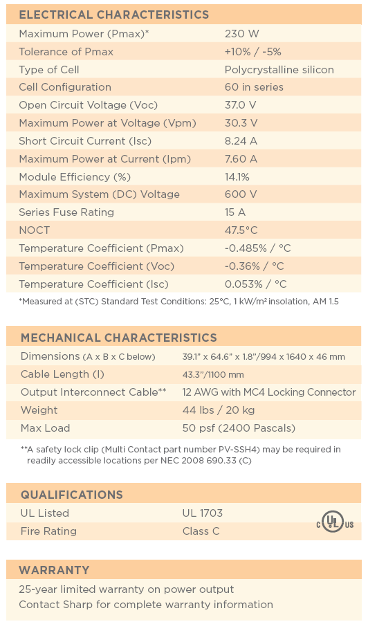

Slide 15
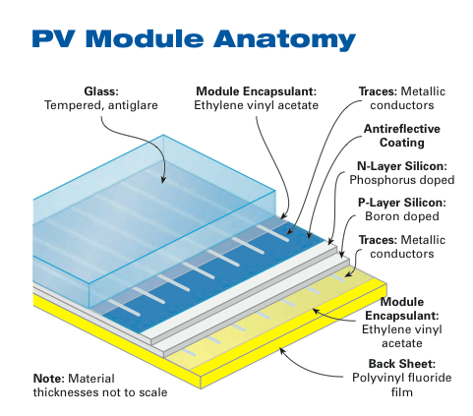
PV Modules
Courtesy Home Power Magazine

Slide 16
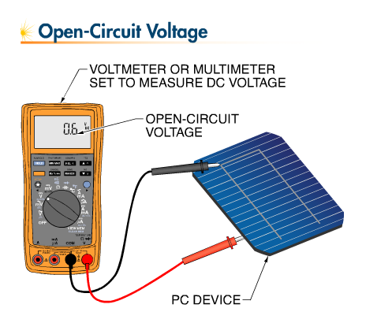
Silicon Cell Voltage
.5 - .6 volts/cell
Not related to size
Voltage affected by temperature
Open circuit voltage
Maximum power voltage
For Sharp 80 watt (36 cells)
Voc = 21.6/36 = .6 Voc/cell

Slide 18
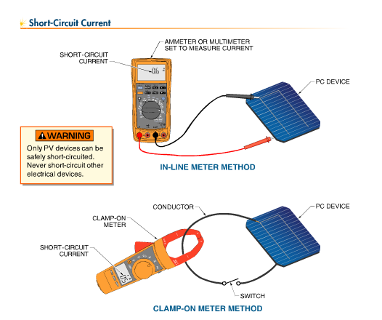
Silicon Cell Current Production
Related to size of cell
.2 amps/square inch or .03 amps (30 milliamps) per square centimeter
Affected by irradiance primarily
Short Circuit Current
  Used to determine maximum current
  Isc X 1.56 to estimate maximum current for wire sizing
Maximum Power Current

Slide 19
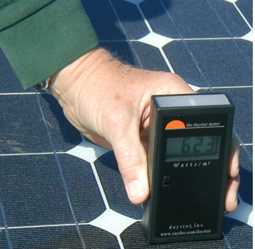
Amperage is proportional to irradiance
If a module has a short-circuit current of 8 amps at 1000 w/m2, what would the short circuit current be at 623 watts/m²?
  623 watts/m² ÷ 1000 watts/m² = .623 or 62.3%
  8 A x .623 = 4.98 A

Slide 20
Two factors that affect PV Module Performance
Temperature
Irradiance (solar power)

Slide 21
Response to Temperature
Increasing temperature reduces power output
Increasing temperature increases current slightly
Current
Decreasing temperature increases voltage
T = 0 ºC
Increasing temperature reduces voltage
T = 25 ºC
T = 50 ºC
Voltage
Notes:
This is the first demonstration of how temperature affects voltage and current. The point of this slide is to show how voltage has a dramatic change with temperature while current change is minimal.
This is a good place to introduce the term “inversely proportional” in respect to temperature and voltage. We don’t need to get too far into specifics here, just show the general concept and how the IV curves move around.

Slide 22
Response to Irradiance
IV Curves at Constant Temperature
Current increases proportionally increasing irradiance
1000 W/m²
Maximum power voltage changes little with irradiance
750 W/m²
Current
500 W/m²
250 W/m²
Voltage changes insignificantly with irradiance
Voltage
Notes:
Another way to look at the effect of irradiance on current values. Since they got the concept in the last slide, this slide is intended to get them to evaluate how the IV curve is changed and even apply some math to determine the current values over varying irradiance values. Point out how the curves are shifting in the vertical dimension much more than the horizontal. You can even give a Isc value for a module at STC conditions and get them to calculate the new values for different irradiance values. This will come up again in the next slide so make sure they are aware of the way to accomplish it. Ask students to ID different points on the curves (Voc, Isc…)

Slide 23
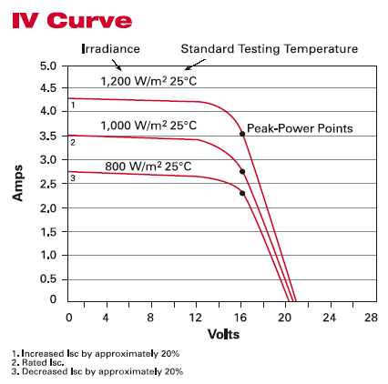
IV Curve

Slide 24
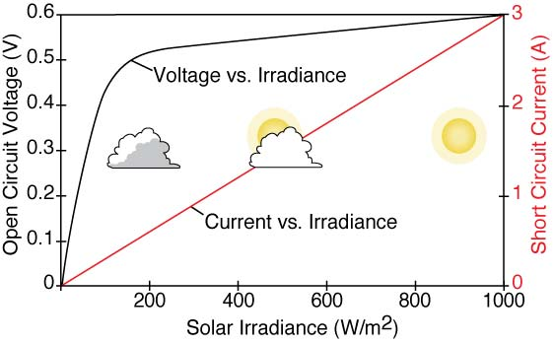
Impact of Irradiance on Voltage & Current
Voltage increases rapidly, current increases proportionally w/ irradiance

Slide 25
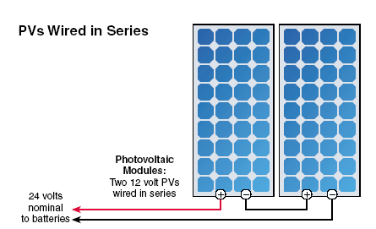
Series Wiring (Voltage Increases)

Slide 26
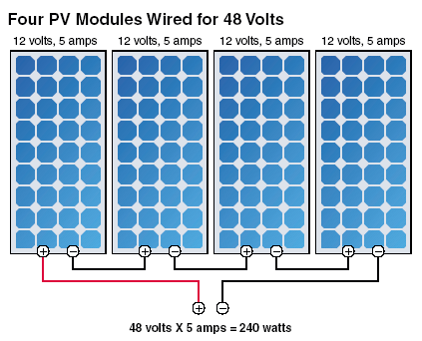
Series Wiring

Slide 27
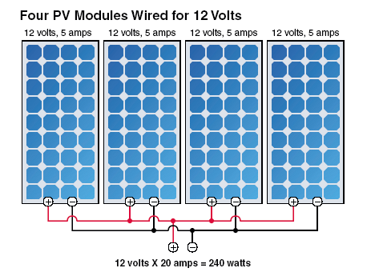
Parallel Wiring (Amperage Increases)

Slide 28
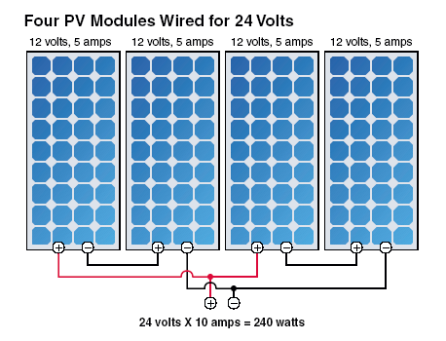
Series & Parallel

Slide 29
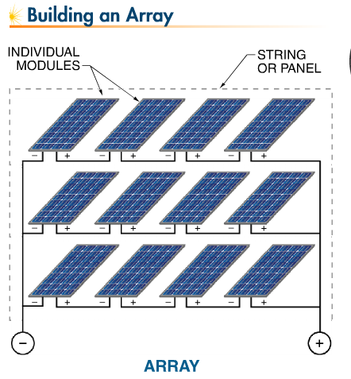

Slide 30
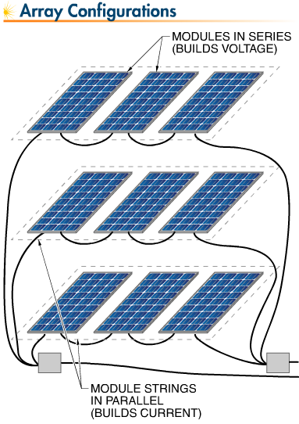

Slide 31
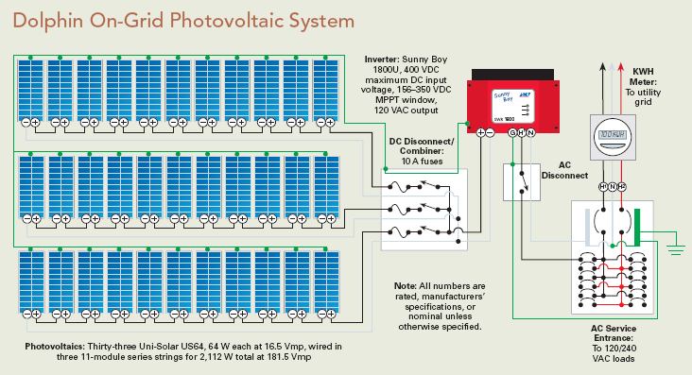
Direct Grid Tie System

Slide 32
48 Volt battery charging system

Slide 33
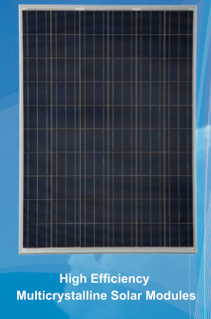
Standard Test Conditions (STC)
        STC (Name Plate Rating)
        Cell temp 25 Degree C
        Irradiance 1000 W/square meter
        Air Mass Index 1.5

Slide 34
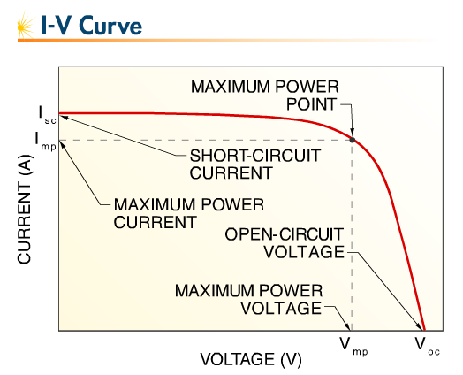
Photovoltaic Device IV Curve at STC
(25 C (77 F) and 1000 watts/m²)

Slide 36
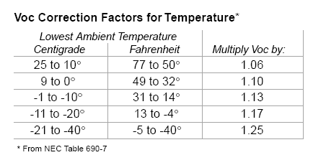
Calculating maximum voltage and maximum string size
  Example: How many modules, each having a Voc of 36.5 V can be placed in a series string without exceeding the 600 volt limit of a grid tie inverter when the record low temperature is -30 C?
Voc = 36.5 volts x 1.25 = 45.62 Voc
600 volt inverter/45.62= 13 modules

Slide 37
Direct Grid Tie System

Slide 38
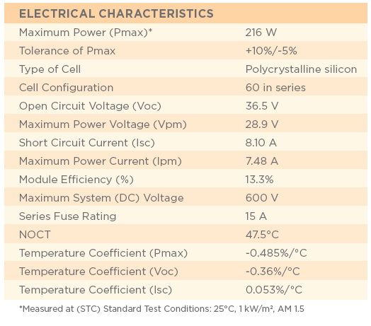

Slide 39
Open Circuit Voltage Temperature Coefficient
(% change per degree C)
Example
  How many Sharp 216 watt modules, each having a Voc of 36.5 V and temperature coefficient of -0.36%/C, can be placed in a series string without exceeding the 600 volt limit of a grid tie inverter when the record low temperature is -31 C?
    -0.36%/C = .36/100 = .0036
    .0036 x 36.5 V = .13 V/C
    Delta T = 25C to – 31 = 56 C
    .13 V/C x 56 = 7.28 volts
    36.5 Voc + 7.28 volts = 43.78 Voc @ -31C
    600 V/43.78= 13.7 modules = 13 modules max per string

Slide 40
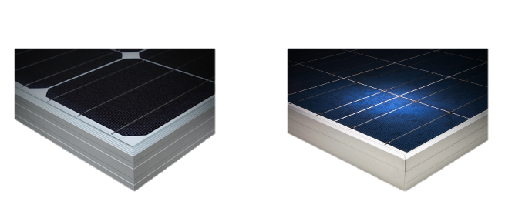
Choosing a module
Cost
Aesthetics
Material Warranty (years)
  Range of 1 – 10 years
Power Warranty (Years) – limited warranty for module power at STC minus power tolerance percentage (+/- 5%)
  20 years common at 90% for first 10 years and 80% for next 10 years (100 watts x .95 x .90 = 85.5 watts)
Power Density/Efficiency

Slide 41
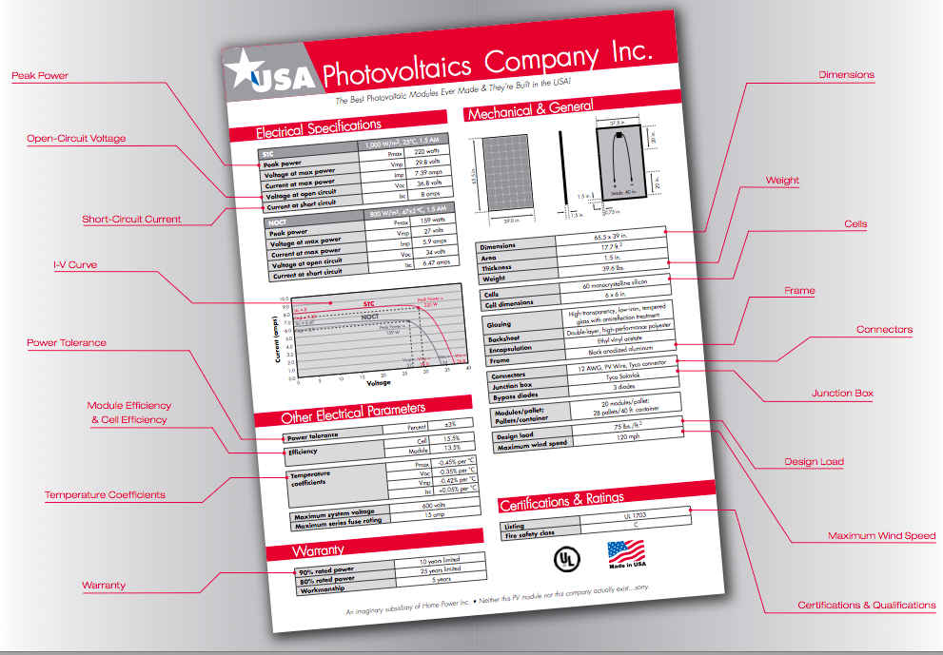

Slide 42
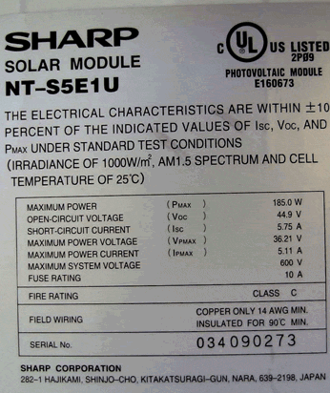
Module Namplate

Slide 43
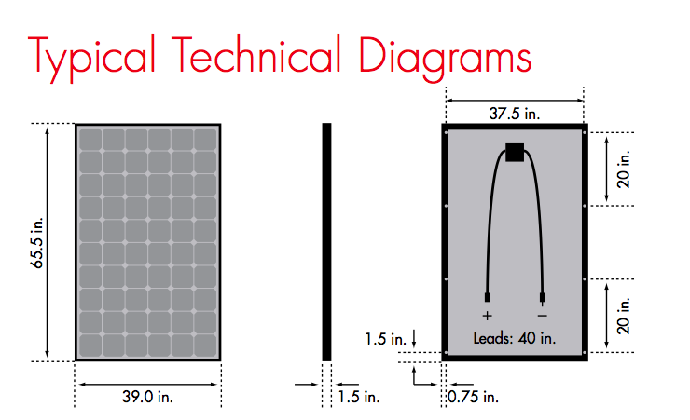
Module Specifications
Courtesy Home Power Magazine

Slide 44
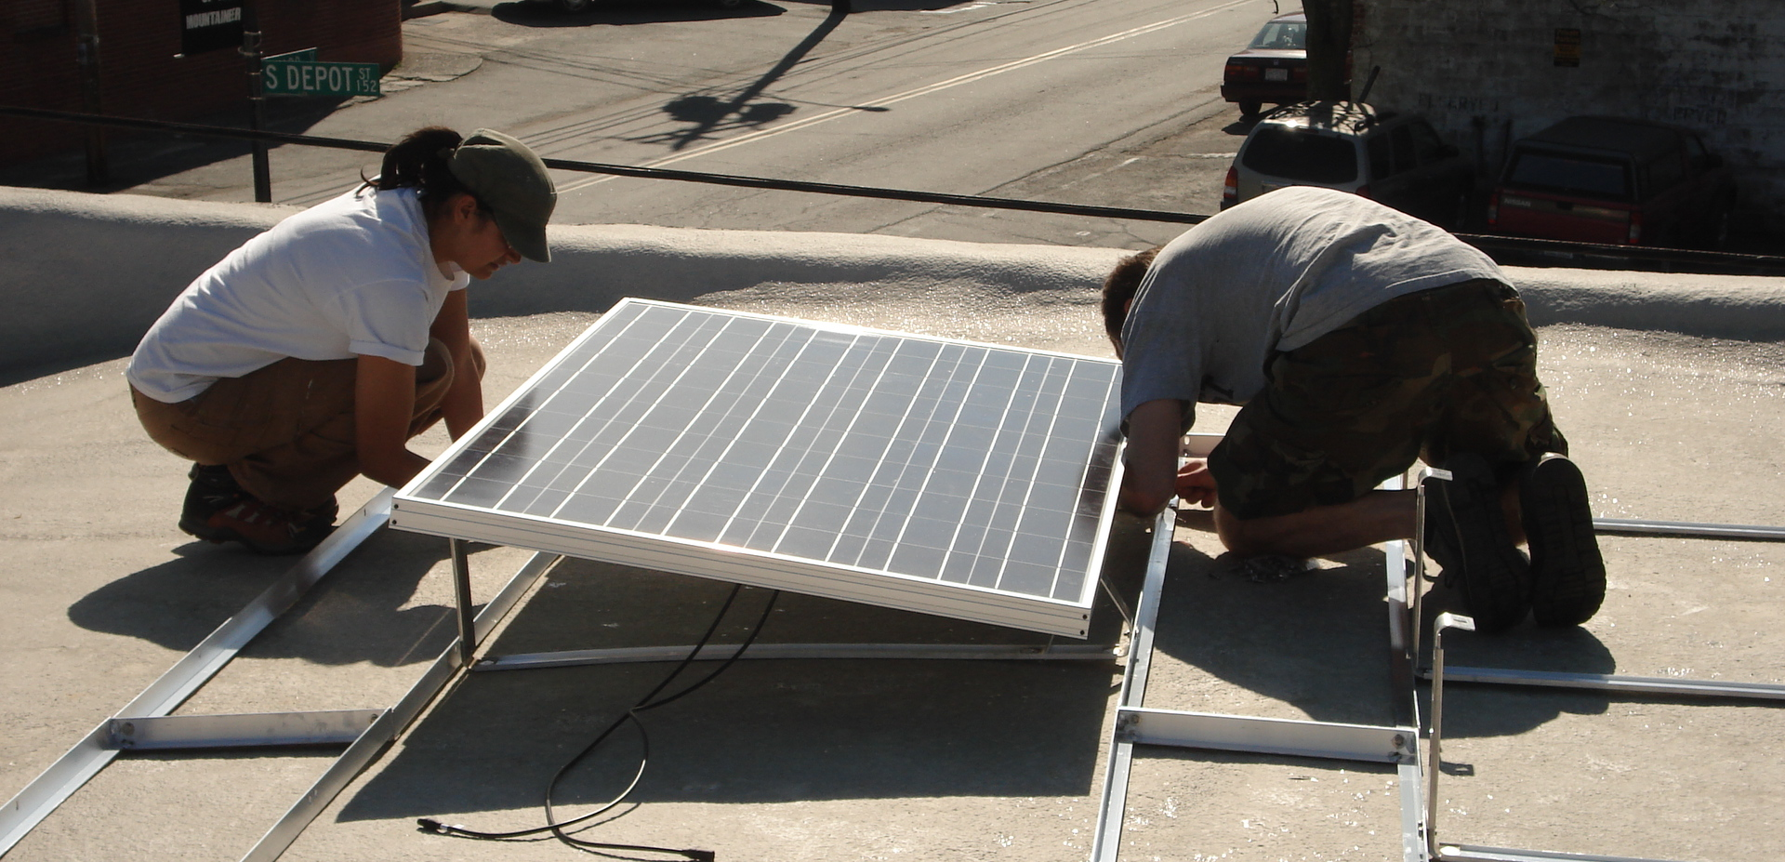
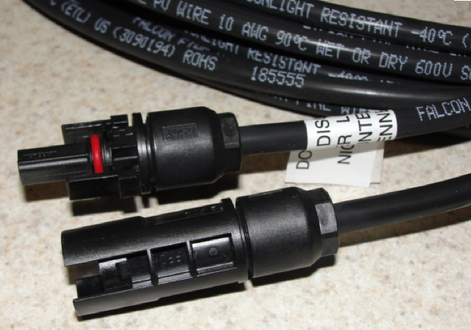
Quick Connects (MC, Tyco, etc)

Slide 45
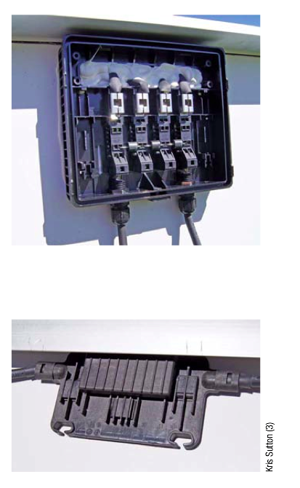
Module J-Box
Field Serviceable Junction Box:
Less common today and found primarily on smaller modules
Sealed Junction Box:
Most common, safer to wire, but usually cannot replace leads
Courtesy Homepower Magazine/Kris SUtton

Slide 46
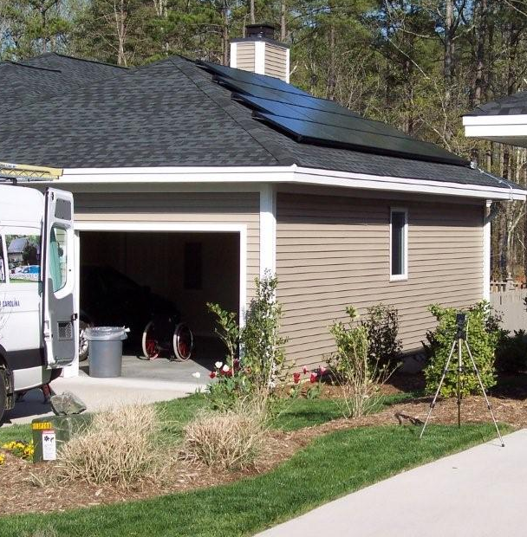
1000 watts of crystalline PV fits in ~100 square feet.
How much space is needed?
Thin film efficiency is about half, so 500 watts of thin film in ~100 square feet

Slide 47
How many modules do you need?
Each KW of PV array (4 – 250 watt modules) can produce about 1,000 KWH/year.
Average American House uses 10,000 KWH/year
10,000 KWH/year / 1000 KWH/KW = 10 KW
10 KW = 10,000 Watts/250 watts = 40 modules

