Slide 1
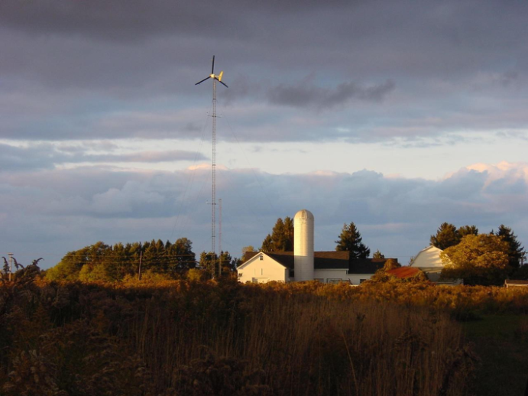
Small (Wind) is Beautiful

Slide 2
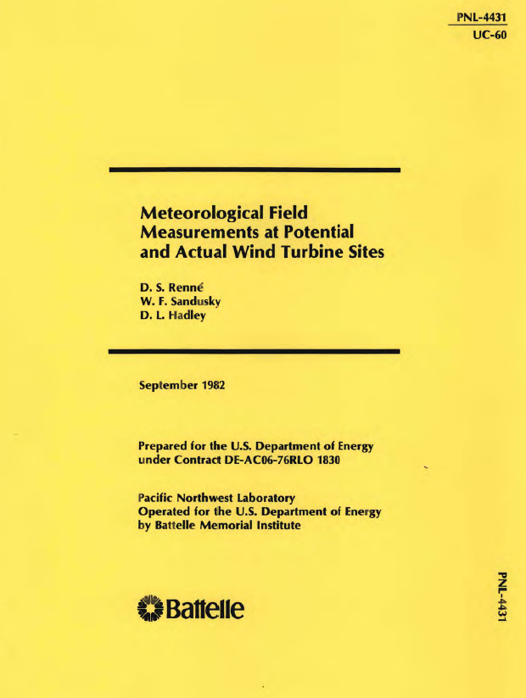
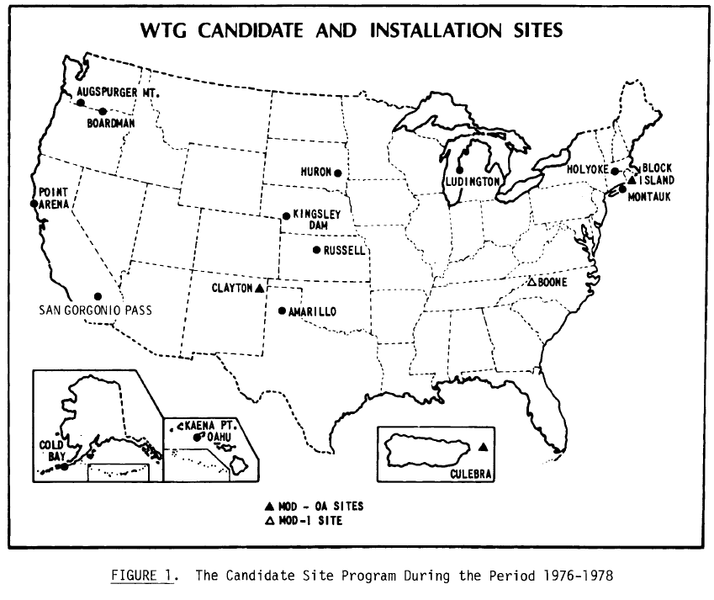
Early DOE Sponsored Wind Resource Assessment
15 sites selected
Boone: Dec 1976 – July 1981

Slide 3
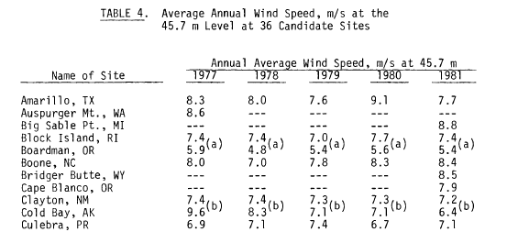
Boone Site Selected for MOD 1

Slide 4
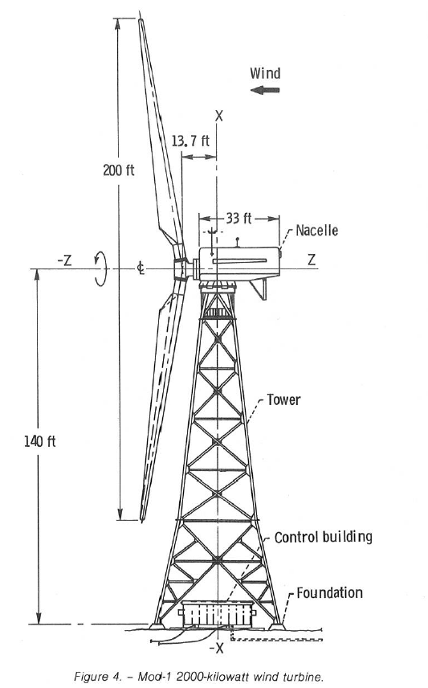
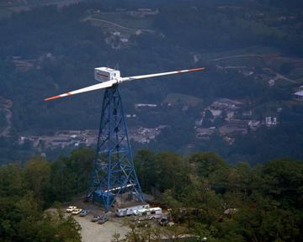
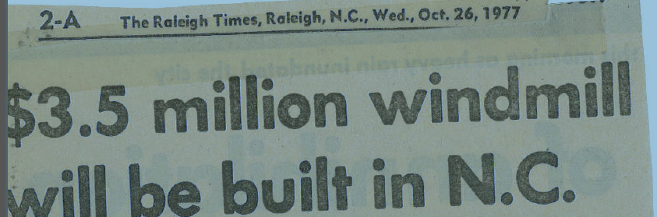
Boone, NC Gets World’s Largest Wind Turbine
1978 - 1983

Slide 5
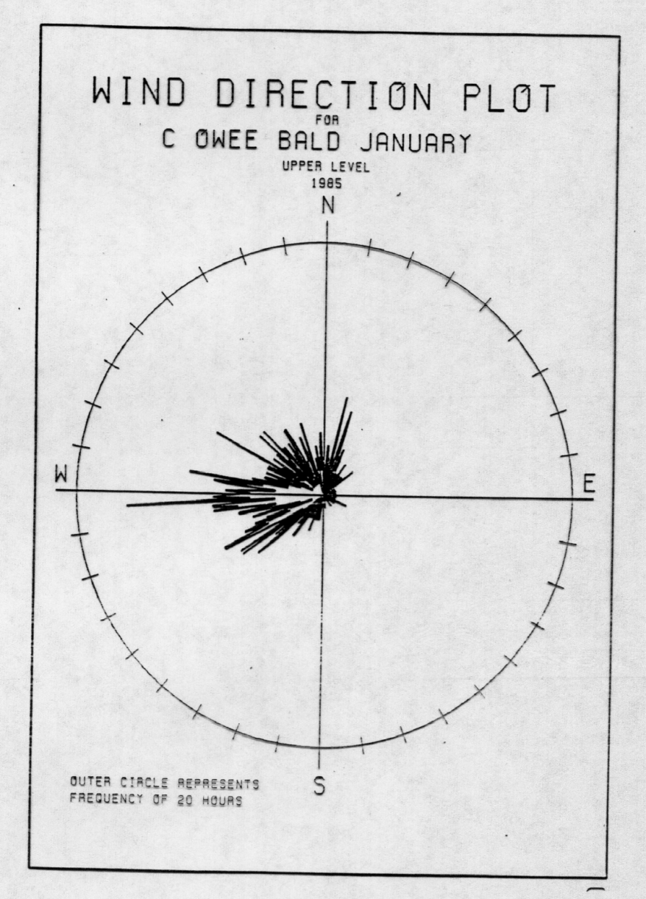
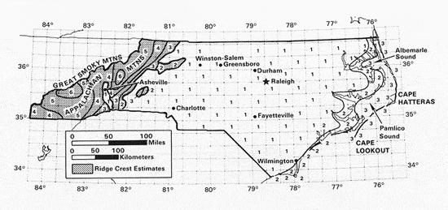
Wind Maps and Wind Data from 1980’s

Slide 6
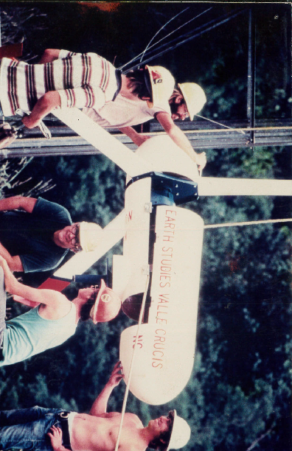
Appalachian Earth Studies Program Established 1977
Early wind studies and projects
  1980 proposal to TVA to establish a small scale wind power utilization in the Southern Appalachian region
    Enertech & Jacobs wind turbines installed with help from Charlie Hall from Vermont
  1982 Study of the Mod-1 Wind Turbine in Boone, NC and its Future Options
  1982 - First survey of public attitudes towards wind energy conducted in western NC

Slide 7







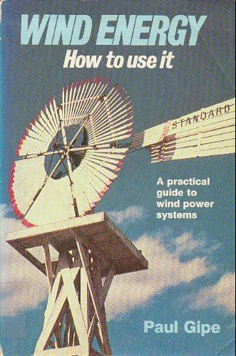
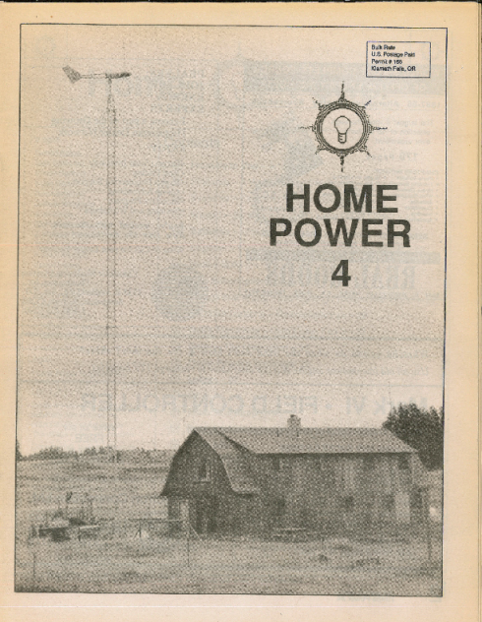
1970
1968
1970
1973
1975
1981
1983
1978
1987

Slide 8
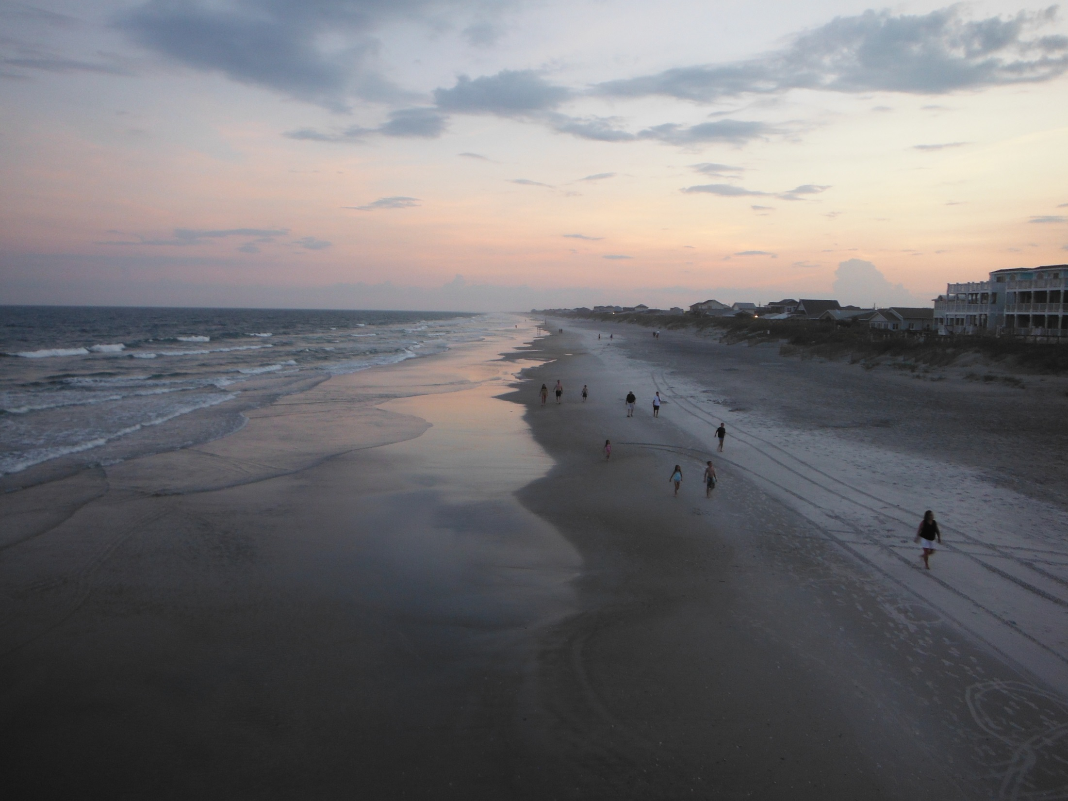

Slide 9
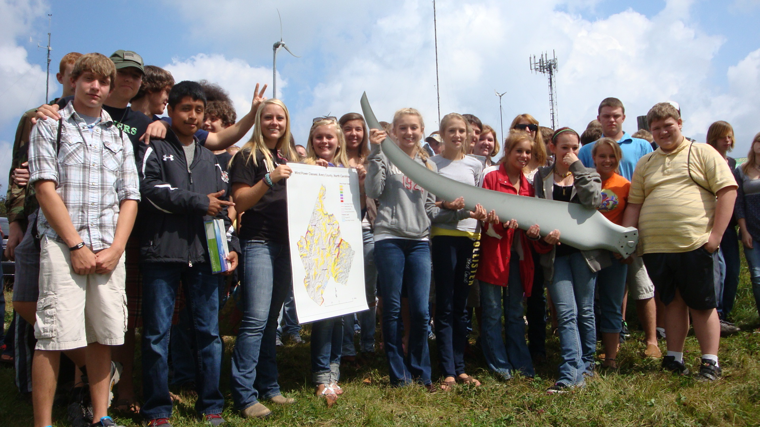

Slide 10
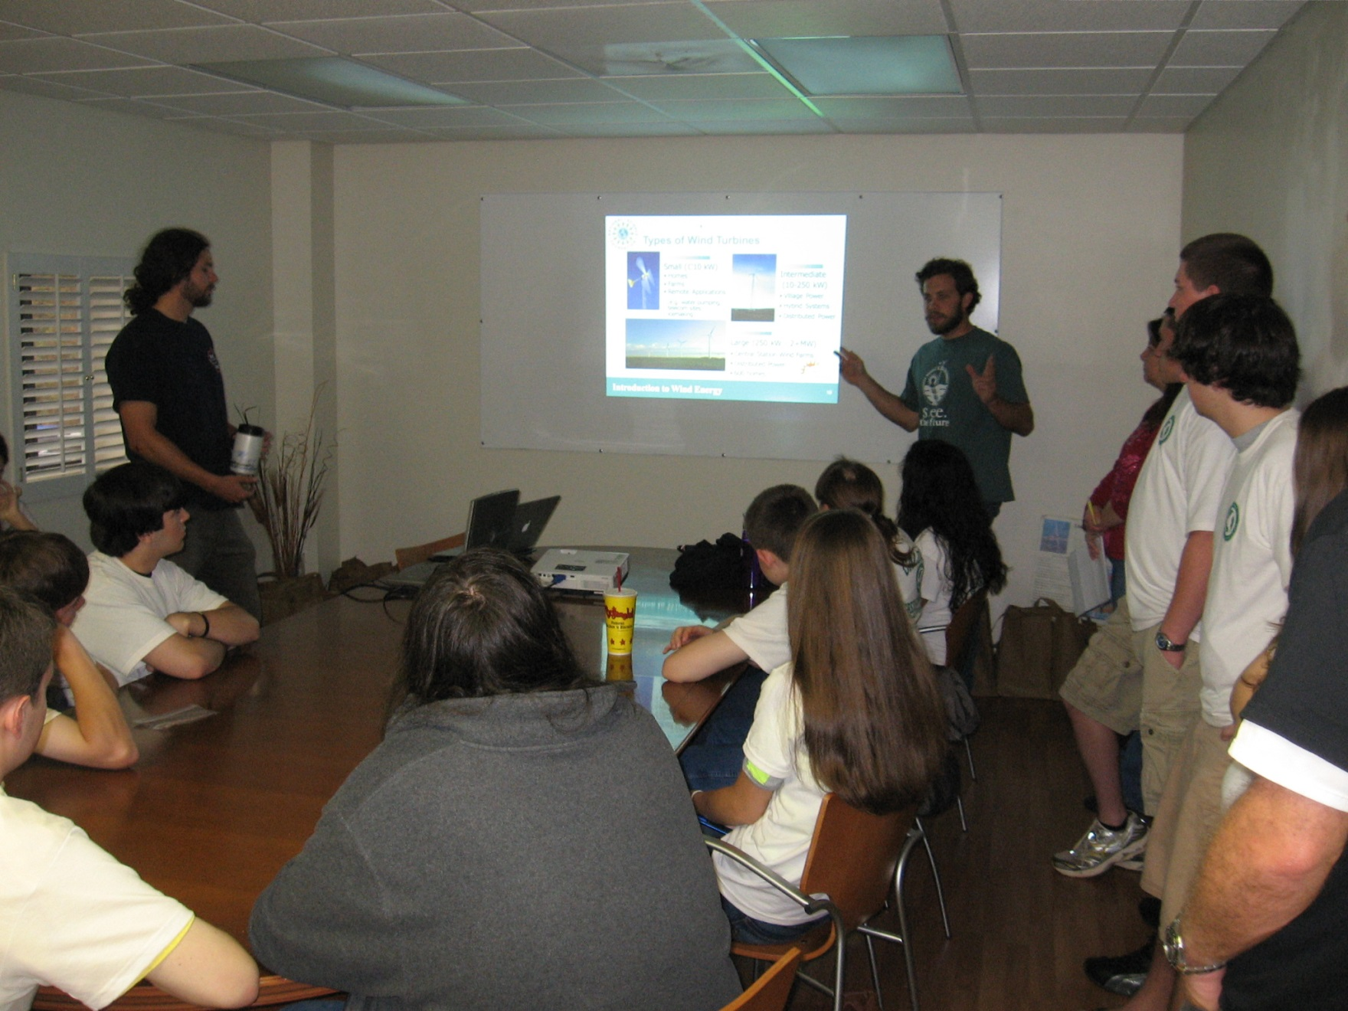

Slide 11
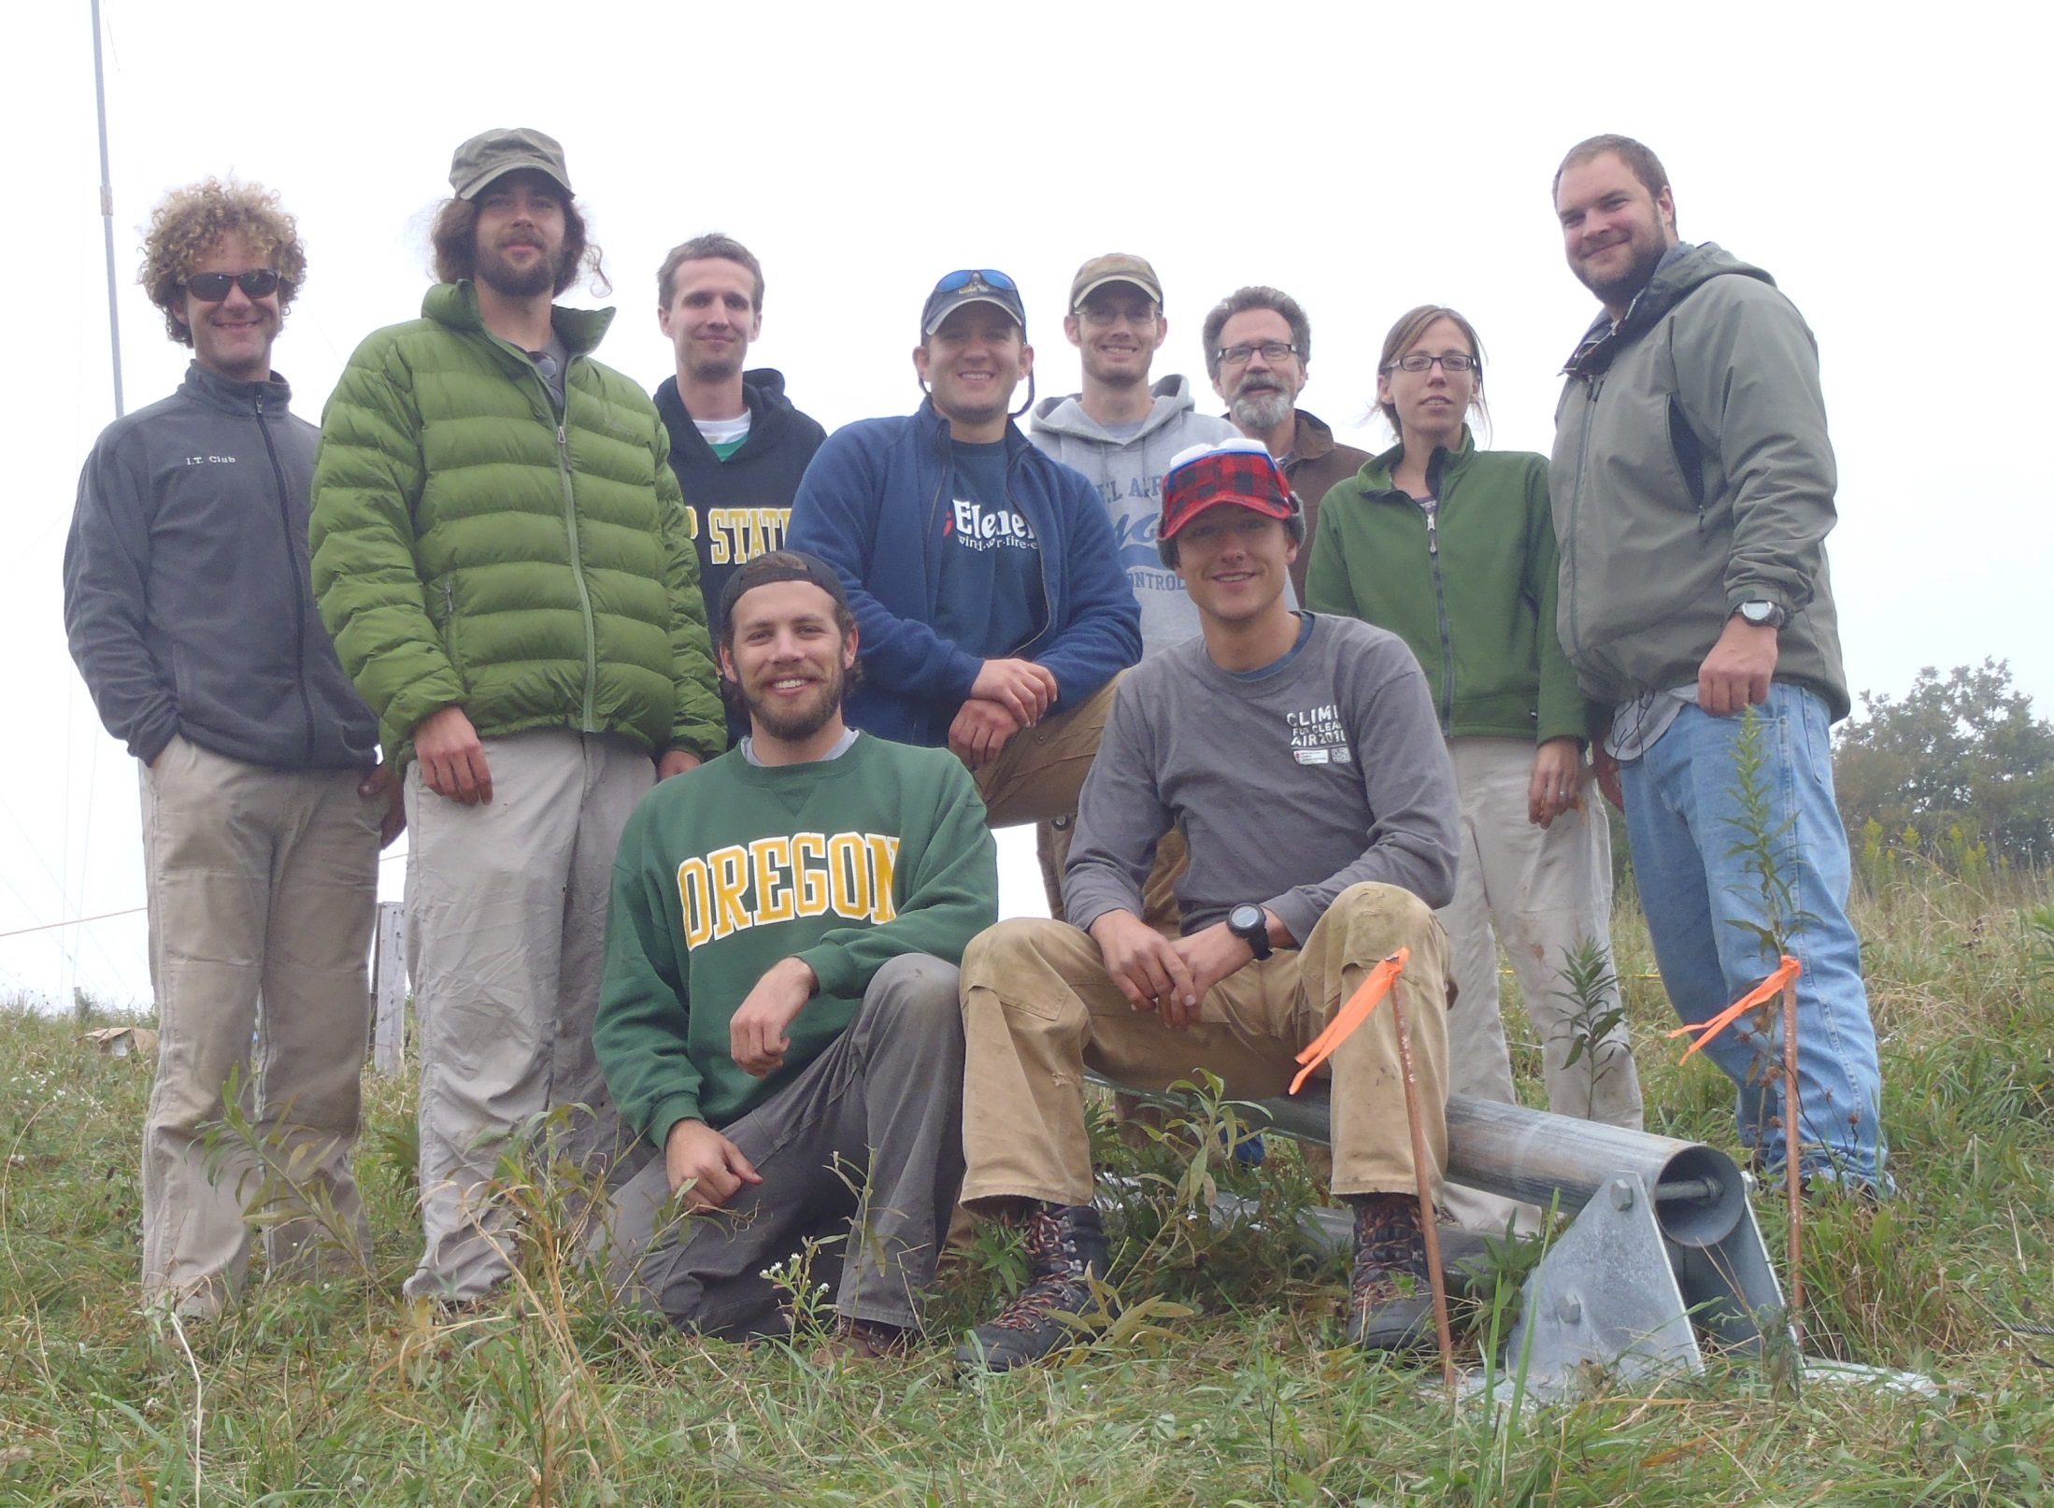

Slide 12
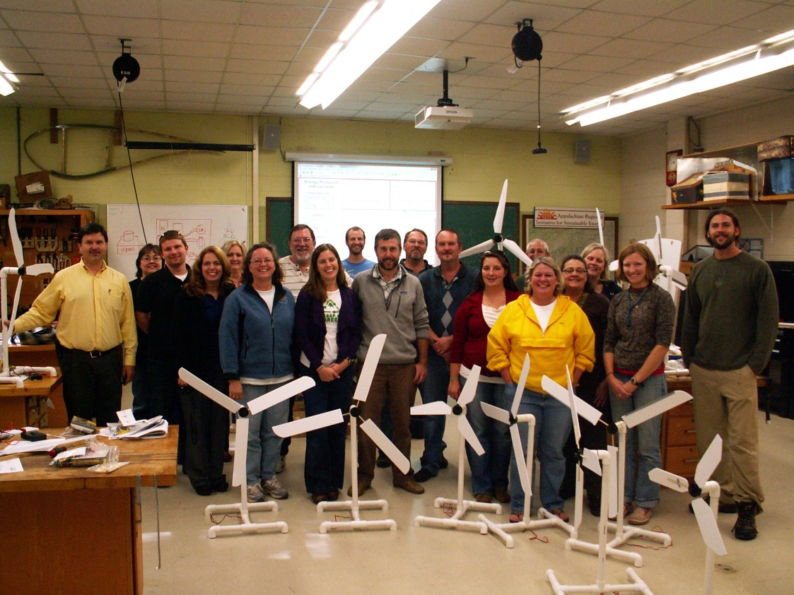

Slide 13
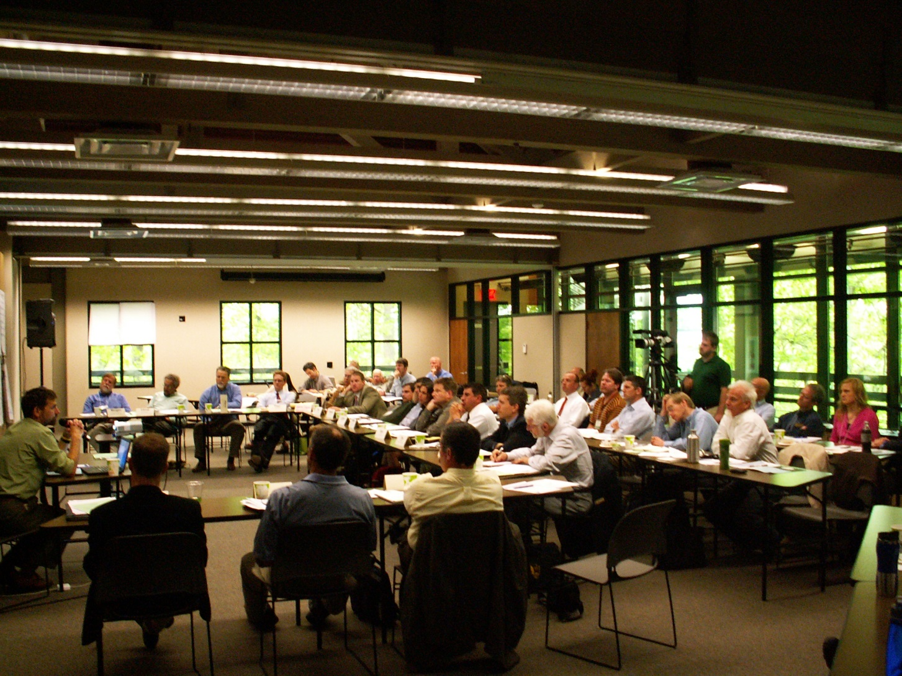

Slide 14
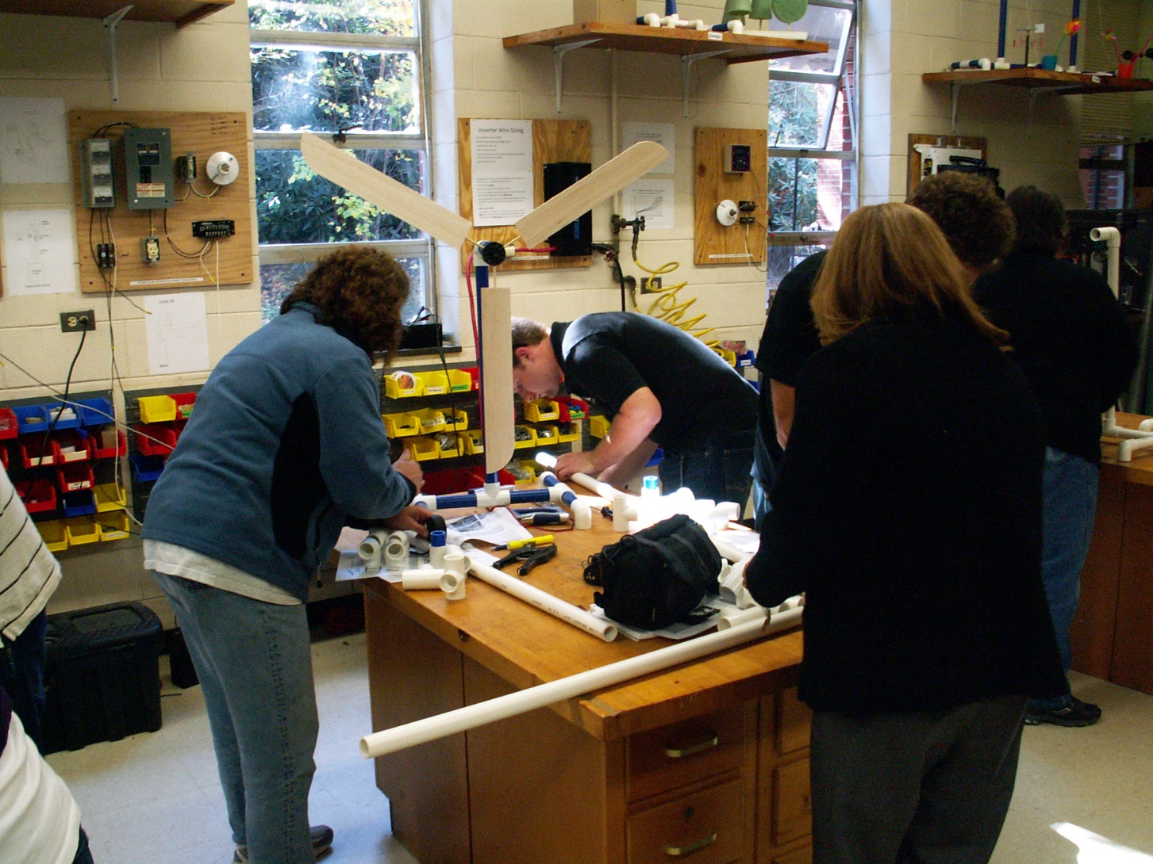

Slide 15
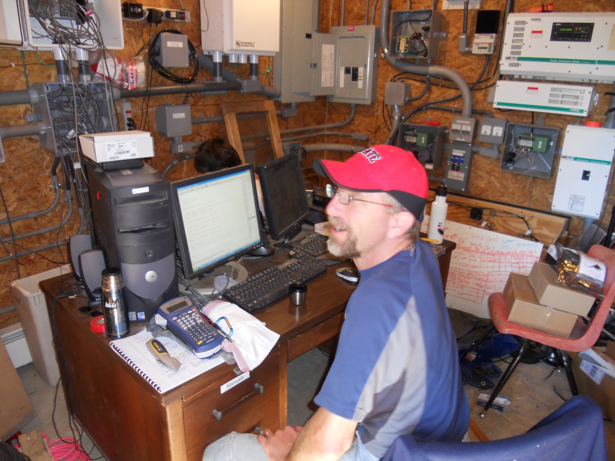

Slide 16
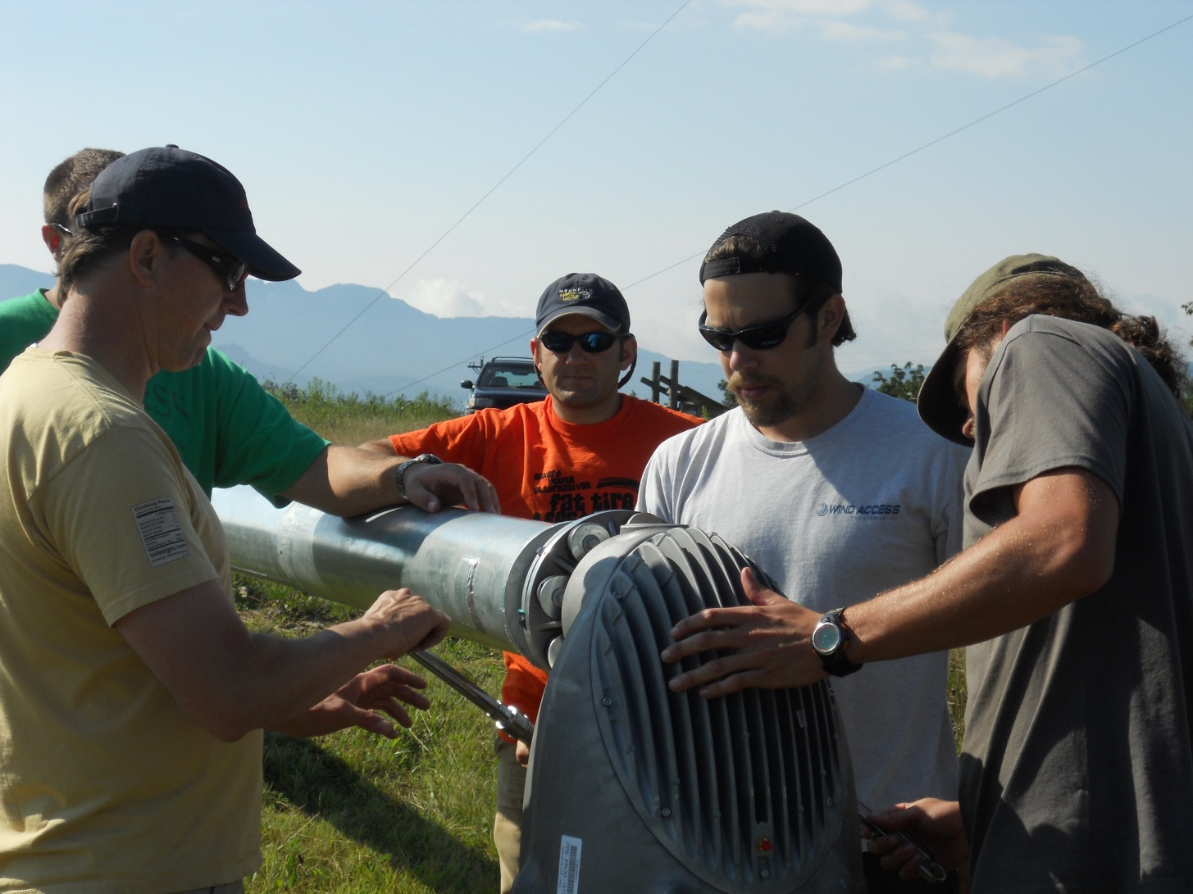

Slide 17
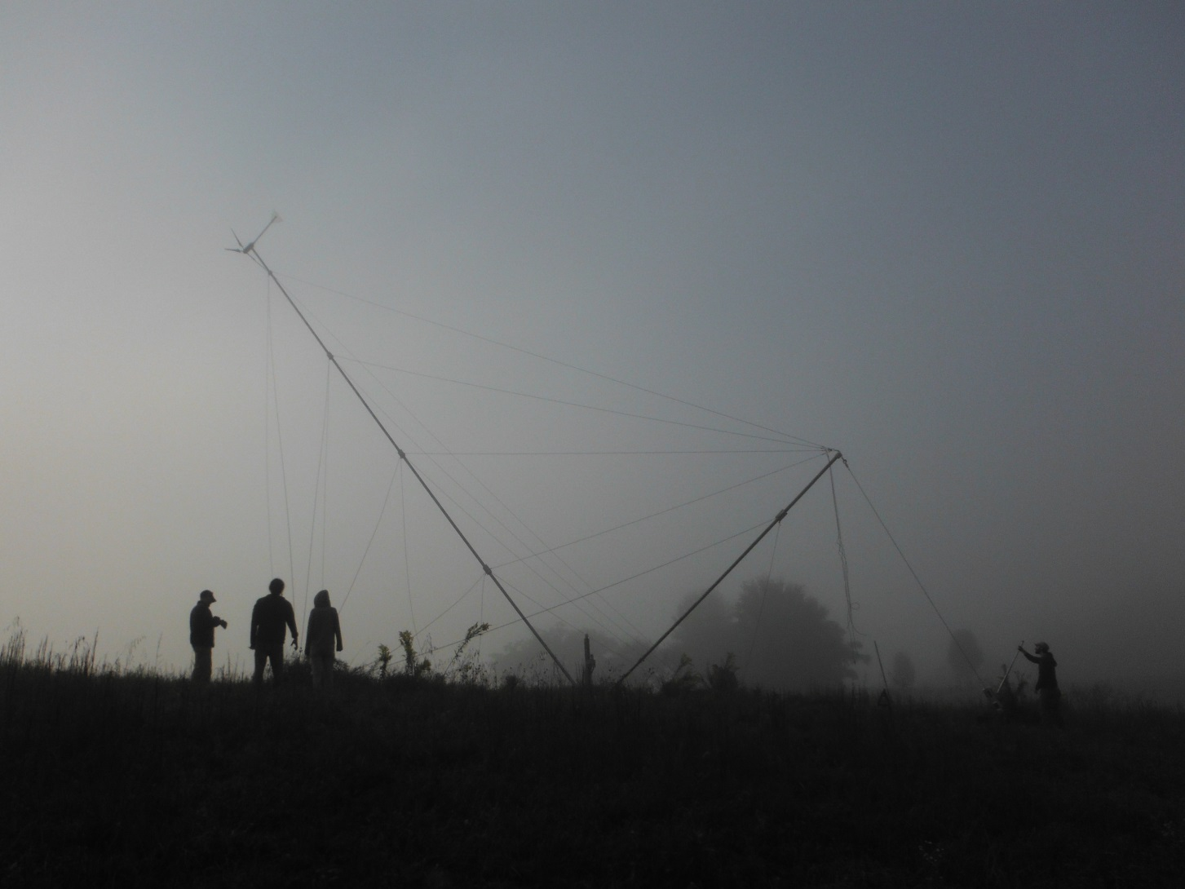

Slide 18
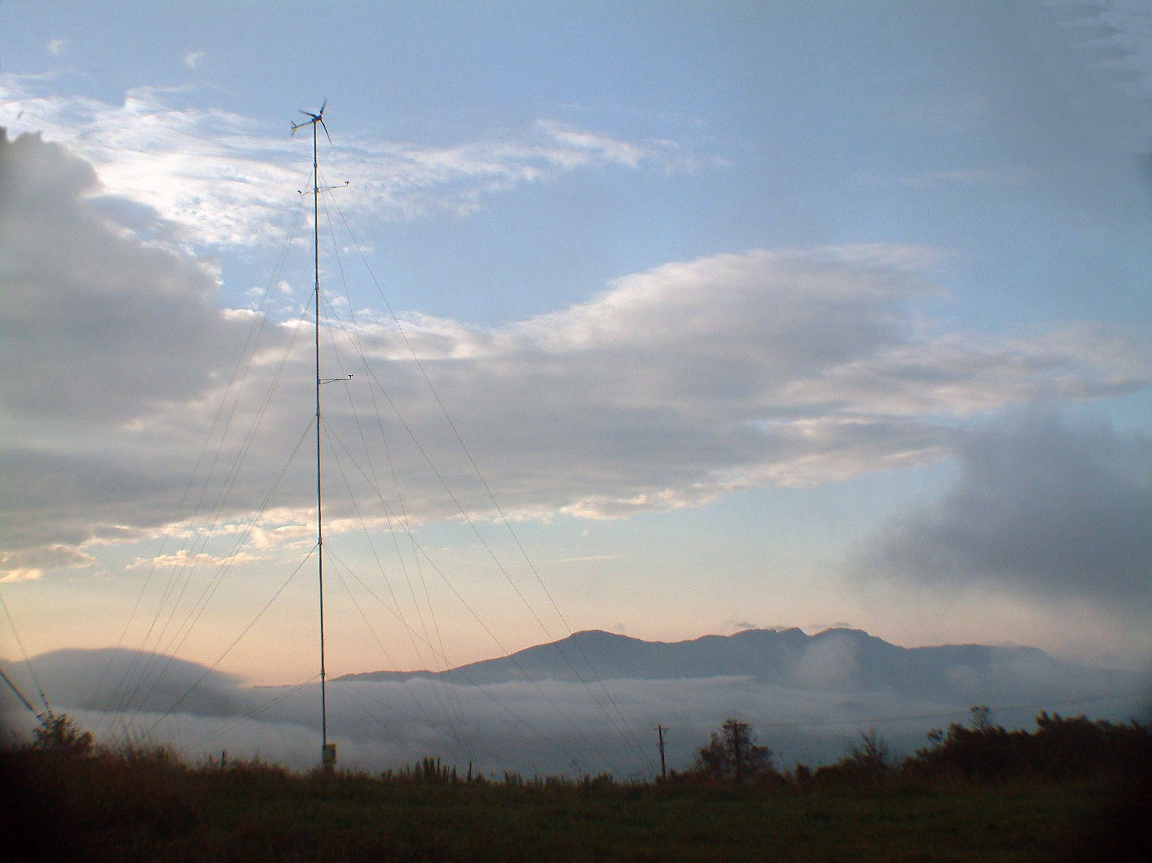

Slide 19
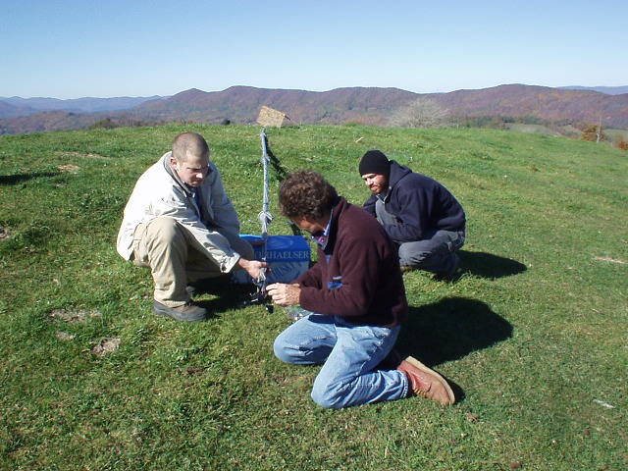

Slide 20
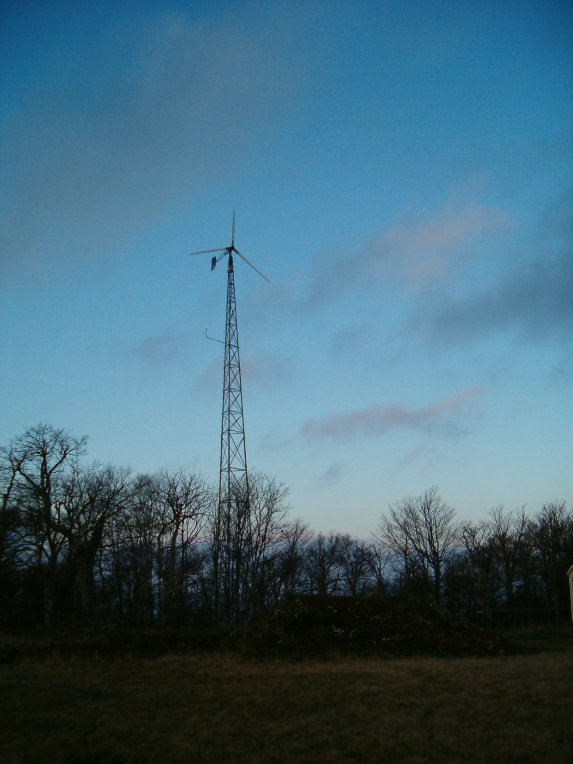

Slide 21
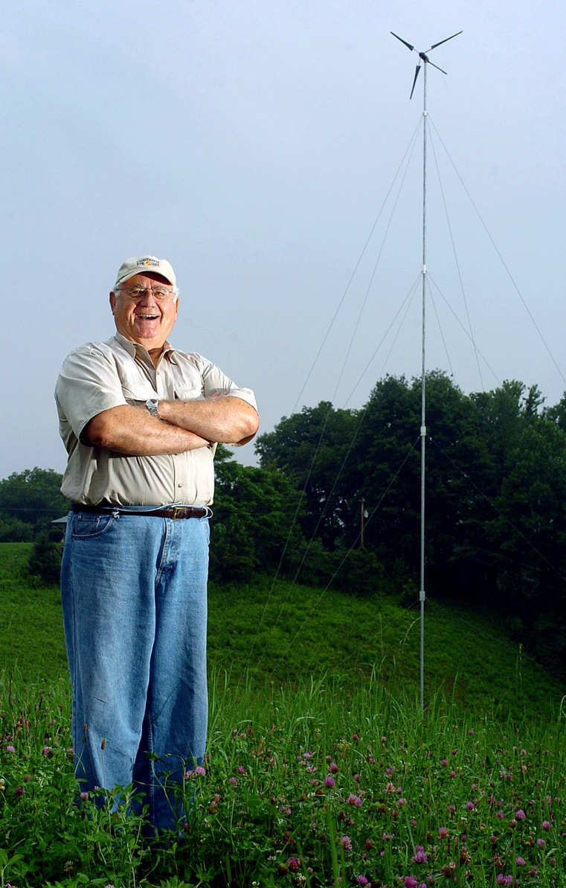

Slide 22
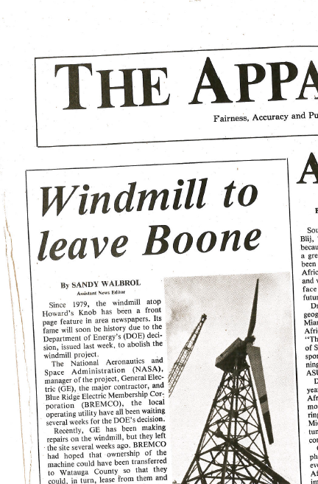

Slide 23
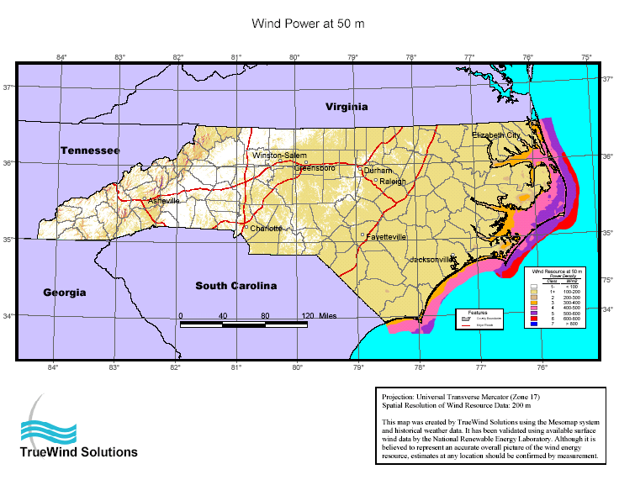
2,400 MW – 12,000 MW

Slide 24
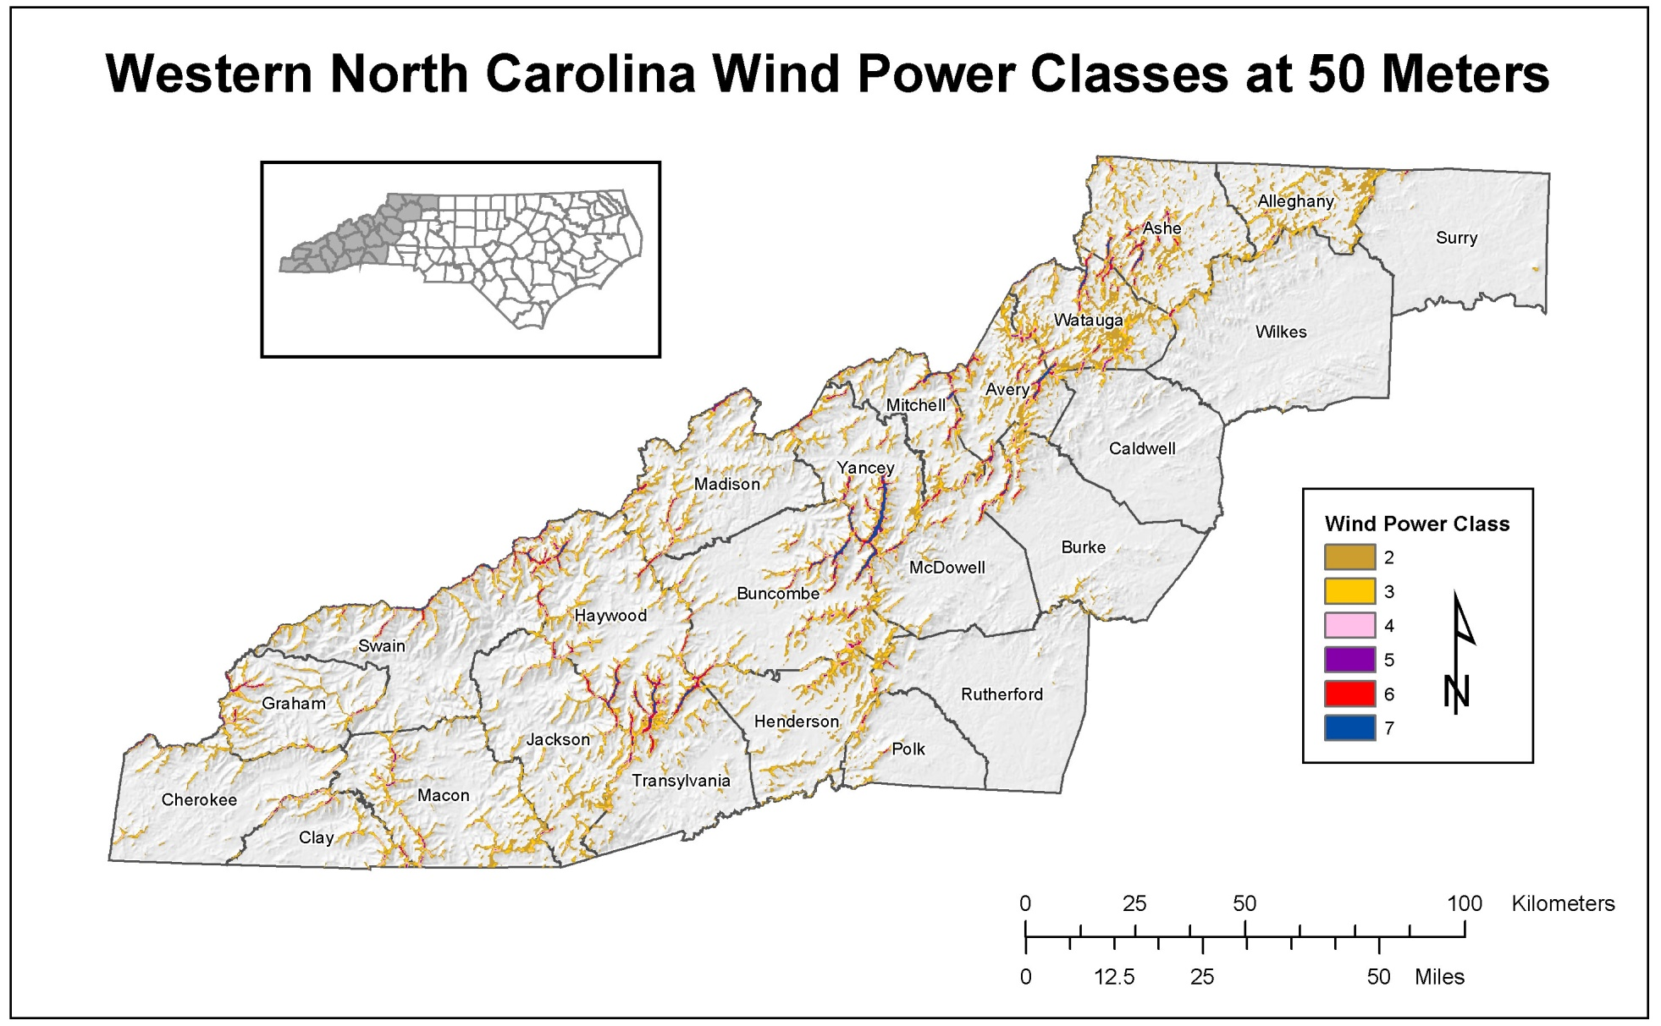

Slide 25
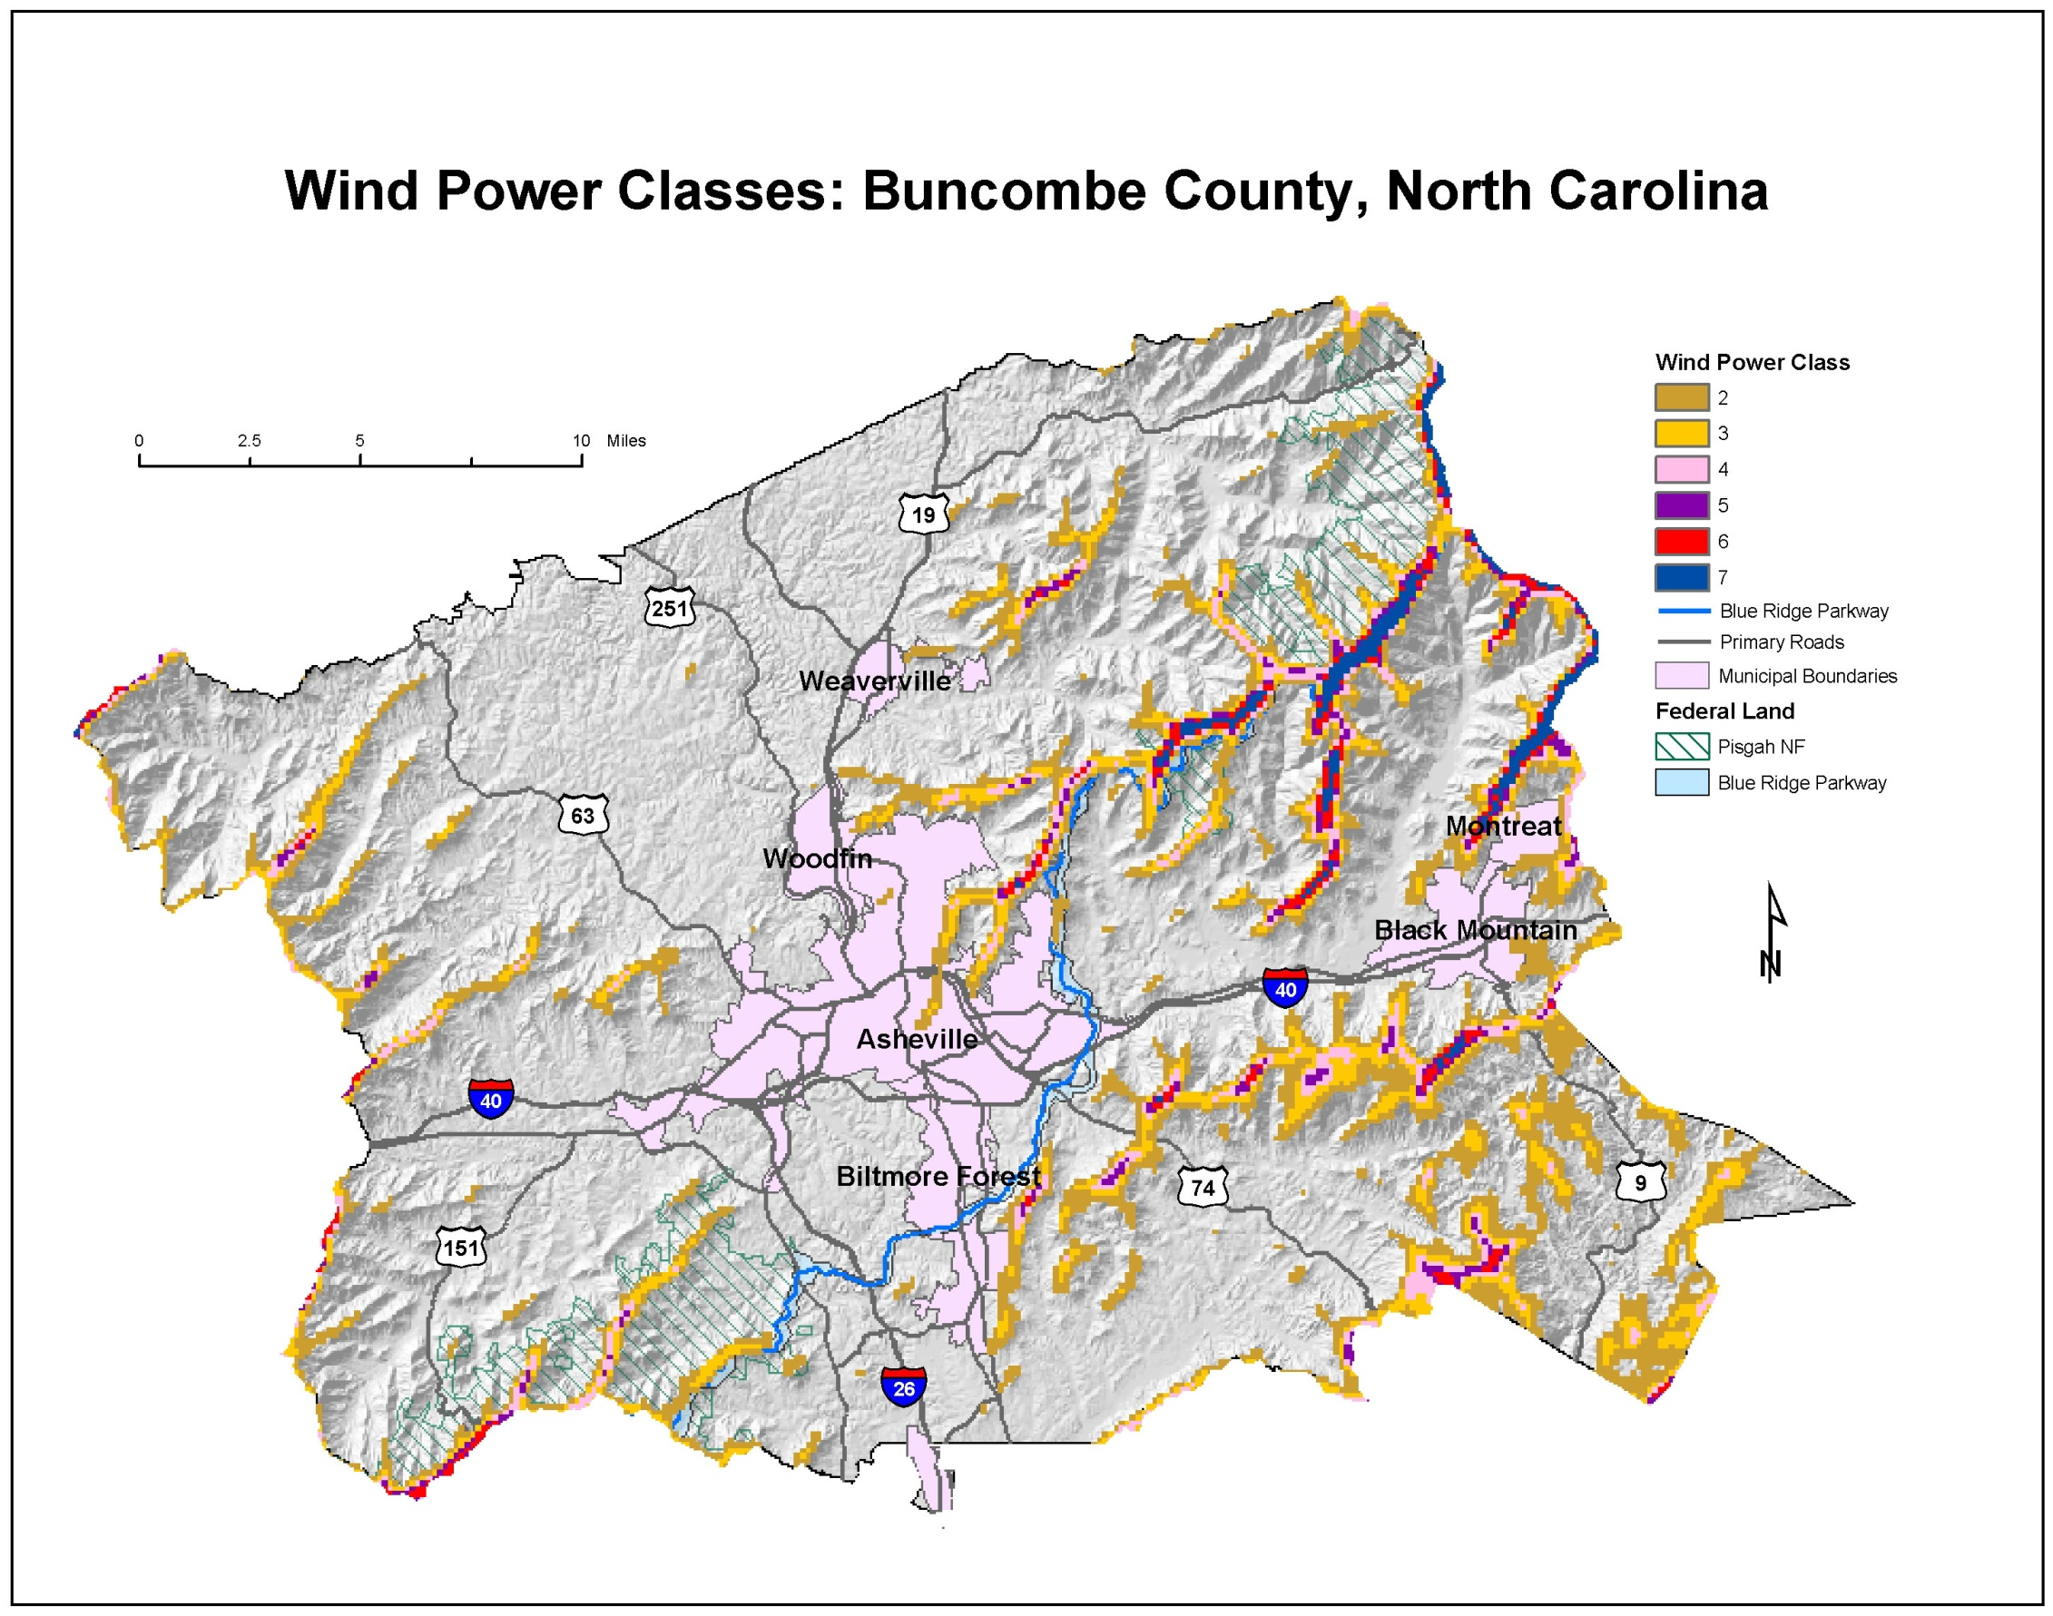

Slide 26
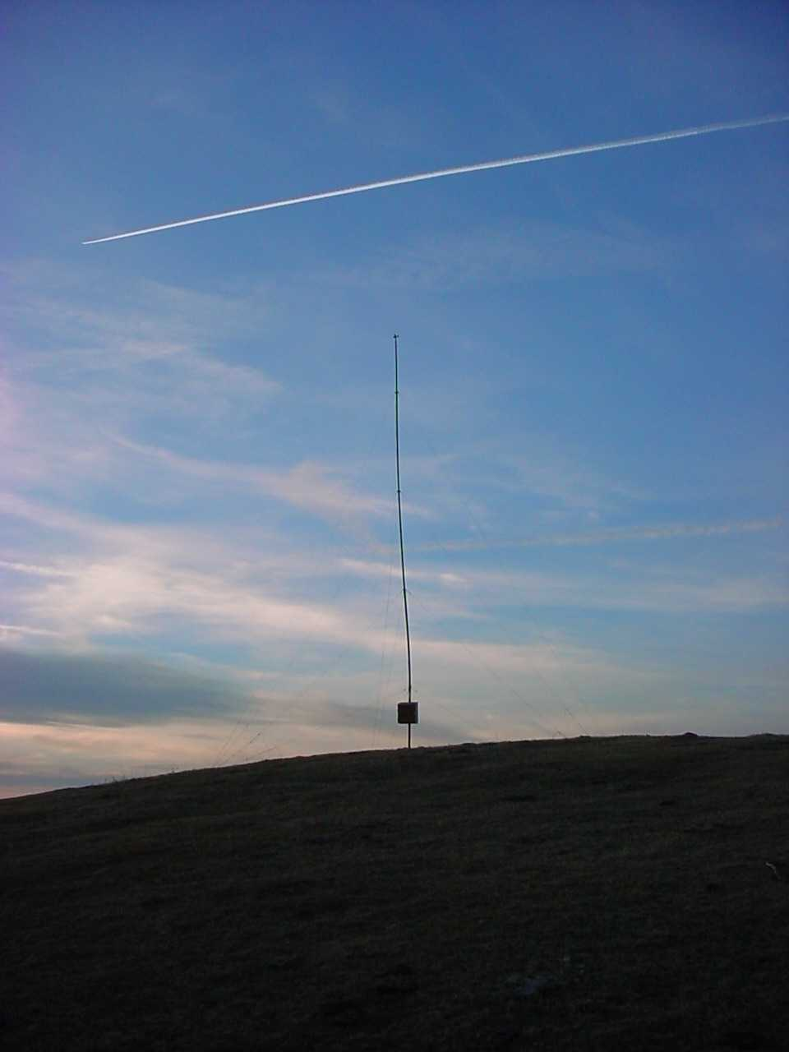
Anemometers
Financing wind projects normally requires actual wind measurement by third party. 1 year of data is desired.

Slide 27
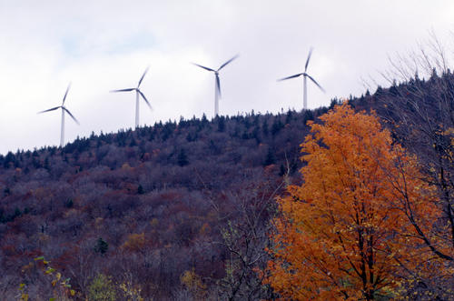
Wind Power For North Carolina
Notes:
5 - 6 MW wind project; a realistic target for 2004

Slide 28
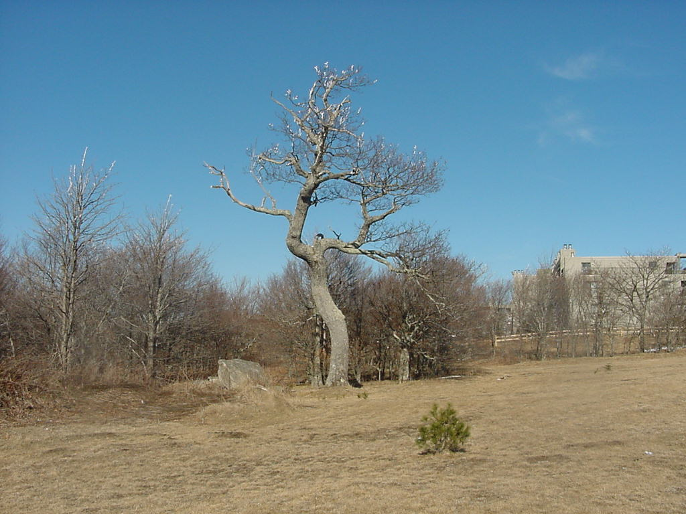

Slide 29
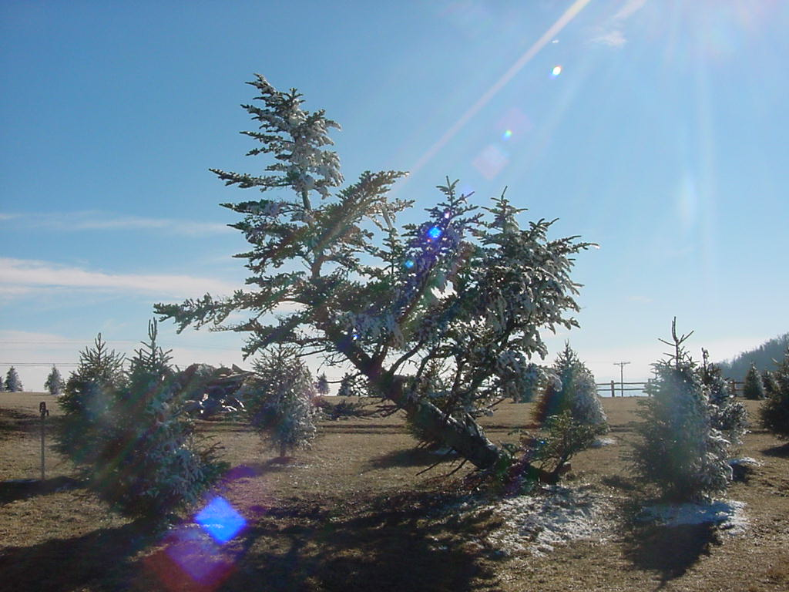

Slide 30
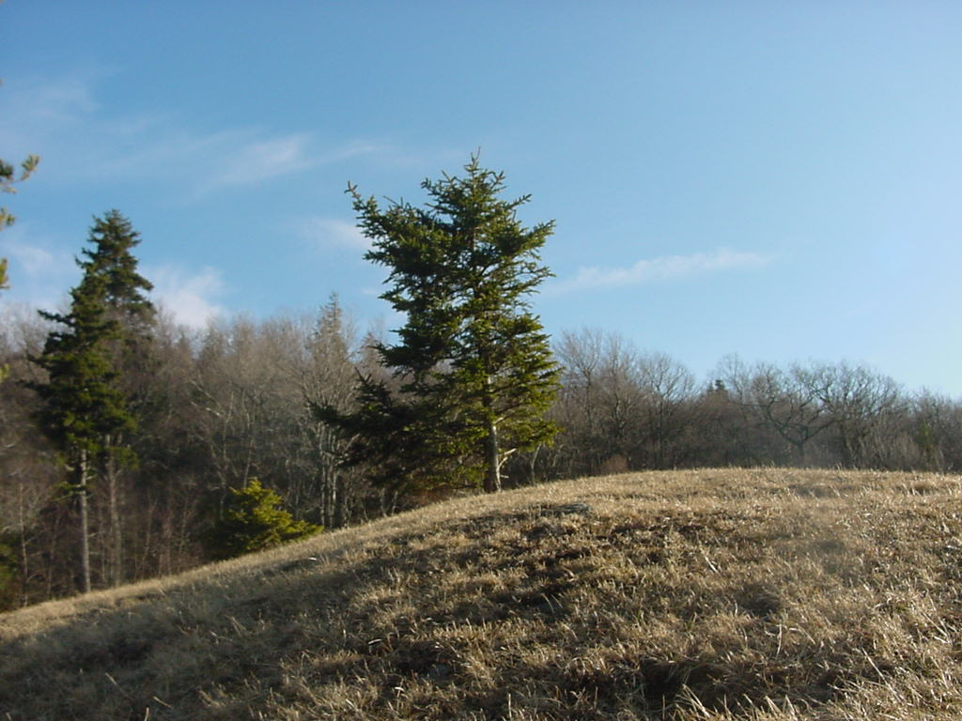

Slide 31
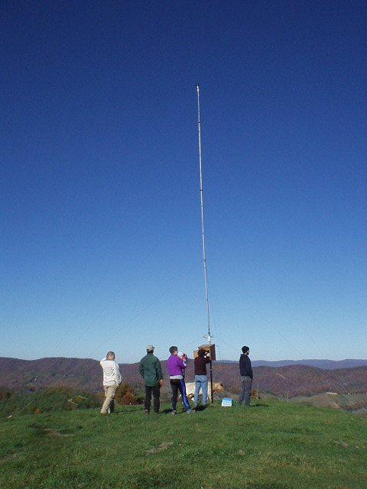

Slide 32
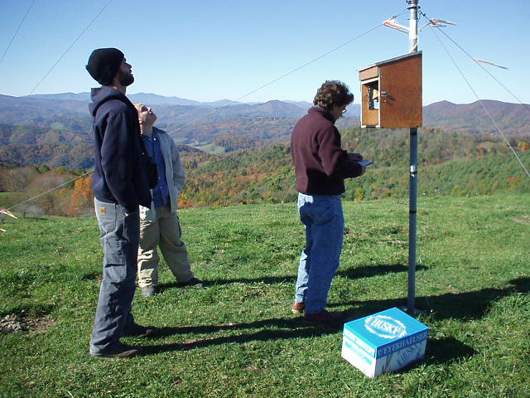

Slide 33
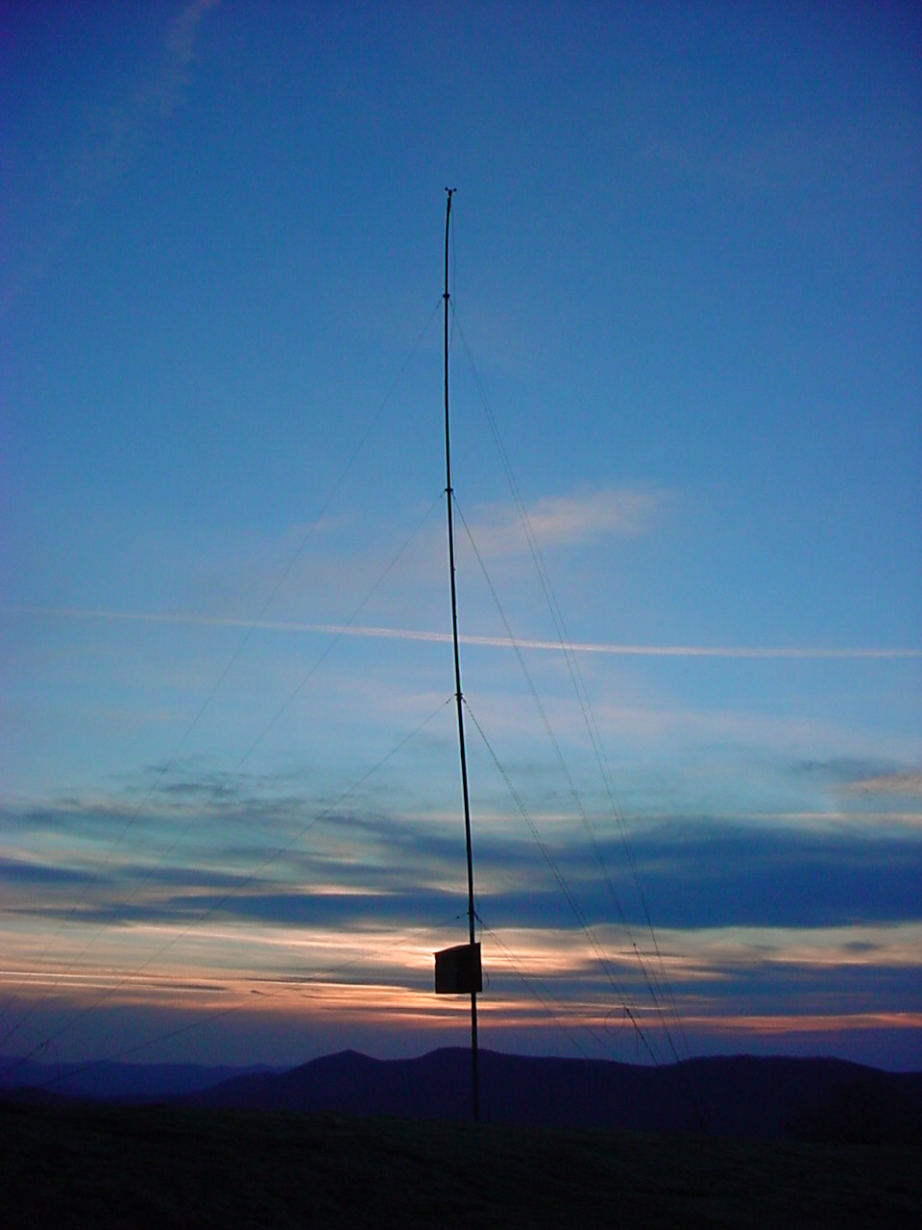

Slide 34
Boone, NC 2MW Mod-1 Turbine: 1979 - 1983

Slide 36
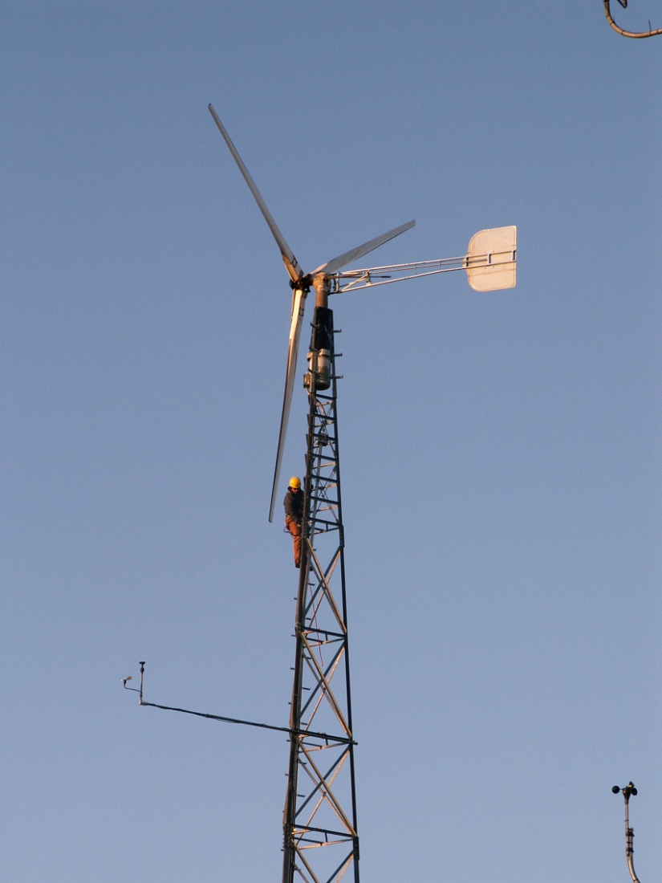
History of Program
Program had its beginnings in 1978 as Earth Studies in IDS
Moved to Technology Department in 1984
Likely the oldest continuously operating program for the study of AT in America

Slide 37
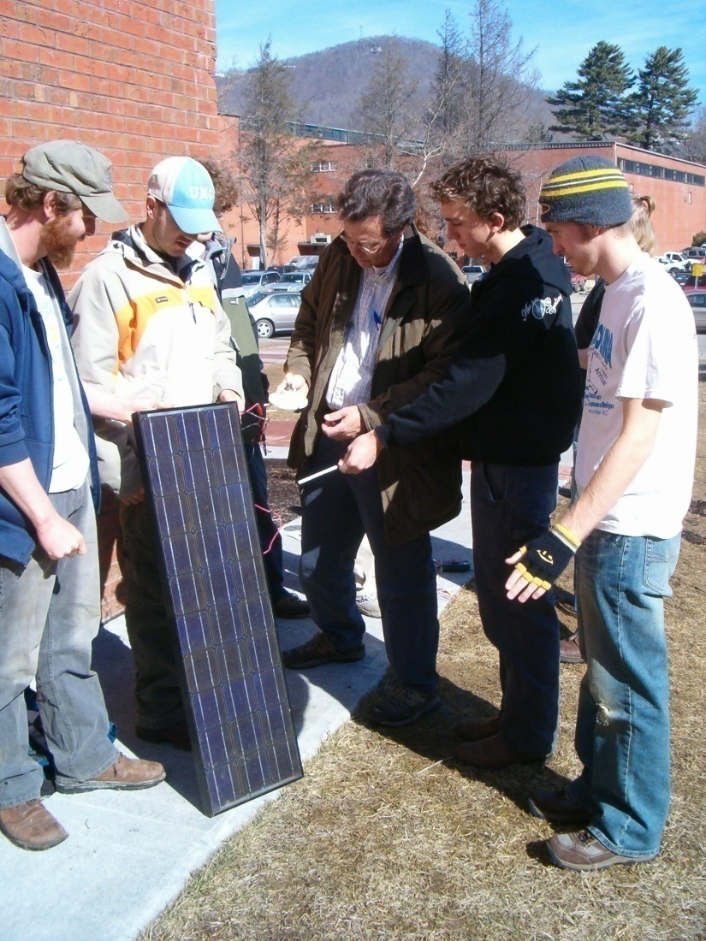
Appalachian’s Appropriate Technology Programs
BS in Appropriate Technology
Undergraduate Minor in AT
MA in Appropriate Technology
Non-credit Workshops

Slide 38
AT Undergraduate Majors

Slide 39
BS Curriculum (122 Hours for BS)
Core Courses (41 hrs)
  English
  Math
  Science
  Physical Education
  Social Sciences
  Humanities
Introductory TEC courses (24-27 hrs)
  Drafting & Design
  Tools, Materials & Processes
Interdisciplinary Courses (9 -11 hrs)
  Environmental ethics, economics, planning
Technical Specialization (22-24 hrs)
  AT related courses
Senior Project/Thesis (3 hrs)
Electives or Internship (12 hrs)

Slide 40
AT Courses Offered
Introduction to Energy Issues & Technology
Wind & Hydro Power Technology
Photovoltaic System Design & Construction
Sustainable Building Design & Construction
Solar Thermal Energy Technology
Building Science
Sustainable Transportation
Sustainable Resource Management
Sustainable Water & Wastewater Technology
Biodiesel Technology

Slide 41
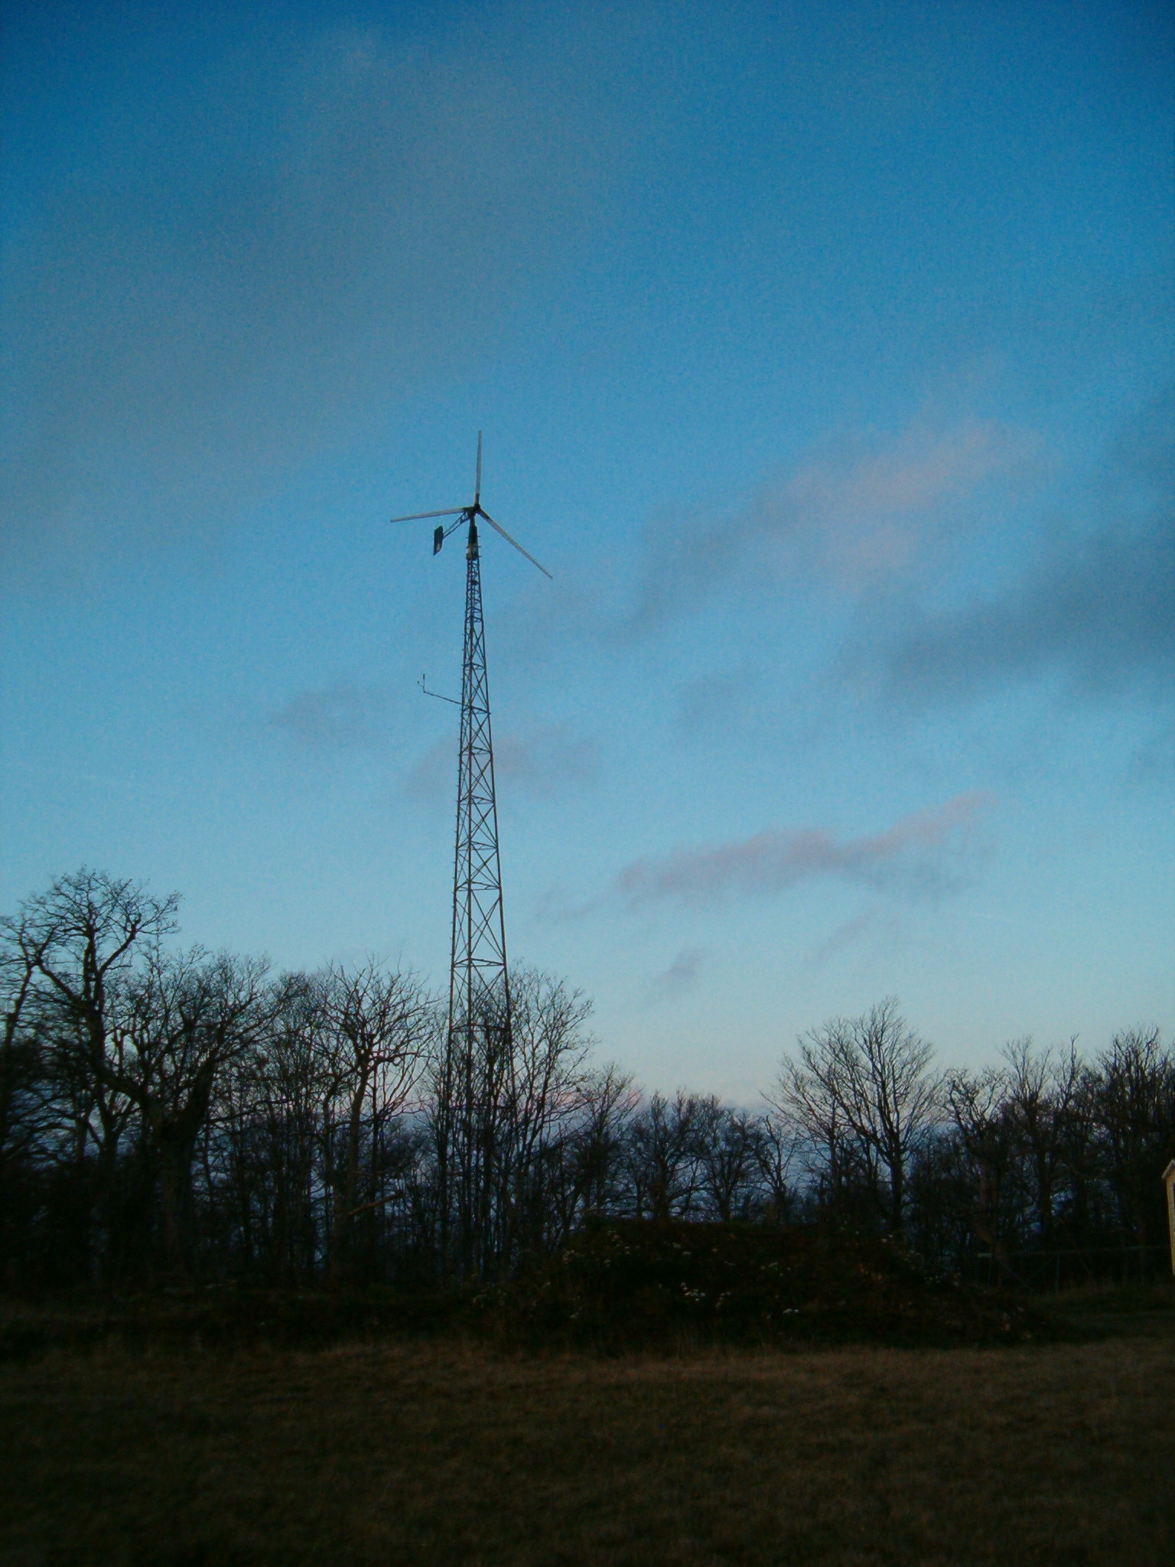
North Carolina Wind Energy Projects
Appalachian Renewable Energy Initiative
Funding from the NC State Energy Office, US DOE
Tennessee Wind Working Group
March 5, 2005

Slide 42
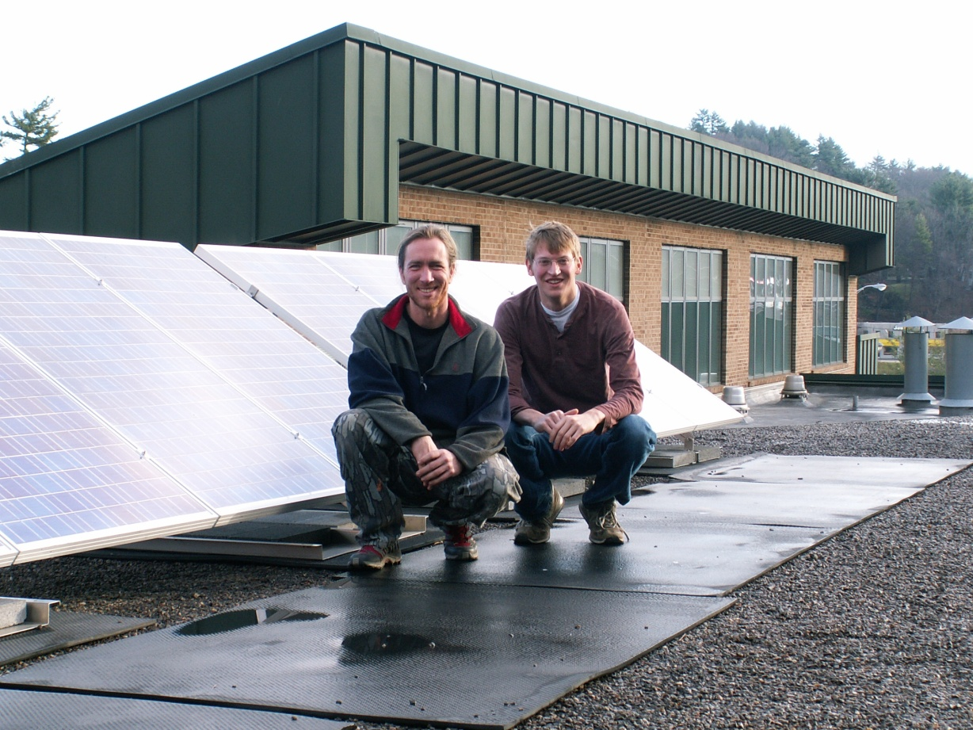
Major Aspects
Resource Assessment
Technology Assessment
Outreach & Education

Slide 43
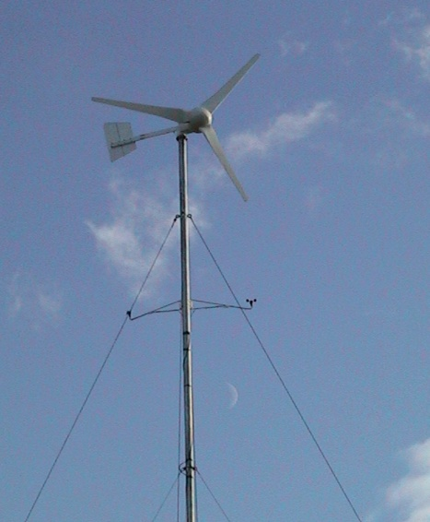
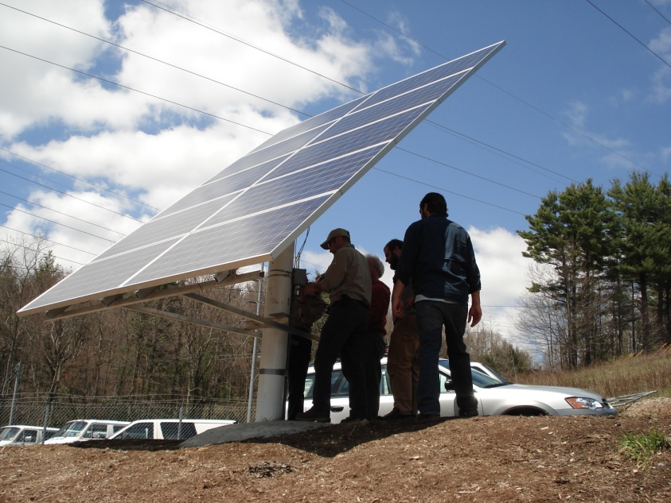
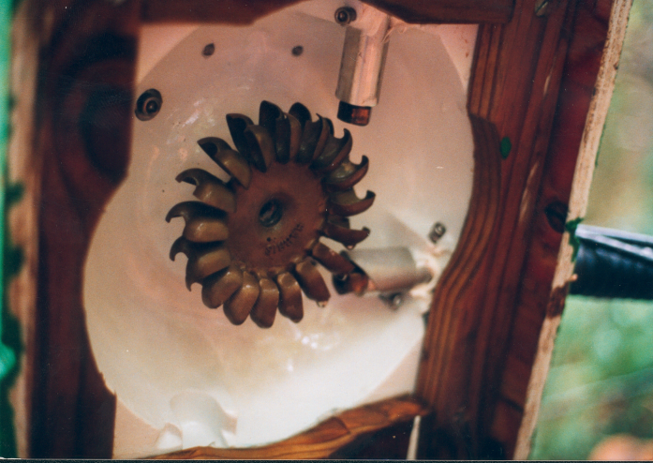
Target Technologies
Wind Power
Solar Power
Hydro Power

Slide 44
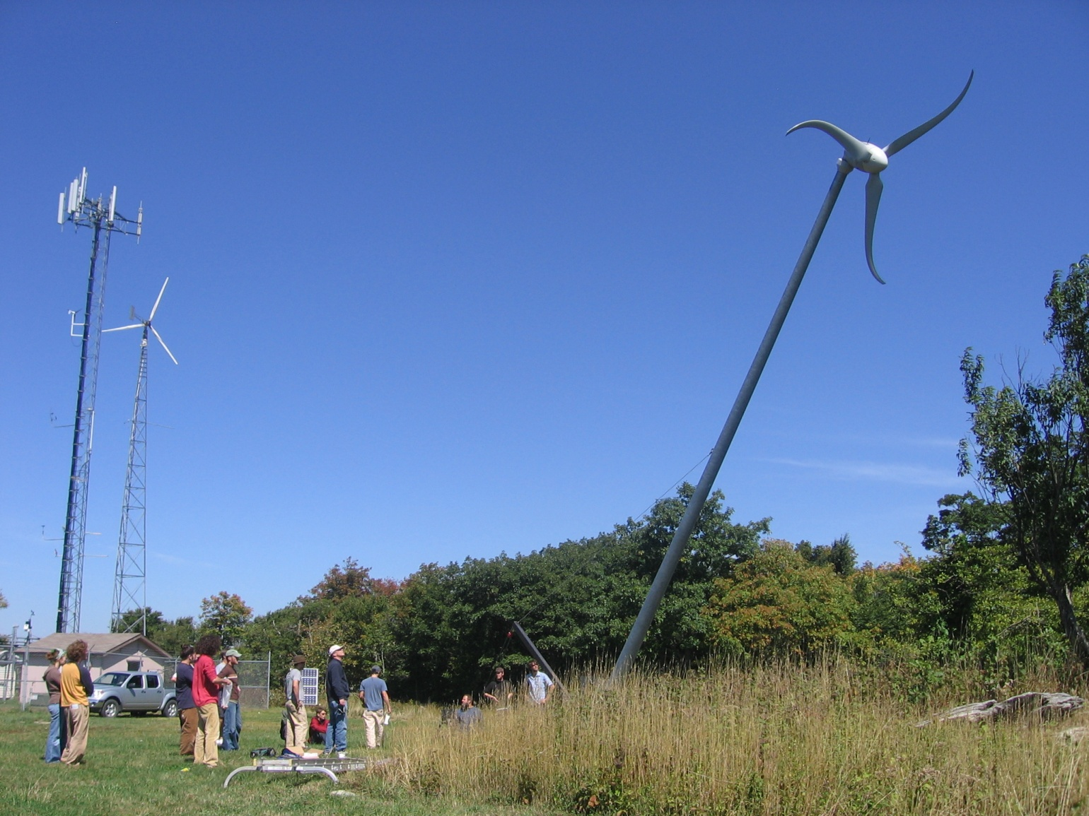
Wind Energy

Slide 45
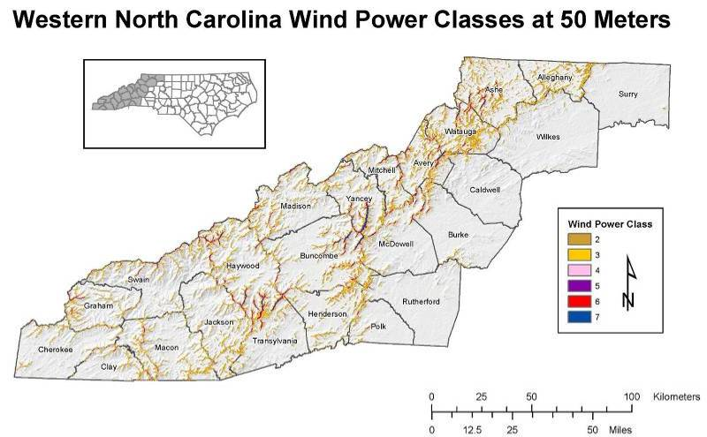
24 County Western NC Wind Map
Acres of Windy Land in WNC
Class >= 2 771,024 acres
Class >= 4 [utility wind] 138,000 acres
1850 miles of Ridge line (1000 miles with class 4 & above)

Slide 46
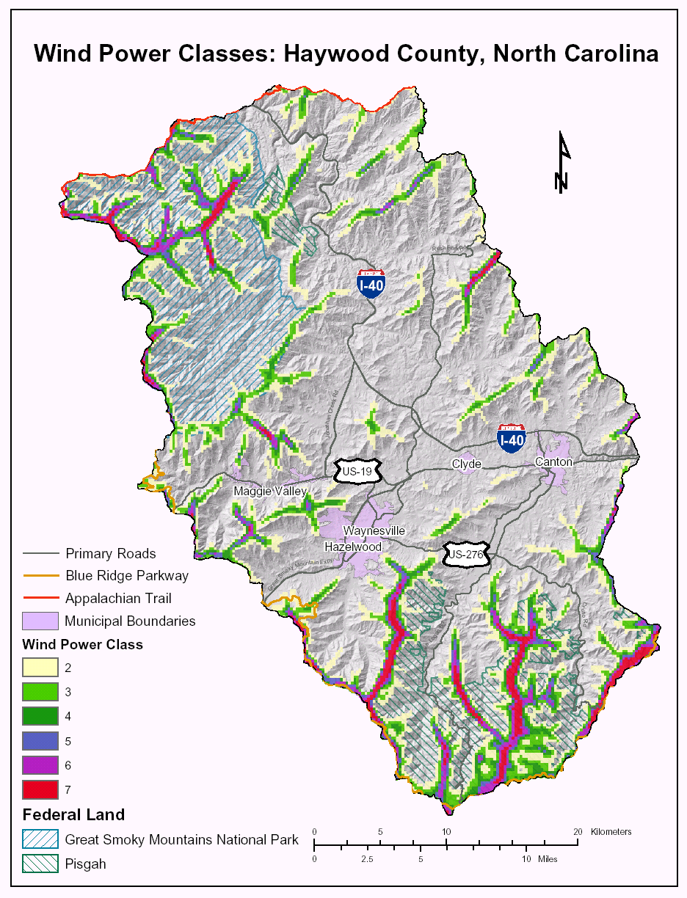
County Wind Maps for Western NC
True Wind Map Combined With:
Road data
Digital elevation models
Public lands
Appalachian Trail
Town boundaries
Utility grid
Tax parcel maps
www.wind.appstate.edu

Slide 47
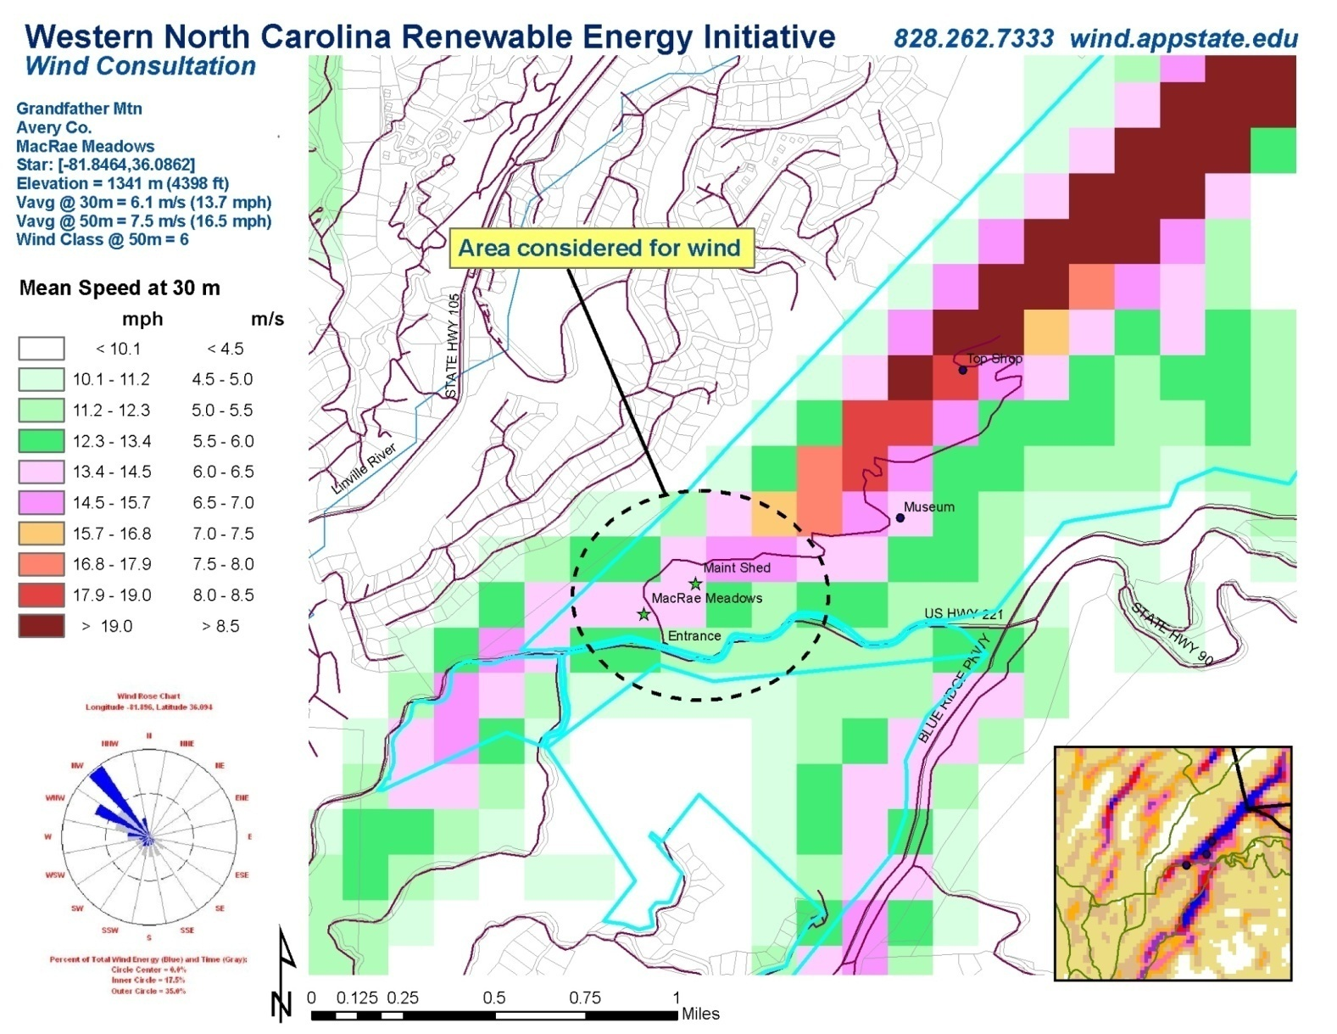
Custom Wind Maps

Slide 48
Mailing to 16,000 property owners; class 3 & higher

Slide 49
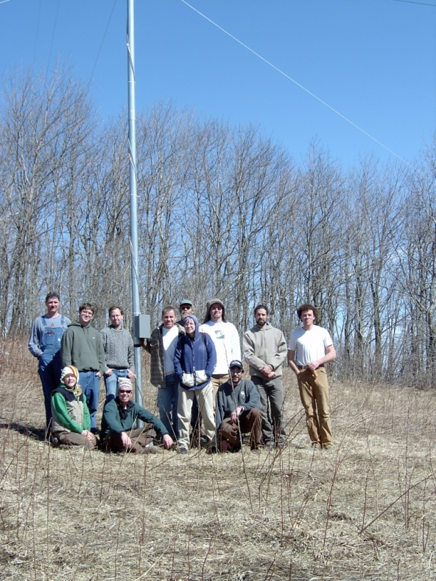




Anemometer Loan Program

Slide 50

Appalachian Small Wind
Research & Demonstration Site

Slide 51

Economics
Each 100 MW of wind energy development in region will produce approximately:
$27 million in economic benefit to state during construction and over $60 million over project life
$7.32 million paid in wages during construction and $1.35 million in wages each year during operation
  250 jobs during construction
  45 long term jobs
Property tax revenue: approximately $550,000/year in NC (low by national standards)
Land Lease Payments: $250,000 - $400,000/year (2-3% of gross revenue or $2500-4000/MW/year)
Approximately 350 million kwh every year, at a competitive price and without any air pollution or energy price increases. Enough to power 33,000 houses.
Each MW of wind development costs approximately $1million dollars
Each MW of wind will produce between 3 – 3.5 million kwh/year on a good wind site.

Slide 52

Attitude Survey Work
Western NC Survey found:
  75% support wind energy
  63.5% support for turbines on ridge tops, 19% against
  79% supported single turbines, 9% against
  57.3% supported clusters of 10 or more turbines on ridge tops, 27.5% against
  66% supported turbines near their home, 21% against

Slide 53

Number of Utility Scale Turbines in Class 4/5 Sites @ 80m to produce 10%:

Slide 54

What could it look like? Fuhrlander
From the Blue Ridge Parkway overlook; 1-1/4 miles away

Slide 55

Macro Avian Impact Assessment
Potential Avian Impacts of Wind Energy Development
in
Western North Carolina: A Literature Review
prepared by
Curtis Smalling
Ecos of the Blue Ridge
667 George Moretz Lane
Boone, NC 28607
For
North Carolina State Energy Office
&
US Department of Energy
January 2003

Slide 56





TVA Stone Mt. Site Issues
Listed, Proposed Endangered, Threatened, or Species of Concern
  Weller’s Salamander
  Cooper’s Hawk
  Peregrine Falcon
  Common Raven
  Yellow-Bellied Sapsucker
  Shrews
  Eastern Big Eared Bat
  Indiana Bat
  Golden-Winged Warbler

Slide 57







ASHE COUNTY SPECIES OF CONCERN

Slide 58


Noise Research

Slide 59



Biodiesel

Slide 60
Renewable Energy Initiative
Solar Thermal Water Heating for the Plemmons Student Union
Raley Photovoltaics (PV) Project
Broyhill Wind Project
Harper Hall PV Project
Biodiesel PV project
Biodiesel Processor & Supply project

Slide 61

BioDiesel

Slide 62


Renewable Energy Workshops

Slide 63

Workshops

Slide 64

Website: wind.appstate.edu

Slide 65

Wind Working Group
Telephone Conferences
Meetings
Meetings with elected officials
and others
Fact Sheet development
Public policy work
Model Wind Ordinance
Regional articles and presentations
Coalition of Environmental,
Energy, State Energy Office,
DOE, University, and
Industry folks

Slide 66


Anemometer Loan Program

Slide 67


Slide 71
Outreach & Education

Slide 72



Slide 73



International Work

Slide 74

Student Clubs
ASU Sustainable Energy Society
Sustainable Transportation Club
Habitat for Humanity

Slide 75


Technical Assistance
Resource assessment consultations for solar, wind & hydro
Provide information & answer questions
Recommend installers in region
Policy recommendations
Presentations, meetings & tours
.

Slide 76




Outreach & Public Education
Over 50 workshops in last 5 years
NABCEP Certification workshops for installers and industry professionals
Online Webinars and Trainings
Partnerships with Community Colleges and economic development groups
Lots of requests from Cooperative Extensions, Chambers of Commerce, and other groups for workshops & presentations

Slide 77



Regional Meetings & Forums

Slide 78
Anemometer Loan Program

Slide 79
Wind Energy

Slide 80
Appalachian Small Wind
Research & Demonstration Site

Slide 81

Madison County Wind For Schools
3 turbines installed
Partnered with Russell Blevins from RC&D
5 teacher workshops since spring 09
Curriculum materials collected, developed and distributed

Slide 82




Creating a Sustainable Energy Economy
Is it possible?
What can we do?
What should we do?
How can we do it?

Slide 83
“Humanity already possesses the fundamental scientific, technical, and industrial know-how to solve the carbon and climate problem for the next half century.”
      Robert Socolow & Stephen Pacala,
      Princeton University, 2004

