Slide 1
AT Advisors
Dr. Jim Houser A – F
Dr. Brian Raichle G – L
Dr. Jeremy Ferrell M – R
Dr. Dennis Scanlin S - Z

Slide 2
AT Request for New Position

Slide 3
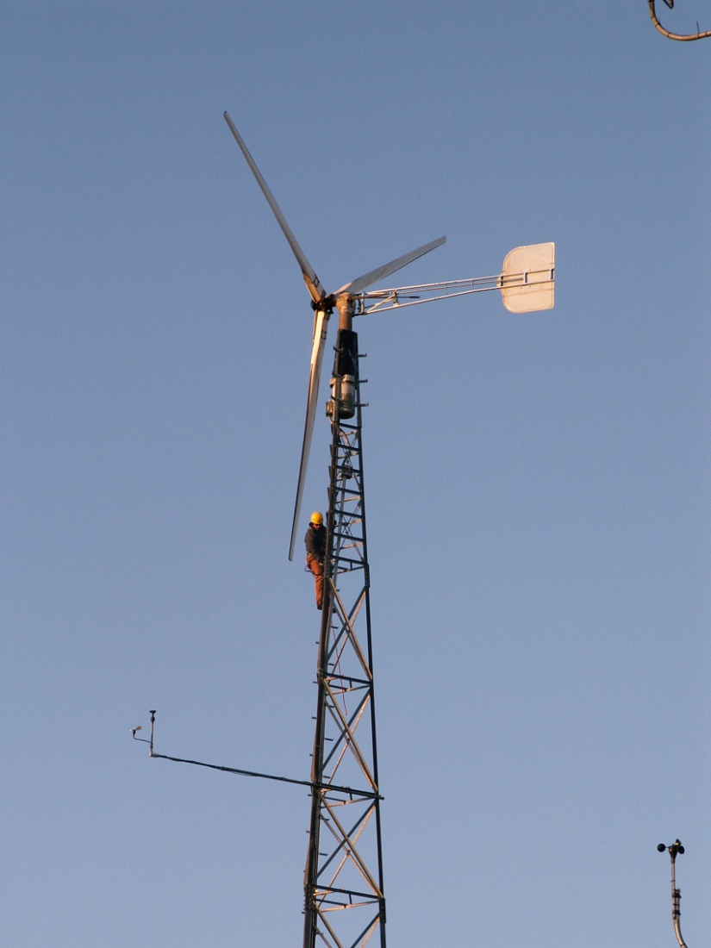
History of AT Program
Program had its beginnings in 1978 as Earth Studies in IDS
Moved to Technology Department in 1984
Likely the oldest continuously operating program for the study of AT in America

Slide 4
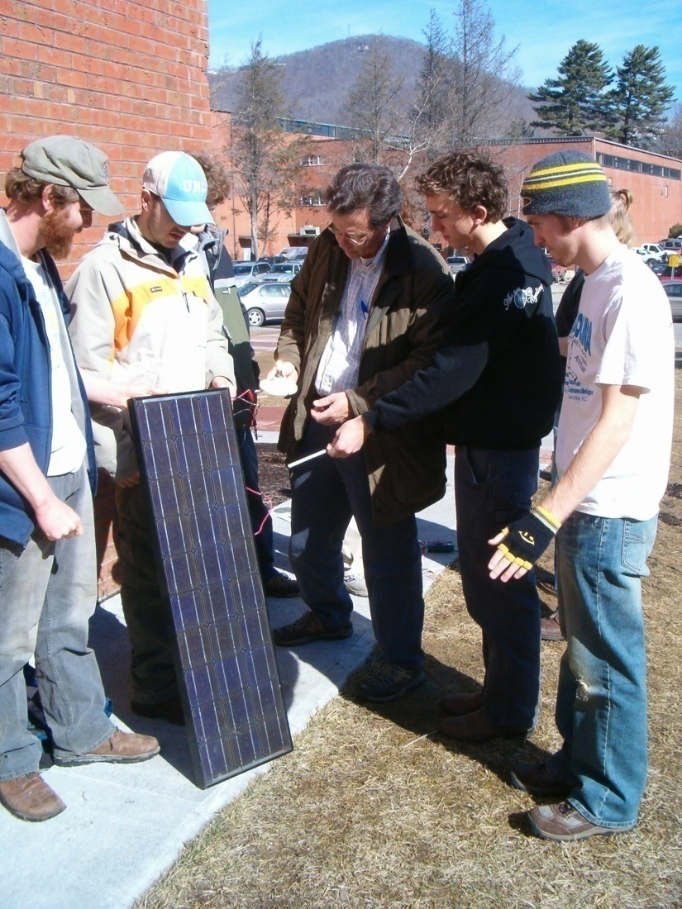
Appalachian’s Appropriate Technology Program Involvement
BS in Appropriate Technology
Undergraduate Minor in AT
MS in Technology with AT concentration
MS Renewable Energy Engineering
Non-credit Workshops & Public Outreach & Education

Slide 5
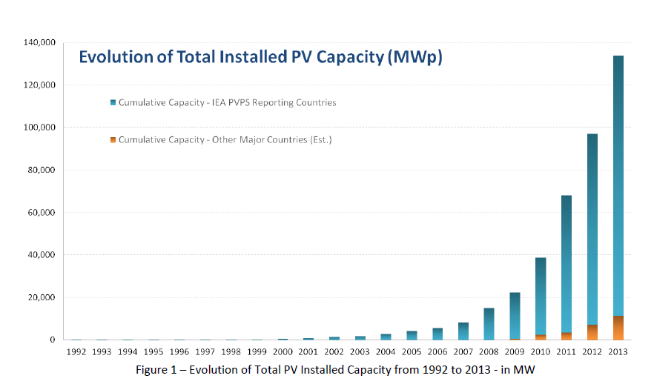
World Cumulative PV Capacity 2013 (MW)

Slide 6
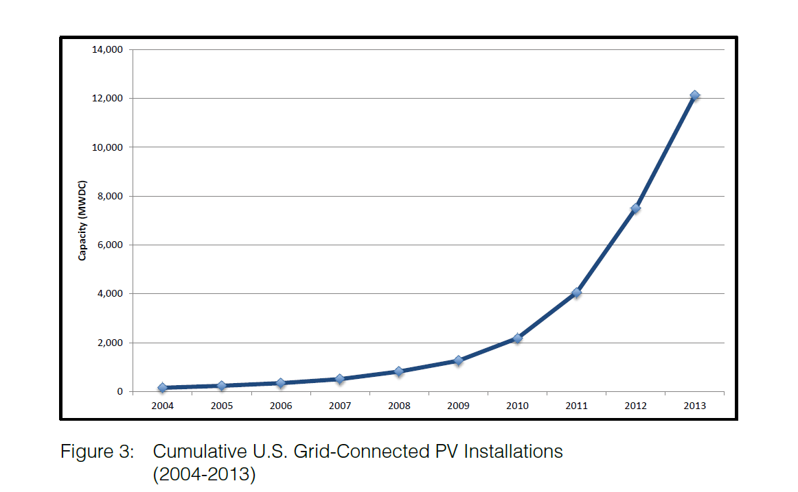
US Cumulative PV Installed Capacity (MW)
Source: US Solar Market Trends 2012, IREC, July 2014

Slide 7
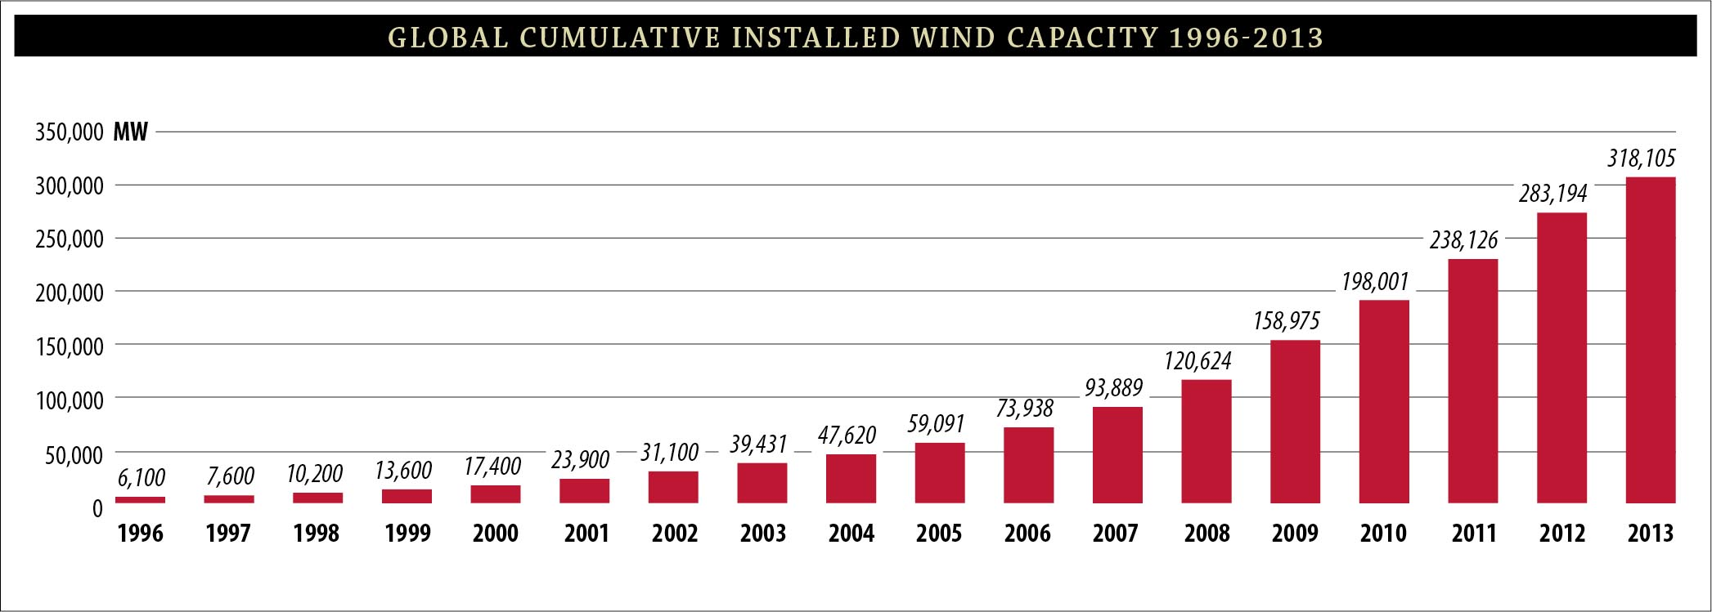
World Cumulative Wind Power

Slide 8
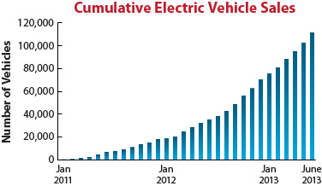
US Electric Vehicle Sales

Slide 9
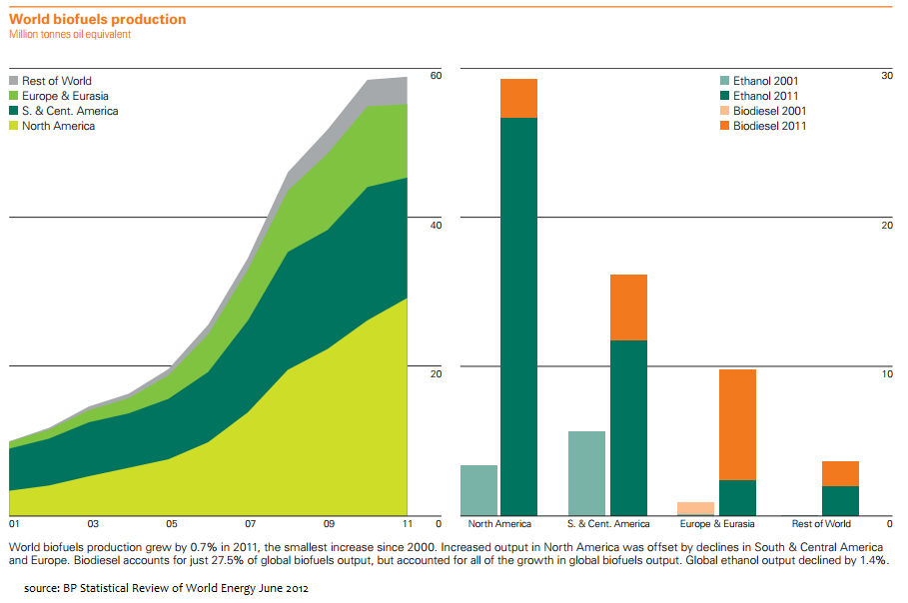
Growth of the Biofuels Industry

Slide 10
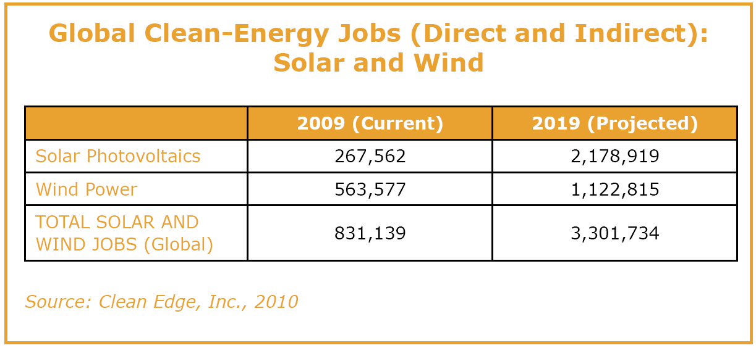
Many New Jobs

Slide 11
AT Majors

Slide 12
AT Undergraduate & Graduate Majors

Slide 13
Total TED Majors 2013/2014

Slide 14
2014 2015 Credit Hours Generated Per Full Time Faculty Member

Slide 15
Number of Advisees Per
Full Time Faculty Member

Slide 16
AT Program Overview
Over 200 Undergraduate majors
Mean SAT scores in 2011 was 1161 (highest in the Department and among highest in College)
20 – 40 graduate students
Multiple service courses offered
Only 4 full time faculty (shared with grad program & core)
8 Part-time faculty in 2014
Only 1500 SF of dedicated lab space (PV lab)
More than $1 million in grants and contracts over last 15 years
Off campus R&D facilties
  Beech Mt Wind Site
  Solar R & D site near motor pool
  Biofuels R & D site
  Nexis Project
61 advisees per faculty member currently

