Slide 1

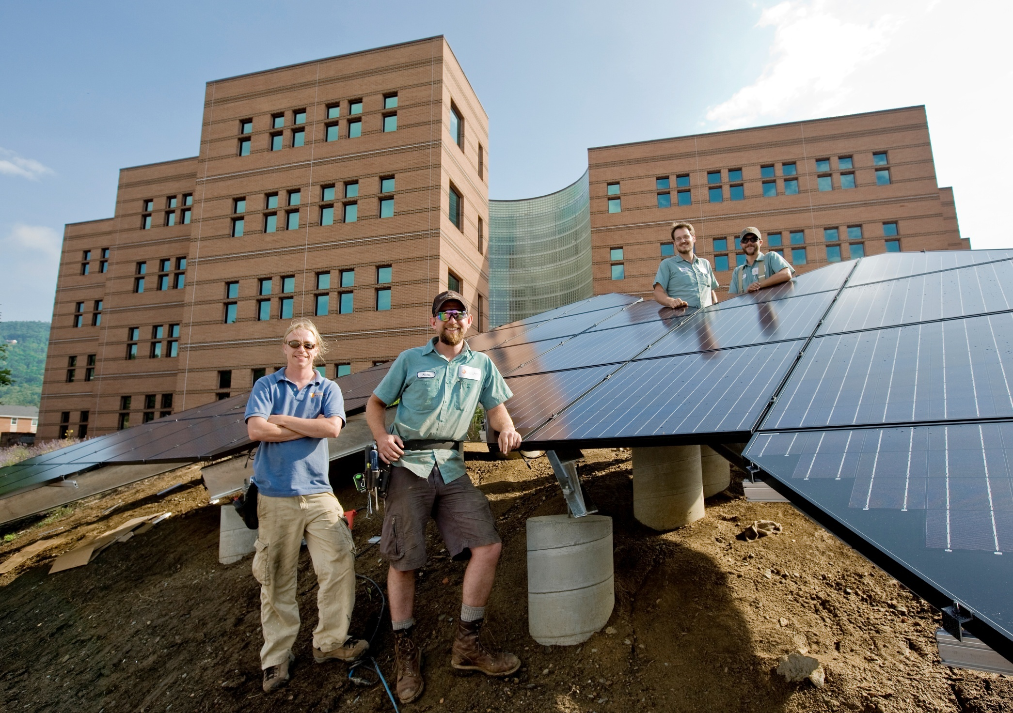
Photovoltaic System Fundamentals

Slide 2


Appalachian State University
^{Provider Number: 60114136}
1-1/2 Day Photovoltaic System Fundamentals
^{Course Number: AECAIA061314 A}
Dennis Scanlin
^{Date: June 13-14, 2014}
10 LU|HSW Credits earned on completion of this course will be reported to AIA CES for AIA members. Certificates of Completion for both AIA members and non-AIA members will be received at the end of the class.
This course is registered with AIA CES for continuing professional education. As such, it does not include content that may be deemed or construed to be an approval or endorsement by the AIA of any material of construction or any method or manner of handling, using, distributing, or dealing in any material or product.
_______________________________________
Questions related to specific materials, methods, and services will be addressed at the conclusion of this presentation.

Slide 3
Course Description
This 1 1/2 day workshop will introduce participants to the basic concepts, tools, materials and construction and engineering techniques needed to design and construct systems that convert solar resources into electricity with photovoltaic (PV) technologies. Participants will learn how to assess the solar resources available at a particular site and how to use that information to estimate the energy production and economics of a PV system. Participants will learn how to design and construct safe and reliable code compliant photovoltaic systems. The workshop will address contemporary trends, products and policies and incentives. It will include lectures and power point presentations, site assessment and system design and construction activities, computer modeling, and exploration of numerous systems we have set up around the Department of Technology & Environmental Design at Appalachian State University.
Learning Objectives
At the end of the this course, participants will be able to:
Measure and assess solar resources at a site and using that data estimate the energy production and system economics of photovoltaic systems.
Identify and describe a wide variety of components used in solar electricity producing systems and basic system types.
Design and construct both grid tied and battery based photovoltaic systems.
Describe policies and incentives in place to stimulate the market for PV in NC and estimate the economics of PV systems.

Slide 4
PV Workshop Agenda
Friday
  9 Intro to PV
  10 Site Assessment
  11 PV Cells, Modules & Arrays
  12 Lunch
  1 Combiner Boxes & Disconnects
  2 Inverter Technology
  3 Batteries
Saturday
  9 Charge Controllers
  10 Power Systems
  11 Economics
  12 Summary & Review

Slide 5
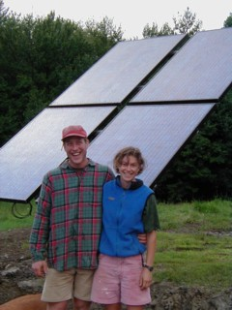
Advantages of Photovoltaics
Modular and easily scalable
No moving parts
Reliable, proven technology
Durable (last more than 50 years)
Long Warranties
Price Continues to Decrease
No Operational Pollution
Solar Energy is available everywhere & free
Varied Applications

Slide 6
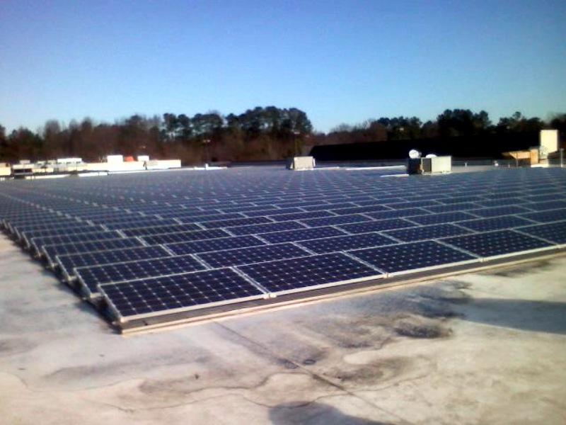
Disadvantages
Cost ????? - approximately $.20/kwh without incentives; about $.09/kwh with incentives in NC (assuming $4/watt and 65% tax credit)
Low efficiency compared with solar thermal
Require a lot of surface area
Lack of experience and knowledge

Slide 7
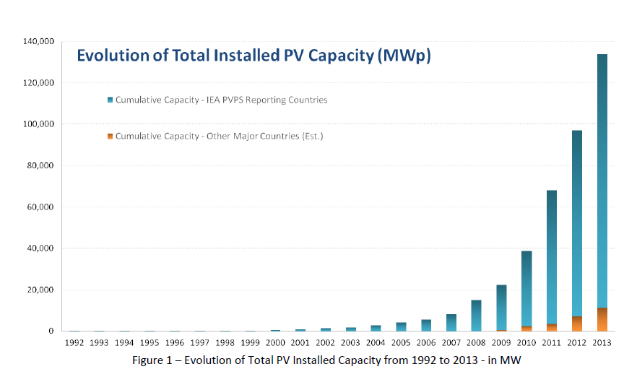
World Cumulative Capacity 2013 (MW)

Slide 8
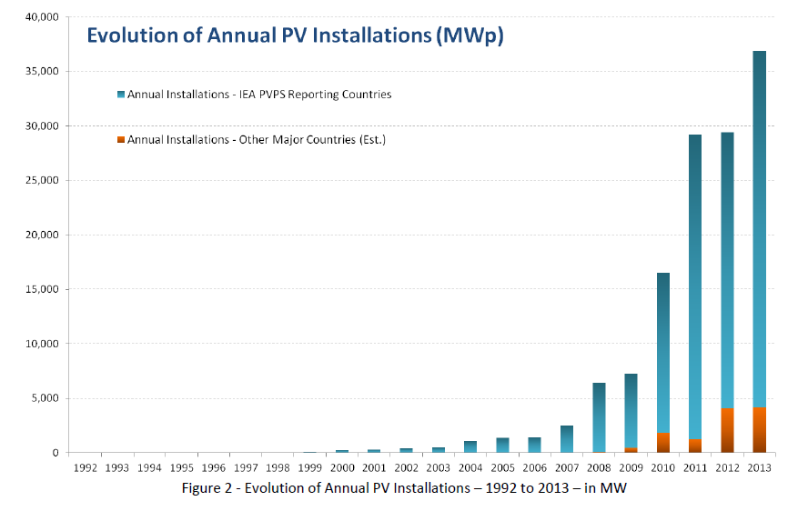
2013 Annual PV Installations (MW)

Slide 9
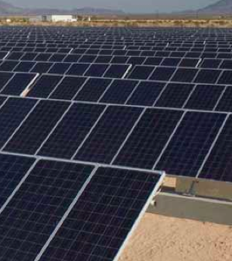
Factors Influencing Growth
Falling Prices
Strong Consumer Demand
Available Financing
Public Policies
  Feed in Tariffs (FITs)
  Renewable Portfolio Standards (RPS)
  Rebates
  Tax Credits

Slide 10
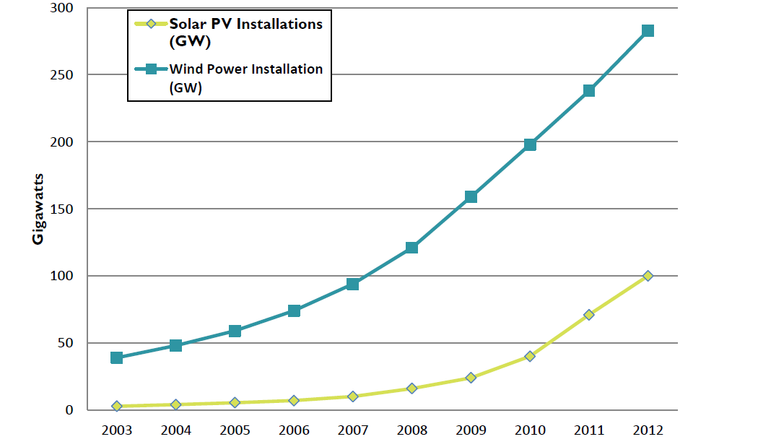
World Cumulative Installed Capacity (GW) of Wind & PV
Source: Vital Signs. Worldwatch Institute, 2013

Slide 11
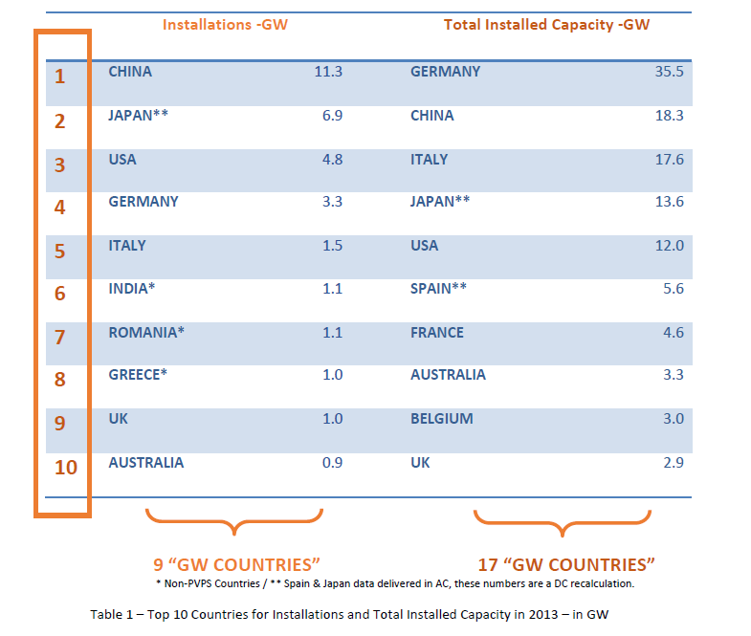
Leading PV Adopter Countries in 2013

Slide 12
Cumulative PV in 2013 by Country (MW & %)

Slide 13
PV Growth Trends
World installed capacity grew by 39% in 2013 (36.9 GW)
1% of world’s electricity (some countries are producing as much a 8%)
Annual worldwide growth has averaged 50% per year over last 5 years
> 140,000 MW in 2014
China (11.3 GW), Japan (6.9 GW), US (4.75 GW) Germany(3.3 GW) & Italy (1.5 GW) are leading adopters in 2013
$140.4 billion invested in 2012
Over past 10 years world PV capacity grew from 10 GW to 140,000 GW

Slide 14
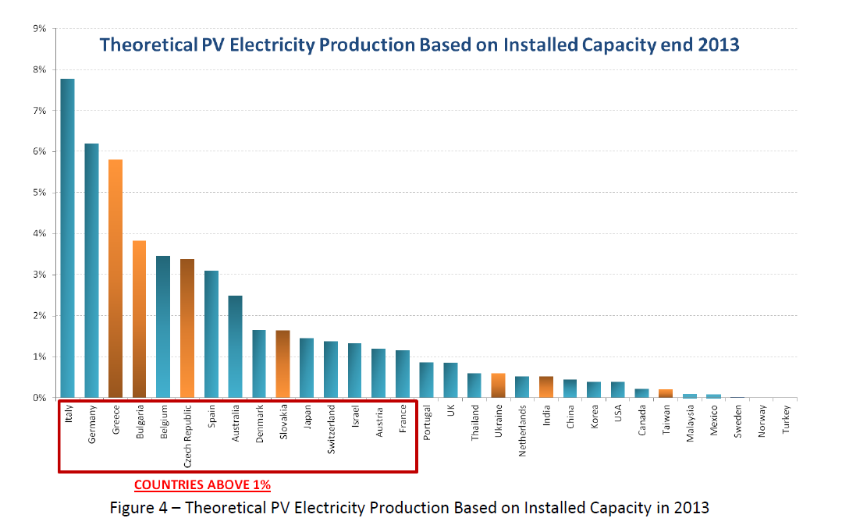
Percent of Electricity From PV

Slide 15
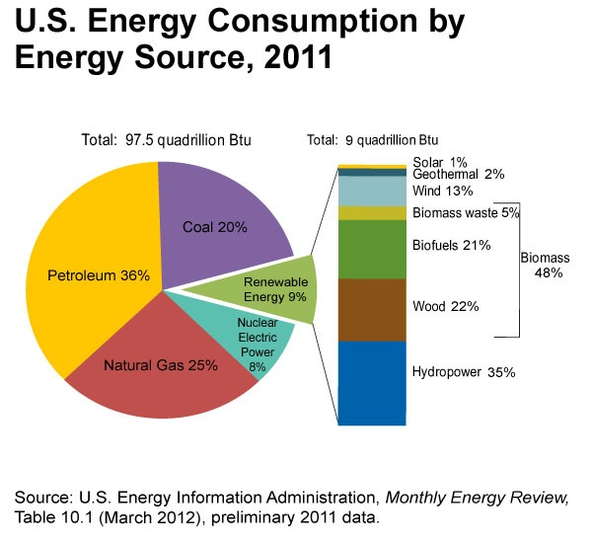

Slide 16
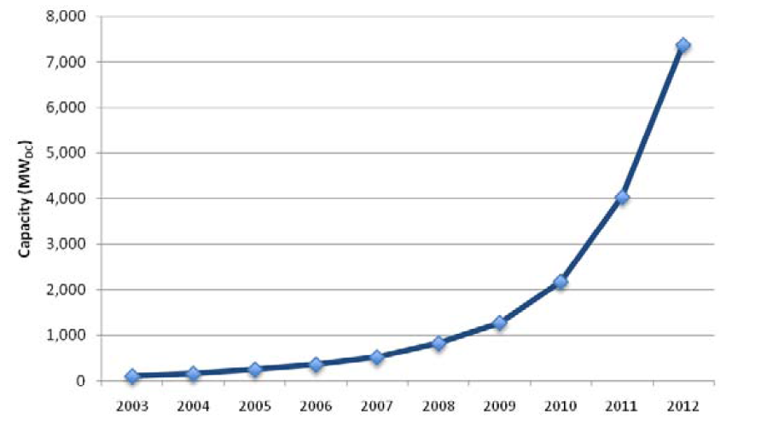
US Cumulative PV Installed Capacity (MW)
Source: US Solar Market Trends 2012, IREC, July 2013

Slide 17
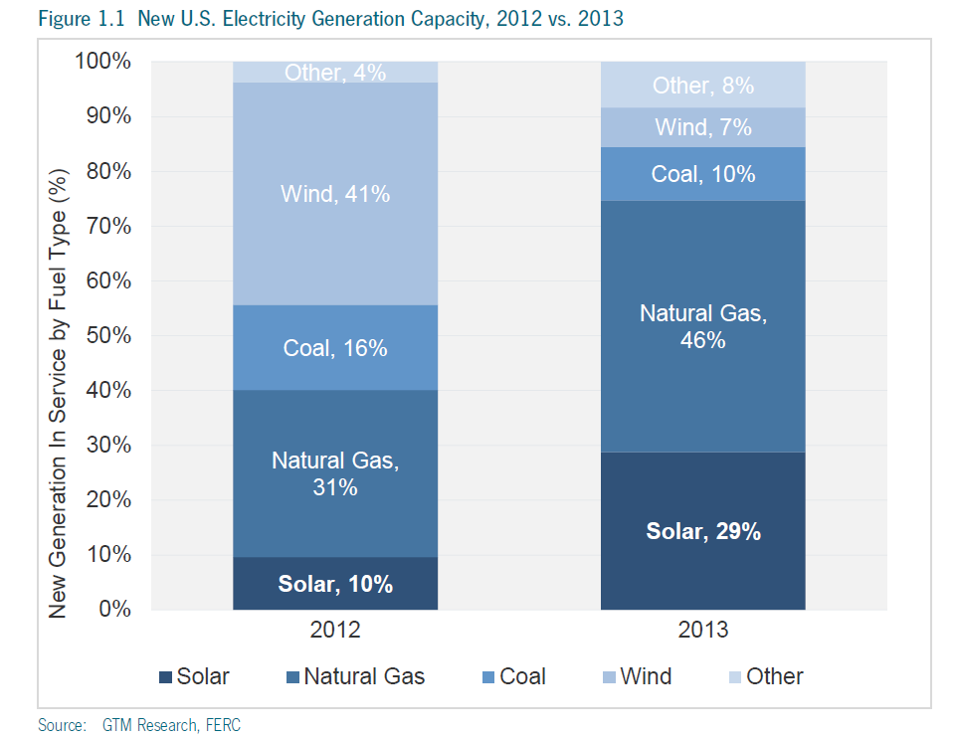

Slide 18
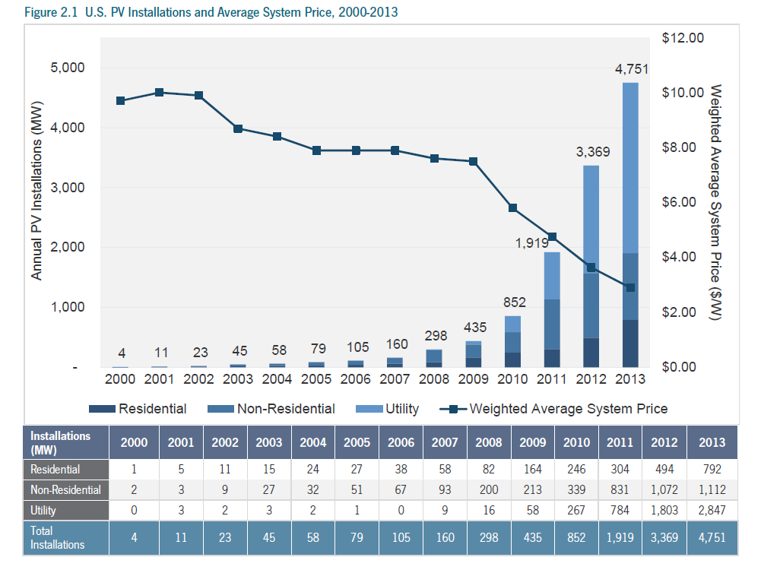

Slide 19
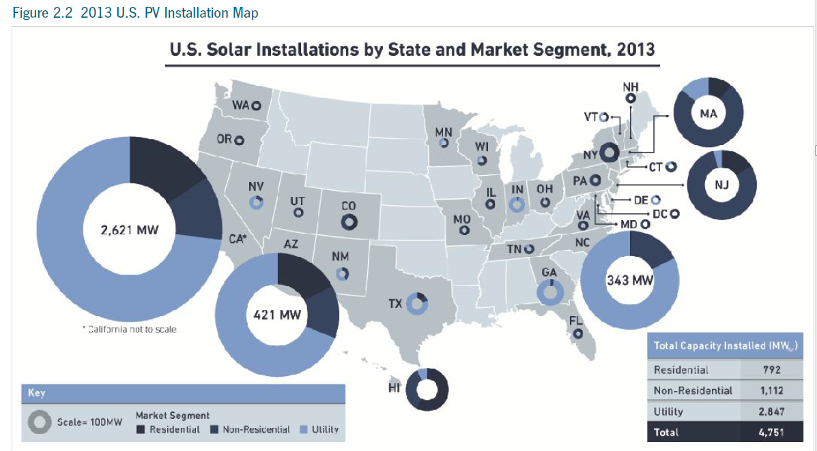
PV Installation by State, 2013

Slide 20
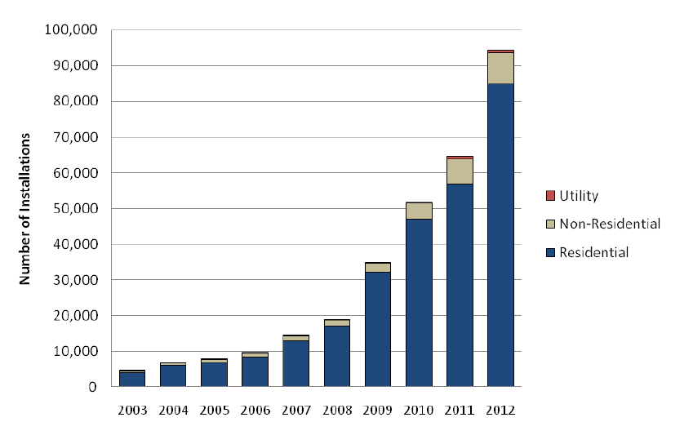
Number and Type of Annual US PV Installations
Source: US Solar Market Trends 2012, IREC, July 2013

Slide 21
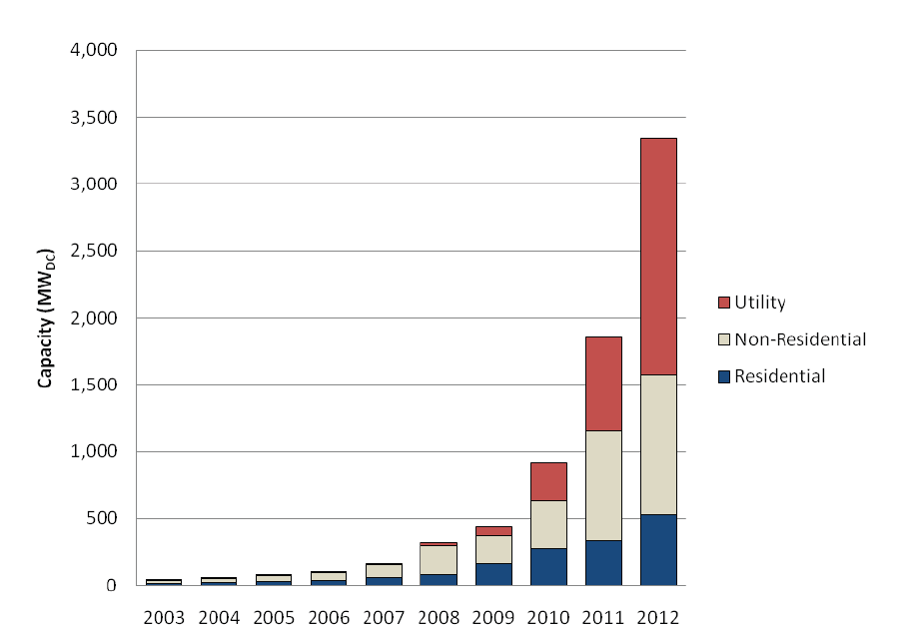
Annual US PV Installations by Year and Type (MW)
Source: US Solar Market Trends 2012, IREC, July 2013

Slide 22
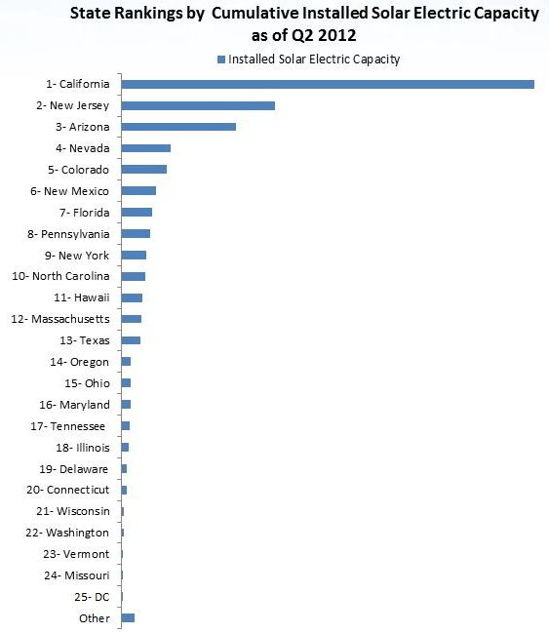

Slide 23
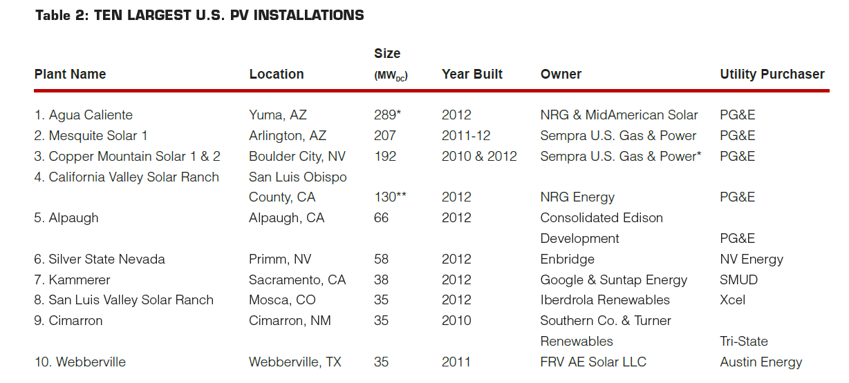
Largest US PV Installations
Source: US Solar Market Trends 2012, IREC, July 2013

Slide 24
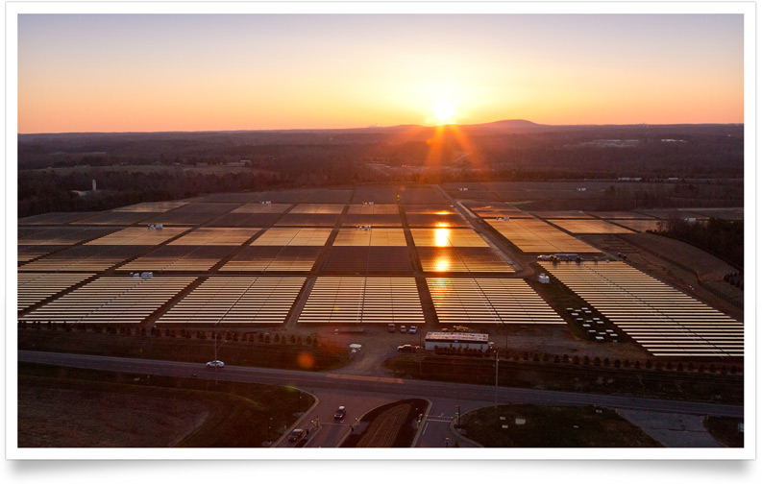
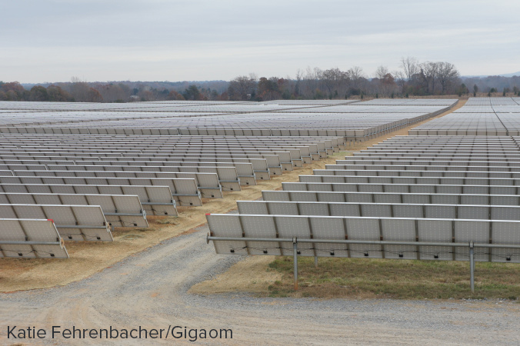
Apple NC 20 MW – 100 acre Solar Farm

Slide 25
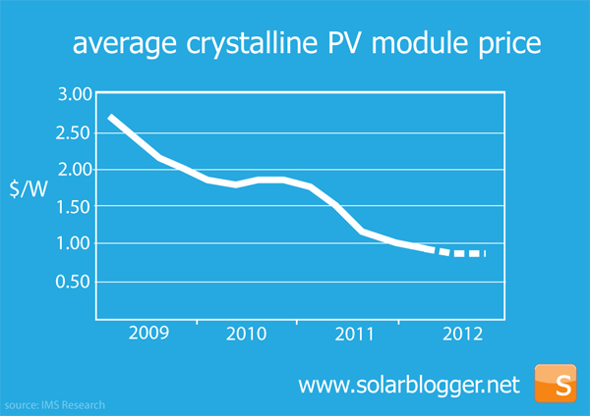

Slide 26
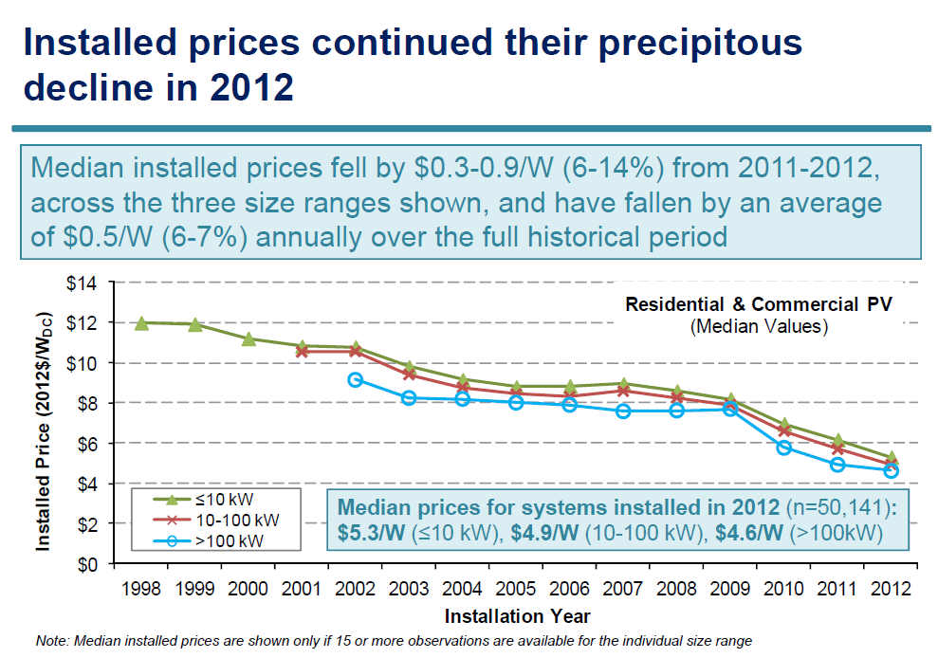

Slide 27
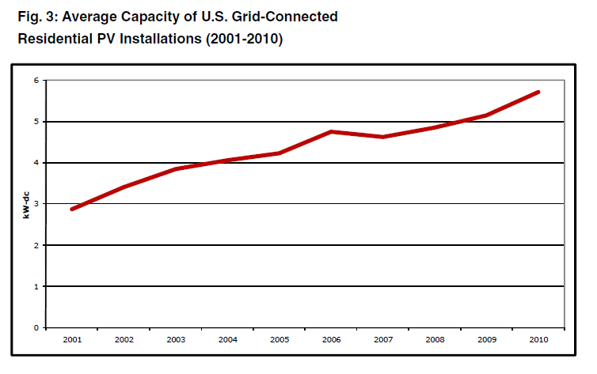
US Residential Grid- tied

Slide 28
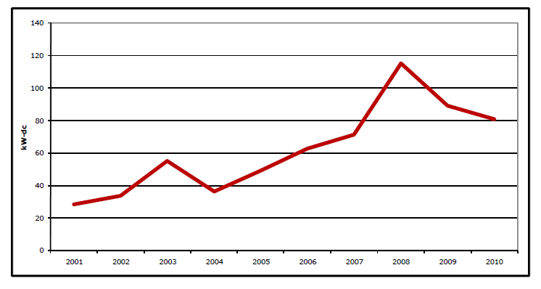
US Non-Residential Grid-tied

Slide 29
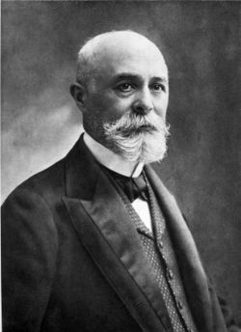
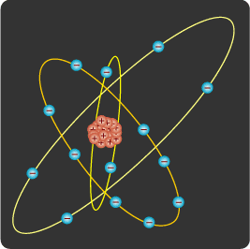
Photovoltaic History
1839 Edmund Becquerel - first recognized the effect

Slide 30
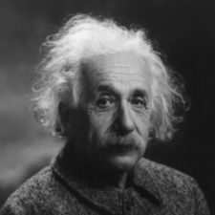
Early PV milestones
1839 – discovery of the photovoltaic effect;
1873 – Willoughby Smith discovers the photoconductivity of selenium
1883 – Charles Fritts develops first selenium cell (1% efficient)
1904 – Einstein published his paper on the photoelectric effect (along with a paper on his theory of relativity)
1921 – Albert Einstein wins the Nobel Prize for his theories (1904 paper) explaining the photoelectric effect

Slide 31
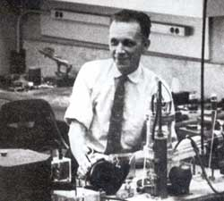
P-N Junction & 1st cells
Russel Ohl – worked at Bell Labs in 1930’s & 1940’s
Discovered the P-N junction in 1939
Patented 1st modern solar cell called a “Light sensitive device”

Slide 32
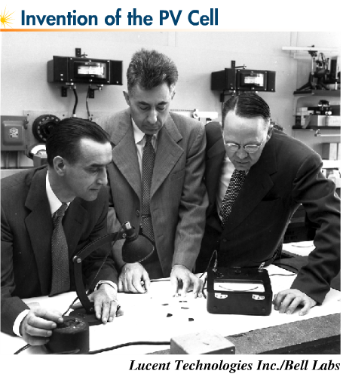
1953 - THE DREAM BECOMES REAL
Gerald Pearson, Daryl Chapin, and Calvin Fuller of Bell Labs were the principle discoverers of the silicon solar cell called a “solar battery”
Dopants used to produce 6% efficient cells

Slide 33
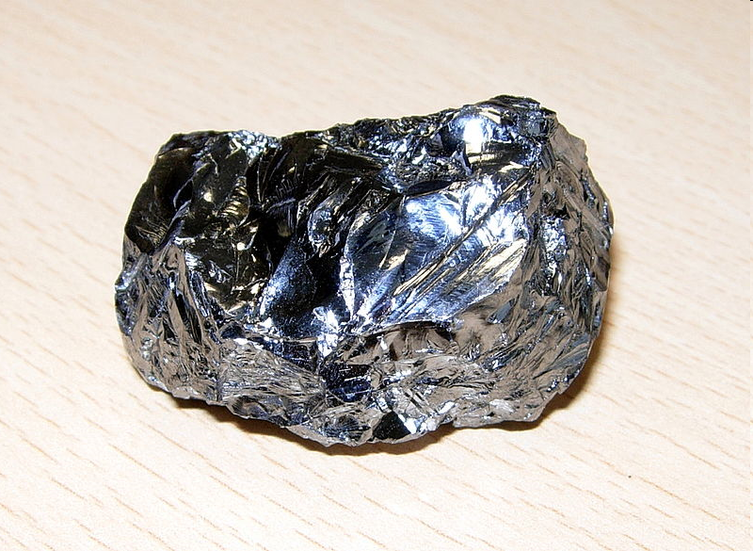
Silicon
Makes up ¼ of earth’s crust; 8th most common element in universe; 2nd most common (25%) on earth after oxygen
Sand
Amethyst
Granite
Quartz
Flint
Opal
Asbestos
Clay

Slide 34
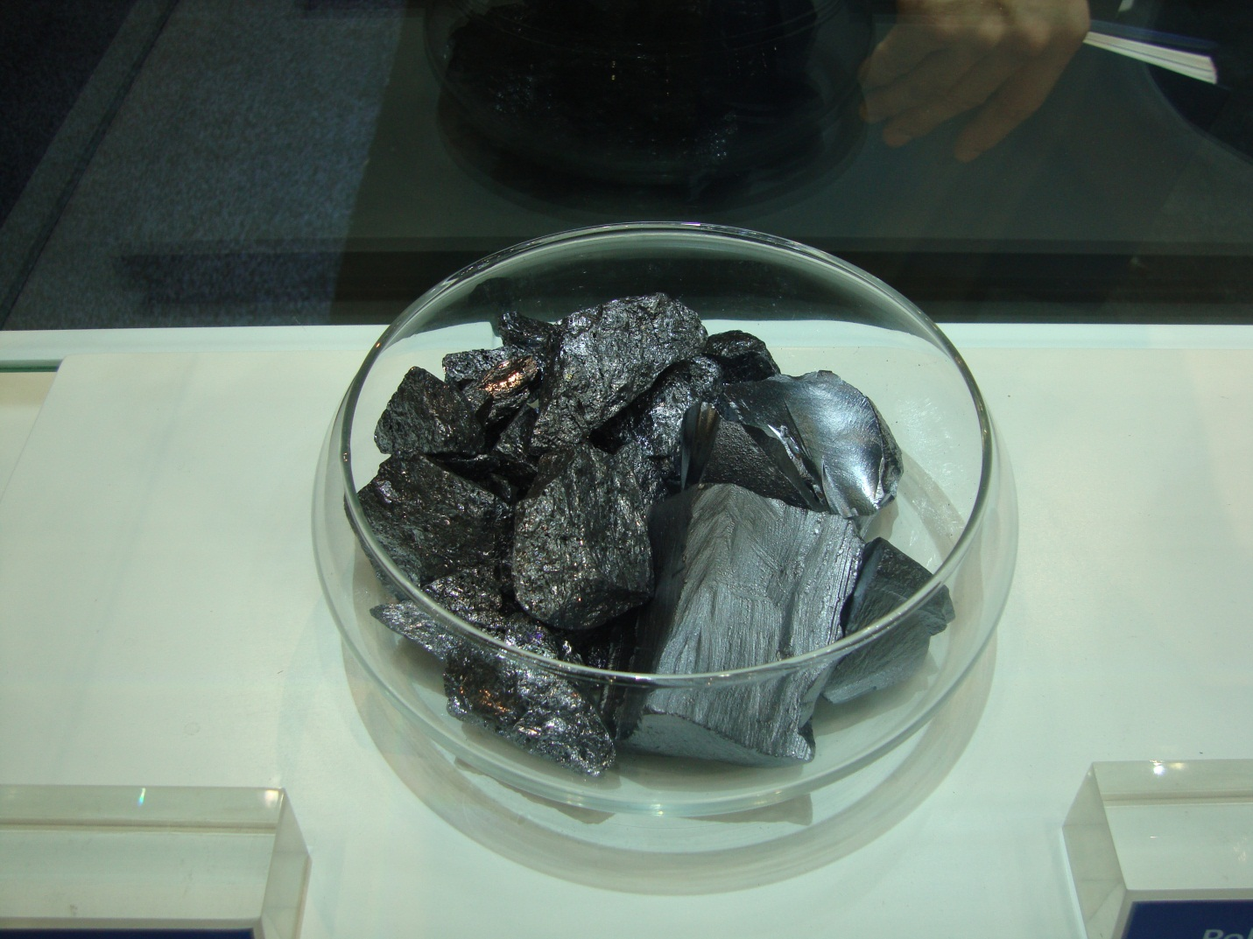
Silicon

Slide 35
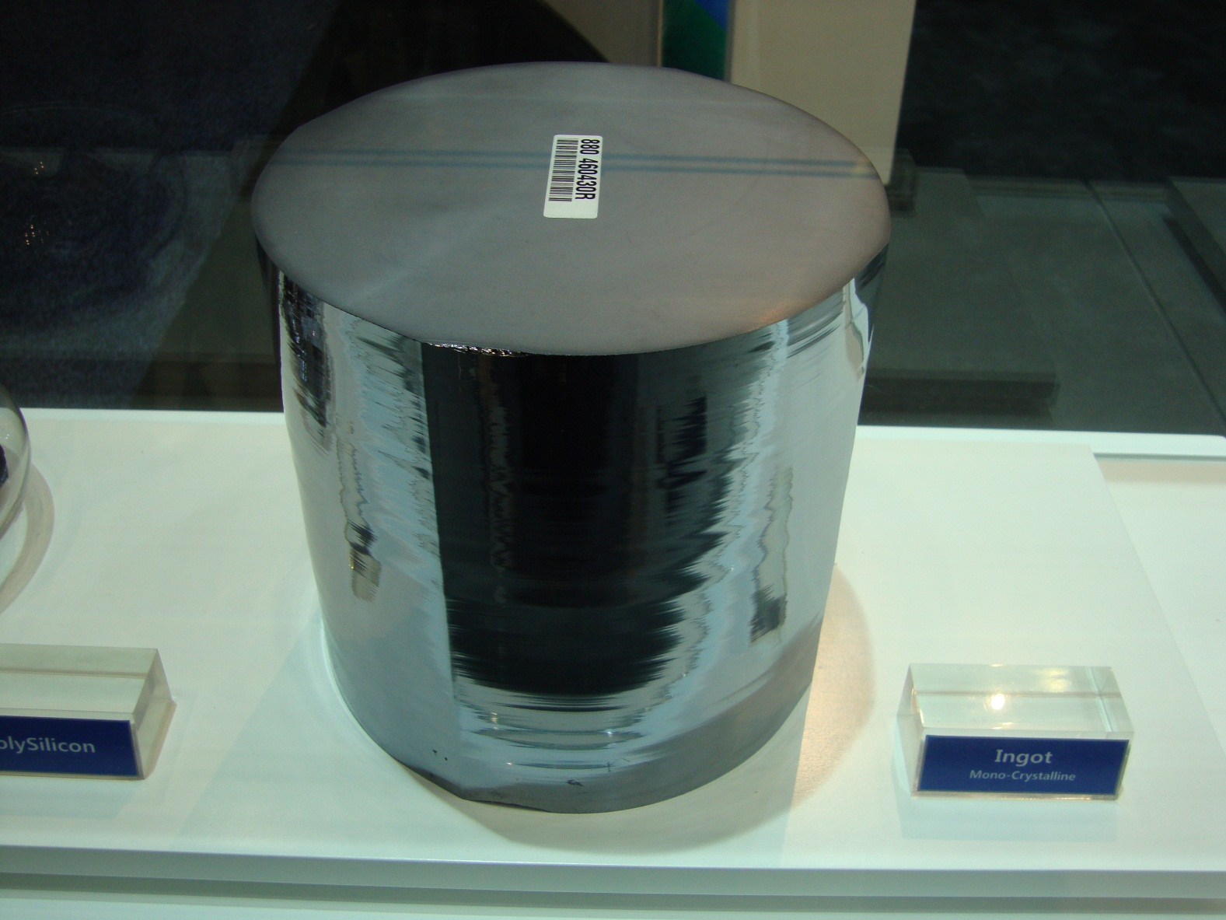
Silicon Ingot

Slide 36
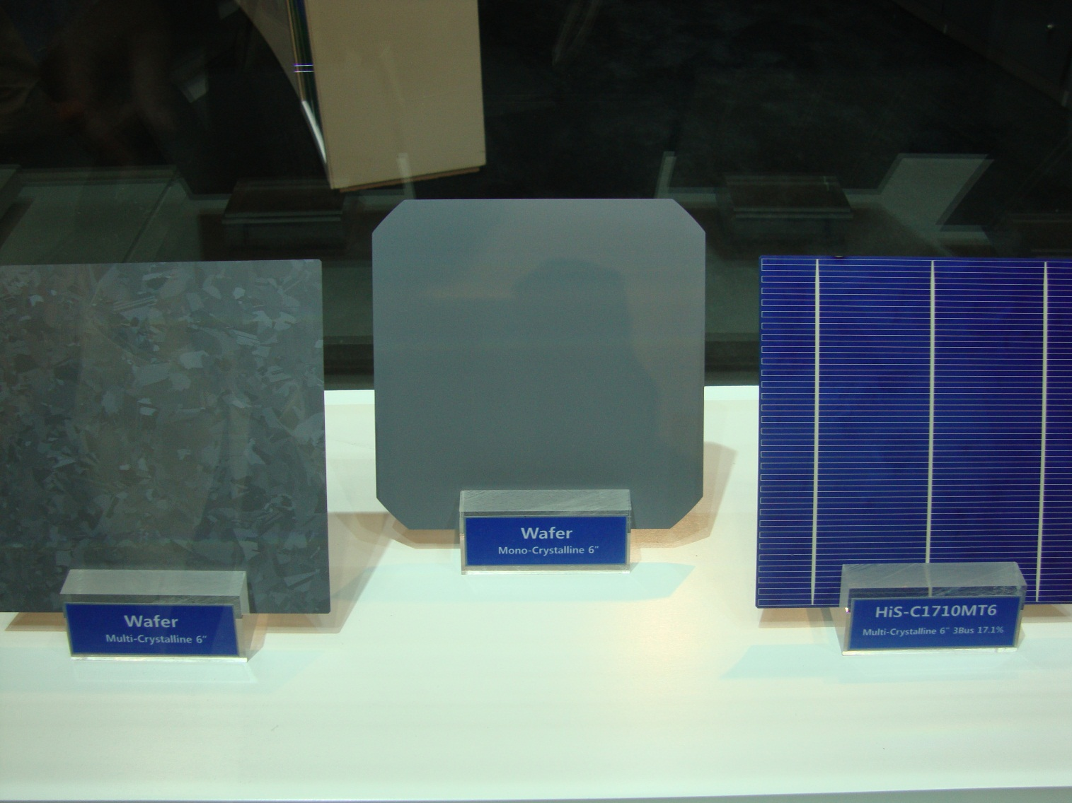
PV cells

Slide 37
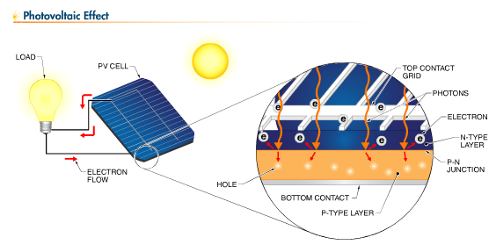
Photovoltaic Effect

Slide 38
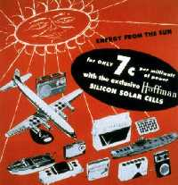
1956 - Searching for Applications
Novelty items such as toys and radios run by solar cells were First

Slide 39
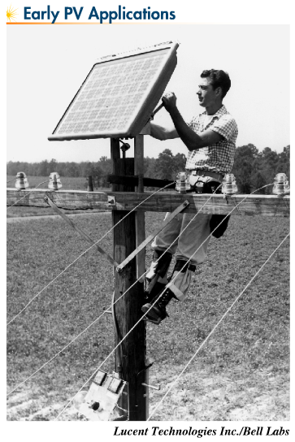

Slide 40
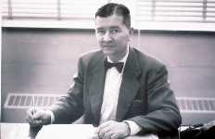
Late 1950s - Saved by the Space Race
The late Dr. Hans Ziegler, the chief advocate for powering satellites with silicon solar cells

Slide 41
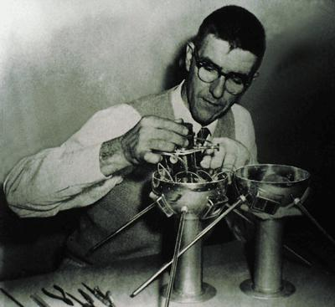
Vanguard I - first PV powered satellite
Launched in 1958; 4th artificial satellite
solar panel: 0.1W, 100 cm²
Vanguard's solar cells operated for about seven years, while conventional batteries used to power another transmitter on board Vanguard lasted only 20 days.
Still orbiting; longest orbiting artificial satellite
$1000/watt

Slide 42
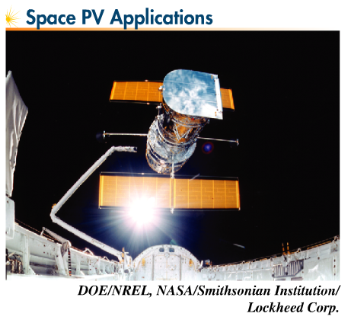

Slide 43
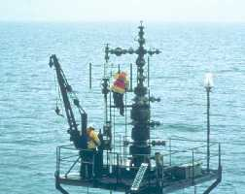
Early 1970s - The First Mass Earth Market
Solar cells power navigation warning lights and horns on most off-shore gas and oil rigs throughout the world

Slide 44

1970s - Captain Lomer's Saga
Lighthouses

Slide 45
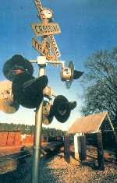
1974 - Working on the Railroad
The first solar-powered crossing depicted in this picture began operating at Rex, Georgia in 1974 for the Southern Railway (now the Norfolk/Southern)

Slide 46
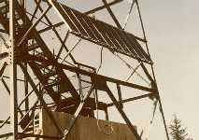
Late 1970s - Long Distance for Everyone
One of Telecom Australia's (now Telstra) many solar-powered microwave repeaters, whose installation began in the late 1970s, to provide Australians living in remote areas with high-quality telecommunication service

Slide 47
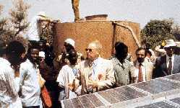
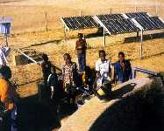
1970s - Father Verspieren Preaches the Solar Gospel
Water pumping for people and livestock in developing world

Slide 48
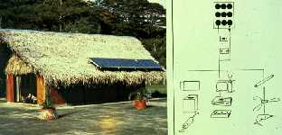
1980s - Electrifying the Unelectrified
A common sight in French Polynesia: solar modules on thatched roofs

Slide 49
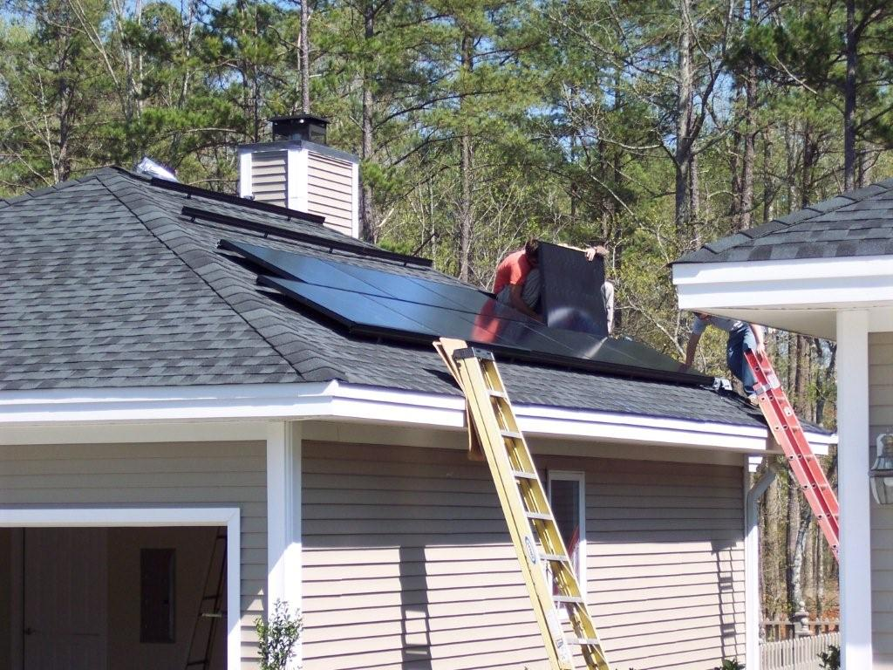
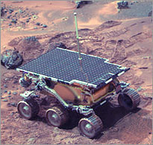
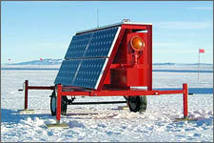
Current PV Applications
Residential/commercial grid-direct systems
Utility scale “solar farm” electricity production
Telecommunications
Water Pumping
Off-grid (stand-alone)
Satellites and space stations
Battery charging in myriad applications

Slide 50
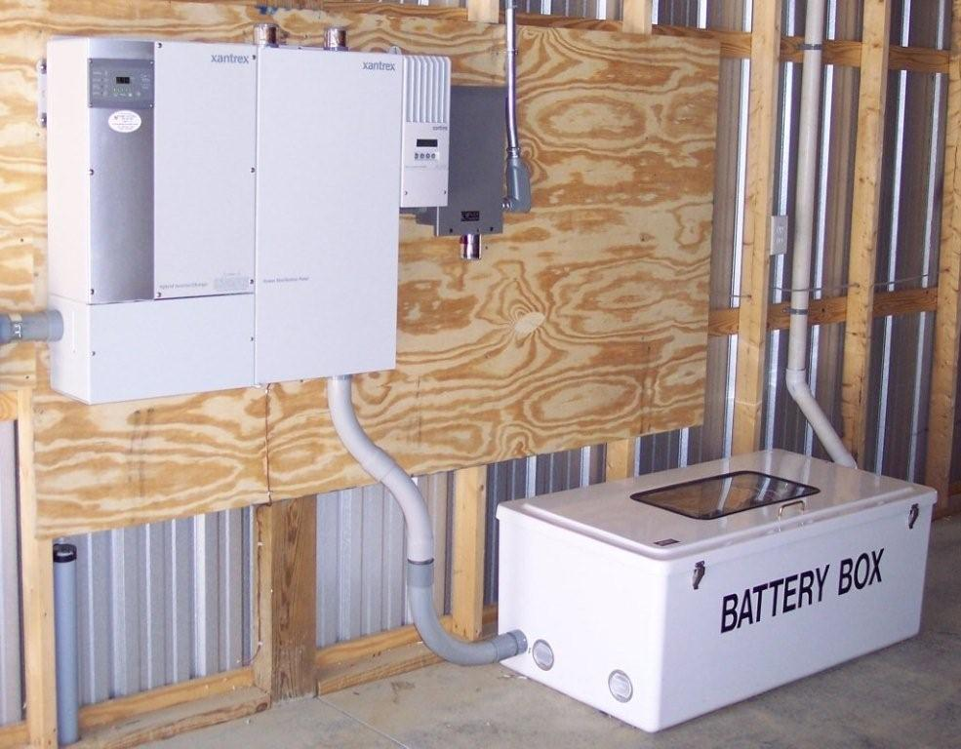
Types of Systems
DC direct
Battery charging
Hybrid systems
Grid-direct
Grid-tied with battery backup

Slide 51
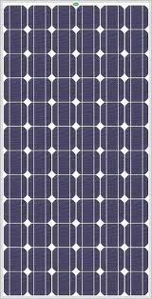

DC-Direct System
PV Array –
DC energy production
DC-Direct Load
*Simple, Reliable
*No Sun, No Energy
*PV produces DC power
*Load requires DC power
*Array and Load matched in power (watts)

Slide 52

Direct PV Systems

Slide 53

Direct PV System

Slide 54



Battery-Charging System (DC only)
*Loads operate at night or in cloudy weather
*Battery bank can supply large surge currents
*Charge controller keeps battery from overcharging
PV Array –
DC Energy Production
Charge Controller
Batteries - DC Energy Storage
DC Load(s)

Slide 55


Off-Grid System with AC loads
PV Array –
DC Energy Production
Charge Controller
Batteries - DC Energy Storage
AC Load(s)
Inverter/Charger
DC Load(s)

Slide 56






Charge Controller
DC Junction Box
Combiner Box
PV array
Inverter
Battery

Slide 57


Slide 58


Slide 59
Hybrid (Off-Grid) Systems

Slide 60



Grid-Direct

Slide 61
Grid-Direct
”Utility intertie”, “Grid-tie” or “Utility-interactive”
No batteries or charge controller. Utility grid acts as power reserve.
Inverter automatically shuts down with utility failure.
PURPA: Utilities pay “avoided costs” for PV power generated and “sold” to the grid.
Buy all/sell all – different rates
Net metering- meter spins backwards and forwards

Slide 62

Direct Grid Tie System

Slide 63

Residential/Commercial Grid-Direct

Slide 64

Utility Scale Solar Farms

Slide 65

Grid-Tied with Battery Backup
*Will operate when grid fails.
*Provides back up power to “essential loads.”
*More expensive.

Slide 66
Grid Tie with Battery Backup

