Slide 1
Part 3:
Keeping Homes Healthy
Dr. Susan Doll

Slide 2
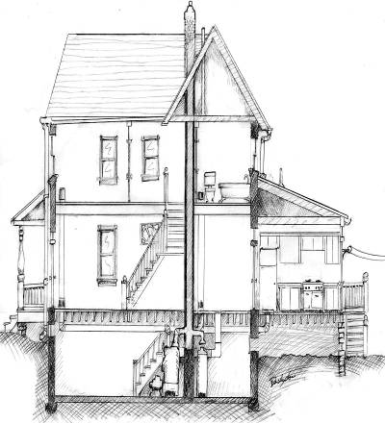
7 Healthy Homes Principles
Keep It:
Dry
Clean
Ventilated
Pest-Free
Safe
Contaminant-Free
Maintained
Notes:
While there is no recipe that can guarantee a healthy home, you’ll be learning about key principles that can help create healthier indoor environments. You’ll hear about these principles throughout the course of the training.
In this training, we are introducing a new way of thinking about the home environment – an approach that considers the people living in the home, the building itself, and the potential health problems.

Slide 3
7 Healthy Homes Principles
Keep It:
Dry
Clean
Ventilated
Pest-Free
Safe
Contaminant-Free
Maintained
Notes:
While there is no recipe that can guarantee a healthy home, you’ll be learning about key principles that can help create healthier indoor environments. You’ll hear about these principles throughout the course of the training.
In this training, we are introducing a new way of thinking about the home environment – an approach that considers the people living in the home, the building itself, and the potential health problems.

Slide 4
IAQ is Important
Americans spend 90% of their day indoors – in classrooms, offices, commercial buildings, at home.
Airborne chemicals indoors are often at least two to five times higher than outdoors.
Airborne microbial populations can be different and amplified relative to outdoor populations.
When compared to other threats to human health, the EPA Science Advisory Board consistently ranks indoor air pollution among the top 4 environmental risks facing Americans.

Slide 5
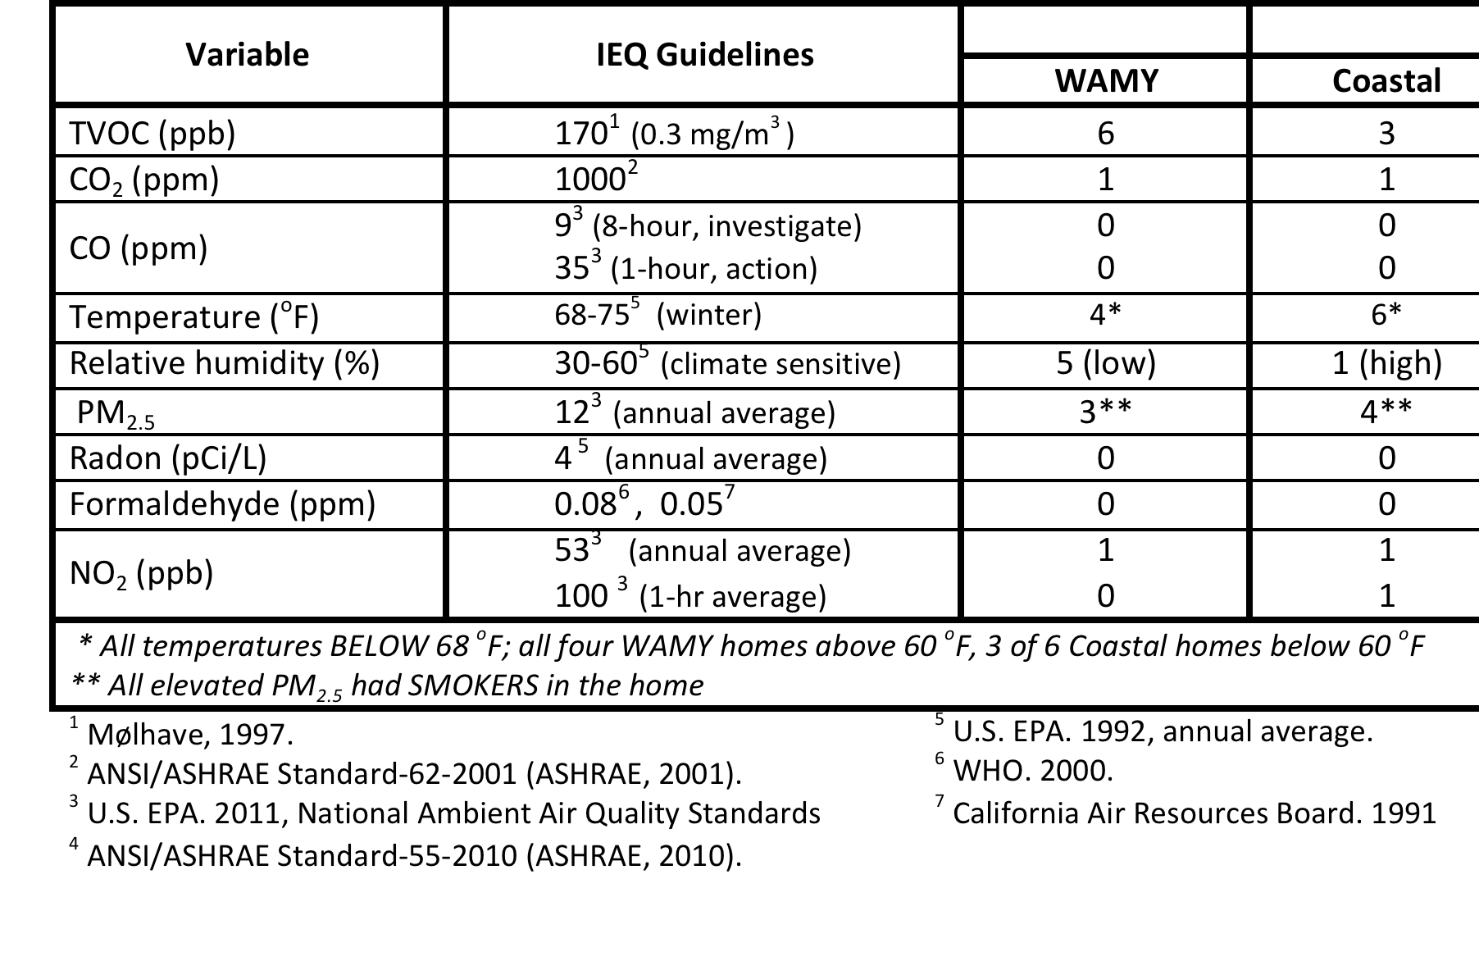
Standards for
Air Quality
Contaminants
  EPA (outdoors)
  NAQS
  OSHA: occupational,
  high exposure/short time
  PEL - Permissible Exposure Level
  (1 hour, 8-hour, lifetime limits)
  WHO (World Health Oranization)
  ASHRAE (CO₂ surrogate)
Thermal Comfort - ASHRAE

Slide 6
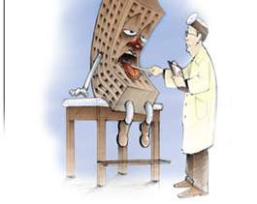
Sick Building Syndrome
  Symptoms linked to building
  Resolve when not in building
  Effect a substantial fraction of occupants
Non-Specific Symptoms
Dry, itchy eyes
Nasal irritation
Hoarseness, irritated throat, laryngitis
Skin problems
Fuzzy thinking, memory
Irritability, sleep disruption, fatigue
Headaches, nausea

Slide 7
Building-Related Illness
  Discrete identifiable disease or illness
  Can be traced to specific source within a building
Examples:
asthma exacerbation
Legionnaires’ disease
hypersensitivity pneumonitis
carbon monoxide poisoning

Slide 8
Pathway to Disease
SOURCE
DISPERSAL
EXPOSURE
OUTCOME

Slide 9
Pathway to Disease
  Materials, people, pets, activities => generated indoors/outdoors
  gases, chemicals, particles, allergens
SOURCE
DISPERSAL
EXPOSURE
OUTCOME

Slide 10
Pathway to Disease
  Materials, people, pets, activities => generated indoors/outdoors
  gases, chemicals, particles, allergens
  Airborne contaminants => concentration in air over time
  diffusion, aerosolization, convection/contain, decay
SOURCE
DISPERSAL
EXPOSURE
OUTCOME

Slide 11
Pathway to Disease
  Materials, people, pets, activities => generated indoors/outdoors
  gases, chemicals, particles, allergens
  Airborne contaminants => concentration in air over time
  diffusion, aerosolization, convection/contain, decay
  Inhalation, contact => time spent indoors + activities
  proximity, breathing rate
SOURCE
DISPERSAL
EXPOSURE
OUTCOME

Slide 12
Pathway to Disease
  Materials, people, pets, activities => generated indoors/outdoors
  gases, chemicals, particles, allergens
  Airborne contaminants => concentration in air over time
  diffusion, aerosolization, convection/contain, decay
  Inhalation, contact => time spent indoors + activities
  proximity, breathing rate
  Recipient => Adverse Health Effects
  age, immune status, genetics
SOURCE
DISPERSAL
EXPOSURE
OUTCOME

Slide 13
Ways to Reduce Health Impact
SOURCE
1
MAKE LESS - use a better product, stop doing it
EMIT LESS INDOORS – control emission at source, chimney/vent
2
DISPERSAL
EXPOSURE
OUTCOME

Slide 14
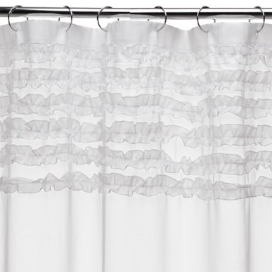
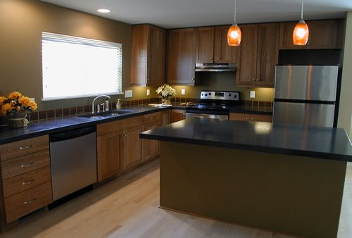

REDUCE - low VOC products

Slide 15
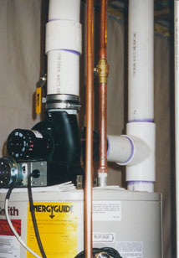
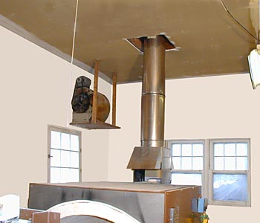
REDUCE – vent to outside
POTTERY KILN
WATER HEATER

Slide 16
Ways to Reduce Health Impact
SOURCE
1
MAKE LESS - use a better widget, stop doing it
EMIT LESS INDOORS – control emission at source, chimney, vacuum
2
DISPERSAL
3
DILUTE – Passive (windows, doors, vents) Active (fan)
REMOVE FROM AIR – filter, absorbent
4
EXPOSURE
OUTCOME

Slide 17
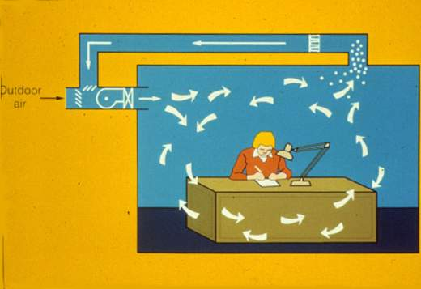
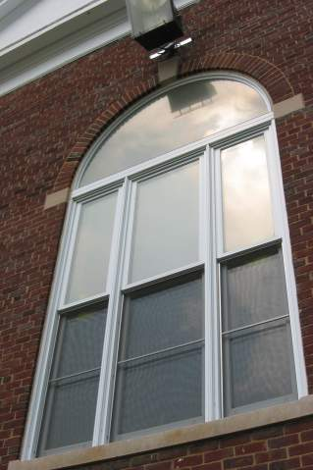
DILUTE - Ventilation
Heating, ventilation, and air conditioning systems (HVAC)
Supply mixture of outdoor and recirculated indoor air that has been filtered and thermally conditioned
“Natural” ventilation (i.e. windows)

Slide 18
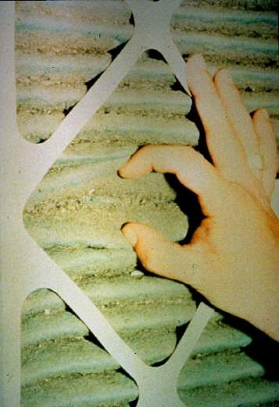
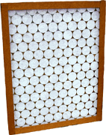
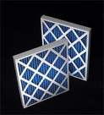
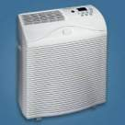
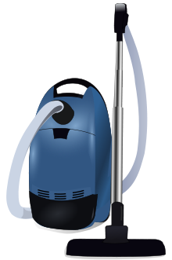
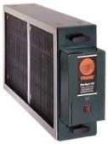
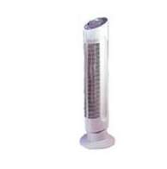
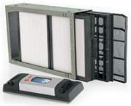

REMOVE – particles
Standard
Pleated
HEPA
Electronic
Intense field
dielectric
Ionic

Slide 19
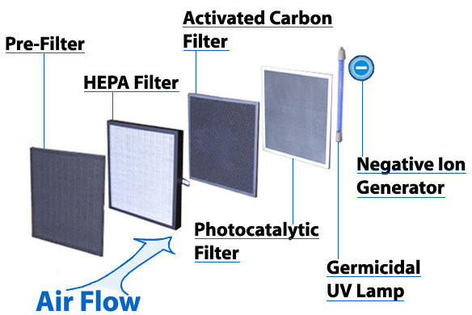
REMOVE – all types

Slide 20
Ways to Reduce Health Impact
SOURCE
1
MAKE LESS - use a better widget, stop doing it
EMIT LESS INDOORS – control emission at source, chimney, vacuum
2
DISPERSAL
3
DILUTE – Passive (windows, doors, vents) Active (fan)
REMOVE FROM AIR – filter, scrubber
4
EXPOSURE
5
AVOID - reduce time in exposure area
PROTECT – reduce contact or inhalation (mask, gloves)
6
OUTCOME

Slide 21



Limiting Exposure
Dedicated/Separate Workspace
Personal Protective Equipment (PPE)

Slide 22
Ways to Reduce Health Impact
SOURCE
1
MAKE LESS - use a better widget, stop doing it
EMIT LESS INDOORS – control emission at source, chimney, vacuum
2
DISPERSAL
3
DILUTE – Passive (windows, doors, vents) Active (fan)
REMOVE FROM AIR – filter, scrubber
4
EXPOSURE
5
AVOID - reduce time in exposure area
PROTECT – reduce contact or inhalation (mask, gloves)
6
OUTCOME
7
REDUCE RISK - Improve general health conditions, early and effective treatment, identify source

Slide 23

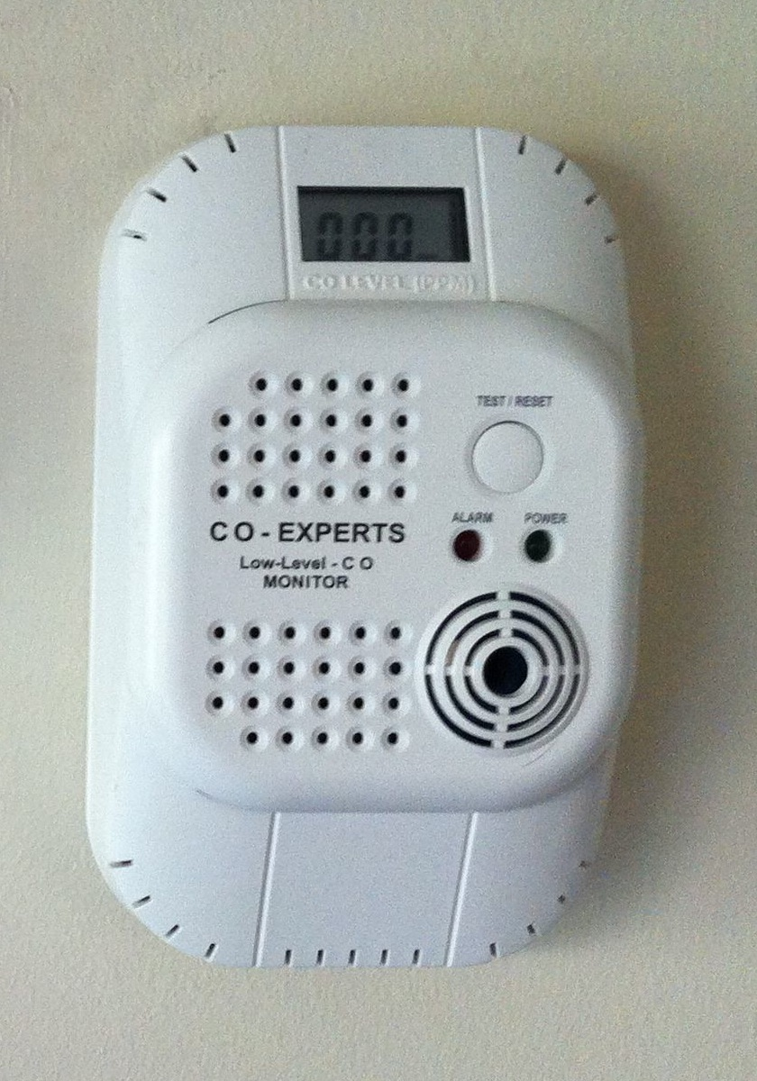
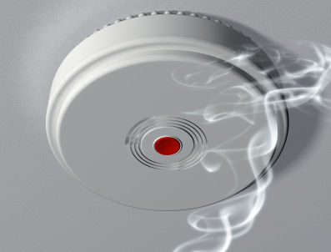
Reduce Risk
Vulnerable Populations
Early Warning Monitors

Slide 24
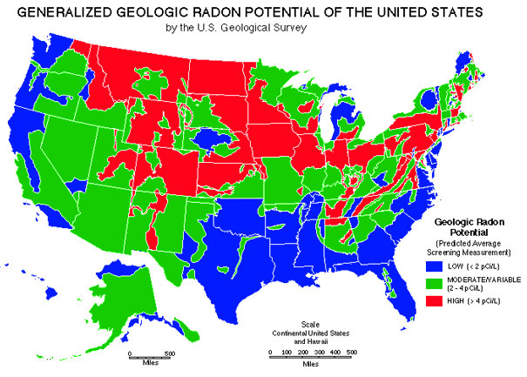
RADON: a special case
SOURCE
1
MAKE LESS - use a better widget, stop doing it
EMIT LESS INDOORS – control emission at source, chimney, vacuum
2
DISPERSAL
3
DILUTE – Passive (windows, doors, vents) Active (fan)
REMOVE FROM AIR – filter, scrubber
4
EXPOSURE
5
AVOID - reduce time in exposure area
PROTECT – reduce contact or inhalation (mask, gloves)
6
OUTCOME

Slide 25
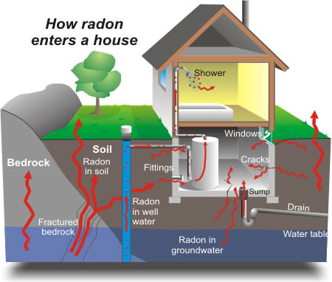

Slide 26
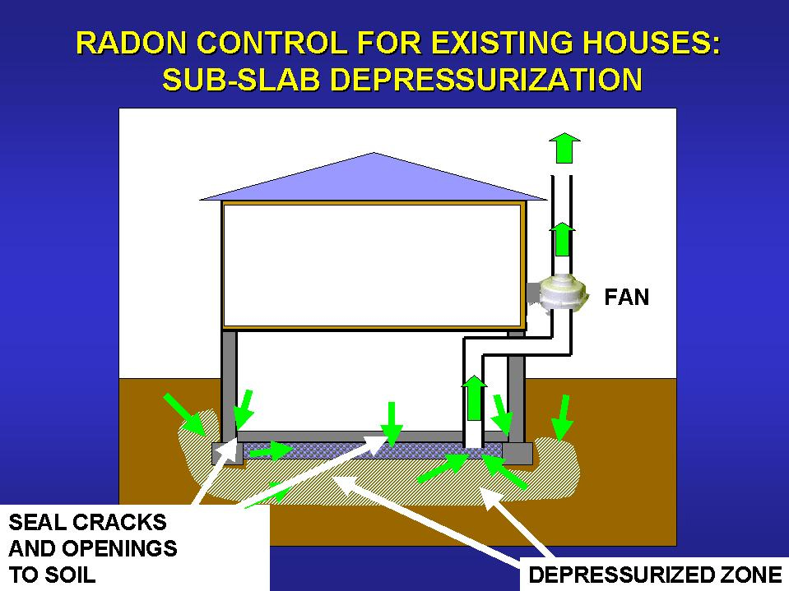
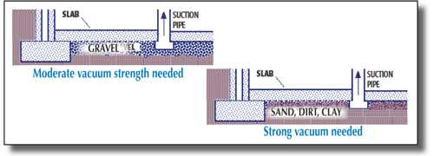
RADON – prevention

Slide 27
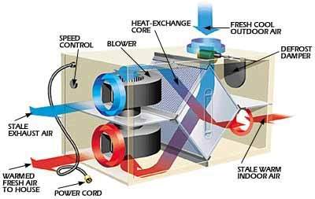
RADON – dilution
Heat Recovery Ventilator

Slide 28
7 Healthy Homes Principles
Keep It:
Dry
Clean
Ventilated
Pest-Free
Safe
Contaminant-Free
Maintained
Notes:
While there is no recipe that can guarantee a healthy home, you’ll be learning about key principles that can help create healthier indoor environments. You’ll hear about these principles throughout the course of the training.
In this training, we are introducing a new way of thinking about the home environment – an approach that considers the people living in the home, the building itself, and the potential health problems.

Slide 29
SOURCE
Air Quality
  Gases
  Chemicals/fumes (VOCs)
  Particulates
  Allergens
Thermal Comfort
  Temperature
  Humidity
DISPERSAL
EXPOSURE
OUTCOME

Slide 30
OPPORTUNISTIC Sources
Proliferate in Favorable Environments:
Rodents – gaps in envelope
Cockroaches – ready food source
Bacteria – standing water
Dust Mites – skin scales, high humidity
Fungi – moisture, substrate

Slide 31
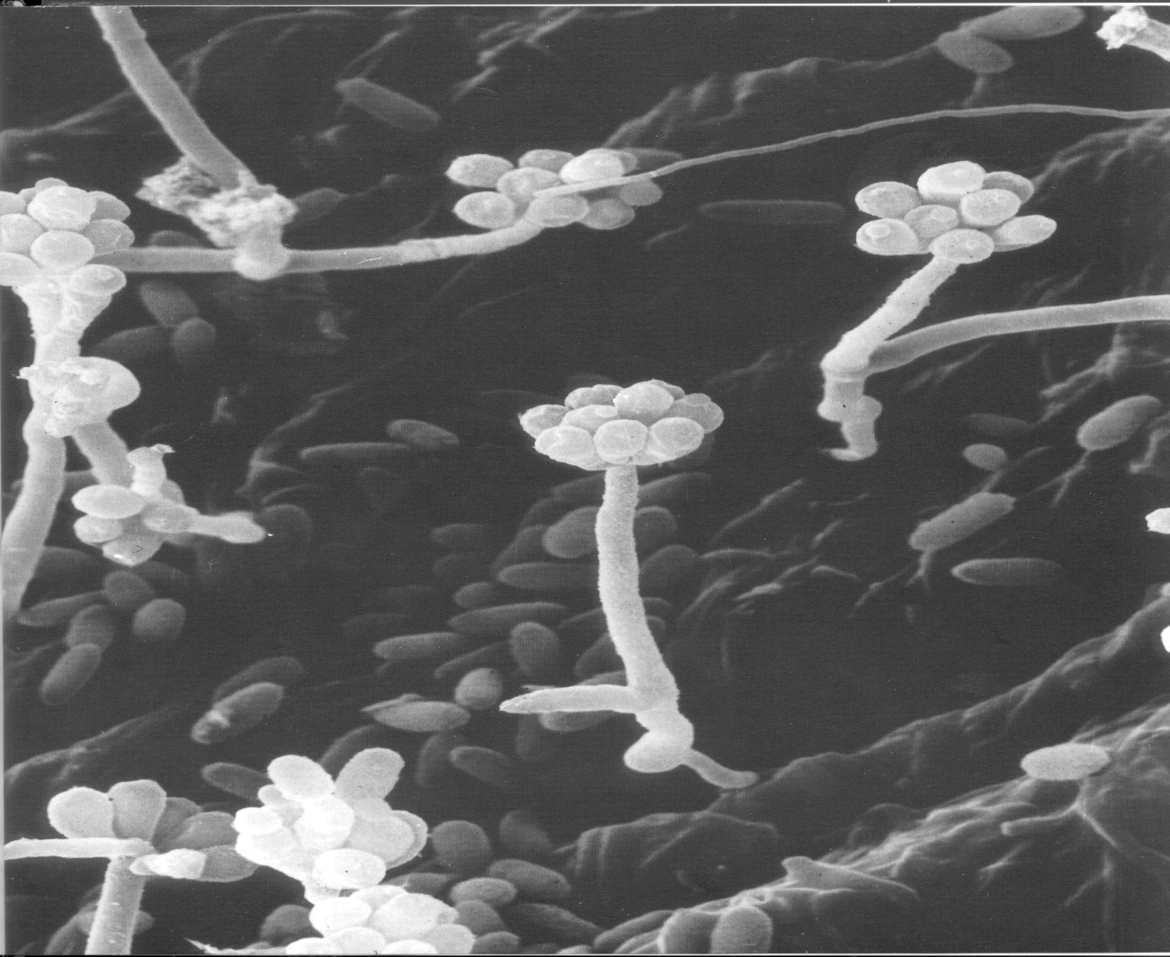
Fungal Growth Requirements
Nutrients
Temperature
Moisture

Slide 32
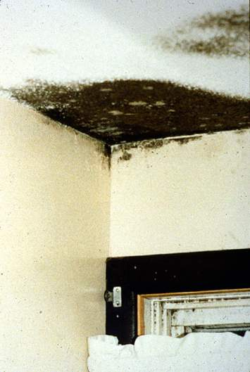
Indoor Environments
Indoor surfaces can support fungal growth by providing
  sufficient oxygen
  suitable temperatures
  source of nutrition
  moisture
MOISTURE CONTROL IS KEY !

Slide 33
7 Healthy Homes Principles
Keep It:
Dry
Clean
Ventilated
Pest-Free
Safe
Contaminant-Free
Maintained
Notes:
While there is no recipe that can guarantee a healthy home, you’ll be learning about key principles that can help create healthier indoor environments. You’ll hear about these principles throughout the course of the training.
In this training, we are introducing a new way of thinking about the home environment – an approach that considers the people living in the home, the building itself, and the potential health problems.

Slide 34
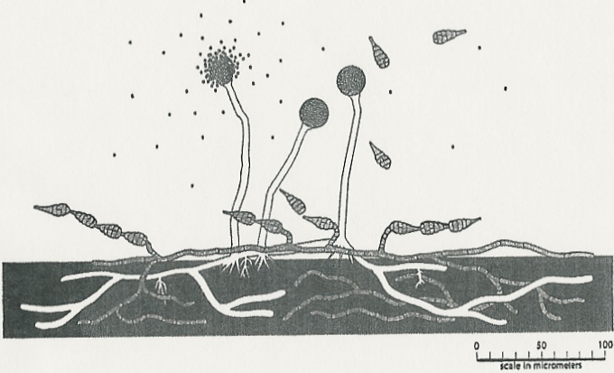
Mold (fungi)
Naturally occurring single-cell organisms
Found in all environments at some levels
In the right conditions mold multiplies, forms colonies, and sporulates

Slide 35
Agents of disease produced by molds
Spore
Glucans
Allergens
Toxins
Gases

Slide 36
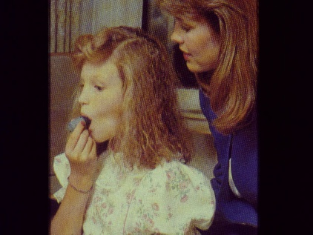
Human Health Effects
Allergic
  Asthma trigger (possible promoter)
  Damp/moldy homes lead to respiratory system illnesses in children
Irritant
  Mucous membrane (eyes, nose, throat) irritation and may lead to headaches
Notes:
36

Slide 37
Human Health Effects (cont.)
Infectious
  Healthy people are only affected by a few infectious fungi
  Immuno-compromised susceptibility
Toxic
  Mycotoxicoses
    Toxic effects well documented related to ingestion
    Some evidence in agricultural settings
    Lack of evidence between disease and mycotoxin exposure in homes or offices
Notes:
37

Slide 38

Toxic Mold?
“The hazards presented by molds that may contain mycotoxins should be considered the same as other common molds. . . There are very few case reports that toxic molds. . . can cause unique or rare health conditions such as pulmonary hemorrhage or memory loss. These case reports are rare, and a causal link between the presence of the toxic mold and these conditions has not been proven.”
-- US Center for Disease Control
Notes:
http://www.cdc.gov/nceh/airpollution/mold/stachy.htm#Q14

Slide 39

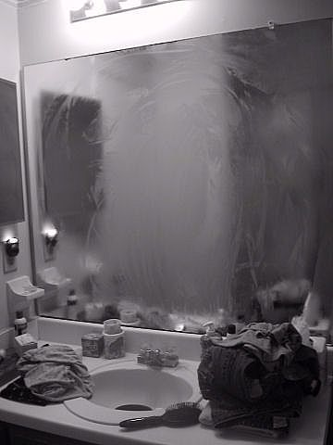
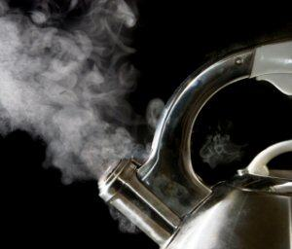
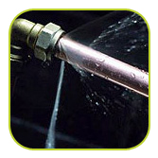
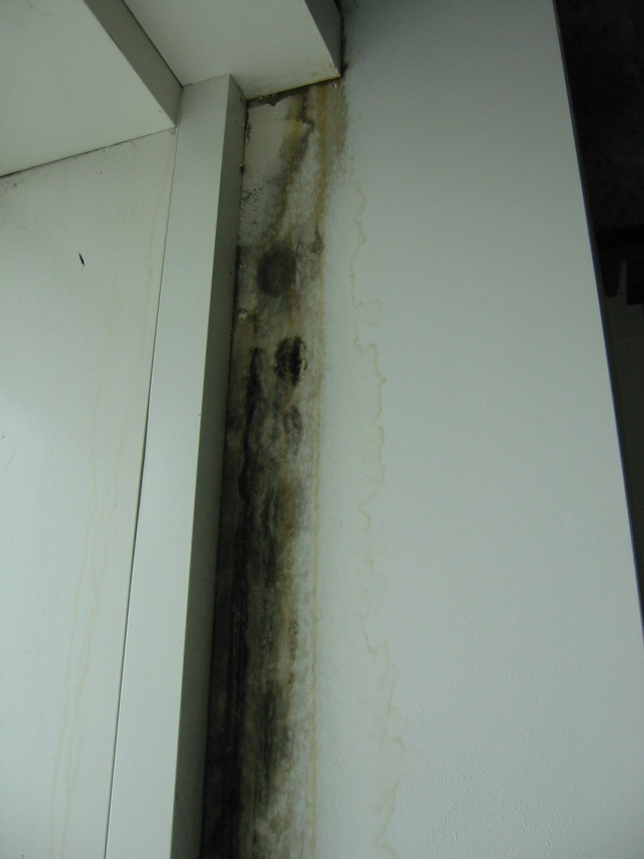

Moisture Sources
Occupants (exhaled)
Activities (cook, shower)
Water-related Utilities
Building Envelope
Humidity/Cold Surfaces

Slide 40
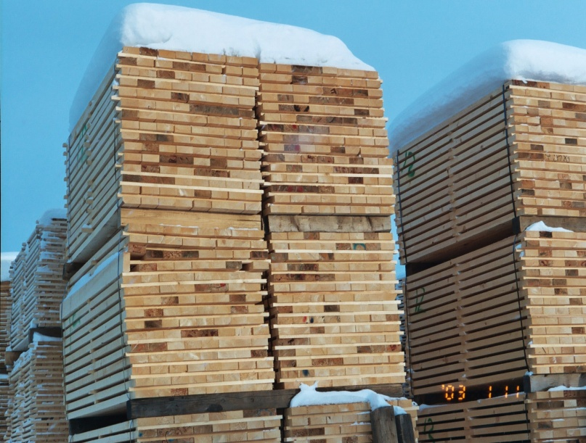
Moisture capacity of homes
100 years ago with masonry walls houses could hold 500 gls of water
50 years ago wood houses could hold 100 gls of water
Today metal studs, gypsum, & vinyl can hold 50 – 5 gls of water

Slide 41
Key Questions
When is high humidity a problem?
If a material gets wet, how long before it gets moldy?
What role do material properties play in development and prevention of mold growth?

Slide 42
Wallboard (W)
Ceiling Tile (CT)
Plywood (P)
Oriented Strand Board
(OSB)

Slide 43
Test Conditions
Number of Samples
Moisture Content W CT P OSB
  5 mg/cm³ (75%RH) 2 2 - -
  7 mg/cm³ (85%RH) 2 2 - -
  10 mg/cm³ (95%RH) 2 2 - -
  15 mg/cm³ (~100%RH) 2 2 - -
  50 mg/cm³ 2 2 2 2 (75%RH)
  75 mg/cm³ 2 2 2 2 (85%RH)
  100 mg/cm³ - 2 2 2 (95%RH)
  150 mg/cm³ 2 2 2 2 (~100%RH)
  200 mg/cm³ - - 2 2
  250 mg/cm³ 2 2 2 2
  300 mg/cm³ - - 2 2
  350 mg/cm³ 2 2 2 2

Slide 44
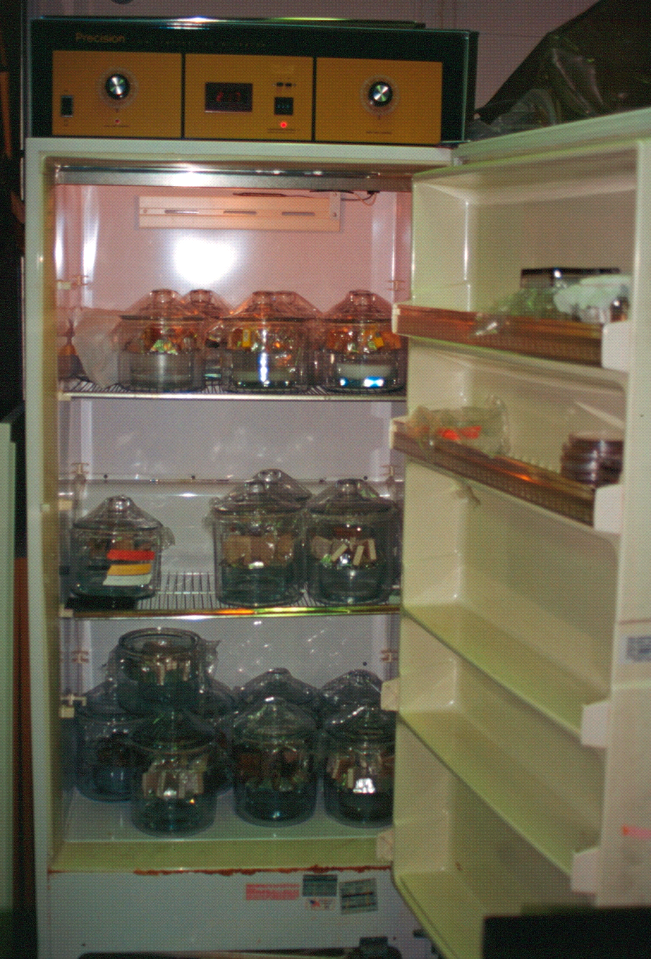
Temperature control
  (+/- 0.2 °C)

Slide 45
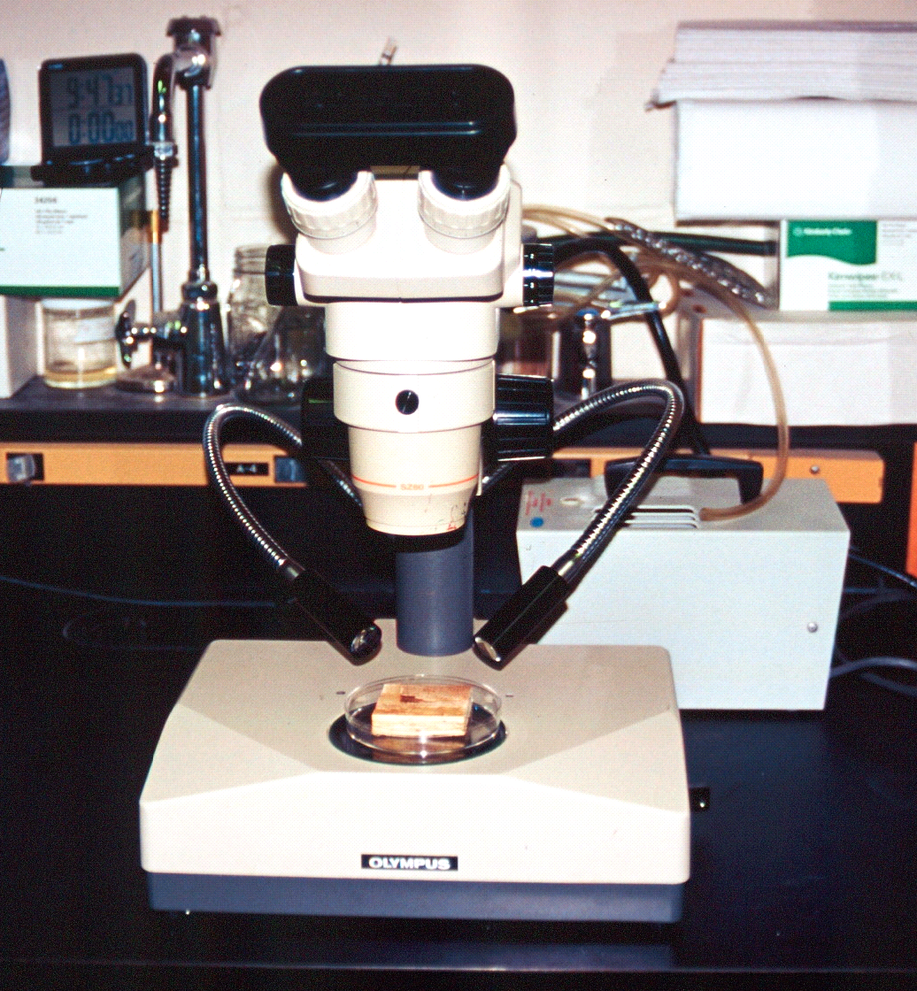
Fungal Growth Evaluation
In-situ observation
  Examine surfaces @ 20X magnification
  Record observations on grid data sheet
  => morphology
  => area coverage
N = 150 samples

Slide 46
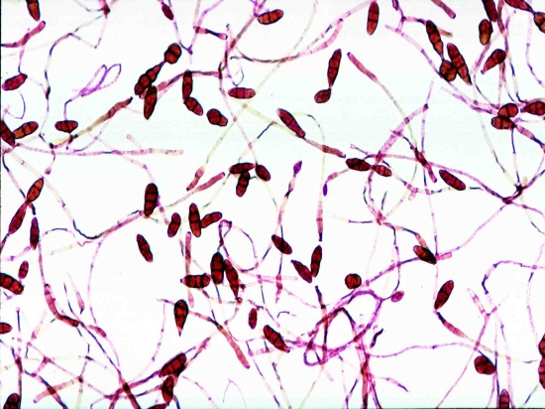
When“moisture” is a problem
Liquid water is necessary (growth in days)
    Condensation
    Leaks
    Floods
    Spills
Very few fungi will grow with only equilibrium moisture from the air, then only if RH is >95%. (growth in weeks to months)

Slide 47
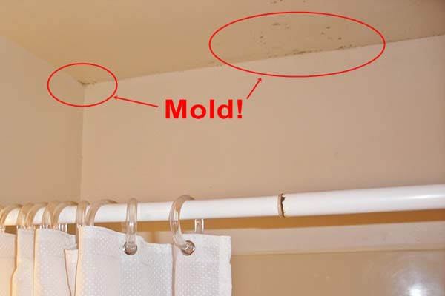
Role of Materials
What kind of ‘food’ is available for growth
Moisture retention properties
Location

Slide 48
Potential High Risk Areas
Materials with organic content
Cool subgrade and exterior surfaces
Materials under/behind furniture or built-in cabinetry, sub flooring
Surfaces behind impermeable finishing materials
Horizontal surfaces where pooling may occur
Cavities where moisture can accumulate

Slide 49
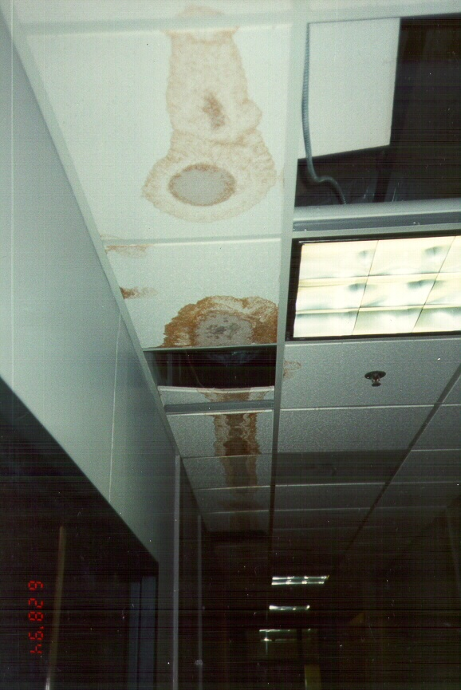
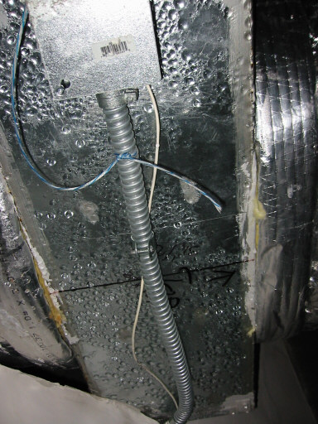
Faulty HVAC installation

Slide 50
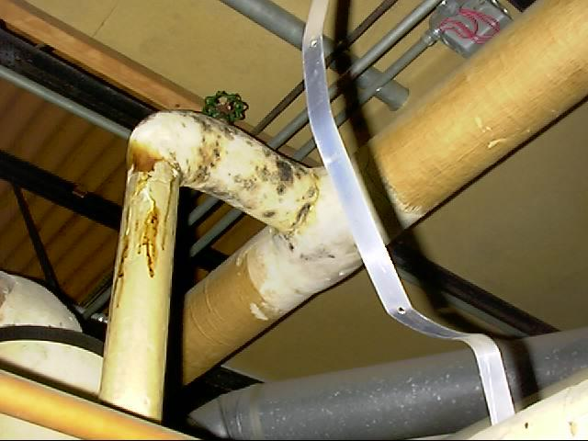
Building Systems - Leaking Pipes

Slide 51
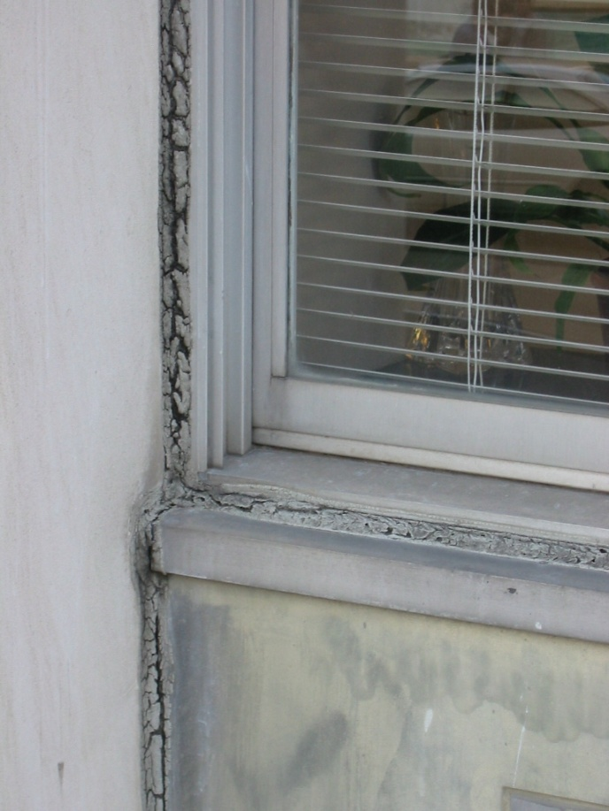
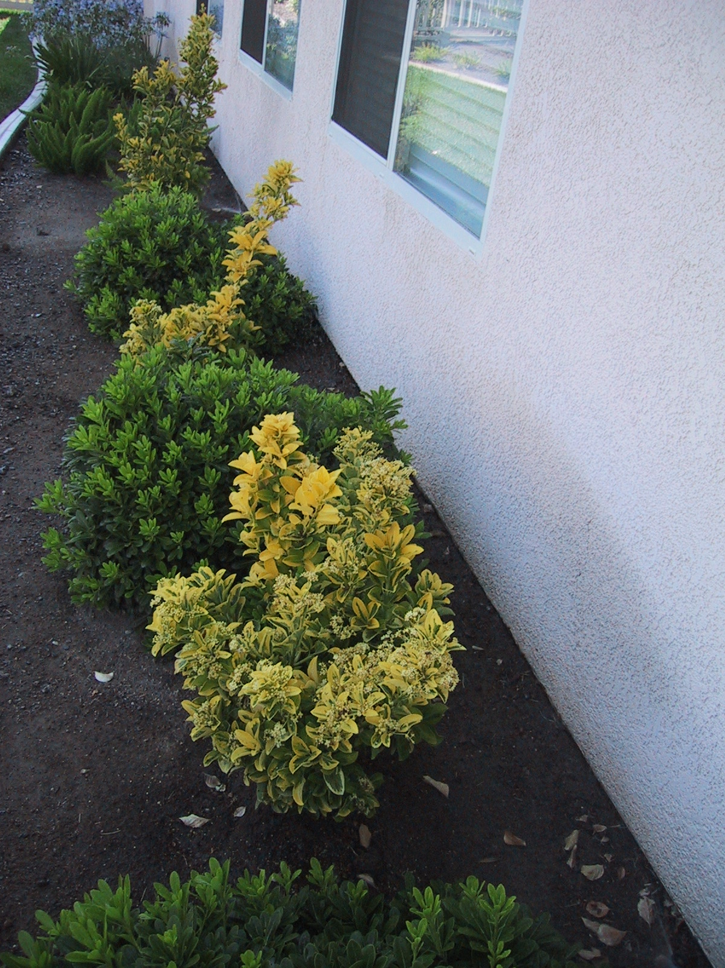
Exterior Details
Caulking
failures
Landscaping
sprinkler lines

Slide 52
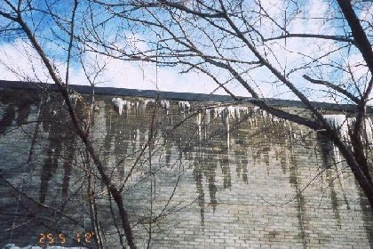
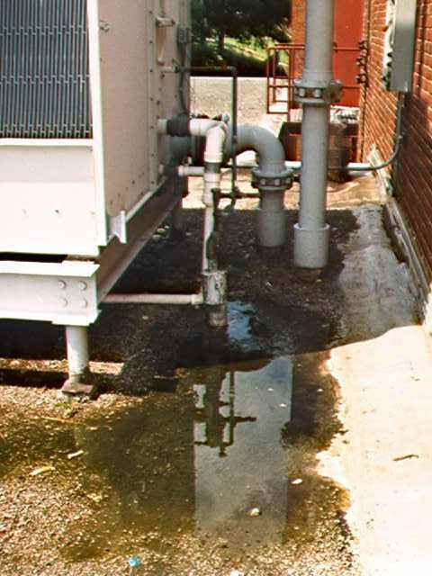
Roof Design
Flat roofs
Ice dams

Slide 53
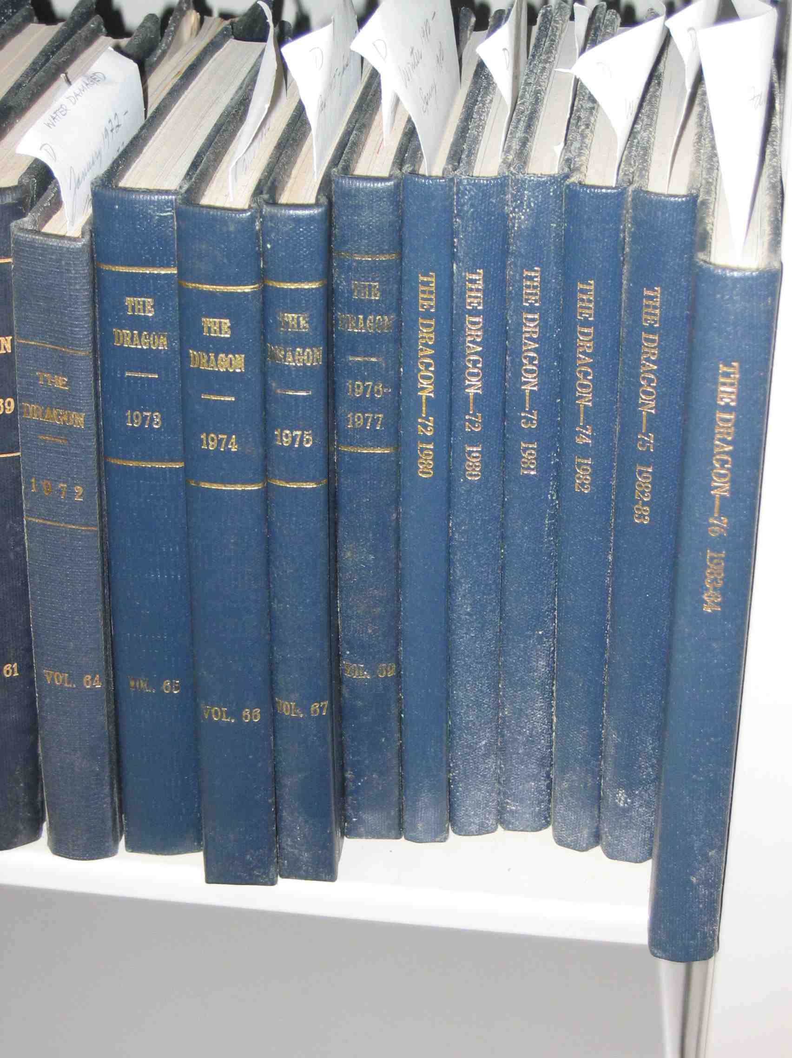
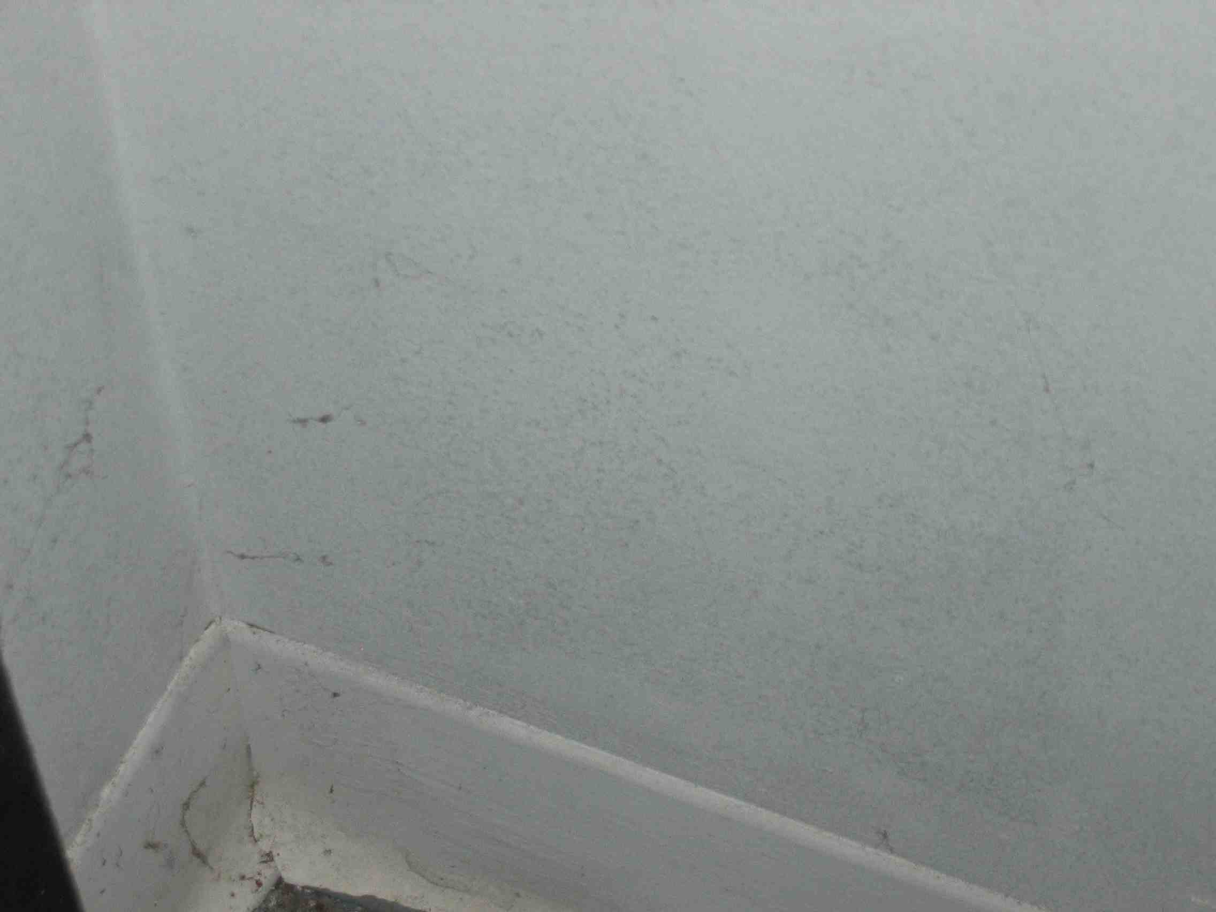
Unconditioned Subgrade Spaces

Slide 54
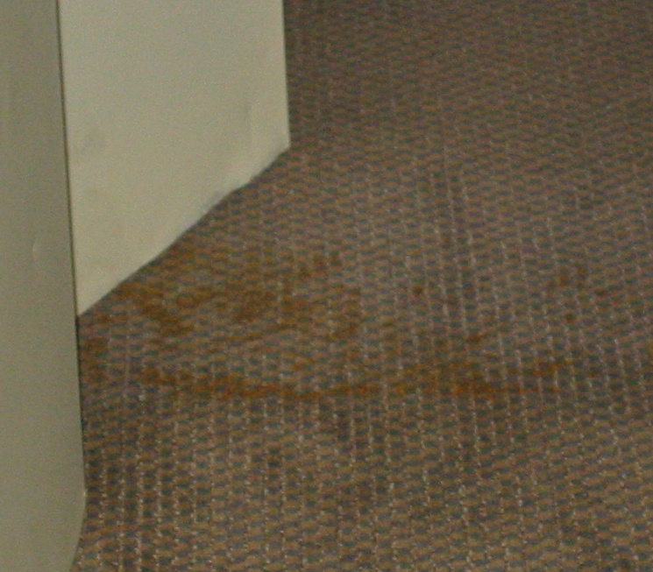
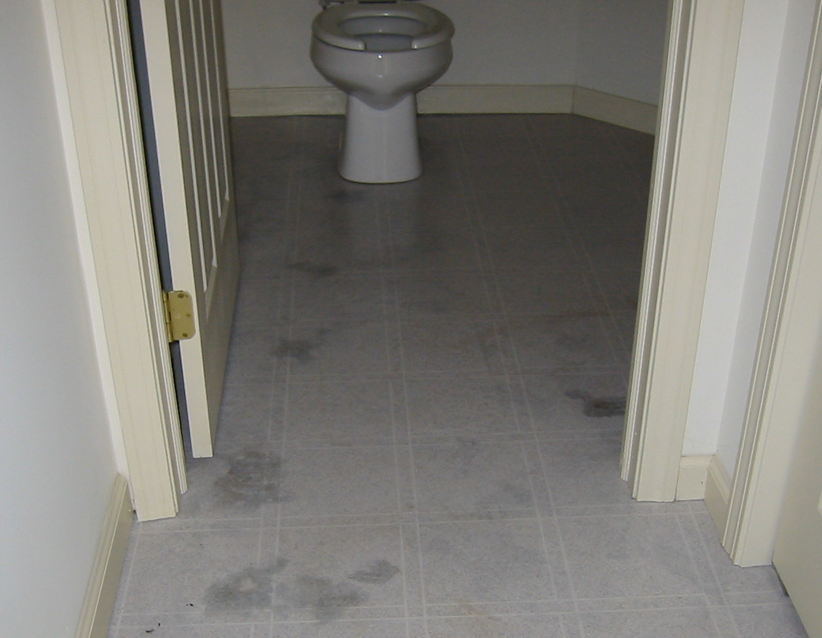
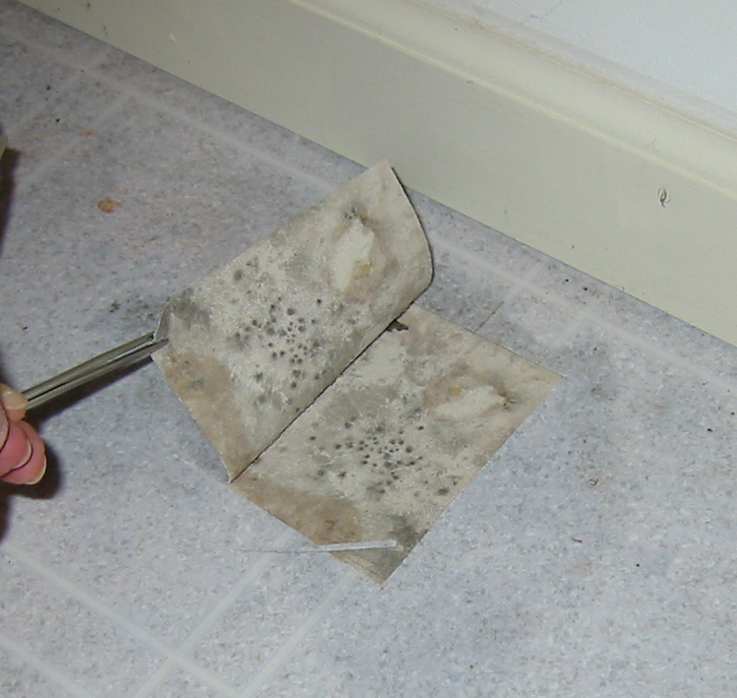

Sub Flooring

Slide 55

Impervious Wall Coverings

Slide 56


Insulated Wall Cavities

Slide 57


How to prevent mold growth
Ventilate moisture at source
Repair leaks as they occur
Clean up water from floods quickly
Prevent ground water intrusion
Insulate to prevent cold surfaces
Dehumidify where appropriate
Limit use of humidifiers
Appropriate materials
Vent Fans

Slide 58
If you still get mold...
BASIC RULES FOR CLEANUP

Slide 59
7 Healthy Homes Principles
Keep It:
Dry
Clean
Ventilated
Pest-Free
Safe
Contaminant-Free
Maintained
Notes:
While there is no recipe that can guarantee a healthy home, you’ll be learning about key principles that can help create healthier indoor environments. You’ll hear about these principles throughout the course of the training.
In this training, we are introducing a new way of thinking about the home environment – an approach that considers the people living in the home, the building itself, and the potential health problems.

