Slide 1
Part 5:
Practical Applications/ Diagnostics

Slide 2
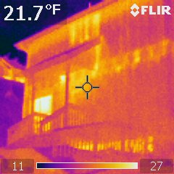
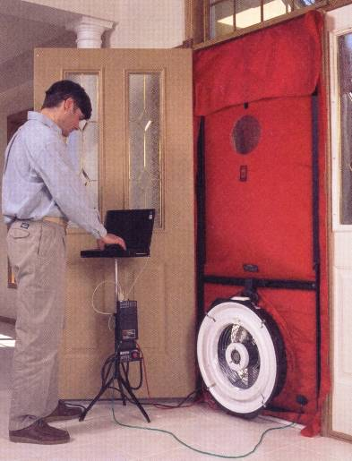
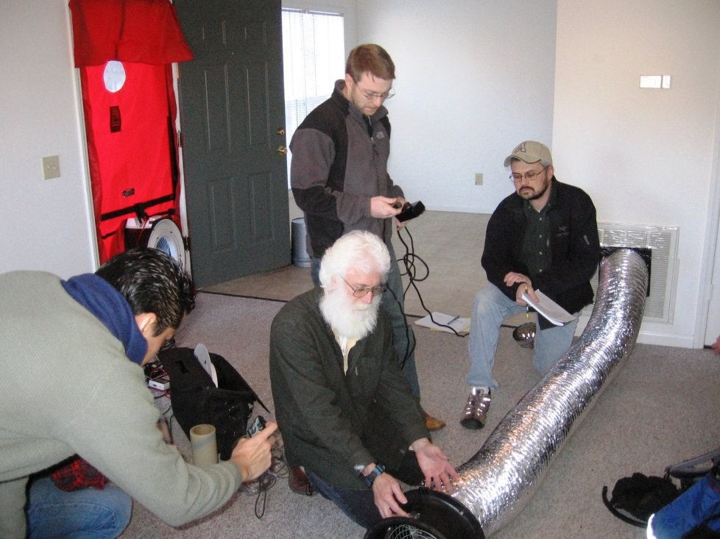
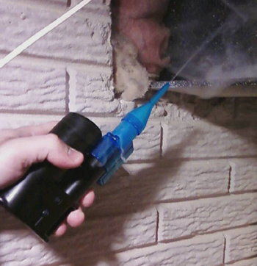
Air Leakage Diagnostics
  History
  Magnitude
  Location
  Interpretation

Slide 3
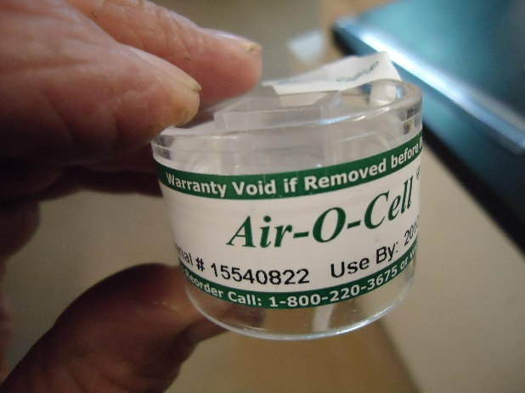
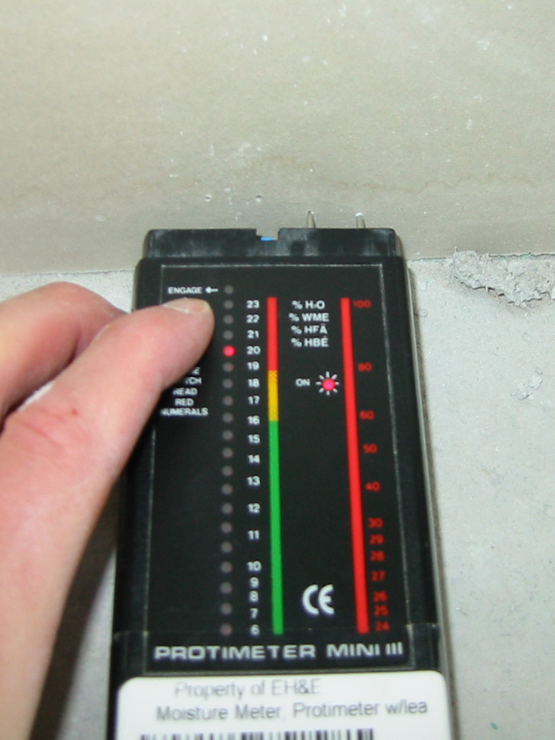
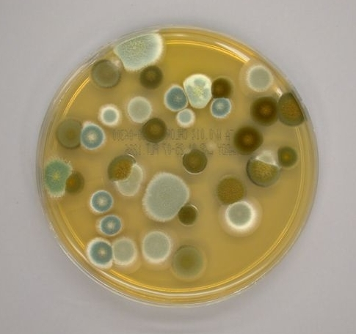
Mold/Moisture Diagnostics
  History
  Observation
  Moisture identification
  Sampling?
  Interpretation

Slide 4
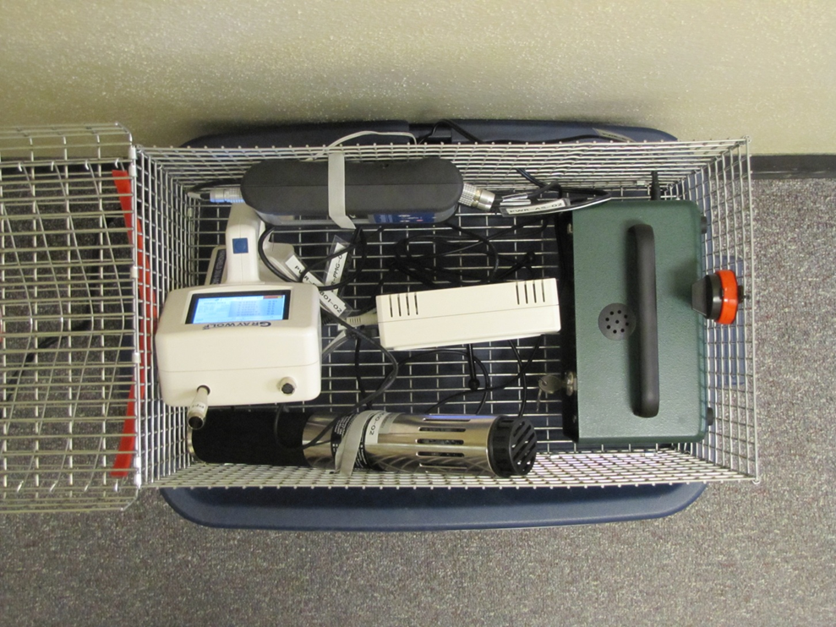

IEQ Diagnostics
FORMALDEHYDE
IAQ Probe & Logger
(CO, CO2, TVOC, %RH, temp)
NO₂
  History
  Observation
  Source identification
  Sampling?
  Interpretation
PARTICLE
COUNTER
RADON

Slide 5


This concludes The American Institute of Architects Continuing Education Systems Course
Contact Information:
energy.appstate.edu
Janet Miller, millerjm1@appstate.edu
Follow us on Facebook!
AppEnergyCenter

