Slide 1
Part 5: Practical Applications/ Diagnostics

Slide 2
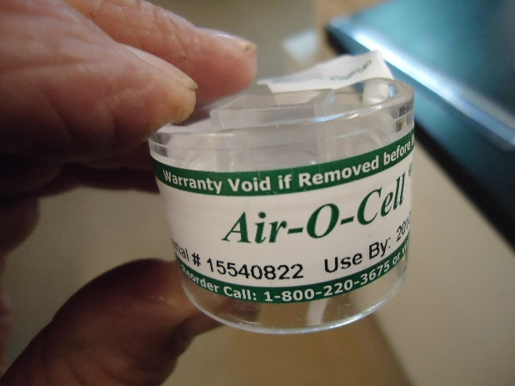
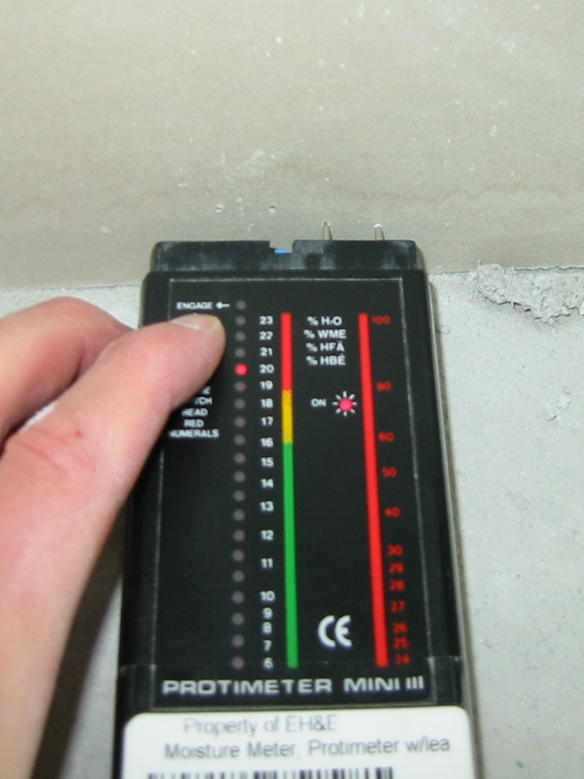
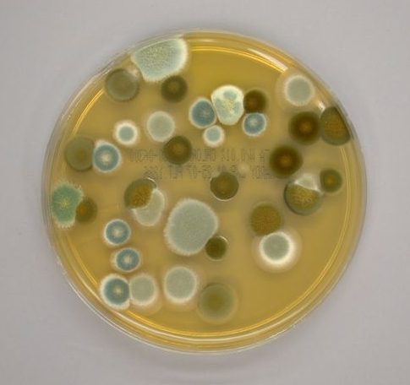
Mold/Moisture Diagnostics
History
Observation
Moisture identification
Sampling?
Interpretation

Slide 3
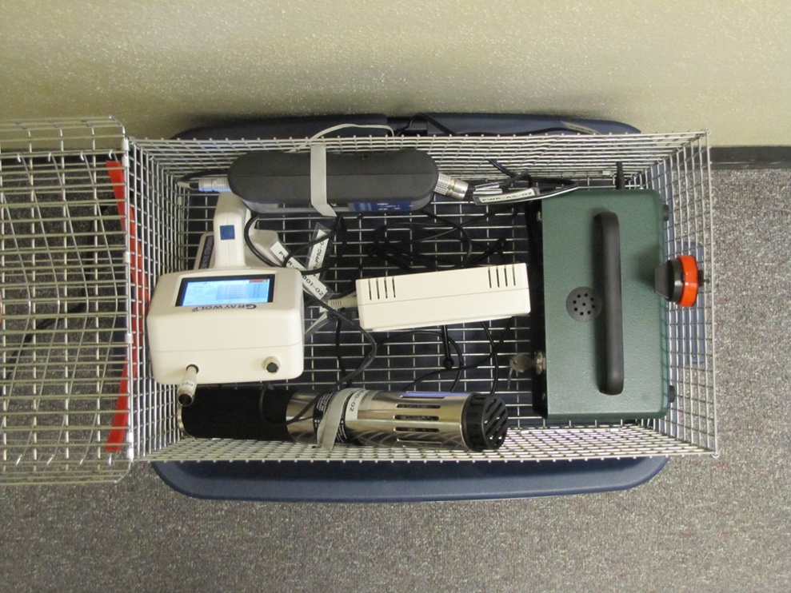
IEQ Diagnostics
FORMALDEHYDE
IAQ Probe & Logger
(CO, CO2, TVOC, %RH, temp)
NO₂
History
Observation
Source identification
Sampling?
Interpretation
PARTICLE
COUNTER
RADON

