Slide 1
Part 4: Smart Building Practices
The practice of creating structures and using processes that are environmentally responsible and resource-efficient throughout a building’s life cycle.
  This includes:
    Site design and management
    Resource efficiency
    Energy efficiency
    Water efficiency
    Indoor Air Quality
    Owner education
    3rd Party verification
    Looks at the building “as a whole” rather that individual pieces that come together.
Notes:
“as a whole” - we know that for every action there is a reaction. When we consider the building as one we take into account how all the pieces add up to a whole. If we fail to do this we may build a structure that uses less resources but one that is not very energy efficient. Or we may construct a building that has great energy efficiency but has horrible indoor air quality. For centuries building have been constructed as pieces and at the end they are the sum of those pieces. The modern era is ushering in more advanced products and processes and the need to build “as a whole” is not only better but is also a must for occupant comfort and safety.

Slide 2



How do you IDENTIFY an Energy Efficient Home?
Labels and Certificates
The 3rd party inspection importance
Field Verification
ENERGY STAR Products/Efficient Equipment??
Questions to ask the seller/builder
Notes:
Narrative:
Point of Slide:

Slide 3

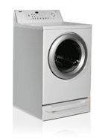
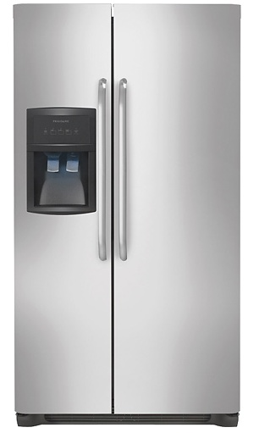
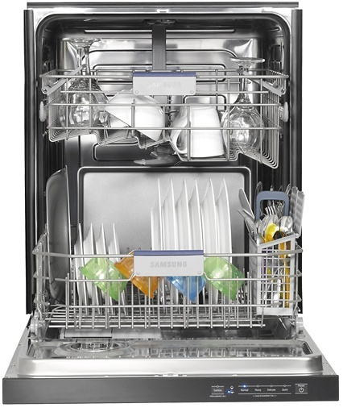
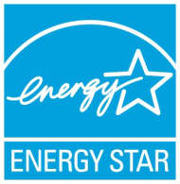
ENERGY STAR Products vs. ENERGY STAR Homes
While Energy Efficient Home Programs will often require the use of ENERGY STAR certified lighting and appliances these alone do not equal qualified!!
Notes:
Narrative:
What is the ENERGY STAR Advanced Lighting Package (ALP)?
An ENERGY STAR ALP designation identifies homes equipped with a comprehensive set of ENERGY STAR qualified light fixtures. With an ALP installed, homebuyers can expect to save energy and money through reduced lighting operating costs - while sacrificing nothing for aesthetics! ENERGY STAR qualified fixtures are available in many designs and fixture-types, giving homeowners a wide range of choices to create just the right look for their home.
The ALP designation applies to lighting packages, for new home construction, that consist of a minimum of 60% ENERGY STAR qualified hard-wired fixtures and 100% ENERGY STAR qualified ceiling fans where installed.
Point of Slide:
Realtors working with builders that are doing the Advanced Lighting Package should know the requirements of the optional program.

Slide 4
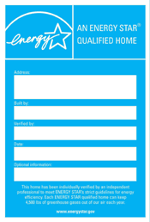
ENERGY STAR
Criteria for New Homes
High performance windows
Tight construction and ducts
Effective insulation
Efficient, properly installed equipment
Water management
Efficient lighting, water heating, appliances
Ventilation, filtration, combustion safety
Energy Modeling
Third-party verification
Notes:
Narrative:
So, really, what is involved in an ENERGY STAR home? The ENERGY STAR criteria requires the home to have effective insulation, high performance windows, tight construction and tight ducts, efficient equipment and third party verification. We will talk about each of these areas in detail and answer some of your questions about the benefits these different areas provide your homebuyers.
Point of Slide:
This slide is setting up this section and to put the ENERGY STAR criteria in simple categories that are easy for the Realtors to remember.

Slide 5
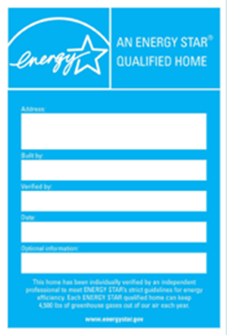
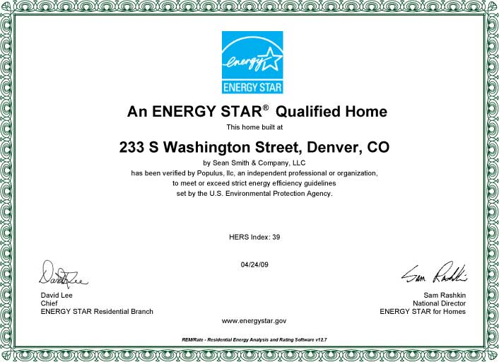
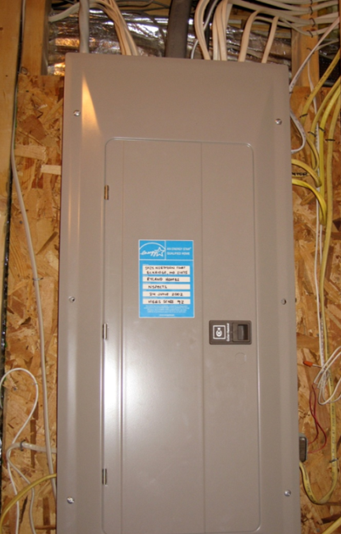
The ENERGY STAR Home sample certificate
Notes:
Narrative: sample certificate and sticker which is most often located on the electrical panel of a home.

Slide 6
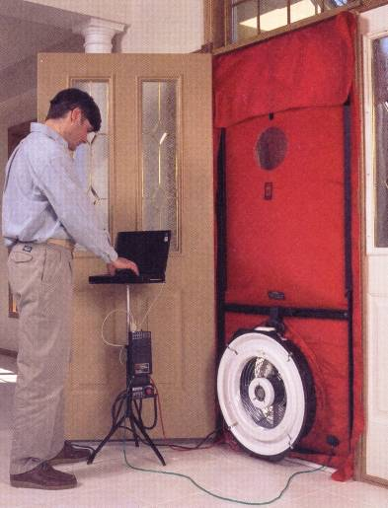
FIELD VERIFICATION
Blower Door Test
ENERGY STAR qualified homes are inspected and tested by an independent Home Energy Rater to meet EPA's guidelines for energy efficiency.
The Blower Door test measures how much air leaks out of a home’s envelope by studying at how much air must be removed from the home to reach a certain pressure level, thus testing the efficiency of the building envelope.

Slide 7
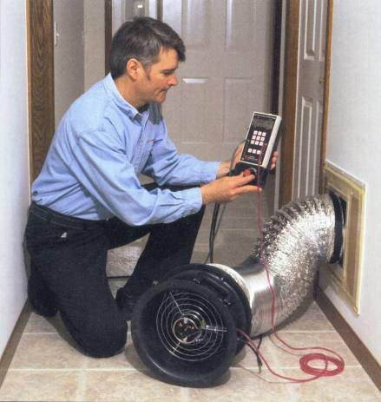
FIELD VERIFICATION
Duct Blaster Test
Duct blaster test measures the leakiness of the home’s duct system.
The average new American home duct system has about 20-30% air leakage.

Slide 8
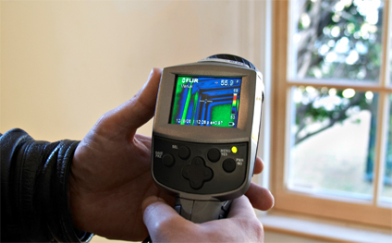
FIELD VERIFICATION
Infrared Camera Diagnostics
Many Home Energy Raters use infrared cameras to pinpoint areas where heat and cold can escape from a home so they can be sealed and properly insulated by the builder.

Slide 9
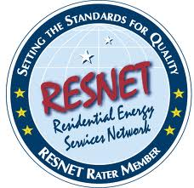
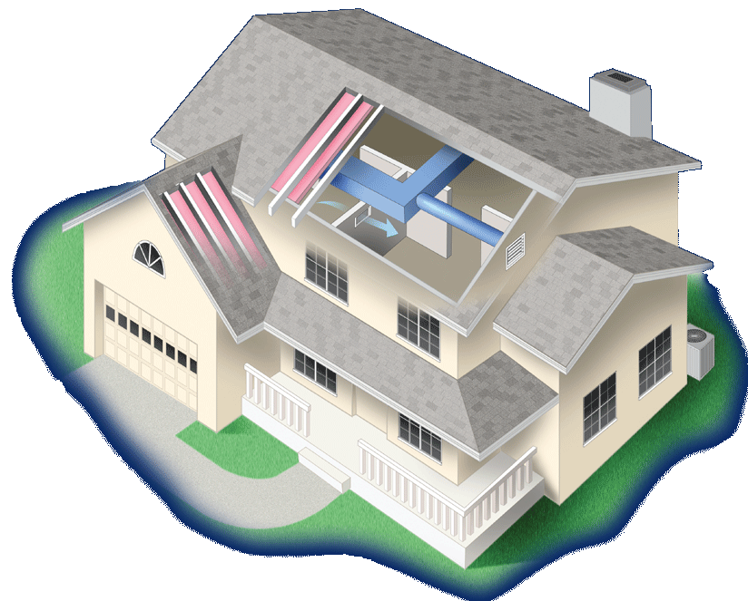
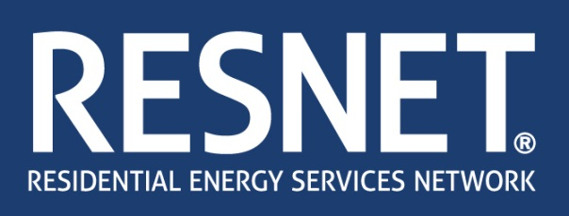
Third-Party Verification
Third-Party Verification: Quality Assurance
  HERS Raters inspect and/or test homes several times during the construction process
  Often they model homes using software to determine the appropriate mix of measures needed to achieve a certain level of performance
  Assist builder and subs
  Not just another inspector
5
Notes:
Narrative:
One major piece of the ENERGY STAR program that helps it be more credible is the Third Party Testing and Verification. Home Energy Raters are trained by one of a few building science organizations around the country and they have to take a pretty tough exam that proves they understand building science and how to inspect and test a new home built to the ENERGY STAR standards. HERS raters are what they are called generally. These raters do two different inspection visits to each home. First, they come in and inspect air sealing and insulation by using a Thermal Bypass Checklist developed by EPA. Next, they come in and test the duct system tightness with a small fan contraption we all call a duct blaster. On the same visit, they test the tightness of the home by hooking up a blower door and depressurizing the home and measuring how much air is leaving the home per minute. Each home will have a different target on home tightness and if they do not meet this target, the Home Energy Rater will inform the builder so they can do more air sealing in the home until they meet the air tightness standard.
Point of Slide:
This slide and the following slide illustrate some tools used by Home Energy Raters as they inspect and test ENERGY STAR homes.

Slide 10

REM Rate Modeling software
Use to “energy model” residential structures
Provides annual energy use data

Slide 11
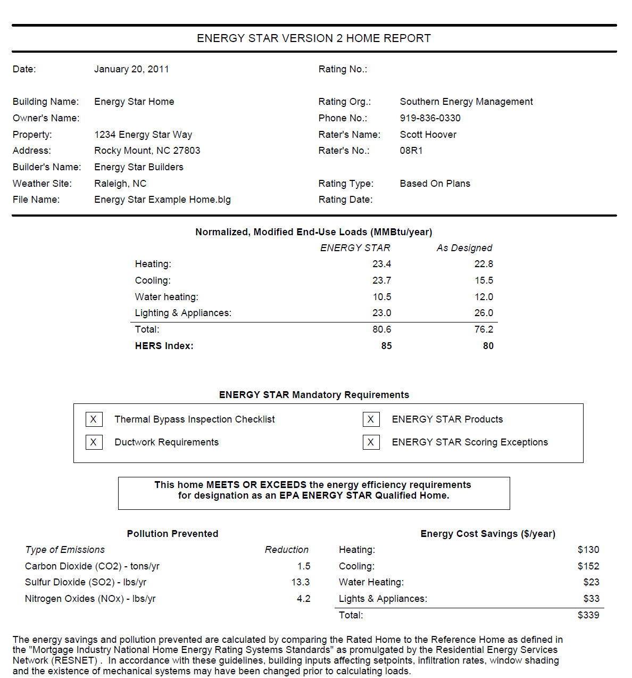
ENERGY STAR REM report
Use in the Present Value of Future Savings equation

Slide 12
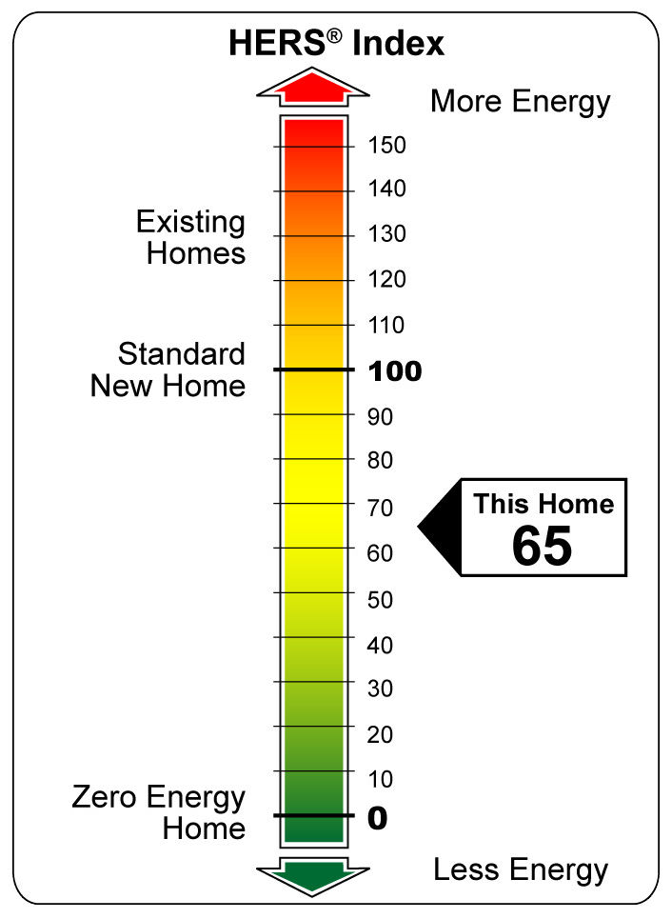
ENERGY STAR – Home Energy Raters and the HERS Index
  Determine the HERS score of all homes they rate.
  HERS Index
    A measure of a homes level of efficiency
    The lower the better
    Each 1-point decrease in the HERS Index corresponds to a 1% reduction in energy consumption compared to the HERS Reference Home.
Notes:
This is the first mention of the HERS Index. Be sure to spend ample time here assuring the class understands this score and scale before moving on.

Slide 13
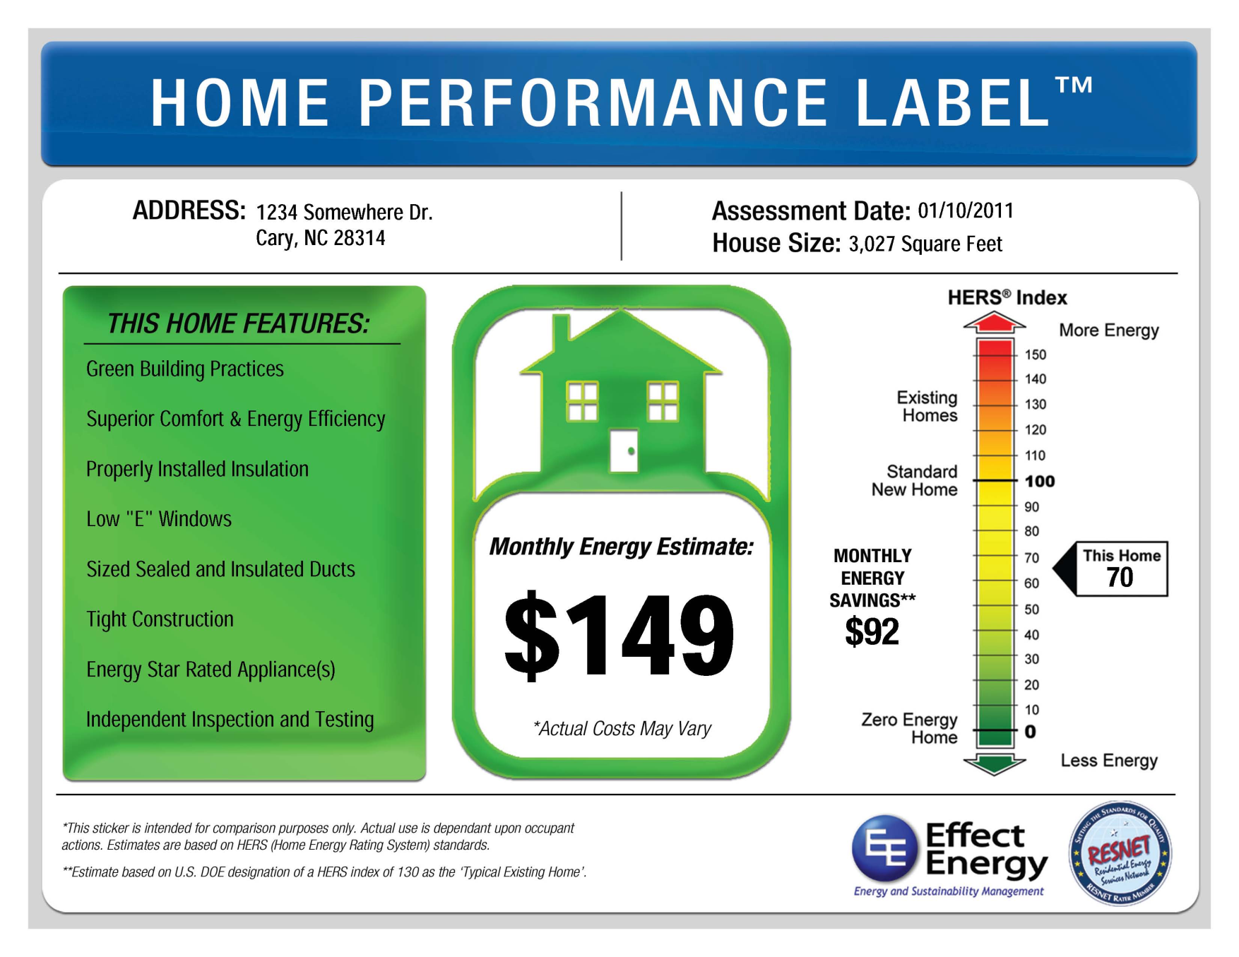
HERS Index can be used without ENERGY STAR qualification

Slide 14
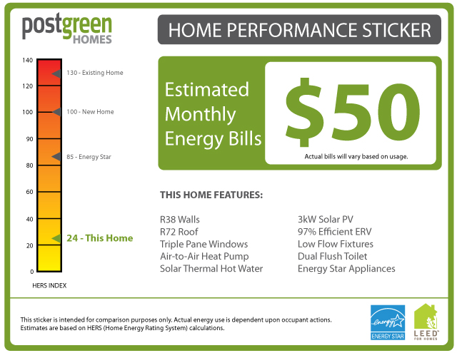

Slide 15

How do you Identify a “Green” Home
What is the difference?
  Certified Green Buildings
    Have been certified to a national standard and third party verified to have complied with the provisions of that standard.
  Green Features
    Are built in elements to any building that provide significant pay back. These features are typically advanced processes that are associated with a certification or that stand alone as significant building upgrades.
  Green washing
    The act of misleading consumers regarding the benefits of a product, process or service. This may often be unintentional and in today’s “green marketing "arena we must be very carefully not to misinform the client.
Notes:
We know Certified Green Buildings offer a structure we can firmly stand on. Lets look deeper into Green Features and green washing to ensure we are well informed and do not misrepresent our clients.

Slide 16
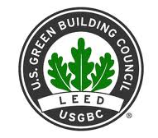
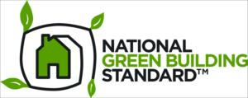
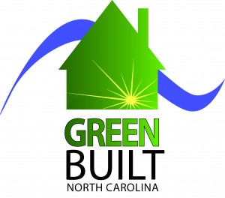
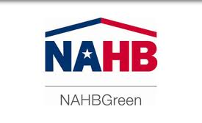
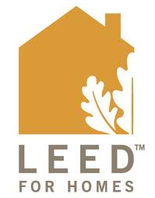




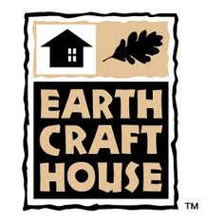

Nationally Recognized Green Building Programs

Slide 17
Nationally Recognized Green Building Programs
What do all programs we will talk about today have in common?
  3rd Party verified
  Nationally or regionally recognized with a track record of success
  Address multiple categories as part of the certification
    Resource and material efficiency
    Water efficiency
    Energy efficiency and environment
    Indoor air quality
    Site development
    Site location
    Building design
  Point’s based rating system – bronze, silver, gold, etc.

Slide 18
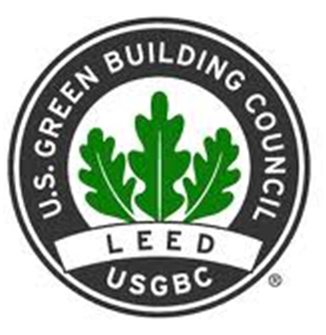
LEED for Homes
LEED – Leadership in Energy and Environmental Design
  Developed by the USGBC (U.S. Green Building Council)
  Offers certifications for homes, new buildings, developments, and existing buildings
  LEED-certified buildings are designed to:
    Lower operating costs and increase asset value
    Reduce waste sent to landfills
    Conserve energy and water
    Be healthier and safer for occupants
    Reduce harmful greenhouse gas emissions
    Qualify for tax rebates, zoning allowances and other incentives in hundreds of cities

Slide 19
LEED cont…
LEED – Leadership in Energy and Environmental Design
  Offers a variety of professional credentials
    LEED for Homes Green Raters
    LEED Green Associate
    LEED AP
      BD+C – Building Design + Construction
      ID+C – Interior Design + Construction
      HOMES
      O+M – Operation + Maintenance (existing buildings)
      ND - Neighborhood Development
  Educates and certifies a network of accredited green raters/verifiers that provides 3rd party oversight on all LEED projects.

Slide 20
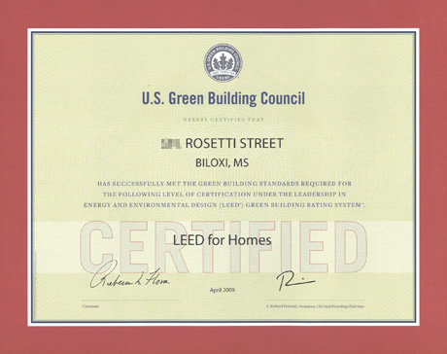
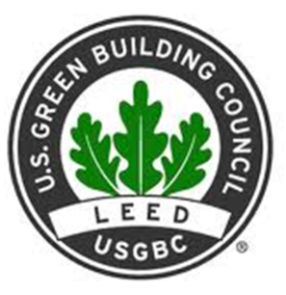
LEED sample certificate of approval

Slide 21
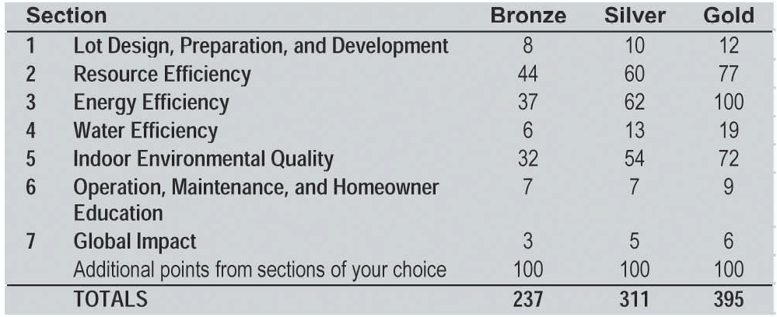
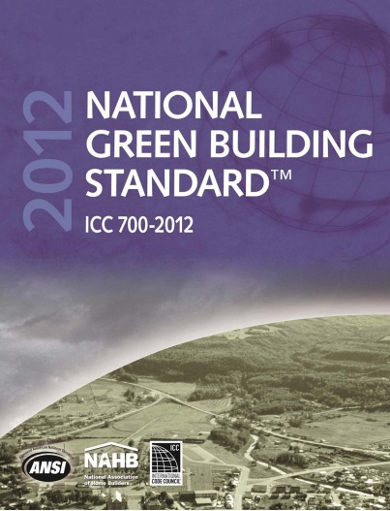
Notes:
Narrative:
Point of Slide:

Slide 22
National Green Building Standard – NAHB Green
  Created by the National Association of Homebuilders and the NAHB Research Center (now the Home Innovation Research Lab)
  Developed the National Green Building Standard - used for rating new and remodeled single- and multifamily buildings as well as residential subdivisions. It is the first and only such residential green rating system to have earned the approval of the American National Standards Institute (ANSI).

Slide 23
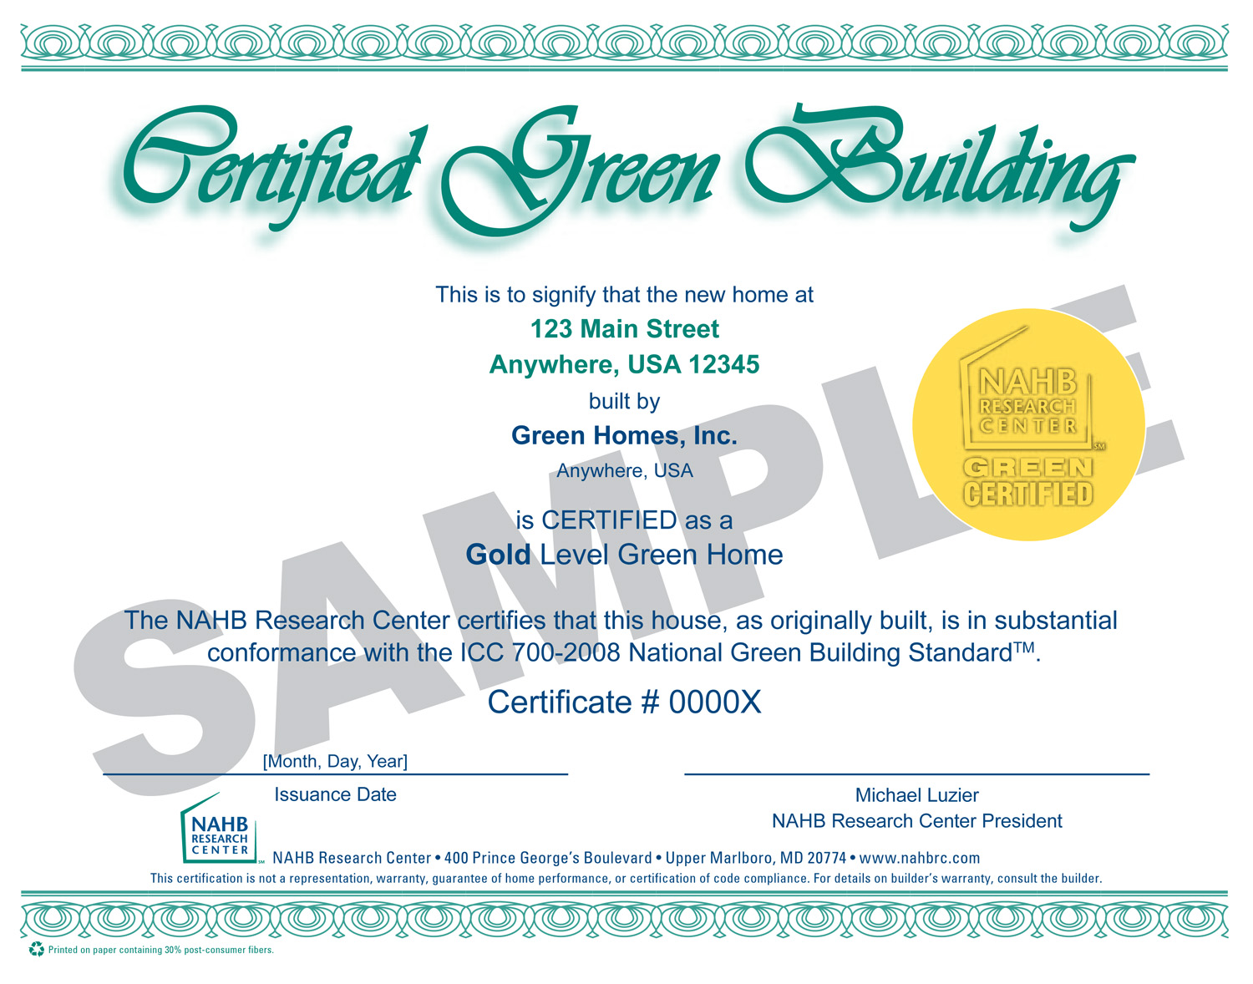
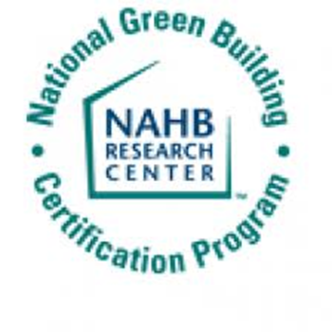
NAHB Green sample certificate

Slide 24
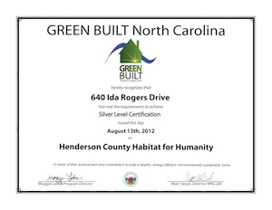

GreenBuilt North Carolina
Minimum point values per category
Site Opportunities: | 10 | Indoor Air Quality Opportunities: | 15
Water Opportunities: | 9 | Materials Opportunities: | 18
Building Envelope Opportunities: | 14 | Bonus Opportunities: | 3
Comfort Systems Opportunities: | 18 | Community Checklist: | 5
RATING SCALE
105 - 160 points: Certified
161 - 210 points: Silver certified
211 - 300 points: Gold certified
301+ points: Platinum certified
Notes:
Narrative:
Point of Slide:

Slide 25
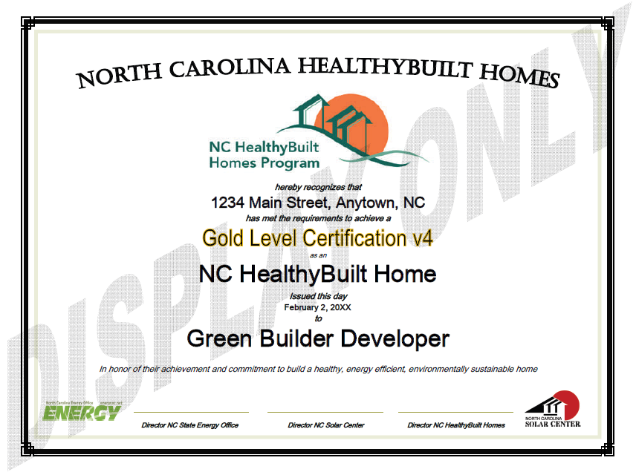
Notes:
Narrative:
Point of Slide:

Slide 26

NC Green Built Homes
NC Green Built Homes (formerly NC Healthy Built Homes)
  Sample certificate

Slide 27
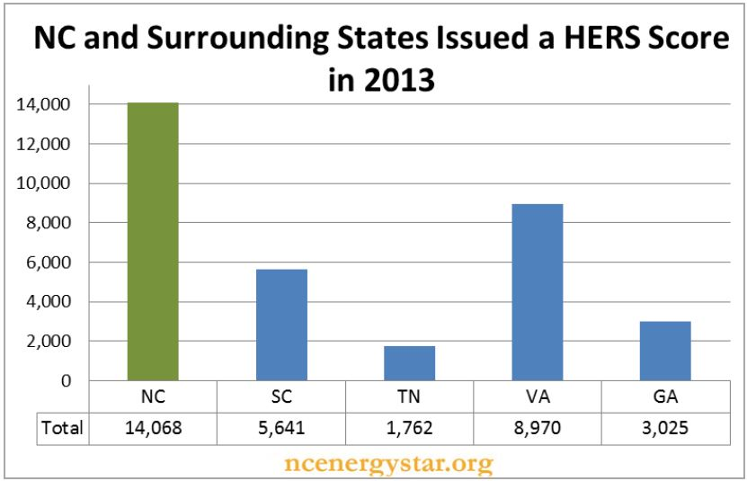

Slide 28
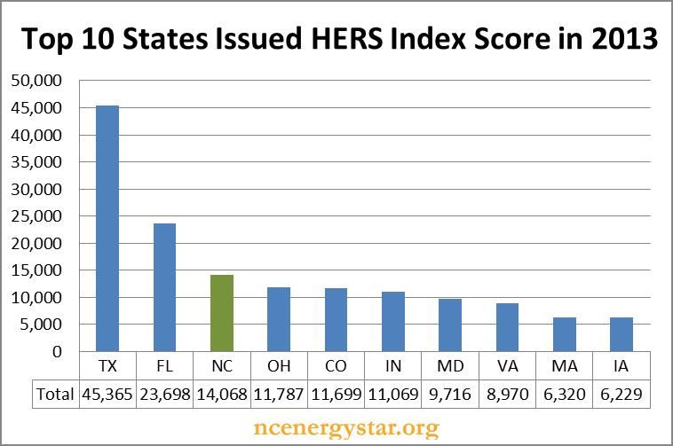

Slide 29
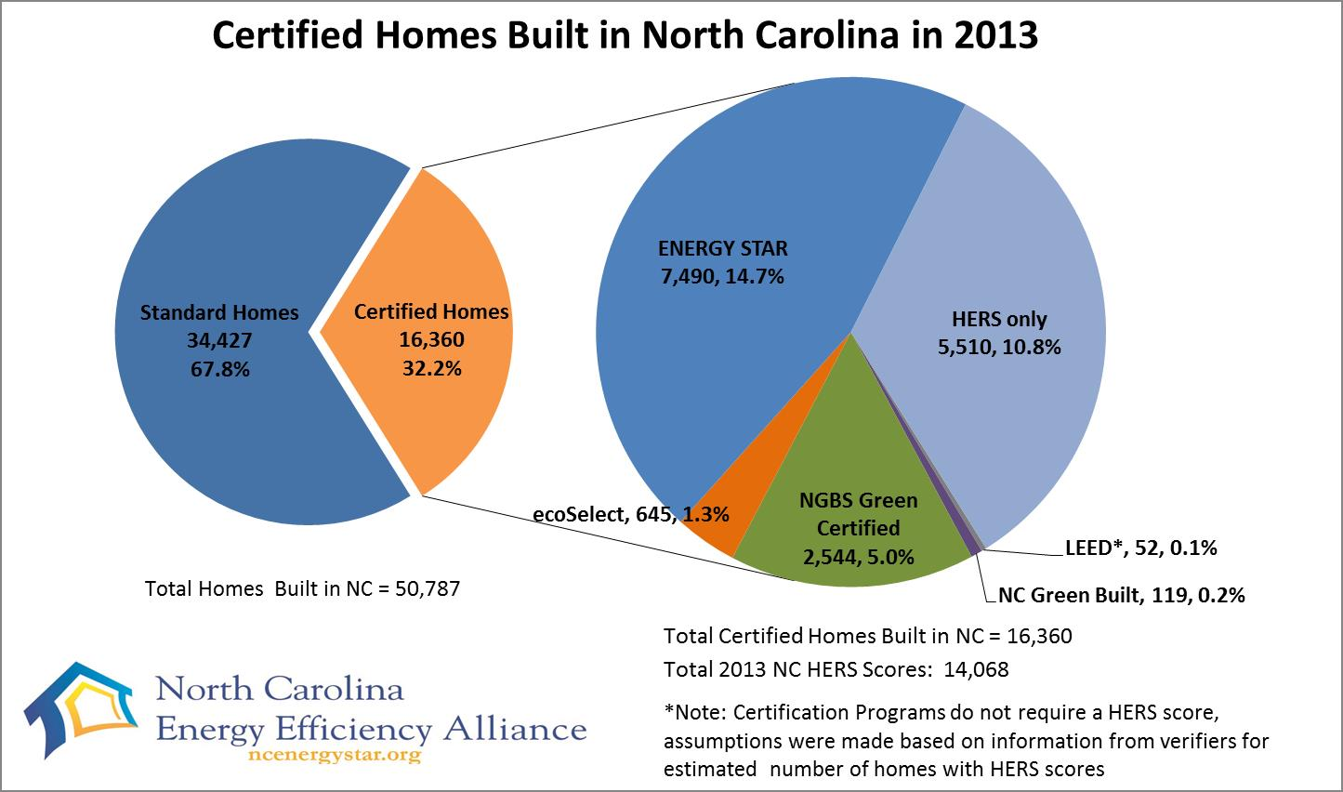

Slide 30
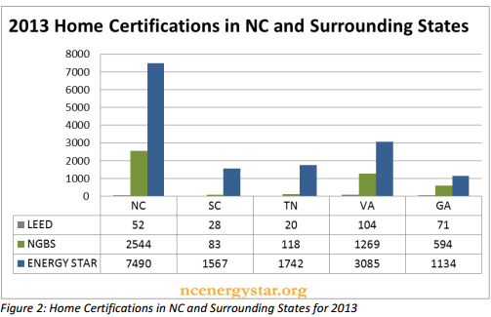

Slide 33
Year | Number of Homes Issued HERS Index Score | % of New Home Sold
2013 | 218,000 | 51%
2012 | 128,000 | 40%
2011 | 120,000 | 38%
2010 | 116,000 | 31%
2009 | 100,000 | 21%

Slide 34
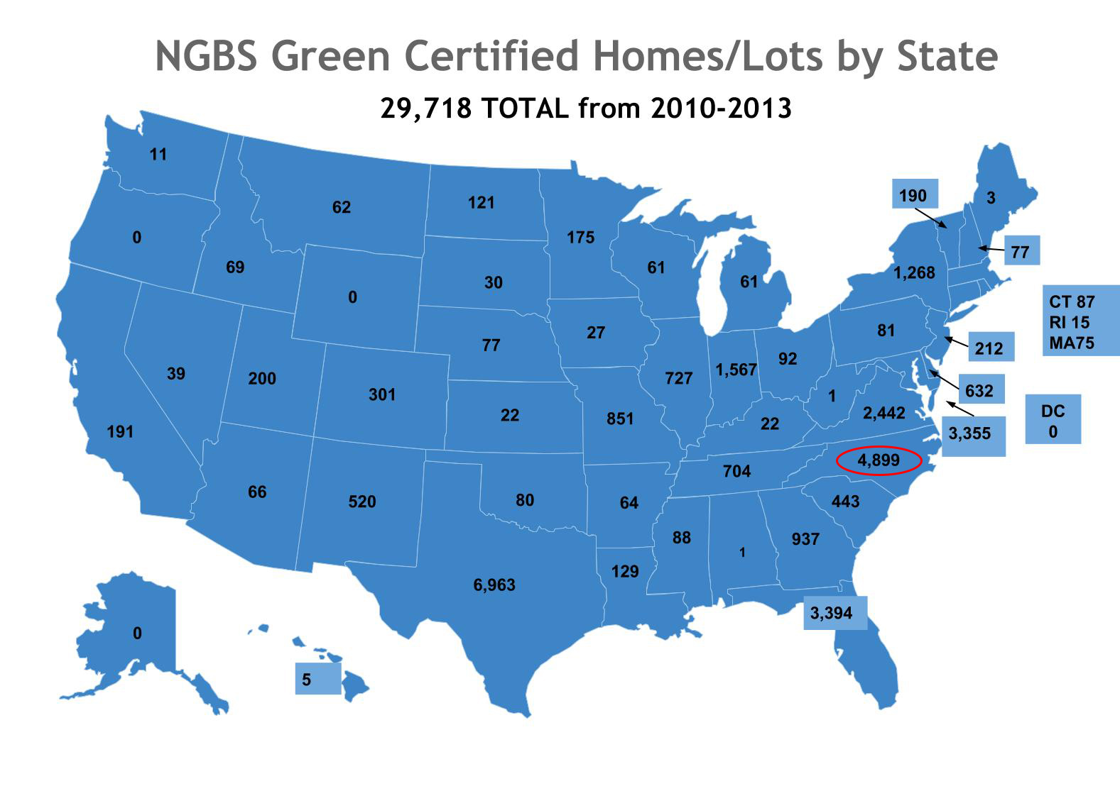
Up to date #’s
4899 total units
  3596 multi-family units
  1403 single family units
Notes:
NC ranks 1st nationally in the # NAHB Green certified buildings

Slide 35

Current trends and other Resources….

Slide 36
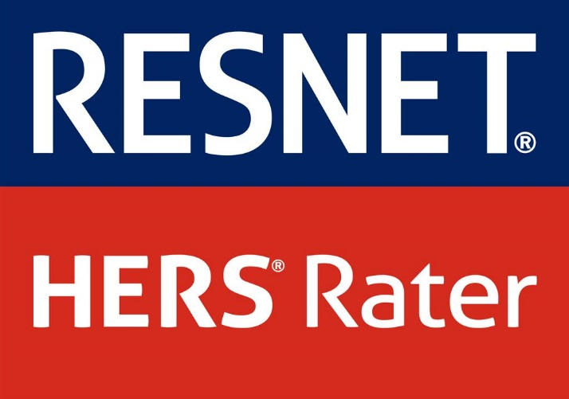
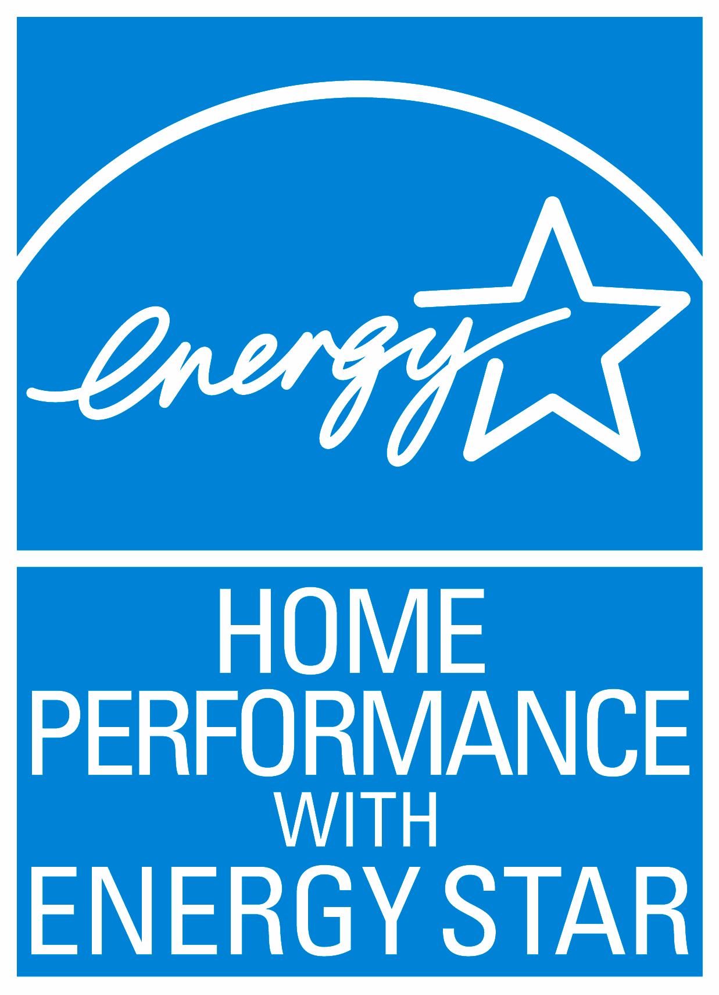
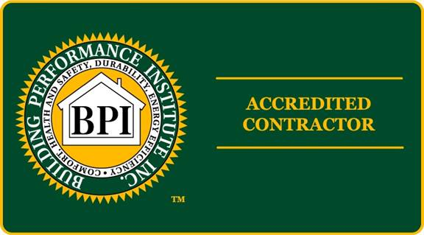

Existing Home Retrofit Programs

Slide 37
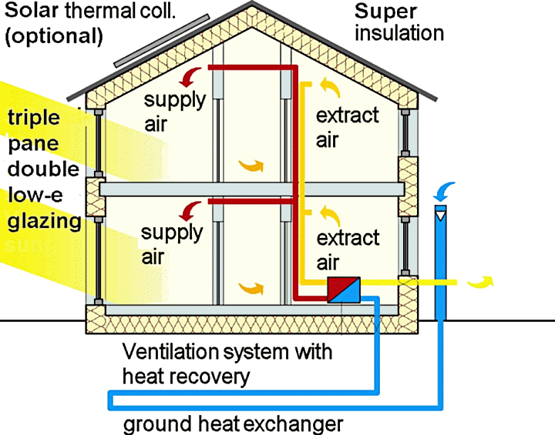
Passive House

Slide 38
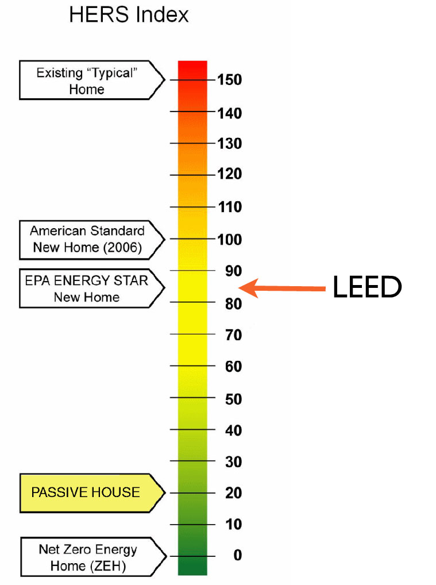
(no Photovoltaic .i.e. solar electric panels, roughly here (solar hot water potentially)
(WITH Photovoltaic .i.e. solar electric panels, can be negative HERS score or PLUS ENERGY

Slide 39

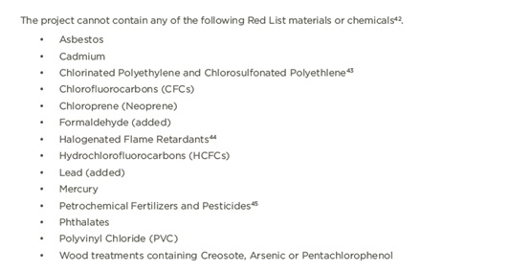
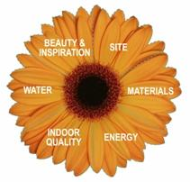

Slide 40
The Leading Edge -- 2012 NC HERO Code
The new code also includes the High Efficiency Residential Option (HERO) Appendix which delivers a 30% imenergy efficiency over the state’s curreprovement in minimum nt energy code. Completely voluntary and optional -- a great prescription for energy savings in all 3 NC climate zones.
So how does this compare to ENERGY STAR? Will this make all of our NC Homes “Green”?
New 2012 NC Code minimum: 15% better than 2009
New 2012 NC HERO Code Option: 30% better than 2009
ENERGY STAR v3 in 2012: Approx. 15-20% better than 2012 NC Code

Slide 41
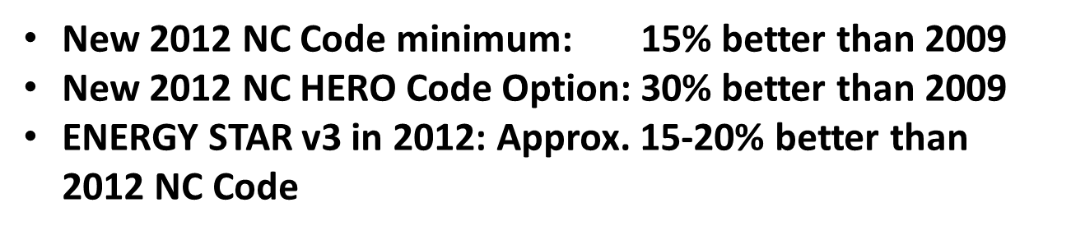
NC 2012 HERO Code
High
Efficiency
Residential
Option

Slide 42
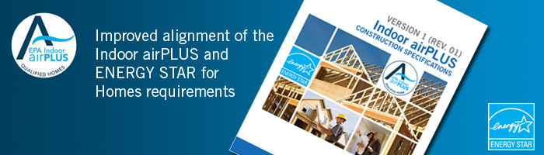
Moisture Control
Radon Control
Pest Management
Heating, Ventilating, and Air-Conditioning (HVAC)
Combustion Venting
Building Materials
Homeowner Education
Indoor airPLUS homeowners receive a checklist of verified indoor air quality features, and instructions for operating and maintaining equipment to continue minimizing risks of indoor air quality problems.

Slide 43
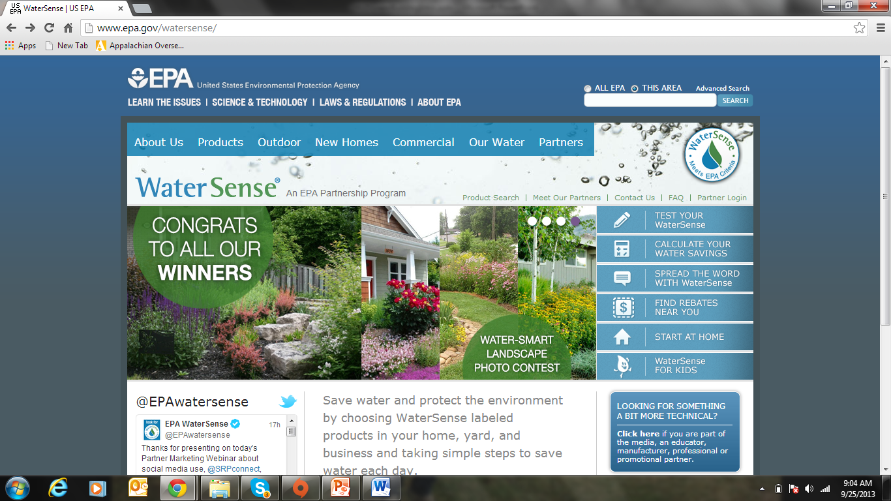

Slide 44
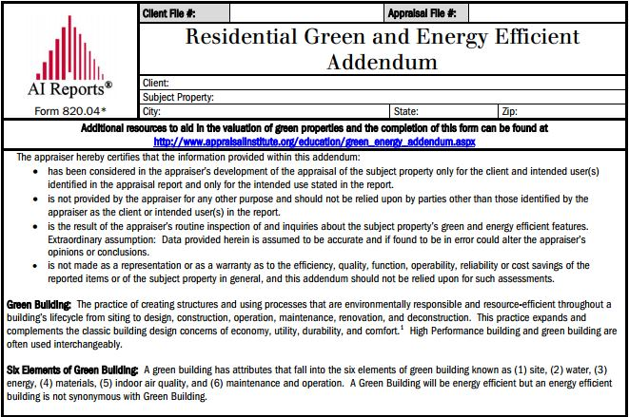

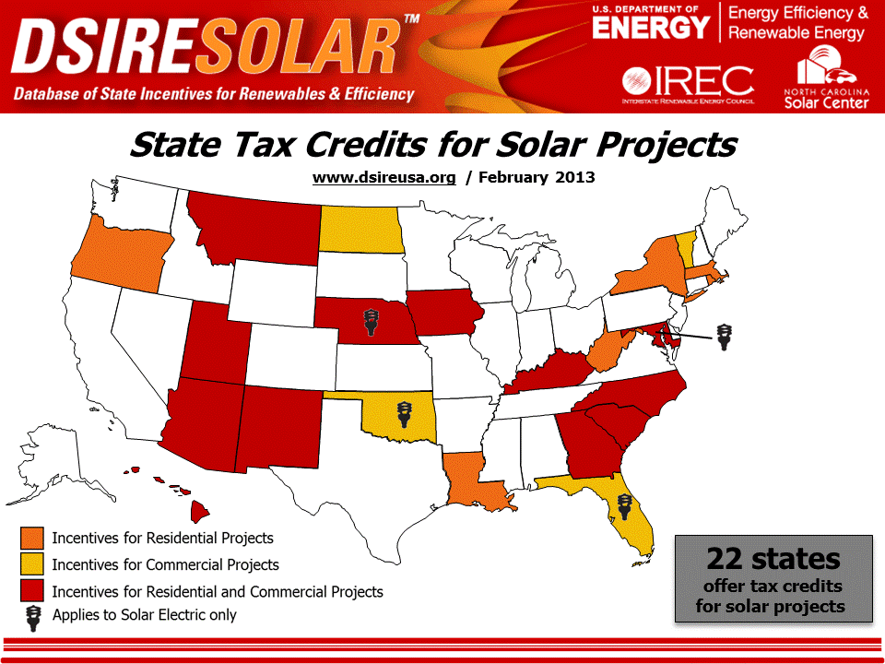
Other Important Resources…

Slide 45

www.dsireusa.org

Slide 46

More than 40 utility incentives currently available in NC.
Over 30 of these are related to residential energy efficiency!
www.dsireusa.org

Slide 47

Greening the MLS

Slide 48


Greening the MLS
What ELSE should we do with this information?
Brokers need to fill this out!

Slide 49
Greening the MLS
Why is a green MLS important
  Assists appraisers in valuing high performance buildings and finding appropriate comps.
  Assists consumers and agents in their search for existing high performance homes or buildings.
  If properly done will prevent green-washing
  Clearly defines what is green according to that region and help protect agents.
  Assists in the valuation of “green” homes
  How do we value “green” homes???? !@#$%^

Slide 50
Appraising Green Building

Slide 51
Green Appraising Methods
Making Adjustments for Energy Efficiency
  Matched Pairs
  Present Value of future savings
  GRM
  Cost Approach
  Marshall & Swift has a Green Section to the Residential Cost Handbook
  Survey local builders and organizations.
  Ask your peers
  Web search engine
  Many sources
Adjustments for What?
  Anything the market recognizes
    Energy Cost Savings
    HERS Rating
    Certification
    Solar Panels
    PV arrays
    Geo-thermal or other high efficiency HVAC system

Slide 52


This concludes The American Institute of Architects Continuing Education Systems Course
Contact Information:
energy.appstate.edu
Janet Miller, millerjm1@appstate.edu
Follow us on Facebook!
AppEnergyCenter

