Slide 1
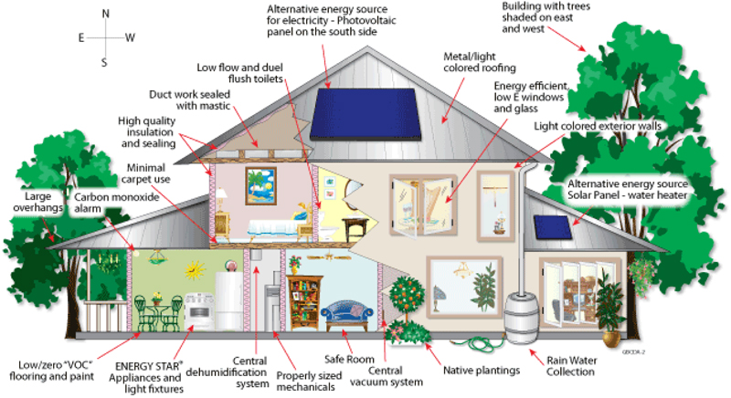
Part 2: Buildings as a System
Lee F. Ball Jr., PhD
balllf@appstate.edu

Slide 2
What Is a High Performance, Energy Efficient or GREEN Home ?
Green homes incorporate a “Systems Approach” of building practices based on building science fundamentals
Improved building practices will:
Reduce the overall amount of energy a home uses
Improve occupant health, safety, comfort, and durability of the home (ex. Improve IAQ)
Increase environmental responsibility
Notes:
Narrative:
Point of Slide:

Slide 3
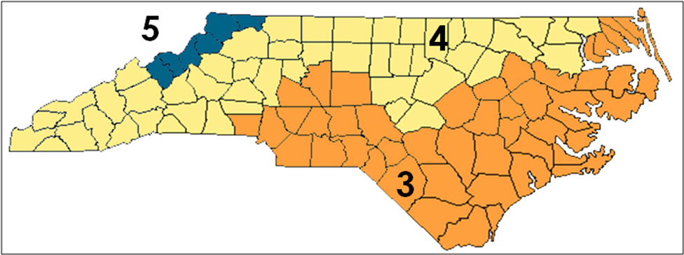
NC Climate Zones: 3, 4, 5
A high performance home must be designed for its particular climate

Slide 4
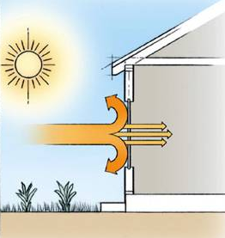
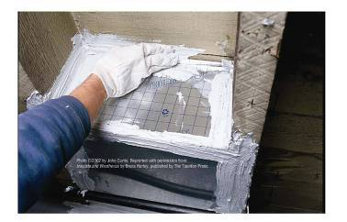
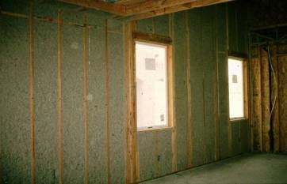
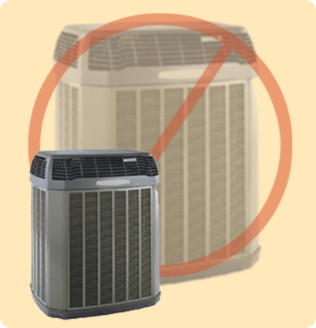
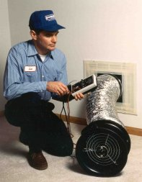
What makes a High Performance Home better than a traditional code-built home?
1
2
3
4
5
High
Performance
Windows
Tight Construction and Ducts
Effective Insulation
Efficient Equipment
Third-Party Verification

Slide 5
For your home to do its job,
it must also effectively separate
The inside…
…from the outside?
It depends on the climate and intended function of the building!

Slide 6
Building Envelope and Thermal Envelope
Wind
Rain
Ground water
Radon
Uncomfortable temperatures
Humidity
Bugs and pests
If the building envelope is not constructed properly and/or not ventilated correctly, you’re home is probably letting in:

Slide 7
FORCES ON YOUR HOME
Driving Forces always move
in the same direction:
to
More
More Pressure
More Moisture
More Heat
Less
Less Pressure
Less Moisture
Less Heat

Slide 8
BUILDING SCIENCE KEY COMPONENTS
High-
Performance
Homes
Control
Air Flow
Control
Thermal Flow
Control
Moisture Flow (Vapor, Bulk)
All three are interconnected…..thus the reason for a systems approach to building design.

Slide 9
CONTROLLING
AIR FLOW

Slide 10
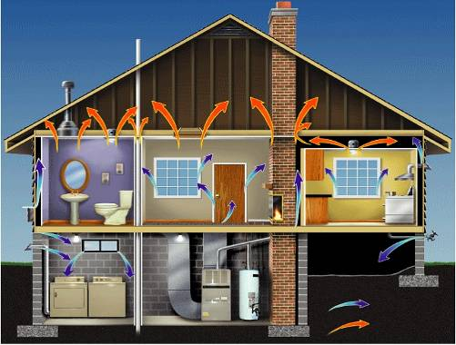
HERE ARE THE LARGER HOLES
Access
Panels
Chases
Dropped
Ceilings
Ceiling fixtures
Sill Plates
Window Openings
Vents
Plumbing Penetrations
Door Openings
Ducts

Slide 11
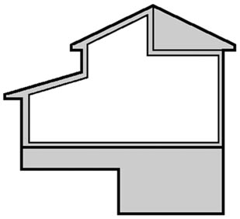
CONTROLLING AIR FLOW
One Out
= One In
If air is leaking out, it must also be leaking in; a vacuum can’t be created under natural conditions.
Courtesy of Southface Institute

Slide 12
COMPLETE AIR BARRIERS

Slide 13
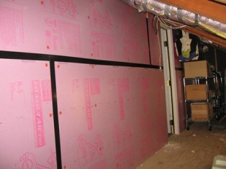
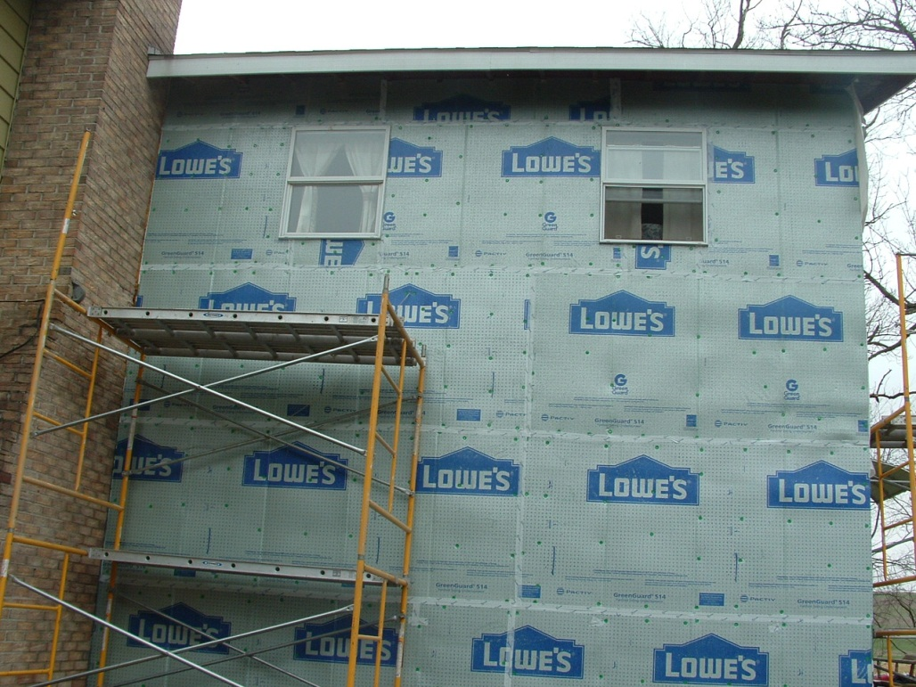
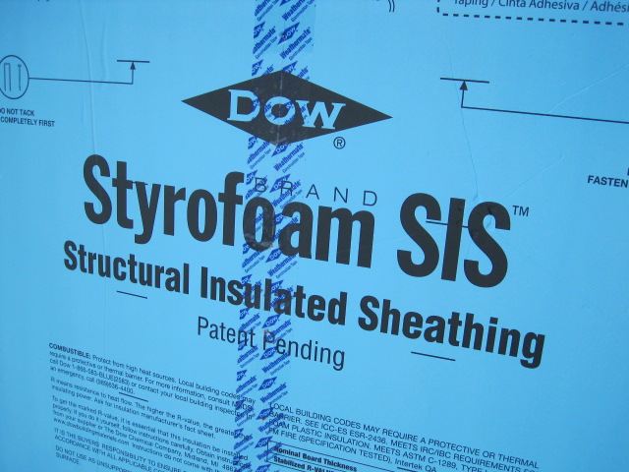
COMPLETE AIR BARRIERS
Taping the house wrap or insulated sheathing.

Slide 14
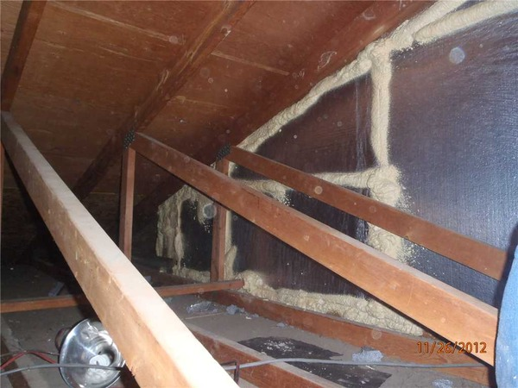
Complete Air Barriers

Slide 15
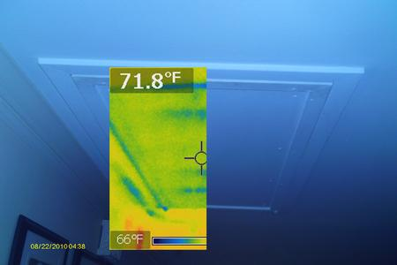
CONTROLLING AIR FLOW: Air Sealing Attic Access Issues & Solutions

Slide 16
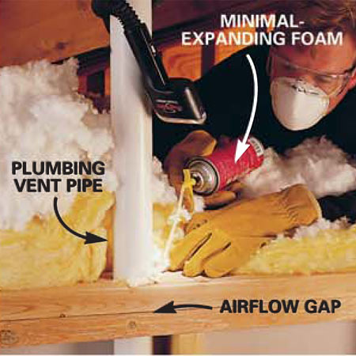
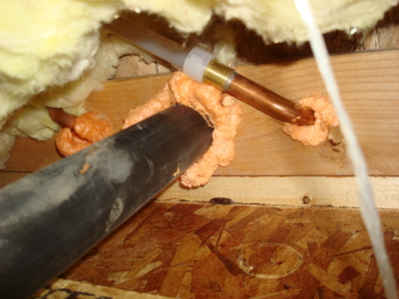
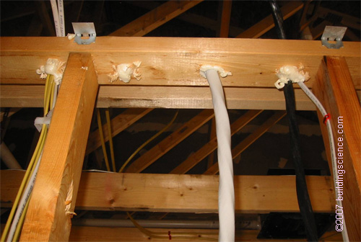
CONTROLLING AIR FLOW: Air Sealing Plumbing & Electrical Penetrations

Slide 17
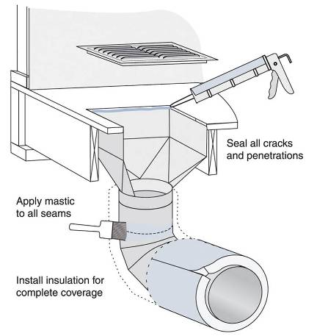
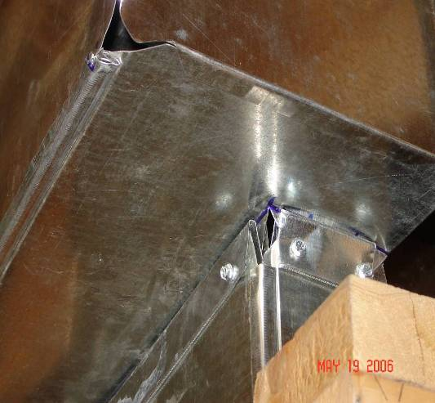
AFFORDABILITY PROBLEMS: DUCT LEAKAGE
CONTROLLING AIR FLOW: Duct Sealing POOR BOOT CONNECTIONS
Boot connection

Slide 18
TIGHT DUCTS
DUCT BOOTS & SEAMS
SEALED WITH MASTIC
Sealing duct connections prevents loss of conditioned air.

Slide 19
CONTROLLING
THERMAL FLOW

Slide 20
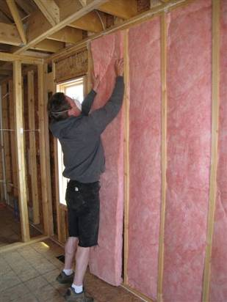
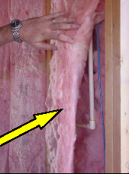
PROPER INSULATION
There are no gaps, voids or compression here, and the insulation is fully aligned with the interior surface. Note that the insulation is also carefully fit around piping and electrical wiring.

Slide 21
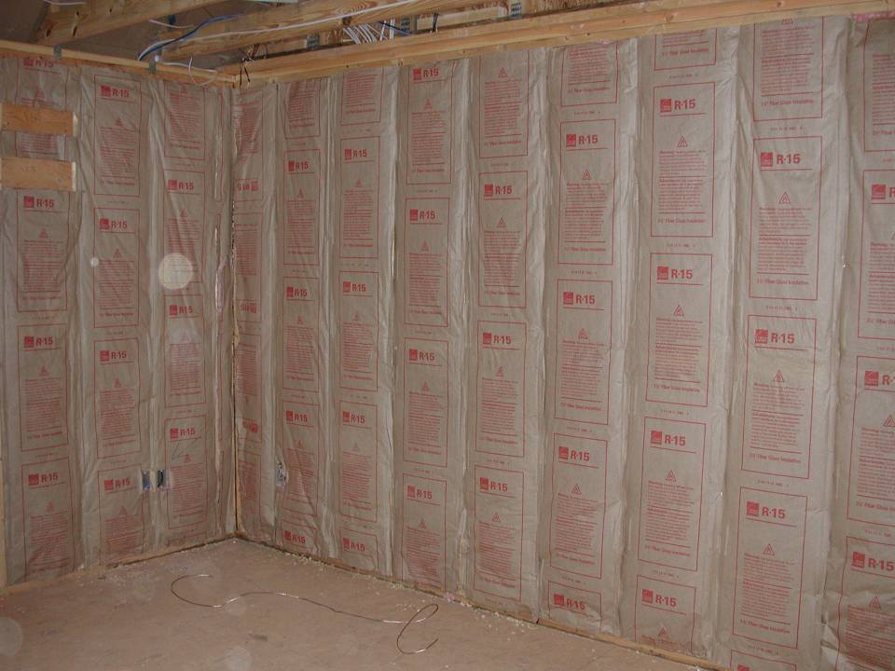
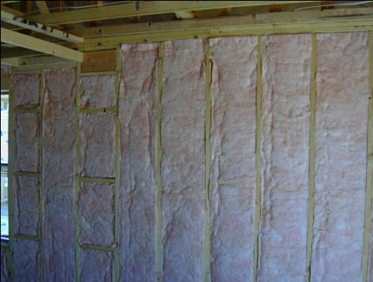
Fiberglass batts properly installed
Notes:
Narrative:
Isn’t this what you’d want a buyer to see if they walked thru the house during construction? This insulation job is installed correctly with no misalignment, gaps, voids or compression.
Point of Slide:
The class should understand that insulation can be installed correctly. ENERGY STAR’s 3rd party inspection helps to ensure this happens every time.

Slide 22
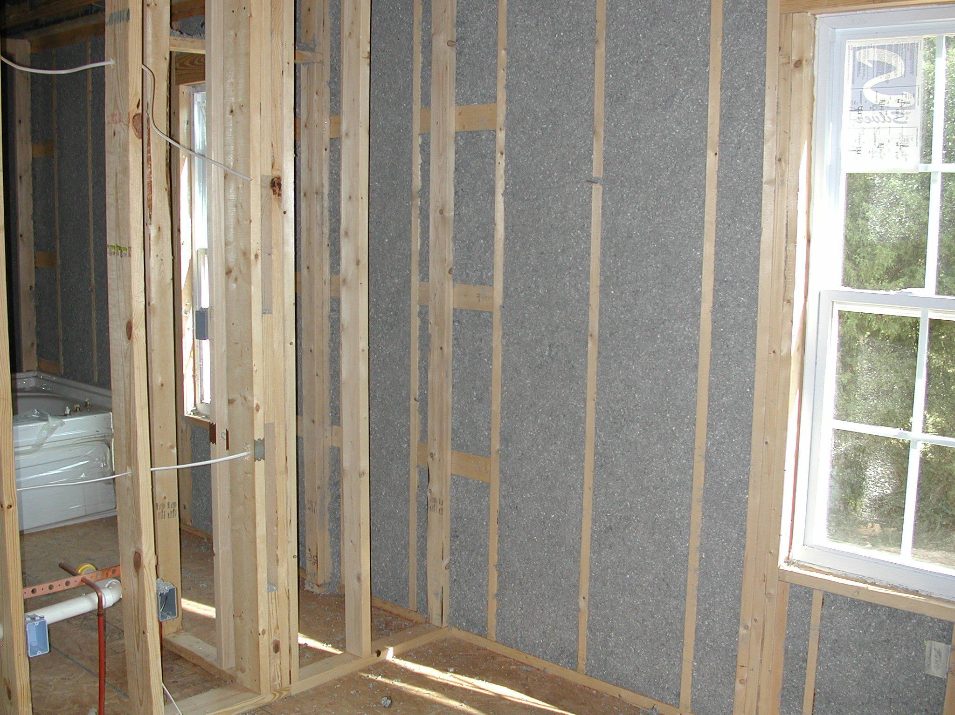
Blown cellulose properly installed
Notes:
Narrative:
Point of Slide:

Slide 23
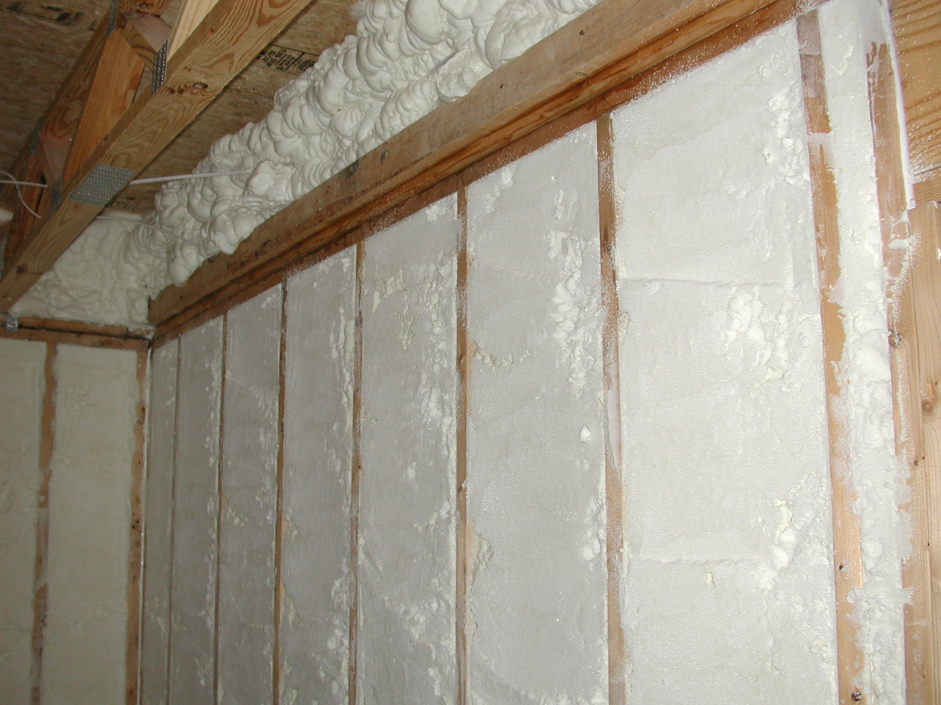
Spray foam properly installed
Notes:
Narrative:
Point of Slide:

Slide 24
CONTROLLING THERMAL FLOW
Most insulation
is NOT an air barrier*
Resists Conduction
Air Flow
*any solid material that blocks air flow
including sealing at edges and seams

Slide 25
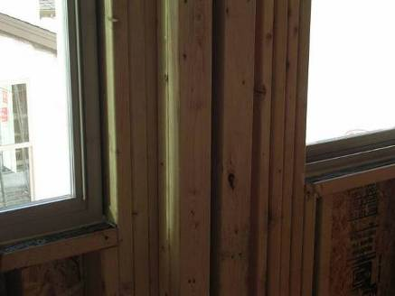
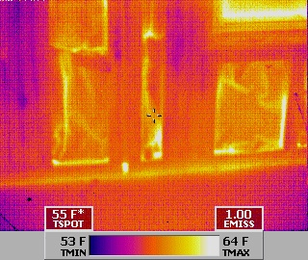
CONTROLLING THERMAL FLOW: CONDUCTION THROUGH FRAMING
The infrared image on the right shows thermal conduction where several wood studs are lined up next to each other, rather than leaving room for insulation.
Notice the cooler temperature where the studs are, indicating that heat is escaping more easily through the wood.

Slide 26
CONTROLLING
MOISTURE FLOW

Slide 27
CONTROLLING MOISTURE FLOW
While keeping the rain from leaking in your home is important, most moisture damage comes from air flow, because
ALL air carries moisture.

Slide 28
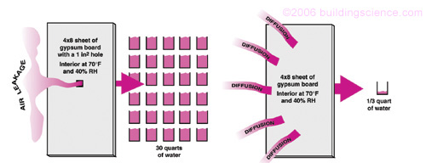
CONTROLLING MOISTURE FLOW
Example: 4’ x 8’ Sheet of Gypsum Board*
Air leakage will ultimately lead to moisture problems for your home.
This is the volume of water that enters a 1 square inch hole in your home over the course of one cooling season.
1 in.
sq.
hole
30 quarts water

Slide 29
BUT HOW DOES THIS AFFECT MY HOME ON THE INSIDE?
Holes and cracks allow inside warm air to reach an exterior sheathing surface.
If the outside surface is below the 45°F dew point, moisture will condense out of the air.

Slide 30
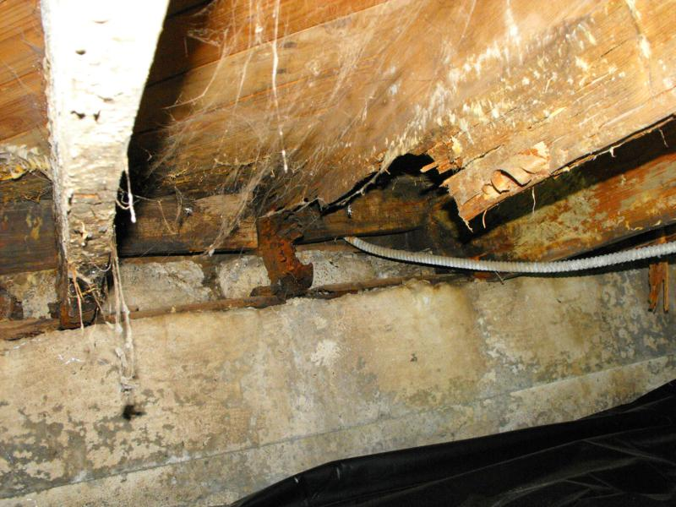
CONTROLLING MOISTURE FLOW: ACTION AT THE SURFACES
Crawlspaces provide perfect opportunities for condensation:
Driving forces push hot, humid air in this small basement to meet the cooler, conditioned spaces above. This image shows the damage that action at the surfaces can cause.

Slide 31
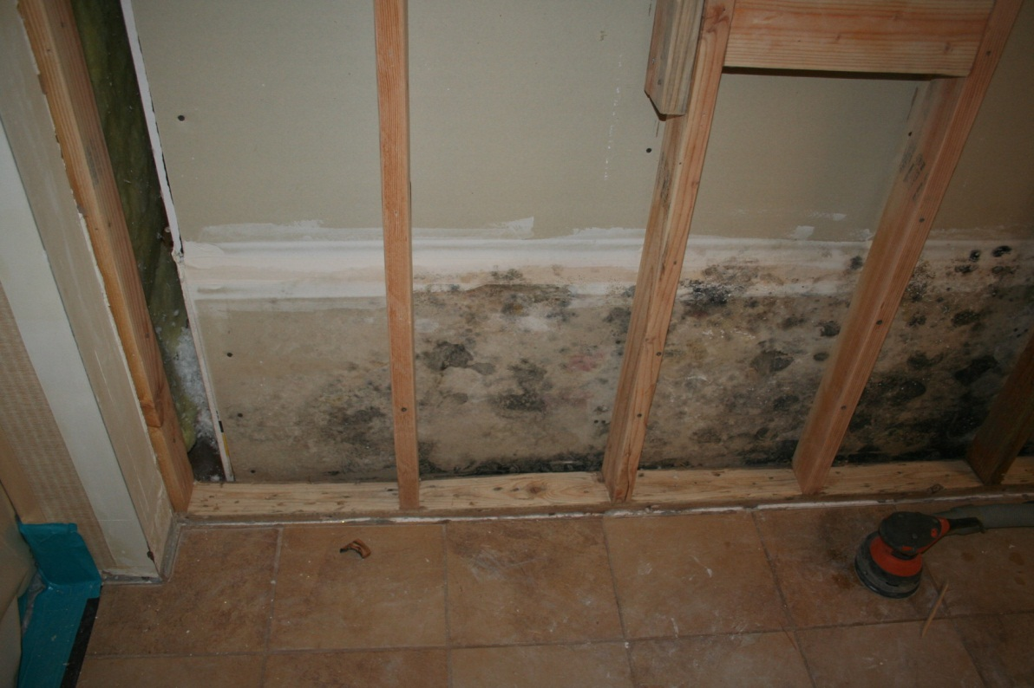
CONTROLLING MOISTURE FLOW: ACTION AT THE SURFACES
Courtesy of Building Science Corp.
Combine moisture, wood, and the dark environment inside the wall assembly and you have the perfect conditions for mold and dry rot.

Slide 32
Remember!
The House is a System
But what happens when they are not perfect systems?

