Slide 1

Building Energy Efficiency & Indoor Environmental Quality
^{Course Number: AIACES051713-B}
Susan Doll & Lee Ball
^{Date: October 3, 2014}
Appalachian State University
^{Provider Number: 60114136}

Slide 2
7 LU|HSW Credits earned on completion of this course will be reported to AIA CES for AIA members. Certificates of Completion for both AIA members and non-AIA members will be received at the end of the class.
This course is registered with AIA CES for continuing professional education. As such, it does not include content that may be deemed or construed to be an approval or endorsement by the AIA of any material of construction or any method or manner of
handling, using, distributing, or dealing in any material or product.
_______________________________________
Questions related to specific materials, methods, and services will be addressed at the conclusion of this presentation.

Slide 3
Course
Description
 | As building envelopes have become tighter to improve energy efficiency and meet the changes required by the new NC Building Code, it is important to understand the relationship between energy efficiency measures and indoor environment quality (IEQ). Potential impacts on IEQ depend upon several factors including contaminant generation and ventilation rates, construction methods, building pressure differences and airflow patterns. This workshop will cover an integrated approach to building performance that addresses these inter-related issues. Participants will learn how to evaluate and address factors that can lead to common IEQ problems. Demonstrations will include blower door diagnostics and infrared thermography for quantifying air leakage and identifying heat transfer pathways, and air sampling methods and interpretation of results for evaluating building performance and IEQ.

Slide 4
Learning
Objectives
At the end of the this course, participants will be able to:
Understand how basic building science and construction techniques can affect indoor environment quality (IEQ) and may impact health of building occupants.
Review energy-efficiency measures outlined in the North Carolina Building Code and understand the inter-relationship with IEQ.
Participants will be able to identify design strategies that have the potential to enhance IEQ while maintaining energy efficiency objectives.
Participants will learn how to identify sources of air leakage through the use of diagnostic equipment.

Slide 5
Workshop Agenda
INTRODUCTIONS
PART 1: The Indoor Environment
PART 2: Buildings as a System
<Break for lunch 12-1pm>
PART 3: Keeping Homes Healthy
PART 4: Smart Energy Practices
PART 5: Practical Solutions, Q & A

Slide 6
PART 1:
The Indoor Environment
Dr. Susan Doll

Slide 7
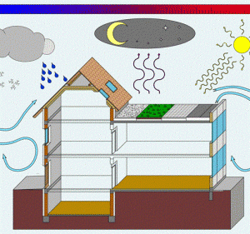
The Built Environment
SHOULD…
Protect from elements (wind, rain)
Protect from animals and pests
Keep us warm in winter
Comfortable in summer
Accommodate occupant activities
SHOULD NOT…
Wreck the planet
Drive us to the poor house
Cause discomfort
Make us sick

Slide 8
BUILT ENVIRONMENT
– Exterior, Boundary, Interior Space
UNCONDITIONED
(attic)
INDOOR ENVIRONMENT
(conditioned living space)
OUTDOORS
(garage)
(basement, crawlspace)

Slide 9
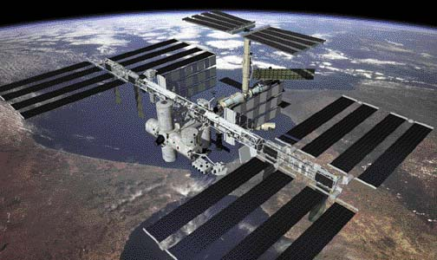

“TIGHTNESS” of Envelope
No Exchange =>
Completely Open

Slide 10
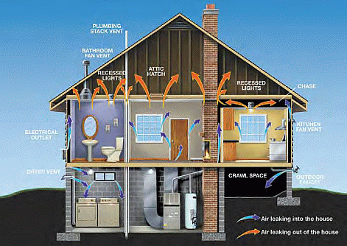
Tight Buildings
  Mainly to improve energy efficiency
  Reduced air leakage around doors and windows
  Seal openings in walls, floors and ceilings
  Improve insulation to reduce thermal loss

Slide 11
BUILT ENVIRONMENT
– Exterior, Boundary, Interior Space
- Airflow Quality, Magnitude, Direction
UNCONDITIONED
(attic)
INDOOR ENVIRONMENT
(conditioned living space)
OUTDOORS
(garage)
(basement, crawlspace)

Slide 12
BUILT ENVIRONMENT
– Exterior, Boundary, Interior Space
- Airflow Quality, Magnitude, Direction
- Contaminant Type, Source, Strength
++
+
UNCONDITIONED
(attic)
++
+++
+
+++
INDOOR ENVIRONMENT
(conditioned living space)
OUTDOORS
+++
(garage)
SYSTEMS
MATERIALS
+++
+
OCCUPANTS
++
+
+
++++
++++
++++
(basement, crawlspace)
++++
++++
++++

Slide 13
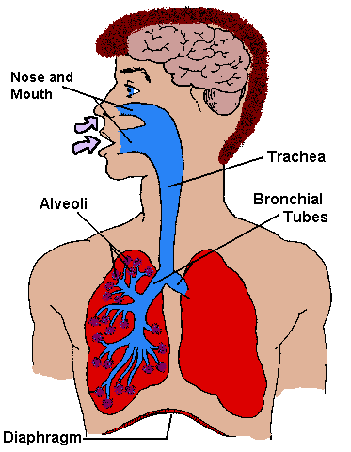
IAQ vs. IEQ
  Indoor Air Quality
    Makeup of airborne substances
    Gases, chemicals, particles
    Allergens

Slide 14

IAQ vs. IEQ
  Indoor Air Quality
    Makeup of airborne substances
    Gases, chemicals, particles
    Allergens
  Indoor Environment Quality
    Occupant experience of the indoors
    Includes IAQ, thermal comfort, drafts
    Noise, lighting

Slide 15

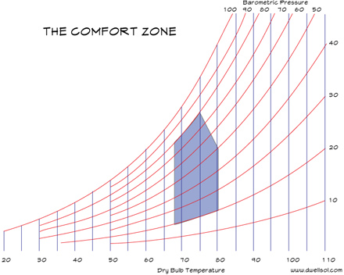
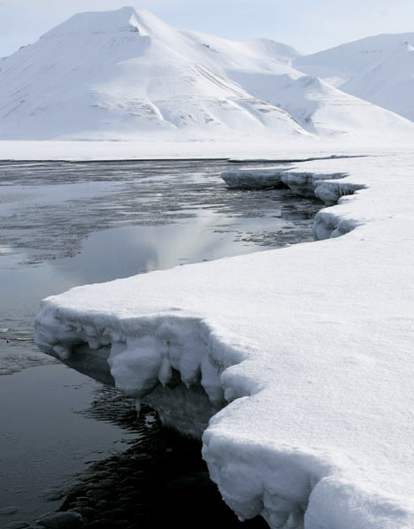

Thermal Comfort

Slide 16
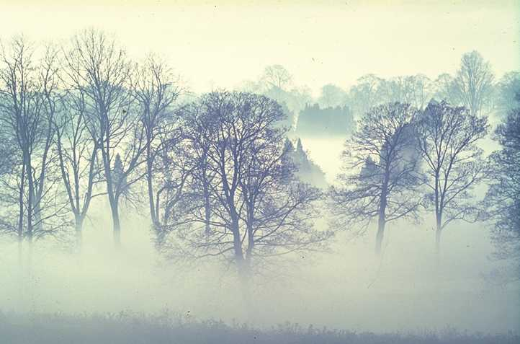

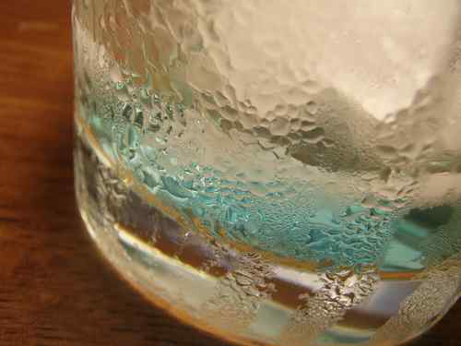

Dew Point - condensation
Warm air holds more moisture per volume
As air cools, moisture condenses
Moist air condenses on cold surfaces

Slide 17
Air Quality
  Gases
  Chemicals/fumes (VOCs)
  Particulates
  Allergens
Thermal Comfort
  Temperature
  Humidity

Slide 18
Air Quality
  Gases
  Chemicals/fumes (VOCs)
  Particulates
  Allergens
Thermal Comfort
  Temperature
  Humidity
INTERACTION
??

Slide 19
How do thermal comfort parameters impact IAQ?
Occupant Material
Comfort Integrity Contaminants
Temp X + Offgassing
Humidity X -- Allergens (dust mites)
Dew Point --- X (mold)

Slide 20
Air Quality
  Gases
  Chemicals/fumes (VOCs)
  Particulates
  Allergens
Thermal Comfort
  Temperature
  Humidity
??
Occupants
Building/Systems
INTERACTION

Slide 21

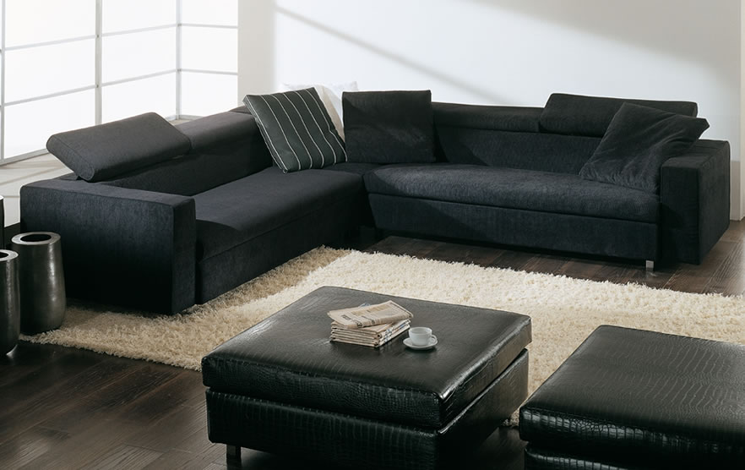

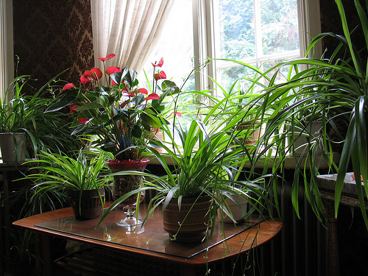
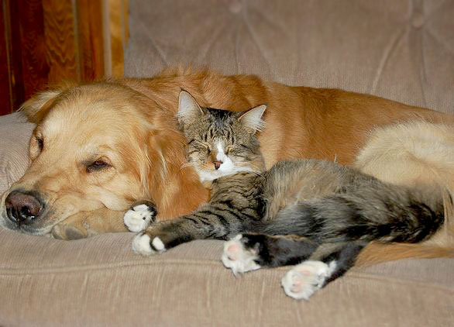
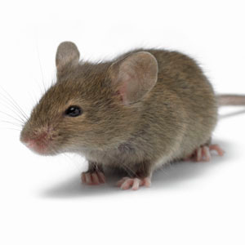

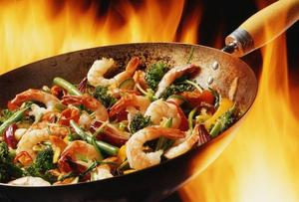
Contaminant Sources
  Building – envelope & systems
  Furnishings
  – functional, ornamental
  Occupants
  – people, plants,
  pets, pests
  Indoor activities
  – daily living, recreational

Slide 22
  Gases:
Outdoor Sources
Combustion Products

Slide 23
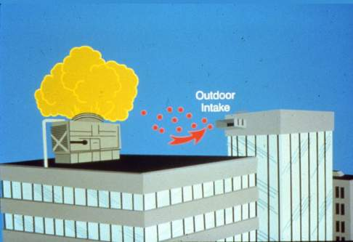
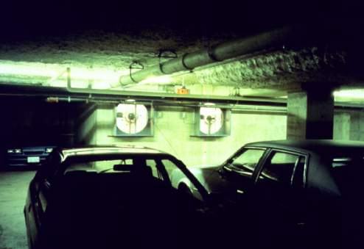
Outdoor Sources & Building Design
Air Intakes
- rooftop
- parking garage

Slide 24
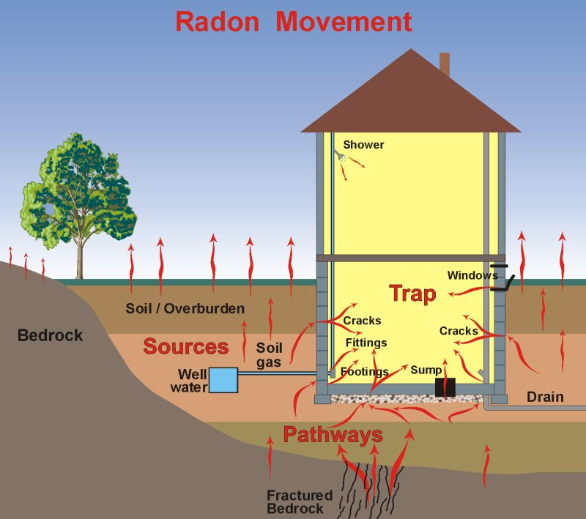
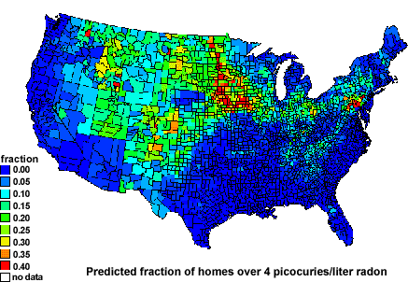
Radon
Radon is a gaseous, colorless, highly toxic radioactive element
Sources: earth and rock beneath home; well water; building materials
Health effect: lung cancer
Notes:
24
Heating and Cooling Systems are designed to provides thermal comfort. Thermal comfort does not have a universal definition and is therefore defined by the satisfaction of inhabitants.

Slide 25
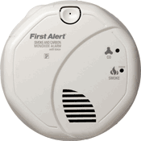
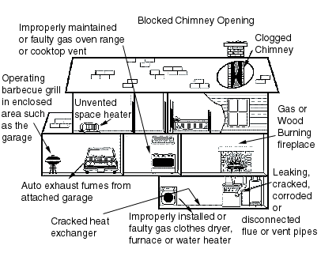
Combustion - Carbon Monoxide
Colorless, odorless gas produced by incomplete combustion of a fuel containing carbon
Combines with hemoglobin, replacing oxygen
Symptoms
  Headache, Fatigue
  Shortness of breath
  Nausea, Dizziness
Most common sources
  house fires
  heaters
  car exhaust
Common problems
  heater maintenance
  insufficient air supply
  unintended air pathways
Notes:
25
Heating and Cooling Systems are designed to provides thermal comfort. Thermal comfort does not have a universal definition and is therefore defined by the satisfaction of inhabitants.

Slide 26
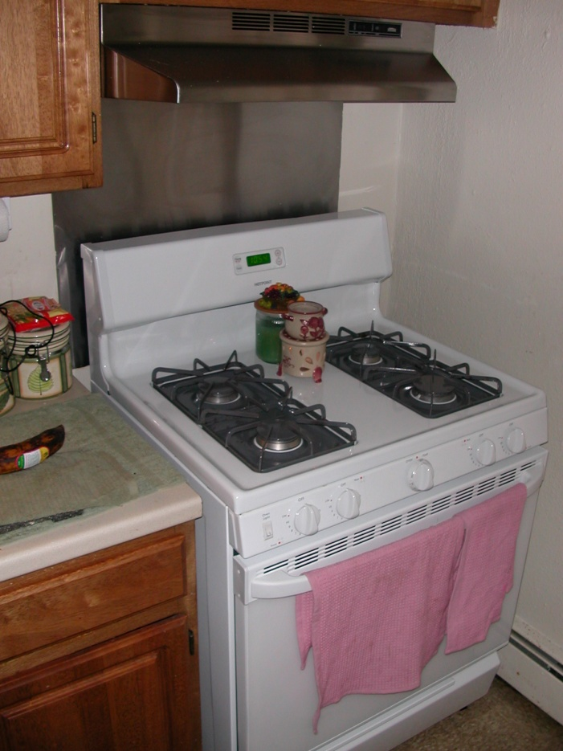
Combustion - Oxides of Nitrogen (NO_{x})
Produced by high-temperature combustion
Sources
  gas stoves
  heaters
  car exhaust
Health effects
  respiratory
  asthma
Indoor NO₂ levels are function of:
  indoor sources
  pilot lights
  exhaust/range hood
  usage pattern
  outdoor levels
  size of home
  ventilation rate
  humidity
Notes:
26
Heating and Cooling Systems are designed to provides thermal comfort. Thermal comfort does not have a universal definition and is therefore defined by the satisfaction of inhabitants.

Slide 27
  Chemicals:
Formaldehyde
Volatile Organic Compounds (VOCs)

Slide 28
Product Offgassing
Amount, type, concentration
Depends on…
  Type of material
  Age
  Temperature and humidity
  Absorbtion/desorption
  Ventilation/air concentration

Slide 29
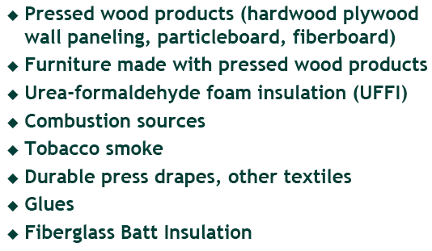
Sources of Formaldehyde

Slide 30
VOCs
"volatile organic compound" - carbon-containing chemicals that are gases at room temperature
Semi-volatile organic compounds (SVOCs) are present partly as gaseous airborne chemicals and partly as chemicals adsorbed on indoor surfaces and microscopic airborne and settled particles.
Sources: building materials, furnishings, cleaning compounds, office equipment, personal care products, air fresheners, pesticides, people, and unvented combustion processes such as tobacco smoking or cooking with gas stoves
suspected health effects may include sensory irritation symptoms, allergies and asthma, neurological and liver toxicity, and cancer

Slide 31
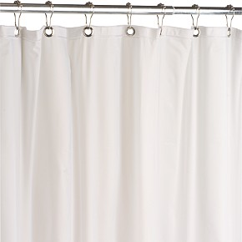
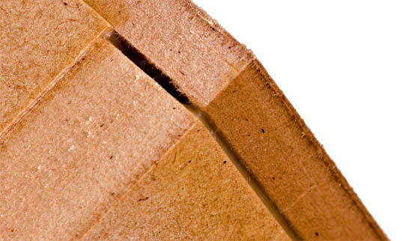

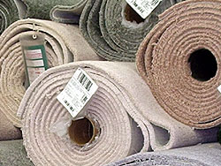
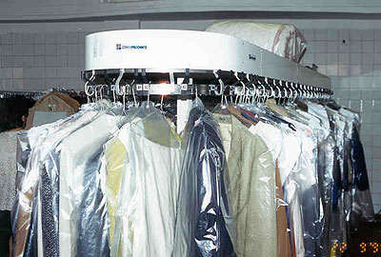

Sources of VOCs
Materials
Paints, varnish
Plastics
Flooring Material
Dry cleaning
Cleaning Supplies

Slide 32
Offgassing - decay curve
2 weeks

Slide 33
  Particulates:
Dust
Smoke
Aerosols

Slide 34
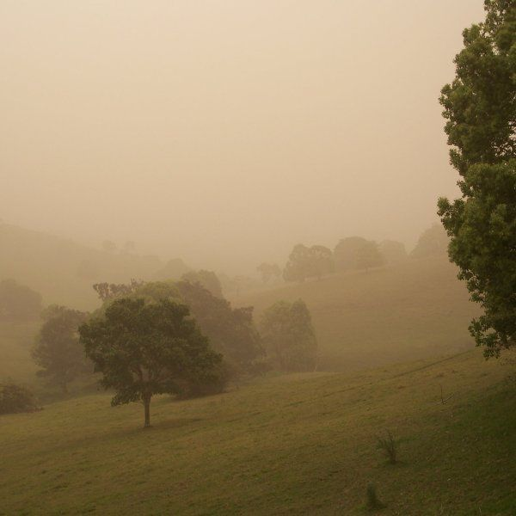
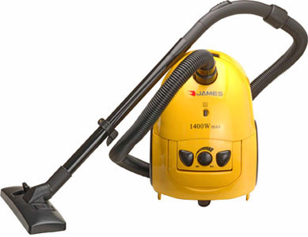

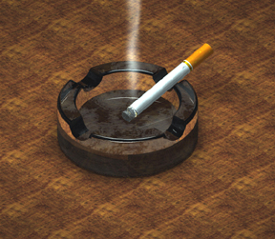
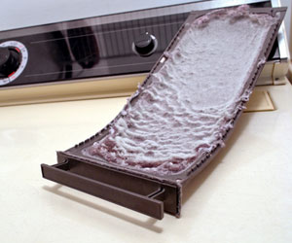
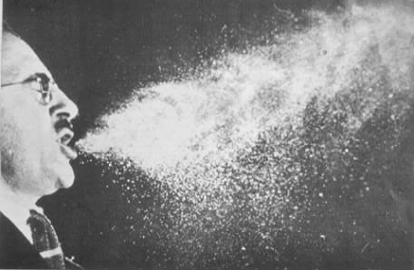
Particle Sources
Cooking
Outside Dust
Occupants
Smoking

Slide 35
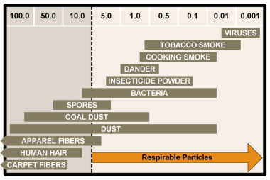
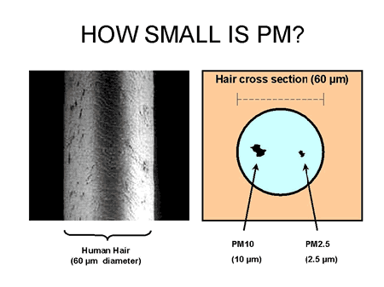
Particle Sizes: PM_{2.5} , PM₁₀

Slide 36
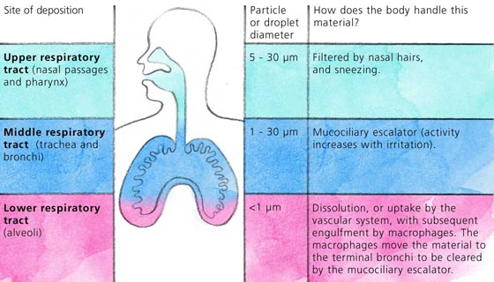
Why Size DOES matter!

Slide 37
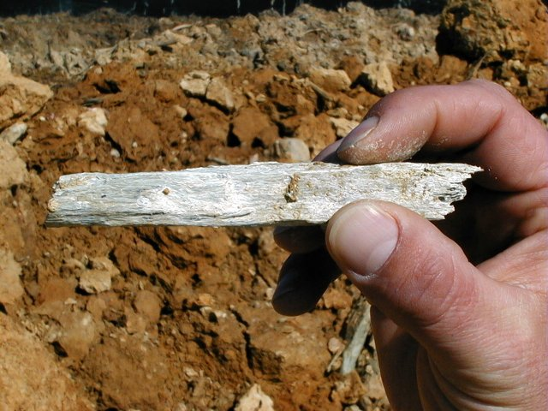
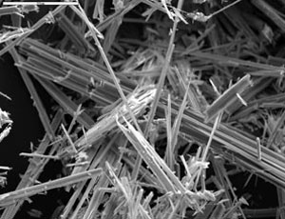
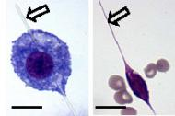
Asbestos
Asbestos is a mineral fiber
Used in over 3000 materials
  asbestos-cement products
  ceiling and floor tiles
  insulation
  brakes
Health effects
  lung cancer (mesothelioma)
All new uses banned by EPA in 1989
Notes:
37
Heating and Cooling Systems are designed to provides thermal comfort. Thermal comfort does not have a universal definition and is therefore defined by the satisfaction of inhabitants.

Slide 38
Allergens:
Elicit an allergic reaction in sensitive individuals
Usually biological in nature

Slide 39
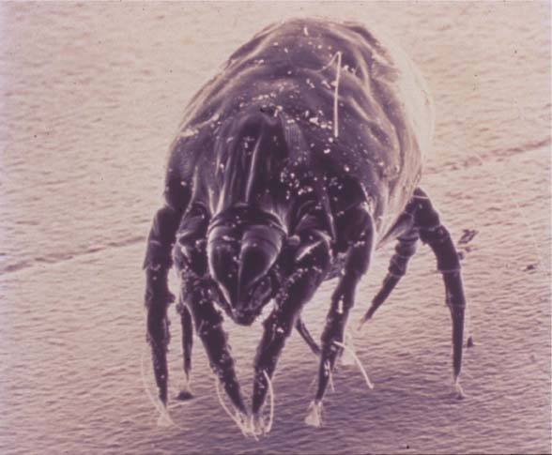
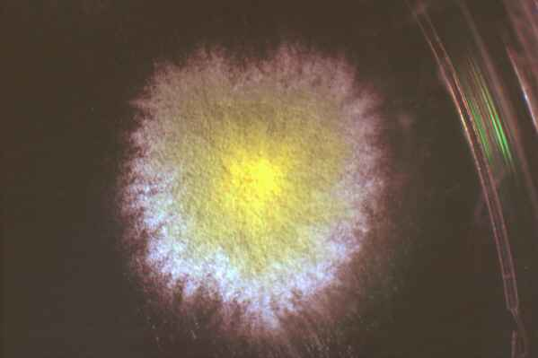

Allergens
Living microorganisms
(e.g. fungi, bacteria, viruses)
Particles & fragments of organisms
(e.g. pollen, spores, mycelia, endotoxin)
Particulate waste products
(e.g. pet dander, dust mite fecal pellets)
Metabolic products
(e.g. mycotoxins, microbial VOCs)

Slide 40
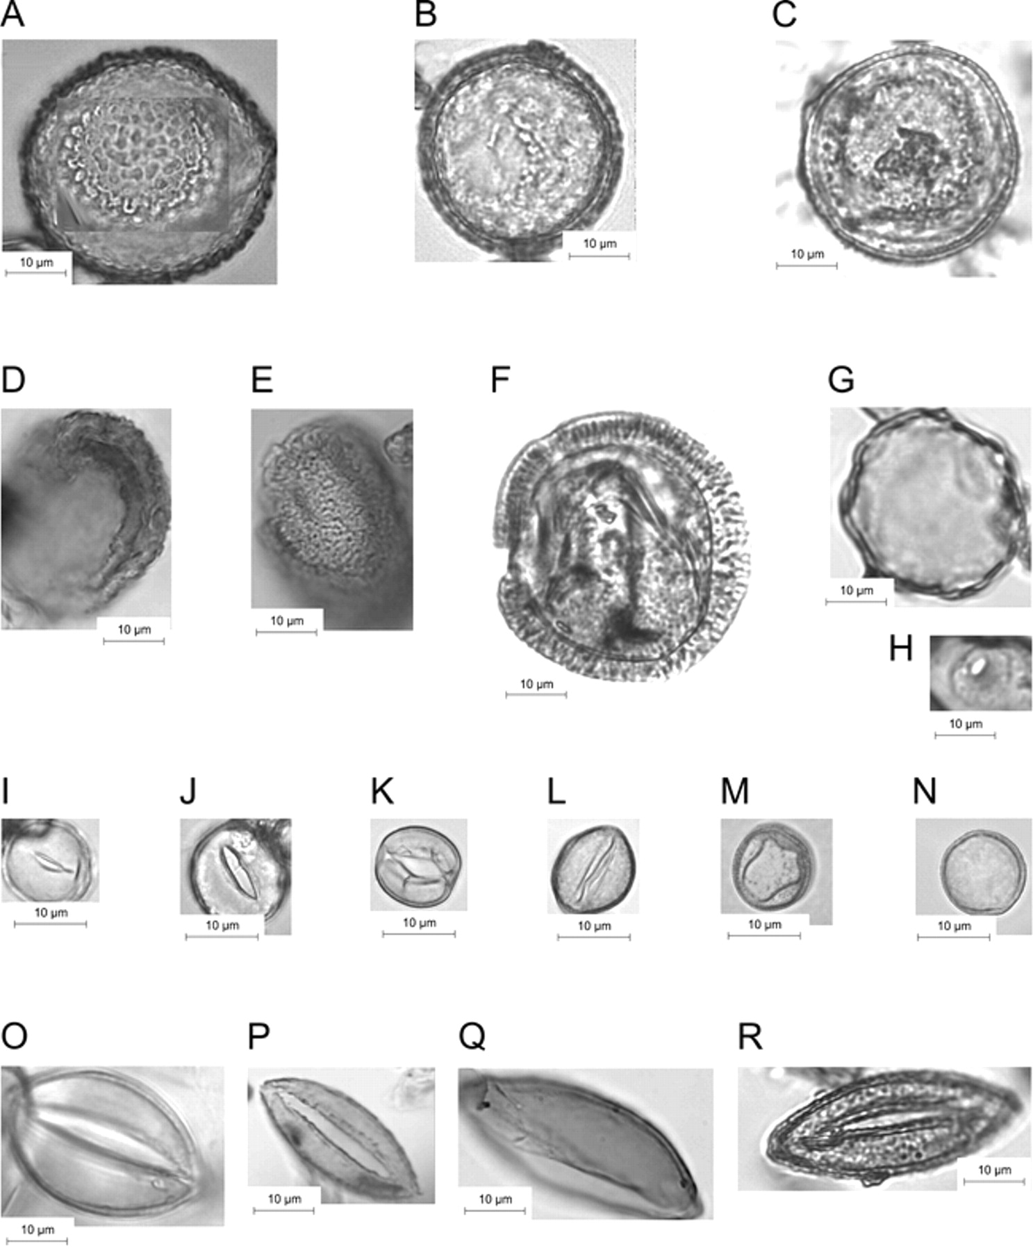
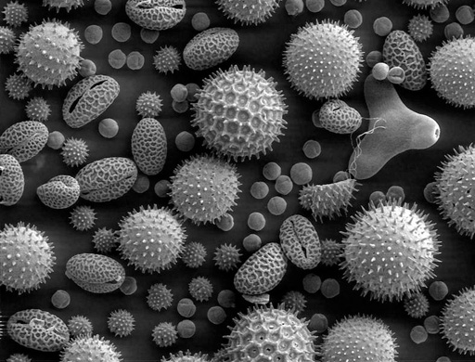
Pollen
Mainly outdoor plants
Seasonal
Generally large (>10 μm)
Notes:
40
Heating and Cooling Systems are designed to provides thermal comfort. Thermal comfort does not have a universal definition and is therefore defined by the satisfaction of inhabitants.

Slide 41
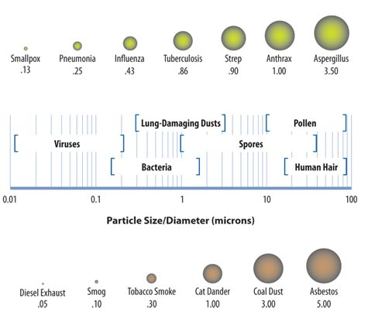

Slide 42
Air Quality
  Gases
  Chemicals/fumes (VOCs)
  Particulates
  Allergens
Thermal Comfort
  Temperature
  Humidity
Occupants
Building/Systems
INTERACTION
??

Slide 43
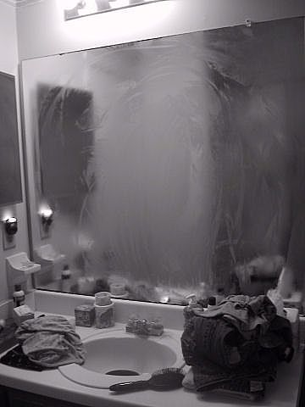
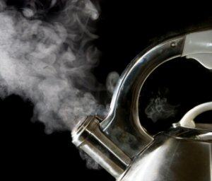
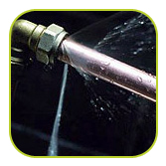
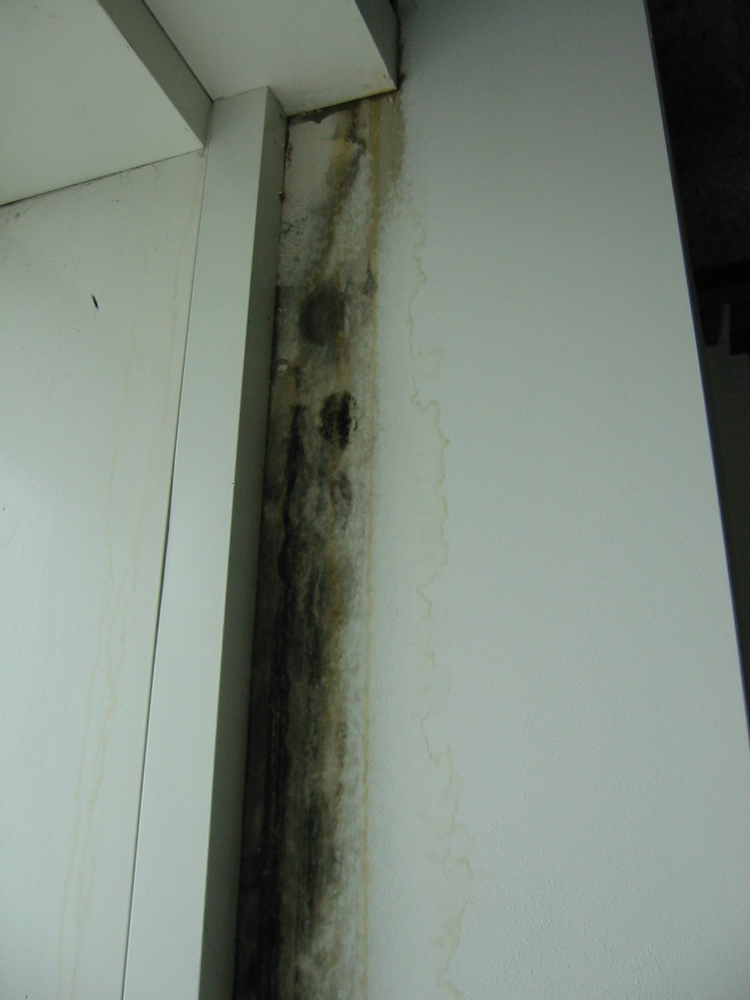
Moisture Sources
Occupants (exhaled)
Activities (cook, shower)
Water-related Utilities
Building Envelope
Humidity/Cold Surfaces

Slide 44
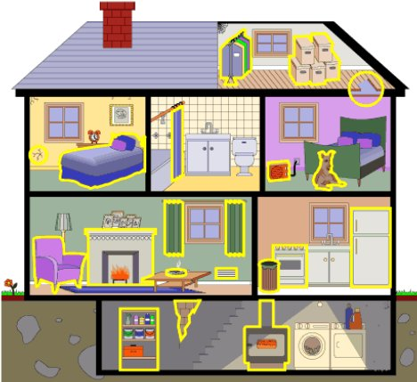
Name That Source & Type!!
1
2
3
6
5
7
8
4
9
11
14
10
16
12
15
13
18
19
20
17

Slide 45
Building Envelope and Systems are KEY to good IEQ
Buildings are “too” tight:
  Moisture accumulation
  Contaminant accumulation
  Thermal discomfort
Uncontrolled air exchange:
  Contaminant source
  Contaminant migration from unconditioned spaces
  Drafts
  Energy loss
Inadequate or spotty insulation
  Cold condensing surfaces
  Energy Loss

