Slide 1


Supply Chain Management
@
Dr. Jim Stoddard, Department Head
Dr. Dinesh Dave`, SCM Program Director
Dr. William Northington, Associate Professor
Mr. Doug Marrelli, Professional in Residence
John A. Walker College of Business

Slide 2

Supply Chain Management Programs Currently Offered
SCM Minor
  Created in 2008 after a study found SCM knowledge, skills, and abilities lacking in the workforce
  Provides a multi-disciplinary curriculum to complement both Business and Non-Business majors
  Created in 2016 after a study found SCM knowledge, skills, and abilities lacking in the workforce. More demand after the pandemic
  Provides a multi-disciplinary curriculum to complement Business majors. Double major/minor can be easily added
  Currently 272 students (206 declared majors, 37 Undeclared, 29 minors). Online BSBA in SCM was recently introduced
SCM Major
MBA w/SCM concentration
  Created in 2014 for our MBA students to obtain the SCM knowledge, skills, and abilities requested by employers

Slide 3
Why Major in Supply Chain Management?
Great Courses
  Relevant and dynamic curriculum
  Pairs well with all majors
  Complete required courses in 3 semesters
  Build marketable skills
Great Faculty
  Award winning professors
  Industry experience
  Faculty who care about your success
Great Careers
  Projected increases in demand
  Large network of recruiters
  Diverse job opportunities
  High starting salaries

Slide 4
Supply Chain Management Data
Fall 2023 Data (In progress) – No. of Majors = 206

Slide 5
Supply Chain Management Data

Slide 6




















Our Supply Chain Board of Advisors
Our advisory board members are executives from the following:
Notes:
Internships and Scholarships
Bonded Logistics
FedEx
Global Shippers Association
Hanesbrands /Sara Lee Corporation
IBM
Lowe’s Companies, Inc.
M33 Integrated Solutions
Mapally
Mediterranean Shipping Company (USA)
Microsoft
Murray Supply Company
PHH Corporation
Prysmian Group – Draka
Saudi Basic Industries Corporation (SABIC)
Job Placement
Speaker to the Supply Chain Club
Guest Speaker in the Classes

Slide 7
Supply Chain Management Major
Currently, 272 students (206 declared majors, 37 Undeclared, 29 minors); which is one of the largest SCM programs in the North Carolina University System
Fully Online BSBA in SCM has been introduced
SCM is one of the most popular concentrations in our MBA program
SCM is one of the favorable concentrations in our Applied Data Analytics program

Slide 8
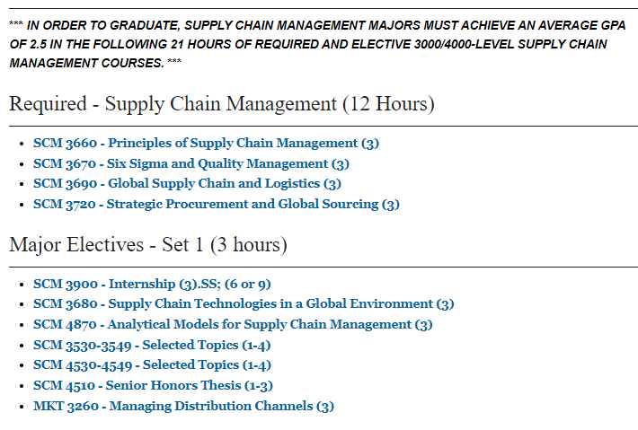
SCM Major Curriculum
Notes:
Courses can count double…
2 elective courses in your major
3 Supply Chain courses

Slide 9
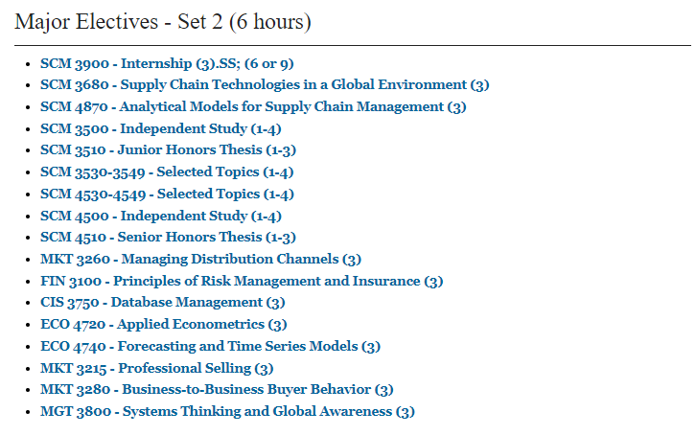
SCM Major Curriculum (Contd)
Notes:
Courses can count double…
2 elective courses in your major
3 Supply Chain courses

Slide 10
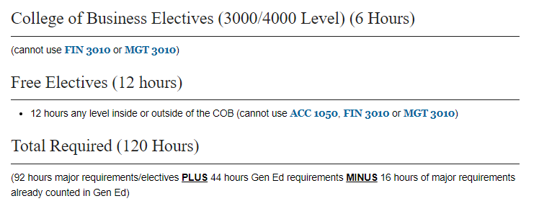
SCM Major Curriculum (Contd)
Notes:
Courses can count double…
2 elective courses in your major
3 Supply Chain courses

Slide 11
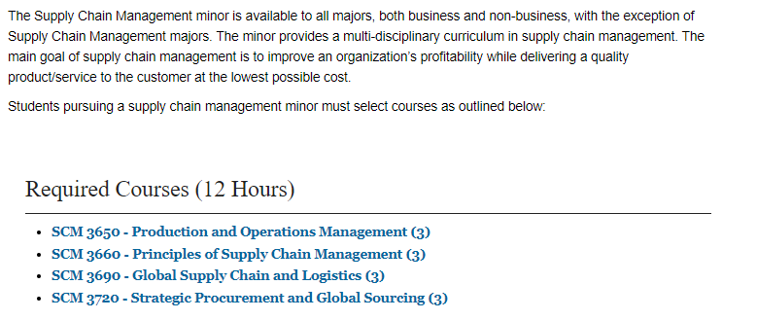
SCM Minor Curriculum
Notes:
Courses can count double…
2 elective courses in your major
3 Supply Chain courses

Slide 12
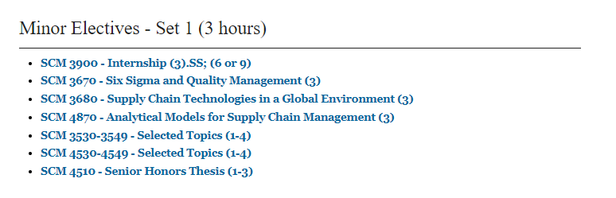
SCM Minor Curriculum (Contd)
Notes:
Courses can count double…
2 elective courses in your major
3 Supply Chain courses

Slide 13
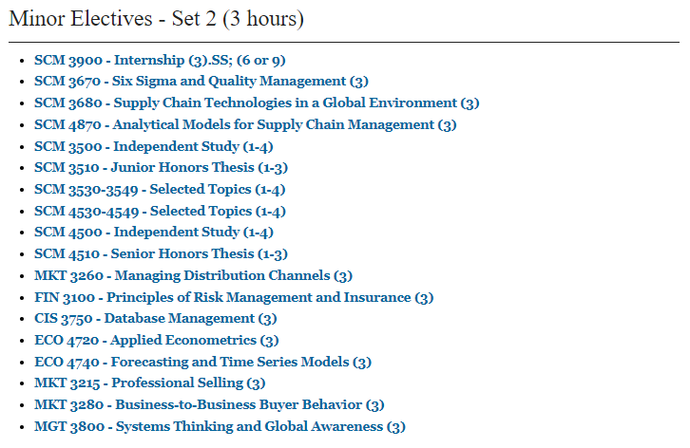
SCM Minor Curriculum (Contd)
Notes:
Courses can count double…
2 elective courses in your major
3 Supply Chain courses

Slide 14
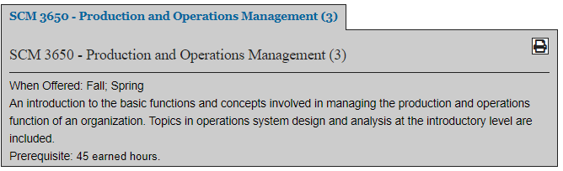
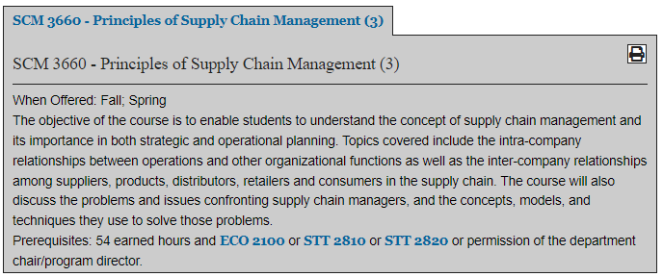
SCM Courses Description
Notes:
Courses can count double…
2 elective courses in your major
3 Supply Chain courses

Slide 15
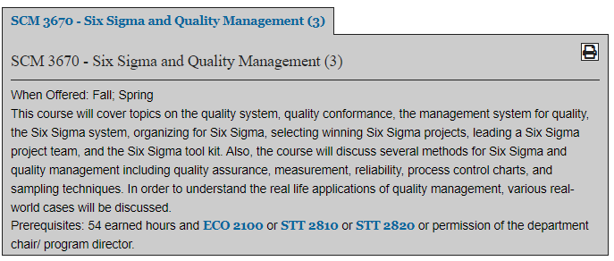
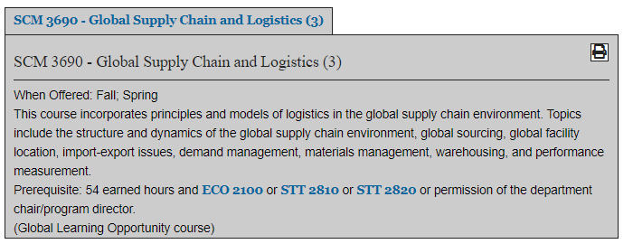
SCM Courses Description (Contd)
Notes:
Courses can count double…
2 elective courses in your major
3 Supply Chain courses

Slide 16
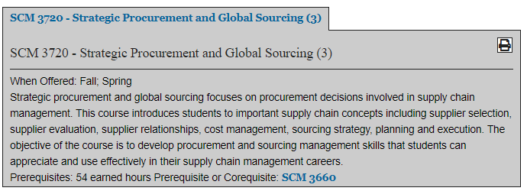
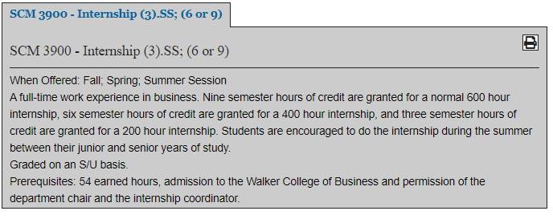
SCM Courses Description (Contd)
Notes:
Courses can count double…
2 elective courses in your major
3 Supply Chain courses

Slide 17
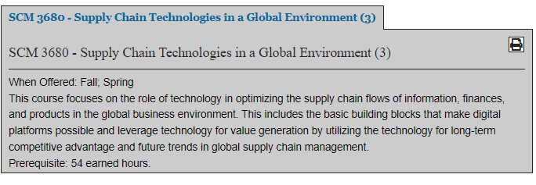
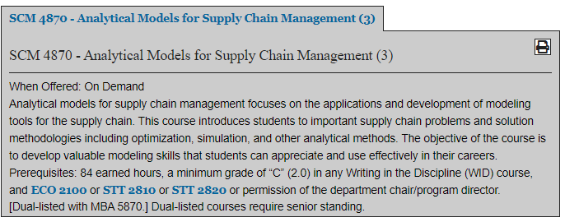
SCM Courses Description (Contd)
Notes:
Courses can count double…
2 elective courses in your major
3 Supply Chain courses

Slide 18
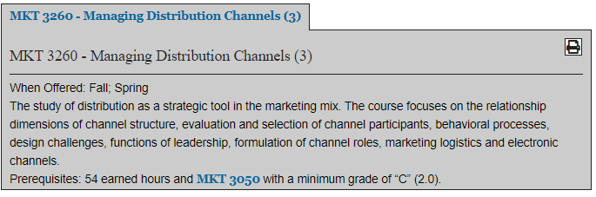
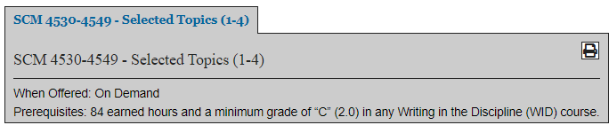
SCM Courses Description (Contd)
Notes:
Courses can count double…
2 elective courses in your major
3 Supply Chain courses

Slide 19
Appalachian Supply Chain Club (ASCC)
(ASCC.appstate.edu)
Our Student SCM Club is sponsored by the Association for Operations Management (APICS a.k.a ASCM)
  Free to join the club ($0 to join)
  Includes student membership in APICS/ASCM
  Possibility of CSCMP free membership
  Internship Opportunities
  Job Opportunities
  Guest Speakers
  Networking with SCM professionals

Slide 20
Employers
Amazon
C. H. Robinson
Transportation Insight
Schneider
Target Corporation
Sunrise Technologies
Lowe’s
VF Corporation
Ahold-Delhaize
Publix
Total Quality Logistics
Maersk
LeanCor
Camelot 3PL Software
Syngenta
Hanes Companies
Georgia-Pacific
Syfan Logistics
Ralph Lauren
Red Classic Transportation Services
Old Dominion
XPO Logistics, Inc.
Aldi Foods
Gilbarco-Veederoot

Slide 21
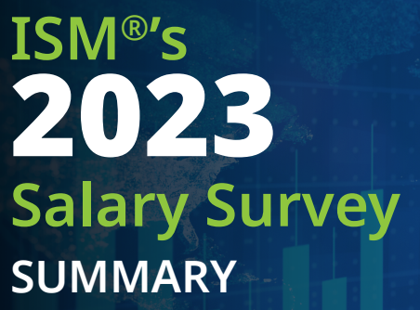
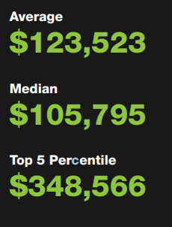
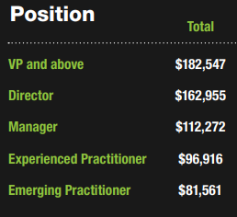
Institute for Supply Management (ISM)
2023 Salary Survey

Slide 22
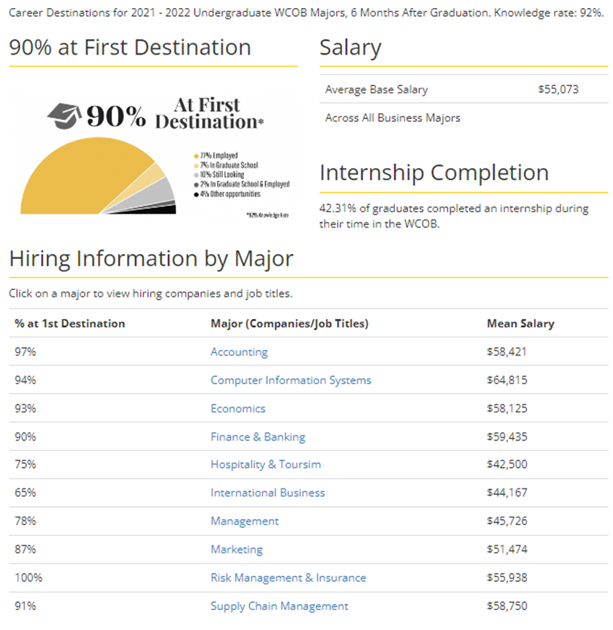
SCM Graduates - COB Career Center
2021-22 COB Undergraduate Student Success

Slide 23
A Few Highlights
SCM Program Received $100,000 Endowed Scholarship from Mr. Winstead
SCM Advisory Board with CSCMP Charlotte Roundtable Completed Endowed Scholarship
Endowed scholarship in memory of Dr. Beth Ellington
CSCMP Charlotte Roundtable and CEO of Acuitive Solutions pledged about $5,000 to support CSCMP Memberships (unlimited membership to students and about 10-12 membership to faculty & staff)
Continue to develop strong professional association with several reputable companies
SCM Major reported average salary of $58,750 (Source: COB Career Services)
CSCMP Charlotte provided a scholarship to SCM Major
NC League of Transportation & Logistics (NC LTL) continues to encourage our students to apply for the scholarship
Continue collaboration with Joseph Institute of Management (JIM) & Kristu Jayanti College (Bangalore)

Slide 24

Thank you so much

