Slide 1
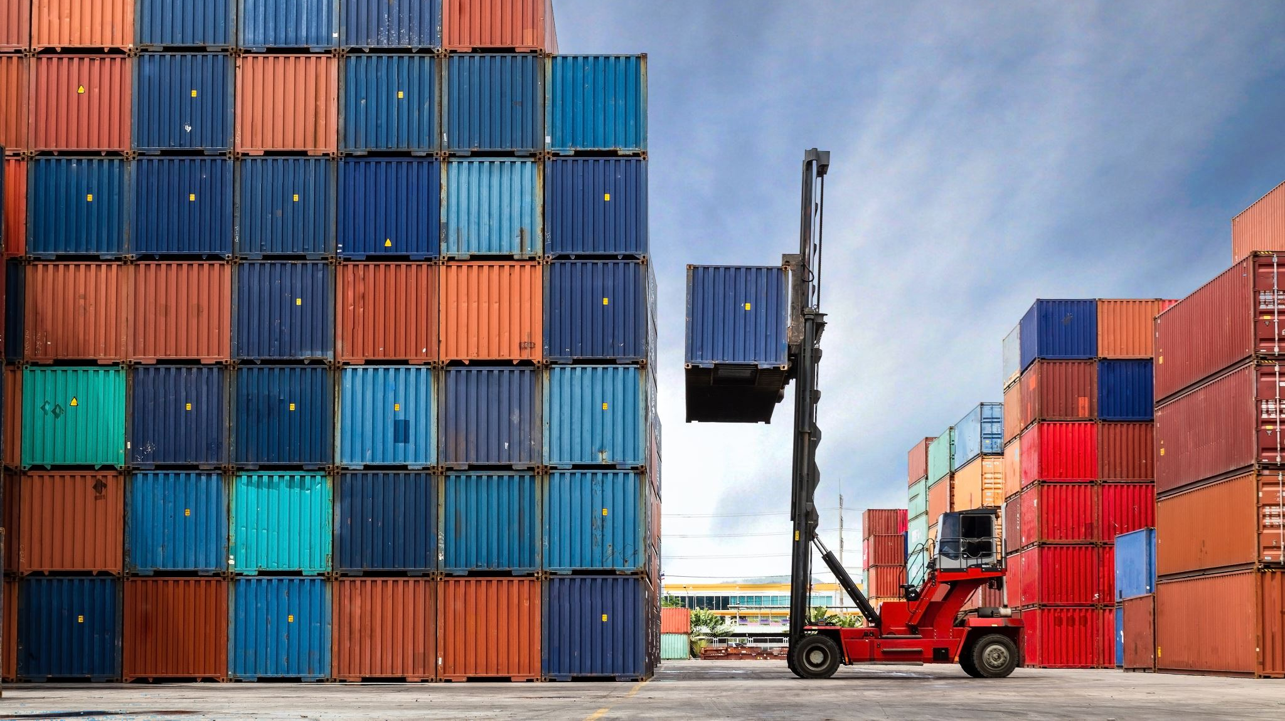
Supply Chain Management
@ Appalachian State University

Slide 2
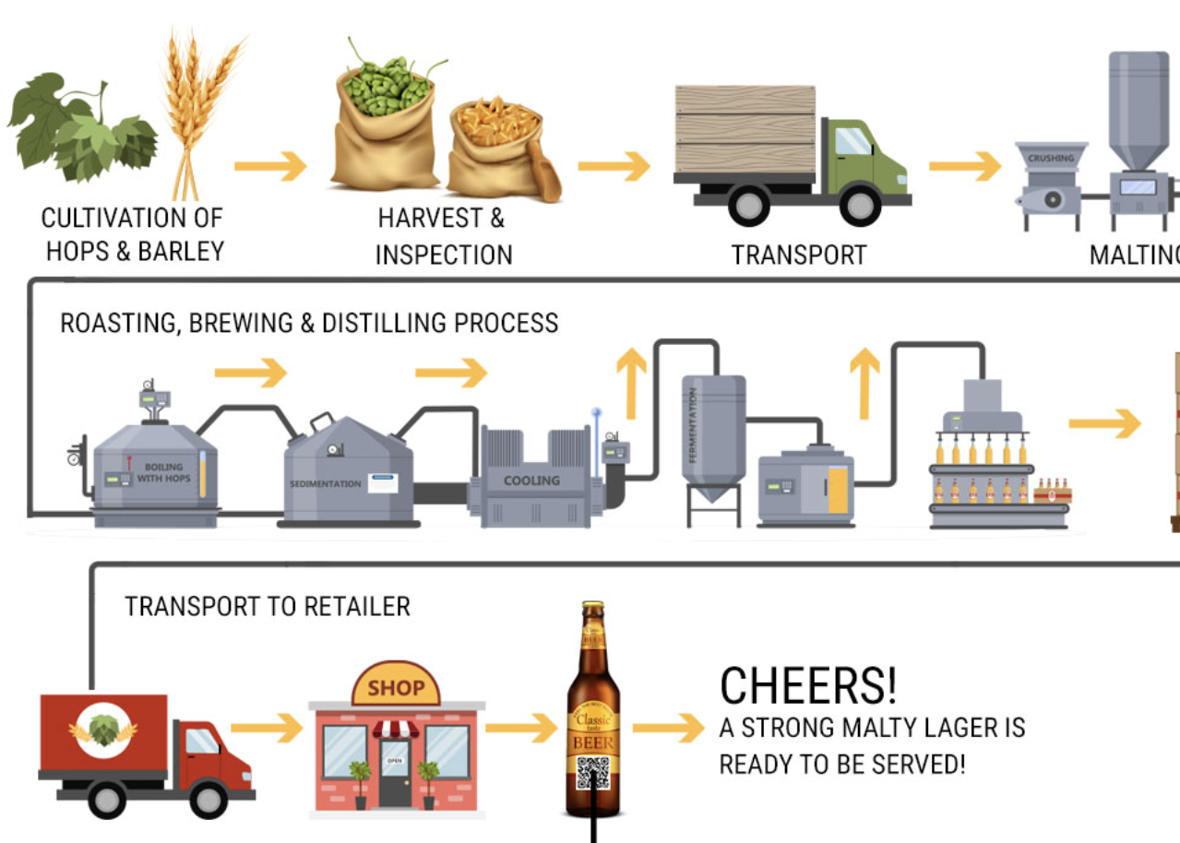
Examples of a Supply Chain From a small, local, regional brewery.

Slide 3
What is Supply Chain Management?
Planning – figuring out how to meet customer and manufacturer demands
Sourcing – building robust relationships with suppliers and working with them to procure raw materials at the right time
Manufacturing – dividing production tasks into sub-tasks and then predicting and managing how they will interact with distribution channels and customer requirements
Delivering – shipping goods to end-users through various channels
Returning – accepting defective, faulty, or unwanted products, usually for resale

Slide 4
What do SCM Professionals do?
Assure that the right materials are in the right place at the right time and at the right price by coordinating the organization’s Information Flows, Material Flows, Financial Flows & Risk Flows in a Global Competitive Environment.
Currently, SC Executives incorporate Environmental Sustainability, Financial Sustainability & Organizational Sustainability.

Slide 5



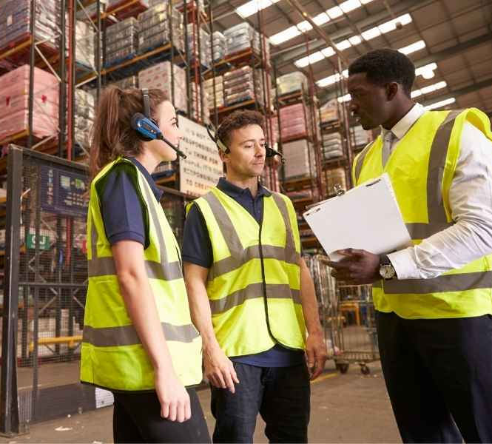
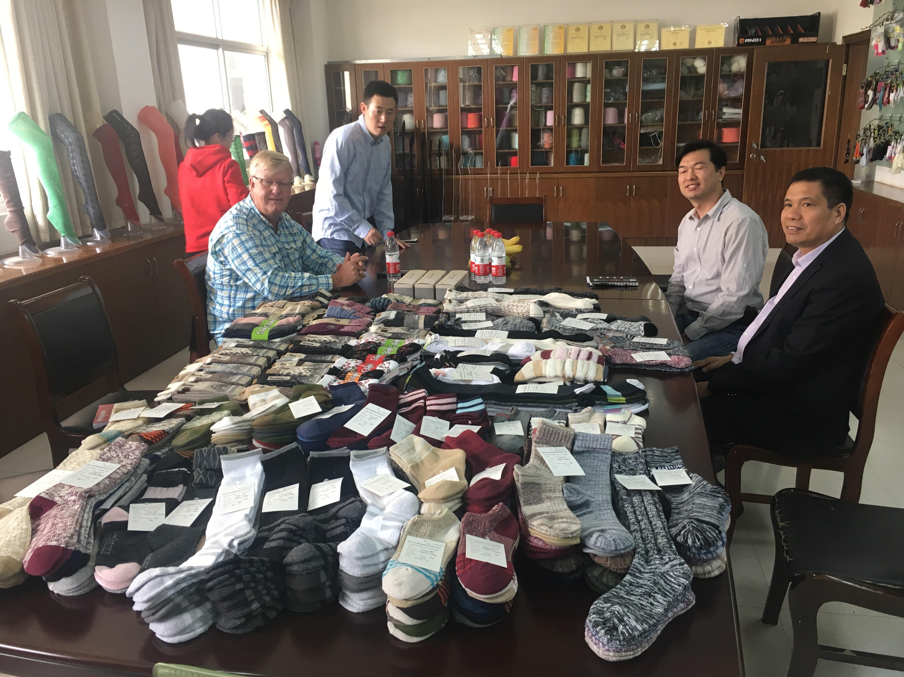
Potential Careers in Supply Chain
Buyer
Customs Broker
Product Designer
Warehouse Manager
Quality Control Lead
Logistics Coordinator
Production Manager
Transportation Manager
Data Analyst and more….

Slide 6
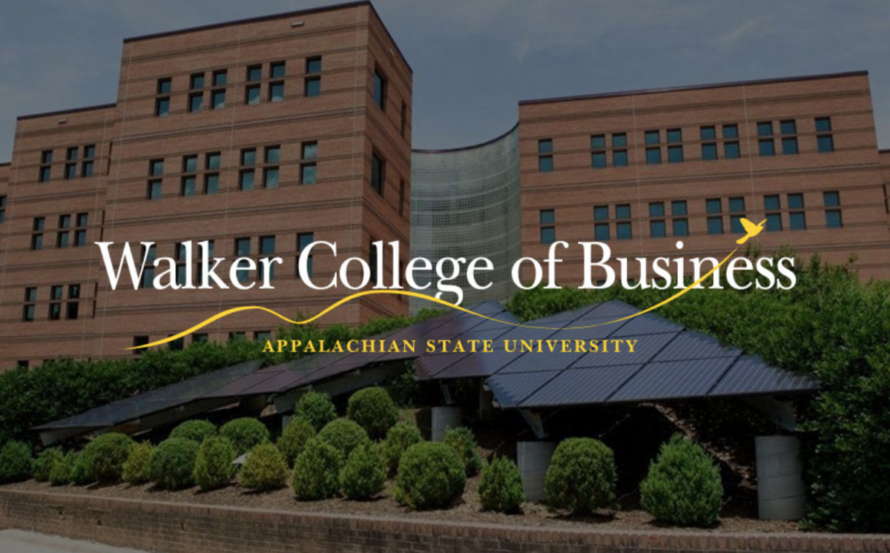
Supply Chain Management Programs Currently Offered
SCM Major
Created in 2016 after a study found SCM knowledge, skills, and abilities lacking in the workforce. More demand after the pandemic
MBA w/ SCM Concentration
Created in 2014 for our MBA students to obtain the SCM knowledge, skills, and abilities requested by employers
Provides a multi-disciplinary curriculum to complement Business majors. Double major/minor can be easily added
Currently 292 students (248 declared majors, 25 Undeclared, 19 minors). Flight Path BSBA in SCM (Fully Online) was recently introduced
SCM Minor
Created in 2008 after a study found SCM knowledge, skills, and abilities lacking in the workforce
Provides a multi-disciplinary curriculum to complement both Business and Non-Business majors

Slide 7

Why Major in Supply Chain Management?
Great Faculty
Award winning professors
MBA w/ SCM Concentration
Projected increases in demand
Great Courses
Relevant and dynamic curriculum
Pairs well with all majors
Complete required courses in 3 semesters
Build marketable skills
Industry experience
Faculty who care about your success
Large network of recruiters
Diverse job opportunities
High starting salaries

Slide 8



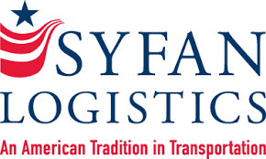











Our Supply Chain Board of Advisors
Our advisory board members are executives from the following:
Notes:
Internships and Scholarships
Bonded Logistics
FedEx
Global Shippers Association
Hanesbrands /Sara Lee Corporation
IBM
Lowe’s Companies, Inc.
M33 Integrated Solutions
Mapally
Mediterranean Shipping Company (USA)
Microsoft
Murray Supply Company
PHH Corporation
Prysmian Group – Draka
Saudi Basic Industries Corporation (SABIC)
Job Placement
Speaker to the Supply Chain Club
Guest Speaker in the Classes

Slide 9
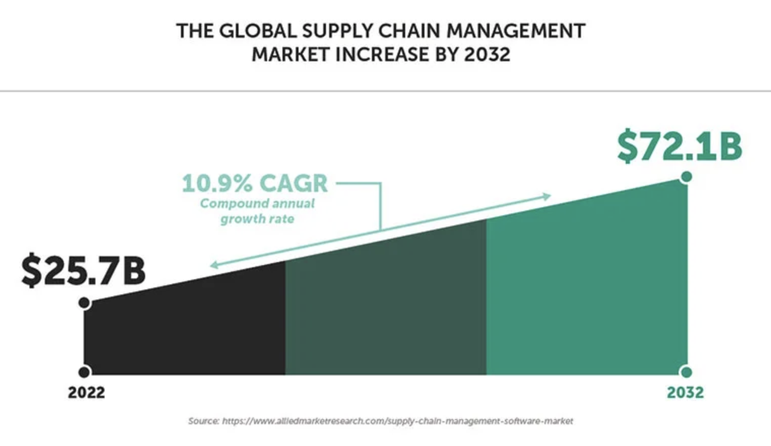
Why Major in Supply Chain Management?
It is easy to double major (e.g., Marketing & SCM, Management & SCM, Finance & SCM, CIS & SCM, etc.)
You can add SCM Major or SCM Minor without adding additional class in your curriculum (e.g., some classes will double count, fill your COB and free electives with SCM classes)
Currently, 292 students (248 declared majors, 25 Undeclared, 19 minors); which is one of the largest BSBA - SCM programs in the North Carolina University System
Flight Path (Fully Online) BSBA in SCM has been introduced

Slide 10
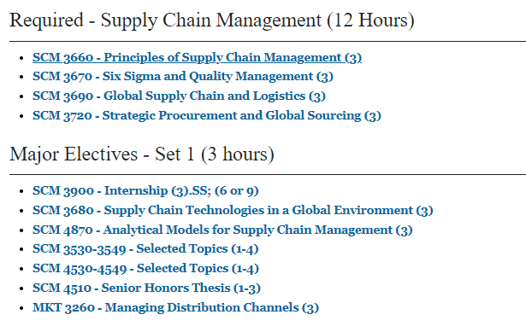
SCM Major Curriculum
Notes:
Courses can count double…
2 elective courses in your major
3 Supply Chain courses

Slide 11
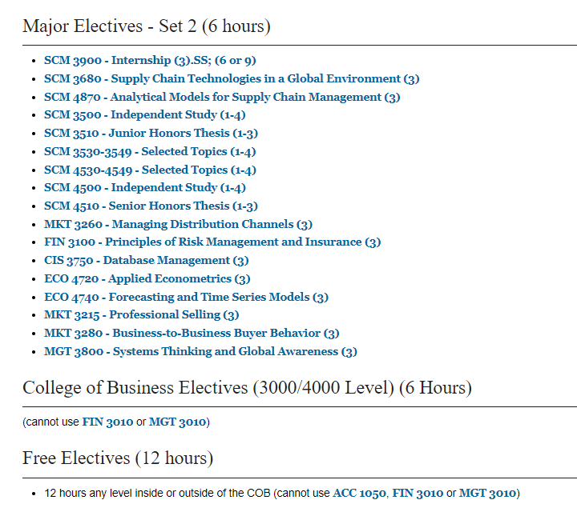
SCM Major Curriculum
(CONTINUED)
Notes:
Courses can count double…
2 elective courses in your major
3 Supply Chain courses

Slide 12
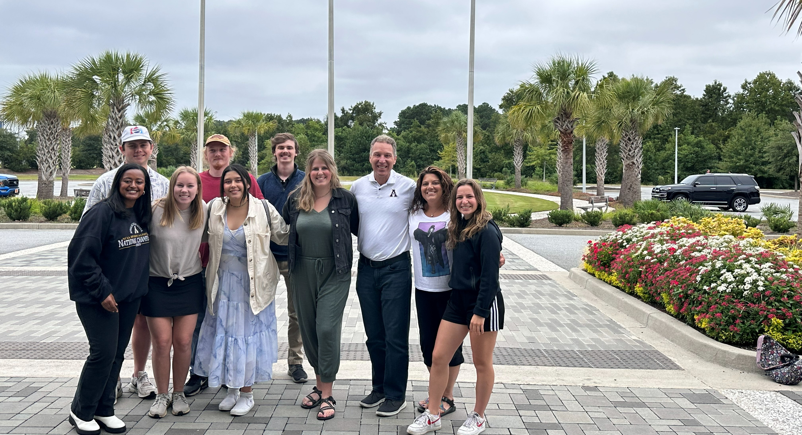
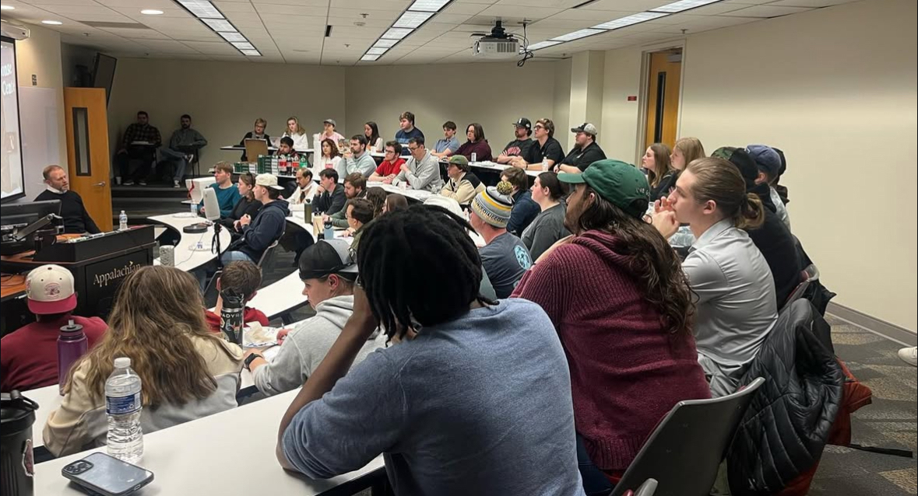
Appalachian Supply Chain Club (ASCC)
Our Student SCM Club is sponsored by the Association for Operations Management (APICS a.k.a. ASCM)
Free to join the club ($0 to join)
Includes student membership in APICS/ASCM
Possibility of CSCMP free membership
Internship Opportunities
Job Opportunities
Guest Speakers
Networking with SCM professionals
Click the link Appalachian Supply Chain Club Engage (https://engage.appstate.edu/organization/supply-chain-club)

Slide 13
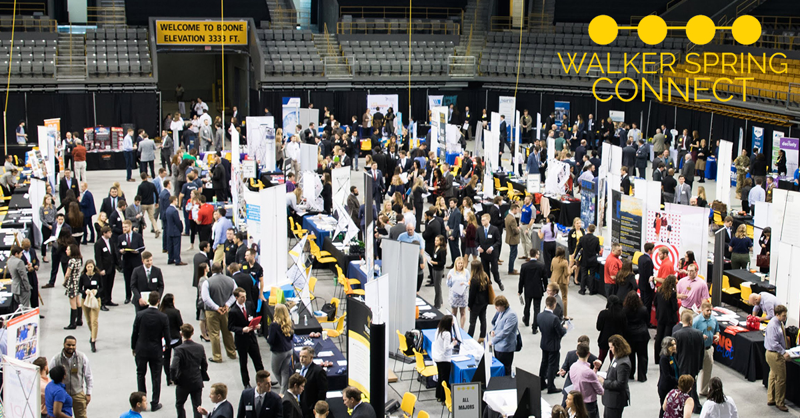
Employers
Amazon
Transportation Insight
Schneider
Target Corporation
Sunrise Technologies
Lowe’s
VF Corporation
Ahold-Delhaize
Publix
Total Quality Logistics
Maersk
Camelot 3PL Software Syngenta
Hanes Companies
Georgia-Pacific
Syfan Logistics
Ralph Lauren
Old Dominion
XPO Logistics, Inc.
Aldi Foods
Gilbarco-Veederoot

Slide 14
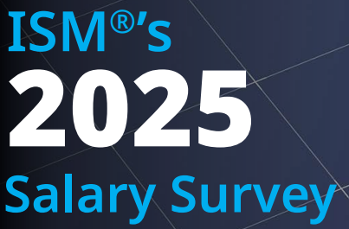
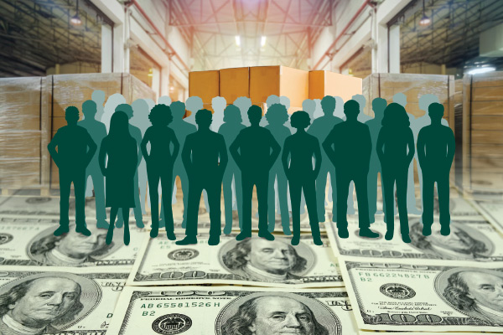
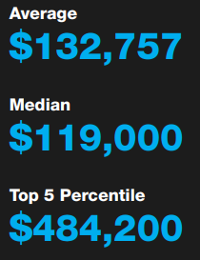
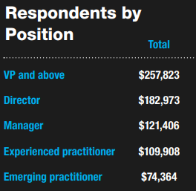
Institute for Supply Management (ISM) 2025 Salary Survey

Slide 15
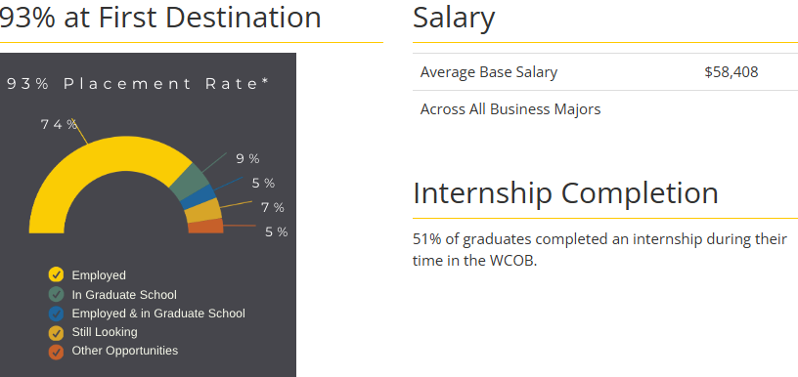
SCM Graduates - COB Career Center 2023-24 COB Undergraduate Student Success
SCM Placement Rate: 94% with Average Salary of $61,200

Slide 16
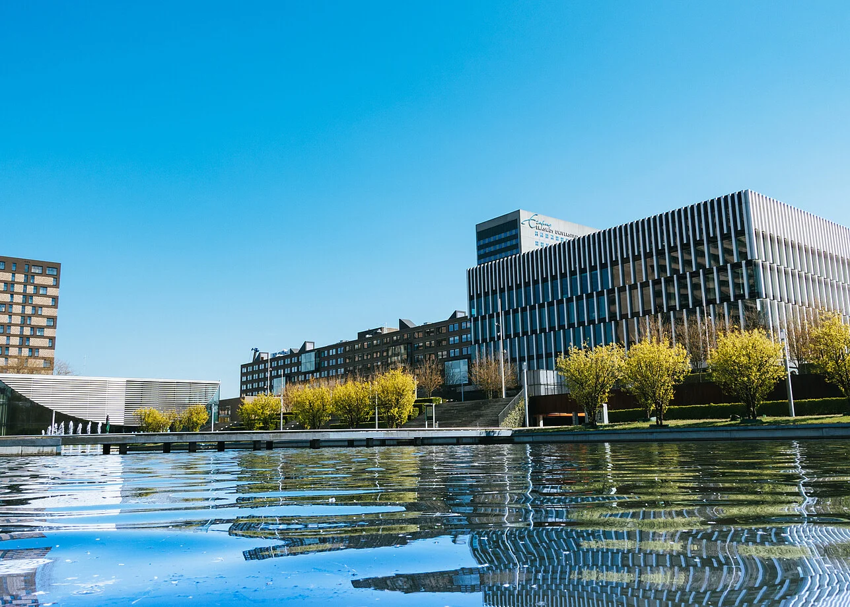
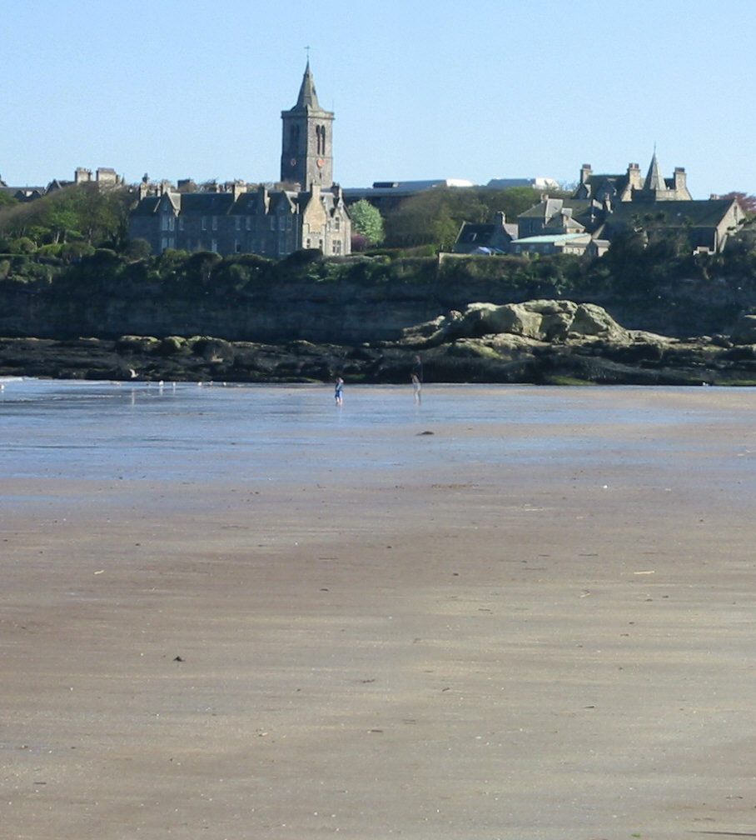

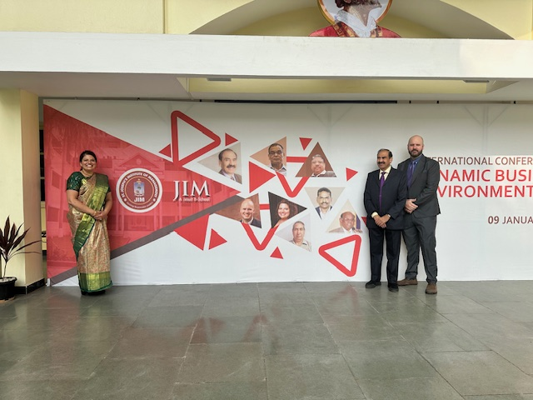

International Collaboration of SCM Program
International collaboration/collaboration:
Connections in India
FRANCE – Near Normandy – Largest Commercial Container Port of France
University of Le Havre-Normandy: Institut supérieur d'études logistiques
In the process of developing connection in the Netherlands - Rotterdam Business School
2027 European Supply Chain Summer Immersion in Ireland with Dr. Riley and Professor Palmer.

Slide 17
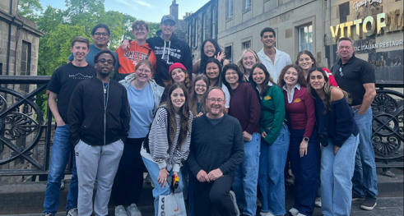
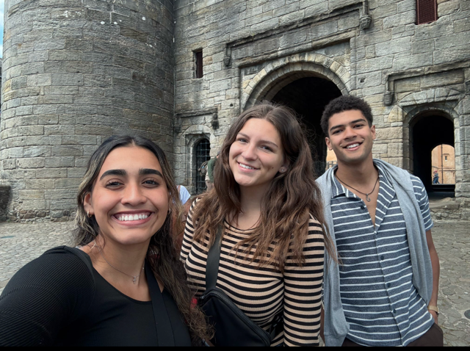
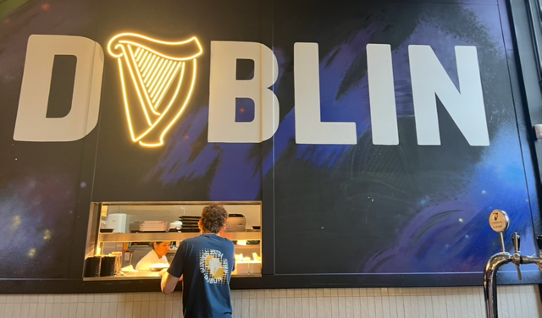
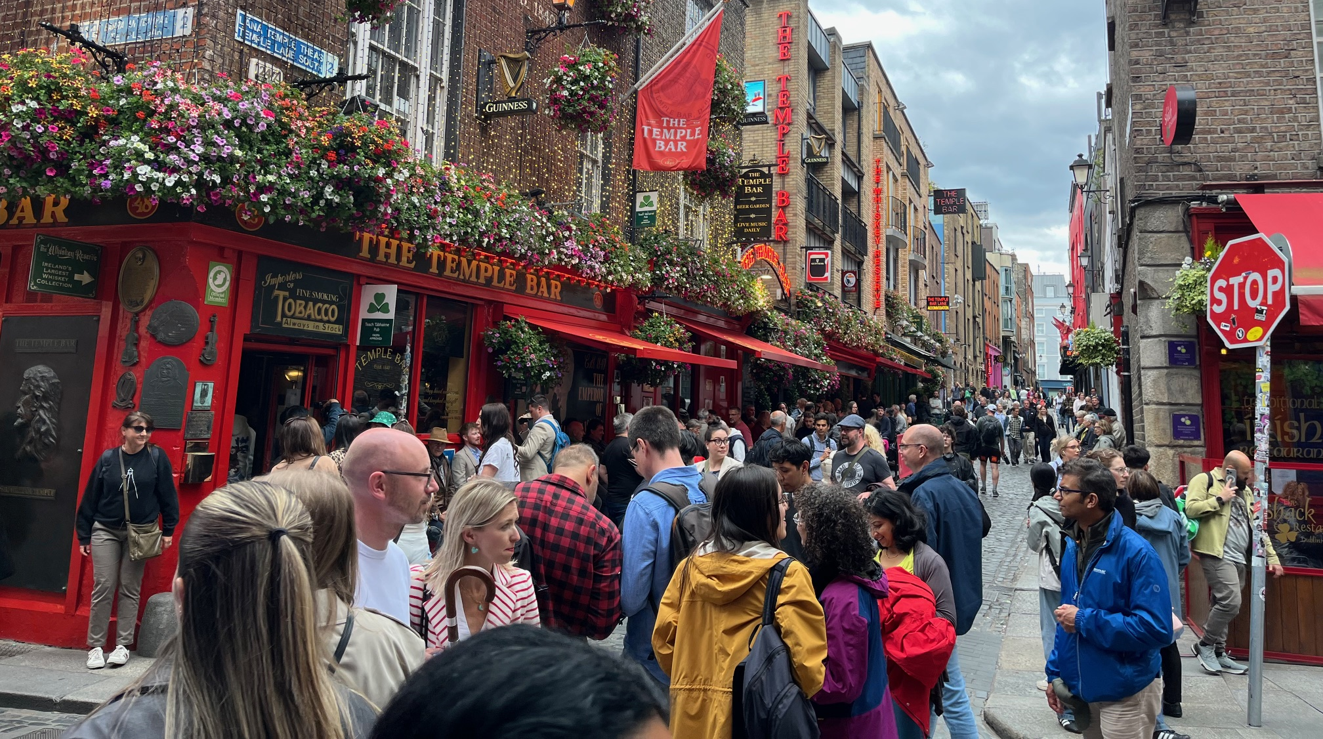

Slide 18
For More Information Contact: Supply Chain Management Faculty
Dr. Dinesh Davè (daveds@appstate.edu)
Dr. Jason Riley (rileyjm4@appstate.edu)
Dr. Ken Corley (corleyjk@appstate.edu)
Dr. Laura Laws (brewerLL@appstate.edu )
Mr. Daman Palmer (palmerdk@appstate.edu)
Mr. Doug Marrelli (marrellidm@appstate.edu)
Dr. Mike Ogle (oglemk@appstate.edu)
Mr. Colin Dees (deesch@appstate.edu)
Ms. MaKeyla Childs (childsmk@appstate.edu)
Ms. Natalie Noah (martinns@appstate.edu)

