Slide 1


Supply Chain Management
@

Slide 2

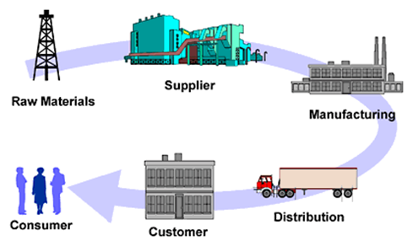
What is Supply Chain Management?

Slide 3
What is Supply Chain Management?
Synchronizing all Activities within the Supply Chain
Maximizing the Supply Chain’s Competitive Advantage
Adding Value for the Customers and Consumers
The “Lifeblood” of any Successful Business

Slide 4
What do SCM Professionals do?
Assure that the right materials are in the right place at the right time and at the right price by coordinating the organization’s Information Flows, Material Flows, Financial Flows & Risk Flows in a Global Competitive Environment.
Currently, SC Executives incorporate Environmental Sustainability, Financial Sustainability & Organizational Sustainability.

Slide 5
Supply Chain Management Programs Currently Offered
SCM Minor
  Created in 2008 after a study found SCM knowledge, skills, and abilities lacking in the workforce
  Provides a multi-disciplinary curriculum to complement both Business and Non-Business majors
  Created in 2016 after a study found SCM knowledge, skills, and abilities lacking in the workforce. More demand after the pandemic
  Provides a multi-disciplinary curriculum to complement Business majors. Double major/minor can be easily added
  Currently 292 students (248 declared majors, 25 Undeclared, 19 minors). Flight Path BSBA in SCM (Fully Online) was recently introduced
SCM Major
MBA w/SCM concentration
  Created in 2014 for our MBA students to obtain the SCM knowledge, skills, and abilities requested by employers

Slide 6
Why Major in Supply Chain Management?
Great Courses
  Relevant and dynamic curriculum
  Pairs well with all majors
  Complete required courses in 3 semesters
  Build marketable skills
Great Faculty
  Award winning professors
  Industry experience
  Faculty who care about your success
Great Careers
  Projected increases in demand
  Large network of recruiters
  Diverse job opportunities
  High starting salaries

Slide 7



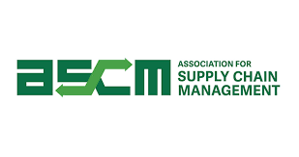
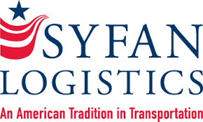




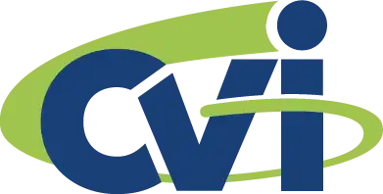

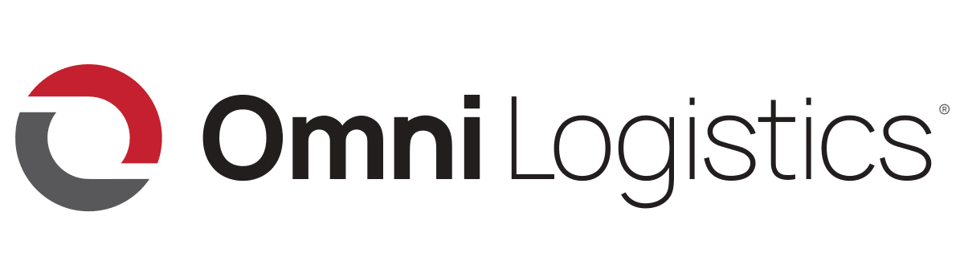


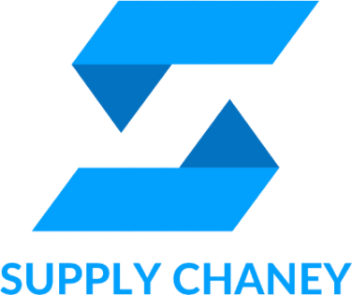

Our Supply Chain Board of Advisors
Our advisory board members are executives from the following:
Notes:
Internships and Scholarships
Bonded Logistics
FedEx
Global Shippers Association
Hanesbrands /Sara Lee Corporation
IBM
Lowe’s Companies, Inc.
M33 Integrated Solutions
Mapally
Mediterranean Shipping Company (USA)
Microsoft
Murray Supply Company
PHH Corporation
Prysmian Group – Draka
Saudi Basic Industries Corporation (SABIC)
Job Placement
Speaker to the Supply Chain Club
Guest Speaker in the Classes

Slide 8
Supply Chain Management Major
It is easy to double major (e.g., Marketing & SCM, Management & SCM, Finance & SCM, CIS & SCM, etc.)
You can add SCM Major or SCM Minor without adding additional class in your curriculum (e.g., some classes will double count, fill your COB and free electives with SCM classes)
Currently, 292 students (248 declared majors, 25 Undeclared, 19 minors); which is one of the largest BSBA - SCM programs in the North Carolina University System
Flight Path (Fully Online) BSBA in SCM has been introduced

Slide 9
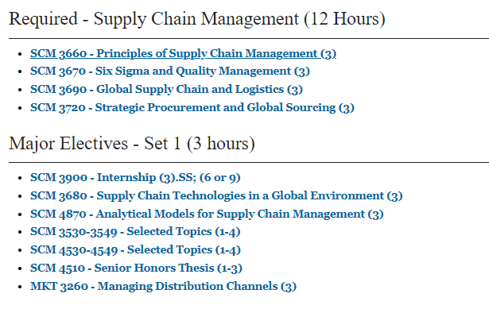
SCM Major Curriculum
Notes:
Courses can count double…
2 elective courses in your major
3 Supply Chain courses

Slide 10
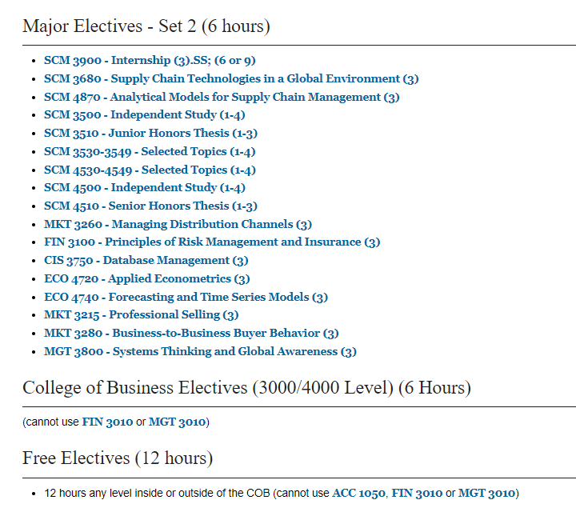
SCM Major Curriculum
(CONTINUED)
Notes:
Courses can count double…
2 elective courses in your major
3 Supply Chain courses

Slide 11
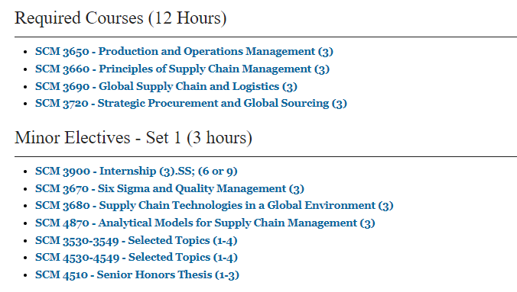
SCM Minor Curriculum
Notes:
Courses can count double…
2 elective courses in your major
3 Supply Chain courses

Slide 12
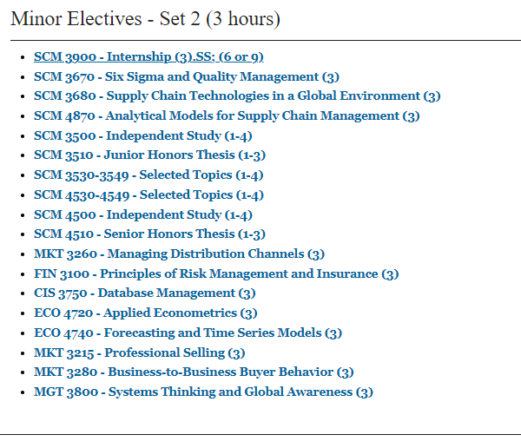
SCM Minor Curriculum
(CONTINUED)
Notes:
Courses can count double…
2 elective courses in your major
3 Supply Chain courses

Slide 13
Appalachian Supply Chain Club (ASCC)
Our Student SCM Club is sponsored by the Association for Operations Management (APICS a.k.a. ASCM)
  Free to join the club ($0 to join)
  Includes student membership in APICS/ASCM
  Possibility of CSCMP free membership
  Internship Opportunities
  Job Opportunities
  Guest Speakers
  Networking with SCM professionals
  Click the link Appalachian Supply Chain Club Engage (https://engage.appstate.edu/organization/supply-chain-club)

Slide 14
Employers
Amazon
Transportation Insight
Schneider
Target Corporation
Sunrise Technologies
Lowe’s
VF Corporation
Ahold-Delhaize
Publix
Total Quality Logistics
Maersk
Camelot 3PL Software
Syngenta
Hanes Companies
Georgia-Pacific
Syfan Logistics
Ralph Lauren
Red Classic Transportation Services
Old Dominion
XPO Logistics, Inc.
Aldi Foods
Gilbarco-Veederoot

Slide 15
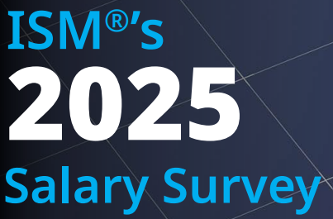
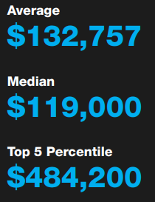
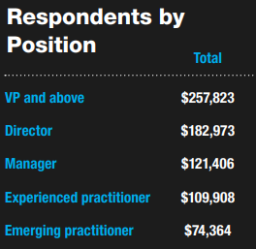
Institute for Supply Management (ISM)
2025 Salary Survey

Slide 16
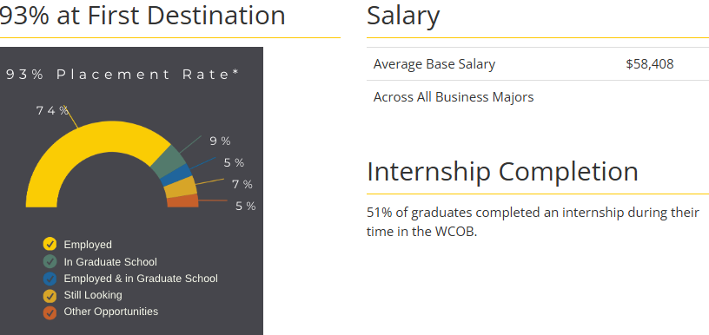
SCM Graduates - COB Career Center
2023-24 COB Undergraduate Student Success
SCM Placement Rate: 94% with Average Salary of $61,200

Slide 17

International Collaboration of SCM Program
International collaboration/collaboration:
  Connections in India
  FRANCE – Near Normandy – Largest Commercial Container Port of France
    University of Le Havre-Normandy: Institut supérieur d'études logistiques
  In the process of developing connection in the Netherlands - Rotterdam Business School

Slide 18
For More Information Contact:
Supply Chain Management Faculty
Dr. Dinesh Davè (daveds@appstate.edu)
Dr. Jason Riley (rileyjm4@appstate.edu)
Dr. Ken Corley (corleyjk@appstate.edu)
Dr. Laura Brewer (brewerLL@appstate.edu )
Mr. Daman Palmer (palmerdk@appstate.edu)
Mr. Doug Marrelli (marrellidm@appstate.edu)
Dr. Mike Ogle (oglemk@appstate.edu)
Mr. Colin Dees (deesch@appstate.edu)
Ms. MaKeyla Childs (childsmk@appstate.edu)
Ms. Natalie Noah (martinns@appstate.edu)

