Slide 1

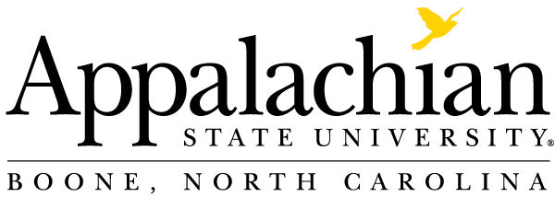
Supply Chain Management
@

Slide 2

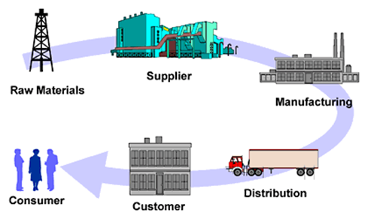
What is Supply Chain Management?

Slide 3
What is Supply Chain Management?
Synchronizing all Activities within the Supply Chain
Maximizing the Supply Chain’s Competitive Advantage
Adding Value for the Customers and Consumers
The “Lifeblood” of any Successful Business

Slide 4
What do SCM Professionals do?
Assure that the right materials are in the right place at the right time and at the right price by coordinating the organization’s Information Flows, Material Flows, Financial Flows & Risk Flows in a Global Competitive Environment.
Currently, SC Executives incorporate Environmental Sustainability, Financial Sustainability & Organizational Sustainability.

Slide 5
Supply Chain Management Programs Currently Offered
SCM Minor
  Created in 2008 after a study found SCM knowledge, skills, and abilities lacking in the workforce
  Provides a multi-disciplinary curriculum to complement both Business and Non-Business majors
  Created in 2016 after a study found SCM knowledge, skills, and abilities lacking in the workforce. More demand after the pandemic
  Provides a multi-disciplinary curriculum to complement Business majors. Double major/minor can be easily added
  Currently 292 students (248 declared majors, 25 Undeclared, 19 minors). Flight Path BSBA in SCM (Fully Online) was recently introduced
SCM Major
MBA w/SCM concentration
  Created in 2014 for our MBA students to obtain the SCM knowledge, skills, and abilities requested by employers

Slide 6
Why Major in Supply Chain Management?
Great Courses
  Relevant and dynamic curriculum
  Pairs well with all majors
  Complete required courses in 3 semesters
  Build marketable skills
Great Faculty
  Award winning professors
  Industry experience
  Faculty who care about your success
Great Careers
  Projected increases in demand
  Large network of recruiters
  Diverse job opportunities
  High starting salaries

Slide 7



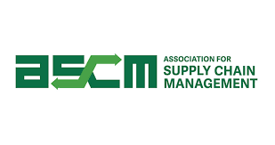
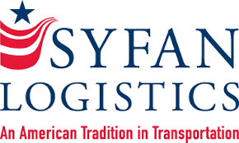


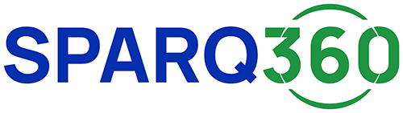

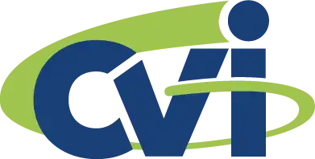

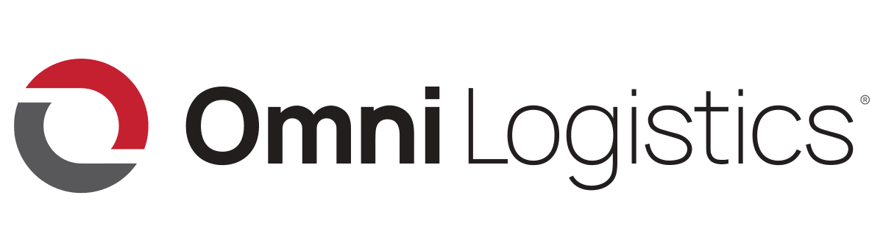


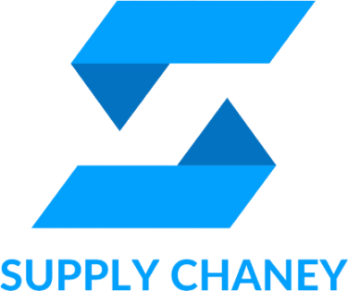

Our Supply Chain Board of Advisors
Our advisory board members are executives from the following:
Notes:
Internships and Scholarships
Bonded Logistics
FedEx
Global Shippers Association
Hanesbrands /Sara Lee Corporation
IBM
Lowe’s Companies, Inc.
M33 Integrated Solutions
Mapally
Mediterranean Shipping Company (USA)
Microsoft
Murray Supply Company
PHH Corporation
Prysmian Group – Draka
Saudi Basic Industries Corporation (SABIC)
Job Placement
Speaker to the Supply Chain Club
Guest Speaker in the Classes

Slide 8
Supply Chain Management Major
It is easy to double major (e.g., Marketing & SCM, Management & SCM, Finance & SCM, CIS & SCM, etc.)
You can add SCM Major or SCM Minor without adding additional class in your curriculum (e.g., some classes will double count, fill your COB and free electives with SCM classes)
Currently, 292 students (248 declared majors, 25 Undeclared, 19 minors); which is one of the largest BSBA - SCM programs in the North Carolina University System
Flight Path (Fully Online) BSBA in SCM has been introduced

Slide 9

The SCM Major pairs well with a Major in..
CIS
In “The World is Flat,” five of Friedman’s flatteners are technologies that have facilitated extraordinary competitive advantages in SCM.
Finance
SCM provides 40% higher valuation for companies within
DJI Index and S&P 500 Index.
Accounting
Lower supply chain costs 25% - 50%
Improved capacity realization 10% - 20%
Forecast accuracy improvement 25% - 80%
Increase in overall productivity 10% - 16%
Inventory Cost Reduction 25% - 60%
Entrepreneurship
SCM is a dominant enabler of new global enterprises and flat competition. Anyone can now build an international supply chain and compete globally.
Management / HR
With SCM Management costs as a percentage of revenue are 50% less than median companies. SCM increases employment opportunity.
Marketing
Improved delivery performance 16% - 28%
Reduction in order fulfillment cycle time 30% - 50%
Improvement in forecast accuracy 25% - 80%
Lower supply chain costs 25% - 50%
Improvement of fill rates 20% - 30%
Economics
“Central to the way that companies produce things is the way that they manage their supply chains.” Virtual extended enterprises now cross all boundaries via SCM. Micro and macro economies are more complex and interdependent than ever before.
Supply Chain Management helps companies and
professionals in all disciplines excel.
Sources: The Supply Chain Council, The Economist, PRTM-The Performance Measurement Group, “The World is Flat” by Thomas Friedman

Slide 10
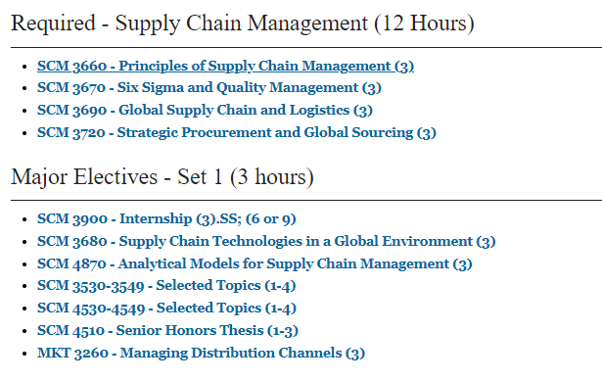
SCM Major Curriculum
Notes:
Courses can count double…
2 elective courses in your major
3 Supply Chain courses

Slide 11
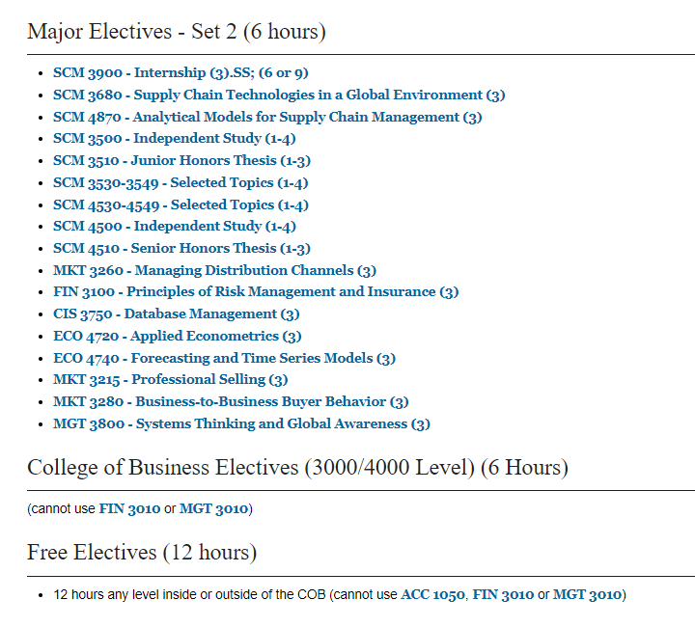
SCM Major Curriculum
(CONTINUED)
Notes:
Courses can count double…
2 elective courses in your major
3 Supply Chain courses

Slide 12
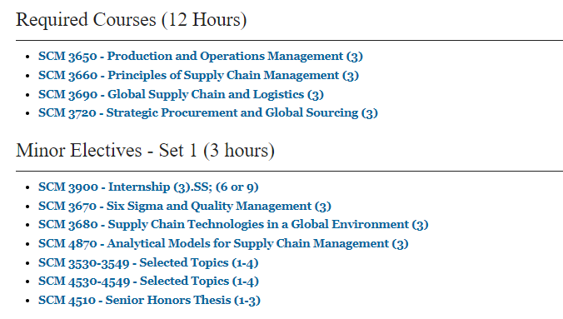
SCM Minor Curriculum
Notes:
Courses can count double…
2 elective courses in your major
3 Supply Chain courses

Slide 13
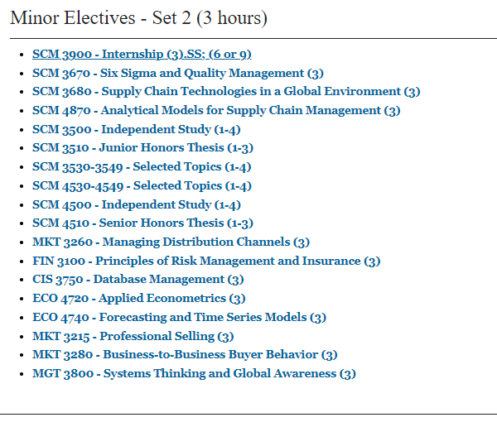
SCM Minor Curriculum
(CONTINUED)
Notes:
Courses can count double…
2 elective courses in your major
3 Supply Chain courses

Slide 14
Appalachian Supply Chain Club (ASCC)
Our Student SCM Club is sponsored by the Association for Operations Management (APICS a.k.a. ASCM)
  Free to join the club ($0 to join)
  Includes student membership in APICS/ASCM
  Possibility of CSCMP free membership
  Internship Opportunities
  Job Opportunities
  Guest Speakers
  Networking with SCM professionals
  Click the link Appalachian Supply Chain Club Engage (https://engage.appstate.edu/organization/supply-chain-club)

Slide 15
Employers
Amazon
Transportation Insight
Schneider
Target Corporation
Sunrise Technologies
Lowe’s
VF Corporation
Ahold-Delhaize
Publix
Total Quality Logistics
Maersk
Camelot 3PL Software
Syngenta
Hanes Companies
Georgia-Pacific
Syfan Logistics
Ralph Lauren
Red Classic Transportation Services
Old Dominion
XPO Logistics, Inc.
Aldi Foods
Gilbarco-Veederoot

Slide 16
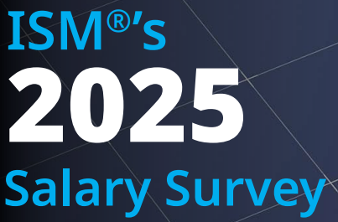
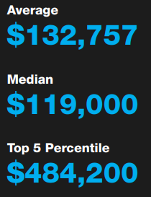
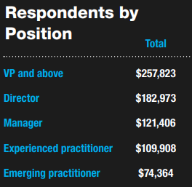
Institute for Supply Management (ISM)
2025 Salary Survey

Slide 17
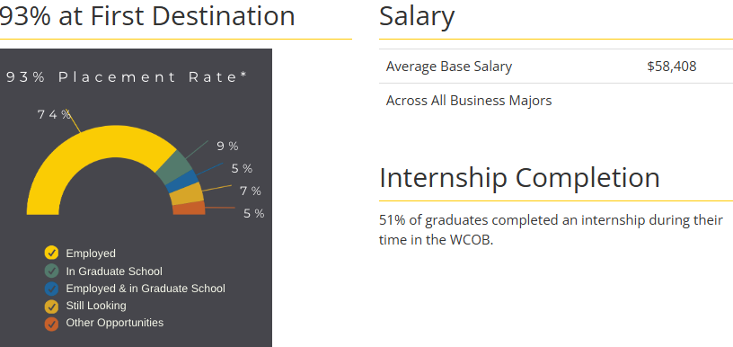
SCM Graduates - COB Career Center
2023-24 COB Undergraduate Student Success

Slide 18
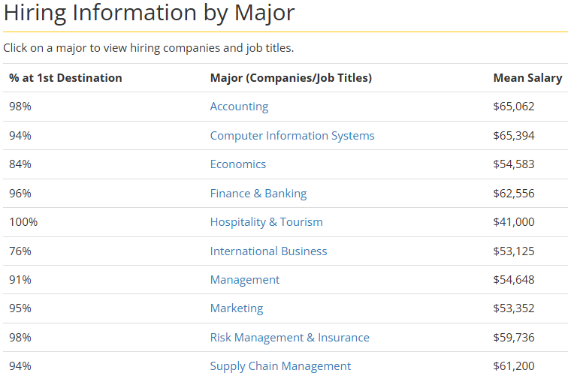
SCM Graduates - COB Career Center
2023-24 COB Undergraduate Student Success

Slide 19

International Collaboration of SCM Program
International collaboration/collaboration:
  Connections in India
  FRANCE – Near Normandy – Largest Commercial Container Port of France
    University of Le Havre-Normandy: Institut supérieur d'études logistiques
  In the process of developing connection in the Netherlands - Rotterdam Business School

Slide 20
For More Information Contact:
Supply Chain Management Faculty
Dr. Dinesh Davè (daveds@appstate.edu)
Dr. Jason Riley (rileyjm4@appstate.edu)
Dr. Ken Corley (corleyjk@appstate.edu)
Dr. Laura Brewer (rbrewerLL@appstate.edu )
Mr. Daman Palmer (palmerdk@appstate.edu)
Mr. Doug Marrelli (marrellidm@appstate.edu)
Dr. Mike Ogle (oglemk@appstate.edu)
Mr. Colin Dees (deesch@appstate.edu)
Ms. MaKeyla Childs (childsmk@appstate.edu)

