Slide 1
Supply Chain Management
@
Dr. Dinesh Dave`, SCM Program Director
Dr. Laura Brewer, Assistant Professor
Dr. Ken Corley, Associate Professor
Mr. Daman Palmer, Lecturer
Dr. Mike Ogle, Lecturer

Slide 2
What is Supply Chain Management?

Slide 3
Supply Chain Management Programs Currently Offered
SCM Minor
Created in 2008 after a study found SCM knowledge, skills, and abilities lacking in the workforce
Provides a multi-disciplinary curriculum to complement both Business and Non-Business majors
Created in 2016 after a study found SCM knowledge, skills, and abilities lacking in the workforce. More demand after the pandemic
Provides a multi-disciplinary curriculum to complement Business majors. Double major/minor can be easily added
Currently 280 students (212 declared majors, 37 Undeclared, 32 minors). Online BSBA in SCM was recently introduced
SCM Major
MBA w/SCM concentration
Created in 2014 for our MBA students to obtain the SCM knowledge, skills, and abilities requested by employers

Slide 4
Why Major in Supply Chain Management?
Great Courses
Relevant and dynamic curriculum
Pairs well with all majors
Complete required courses in 3 semesters
Build marketable skills
Great Faculty
Award winning professors
Industry experience
Faculty who care about your success
Great Careers
Projected increases in demand
Large network of recruiters
Diverse job opportunities
High starting salaries

Slide 5
Supply Chain Management Data
Spring 2024 Data (In progress) – No. of Majors = 248

Slide 6
Current SCM Students

Slide 7
Our Supply Chain Board of Advisors
Our advisory board members are executives from the following:
Notes:
Internships and Scholarships
Bonded Logistics
FedEx
Global Shippers Association
Hanesbrands /Sara Lee Corporation
IBM
Lowe’s Companies, Inc.
M33 Integrated Solutions
Mapally
Mediterranean Shipping Company (USA)
Microsoft
Murray Supply Company
PHH Corporation
Prysmian Group – Draka
Saudi Basic Industries Corporation (SABIC)
Job Placement
Speaker to the Supply Chain Club
Guest Speaker in the Classes

Slide 8
Supply Chain Management Major
Currently, 280 students (212 declared majors, 37 Undeclared, 32 minors); which is one of the largest SCM programs in the North Carolina University System
Fully Online BSBA in SCM has been introduced
SCM is one of the most popular concentrations in our MBA program
SCM is one of the favorable concentrations in our Applied Data Analytics program

Slide 9
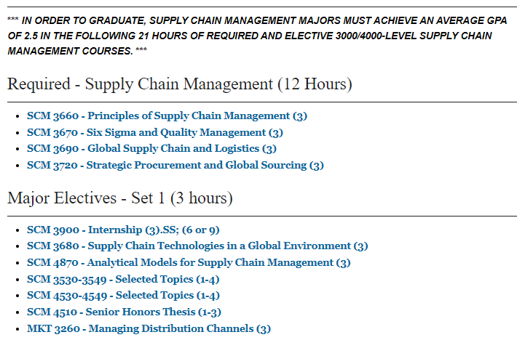
SCM Major Curriculum
Notes:
Courses can count double…
2 elective courses in your major
3 Supply Chain courses

Slide 10
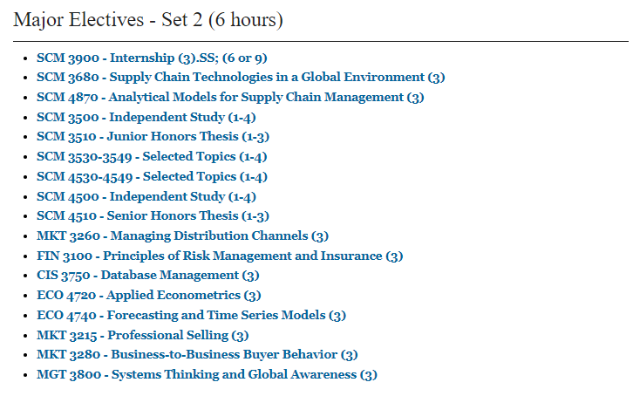
SCM Major Curriculum (Contd)
Notes:
Courses can count double…
2 elective courses in your major
3 Supply Chain courses

Slide 11
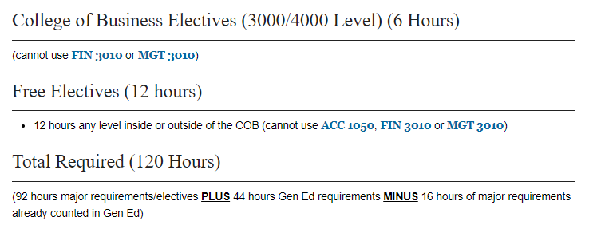
SCM Major Curriculum (Contd)
Notes:
Courses can count double…
2 elective courses in your major
3 Supply Chain courses

Slide 12
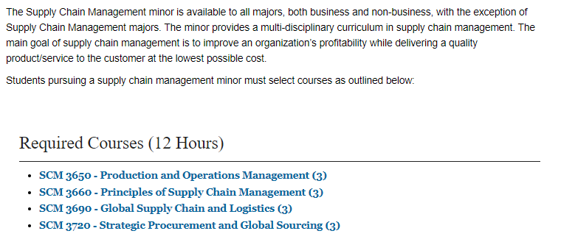
SCM Minor Curriculum
Notes:
Courses can count double…
2 elective courses in your major
3 Supply Chain courses

Slide 13
SCM Minor Curriculum (Contd)
Notes:
Courses can count double…
2 elective courses in your major
3 Supply Chain courses

Slide 14
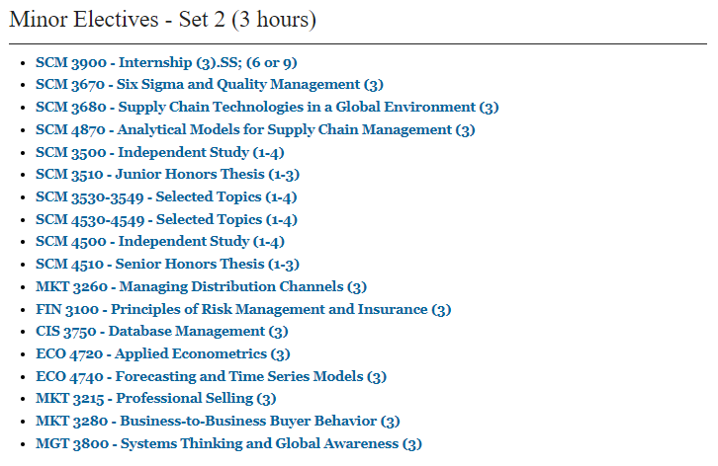
SCM Minor Curriculum (Contd)
Notes:
Courses can count double…
2 elective courses in your major
3 Supply Chain courses

Slide 15
Appalachian Supply Chain Club (ASCC) (ASCC.appstate.edu)
Our Student SCM Club is sponsored by ASCM & CSCMP – Professional Organizations
Free to join the club ($0 to join)
Includes student membership in ASCM (Association of Supply Chain Management)
Possibility of CSCMP (Council of Supply Chain Management Professionals) free membership
Paid Internship and Employment Opportunities
Guest Speakers & Networking with SCM professionals

Slide 16
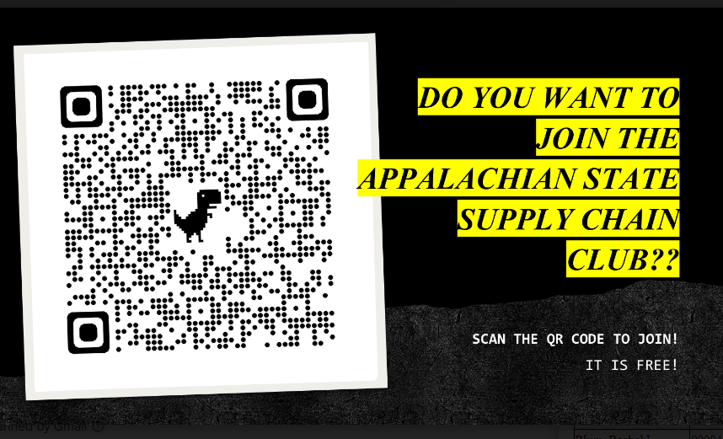
Join the Supply Chain Club (ASCC) NOW

Slide 17
Employers
Amazon
C. H. Robinson
Transportation Insight
Schneider
Target Corporation
Sunrise Technologies
Lowe’s
VF Corporation
Ahold-Delhaize
Publix
Total Quality Logistics
Maersk
LeanCor
Camelot 3PL Software
Syngenta
Hanes Companies
Georgia-Pacific
Syfan Logistics
Ralph Lauren
Red Classic Transportation Services
Old Dominion
XPO Logistics, Inc.
Aldi Foods
Gilbarco-Veederoot

Slide 18
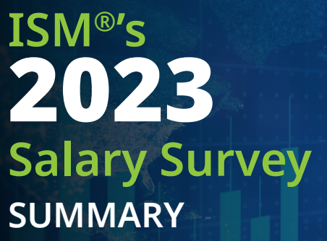
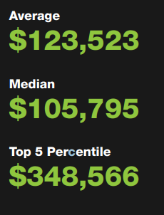
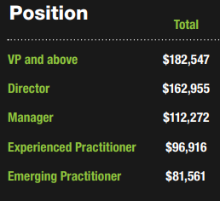
Institute for Supply Management (ISM) 2023 Salary Survey

Slide 19
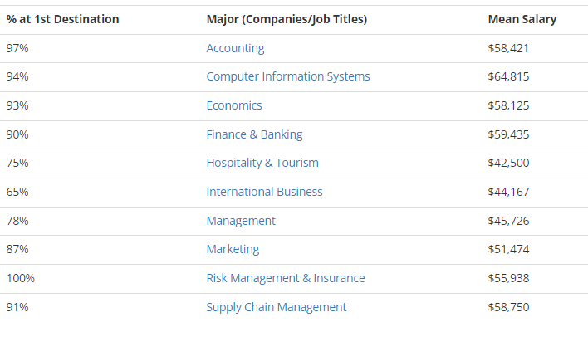
SCM Graduates - COB Career Center 2022-23 COB Undergraduate Student Success

Slide 20
A Few Highlights
SCM Program Received $100,000 Endowed Scholarship from Mr. Winstead
SCM Advisory Board with CSCMP Charlotte Roundtable Completed Endowed Scholarship & Endowed scholarship in memory of Dr. Beth Ellington
CSCMP Charlotte Roundtable and CEO of Acuitive Solutions pledged about $5,000 to support CSCMP Memberships
SCM Major reported average salary of $58,750 (Source: COB Career Services)
NC League of Transportation & Logistics (NC LTL) continues to encourage our students to apply for the scholarship
Continue collaboration with Joseph Institute of Management (JIM) & Kristu Jayanti College (Bangalore), INDIA
Developing collaboration with Le Havre University in FRANCE

Slide 21
Questions? Thank you very much

