Slide 1
Supply Chain & GLOBAL SUPPLY CHAIN
Dr. Dinesh S. Davè
Professor & Director
Supply Chain Management Program
Department of Marketing & Supply Chain Management
John A. Walker College of Business
Appalachian State University

Slide 2
What is Supply Chain Management
What is Global Supply Chain – MIT Video
https://youtu.be/gBRrG0-SA1I

Slide 3
What is Supply Chain Management
Supply chain management encompasses the planning and management of all activities involved in sourcing and procurement, conversion, and all logistics management activities. Importantly, it also includes coordination and collaboration with channel partners, which can be suppliers, intermediaries, third party service providers, and customers. In essence, supply chain management integrates supply and demand management within and across companies. (CSCMP)

Slide 4
What is Supply Chain Management
A supply chain is a complex system in which raw materials are transformed into finished products and then distributed to the final users.
A supply chain includes suppliers, manufacturing centers, warehouses, distribution centers and retail outlets.

Slide 5
Supply chain management describes the coordination of all activities starting with raw materials and ending with a satisfied customer.
A supply chain may include suppliers, manufacturers, distributors, wholesalers and retailers working together to deliver products and services to end customers
Notes:
May be more accurate to use the term “supply network” or “supply web”

Slide 6
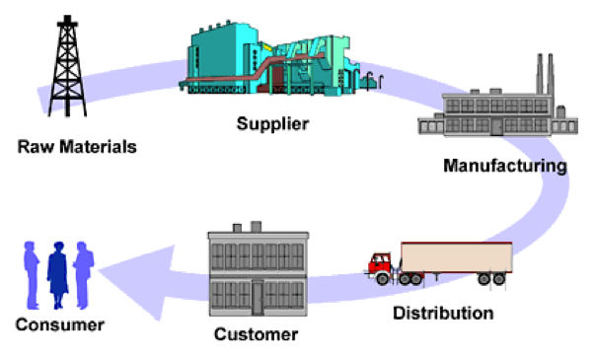
Notes:
May be more accurate to use the term “supply network” or “supply web”

Slide 7
Objectives of Supply Chain
Main objectives of SCM are to improve the overall organizational performance and customer satisfaction by improving product and service delivery to customer - Customer the only source of revenue
Sources of cost include flows of information, products, or funds between stages of the supply chain
Effective supply chain management involves the management of supply chain assets and product, information, and fund flows to grow the total supply chain surplus
Notes:
May be more accurate to use the term “supply network” or “supply web”

Slide 8
Goals of Supply Chain
Efficient Fulfillment
Enhance Customer Value & Customer Value Creation
Meet and Exceed Customer Requirements
Enhance Organizational Responsiveness
Build Network Resiliency
Facilitate Financial Success
A supply chain satisfies customer needs by managing assets and flows of information, product, and funds across all parties involved (raw materials → end consumer)
The SCM involves the process of coordinating activities among suppliers, manufacturing facilities, DCs, and customers so that the company produces and/or distributes the right product at the right time to the right place at a minimum cost while maintaining the desired level of service.
Notes:
May be more accurate to use the term “supply network” or “supply web”

Slide 9
A supply chain satisfies customer needs by managing assets and flows of information, material & finances
Notes:
May be more accurate to use the term “supply network” or “supply web”

Slide 10
Flows in Supply Chain
Product Flow includes movement of goods & raw materials from supplier to consumer in the chain of supply. Product flow also involves returns and rejections which is called reverse flow. The goods generally flow downstream (forward) from the source to consumer. The backward (or upstream) flow of materials, mainly associated with product returns.

Slide 11
Financial Flow:
Financial flow comes from two sources: a) from the cost and investment perspective and b) from flow of funds.
Costs and investments add on as moving forward in the supply chain. The optimization of total supply chain cost contributes directly to overall profitability.
Similarly, optimization of supply chain investment contributes to the optimization of return on the capital invested in a company.
Flow of funds are from the ultimate consumer of the product back down through the chain.

Slide 12
Financial Flow (Continued):
The supply chain has both accounts payable and accounts receivable activities; they include payment schedules, credit, and additional financial arrangements.
Both funds flow in opposite directions: receivables (funds inflow) and payables (funds outflow).
Great opportunities and challenges in managing financial flows in supply chains.
The integrated management of this flow is a key SCM activity, and one which has a direct impact on the cash flow position and profitability of the company.

Slide 13
Information Flow:
SCM involves information and communication between suppliers, logistics companies, subcontractors, and other entities in the chain of supply.
For example, information include:
  bills of materials
  Product data
  pricing
  inventory levels
  customer and order information
  delivery scheduling,
  supplier and distributor information
  delivery status
  current cash flow and ﬁnancial information, etc.
Information ﬂows in the supply chain are bidirectional
Faster and accurate information ﬂow enhances SC eﬀectiveness and Information Technology provides significant benefits.

Slide 14
Value in Supply Chain:
A supply chain has a series of value creating processes over the chain of supply to provide added value to the final customers.
A value chain is a set of activities an organization performs in order to deliver a valuable product or service for the market (Competitive Advantage by Michael Porter).
A value chain describes the process by which businesses receive raw materials, add value to the raw materials through various processes to create a finished product for the customers.
Supply chain is closely related to value chain and they compliment and supplement each other.

Slide 15
Risk in Supply Chain:
Risks in supply chain can occur due to uncertainty in demand, supply, price, lead time, etc. and they result in financial loss for organization and/or the entire supply chain.
Risks can appear as any kind of disruptions, price volatility, and poor perceived quality of the product or service, process / internal quality failures, deficiency of physical infrastructure, natural disaster, etc.
Risk factors may also include cash flow constraints, inventory financing, and delayed payment.
Risks can be external or internal and move either way with product or financial or information or value flow.

Slide 16
Integrative Approach in SCM
Supply chain management integrates key business processes from end user through original suppliers, manufacturer, retailers, and 3PLs and this collaboration is a critical success factor in a dynamic global market environment.
The collaboration is necessary for enhancing value in the system by sharing and utilization of resources, assets, facilities, processes; sharing of information, knowledge, systems between different tiers in the chain and is vital for the success of each chain in improving lead-times, process execution efficiencies and costs, quality of the process, inventory costs, and information transfer in a supply chain.

Slide 17
Integration leads to better collaboration for synchronized production scheduling, collaborative product development, collaborative demand and logistic planning.
With increased information visibility and relevant operational knowledge and data exchange, integrated supply chain partners can be more responsive to volatile demand, change in technology, and globalization.

Slide 18
In order to accomplish a greater supply chain performance (e.g., cost, quality, flexibility and lead-time), companies should consider: internal / external integration; functional integration, geographical integration; and Integration through IT.

Slide 19
Supply Chain Decisions
Supply chain strategy or design
  How to structure the supply chain over the next several years
Supply chain planning
  Decisions over the next quarter or year
Supply chain operation
  Daily or weekly operational decisions

Slide 20
Supply Chain Strategy or Design
Decisions about the configuration of the supply chain, allocation of resources
Strategic supply chain decisions
  Outsource supply chain functions
  Locations and capacities of facilities
  Products to be made or stored at various locations
  Modes of transportation
  Information systems
Supply chain design must support strategic objectives
Supply chain design decisions are long-term and expensive to reverse – must take into account market uncertainty

Slide 21
Supply Chain Planning
Definition of a set of policies that govern short-term operations
Fixed by the supply configuration from strategic phase
Goal is to maximize supply chain surplus given established constraints (i.e., Supply chain surplus = Revenue generated from customers - Total cost to produce and deliver the product)
Starts with a forecast of demand in the coming year
Planning decisions:
  Which markets will be supplied from which locations
  Planned buildup of inventories
  Subcontracting
  Inventory policies
  Timing and size of market promotions
Must consider demand uncertainty, exchange rates, competition over the time horizon in planning decisions

Slide 22
Supply Chain Operations
Time horizon is generally weekly or daily
Decisions regarding individual customer orders
Goal is to handle incoming customer orders as effectively as possible
Allocate orders to inventory or production, set order due dates, generate pick lists at a warehouse, allocate an order to a particular shipment, set delivery schedules, place replenishment orders
Much less uncertainty due to short time horizon

Slide 23
Strategic fit - Competitiveness & SC Strategies
Aligning supply chain strategy with competitive strategy. Companies build a competitive strategy to target customer segments and design strategies to satisfy needs of customer segments.
A company may face challenge: a) because of a lack of strategic fit or b) because its overall supply chain design, processes & resources do not provide the capabilities to support the desired strategy.
Strategic fit requires that all functions within a firm and stages in the supply chain target the same goal of meeting customer needs

Slide 24
The competitive strategy and all functional strategies must fit together to form a coordinated overall strategy. Each functional strategy must support other functional strategies and help a firm reach its competitive strategy goal.
The different functions in a company must appropriately structure their processes and resources to be able to execute these strategies successfully.
The design of the overall supply chain and the role of each stage must be aligned to support the supply chain strategy.

Slide 25
How to Achieve Strategic Fit
Understanding the customer and supply chain uncertainty
Understanding the supply chain capabilities
Achieving strategic fit

Slide 26
Understanding the Customer and Supply Chain Uncertainty
Quantity of product needed in each lot
Response time customers are willing to tolerate
Variety of products needed
Service level required
Price of the product
Desired rate of innovation in the product
Demand uncertainty – uncertainty of customer demand for a product
Implied demand uncertainty – resulting uncertainty for only the portion of the demand that the supply chain plans to satisfy based on the attributes the customer desires

Slide 27
Implied Uncertainty and Other Attributes
Forecasting is more accurate when demand has less uncertainty.
Increased implied demand uncertainty leads to increased difficulty in matching supply with demand. For a given product, this dynamic can lead to either a stock-out or an oversupply situation.
Markdowns are high for products with greater implied demand uncertainty because oversupply often results

Slide 28
Understanding Supply Chain Capabilities
Supply chain responsiveness is the ability to
  Respond to wide ranges of quantities demanded
  Meet short lead times
  Handle a large variety of products
  Build highly innovative products
  Meet a high service level
  Handle supply uncertainty
Responsiveness comes at a cost
Supply chain efficiency is the inverse to the cost of making and delivering the product to the customer

Slide 29
Achieving Strategic Fit
Ensure that the degree of supply chain responsiveness is consistent with the implied uncertainty
Assign roles to different stages of the supply chain that ensure the appropriate level of responsiveness
Ensure that all functions maintain consistent strategies that support the competitive strategy

Slide 30
Capacity, inventory, time, information, and price are the five levers that a supply chain can use to deal with this uncertainty.
Investing more in one lever generally allows the supply chain to invest less in one or more of the other levers.
To achieve strategic fit, a supply chain must find the right balance between investments in the five levers to effectively serve the target customer segment(s).

Slide 31
Framework for Supply Chain Decisions

Slide 32
Logistical Drivers
  Facilities
  Inventory
  Transportation
Cross-Functional Drivers
  Information
  Sourcing
  Pricing
Interactions determine overall supply chain performance

Slide 33
The major drivers of supply chain performance are facilities, inventory, transportation, information, sourcing, and pricing.
Each driver affects the balance between responsiveness and efficiency and the resulting strategic fit.
Thus, it is important for supply chain designers to structure the six drivers appropriately to achieve strategic fit.

Slide 34
Facilities
  The physical locations in the supply chain network where product is stored, assembled, or fabricated
Inventory
  All raw materials, work in process, and finished goods within a supply chain
Transportation
  Moving inventory from point to point in the supply chain

Slide 35
Information
  Data and analysis concerning facilities, inventory, transportation, costs, prices, and customers throughout the supply chain
Sourcing
  Who will perform a particular supply chain activity
Pricing
  How much a firm will charge for the goods and services that it makes available in the supply chain

Slide 36
Global Supply Chain (GSCM)
A worldwide network of suppliers, manufacturers, warehouses, distribution centers, and retailers to acquire raw materials, conduct transformation processes, and deliver products to customers.
Organizations of one country develop partnership and/or dependency with organizations in other countries to achieve competitive advantages.

Slide 37
Global Supply Chain (GSCM)
Firms are creating global supply chains because it enables them to reduce their costs by taking advantage of lower production costs
GSCM involves planning of the entire supply chain with the goal of achieving high level of customer satisfaction while minimizing the cost.
GSCM helps exploring new markets, enables business growth, and companies can learn about to new technologies from their international partners

Slide 38
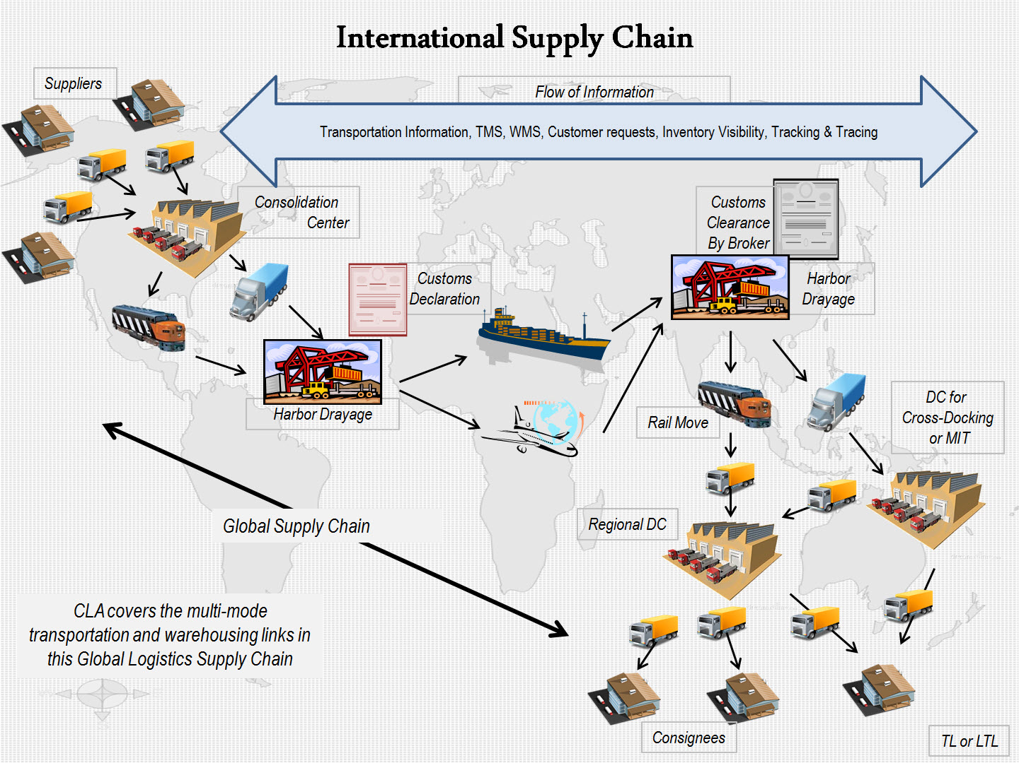
Global Supply Chain (GSCM)
CLA – Certified Logistics Associate. Harbor Drayage - An intermodal freight transport, drayage is the transport of containerized cargo by specialized trucking companies between ocean ports or rail ramps and shipping docks. Figure Adopted from COSCO Shipping Logistics – North America

Slide 39
Global Supply Chain Management (GSCM)
Absolute advantage
Lower cost and/or access to items not available locally
Comparative advantage
Differences in the cost of producing products in different countries

Slide 40

Contributing Factors
Population size and distribution
Urbanization
Land and resources
Technology and information
Globalized economy

Slide 41
Population
Country | 2010 | 2015 | 2050
 | Population | Population | Expected Pop.
China | 1,330,141,295 | 1,361,512,535 | 1,303,723,332
India | 1,173,108,018 | 1,251,695,584 | 1,656,553,632
United States | 310,232,863 | 321,362,789 | 439,010,253
Indonesia | 242,968,342 | 255,993,674 | 313,020,847
Brazil | 201,103,330 | 204,259,812 | 260,692,493
Pakistan | 184,404,791 | 199,085,847 | 276,428,758
Nigeria | 152,217,341 | 181,562,056 | 264,262,405
Bangladesh | 156,118,464 | 168,957,745 | 233,587,279
Russia | 139,390,205 | 142,423,773 | 109,187,353
Japan | 126,804,433 | 126,919,659 | 93,673,826
TOP TEN Countries | 4,016,489,082 | 4,213,773,474 | 4,950,140,178
Rest of the World | 2,829,120,878 | 3,050,850,319 | 4,306,202,522
TOTAL World Population | 6,845,609,960 | 7,264,623,793 | 9,256,342,700

Slide 42
Urbanization
Today, 55% of the world’s population lives in urban areas
It is expected to increase to 68% by 2050.
Tokyo is the world’s largest city, followed by New Delhi, Shanghai with 26 million, Mexico City, São Paulo.
Today, Cairo, Mumbai, Beijing and Dhaka all have close population. Delhi is projected to continue growing and to become the most populous city in the world around 2028.

Slide 43
As the world continues to urbanize, sustainable development depends increasingly on the successful management of urban growth, especially in low-income and lower-middle-income countries
Many countries will face challenges in meeting the needs of their growing urban populations, including for housing, transportation, energy systems, infrastructure, employment, education and health care.

Slide 44
Land & Resources
Shortage of fresh water
Resources will be used faster
Shortage of food
Financial constraints in purchasing food
  People in India spend a significant portion of income on food
  United States spends comparatively much less

Slide 45
Technology & Information
Technology has two important dimensions
Technology as an “internal” change agent
  Enhanced efficiency, effectiveness, and ability of an organization to compete in the global marketplace
Technology as an “external” change agent
  New forms of competition or new business models
  E.g., a) Omnichannel, a multi-channel sales approach that provides the customer with an integrated customer experience. The customer can be shopping online or mobile device, or by telephone, or in a bricks and mortar store and the experience would be seamless., b) Global sourcing

Slide 46
Globalized Economy
Economic globalization is an irreversible trend.
Economic globalization is the increasing interdependence of world economies as a result of the growing scale of cross-border trade of commodities and services, flow of international capital and wide and rapid spread of technologies.

Slide 47
It is critical that global sourcing decisions be made while accounting for total cost that should include the impact of global sourcing on freight, inventories, lead time, quality, on-time delivery, minimum order quantity, working capital, and stock- outs.
Other factors to be considered include the impact on supply chain visibility, order communication, invoicing errors, and the need for currency hedging.
Offshoring typically lowers labor and fixed costs but increases risk, freight costs, and working capital.

Slide 48
Risk in Global Supply Chains
Risks include supply disruption, supply delays, demand fluctuations, price fluctuations, and exchange-rate fluctuations
Critical for global supply chains to be aware of the relevant risk factors and build in suitable mitigation strategies
Good network design can play a significant role in mitigating supply chain risk
Every mitigation strategy comes at a price
Global supply chains should generally use a combination of rigorously evaluated mitigation strategies along with financial strategies to hedge uncovered risks

Slide 49
EPIC Structure
Economy
  GDP growth rate, population, foreign investment, exchange rate stability, and sourcing & production location (i.e., balance of trade)
Politics
  Ease of doing business, legal and regulatory framework, risk of political stability, and intellectual property rights

Slide 50
EPIC Structure
Infrastructure
  Transportation infrastructure, utility infrastructure, telecommunications and connectivity,
Competence
  Labor relations, education level, logistics competence, customs and security

Slide 51
Economy
The economic output of the country and potential growth, country’s ability to attract direct foreign investment, and attractive return on investment
  Economic output & growth rate: Measured by the GDP at purchasing power parity is a good indicator of potential for consumer sales. GDP growth rate (sometimes average GDP rate for last 5 years) is also an indicator for future investments
  Population size: Population provides an indication of potential for customer sales, particularly in a developed country. GDP per capita can be used in lieu of population size.

Slide 52
  Foreign direct investment (FDI): A strong indicator of the global market’s view in the economic potential of a country. High FDI indicates that the country’s economy to improve and low FDI indicates that the country will face challenge.
  The United Nations Conference on Trade and Development (UNCTAD) publishes the report on investment and enterprise development within the United Nations System.
  UNCTAD uses four economic determinants:
    Attractiveness of the market
    Availability of low-cost labor and skills
    Presence of natural resources
    Presence of FDI

Slide 53
Exchange rate stability & consumer price inflation: Exchange rate stability plays a role in finding out SC activity. Devaluation of the currency is viewed as expansionary & it can stimulate economy by increasing exports and it can help in trade deficit
Stable exchange rate provides companies with a higher comfort level when making an investment decisions
Exchange rate fluctuations affect procurement & logistics decisions. Weak exchange rate may encourage forward buying of imported products in larger quantities and could increase inventory
Consumer price inflation influence the procurement decision – high inflation rate leads to a lower purchasing power of the local currency which tend to promote forward buying

Slide 54
Balance of trade: Trade balance or imbalance measures disequilibrium between inflows and outflows of goods & services for the country
Balance of trade can affect procurement and transportation cost between countries

Slide 55
Politics
Politics dimension covers the ease of doing business such as bureaucracy & corruption, the legal & regulatory framework such as taxes and tariff barriers, the risk of political stability, and intellectual property rights.
  Ease of doing business: It affects cost and time on various activities such as land acquisition, hiring, facility construction, cross-border transportation, etc. Bureaucracy and corruption can hider the ease of doing business and they affect organization in supply chain activities and hinder smooth flow of goods as well as they can increase cost and lead-times

Slide 56
Legal & regulatory framework: The level of government oversight and any restrictions on doing business as well as on the SC investment – quality of them have a strong influence on competitiveness.
  Perception of the government policies to promote private sector
  Rules of society
    Contract enforcement
    Property rights
    Law enforcement
    Legal system – courts
    Likelihood of crime & violence
    Taxes and tariff
    Corporate tax rates and tariff barriers provide information of cost of doing business and impact SC investments in production, warehousing, distribution, sales, etc.

Slide 57
  Political stability: Influences long-term viability of investment. Failure of basic conditions & responsibilities such as loss of control of territory, legitimate authority to make collective decisions, inability to provide public services. Political stability drives diversification and risk management in global SC. Political ability provides challenges for locating companies (e.g., develop a plan for potential disaster)

Slide 58
  Intellectual property rights: Affects the long-term viability of an organization’s efforts to capitalize on core competence. Country with poor IP enforcement is pen for imitations of the company’s products and it could lead to a loss of brand image, particularly the imitation product has inferior quality. Also, loss of revenue due to imitation products.

Slide 59
Infrastructure
Efficient infrastructure is imperative for the smooth and effective function of SC. A well designed infrastructure can reduce the distance between regions in the country and integrate the national market as well as connect it to market in other countries at a minimal cost. An effective roads, railroads, ports, and airports enable businesses to receive their goods & services to or from foreign markets in secure and in a timely manner. The utility supply and the network allow organizations to operate smoothly.
  Transportation Infrastructure: The most critical component of the dimension which includes: road network, rail network, water transportation, and air transportation. The quality of roads, railroads, ports, and airports are used to rank the physical infrastructure.

Slide 60
  Utility Infrastructure: Utility is related to the generation and transmission of electricity, fossil fuels including oil, natural gas, coal, wind power, and solar. Utility infrastructure is evaluated based on the presence or absence of interruptions to power supply and the voltage fluctuations.
  Telecommunications & Connectivity Infrastructure: Connectivity relates to how well information is communicated and it is measured by the number of telephone lines and the number of internet subscribers. Both the absolute values and the per capita values of mobile phones and Internet connections are considered in evaluating the connectivity.

Slide 61
Competence
Competence is the combination of knowledge, skills, ability to produce a successful performance. For SCM, it is the combination of labor skills, management skills, knowledge of logistics functions, and presence or absence of barriers of customs processes & procedures. The labor market must have the flexibility to transfer workers from one trade to another easily. Companies look to enhance labor productivity as well as management staff with sophisticated management techniques.
  Labor relation: Labor relation serves to attract foreign direct investment in the country. The factors include: worker-employer relations, productivity and pay, employee turnover, labor laws, ease of hiring and firing employees, and ease of shutting down the business. Inexpensive labor can be a major attraction for industrial organizations to invest in developing countries.

Slide 62
  Education level for line workers & management: The line staff and management need to become familiar with latest business practices including continuous improvement methods. They need to understand the cost of quality and problem solving processes. This dimension uses the quality of educational system, the quality of management schools, employee training availability, and the dependency on professional management.
  Logistics operational competence: How well various logistics functions perform along the SC within a country. They include the competence and quality of logistics services in form of transport operators, customs brokers, warehousing, ability to trace consignments, the ability to deliver shipments on time, etc.

Slide 63
  Customs and security: Efficiency of clearance procedures used by customs authorities in terms of speed, simplicity, and predictability of processes used to clear goods at the port of entry. Also, proper security controls to ensure the protection of the internal market and the security of international supply chains.

Slide 64
EPIC Data Source
Dimension | Variable | Data Source
Economy | GDP & GDP Growth Rate | CIA World Factbook & WTO
 | Population Size | CIA World Factbook
 | Foreign Direct Investment | UNCTAD FDI Attraction/Potential Index
 | Exchange Rate Stability & Consumer Price Index | CIA World Factbook
 | Balance of Trade | World Trade Organiation
Politics | Ease of Doing Business | World Bank EDBI and WGI
 | Legal & Regulatory Framework | World Bank WGI
 | Risk of Political Stability | Economist Political Instability Index
 | Intellectual Property Rights | International Property Rights Index
Infrastructure | Transportation Infrastructure | World Economic Forum GCI
 | Utility Infrastructure | World Economic Forum GCI
 | Telecommunications & Connectivity | CIA World Factbook
Competence | Labor Relations | World Economic Forum GCI
 | Education Level | World Economic Forum GCI
 | Logistics Competence | World Bank Logistics Performance Index
 | Customs & Security | World Bank Logistics Performance Index

Slide 65


