Slide 1


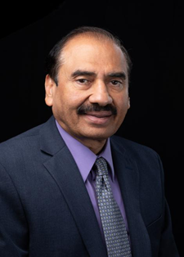
Supply Chain Management
@
Dr. Dinesh Dave`
Director of SCM Program
daveds@appstate.edu

Slide 2

Supply Chain Management Programs Currently Offered
SCM Minor
Created in 2008 after study found SCM knowledge, skills and abilities lacking in the workforce
Current enrollment in the SCM minor is about 60 students
Provides a multi-disciplinary curriculum to complement both Business and Non-Business majors
SCM Major
Created in 2016 after study found SCM knowledge, skills and abilities lacking in the workforce
Current enrollment in the SCM major (declared and undeclared) and minor are approximately 212
Provides a multi-disciplinary curriculum to complement Business majors. Double major can be easily added
MBA w/SCM concentration
Created in 2014 for our MBA students to obtain the SCM knowledge, skills and abilities being requested by employers

Slide 3
Why Major in Supply Chain Management?
Great Courses
Relevant and dynamic curriculum
Pairs well with all majors
Build marketable skills
Complete required courses in 3 semesters
Great Faculty
Award winning professors
Industry experience
Faculty who care about your success
Great Careers
Large network of recruiters
Diverse job opportunities
High starting salaries
Projected increases in demand

Slide 4
Supply Chain Management Major
It is easy to double major (e.g., Marketing & SCM, Management & SCM, Finance & SCM, CIS & SCM, etc.)
You can add SCM Major or SCM Minor without adding additional class in your curriculum (e.g., some classes will double count, fill your COB and free electives with SCM classes)
Currently, approximately 190 majors and minors in Supply Chain Management; which is one of the largest SCM majors in North Carolina Universities

Slide 5

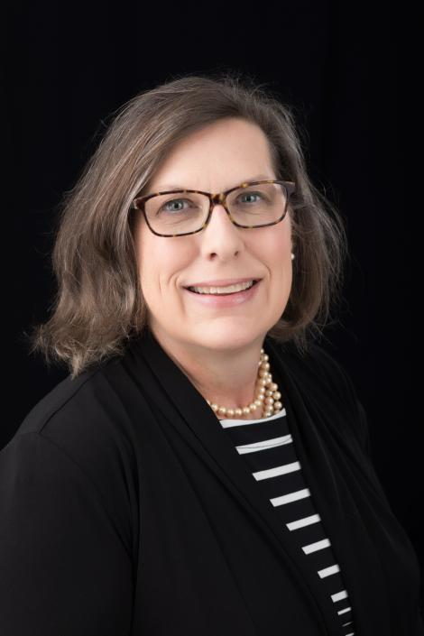
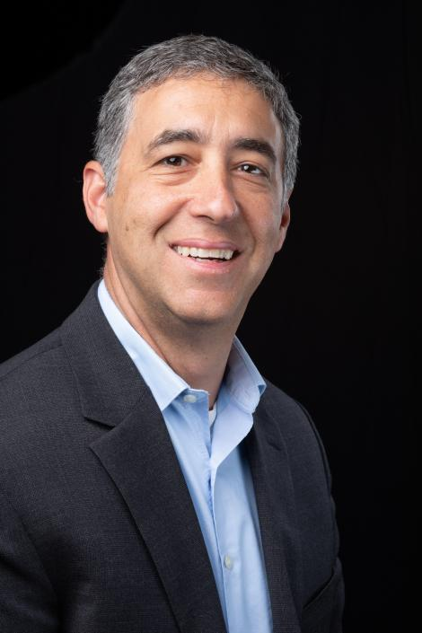
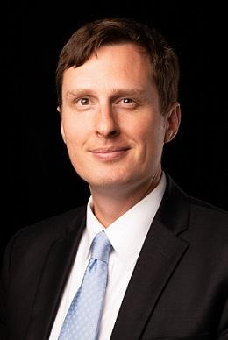
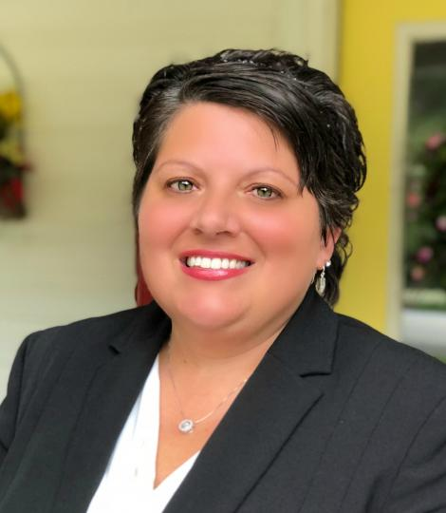
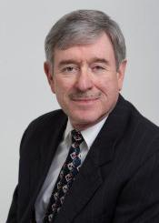
Supply Chain Management Faculty

Slide 6

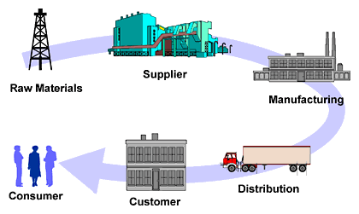
The SCM Minor pairs well with a Major in..
CIS
In “The World is Flat,” five of Friedman’s flatteners are technologies that have facilitated extraordinary competitive advantages in SCM.
Finance
SCM provides 40% higher valuation for companies within
DJI Index and S&P 500 Index.
Accounting
Lower supply chain costs 25% - 50%
Improved capacity realization 10% - 20%
Forecast accuracy improvement 25% - 80%
Increase in overall productivity 10% - 16%
Inventory Cost Reduction 25% - 60%
Entrepreneurship
SCM is a dominant enabler of new global enterprises and flat competition. Anyone can now build an international supply chain and compete globally.
Management / HR
With SCM Management costs as a percentage of revenue are 50% less than median companies. SCM increases employment opportunity.
Marketing
Improved delivery performance 16% - 28%
Reduction in order fulfillment cycle time 30% - 50%
Improvement in forecast accuracy 25% - 80%
Lower supply chain costs 25% - 50%
Improvement of fill rates 20% - 30%
Economics
“Central to the way that companies produce things is the way that they manage their supply chains.” Virtual extended enterprises now cross all boundaries via SCM. Micro and macro economies are more complex and interdependent than ever before.
Supply Chain Management helps companies and
professionals in all disciplines excel.
Sources: The Supply Chain Council, The Economist, PRTM-The Performance Measurement Group, “The World is Flat” by Thomas Friedman

Slide 7
Appalachian Supply Chain Club (ASCC)
(ASCC.appstate.edu)
Our Student SCM Club is sponsored by the Association for Operations Management (APICS a.k.a ASCM), Foothills Chapter
  Dues include student membership in APICS/ASCM and ISM
  Internship Opportunities
  Job Opportunities
  Guest Speakers
  Networking with SCM professionals
  Attend monthly APICS/ASCM Meetings
  Select students attend the CSCMP Global Conference and participate in the ISM-CV Student Case Competition

Slide 8

















Our Supply Chain Board of Advisors
Our advisory board members are executives from the following:
Notes:
Internships and Scholarships
Bonded Logistics
FedEx
Global Shippers Association
Hanesbrands /Sara Lee Corporation
IBM
Lowe’s Companies, Inc.
M33 Integrated Solutions
Mapally
Mediterranean Shipping Company (USA)
Microsoft
Murray Supply Company
PHH Corporation
Prysmian Group – Draka
Saudi Basic Industries Corporation (SABIC)
Job Placement
Speaker to the Supply Chain Club
Guest Speaker in the Classes

Slide 9
Employers
C. H. Robinson
Transportation Insight
Ingersoll Rand
Target Corporation
Sunrise Technologies
Lowe’s
VF Corporation
Amazon
Ahold-Delhaize
Publix
Wix
Syngenta
Georgia-Pacific
R. J. Reynolds
Maersk
Ralph Lauren
Red Classic Transportation Services
Old Dominion
XPO Logistics, Inc.
Aldi Foods
SafeWay Foods

Slide 10
Material Handling & Logistics
2018 Salary Survey
Average Salary by Age
source: http://mhlnews.com

Slide 11
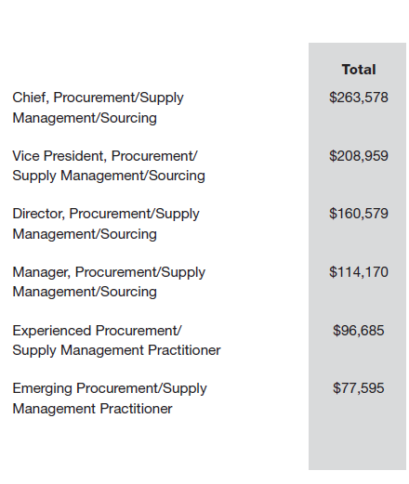
ISM 2018 Salary Survey
source: https://www.instituteforsupplymanagement.org

Slide 12
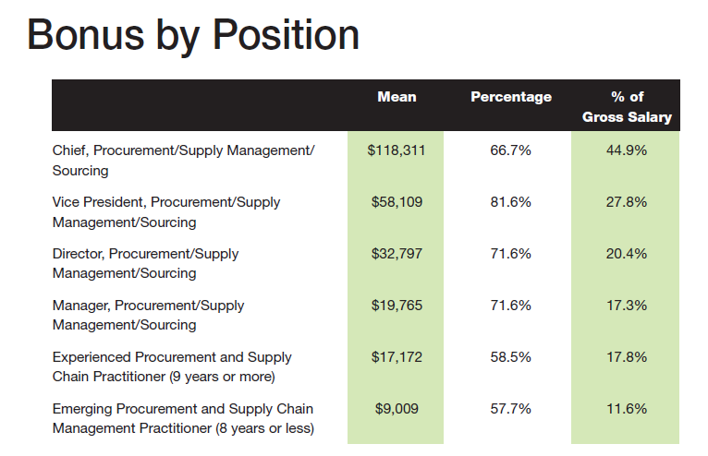
ISM 2018 Salary Survey
source: https://www.instituteforsupplymanagement.org

Slide 13
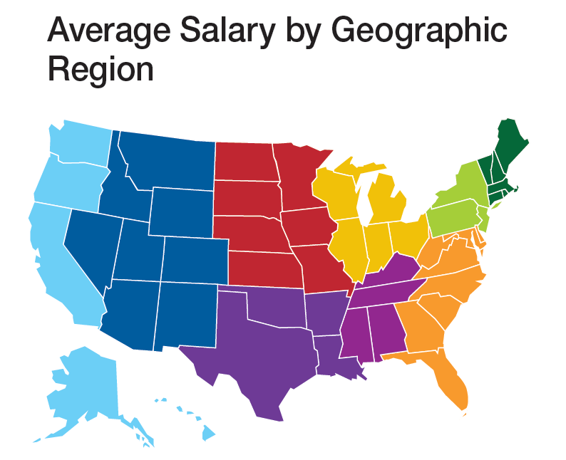
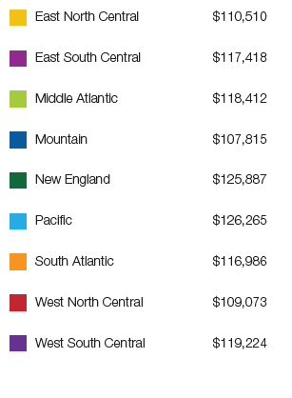
ISM 2018 Salary Survey
source: https://www.instituteforsupplymanagement.org

Slide 14
Material Handling & Logistics
2018 Salary Survey
Average Salary by Geographic Region
Region (% of response) Salary
■ New England (CT, MA, ME, NH, RI, VT) (4%) $80,256
■ Middle Atlantic (NJ, NY, PA) (14%) $86,265
■ South Atlantic (DC, DE, FL,
GA, MD, NC, SC, VA, WV) (9%) $86,606
■ North Central (IA, IL, IN, KS, MI,
MN, MO, ND, NE, OH, SD, WI) (36%) $96,070
■ South Central (AL, AR, KY, LA,
MS, OK, TN, TX) (13%) $106,854
■ Mountain (AZ, CO, ID, MT, NM,
NV, UT, WY) (5%) $86,647
■ Pacific (AK, CA, HI, OR, WA) (12%) $87,936
Other North America (7%) $100,710
source : http://mhlnews.com

Slide 15
SCM Major
COURSES | PREREQUISITE(S) | NOTES/REMARKS
Required: 4 Courses – 12 S. H.
SCM 3660: Principles of Supply Chain Management | ECO 2100 or STT 2810 or STT 2820 | Free Elective and/or COB Elective
SCM 3670: Six Sigma and Quality Management | ECO 2100 or STT 2810 or STT 2820 | Free Elective and/or COB Elective
SCM 3690: Global Supply Chain and Logistics | ECO 2100 or STT 2810 or STT 2820 | Free Elective and/or COB Elective
SCM 3720: Strategic Procurement & Global Sourcing | Prereq/Coreq SCM 3660 | Free Elective and/or COB Elective
Electives: 3 courses – 9 S. H.
SCM 3900: Internship (3 or 6 s.h.) | Jr. Status | Free Elective and/or COB Elective
SCM 3680: Supply Chain Technologies in a Global Environment | CIS 1026 or CIS 2050 or equivalent | Free Elective and/or COB Elective
SCM 4870: Analytical Models for Supply Chain Management | ECO 2100 or STT 2810 or STT 2820 | Free Elective and/or COB Elective
CIS 3610: Project Management |  | Free Elective and/or COB Elective/CIS Major
CIS 3750: Database Management | CIS 2050 & pre/coreq. CIS 3250 | Free Elective and/or COB Elective/CIS Major
MGT 3620: Human Resource Management OR MGT 3670: International Human Resource Management | Jr. Status | Free Elective and/or COB Elective/CIS Major
MKT 3260: Managing Distribution Channels OR MKT 3230: Business-To-Business Marketing | Min. grade of C in MKT 3050 & Jr. Status | Free Elective and/or COB Elective/Mkt Major
FIN 3100: Principles of Risk Management & Insurance | Jr. Status | Free Elective and/or COB Elective/Ins. Major

Slide 16
SCM Minor
COURSES | PREREQUISITE(S) | NOTES/REMARKS
Required: 4 Courses – 12 S. H.
SCM 3650: Production and Operations Management | 54 semester hours | COB Core Class
SCM 3660: Principles of Supply Chain Management | ECO 2100 or STT 2810 or STT 2820 | Free Elective and/or COB Elective
SCM 3670: Six Sigma and Quality Management | ECO 2100 or STT 2810 or STT 2820 | Free Elective and/or COB Elective
SCM 3690: Global Supply Chain and Logistics | ECO 2100 or STT 2810 or STT 2820 | Free Elective and/or COB Elective
Electives: 3 courses – 6 S. H.
SCM 3900: Internship (3 s.h.) | Jr. Status | Free Elective and/or COB Elective
SCM 3680: Supply Chain Technologies in a Global Environment | CIS 1026 or CIS 2050 or equivalent | Free Elective and/or COB Elective
SCM 4870: Analytical Models for Supply Chain Management | ECO 2100 or STT 2810 or STT 2820 | Free Elective and/or COB Elective
CIS 3610: Project Management |  | Free Elective and/or COB Elective/CIS Major
CIS 3750: Database Management | CIS 2050 & pre/coreq. CIS 3250 | Free Elective and/or COB Elective/CIS Major
MGT 3620: Human Resource Management OR MGT 3670: International Human Resource Management | Jr. Status | Free Elective and/or COB Elective/CIS Major
MKT 3260: Managing Distribution Channels OR MKT 3230: Business-To-Business Marketing | Min. grade of C in MKT 3050 & Jr. Status | Free Elective and/or COB Elective/Mkt Major
FIN 3100: Principles of Risk Management & Insurance | Jr. Status | Free Elective and/or COB Elective/Ins. Major

Slide 17
For More Information Contact:
Supply Chain Management Faculty
ratcliffeah@appstate.edu
Dr. Dinesh Davè (daveds@appstate.edu) - Director
Dr. Beth Ellington (ellingtonve@appstate.edu)
Dr. Steven Leon (leonsm@appstate.edu)
Dr. Aaron Ratcliffe (ratcliffeah@appstate.edu )
Mr. Bill Phillips (phillipsww@appstate.edu)
Ms. Laura Brewer (brewerll@appstate.edu)

