Slide 1
Supply Chain Management
@
For more information, please contact:
Dr. Dinesh Dave`, Director of SCM Program
DaveDS@appstate.edu
Mrs. Laura Brewer, Lecturer SCM
BrewerLL@appstate.edu
Dr. Ken Corley, Associate Professor
CorleyJK@appstate.edu
Mr. Bill Phillips, Lecturer SCM
PhillipsWW@appstate.edu

Slide 2
What is Supply Chain Management?

Slide 3
What is Supply Chain Management?
Synchronizing all Activities within the Supply Chain
Maximizing the Supply Chain’s Competitive Advantage
Adding Value for the Customers and Consumers
The “Lifeblood” of any Successful Business

Slide 4
What do SCM Professionals do?
Assure that the right materials are in the right place at the right time and at the right price by coordinating the organization’s Information Flows, Material Flows, Financial Flows & Risk Flows in a Global Competitive Environment.
Currently, SC Executives incorporate Environmental Sustainability, Financial Sustainability & Organizational Sustainability.

Slide 5
Supply Chain Management Programs Currently Offered
SCM Minor
Created in 2008 after a study found SCM knowledge, skills, and abilities lacking in the workforce
Provides a multi-disciplinary curriculum to complement both Business and Non-Business majors
Created in 2016 after a study found SCM knowledge, skills, and abilities lacking in the workforce. More demand after the pandemic
Provides a multi-disciplinary curriculum to complement Business majors. Double major/minor can be easily added
Currently 273 students (193 declared majors, 45 Undeclared, 35 minors). Online BSBA in SCM just introduced
SCM Major
MBA w/SCM concentration
Created in 2014 for our MBA students to obtain the SCM knowledge, skills, and abilities requested by employers

Slide 6
Why Major in Supply Chain Management?
Great Courses
Relevant and dynamic curriculum
Pairs well with all majors
Complete required courses in 3 semesters
Build marketable skills
Great Faculty
Award winning professors
Industry experience
Faculty who care about your success
Great Careers
Projected increases in demand
Large network of recruiters
Diverse job opportunities
High starting salaries

Slide 7
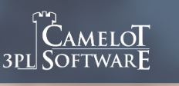
Our Supply Chain Board of Advisors
Our advisory board members are executives from the following:
Notes:
Internships and Scholarships
Bonded Logistics
FedEx
Global Shippers Association
Hanesbrands /Sara Lee Corporation
IBM
Lowe’s Companies, Inc.
M33 Integrated Solutions
Mapally
Mediterranean Shipping Company (USA)
Microsoft
Murray Supply Company
PHH Corporation
Prysmian Group – Draka
Saudi Basic Industries Corporation (SABIC)
Job Placement
Speaker to the Supply Chain Club
Guest Speaker in the Classes

Slide 8
Supply Chain Management Major
It is easy to double major (e.g., Marketing & SCM, Management & SCM, Finance & SCM, CIS & SCM, etc.)
You can add SCM Major or SCM Minor without adding additional class in your curriculum (e.g., some classes will double count, fill your COB and free electives with SCM classes)
Currently, 273 students (193 declared majors, 45 Undeclared, 35 minors); which is one of the largest SCM programs in the North Carolina University System
Fully Online BSBA in SCM has been introduced

Slide 9
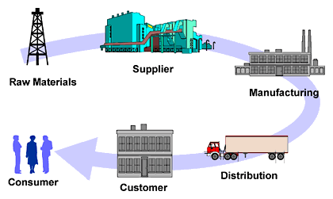
The SCM Major pairs well with a Major in..
CIS
In “The World is Flat,” five of Friedman’s flatteners are technologies that have facilitated extraordinary competitive advantages in SCM.
Finance
SCM provides 40% higher valuation for companies within
DJI Index and S&P 500 Index.
Accounting
Lower supply chain costs 25% - 50%
Improved capacity realization 10% - 20%
Forecast accuracy improvement 25% - 80%
Increase in overall productivity 10% - 16%
Inventory Cost Reduction 25% - 60%
Entrepreneurship
SCM is a dominant enabler of new global enterprises and flat competition. Anyone can now build an international supply chain and compete globally.
Management / HR
With SCM Management costs as a percentage of revenue are 50% less than median companies. SCM increases employment opportunity.
Marketing
Improved delivery performance 16% - 28%
Reduction in order fulfillment cycle time 30% - 50%
Improvement in forecast accuracy 25% - 80%
Lower supply chain costs 25% - 50%
Improvement of fill rates 20% - 30%
Economics
“Central to the way that companies produce things is the way that they manage their supply chains.” Virtual extended enterprises now cross all boundaries via SCM. Micro and macro economies are more complex and interdependent than ever before.
Supply Chain Management helps companies and
professionals in all disciplines excel.
Sources: The Supply Chain Council, The Economist, PRTM-The Performance Measurement Group, “The World is Flat” by Thomas Friedman

Slide 10
SCM Major Required Curriculum
COURSES | PREREQUISITE(S) | NOTES/REMARKS
Required: 4 Courses – 12 S. H.
SCM 3660: Principles of Supply Chain Management | ECO 2100 or STT 2810 or STT 2820 or permission of Director/ Chairperson | Free Elective and/or COB Elective
SCM 3670: Six Sigma and Quality Management | ECO 2100 or STT 2810 or STT 2820 or permission of Director/ Chairperson | Free Elective and/or COB Elective
SCM 3690: Global Supply Chain and Logistics | ECO 2100 or STT 2810 or STT 2820 or permission of Director/ Chairperson | Free Elective and/or COB Elective
SCM 3720: Strategic Procurement & Global Sourcing | Prereq/Coreq SCM 3660 | Free Elective and/or COB Elective
Electives: 3 courses – 9 S. H.
SCM 3900: Internship (3* or 6 s.h.) | Jr. Status | Free Elective and/or COB Elective
SCM 3680: Supply Chain Technologies in a Global Environment | CIS 1026 and CIS 2050 or equivalent or permission of Director/Chairperson | Free Elective and/or COB Elective
SCM 4870: Analytical Models for Supply Chain Management | ECO 2100 or STT 2810 or STT 2820 or permission of Director/ Chairperson | Free Elective and/or COB Elective
CIS 3750: Database Management | CIS 2050 & pre/coreq. CIS 3250 | Free Elective and/or COB Elective/CIS Major
MGT 3620: Human Resource Management OR MGT 3670: International Human Resource Management | Jr. Status | Free Elective and/or COB Elective/CIS Major
MKT 3260: Managing Distribution Channels OR MKT 3230: Business-To-Business Marketing OR MKT 3215: Professional Selling | Min. grade of C in MKT 3050 & Jr. Status | Free Elective and/or COB Elective/Mkt Major
FIN 3100: Principles of Risk Management & Insurance | Jr. Status | Free Elective and/or COB Elective/Ins. Major
* Only 3 semester hours will count toward the required elective
Notes:
Courses can count double…
2 elective courses in your major
3 Supply Chain courses

Slide 11
SCM Minor Required Curriculum
COURSES | PREREQUISITE(S) | NOTES/REMARKS
Required: 3 Courses – 9 S. H.
SCM 3660: Principles of Supply Chain Management | ECO 2100 or STT 2810 or permission of Director or Chairperson | Free Elective and/or COB Elective
SCM 3670: Six Sigma & Quality Management | ECO 2100 or STT 2810 or permission of Director or Chairperson | Free Elective and/or COB Elective
SCM 3690: Global Supply Chain and Logistics | ECO 2100 or STT 2810 or permission of Director or Chairperson | Free Elective and/or COB Elective/CIS Major
Electives: 2 courses – 6 S. H.
SCM 3900: Internship | Jr. Status | Free Elective and/or COB Elective
SCM 3680: Supply Chain Technologies in a Global Environment | CIS 1026 and CIS 2050 or equivalent or permission of Director or Chairperson | Free Elective and/or COB Elective/CIS Major
SCM 4870: Analytical Models for Supply Chain Management | ECO 2100 or STT 2810 or permission of Director or Chairperson
MGT 3620: Human Resource Management OR MGT 3670: International Human Resource Management | Jr. Status | Free Elective and/or COB Elective/Mgt Major
MKT 3260: Managing Distribution Channels OR MKT 3230: Business-To-Business Marketing OR MKT 3215: Professional Selling | Minimum grade of C in MKT 3050 & Jr. Status | Free Elective and/or COB Elective/Mkt Major
FIN 3071: Principles of Risk Management | Jr. Status | Free Elective and/or COB Elective/Ins. Major
Notes:
Courses can count double…
2 elective courses in your major
3 Supply Chain courses

Slide 12
Appalachian Supply Chain Club (ASCC) (ASCC.appstate.edu)
Our Student SCM Club is sponsored by the Association for Operations Management (APICS a.k.a ASCM)
Free to join the club ($0 to join)
Includes student membership in APICS/ASCM
Internship Opportunities
Job Opportunities
Guest Speakers
Networking with SCM professionals

Slide 13
Employers
Amazon
C. H. Robinson
Transportation Insight
Schneider
Target Corporation
Sunrise Technologies
Lowe’s
VF Corporation
Ahold-Delhaize
Publix
Total Quality Logistics
Maersk
LeanCor
Camelot 3PL Software
Syngenta
Hanes Companies
Georgia-Pacific
Syfan Logistics
Ralph Lauren
Red Classic Transportation Services
Old Dominion
XPO Logistics, Inc.
Aldi Foods
Gilbarco-Veederoot

Slide 14
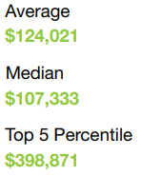
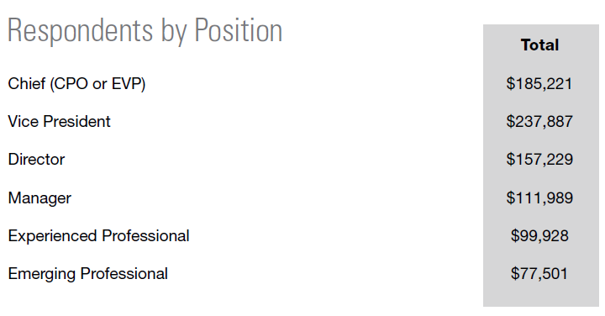
Institute for Supply Management (ISM) 2021 Salary Survey

Slide 15
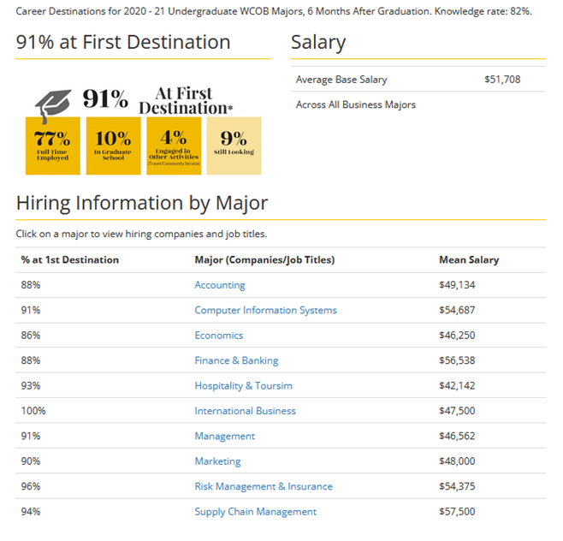
SCM Graduates - COB Career Center 2020-21 COB Undergraduate Student Success

Slide 16
For More Information Contact: Supply Chain Management Faculty
ratcliffeah@appstate.edu
Dr. Dinesh Davè (daveds@appstate.edu) - Director
Dr. Ken Corley (corleyjk@appstate.edu)
Dr. Steven Leon (leonsm@appstate.edu)
Dr. Aaron Ratcliffe (ratcliffeah@appstate.edu )
Mr. Bill Phillips (phillipsww@appstate.edu)
Ms. Laura Brewer (brewerLL@appstate.edu)
Dr. Mike Ogle (oglemk@appstate.edu)

