Slide 1
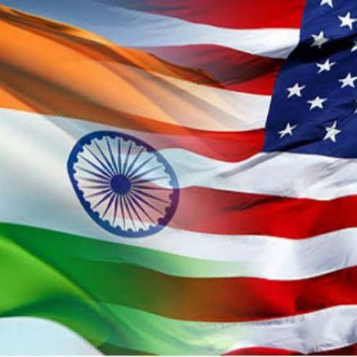
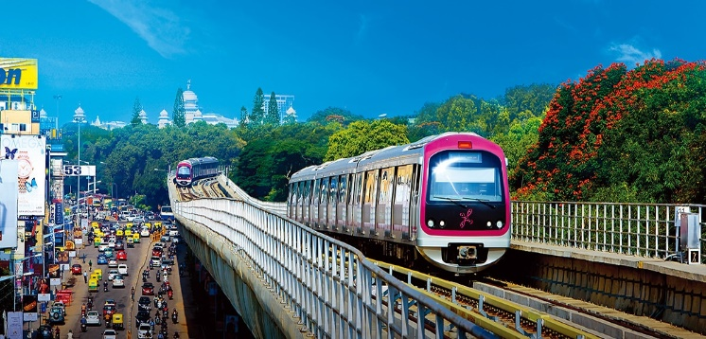
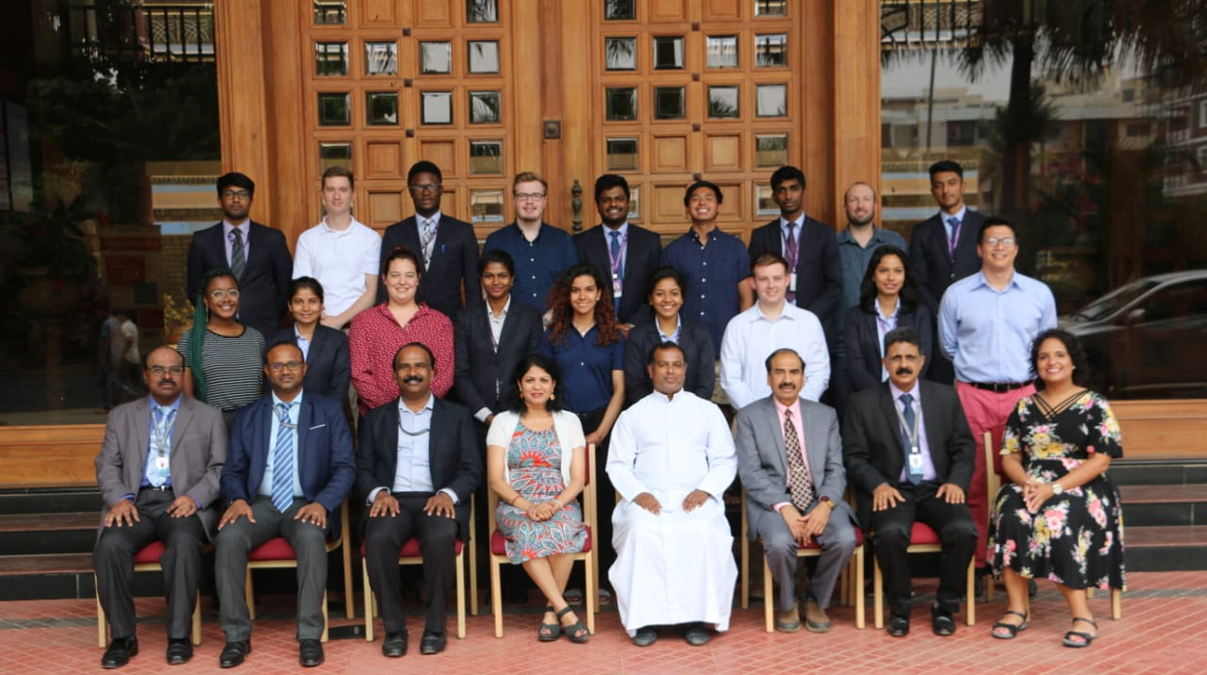
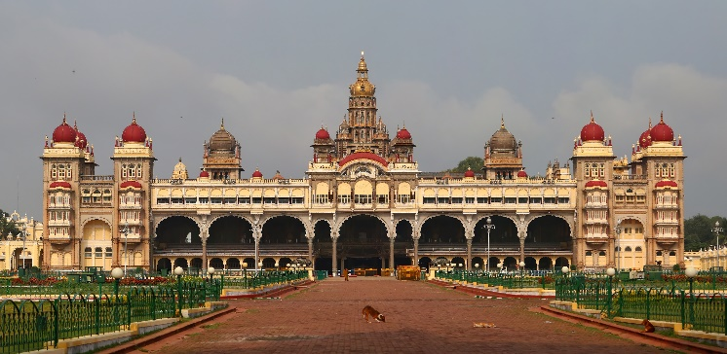
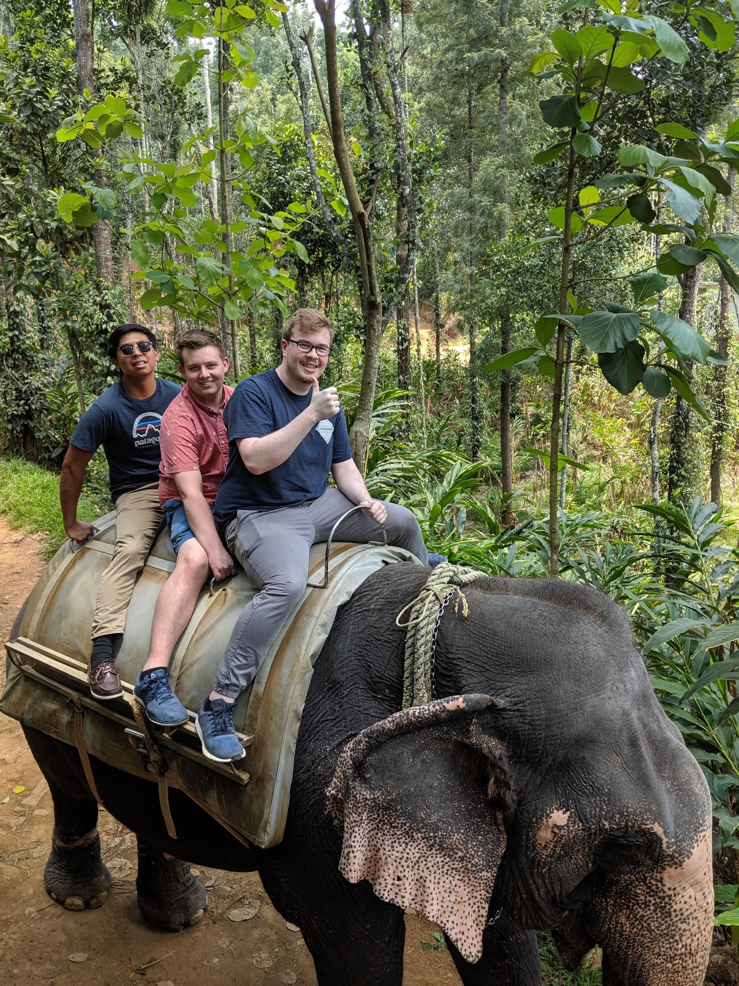
May 11 to 24, 2020 India Trip
Global Supply Chain, Logistics, and Analytics
An immersive experience of Indian culture, history, and the rustic nature!
Locations:
Bangalore
Mysore
Kabini National Forest
Contacts:
Dr. Lakshmi Iyer:
iyerLs@appstate.edu
Dr. Dinesh Davè:
daveds@appstate.edu
Courses - 3 credit hours:
SCM 4350*-Global Supply Chain and Logistics
MBA 5020-International Experience
* Can enroll in independent study if pre-req for 4350 not met.
Program Cost: $3,508 (Includes: airfare, in-country program transportation, lodging, international health and evacuation insurance, program events, most meals, and OIED/CCS administrative fee)

