Slide 1

SCM Program Highlights
Fall 2022

Slide 2
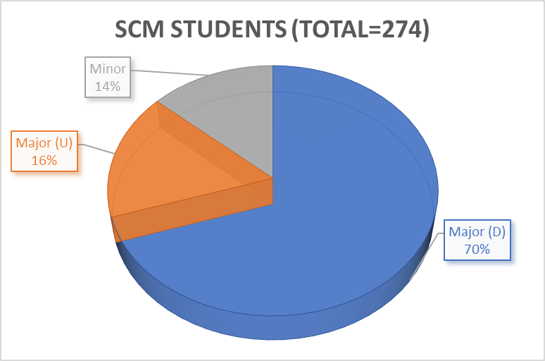
Overall SCM Data

Slide 3
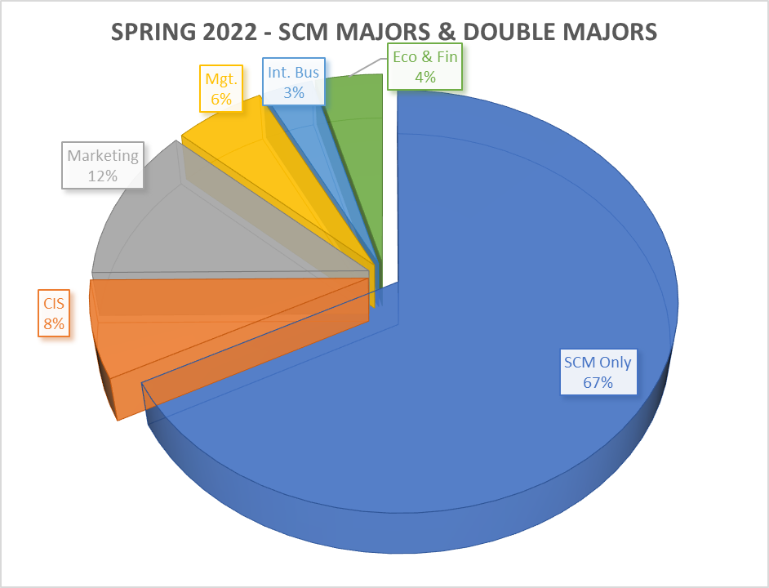
Spring 2022- Declared SCM Majors/Double Majors
Declared Majors | No. of Students
SCM Only | 126
CIS | 14
Marketing | 22
Management | 11
International Bus | 6
Eco & Fin | 8
Total | 187

Slide 4
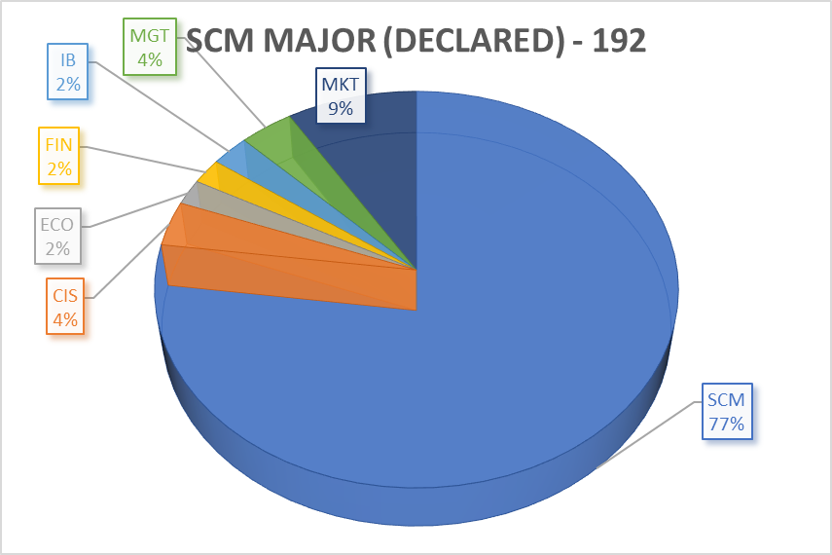
Fall 2022- Declared SCM Majors/Double Majors

Slide 5



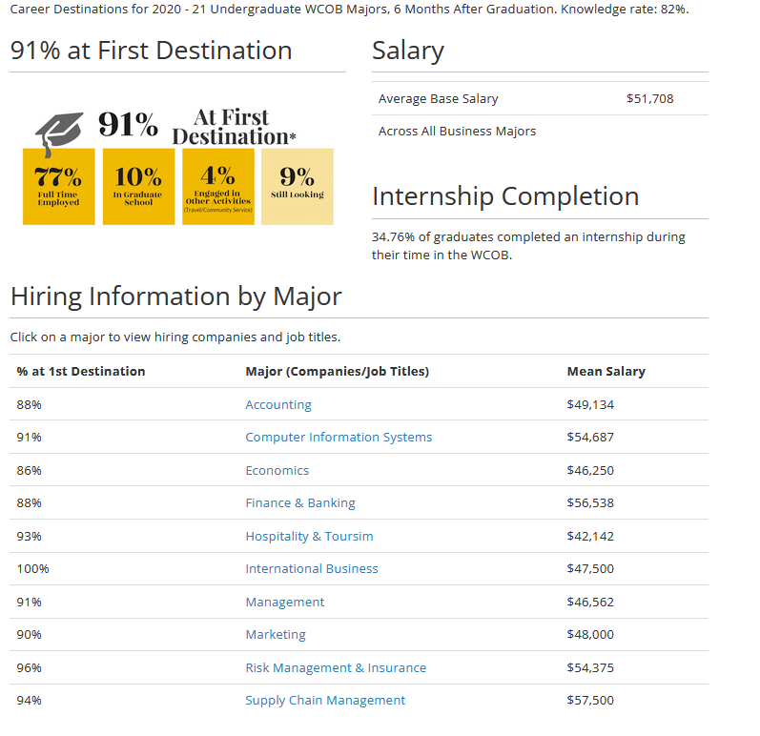

Career Destination/Student Success

Slide 6
Summer 2022 – Internship Information

Slide 7
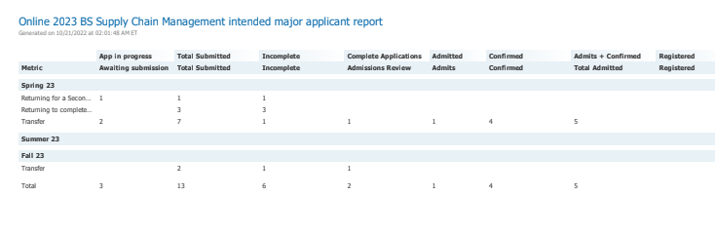
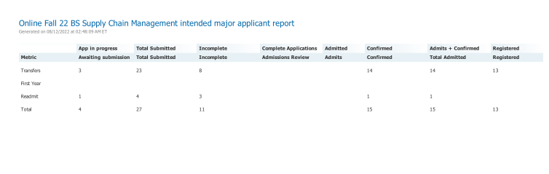
New Initiative From Fall 2022
Online BSBA in SCM

Slide 8

A Few SCM Program Highlights
SCM Program Received $100,000 endowed scholarship SCM Advisory Board with CSCMP Charlotte Roundtable Completed Endowed Scholarship Endowed scholarship in memory of Beth Ellington APICS a.k.a. ASCM continues to provide annual scholarship CSCMP – Charlotte is providing annual scholarship (Talent Center) and in the SCM program discretionary fund CSCMP Charlotte Roundtable and CEO of Acuitive Solutions pledged to support CSCMP Memberships (unlimited membership to students and about 10-12 membership to faculty & staff) C H Robinson is providing $1,000 to the SCM Student Club and in the in the SCM program discretionary fund Continue to develop strong professional association with several reputable companies SCM Major reported highest average salary of $57,500 (Source: COB Career Services)

Slide 9
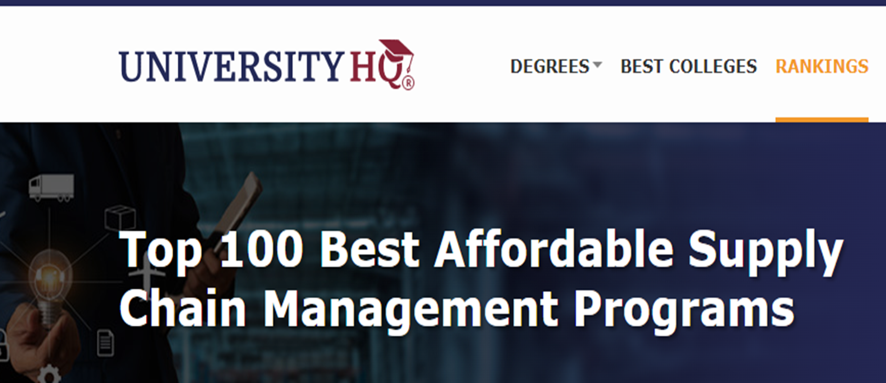
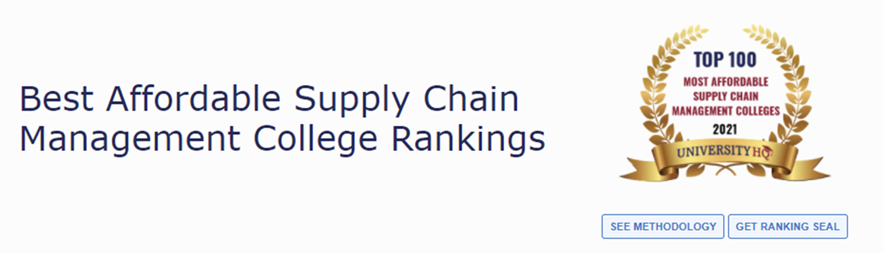
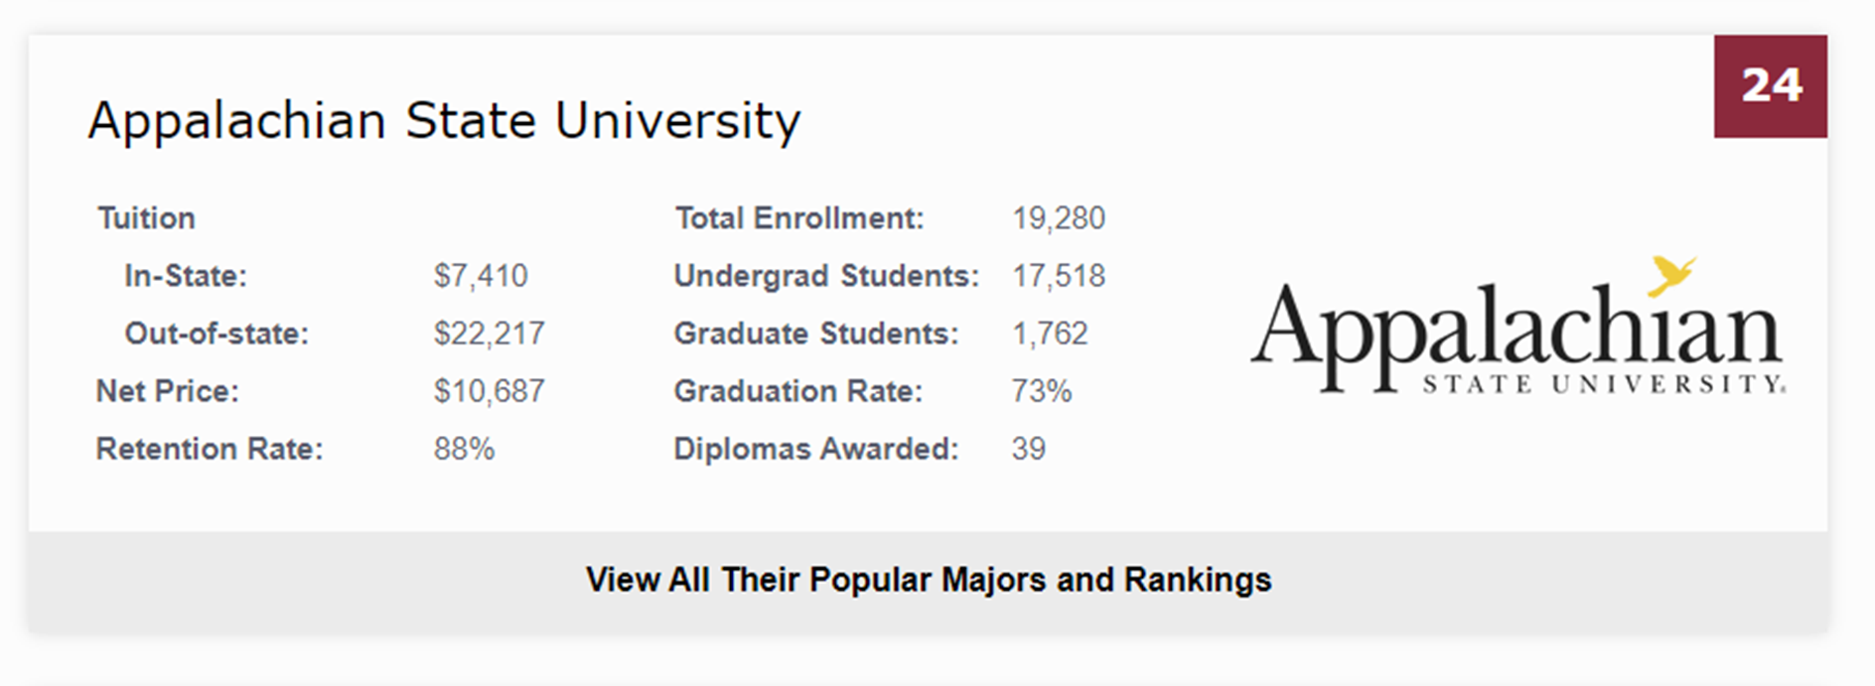
SCM Program Ranked 24 out of Best 100 in the US

