Slide 1
SCM Program Highlights

Slide 2
Overall SCM Data

Slide 3
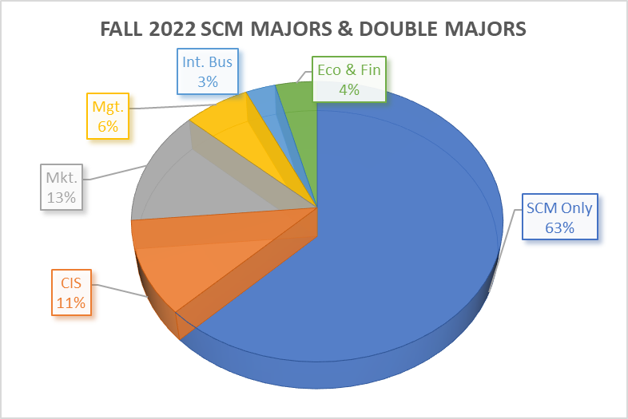
Fall 2021- Declared SCM Majors/Double Majors
Declared Majors | No. of Students
SCM Only | 109
CIS | 19
Marketing | 23
Management | 11
International Bus | 5
Eco & Fin | 7
Total | 174

Slide 4
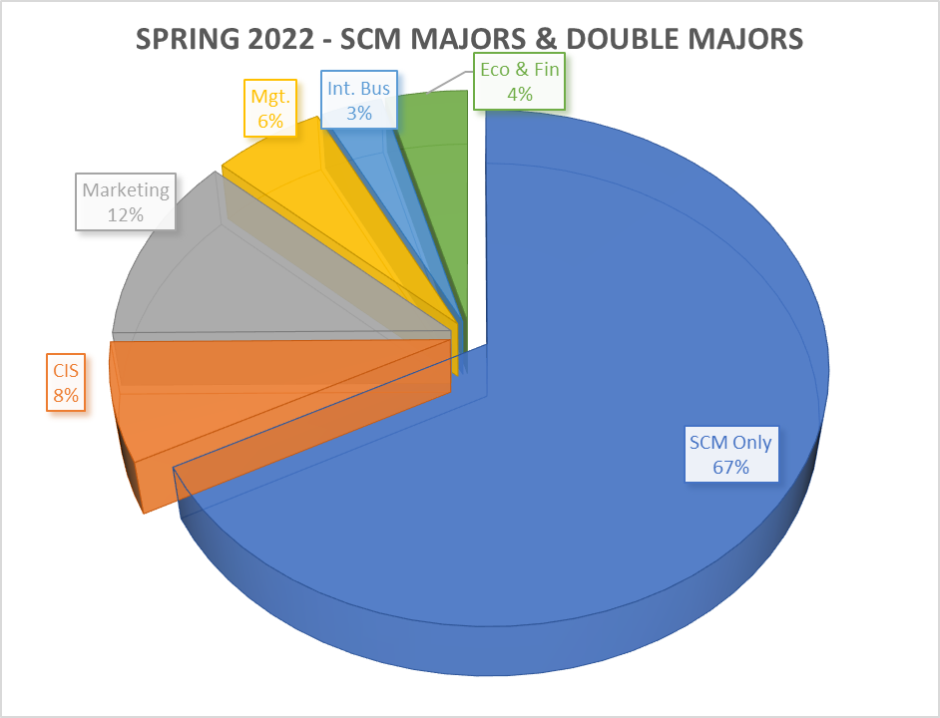
Spring 2022- Declared SCM Majors/Double Majors
Declared Majors | No. of Students
SCM Only | 126
CIS | 14
Marketing | 22
Management | 11
International Bus | 6
Eco & Fin | 8
Total | 187

Slide 5
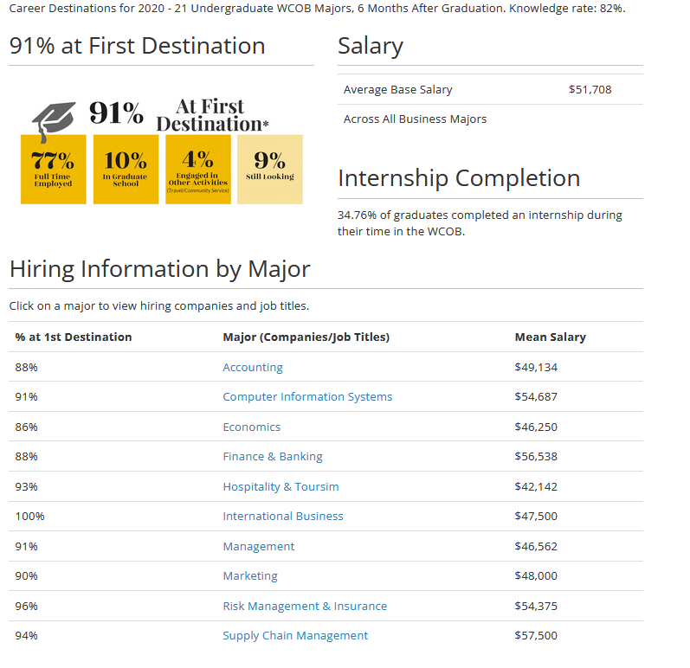
Career Destination/Student Success

Slide 6
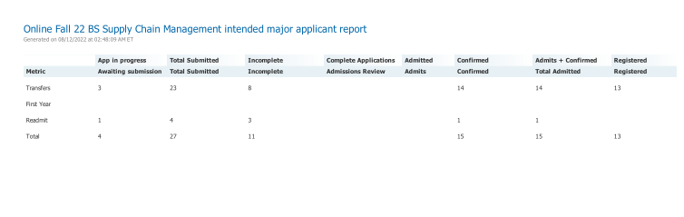
New Initiative From Fall 2022
Online BSBA in SCM

Slide 7
A Few SCM Program Highlights
SCM Program Received $100,000 Endowed Scholarship from Mr. Winstead SCM Advisory Board with CSCMP Charlotte Roundtable Completed Endowed Scholarship Endowed scholarship in memory of Beth Ellington APICS a.k.a. ASCM continues to provide annual scholarship CSCMP Charlotte Roundtable and CEO of Acuitive Solutions pledged about $5,000 to support CSCMP Memberships (unlimited membership to students and about 10-12 membership to faculty & staff) SCM Group discusses a possibility of a Certificate Program in SCM at the Hickory campus (Attempt to start this initiative in Fall 2024) Continue to develop strong professional association with several reputable companies SCM Major reported highest average salary of $57,500 (Source: COB Career Services)

Slide 8
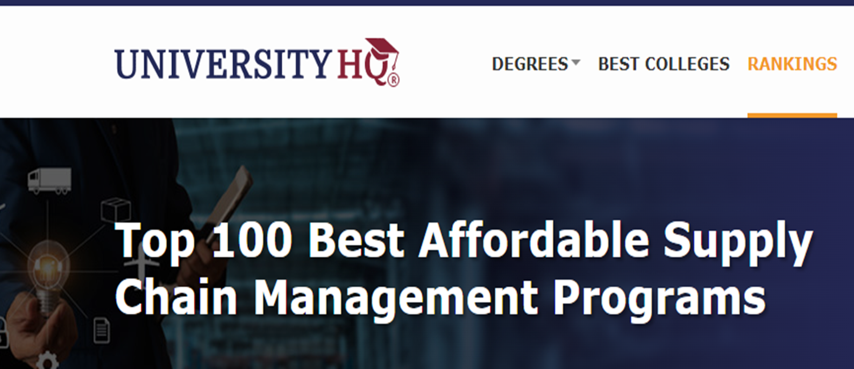
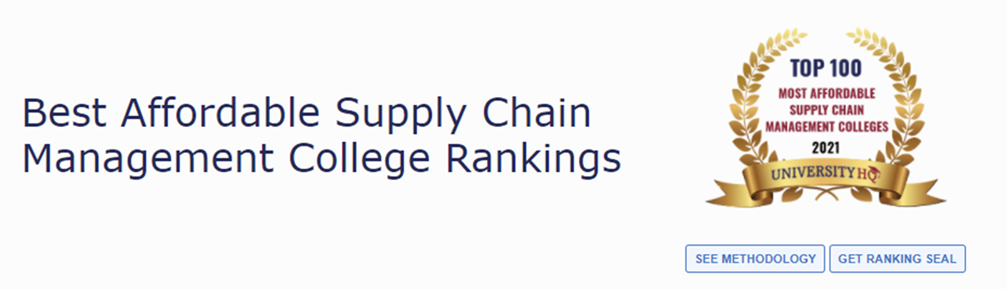
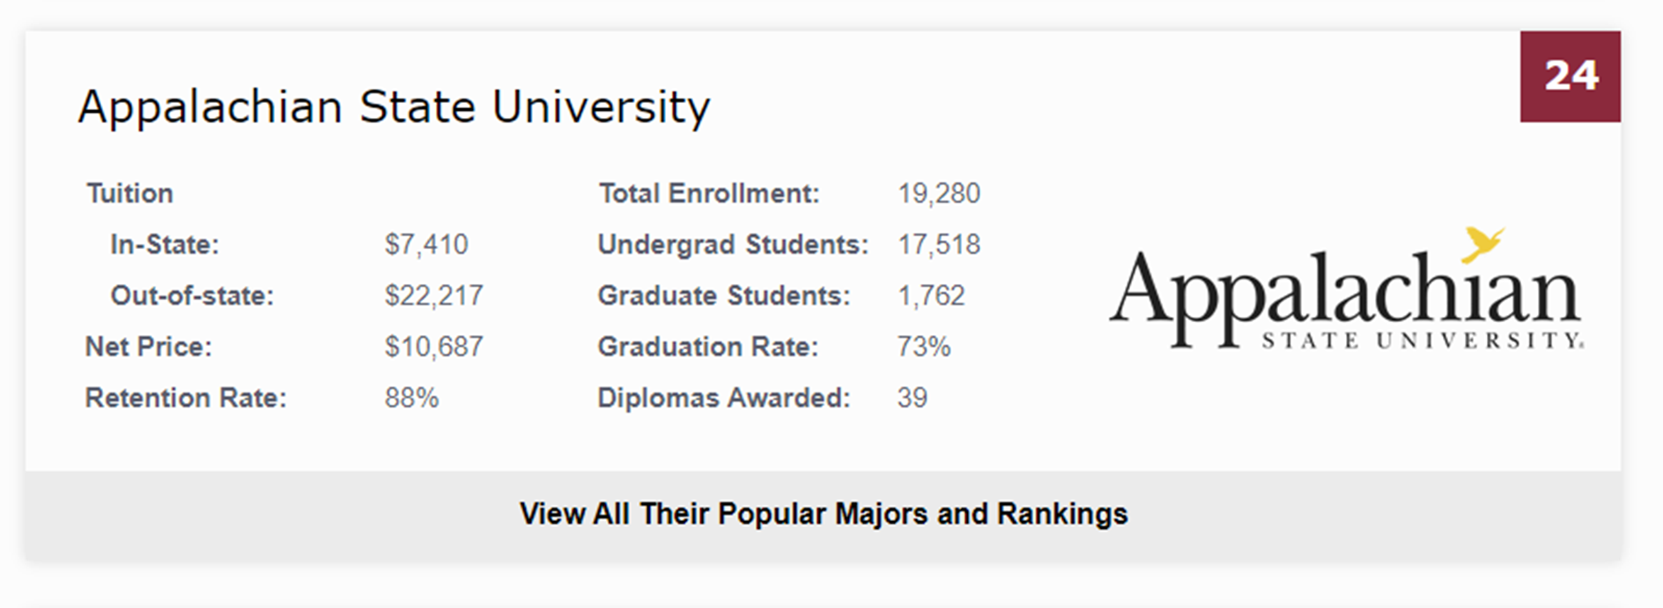
SCM Program Ranked 24 out of Best 100 in the US

