Slide 1
Supply Chain Management

Slide 2
What do SCM Professionals do?
They get the…
…right materials…
…to the right place…
…at the right time…
…at the right price.

Slide 3
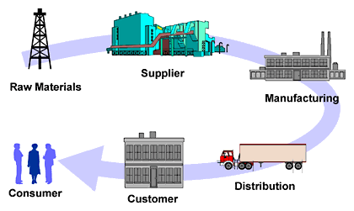
The SCM Major pairs with all Majors…
SCM helps companies and professionals across all disciplines
CIS
In “The World is Flat,” five of Friedman’s flatteners are technologies that have facilitated extraordinary competitive advantages in SCM.
Finance
SCM provides 40% higher valuation for companies within
DJI Index and S&P 500 Index.
Accounting
Lower supply chain costs 25% - 50%
Improved capacity realization 10% - 20%
Forecast accuracy improvement 25% - 80%
Increase in overall productivity 10% - 16%
Inventory Cost Reduction 25% - 60%
Entrepreneurship
SCM is a dominant enabler of new global enterprises and flat competition. Anyone can now build an international supply chain and compete globally.
Management / HR
With SCM Management costs as a percentage of revenue are 50% less than median companies. SCM increases employment opportunity.
Marketing
Improved delivery performance 16% - 28%
Reduction in order fulfillment cycle time 30% - 50%
Improvement in forecast accuracy 25% - 80%
Lower supply chain costs 25% - 50%
Improvement of fill rates 20% - 30%
Economics
“Central to the way that companies produce things is the way that they manage their supply chains.” Virtual extended enterprises now cross all boundaries via SCM. Micro and macro economies are more complex and interdependent than ever before.
Sources: The Supply Chain Council, The Economist, PRTM-The Performance Measurement Group, “The World is Flat” by Thomas Friedman

Slide 4
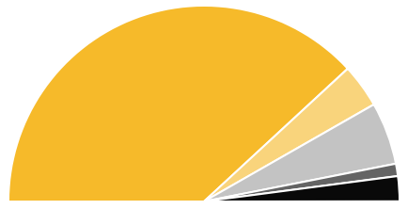
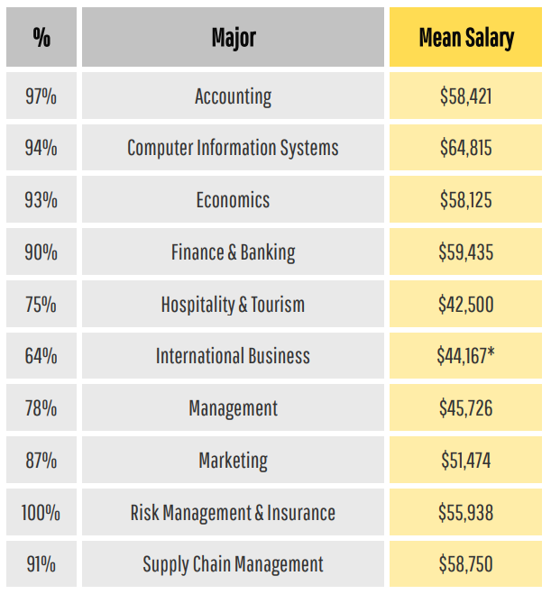
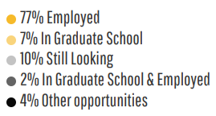
COB Career Center 2021-2022 COB Student Success

Slide 5
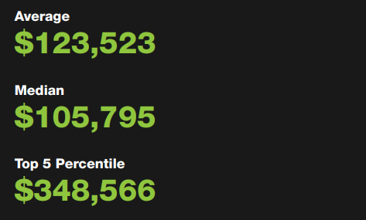
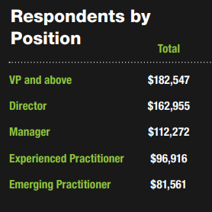
Institute for Supply Management (ISM)

Slide 6
Supply Chain Management Programs
SCM Minor
Created in 2008 after a study found SCM knowledge, skills, and abilities lacking in the workforce
Provides a multi-disciplinary curriculum to complement both Business and Non-Business majors
Created in 2016 after a study found SCM knowledge, skills, and abilities lacking in the workforce. More demand after the pandemic
Provides a multi-disciplinary curriculum to complement Business majors. Double major/minor can be easily added
Currently 287 students (211 declared majors, 38 Undeclared, 38 minors). Online BSBA in SCM just introduced
SCM Minor
MBA w/SCM concentration
Created in 2014 for our MBA students to obtain the SCM knowledge, skills, and abilities requested by employers

Slide 7
Appalachian Supply Chain Club (ASCC)
Free Club Membership
Includes student membership in ASCM
Includes student membership in CSCMP
Internship Opportunities
Job Opportunities
Guest Speakers
Networking with SCM professionals

Slide 8
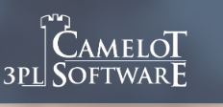
Our Supply Chain Board of Advisors
Our advisory board members are executives from the following:
Notes:
Internships and Scholarships
Bonded Logistics
FedEx
Global Shippers Association
Hanesbrands /Sara Lee Corporation
IBM
Lowe’s Companies, Inc.
M33 Integrated Solutions
Mapally
Mediterranean Shipping Company (USA)
Microsoft
Murray Supply Company
PHH Corporation
Prysmian Group – Draka
Saudi Basic Industries Corporation (SABIC)
Job Placement
Speaker to the Supply Chain Club
Guest Speaker in the Classes

Slide 9
For More Information Contact: Supply Chain Management Faculty
Dr. Dinesh Davè (daveds@appstate.edu)
Dr. Ken Corley (corleyjk@appstate.edu)
Dr. Steven Leon (leonsm@appstate.edu)
Dr. Laura Brewer (brewerLL@appstate.edu)
Dr. Mike Ogle (oglemk@appstate.edu)
Mr. Doug Marrelli (marrellidm@appstate.edu)
Mr. Daman Palmer (palmerdk@appstate.edu)
Mr. Milind Patwardhan (patwardhanmv@appstate.edu)

