Slide 1
Leadership Accounts
Four major categories
Trait or Great Man/Woman
Personality or who they are
Behavioral
Behaviors or what they do
Contingency
The leadership style & situation interact or how they fit
Charismatic
Symbolic gestures & emotional appeal or how they make us feel

Slide 2
Trait Theories
Leaders possess certain personal attributes that distinguish them from others
Personality
Stable dispositions to behave a certain way
The Big 5, emotional maturity, energy level
Needs or motives
Desire for particular stimuli and experiences
Achievement, affiliation, power, autonomy
Values
Internalized attitudes about what is right and wrong
Fairness, honesty, justice, freedom, loyalty
Skills
Technical, interpersonal, conceptual
Things, people, ideas

Slide 3
Leader Traits
Emergence
Within-group phenomenon
Performance
Between-group phenomenon
Neuroticism | -.24
Extraversion | .33
Openness | .24
Agreeableness | .05
Conscientiousness | .33
Sociability | .24
Dominance | .24
Achievement | .23
Neuroticism | -.22
Extraversion | .24
Openness | .24
Agreeableness | .21
Conscientiousness | .16
Trait | Business | Gov/Military | Students
Neuroticism | -.15 | -.23 | -.27
Extraversion | .25 | .16 | .40
Openness | .23 | .06 | .28
Agreeableness | -.04 | -.04 | .18
Conscientiousness | .05 | .17 | .36
 | Performance |  | Emergence
Judge et al 2002

Slide 4
Distal and Proximal Attributes
Distal
Stable and difficult to change like abilities, motives, and personality
Proximal
Less stable and may be changed through training, education, and experience
Leader’s operating environment is a moderator of how proximal traits may influence the display and quality of leader processes.
Zaccaro et al 2004

Slide 5
Boundaries
No universal traits found that predict leadership equally well in all situations.
Traits are more or less relevant in some situations.
Traits predict behavior better in “weak” than “strong” situations.
Leadership is often designated or acquired by status.
Unclear evidence of the cause and effect of relationship of leadership and traits.
Leadership experience may change people.
Traits better predict the appearance of leadership than they do distinguishing effective and ineffective leaders.
Seeming is not the same as being.
Some leader traits may be acquired such as those referred to as proximal traits.

Slide 6
Behavioral Theories
Posit that behaviors distinguish effective from ineffective leaders
McGregor Theory X and Theory Y
Leader behaviors correspond to beliefs about human nature
Ohio State Leadership Studies
From list of 1,800 leader behaviors, 150 items were used in a questionnaire (LBDQ) that asked subordinates to rate how characteristic each statement was of their leader

Slide 7
Sample LBDQ Items
Consideration
Is friendly and approachable
Does little things to make work pleasant
Treats work unit members as equals
Looks out for the personal welfare of work units members
Implements work unit suggestions
Treats work unit members as his or her equal
Initiating Structure
Schedules work to be done
Assigns work unit members to particular duties
Applies uniform procedures to executing work
Informs work unit members of what is expected of them
Allocates resources to work unit members to complete work assignments
Establishes standards for work
Descriptive more than prescriptive
What leaders ‘do’
Uncertainty, external threat, time pressure make IS valuable
Low GNS followers may prefer IS leaders
Engaging, well-structured tasks may obviate advantages of IS

Slide 8
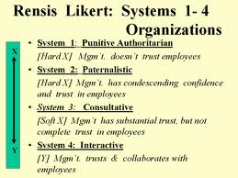
U of Michigan Studies
Production versus Employee Orientations
Concern for production
Close supervision, concentration on task & goals
Concern for interpersonal relations
General supervision, concern for people & relationships
Proved superior to production orientation
Further research at Michigan using their model led to Likert’s System 4 Model of Leadership which emphasized
Participative Leadership

Slide 9
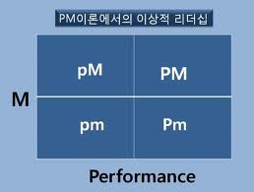
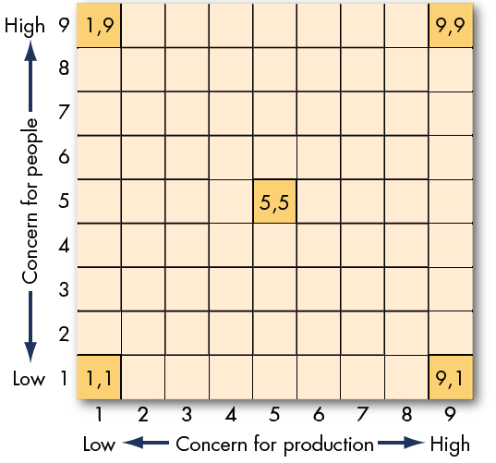
Managerial Grid
Country club
Team leader
Blake & Mouton (1964)
Ohio State and Michigan studies converge on ‘task’ versus ‘people’ centered behaviors
HIGH-HIGH LEADER
Concern for both
Leader styles
A parallel Japanese behavioral program called “PM Leader Theory”
The PM Leader is high in performance and maintenance behaviors
Impoverished
Authoritarian

Slide 10
Leader Behaviors
Largely descriptive in emphasis
Two main dimensions emerge
Task-oriented
People-oriented
No clear conclusion as to which is most effective
Do situations matter?
If so, what distinguishes one situation from another so that leader style (traits and behaviors) may contribute to success?

Slide 11
LPC Scale Think of the person with whom you can work least well. S/he may be someone you work with now or someone you knew in the past. S/he does not have to be the person you like least well, but should be the person with whom you had the most difficulty in getting a job one. Describe this person by circling one of the numbers between each pair of adjectives.
Think of the person with whom you can work least well. S/he may be someone you work with now or someone you knew in the past. S/he does not have to be the person you like least well, but should be the person with whom you had the most difficulty in getting a job done. Describe this person by circling one of the numbers between each pair of adjectives. You may wish to print this out
1. Pleasant | 8 | 7 | 6 | 5 | 4 | 3 | 2 | 1 | Unpleasant
2. Friendly | 8 | 7 | 6 | 5 | 4 | 3 | 2 | 1 | Unfriendly
3. Rejecting | 1 | 2 | 3 | 4 | 5 | 6 | 7 | 8 | Accepting
4. Tense | 1 | 2 | 3 | 4 | 5 | 6 | 7 | 8 | Relaxed
5. Distant | 1 | 2 | 3 | 4 | 5 | 6 | 7 | 8 | Close
6. Cold | 1 | 2 | 3 | 4 | 5 | 6 | 7 | 8 | Warm
7. Supportive | 8 | 7 | 6 | 5 | 4 | 3 | 2 | 1 | Hostile
8. Boring | 1 | 2 | 3 | 4 | 5 | 6 | 7 | 8 | Interesting
9. Quarrelsome | 1 | 2 | 3 | 4 | 5 | 6 | 7 | 8 | Harmonious
10. Gloomy | 1 | 2 | 3 | 4 | 5 | 6 | 7 | 8 | Cheerful
11. Open | 8 | 7 | 6 | 5 | 4 | 3 | 2 | 1 | Guarded
12. Backbiting | 1 | 2 | 3 | 4 | 5 | 6 | 7 | 8 | Loyal
13. Untrustworthy | 1 | 2 | 3 | 4 | 5 | 6 | 7 | 8 | Trustworthy
14. Considerate | 8 | 7 | 6 | 5 | 4 | 3 | 2 | 1 | Inconsiderate
15. Nasty | 1 | 2 | 3 | 4 | 5 | 6 | 7 | 8 | Nice
16. Agreeable | 8 | 7 | 6 | 5 | 4 | 3 | 2 | 1 | Disagreeable
17. Kind | 8 | 7 | 6 | 5 | 4 | 3 | 2 | 1 | Unkind
18. Insincere | 1 | 2 | 3 | 4 | 5 | 6 | 7 | 8 | Sincere
Notes:
Task <62, Relationship >76

Slide 12
THE Contingency Theory of Leadership
Fiedler maintains that leader style interacts with situational variables to yield effectiveness
Least Preferred Co-worker Score
LPC score reflects a leader’s ‘motive hierarchy’
It was the best of times, it was the worst of times
EQUALITY preference
Group Maintenance
Harmony & low conflict
Esteem: relationships
High LPC
EQUITY preference
Group Performance
Incentives & signal
Esteem: achievement
Low LPC

Slide 13
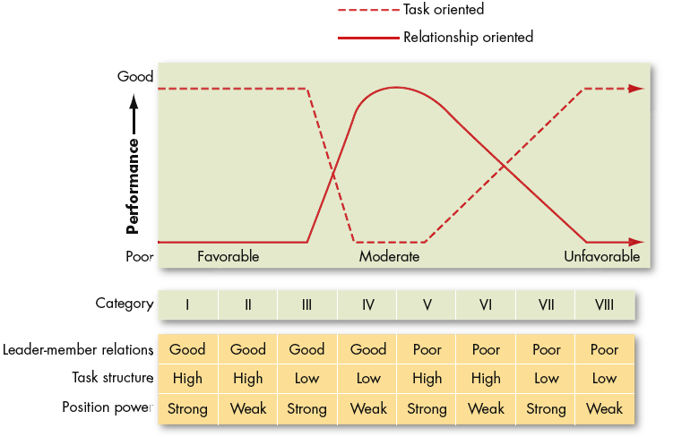
Fiedler’s Contingency Theory
Situational
Favorability

Slide 14
Review of Contingency Theory
Imaginative & complex
Leader style is fixed
Select leader to fit situation
Yet, LPC measure is poor for this purpose
Measurement problems; especially for young leaders
Are different situational variables of different importance?
Task structure x10 importance of LPC score
Suggests there are substitutions for leadership
Medium (undifferentiated) LPC leaders seem most desirable across most situations

Slide 15
Cognitive Resource Theory
Fiedler, again
A leader applies a reserve of cognitive resources to the resolution of problem situations
Intelligence and Experience
Social stress and Leader directiveness
Directive leadership arises during stressful periods - the worst of times
More intelligent/Experienced leaders manage stressful and complex situations better and so provide better directive leadership
Leader as Decider
Social Stress for Leader
*Intelligence
*Experience
Decision Quality
*Both Intelligence and Experience are poorly defined and measured in research ☹
Napoleon's definition of a military genius was "the man who can do the average thing when all those around him are going crazy."

Slide 16
CRT is a Diathesis-Stress Model
survival
Inoculated ~ High CR
Not inoculated ~ Low CR
Leader effectiveness
exposure
‘stress’

Slide 17
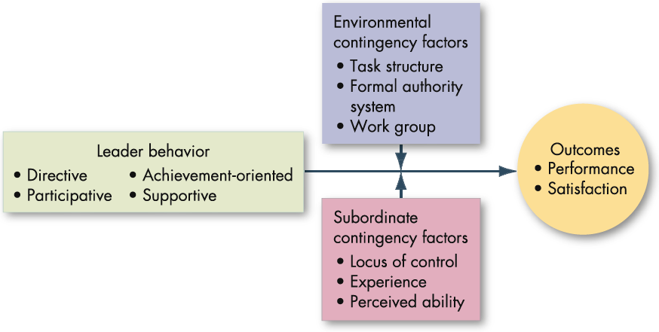
Path-Goal Theory of Leadership
Leaders motivate followers by offering increasing payoffs for work-goal attainment
Leaders clear the path for employee success like offensive linemen
Clarify the path, remove roadblocks, increase personal satisfaction
Closely affiliated with Expectancy theory (resolving ambiguities)
Example: performance on a well Structured task with Capable employees does not benefit from Directive leadership
What if the task is stressful, boring, tedious, or dangerous?

Slide 18
Hersey & Blanchard’s Situational Leadership Theory
Unable and Unwilling
Unable but Willing
Able and Unwilling
Able and Willing
Telling
Follower readiness: ability and willingness
Selling-coaching
Leader as Teacher
Leader: decreasing need for support and supervision
Participating
Delegating
Directive
High Task and Relationship Orientations
Supportive Participative
Monitoring
A theory of FOLLOWERS as much as LEADERS
Follower “readiness” (maturity) is key contingency variable
Ability (Capable, skilled, knowledgeable)
Motivation (Willing, committed, dedicated)
Obvious relevance to training and educational contexts

Slide 19
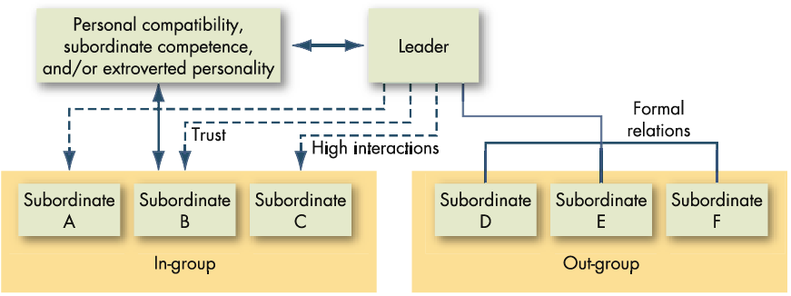
LMX: Leader-member exchange
Leaders establish different relations with work group members; time is limited
In-group members experience high LMX
Out-group members relegated to low LMX

Slide 20
LMX is about Roles and Exchanges
Negotiating Latitude/Autonomy
Perspective Taking
Similarity
Leader as Politician

Slide 21
Leadership Substitutes
Some factors make leadership less important
Act as ‘substitutes for leadership’
May explain why leadership or different leader styles don’t show evidence of effectiveness
The presence of a substitute makes the leadership effect less apparent
Degree of formalization (roles are institutionalized)
Group cohesiveness
Routine, repetitive tasks, or engaging work
Ability, motivation, experience of followers
Conversely, absence of substitutes may enhance leader importance

Slide 22
Charismatic Leadership Historical progression from Princes and Heroes to the Bureaucratic Leader (Weber)
The Prince
The Hero
The Prince uses hard power and has will to power
Transactional leadership
A Prince relies on hard power sources, cunning, and fortune to sustain his elevated position
The Hero uses soft power and has will to serve
Transformational leadership
Heroes rely on soft power such as inspirational appeal, attractive personal qualities
Problem is Charisma can be dark or light
Motives may be hidden and non-transparent
Weber’s preference for the Bureaucratic-Leader is based on knowledge and qualifications, legitimate power in a hierarchy, in order to minimize risk and problems of Prince & Hero leaders
Have leaders been tamed by the modernist era?
Are B-leaders sufficiently inspiring? Are they prone to administrative careerism and personal ambition? Are they really more transparent than the Hero or more service-oriented than the Prince?

Slide 23
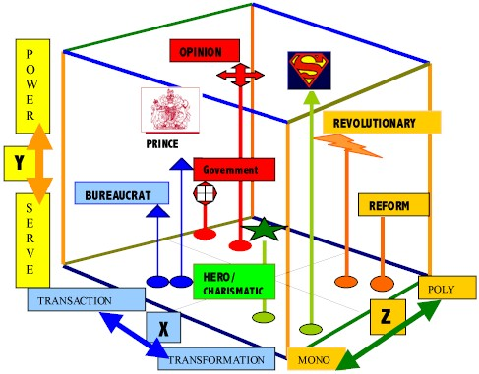
In the Box of Modernist Leadership Theory
David Boje
X=TvT Y=PowervService Z=OnevManyvoices; Superman is Hero on steroids
http://business.nmsu.edu/~dboje/teaching/338/leadership_box_choose.htm

Slide 24
Summary
Leadership versus management
Major dimensions
Leader cognitive/personality resources
Task and people orientation
Situational contingencies
Followers: readiness and relationships
Charismatic Leadership
Substitutes
Leaders are born (distal traits) and made (proximal traits and opportunity)

Slide 25
4 Meta Concepts
Inference
Tension
Cohesion
Direction

