Slide 1
OB Extra Credit Option
Voluntary
Due: Last Day of Class – Tuesday, November 24th
Book Review
Read and compose a 3-page single-spaced review of Dale Carnegie’s “How to Win Friends and Influence People”
Graded on originality and relevance to course content; what anecdotes you may draw from personal experience; grammar; and interesting narrative
A testimonial about the book

Slide 2
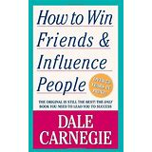
Widely available from booksellers or on the internet
HERE is a simple Bing search that leads to a host of ways to buy the book or to obtain a free PDF version.
It does not matter to me if you read the first edition or the latest edition.

