Slide 1
Organizational Culture
A system of shared meanings and beliefs
Identifies what goals are sought
Core values (terminal values)
Prosperity, harmony, freedom, self-respect
Communicates how to achieve goals
Behavioral norms (instrumental values)
Honesty, obedience, ambitious, independent
Reflected in vision and mission statements
Vision
What we intend to achieve
Mission
What we do; Who we serve; and How?

Slide 2
How is culture transmitted
Explicit statements regarding values
Vision & mission
Forms: translate values into practice
Permissible business strategies
Differentiation, price competitive, niche identification
Structures
Centralization versus delegation (uniformity v specialization)
Administrative Processes
Compensation & performance management practices
Firm-sponsored social organizations & communication
Company softball team, Company parties, newsletters, celebrations
Artifacts, Stories, Metaphors, Heroes, & Norms

Slide 3
When and Why Culture Matters Most
Members represent firm to clients
Direct supervision is difficult
Need to differentiate from competitors
Member behavior is discretionary
Culture as a social control mechanism and as a device to distinguish the firm from competitors

Slide 4
What Determines Culture
EVENTS
2008
Deepwater Horizon
Chipotle
Wells Fargo
Management
Forms
strategy
structure
processes
CULTURE
Industry Environment
customer requirements
competition/munificence
societal expectations
Assumptions
Values
Prime beneficiaries or their agents may shape values consistent with assumptions
Management develops the forms necessary to conduct business
Culture and forms must conform to industry imperatives – the right thing to do.
electric utility
financial services
food services
oil exploration
Dotted lines = Influence
Solid lines = Controlling influence
Adapted from Gordon 1991

Slide 5
Requisite and Discretionary Values
Service
Etc.
Vegan
French
Buffet
Value
Industry Imperative
Aesthetics
Non-GMO
Fast food
Etc.
Casual
Availability

Slide 6
How culture is preserved: ASA Model (The people make the place; Schneider, 1987)
Attraction
People are differentially attracted to careers as a function of their own interests and personality
People maintain preferences for different “Forms”
Selection (and Socialization)
Organizations end up choosing people who share many common personal attributes
Interviews, Realistic Job Previews, Personality tests
person-organization fit via Value congruence
Attrition
Compatibles remain longer than ‘Misfits’
Rosabeth Moss Kanter (Homosocial reproduction)

Slide 7
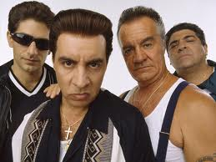
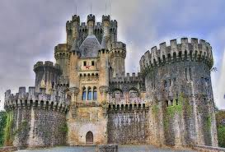
Cultural Types (Sonnenfeld’s Typology)
Academy
The Learning Organization
Mastery - Careers
knowledge, competence, specialization, training, silos
Baseball Team
The Natural
Performance - Free agents
outcomes, entrepreneurship, risk-taking, incentives
Club
The Family
Conformity - Seniority
loyalty, fitting in, experience, generalists, career lattices
Fortress
The Castle
Faithfulness - Knights
preoccupied with survival, defensive, messiah-silver bullet
Notes:
Academy
steady career climbers
recruit @ college campuses
skill-based pay programs
certification programs
Baseball Team
reward outcomes and provide big incentives
risk takers
a lot of job hopping
low in loyalty
Club
value team players
with experience comes knowledge; show of loyalty
high homogeneity
Fortress
an org that has fallen on hard times
seeking a messiah for deliverance

Slide 8
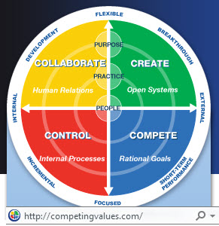
Competing Values Framework
COLLABORATE – Human Relations - CLAN
Focus: Values
Situation: A community united by shared beliefs, competency is closely linked to unique abilities, lifestyle identification
Purposes: Community and knowledge
Practices: Building teams and
developing communities, training,
and coaching, creating shared
vision and values, harmonious
work environment
People: Build trust, helpful,
resolves conflict, empowering,
good listener, encourages
participation
Environment: Harmonious
atmosphere, collaborative
workplace, informal communication,
shared values
Measures: Employee satisfaction,
employee turnover, training per
employee, peer review
CREATE – Open Systems - ADHOCRACY
Focus: Vision
Situation: Differentiation creates significantly higher margins, a new Methodology changes the game, an industry is situated around blockbuster invention
Purposes: Innovation and Growth
Practices: Encouraging radical thinking,
launching new ventures, speculating
emerging opportunities, launching
change initiatives, destroying old practices
People: Visionary, optimistic, generalist,
enthusiastic, quick thinker, expressive
Environment: Stimulating projects,
flexible hours, free from everyday
constraints, diverse workforce
Measures: Diversity of experiments, new
market growth, adoption rate, revenues from new products and services
COMPETE – Rational Goals - Market
Focus: Goals
Situation: Shareholder demands are
the primary driver, aggressive
competition, markets change from
mergers and acquisitions, investors
demand quick results
Purposes: Profits and speed
Practices: Managing performance
through objectives, investing for
increasing rates of return, quickly
starting and killing initiatives, quickly confronting problems
People: Goal oriented, assertive, driven, accountable, decisive, competitive
Environment: High pressure, fast moving, quantifiable results, pay for performance
Measures: Gross Profit, time to market, return on investment, operating income
CONTROL - Processes - HIERARCHY
Focus: Process
Situation: Organization has large and
complex scope and scale, government
regulations and standards determine
business practices, failure is no option
Purposes: Efficiency and quality
Practices: Implementing large scale
technology and systems, applying
continuous improvement processes, complying with regulations, adhering to standards
People: Organized, methodical, technical, practical, objective, persistent
Environment: Clear roles, logical objectives, structured work, cohesive work processes
Measures: Budget adherence, milestones achieved, number of failures, regulatory compliance

Slide 9
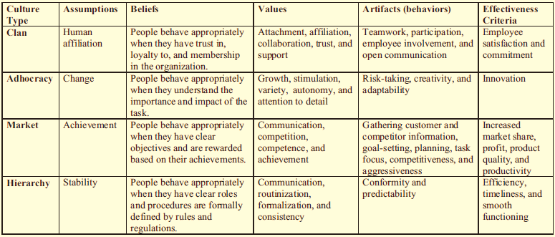
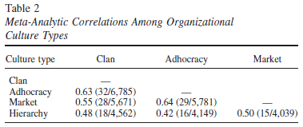
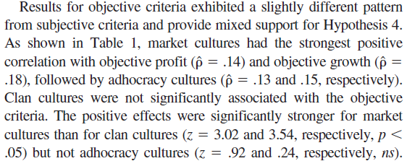
CVF 4 Culture Types
Hartnell, Ou, & Kinicki 2011

Slide 10
Cultural Types (Deal & Kennedy’s Typology)
High Risk
Low Risk
Driving
High Risk & Fast Feedback
Individualistic - objectives
police, construction, consulting, ad agencies
Outgoing
Low Risk & Fast Feedback
Team - activity
Sales, retail stores, real estate, large computer firms
Fast
Feedback
Specialist
High Risk & Slow Feedback
Competence - ideas
Aerospace, investment, Oil, military, high-technology
Control
Low Risk & Slow Feedback
Conformity - process
Banks, insurance, utilities, accounting, public agencies
Slow
Feedback
Notes:
Driving - Macho-Tough Guy
tolerate high risks - measure of success
get things done quickly - emergency attitude
short-term orientation; don’t learn; do not value cooperation
fashionable; ‘in’, one-on one sports. ‘no hellos’, scoring points
Outgoing - Work hard/Play hard
team-based approaches to problem solving
hyperactive world of work (phone, PC, interview)
short-term orientation; the quick fix
like team sports, like to party together, company parties
Specialist - Bet your company
technically competent; can live with ambiguity
slowly get things done, don’t respond well to sudden change
rather conformist in dress to status position, like golf
work in high-stakes ventures (oil drilling, Athlon)
Control - Process
cautious, orderly, & punctual - attend to detail
bureaucratic, red-tape, process-oriented, ‘memo wars’
‘style is substance’ - process over production
slow changing, abhor uncertainty, jogging

Slide 11
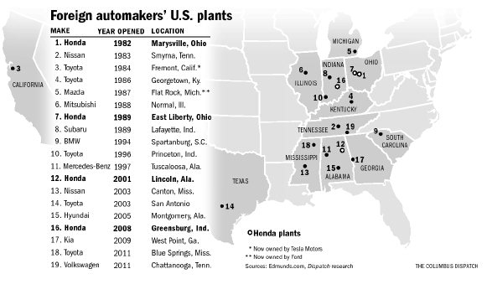
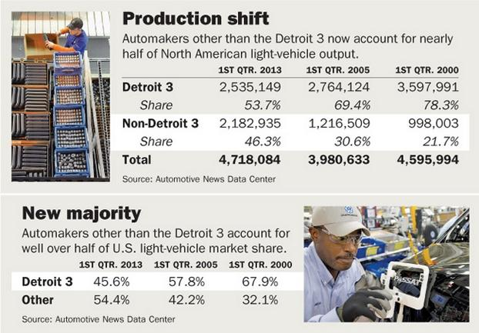
Culture Challenges
The Challenge of Culture & personality
Japanese auto companies in the US
Trade imbalance circa 1980-90
Cultural differences between US and Japan
Regional, personality, value & attitudinal
Notes:
Devices that emphasize personal values & beliefs
Interview
Realistic Job Previews
Personality and Attitude Tests
Integrity Testing
Japanese Auto Companies in US
Personality and attitude testing
humility, changeableness, team orientation, anti-union
Walt Disney
originally hired fair/carnival folk (hucksters)
specific vocabulary consistent with wholesome culture
law enforcement = security hosts
employees = cast members
customers = guests
rides = attractions
REVIEW DISNEY MATERIALS

Slide 12
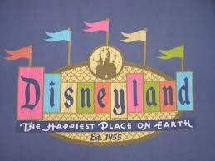
Culture Challenges
The Challenge of a New Business Enterprise
Walt Disney Company
Family-friendly theme park @ Disneyland
Disney Culture (cast members, security hosts, and guests)
personal references: character
physical appearance: grooming, conformity
service orientation: enthusiasm, integrity

Slide 13
Purpose-Driven Culture
A company’s vision and mission communicates its purpose or ‘raison d'être’
Purpose-driven companies transmit a consistent message, bolstered by articulate values, that resonate with employees and customers
Purpose-driven companies perform better
Higher job satisfaction (79% to 19%)
Strong financial performance (91% to 65%)
Clearly defined culture & beliefs (89% to 38%)
Survey of 3,300 executives by Deloitte concluded that culture was the most important issue they faced to assure success

Slide 14
Purpose
Whole Foods
To improve customer’s health and well-being
USAA (United Services Automobile Association)
Supporting members of the military and their families
Pentair (water purification & swimming pool equipment)
To improve the quality of life for people around the world
Saint Jude’s Children’s Research Hospital
Advance cures, and means of prevention, for pediatric catastrophic diseases
ASU College of Business
To be recognized as a national leader in innovative, life-changing undergraduate and graduate business programs

Slide 15
The Google Bump
Great perks at Google¹
But free gourmet-quality food is only a manifest benefit
Instead, the intended purpose is to encourage employee relationships
A common gathering spot
Deliberate manipulation of service lines
Deliberate crowding of diners seated at long tables
Thus, employees ‘bump’ into each other with frequency
Offers paid time off for volunteering
Onsite fitness center
Discounted gym memberships
Onsite medical care facility
Offers college tuition reimbursement to employees
Free gourmet-quality dining
Paid Holidays 13
Paid Vacation 15
Sick days Unlimited
140 applicants per employee hire
Spouse receives ½ salary for 10 years in event of employee death
Ranked #1 Best place to work by Fortune in 2015

Slide 16
Functions & Dysfunctions of Culture
Distinguishes one company from another
Conveys a sense of identity among members
Facilitates commitment to something larger than self-interest*
Enhances social system stability
Serves as a behavioral control mechanism
Adopted culture may be misfit or maladaptive
Perpetuates a spoils system*
Encourages conformity
Stokes conflict with subcultures
Resistant to change

Slide 17
Summary
Culture
Enhances predictability of behavior
Provides a common referent for employees
Serves a unifying/integrative function
Identifies the organization
Requires ‘management’ & ‘investment’
Makes change more difficult
Involves limited choice correspondent with industry assumptions
May perpetuate dysfunction

