Slide 1
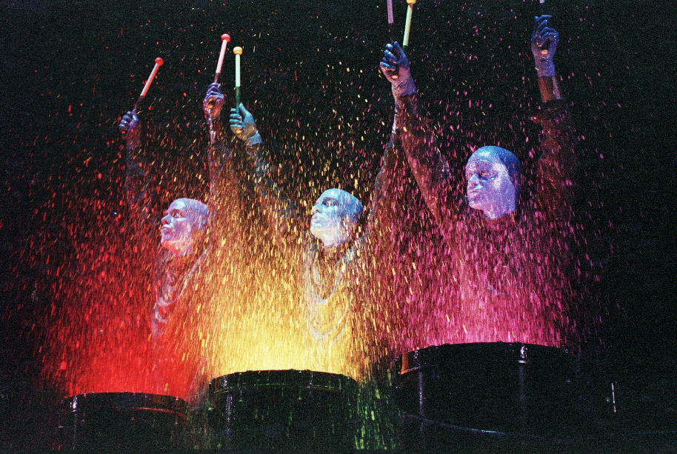
Why Groups?
Collaborative nature of human endeavors
And competition between groups
Pronounced effects on behavior
Good and bad; moral compass/deviance
Contemporary organizations structure work in groups
Work teams
Management delegation
Emphasis on leadership role
Empowerment & partnering
3’fer
Technology

Slide 2
Group Perspectives
Psychoanalysis
People join groups to reduce anxiety & fulfill power motives
To fit in so as to feel less nervous and anxious and to assume a position of power
Behaviorism
People join groups to secure rewards & avoid punishment: groups as a device
Cognitive
People join groups to affirm their self-concept
To feel & think ‘good’ about themselves; social identity
Why does someone join a church group?

Slide 3
Why we Hate and Love Groups
Because they Rock!
Meet new people
Discover new ideas
Validate our beliefs
Provide help
Increase one’s own commitment
Reaffirm our sense of agency
Meh, more like Green Eggs & Ham
Take too much time
Reward popularity and not good ideas
Social loafers steal credit
Imposes limits on personal freedom

Slide 4
Models of Group Development
Tucker’s 5-Stage Model
Forming (Orientation)
getting acquainted; KSAO inventory
Roles & responsibilities unclear
The leader, if any, directs the group
At this stage, often external leadership

Slide 5
Models of Group Development
Tucker’s 5-Stage Model
Storming (Conflict)
conflict about goals, roles, means
task & interpersonal conflict
coalition formation

Slide 6
Models of Group Development
Tucker’s 5-Stage Model
Norming (Cohesion)
norm development
Roles, goals, and means more accepted & understood
potential for groupthink
high maintenance

Slide 7
Models of Group Development
Tucker’s 5-Stage Model
Performing (Maturity)
efficient and task-focused
less process loss
greater tolerance
identification with the team

Slide 8
B. Punctuated Equilibrium Model
Sequence of events:
Setting group direction
First phase of inertia
Half-way point transition
Major changes
Second phase of inertia
Accelerated activity
A Model constrained to Temporary Groups with deadlines.
Often, temporary groups exhibit features of both the 5 stage model and the PEM.

Slide 9
Implications
Groups require time to form, transition, and consolidate into effective teams
Teams require group maturity
Groups experience periods of inertia
Particularly when less mature
Groups may cycle through these stages as old members leave and new members join
Managers often are threatened by group changes and yet these are often inevitable

Slide 10
Diffusion of Responsibility versus Social Facilitation
Diffusion of Responsibility
Individual responsibility declines in groups
Social Loafing
Social Facilitation
Individual performance benefits from social presence
Well-learned behavior
Practice, routinization
Social Presence
Increased Arousal
Triggered Dominant Response
Competition & co-acting
Audience effect
Private

Slide 11
Social Influence in Groups
As Agents or Recipients of social influence
 | As AGENT | As RECIPIENT
Informational | Appeal to information such as facts, data, logic, evidence - Rational | Conformity/Compliance from ambiguity; a search for social proof or validation; uncertainty as to what is correct; motive is to resolve ambiguity
Normative | Emotional appeals or to morality, popular consensus or righteousness - Affective | Conformity/Compliance from seeking social approval; avoidance of social ridicule; submission to peer pressure; motive is to get along

Slide 12
Group Norms
Informal rules adopted to regulate member behavior
Immediate objective is to gain conformity
classroom participation; on-time arrival
Often considered ‘courtesy’
Developed for behaviors considered important to group survival/success
Do not equally apply to all members
idiosyncrasy credits
senior, junior, more capable members

Slide 13
Functions of Norms
Enhance group survival/privileges
ex: not discuss salaries outside department
Simplify behavior & expectations
ex: establish a routine for paying lunch
Avoid embarrassing situations
ex: prohibiting romantic relationships
Identify the Group and express values
attire; office design; logo; corporate colors; language
process
identity
survival

Slide 14
Return Potential Model
Point of maximum return
Range of tolerable behavior
Intensity
Crystallization
Highly approve
Participation
Absences
Cuss words
Eye contact
Plagiarizing
Return to buffet
Indifferent
Highly disapprove

Slide 15
Transmission of Norms
Muzafir Sherif (1936)
Autokinetic Effect
visual anchor (horizon)
Social anchoring
opinions of others
An Unknown Truth
ambiguous stimulus
Informational influence
Generational transmission
fads & fashions

Slide 17
Conformity to Group Norms
Solomon Ash (1951)
Conformity to the group
Known Truth
Normative influence
7 panelists (1 subject & 6 confederates)
Boundary conditions
Size of the group (3)
Group member status (freshmen, seniors)
Presence of dissent
even when dissent is incorrect it reduces conformity

Slide 18
Factors that Influence Conformity
Group size (levels off at 3)
Member status
Presence of dissent
Potential coalition
Private/Public response
Personnel decisions
Prior commitment
Avoidance of dissonance

Slide 19
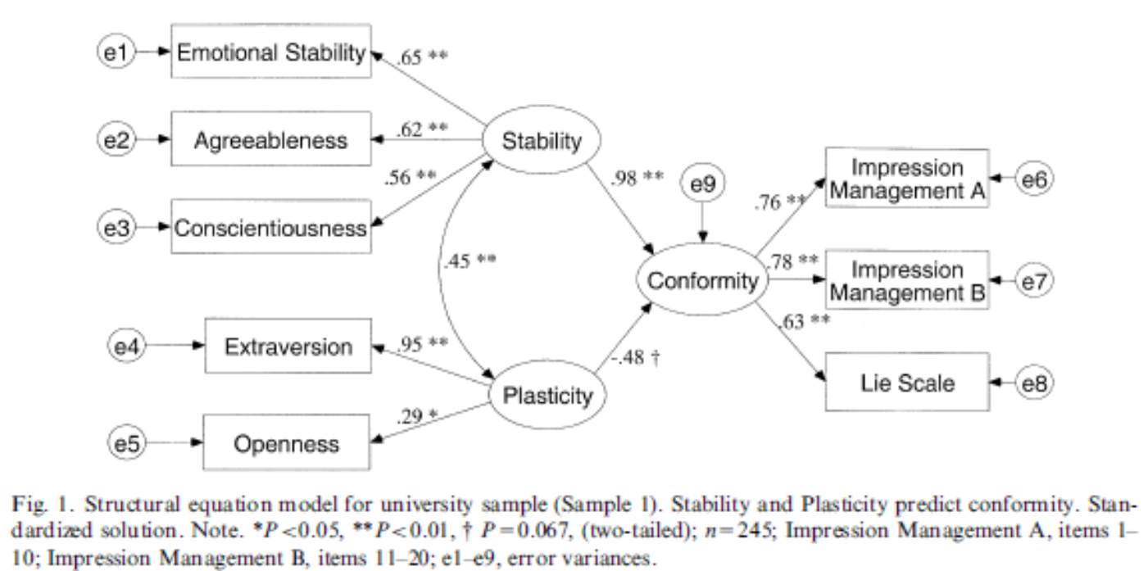
Are Some People More Prone to Conformity Effects?

Slide 20
Group Cohesion
1. Similarity +
2. Maturity +
3. Frequency of contact +
4. Goal clarity +
5. Success +
6. External threat – competition +
7. Group size -
8. Resources +
9. Isolation +
10. Difficulty of admission +
11. Distinctiveness +

Slide 21
A Group Cohesion Model
Frequency of Contact
Goal Clarity
Success/Performance
Similarity
COHESION
External Threat
Maturity
Distinctiveness
Resources
Group Size
Difficulty of Admission
Isolation

Slide 22
Groups vs. Teams
Identification
Team goals are one’s own
Trust
Open expression of ideas
Constructive resolution of conflict
Creating ‘win-win’ accommodations
Recognition of uniqueness of team members
Each member has special status by virtue of being on the team
Maturity
Team functions at the performing stage
Tolerance of dissent
Less obsessed with maintenance
Has adopted better conflict resolution methods

