Slide 1
Motivating Employees in Organizations
Behavioral Requirements for Organizational Success
People must be attracted to join the organization and to remain as members
To offset cost of recruitment, selection, training, and additional supervision for less experienced employees
How to Attract and Retain?
People must perform the tasks for which they are hired dependably
> marginal cost of labor; capitalization rate on labor utilization
How to achieve performance/profitability goals?
People must go beyond the formal role requirements
Surplus value from extra-role behaviors
How to encourage extra effort?
If you are like a wheelbarrow, always needing to be pushed, do NOT apply for work here

Slide 2
Motivating Employees in Organizations
A Brief compendium of prescriptions:
Tailor incentives and work conditions to individuals.
Link rewards to performance.
Engage individuals’ aspirations.
Clarify path-goal relationships.
Make the work meaningful.
Empower employees.
Check the system for fairness.
Provide support and respect.
Need theories
Maslow & Alderfer
Learned Needs
2-factor theory
Job Characteristics Model
Self-determination
OB Mod
Goal setting theory
Justice theories
Expectancy theory
Self-efficacy

Slide 3
1. Tailor incentives and work conditions to individuals.
Need theories maintain people have universal needs
From Maslow’s 5 to Alderfer’s 3
but may emphasize specific ones
Depending on where they are located in the need hierarchy – which need is pre-potent
Based on their Learned Needs
Self-actualization
Esteem
Social
Security
Physiological
Existence
Relatedness
Growth

Slide 4
Murray’s Learned Needs
Propose that people develop needs based on socialization and life experiences
Some needs are more dominant than others
Society may influence the acquisition of needs
Suggests the importance of cultural values
Consider an ethos of equality versus excellence
Needs/Motives may be acquired / learned
Training of managers and employees is possible
Nach, Naff, Naut
Npow
Personal versus institutional
Leadership and career advancement correlates
Conquistadors versus stewards

Slide 5
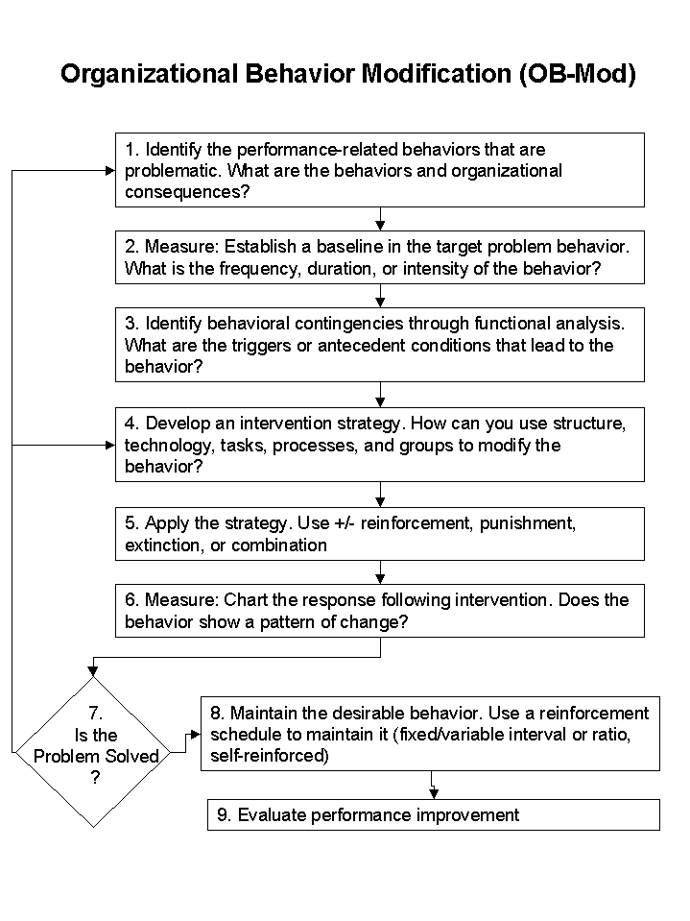
2. Link rewards to performance
OBM - Apply reinforcement theory to the management of workplace behavior
Systematic manipulation of consequences for behaviors and results
Leverages robust learning theory principles
Focuses on behavior not person
Presents clear consequences
Context sensitive!
Safety behaviors and pizza delivery
Selectors and quantity/quality goals at Merchandize Distributors Inc.
Poker hands and absence control
Morton-Thiokol and O-ring defects

Slide 6
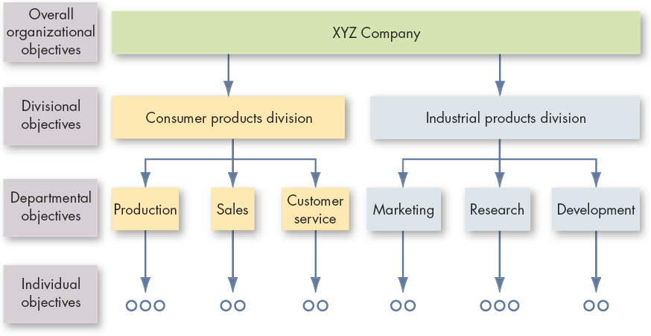
3. Engage individuals’ aspirations
Establish a goal-setting system that is SMART
Specific goals
Measurable outcomes that permit monitoring
Achievable, yet difficult
Relevant to larger outcomes
Time-based
MBO
Do your best
Increase sales
Sell more men’s suits
Sell 120 men’s suits by quarter’s end
Management by Objectives

Slide 7
4. Clarify path-goal relationships
Training
Resources
Teamwork
Rating bias
Record errors
Org solvency
Effort
Performance
Outcome
Expectancy
Instrumentality
Valence
Expectancy Theory of Motivation (Victor Vroom)
V-I-E
Rational Hedonism

Slide 8
Paths & Choices
Effort Exam Grade World History
.50 .33
Effort Exam Grade Finance
.50 .33
Effort Exam Grade Sociology
.75 .20
Effort Exam Grade Marketing
.25 .33

Slide 9
5. Make the work meaningful
Have you both loved and hated your job?
Herzberg’s 2-factor theory explains this confusion
Motivators / Content
achievement
responsibility
recognition
growth
work itself
Compensation serves as both a signal of achievement and as a means of satisfying lower-order needs
Hygiene / Context
policy
supervision
coworkers
work conditions
subordinates
Salary
and other rewards

Slide 10
Herzberg
Unidimensional
dissatisfaction satisfaction
Two-factor
high satisfaction
no dissat high dissat
no satisfaction
Herzberg was a Public Health Administrator
‘hygiene’
lower- vs. higher-order need satisfaction
Novelty of ideas
Attributions as artifact?
two vs. unidimensional view of satisfaction

Slide 11
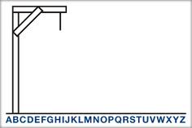
KITA
A motivational technique
imported from the Far East?
No, just old wine
positive
seduction
negative
rape
employees as pets
__ __ __ __ __ __ __ __ __ __ __ __

Slide 12
Job Characteristics Model
Job Characteristics
Skill variety
Psychological States
Experienced Meaningfulness
Psychological and Behavioral Outcomes
Satisfaction
Turnover
Task identity
Task significance
Autonomy
Feedback
Responsibility
Knowledge of results
Performance
The Job Characteristics Model by Hackman & Oldham
Vertical versus horizontal loading of jobs
Job enrichment versus enlargement
Moderators such as Growth Need Strength

Slide 13
6. Empower employees
Self-determination theory advocates employee autonomy
Understanding the effects of rewards requires a consideration of the interpretation that recipients give to the receipt of a reward
In terms of self-determination and competence
Needs for competency and autonomy underlie intrinsic motivation
Anything that detracts from these feelings reduces IM
Coercive reward systems undermine motivation
Satisfying the need for relatedness serves to enhance IM
Underscores the importance of coworker and leader relationships
Also emphasizes the idea that employee identification with goals and purpose of firm support self-determination perceptions

Slide 14
A continuum of Self-Determination
Amotivation
Extrinsic Motivation
Intrinsic
Motivation
Absence of Intentional Regulation
External
Regulation
–
Reward & Punishment
Introjected Regulation
–
Self-image
-ego-
Identified Regulation
–
Importance of Goals-Values-Regulations
Integrated Regulation
–
Coherence of GVRs with self
Interest & enjoyment of the task
Non-volitional
Behavior –
Coercion
Volitional
Behavior
Semi-volitional Behavior
Gange & Deci (2005)

Slide 15
7. Check the system for fairness
Justice theories explain justice perceptions
One form is Distributive Justice
equitable versus equal distribution of outcomes
Equity theory and the equity ratio
Salary
Working conditions
Supervisor
Coworkers
Self Outputs
Other Outputs
Self
Inputs
Other Inputs
Effort
Education
Experience
OCBs

Slide 16
Procedural & Interactional Justice
Procedural Justice
involves how the distribution was determined
participation
accuracy
appeals
may offset feelings of poor distributional outcomes
Interactional Justice
Interpersonal treatment when procedures are implemented
Politeness, respect, dignity, adequacy of explanation
The appraisal interview & performance narratives
How to implement in a performance management system?

Slide 17
8. Provide support and respect
Self-efficacy theory (Albert Bandura)
Confidence that one can execute a behavior competently
Enactive mastery – previous success & experience
Vicarious modelling – observing others’ success
Verbal persuasion – encouragement by others
Discomfort versus Self-efficacy
Relevant to goal-setting and expectancy theories
Rater
Self-efficacy
Ratings
Rater Discomfort

Slide 18
Organizational support
Material and psychological support for work
Capacity x Willingness x Opportunity = Performance
Capacity = ability
Willingness = motivation
Opportunity = situation
Opportunity has been the neglected variable
Opportunity can be considered facilitators or if obstacles that impede performance, then they are constraints
Situational constraints act as a ceiling effect on potential maximum performance
Capacity
Opportunity
Willingness

Slide 19
Everyone has a favorite theory
Self-determination
Rational
Instrumental
Equity
Pre-destined
Our values likely influence if not determine our theoretical predilections.
You might ask yourself “What do I believe best explains human motivation. What assumptions do I make about the human condition to arrive at that favored theory?”
Do you maintain a more optimistic or pessimistic view of human motives?

