Slide 1
CHARACTERIZATIONS OF THE NATURE OF WORK
NECESSARY EVIL
religious & secular origins; coercive
VIRTUE
early Christians; Protestant Ethic; moral
INSTRUMENTALITY
reinforcement theory; Fred Taylor; “economic imperialism”; economic calculation of utility
INTRINSICALLY GOOD ACTIVITY
self-actualization; psychological; esteem
MLK audio

Slide 2
Values and Attitudes
Values
early socialization
stable
more broad
hard to change
form basis of attitudes
Attitudes
encounter driven
less stable
specific to “attitude object”
reflect application of values; often a combination of multiple values

Slide 3
Attitude Components
A. Affective
expressed evaluation of the object
How one feels
B. Behavioral
expressed intention or actual doing
What one does or intends to do
C. Cognitive
expressed beliefs about the object
What one thinks or believes

Slide 4
Azjen-Fishbein Model of Reasoned Action
V
a
l
u
e
s
Attitude
Behavior
Intention
Perceived Subjective Norms
Contingencies
Perceived Behavioral Control

Slide 5
Attitude Change & Maintenance
Balance Theory
people desire to maintain balanced relationships involving others and attitude objects
P-O-X relations
interpersonal
Cognitive Consistency Theory
people wish to maintain consistent beliefs about an attitude object
unqualified good/bad; no shades of gray
intrapersonal
O
P
X

Slide 6
Cognitive Dissonance Theory
Attitude - Behavior inconsistency creates psychological TENSION
When we maintain an original attitude and behave inconsistent with it
Strength of devotion to the idea/attitude
Desire to preserve one’s positive self-image
When we invest effort or resources in a decision it becomes difficult to change the direction of our behavior
Escalation of commitment
Penance
Severity of initiation

Slide 7
The Classic Study
Festinger & Carlsmith (1957)
boring task
attitude questionnaire (time 1)
Oops!
$1 $20
attitude questionnaire (time 2)

Slide 8
More Dissonance Research
Handicapped Access
Identified students who strongly advocate handicapped access
counter attitudinal vs. neutral essay
offered opportunity to help by volunteering to escort a handicapped student on campus
Sexual Discussion Group (1960)
women’s campus
recite passages from romance vs. explicit erotic novel
offered opportunity to return to next group meeting as a full member

Slide 9
Buyer’s Remorse as Dissonance
Decisions to join groups or organizations are susceptible to dissonance effects
severity of initiation produces greater desire to remain member of the group
Fraternities, sororities, elite groups, cults
electing to attend ASU
Purchasing Behavior
buying a car or computer for example, produces a desire to avoid ‘buyer’s remorse’ and to confirm the wisdom of your decision

Slide 10
Social Judgment Theory
Likelihood of attitude change is influenced by the extremity of the attitude and the degree of ego involvement in the attitude
Latitude of Acceptance narrower when ego involvement is high; tolerance of diverse views is constrained
more similar views are ‘assimilated’ and views in the rejection area are seen as more different than they actually are - contrasted.
Initial position
Latitude of Acceptance
Latitude of Rejection

Slide 11
Job Satisfaction
Top Occupations in Job Satisfaction
1 Clergy 3.79 87.2
2 Physical Therapists 3.72 78.1
3 Firefighters 3.67 80.1
4 Education Administrators 3.62 68.4
5 Painter, Sculptors, Related 3.62 67.3
6 Teachers 3.61 69.2
7 Authors 3.61 74.2
8 Psychologists 3.59 66.9
9 Special Education Teachers 3.59 70.1
10 Operating Engineers 3.56 64.1
11 Office Supervisors 3.55 60.8
12 Security & Financial Services Salespersons 3.55 65.4
Bottom Occupations in Job Satisfaction
1 Roofers 2.84 25.3
2 Waiters/Servers 2.85 27.0
3 Laborers, Except Construction 2.86 21.4
4 Bartenders 2.88 26.4
5 Hand Packers and Packagers 2.88 23.7
6 Freight, Stock, & Material Handlers 2.91 25.8
7 Apparel Clothing Salespersons 2.93 23.9
8 Cashiers 2.94 25.0
9 Food Preparers, Misc. 2.95 23.6
10 Expediters 2.97 37.0
11 Butchers & Meat Cutters 2.97 31.8
12 Furniture/Home Furnishing Salespersons 2.99 25.2
Rank, Occupations Mean Score, % Very Satisfied
Mean Score: Runs from 1 for someone who is Very Dissatisfied to 4 for someone who is Very Satisfied.
Job Satisfaction: On the whole, how satisfied are you with the work you do—would you say you are very satisfied, moderately satisfied, a little dissatisfied, or very dissatisfied?
The Society for Human Resource Management (SHRM), an international association of HR professionals, found 80 percent of workers liked their jobs. Sirota Consulting, a New York-based attitude research company, reported a satisfaction rate of 76 percent. Harris Interactive is one of several companies reporting less positive findings. A market research firm, it found 41 per cent disliked their jobs. The Conference Board, a management advisory organization, placed the satisfied figure at 50 percent in one poll and much lower in another. Conducted for the Conference Board by research agency TNS, it said 25 percent of American workers admitted they are just "showing up for a paycheck."

Slide 12
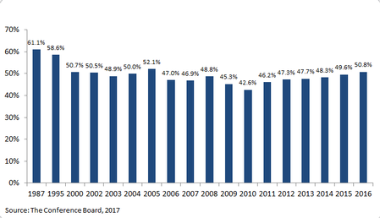
Job Satisfaction Finally on Rise
Traditionally 65% report being satisfied or very satisfied
Low of 42.6% reached in 2010; recent trend upwards
Conference Board Survey 2017

Slide 13
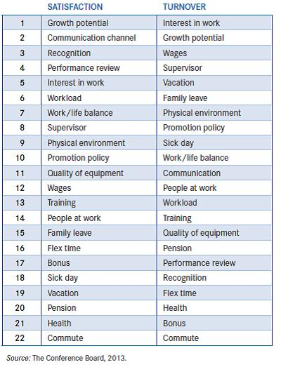
Conference Board Survey 2013 The most important determinants of Satisfaction & Turnover
Different factors more important for each but look at the top 10 for common causes.
Men & women have similar rankings; promotion and wages more important for men – work-life balance, co-workers, flex time for women.
For workers under 35, supervisor and coworkers are more important than other age groups; for over 55, job security and workload.

Slide 14
Job Satisfaction
Of importance since Hawthorne
Is ‘the job’ one idea in the minds of people?
Global (☺ - 😐 - ☹) versus Facet satisfaction
Five core Facets of the job
pay
advancement opportunities
the work itself
coworkers
supervisor
Other Facets may apply to different jobs
based on industry (healthcare; hospitality)

Slide 15
Satisfaction & Performance Models
Satisfaction Performance
Performance Satisfaction
Bi-directional causality
Third variable account
r~.30s
Satisfaction
Performance
Organizational Citizenship Behaviors

Slide 16
Organizational Citizenship Behaviors (OCBs)
Compliance
complies with rules
follows policy
arrives on time
does not abuse breaks
responsibly consumes resources
courteous
Altruism
offers assistance
mentors others
arrives early, stays late
assumes additional roles
trustworthy
takes initiative
fosters morale

Slide 17
Organizational Commitment
In spite of job dissatisfaction, people remain
Organizational commitment is a stabilizing force that acts to maintain behavioral direction when expectancy/equity conditions are not met
What mechanisms operate to sustain behavior in the face of disappointment?
Parents don’t easily give up on children
Consumers remain loyal to brands despite evidence
Employees don’t quit out of hand when the employment relationship erodes

Slide 18
3-Factor Structure of Organizational Commitment
Normative commitment
the desire to stay with an organization based on a sense of duty, loyalty or moral obligation
- as a moral obligation; reciprocity
Affective commitment
the emotional attachment a person feels for the organization because they believe their goals and values are congruent with that of the organization
- as an attitude; social identity
Continuance commitment
the desire to remain with the organization based on the costs of leaving or a sense that available comparable alternatives are limited
- as an instrumental calculation; investments & side-bets

Slide 19
The EVLN Model
 | Active | Passive
Destructive | EXIT | NEGLECT
Constructive | VOICE | LOYALTY

Slide 20
Conference Board Survey
The Ages of Satisfaction
Less than two out of every five workers under the age of 25 are satisfied with their jobs. This segment of the population has the lowest level of satisfaction and the lowest level ever recorded in the nearly 20-year history of this survey.
Workers age 45-54 expressed the second lowest level of satisfaction with less than 45 percent content with their current job.
At the other end of the scale are workers 55-64 and 65 and over. Nearly half of all workers in these age groups are satisfied with their employment situation.
Money Does Buy Some Satisfaction
As expected, the lowest level of job satisfaction is exhibited among workers earning $15,000 or less per year.
Workers whose earnings exceed $50,000 per year, at 52 percent, are the most satisfied with their employment situation.
What About the Job?
Employees rated bonus plans and promotion policies as the least satisfactory benefits of employment, with less than 23 percent claiming they are satisfied with their company's policies.
Educational and job training programs as well as non-monetary reward/recognition and performance review processes did not fare well either. Less than 30 percent of respondents claim to be satisfied with these job aspects.
Less than 36 percent of employees expressed contentment with their workload, work/life balance, communication channels and potential for growth.
At the other end of the scale, more than 56 percent of workers are satisfied with their commute and co-workers as well as interest in their work.
Location, Location, Location
Less than 41 percent of householders in the Middle Atlantic states (NY, NJ and PA) claim to be satisfied with their current job.
The West South Central region (TX, OK, AR, LA) is home to the second least satisfied workforce. Only 43 percent of workers say they are satisfied with their overall employment situation.
The most content workers tend to reside in the Mountain states (MT, ID, WY, NV, UT, CO, AZ, NM). Here, 56 percent of all workers say they are satisfied with their job.

