Slide 1
Individual Differences
Those work-relevant characteristics, both innate and acquired, that account for work behavior differences
    Earlier: technical-interpersonal-conceptual differences in skill-sets
KSAO’s : HRM acronym
  Knowledge
  Skills
  Abilities
  Other Characteristics

Slide 2
Knowledge & Skills
Similar in that they are both:
    acquired, changeable through practice
    relatively easily and precisely measured
    easily made observable
  Knowledge
    possession of specific information
      traffic laws, accounting practices, market value
  Skill
    learned psycho-motor behavior
    behavioral application of knowledge
      driving test, report taxable income, residence

Slide 3
Abilities & Other Characteristics
Similar in that they are:
    not easily changed; stable
    usually difficult to measure accurately
    inferred; not directly observed
  Abilities
    mental (cognitive ability-IQ, verbal, math)
    physical (stamina, explosive strength)

Slide 4
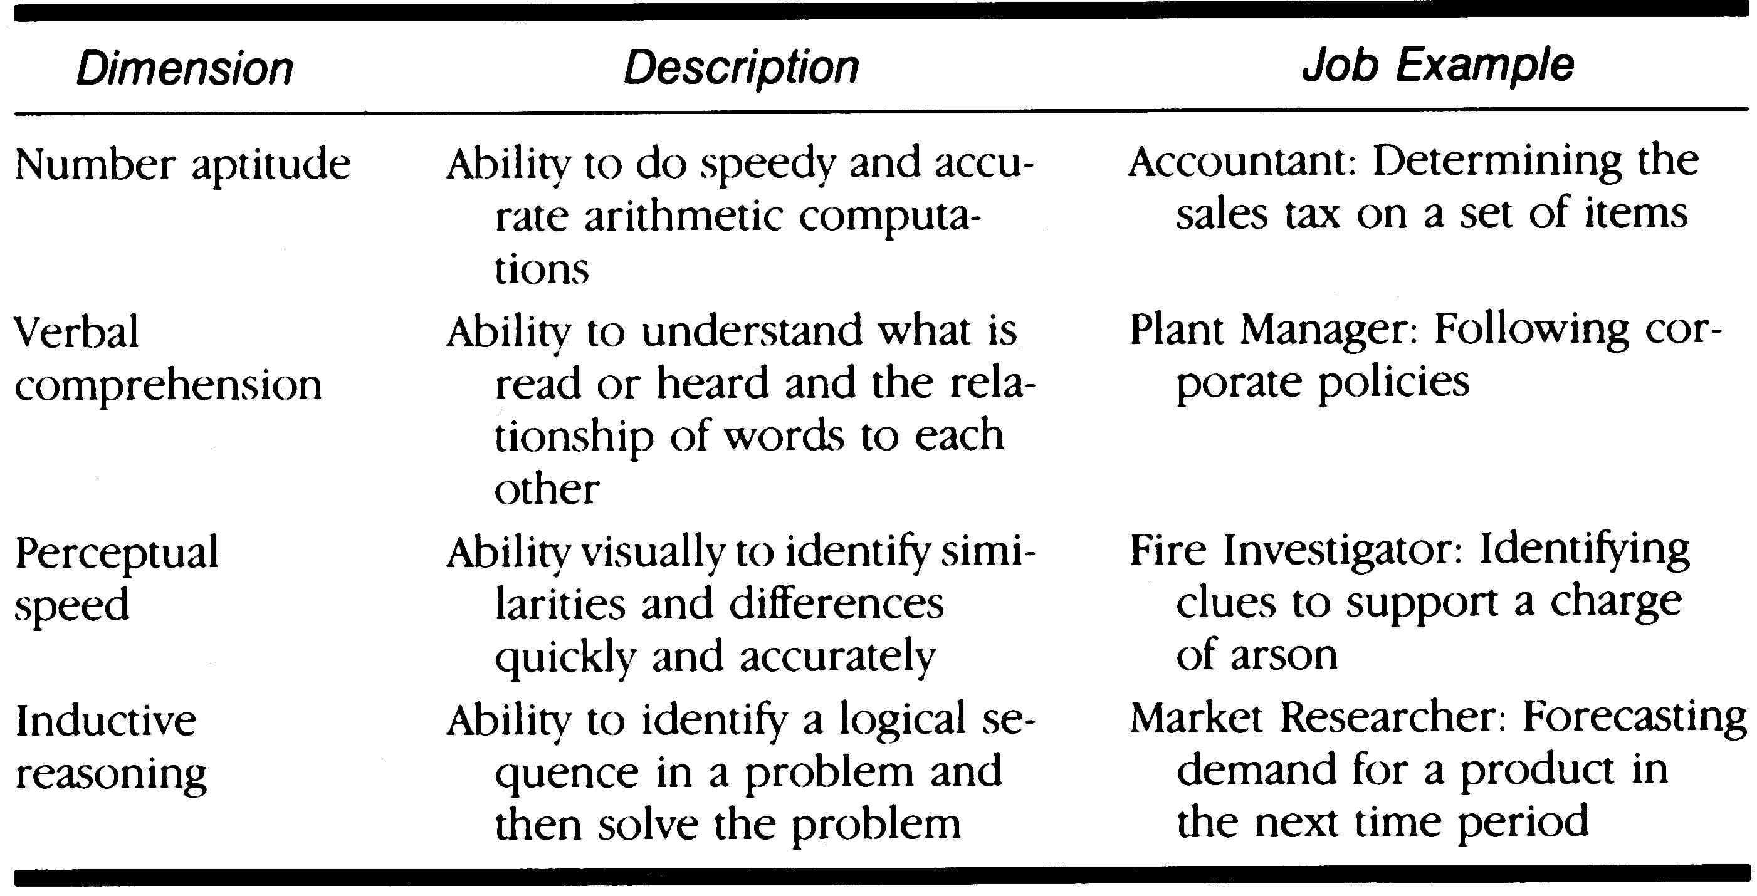
Cognitive Ability Examples in the Workplace

Slide 5
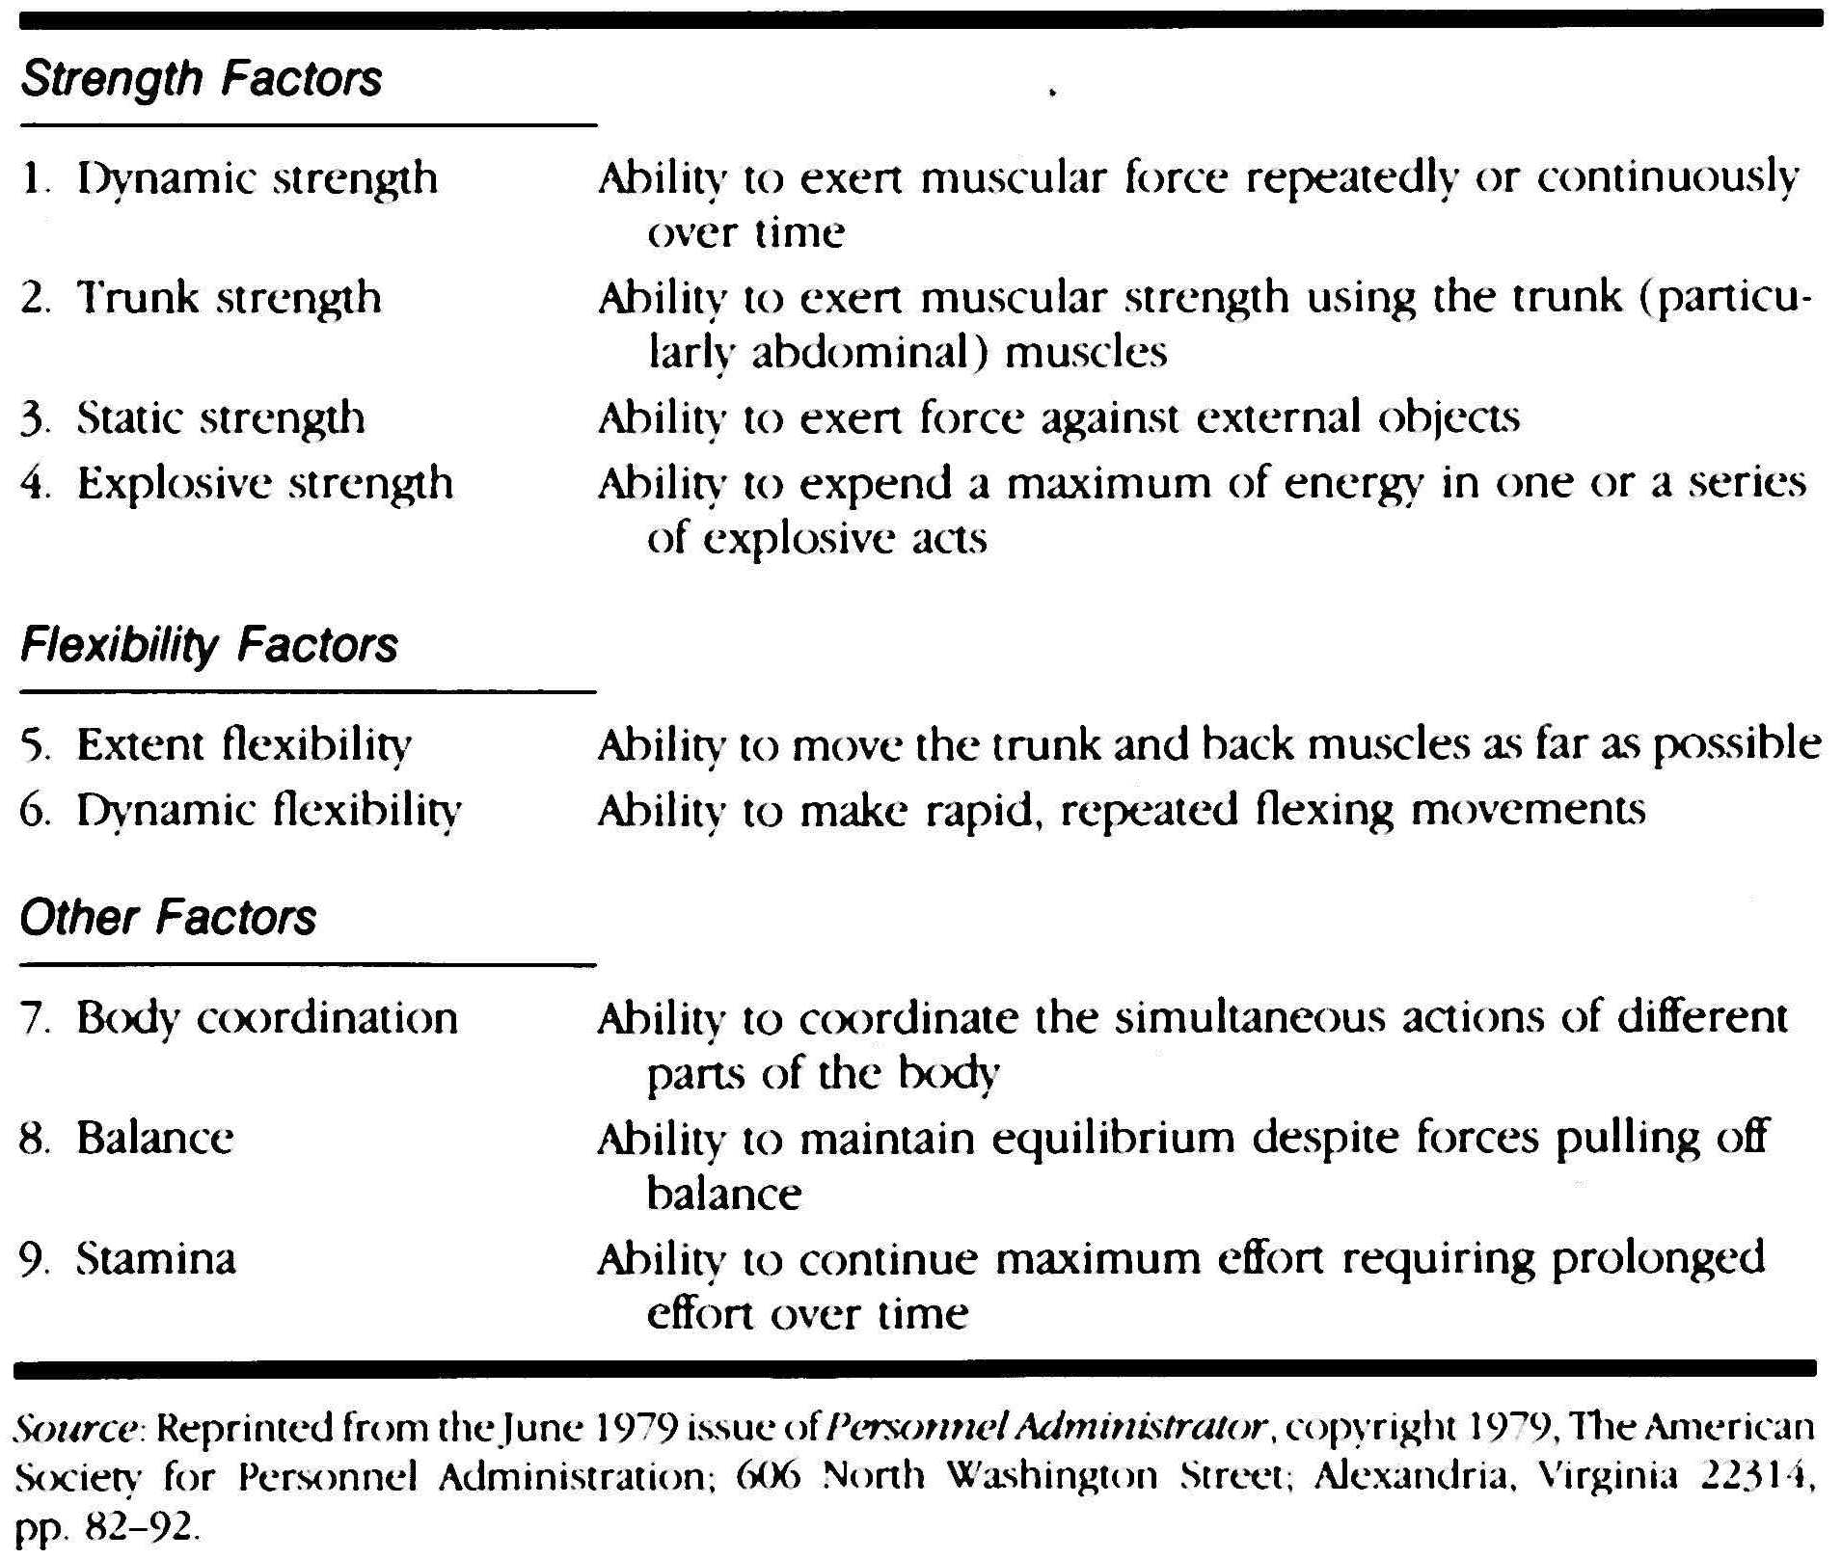
Physical Ability Taxonomy

Slide 6
City of San Diego Police Officer Physical Abilities Test

150 yards
150^{A} lb.
Dummy Drag
Stairs
3 ft barrier
75 lb. Handcuff Apparatus
120 yards
6 ft
barrier

^{A}In 2020, Average male (~200 lbs) and female (170 lbs) weight.

Slide 7
Other Characteristics
Personality
  relatively enduring behavioral predispositions that reflect both genetic and environmental influences
  stable
  difficult to change
  inferred
Biographical Data
  Experiential and accomplishment differences
  education level, work history, leadership, group membership, history of working in teams, etc.

Slide 8
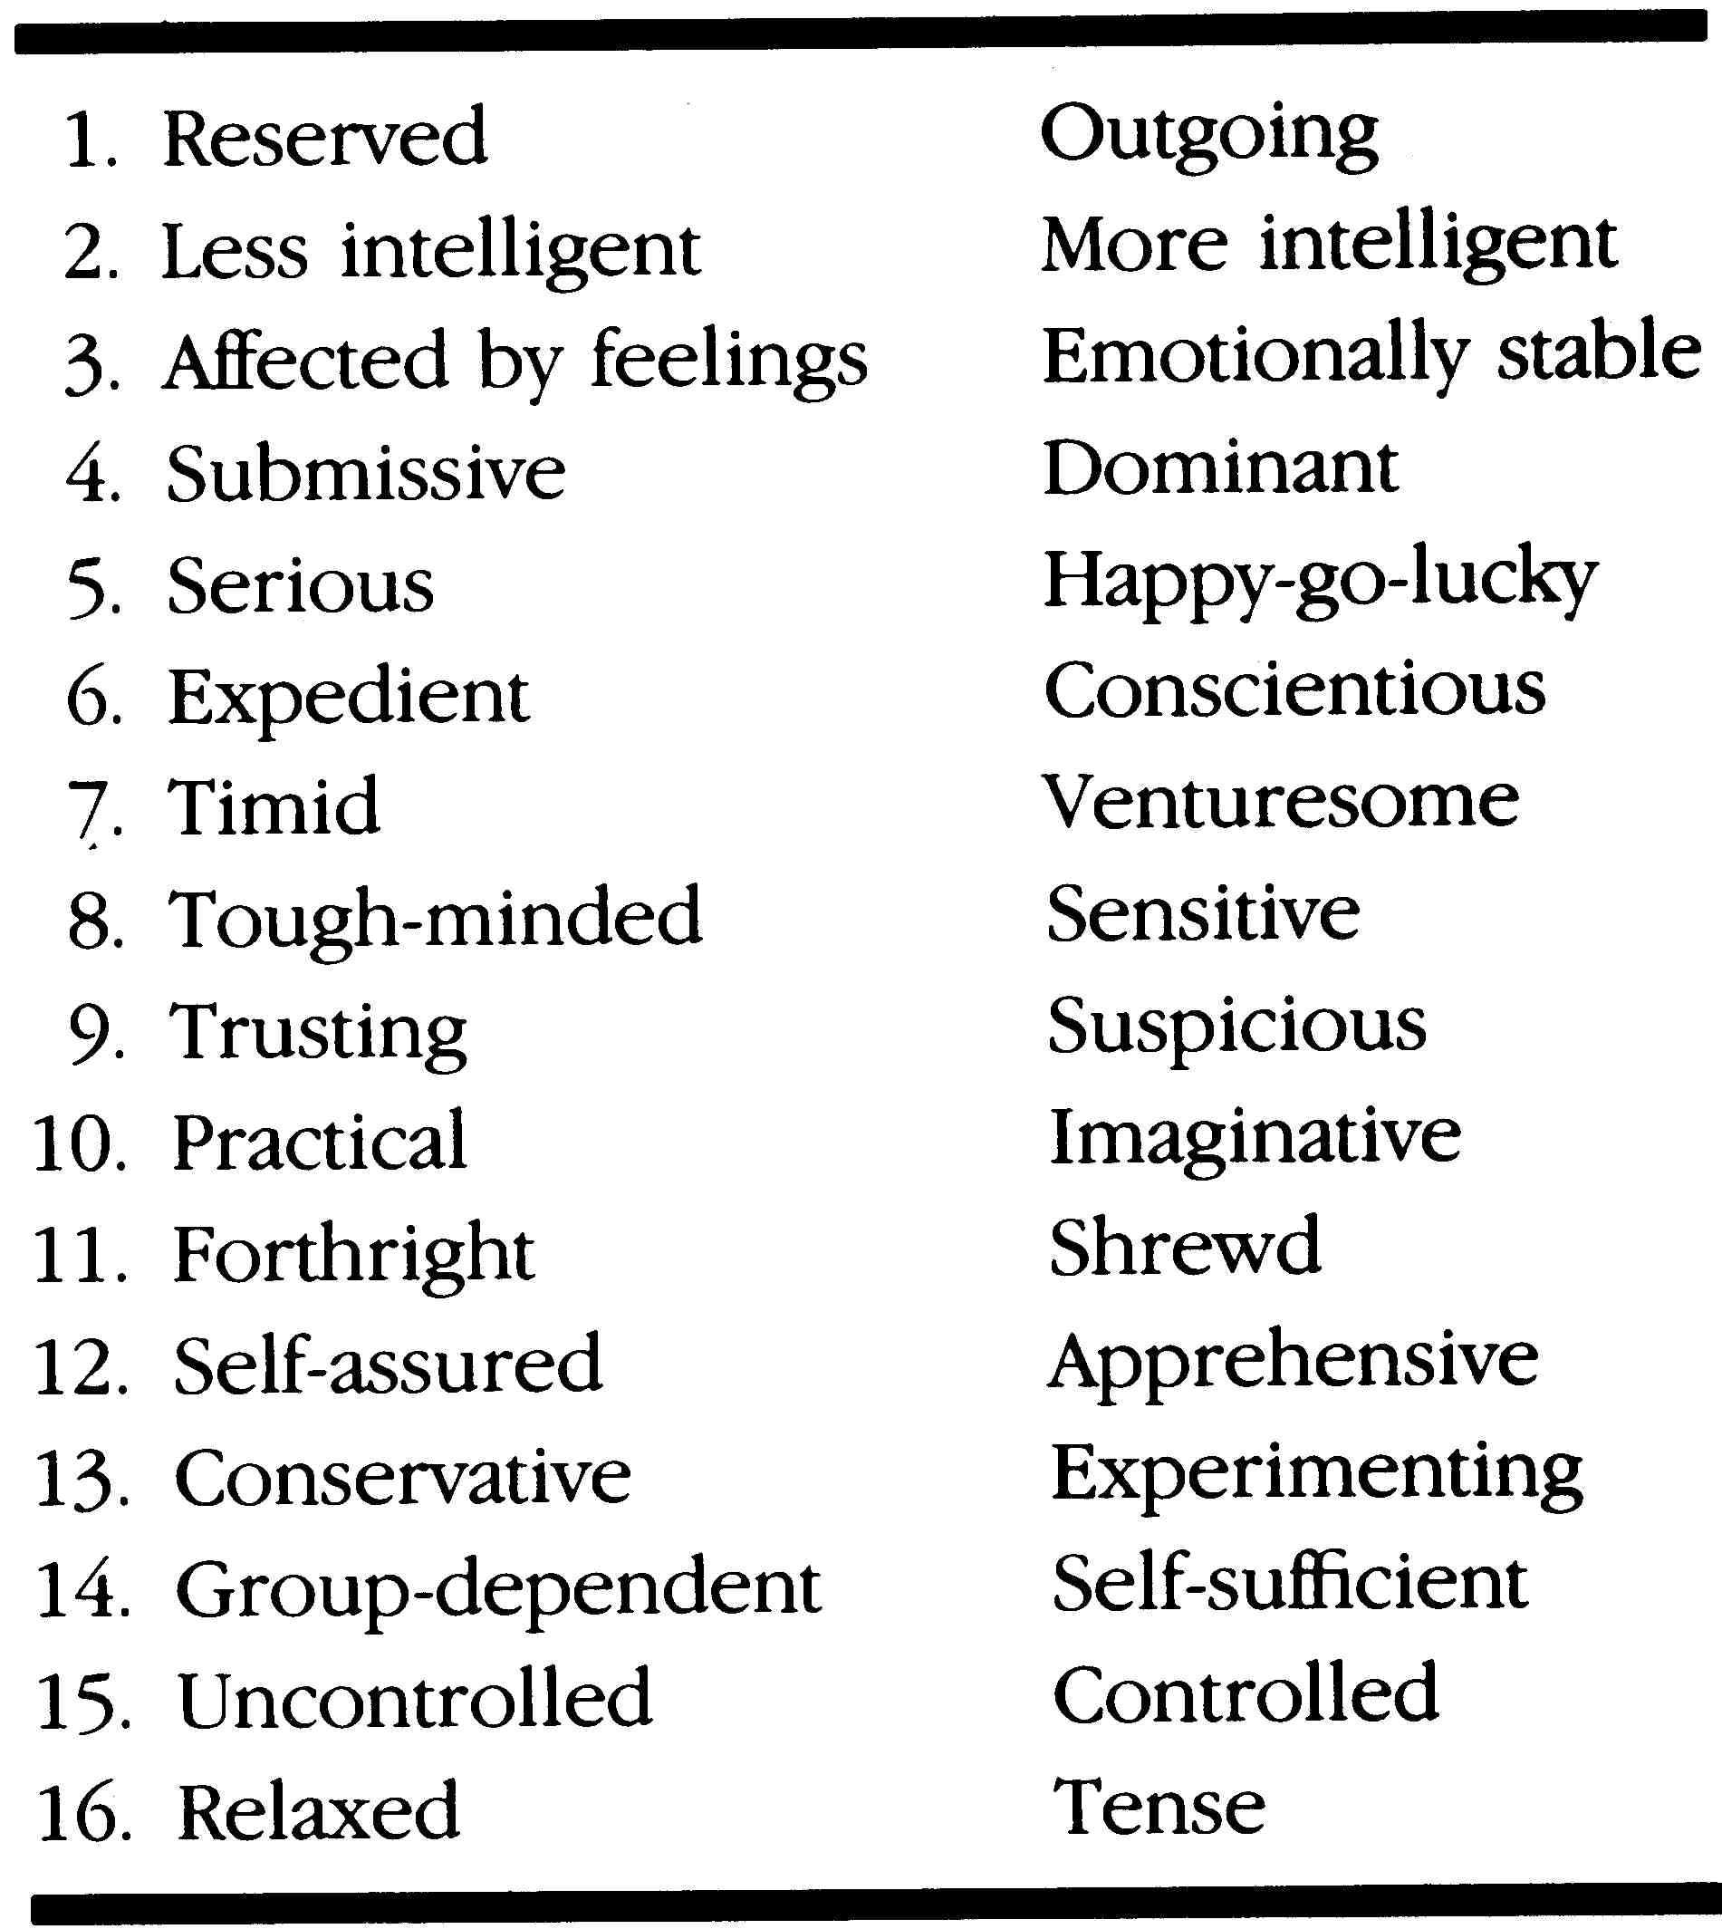
16 Personality Factor Questionnaire Source Traits
Raymond Cattell
chemistry major
sought ‘elements’ of behavior
personality traits as basic elements
ERGs
  internal drives
Sentiments
  cultural socialization
ERGs & Sentiments combine to (direct) behavior

Slide 9
16PF Factors
Descriptors of Low Range | Primary Factor | Descriptors of High Range
Reserve, impersonal, distant, cool, reserved, impersonal, detached, formal, aloof (Sizothymia) | Warmth | Warm, outgoing, attentive to others, kindly, easy going, participating, likes people (Affectothymia)
Concrete thinking, lower general mental capacity, less intelligent, unable to handle abstract problems (Lower Scholastic Mental Capacity) | Reasoning | Abstract-thinking, more intelligent, bright, higher general mental capacity, fast learner (Higher Scholastic Mental Capacity)
Reactive emotionally, changeable, affected by feelings, emotionally less stable, easily upset (Lower Ego Strength) | Emotional Stability | Emotionally stable, adaptive, mature, faces reality calm (Higher Ego Strength)
Deferential, cooperative, avoids conflict, submissive, humble, obedient, easily led, docile, accommodating (Submissiveness) | Dominance | Dominant, forceful, assertive, aggressive, competitive, stubborn, bossy (Dominance)
Serious, restrained, prudent, taciturn, introspective, silent (Desurgency) | Liveliness | Lively, animated, spontaneous, enthusiastic, happy go lucky, cheerful, expressive, impulsive (Surgency)
Expedient, nonconforming, disregards rules, self indulgent (Low Super Ego Strength) | Rule-Consciousness | Rule-conscious, dutiful, conscientious, conforming, moralistic, staid, rule bound (High Super Ego Strength)
Shy, threat-sensitive, timid, hesitant, intimidated (Threctia) | Social Boldness | Socially bold, venturesome, thick skinned, uninhibited (Parmia)
Utilitarian, objective, unsentimental, tough minded, self-reliant, no-nonsense, rough (Harria) | Sensitivity | Sensitive, aesthetic, sentimental, tender minded, intuitive, refined (Premsia)
Trusting, unsuspecting, accepting, unconditional, easy (Alaxia) | Vigilance | Vigilant, suspicious, skeptical, distrustful, oppositional (Protension)
Grounded, practical, prosaic, solution orientated, steady, conventional (Praxernia) | Abstractedness | Abstract, imaginative, absent minded, impractical, absorbed in ideas (Autia)
Forthright, genuine, artless, open, guileless, naive, unpretentious, involved (Artlessness) | Privateness | Private, discreet, nondisclosing, shrewd, polished, worldly, astute, diplomatic (Shrewdness)
Self-Assured, unworried, complacent, secure, free of guilt, confident, self satisfied (Untroubled) | Apprehension | Apprehensive, self doubting, worried, guilt prone, insecure, worrying, self blaming (Guilt Proneness)
Traditional, attached to familiar, conservative, respecting traditional ideas (Conservatism) | Openness to Change | Open to change, experimental, liberal, analytical, critical, free thinking, flexibility (Radicalism)
Group-oriented, affiliative, a joiner and follower dependent (Group Adherence) | Self-Reliance | Self-reliant, solitary, resourceful, individualistic, self sufficient (Self-Sufficiency)
Tolerated disorder, unexacting, flexible, undisciplined, lax, self-conflict, impulsive, careless of social rues, uncontrolled (Low Integration) | Perfectionism | Perfectionistic, organized, compulsive, self-disciplined, socially precise, exacting will power, control, self �sentimental (High Self-Concept Control)
Relaxed, placid, tranquil, torpid, patient, composed low drive (Low Ergic Tension) | Tension | Tense, high energy, impatient, driven, frustrated, over wrought, time driven. (High Ergic Tension)

Slide 10
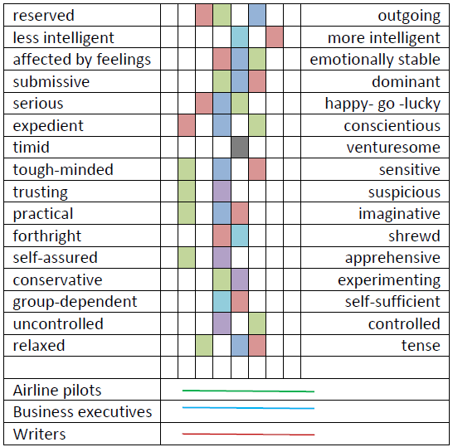
16PF Profiles

Slide 11
MMPI (Minnesota Multiphasic Personality Inventory)
Hypochondriasis (Hs, aka scale 1)
  Health anxiety
Depression (D or 2)
  Feelings of despondency and dejection
Hysteria (Hy or 3)
  Exaggerated and uncontrolled emotion/excitement
Psychopathic deviate (Pd or 4)
  Narcissistic, hostile, and exploitative tendencies
Masculinity/femininity (Mf or 5)
  Gender role identification
Paranoia (Pa or 6)
  Suspicion and mistrust without justification
Psychasthenia (Pt or 7)
  Excessive anxiety, phobias, and obsessions
Schizophrenia (Sc or 8)
  Confused perceptions and thinking about reality
Hypomania (Ma or 9)
  Disinhibition, excitable, elevated mood and activity
Social introversion (Si or 0)
  Social avoidance and social anxiety
10 major clinical subscales
Host of many component scales
567 items
True/not true
3rd most widely used psychological test
Only test used in courts
http://www.upress.umn.edu/test-division/mmpi-2/mmpi-2-scales

Slide 12
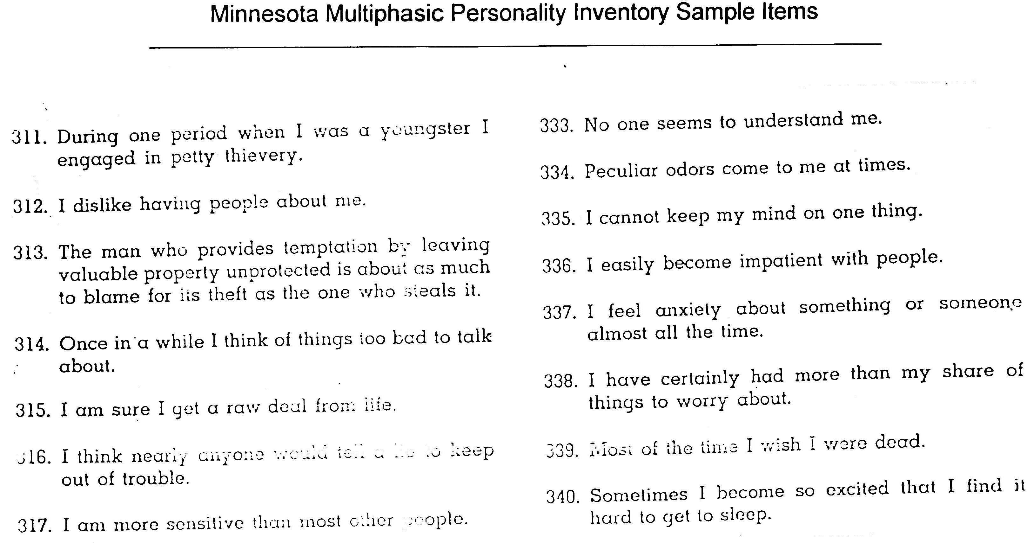

Slide 13
The Big 5 or More?
Agreeableness
Compliant; sensitive to opinion; yielding; trusting; altruistic
Conscientiousness
Organized; controlled; deliberate; disciplined; dutiful; focused
Emotional Stability
Well-adjusted; unworried; calm; confident; content
Extraversion
Outgoing; optimistic; gregarious; vigorous; active; assertive; warm
Openness
Dreamer; intellectually curious; open to ideas & values; tolerant; imaginative
Honesty-Humility
Integrity; rule-follower; uninterested in lavish wealth or material gain; non-entitled

Slide 14
Heritability of Traits
Trait | Heritability | Sex Differences
Extraversion | .54 | Yes; F higher
Agreeableness | .42 | Yes; F higher
Conscientiousness | .49 | Yes; F higher
Emotional stability | .48 | Yes; M higher
Openness | .57 | Probably not
Intelligence | .80s+ (in adults) | No
Vocational Interests | .30s+ (.40 artistic) | NA
Schizophrenia | .80 | No
Depression | .37 | Mixed Findings
Anti-social behavior | .40+ (in adults) | No
Anxiety Disorder | .30 | No
Thomas Bouchard (2004). Genetic Influence on Human Psychological Traits.
Schmitt et al. (2008). Sex Differences in Big 5 Across Personality Traits Across 55 Cultures.

Slide 15

Validity for Big 5 by Occupational Category
Personality Dimension | Sales | Customer Service | Managers | Skilled and Semi-skilled | JOB | Training
 |  |  |  |  | Performance
Conscientiousness | .29 | .27 | .19 | .17 | .24 |  | .03
Emotional Stability | .15 | .13 | .13 | .09 | .15 |  | .09
Agreeableness | .06 | .19 | -.04 | .11 | .12 |  | .21
Extraversion | .16 | .11 | .13 | .01 | .09 |  | .19
Openness | .04 | .17 | -.03 | -.02 | .06 |  | .14
Hurtz & Donovan 2000

Slide 16
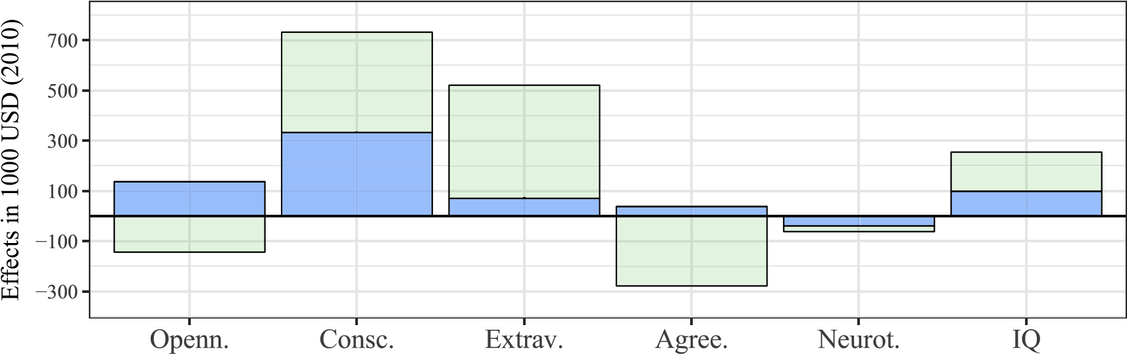
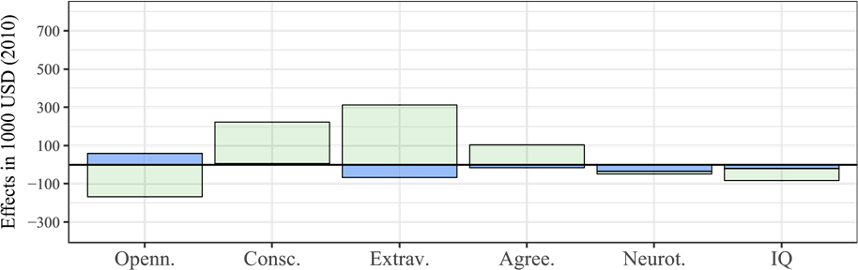
Personality & IQ on Lifetime Earnings
Male Data
Direct Effect of personality or IQ
Female Data
Indirect Effect thru
Education
Gensowski (2018). Personality & IQ on Lifetime Earnings

Slide 17
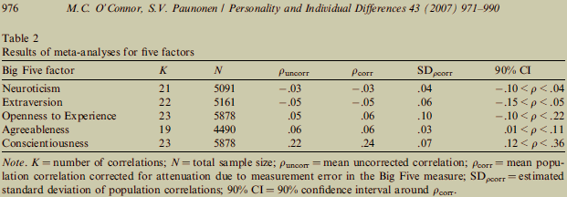
Big 5 and Academic Performance
How might each B5 factor be implicated in academic performance?
- managing anxiety and evaluation apprehension
- socializing or studying
- curious; tolerant of opposing ideas
- compliant; meeting expectations of others
- deliberate; organized

Slide 18
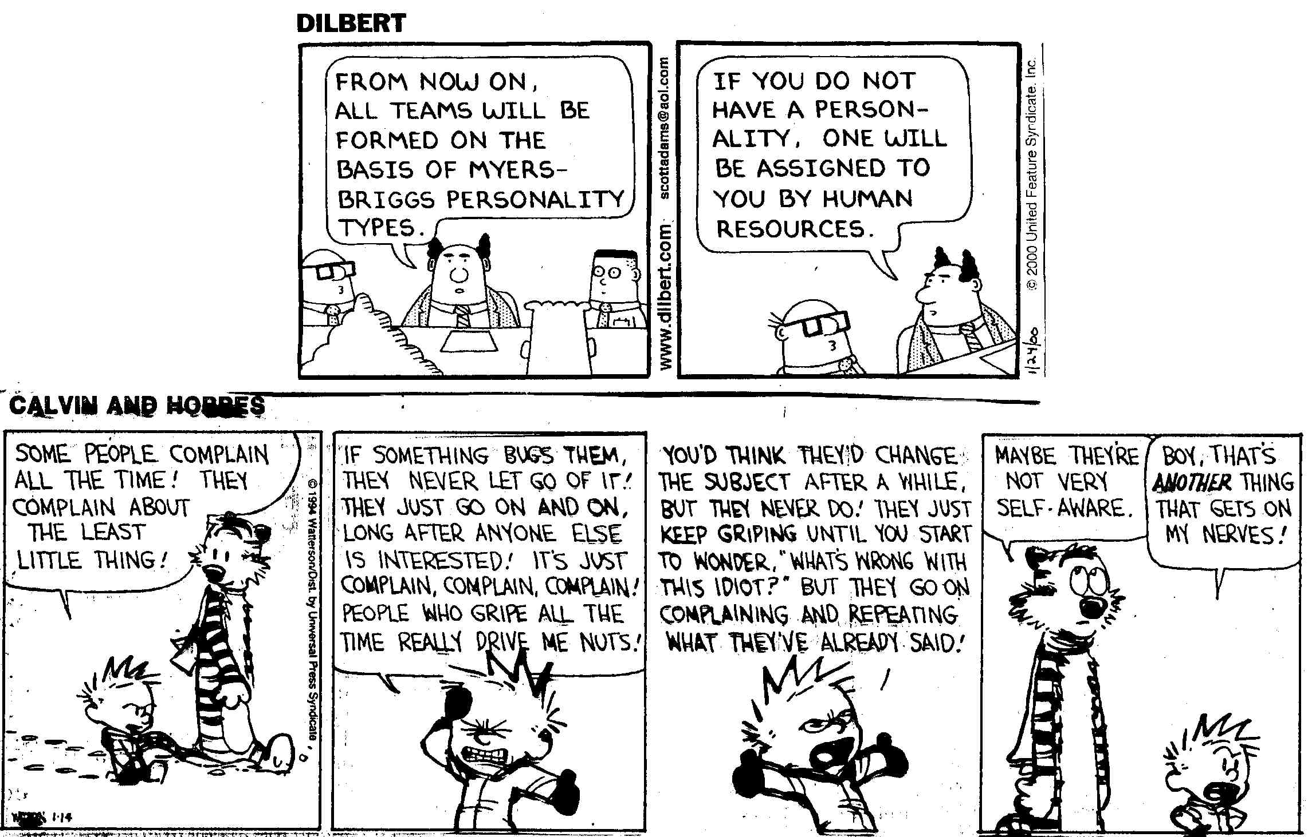

Slide 19
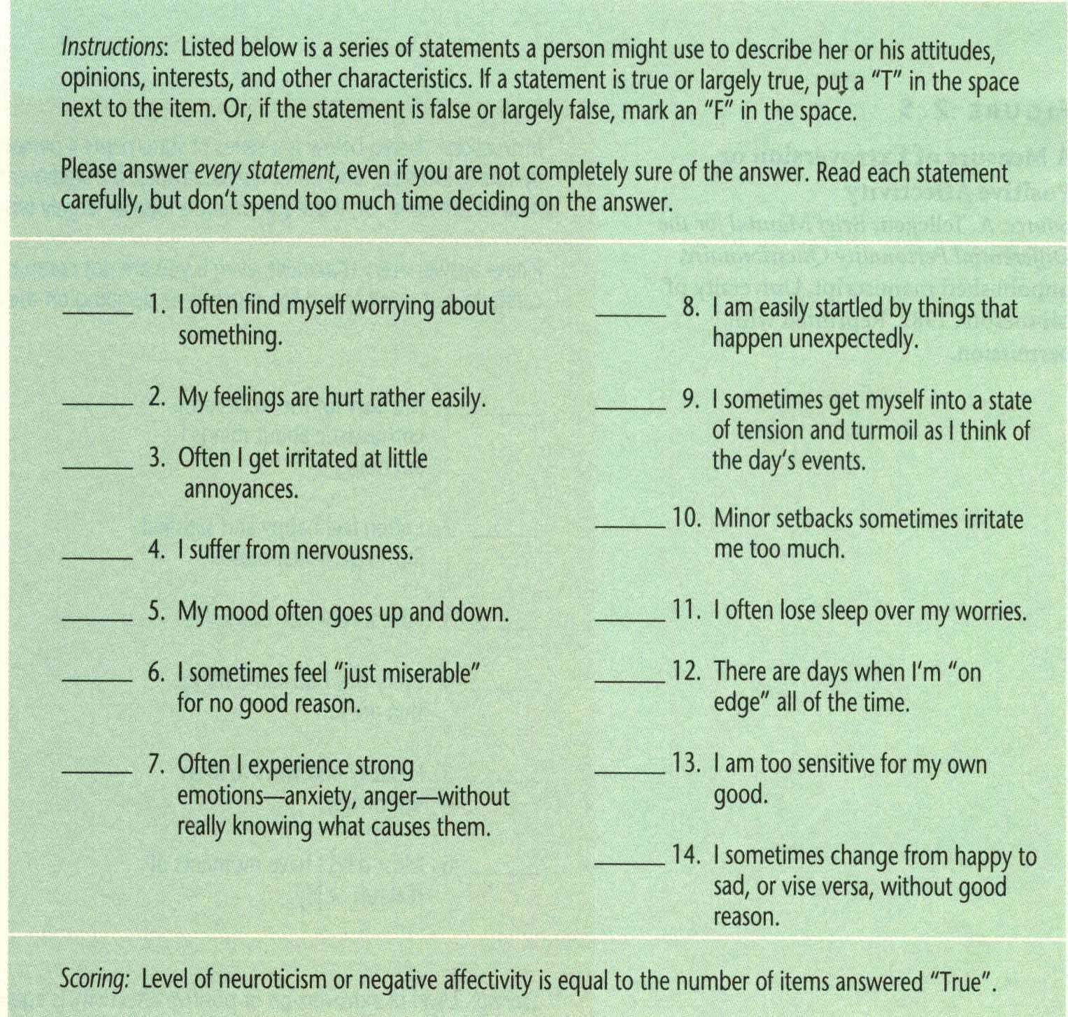
Negative Affectivity

Slide 20
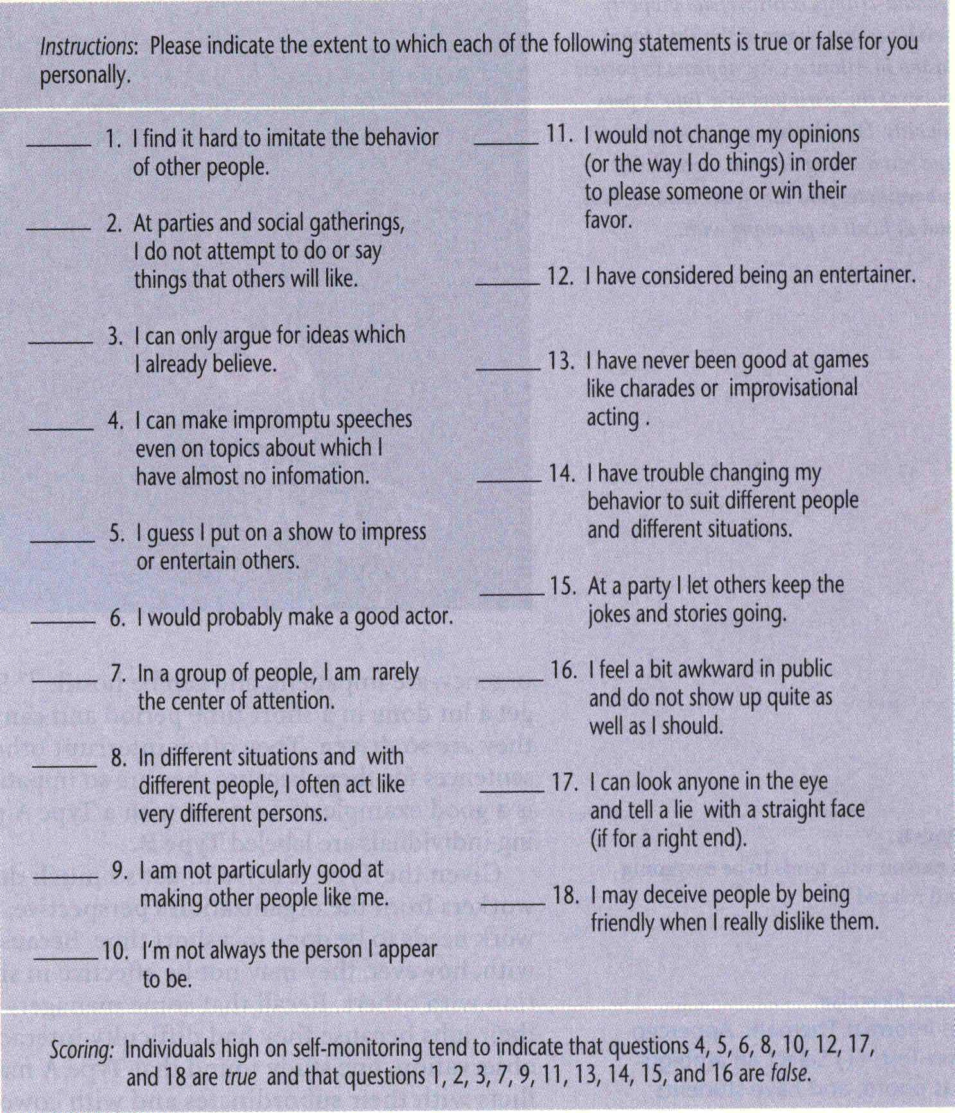
Self-Monitoring

Slide 21
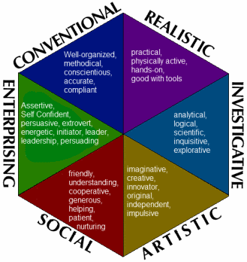
Holland’s Hexagonal Model of Occupational Personalities
Are your personal interests compatible with those of others who populate different occupations?
Occupational themes may be ‘oppositional’ or ‘congenial’

Slide 22
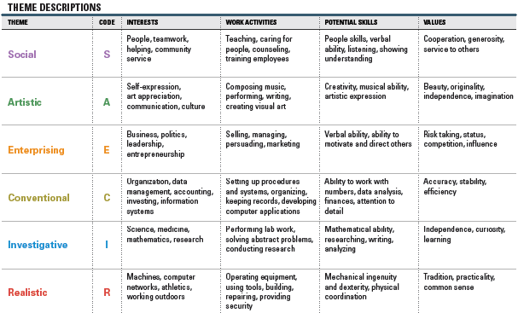
Hexagonal Model Themes
https://www.skillsone.com

Slide 23
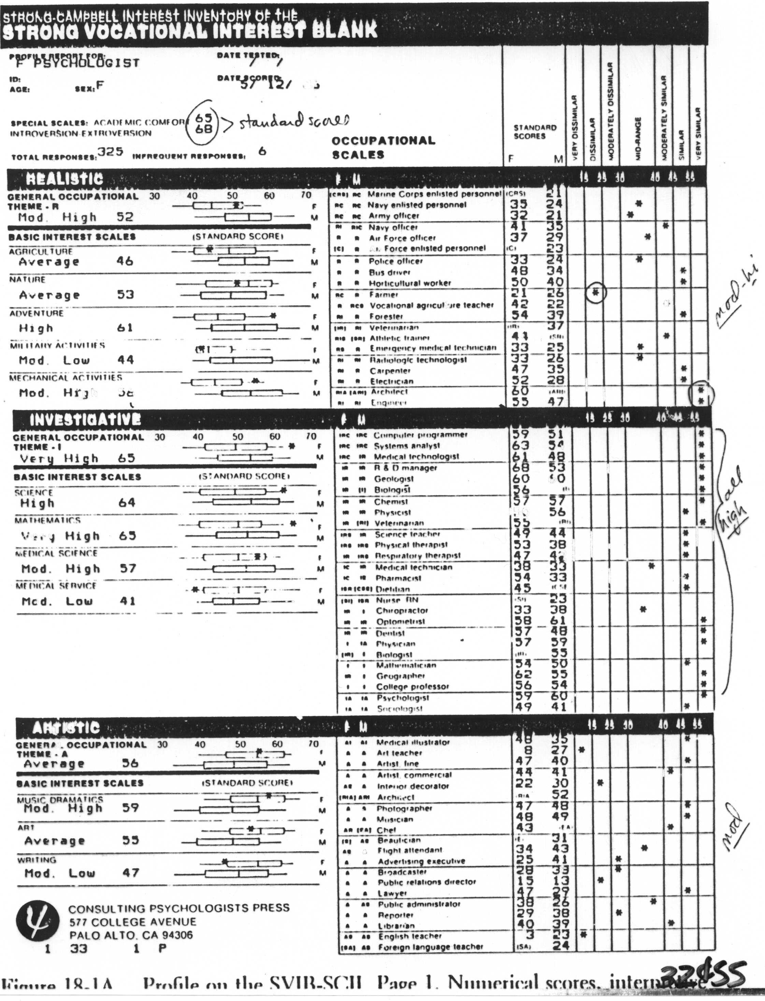
SVIB₁
The Strong-Campbell Vocational Interest Blank
28 year-old female psychologist
Page 1

Slide 24
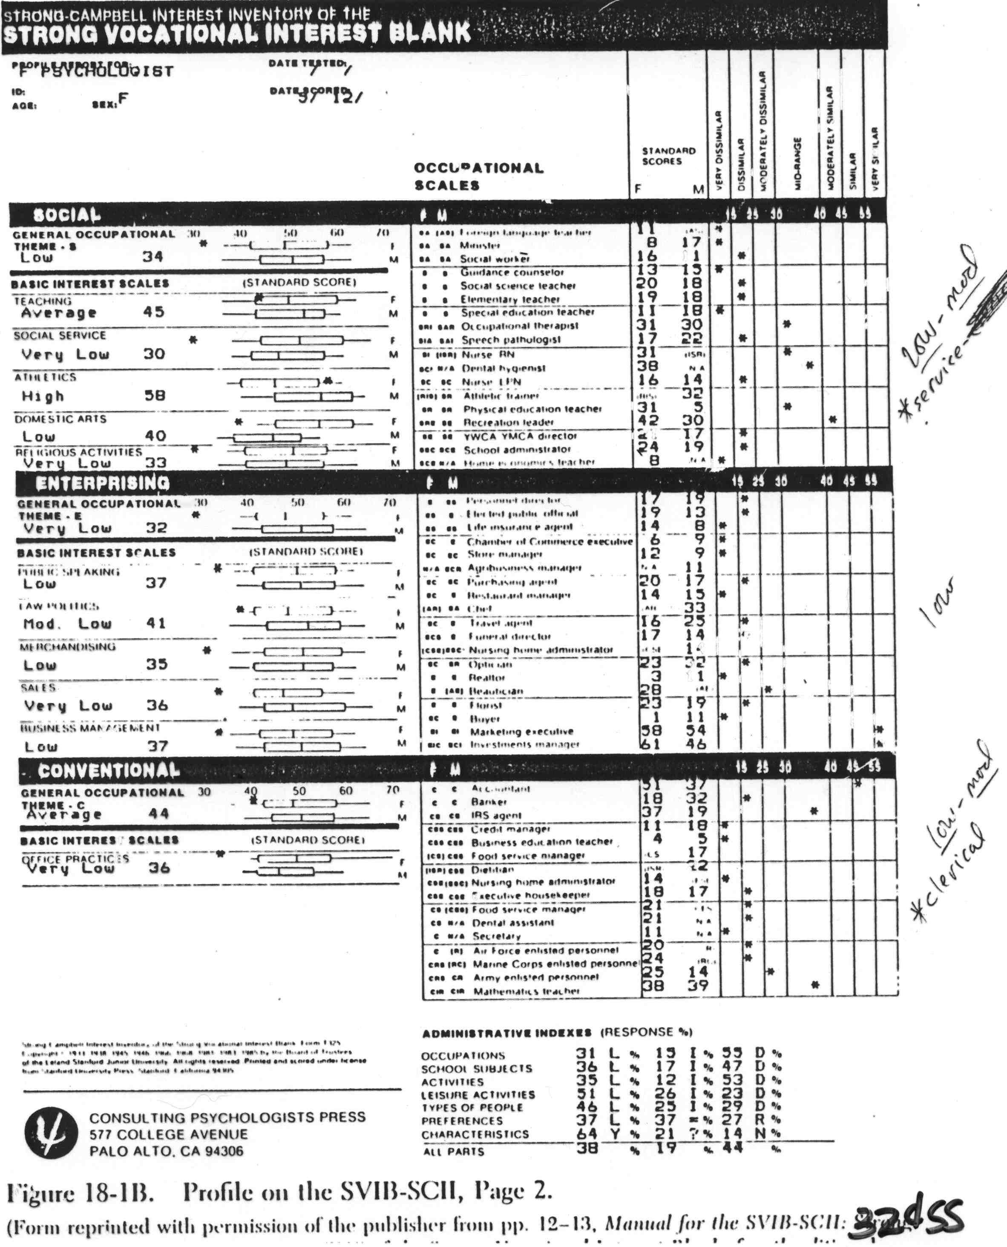
SVIB₂

Slide 25
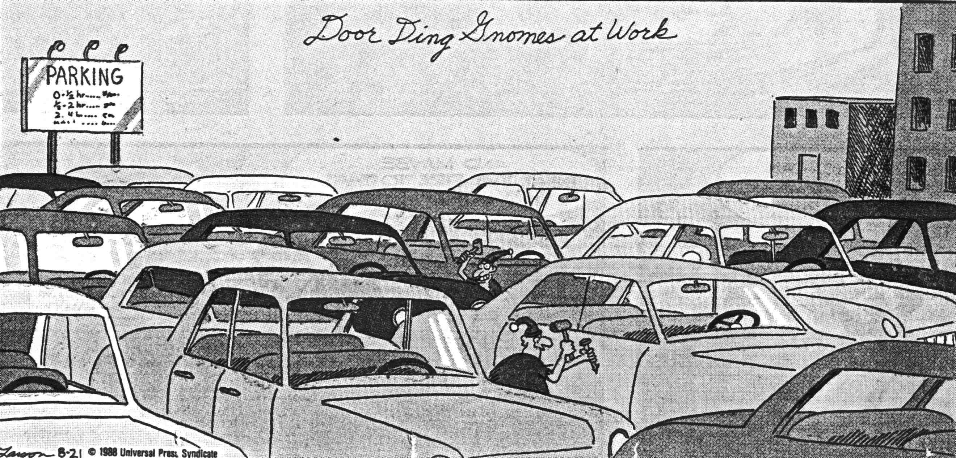
KSAOs?

