Slide 1
Metaphors of Organizations
Organizations are:
Machines – efficient, reliable, routine, control, order
Brains – intelligence, knowledge, learning systems
Cultures – values, beliefs, rituals, mission, vision
Political systems – power, authority, influence, leadership, spoils systems, conflict of interests
Psychic prisons – groupthink, sociopaths, dysfunctional family, anxiety, repression
Instruments of Domination – alienation, repression, exploitation, social and environmental degradation
Organisms – ontogeny, open systems, adapt, entropy

Slide 2
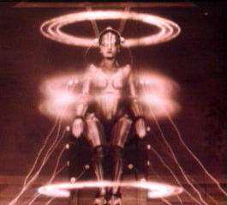
History of OB
Industrial Revolution
Disruptive societal changes
Fossil fuel energy
Factory system
Ensuing social chaos
Prevailing Metaphor of the Age
the ‘machine’
Characteristics of the machine
Structure-Components-Process
Max Weber Sir Francis Galton Frederick Taylor
The earliest recorded use of the word “weekend,” occurred in 1879 in an English magazine called Notes and Queries:
In Staffordshire, if a person leaves home at the end of his week’s work on the Saturday afternoon to spend the evening of Saturday and the following Sunday with friends at a distance, he is said to be spending his week-end at So-and-so.¹

Slide 3
Structure
Max Weber
Rational system of organization
Division of labor
Rules & regulations
Hierarchy of authority & limited span of control
Technical qualifications / certification
Impersonality of the office & temporary incumbency
Ideal Type
Idea that can only be approximated
Weber’s perfect form of an organization
Structured like a machine
Bureaucracy

Slide 4
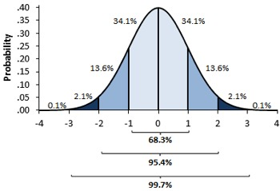
Components
Sir Francis Galton
Anthropometrist
Massive data collection on human attributes
Normal curve; Gaussian distribution
Correlation & Regression; Karl Pearson
Fingerprints
Genetic transmission of traits
Survival of the fittest
Applied also to human achievement
Employees as components of the machine that vary with respect to their likely success in responding to work demands – thus, need to be carefully selected

Slide 5
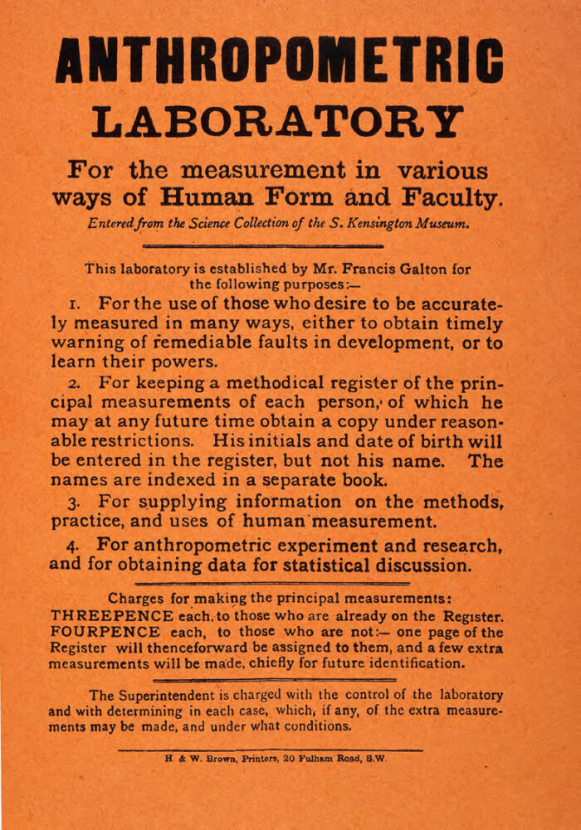

Slide 6
Process
Frederick Taylor
Optimizing the behavior of machine components
Taylor, Frederick Winslow (a.k.a. ‘Speedy’ 1856-1915), American industrial engineer, who originated scientific management in business. In 1878, he began working at the Midvale Steel Company. He refused admission to Harvard and instead became an apprentice machinist. His observations of work led to revolutionary changes in management practice.
Taylor developed detailed systems to gain maximum efficiency from both workers and machines in the factory. His systems relied on time and motion studies, to identify the best methods for performing a task in the least amount of time.
Taylor served as consulting engineer for several companies. His management methods were published in The Principles of Management (1911).

Slide 7
Scientific Management Ideas
To Maximize Performance & Efficiency
Systematic selection of employees
Training in the best methods
Customized tools and work aides
Incentives for good work
Management & Employee Relations
Management accountability
Management ‘Plans’ the work and Employees ‘Do’ the work
Characteristics of Employees
‘All the worker wants is money’
Theory X management

Slide 8
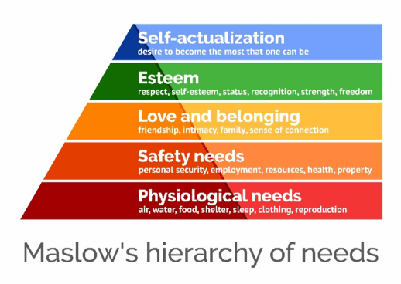
Human Relations Movement as a Challenge to Scientific Management
Hawthorne studies and World War 2 broadened recognition of social context variables as drivers of human behavior at work.
Work in this post-war period reflected a preoccupation with employee needs in all their complexity. Workers were no longer seen as working simply for a wage.
In response, a host of different need theories emerged, all of which somehow or another implicated worker participation as a panacea for industrial relations and productivity problems.

Slide 9
Human Relations Management
This ‘new management philosophy’ came to be termed by Douglas McGregor Theory Y management in contrast to what he called the established assumptions of scientific management which had prevailed - Theory X.
Theory X Theory Y
Employees wish to avoid work vs. Work is natural
Employees shirk responsibility vs. Desire responsibility
Employees must be coerced vs. Capable of self-direction
Employees seek security vs. Opportunities for growth
MGT role is to: control employees develop employee potential
Management training and education, leadership development, group processes, and employee attitude surveys were the rage.

Slide 10
Decline of the Human Relations Movement
No single management style emerged as best suited for all situations.
Slowing economic growth in the United States.
Successful global competition of Germany and Japan.
Increased cost of labor relative to capital expenditures for machinery.
Movement into the workforce of a more diverse and better educated population of employees.
Cynical use of human relations philosophy to obtain worker compliance in return for marginal gains in worker participation.

Slide 11
Circa 2000+ Management
diversity
empowerment
development
entire person
Rosabeth Moss Kanter
if x then y, else z
truth boundaries
Fred Fiedler & Frederick Herzberg
customer focus
system factors
statistical quality control
continuous improvement
W. Edwards Deming & Joseph Juran
biological metaphor
interdependence of subsystems
input–thru put-output
entropy
Daniel Katz & Robert Kahn

Slide 12
Open Systems Schematic
E n v i r o n m e n t
Economy & Labor
Legal & Regulatory
Competition
Suppliers
Consumers
Culture
Training
Materials
People
Capital
Transformation Processes
Business & Societal
Outcomes
INPUT
OUTPUT
Technology
Leadership
ENTROPY
Feedback

