Slide 1
Performance Management
  Consists of 4 components
    Criterion development
      Job analysis and identifying dimensions
        Identifying what contributions are valued
    Performance measurement
      Scaling performance
        Objective and/or subjective measures
    Performance appraisal
      Administering the process
        SMART goals, training, interviews
    Coaching
      Feedback and guidance

Slide 2
University Faculty Example
Criterion Dimensions | Specific Criteria | Specific Criterion Measures | Weight (Minimum versus Maximum) | Category or Rating Continuum
Scholarship | Publications | # in refereed journals vs chapters or invited papers | 30% - 50% | Fails to meet (1) Meets expectations (2) Exceeds expectations (3)
 | Presentations | National versus regional conferences
Teaching | Student evaluations | Ratings (1-5) or compared to department norms | 40% - 50%
 | Peer evaluations | Ratings and/or Narratives
Service | University | Univ-College-Dept Committees | 10% - 20%
 | External | Community

Slide 3
Criterion Development
Process of identifying contributions deemed worthy of recognition & reward
  Technical core
    Largely objective, bureaucratic
      Often results or behavioral prescriptions
  Contextual periphery
    Often subjective, personal
      Often supportive behaviors and attitudes
  Some combination of both constitute what we refer to as an Ultimate Criterion
    Consummate goal; an exhaustive representation of employee contributions

Slide 4
Results, Behavior, and/or Competencies
Results
  Units sold
  $ of sales
  Customers served
  % client growth
Behavior
  Followed greeting protocol
  Up sold
  Described warranty & returns policy
  Mentored team members
Competencies/Skills/Traits
  Self-appraisal and continuous learning
  Listening beyond product need
  Vision of a committed customer relationship
  Establishing sales strategy
  Maintains a team focus
  MS XML certified
Results
Behavior
Competencies, Skills & Traits

Slide 5
Ultimate Criterion versus Actual Criteria
Criterion deficiency
Criterion contamination
Contaminant
Ultimate Criterion
Contaminant
Criterion relevance
Actual criterion
Goal is to maximize relevance and minimize contamination & deficiency

Slide 6
Evaluation of an Actual Criterion
Relevance
  vs. deficiency & contamination
Reliability
  Relative absence of measurement error
Sensitivity
  Ability to differentiate
Practicality
  Available, plausible, acceptable

Slide 7
Hard/Objective/Low Judgment Criteria
Production records
  Frequently contaminated and not available
    Situational constraints
    Low discrimination in jobs where found
    Limited applicability
Personnel records
  Frequently contaminated, deficient, low base-rates
    Attendance
    Disciplinary records
    Commendations

Slide 8
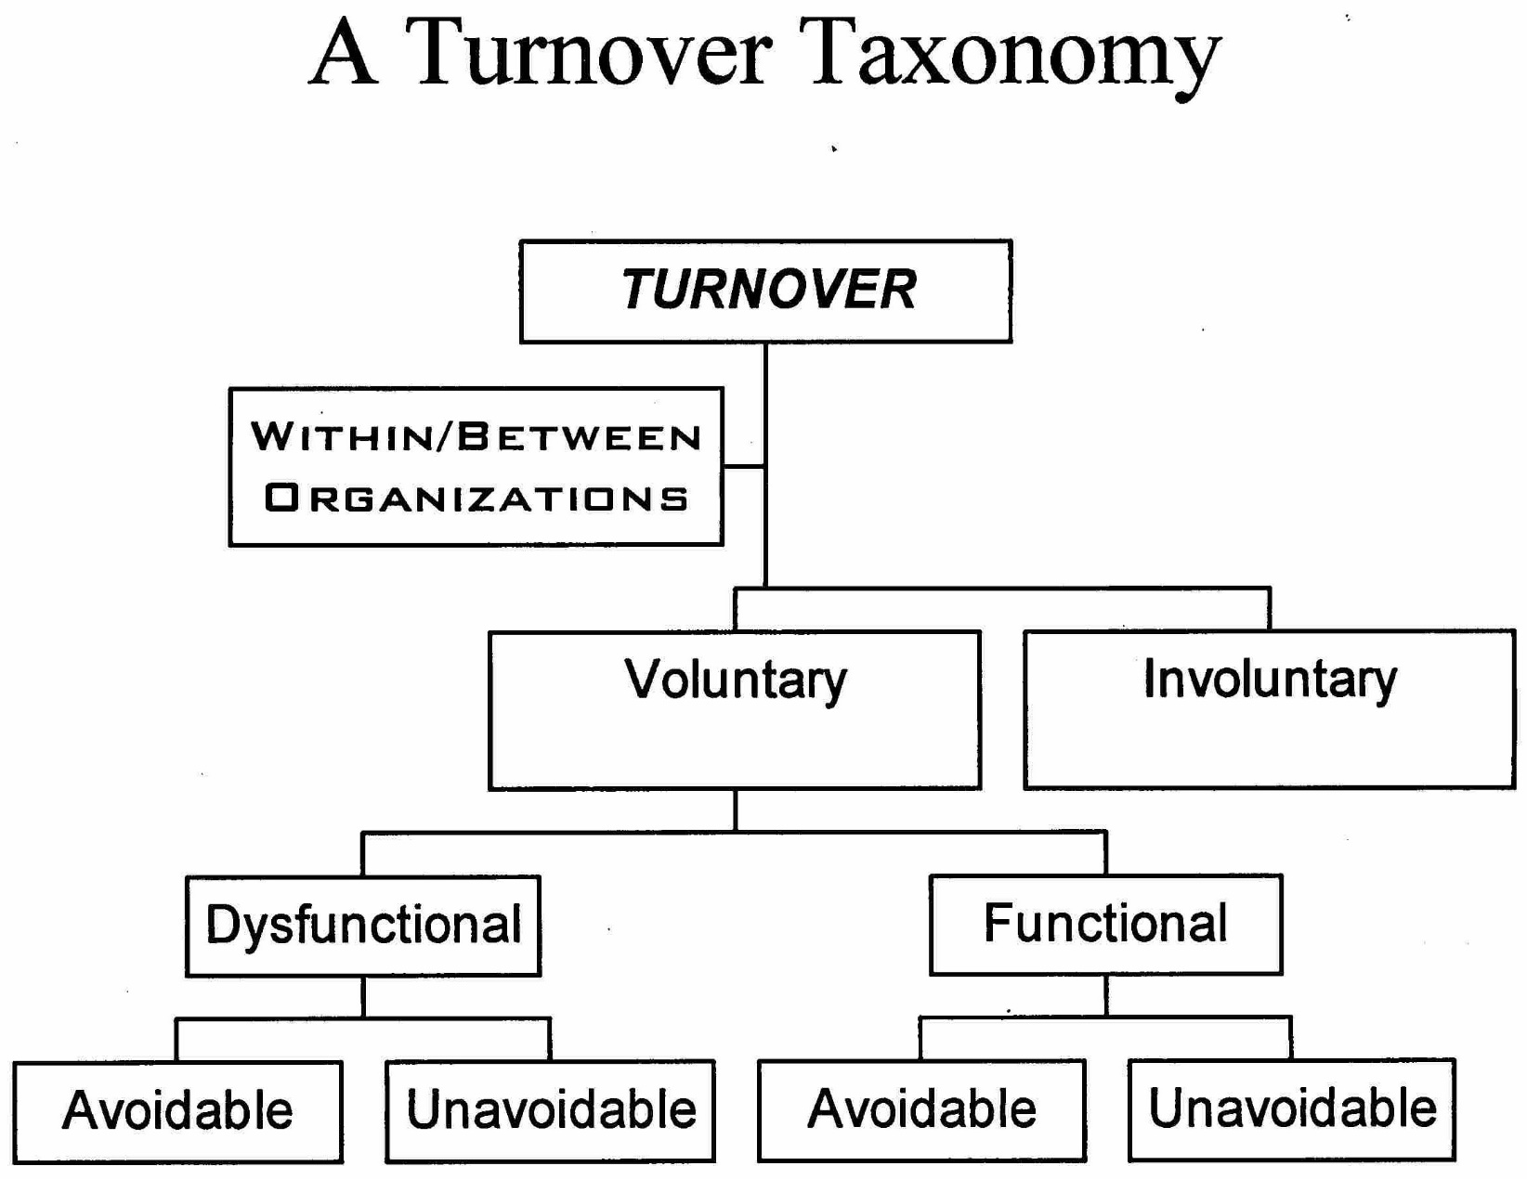
Taxonomic Problems with Criteria

Slide 9
Soft, Subjective, High Judgment Criteria
Strengths & Weaknesses of Rating Sources
  Supervisor
  Peer
  Self
  Subordinate
  Client/customer
    Each has unique features
      Strengths, weaknesses, & limitations
      360° appraisal

Slide 10
Relative/Normative Rating Systems
    Straight ranking
    Alternation ranking
      Best-worst-next best, etc.
    Paired comparisons
    Forced distribution
      Different performance distribution assumptions (normal; skewed)
    Forced Ranking
Janet versus Jill
Jill versus Carol
Carol versus Janet

Slide 11
Forced Ranking Systems
Used by 25% of Fortune 500 Companies*
  Supplement to conventional appraisal
    Consequences are often pronounced
      Talent identification and promotions
      Merit pay
      Reduction in force
  Often on alternative criteria
    Core values (energy, bias for action, entrepreneurship)
    Cultural competencies (cooperation, integrity, flexibility)
  Often applied to senior mgt first
    Expansion to lower mgt levels follows
    Positive effects are time-iteration bound
*Grote 2005; Now less popular as ~15% use it; MS abandoned it in 2013 & Yahoo adopted it

Slide 12
Advantages/Disadvantages
Advantages
Easy to do
Simple and intuitive
Useful for making designation decisions
Information expedites decisions
No across-the-board leniency possible
Disadvantages
Ordinal data only
Low reliability
Loss of comparability
Lack of behavioral specificity
More subject to legal challenge

Slide 13
Absolute/Individual Rating Systems
Narrative Essay
  Written description of target performance
  Provides detailed feedback for evaluation and development
    Useful supplement for quantitative ratings
  Qualitative: often non-comparable data
  Quality of narratives varies greatly between raters
    Writing skills and motivation of raters influence narrative account of ratees

Slide 14
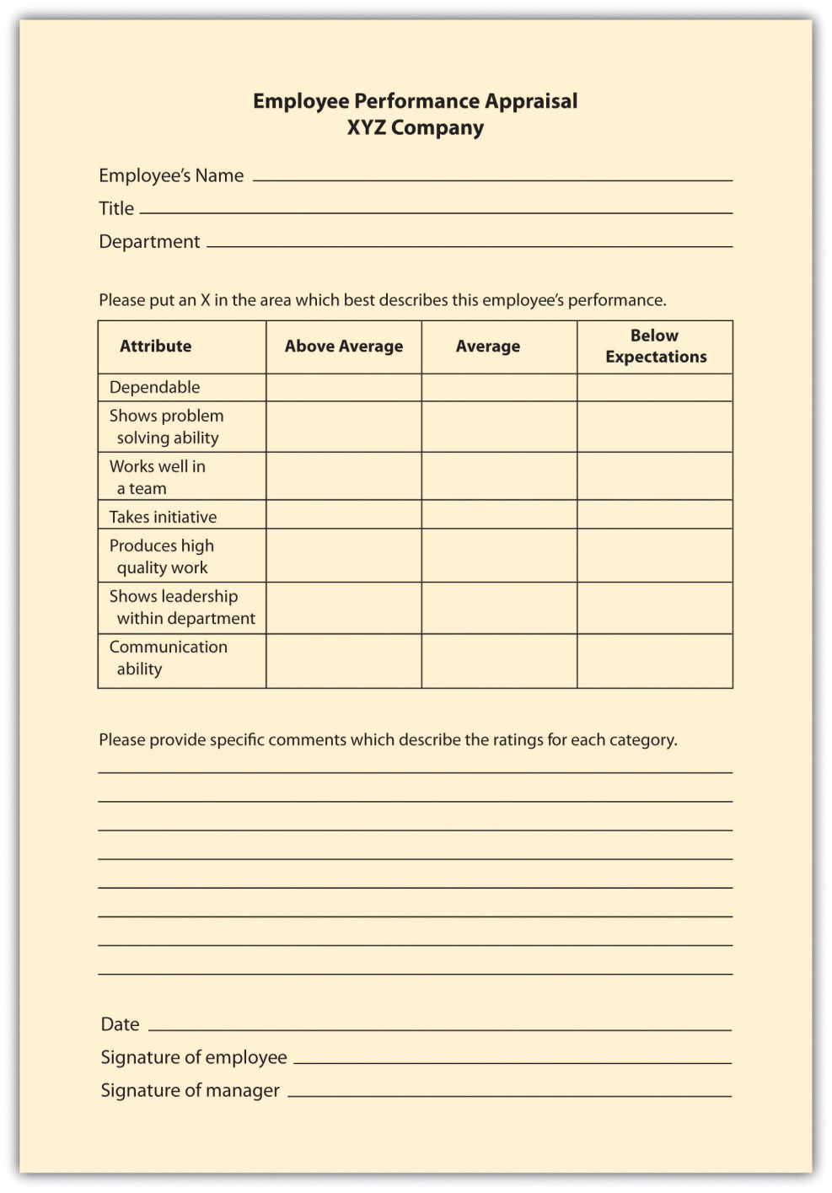
Graphic Rating Scales
Common but giving ground to other methods
  Need to define
    Dimensions
    Adjectival Anchors
  Poor feedback vehicle
    Often coupled with a narrative essay

Slide 15
Behaviorally Anchored Rating Scales
A family of rating scales that employ the critical incident technique and Thurstone scaling methodology
  Conceptual implications
    Use of human tendency to stereotype as a means of improving rating accuracy
  Technical
    Provided a method to study process aspects of performance
  Practical
    Participation in scale development; rater discomfort with traits; enriched feedback

Slide 16
BARS Development
A common procedure for developing BARS
  Conduct Job Analysis to identify job dimensions
  Incumbents compose Critical Incidents that correspond to job dimensions
  Incidents are edited for grammar & brevity
  Redistributed for ‘retranslation’:
    Rating of effectiveness
    Assignment to dimensions
  Items with high agreement are retained

Slide 17
Team BARS for HRM
Contributing to Team Work | 5 | • Does more or higher-quality work than expected. • Makes important contributions that improve the team's work. • Helps to complete the work of teammates who are having difficulty.
 | 4 | Demonstrates behaviors described in both levels 3 and 5
 | 3 | • Completes a fair share of the team's work with acceptable quality. • Fills in for teammates when it is easy or important. • Keeps commitments and completes assignments on time.
 | 2 | Demonstrates behaviors described in both levels 1 and 3
 | 1 | • Does not do a fair share of the team's work. Delivers sloppy or incomplete work. • Misses deadlines. Is late, unprepared, or absent for team meetings. • Does not assist teammates. Quits if the work becomes difficult.
BARS take a variety of forms
  For example could take behavior frequency format
  All reference behavior as opposed to traits
  Use behaviors as anchors along the dimension to be rated instead of ‘poor, average, good’

Slide 18
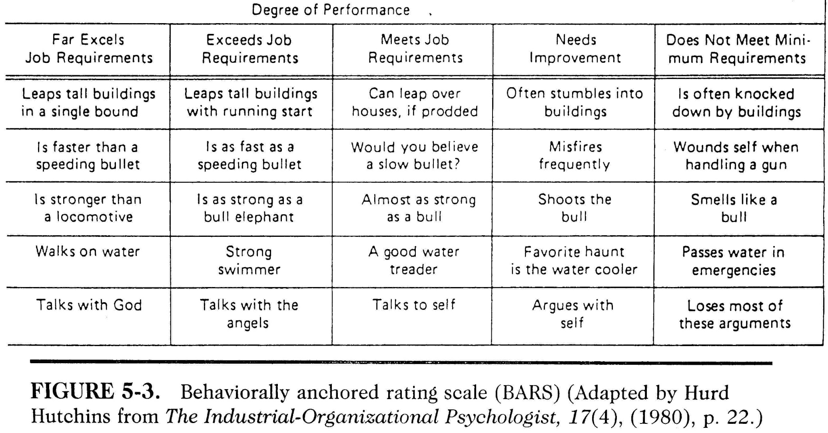
A BARS for the rest of us

Slide 19
Management & Technical Appraisal Methods
MBO
  Used by about ½ of Fortune 500 companies
  Peter Drucker (1954)
  Core Features
    Control
      Participative development of standards
      Accountability
    Self-monitoring
      Objective indices – reduce subjectivity
      Feedback provision
    Goal setting
      Future-oriented

Slide 20
Typical Process
Supervisor & employee meet to discuss plans and negotiate goals
  Focus on hard criteria
    SMART goals
Intermediate review
  Assess goal progress; potentially revise plan
Final evaluation
  Assessment of goal achievement
  Feedback & developmental debriefing
  Establish goals for next cycle

Slide 21
MBO Research & Practice
Rodgers & Hunter 1991
  Meta analysis of 70 MBO studies
  68/70 showed productivity gains
  Commitment Moderator
    (a) Executives subject to MBO program and (b) Communication of commitment to program
    Hi commitment (57% gain) versus Low commitment (6% gain)
Criticized for short time-term focus
Limit goals to 3 or 4 objectives
Must be quantifiable or “evidential”
  Did/did not achieve
A control device
Requires commitment at the top

