Slide 1
DOT, DOL, & O*NET
Dictionary of Occupational Titles Listing
  Correspondent with USDOL Handbook for Analyzing Jobs
  Last updated 1991
    Deficient in representing IT occupations
    Very specific job information
      Yet many jobs included in the DOT were antiquated; reflecting the rapid changes in work occurring during this period

Slide 2
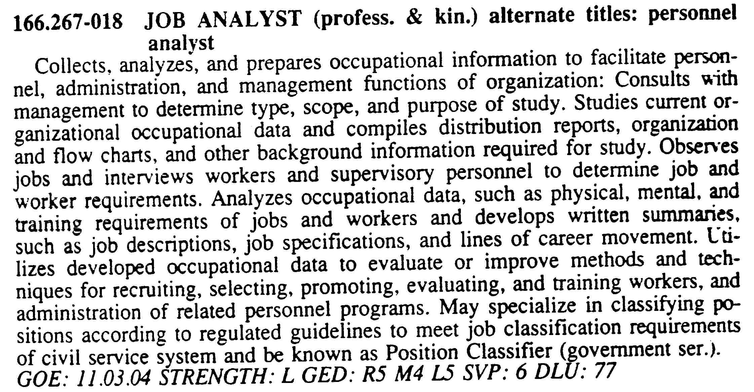
DOT Entry for Job Analyst
WORKER FUNCTIONS from DOT
DATA (4th Digit) PEOPLE (5th Digit) THINGS (6th Digit)
0 Synthesizing 0 Mentoring 0 Setting Up
1 Coordinating 1 Negotiating 1 Precision Working
2 Analyzing 2 Instructing 2 Operating-Controlling
3 Compiling 3 Supervising 3 Driving-Operating
4 Computing 4 Diverting 4 Manipulating
5 Copying 5 Persuading 5 Tending
6 Comparing 6 Speaking-Signalling 6 Feeding-Offbearing
7 Serving 7 Handling
8 Taking Instructions-Helping
It’s all about the verbs

Slide 3
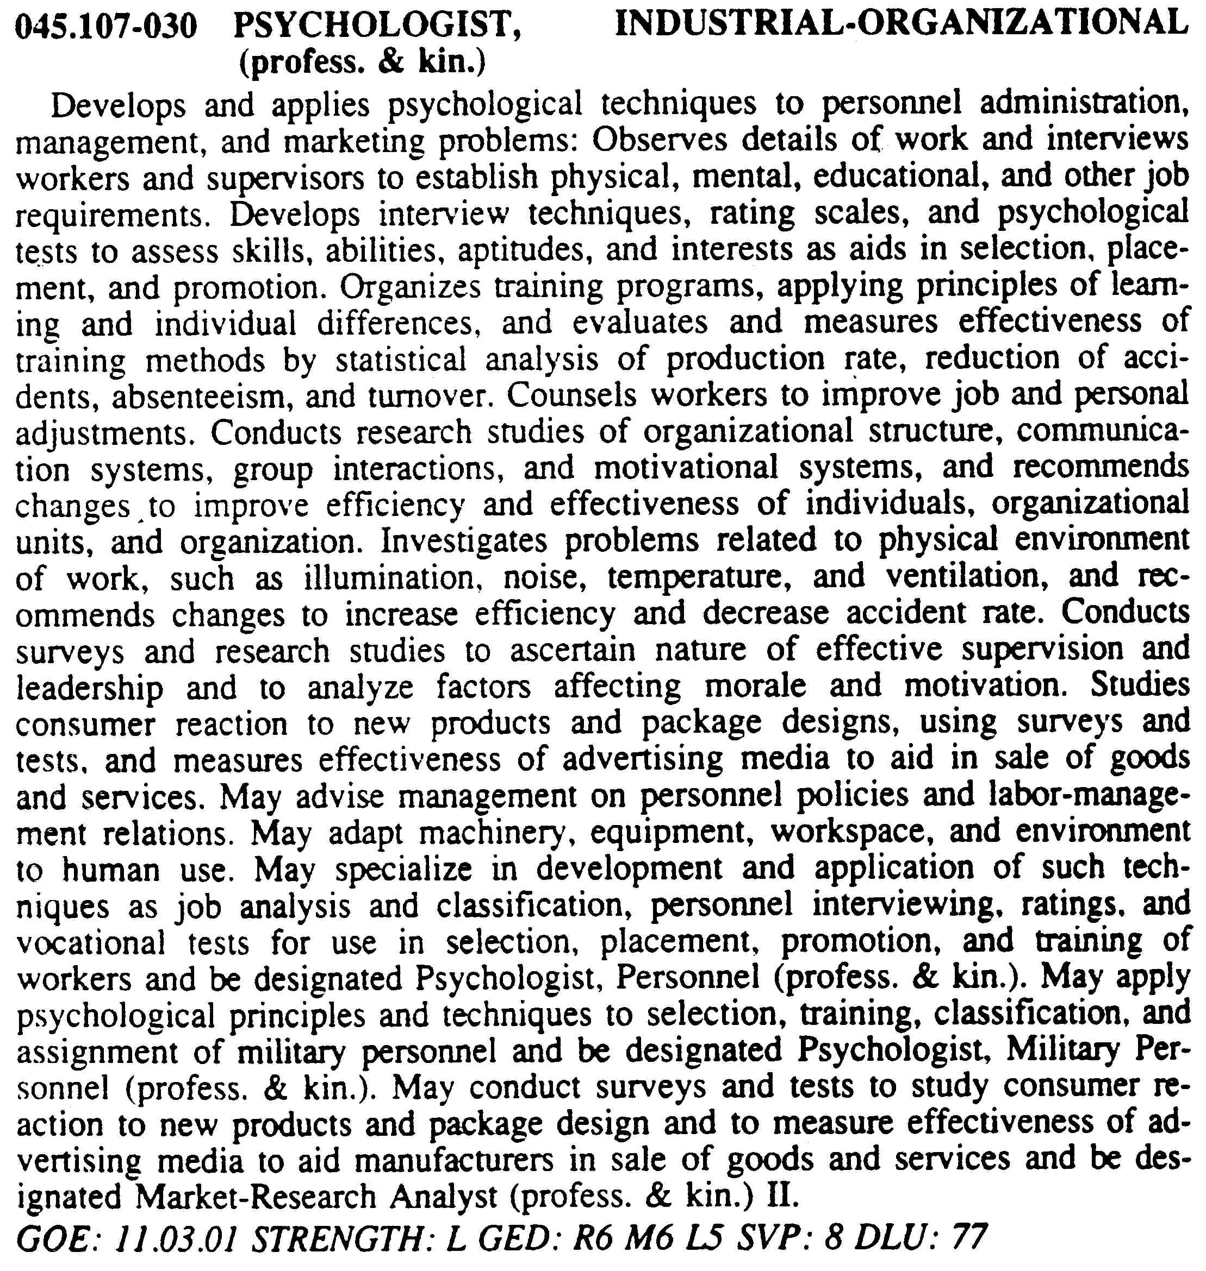
DOT Entry for I/O Psychologist

Slide 4
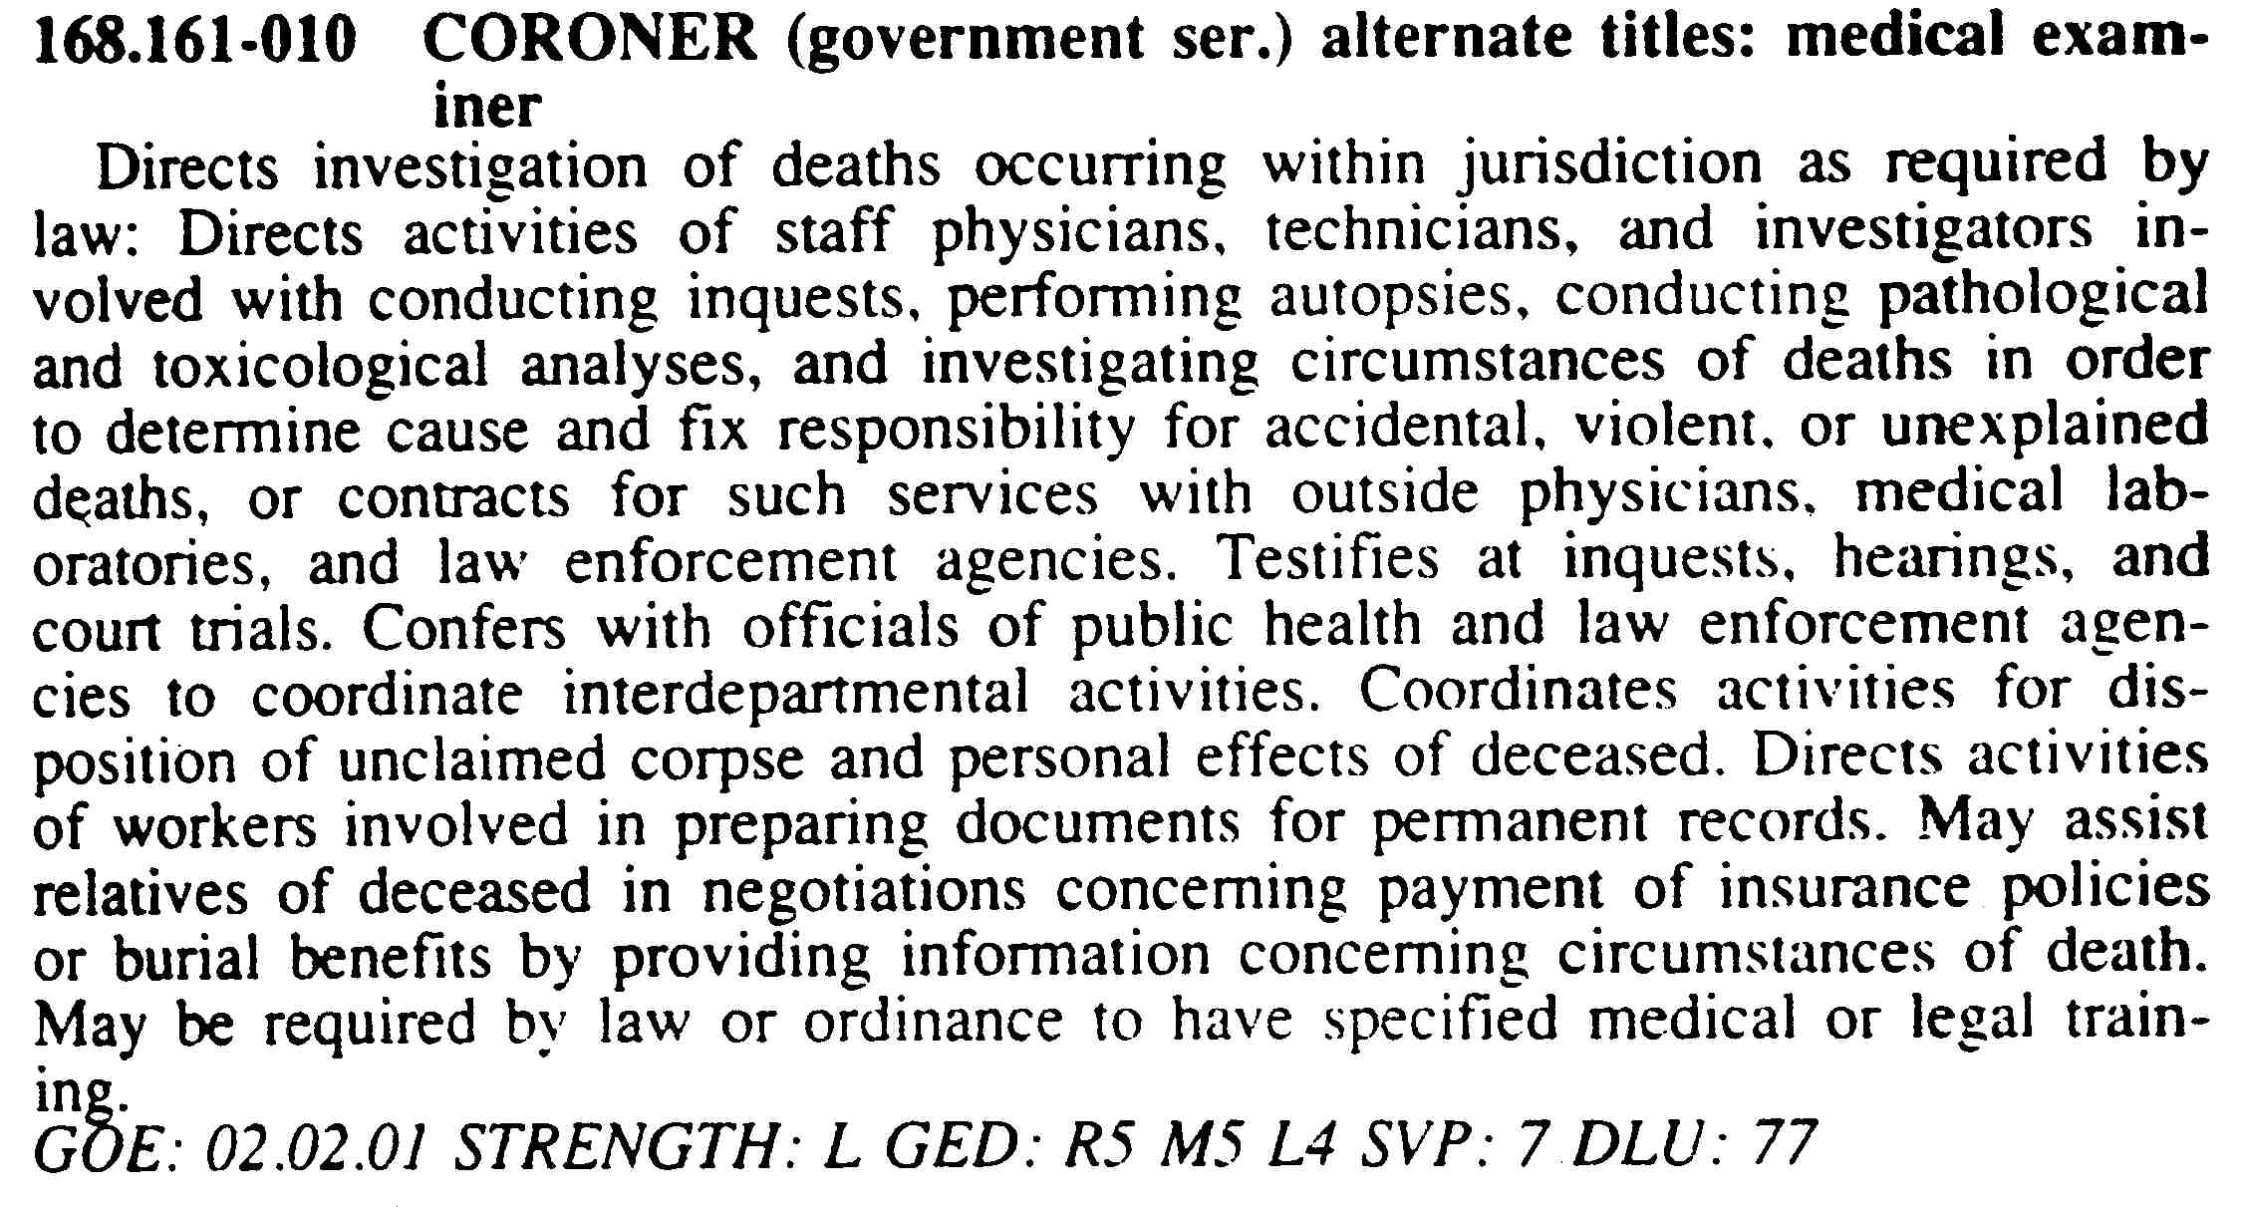
DOT Entry for Coroner

Slide 5

O*NET
Occupational Information Network
  The O*NET system serves as the nation's primary source of occupational information
    Free service as opposed to fee-based
  O*Net
    OOH: Occupational Outlook Handbook
      Human Resources Specialist
    O*Net
      Human Resources Specialist

