Slide 1
Job Design
A tool for motivating workers
A tool for increasing efficiencies
Job Design: The process of linking specific tasks to specific jobs and deciding what techniques, equipment, and procedures should be used to perform those tasks

Slide 2
Job Design Methods & Approaches
Early 1900’s 1940’s-50s 1970’s-80’s
Scientific Management
simplify jobs
simplify worker characteristics
Job Enlargement
Job Enrichment
Sociotechnical
Job Characteristics Theory
and
Social Information Processing Theory
Walker & Guest (1952) Total Job Situation

Slide 3
Scientific Management
  Frederick Taylor and Frank & Lillian Gilbreth
  Theory X
    Work is planned by management
    Work is merely an instrumentality
  Work simplification
    ‘Therblig’
  Hired hands
  Engineering emphasis
    Focus was on efficiency and countering worker ‘fatigue’ (physical and psychological exhaustion), not on job satisfaction or other worker sentiments

Slide 4
Post WW2: Job Enlargement & Enrichment
Enlargement:
  Increasing the number of tasks a worker performs
  All of the tasks at the same level of difficulty and responsibility
  Also called horizontal job loading
Enrichment:
  Increasing a worker’s responsibility and control over his or her work
  Also called vertical job loading
  Early Need Theory application to jobs

Slide 5
The Total Job Situation Walker & Guest
Pay
Job security
Physical working conditions
The worker’s immediate job
Relation to fellow coworkers
Relation to supervisors
Relation to union
Promotion and transfer
Compare to Scientific Management
Pay
Job security
Physical working conditions

Slide 6
Sociotechnical Systems
Original effort to align human and technical goals
  Technical behavior is by design and predetermined
  Human behavior is purposeful and spontaneous
  Responsible autonomy
    Use of teams to regulate behavior & enrich work
  Adaptability
    Cross-training and job rotation permit responses to changing circumstances
  Whole tasks
    Identifiable complete work product; ownership
  Meaningfulness
    Psychological significance of work; multiple skills

Slide 7
Job Characteristics Model: Hackman & Oldham
Job Characteristics Psychological States Outcomes
Skill Variety
2. Task Identity
3. Task Significance
4. Autonomy
5. Feedback
More Satisfaction
Experienced Meaningfulness
Responsibility
Feedback
Higher Performance
Less Absenteeism & Turnover
Employee KSAOs
GNS, for example
Contribute to the Motivating Potential Score of the Job [(SV+TI+TS/3) x A x F]

Slide 8
Hi-Lo Job Characteristics
Job Characteristic | High | Low
Skill Variety | Owner-operator of a garage | Spray painter on assembly line
Task Identity | Cabinet maker | Lathe operator
Task Significance | Intensive care nurse | Floor sweeper
Autonomy | Commercial fisherman | Assembly line worker
Feedback | Comedian | Receptionist

Slide 9
Job Design and Facet Job Satisfaction
Kinicki et al (2002)

Slide 10
Growth Need Strength
An individual difference variable that accounts for responsiveness to job redesign interventions
  It represents a personal preference for satisfying higher order needs
    Forced-choice format for measuring
    Item: Which do you prefer?
    A high paying job |_|_|_|_|_| A job where you make most decisions
    A very routine job |_|_|_|_|_| A job where your coworkers are not very friendly

Slide 11
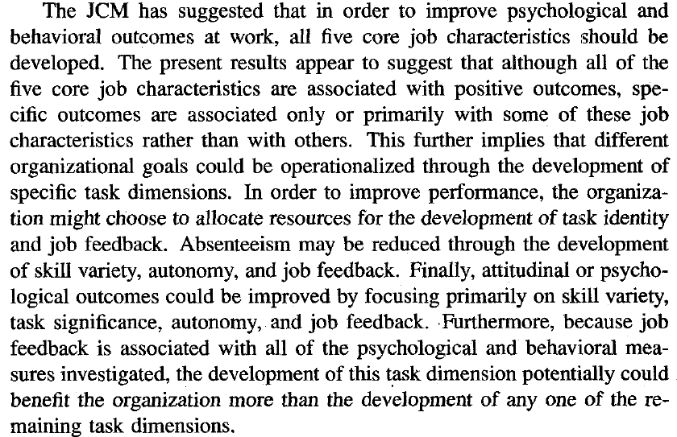
Meta Analysis Summary & GNS
GNS moderates job enrichment-outcome relationship (Loher et al, 1985)
Outcomes
r=.68
r=.38
Job enrichment
Fried & Ferris 1987
 | Skill variety | Task significance | Task identity | Autonomy | Feedback
Performance |  |  | + |  | +
Absenteeism | + |  |  | + | +
Psychological outcomes | + | + |  | + | +

Slide 12
Social Information Processing Model
Information from other people and workers’ own past behaviors influence workers’ perceptions of and response to the design of their jobs.
    Direct social influence from communication
    Drawing attention to specific job characteristics
    Resolving ambiguity
Implications:
  Newcomers will be influenced by the motivation & satisfaction of their work group independent of actual objective reality
  Attitudes are contagious
    Peer pressure to adopt a similar attitude toward an attitude object, such as the job, manager, others
    Low GNS employees response to job enrichment are perhaps more prone to social information and situational variables

Slide 13
Summary
Job design ideas have progressed
  From the particular to the “total job situation”
    Considering the job context
  From horizontal to vertical
    Higher-order needs beyond pay & security
  From machine to open system
    Sociotechnical, motivational, and social information

